Slide 1
Stray Light Analysis GOES-13 Imager
Tim Schmit, ASPB
Tony Schreiner, CIMSS
16-Nov-2010
Introduction
Day 255
Day 257
Day 284

Slide 2
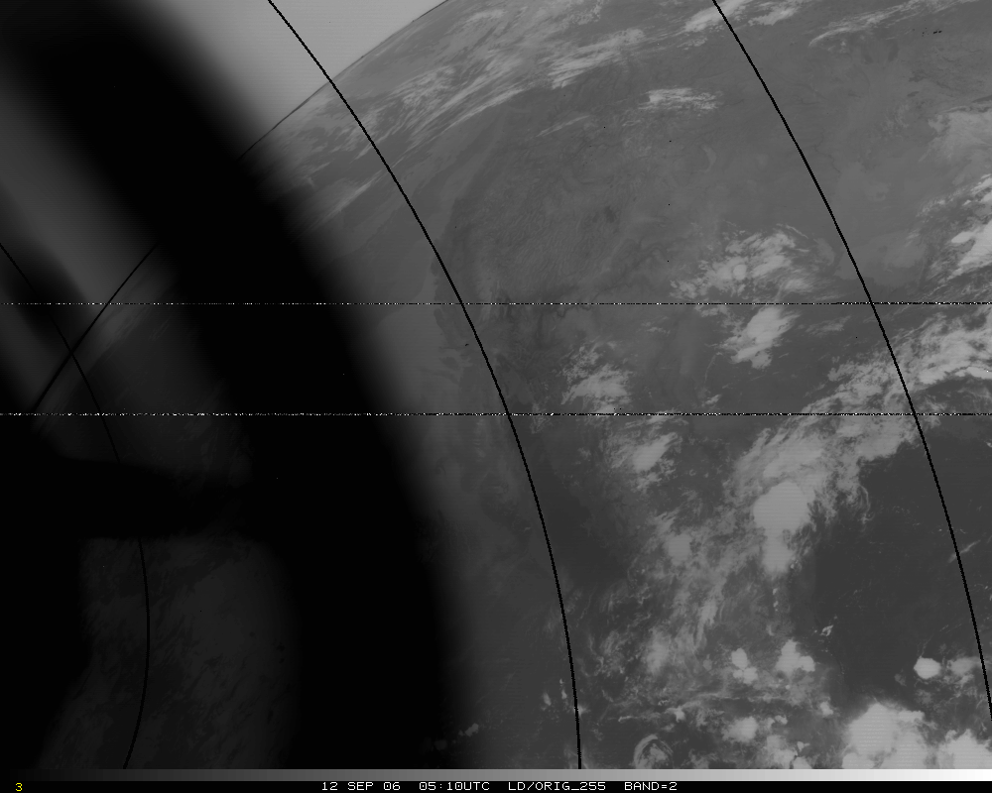
Band 2, Original – too hot by several K!
Band 2, Original – too hot by 50K!

Slide 3
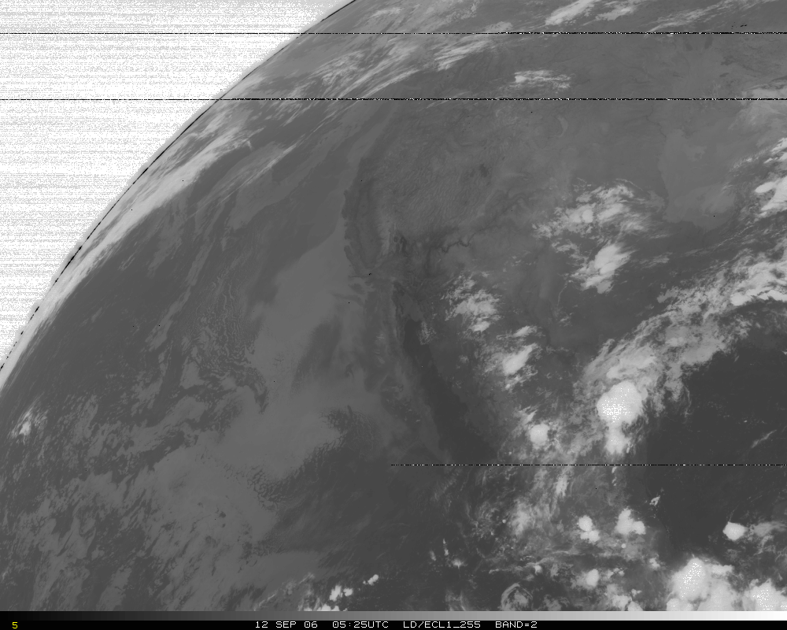
Band 2, later image

Slide 4
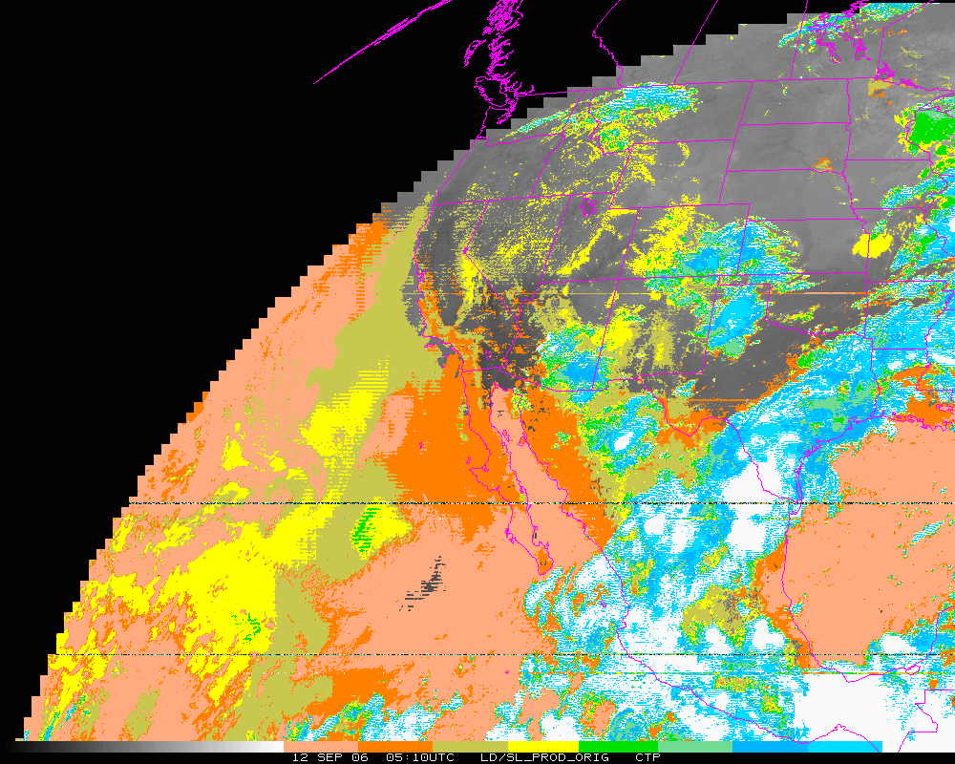
Cloud-top Pressure (color-range). Original – too “cloudy” over some regions, but misses other clouds!
Clear Low cloud High Cloud

Slide 5
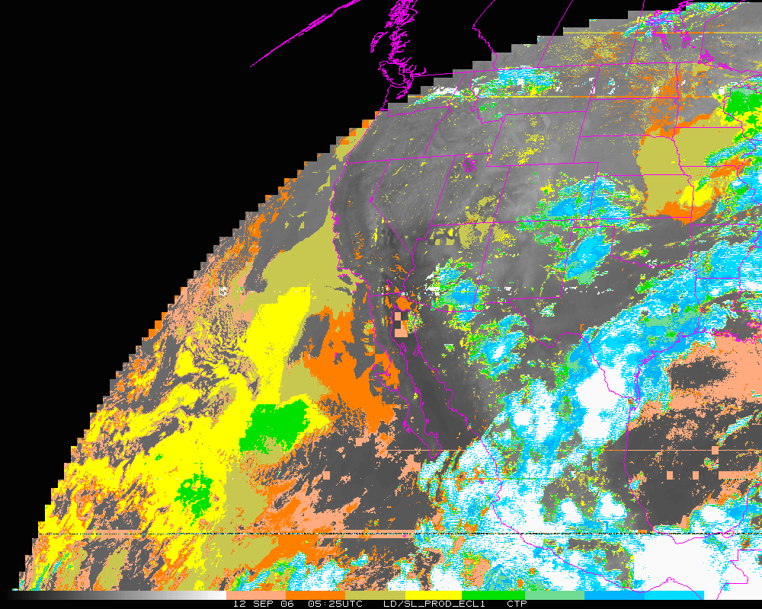
Cloud-top Pressure (color-range). Later image.
Clear Low cloud High Cloud

Slide 6
Stray Light Analysis GOES-13 Imager
Tim Schmit
ASPB
Day 255

Slide 7
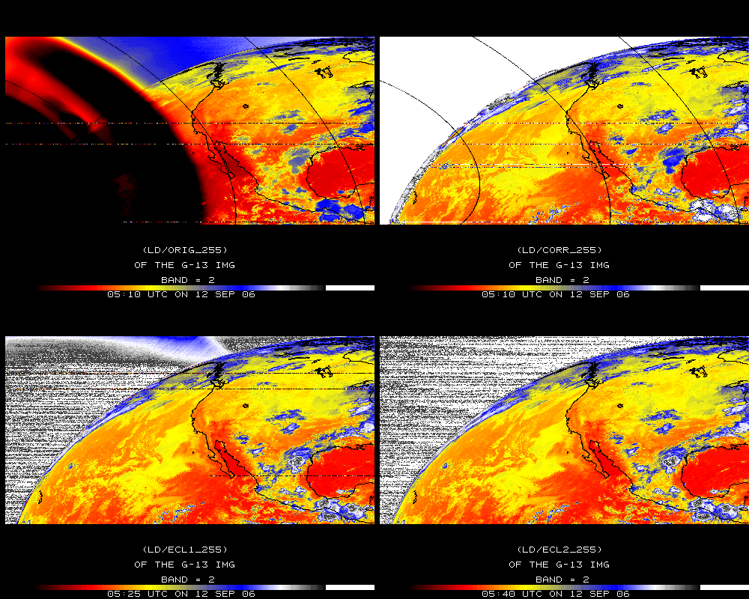
Band 2

Slide 8
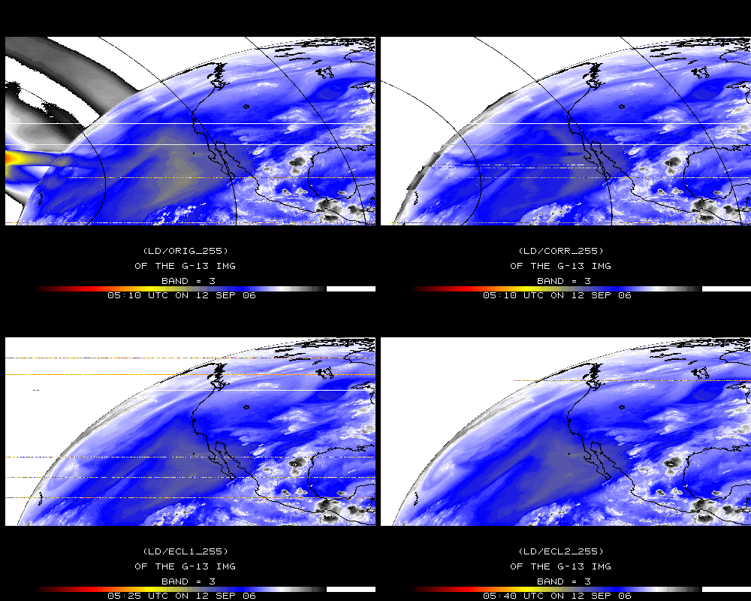
Band 3

Slide 9
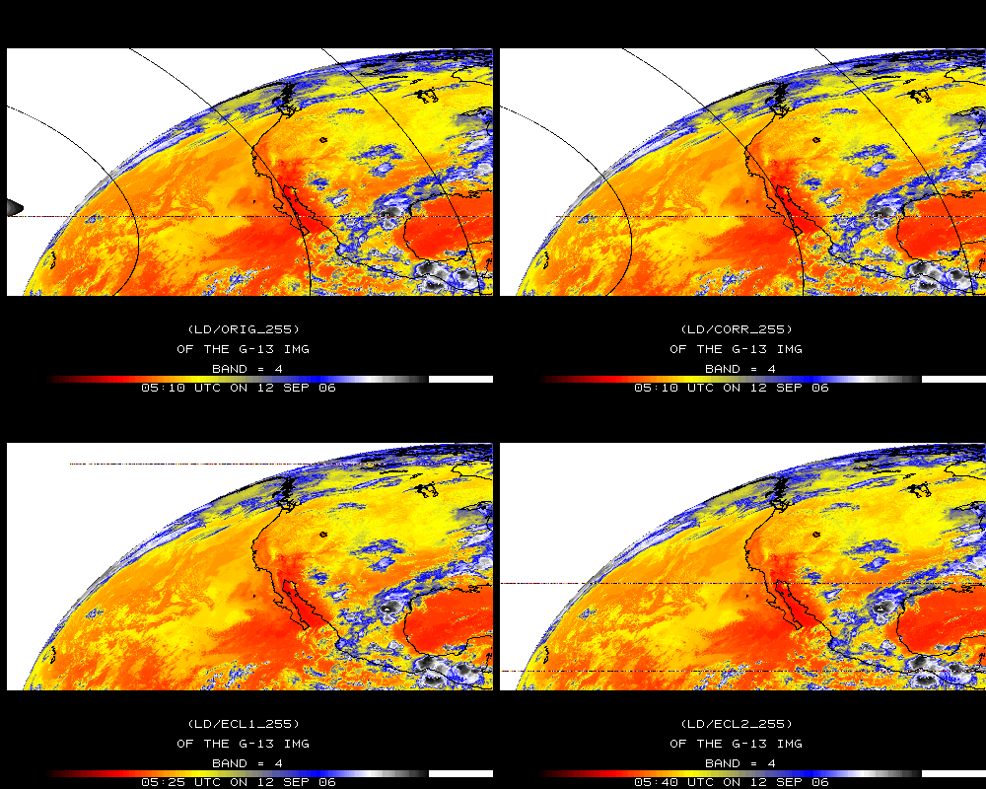
Band 4

Slide 10
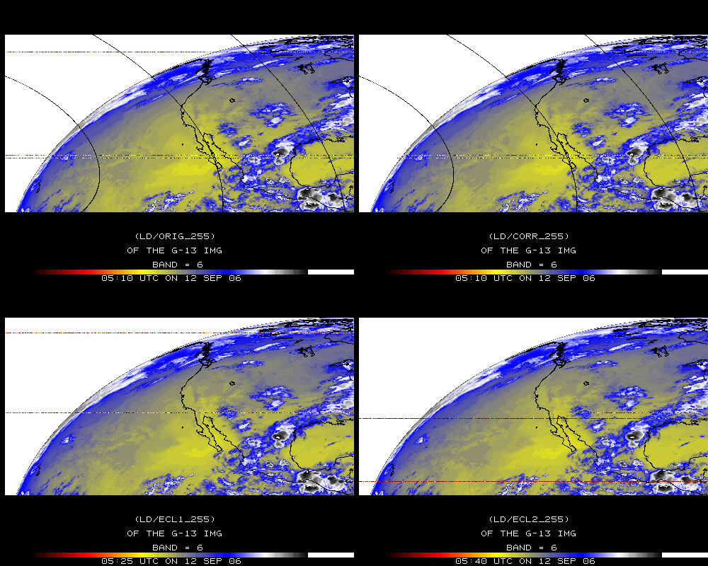
Band 6

Slide 11
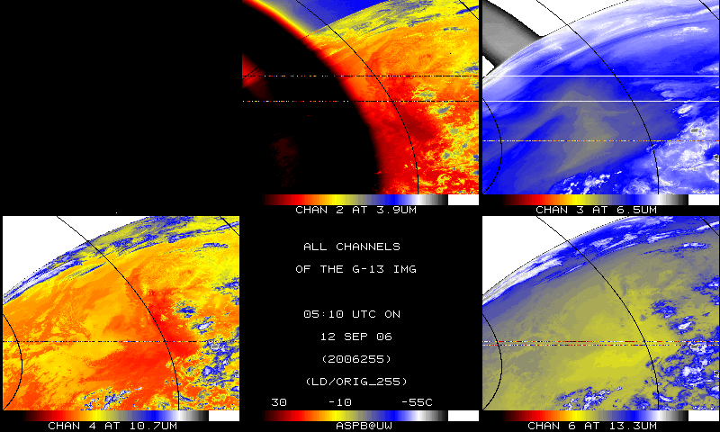
IR bands, Original

Slide 12
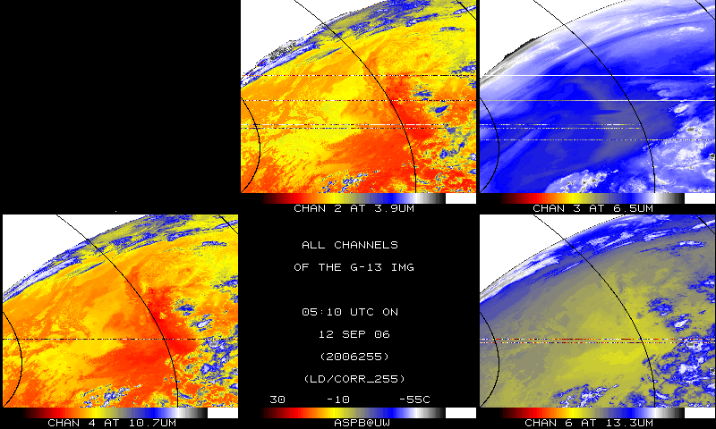
IR bands, Corrected

Slide 13
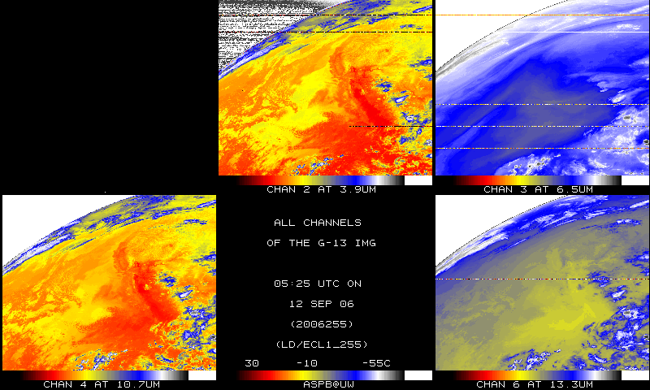
IR bands, 15-minutes later

Slide 14
Band 2, Original

Slide 15
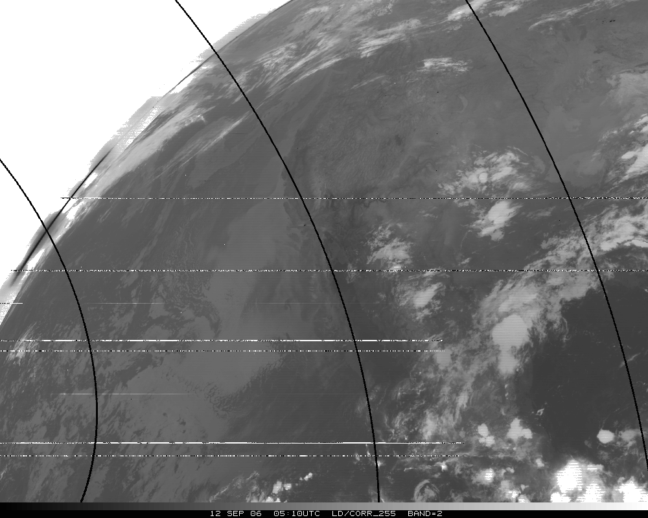
Band 2, Corrected

Slide 16
Band 2, later image

Slide 17
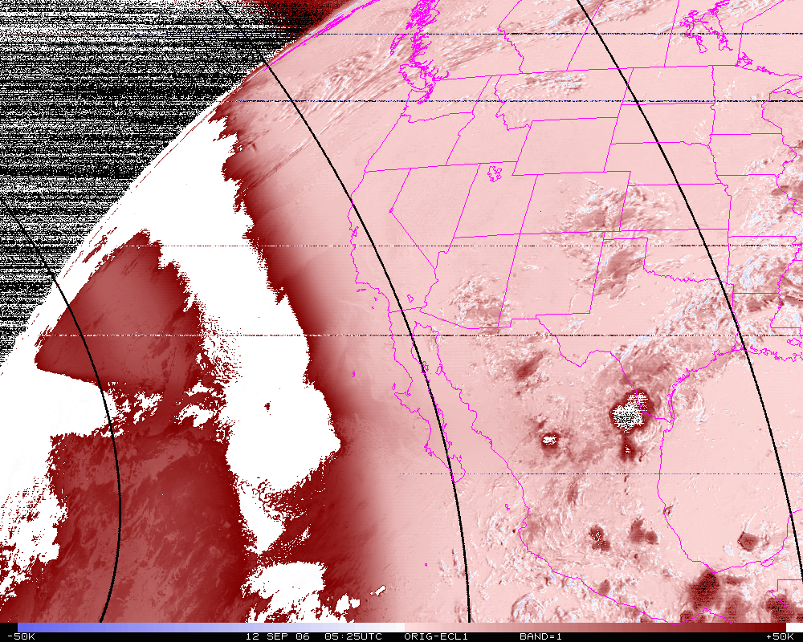
Band 2, difference image (org-eclipse)

Slide 18
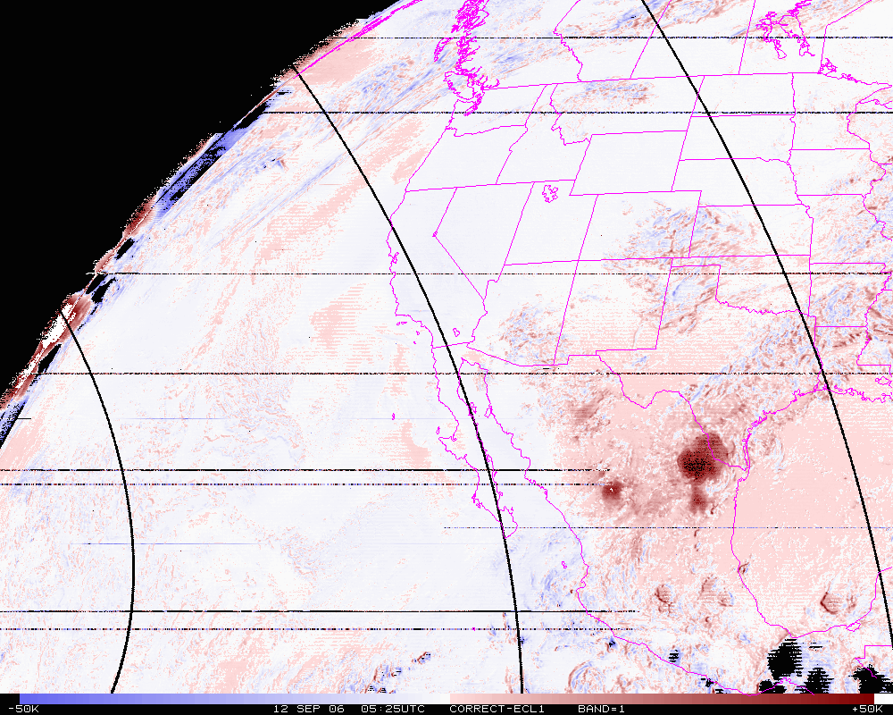
Band 2, difference image (corrected-eclipse)

Slide 19
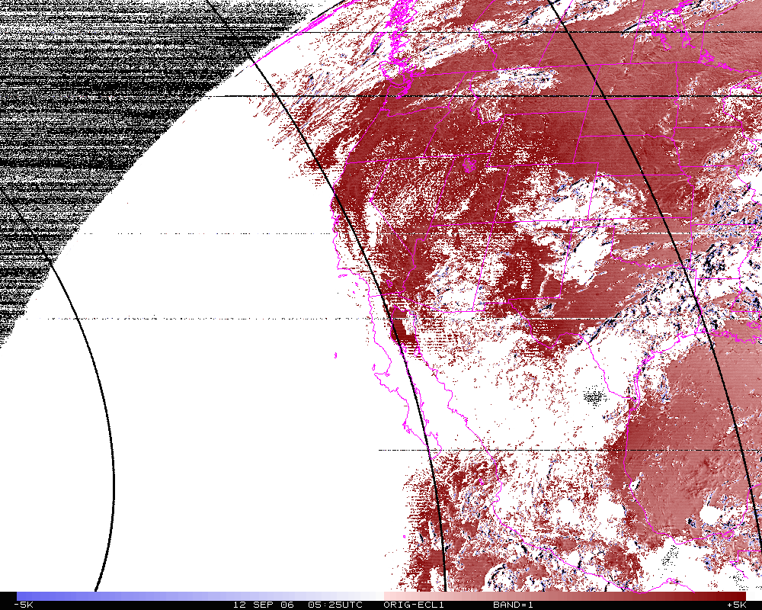
Band 2 Difference
N=14342
Mean= 4.0K
Band 2, difference image (org-eclipse) Smaller range.

Slide 20
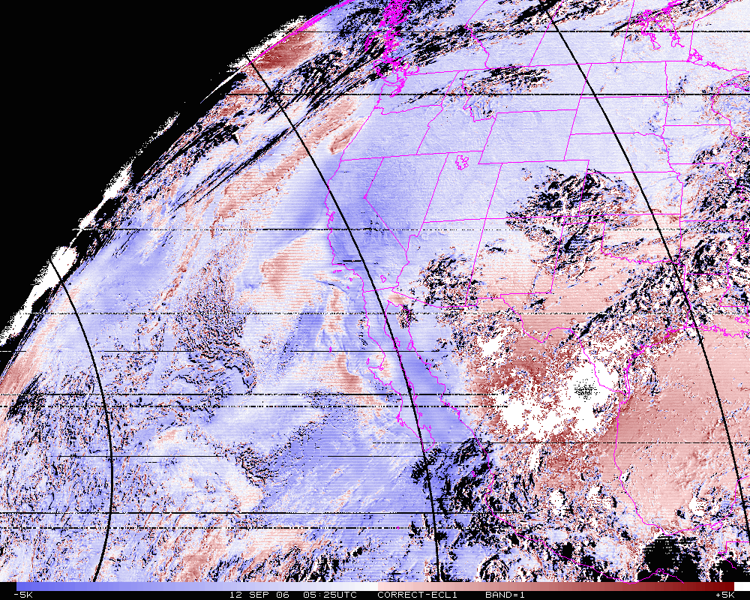
Band 2 Difference
N=14342
Mean= -1.1K
Band 2, difference image (corrected-eclipse). Smaller range.

Slide 21
GOES CTP
GOES Imager Cloud-top pressure (and cloud mask)
During the nighttime, uses the brightness temperature difference between the 4 and 11 micrometer bands.
In general, if the 4 um is colder than the 11 um, than a cloud is assumed.
Also, the 11 um data are compared to a background Sea Surface Temperature.
The 4 um data are not used in the cloud-top pressure determination, just in the cloud mask (cloud/ no cloud).

Slide 22
Cloud-top Pressure (color-range). Original
Clear Low cloud High Cloud

Slide 23
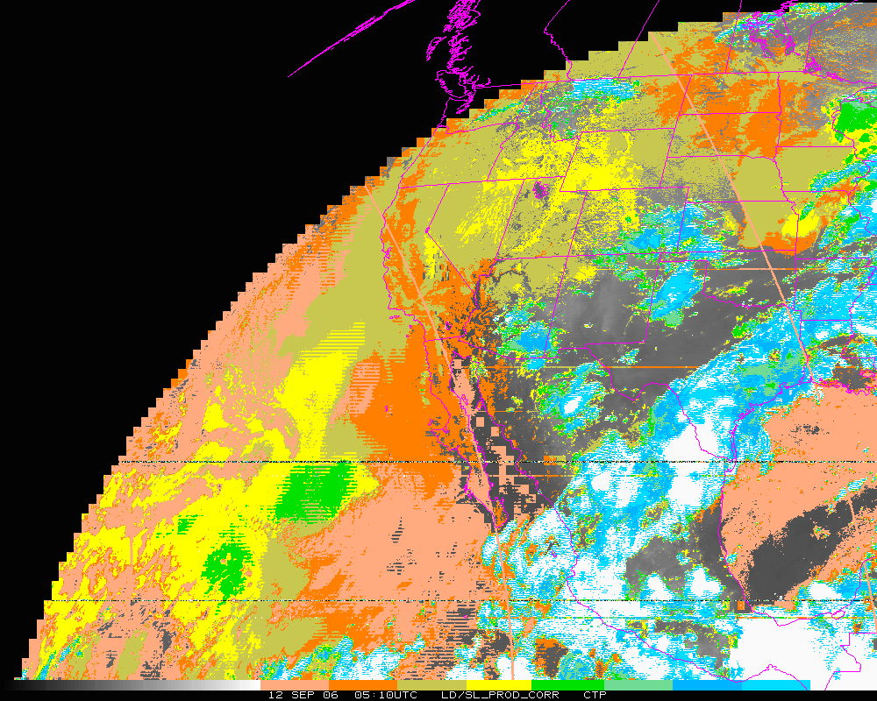
Cloud-top Pressure (color-range). Corrected
Clear Low cloud High Cloud

Slide 24
Cloud-top Pressure (color-range). Eclipse 1
Clear Low cloud High Cloud

Slide 25
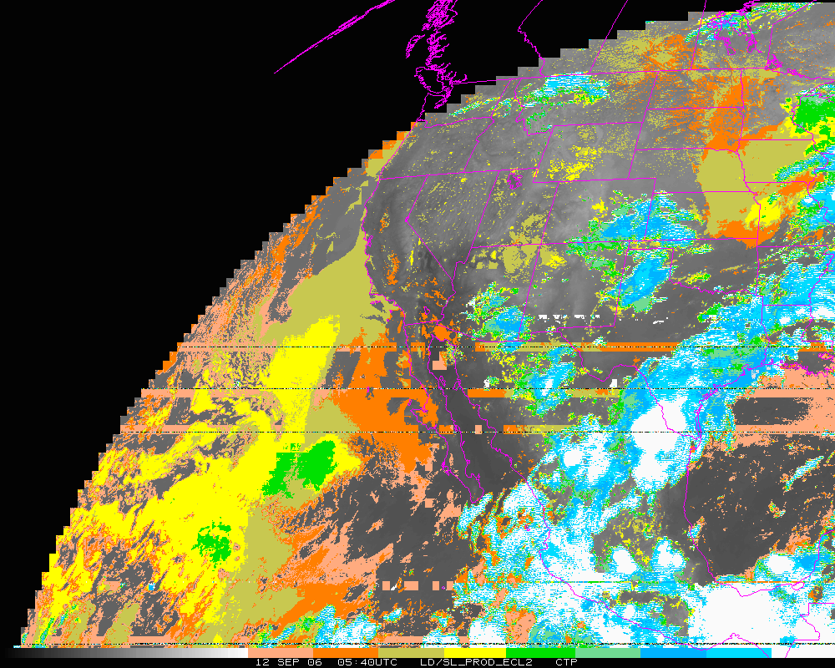
Cloud-top Pressure (color-range). Eclipse 2
Clear Low cloud High Cloud

Slide 26
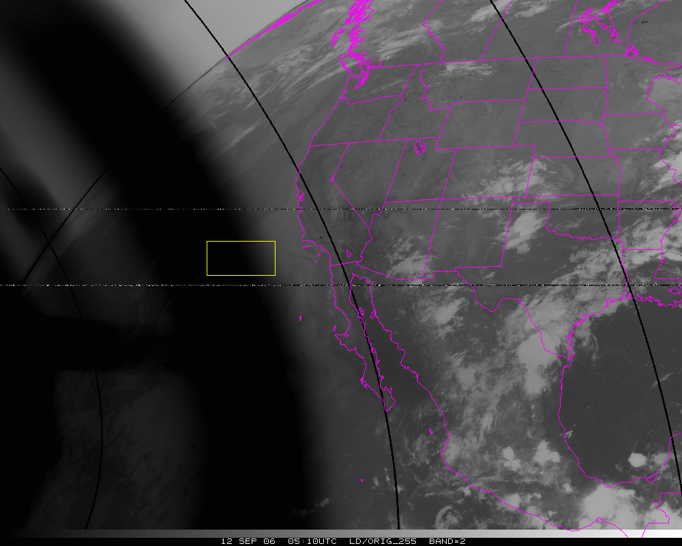
Band=2
N=10302
Org Mean= 325.6K
Cor. Mean= 281.0K
Ecl. Mean= 281.2K

Slide 27
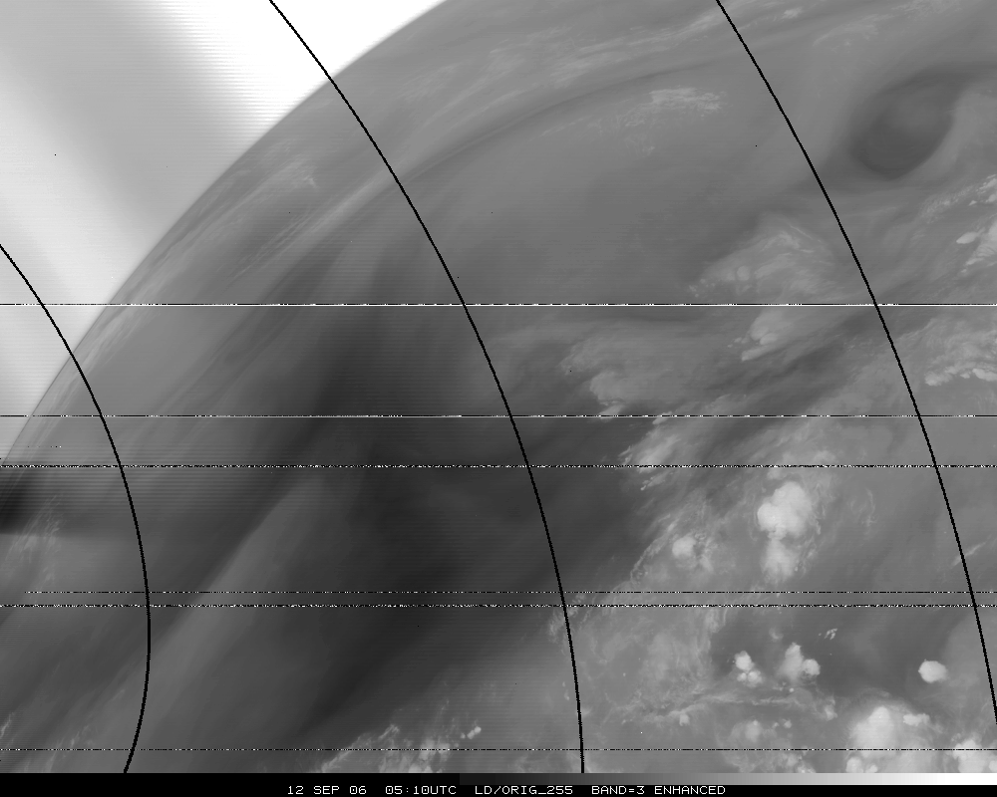
Band 3, Original

Slide 28
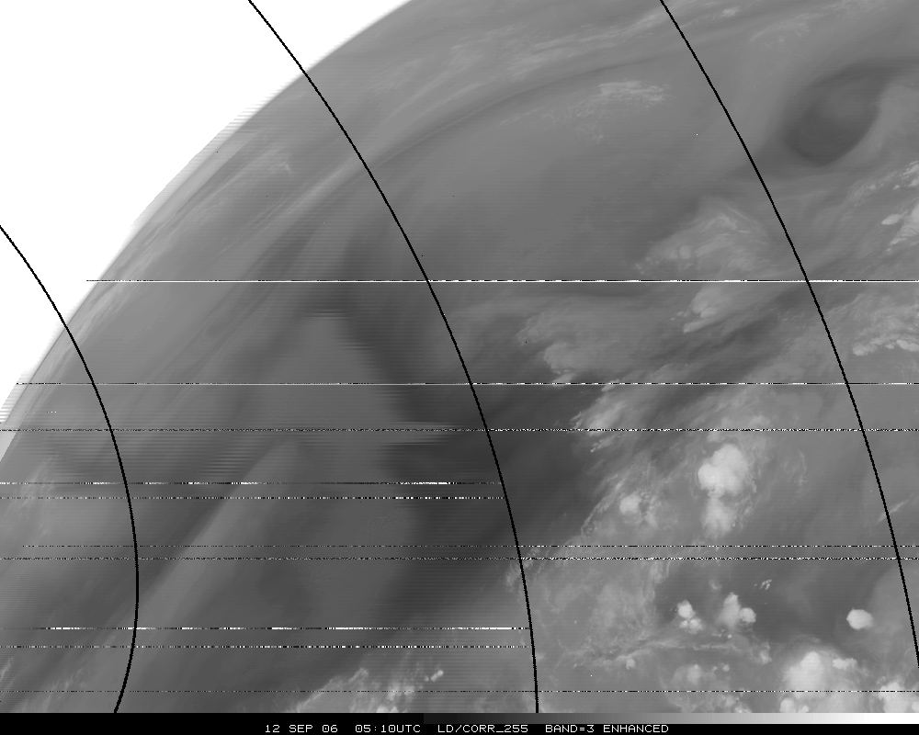
Band 3, Corrected

Slide 29
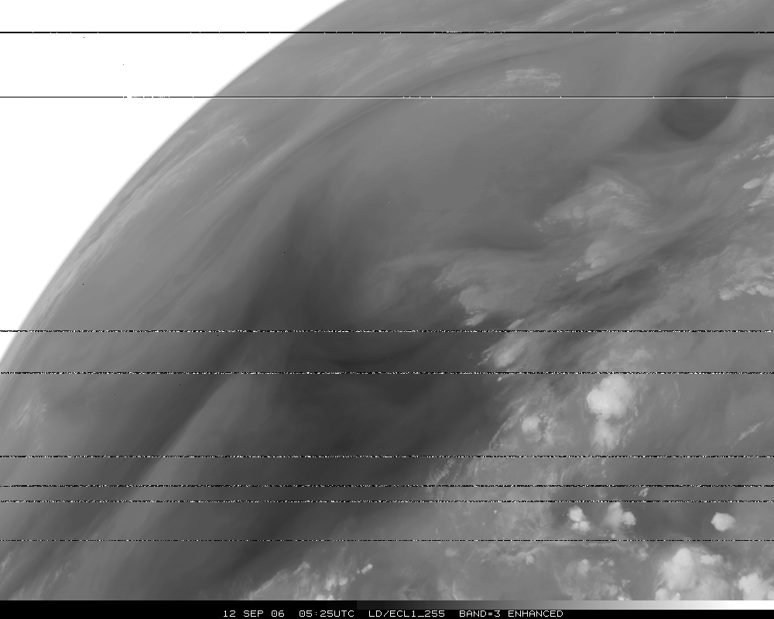
Band 3, Eclipse

Slide 30
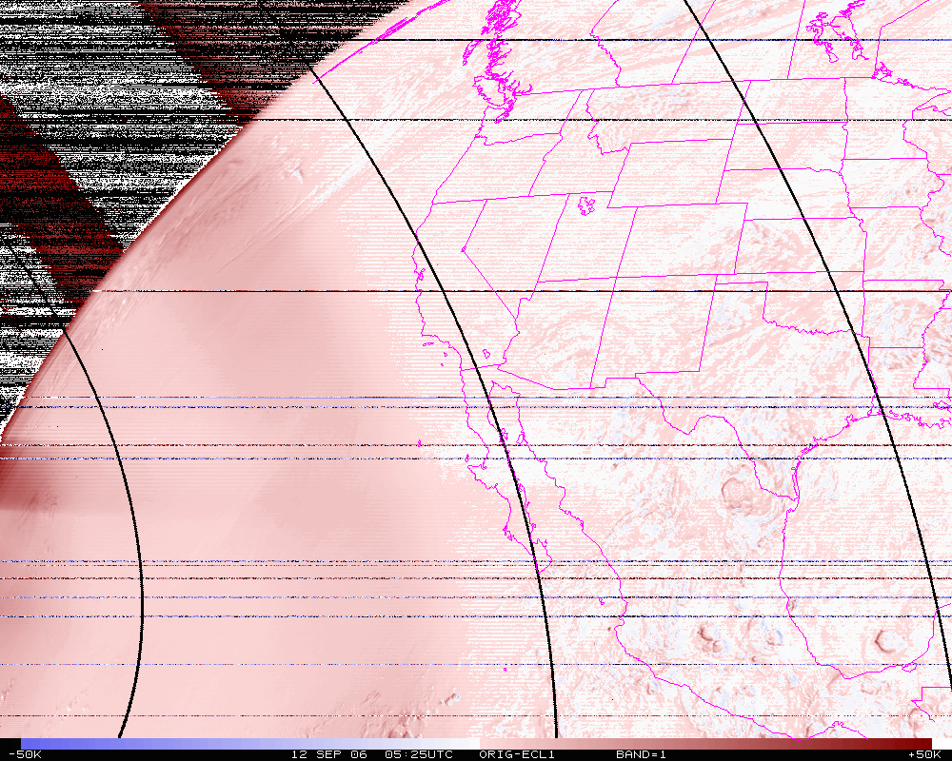
Band 3, difference image (org-eclipse)

Slide 31
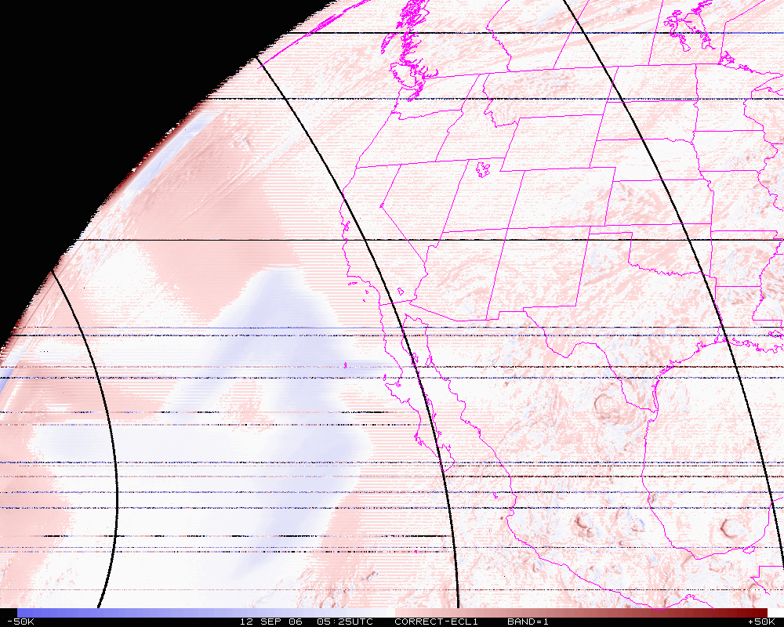
Band 3, difference image (corrected-eclipse)

Slide 32
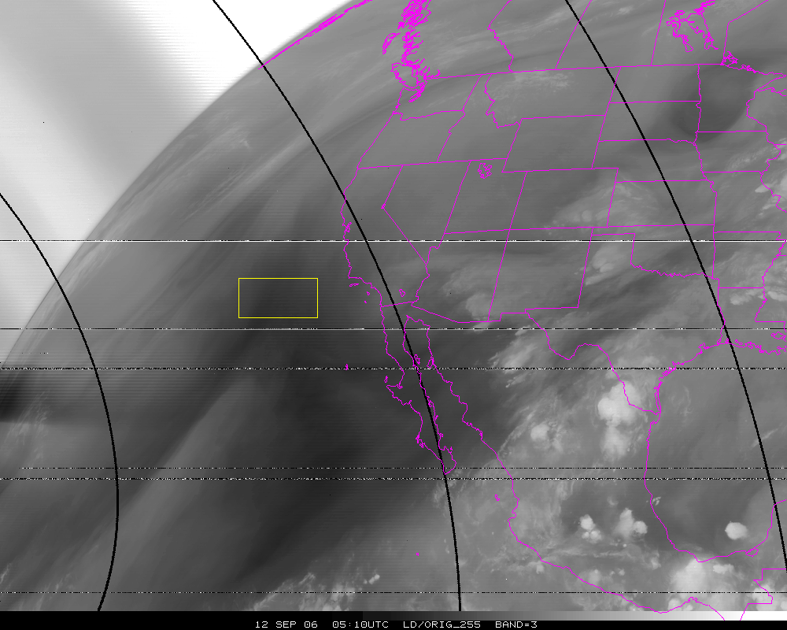
Band=3
N=10302
Org Mean= 258.6K
Cor. Mean= 249.1K
Ecl. Mean= 254.2K

Slide 33
Stray Light Analysis GOES-13 Imager
Tim Schmit
ASPB
Day 257

Slide 34
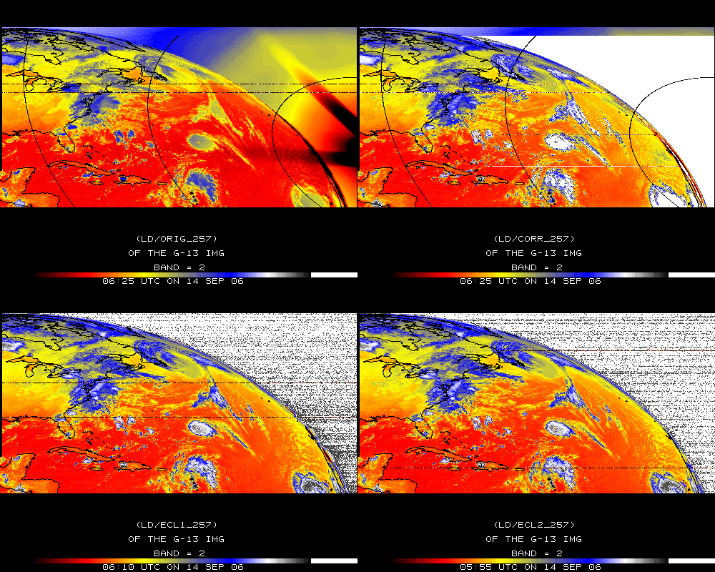
Band 2

Slide 35
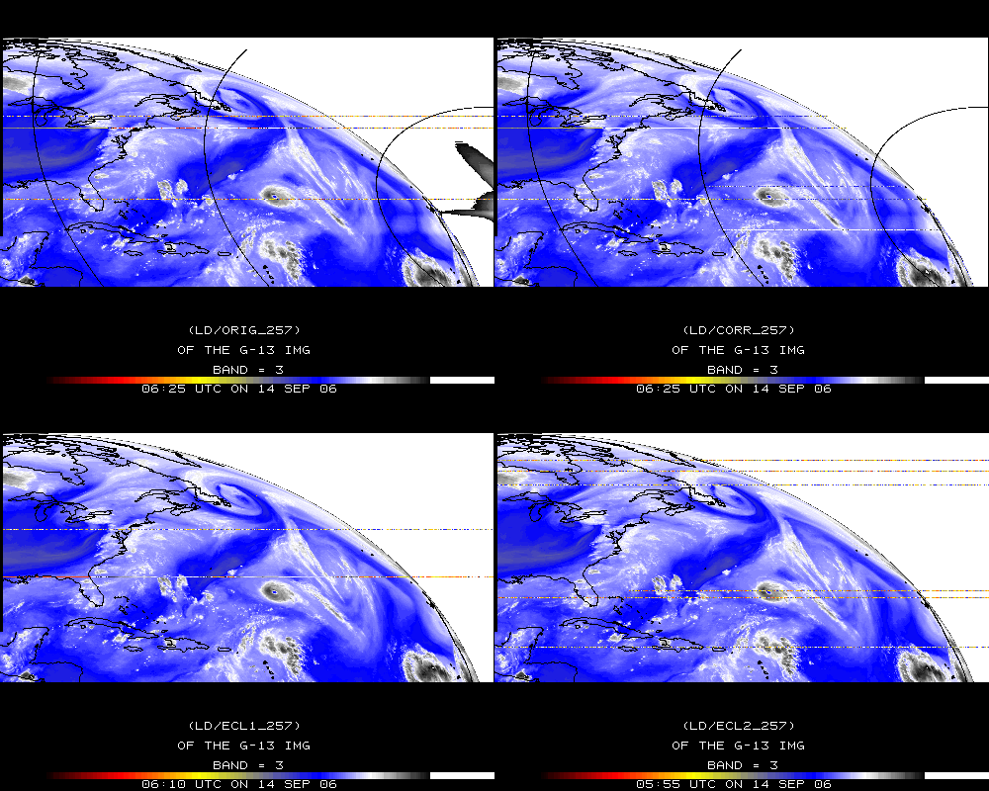
Band 3

Slide 36
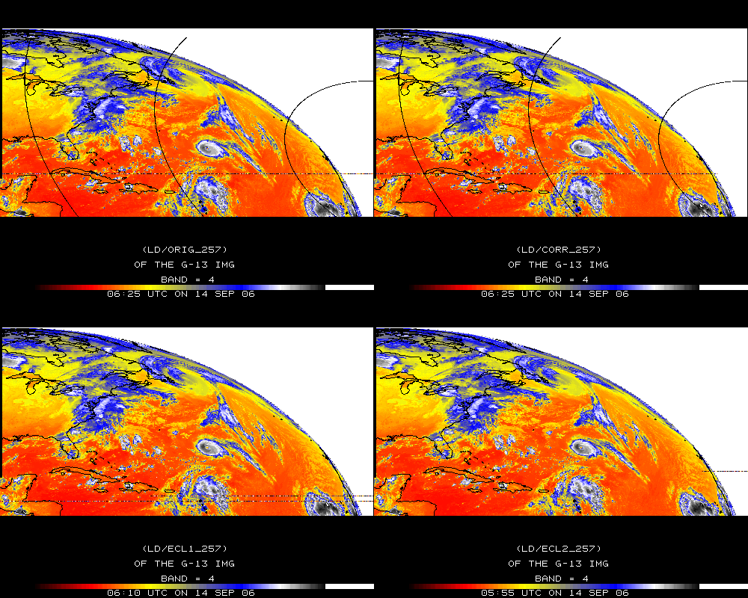
Band 4

Slide 37
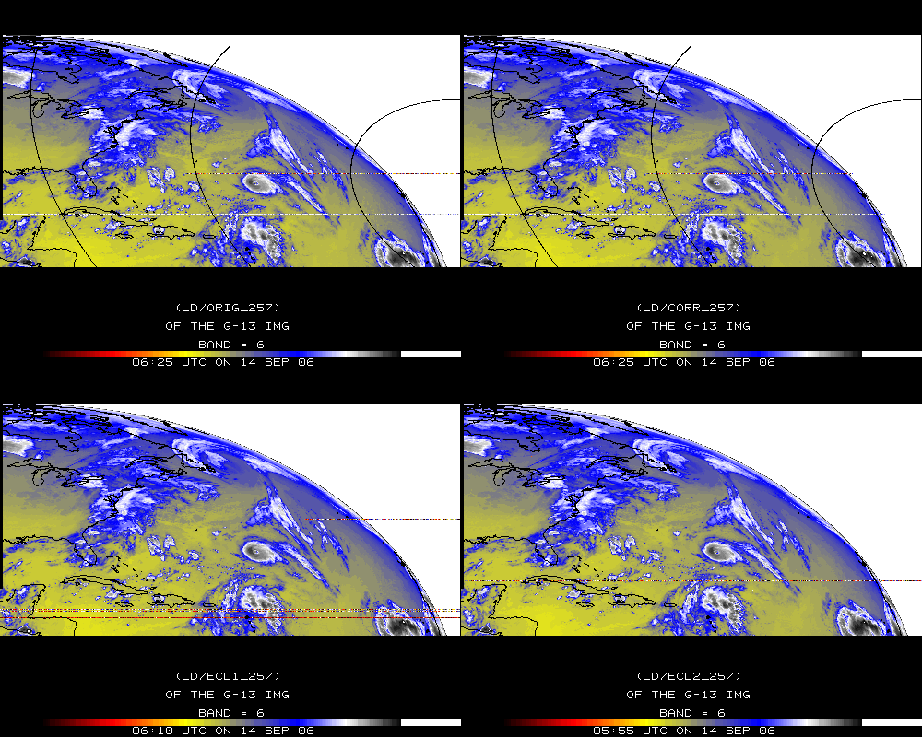
Band 6

Slide 38
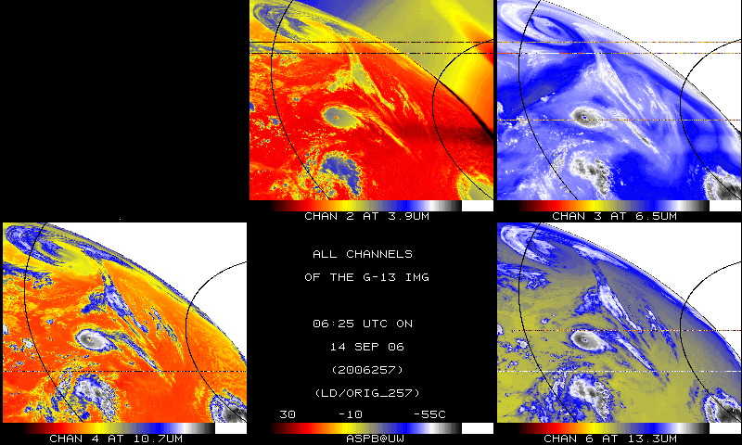
IR bands, Original – Day 257

Slide 39
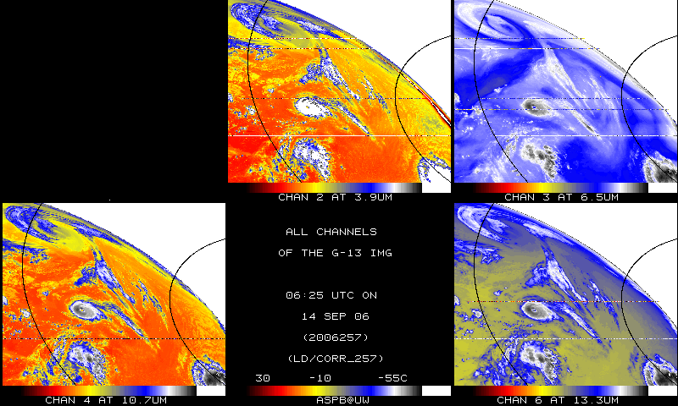
IR bands, Corrected– Day 257

Slide 40
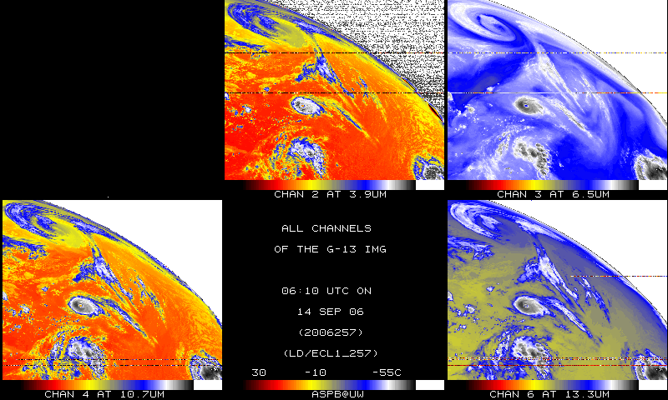
IR bands, 15-minutes earlier – Day 257

Slide 41
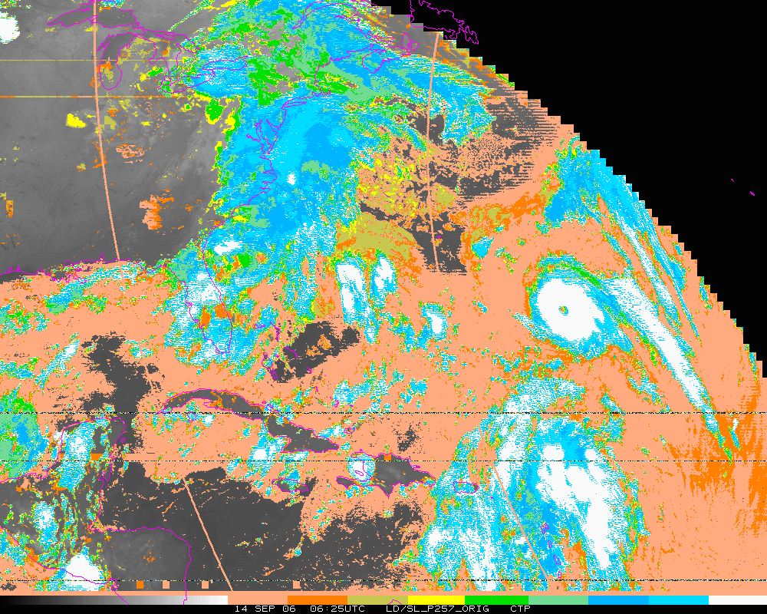
Cloud-top Pressure (color-range). Original
Clear Low cloud High Cloud

Slide 42
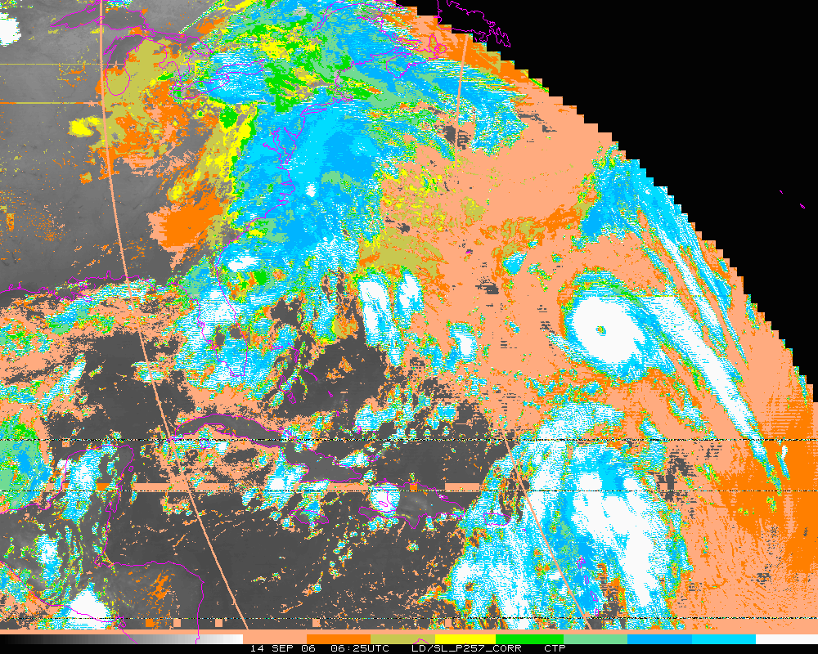
Cloud-top Pressure (color-range). Corrected
Clear Low cloud High Cloud

Slide 43
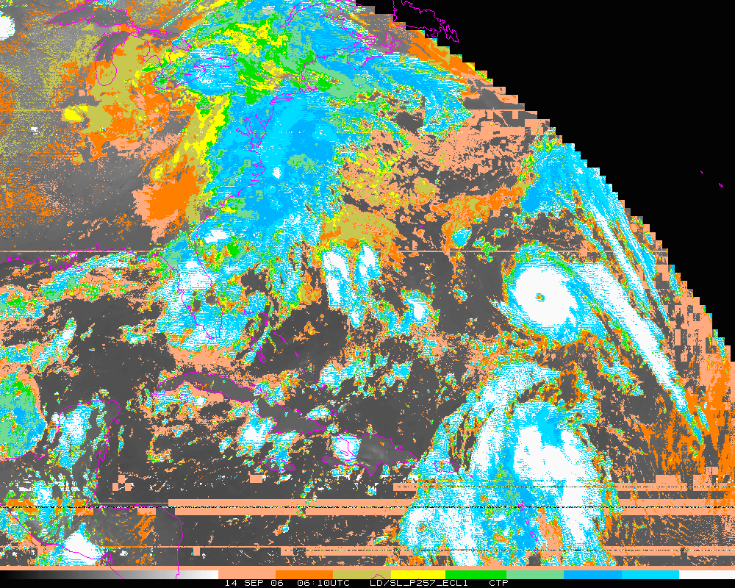
Cloud-top Pressure (color-range). Eclipse 1
Clear Low cloud High Cloud

Slide 44
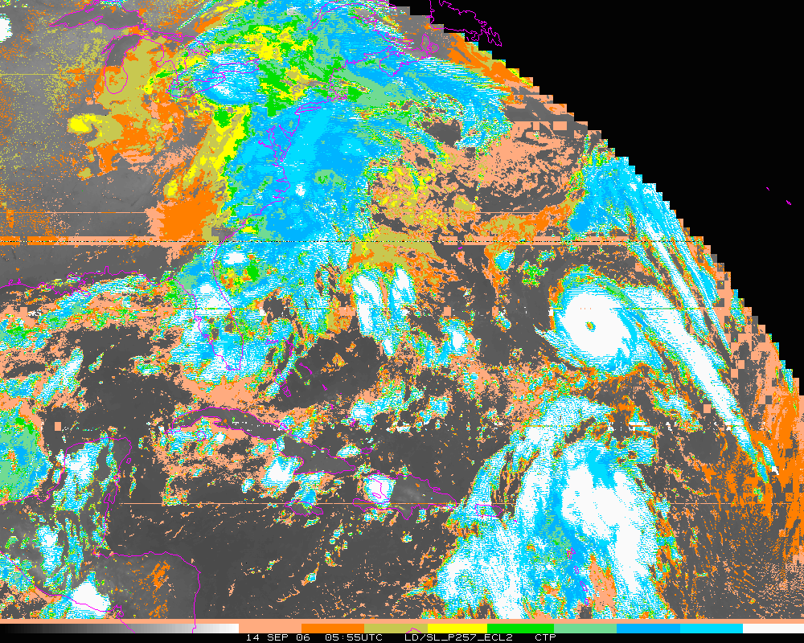
Cloud-top Pressure (color-range). Eclipse 2
Clear Low cloud High Cloud

Slide 45
Stray Light Analysis GOES-13 Imager
Tim Schmit
ASPB
Day 284

Slide 46
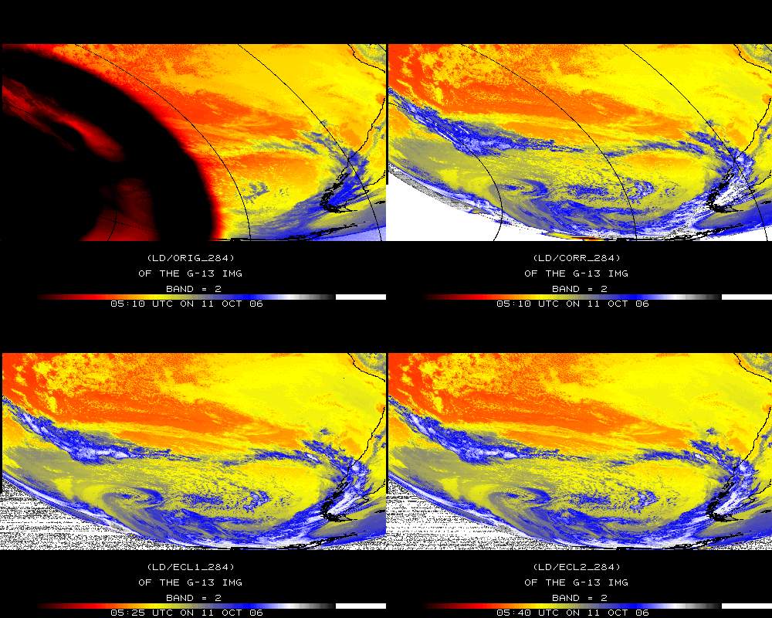
Band 2

Slide 47
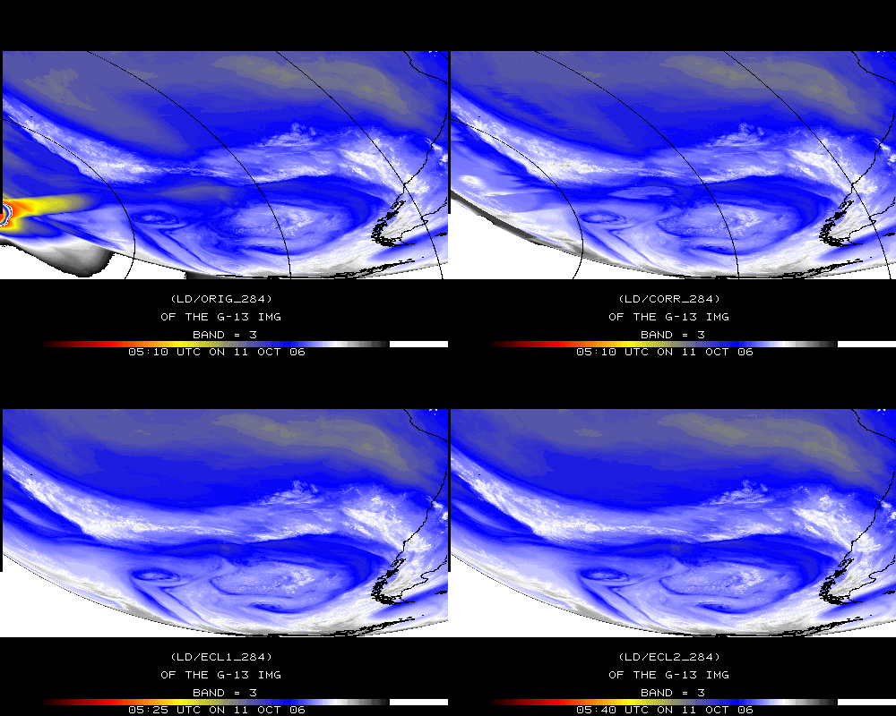
Band 3

Slide 48
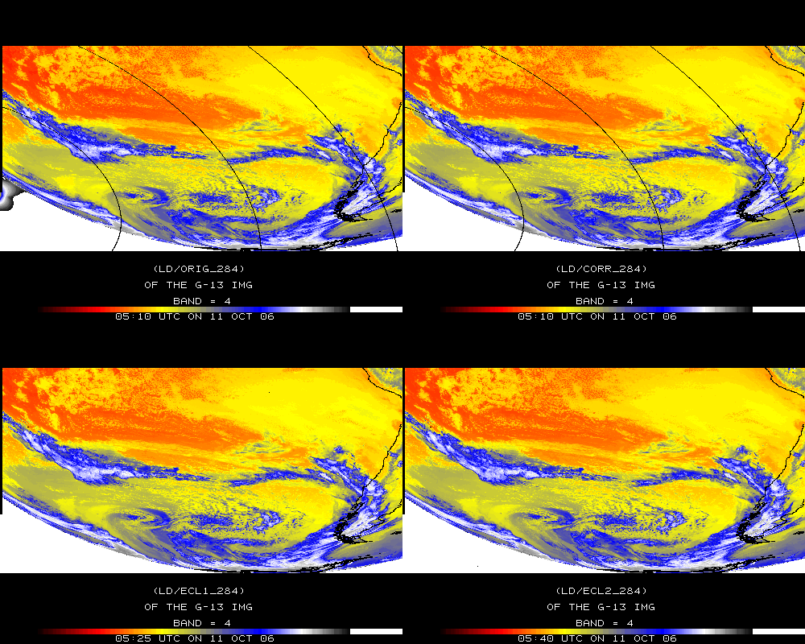
Band 4

Slide 49
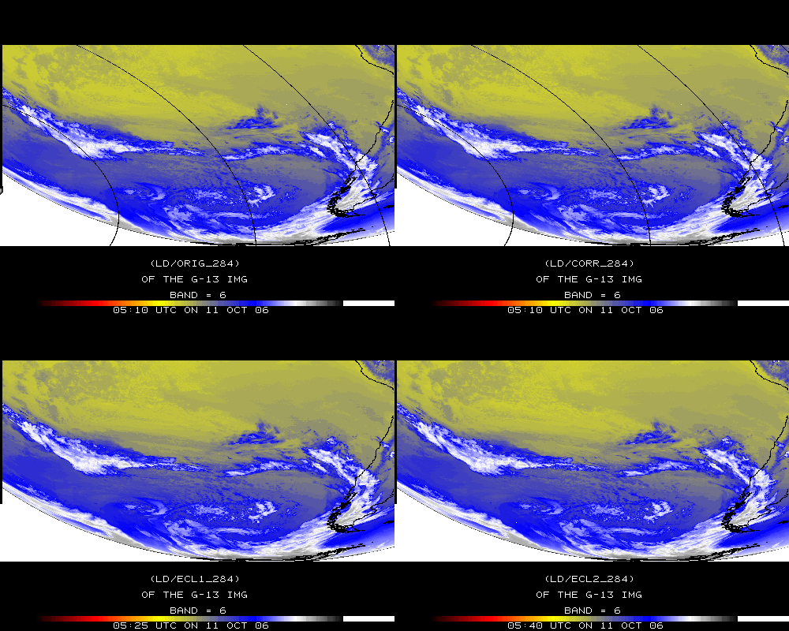
Band 6

Slide 50
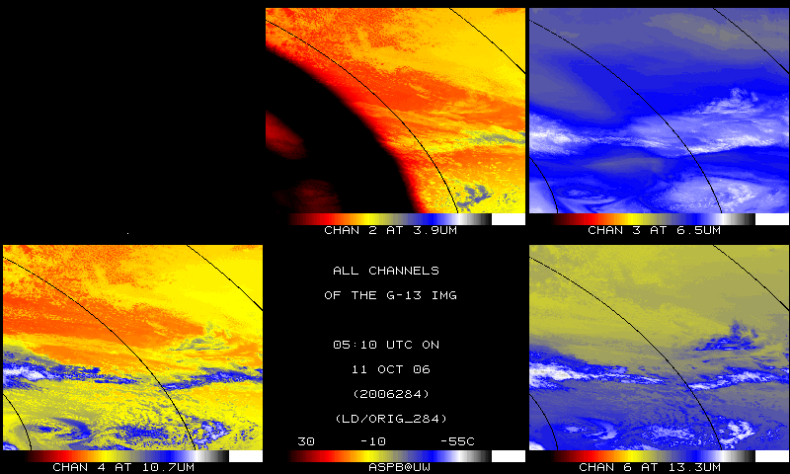
IR bands, Original – Day 284

Slide 51
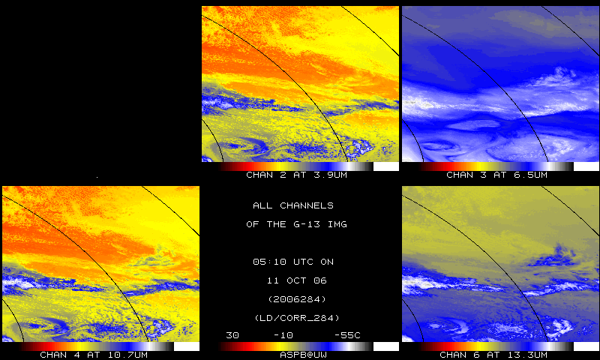
IR bands, Corrected – Day 284

Slide 52
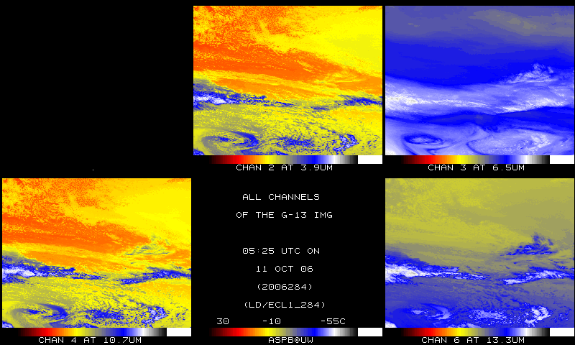
IR bands, 15-min later – Day 284

