Slide 1
Stray Light Analysis GOES-13 Imager
Tim Schmit
ASPB
22-Oct-2010
Day 255
Day 257
Day 284

Slide 2
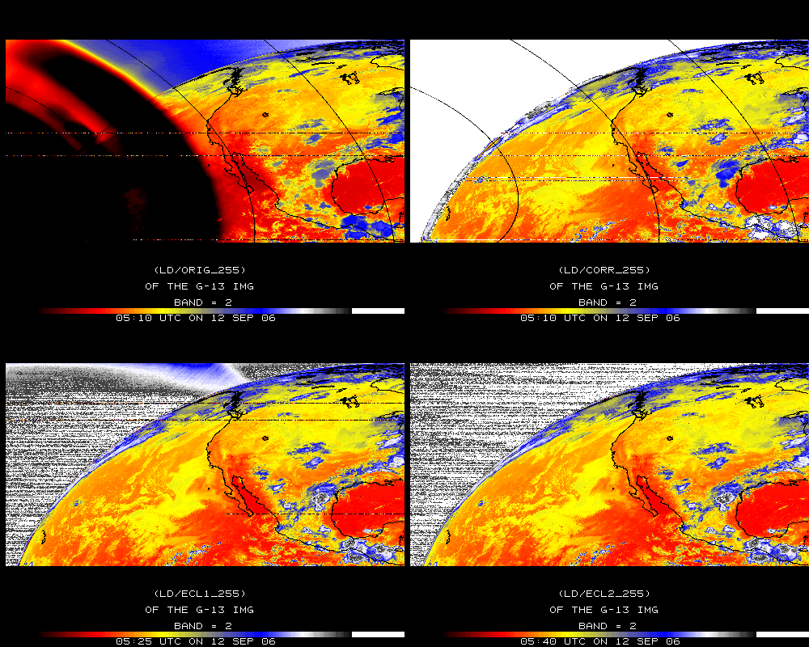
Band 2

Slide 3
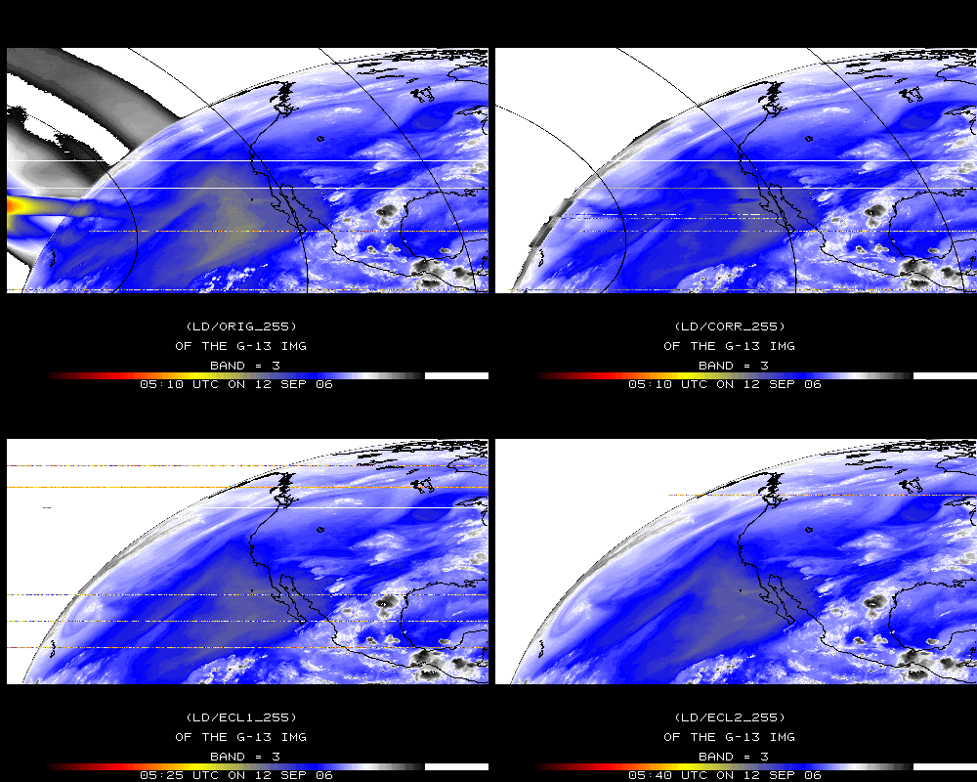
Band 3

Slide 4
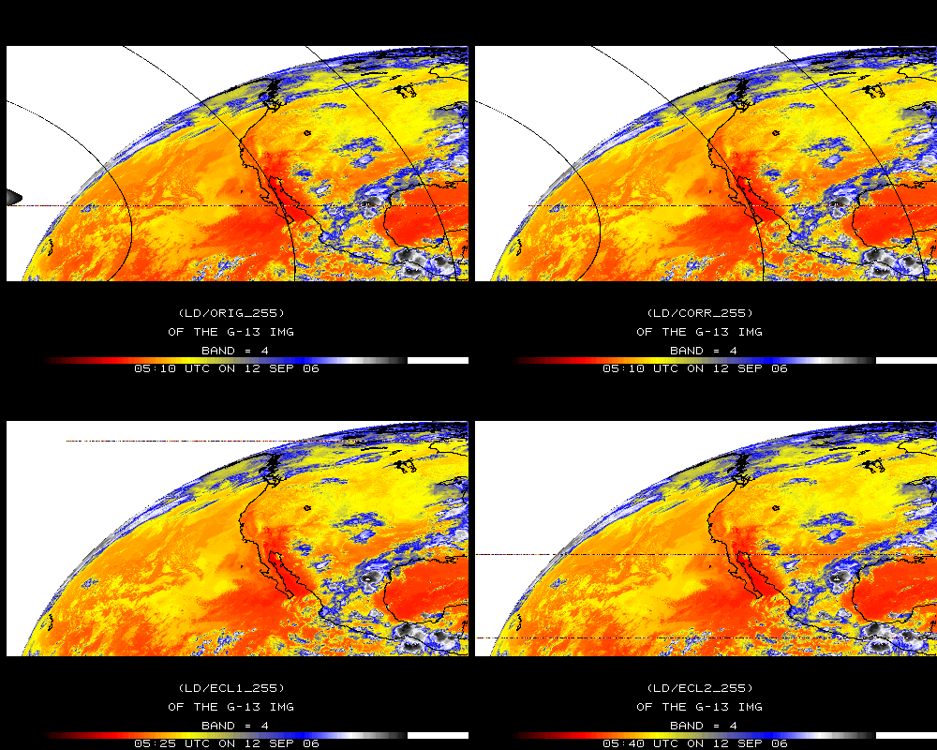
Band 4

Slide 5
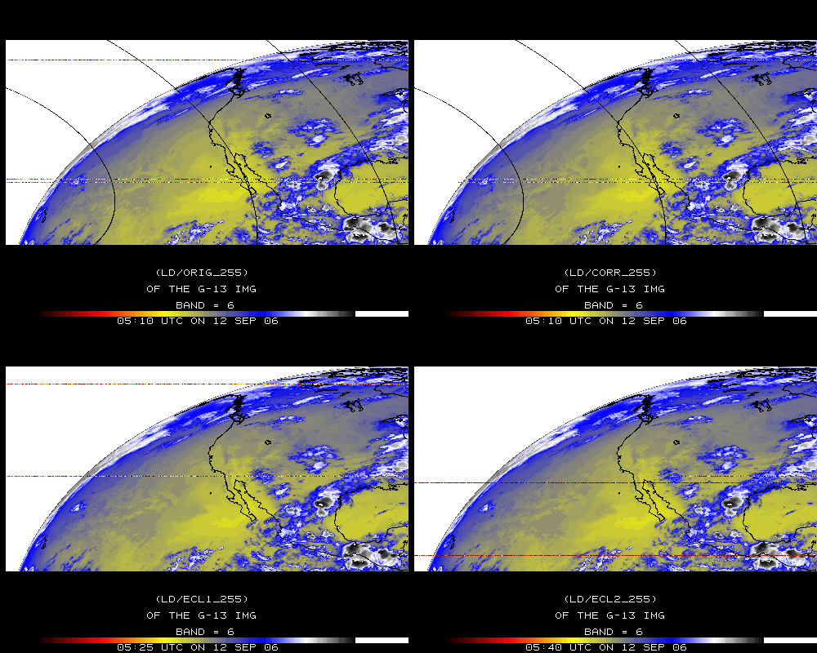
Band 6

Slide 6
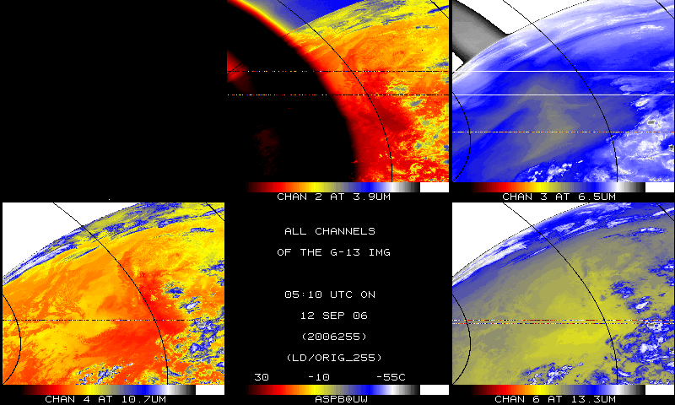
IR bands, Original

Slide 7
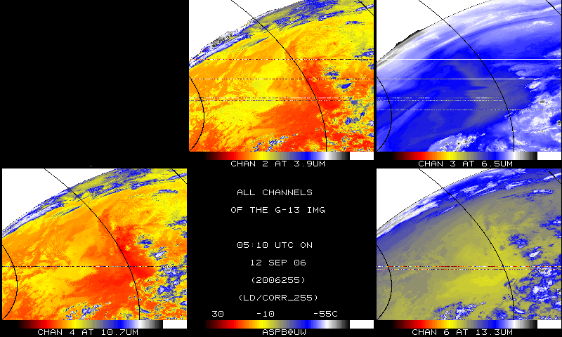
IR bands, Corrected

Slide 8
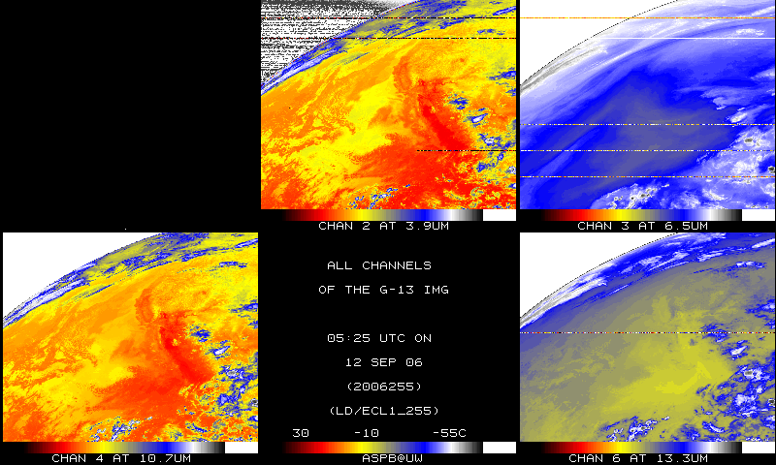
IR bands, 15-minutes later

Slide 9
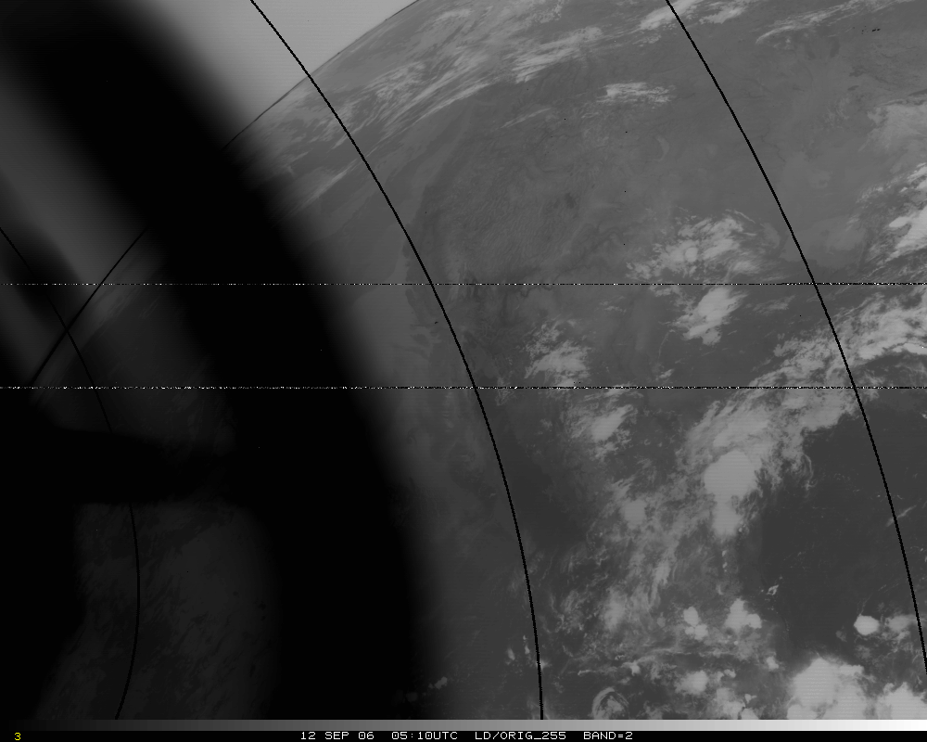
Band 2, Original

Slide 10
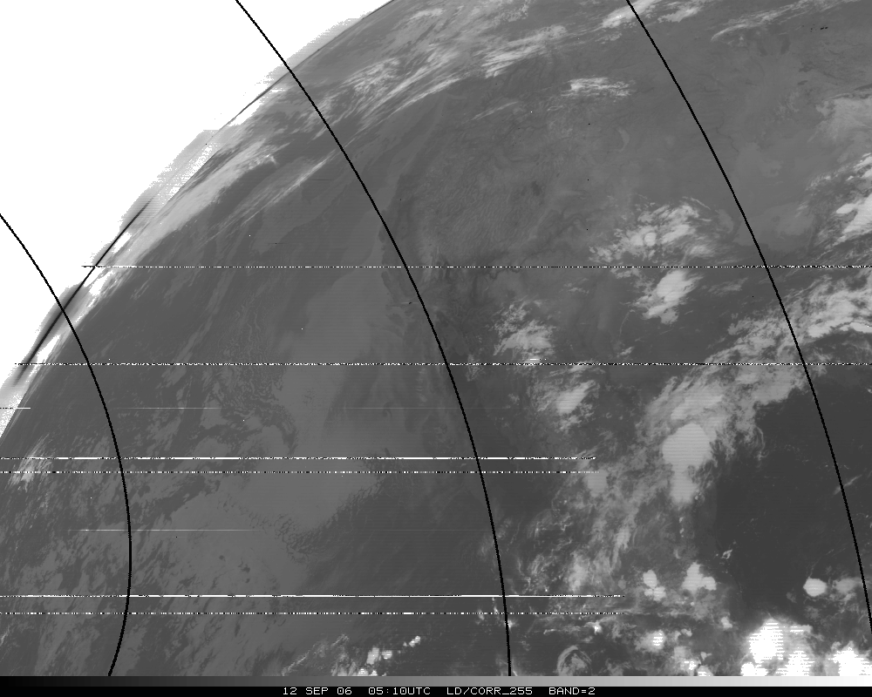
Band 2, Corrected

Slide 11
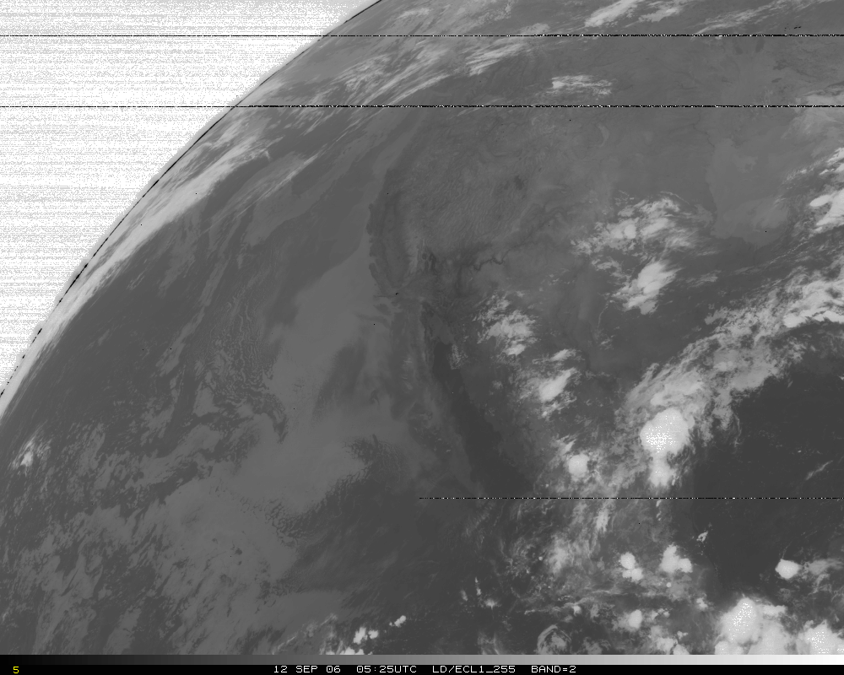
Band 2, later image

Slide 12
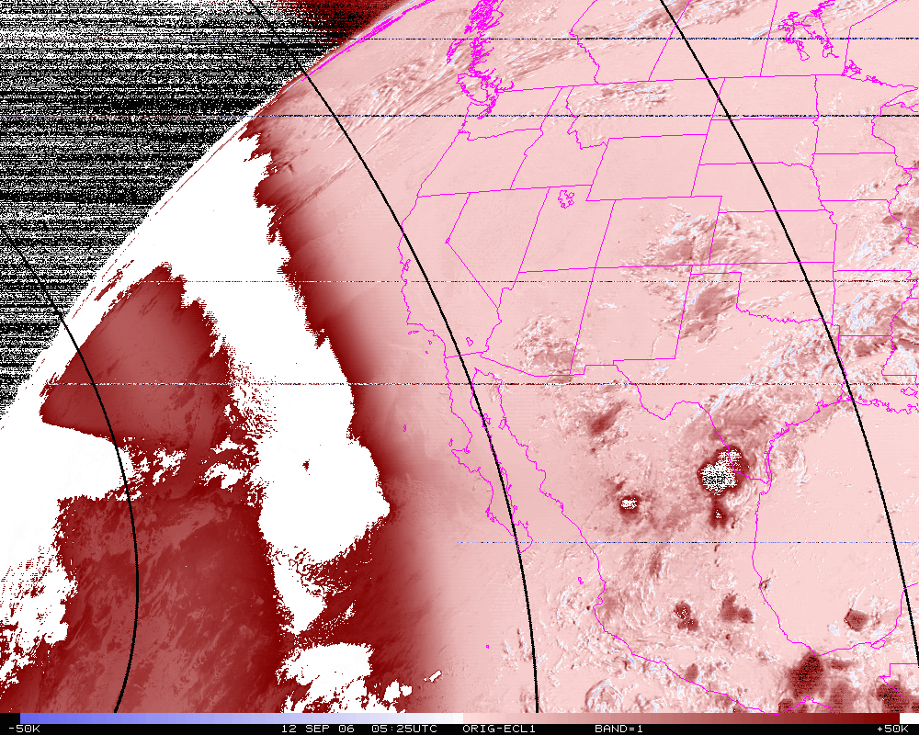
Band 2, difference image (org-eclipse)

Slide 13
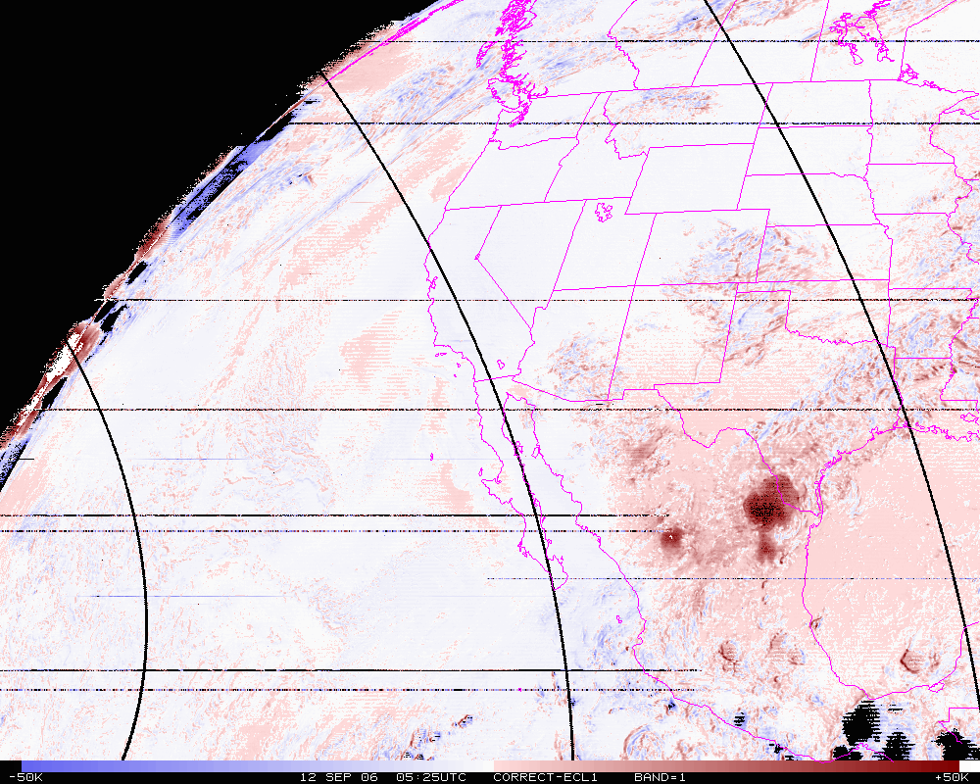
Band 2, difference image (corrected-eclipse)

Slide 14
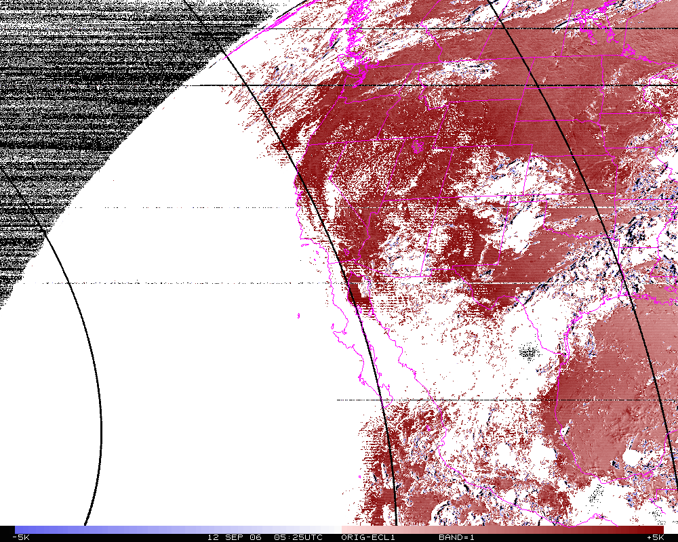
Band 2 Difference
N=14342
Mean= 4.0K
Band 2, difference image (org-eclipse) Smaller range.

Slide 15
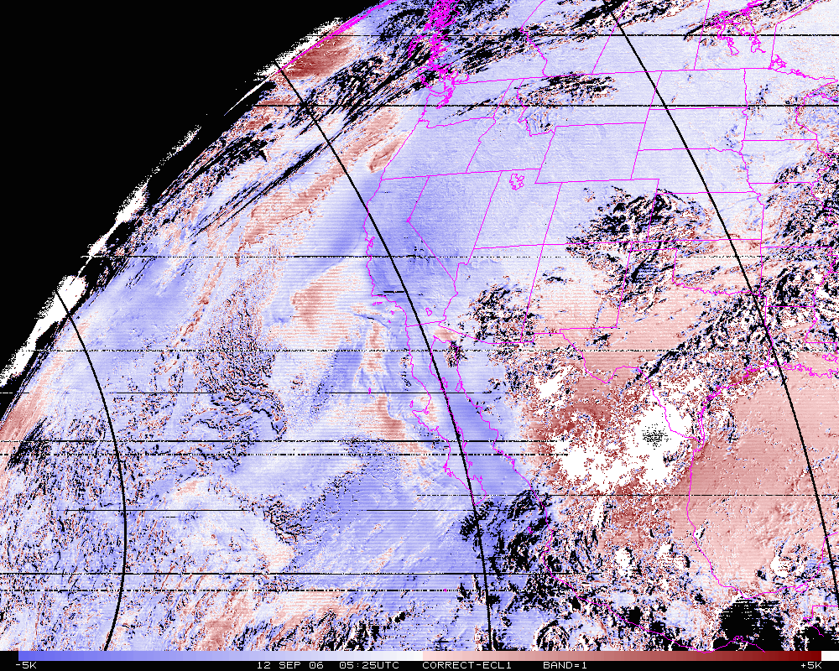
Band 2 Difference
N=14342
Mean= -1.1K
Band 2, difference image (corrected-eclipse). Smaller range.

Slide 16
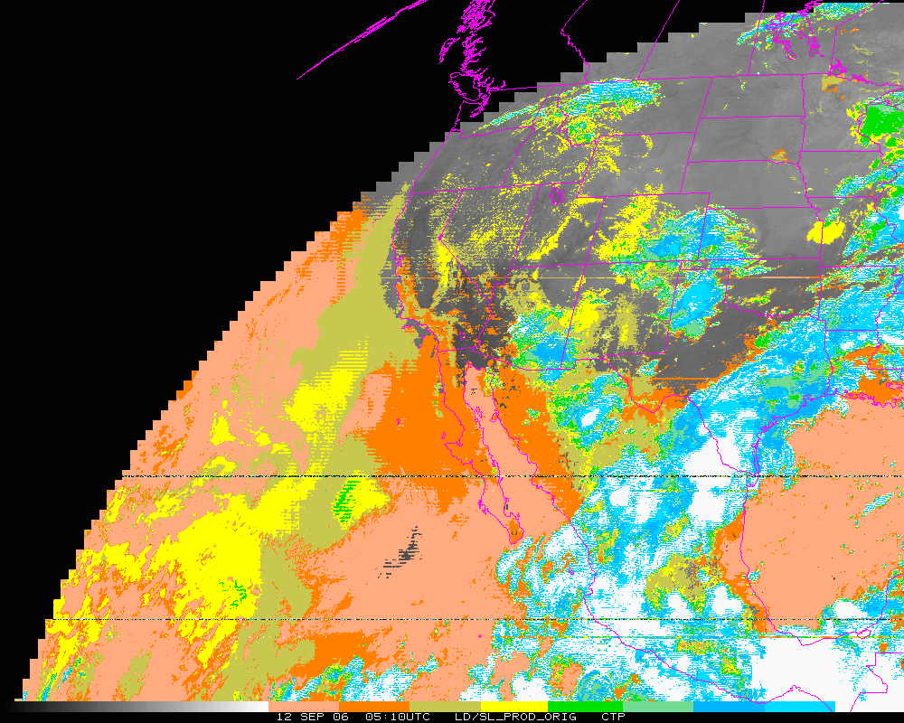
Cloud-top Pressure (color-range). Original

Slide 17
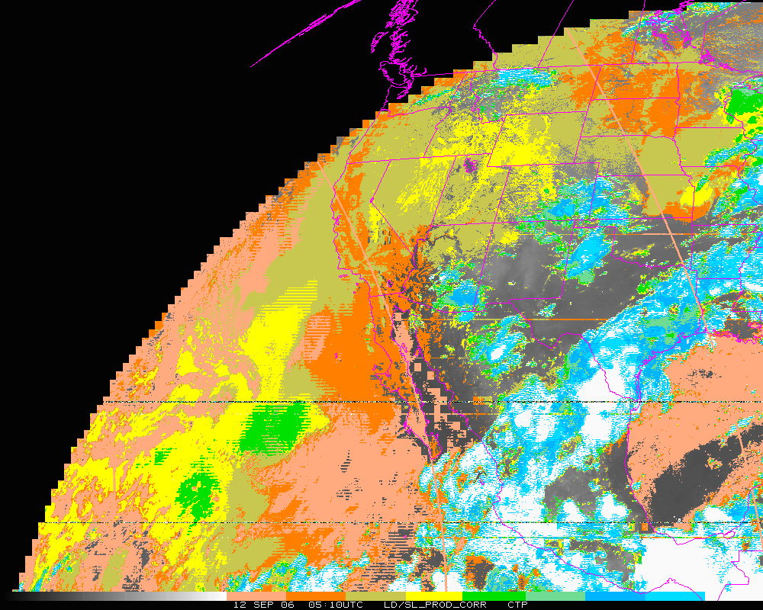
Cloud-top Pressure (color-range). Corrected

Slide 18
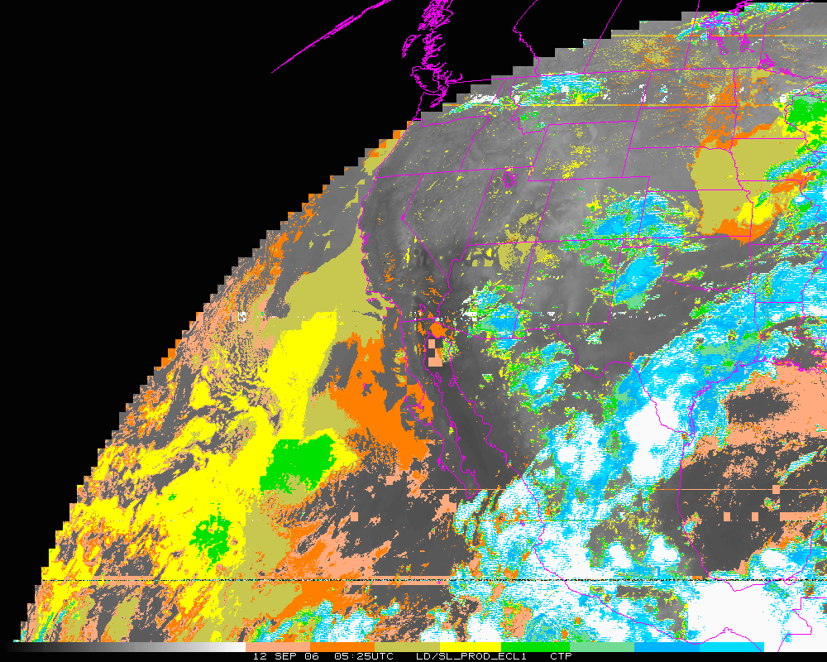
Cloud-top Pressure (color-range). Eclipse 1

Slide 19
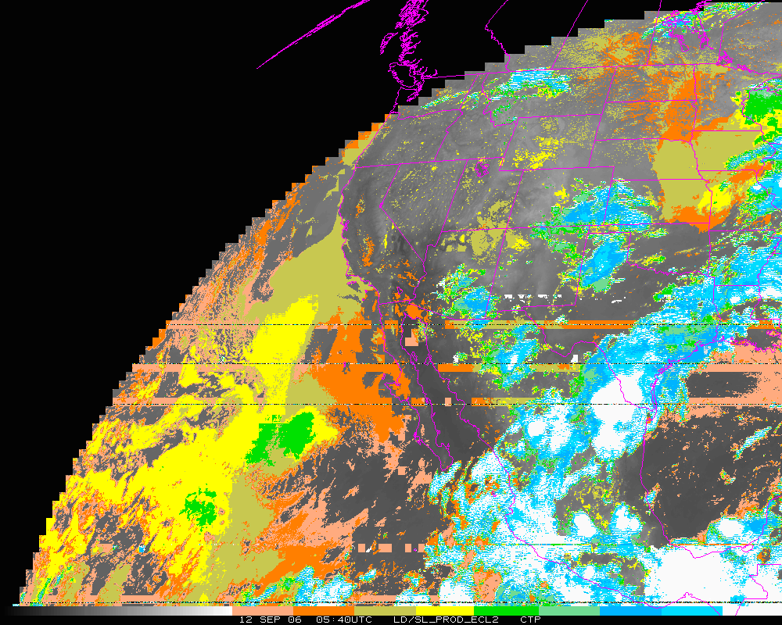
Cloud-top Pressure (color-range). Eclipse 2

Slide 20
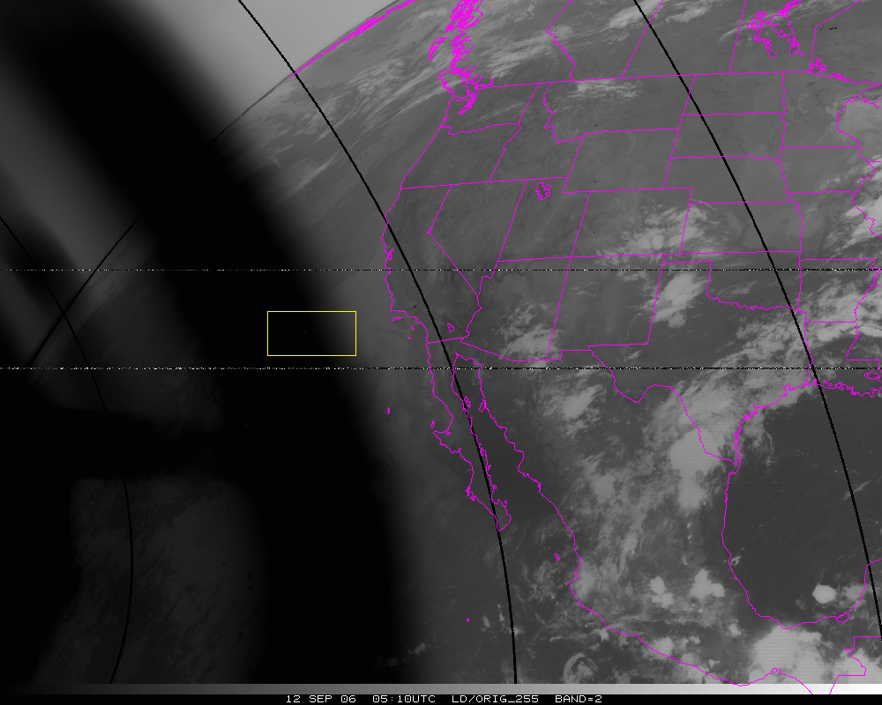
Band=2
N=10302
Org Mean= 325.6K
Cor. Mean= 281.0K
Ecl. Mean= 281.2K

Slide 21
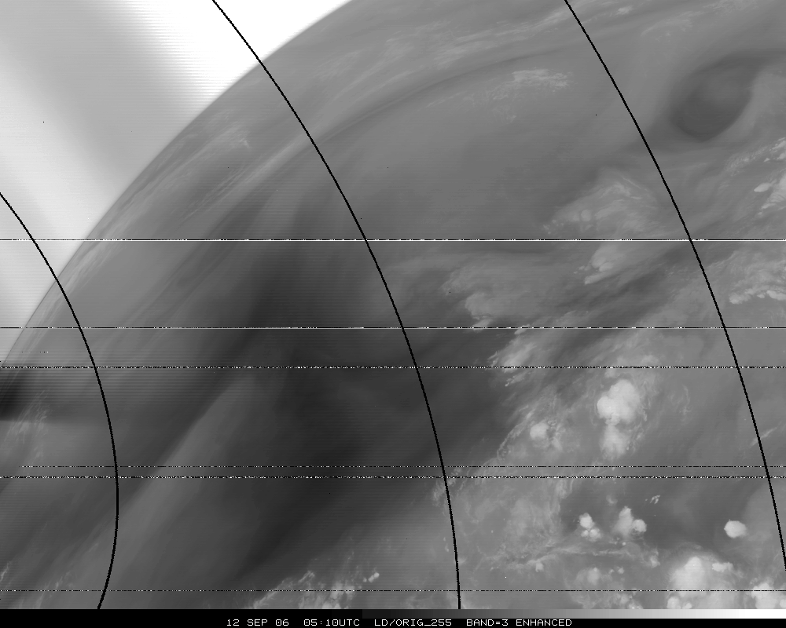
Band 3, Original

Slide 22
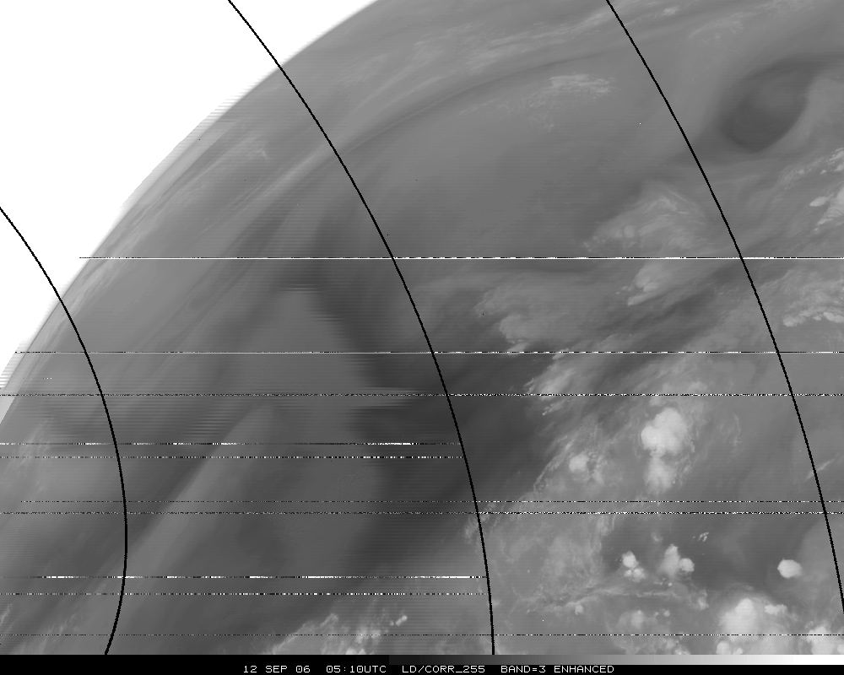
Band 3, Corrected

Slide 23
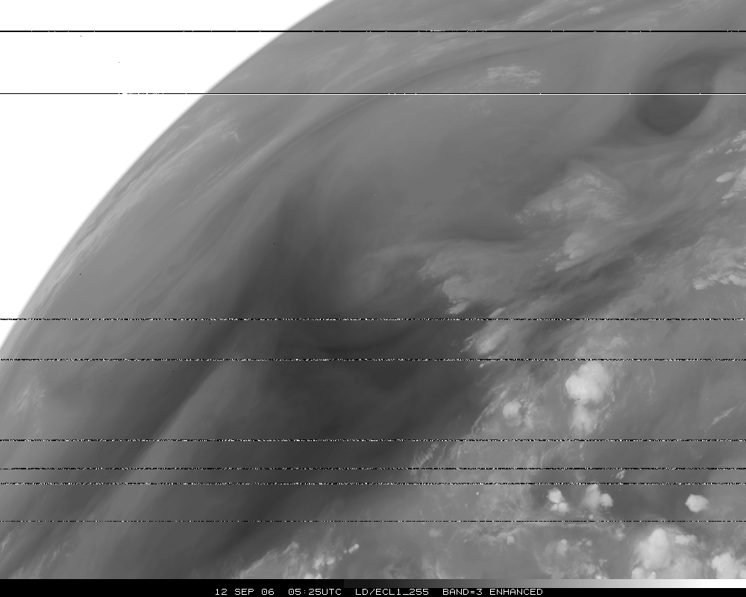
Band 3, Eclipse

Slide 24
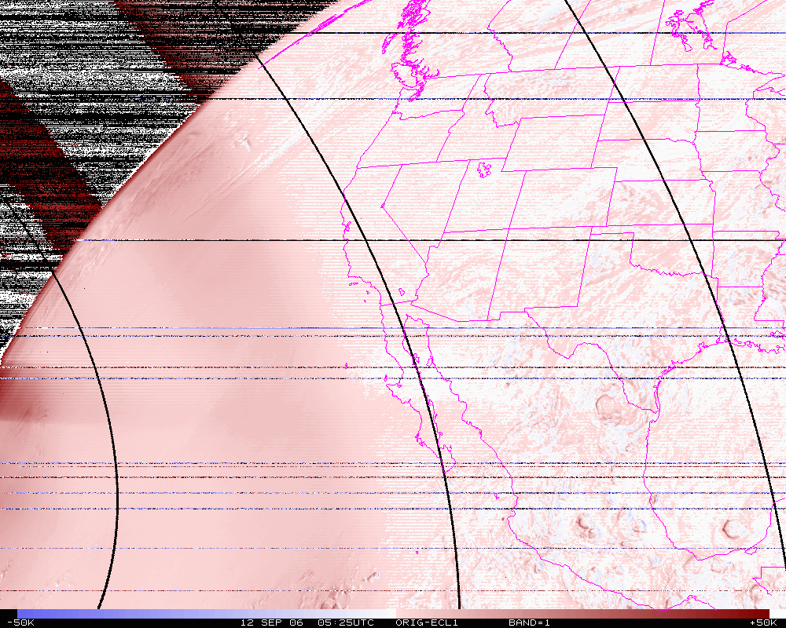
Band 3, difference image (org-eclipse)

Slide 25
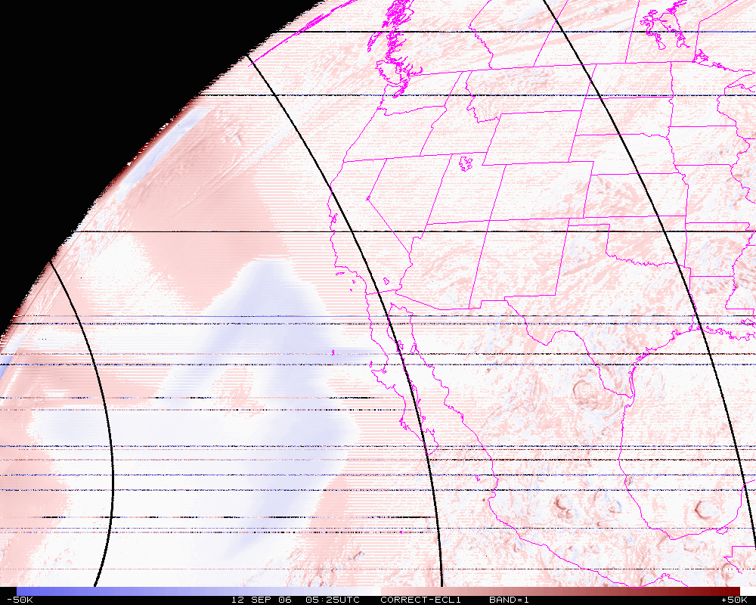
Band 3, difference image (corrected-eclipse)

Slide 26
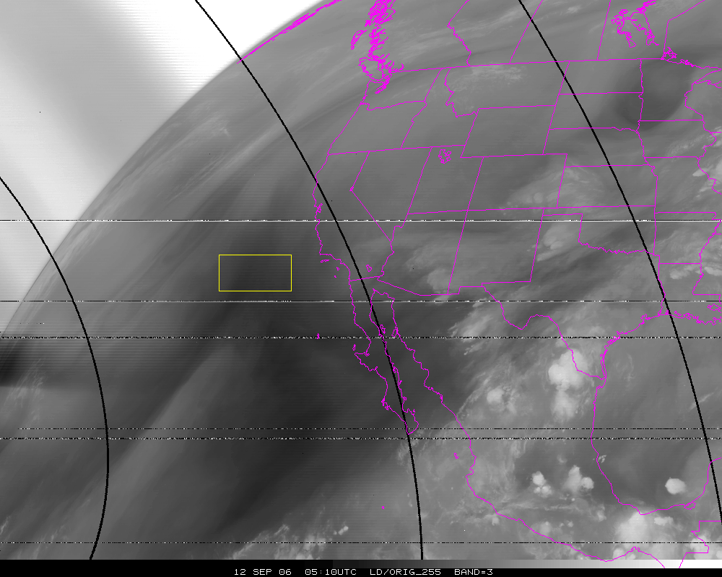
Band=3
N=10302
Org Mean= 258.6K
Cor. Mean= 249.1K
Ecl. Mean= 254.2K

Slide 27
Stray Light Analysis GOES-13 Imager
Tim Schmit
ASPB
22-Oct-2010
Day 257

Slide 28
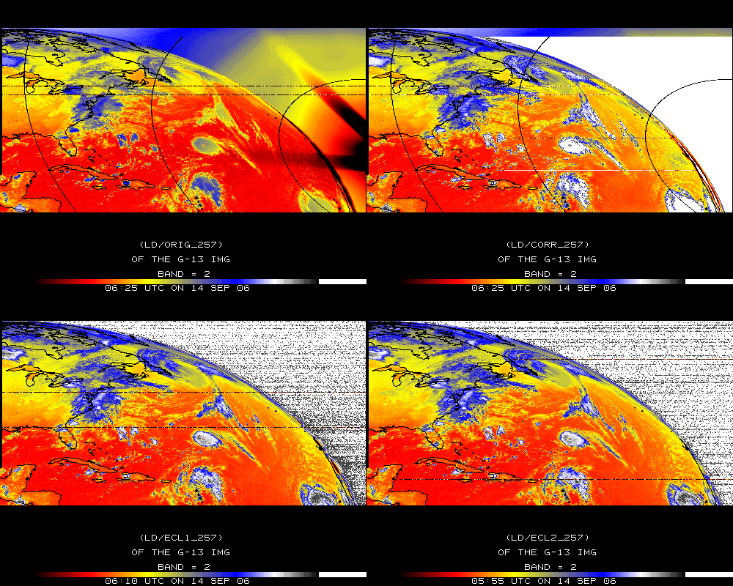
Band 2

Slide 29
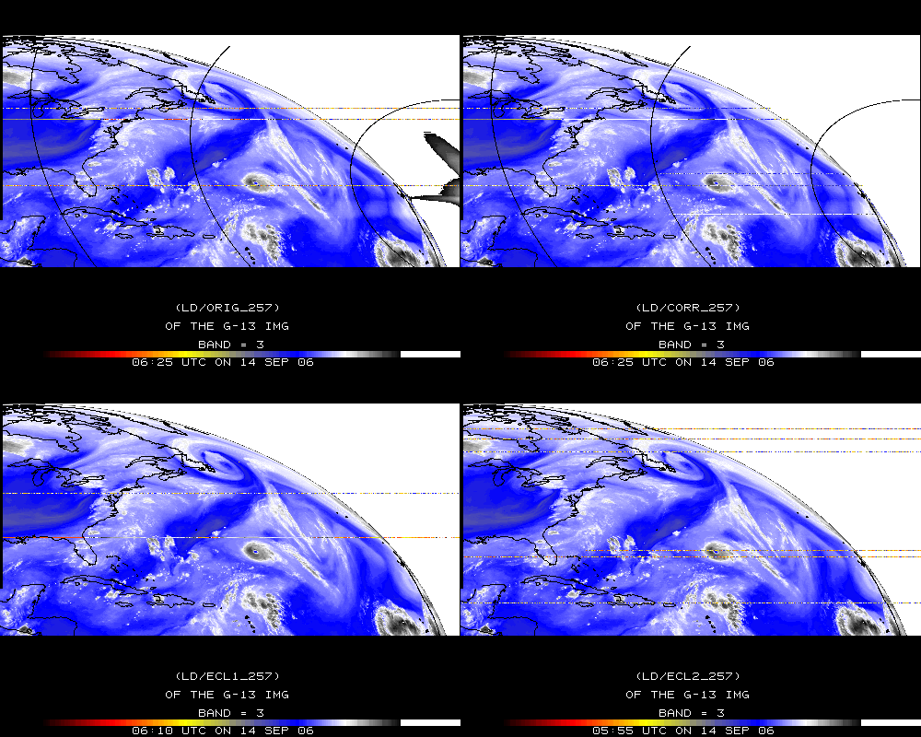
Band 3

Slide 30
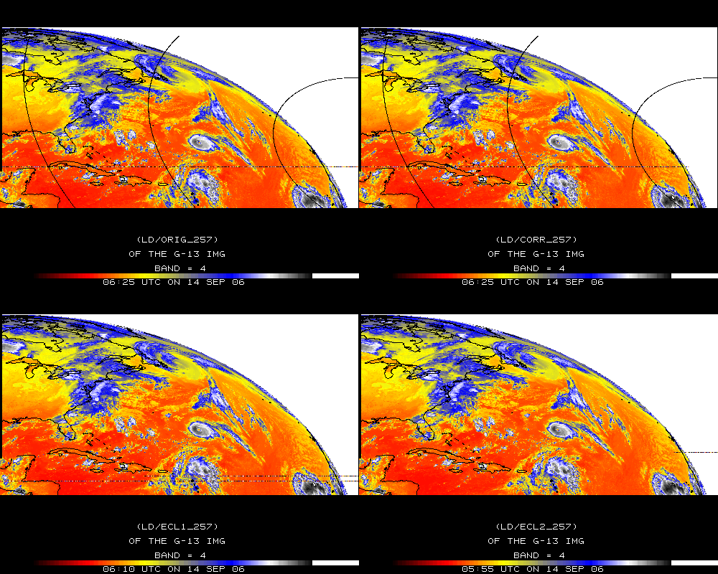
Band 4

Slide 31
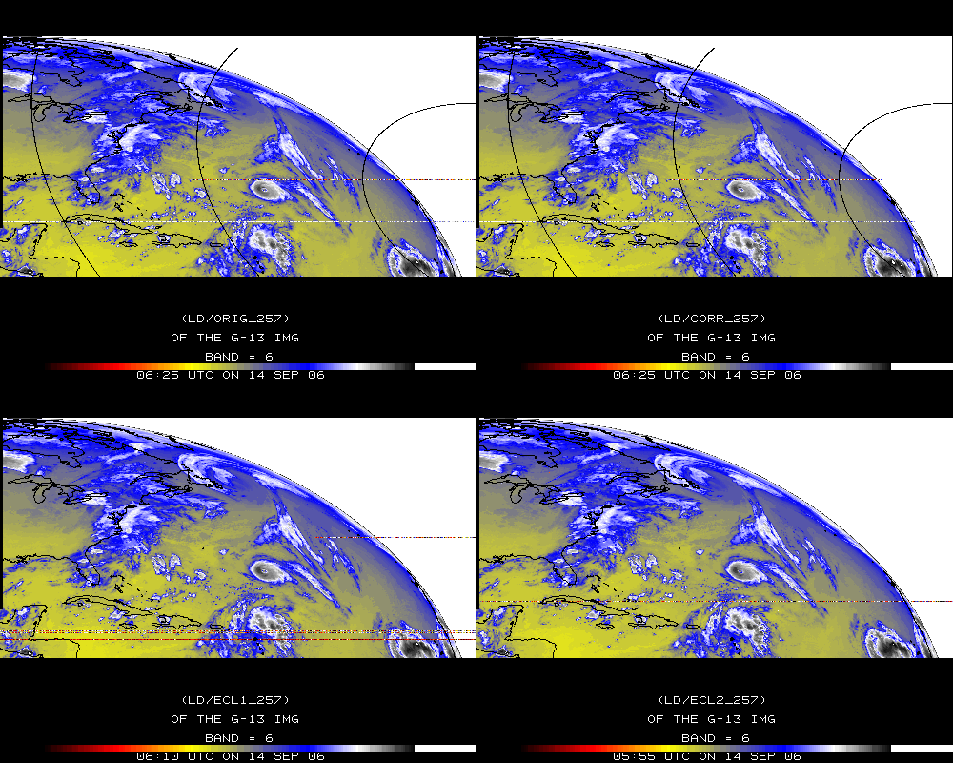
Band 6

Slide 32
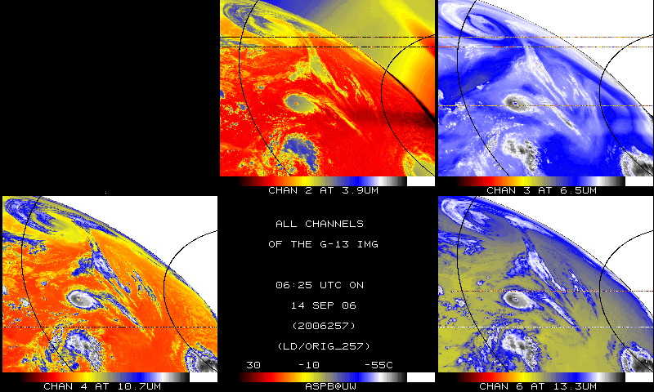
IR bands, Original – Day 257

Slide 33
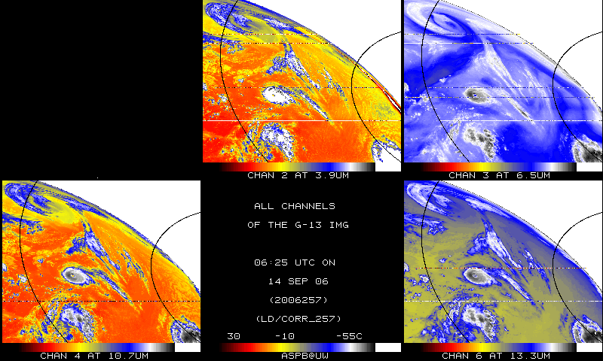
IR bands, Corrected– Day 257

Slide 34
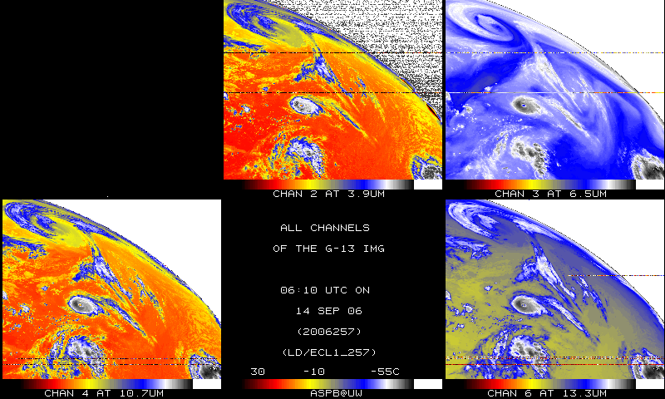
IR bands, 15-minutes earlier – Day 257

Slide 35
Stray Light Analysis GOES-13 Imager
Tim Schmit
ASPB
22-Oct-2010
Day 284

Slide 36
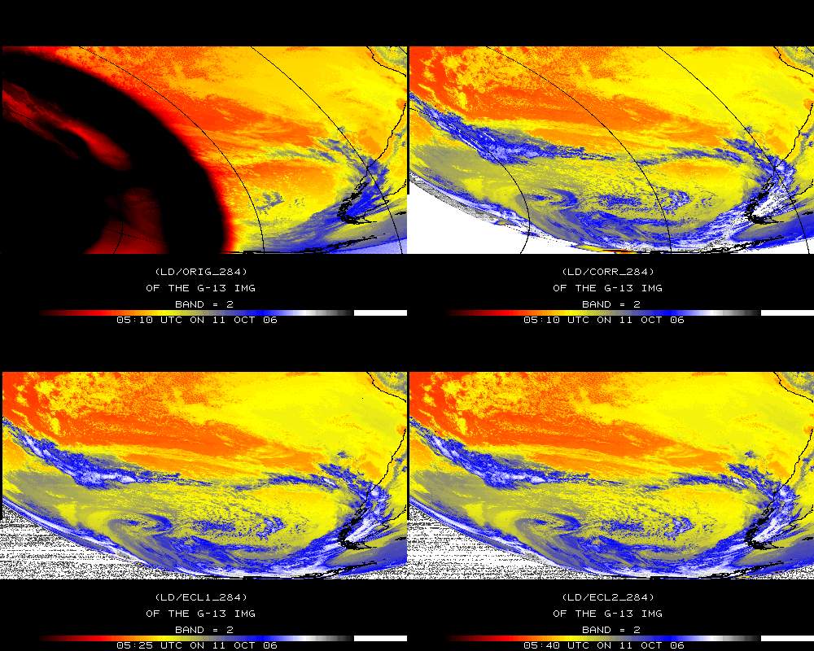
Band 2

Slide 37
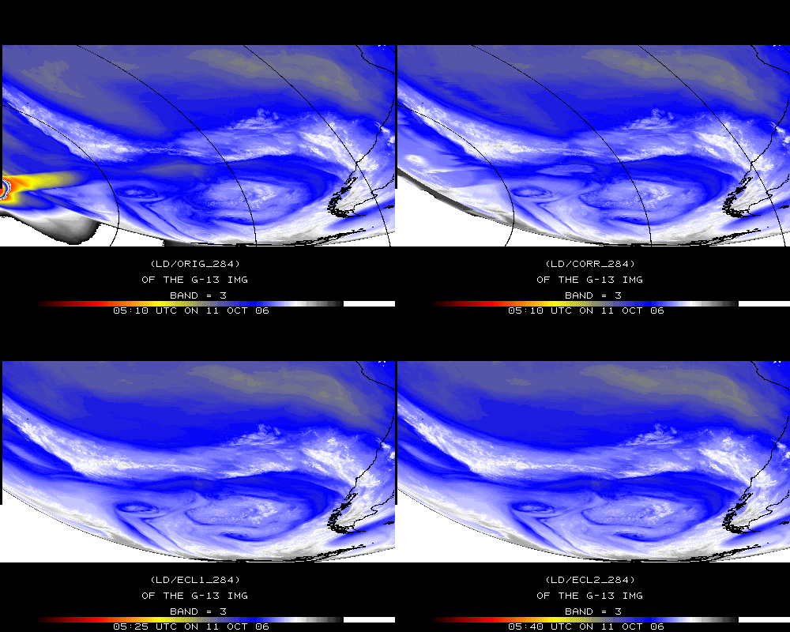
Band 3

Slide 38
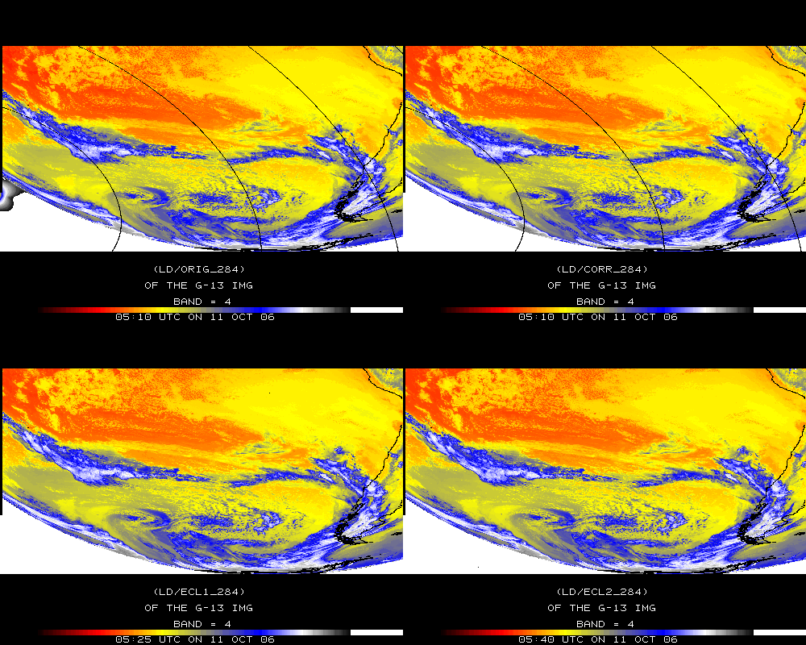
Band 4

Slide 39
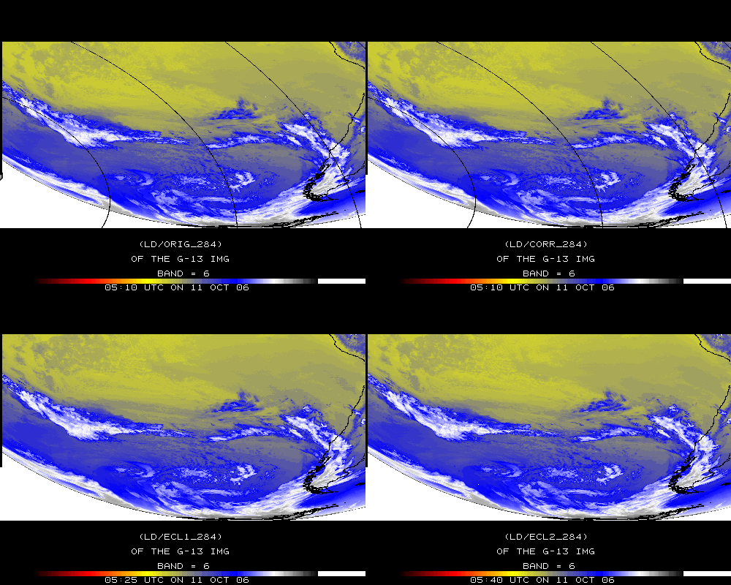
Band 6

Slide 40
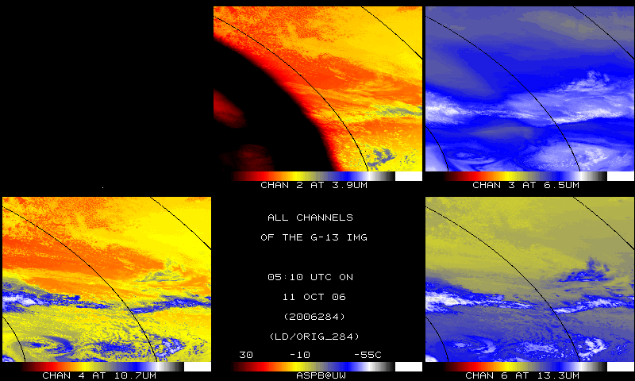
IR bands, Original – Day 284

Slide 41
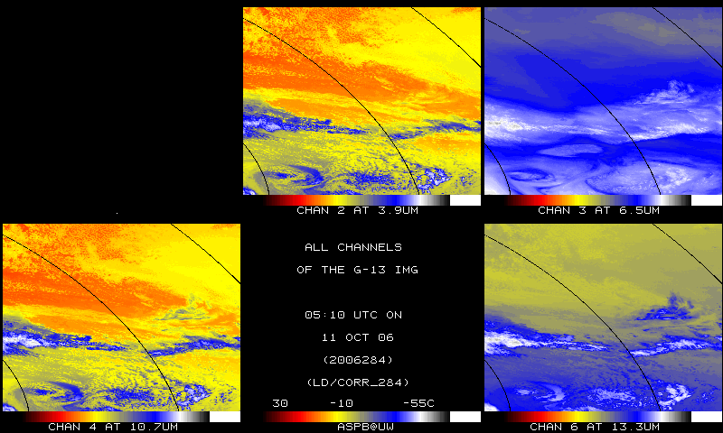
IR bands, Corrected – Day 284

Slide 42
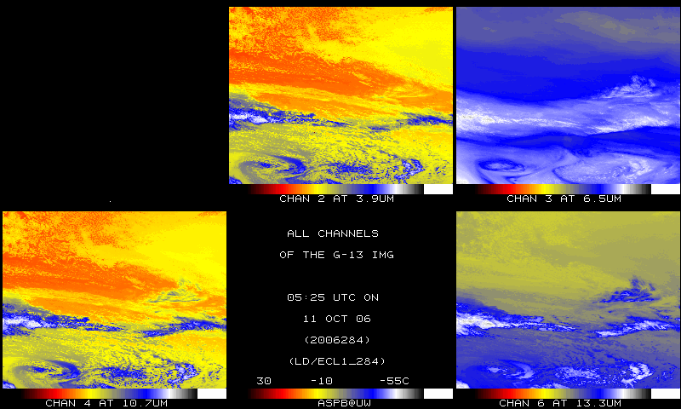
IR bands, 15-min later – Day 284

