Slide 1
Stray Light Analysis GOES-13 Imager
Tim Schmit, ASPB
Tony Schreiner, CIMSS
7-January-2011
Day 255 – Cloud Top Pressure

Slide 2
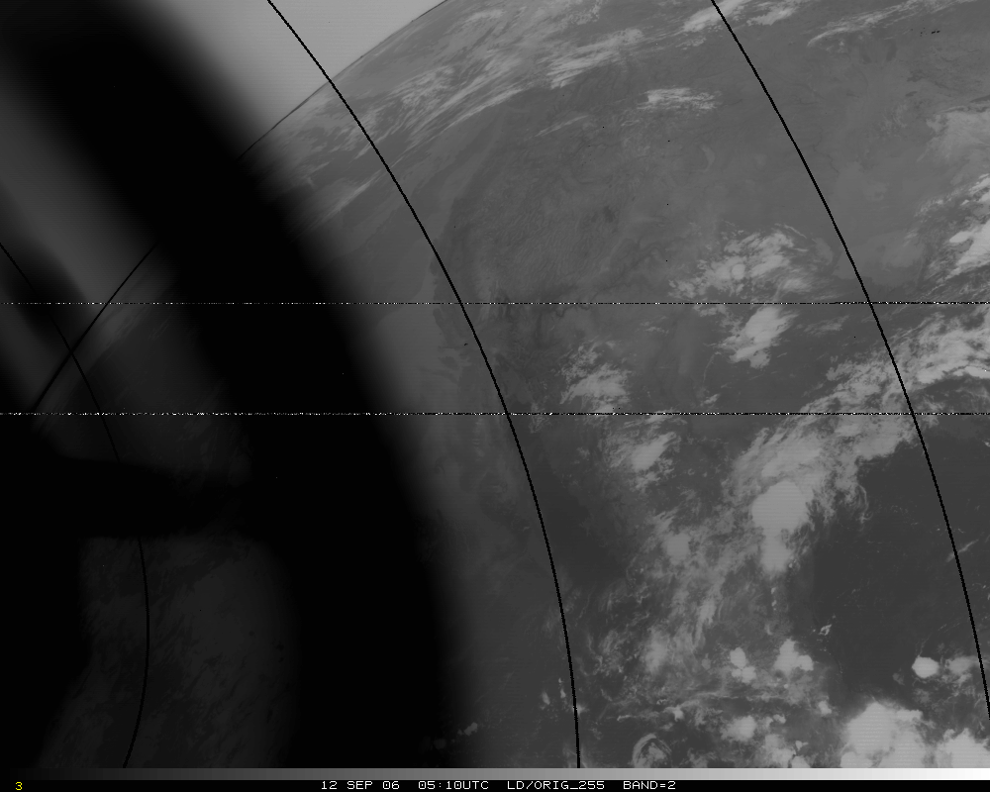
Band 2, Original – too hot by several K!
Band 2, Original – too hot by 50K!

Slide 3
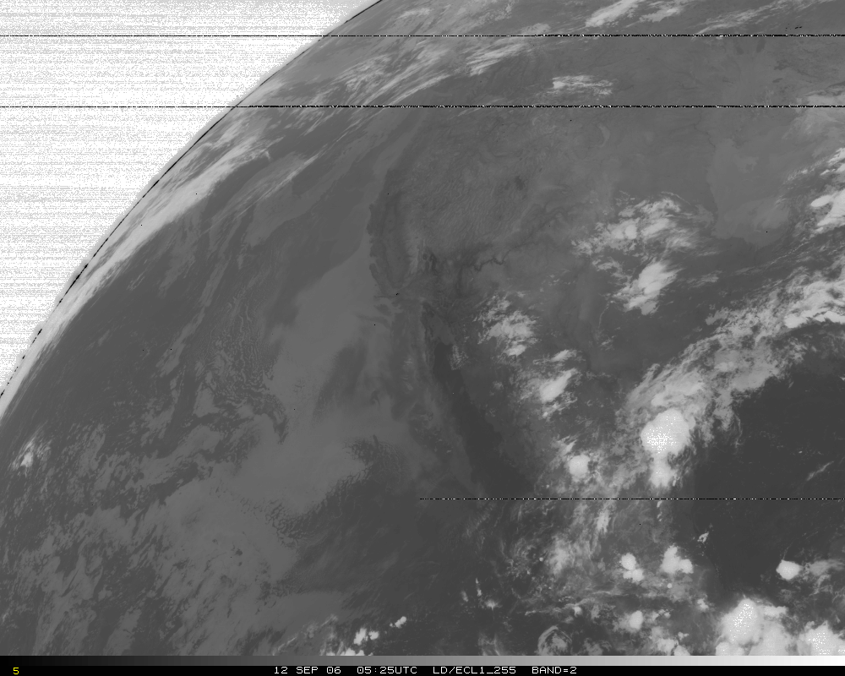
Band 2, later image

Slide 4
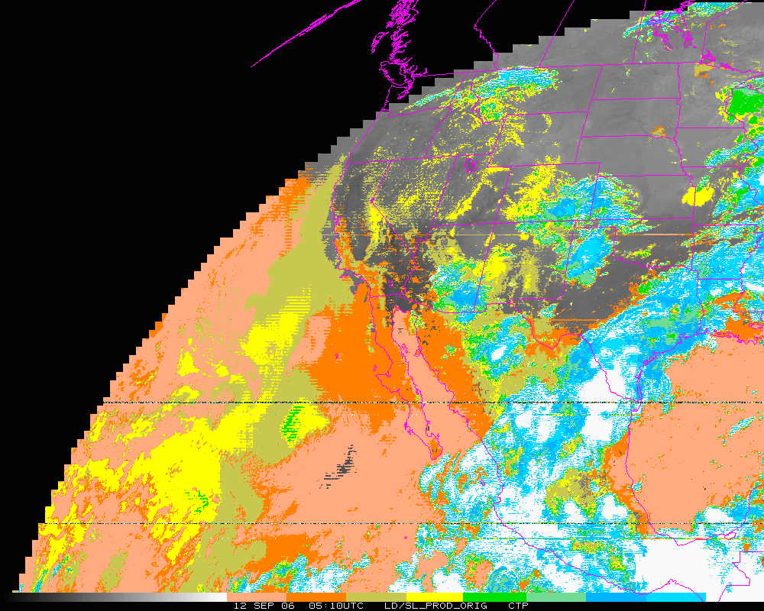
Cloud-top Pressure (color-range). Original – too “cloudy” over some regions, but misses other clouds!
Clear Low cloud High Cloud

Slide 5
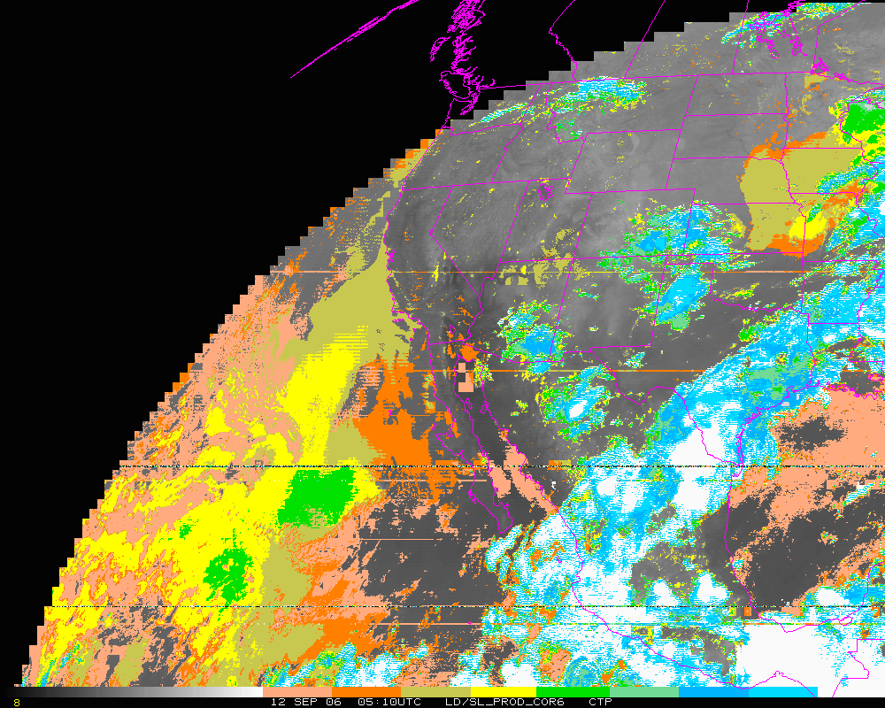
Cloud-top Pressure (color-range). Corrected. In general, corrected both regions.
Clear Low cloud High Cloud
Notes:
…outside of 6 degrees.

Slide 6
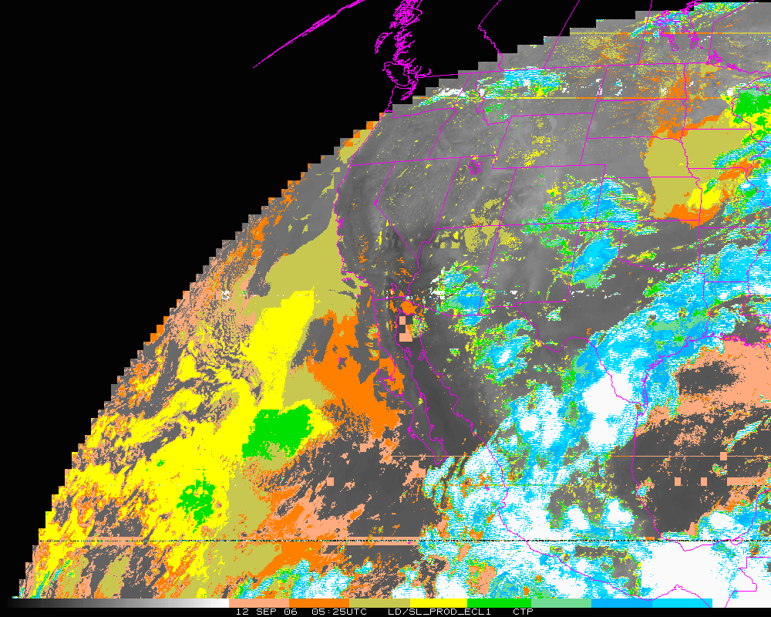
Cloud-top Pressure (color-range). Later image.
Clear Low cloud High Cloud

