Slide 1


GOES-13 Imager
Corrupt Space Look causing bad 4 um data?
(affecting at least fog product)
Path forward….
Timothy J. Schmit (NOAA/NESDIS/STAR)
Mathew M. Gunshor, James P. Nelson III and Anthony J. Schreiner
(CIMSS)
Hyre Bysal (NOAA OSPO)
FangFang Yu (ERT, Inc.)
Michael Sporer (NWS)
Etc.
17-May-2013

Slide 2
Outline
Background
Examples
  August 2012
  April 2013
Way forward options
Requirements

Slide 3
Background
Historically, the GOES-8/12 series did not take images during “KOZ”
  Could be up to 3 hours
GOES-13/15 allows images to now be taken during this time period
Recent issue seems to be corrupted space look and not directly related to the stray light correction
Space looks are scheduled to be on the ‘clean’ side of the earth (away from the sun, etc.)

Slide 4
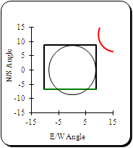
Comment from NWS
2012:
From: Patrick Ayd <patrick.ayd@noaa.gov>
Date: Sun, Aug 19, 2012 at 1:24 AM
Subject: INFO: Bad Fog Channel Images
To: Joshua Scheck <Joshua.Scheck@noaa.gov>
Josh,
I have noticed more and more during the night that bad 3.9 mu satellite images are corrupting the 11-3.9 mu fog channel, reversing the way clouds should appear (i.e all clouds both low and high are colored as very dark).
I have attached two images from 545 UTC on 8-19-12:
fog_sat.png: 11-3.9 mu fog channel with cig/vis plot
3_9_mu.png: 3.9 mu channel
Thanks,
-Patrick
--
Patrick Ayd
General Forecaster
NOAA/NWS WFO Bismarck, ND
Office Phone: (701) 223-4582
232/5:45z FD

Slide 5
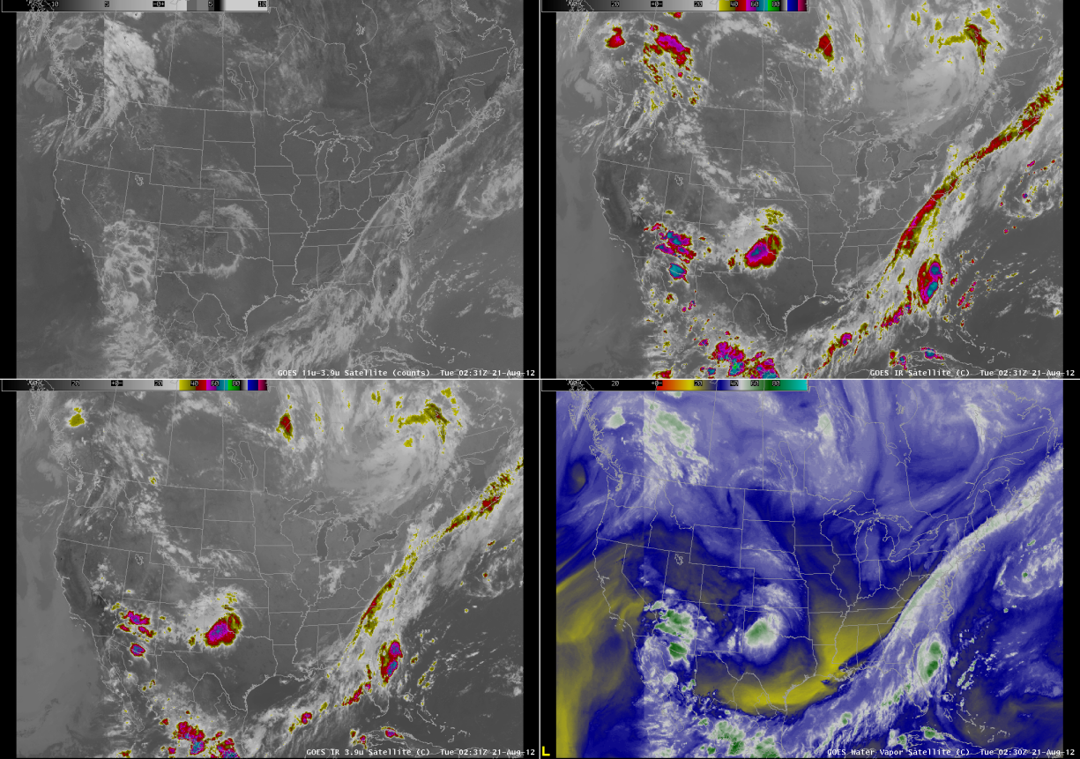
AWIPS as seen at CIMSS
<-Note seam
11 – 4 um in counts
11 um
<-Note seam
4 um
6.5 um

Slide 6

AWIPS as seen at CIMSS
Bad data

Slide 7
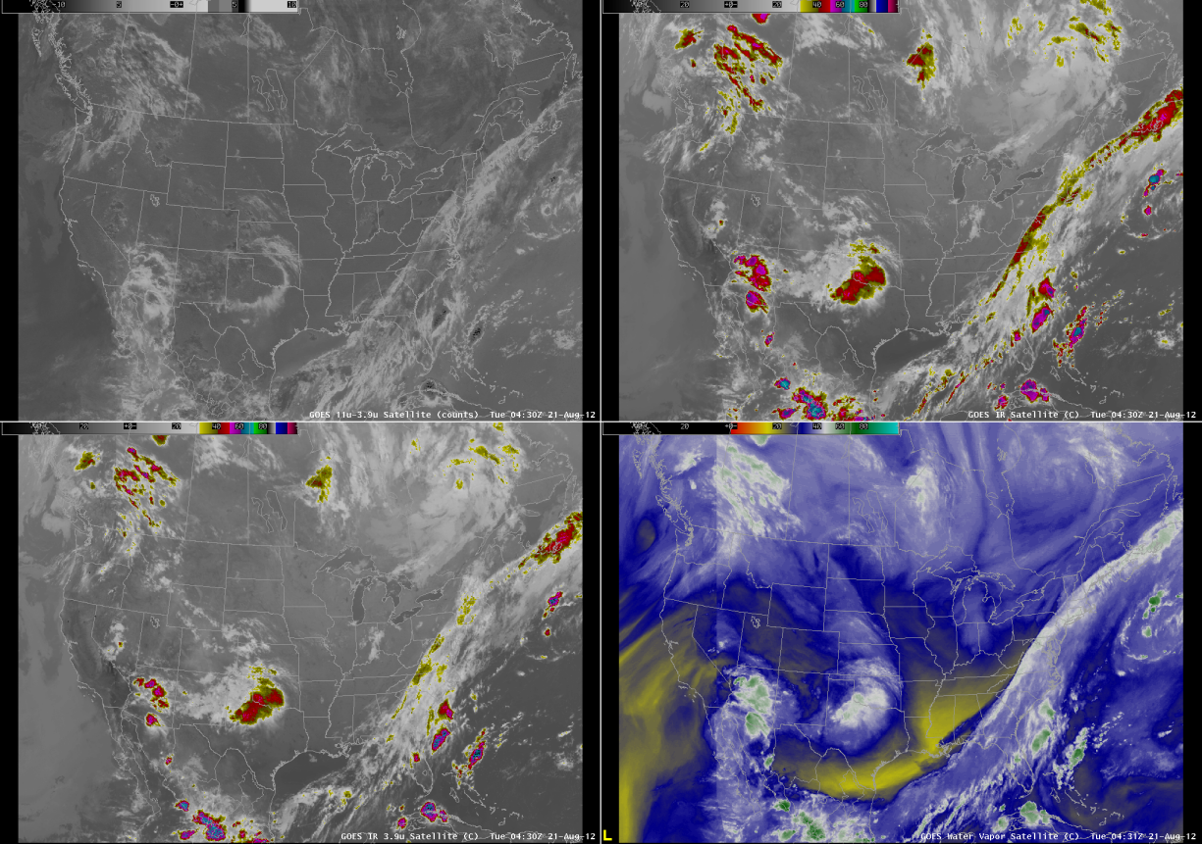
AWIPS as seen at CIMSS

Slide 8
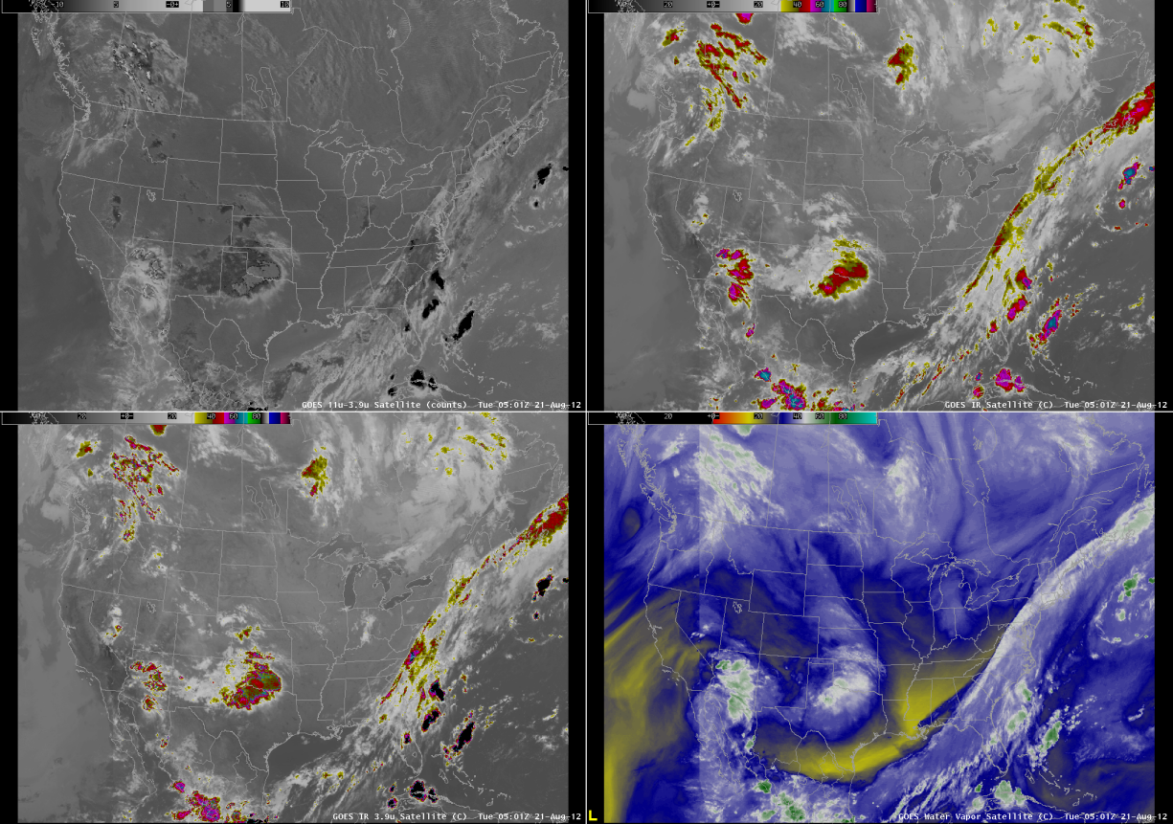
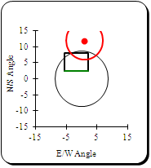
AWIPS as seen at CIMSS
Bad data
234/5:01 CONUS

Slide 9
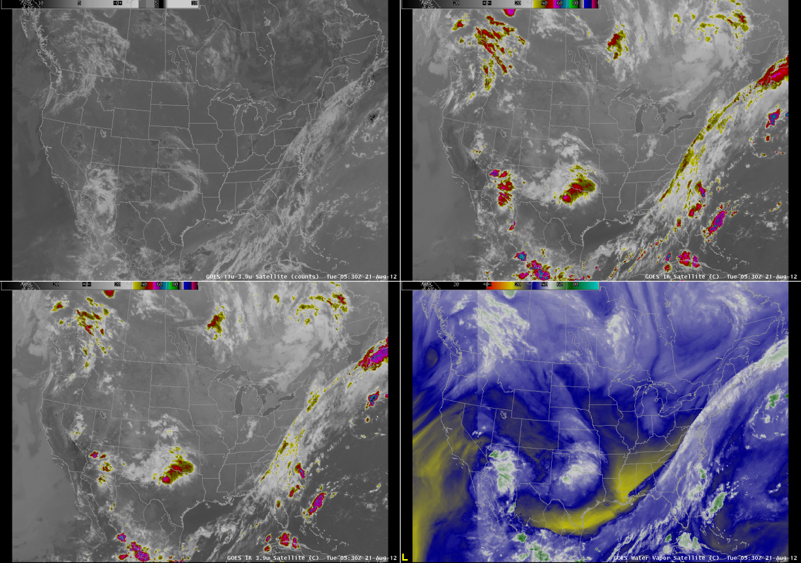
AWIPS as seen at CIMSS

Slide 10
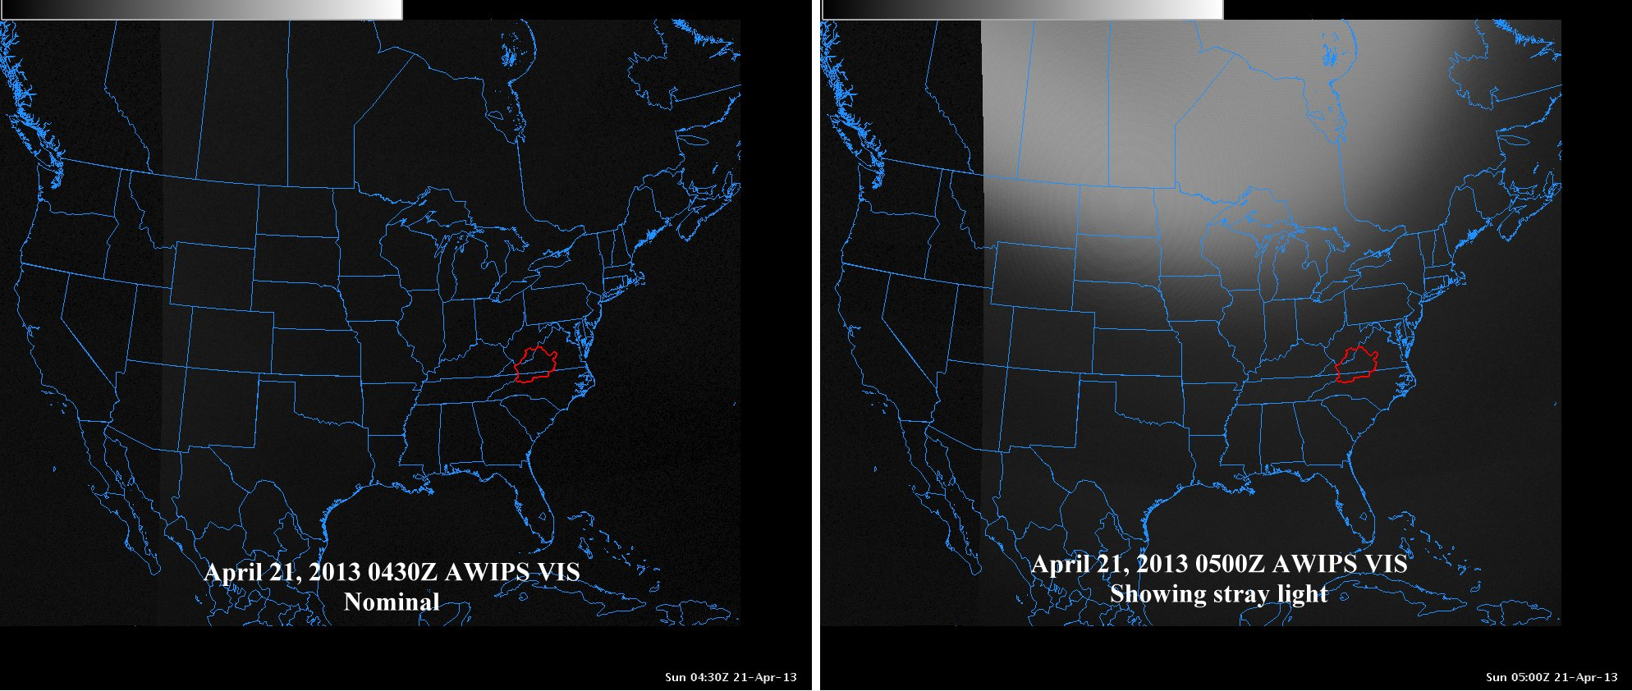
2013:
From the NWS (Blacksburg)

Slide 11
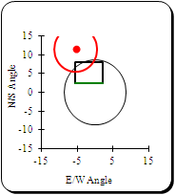
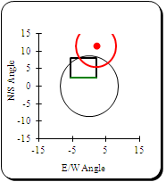
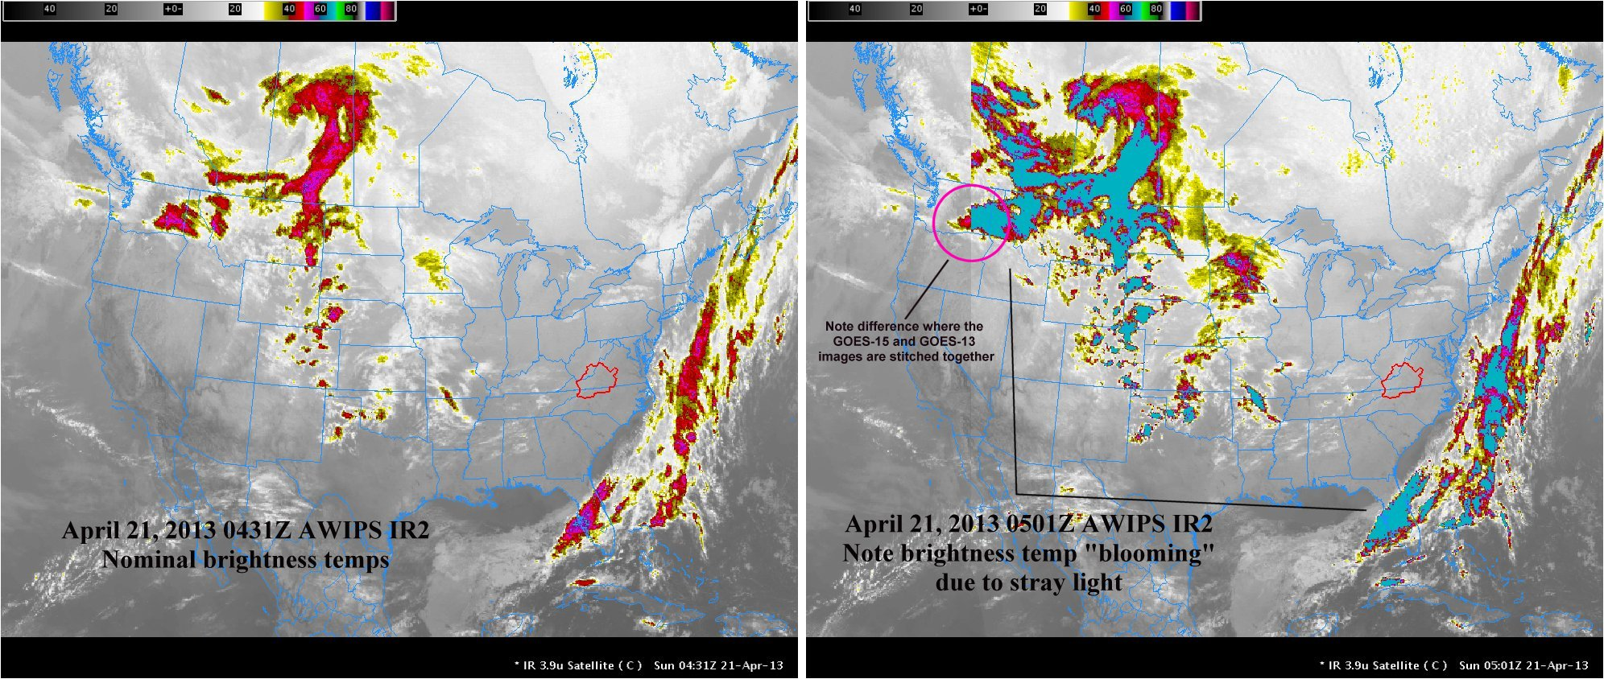
111/4:31 CONUS
111/5:01 CONUS
From the NWS (Blacksburg)

Slide 12
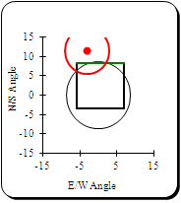
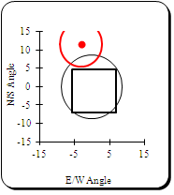
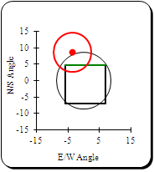
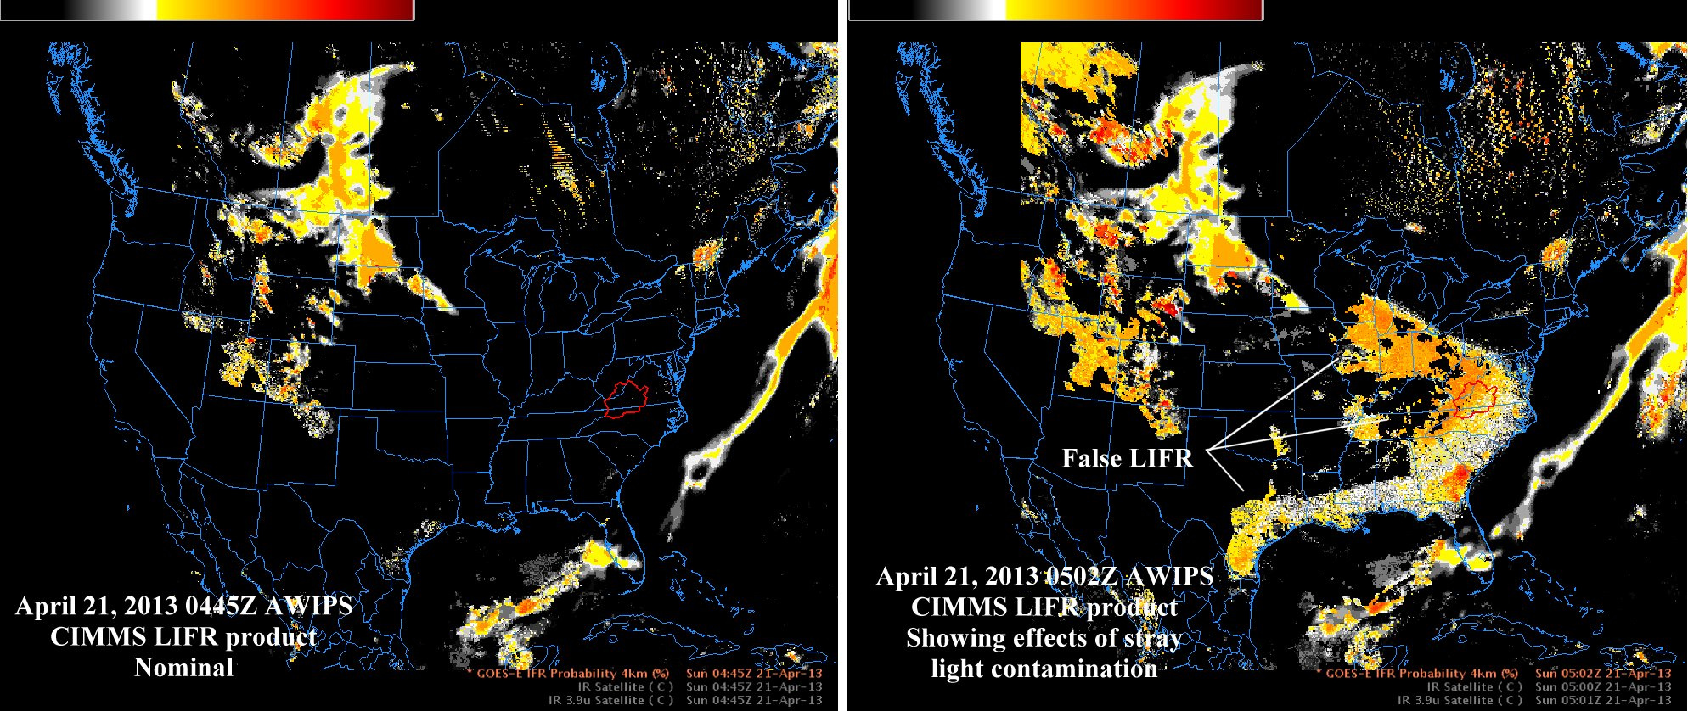
111/4:45 NHX Frame
103/4:45 NHX
ShiftedFrame
111/4:45 NHX
ShiftedFrame
From the NWS (Blacksburg)
Notes:
Should be CIMSS. ☺

Slide 13
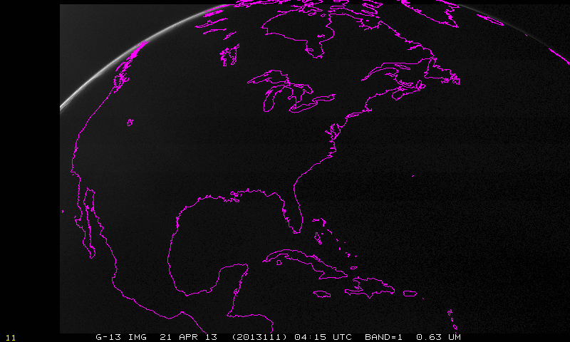
Visible band:

Slide 14
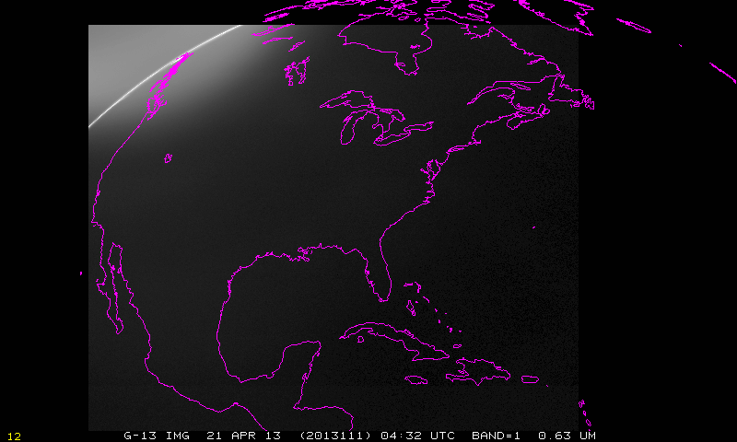

Slide 15
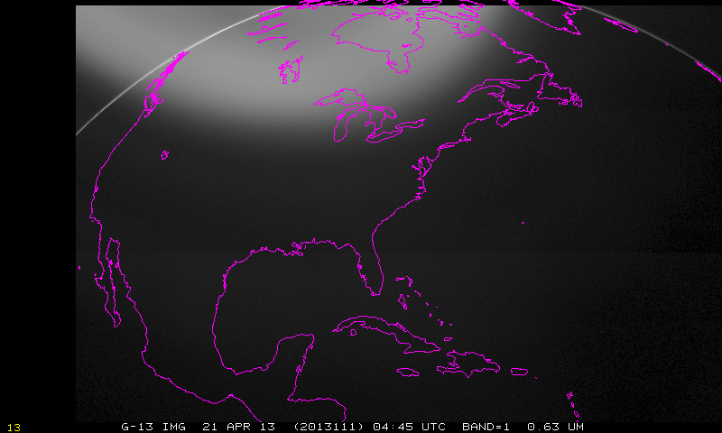
Note stray light evident in visible band

Slide 16
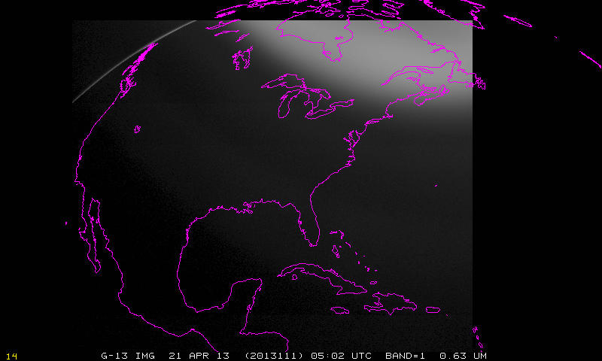
Note stray light evident in visible band

Slide 17
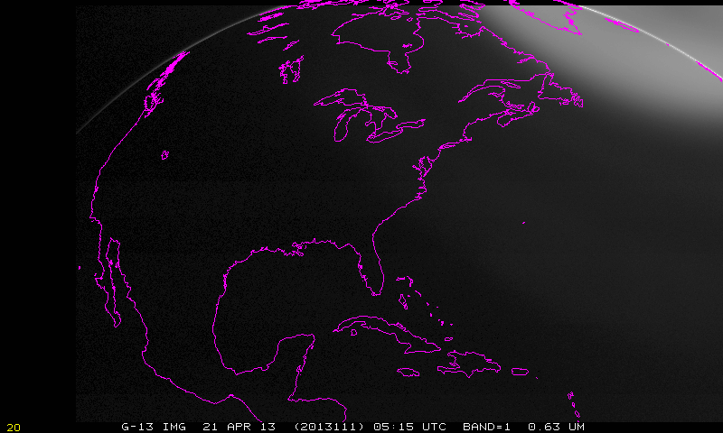

Slide 18
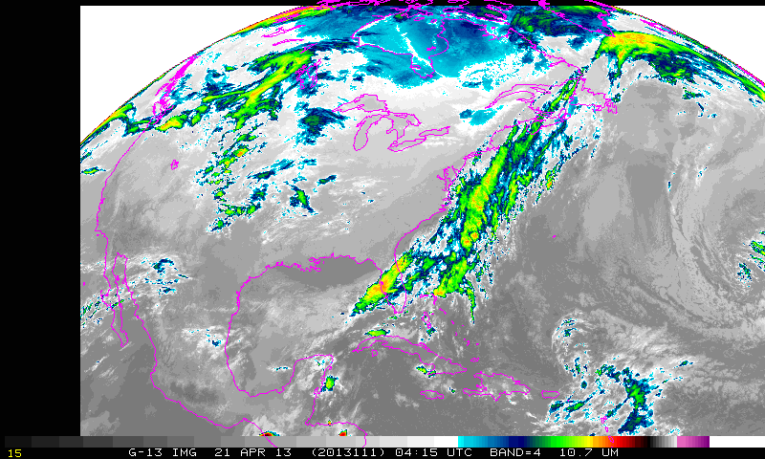
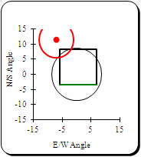
111/4:15 NHEX
Imager, band 4, longwave window

Slide 19
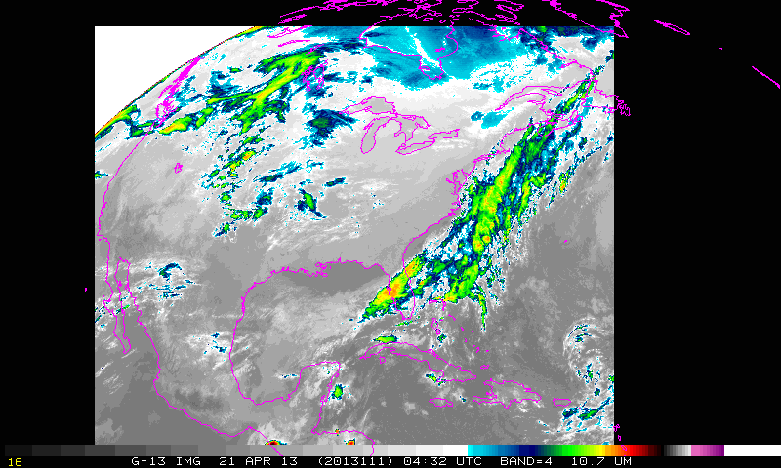
111/4:31 CONUS
Imager, band 4, longwave window

Slide 20
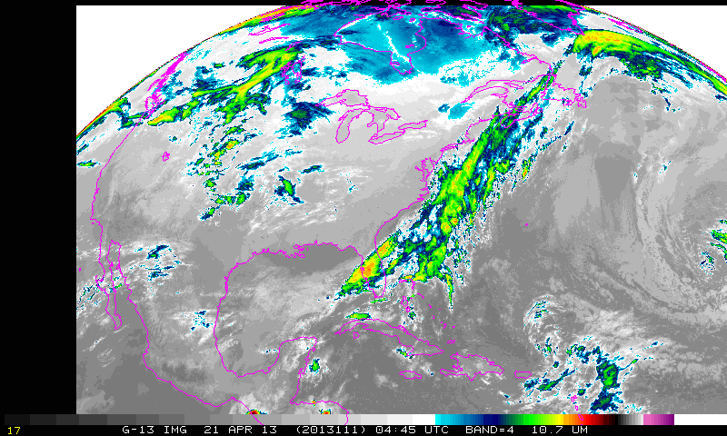
111/4:45 NHX Frame
Imager, band 4, longwave window

Slide 21
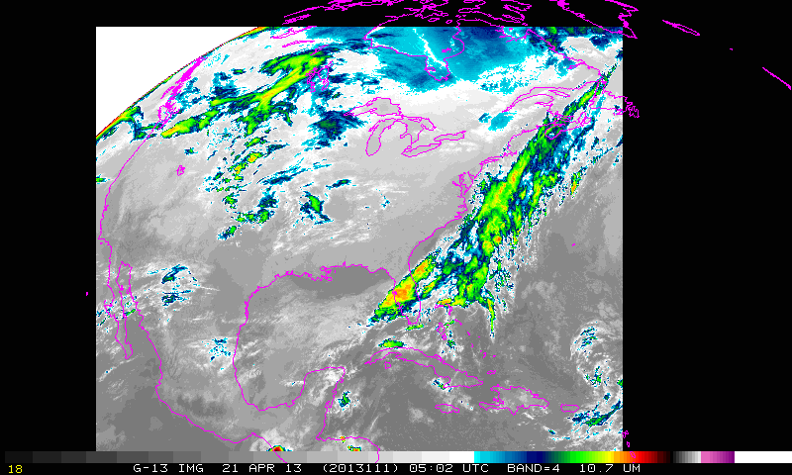
234/5:01 CONUS
Imager, band 4, longwave window

Slide 22
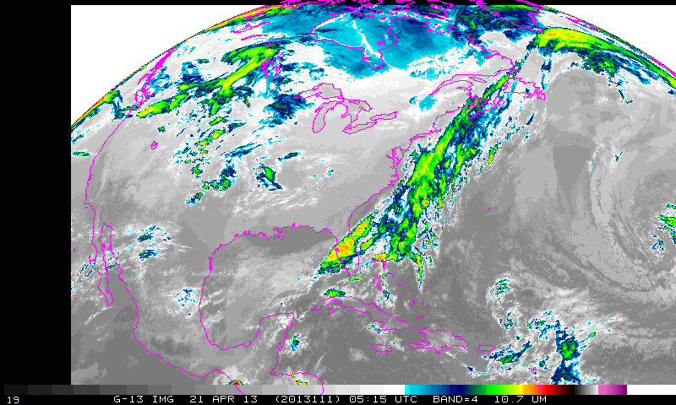
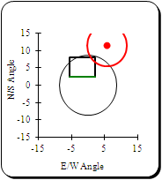
Imager, band 4, longwave window

Slide 23
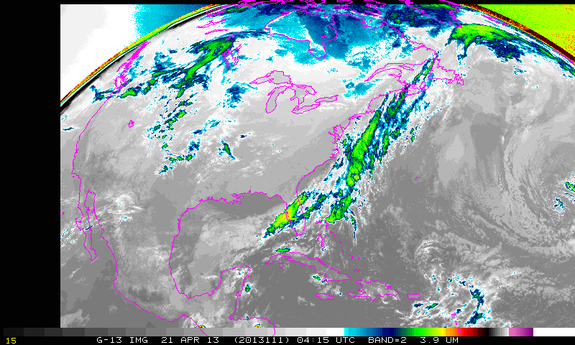
Imager, band 4, shortwave window

Slide 24
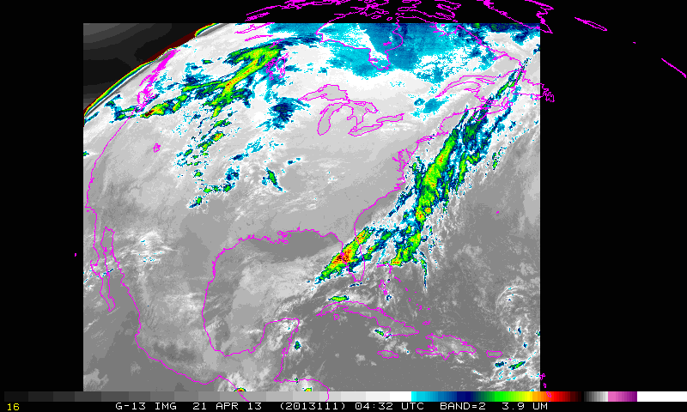
111/4:31 CONUS
Imager, band 4, shortwave window

Slide 25
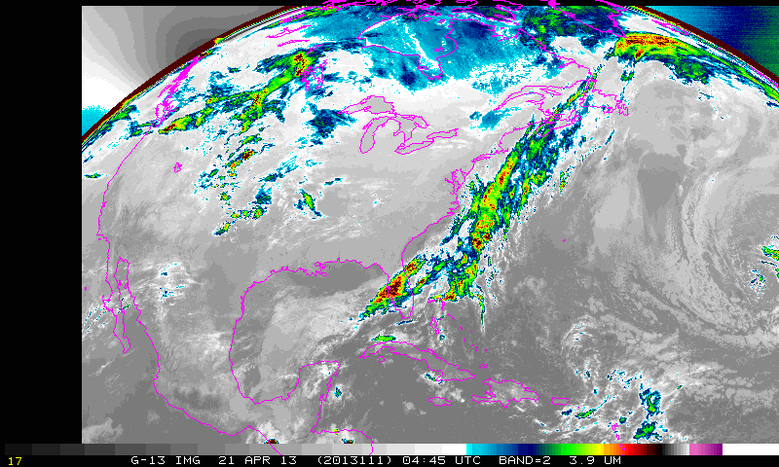
111/4:45 NHX Frame
Imager, band 4, shortwave window

Slide 26
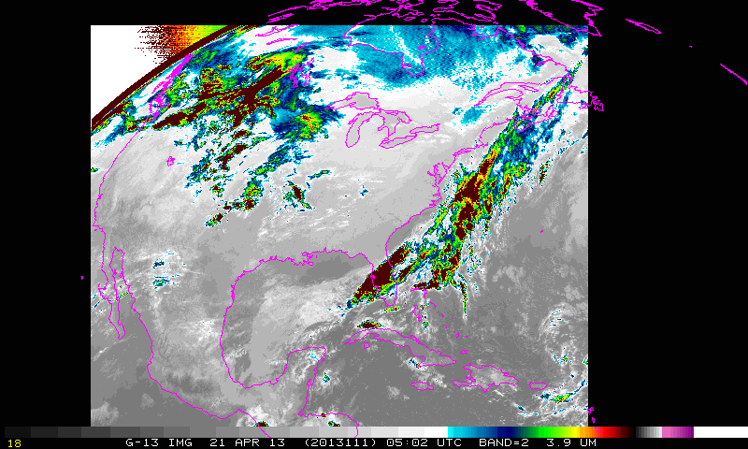
Brightness temperatures corrupted at this time
234/5:01 CONUS
Imager, band 4, shortwave window

Slide 27
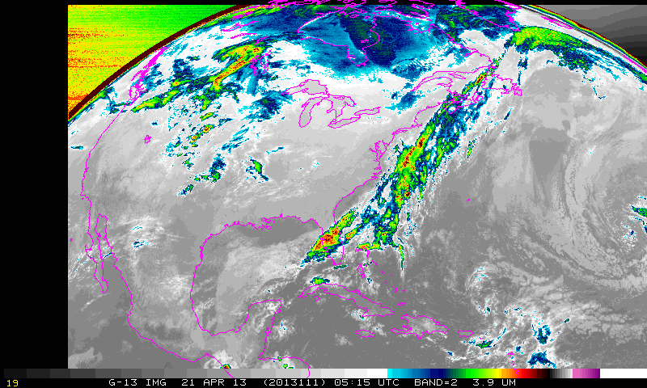
Imager, band 4, shortwave window

Slide 28
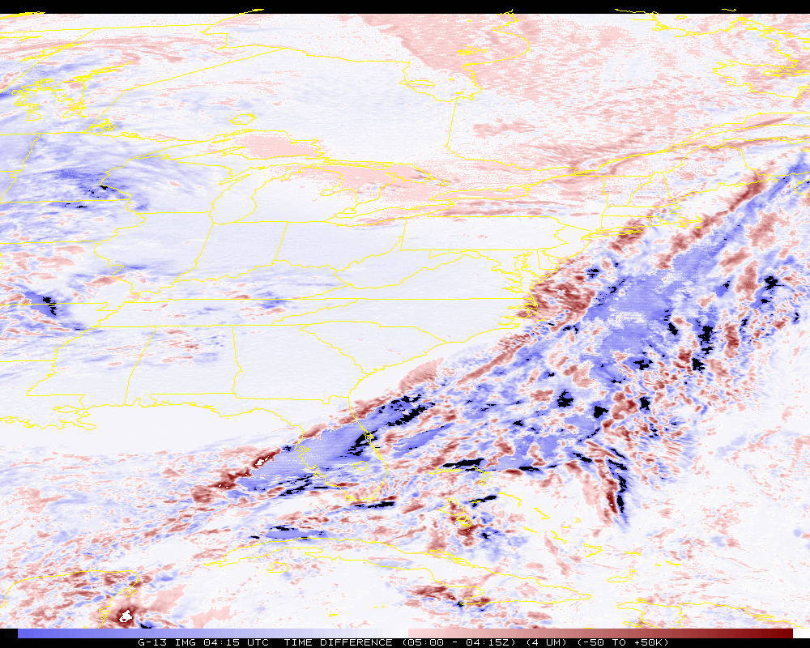
234/5:01 CONUS
Time difference (band 2)
Artificially colder by ~50K
Notes:
This 5:01 images used to be taken with imagers prior to GOES-12 which was more sensitive to heat up when the sun was in this position.

Slide 29
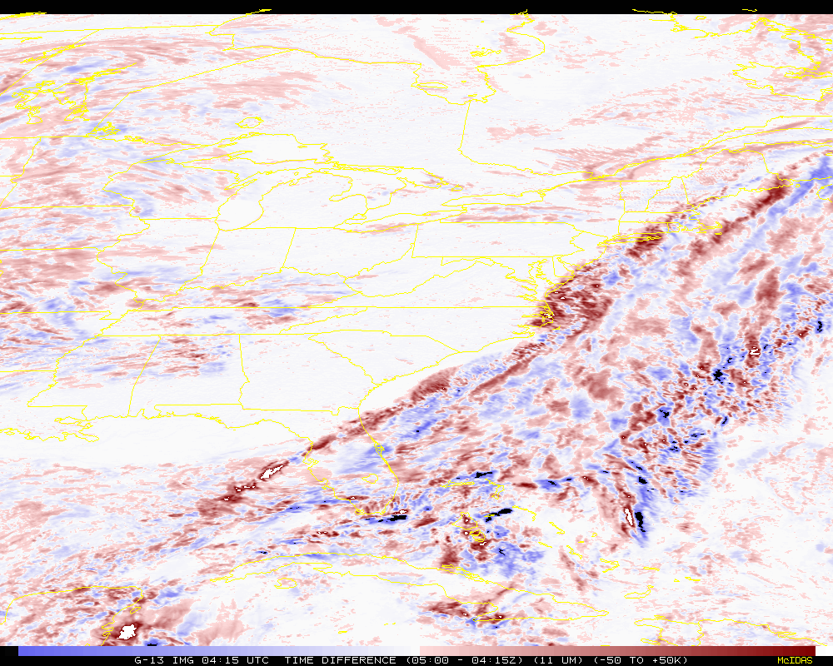
Time difference (band 4)
Notes:
Of course these shouldn’t be the same, given 45 minutes between images.

Slide 30
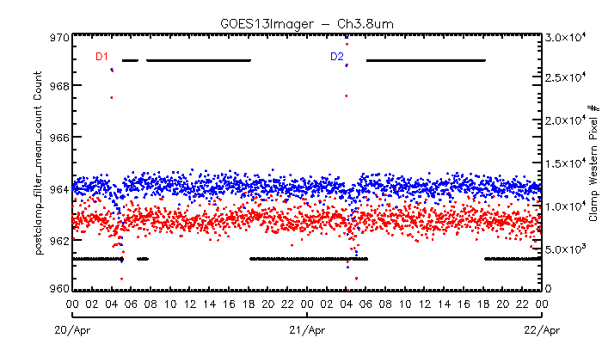
“Out-of-family” Space looks at 05 UTC
From Fangfang Yu

Slide 31
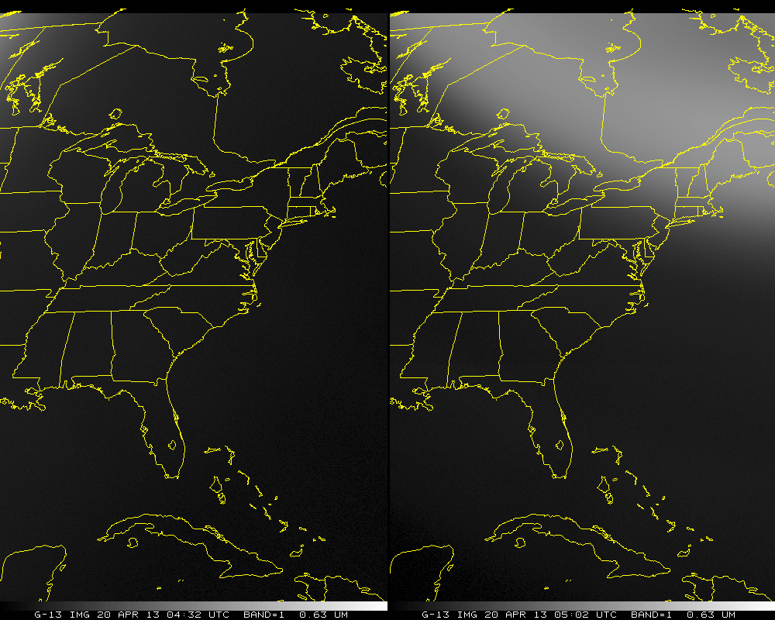

Slide 32
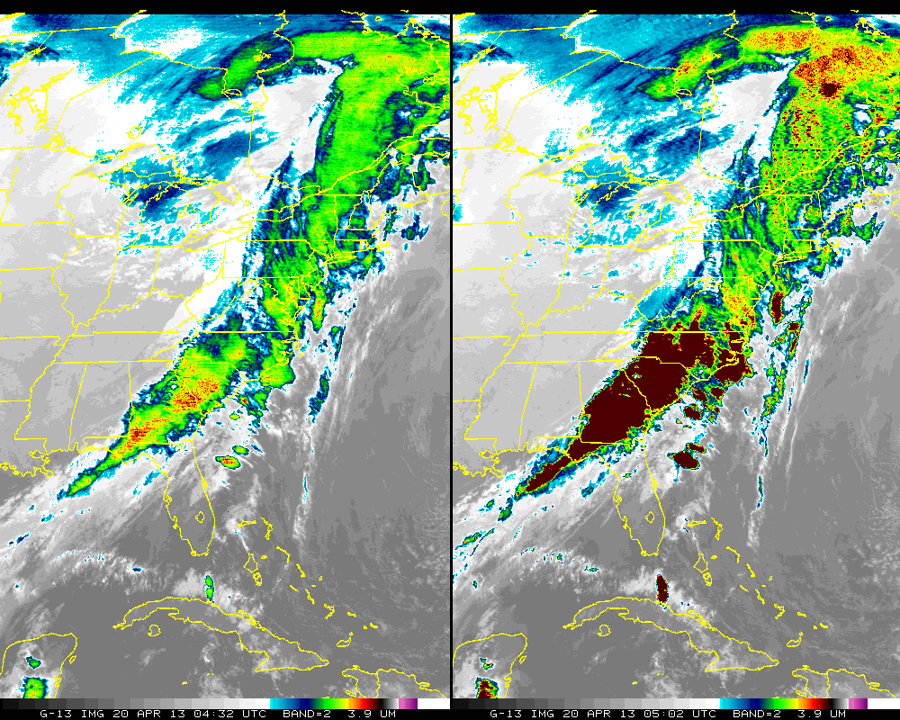

Slide 33
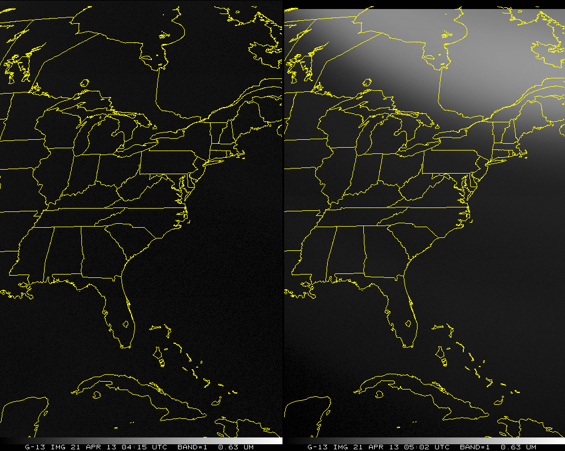

Slide 34
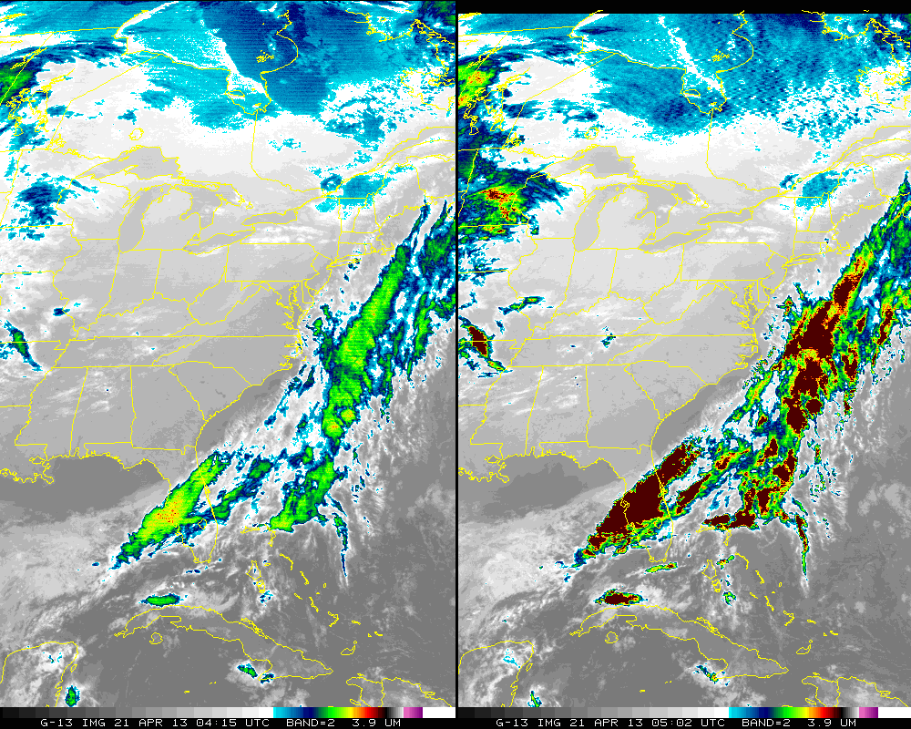

Slide 35
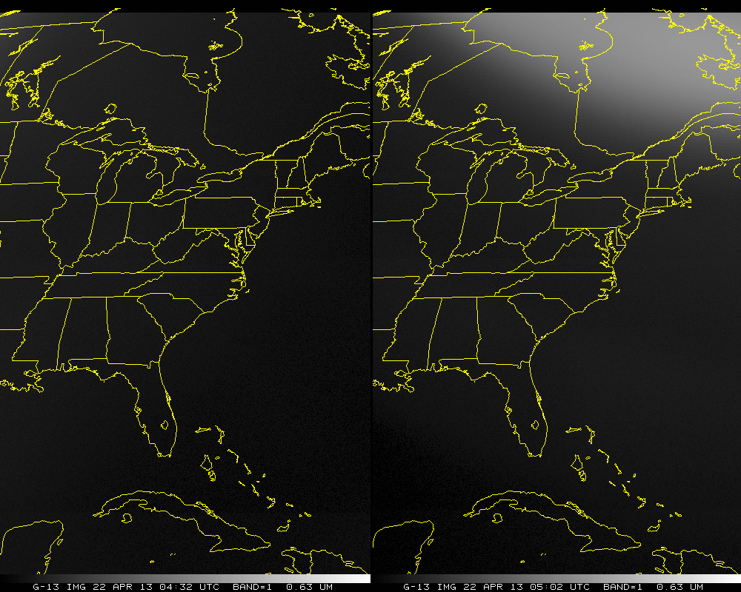

Slide 36
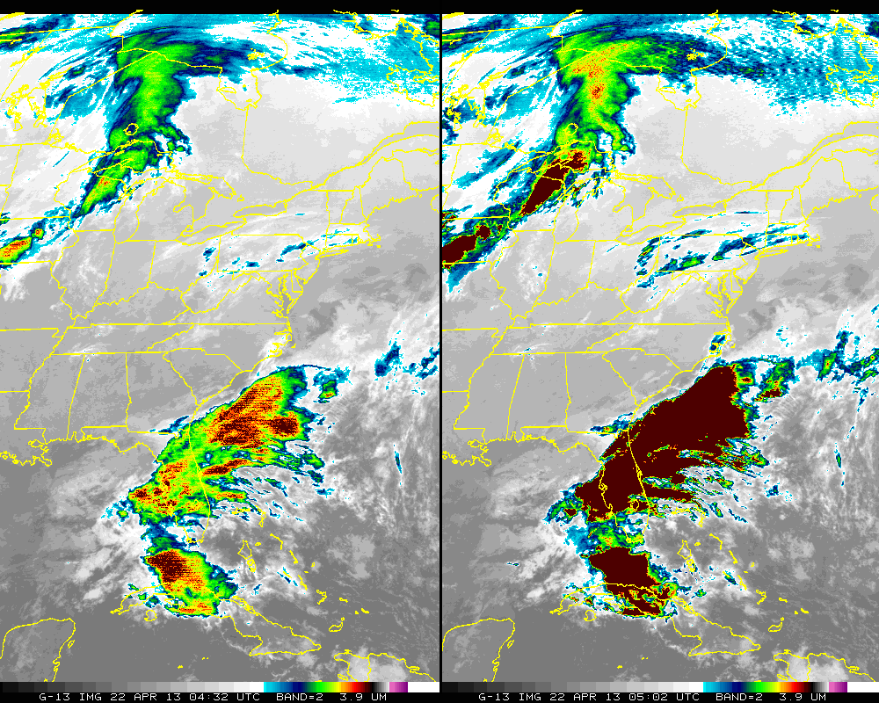

Slide 37
Way Forward Possible Options
Fall Eclipse 2013
Do nothing
    No good, since products are affected and users have noticed.
Have product producers check GVAR stray light flags
    Only works on case-by-case basis
    Each PAL would need to be involved
    NWS/AWIPS does not have the GVAR flags
    Still would produce non-spec compliant 4 um images
    Spec <2K from truth at 300K (= 50-60K at 225K scene)
Don’t send out a GVAR image for this certain time with bad SL
  when the sun is right above/below the poles
  Less than one per day (2 seasons)
Modify calibration procedure
  Filter space look or use previous good space look
  Clamp space look only if post-clamp count is higher than pre-clamp count (X. Wu)
  Scan elsewhere for good space look data, etc.
    Scan to opposite hemisphere during these times
Notes:
Spec has 2K exception at least 1 hour around midnight. I have an ITT presentation package dated 1/12/2011 that references 2K spec at 300K. Do you know ABI spec?

Slide 38
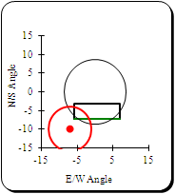
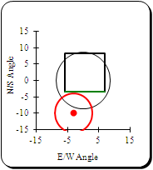
Considerations for Southern Hemisphere
55/4:39 SHEMI
55/5:09 SHEMI
55/4:45 NHEMX

Slide 39
Output from line prefix
STRAYLIGHT 213
(STRAYLIGHT.PGM) *START execution on 2013129 (Thursday May 9, 2013) at 181216 (HHMMSS) UTC
(STRAYLIGHT.PGM) Input program commandline (in 80-byte segments):
STRAYLIGHT 213
(STRAYLIGHT.FOR) OPEN/READ GOES areafile: /home/tims/mcidas/data/AREA0213
(STRAYLIGHT.FOR) Area 213 directory information (Image type, SSEC sensor source #, image ccyyddd, image hhmmss):
4, 180, 2013111, 50200
(STRAYLIGHT.FOR) Check each image line for Stray Light Correction (SLC) information.
(STRAYLIGHT.FOR) Input area AREA0213 lines contain prefixes -- size= 488 bytes= 122 words
(STRAYLIGHT.FOR) Size of prefix DOC (4-byte words)= 119, CAL= 0, BND= 2
(STRAYLIGHT.FOR) Read input area AREA0213 line prefixes now.
(STRAYLIGHT.FOR) All 800 AREA0213 line prefixes now read.
(STRAYLIGHT.FOR) SLCE (# lines w/SLC enabled) = 784, SLCD (# lines w/SLC disabled) = 16
(STRAYLIGHT.FOR) SLCP (# lines w/SLC performed) = 784, SLCNP (# lines w/SLC not performed) = 16
(STRAYLIGHT.FOR) SLCP_FIRST (1st line w/SLC performed) = 17, SLCP_LAST (last line w/SLC performed) = 800
(STRAYLIGHT.FOR) SUNE (# lines w/sun on e/side of earth) = 784, SUNW (# lines w/sun on w/side of earth) = 16
(STRAYLIGHT.FOR) SUNN (# lines w/sun on n/side of earth) = 784, SUNS (# lines w/sun on s/side of earth) = 16
(STRAYLIGHT.FOR) 784 nonzero values were found for the parameter: min_sun_angle_range_of_earth_pixels_in_a_scan
(STRAYLIGHT.FOR) Smallest value = 3 found at line # 17
(STRAYLIGHT.FOR) Largest value = 8 found at line # 669

Slide 40
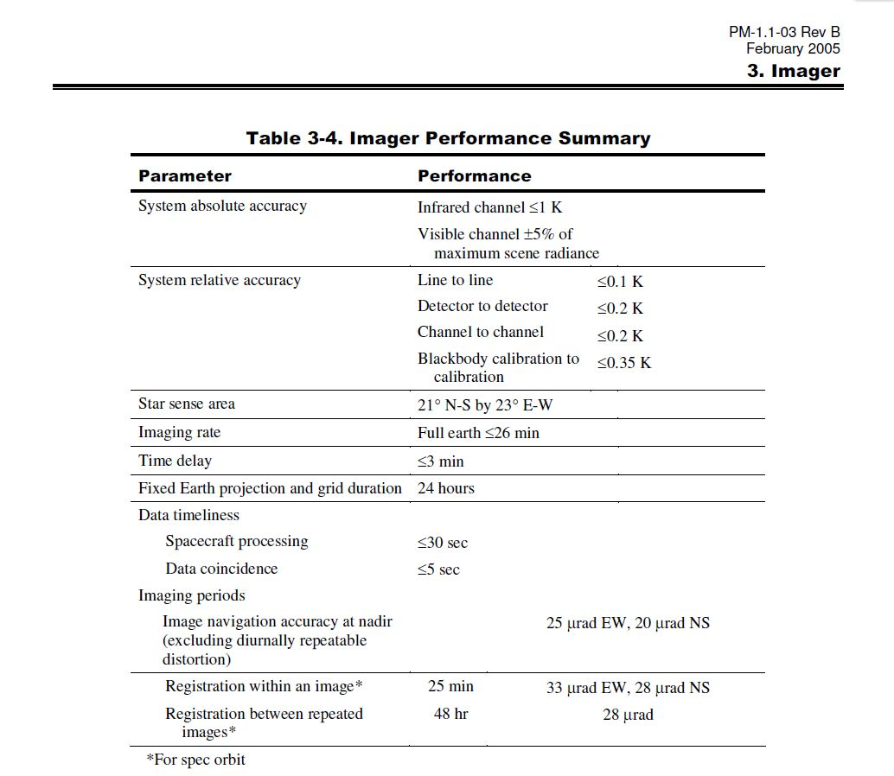
System Absolute Accuracy
Notes:
From Databook

Slide 41
Requirements
What should the accuracy requirement be?
“Accuracy must be within relaxed 2K spec or within historical performance at 6°” (see plot on next page for discussion)
Options based off of historical performance at 6° = 25, 30, 35 GVAR counts?
For comparison to spec
  +/- 1K: ~9 GVAR counts
  +/- 2K: ~17 GVAR counts
  +/- 3K: ~26 GVAR counts
  +/- 4K: ~35 GVAR counts
Replace ME
Notes:
From ITT PDR presentation.

