Slide 1
GOES-13 Imager
Corrupt Space Look causing bad 4 um data?
(affecting at least fog product)
Path forward….
Timothy J. Schmit
(NOAA/NESDIS/STAR)
Mathew M. Gunshor, James P. Nelson III and Anthony J. Schreiner
(CIMSS)
FangFang Yu (ERT, Inc.)
Michael Sporer (NWS)
17-May-2013

Slide 2
Outline
Background
Examples
August 2012
April 2013
Way forward options
Requirements

Slide 3
Background
Historically, the GOES-8/12 series did not take images during “KOZ”
Could be up to 3 hours
GOES-13/15 allows images to now be taken during this time period
Recent issue seems to be corrupted space look and not directly related to the stray light correction
Space looks are scheduled to be on the ‘clean’ side of the earth (away from the sun, etc.)

Slide 4
Comment from NWS
2012:
From: Patrick Ayd <patrick.ayd@noaa.gov> Date: Sun, Aug 19, 2012 at 1:24 AM Subject: INFO: Bad Fog Channel Images To: Joshua Scheck <Joshua.Scheck@noaa.gov>
Josh,
I have noticed more and more during the night that bad 3.9 mu satellite images are corrupting the 11-3.9 mu fog channel, reversing the way clouds should appear (i.e all clouds both low and high are colored as very dark).
I have attached two images from 545 UTC on 8-19-12:
fog_sat.png: 11-3.9 mu fog channel with cig/vis plot
3_9_mu.png: 3.9 mu channel
Thanks,
-Patrick
--
Patrick Ayd
General Forecaster
NOAA/NWS WFO Bismarck, ND
Office Phone: (701) 223-4582

Slide 5
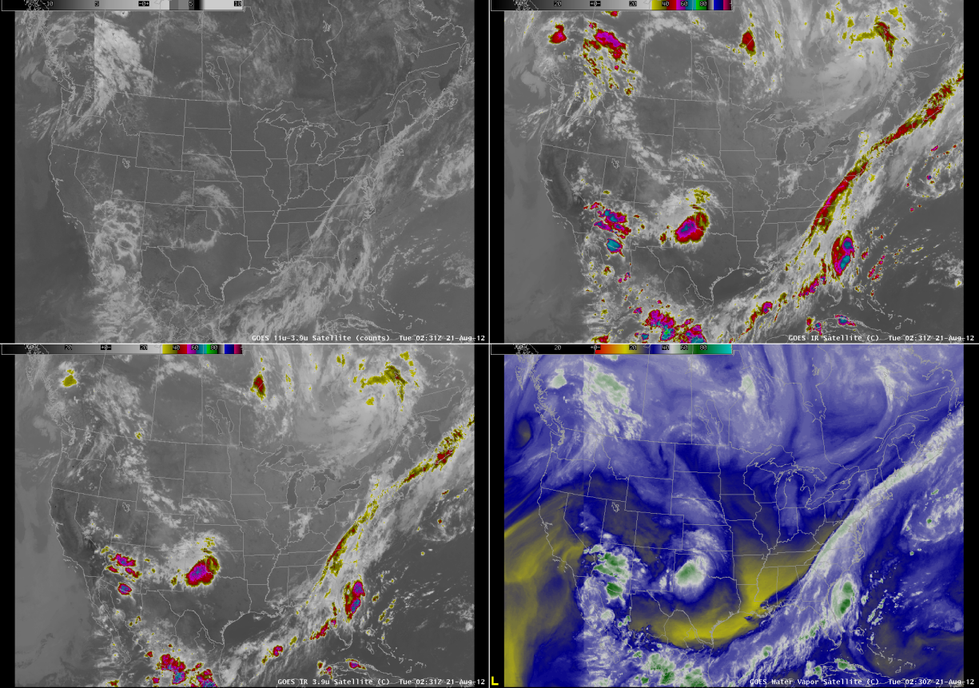
AWIPS as seen at CIMSS
<-Note seam
11 – 4 um in counts
11 um
<-Note seam
4 um
6.5 um

Slide 6
AWIPS as seen at CIMSS
Bad data

Slide 7
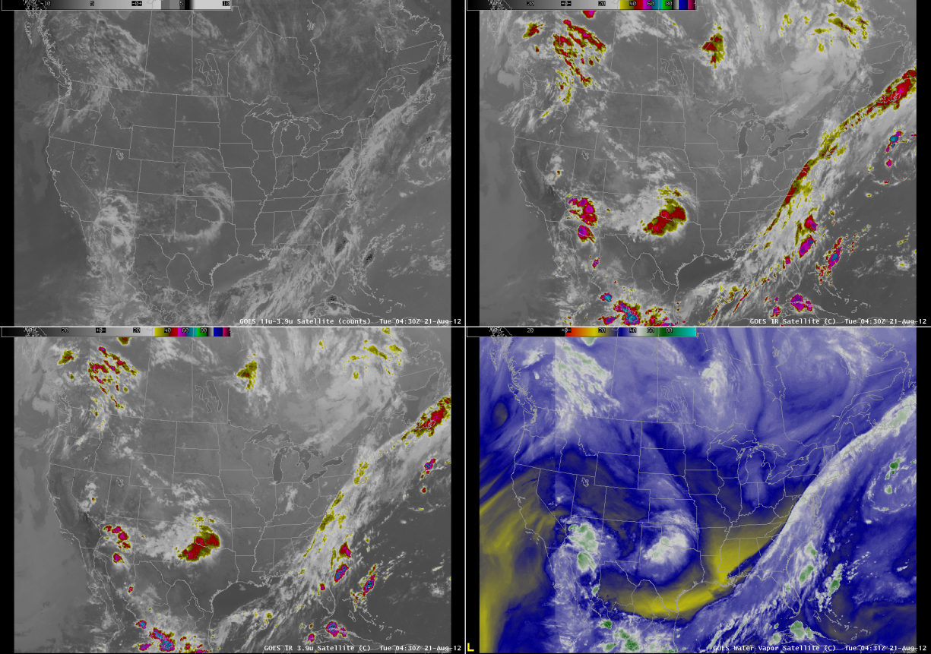
AWIPS as seen at CIMSS

Slide 8
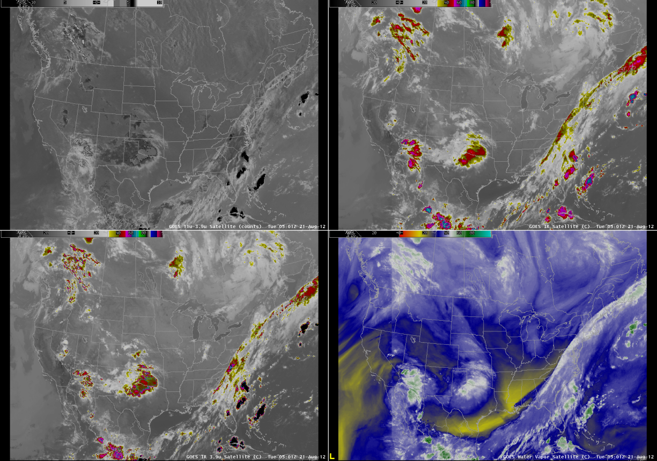
AWIPS as seen at CIMSS
Bad data

Slide 9
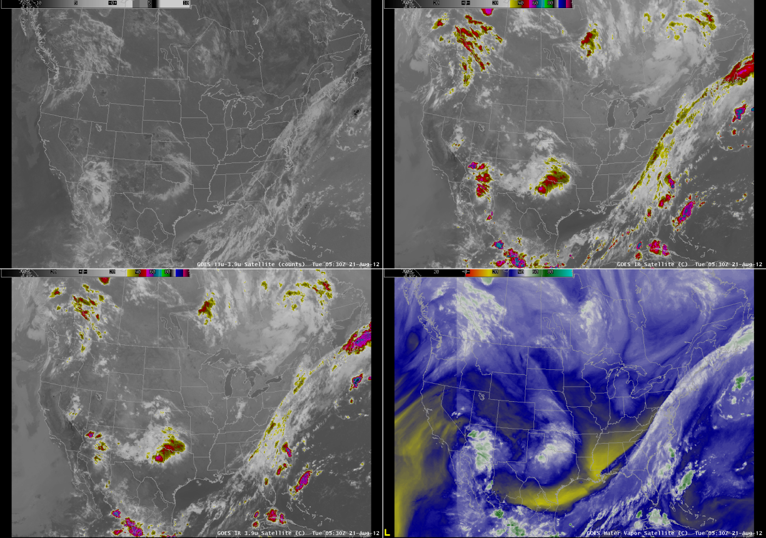
AWIPS as seen at CIMSS

Slide 10
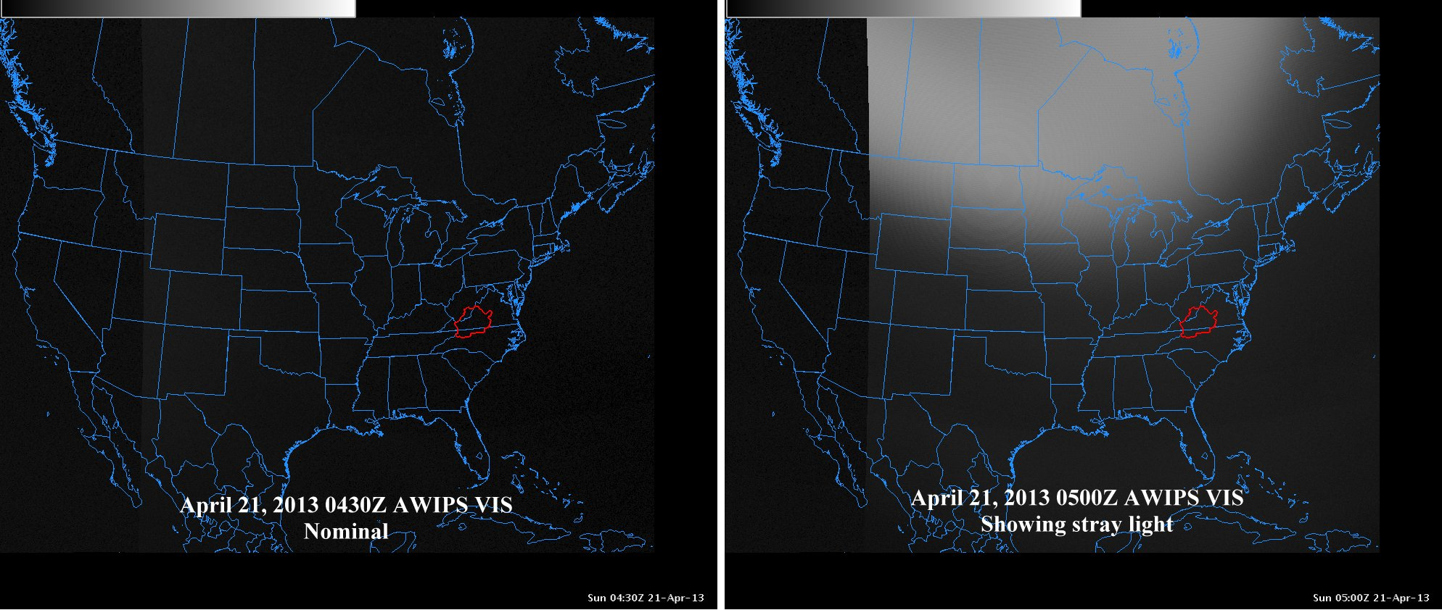
2013:
From the NWS (Blacksburg)

Slide 11
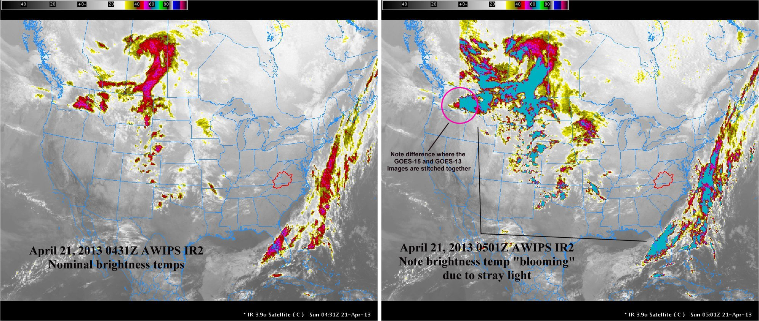
From the NWS (Blacksburg)

Slide 12
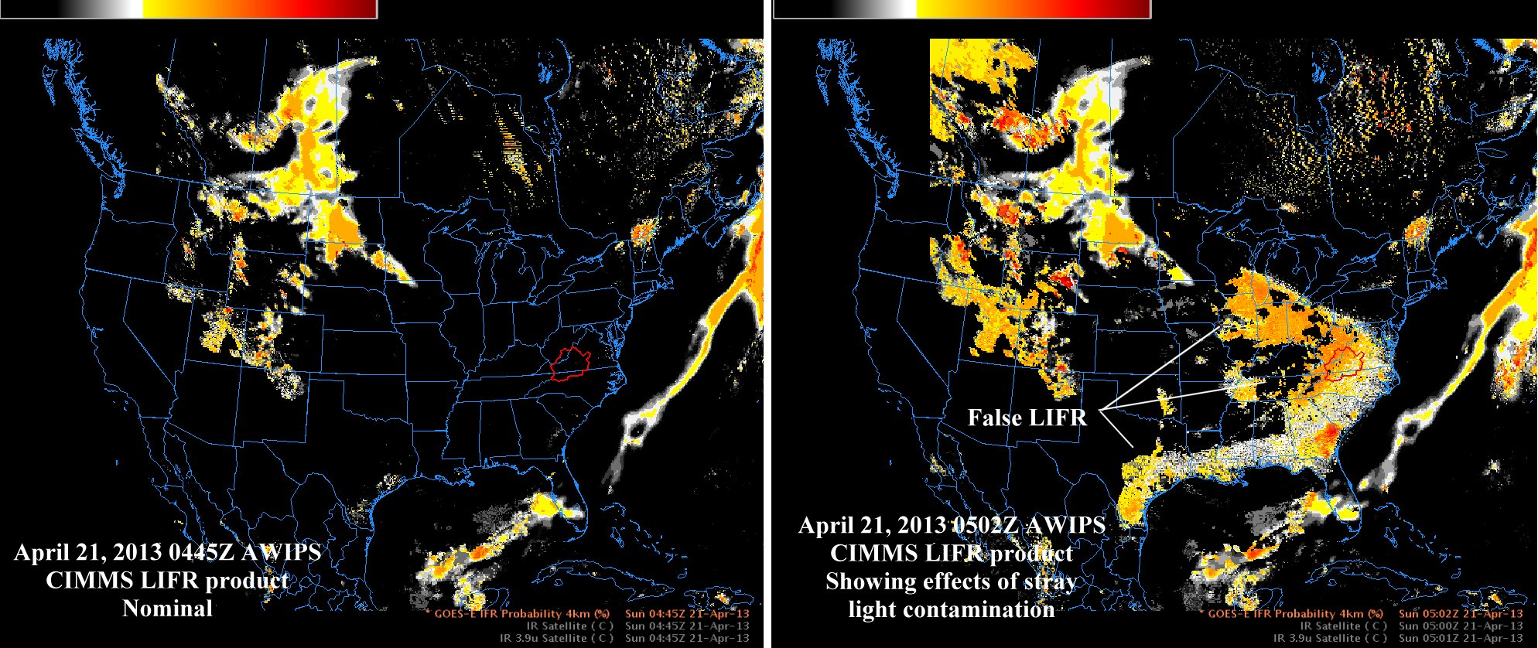
From the NWS (Blacksburg)
Notes:
Should be CIMSS. ☺

Slide 13
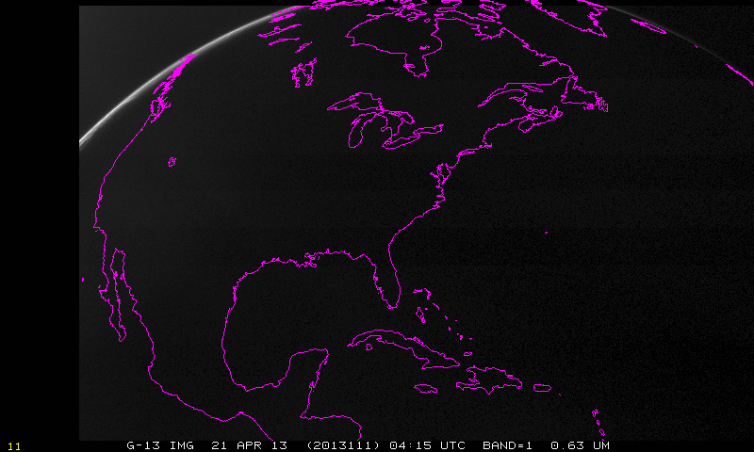
Visible band:

Slide 14
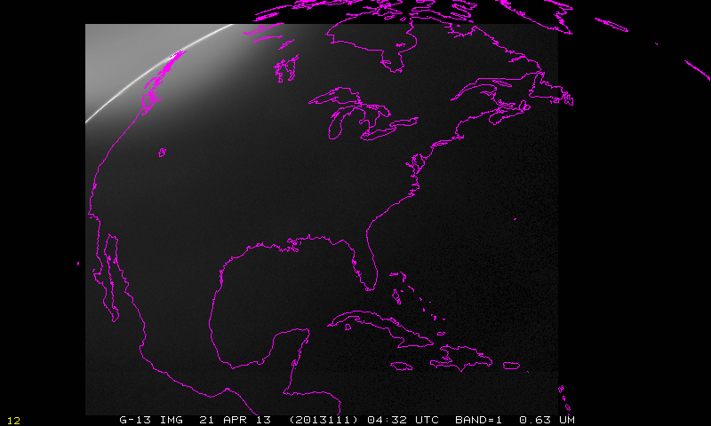

Slide 15
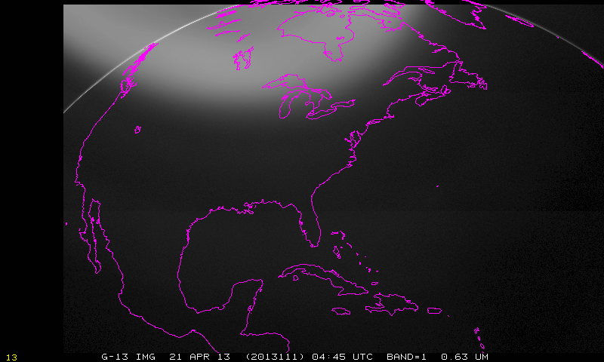
Note stray light evident in visible band

Slide 16
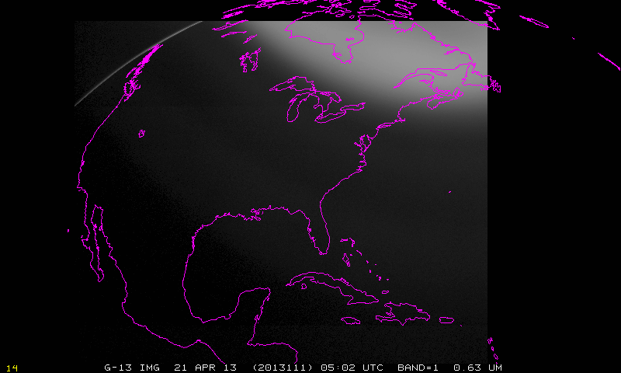
Note stray light evident in visible band

Slide 17
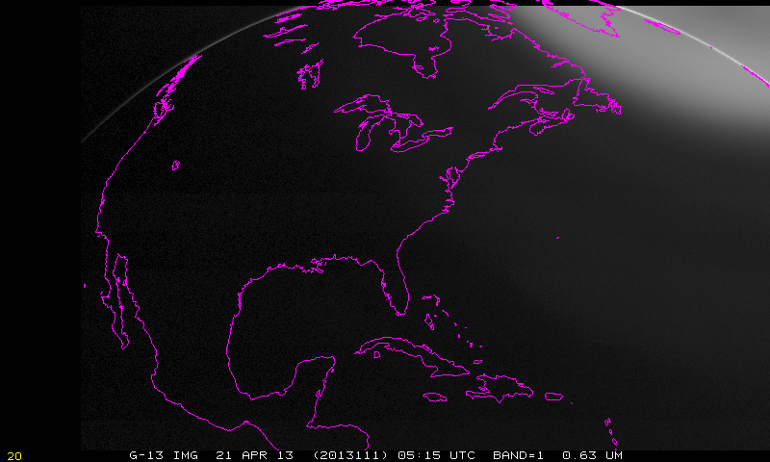

Slide 18
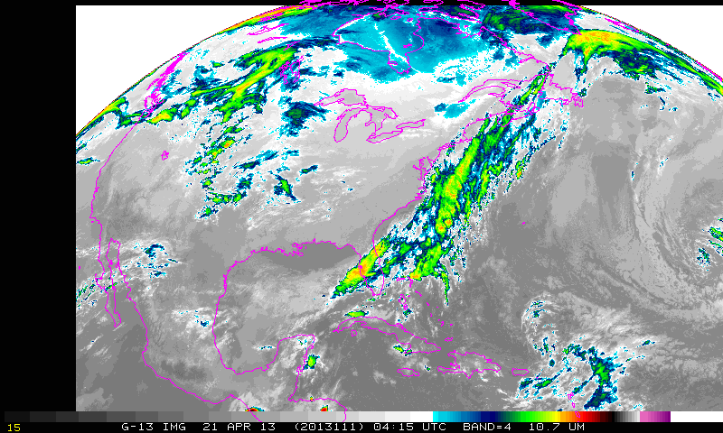
Imager, band 4, longwave window

Slide 19
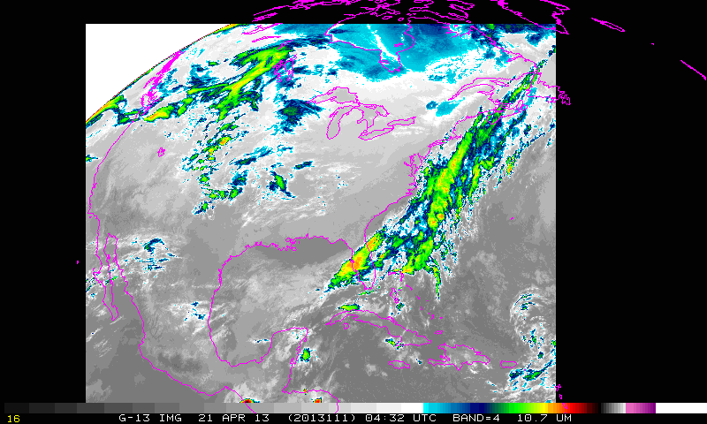
Imager, band 4, longwave window

Slide 20
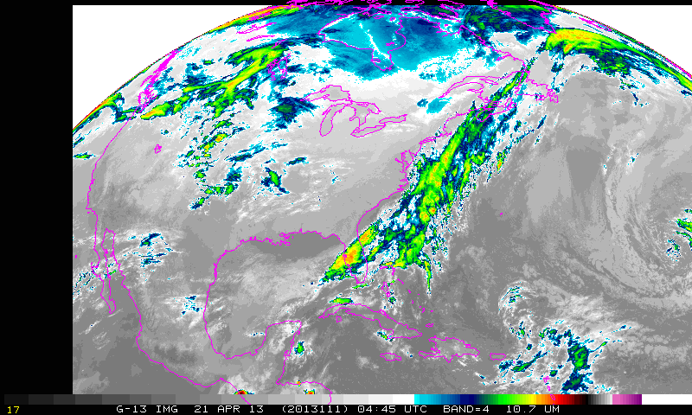
Imager, band 4, longwave window

Slide 21
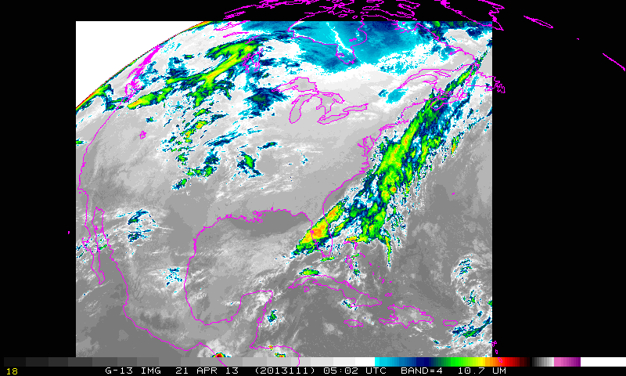
Imager, band 4, longwave window

Slide 22
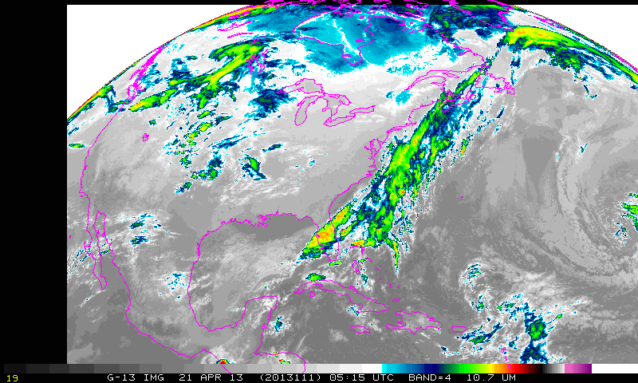
Imager, band 4, longwave window

Slide 23
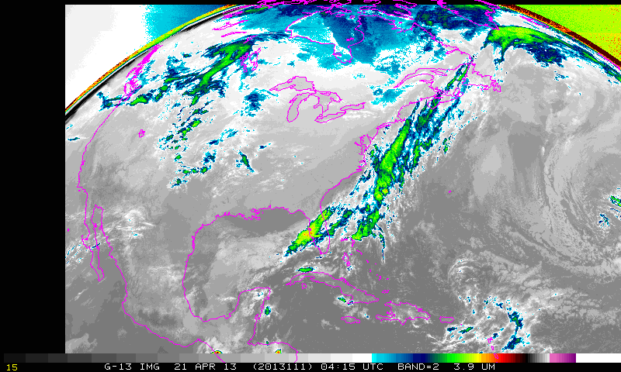
Imager, band 4, shortwave window

Slide 24
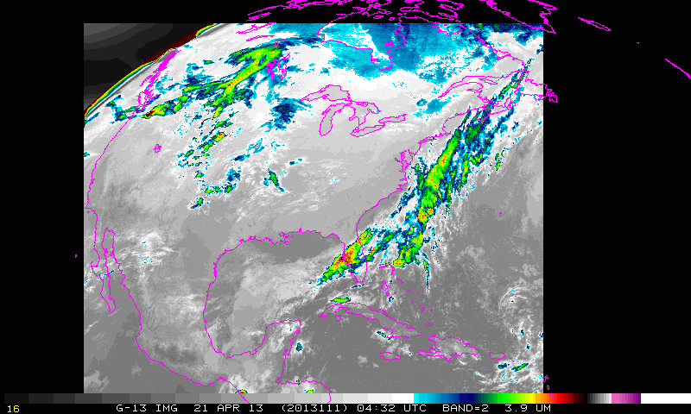
Imager, band 4, shortwave window

Slide 25
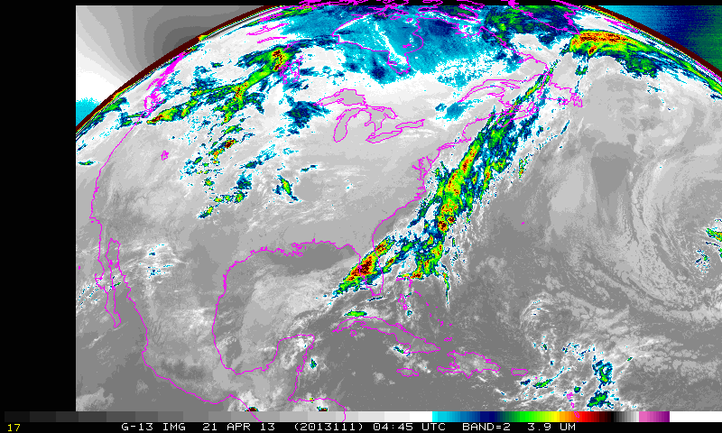
Imager, band 4, shortwave window

Slide 26
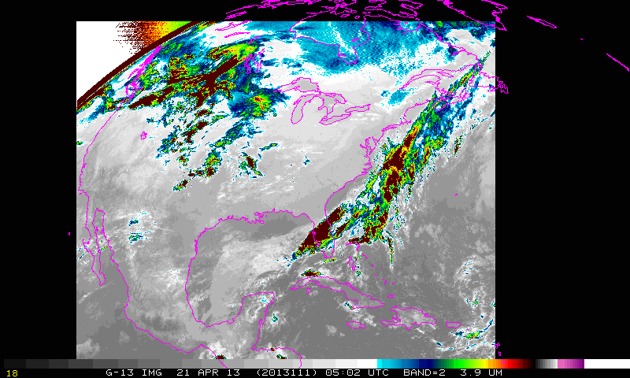
Brightness temperatures corrupted at this time
Imager, band 4, shortwave window

Slide 27
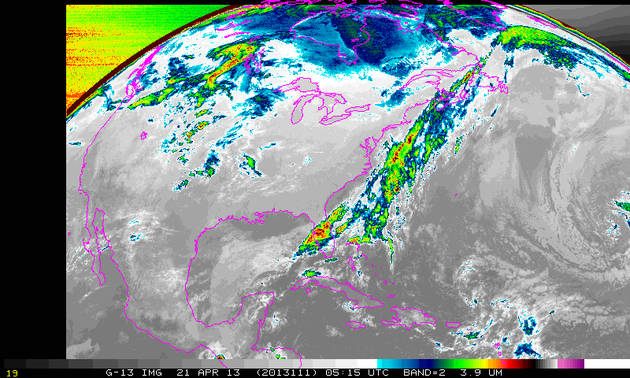
Imager, band 4, shortwave window

Slide 28
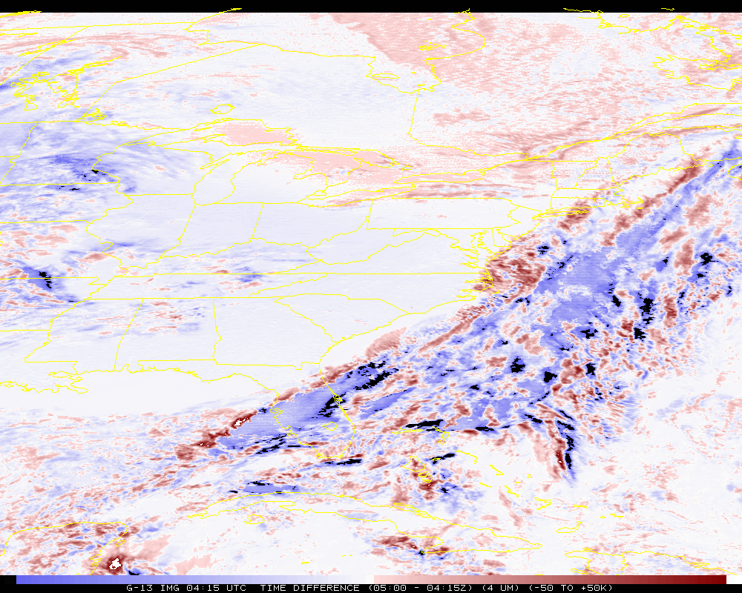
Time difference (band 2)
Artificially colder by ~50K

Slide 29
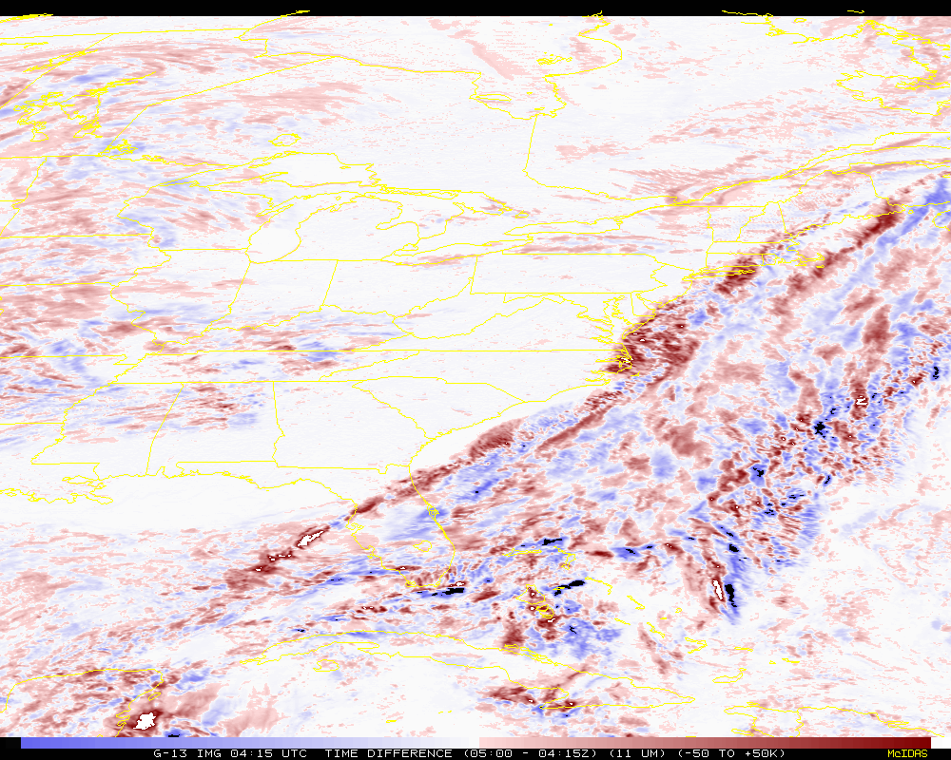
Time difference (band 4)
Notes:
Of course these shouldn’t be the same, given 45 minutes between images.

Slide 30
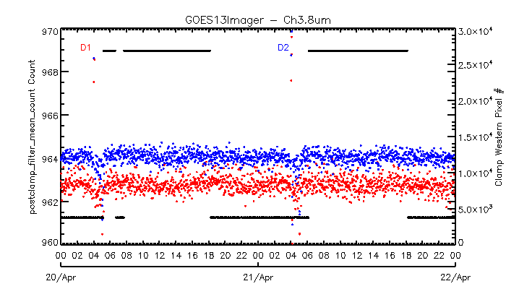
“Out-of-family” Space looks at 05 UTC
From Fangfang Yu

Slide 31
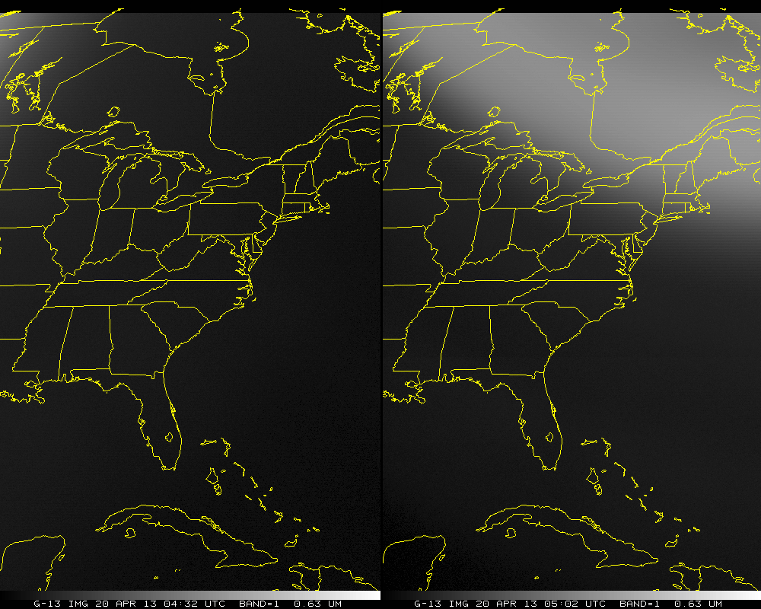

Slide 32
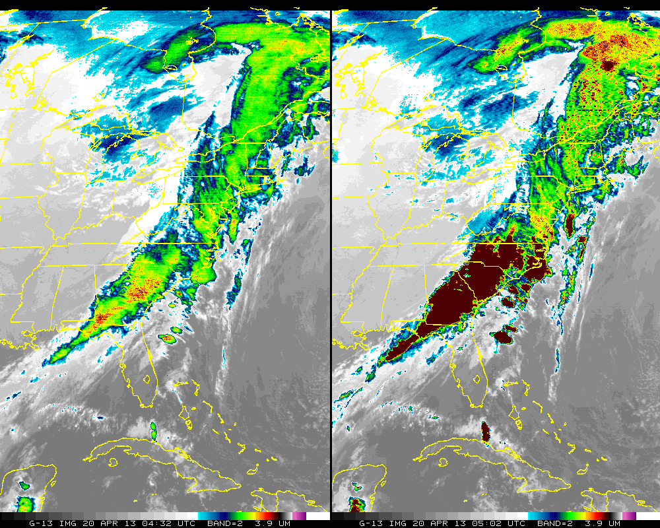

Slide 33
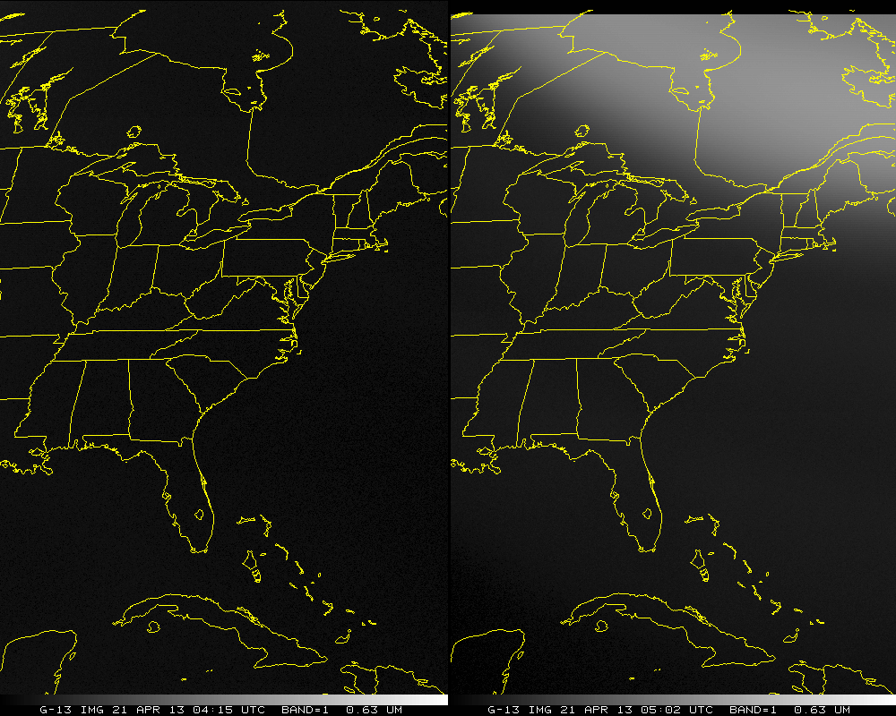

Slide 34
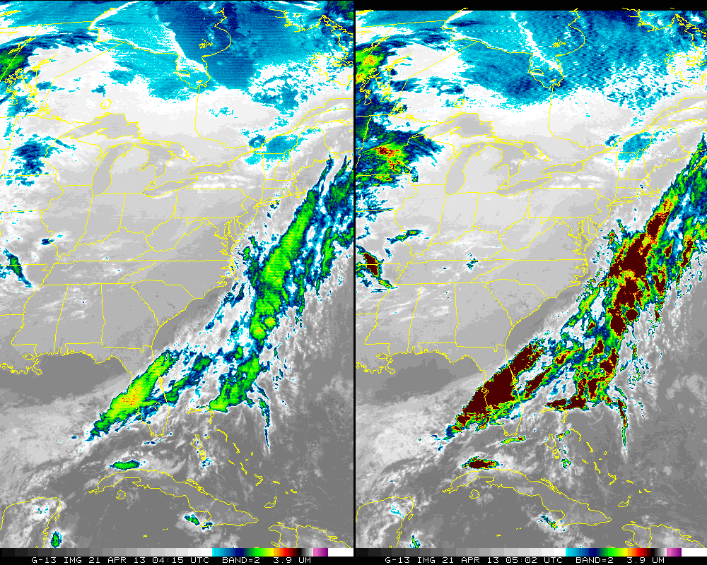

Slide 35
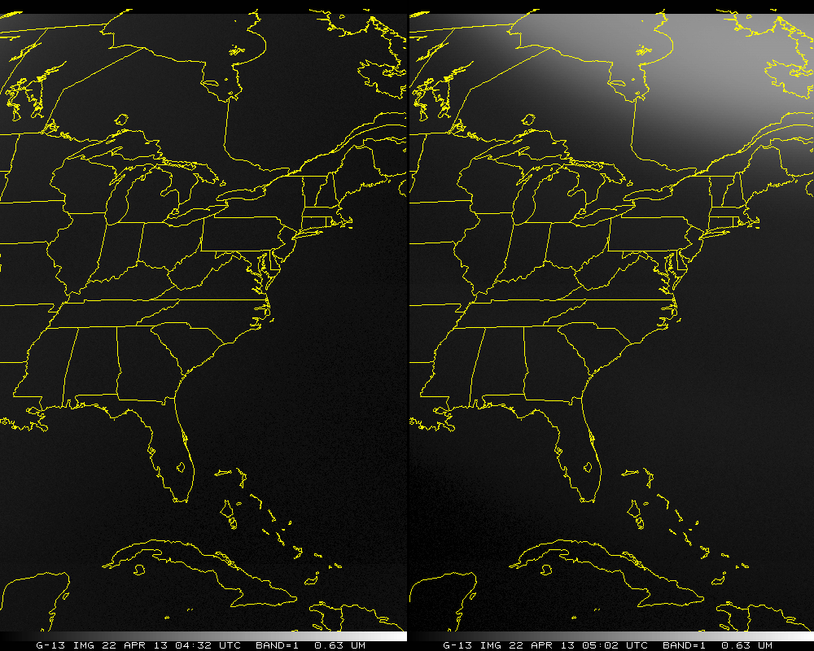

Slide 36
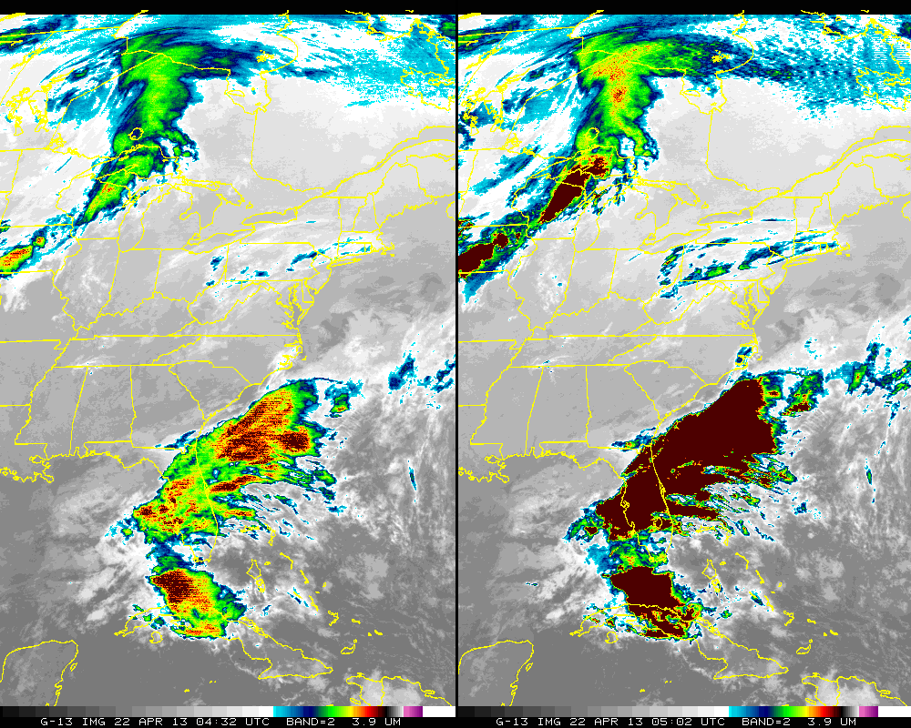

Slide 37
Way Forward Possible Options
Do nothing
No good, since products are affected and users have noticed.
Modify calibration procedure
Filter space look or use previous good space look
Clamp space look only if post-clamp count is higher than pre-clamp count (X. Wu)
Scan elsewhere for good space look data, etc.
Scan to opposite hemisphere during these times
Have product producers check GVAR stray light flags or Notice to Users
Only works on case-by-case basis
Each PAL would need to be involved
NWS/AWIPS does not have the GVAR flags
Still would produce non-spec compliant 4 um images
Spec <1K from truth
Cancel/Shift frames (with ‘corrupt’ space views):
when the sun is right above/below the poles
Less than one per day (2 seasons)

Slide 38
Output from line prefix
STRAYLIGHT 213
(STRAYLIGHT.PGM) *START execution on 2013129 (Thursday May 9, 2013) at 181216 (HHMMSS) UTC
(STRAYLIGHT.PGM) Input program commandline (in 80-byte segments):
STRAYLIGHT 213
(STRAYLIGHT.FOR) OPEN/READ GOES areafile: /home/tims/mcidas/data/AREA0213
(STRAYLIGHT.FOR) Area 213 directory information (Image type, SSEC sensor source #, image ccyyddd, image hhmmss):
4, 180, 2013111, 50200
(STRAYLIGHT.FOR) Check each image line for Stray Light Correction (SLC) information.
(STRAYLIGHT.FOR) Input area AREA0213 lines contain prefixes -- size= 488 bytes= 122 words
(STRAYLIGHT.FOR) Size of prefix DOC (4-byte words)= 119, CAL= 0, BND= 2
(STRAYLIGHT.FOR) Read input area AREA0213 line prefixes now.
(STRAYLIGHT.FOR) All 800 AREA0213 line prefixes now read.
(STRAYLIGHT.FOR) SLCE (# lines w/SLC enabled) = 784, SLCD (# lines w/SLC disabled) = 16
(STRAYLIGHT.FOR) SLCP (# lines w/SLC performed) = 784, SLCNP (# lines w/SLC not performed) = 16
(STRAYLIGHT.FOR) SLCP_FIRST (1st line w/SLC performed) = 17, SLCP_LAST (last line w/SLC performed) = 800
(STRAYLIGHT.FOR) SUNE (# lines w/sun on e/side of earth) = 784, SUNW (# lines w/sun on w/side of earth) = 16
(STRAYLIGHT.FOR) SUNN (# lines w/sun on n/side of earth) = 784, SUNS (# lines w/sun on s/side of earth) = 16
(STRAYLIGHT.FOR) 784 nonzero values were found for the parameter: min_sun_angle_range_of_earth_pixels_in_a_scan
(STRAYLIGHT.FOR) Smallest value = 3 found at line # 17
(STRAYLIGHT.FOR) Largest value = 8 found at line # 669

Slide 39
System Absolute Accuracy
Notes:
From Databook

