Slide 1

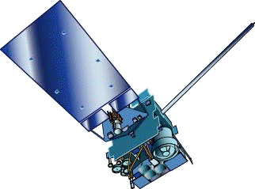
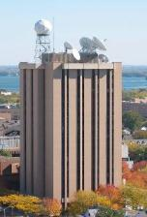
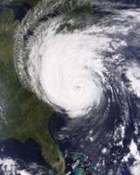


GOES Imager
Stray Light Correction
  Timothy J. Schmit (tim.j.schmit@noaa.gov) and Hyre Bysal
NOAA/NESDIS
Steven Buford
ITT Exelis
Grant Matthews
ITT Exelis
Xiangqian Wu, Sam Chen
NOAA/NESDIS
Mike Weinreb
Riverside Technology Inc.
Tony Schreiner
CIMSS
Madison, WI
Many Others (Zhenping Li, Paul Douglas, Ken Mitchell, etc.)!
Calibration Working Group
27 March 2012
UW-Madison

Slide 2
GOES Imager Stray Light correction
GOES-13/14/15 imagers and sounders are capable of scanning the sun without health and safety issues. However, in the past, NOAA had to cancel or replace all imaging within 6 degrees due to intolerable sun intrusion.
Annual loss: Equivalent to 6 days of imaging.
The sun intrusion is more detectable on shorter wavelength IR channels (especially Channel 2) of the imager with the effect increasing as the scan mirror line-of-sight (LOS) gets closer to the sun.
NOAA and ITT Exelis have characterized the effect of the sun intrusion and developed a correction algorithm to claim >95% of lost images.

Slide 3
Spring eclipse (GOES-13 Imager)
Net Scan Time gained (hours per season):
 | Eclipse | StrayLightCorr | Both
CONUS | 5.8 | 5.4 | 11.2
SHEMI | 5.5 | 5.5 | 11.0
NHEMX | 15.2 | 21.2 | 36.4
FD | 0.0 | 16.0 | 16.0
TOTAL | 26.4 | 48.2 | 74.6
Number of Frames Saved (per season):
 | Eclipse | StrayLightCorr | Both
CONUS | 69 | 65 | 134
SHEMI | 73 | 73 | 146
NHEMX | 65 | 91 | 156
FD | 0 | 37 | 37
TOTAL | 207 | 266 | 473
Notes:
SLC = Stray Light Correction.
Eclipse = more images due to better batteries on SC.

Slide 4
GOES Imager Stray Light correction
The ground system algorithm consists of:
  Subtracting the known amount of additional stray light from the signal outside 6°.
  Using the longer wavelength signal in combination with 3.9-um signal to estimate a truer 3.9-um signal in areas where the sun is within 6° of the pixel and the stray light effect is overwhelming (hybrid).

Slide 5
GOES Imager Stray Light correction
GOES Imager Operational as of February 22, 2012 at 04 UTC.
Currently, GOES-13 Imager only is being corrected for stray light.
Mostly affects imager band 2 (4 micrometer), but all bands can be affected.
Allows extra images to be scanned around satellite midnight.
Corrects most of the ‘extra’ or stray radiation in the earth scenes
  Algorithm from ITT Exelis
Stray Light correction status bits sent out over GVAR and are now part of the McIDAS area line prefix
  Enabled, performed relative position of the sun, etc.
GOES-15 Imager stray light correction is planned for the fall of 2012
The GOES-R ABI can’t scan as close to the sun as the GOES-13/14/15

Slide 6
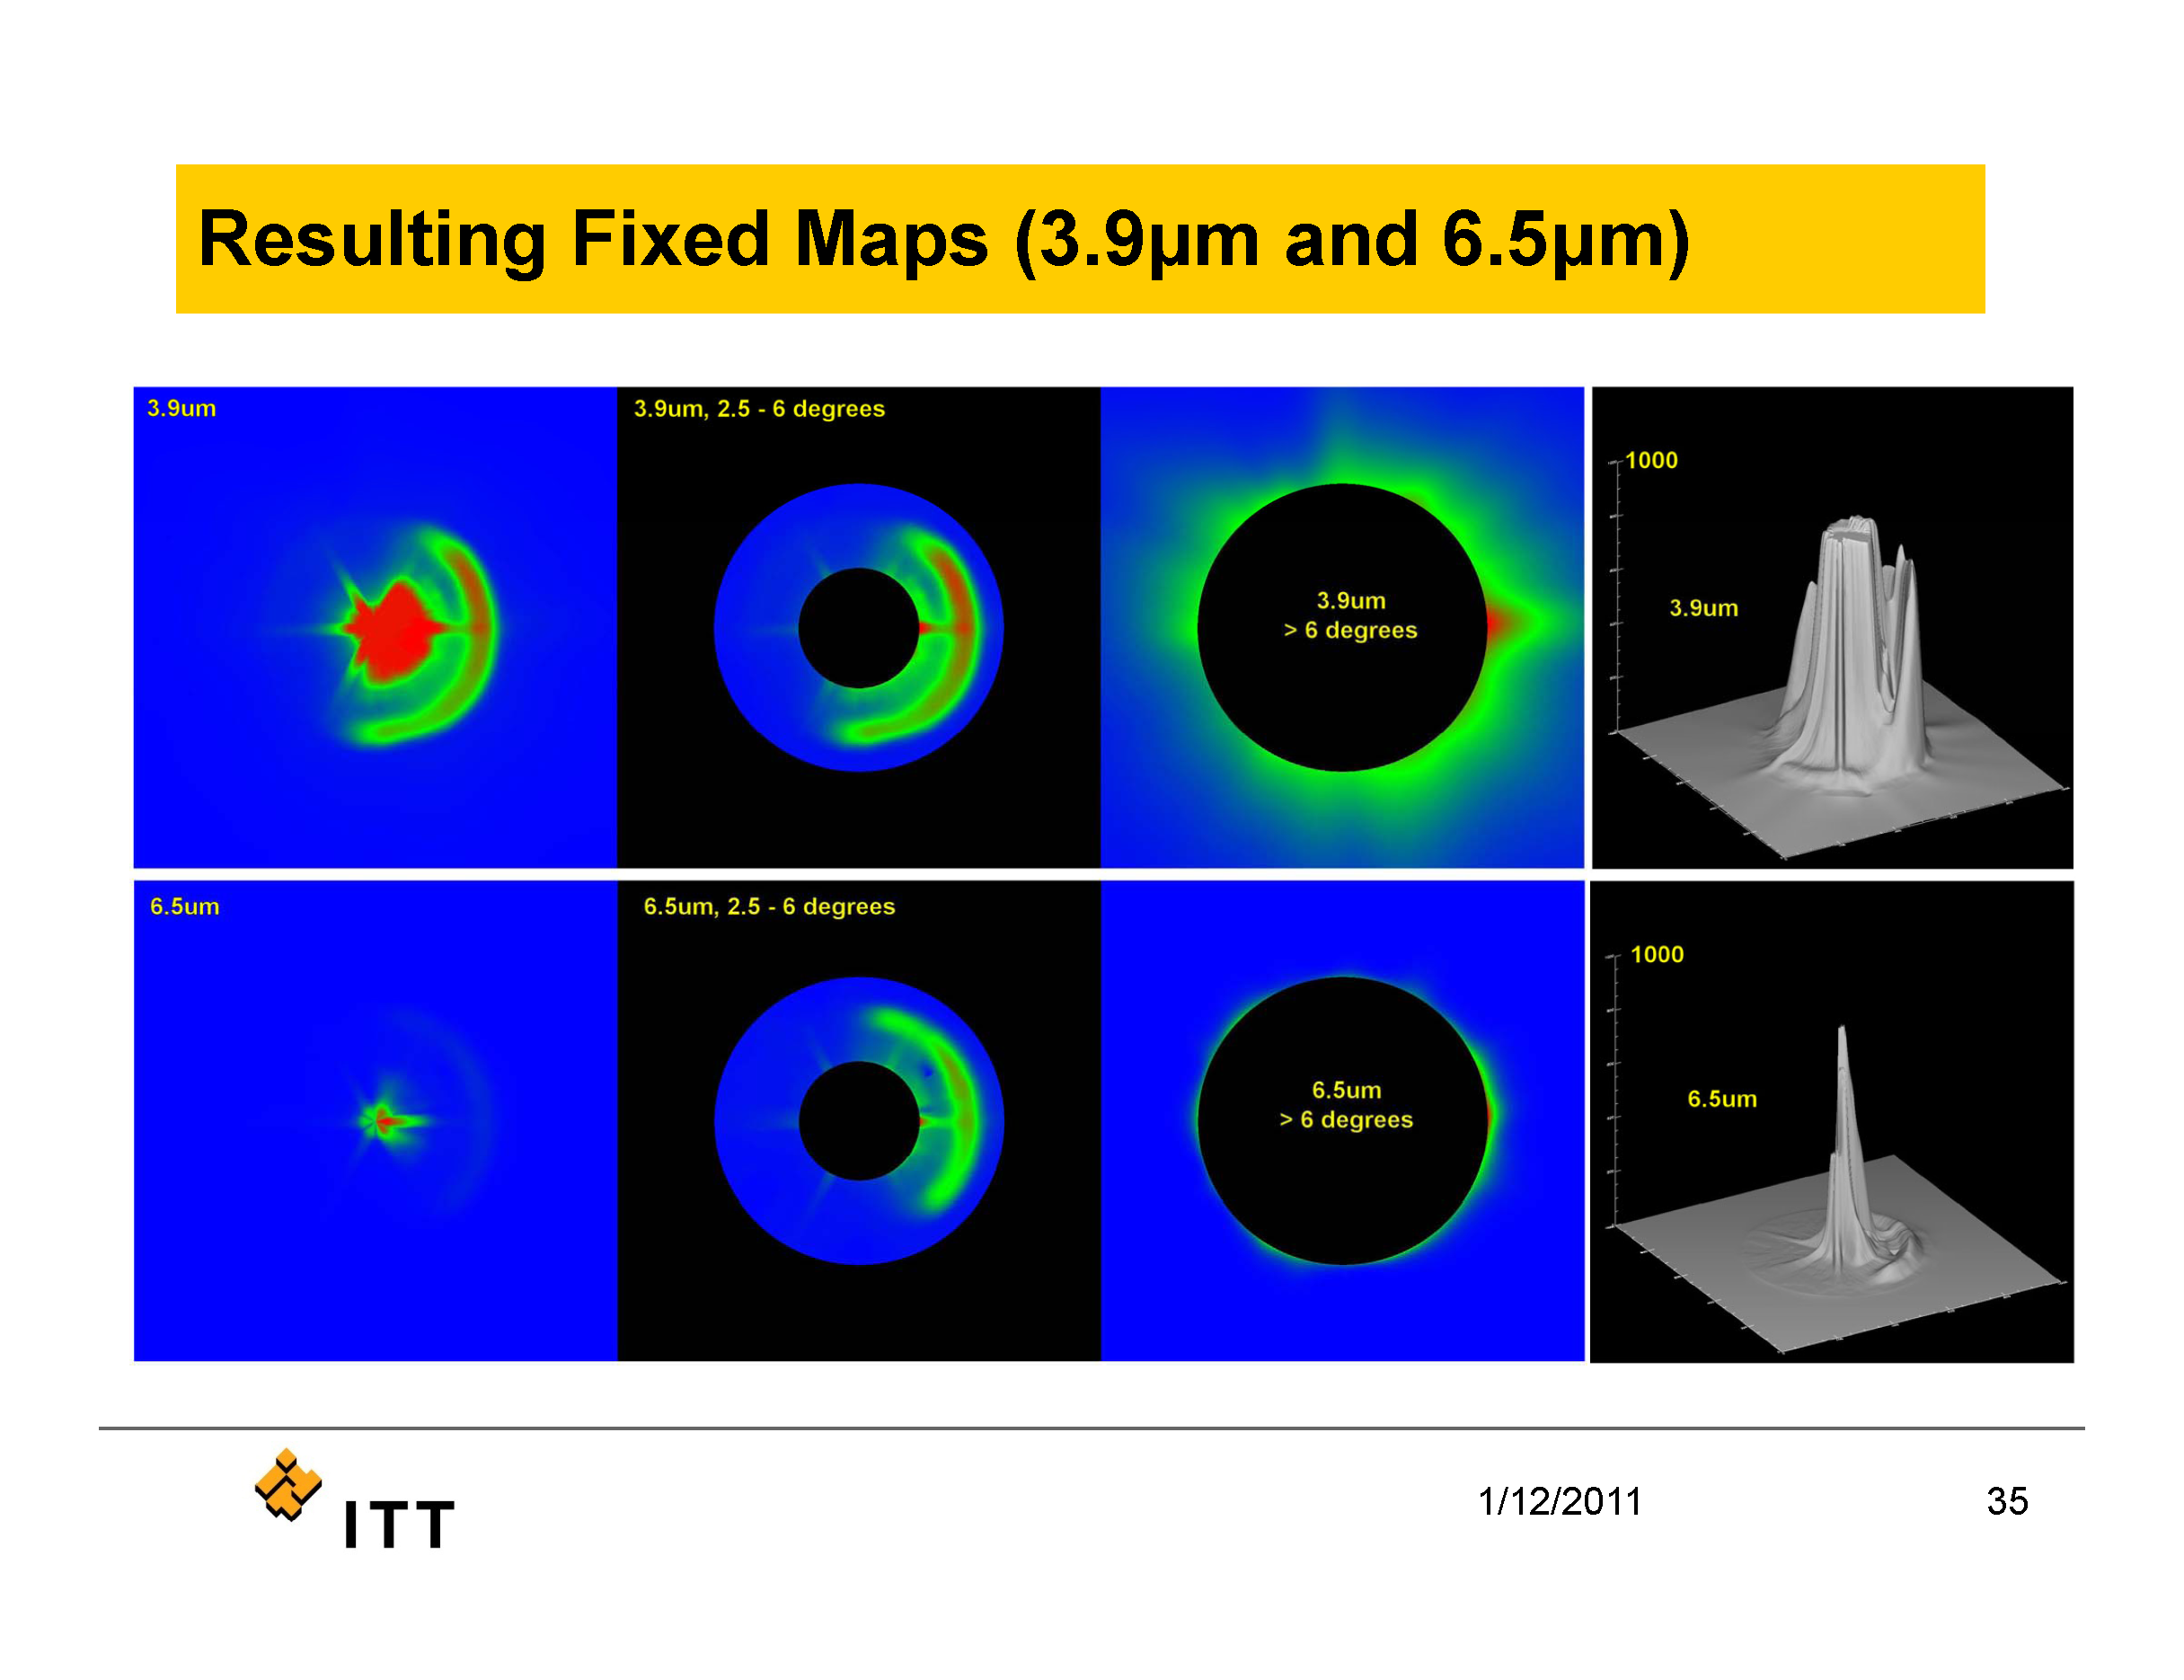

Slide 7
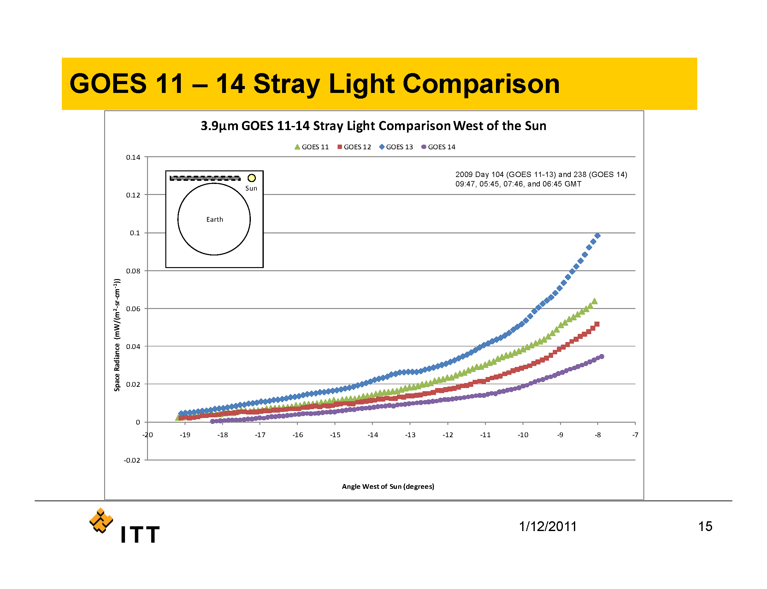

Slide 8
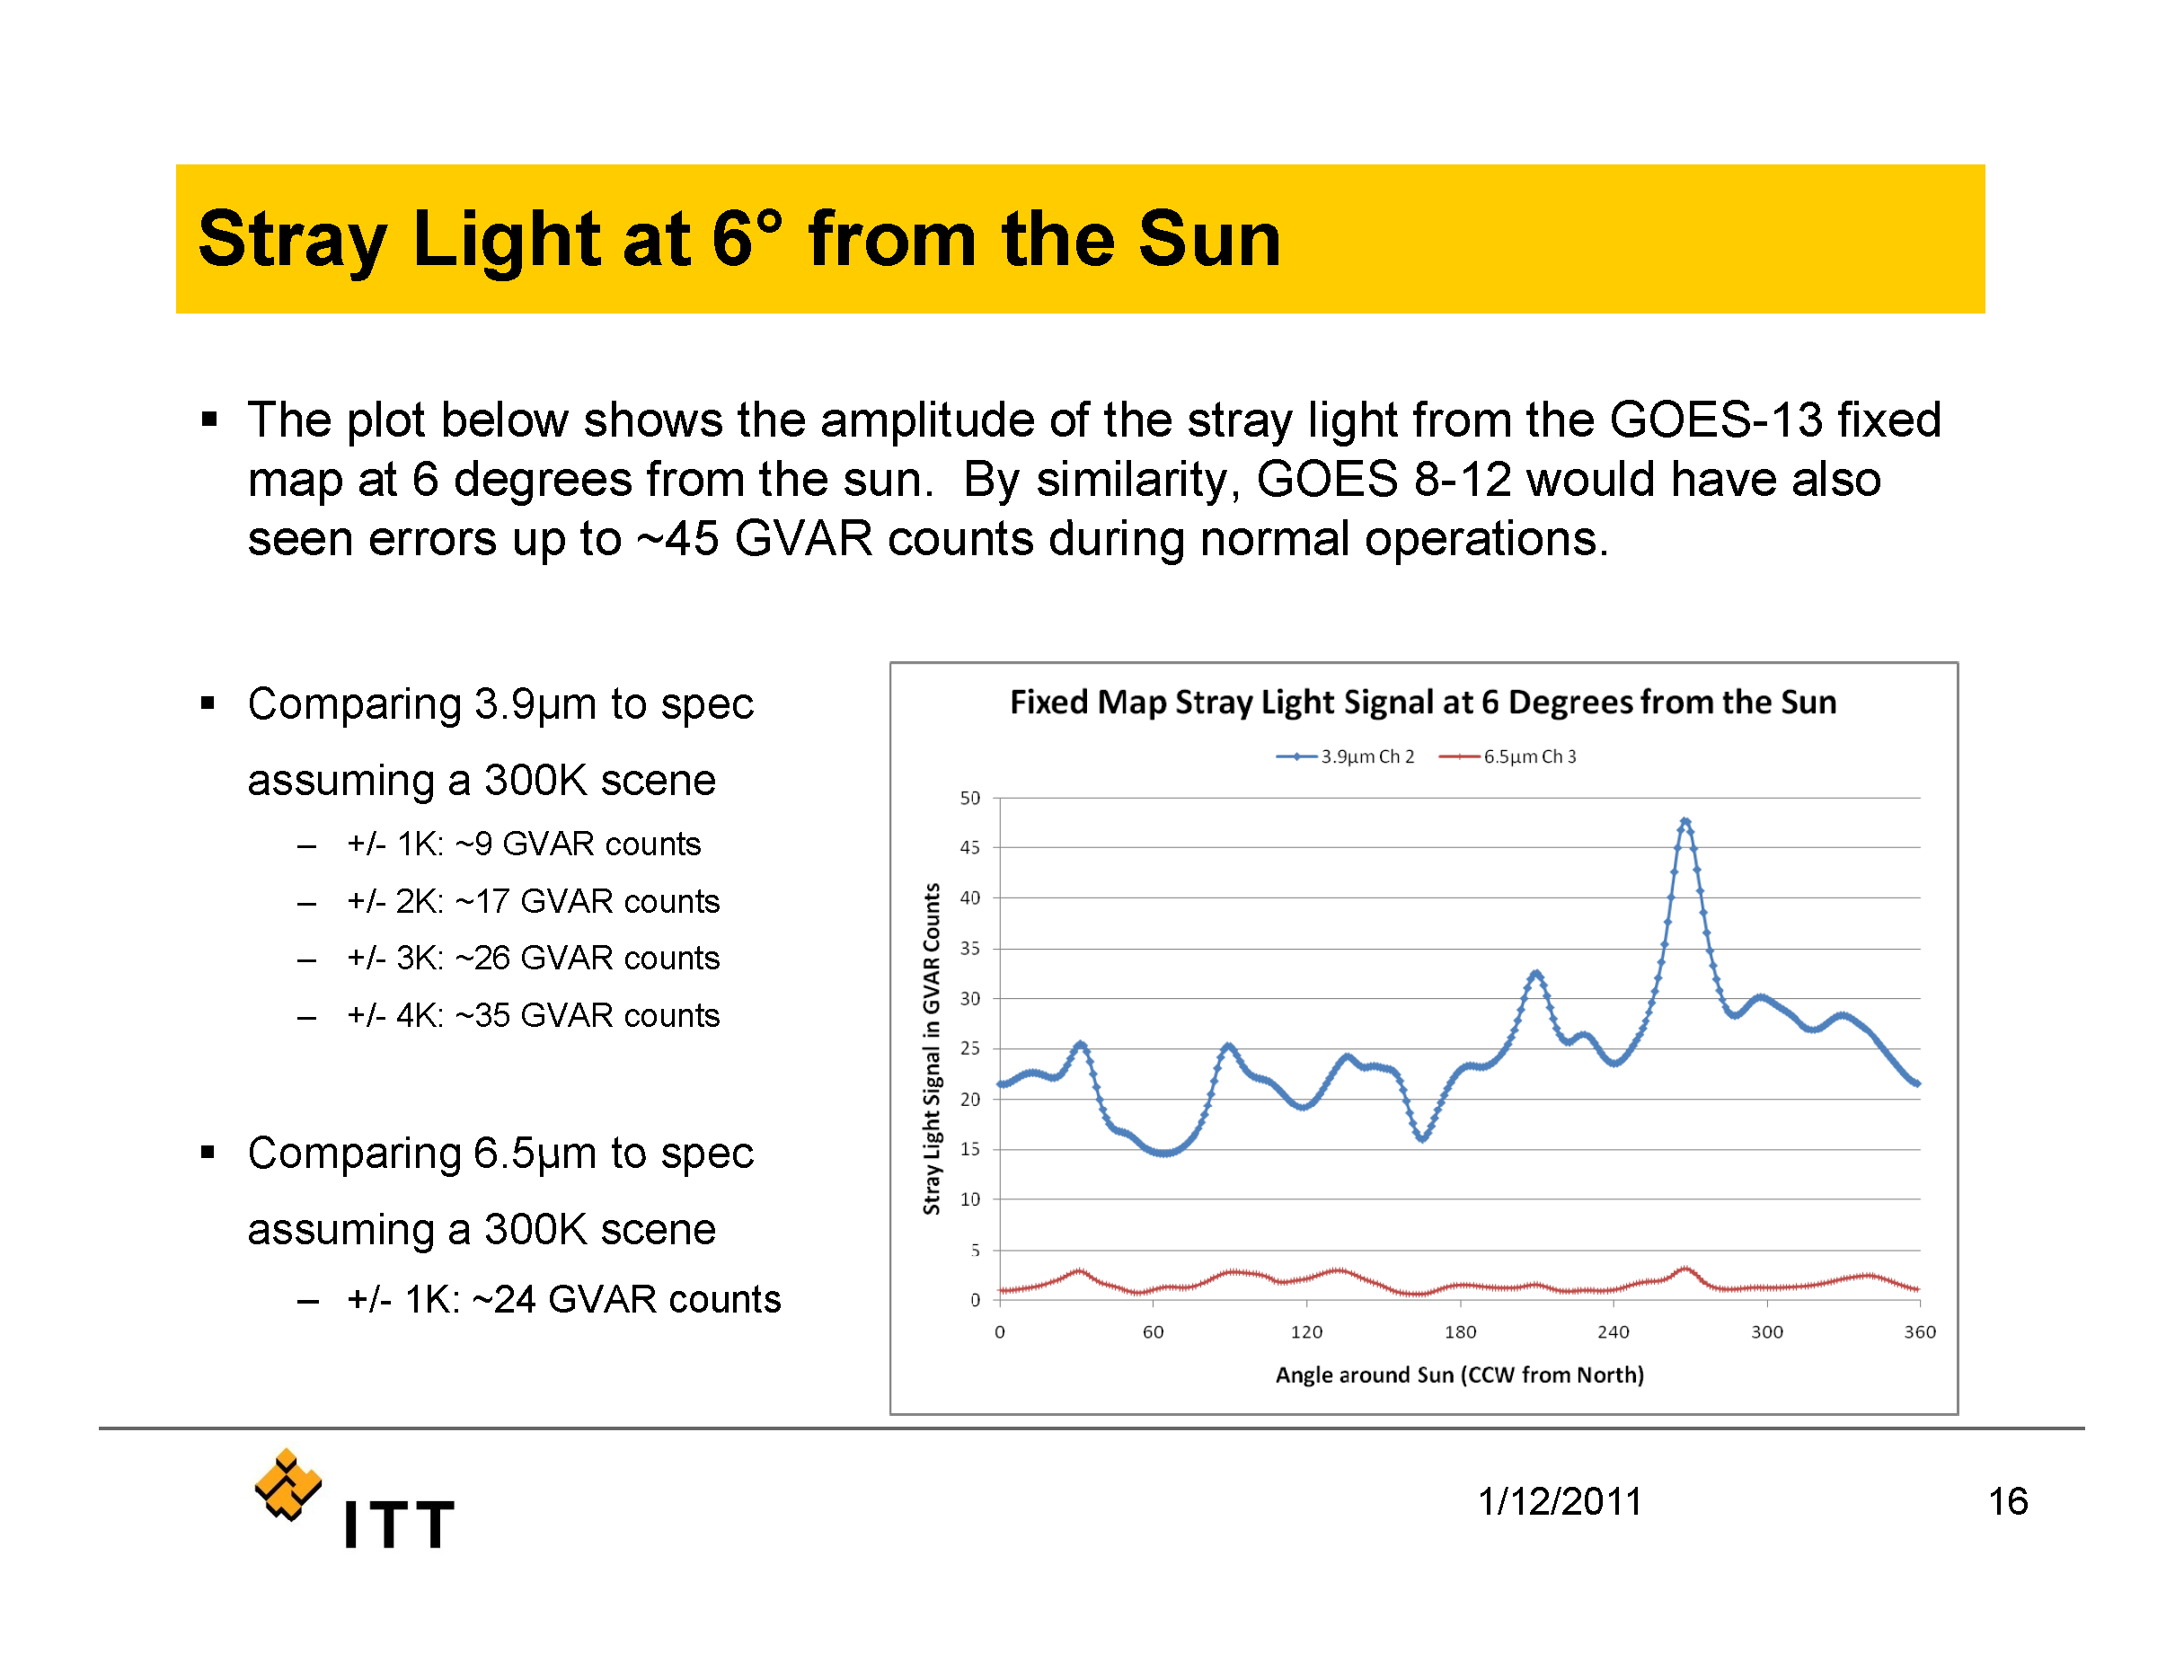

Slide 9
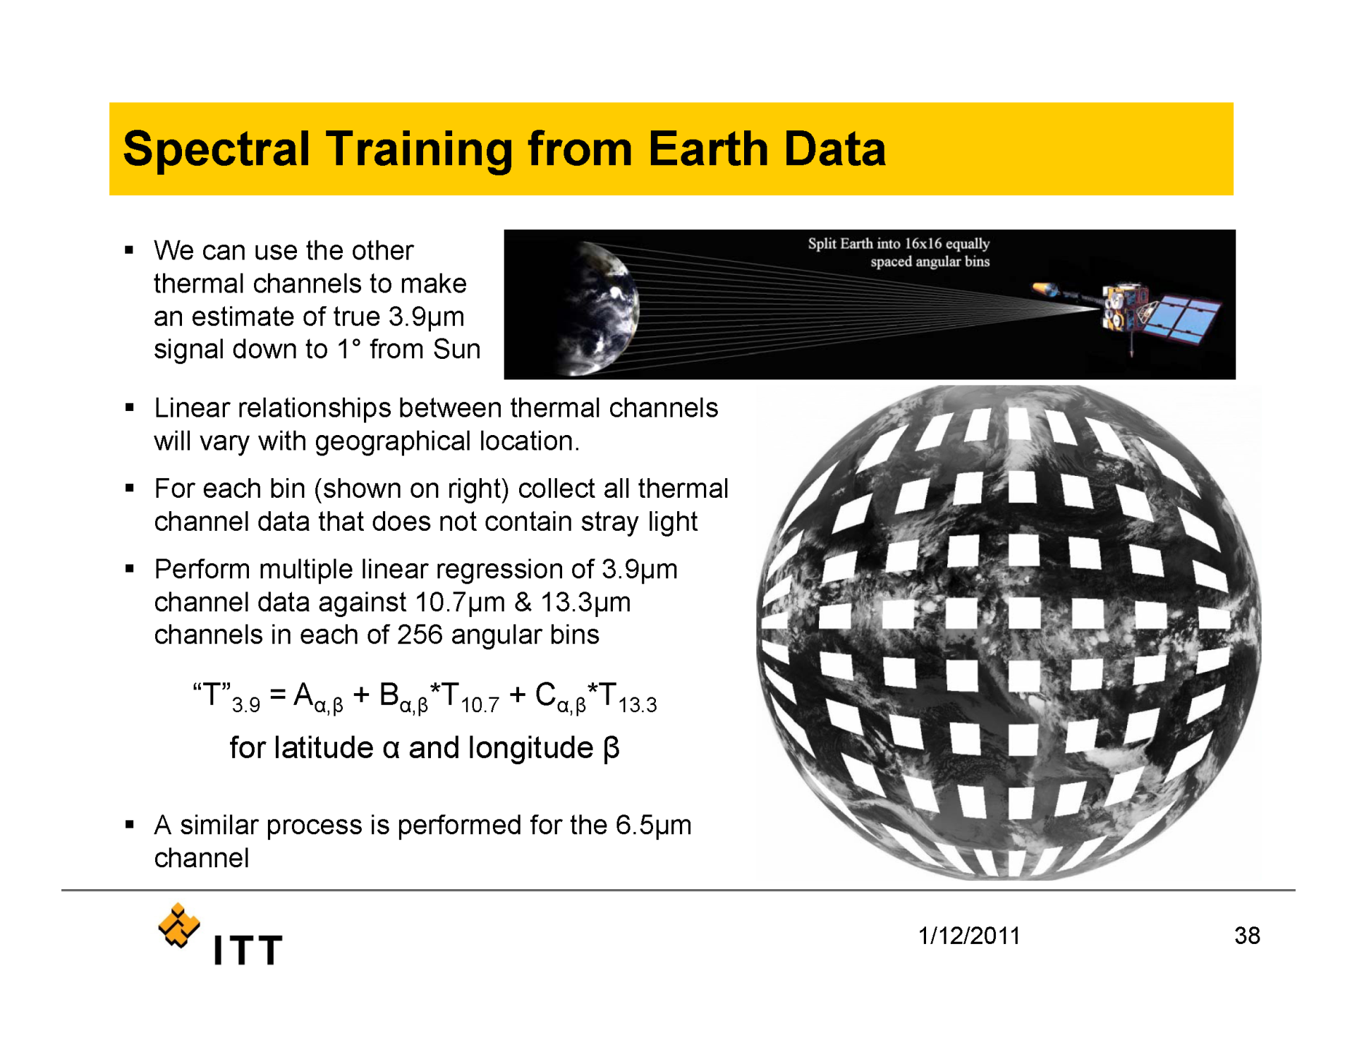

Slide 10
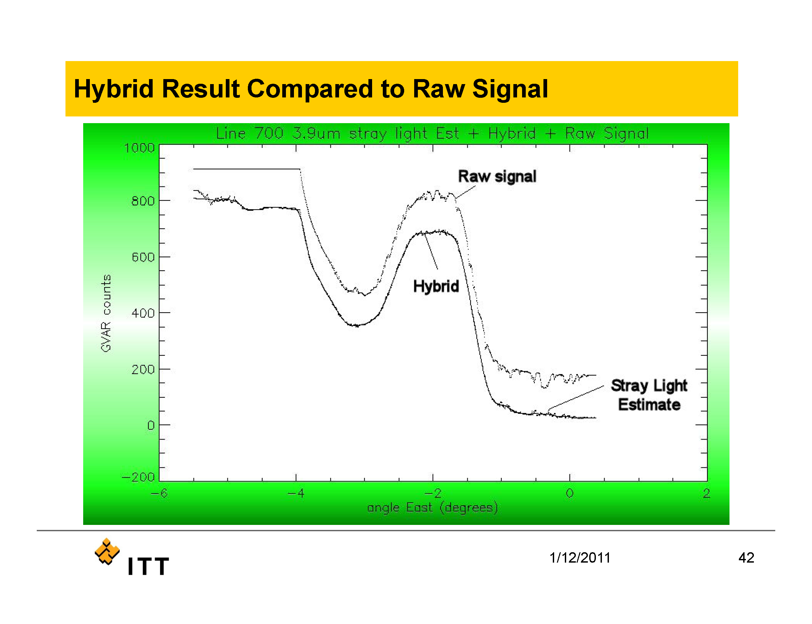

Slide 11
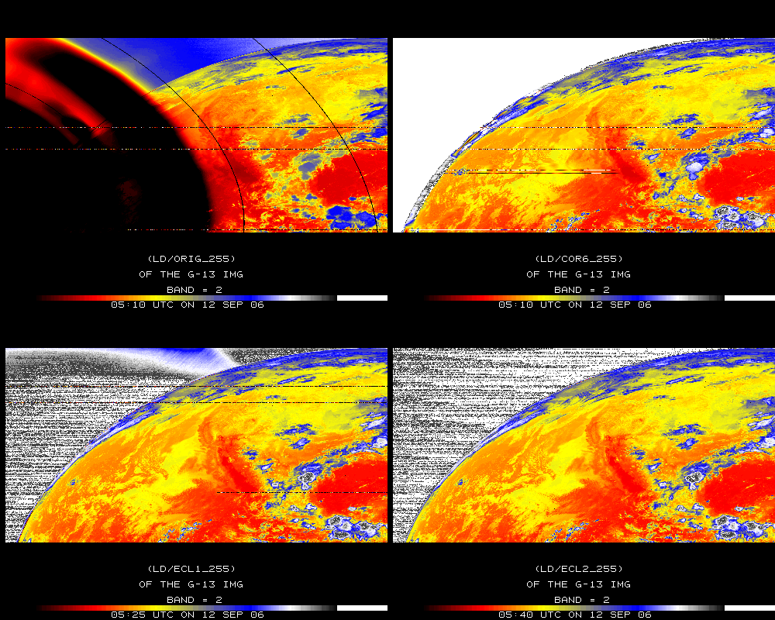
Stray Light Correction
Original
Corrected
GOES-13 Imager Band 2
Later image
Later image
Notes:
The 4 um (band 2 GOES imager) data can be over 50K too hot due to stray light. After being corrected, the image is more similar to subsequent (unaffected) images.
Data ingested by the SSEC data center.

Slide 12
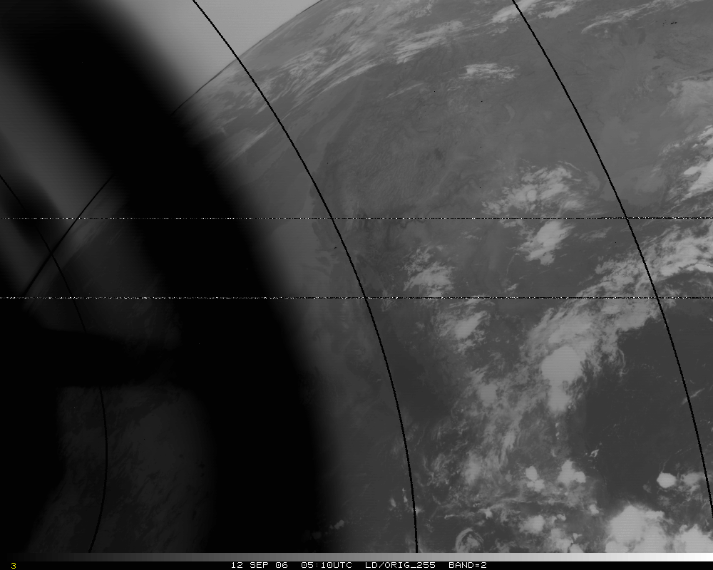
Band 2, Original – too hot by several K!
Band 2, Original – too hot by 50K!

Slide 13
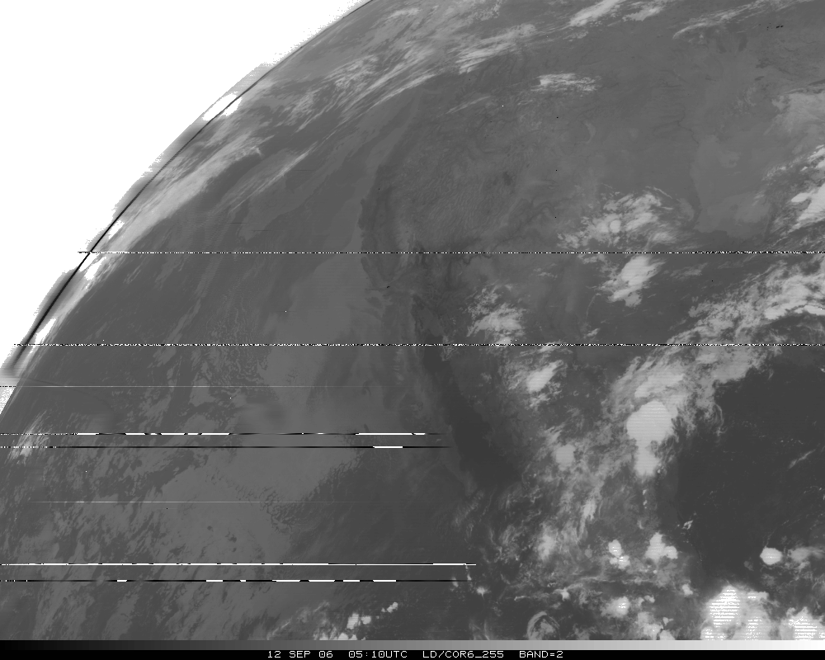
Band 2, Corrected
Notes:
Ignore missing lines, due to ingest.

Slide 14
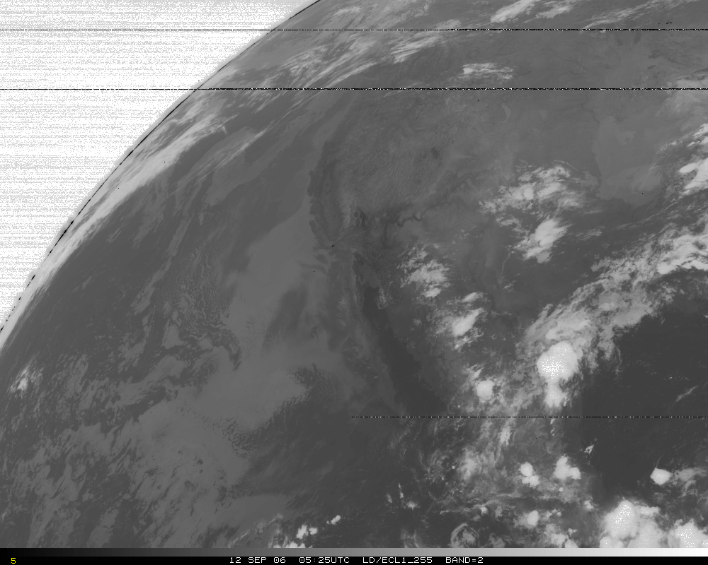
Band 2, later image
Notes:
Ignore missing lines, due to ingest.

Slide 15
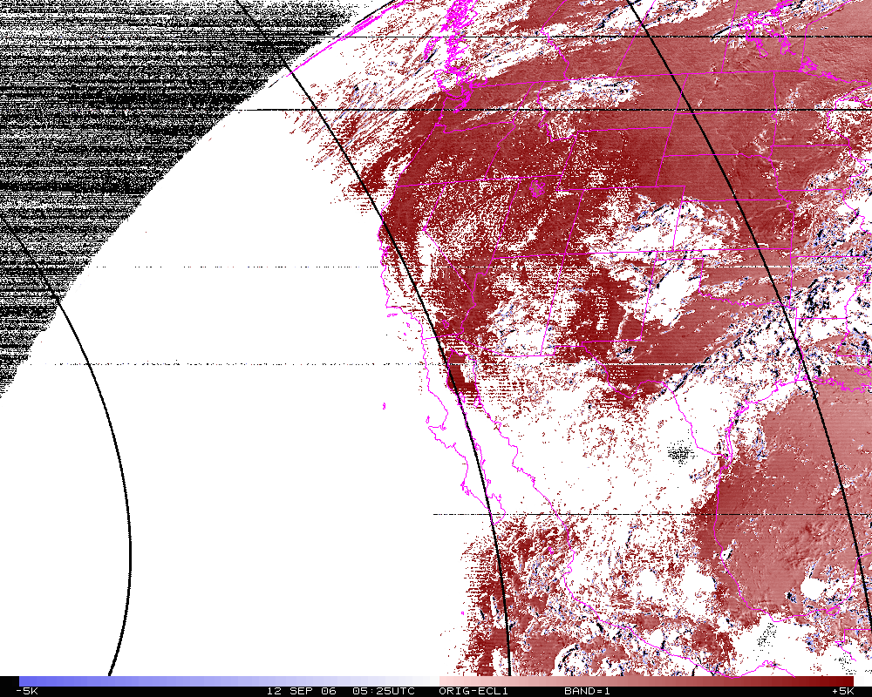
Band 2 Difference
N=14342
Mean= 4.0K
Band 2, difference image (org-eclipse). Smaller range.
Notes:
Note that even far from the sun, there’s still a 4K difference.

Slide 16
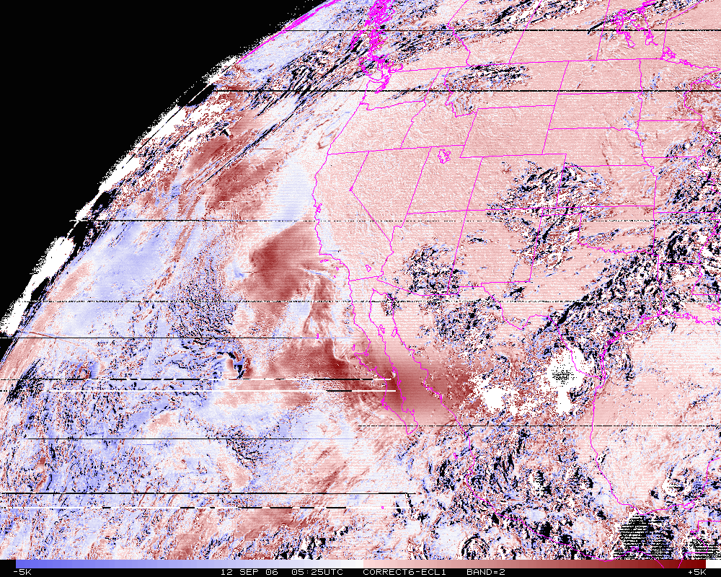
Band 2 Difference
N=14342
Mean= 0.6K
Band 2, difference image (corrected-eclipse). Smaller range.

Slide 17
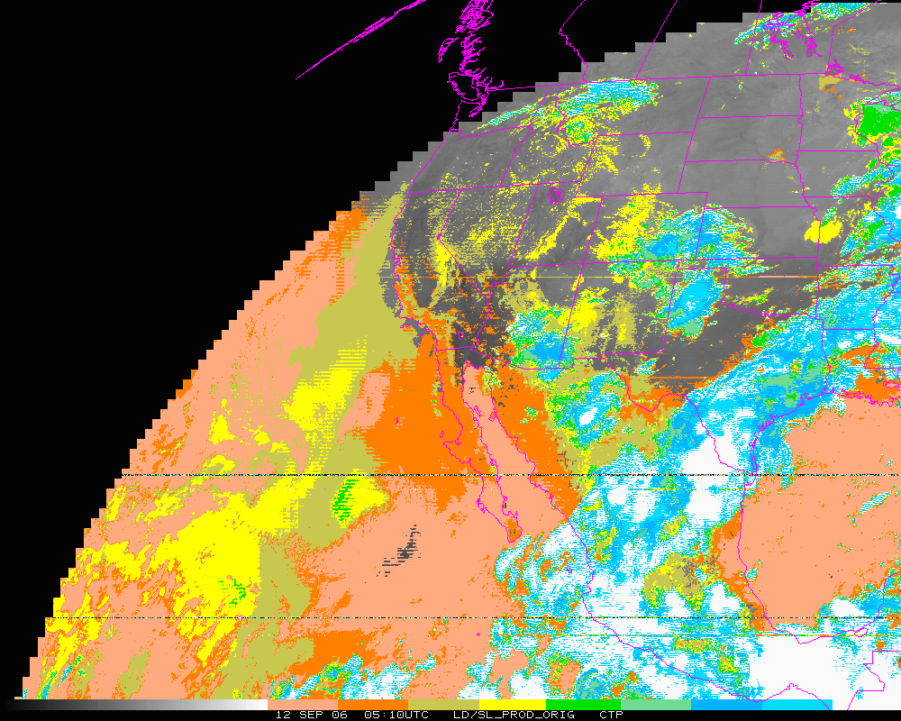
Cloud-top Pressure (color-range). Original – too “cloudy” over some regions, but misses other clouds!
Clear Low cloud High Cloud
Notes:
Derived Product of cloud not correct with data with stray light.

Slide 18
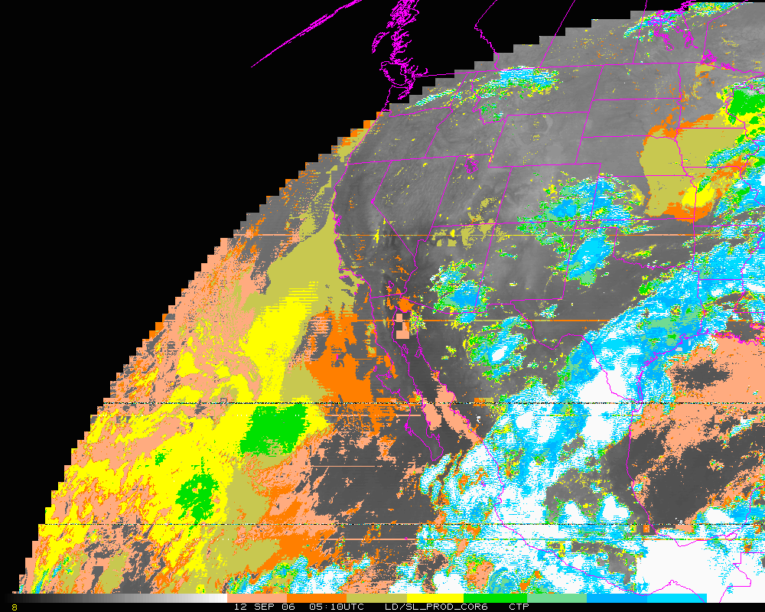
Cloud-top Pressure (color-range). Corrected. In general, corrected both regions.
Clear Low cloud High Cloud
Notes:
…outside of 6 degrees.

Slide 19
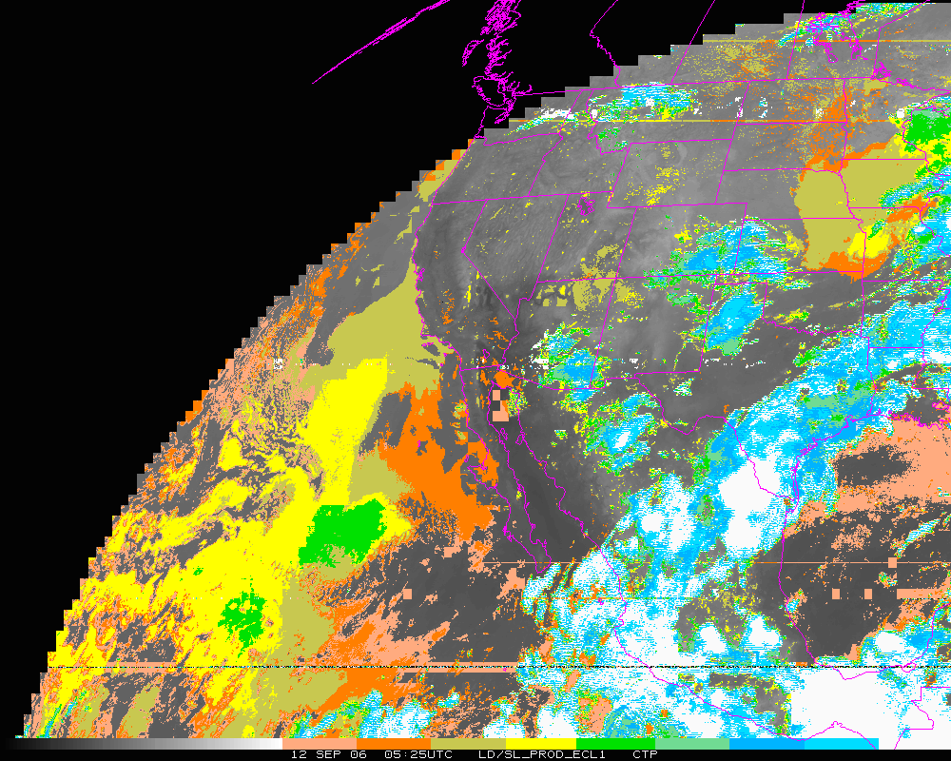
Cloud-top Pressure (color-range). Later image.
Clear Low cloud High Cloud
Notes:
Derived Product of cloud much improved after stray light correction.

Slide 20
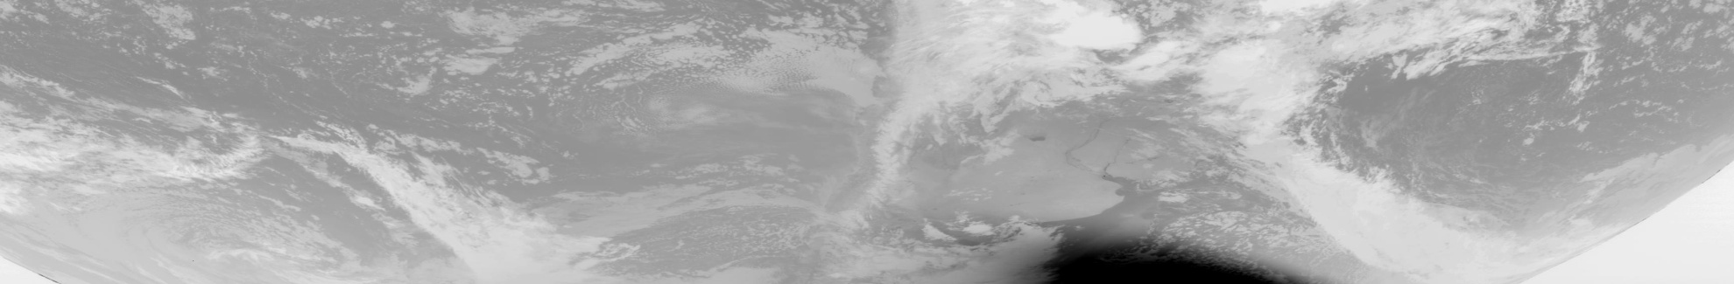
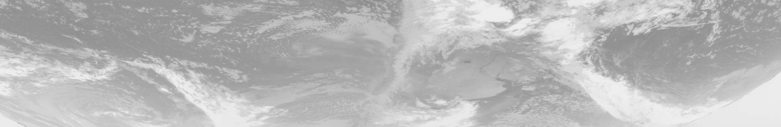
GOES-13 Imager 12/053/05:09 Southern Hemi, Channel 2
Uncorrected for SL
SL Corrected
J. Paul Douglas

Slide 21
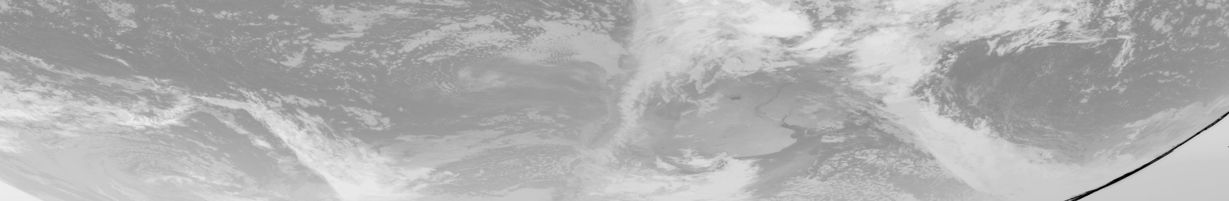
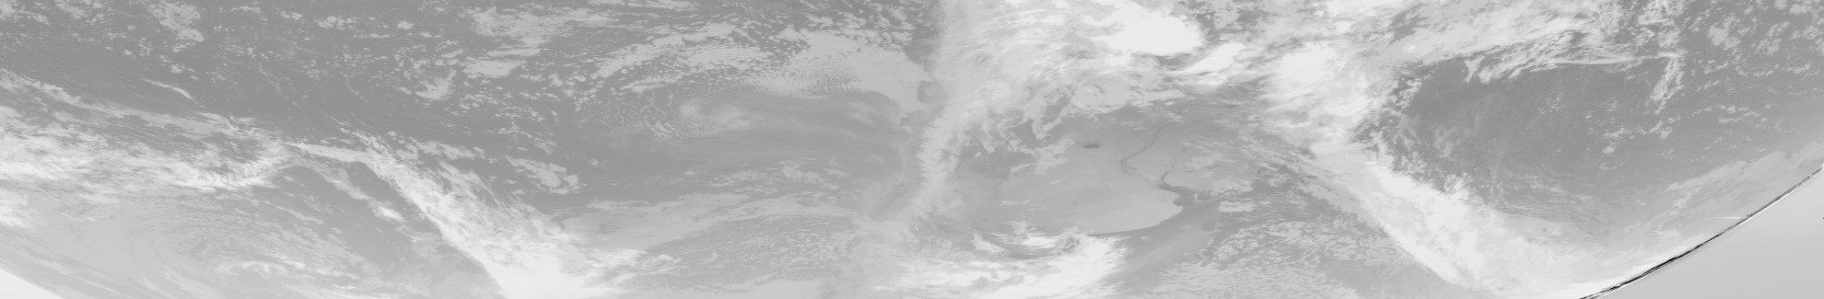
GOES-13 Imager 12/053/05:39 Southern Hemi, Channel 2
Uncorrected for SL
SL Corrected
An artifact has been introduced
J. Paul Douglas

Slide 22
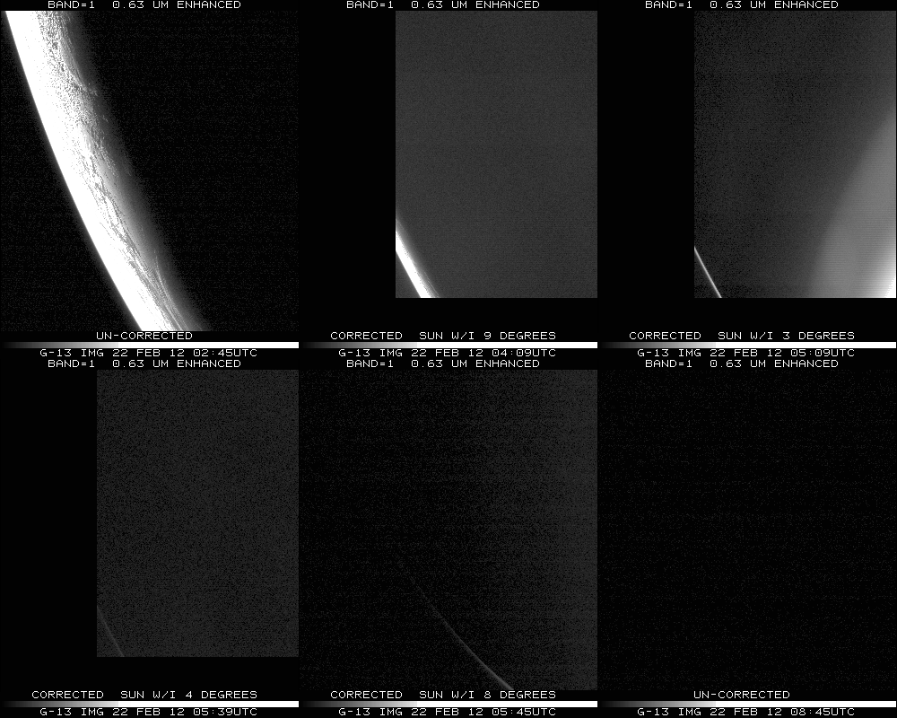
Notes:
Data from SSEC Data Center

Slide 23
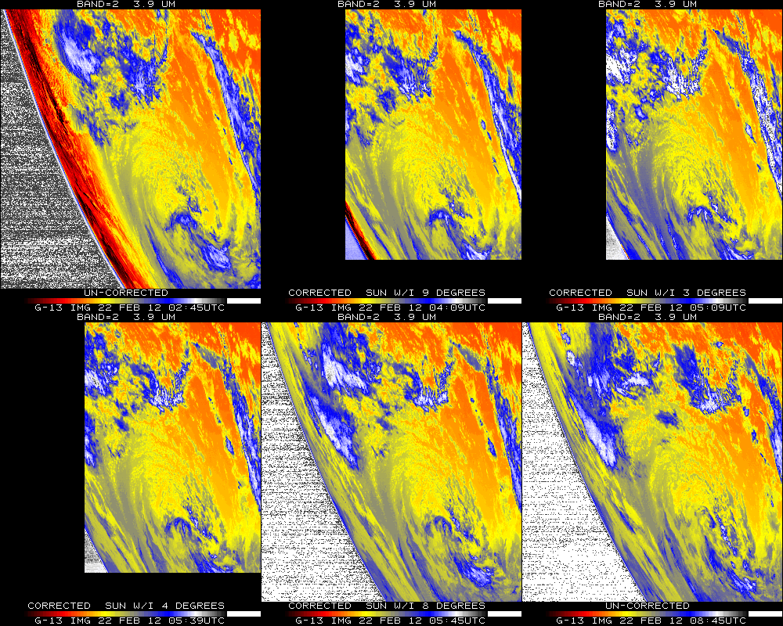
Notes:
Data from SSEC Data Center

Slide 24
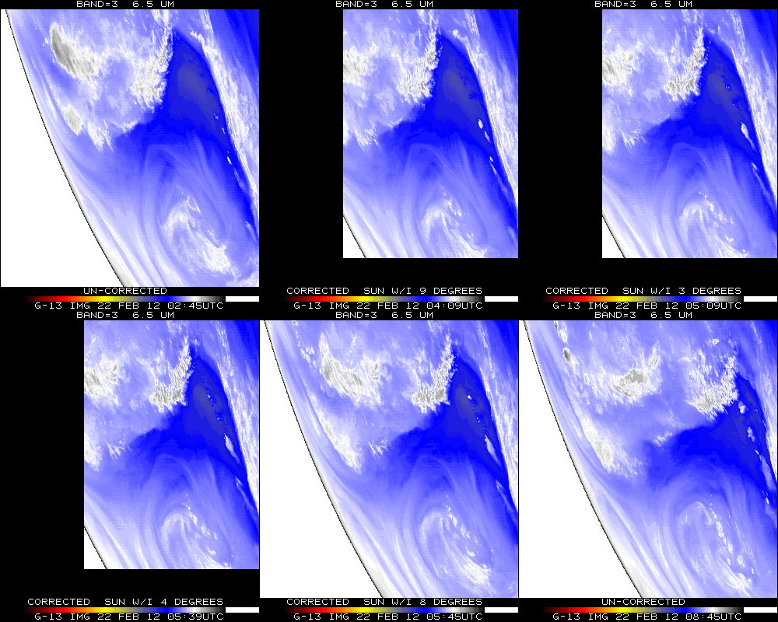
Notes:
Data from SSEC Data Center

Slide 25
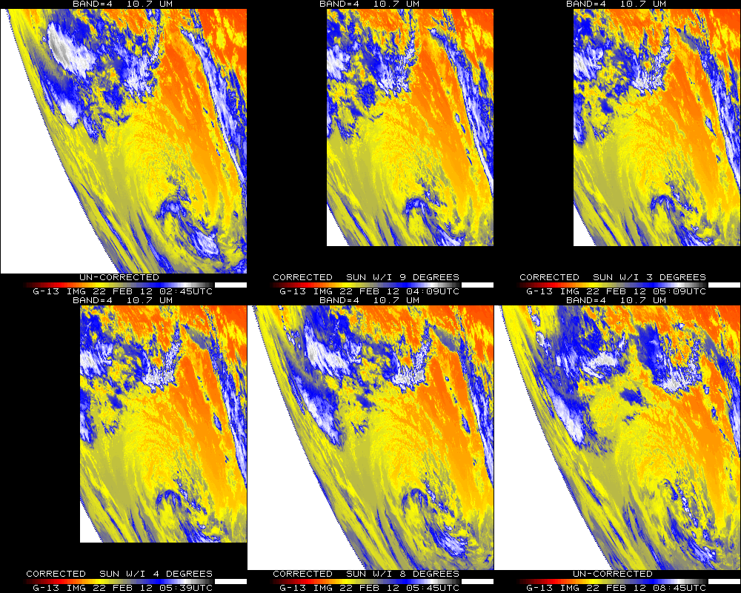
Notes:
Data from SSEC Data Center

Slide 26
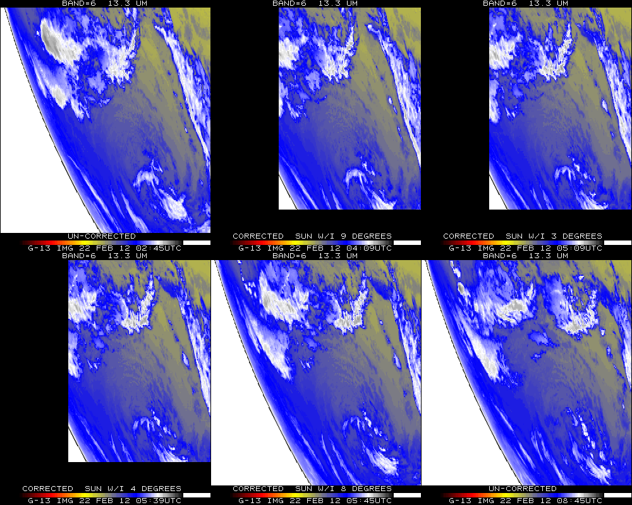
Notes:
Data from SSEC Data Center

Slide 27
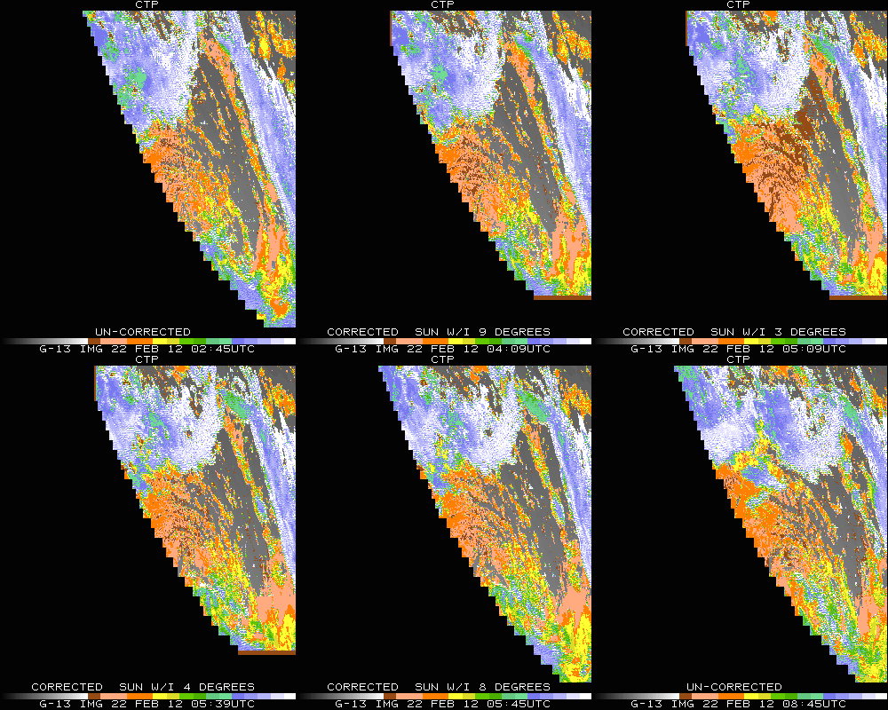

Slide 28
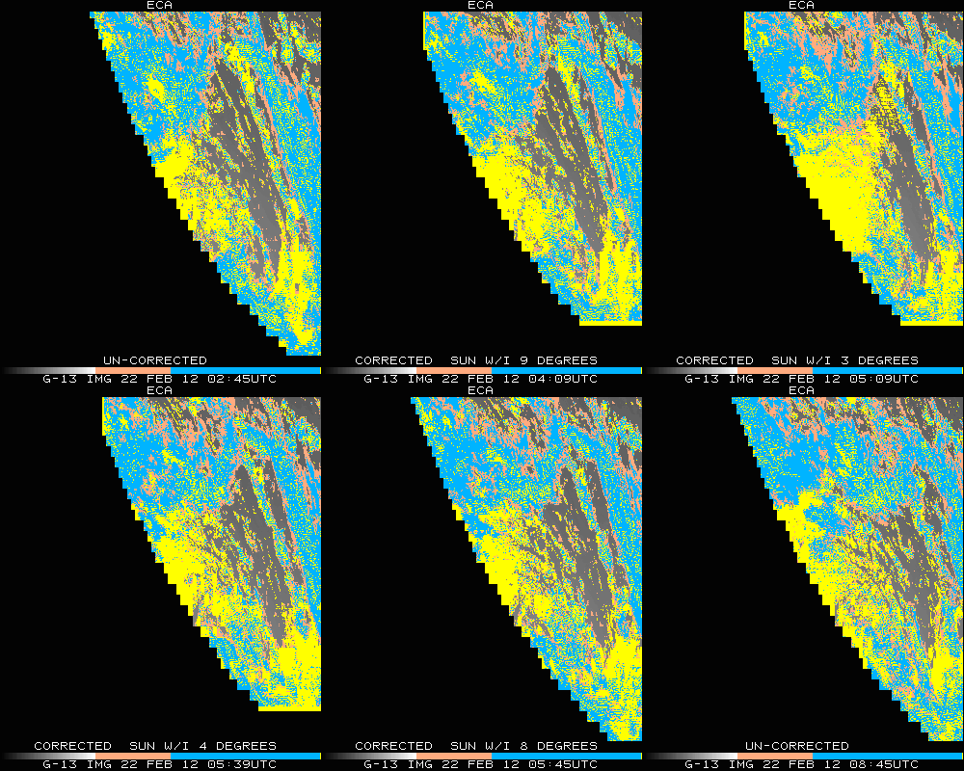

Slide 29
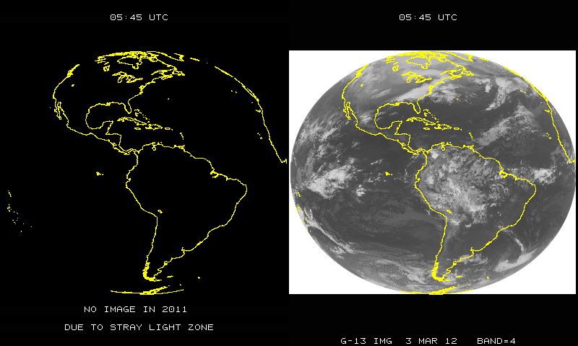

GOES Imager Stray Light correction
Extra full disk image with the Stray light correction, compared to last year.
March 3, 2011
March 3, 2012
Notes:
Of course other times are also added, not just this one time.

Slide 30
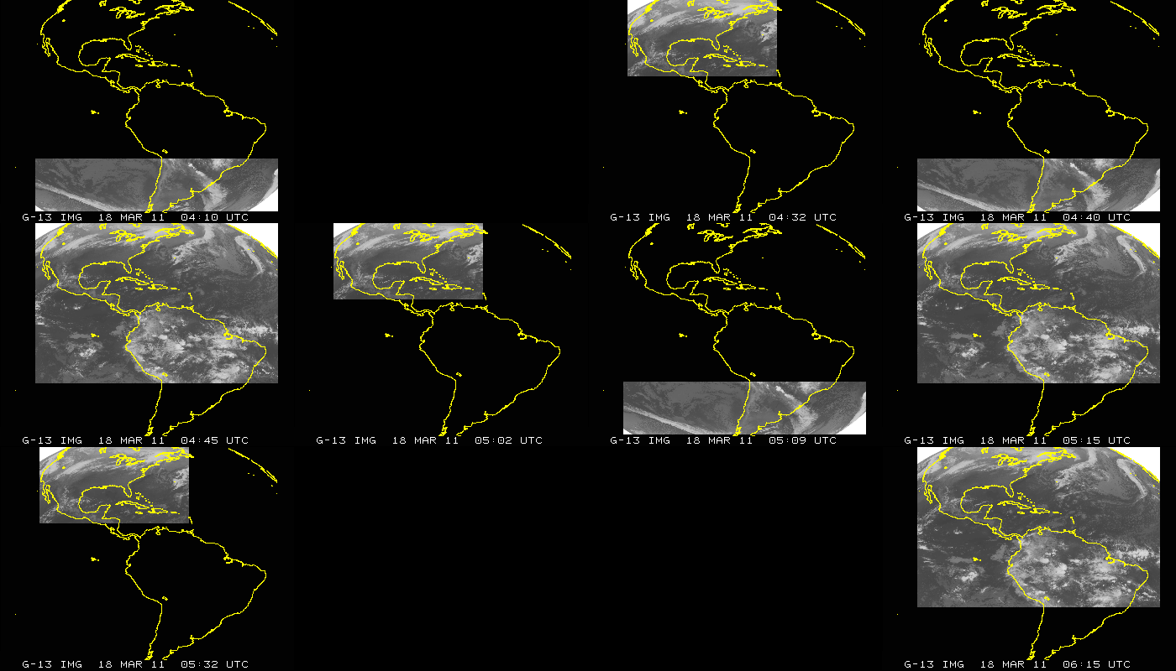
GOES-13 (East) Imager Coverage
JD=077; March 17, 2011 (04:10 to 06:15 UTC); GOES-13 Imager

Slide 31
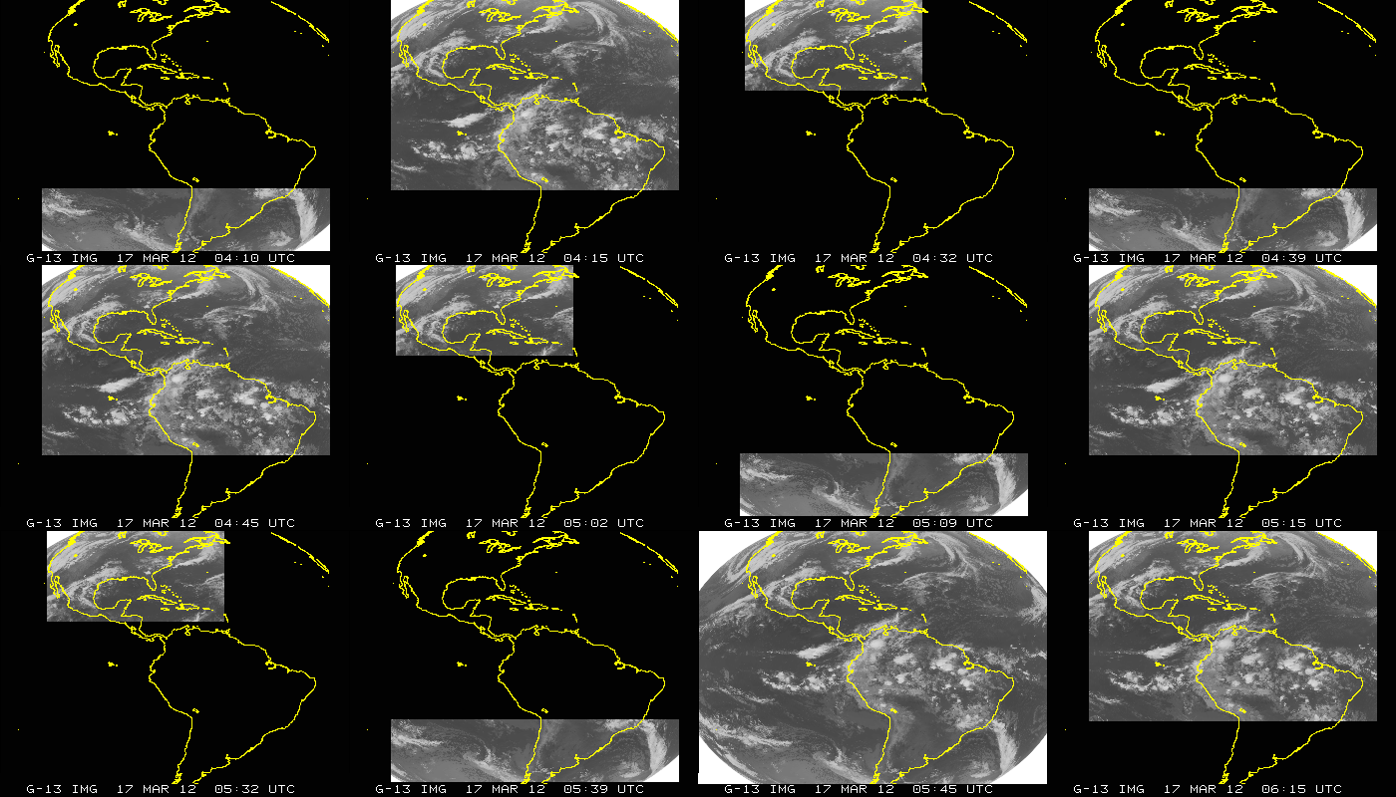
GOES-13 (East) Imager Coverage
JD=077; March 18, 2012 (04:10 to 06:15 UTC); GOES-13 Imager

Slide 32
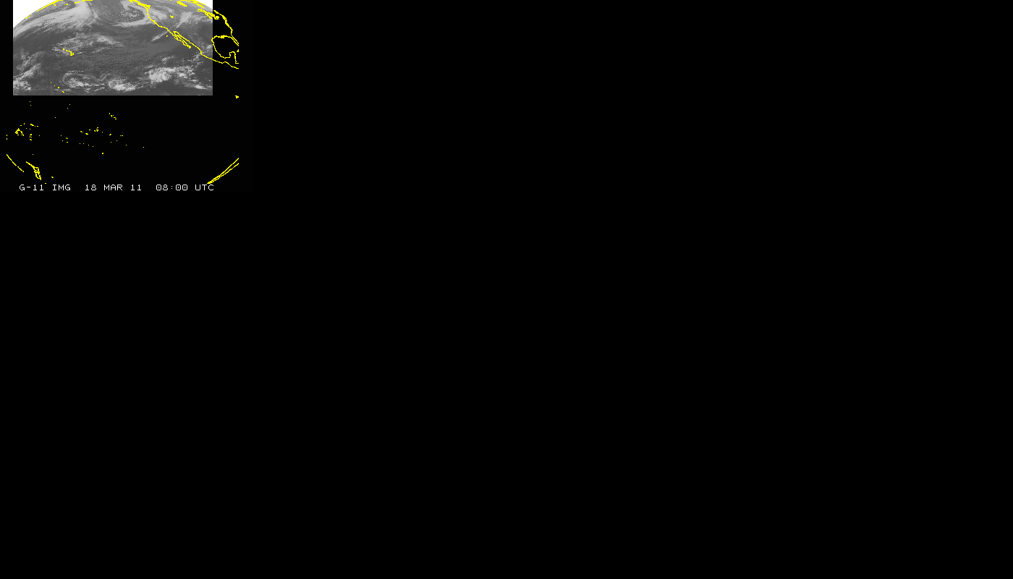
GOES-11 (West) Imager Coverage
JD=077; March 18, 2011 (08:00 to 10:11 UTC); GOES-11 Imager

Slide 33
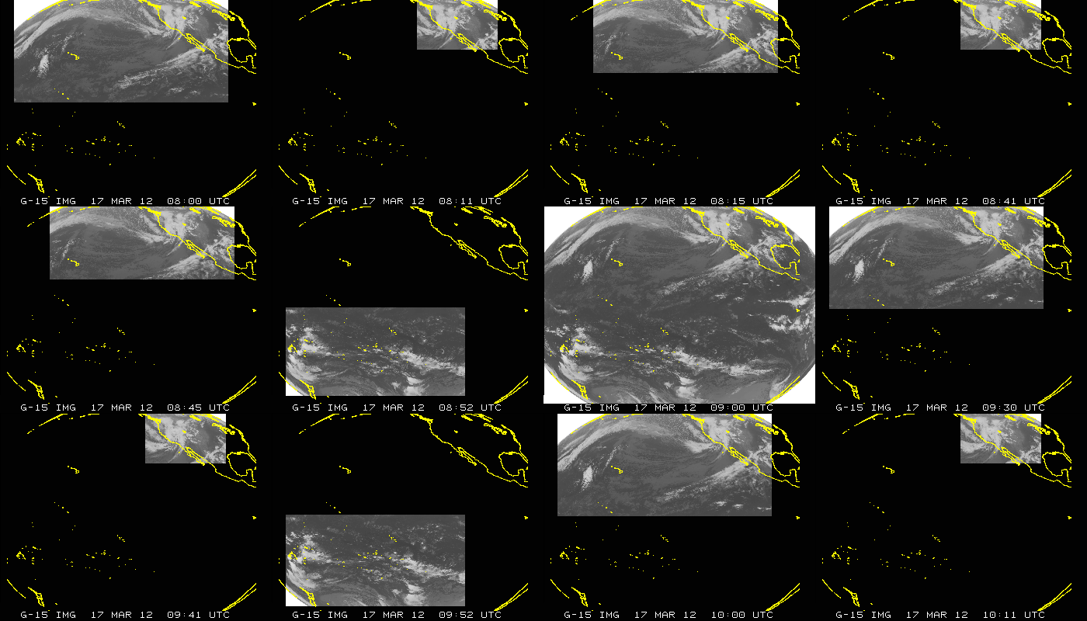
GOES-15 (West) Imager Coverage
JD=077; March 17, 2012 (08:00 to 10:11 UTC); GOES-15 Imager

Slide 34
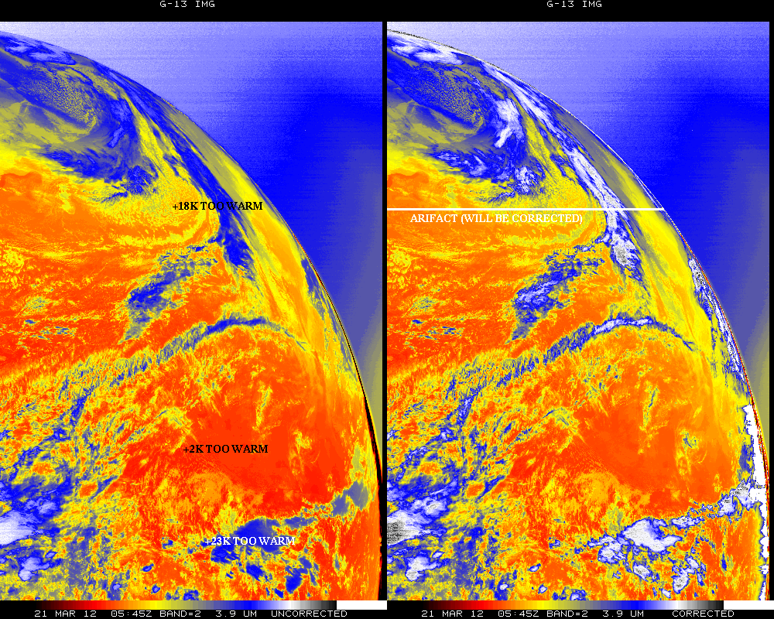
Sample with and without SLC

Slide 35
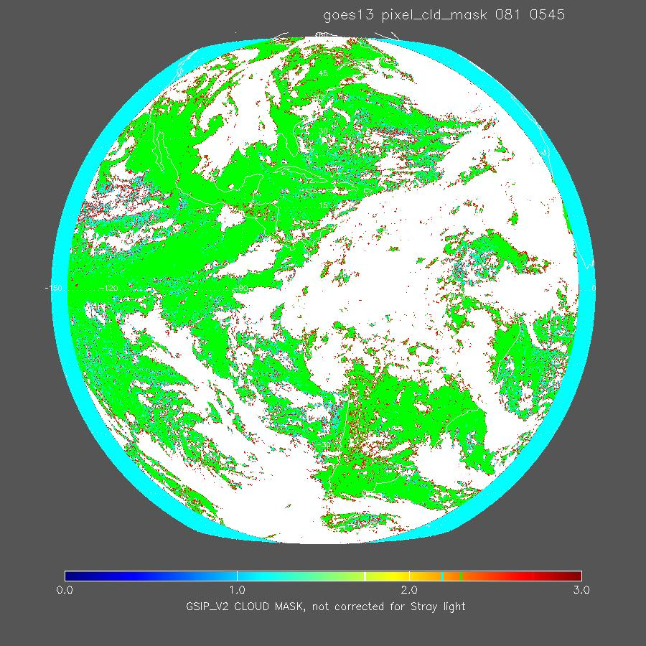
Cloud Mask
Un-corrected
W. Straka
Notes:
(green = clear, cyan = prob clear, red = prob cloud, white = cloud)

Slide 36
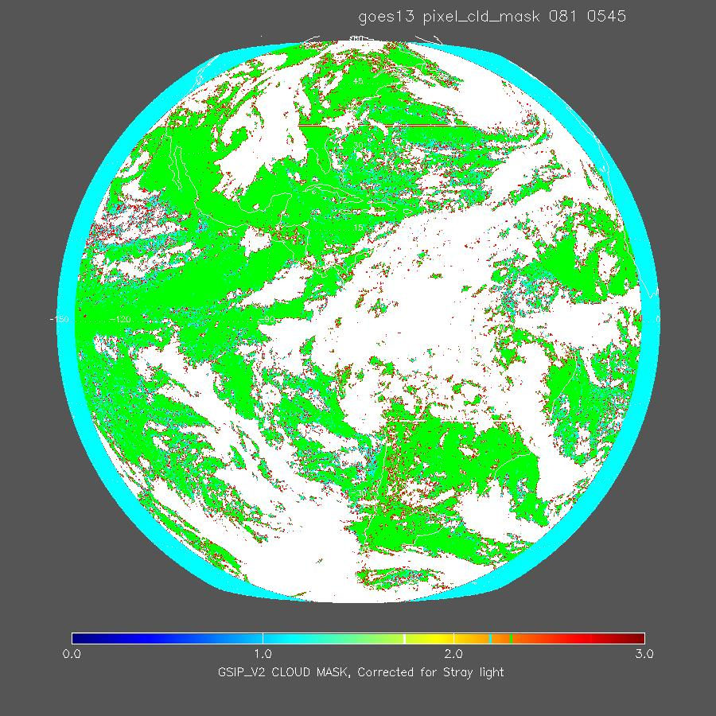
Cloud Mask
Corrected
W. Straka
Notes:
(green = clear, cyan = prob clear, red = prob cloud, white = cloud)

Slide 37
SLC info found the GVAR stream
An example of the type of output of Stray Light Correction information found the GVAR stream, in the area line prefix for the GOES-13 Imager data is shown below. This provides a summary of how each image is modified depending on the time of year (i.e. relative declination of the sun and GOES platform).
Directory information (sensor #, image ccyyddd, image hhmmss): 180, 2012068, 54500
SLCE (# lines w/SLC enabled) = 2705
SLCD (# lines w/SLC disabled) = 0
SLCP (# lines w/SLC performed) = 2705
SLCNP (# lines w/SLC not performed) = 0
SLC_FRST (1st ln w/SLC performed) = 1
SLC_LST (last ln w/SLC performed) = 2705
SUNE (# lines w/sun on e/side earth) = 2705
SUNW (# lines w/sun on w/side earth) = 0
SUNN (# lines w/sun on n/side earth) = 0
SUNS (# lines w/sun on s/side earth) = 2705
2705 nonzero values were found for parameter: min_sun_angle
Smallest sun angle value = 5 found at line # 1419
Largest sun angle value = 15 found at line # 1

Slide 38
Links
Links
http://cimss.ssec.wisc.edu/goes/blog/archives/9816
http://www.osd.noaa.gov/GVAR_Downloads/documents/SLC_GVAR_White_Paper_V1.doc
http://www.ssd.noaa.gov/PS/SATS/MESS/MSG0522058.01.txt

Slide 39
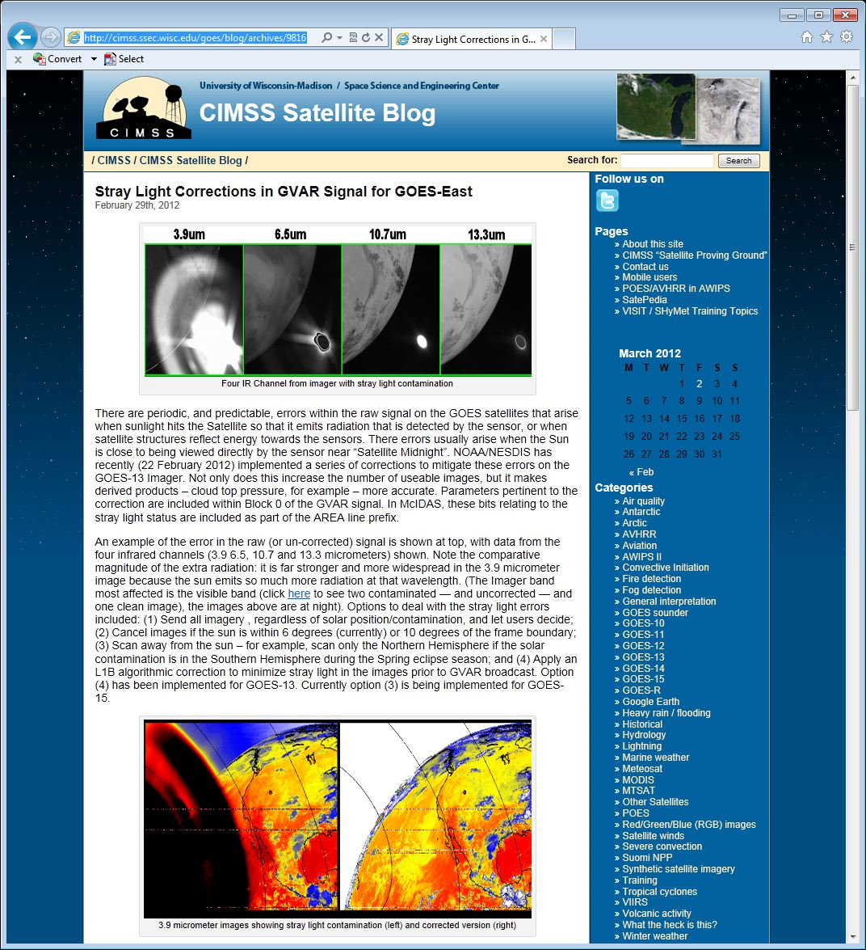
GOES Imager Stray Light correction
http://cimss.ssec.wisc.edu/goes/blog/archives/9816
Notes:
CIMSS blog web page about the SLC implementation.

Slide 40
Back-up
Back-up

Slide 41
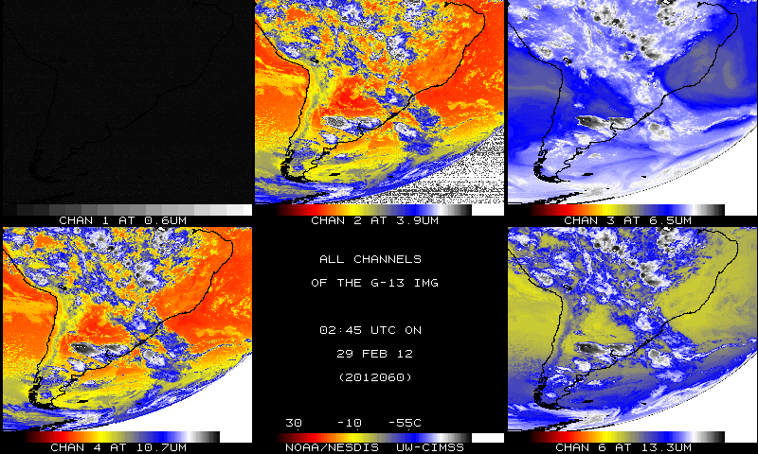
Uncorrected

Slide 42
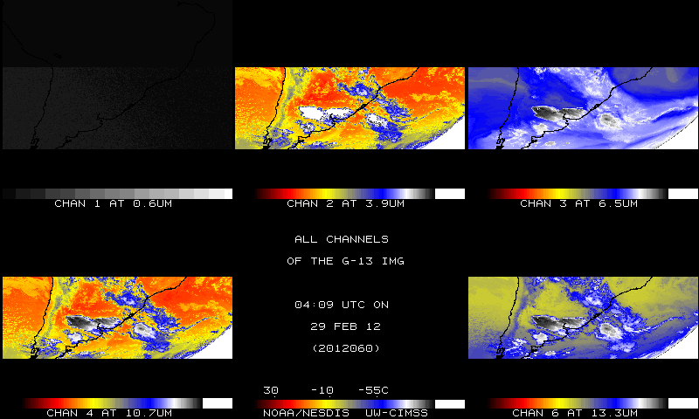
Corrected

Slide 43
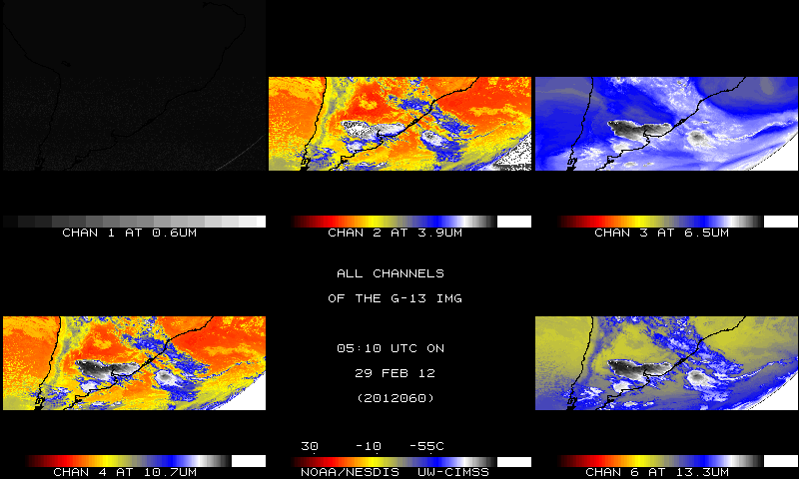
Corrected - Sun within 1 degree

Slide 44
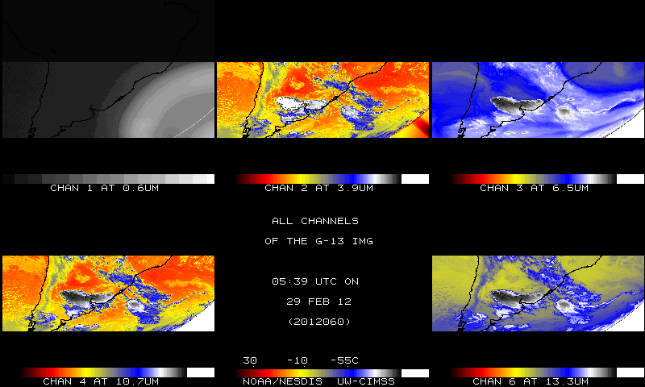
Corrected - Sun within 2 degrees

Slide 45
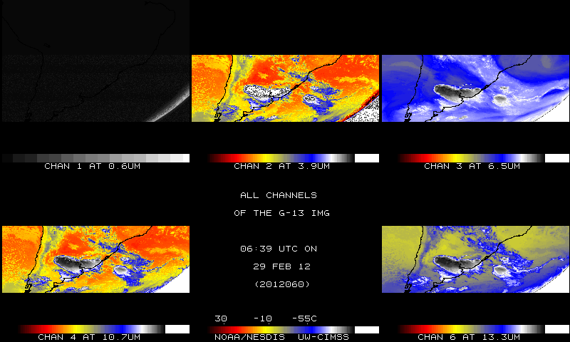
Corrected

Slide 46
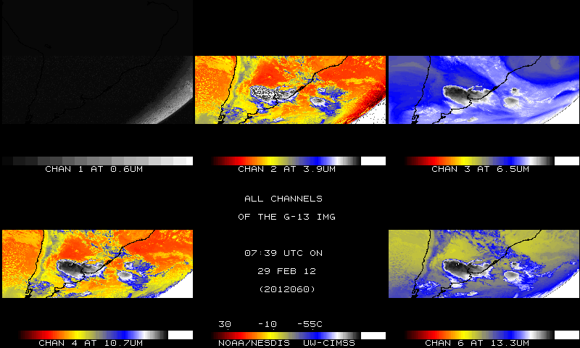
Uncorrected

Slide 47
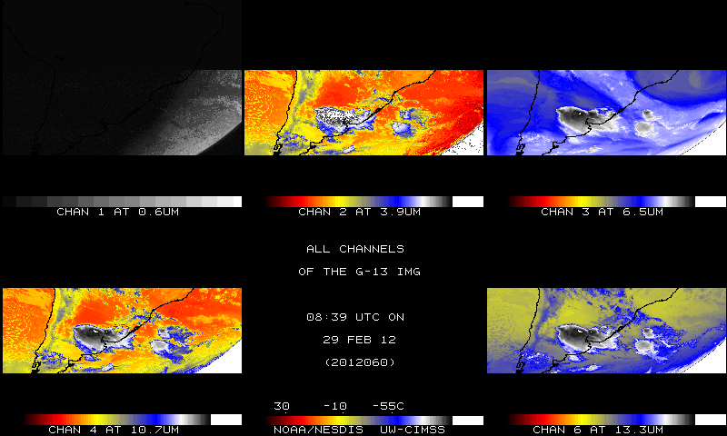
Uncorrected

