Slide 1
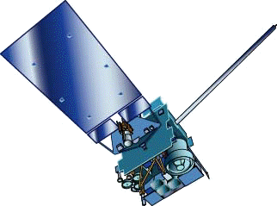
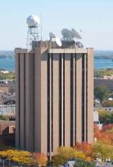
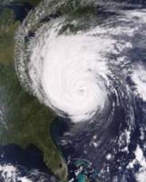
GOES -13
Timothy J. Schmit (tim.j.schmit@noaa.gov) NOAA/NESDIS STAR
Scott Lindstrom, Scott Bachmeier, Tony Schreiner
CIMSS
Madison, WI
Many Others!
Calibration Working Group
25 Sep 2012
UW-Madison

Slide 2
Thanks to
Tony Mostek, Bernie Connell, Mat Gunshor, Chris Schmidt, Jim Nelson, SSEC data center, etc.
NOAA NESDIS

Slide 3
Outline
Imager
Sounder

Slide 4
GOES-13
GOES-13(east): On Sunday 9/23/2012 at approximately 1126z the Sounder autonomously shut down the scan motor in response to an overload condition.
NOAA Engineers responded, placed the sounder in standby mode and convened a tiger team which included the instrument vendor and s/c vendor.
At approximately 2117z the Imager experienced a scan motor overload. Engineers placed the Imager in standby mode shortly afterwards.
The Sounder and Imager instrument current overload conditions appear to be related to a noise with a 100 Hz signature. Numerous telemetry points from each subsystem along with raw data are being analyzed by the tiger team in order to determine the root cause. There is no return to service estimate for GOES-13 at this time.
GOES-14 currently emulating GOES-East schedule and GVAR bounced off GOES-13.
http://www.ssd.noaa.gov/PS/SATS/SPBULL/MSG2681744.01.txt

Slide 5
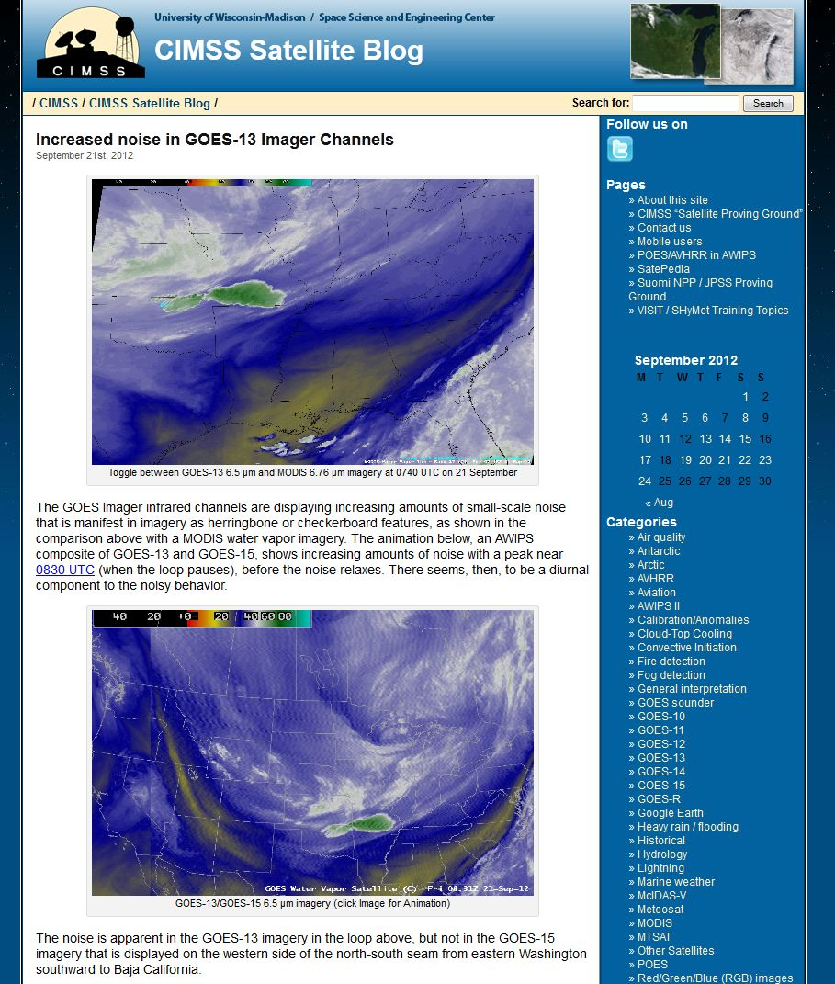
http://cimss.ssec.wisc.edu/goes/blog/archives/11392

Slide 6
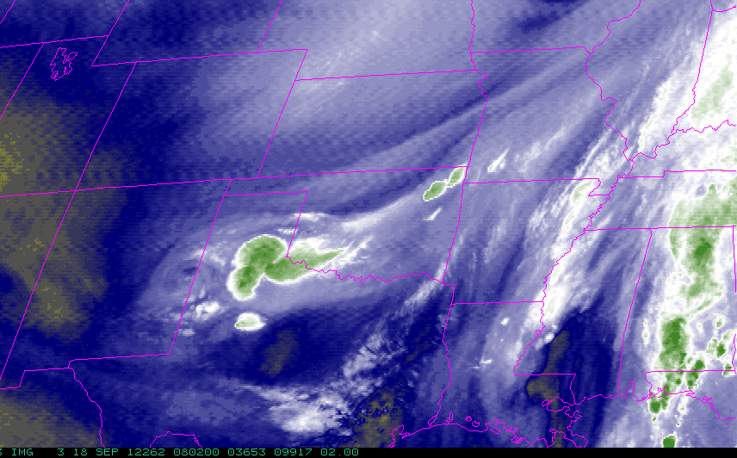
GOES-13 Imager
“Strange” artifacts in imager for the ‘water vapor’ band on September 18. (NWS email)

Slide 7
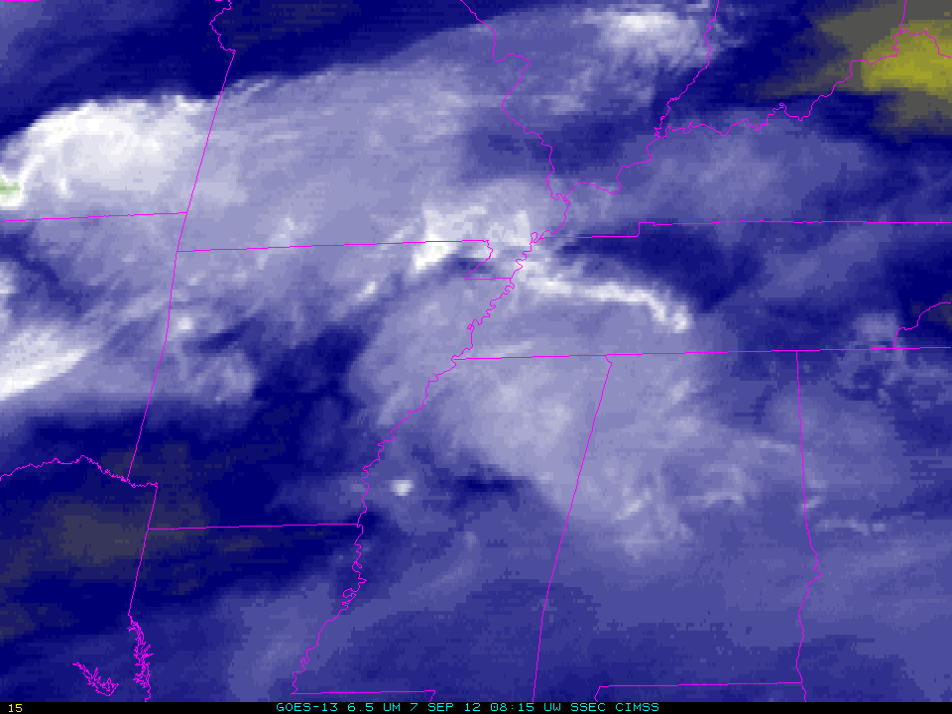
GOES-13 Imager
In retrospect, imager oscillations may have been there since the 16th.

Slide 8
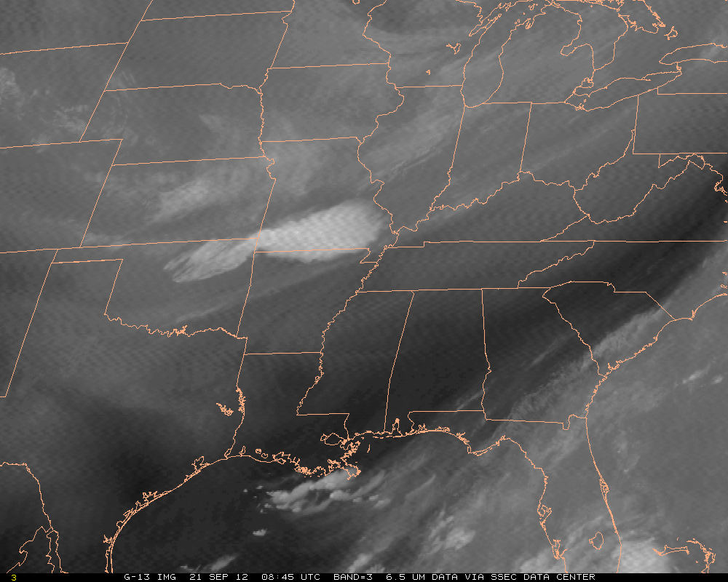
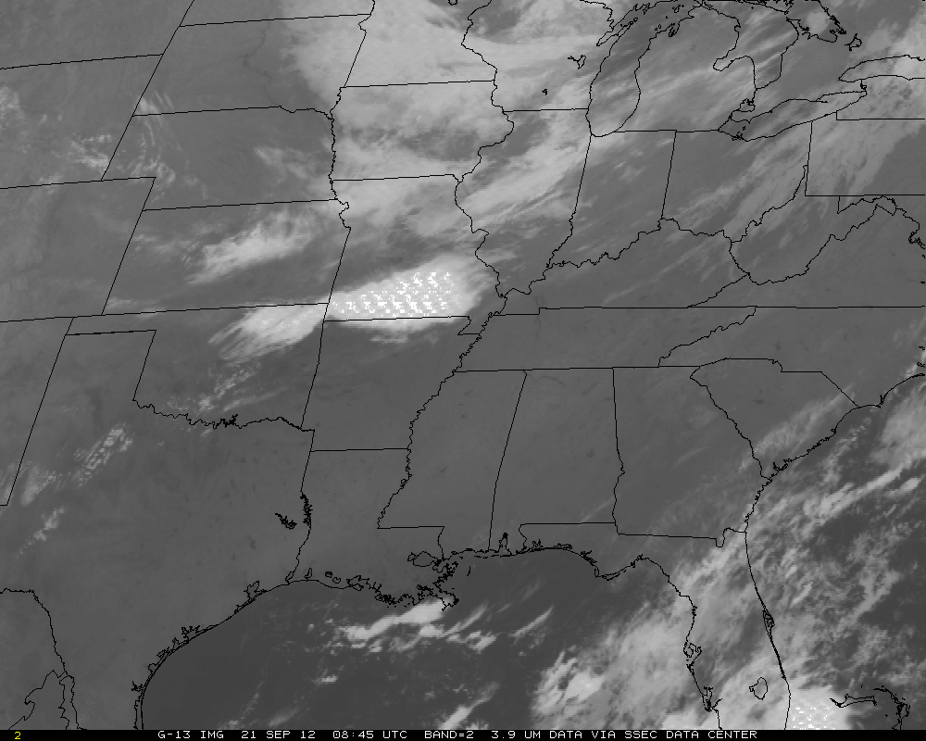
GOES-13
... And other bands (eg, 4um)

Slide 11
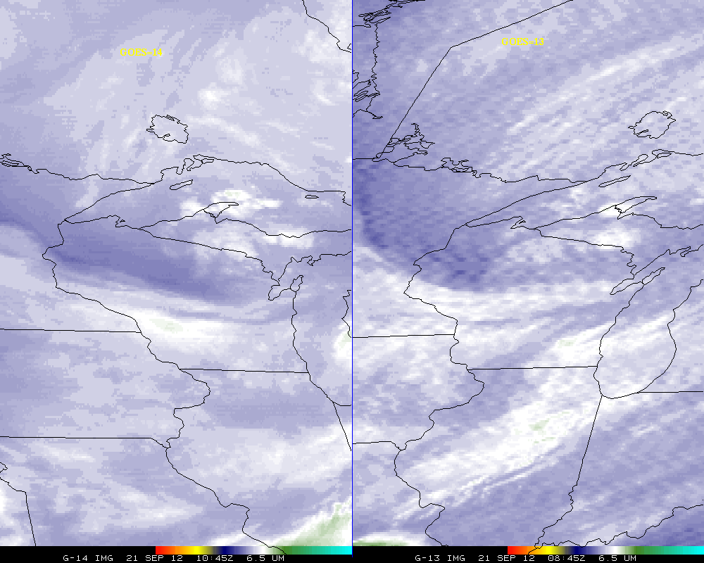
GOES-13
“Strange” artifacts not seen in GOES-14.

Slide 12
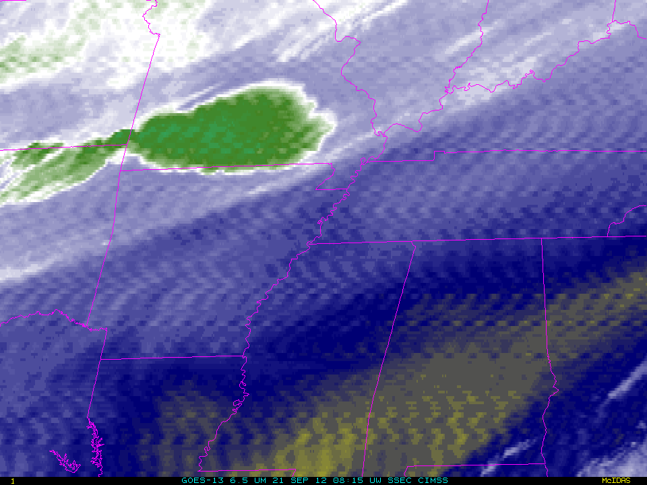
GOES-13

Slide 13
Links
http://cimss.ssec.wisc.edu/goes/blog/archives/11392
http://www.spaceref.com/news/viewsr.html?pid=42154
http://cimss.ssec.wisc.edu/goes/blog/archives/11421
http://www.ssd.noaa.gov/PS/SATS/SPBULL/MSG2681744.01.txt

Slide 14
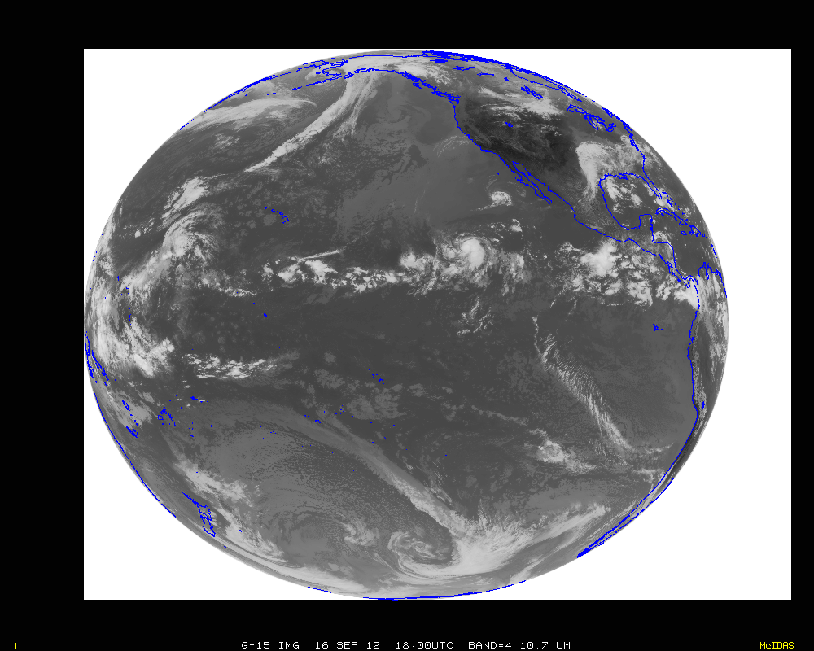

Slide 15
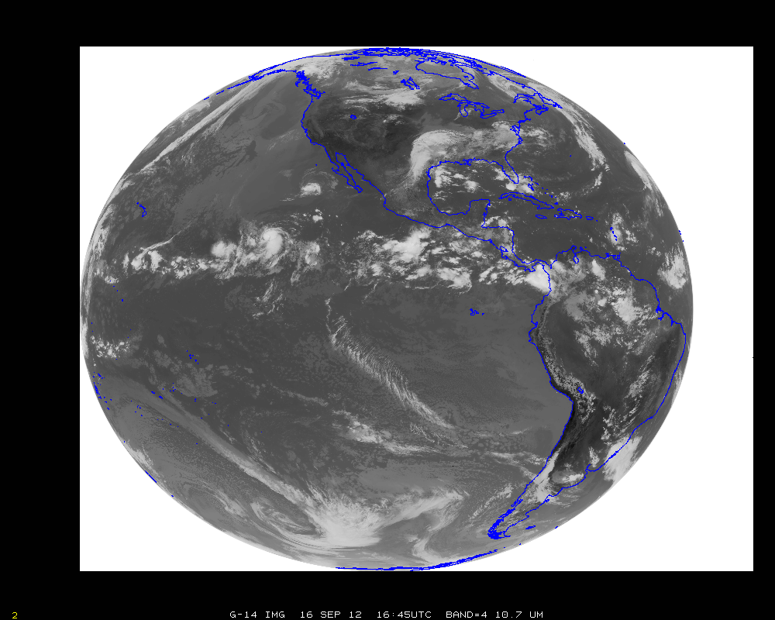

Slide 16
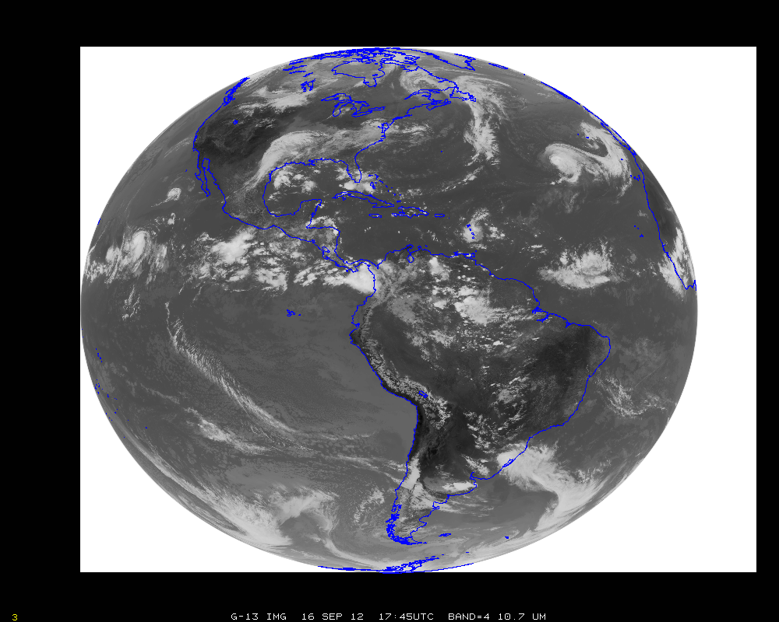

Slide 17
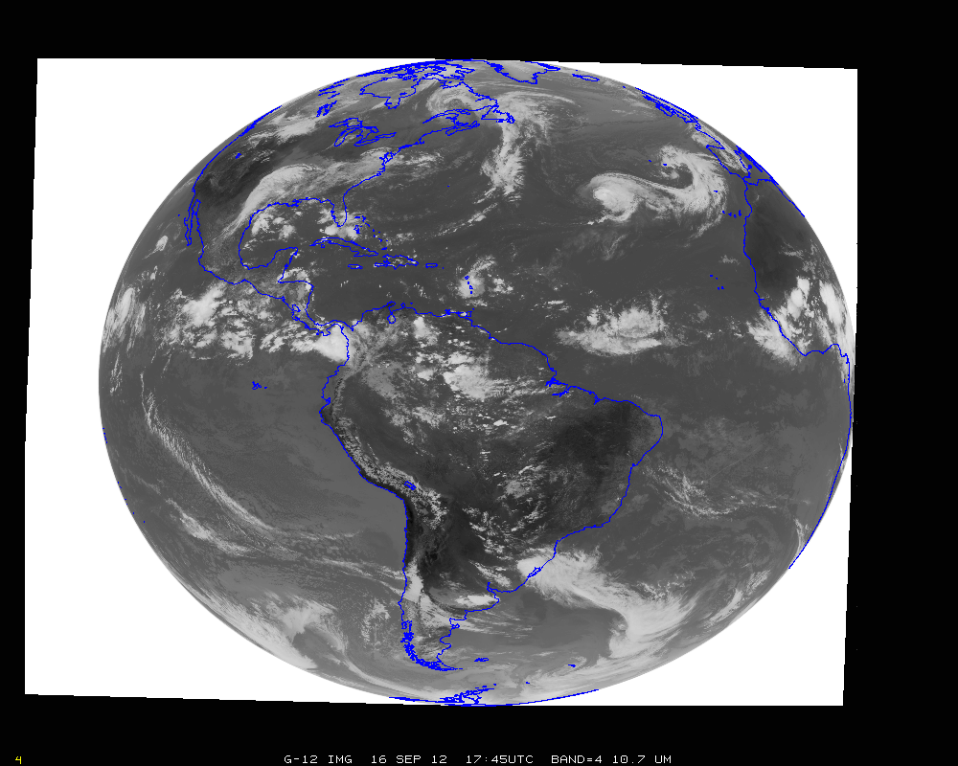

Slide 18
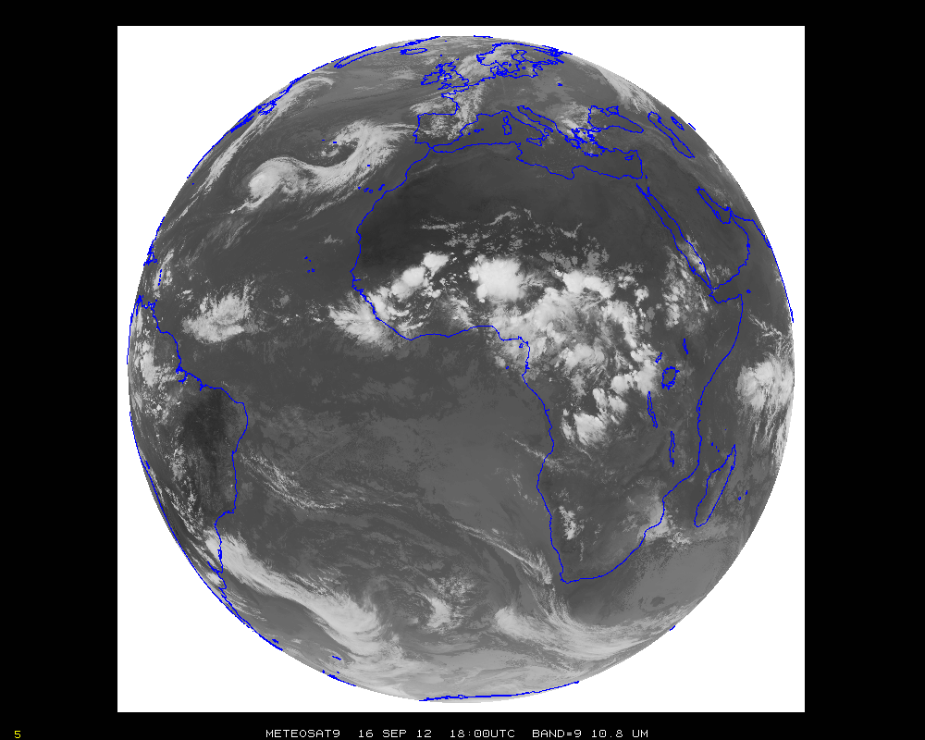

Slide 19
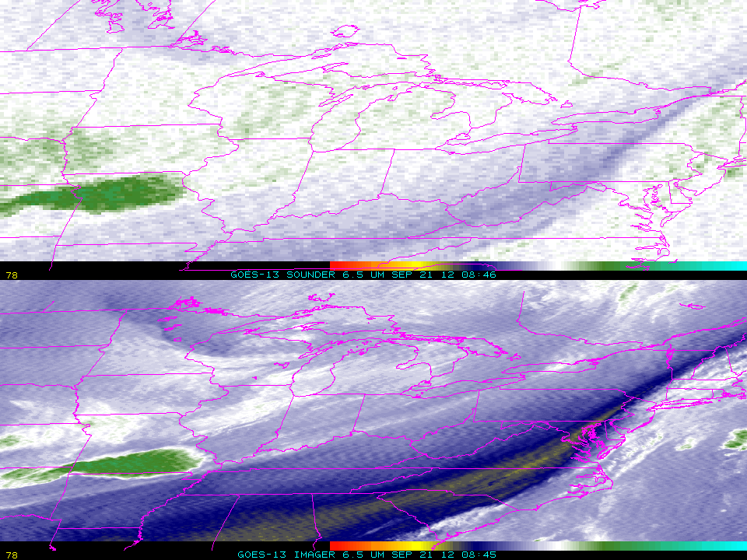
GOES-13
Extra noise in sounder water vapor band.

Slide 20
GOES-13 Sounder Products
Radiances for models
Possibly NCEP has turned off sw channels
Email on September 5th.
Noisy images
Retrievals/Derived Product Images
Noisy LI, TPW, etc + “false” nighttime clouds
DPI operationally to AWIPS
Can be mitigated by turning off sw channels
Being done in research mode at CIMSS
Clouds, used for hourly ‘round-up’
“False” nighttime clouds

Slide 21
Sounder sw noise (Obs minus Calc)
http://cimss.ssec.wisc.edu/goes/sounder_tbb_stats/tbbc.html
(under construction)

Slide 22
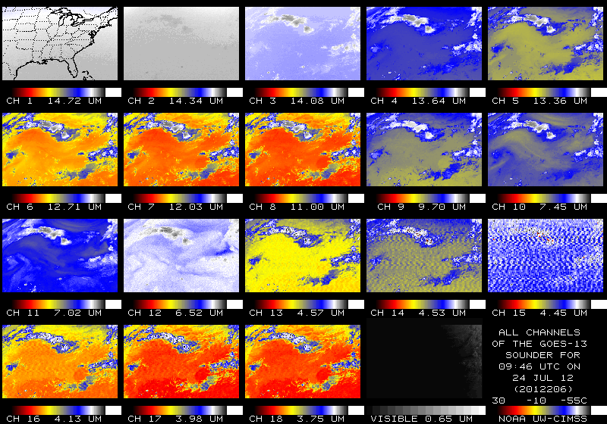
GOES-13 Sounder
Note the strange patterns being seen in the imagery for GOES-13 Sounder channels 13 -> 16!
Notes:
Note the strange patterns being seen in the imagery for GOES-13 Sounder channels 13 -> 16!

Slide 23
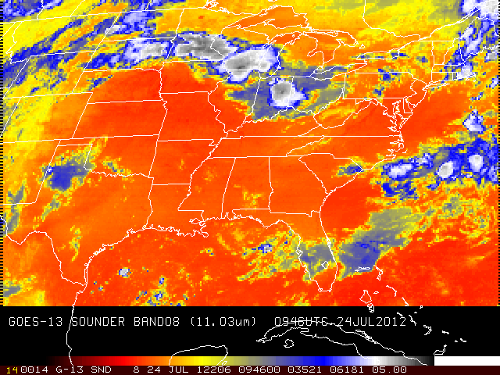
GOES-13 Sounder (11 um)
GOES-13 Sounder
Notes:
A more detailed view of GOES-13 Sounder band 8 (11.03um).

Slide 24
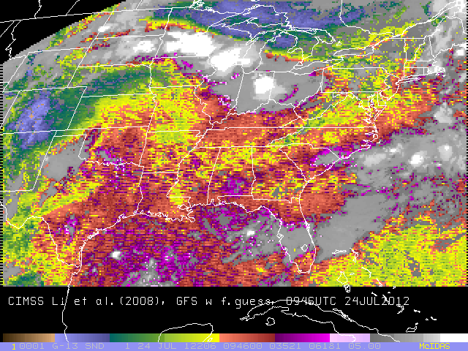
GOES-13 Sounder (Total Precipitable Water - TPW)
Note the striping in the DPI!
Notes:
CIMSS operationally-produced GOES-13 (East) Sounder Total Precipitable Water (TPW), generated by running the Li et al.(2008) retrieval program.

Slide 25
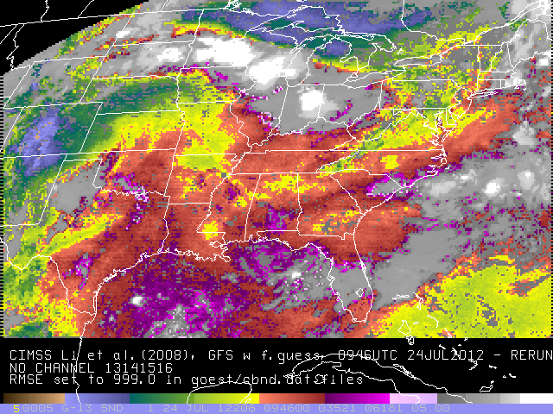
GOES-13 Sounder (TPW)
Without shortwave bands
Striping mitigated in the retrievals by turning off shortwave bands
Notes:
CIMSS GOES-13 (East) Sounder Total Precipitable Water (TPW) generated by rerunning the Li et al.(2008) retrieval program, but excluding Sounder channels
13(4.57um), 14(4.52um), 15(4.45um) and 16(4.13um) from the processing by setting the noise (RMSE) values in both goestbnd.dat(42 levels) and goescbnd.dat(101 levels) to 999.0.

Slide 26
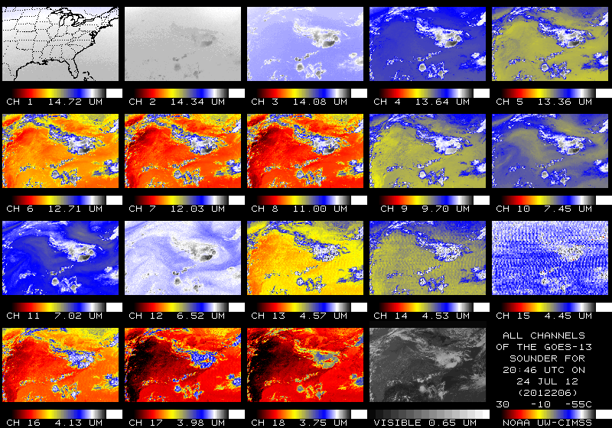
GOES-13 Sounder
Note the strange patterns being seen in the imagery for GOES-13 Sounder channels 13 -> 16!

Slide 27
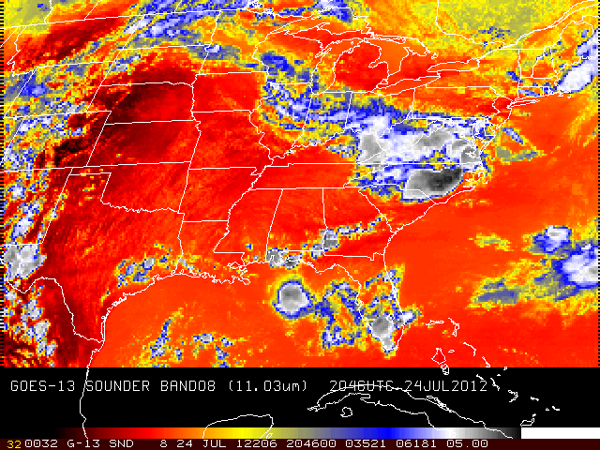
GOES-13 Sounder (11 um)

Slide 28
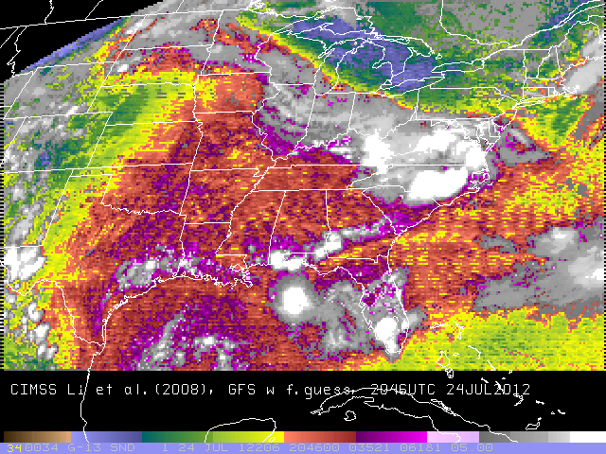
GOES-13 Sounder (TPW)
Note the striping in the DPI!

Slide 29
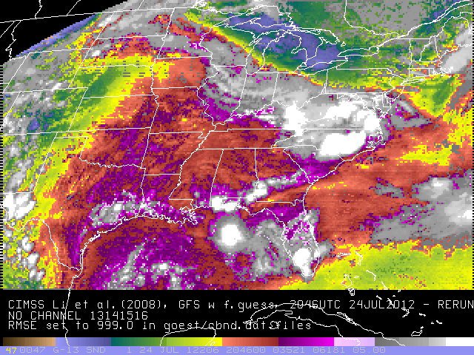
GOES-13 Sounder (TPW)
Without shortwave bands
Striping mitigated in the retrievals by turning off shortwave bands

Slide 30
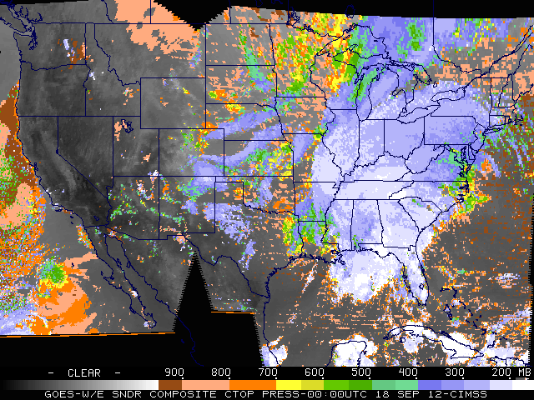
GOES-13
False clouds

Slide 31
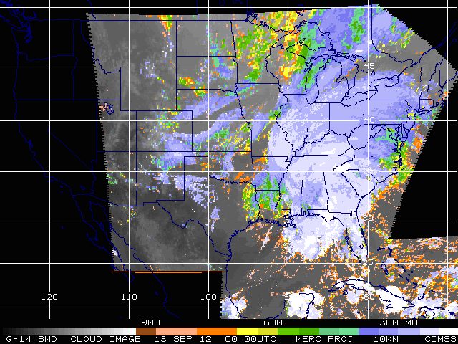
GOES-14
(for comparison)

Slide 32
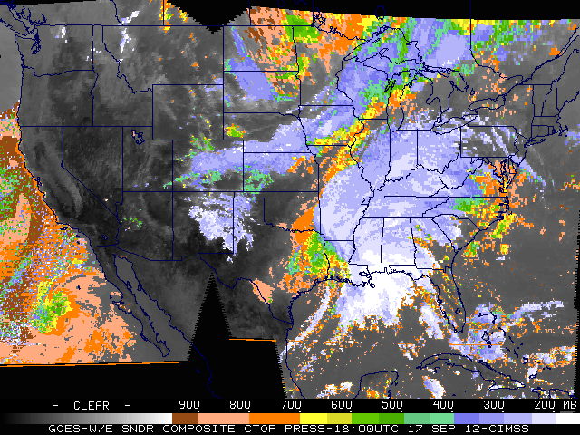
GOES-13
Noisy shortwave bands have less impact during day.

Slide 33
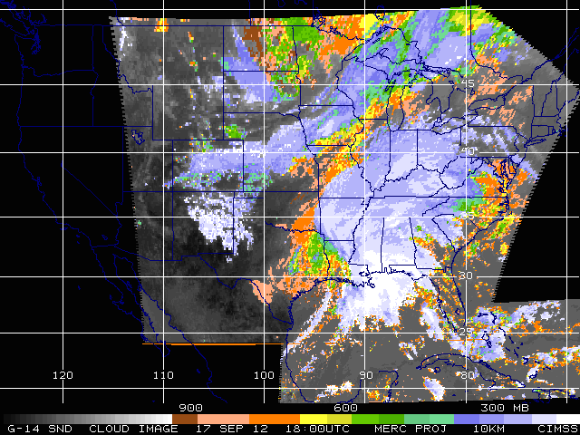
GOES-14
(for comparison)

Slide 34
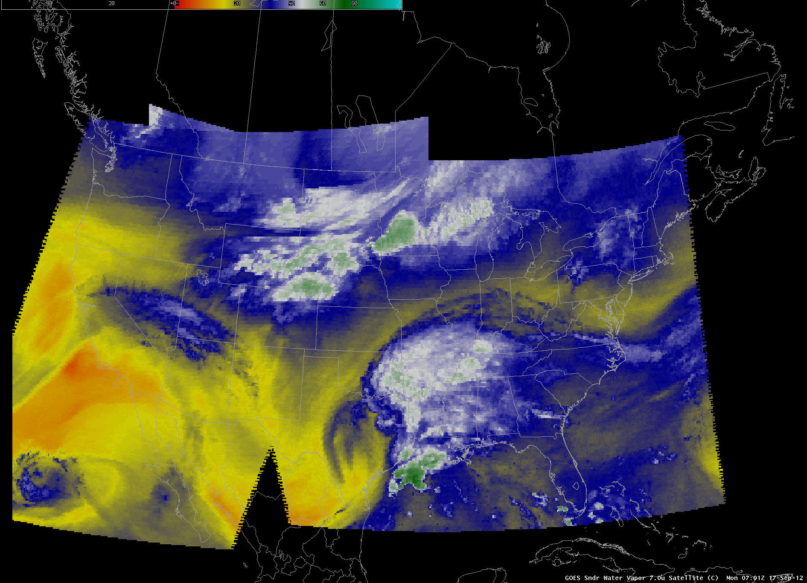
AWIPS: GOES-15/13 Sounders (7 um)

Slide 35
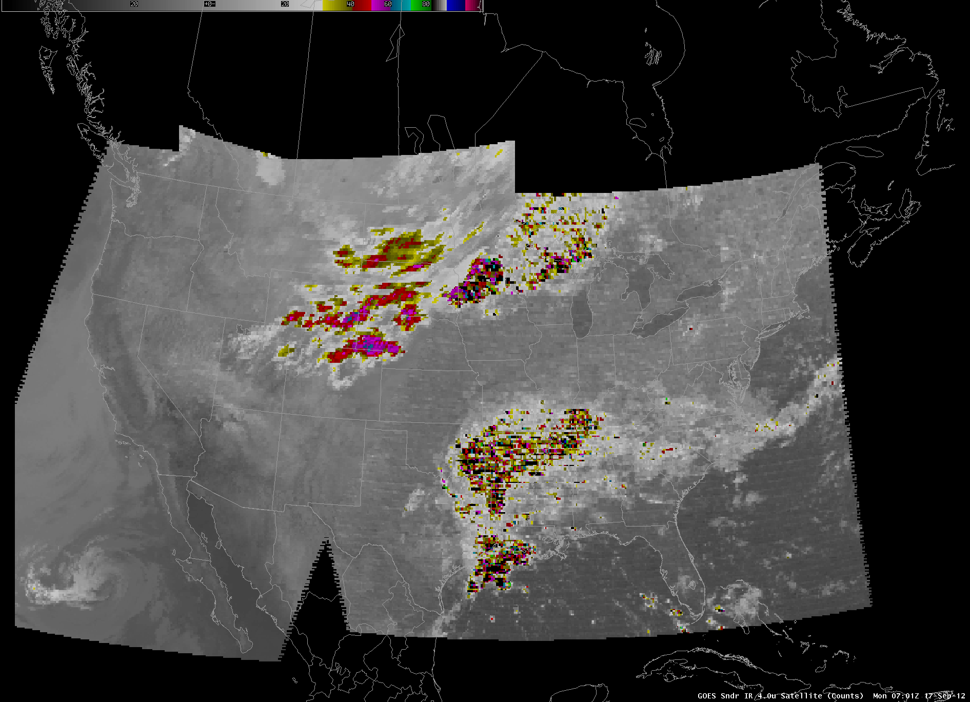
AWIPS: GOES-15/13 Sounders (4 um)

Slide 36
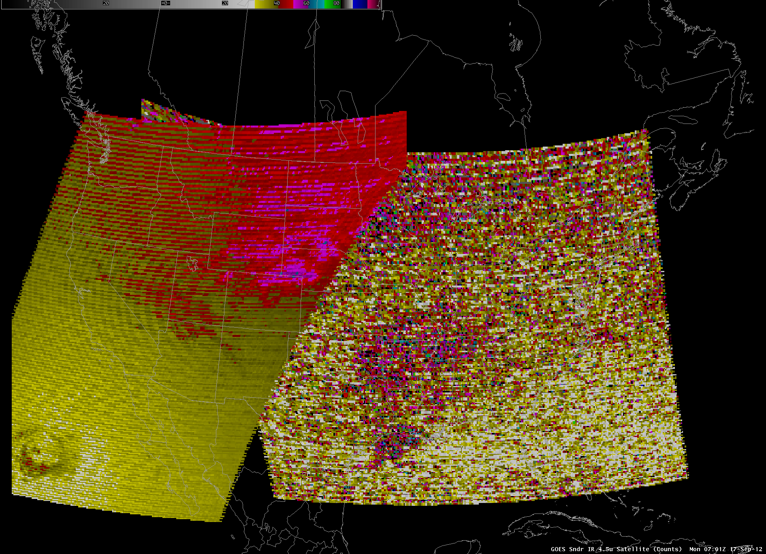
AWIPS: GOES-15/13 Sounders (4.5 um)
Noisy data!

Slide 37
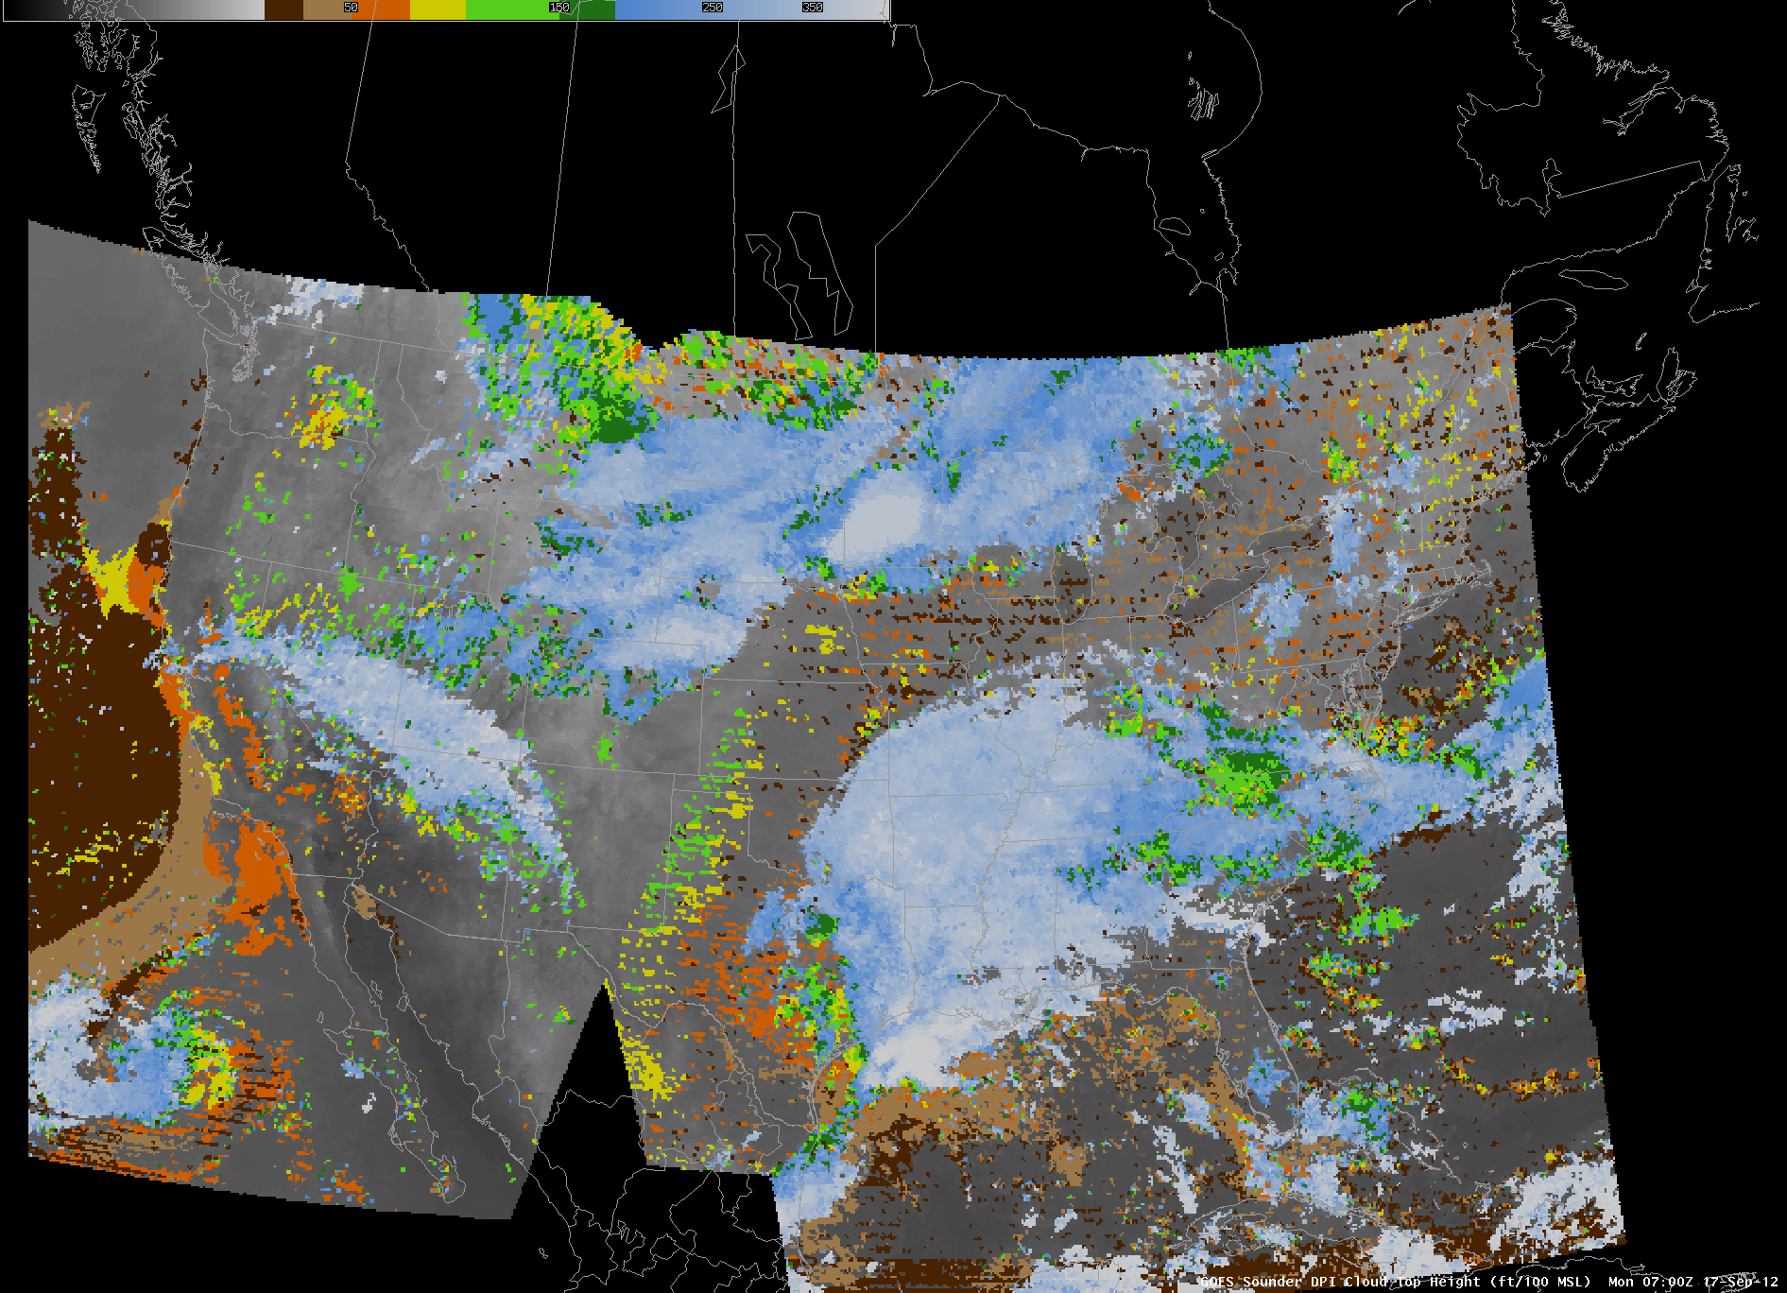
AWIPS: GOES-15/13 Sounders (Cloud top height)
‘false’ clouds

Slide 38
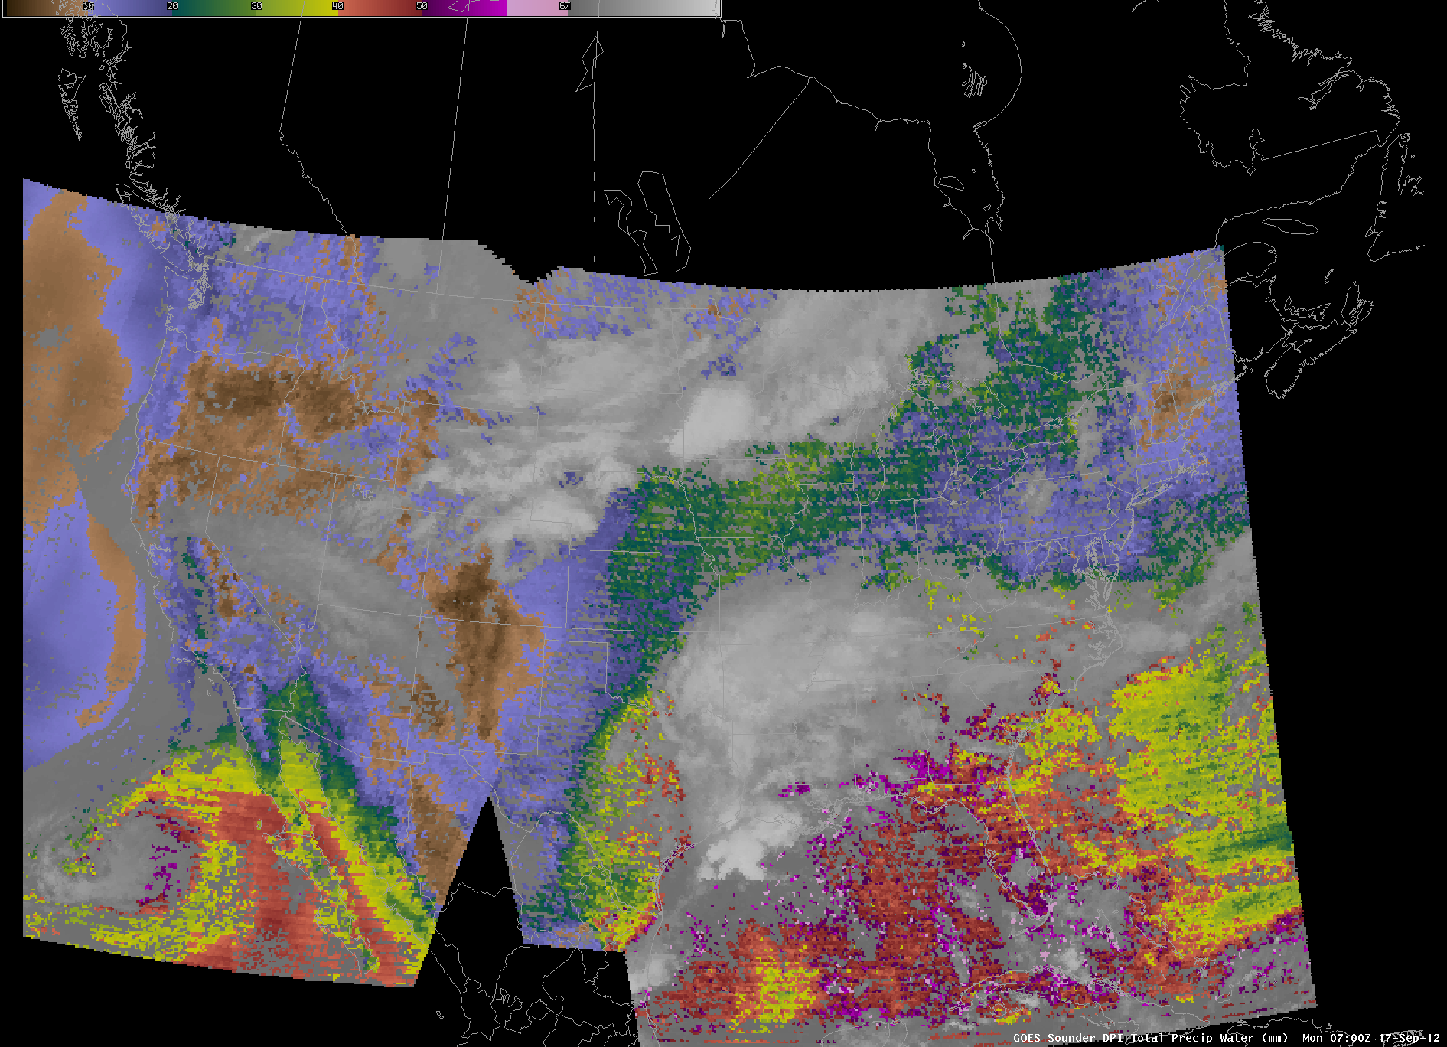
AWIPS: GOES-15/13 Sounders (TPW)
Striping and ‘false’ clouds

