Slide 1
GOES Sounder Products (Soundings and Clouds) use PFAAST
GOES-8/9/10/11/12/13/14/15
From CIMSS web page
http://cimss.ssec.wisc.edu/goes/rt/sounder-dpi.php

Slide 2
Description: GOES-I/P (8/15) Sounders
19 channels (18 Infrared; 1 Visible)
Spatial resolution: ~10km
Hourly scanning over CONUS and adjacent waters
Products include standard imagery and derived, Level-2 products

Slide 3
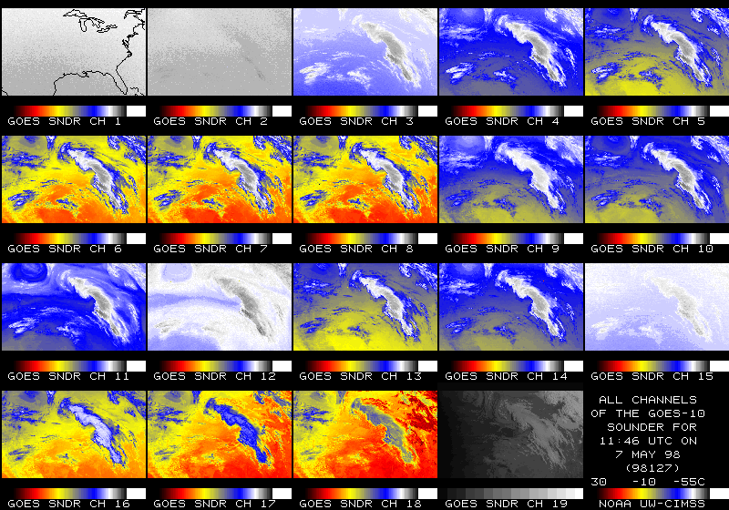
GOES Sounder

Slide 4
Current Sounder Operational Uses
GOES Sounder Product | Operational Use within the NWS
Clear-sky Radiances | Assimilation into NCEP operational regional & global NWP models over water
Layer & Total Precipitable Water | Assimilation into NCEP operational regional & global NWP models; display and animation within NWS AWIPS for use by forecasters at NWS WFOs & National Centers in forecasting precipitation and severe weather
Cloud-top retrievals (pressure, temperature, cloud amount) | Assimilation into NCEP operational regional NWP models; display and animation within NWS AWIPS for use by forecasters at NWS WFOs; supplement to NWS/ASOS cloud measurements for generation of total cloud cover product at NWS/ASOS sites
Surface skin temperature | Image display and animation within NWS AWIPS for use by forecasters at NWS WFOs
Profiles of temperature & moisture | Display (SKEW-Ts) within NWS AWIPS for use by forecasters at NWS WFOs in forecasting precipitation and severe weather
Atmospheric stability indices | Image display and animation within NWS AWIPS for use by forecasters at NWS WFOs in forecasting precipitation and severe weather
Water Vapor Winds | Image display and animation within NWS AWIPS for use by forecasters at NWS WFOs
Notes:
Note the many operational uses of today’s sounder, even with its limited spatial and spectral attributes.

Slide 5
Use by NWS
Forecasters value the current sounder. NWS Forecaster responses (in 1999) to utility of sounder products in severe weather forecasting:
There were 248 valid weather cases:
Significant Positive Impact (30%)
Slight Positive Impact (49%)
No Discernible Impact (19%)
Slight Negative Impact (2%)
Significant Negative Impact (0)
Notes:
NWS Forecaster responses (Summer of 1999) to: "Rate the usefulness of LI, CAPE & CINH (changes in time/axes/gradients in the hourly product) for location/timing of thunderstorms."
NWS Forecaster responses (Summer of 1999) to: "Rate the usefulness of LI, CAPE & CINH (changes in time/axes/gradients in the hourly product) for location/timing of thunderstorms."
There were 248 valid weather cases.
- Significant Positive Impact (30%)
- Slight Positive Impact (49%)
- No Discernible Impact (19%)
- Slight Negative Impact (2%)
Significant Negative Impact (0)
This 1999 NWS survey was written up as part of a Schmit et al paper.
Note that almost 80% of the responses were positive in terms of forecasters support for satellite derived images from the existing GOES sounder.
Current NWS training programs (e.g. SHyMet) will hopefully increase the use and appreciation of new satellite data.
Main Objective of SHyMet (Satellite Hydrology and Meteorology) training program
To prepare National Oceanic and Atmospheric Administration (NOAA) and National Weather Service (NWS) users for the latest polar orbiting and geostationary satellite data and products in the warning and forecast programs with direct links to Government Performance Results Act (GPRA) goals.
Completes end-to-end program cycle for space-based remote sensing as part of NOAA's Strategic Plan for an Integrated Global Environmental Observation and Data Management System and Global Earth Observation System of Systems (GEOSS).

Slide 6
GOES Sounder Data & Products Operational Availability and Use by NWS Forecasters within AWIPS
Derived Product Imagery (DPI)
Many of the retrieved quantities are placed in the form of Derived Product Imagery (DPI) which, when animated, are an effective means of observing the spatial and temporal changes in these quantities
GOES sounder DPI products, heighten forecasters’ situational awareness to potential watch/warning scenarios and often time leading to the issuance of improved forecast products. (See NWS 1999 GOES Sounder Assessment Report)
Used to validate or invalidate forecast guidance provided by Numerical Weather Prediction (NWP) forecast model output
Progression of GOES Sounder Retrieval Products from 50km resolution to 10km resolution.

Slide 7
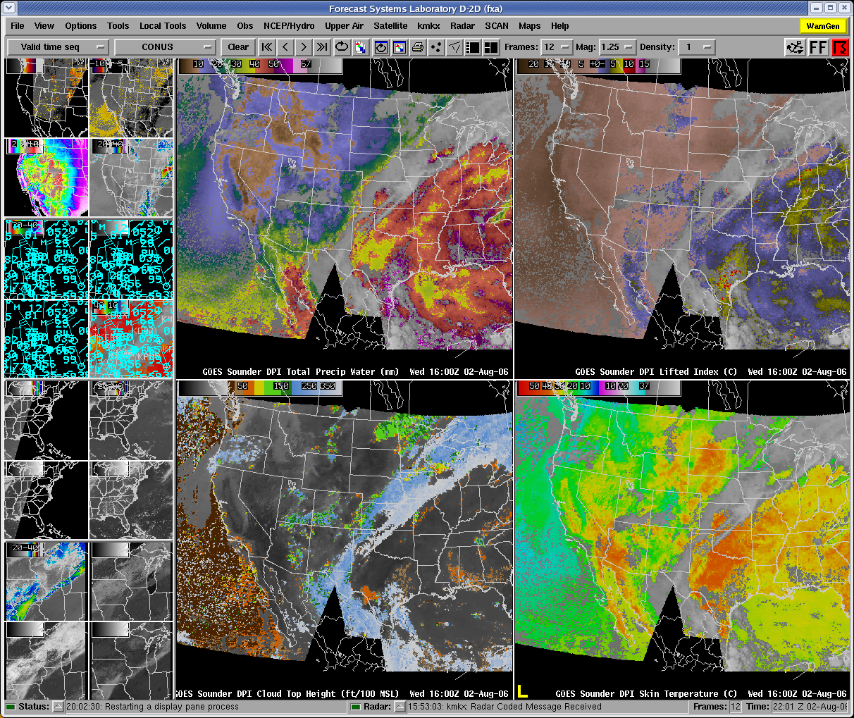
AWIPS Display
Total Precipitable Water
Lifted Index
Cloud-Top Height
Surface Skin Temperature

Slide 8
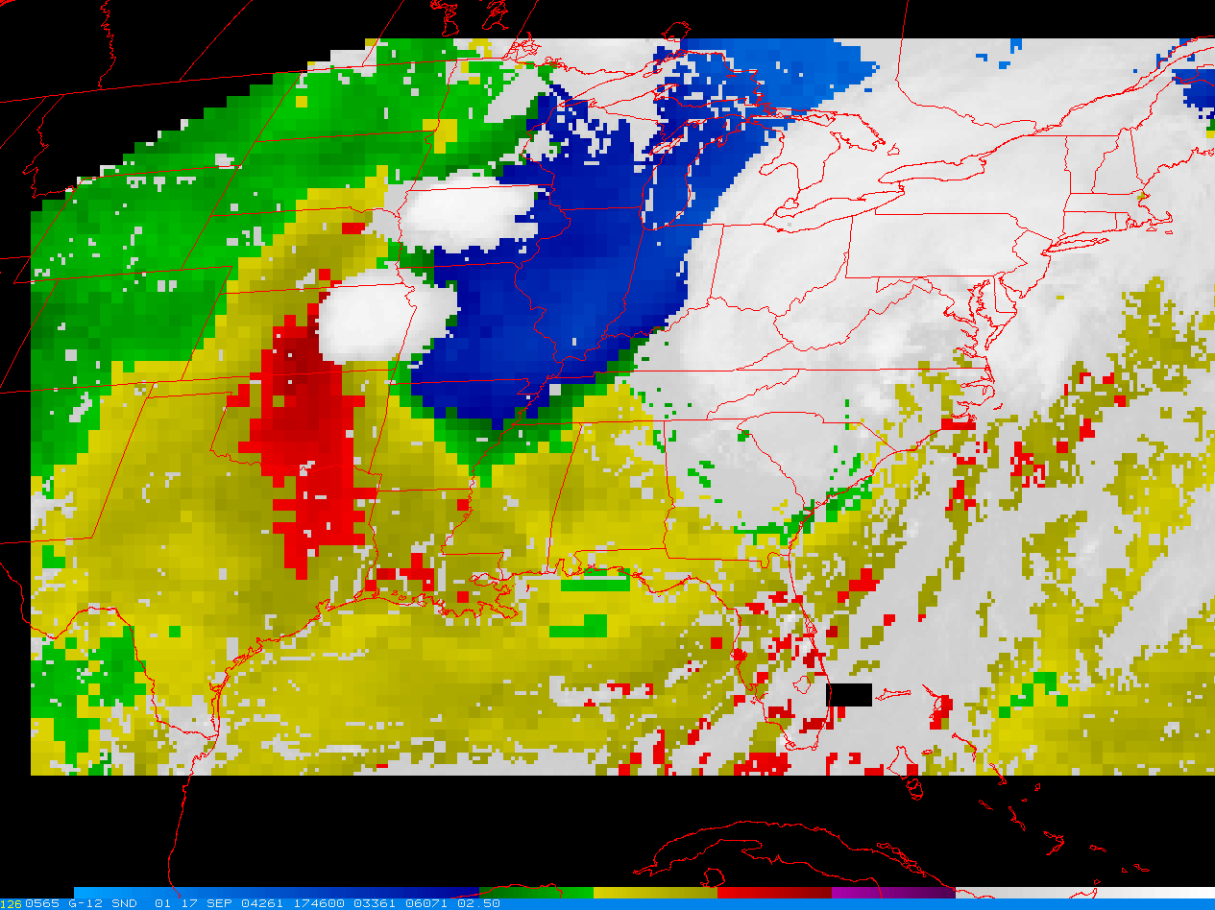
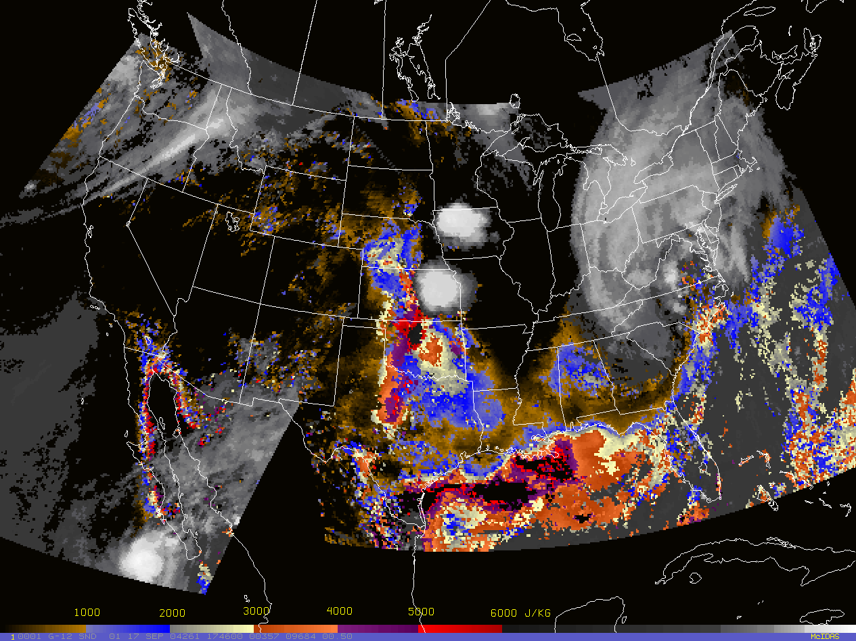
GOES Sounder Stability Indices
Note in both images that the instability axis lies upstream of incipient convection. Recent studies indicate that this is a favorable thermodynamic pattern for a slow moving MCS.
GOES Lowest 100mb MUCAPE (Most Unstable CAPE)
GOES Best Lifted Indices
Courtesy of J. Daniels

Slide 9
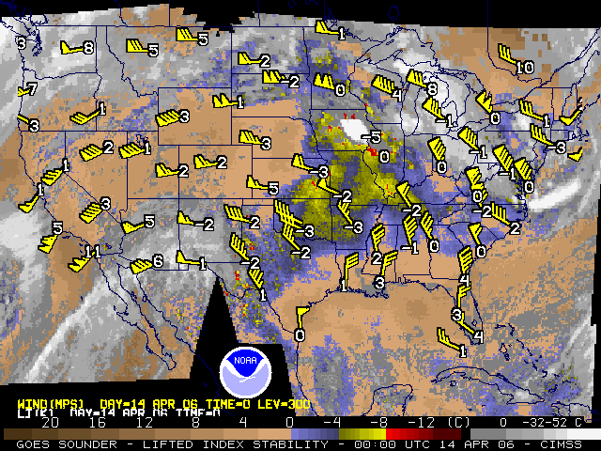

Slide 10
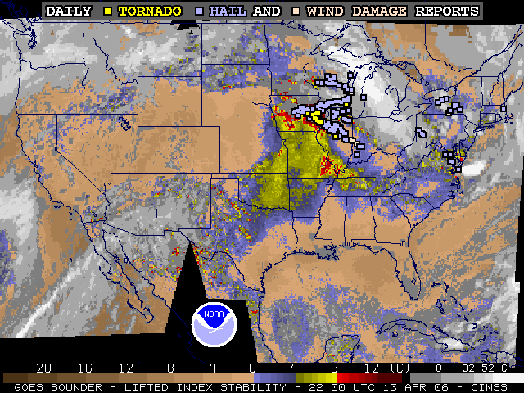

Slide 11
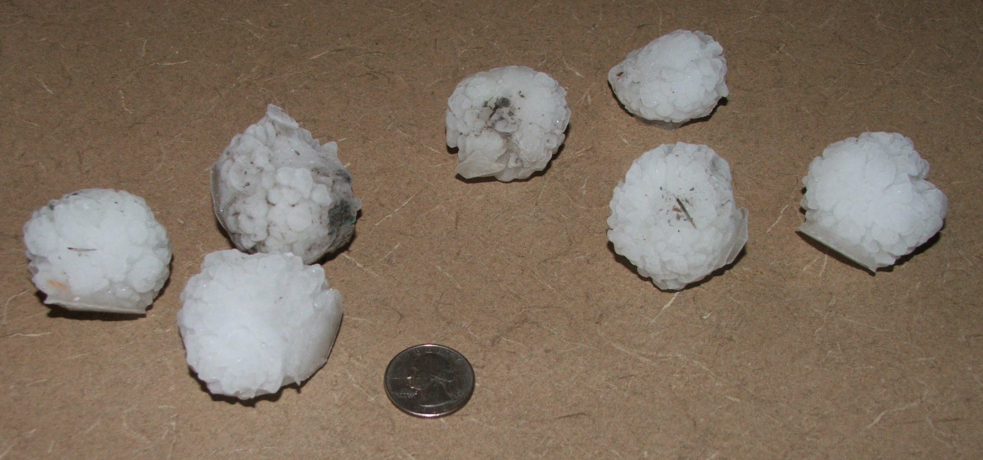
Resulting hail from 13 April 2006 in Madison, WI

Slide 12
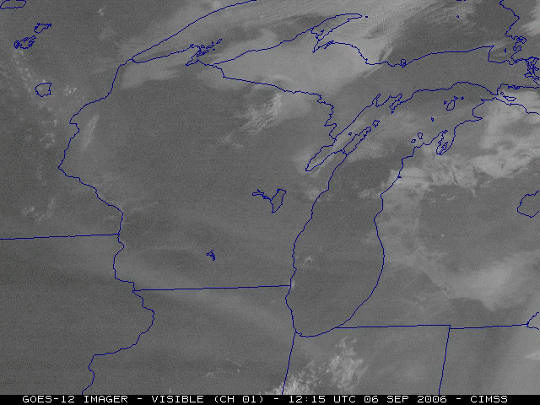
Visible loop from GOES

Slide 13
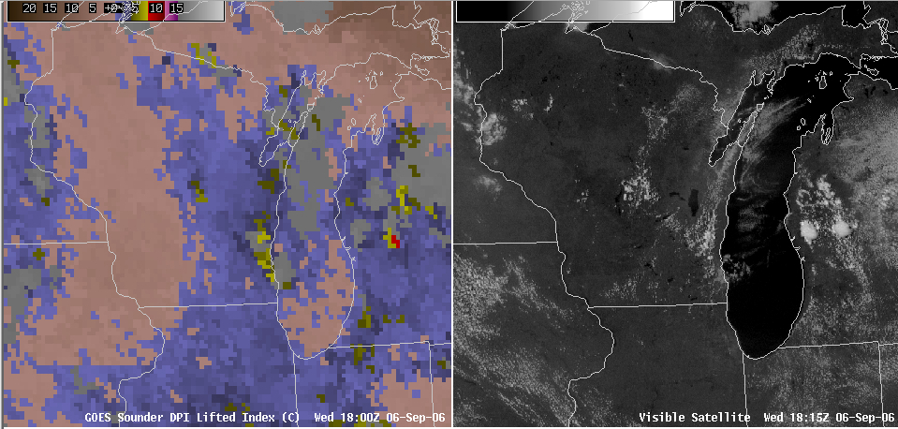
Atmospheric Instability

Slide 14
Cloud Top Products
Cloud Height Algorithms
CO₂ slicing for mid to upper-level non-opaque clouds (Chahine, 1974; Smith and Platt, 1978; Menzel et al, 1983)
IR window for low, opaque clouds
Pixel level retrievals
Distributed to AWIPS, NCEP
Operational Applications
Nowcasting
Aviation Terminal Aerodrome Forecasts (TAFs)
Supplements Automated Surface Observing System (ASOS) with upper-level cloud information
Effective Cloud Amount (ECA) selected as proxy for NWS RTMA hourly sky cover
NWP
Cloud initialization
Assimilated into NCEP North American Mesoscale (NAM) model/NDAS & RUC

Slide 15
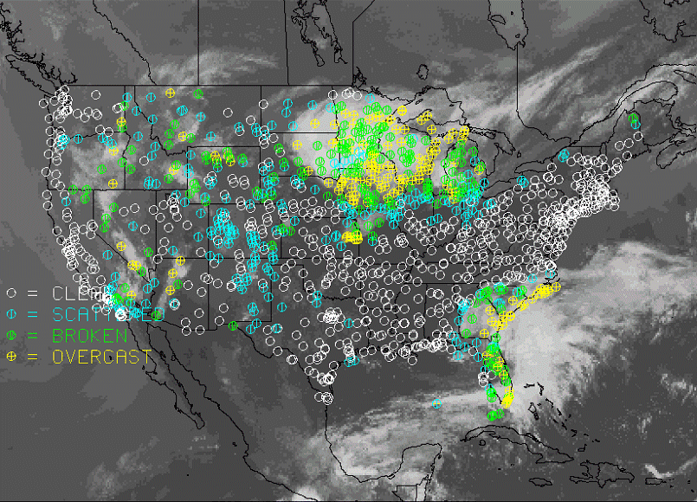
GOES Sounder Supplements Automated Surface Observing
System with Upper (> 12km) Cloud Information

Slide 16
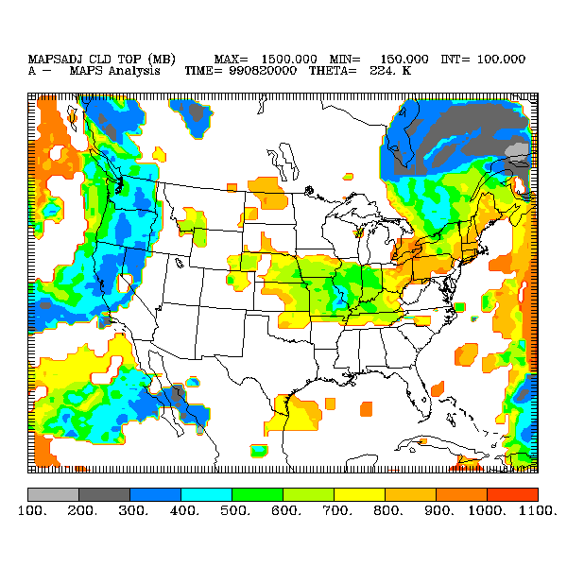
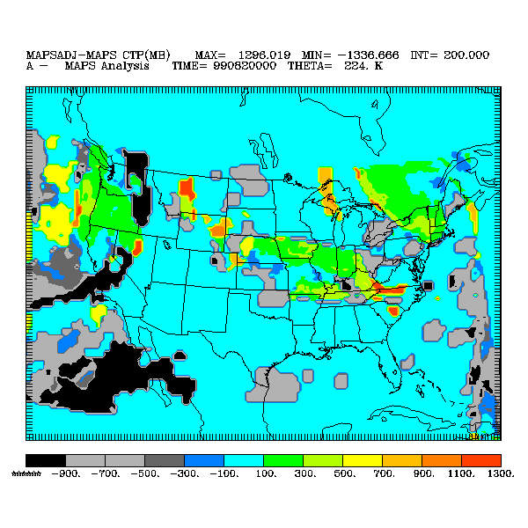
GOES Sounder-Derived Cloud Product in the RUC
00 UTC 23 March 1999
GOES Sounder-Derived
plus
Model-Derived
Cloud Top Pressure
Impact of the
GOES Sounder-Derived
Cloud Product
(Gray to Black indicate
cloud added; Yellow to Red indicate cloud removed by GOES data)

Slide 17
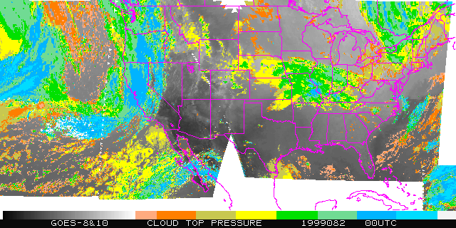
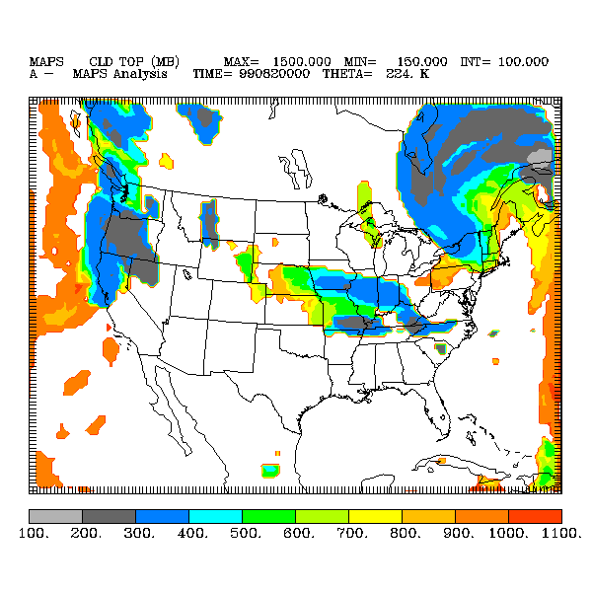
GOES Sounder-Derived Cloud Product in the RUC
00 UTC 23 March 1999
GOES Sounder-
Derived
Cloud Top Pressure
900 mb
600
300
Model-Derived
Cloud Top Pressure

Slide 18
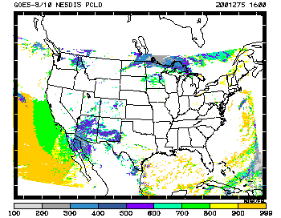
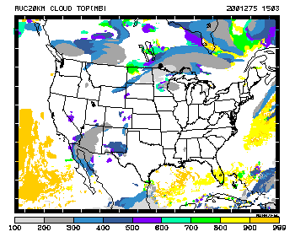
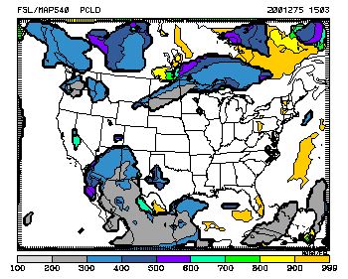
3h 20km RUC cloud-top fcst
w/ GOES cloud assimilation
Verification
Cloud-top pressure
based on NESDIS product
Effect of GOES (sounder cloud)
data on 3-h RUC cloud forecasts
“much improved cloud forecasts”
1800 UTC
Tues 2 Oct 2001
Stan Benjamin – NOAA/FSL
3h 40km RUC cloud-top fcst
No GOES cloud assimilation
Notes:
These figures show the improve of short-term forecasts (in the Rapid Update Cycle model) when the GOES sounder cloud-top information product is assimilated.
The circles show 2 areas of improved cloud forecasts.
From Stan Benjamin:
Update to previous Notice of Intent to Change
- 20-km RUC
- Scheduled for implementation 16 April 2002
pending CAFTI approval

Slide 19
Gridded GOES Sounder Cloud Products in the NWS Real-time Mesoscale Analysis (RTMA) and Analysis of Record Program
Effective Cloud Amount (ECA) selected as proxy for NWS RTMA hourly sky cover
NWS Real-time Mesoscale Analysis (RTMA) and Analysis of Record (AOR) Program
(http://www.emc.ncep.noaa.gov/research/NCEP-EMCModelReview2005/WR_NCEP_REVIEW_AOR.pdf)
RTMA:
RTMA Products Include:
Temp
Dew point temp
Wind: u-component
Wind v-component
Precipitation
Sky Cover
NCEP Provides
NESDIS Provides
Will aid forecasters in validating the National Digital Forecast Database (NDFD)

Slide 20
Clear-Sky Radiances
Sounder clear-sky radiance observations (all channels) at full resolution; not cloud-cleared
Operational Applications
NWP
Assimilated (ocean only) into NCEP’s
North American Mesoscale (NAM) model/NDAS
RUC
GFS/GDAS
Comparison of GOES-12 clear SFOV 11um BTs against GFS model background 11um BTs for one 12Z assimilation cycle shows a well-behaved gaussian distribution

Slide 21
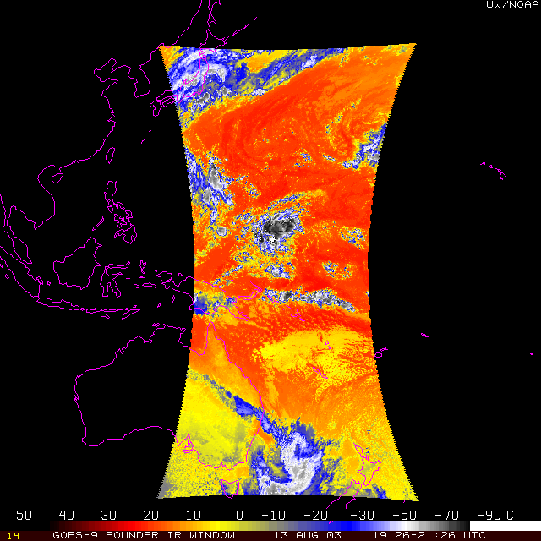
Experimental GOES-9 Sounder data and products
GOES-9 Sounder, IR Window
Notes:
ECA is the effective cloud amount. Images from T. Schreiner.

Slide 22
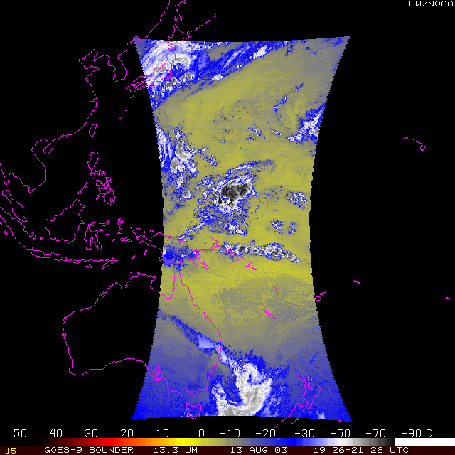
GOES-9 Sounder, Band 5 (13.3 um)
Notes:
ECA is the effective cloud amount

Slide 23
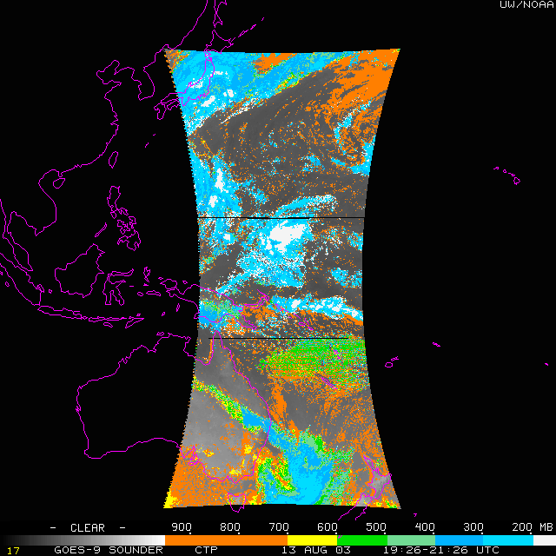
GOES-9 Sounder, CTP
Notes:
ECA is the effective cloud amount. Images from T. Schreiner.

Slide 24
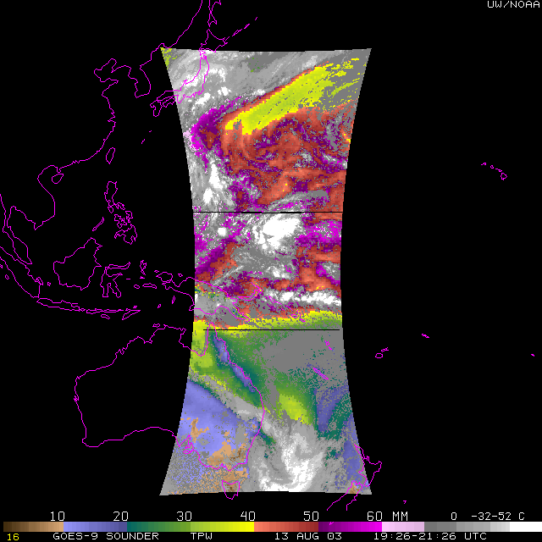
GOES-9 Sounder, TPW
Notes:
ECA is the effective cloud amount

Slide 25
GOES-13

Slide 26
GOES-13

Slide 27
GOES-13

Slide 28
GOES-13

Slide 29
GOES-13

Slide 33
GOES Sounder
When NWS forecasters look at current GOES Sounder operational products such as TPW, Lifted Index, cloud-top temperature, etc., they are using the PFASST forward model

