Slide 1
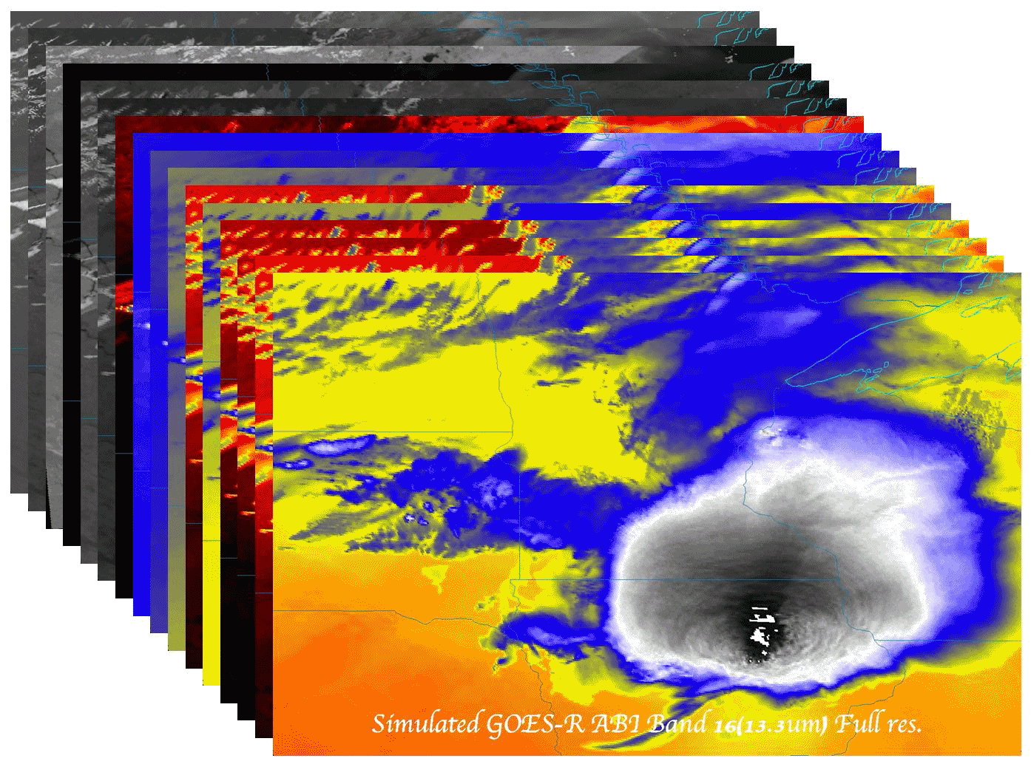
GOES-R ABI (Advanced Baseline Imager) Rapid Refresh Imaging Capabilities
Timothy J. Schmit (tim.j.schmit@noaa.gov)
NOAA/NESDIS/Satellite Applications and Research
Advanced Satellite Products Branch (ASPB)
Madison, WI
Steve Goodman, Dan Lindsey, Bob Rabin, Scott Lindstrom,
Scott Bachmeier, and Chris Velden
NWS Eastern Region Virtual Satellite Workshop
October 30, 2012
UW-Madison

Slide 2
Thanks to…
Justin Sieglaff, John Cintineo and Mat Gunshor
Kevin Ludlum, GOES operators, GOES shift supervisors, etc.
Dave Radell, Frank Alsheimer, Andy Edman, Joleen Feltz, William Straka, Jun Li, Steve Ackerman, Bob Aune, Paul Menzel, Tony Schreiner, Jim Jung, Elaine Prins, Brad Pierce, Wayne Feltz, Jean Phillips, Gary Wade, Don Hillger, Jinlong Li, Jing Zheng, Allen Huang, the SSEC Data Center, Mike Pavolonis, Michael Folmer, Jaime Daniels, ASPB, STAR, NESDIS, NSSL, MUG, Mark DeMaria, and many others!
GOES-R Program Office, NASA, ITT Industries, other industry partners, etc.
You.

Slide 3
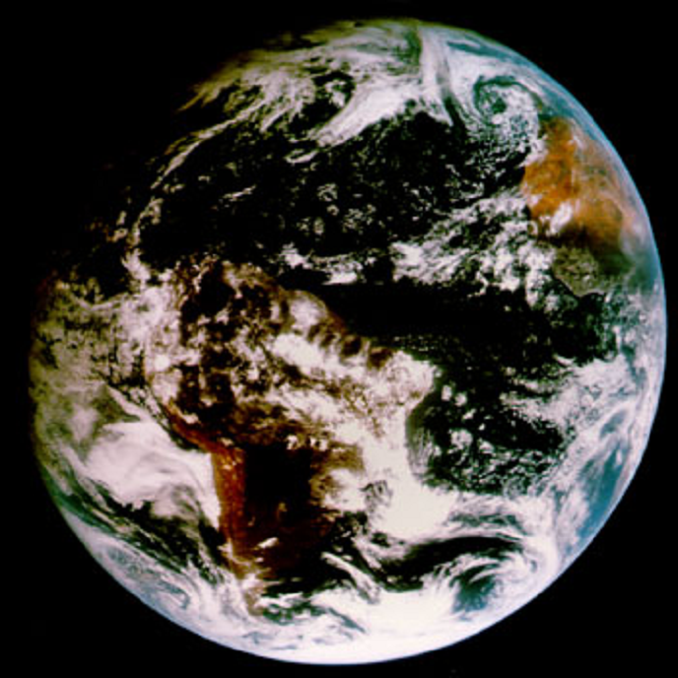
Outline
ABI (Advanced Baseline Imager)
Spectral
Spatial
Temporal
Summary
More information
Questions

Slide 4
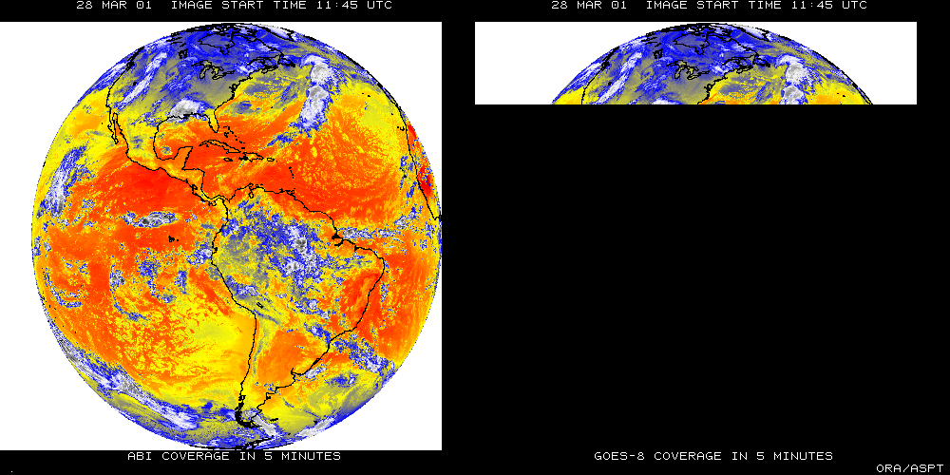
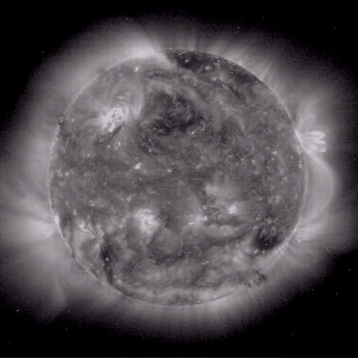
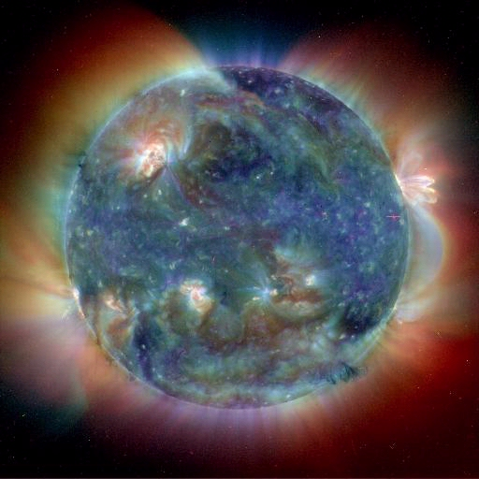
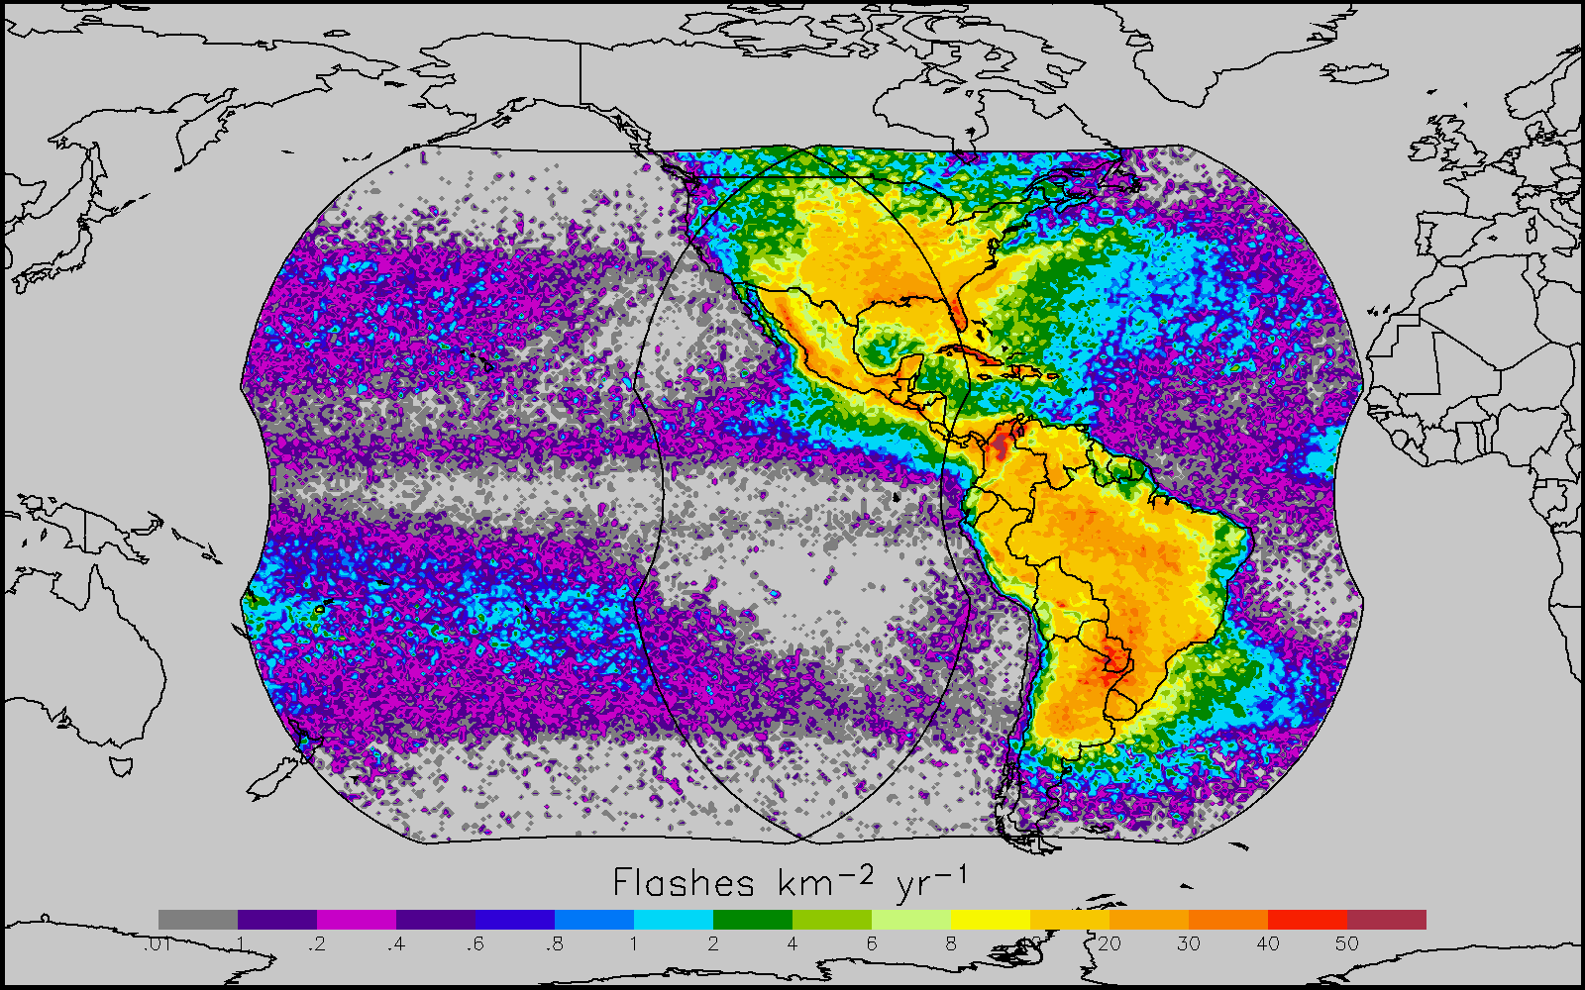
GOES-R main instruments
ABI – Advanced Baseline Imager
Space Weather/Solar
ABI covers the earth approximately five times faster than the current Imager.
Geostationary Lightning Mapper
Images courtesy of SOHO EIT, a joint NASA/ESA program

Slide 5
GOES-R Overview
Advanced Baseline Imager (ABI)
No dedicated Sounder
Geostationary Lightning Mapper (GLM)
Space Weather
Space Environmental In-Situ Suite (SEISS)
Solar Ultra Violet Imager (SUVI)
Extreme Ultra Violet/X-Ray Irradiance Sensor (EXIS)
Magnetometer
Communications
GOES Rebroadcast (GRB)
Low Rate Information Transmissions (LRIT)
Emergency Managers Weather Information Network (EMWIN)
Search and Rescue (SAR)
Data Collection System (DCS)
Notes:
Advanced Baseline Imager (ABI) Earth-viewing
Geostationary Lightning Mapper (GLM) Earth-viewing
Solar Ultra-Violet Imager (SUVI) Sun-viewing
EUVS and XRS Irradiance Sensors (EXIS) Sun-viewing
Space Environment In-Situ Suite (SEISS) Space-viewing
Magnetometer (MAG) Space-viewing

Slide 6
GOES Fly-out Schedule

Slide 7
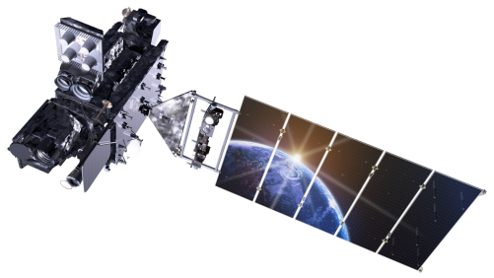
Outline
ABI (Advanced Baseline Imager)
Spectral
Spatial
Temporal
Summary
More information
Questions
Lockheed Martin

Slide 8
The Advanced Baseline Imager:
ABI Current
Spectral Coverage
16 bands 5 bands
Spatial resolution
0.64 μm Visible 0.5 km Approx. 1 km
Other Visible/near-IR 1.0 km n/a
Bands (>2 μm) 2 km Approx. 4 km
Spatial coverage
Full disk 4 per hour Scheduled (3 hrly)
CONUS 12 per hour ~4 per hour
Mesoscale Every 30 sec n/a
Visible (reflective bands)
On-orbit calibration Yes No

Slide 9
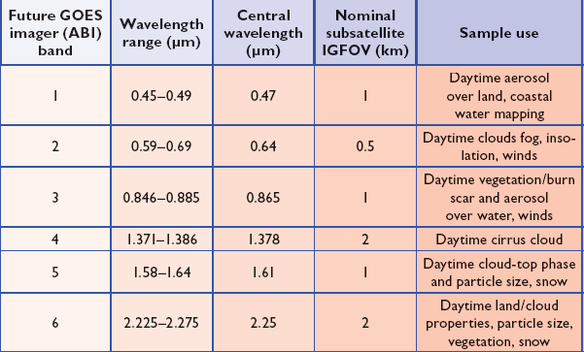
ABI Visible/Near-IR Bands
Schmit et al, 2005
Notes:
Schmit, T. J., M. M. Gunshor, W. P. Menzel, J. J. Gurka, J. Li, and A. S. Bachmeier, 2005: Introducing the next-generation Advanced Baseline Imager on GOES-R. Bull. Amer. Meteor. Soc., 86, 1079-1096.

Slide 10
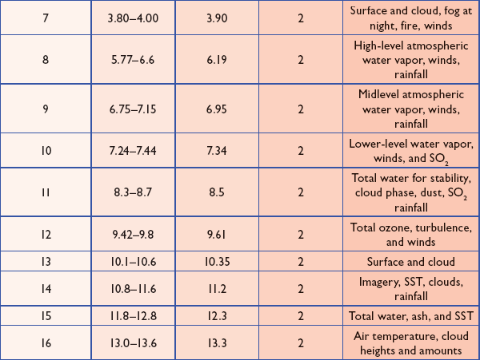
ABI IR Bands
Schmit et al, 2005
Notes:
Schmit, T. J., M. M. Gunshor, W. P. Menzel, J. J. Gurka, J. Li, and A. S. Bachmeier, 2005: Introducing the next-generation Advanced Baseline Imager on GOES-R. Bull. Amer. Meteor. Soc., 86, 1079-1096.

Slide 11
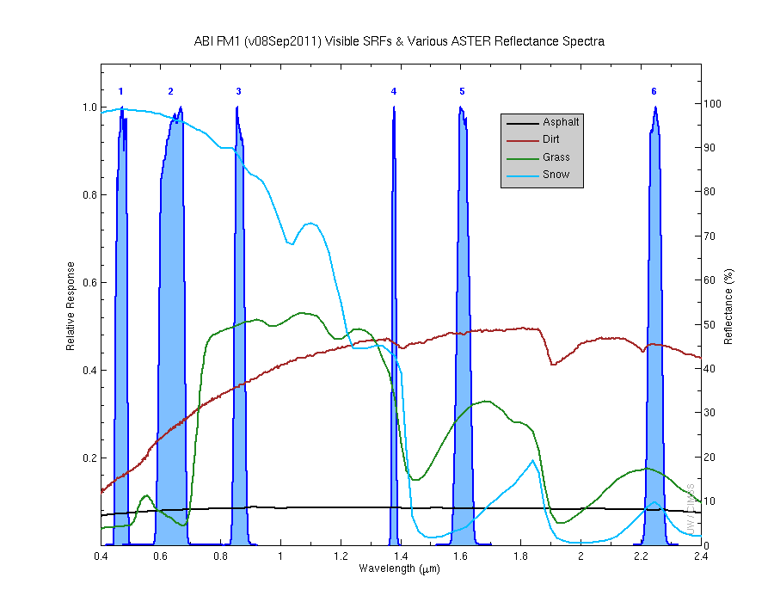
Visible and near-IR channels on the ABI
Aerosols, Insolation
Clouds, Snow
Vegetation, Imagery
Cloud mask, Suspended matter
Snow, Phase
Cloud Particle size
Sample use only, many other uses
The ABI visible and near-IR bands have many uses.
Notes:
Schmit, T. J., M. M. Gunshor, W. P. Menzel, J. J. Gurka, J. Li, and A. S. Bachmeier, 2005: Introducing the next-generation Advanced Baseline Imager on GOES-R. Bull. Amer. Meteor. Soc., 86, 1079-1096.

Slide 12
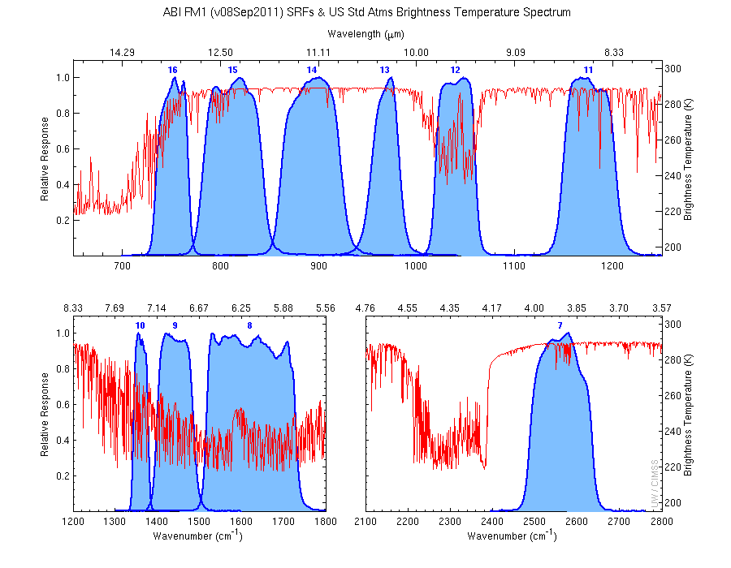
The IR channels on the ABI
Clouds, Stability Indices
SST, Fires, Radiances
Ozone, Downward Radiation
Rainfall, Aerosol
Hurricane, Imagery
Cloud Phase, SST
Sample use only, many other uses
SO2, Radiances
Winds, WV profiling
TPW, Rainfall rate
Fires, Fog
ABI has many more bands than the current operational GOES imagers.
Notes:
Schmit, T. J., M. M. Gunshor, W. P. Menzel, J. J. Gurka, J. Li, and A. S. Bachmeier, 2005: Introducing the next-generation Advanced Baseline Imager on GOES-R. Bull. Amer. Meteor. Soc., 86, 1079-1096.

Slide 13
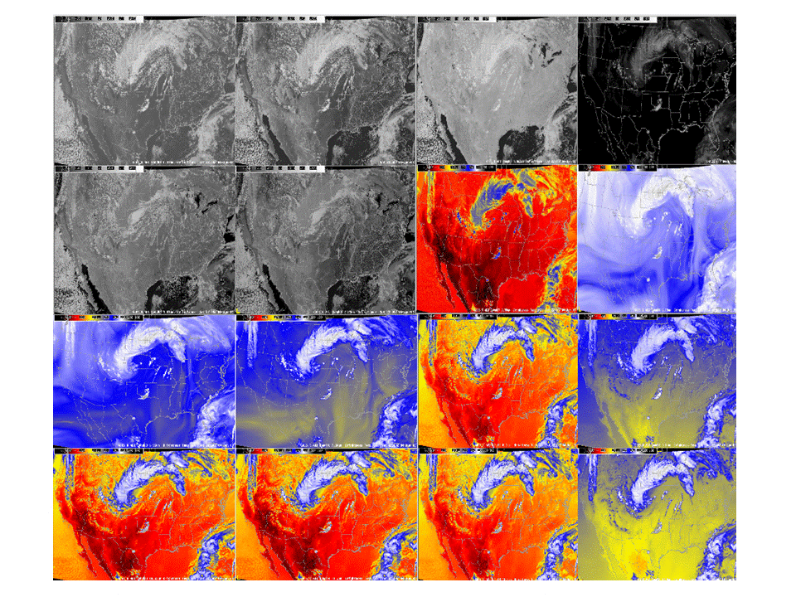
ABI band selection
0.47 μm
0.64 μm
0.86 μm
1.38 μm
1.61 μm
2.26 μm
3.9 μm
6.19 μm
6.95 μm
7.34 μm
8.5 μm
9.61 μm
10.35 μm
11.2 μm
12.3 μm
13.3 μm

Slide 14
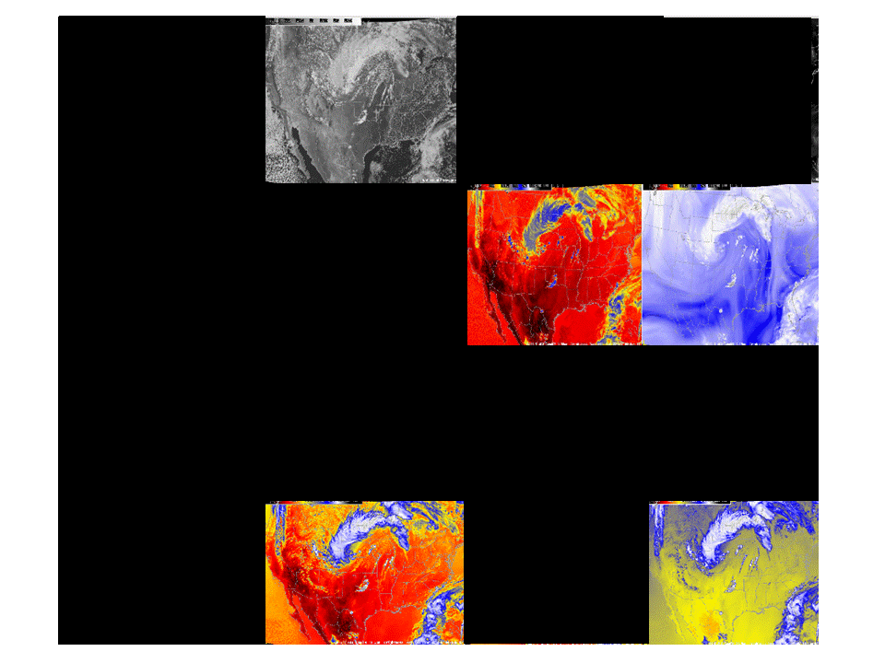
Current GOES band selection

Slide 15
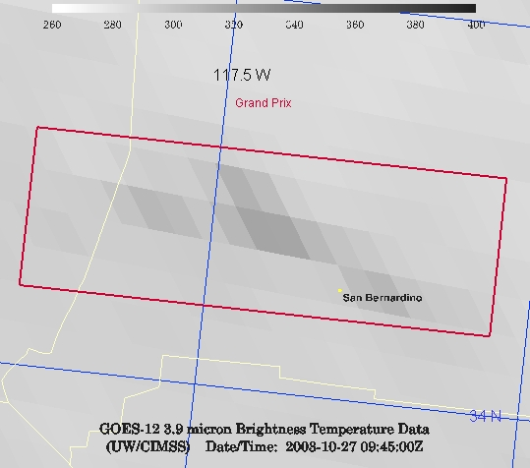
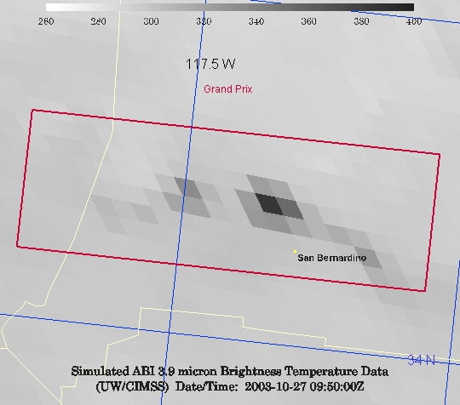
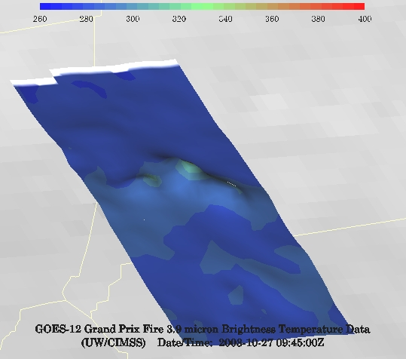
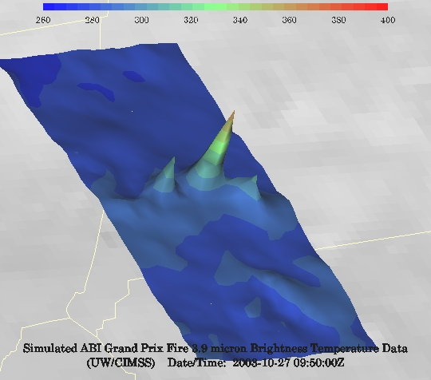
GOES-12 and GOES-R ABI
Simulation of Grand Prix Fire/Southern California
GOES-12
GOES-R ABI
GOES-12
GOES-R ABI
J. Feltz
Notes:
Here are two different fires. What we can see is a more defined peak in the higher resolution data and it is easier to pick out individual hotspots. In addition, the higher saturation tempearture of the ABI allows us to see that the fire is around 370K.

Slide 16
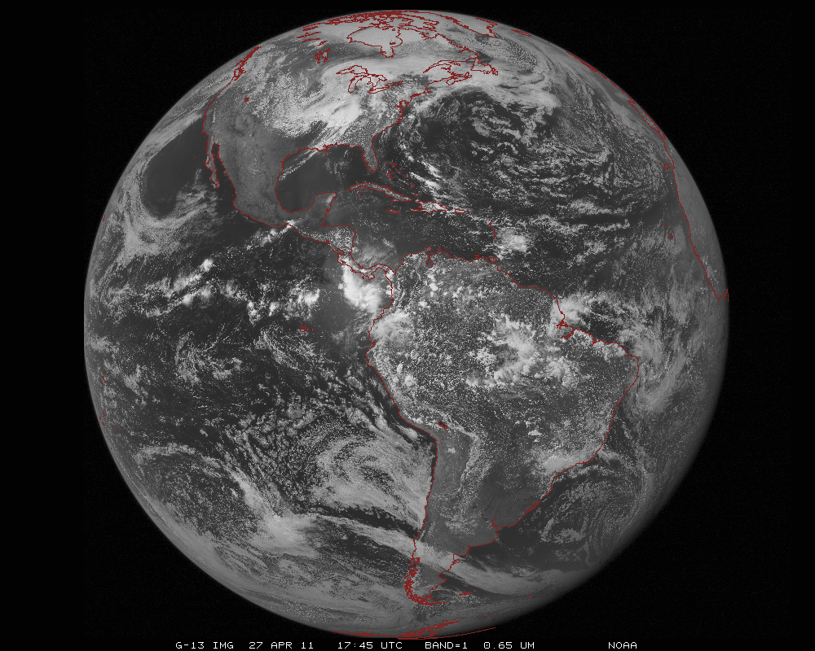
ABI scans about 5 times faster
than the current GOES imager
Anticipated scan mode for the ABI:
- Full disk images every 15 minutes + 5 min CONUS images + mesoscale.

Slide 17
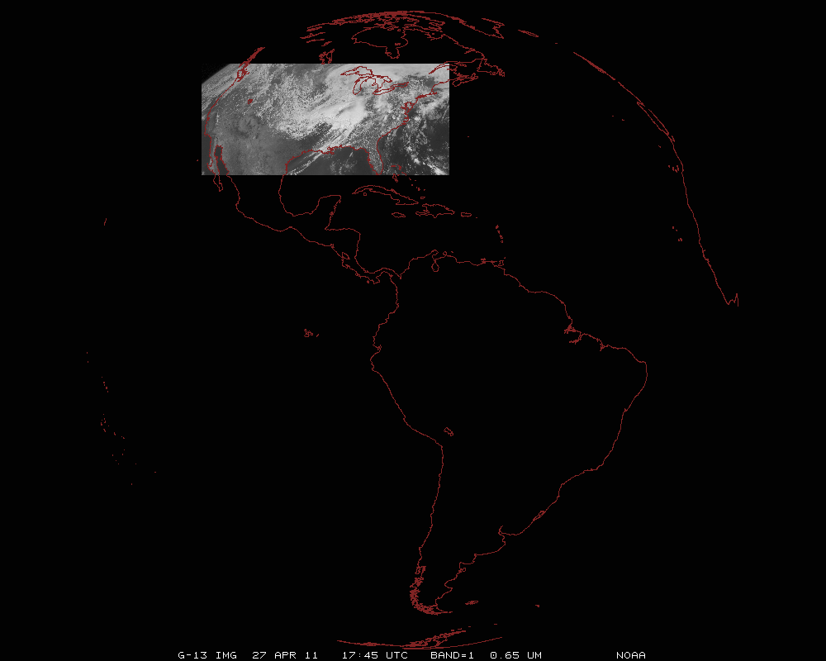
ABI can offer Continental US images every 5 minutes for routine monitoring of a wide range of events (storms, dust, clouds, fires, winds, etc).
This is every 15 or 30 minutes with the current GOES in routine mode.
Notes:
Approx. size of CONUS

Slide 18
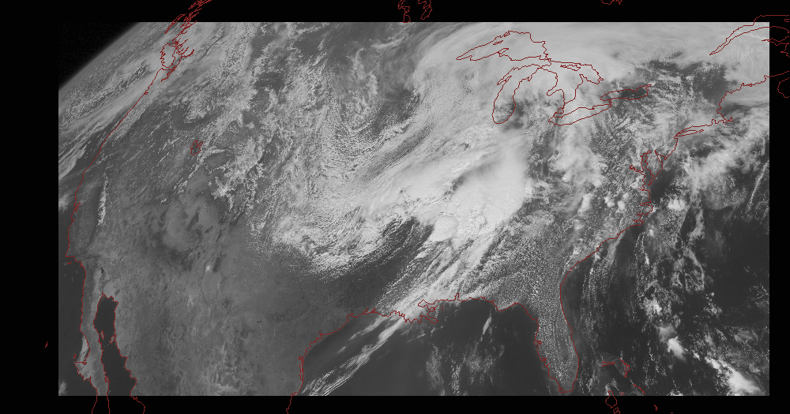
Notes:
Approx. size of CONUS

Slide 19
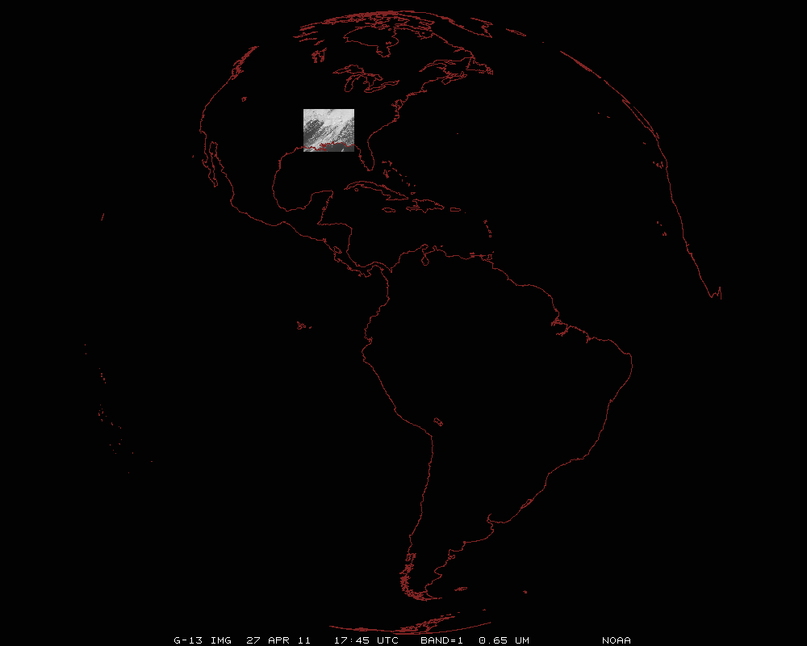
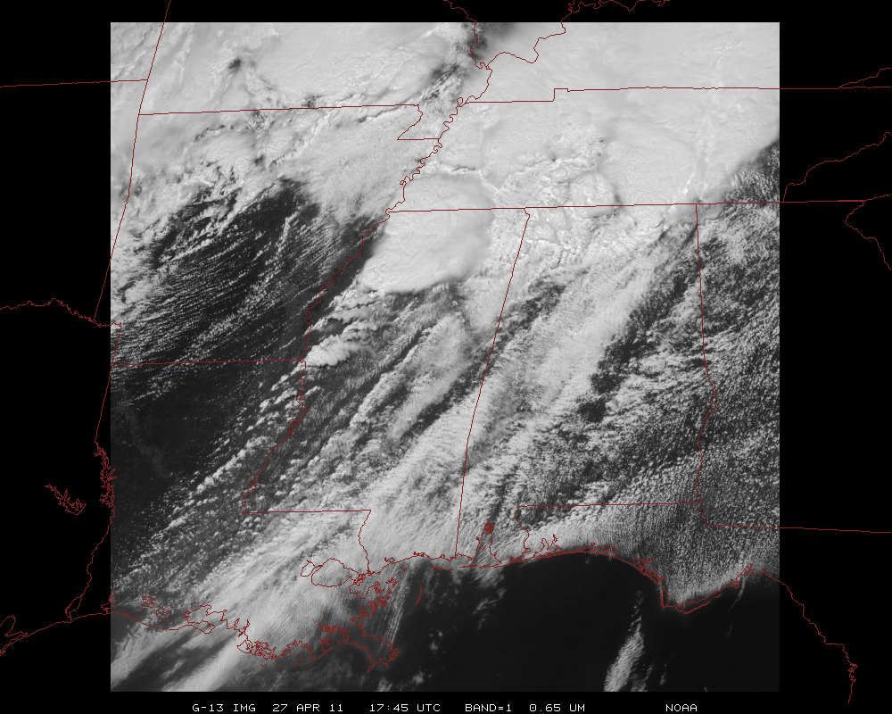
Mesoscale images every 30 seconds for rapidly changing phenomena
(thunderstorms, hurricanes, fires, etc). Or two regions every 60 seconds.
Notes:
Approx. size of meso-scale showing “Franklin”.

Slide 20
GOES-14: Special Rapid Scanning offers glimpse of the ABI
SRSOR (Super Rapid Scan Operations for GOES-R) from GOES-14 imager while it was out of storage.
Daily scanning between mid-August and September 24th
Posted many animations
http://cimss.ssec.wisc.edu/goes/srsor/GOES-14_SRSOR.html
Many phenomena were observed: convection, hurricanes, fires, smoke, etc.,
Data to many groups HPC, OPC, AWC, SPC, etc.
All data archived
Animation from GOES-14 Imager water at 1-min time resolution.
GOES-14 provided very unique information and offers a glimpse into the possibilities that will be provided by the ABI on GOES-R.

Slide 21
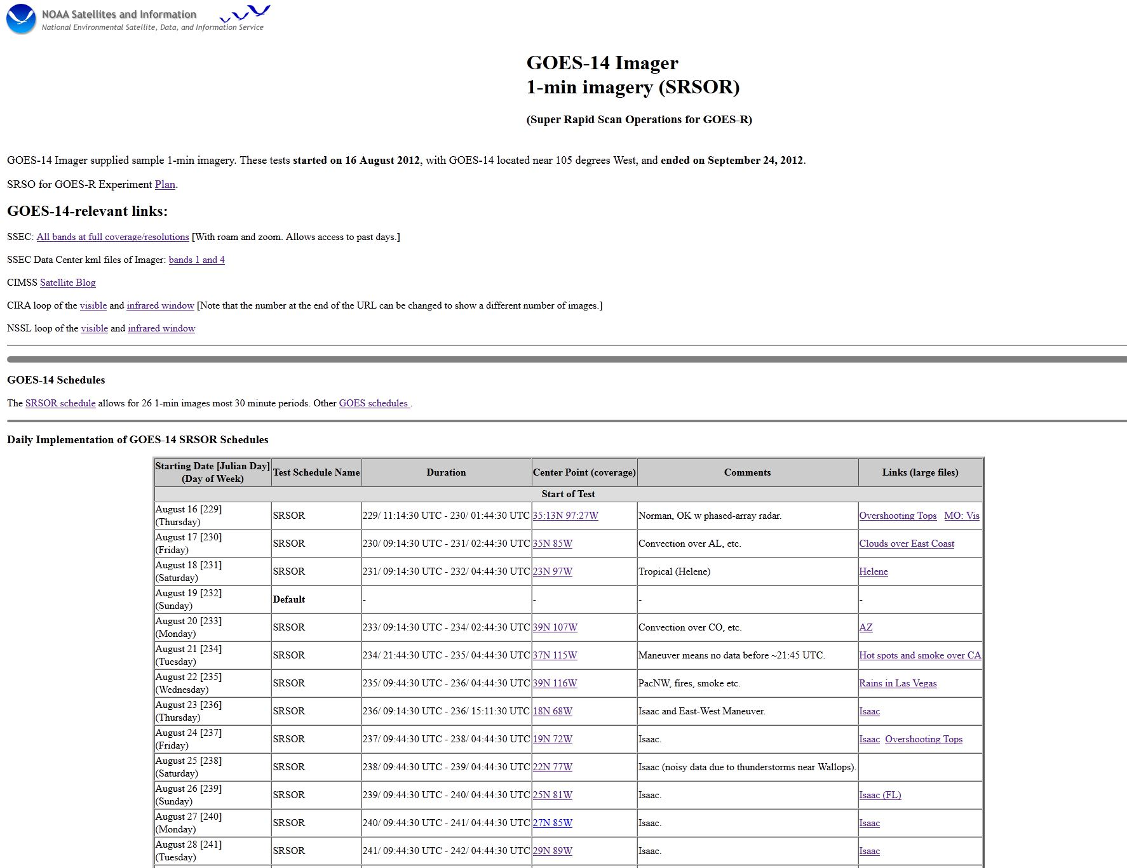
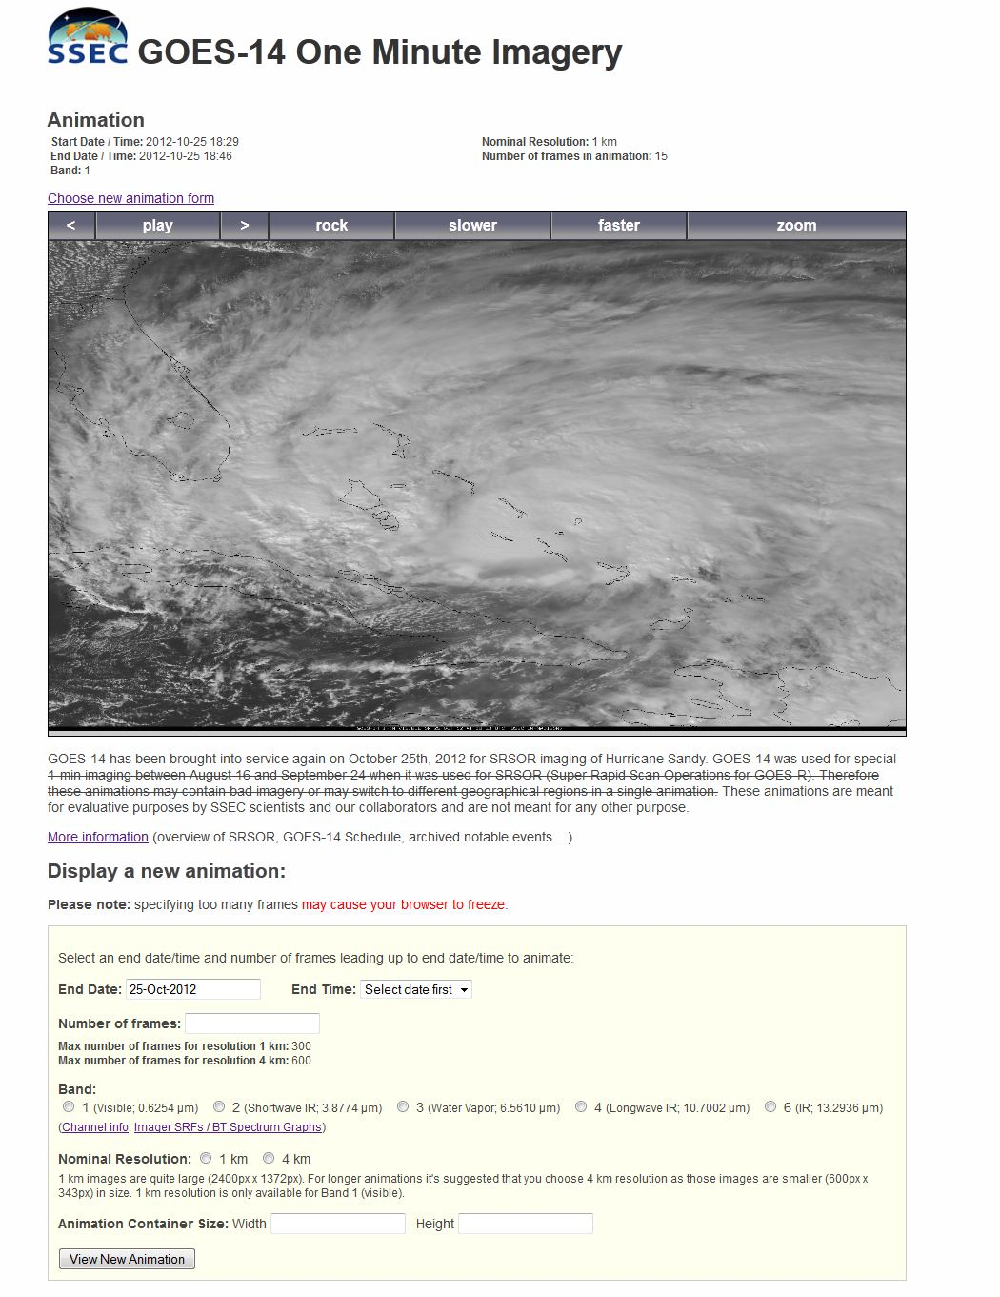
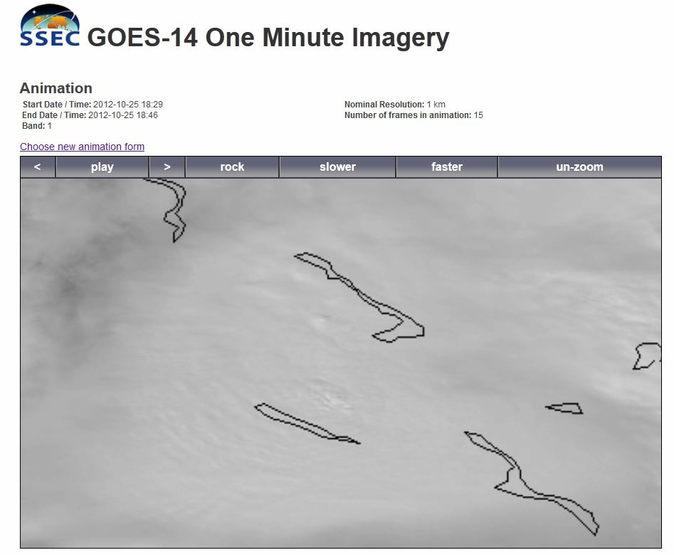
http://www.ssec.wisc.edu/data/1min/

Slide 22
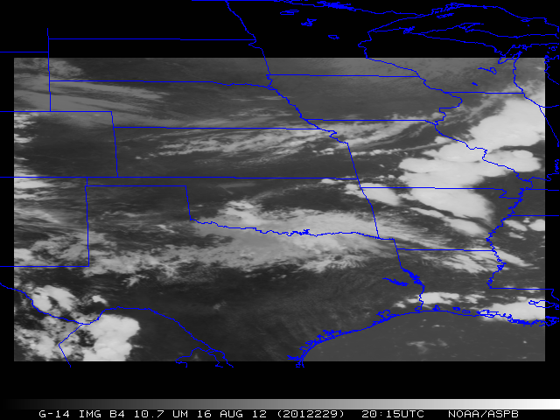

Slide 23
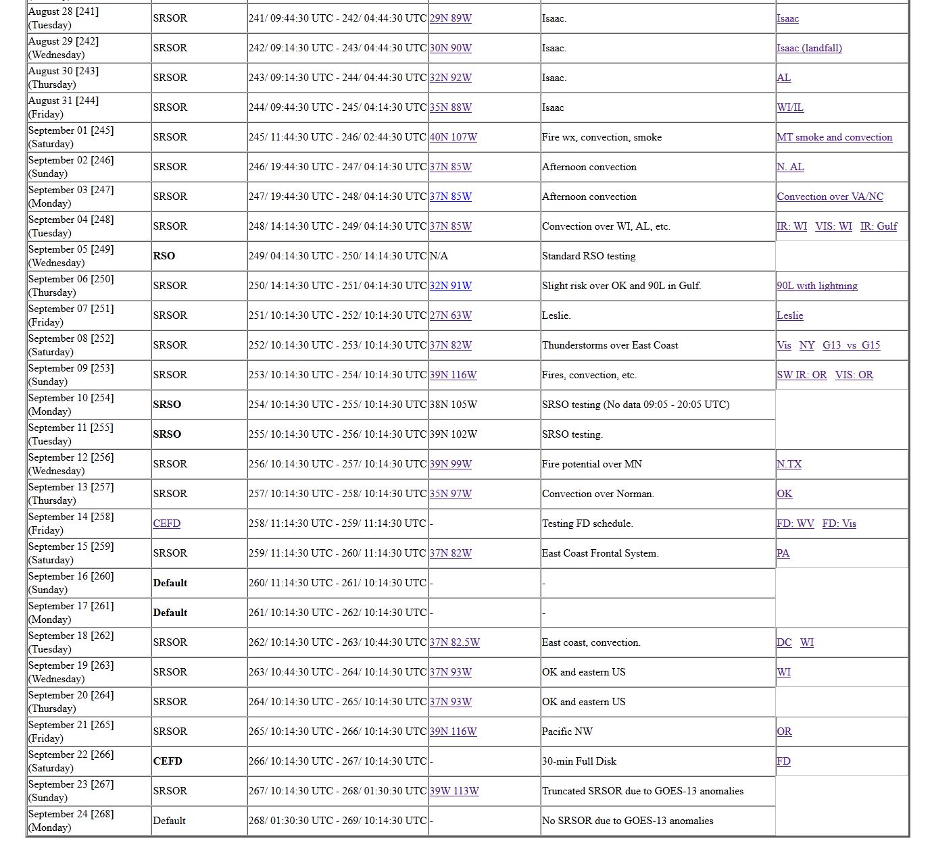
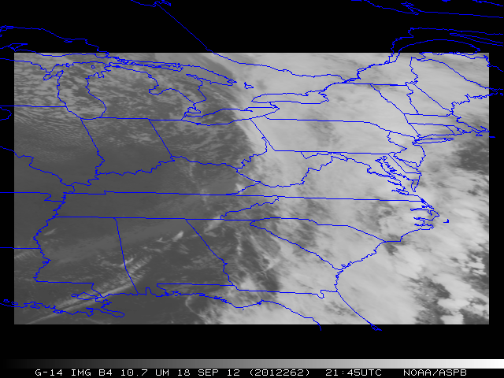

Slide 24
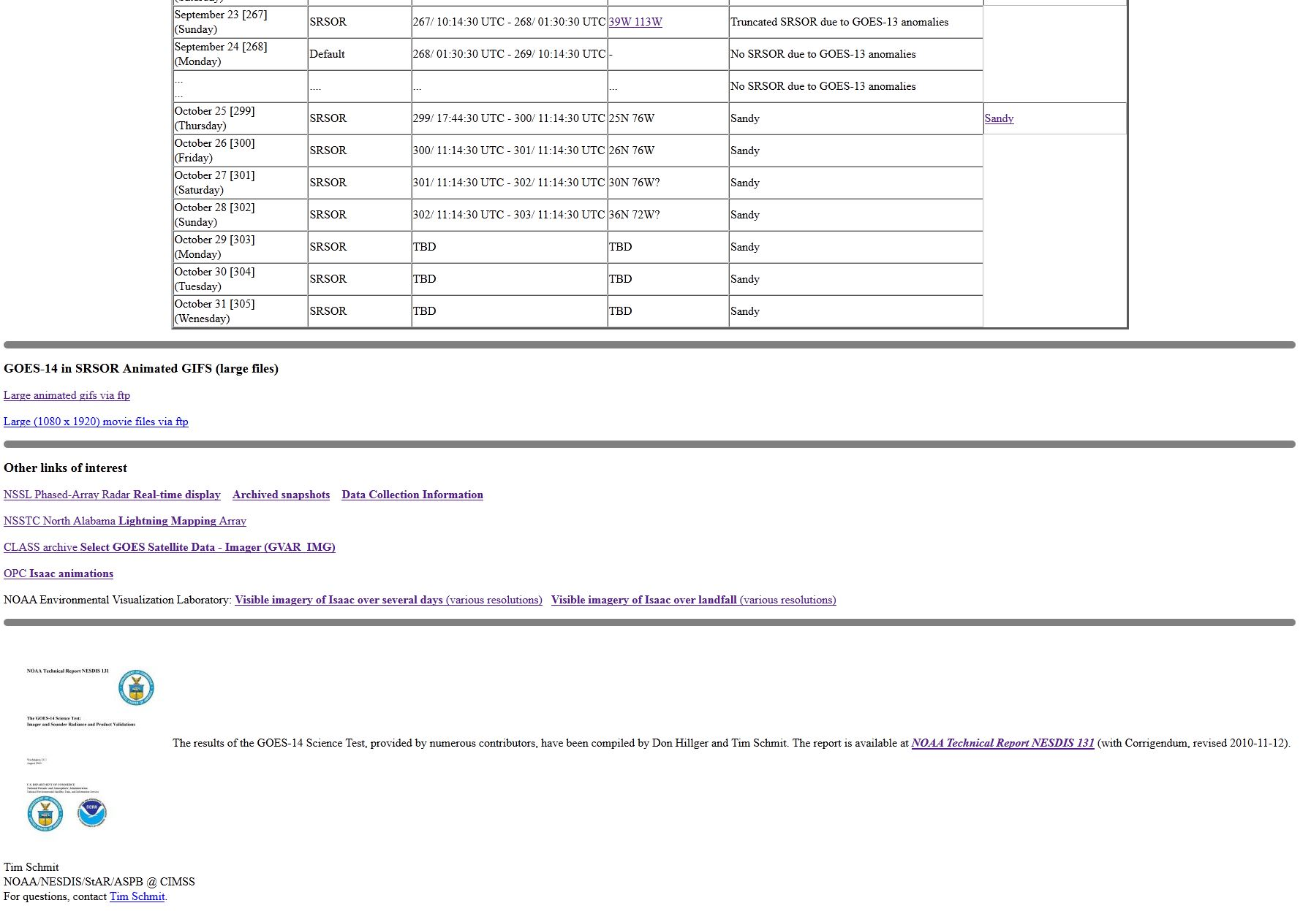
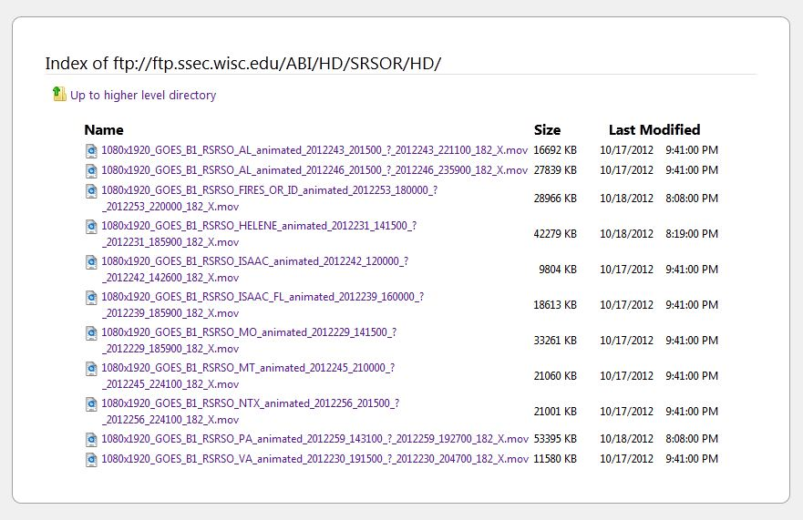

Slide 25
1-min imagery
Operational (GOES-13)
1-min mode (SRSOR from GOES-14)

Slide 26
SRSOR

Slide 27
SRSOR

Slide 28
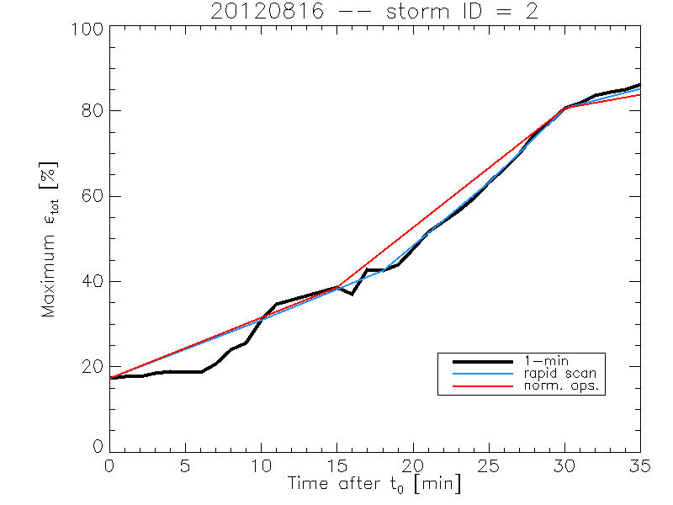
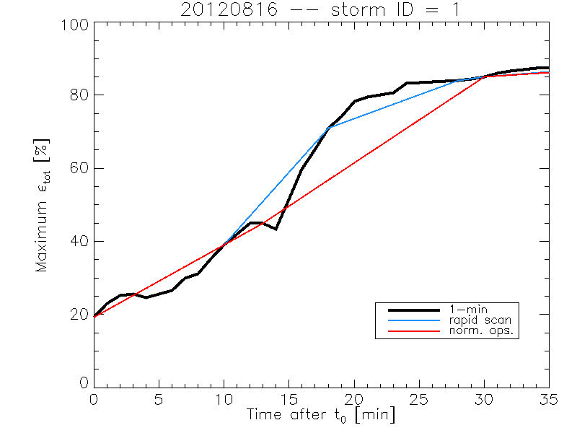
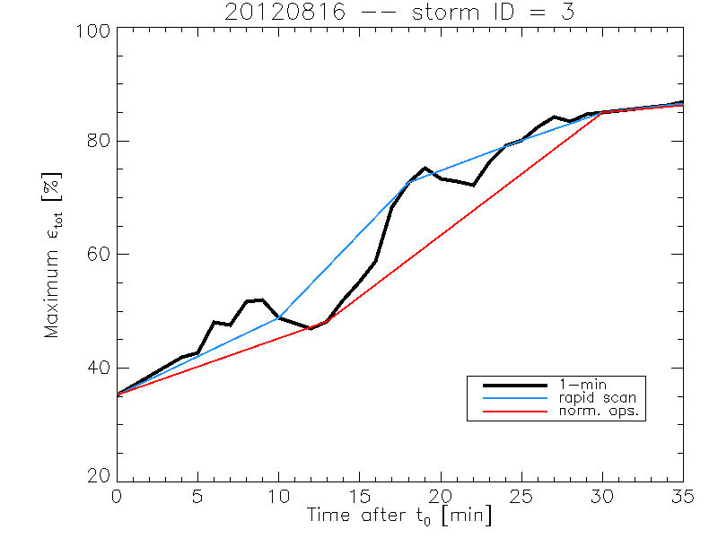
Rate of temporal cooling in the longwave infrared band
Cintineo et al., 2013 (CIMSS)

Slide 29
4 micrometer

Slide 30
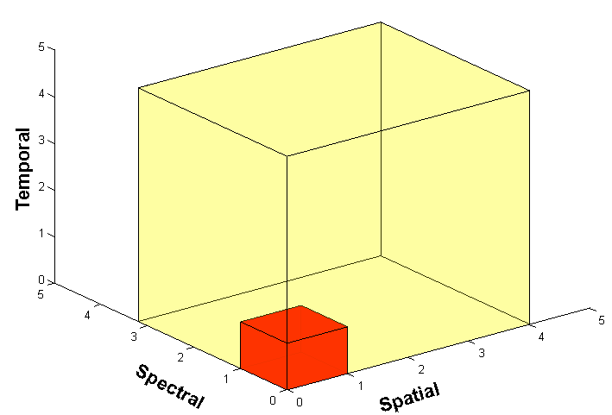
Outline
ABI (Advanced Baseline Imager)
Spectral
Spatial
Temporal
Summary
More information
Questions

Slide 31
Approximate spectral and spatial resolutions of US GOES Imagers
~ Band Center (um) | GOES-6/7 | GOES-8/11 | GOES-12/N | GOES-O/P | GOES-R+
0.47
0.64
0.86
1.6
1.38
2.2
3.9
6.2
6.5/6.7/7 | 14km
7.3
8.5
9.7
10.35
11.2
12.3
13.3
Visible
Near-IR
Box size represents pixel size
8
4
2
“MSI mode”
Infrared
Notes:
0.40 inches = 4km; 0.80 inches = 8km
MSI is Multi-Spectral Imaging Mode (dashed boxes)
This does not show other improvements: SNR, MTF, bit-depth, navigation, coverage rates, etc.

Slide 32
Summary
1. The GOES-R ABI provides mission continuity
2. Two times the image navigation quality
3. Three times the number of imaging bands
4. Four times the spatial resolutions
5. Five times the coverage rate
- Special GOES-14 1-min data pathfinder

Slide 33
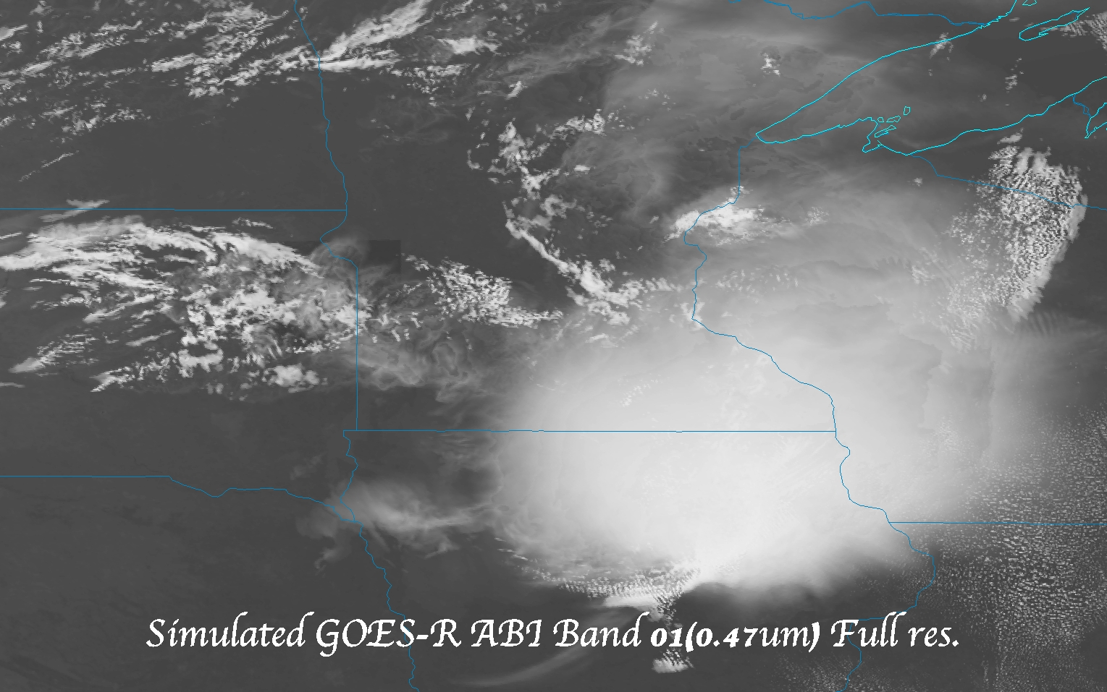
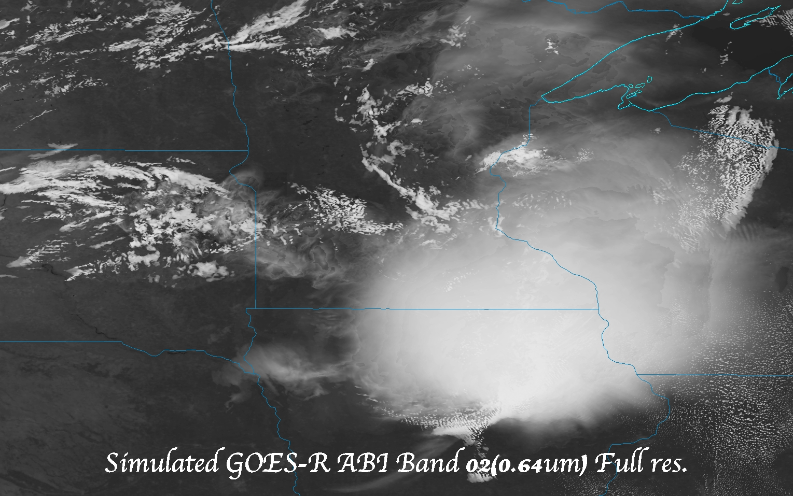
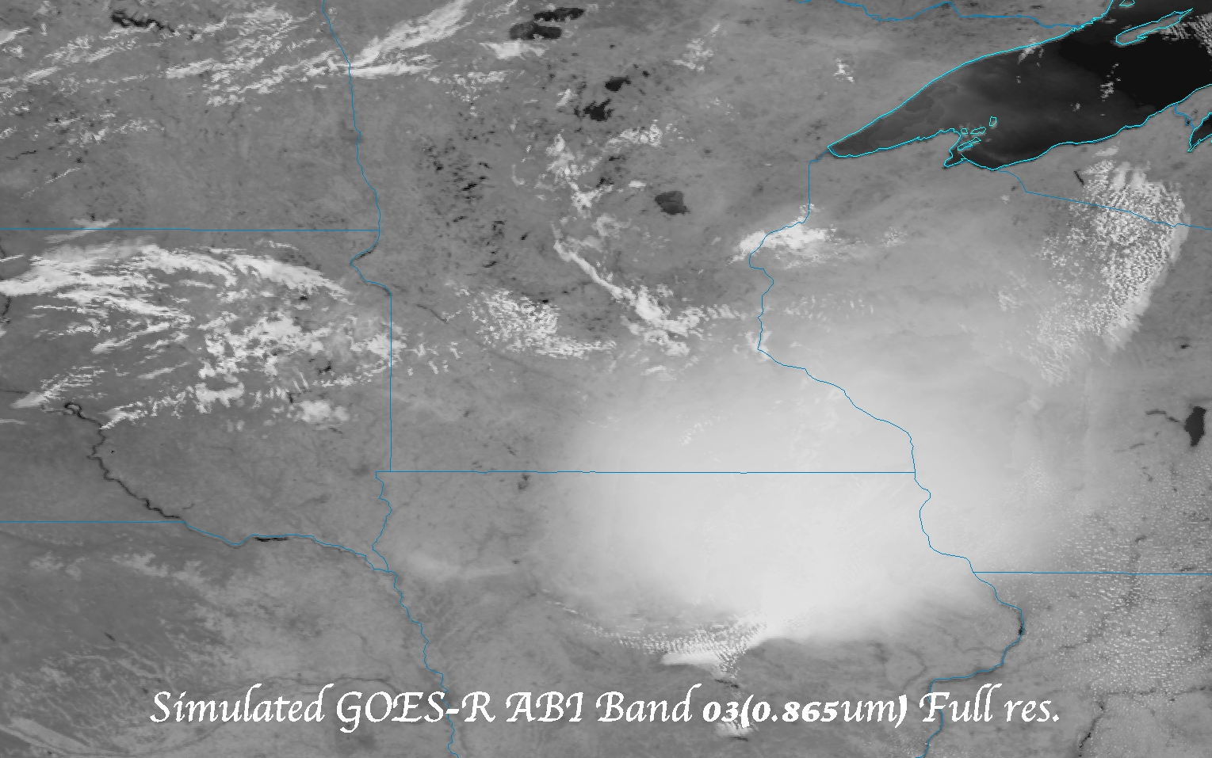
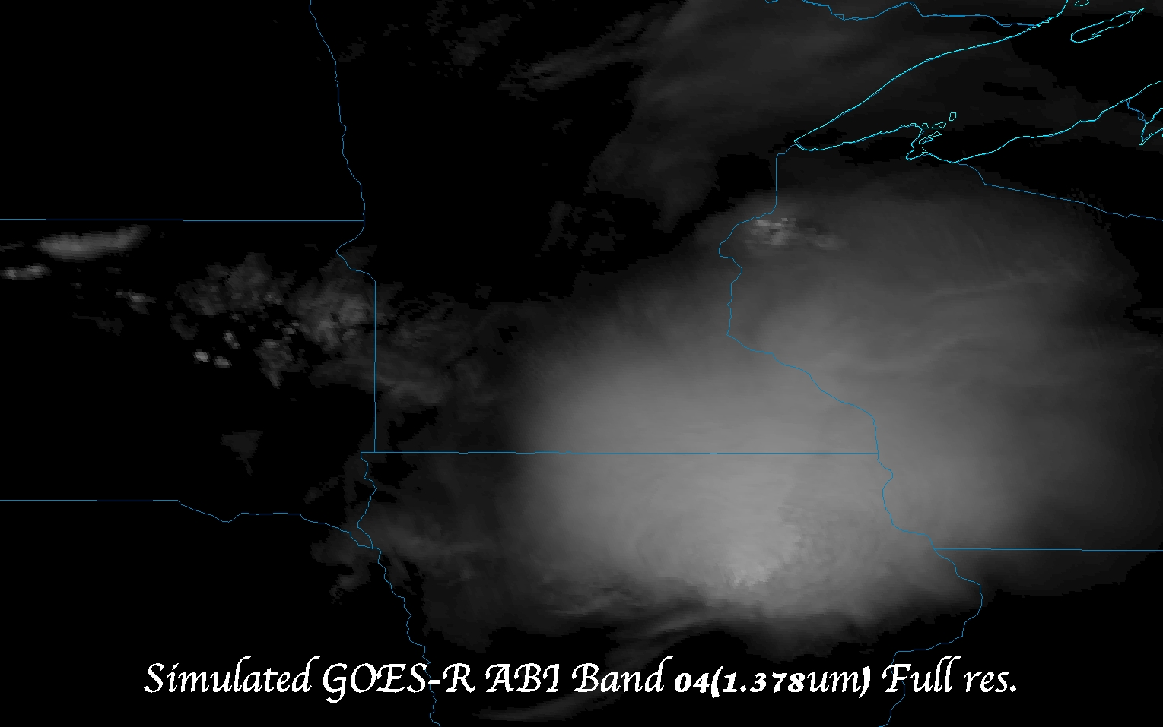
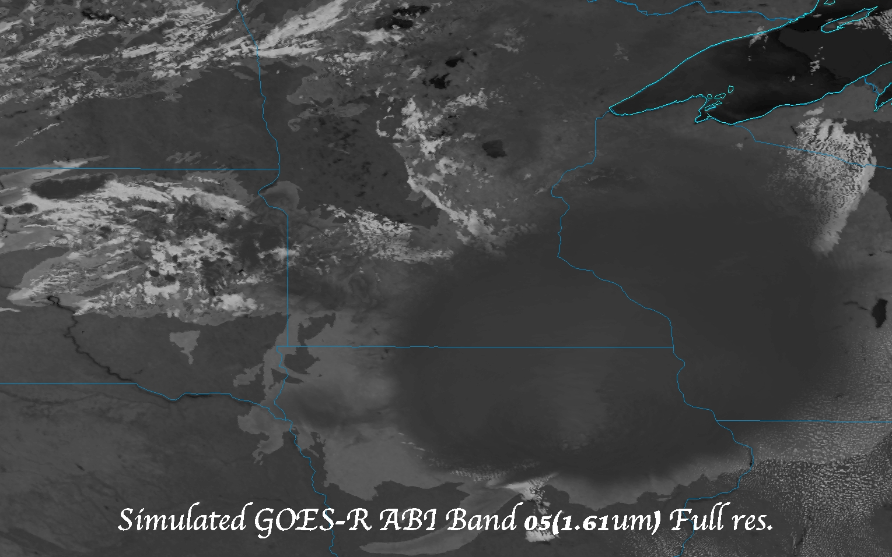
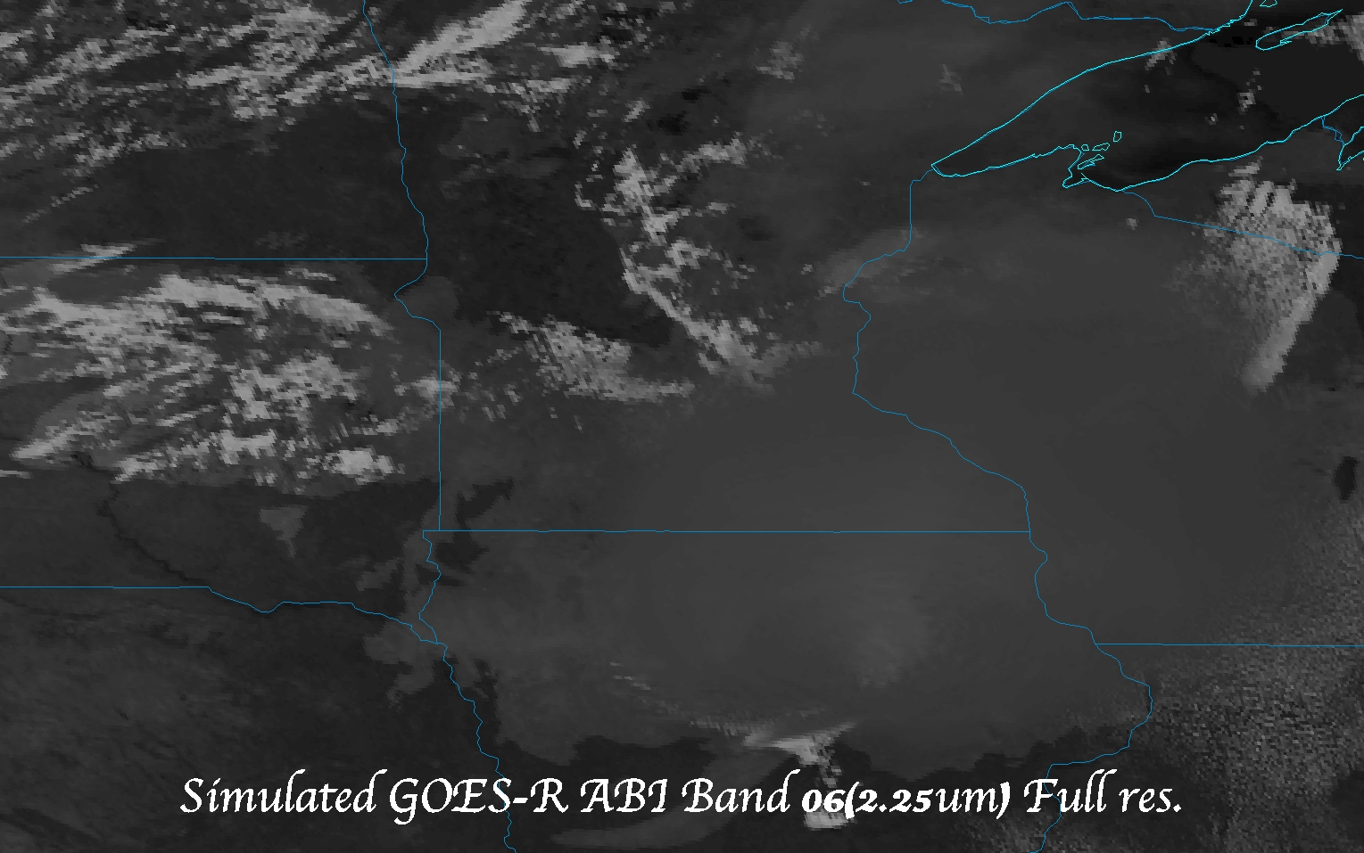
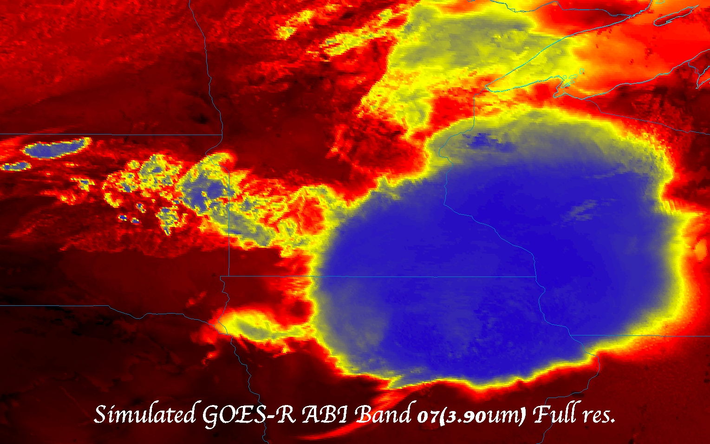
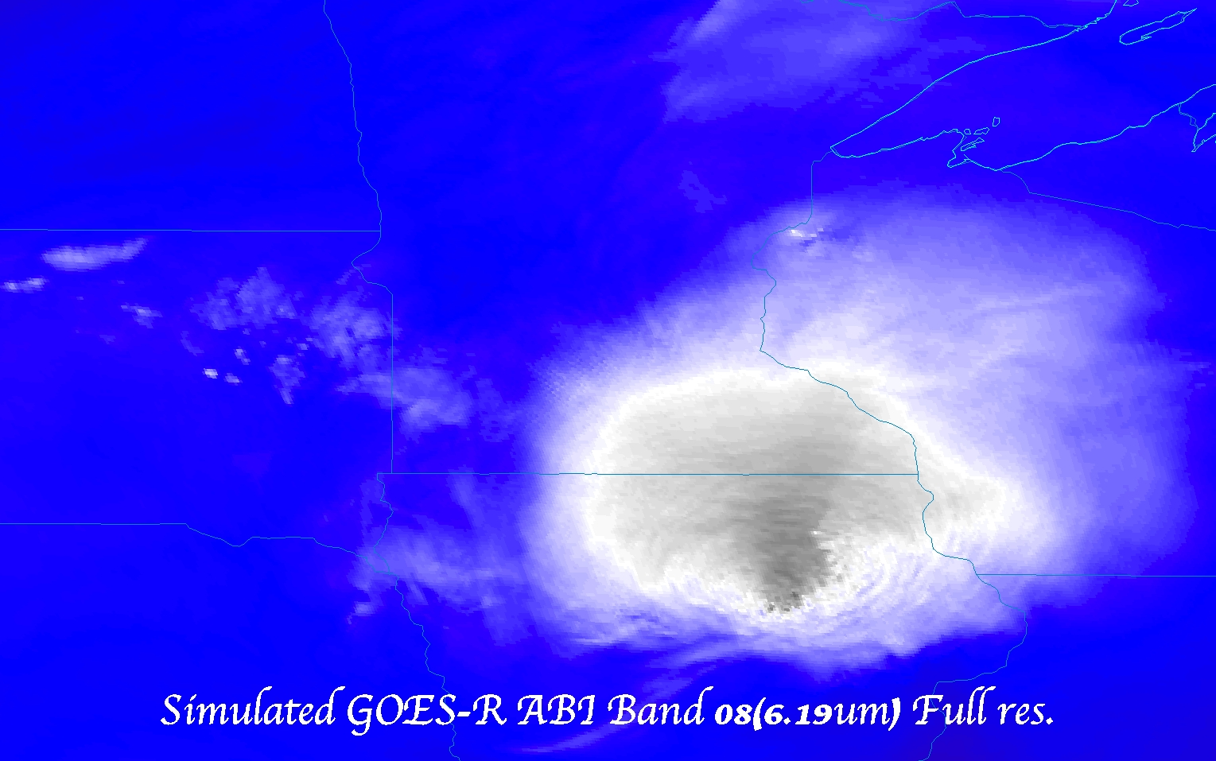
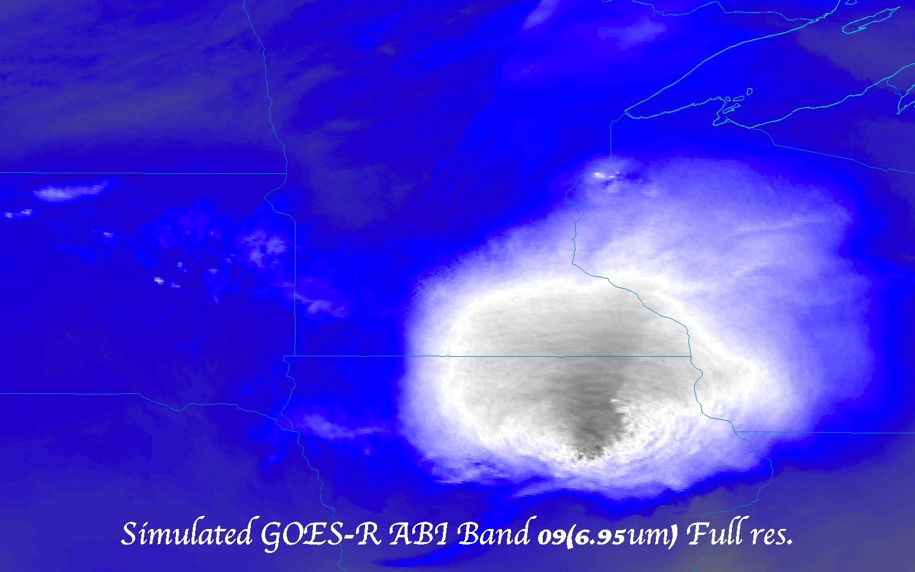
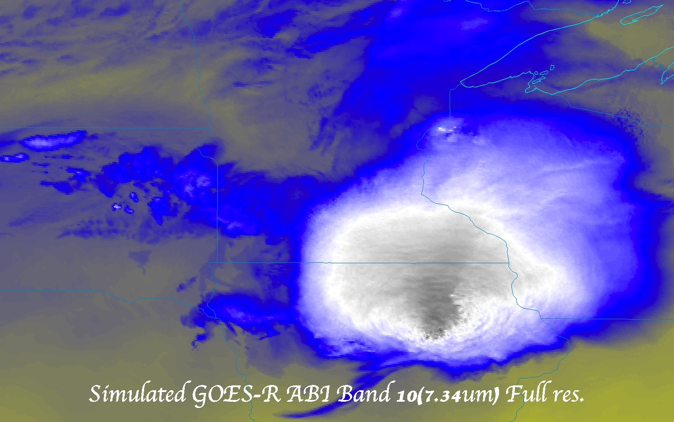
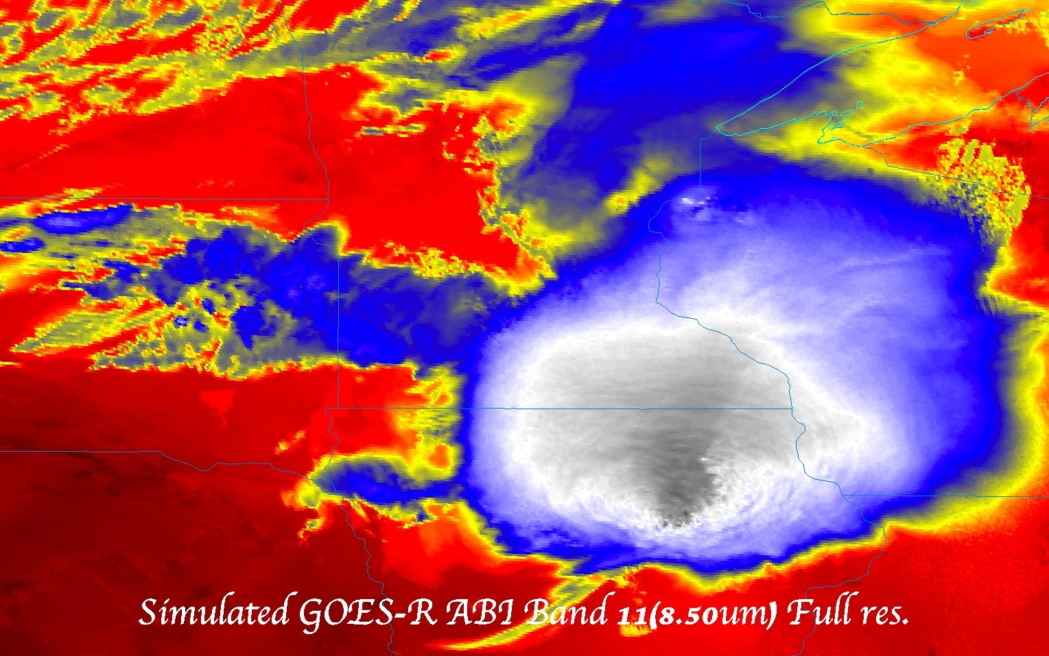
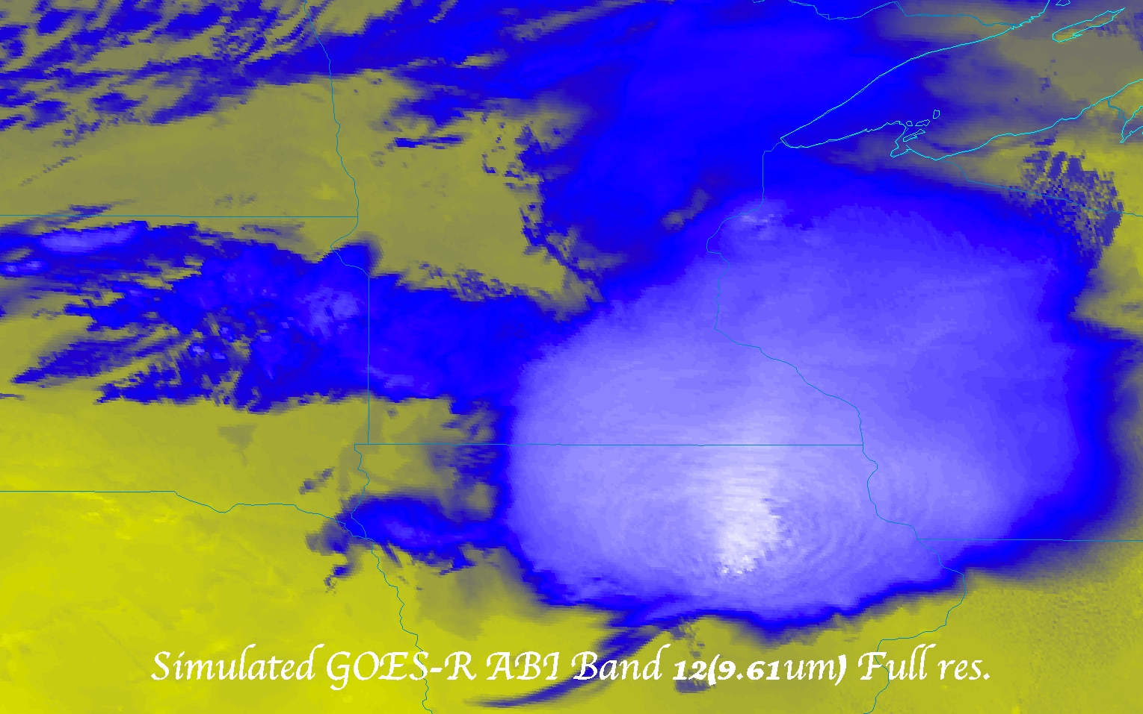
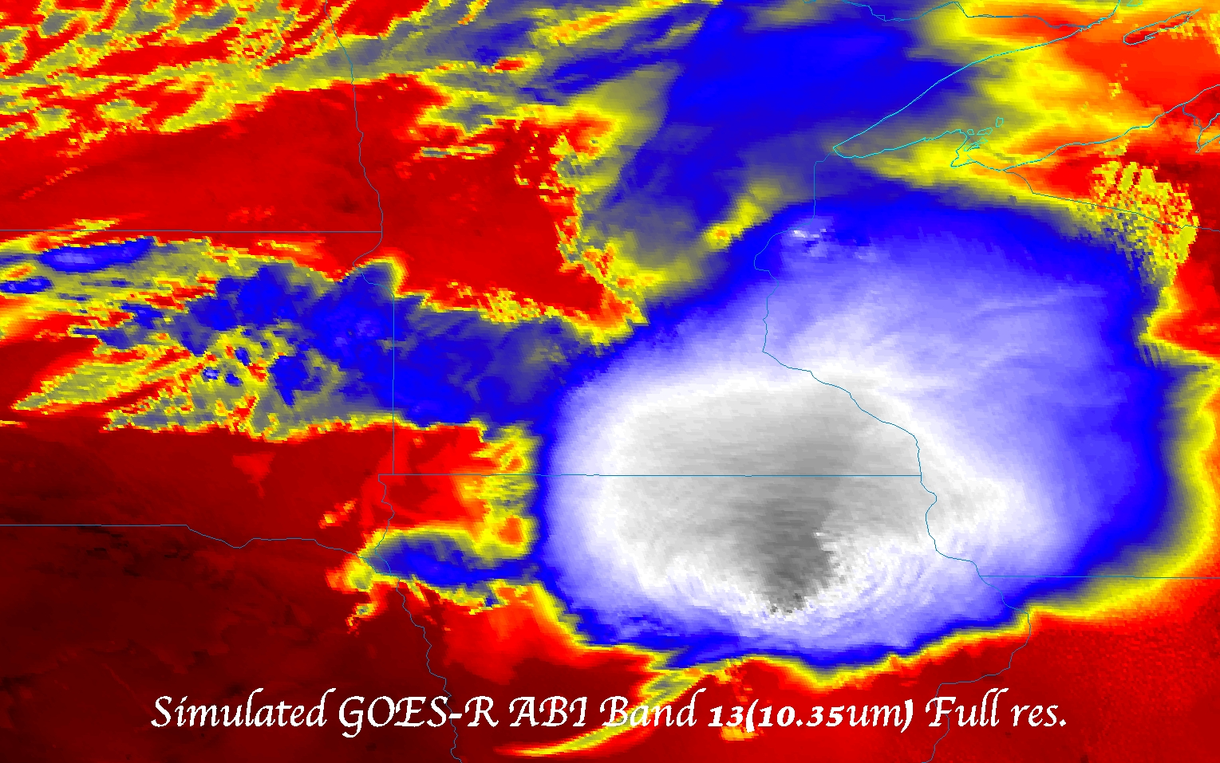
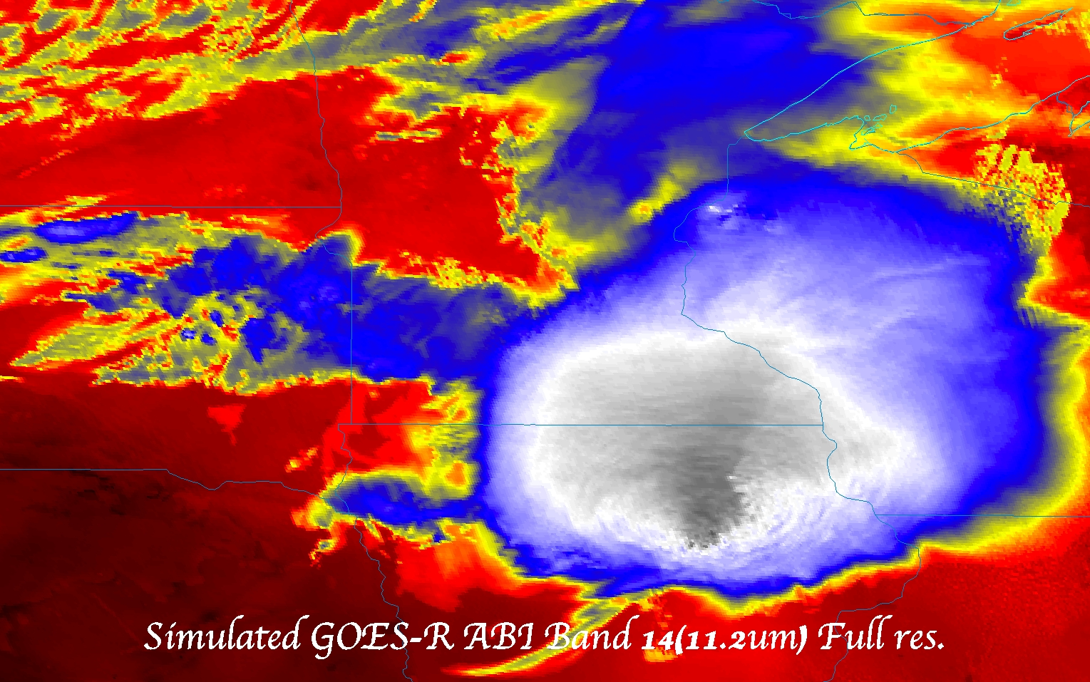
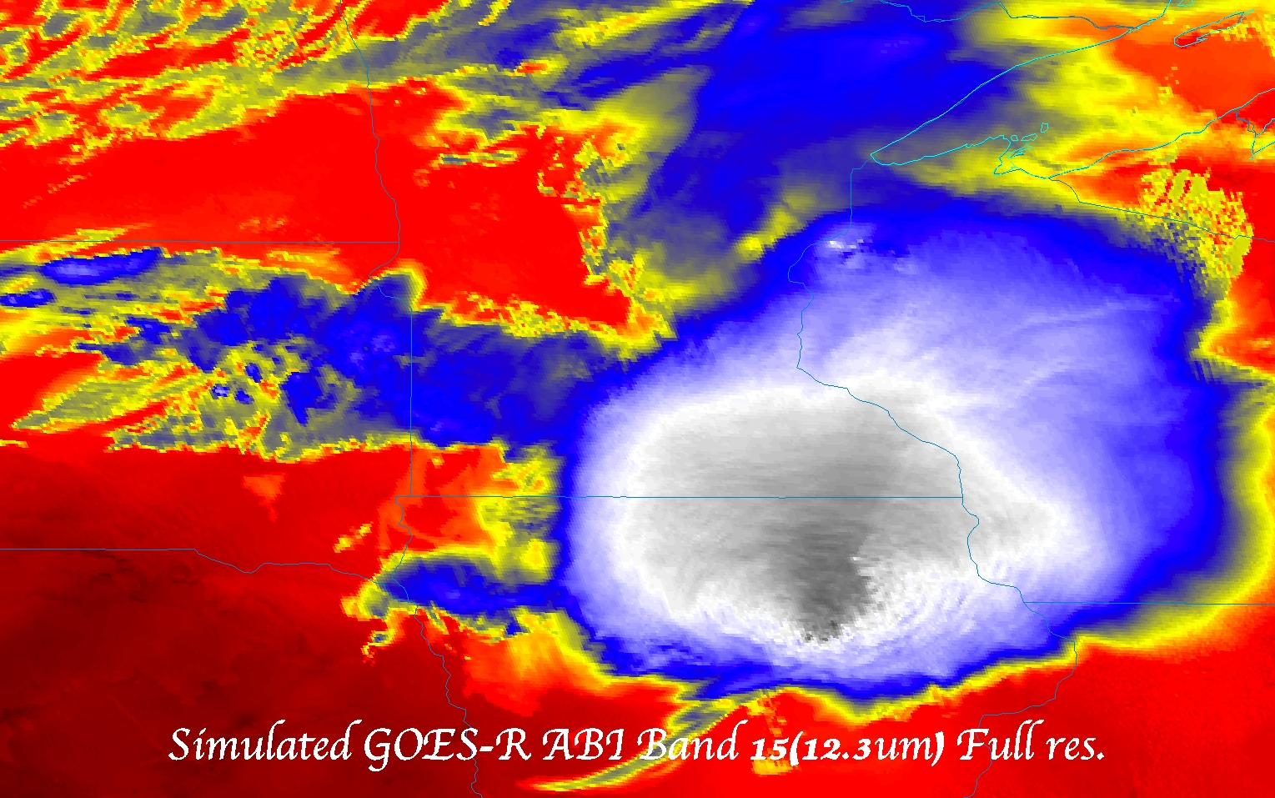
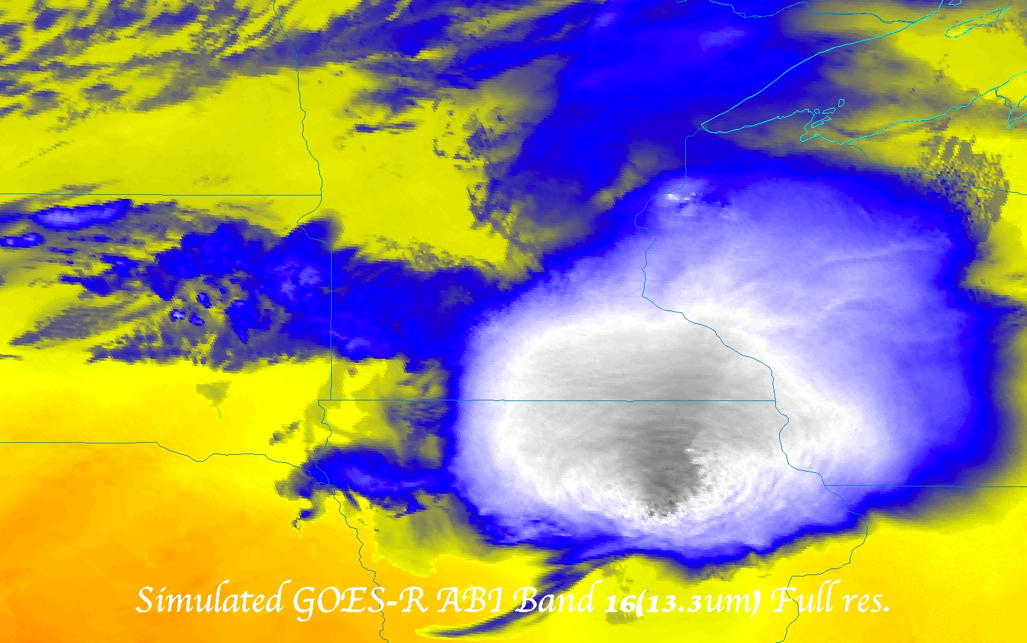

Slide 34
GOES-R ABI Products
Baseline Products
Future Capabilities
Advanced Baseline Imager (ABI)
Aerosol Detection (Including Smoke and Dust) Aerosol Optical Depth (AOD) Clear Sky Masks Cloud and Moisture Imagery Cloud Optical Depth Cloud Particle Size Distribution Cloud Top Height Cloud Top Phase Cloud Top Pressure Cloud Top Temperature Derived Motion Winds Derived Stability Indices Downward Shortwave Radiation: Surface Fire/Hot Spot Characterization Hurricane Intensity Estimation Land Surface Temperature (Skin) Legacy Vertical Moisture Profile Legacy Vertical Temperature Profile Radiances Rainfall Rate/QPE Reflected Shortwave Radiation: TOA Sea Surface Temperature (Skin) Snow Cover Total Precipitable Water Volcanic Ash: Detection and Height
Advanced Baseline Imager (ABI)
Absorbed Shortwave Radiation: Surface Aerosol Particle Size Aircraft Icing Threat Cloud Ice Water Path Cloud Layers/Heights Cloud Liquid Water Cloud Type Convective Initiation Currents Currents: Offshore Downward Longwave Radiation: Surface Enhanced “V”/Overshooting Top Detection Flood/Standing Water Ice Cover Low Cloud and Fog Ozone Total Probability of Rainfall Rainfall Potential Sea and Lake Ice: Age Sea and Lake Ice: Concentration Sea and Lake Ice: Motion Snow Depth (Over Plains) SO₂ Detection Surface Albedo Surface Emissivity Tropopause Folding Turbulence Prediction Upward Longwave Radiation: Surface Upward Longwave Radiation: TOA Vegetation Fraction: Green Vegetation Index Visibility

Slide 35
More information
GOES-R:
http://www.goes-r.gov
http://www.meted.ucar.edu/index.htm
http://cimss.ssec.wisc.edu/goes_r/proving-ground.html
GOES and NASA:
http://goespoes.gsfc.nasa.gov/goes/index.html
http://goes.gsfc.nasa.gov/text/goes.databookn.html
UW/SSEC/CIMSS/ASPB:
http://cimss.ssec.wisc.edu/goes_r/proving-ground/nssl_abi/nssl_abi_rt.html
http://cimss.ssec.wisc.edu/goes/abi/
http://cimss.ssec.wisc.edu/goes/blog/
http://www.ssec.wisc.edu/data/geo/
http://cimss.ssec.wisc.edu/goes/srsor/GOES-14_SRSOR.html
AMS BAMS Article on the ABI

Slide 37
http://www.ssec.wisc.edu/data/1min/

