Slide 1
StAR Imagery Team (JPSS and GOES-R series)
Don Hillger (lead) and Tim Schmit (co-lead)
2019-09-05

Slide 2
JPSS VIIRS Imagery accomplishments thru FY19
S-NPP launched in October 2011
First light imagery on November 21
VIIRS EDR Imagery validated in 12 months
JPSS-1/NOAA-20 launched in November 2017
First light imagery on December 13
VIIRS EDR Imagery validated in 3 months
Validation of VIIRS Imagery involves feedback from users, as opposed to instrument calibration:
Striping (no hard requirement) and noise (signal-to-noise)
Geo-location/mapping accuracy (feature shifts between orbits/satellites)
DNB stray light (towards both poles, due to sun intrusion)
User satisfaction/feedback

Slide 3
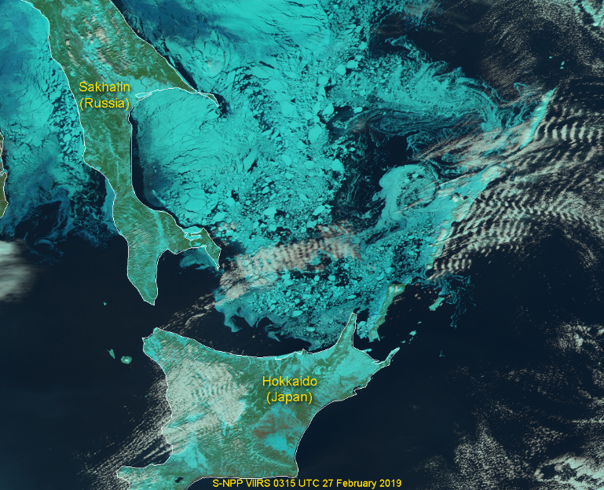
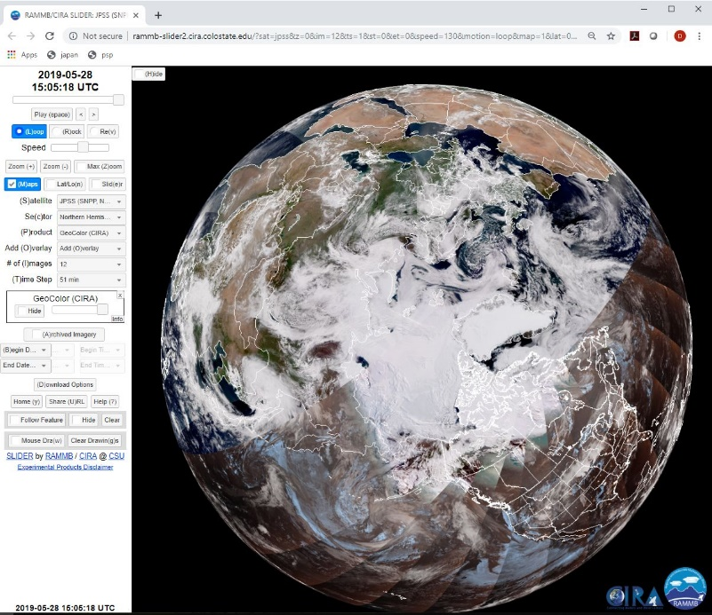
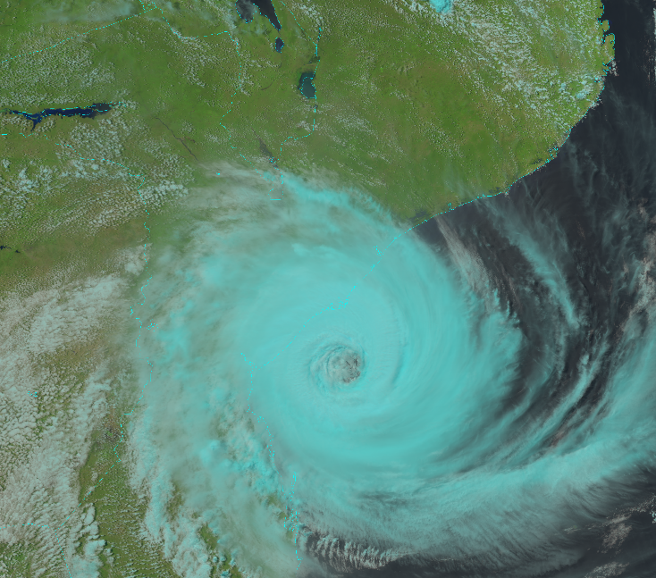
JPSS VIIRS Imagery examples
Various JPSS VIIRS Imagery examples, depicting details on the earth and in the atmosphere which may not seen as well with other instrumentation.

Slide 4
GOES ABI Imagery accomplishments thru FY19
GOES-16 and -17 ABI are operating in the mode 6 (10 min FD flex mode). This provides more timely information to those outside of the CONUS domains.
First suggested in 2014
Lead the critical GOES-17 Peer/Stakeholder Product Validation Review (PS PVR) provisional for imagery (for the stable temperature times) and assisted in the early check-out of GOES-17 ABI at 137.2W.
GOES-17 being declared operational as GOES-West
Critical Predictive Cal (PCal) Analysis for GOES-17
Operational July 25th.
Focal Plane Module (FPM) Temperature Thresholds for ABI Data Quality Flags (DQF)s post-Pcal
Operational Augst 8th.
GOES-13 & -14 Imagery Acquisition and Assessment
Requested by OSPO
Generation of case-study imagery for training team, social media content, and GOES-R program presentations, web, etc.
Validation of GOES ABI Imagery involves feedback from users and inter-facing with the Calibration Working Group.

Slide 5
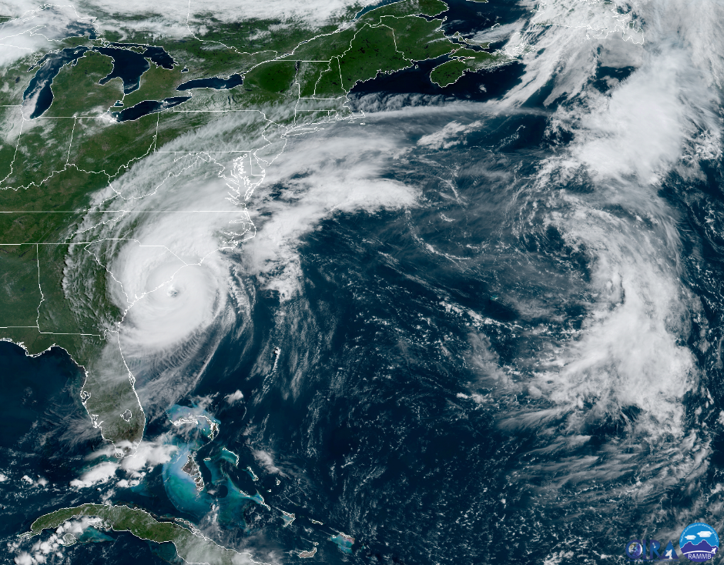
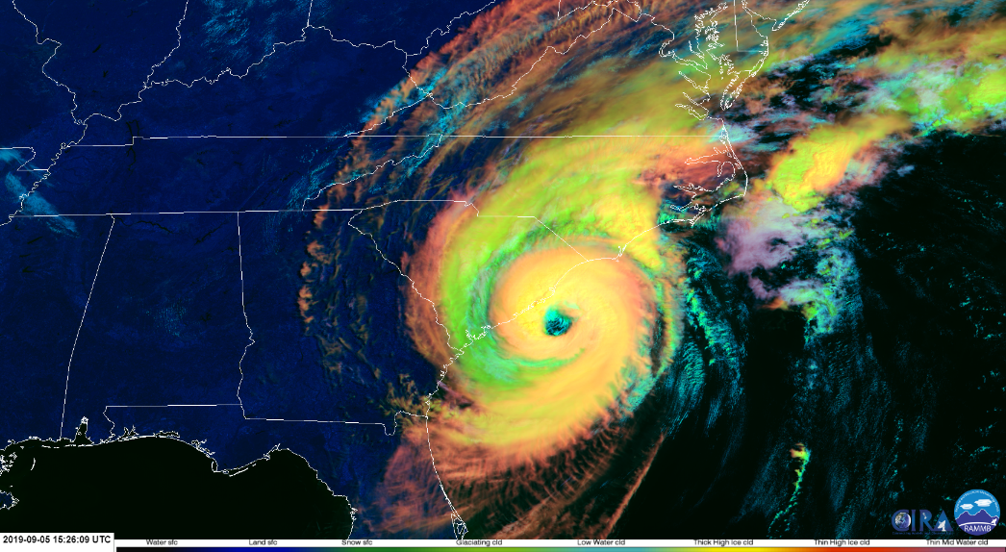
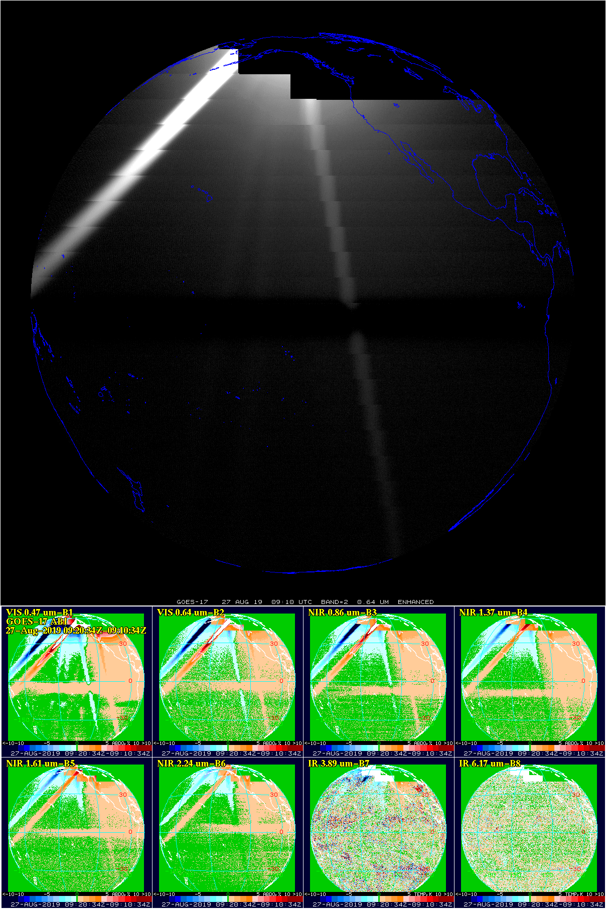
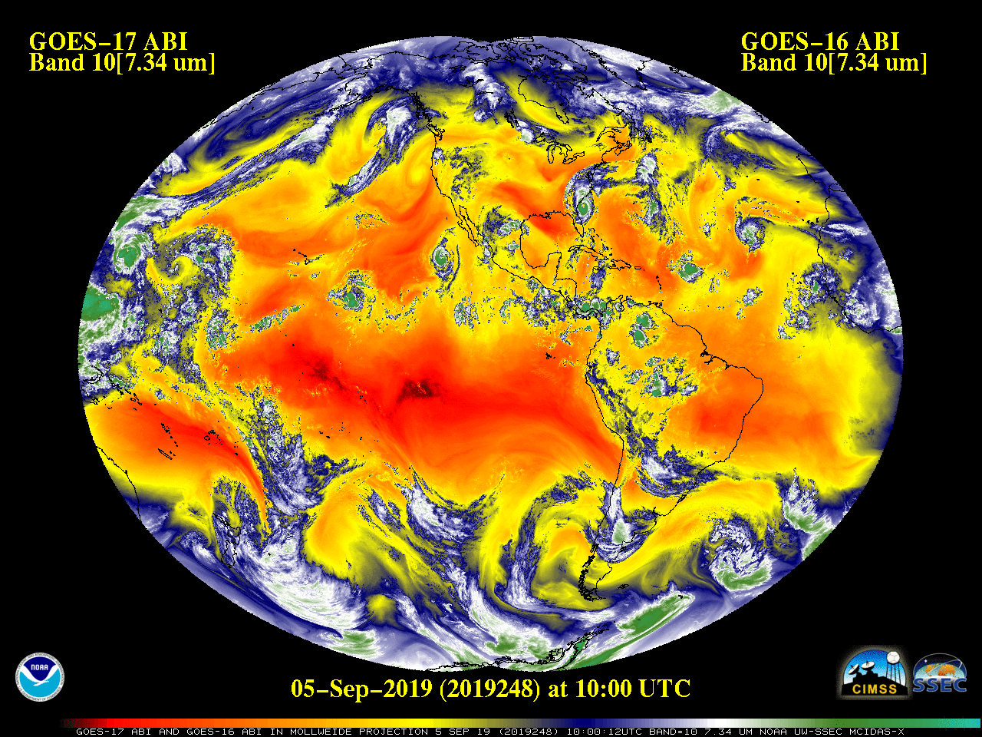
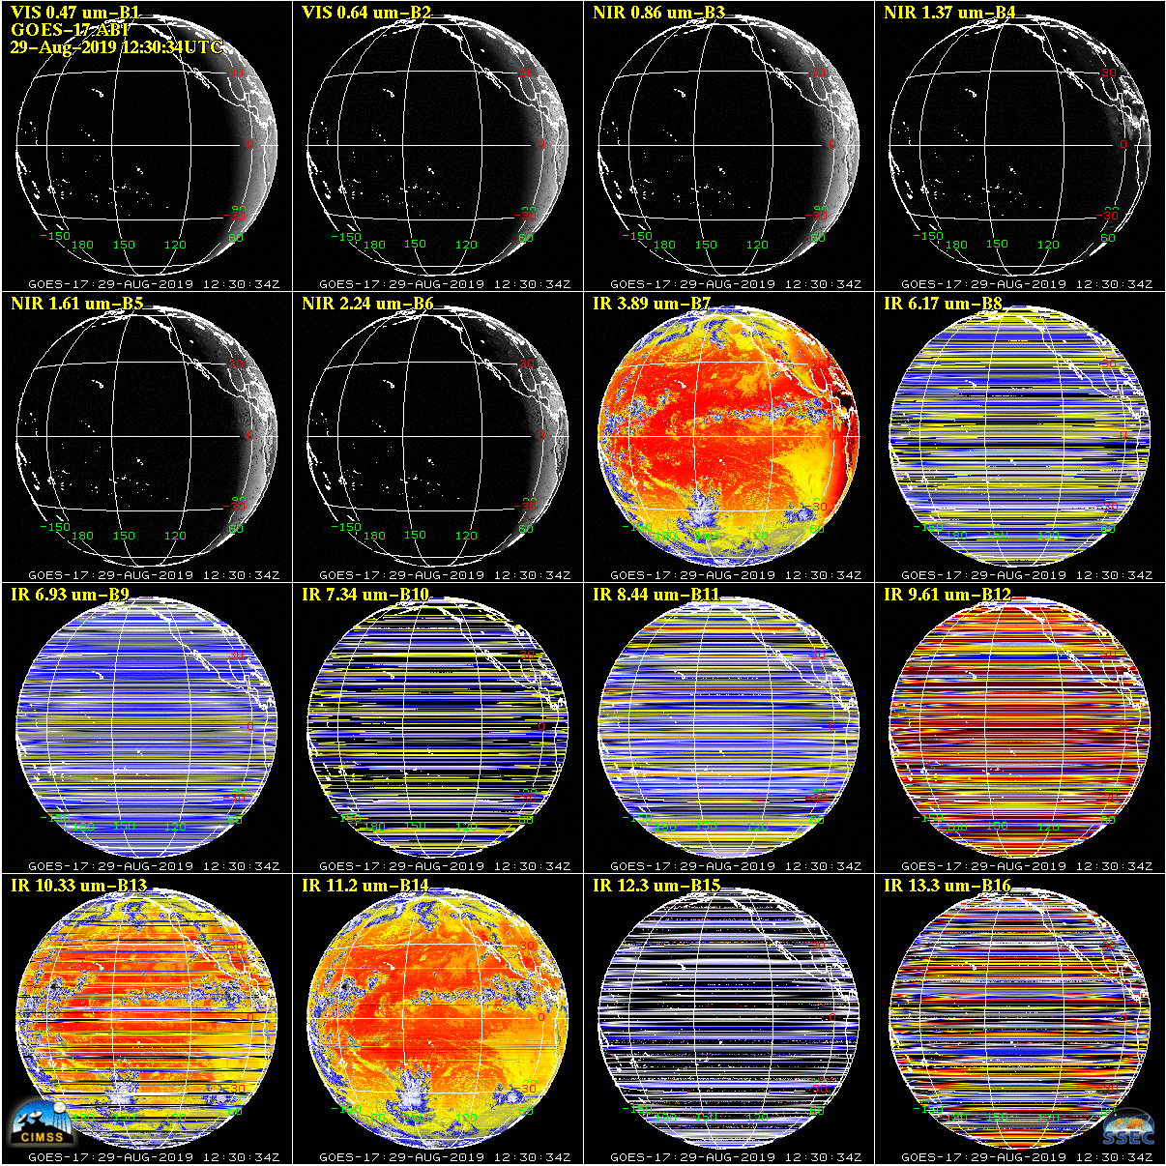
GOES ABI Imagery

Slide 6
FY20 APO Overview (milestones and risks)
JPSS VIIRS Imagery APO Milestone:
Develop code changes for Terrain-Corrected EDR Imagery and deliver to ASSISTT for use in operations.
Risk: must be accomplished before JPSS-2 code freeze (2021) to meet requirements.
Other Milestones/Deliverables:
Update DNB-to-NCC Look Up Table (LUT) for NOAA-20 pseudo-albedos, to replace S-NPP LUT currently in use.
Exploit time-shifted/motion/change information from S-NPP and JPSS-1/NOAA-20, providing Imagery-pair examples with 50 minute separation; Alaska user feedback in particular.
Images of the Month to StAR JPSS Program/website, and interesting Imagery to Social Media outlets.
Provide Imagery and products to Polar SLIDER and other online displays
Continue monitoring realtime Imagery for validation
Continue VIIRS blogs (Polar and Artic blogs)
Validate Imagery (as a KPP) for tests of ground system/software updates
See also https://docs.google.com/spreadsheets/d/1f99tP8A_Xaer72e9poQdumP2gFoMCAI8TC2cW1YKMdI/edit#gid=1902798135

Slide 7
FY20 APO Overview (milestones and risks)
GOES ABI Imagery APO Milestone:
Support the GOES-17 Loop Heat Pipe anomaly, via comparisons with the GOES-16 ABI
Other Milestones:
Fine-tuning the Data Quality Threshold Look Up Table.
Support the operational GOES-16 imagery, mostly via monitoring imagery quality and reporting any artifacts.
Continue generating images and animations for interest for NOAA and others.
Continue monitoring realtime Imagery for validation
Validate Imagery (as a KPP) for tests of ground system/software updates
See also https://docs.google.com/spreadsheets/d/1f99tP8A_Xaer72e9poQdumP2gFoMCAI8TC2cW1YKMdI/edit#gid=1902798135

Slide 8
FY20 Spend Plan Overview
JPSS VIIRS Imagery
CIRA/CSU (S. Miller, C. Seaman, S. Finley) | $380K
School of Mines – Earth Observation Night Lights/Fires/Boats (C. Elvidge) | $50K
CIMSS - McIDAS-X/V tools/display (D. Santek, T. Jasmin) | $50K
Total | $480K
See also https://docs.google.com/spreadsheets/d/1hVx3DuVoNBm2nHQ5hscQom7n4XSDYifD-lEThUg3dZo/edit#gid=1839449828

Slide 9
FY20 Spend Plan Overview
GOES ABI Imagery
CIMSS/UW (M. Gunshor, J. Nelson) | $240K
CIRA/CSU (S. Miller, etc.) | $60K
Total | $300K
See also https://docs.google.com/spreadsheets/d/1hVx3DuVoNBm2nHQ5hscQom7n4XSDYifD-lEThUg3dZo/edit#gid=1839449828

Slide 10
Product Line plans (JPSS)
See separate spreadsheet
Proposed initiatives (for continued funding):
Develop code changes for all 16 M-bands as EDR Imagery (now a fixed set of 6 of 16 bands, which limits EDR use for example in true-color/RGB imagery)
Assess Imagery (as level 1/primary product and a KPP) for ground system/code changes/updates.
Long-term monitoring of S-NPP and JPSS-1/NOAA-20
Pre-launch and post-launch checkout of JPSS-2 and beyond

Slide 11
Product Line plans (GOES Imagery)
See separate spreadsheet
Proposed initiatives (for continued funding):
Continue generating GOES-16 and GOES-17 images and animations of interest for NOAA and others.
Continue monitoring realtime Imagery for validation
GOES-T Post-launch test; including first light imagery
GOES-U Post-launch test; including first light imagery
Validate Imagery (as a KPP) for tests of ground system/software updates

Slide 12
Discussion and Feedback
Checking out GOES-14 each year has been unfunded at SSEC for over six years.
Due to the new funding structure at SSEC, what’s the proper path to see that this critical work, requested by OSPO is full resourced?
Similarly, twice this year, at the request of OSPO, GOES-13 was checked out for imagery quality. This means a needed antenna is available, pointed to the correct location, signal peaked, data ingested, displayed and reported.

