Slide 1
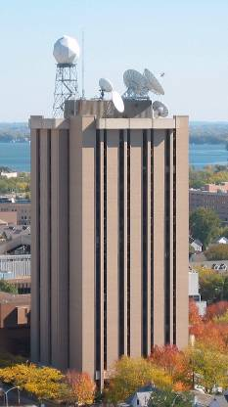
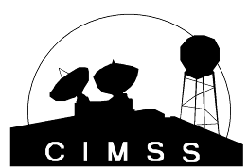
The ABI on GOES-R
Timothy J. Schmit
NOAA/NESDIS/Satellite Applications and Research
Advanced Satellite Products Branch (ASPB)
Kaba Bah, Mathew M. Gunshor, Jun Li, Scott Bachmeier, William Straka, etc.
CIMSS, Madison, WI
James J. Gurka, Steve Goodman, etc.
GOES-R Program Office
Eighth Annual Symposium on Future Operational Environmental Satellite Systems
New Orleans, LA
24 January 2011
UW-Madison

Slide 2
Also Thanks to…
Achtor, Tom; Ackerman, Steve; Antonelli, Paolo; Aune, Bob; Baggett, Kevin; Baum, Bryan; Ellrod, Gary; Feltz, Joleen; Feltz, Wayne; Frey, Rich; Griffin, Michael K.; Gumley, Liam; Heymann, Roger; Hillger, Don; Huang, Allen; Key, Jeff; Knuteson, Bob; Mecikalski, John; Menzel, Paul; Moeller, Chris; Mosher, Fred; Nelson, James; Nasiri, Shaima; Olander, Tim; Plokhenko, Youri; Prins, Elaine; Rabin, Bob; Revercomb, Hank; Schmidt, Chris; Schreiner, Tony; Seemann-Wetzel, Suzanne; Sieglaff, Justin; Strabala, Kathy; Sun, Fengying; Tobin, Dave; Velden, Chris; Wade, Gary; Whittaker, Tom; Woolf, Hal, Jason Oktin, etc.
Mitch Goldberg, AWG co-chairs, AWG Leads, Jaime Daniels, Walter Wolf, GPO, Jordan Gerth, Chian-Yi Liu, Jason Otkin, Thomas Greenwald, Monica Coakley, GOES-R flight/ground, Bill Smith, ASPB, PG, SSEC data center, CWG, NASA, ITT, etc.
You!

Slide 3
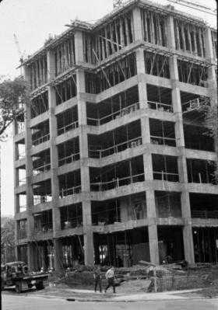
Outline
Current GOES Imager and Sounder
GOES-14/15
ABI (Advanced Baseline Imager)
Temporal
Spatial
Spectral
Summary
More information
Questions

Slide 4
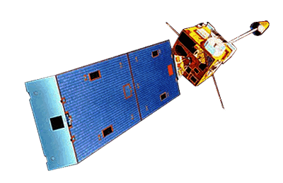
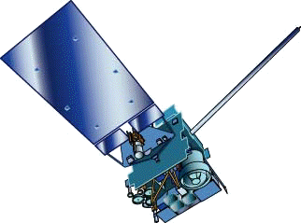
GOES-15
GOES-13/14/15 have similar instruments to GOES-8-12, but on a different spacecraft bus.
Spring and fall eclipse outages will be avoided by larger onboard batteries.
Improved navigation
Improved radiometrics
Similar stray light to GOES-13/14
Operational on Dec 6th, 2011
GOES-8/12
GOES-13/14/15

Slide 5
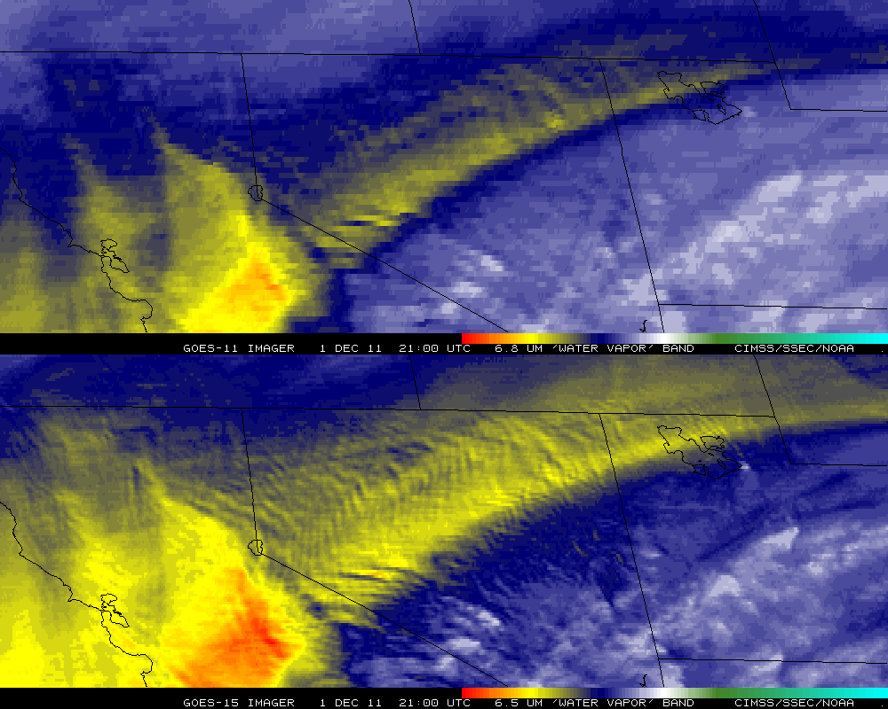
Improved GOES-15 WV imagery
GOES-11
GOES-15

Slide 6
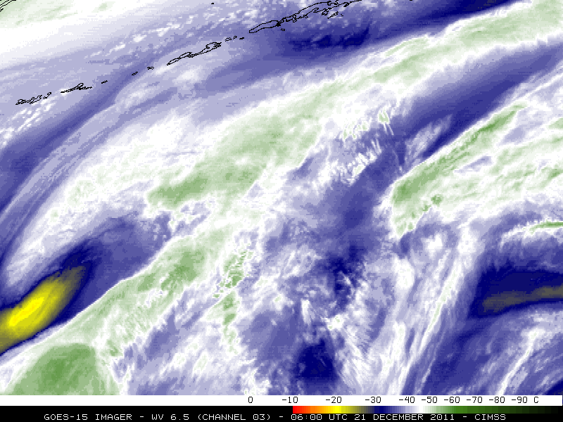
GOES-15 imagery

Slide 7
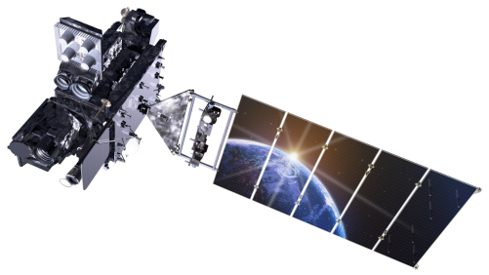
Outline
Current GOES Imager and Sounder
GOES-14/15
ABI (Advanced Baseline Imager)
Temporal
Spatial
Spectral
Summary
More information
Questions
Lockheed Martin

Slide 8
The Advanced Baseline Imager:
ABI Current
Spectral Coverage
16 bands 5 bands
Spatial resolution
0.64 μm Visible 0.5 km Approx. 1 km
Other Visible/near-IR 1.0 km n/a
Bands (>2 μm) 2 km Approx. 4 km
Spatial coverage
Full disk 4 per hour Scheduled (3 hrly)
CONUS 12 per hour ~4 per hour
Mesoscale Every 30 sec n/a
Visible (reflective bands)
On-orbit calibration Yes No

Slide 9
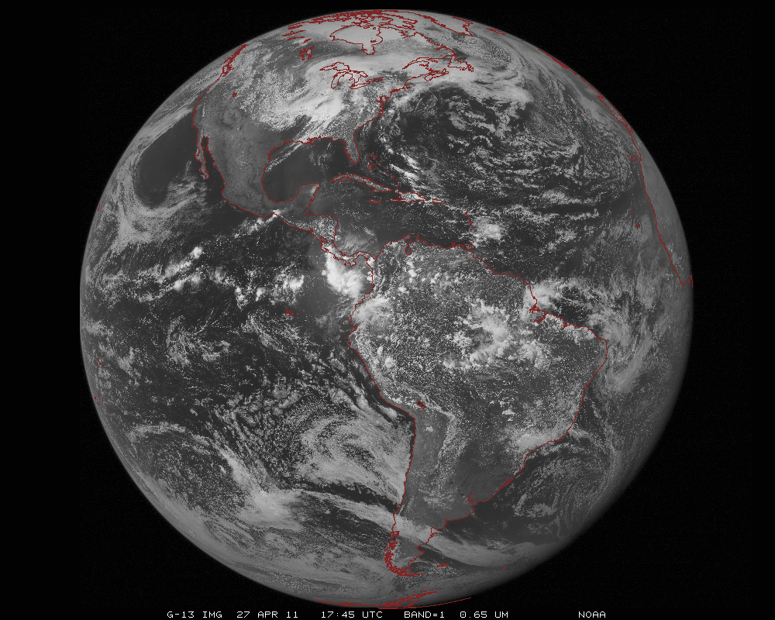
ABI scans about 5 times faster
than the current GOES imager
There are two anticipated scan modes for the ABI:
- Full disk images every 15 minutes + 5 min CONUS images + mesoscale.
or - Full disk every 5 minutes.

Slide 10
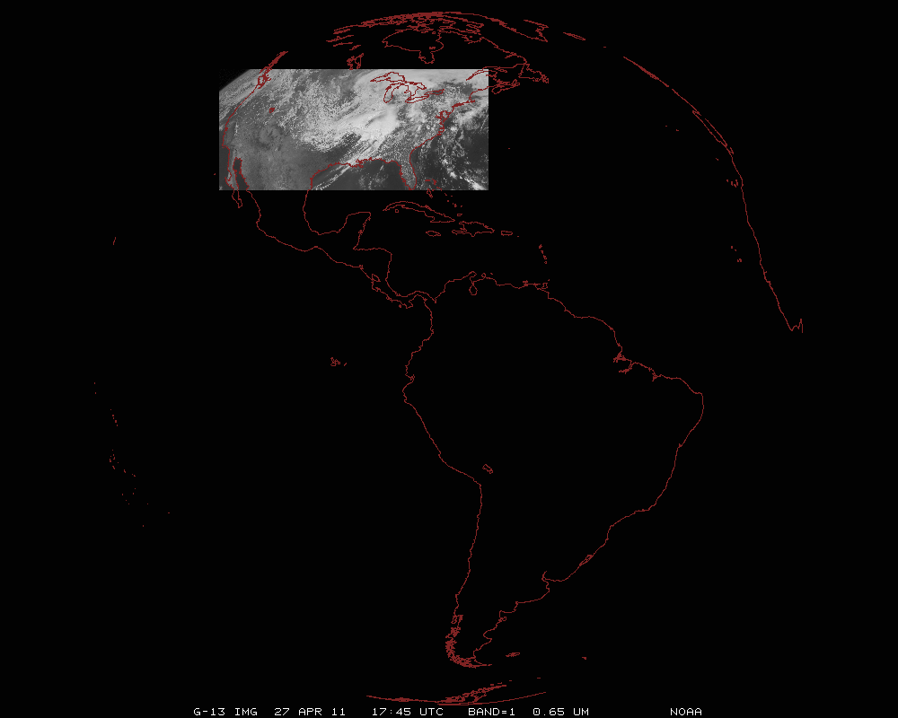
ABI can offer Continental US images every 5 minutes for routine monitoring of a wide range of events (storms, dust, clouds, fires, winds, etc).
This is every 15 or 30 minutes with the current GOES in routine mode.
Notes:
Approx. size of CONUS

Slide 11
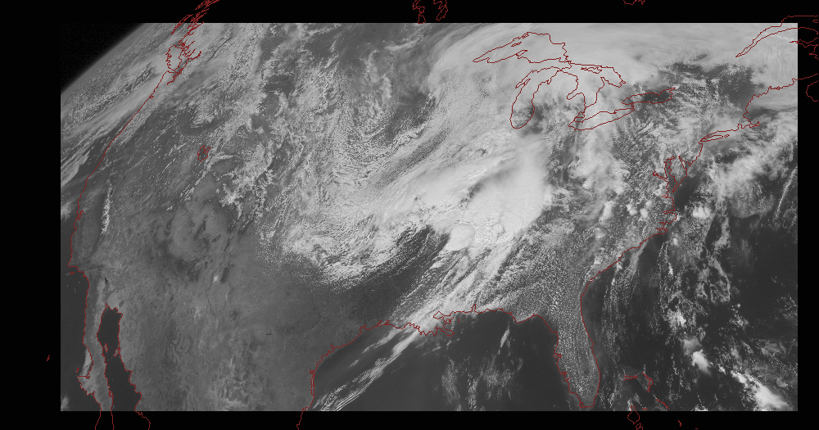
Notes:
Approx. size of CONUS

Slide 12
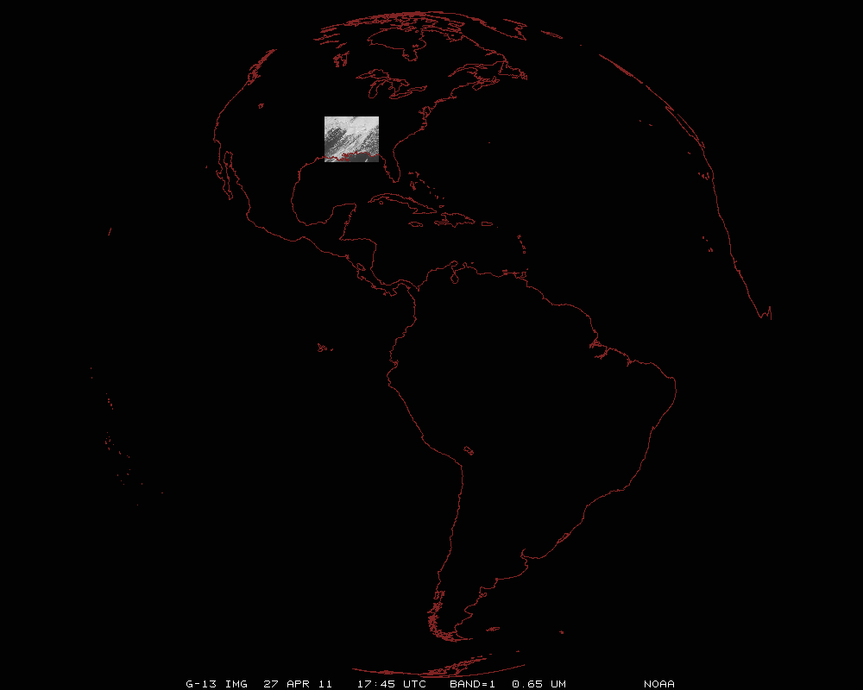
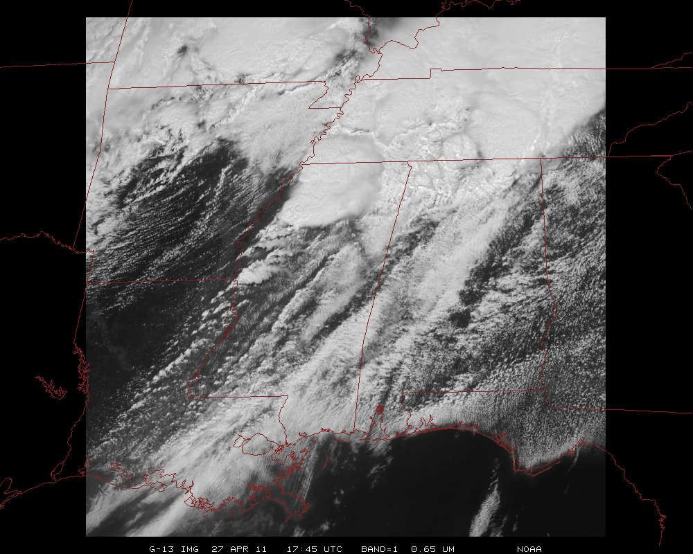
Mesoscale images every 30 seconds for rapidly changing phenomena
(thunderstorms, hurricanes, fires, etc). Or two regions every 60 seconds.
Notes:
Approx. size of meso-scale showing “Franklin”.

Slide 13
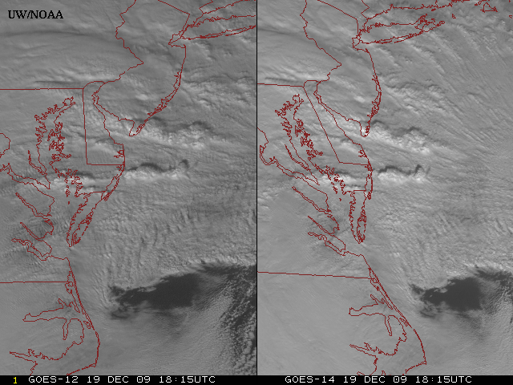
GOES-14: Sample “1-min” imagery
GOES-12
GOES-14
- Visible data from the GOES-14 NOAA Science Test, lead by Hillger and Schmit
- Can these type loops validate meso-scale models?
Notes:
Note the number of different levels of motion you can see (the cyclonic low level circulation over the ocean through the breaks in the higher clouds)... and you can't distinguish those on the GOES-12 loop.

Slide 14
ABI to Imager Noise Comparison
* From ITT at GUC7
ABI |  |  |  | GOES |  |  | -12 | -15
# | Freq. (um) | Spec (K) | Worst Case Estimate* | # | Freq (um) | Spec (K) | Measured (PLT) | Measured (PLT)
7 | 3.9 | 0.1 | 0.10 | 2 | 3.9 | 1.4 | 0.130 | 0.063
8 | 6.185 | 0.1 | 0.06
9 | 6.95 | 0.1 | 0.09 | 3 | 6.x | 1.0 | 0.15 | 0.17
10 | 7.34 | 0.1 | 0.11
11 | 8.5 | 0.1 | 0.04
12 | 9.61 | 0.1 | 0.04
13 | 10.35 | 0.1 | 0.05
14 | 11.2 | 0.1 | 0.04 | 4 | 10.7 | 0.35 | 0.11 | 0.06
15 | 12.3 | 0.1 | 0.05 | 5 | 12.0 | 0.35 | - | -
16 | 13.3 | 0.3 | 0.14 | 6 | 13.3 | 0.32 | 0.19 | 0.13
Similar instrument noise, even with 4-16 times finer spatial resolutions!
Notes:
NEdT is 300K for all bands, but the Water vapor bands are 240K for ABI and 230K for GOES!

Slide 15
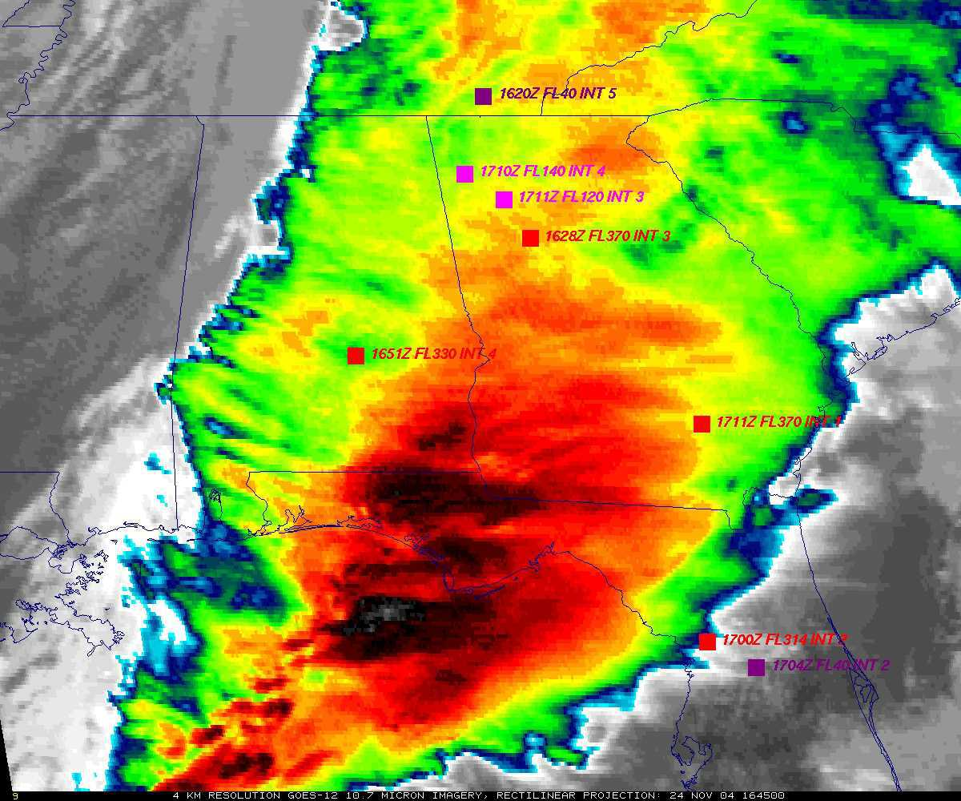
GOES: Cannot monitor waves
GOES
Aircraft turbulence reports plotted (squares).
Figure courtesy of K. Bedka and W. Feltz

Slide 16
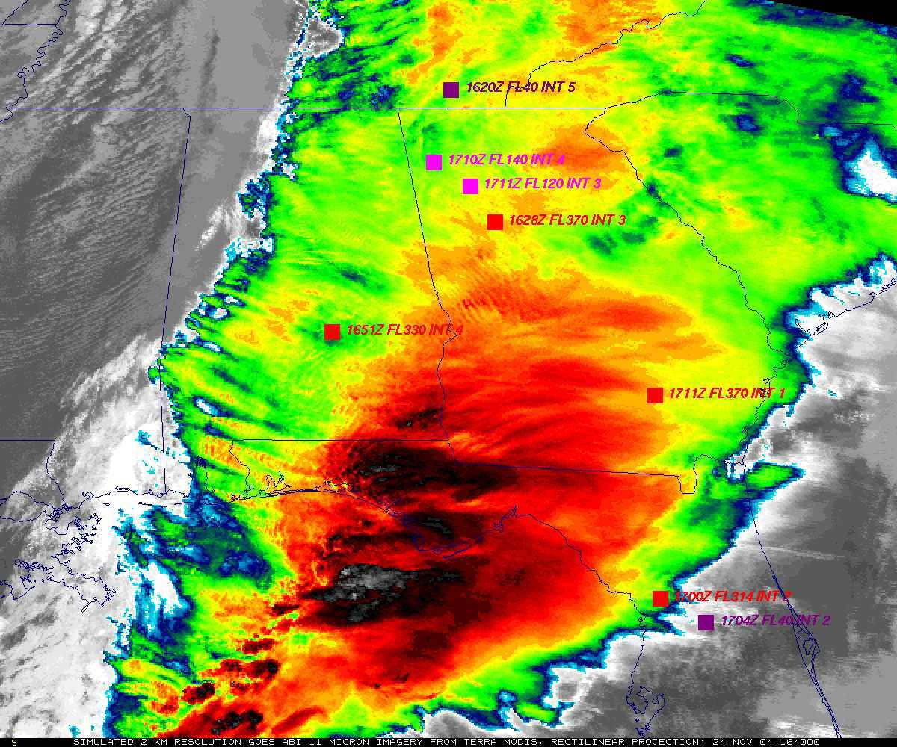
ABI: Can monitor waves
“ABI” from MODIS
Aircraft turbulence reports plotted (squares).
Figure courtesy of K. Bedka and W. Feltz

Slide 17
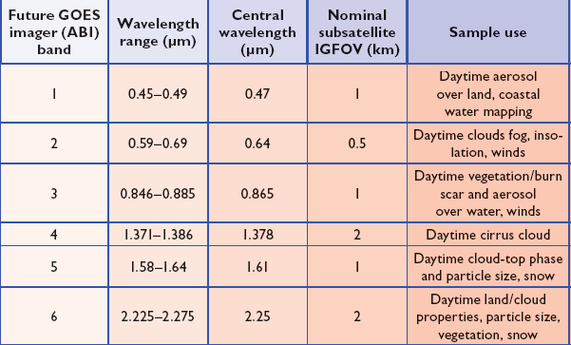
ABI Visible/Near-IR Bands
Schmit et al, 2005
Notes:
Schmit, T. J., M. M. Gunshor, W. P. Menzel, J. J. Gurka, J. Li, and A. S. Bachmeier, 2005: Introducing the next-generation Advanced Baseline Imager on GOES-R. Bull. Amer. Meteor. Soc., 86, 1079-1096.

Slide 18
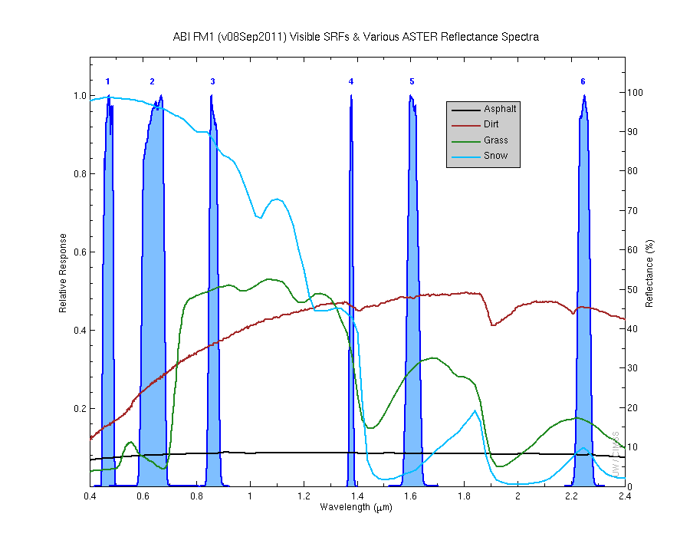
Visible and near-IR channels on the ABI
Aerosols, Insolation
Clouds, Snow
Vegetation, Imagery
Cloud mask, Suspended matter
Snow, Phase
Cloud Particle size
Sample use only, many other uses
The ABI visible and near-IR bands have many uses.
Notes:
Schmit, T. J., M. M. Gunshor, W. P. Menzel, J. J. Gurka, J. Li, and A. S. Bachmeier, 2005: Introducing the next-generation Advanced Baseline Imager on GOES-R. Bull. Amer. Meteor. Soc., 86, 1079-1096.

Slide 19
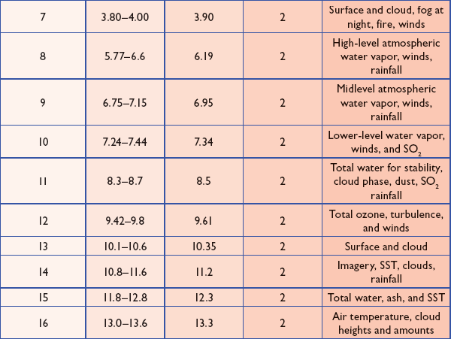
ABI IR Bands
Schmit et al, 2005
Notes:
Schmit, T. J., M. M. Gunshor, W. P. Menzel, J. J. Gurka, J. Li, and A. S. Bachmeier, 2005: Introducing the next-generation Advanced Baseline Imager on GOES-R. Bull. Amer. Meteor. Soc., 86, 1079-1096.

Slide 20
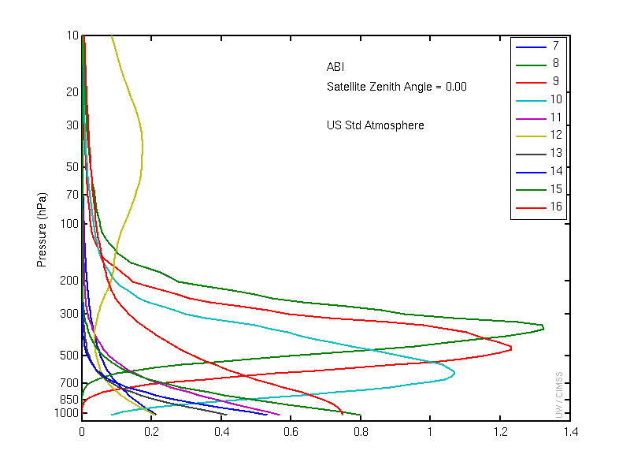
ABI IR Weighting Functions
Clear-sky

Slide 21
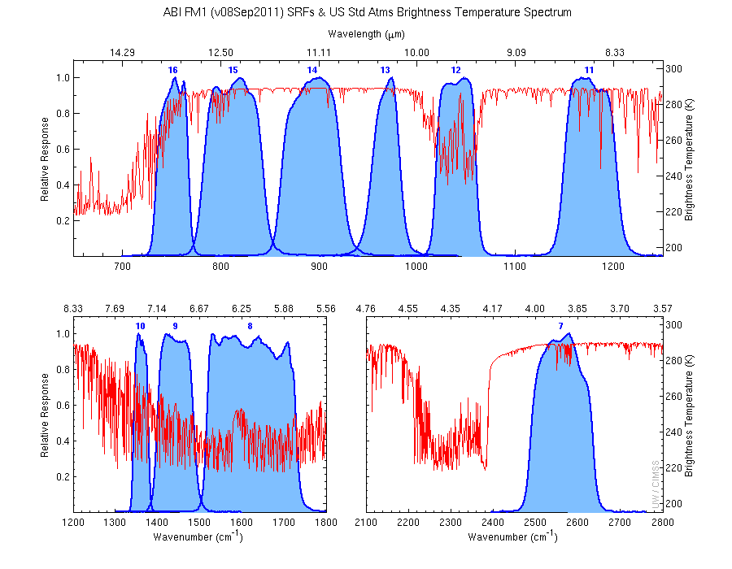
The IR channels on the ABI
Clouds, Stability Indices
SST, Fires, Radiances
Ozone, Downward Radiation
Rainfall, Aerosol
Hurricane, Imagery
Cloud Phase, SST
Sample use only, many other uses
SO2, Radiances
Winds, WV profiling
TPW, Rainfall rate
Fires, Fog
ABI has many more bands than the current operational GOES imagers.
Notes:
Schmit, T. J., M. M. Gunshor, W. P. Menzel, J. J. Gurka, J. Li, and A. S. Bachmeier, 2005: Introducing the next-generation Advanced Baseline Imager on GOES-R. Bull. Amer. Meteor. Soc., 86, 1079-1096.

Slide 22
These NWP model simulations were performed on the 'cobalt' supercomputer at the National Center for Supercomputing Applications at the University of Illinois.
Band 1: Daytime “Blue” band – aerosols, solar insolation, snow cover
Notes:
Otkin, J. A., T. J. Greenwald, J. Sieglaff, and H.-L. Huang, 2009: Validation of a large-scale simulated brightness temperature dataset using SEVIRI satellite observations. J. Appl. Meteor. Climatol., 48, 1613-1626.
Feltz, W. F., K. M. Bedka, J. A. Otkin, T. Greenwald, and S. A. Ackerman, 2009: Understanding satellite-observed mountain wave signatures using high-resolution numerical model data. Wea. Forecasting, 24, 76-86.
Otkin, J. A., and T. J. Greenwald, 2008: Comparison of WRF model-simulated and MODIS-derived cloud data. Mon. Wea. Rev., 136, 1957-1970.

Slide 23
Band 2: Daytime “Red” band – clouds, cloud-mask, optical depth, winds, etc.

Slide 24
Band 3: Daytime “Veggie” band – NDVI, solar insolation, snow cover

Slide 25
Band 4: Daytime “Cirrus” band – cloud mask, aerosol detection

Slide 26
Band 5: Daytime “Snow” band – snow cover, cloud mask, etc.

Slide 27
Band 6: Daytime “Cloud-top phase” band – cloud particle size, snow cover

Slide 28
Band 7: Shortwave IR window band - fog, fires, winds, SST, etc.

Slide 29
Band 8: Upper-level tropospheric water vapor band – moisture, flow, winds

Slide 30
Band 9: Upper/mid-level tropospheric water vapor band – moisture, flow, winds

Slide 31
Band 10: Lower mid-level tropospheric water vapor band– moisture, flow, winds

Slide 32
Band 11: “Cloud-top phase” band – SO₂, dust, SST, stability indices, etc.

Slide 33
Band 12: “Ozone” band

Slide 34
Band 13: “Clean” IR longwave window band – imagery, TPW, etc.

Slide 35
Band 14: IR longwave window band – many cloud parameters, SST, snow cover

Slide 36
Band 15: “Dirty” IR longwave window band – many cloud parameters, TPW

Slide 37
Band 16: “CO2” longwave IR band – cloud height/pressure, stability indices

Slide 38
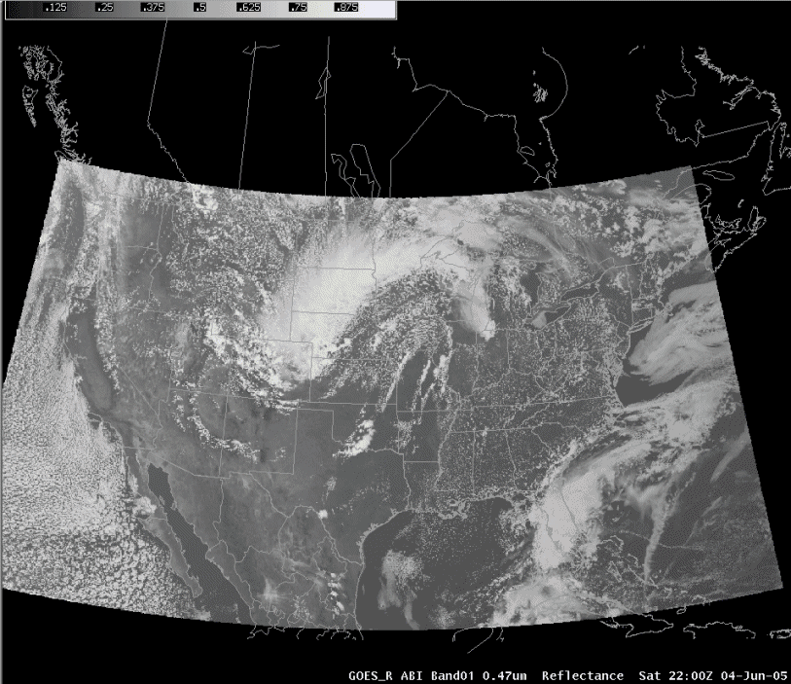
ABI in AWIPS (via netCDF)
J. Oktin et al., CIMSS
Simulated Advanced Baseline Imager (ABI) bands shown; in the legacy AWIPS.
Notes:
http://cimss.ssec.wisc.edu/goes/abi/

Slide 39
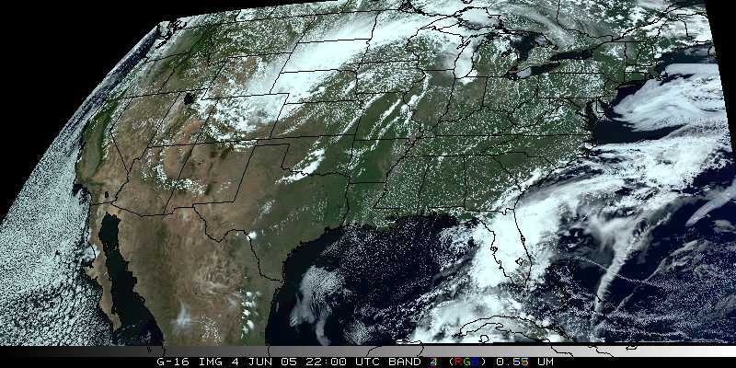
Visualization (“decision aid”)
“True Color” with “synthetic” green from ABI simulated data (from CIMSS); image from Don Hillger, RAMMB.

Slide 40
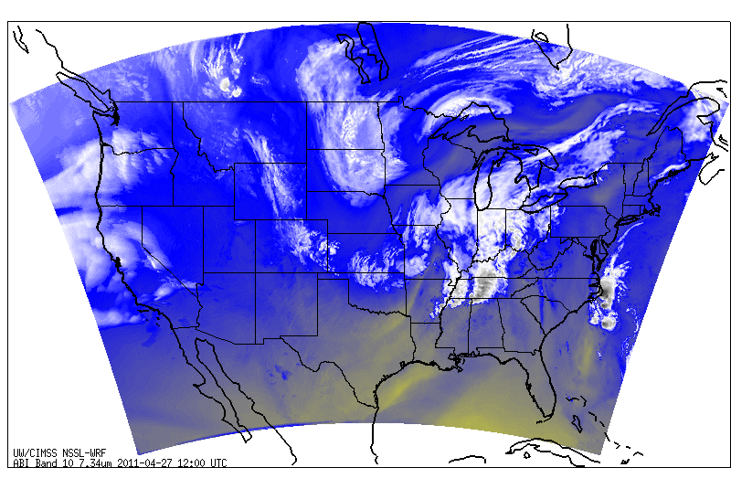
Simulated ABI band – NSSL WRF
- Run in near-realtime each day.
- Future plans call for all ABI bands to be simulated, currently only 8 or 9 are being generated.
http://cimss.ssec.wisc.edu/goes_r/proving-ground/nssl_abi/nssl_wrf_goes.html

Slide 41
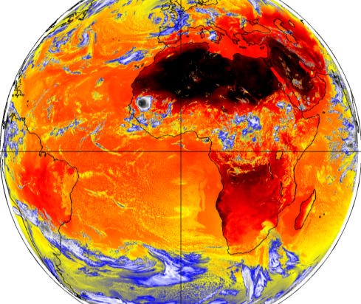
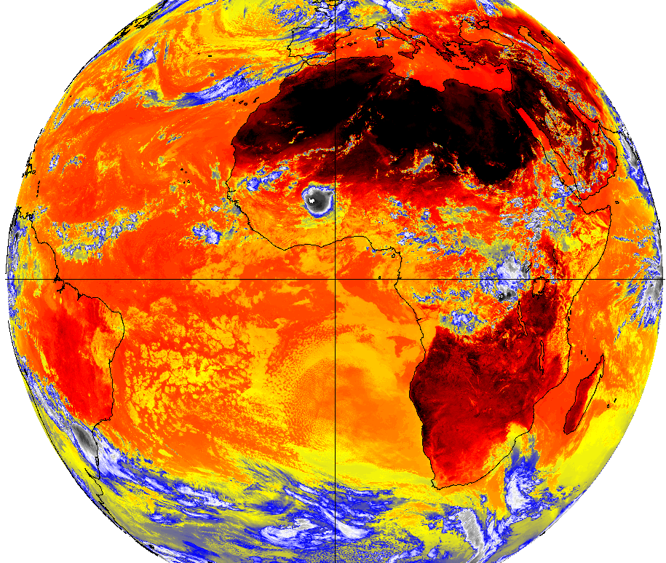
WRF Model-Derived Proxy Radiance Datasets
(UW CIMSS)
Which is which – Proxy/Observed or Observed/Proxy SEVIRI 10.8 μm Tb?
J. Oktin et al., CIMSS
Notes:
Data from this high-resolution simulation has been extensively used by two validation studies, with results shown in the next slide. To the best of our knowledge, this was the largest model simulation (in terms of memory) ever performed at the time and was only surpassed by an even larger simulation late last year. Real image is on the right.

Slide 42
GOES-R Products
Baseline Products
Future Capabilities
Advanced Baseline Imager (ABI)
Aerosol Detection (Including Smoke and Dust) Aerosol Optical Depth (AOD) Clear Sky Masks Cloud and Moisture Imagery Cloud Optical Depth Cloud Particle Size Distribution Cloud Top Height Cloud Top Phase Cloud Top Pressure Cloud Top Temperature Derived Motion Winds Derived Stability Indices Downward Shortwave Radiation: Surface Fire/Hot Spot Characterization Hurricane Intensity Estimation Land Surface Temperature (Skin) Legacy Vertical Moisture Profile Legacy Vertical Temperature Profile Radiances Rainfall Rate/QPE Reflected Shortwave Radiation: TOA Sea Surface Temperature (Skin) Snow Cover Total Precipitable Water Volcanic Ash: Detection and Height
Geostationary Lightning Mapper (GLM)
Lightning Detection: Events, Groups & Flashes
Space Environment In-Situ Suite (SEISS)
Energetic Heavy Ions Magnetospheric Electrons & Protons: Low Energy Magnetospheric Electrons: Med & High Energy Magnetospheric Protons: Med & High Energy Solar and Galactic Protons
Magnetometer (MAG)
Geomagnetic Field
Extreme Ultraviolet and X-ray Irradiance Suite (EXIS)
Solar Flux: EUV Solar Flux: X-ray Irradiance
Solar Ultraviolet Imager (SUVI)
Solar EUV Imagery
Advanced Baseline Imager (ABI)
Absorbed Shortwave Radiation: Surface Aerosol Particle Size Aircraft Icing Threat Cloud Ice Water Path Cloud Layers/Heights Cloud Liquid Water Cloud Type Convective Initiation Currents Currents: Offshore Downward Longwave Radiation: Surface Enhanced “V”/Overshooting Top Detection Flood/Standing Water Ice Cover Low Cloud and Fog Ozone Total Probability of Rainfall Rainfall Potential Sea and Lake Ice: Age Sea and Lake Ice: Concentration Sea and Lake Ice: Motion Snow Depth (Over Plains) SO₂ Detection Surface Albedo Surface Emissivity Tropopause Folding Turbulence Prediction Upward Longwave Radiation: Surface Upward Longwave Radiation: TOA Vegetation Fraction: Green Vegetation Index Visibility

Slide 43
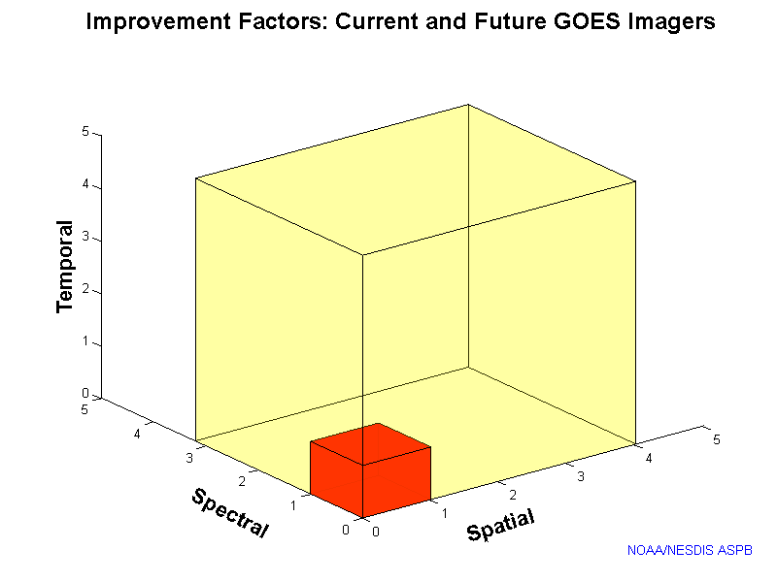
Outline
Current GOES Imager and Sounder
GOES-14/15
ABI (Advanced Baseline Imager)
Temporal
Spatial
Spectral
Summary
More information
Questions

Slide 44
Approximate spectral and spatial resolutions of US GOES Imagers
~ Band Center (um) | GOES-6/7 | GOES-8/11 | GOES-12/13 | GOES-14/15 | GOES-R+
0.47
0.64
0.86
1.6
1.38
2.2
3.9
6.2
6.5/6.7/7 | 14km
7.3
8.5
9.7
10.35
11.2
12.3
13.3
Visible
Near-IR
Box size represents pixel size
4
2
“MSI mode”
Infrared
4
Notes:
0.40 inches = 4km; 0.80 inches = 8km
MSI is Multi-Spectral Imaging Mode (dashed boxes)
This does not show other improvements: SNR, MTF, bit-depth, navigation, coverage rates, etc.

Slide 45
Summary
The ABI on GOES-R will improve over the current instruments (spectrally, spatially and temporally), plus improved image navigation and registration and radiometer performance.
These improvements will greatly assist a host of applications and new products.
Contact information:
tim.j.schmit@noaa.gov

Slide 46
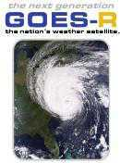
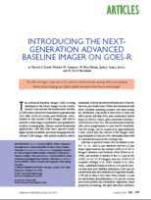
More information
GOES-R:
http://www.goes-r.gov
http://www.meted.ucar.edu/index.htm
http://cimss.ssec.wisc.edu/goes_r/proving-ground.html
GOES and NASA:
http://goespoes.gsfc.nasa.gov/goes/index.html
http://goes.gsfc.nasa.gov/text/goes.databookn.html
UW/SSEC/CIMSS/ASPB:
http://cimss.ssec.wisc.edu/goes_r/proving-ground/nssl_abi/nssl_abi_rt.html
http://cimss.ssec.wisc.edu/goes_r/awg/proxy/nwp/
http://cimss.ssec.wisc.edu/goes/abi/
http://cimss.ssec.wisc.edu/goes/abi/wf
http://cimss.ssec.wisc.edu/goes/blog/
http://www.ssec.wisc.edu/data/geo/
AMS BAMS Article on the ABI (Aug. 2005)

Slide 47
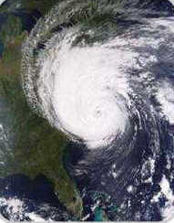
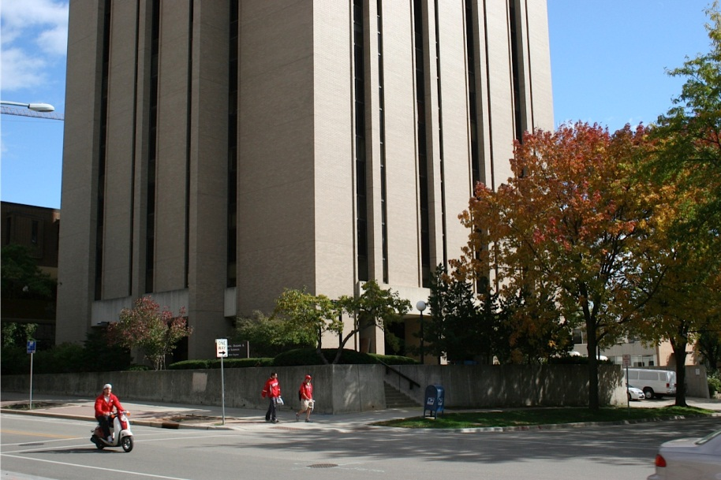
Acknowledgements
The authors would like to thank the entire GOES-R team (especially the GOES-R Program Office); within the government, industry and academia.
The views, opinions, and findings contained in this presentation are those of the author and should not be construed as an official National Oceanic and Atmospheric Administration or U.S. Government position, policy, or decision.

