Slide 1
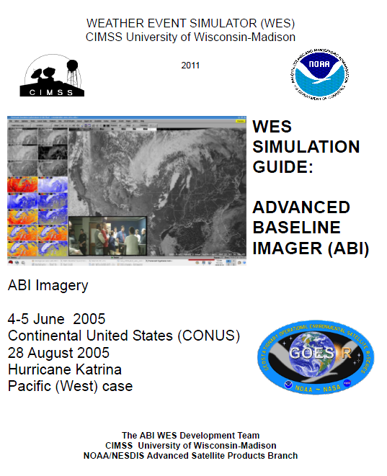
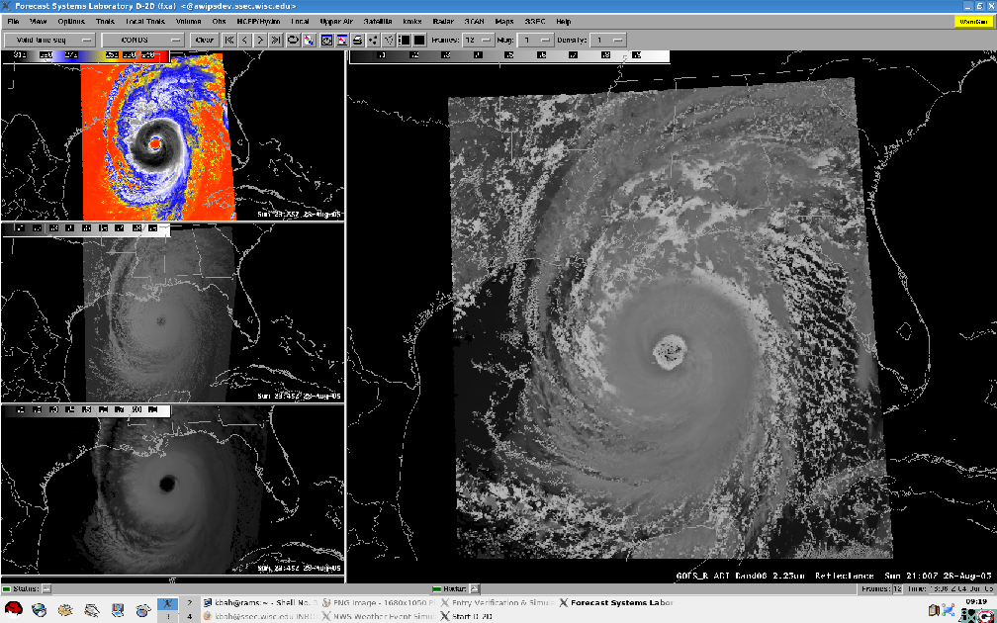
GOES-R ABI WES
Worked with CIMSS/ASPB in developing a GOES-R ABI WES (Weather Event Simulator), which used simulated images to showcase possible uses of each band.

