Slide 1
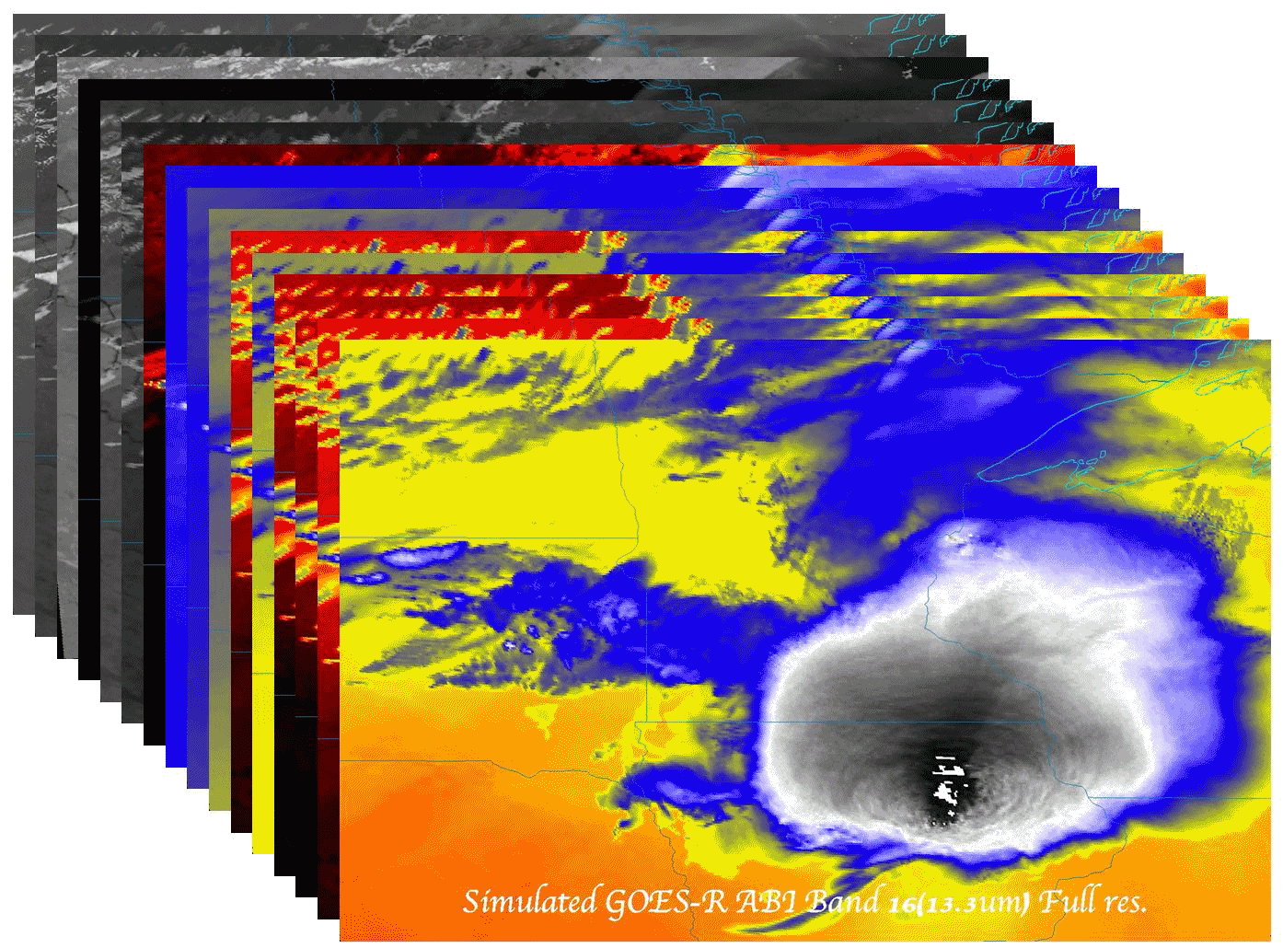
GOES (Geostationary Operational Environmental Satellite) Rapid Scans
Timothy J. Schmit (tim.j.schmit@noaa.gov)
NOAA/NESDIS/Satellite Applications and Research
Advanced Satellite Products Branch (ASPB)
Madison, WI
With help from many others
COPC: COMMITTEE FOR OPERATIONAL PROCESSING CENTERS
5 November 2014
UW-Madison

Slide 2
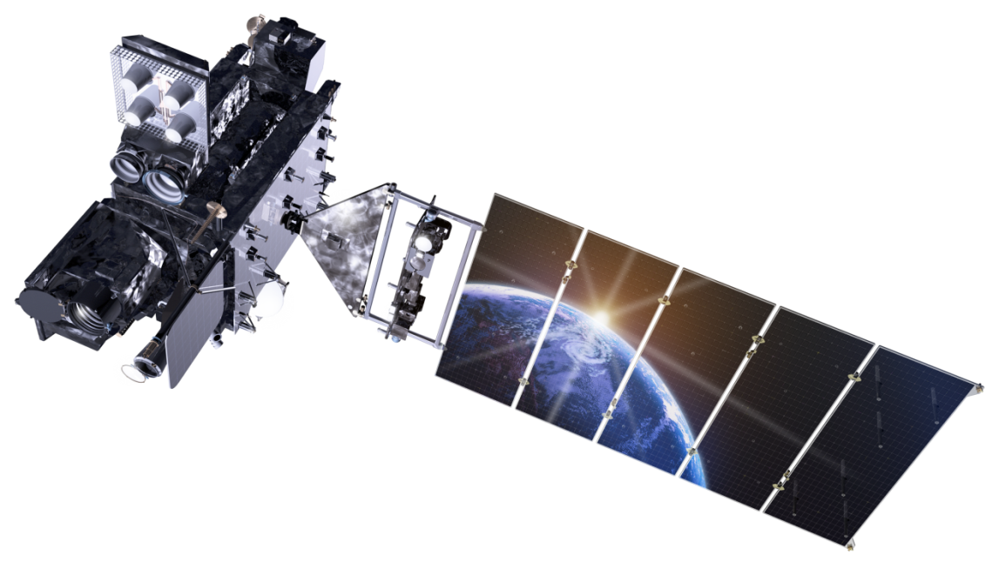
Outline
GOES RSO
Recent GOES-West updates
GOES-R Rapid Scans
Baseline scan strategies
GOES SRSOR
2014 overview
SRSOR 2012/2013 recap
SRSOR examples
More information
Links (animations/references/data)
Lockheed Martin

Slide 3
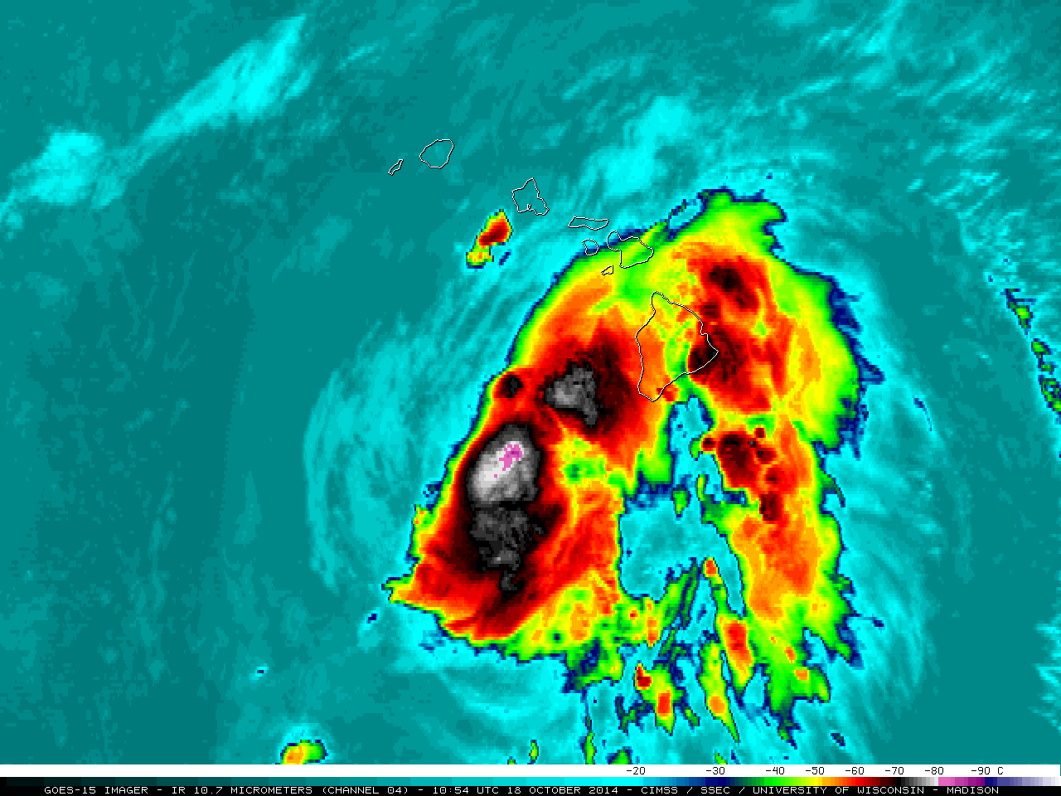
GOES-West RSO
As a result of recent testing, GOES-15 (West) is once again able to call Rapid Scan Operations (RSO) over Hawaii
RSO was called for almost 6 days to monitor Tropical Cyclone Ana
http://www.ospo.noaa.gov/Operations/GOES/schedules.html
http://cimss.ssec.wisc.edu/goes/blog/archives/16856
http://cimss.ssec.wisc.edu/goes/blog/archives/17027

Slide 4
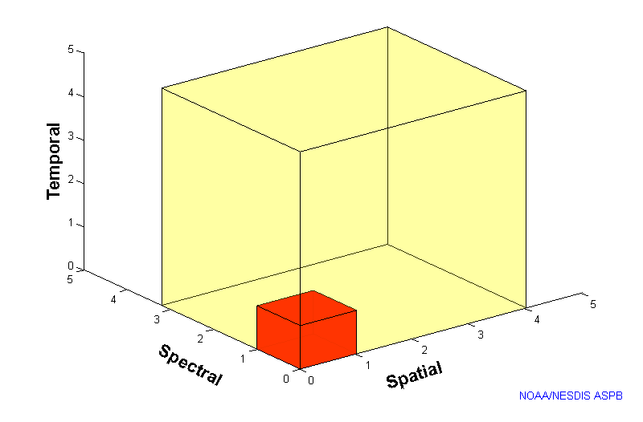
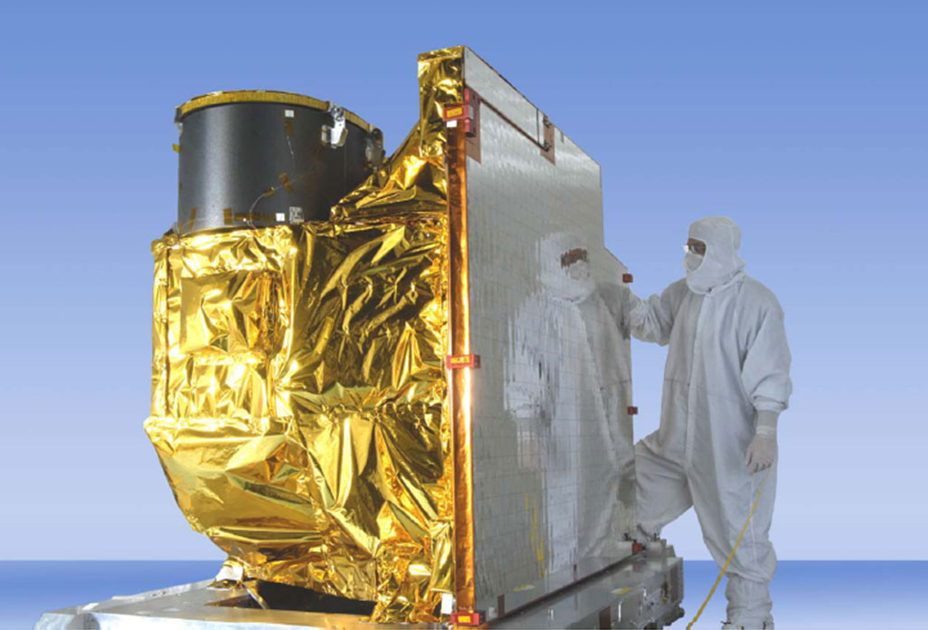
Advanced Baseline Imager
5
4
3
X
Faster scanning (5-minute full disk vs. 25-minute)
X
Improved spatial resolution (2 km IR vs. 4 km)
X
More spectral bands (16 on ABI vs. 5)
Notes:
Slide from J. Gerth, CIMSS.

Slide 5
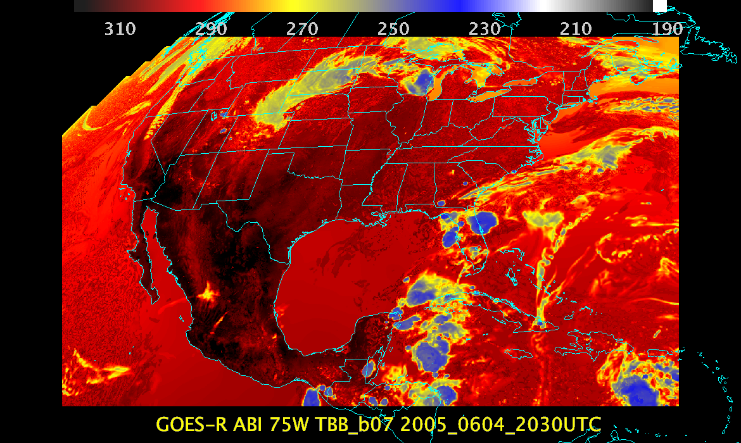
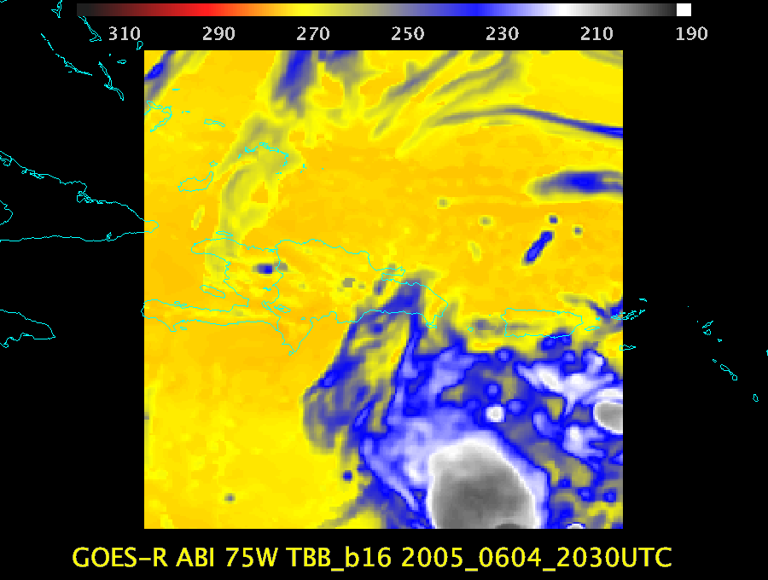
ABI Scan Modes
FD
CONUS
MESO
Scan mode (3) or ‘flex mode’ for the ABI:
- Full disk every 15 minutes + 5 min CONUS
+ 1-min mesoscales (2 locations).
[Scan mode (4) or ‘Continuous Full Disk’ (CFD) is a full disk every 5 min]

Slide 6
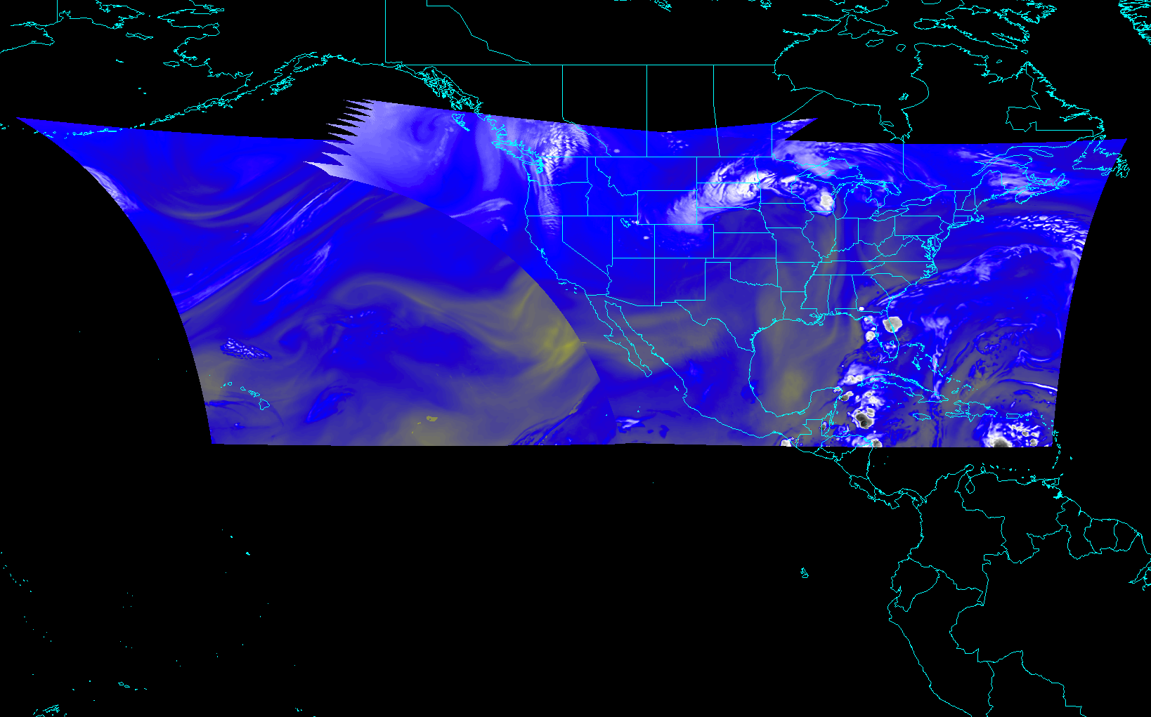
ABI CONUS sectors from East and West (proposed)
Notes:
Different days simulated.

Slide 7
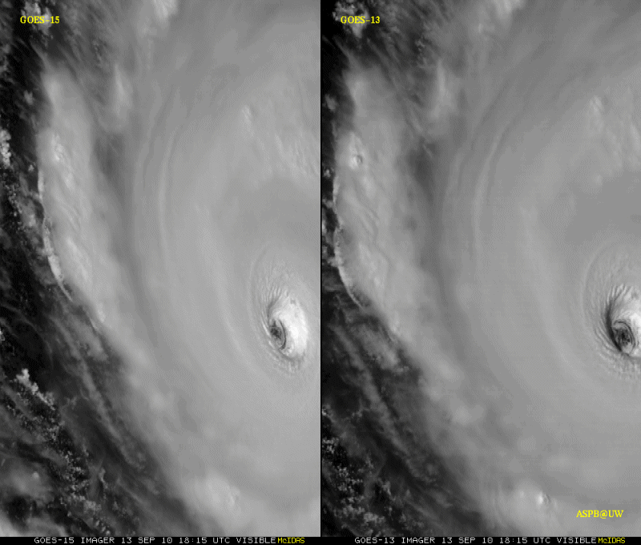
GOES-15: Sample “1-min” imagery
1-min
30-min
Visible data from the GOES-15 NOAA Science Test, lead by Hillger and Schmit
Notes:
Igor

Slide 8
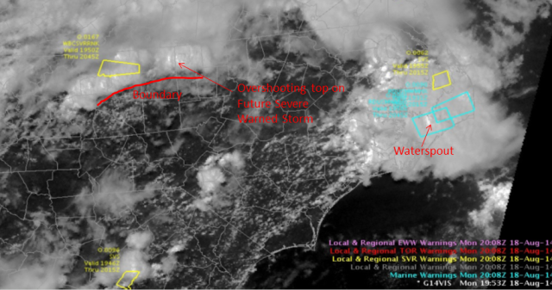
GOES-14: Special Rapid Scanning offers glimpse of the ABI
SRSOR (Super Rapid Scan Operations for GOES-R) from GOES-14 imager
More SRSOR data in both May 8-24 and August 14-28 of 2014.
http://cimss.ssec.wisc.edu/goes/srsor2014/GOES-14_SRSOR.html
Many phenomena were observed: convection, hurricanes, fires, smoke, ...
Data used by the NWS.
Data achived at a number of locations, including NOAA NESDIS CLASS.
NWS Forecaster: SRSOR “….certainly increased our confidence in our warning decisions and ultimately made the process more efficient … having the Super Rapid Scan data very valuable and very worthwhile, … should be able to be built into everyday operations at NWS weather forecast offices around the country.”
GOES-14 Image from CIMMSE blog
http://cimmse.wordpress.com/2014/08/24/an-example-of-how-goes-14-super-rapid-scan-operations-for-goes-r-helped-during-warning-operations-at-nws-wfo-raleigh-nc-on-18-august-2014/
GOES-14 provided very unique information and offers a glimpse into the possibilities that will be provided by the ABI on GOES-R.
Notes:
Data was provided to many groups: WPC, OPC, AWC, SPC, SAB, several WFO, who used the data for discussions and forecasts.

Slide 9
SRSOR in SPC
7 direct references in SPC text forecast products during May and August GOES-14 SRSOR periods
SPC forecasters consistently viewed the 1-min imagery in Operations, incorporating it into their decision-making
Allowed for easier analysis, identification and tracking of:
deepening and clumping of BL cu, vertical growth of cumulus convection, identification and tracking of boundaries, overshooting and collapsing storm tops, character of storm anvils, convectively generated outflow, gravity wave progression, visual assessment of storm-top divergence and flanking line development, diagnosis of near-storm environment though convective trends and cloud character,
All on time scales not otherwise available.
Over time, this imagery will allow forecasters to gain a better understanding of processes related to CI
William Line, SPC Satellite Liaison

Slide 10
GOES-14 SRSOR in SPC
“The one-minute imagery helped me to anticipate areas of new convective development as well, which was useful in developing short-term forecasts and mesoscale discussions for severe weather. ”
“… having the data available routinely would very likely, over time, allow forecasters to gain a better understanding of processes related to convective initiation, as these processes occurring within a cu field would be visually revealed in high temporal -resolution data in a way that 15- or 30-minute imagery cannot as clearly depict.”
“In the pre-storm environment, these data were especially helpful in monitoring the vertical growth of cumulus convection and in the identification of boundaries.”
“I found it to be very useful in… Using cloud character and trends to diagnose boundary locations and motion, and nowcast their potential for either CI or influences on upshear storms to interact therewith.”
“This has provided extra confidence and lead time for the issuance of two mesoscale discussions compared to the normal satellite update frequency/latency. … quite striking. It’s analogous to the difference between watching high-def TVs vs. standard def, ... Satellite imagery at 1-min temporal resolution needs to become the new standard for severe weather operations.”
“Post-storm initiation, the high-resolution data allowed for careful analysis of overshooting and collapsing tops, the character of the storm anvils (ie. health of the storm) and the identification of convectively generated outflows.”
http://satelliteliaisonblog.wordpress.com/category/spc/
Notes:
Highlights added.

Slide 11
GOES-14 Super Rapid Scan Operations to Prepare for GOES-R
SRSOR (Super Rapid Scan Operations for GOES-R) from GOES-14 imager
Data between mid-August and September 24th and late October 2012; and two days in June and 12 days in mid-August, 2013; and mid-May (8-24), 2014
http://cimss.ssec.wisc.edu/goes/srsor/GOES-14_SRSOR.html and
http://cimss.ssec.wisc.edu/goes/srsor2013/GOES-14_SRSOR.html
http://cimss.ssec.wisc.edu/goes/srsor2014/GOES-14_SRSOR.html
GOES-14 provided very unique data and offered a glimpse into the possibilities that will be provided by the ABI on GOES-R in one minute mesoscale imagery
Many phenomena were observed
GOES-14 visible image showing rapid convective development

Slide 12
Future vs Current Imagery

Slide 13
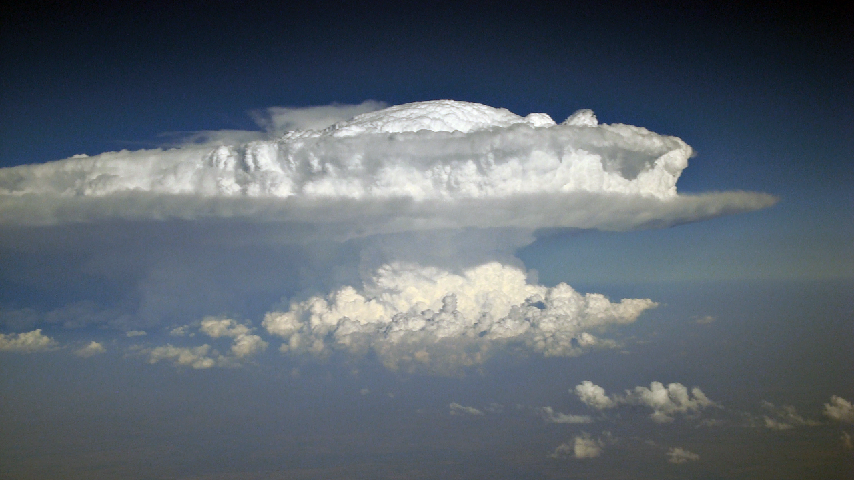
Monitoring The Co-Evolution Of
Total Lightning, Radar, and
GOES-14 Super Rapid Scan Observations
Of Deep Convective Clouds
Kristopher M. Bedka, Cecilia Wang, Patrick Minnis
NASA Langley Research Center
Ryan Rogers, Lawrence D. Carey
University of Alabama in Huntsville
Wayne Feltz
Cooperative Institute for Meteorological Satellite Studies
University of Wisconsin-Madison
Jan Kanak
Slovak Hydrometeorological Institute

Slide 14
Above-Anvil Cirrus Plume
Severe Weather Relationships
Plumes appeared in advance of a severe weather report for 28 of the 33 (85%) events
For the 5 events with no lead-time, the plumes emerged a maximum of 10 mins after the severe weather report
For the other 28 events, the plumes appeared an average of 18 minutes in advance of severe weather with a standard deviation of 14 mins
The large standard deviation was caused by 7 of the plumes providing greater than 30 minutes lead-time
The severe weather nowcast lead-times offered by GOES if it were operating in 15-30-minute operational and 7.5 min rapid scanning modes were determined
A plume would have been observed prior to a severe weather report for 48% of the plume events if GOES were in normal operations; a plume would have been observed prior to a severe weather report for only 64% of the plume events if GOES were in 7.5 min rapid scan mode
For the 48% of the events observed by all scan modes,
SRSOR lead time = 27 mins,
Rapid scan lead time = 22 mins,
Operational lead time = 18 mins
Kristopher M. Bedka et al.

Slide 15
http://www.goes-r.gov

Slide 16
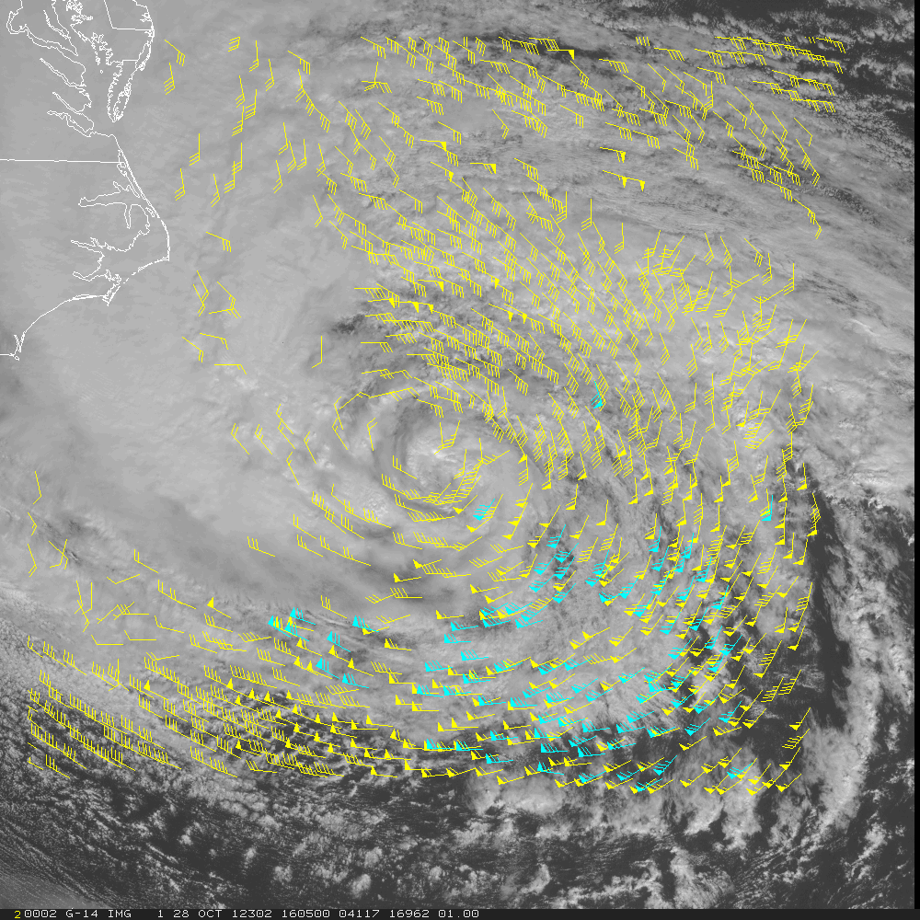
Hurricane force winds (> 75 mph)
Hurricane Sandy
16
Notes:
Hurricane Sandy
AMVs generated from 5-min visible imagery using GOES-R DMW algorithm. A different configuration (11km x11km target scene) was used in order to generated higher resolution winds
The loop is from 1605Z - 1850Z on October 28, 2012

Slide 17
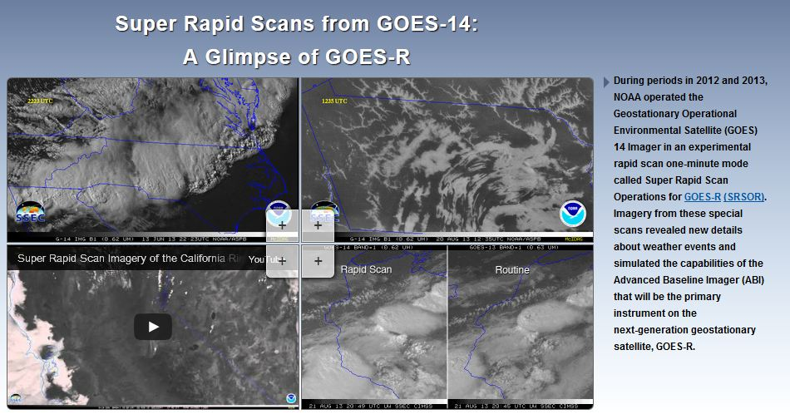
SRSOR Links
http://cimss.ssec.wisc.edu/goes/srsor/GOES-14_SRSOR.html
http://cimss.ssec.wisc.edu/goes/srsor2013/GOES-14_SRSOR.html
http://cimss.ssec.wisc.edu/goes/srsor2014/GOES-14_SRSOR.html
http://www.nesdis.noaa.gov/fourbox/09-23-13/

Slide 18
Accepted References
Schmit, T. J., and co-authors, 2014: Rapid Refresh Information of Significant Events: Preparing users for the next generation of geostationary operational satellites, Bull. Amer. Meteor. Soc., accepted.
http://journals.ametsoc.org/doi/pdf/10.1175/BAMS-D-13-00210.1
Schmit T.J., Goodman S.J., Lindsey D.T., R. M. Rabin, K. M. Bedka, M. M. Gunshor, J. L. Cintineo, C. S. Velden, A. S. Bachmeier, S. S. Lindstrom, and C. C. Schmidt, 2013: Geostationary operational environmental satellite (GOES)-14 super rapid scan operations to prepare for GOES-R. J. Appl. Remote Sens. 0001;7(1):073462. doi:10.1117/1.JRS.7.073462.
http://remotesensing.spiedigitallibrary.org/article.aspx?articleid=1790703
Schmit, Timothy J.; Gunshor, Mathew M.; Menzel, W. Paul; Gurka, James J.; Li, Jun and Bachmeier, A. Scott. Introducing the next-generation Advanced Baseline Imager on GOES-R. Bulletin of the American Meteorological Society, Volume 86, Issue 8, 2005, pp.1079-1096.
http://journals.ametsoc.org.ezproxy.library.wisc.edu/doi/pdf/10.1175/BAMS-86-8-1079

Slide 19
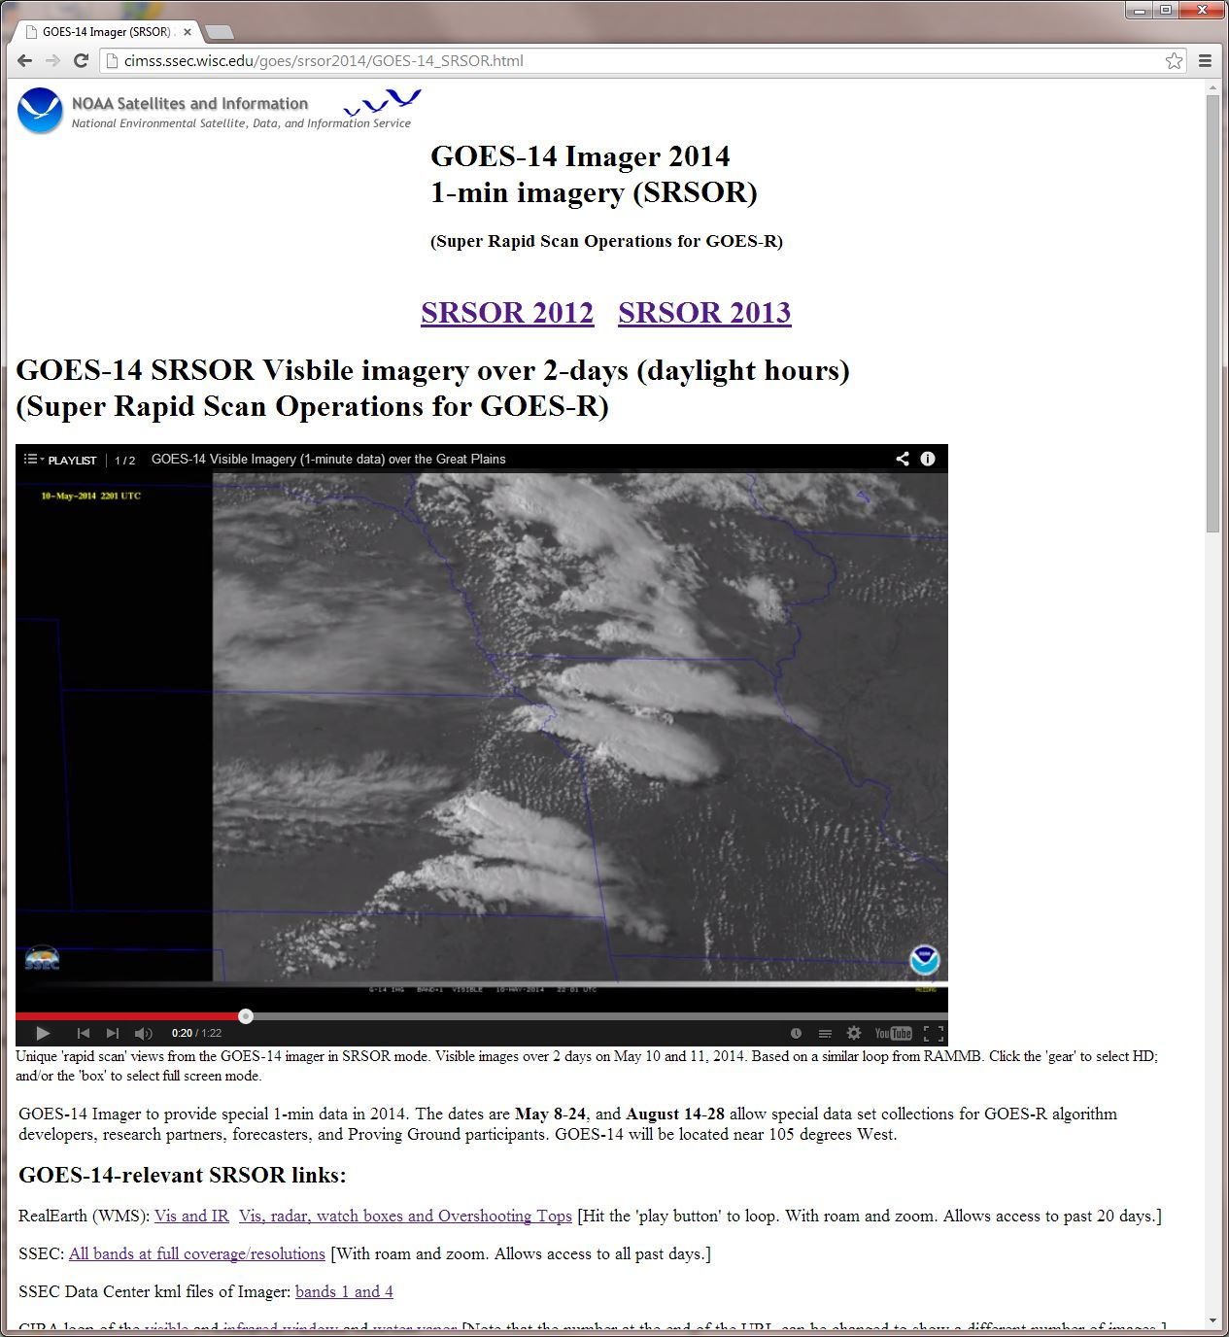
http://cimss.ssec.wisc.edu/goes/srsor2014/GOES-14_SRSOR.html

Slide 20
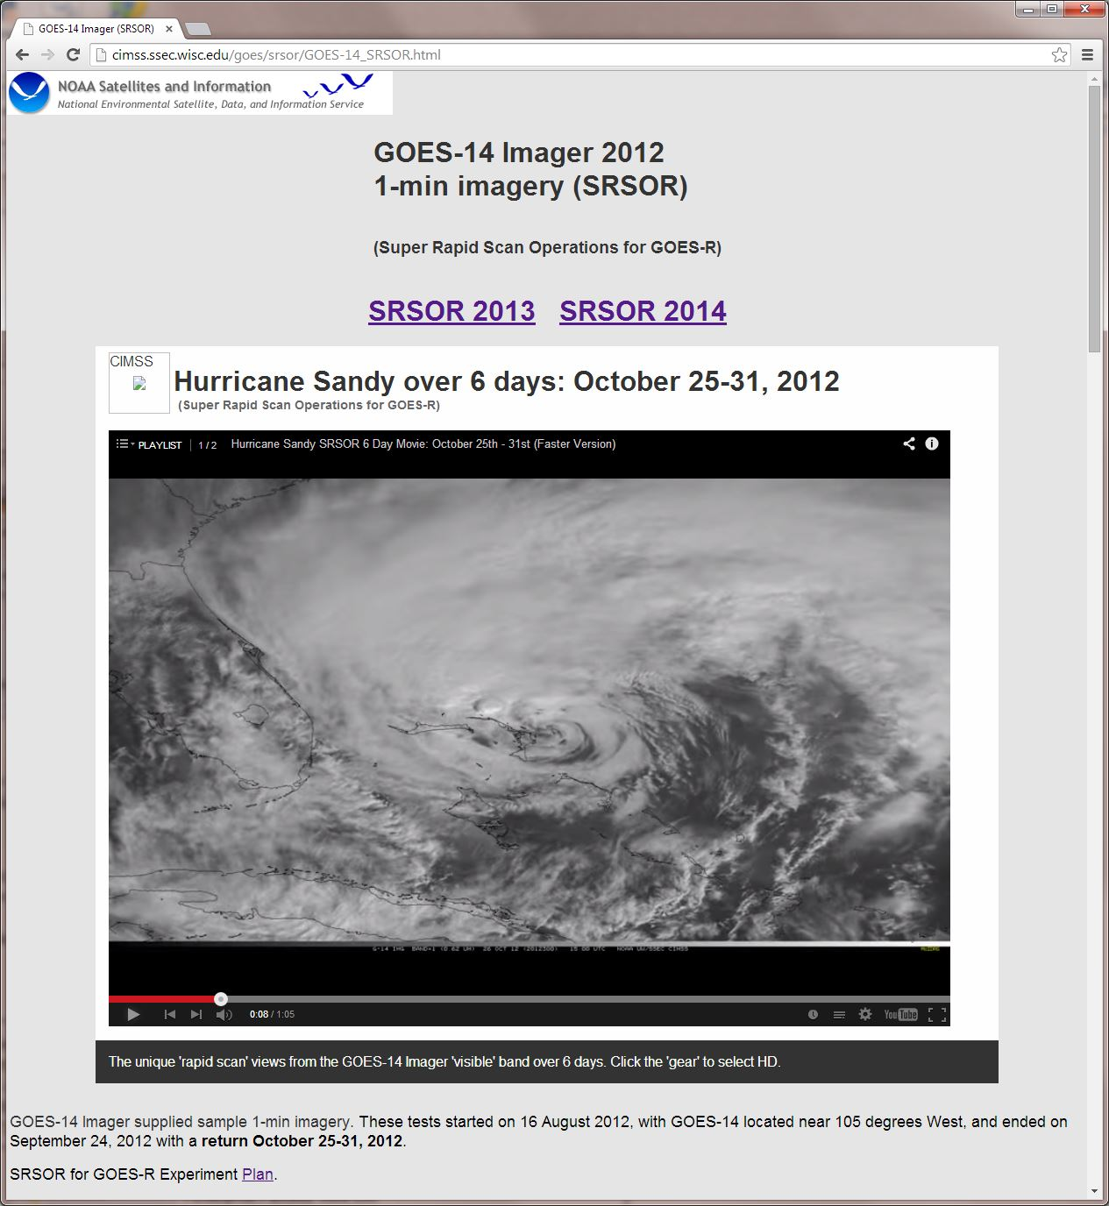

Slide 21
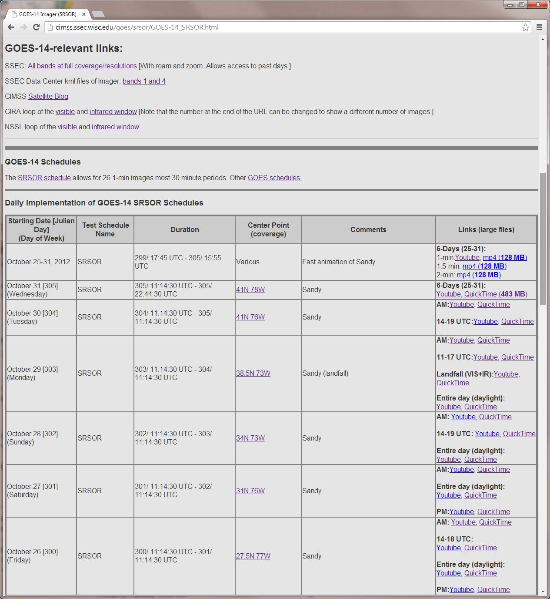

Slide 22
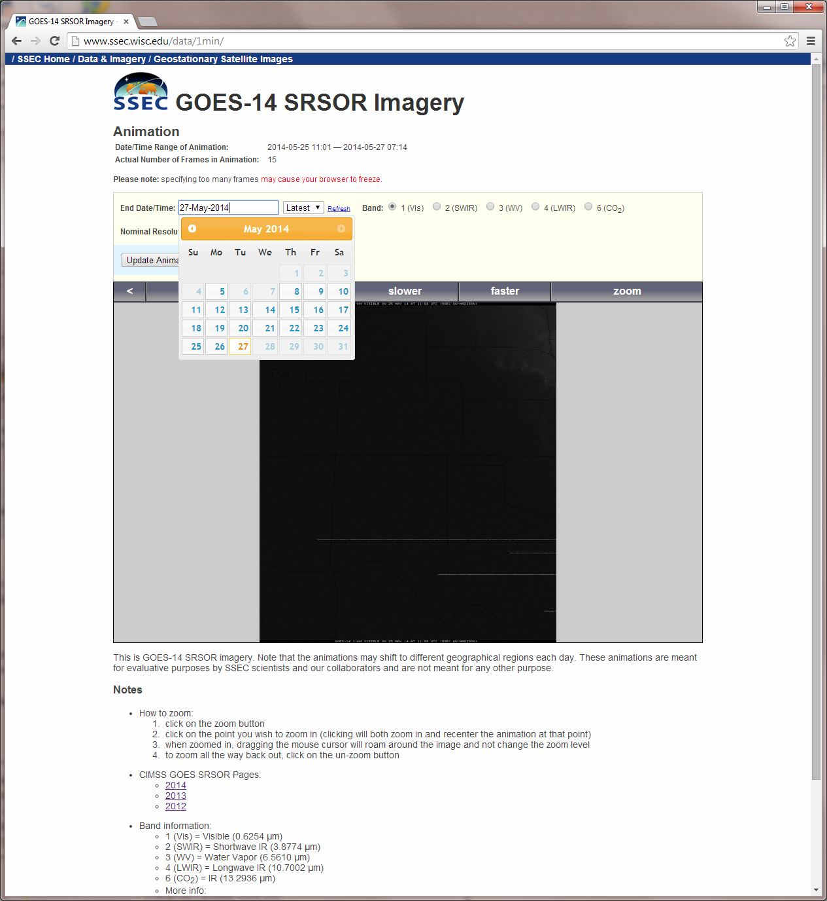
Select date….
http://www.ssec.wisc.edu/data/1min/

Slide 23
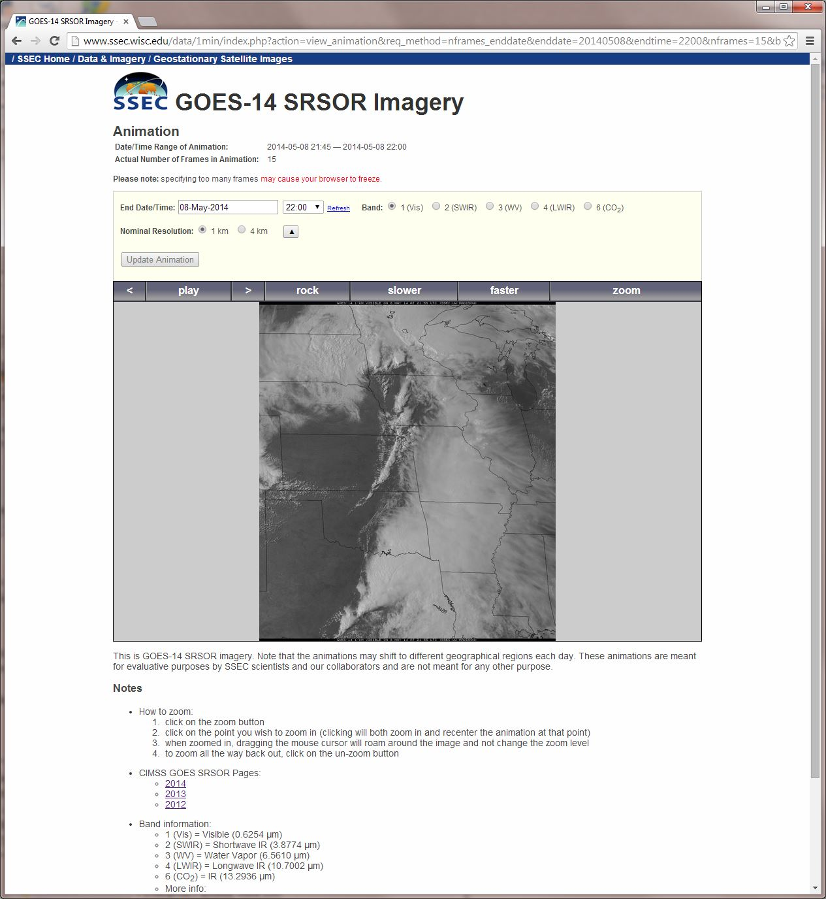
Zoom…
http://www.ssec.wisc.edu/data/1min/

Slide 24
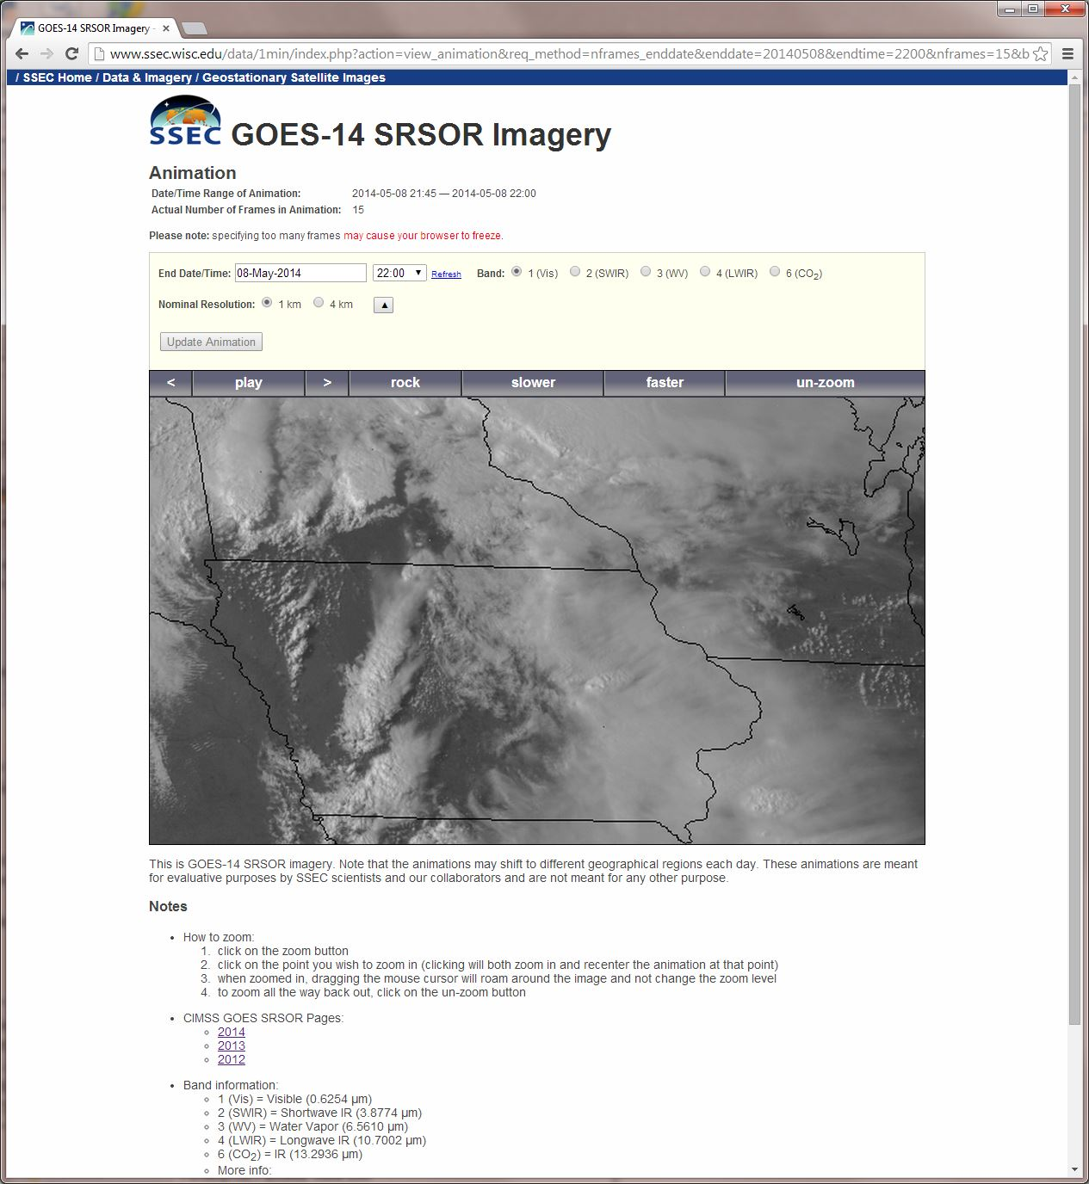
http://www.ssec.wisc.edu/data/1min/

Slide 25
More 1-min data…
Plans call for SRSOR again in parts of the spring and summer of 2015

