Slide 1
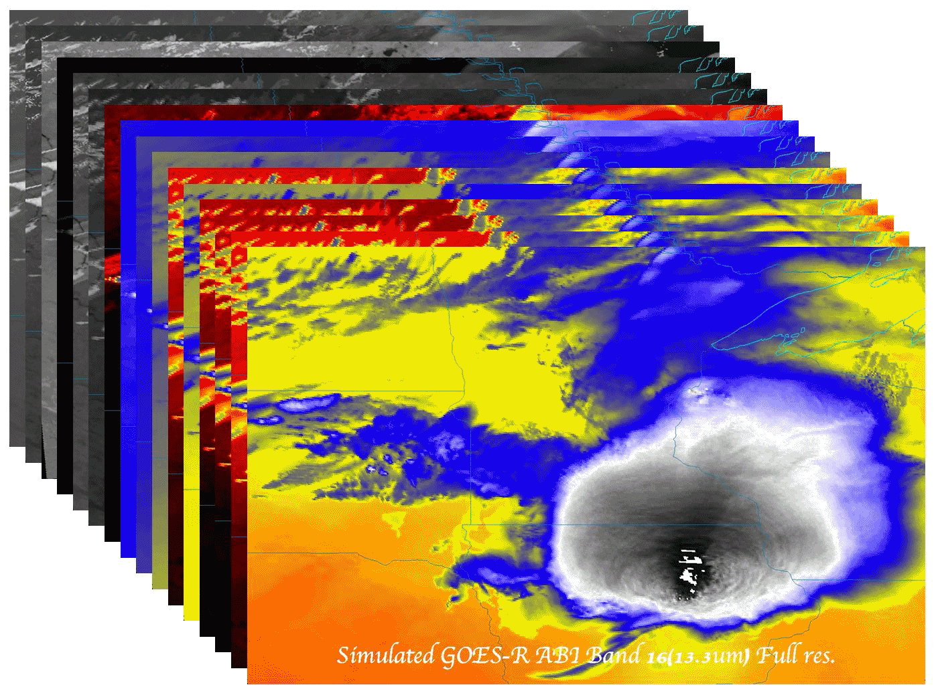
GOES SRSOR
Timothy J. Schmit (tim.j.schmit@noaa.gov)
NOAA/NESDIS/Satellite Applications and Research
Advanced Satellite Products Branch (ASPB)
Madison, WI
Short Course
Lunchtime
Raleigh, NC
June 9, 2015
UW-Madison

Slide 2
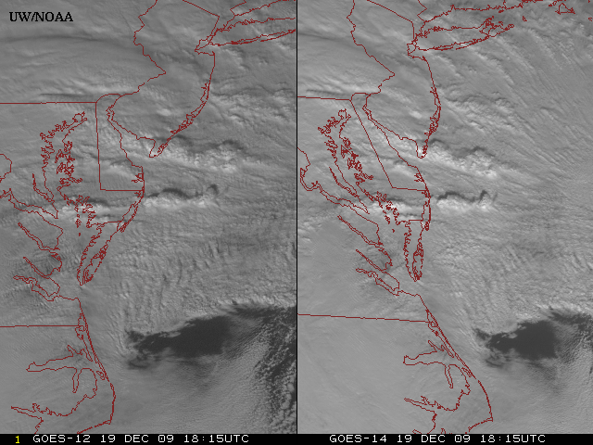
New GOES: Sample “1-min” imagery
GOES-12
GOES-14
See “what is happening”, not “what has happened”.
Notes:
Note the number of different levels of motion you can see (the cyclonic low level circulation over the ocean through the breaks in the higher clouds)... and you can't distinguish those on the GOES-12 loop.

Slide 3
GOES-14 SRSOR 1-min
Click for animations
PycroCu
Hotspots
Vis / 4um
Vis/IRW
1/5/15 min
Storm Rel
1/15 min
Derecho
Fog
Texas
Marie
Sandy
http://cimss.ssec.wisc.edu/goes/srsor/overview_training.html
Notes:
Animations at: ftp://ftp.ssec.wisc.edu/ABI/overview

Slide 4
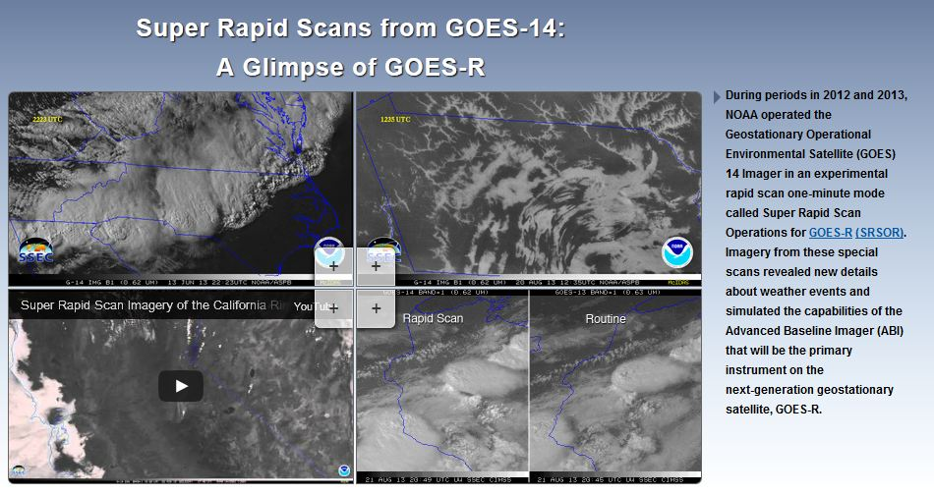
SRSOR Links
http://cimss.ssec.wisc.edu/goes/srsor/GOES-14_SRSOR.html
http://cimss.ssec.wisc.edu/goes/srsor2013/GOES-14_SRSOR.html
http://cimss.ssec.wisc.edu/goes/srsor2014/GOES-14_SRSOR.html
http://cimss.ssec.wisc.edu/goes/srsor2015/GOES-14_SRSOR.html
http://www.nesdis.noaa.gov/fourbox/09-23-13/

