Slide 1
GOES-R AWG Product Validation Tool Development (January 2014)
Imagery (“the KPP”) Application Team
Tim Schmit (STAR)
With help from many others
Kaba Bah, Mat Gunshor, Brad Pierce, Joleen Feltz, Marek Rogal, etc.
Notes:
KPP= Key Product Parameter.

Slide 2
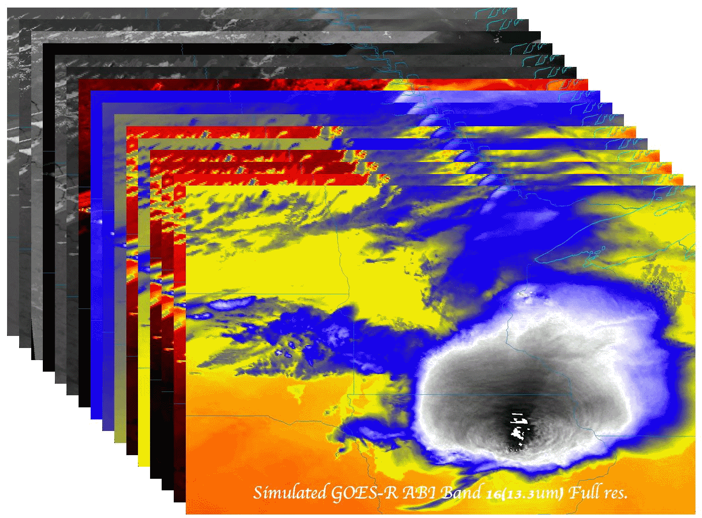
Topics
Product Generation and Assessment Using Available Proxy Data
  Highlight proxy products being generated
  Highlight validation tools/methods and recent validation results
  Highlight any user engagement activities
  Highlight interactions with or support provided to any GOES-R Proving Ground Demonstrations
Identifying and Planning for Algorithm Enhancements Beyond Baseline
  Description of algorithm enhancements that have been tested
  Highlight test results and benefits of enhancements
  List algorithm enhancements you envision needing to be transitioned to operations after launch
Road to GOES-R Post-Launch Test (PLT) and Post-Launch Product Validation
  AWG team plans and approach to validate your team’s product(s) post-launch
  User engagement plans
  Concerns/comments/questions related to the GOES-R PLT and/or post-launch validation
Notes:
Topic areas to cover. Plan on a 15-20 min presentation.

Slide 3
OUTLINE
Products
Pre-Launch Validation Strategies
Routine Validation Tools
“Deep-Dive” Validation Tools
Post-Launch validation Plan
Further Enhancement and Utility of Validation Tools
Summary / Select References
Notes:
Plan on a 15-20 min presentation. Slide counts per topic area are provided as guidance. Slide counts will vary depending upon number of products and tools.

Slide 4
Products
The purpose of the imagery team is two-fold:
  Demonstrate how to convert from GRB scaled radiances (eg, GRB integers) to other physical units, such as radiance, brightness temperatures and brightness values.
  Build files that can be used for processing most all of the ABI products, such as clouds, soundings, etc.
Imagery is the key product for GOES-R.
There are 54 KPP Cloud and Moisture Imagery End-Products (CMIP)
  Single Band Products: 48 End-Products in netCDF format at the resolution native to each band for three types of coverage areas.
    16 bands * 3 coverage areas (Full Disk, CONUS, Mesoscale) = 48
  Multiband Products:6 End-products at 2-km resolution, in netCDF and McIDAS Area file format.
    2 formats (netCDF and McIDAS Area) * 3 coverage areas = 6
Notes:
Provide a list of products and their specifications (spatial and temporal resolution, coverage). Include an example display(s) of your products.

Slide 5
ABI Band Characteristics
Band # | Central Wavelength (um) | Spatial Resolution (km) | Bit-Depth | Used in Cloudy and Moisture Imagery
1 | 0.47 | 1 | 12 | Yes
2 | 0.64 | 0.5 | 12 | Yes
3 | 0.86 | 1 | 12 | Yes
4 | 1.38 | 2 | 12 | Yes
5 | 1.61 | 1 | 12 | Yes
6 | 2.26 | 2 | 12 | Yes
7 | 3.9 | 2 | 13 | Yes
8 | 6.15 | 2 | 12 | Yes
9 | 7.0 | 2 | 12 | Yes
10 | 7.4 | 2 | 12 | Yes
11 | 8.5 | 2 | 12 | Yes
12 | 9.7 | 2 | 12 | Yes
13 | 10.35 | 2 | 12 | Yes
14 | 11.2 | 2 | 12 | Yes
15 | 12.3 | 2 | 12 | Yes
16 | 13.3 | 2 | 12 | Yes
Reflective bands
Emissive (IR) bands
Notes:
Using the ABI PORD instrument definition for band labels.

Slide 6
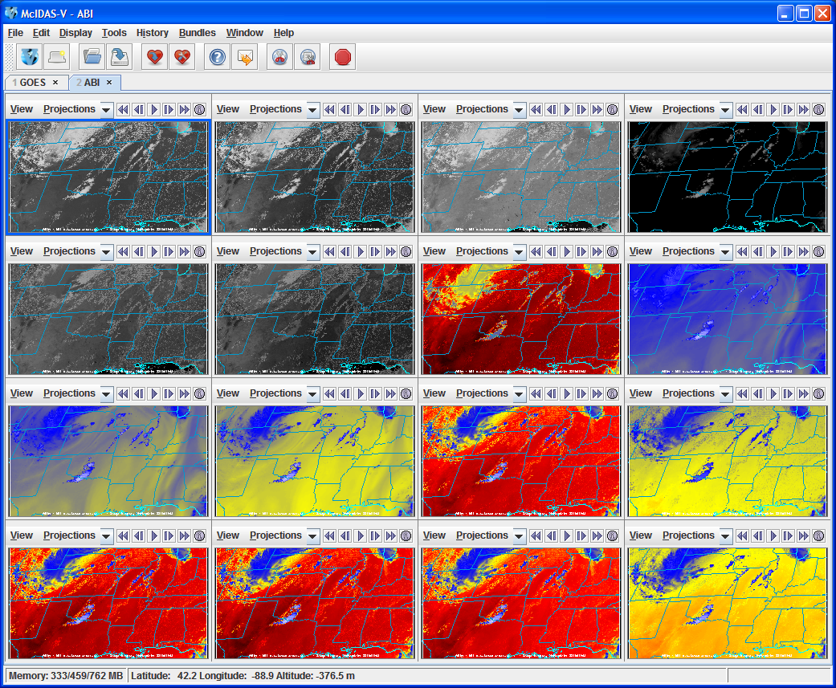
Example CMIP Output ABI bands in McIDAS-V

Slide 7
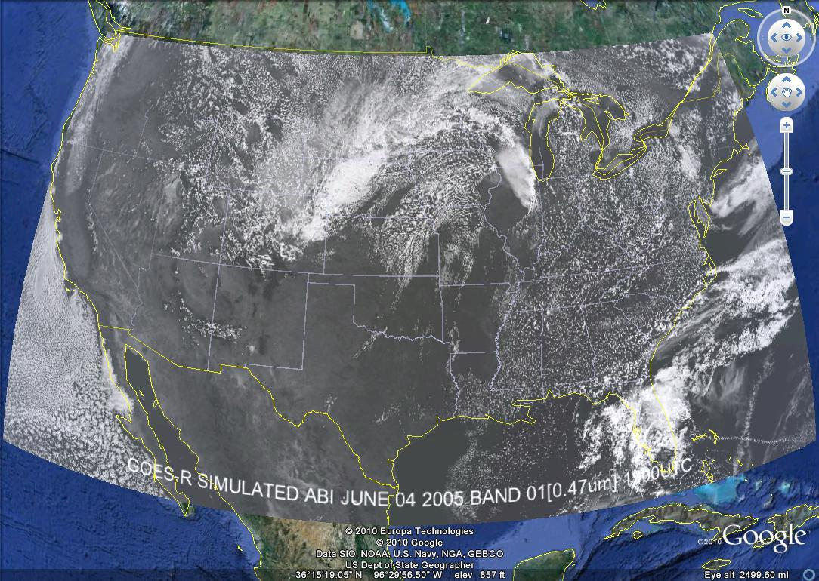
These NWP model simulations were performed on the 'cobalt' supercomputer at the National Center for Supercomputing Applications at the University of Illinois.

Slide 8
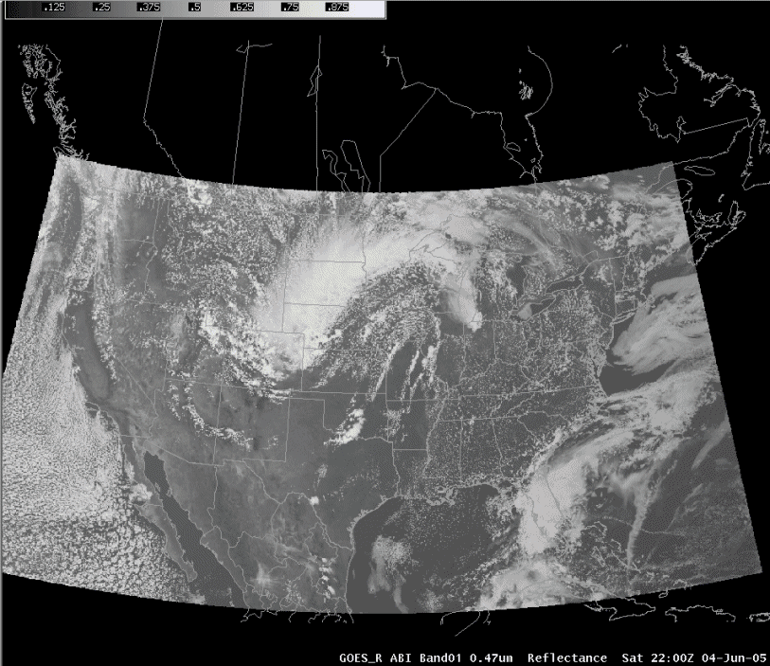
ABI in AWIPS (via netCDF)
Proxy Team; J. Oktin et al., CIMSS
Simulated Advanced Baseline Imager (ABI) bands shown; in the legacy AWIPS.
Notes:
http://cimss.ssec.wisc.edu/goes/abi/

Slide 9
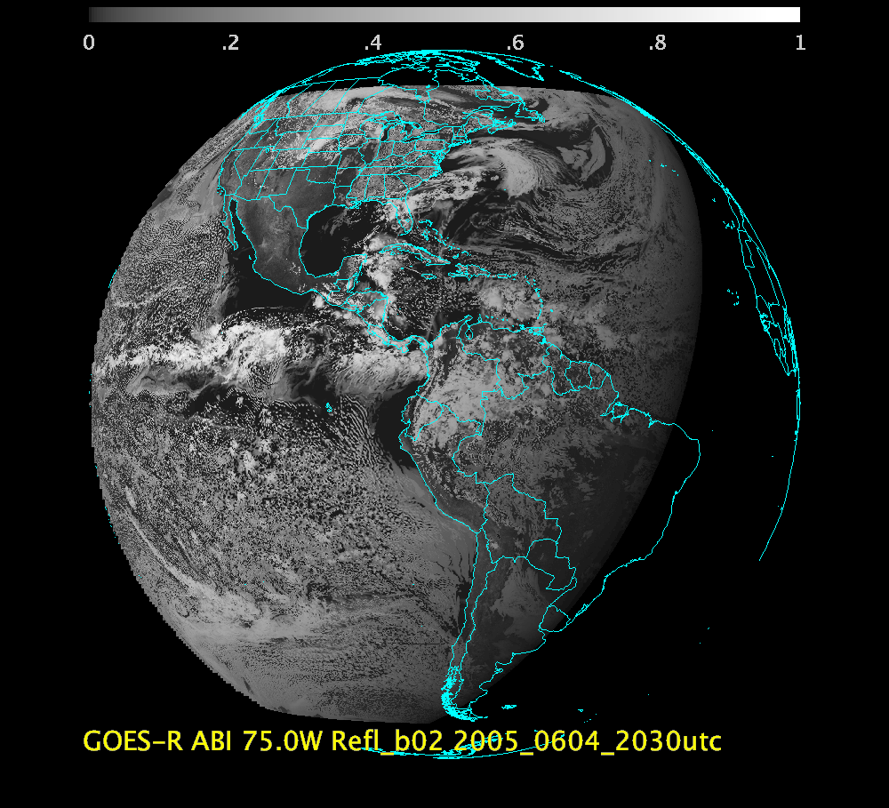
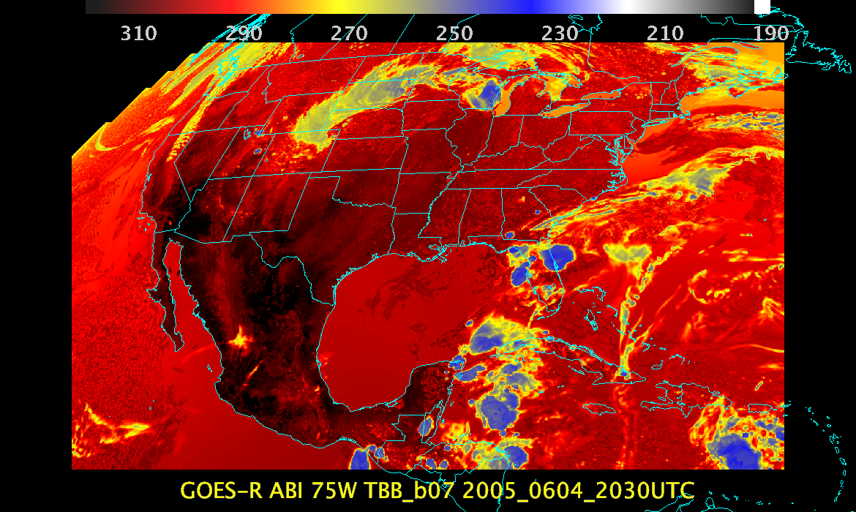
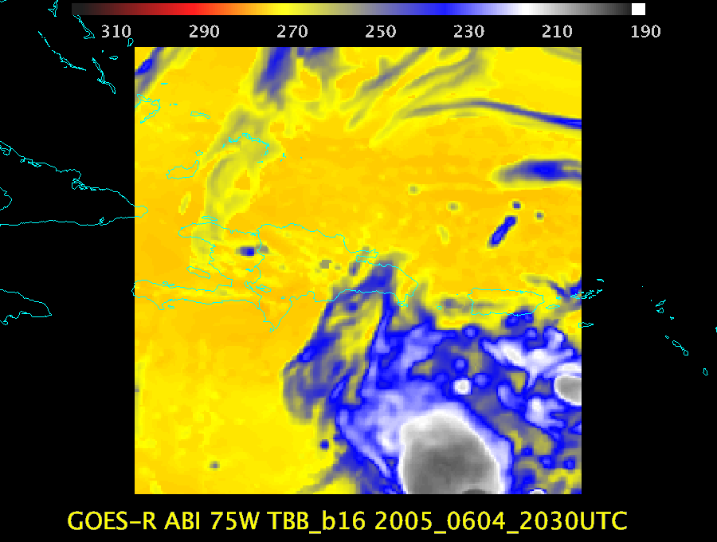
“Triplet” Examples
The “Triplet” refers to the needing at least three time periods for AMV processing.

Slide 10
“Triplet” Datasets
 | 75W | 89.5W | 137W
Model | WRF | WRF | WRF
Number of times | 7 | 7 | TBD
Time range | 20:00-20:30UTC | 20:00-20:30UTC | TBD
Day | 04-Jun-2005 | 04-Jun-2005 | TBD
Sectors | FD, CONUS, MESO | FD, CONUS, MESO | TBD
Types | GRB, VAL | GRB, VAL | TBD
Navigation | FGF | FGF | FGF

Slide 11
In ABI FGF (75W)

Slide 12
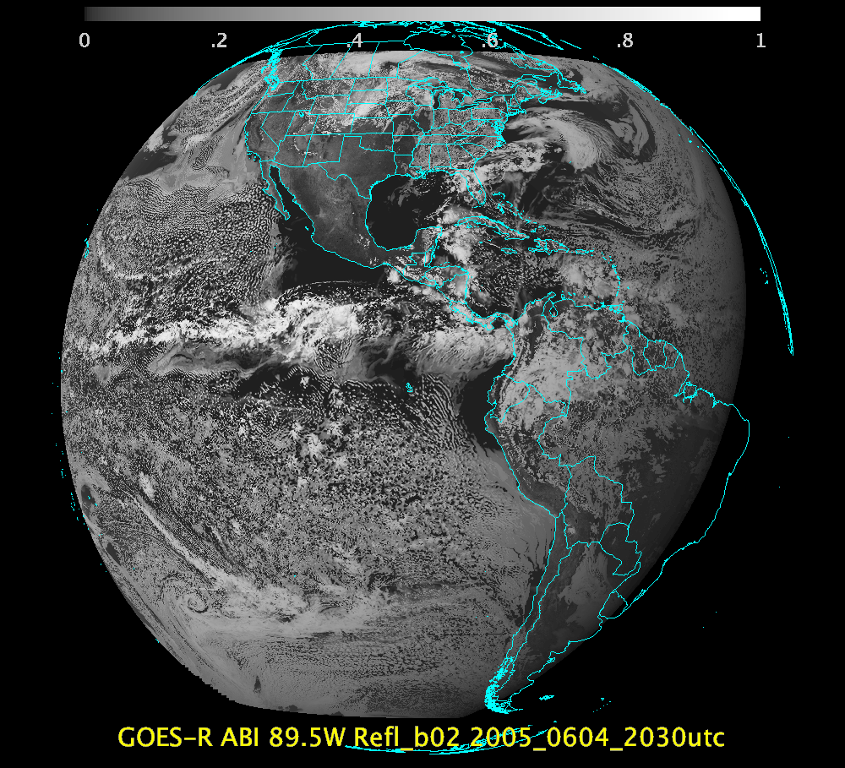
In ABI FGF (89.5W)
SSEC

Slide 13
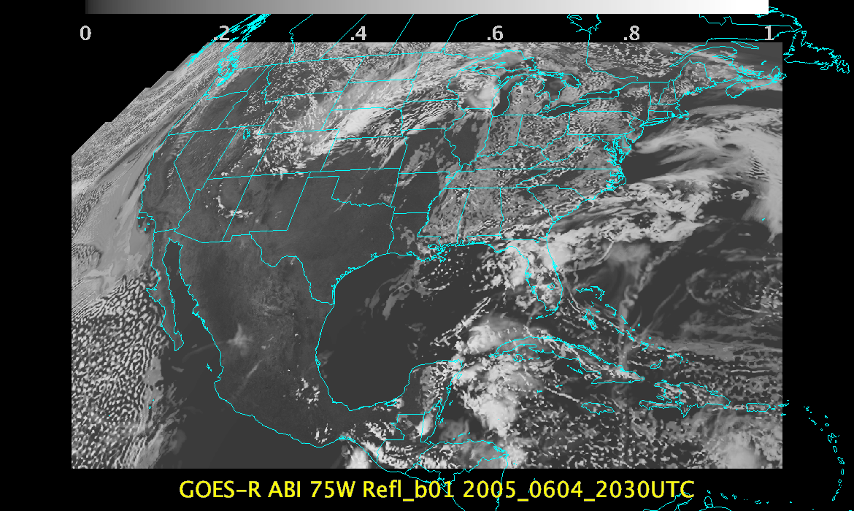

Slide 14
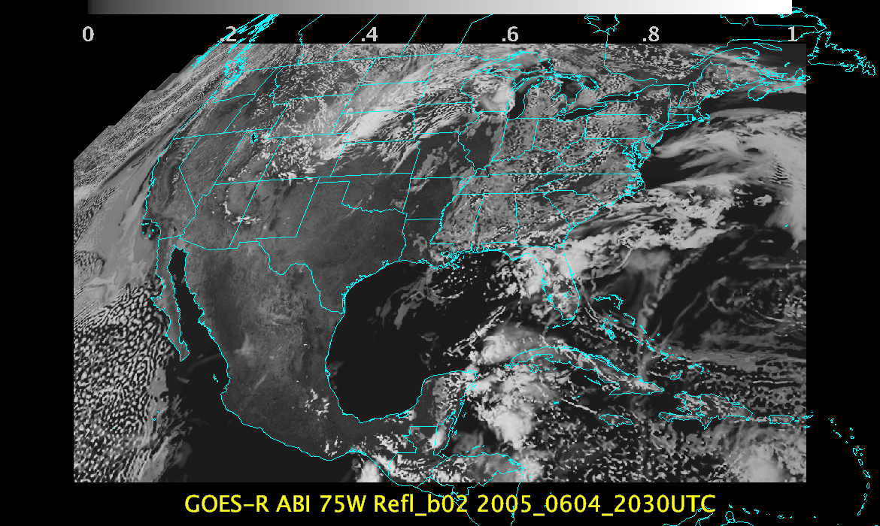

Slide 15
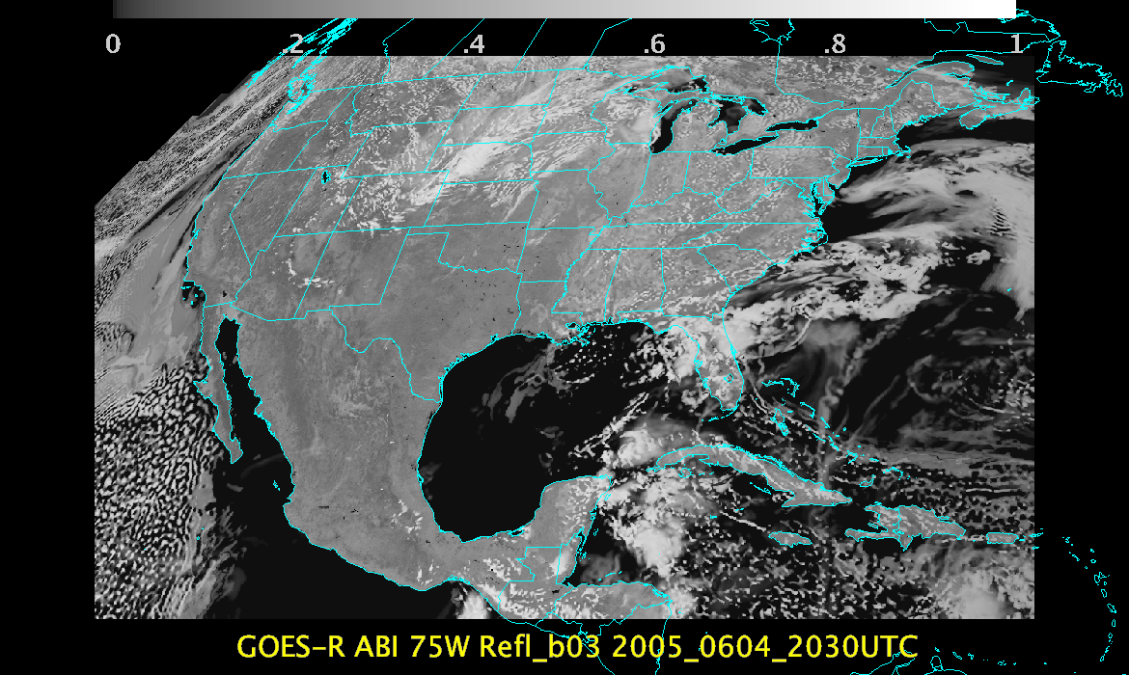

Slide 16
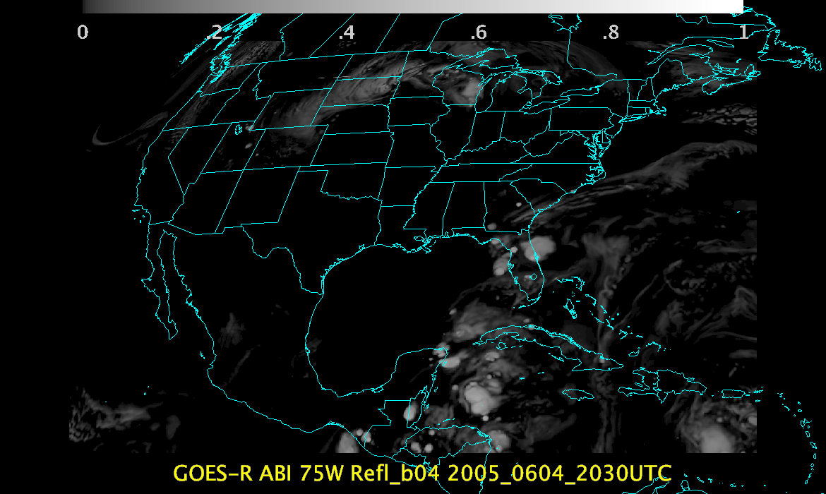

Slide 17
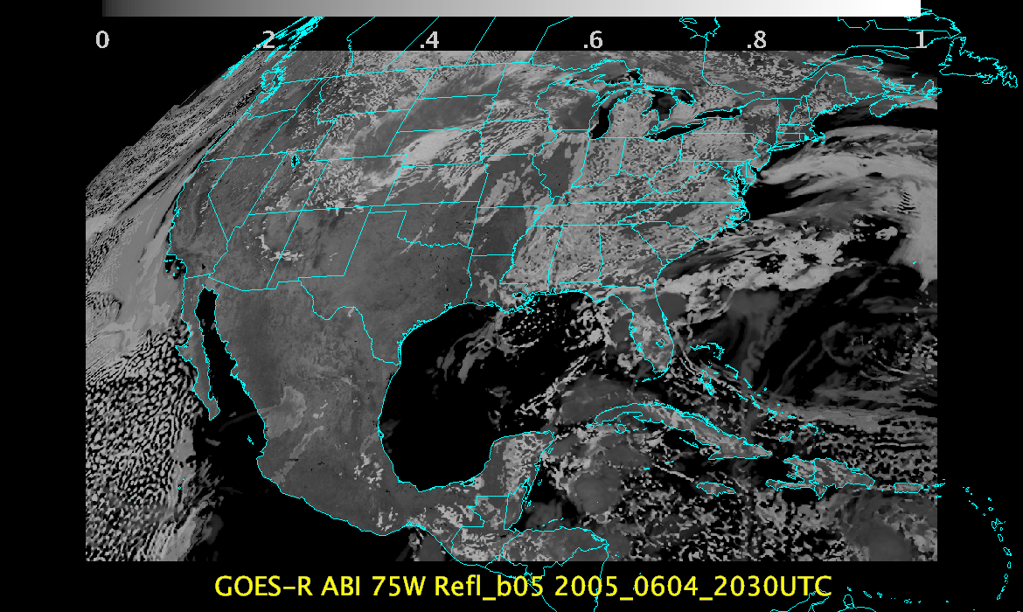

Slide 18
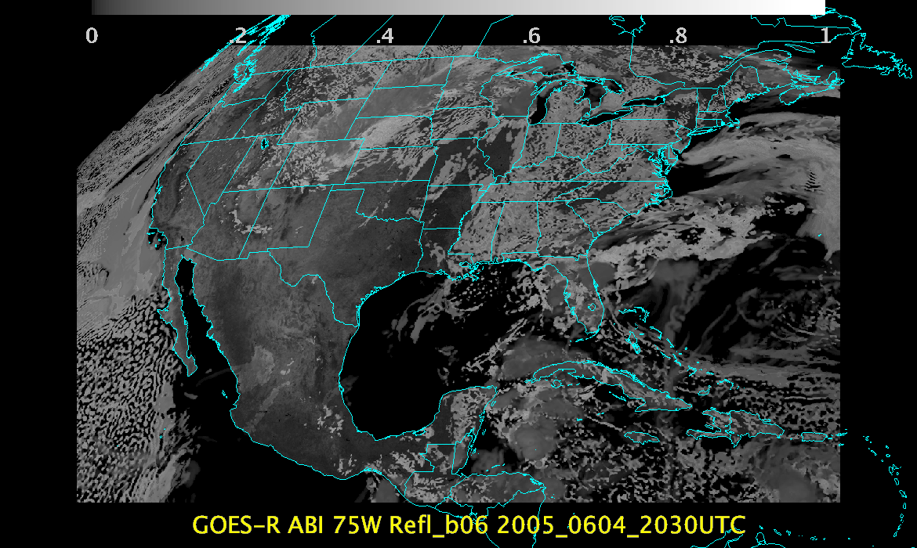

Slide 20
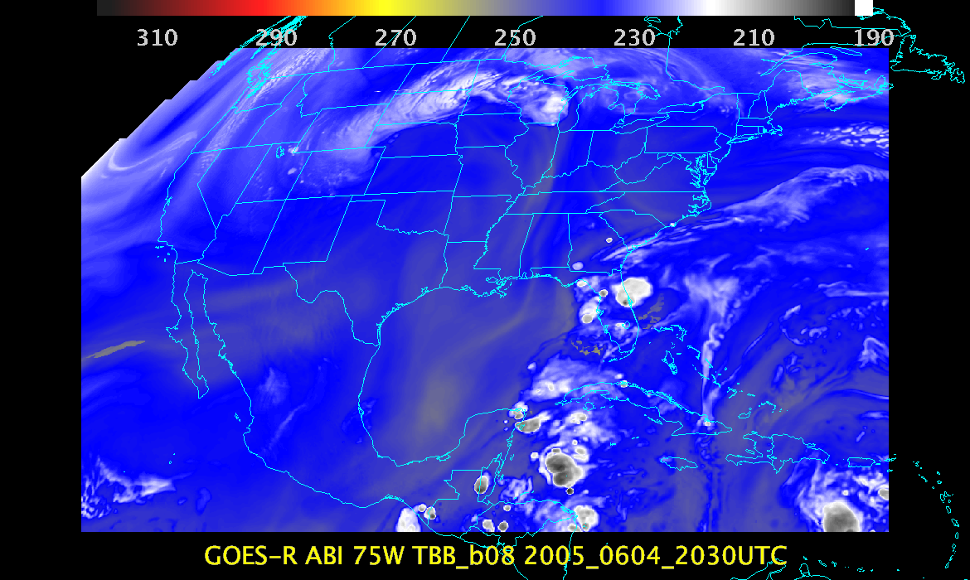

Slide 21
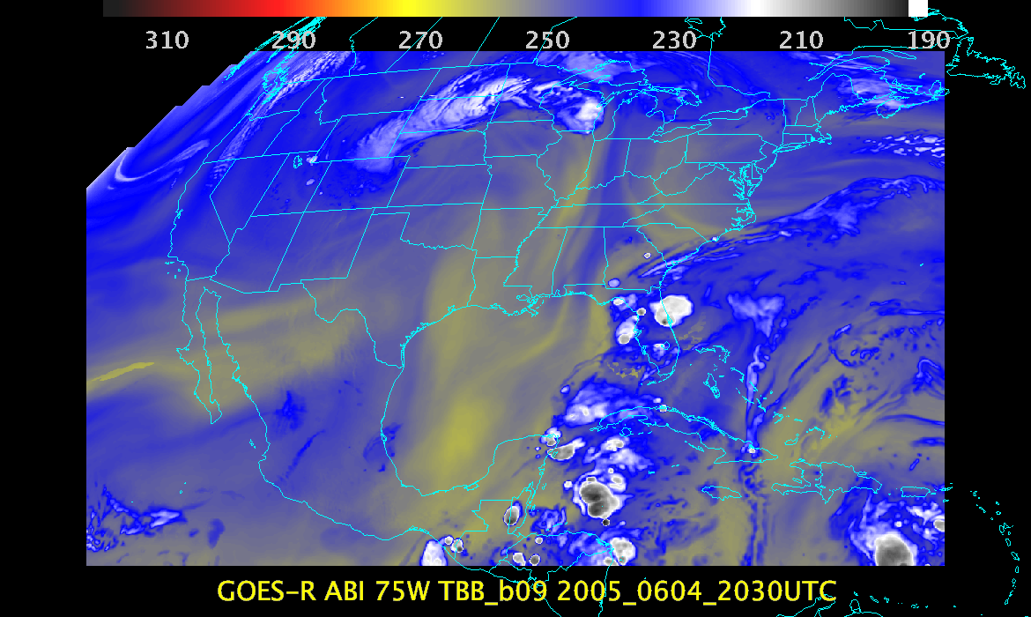

Slide 22
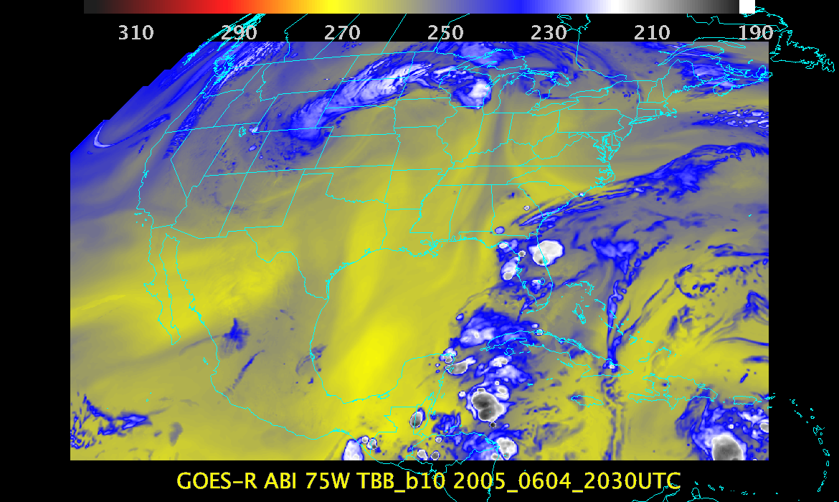

Slide 23
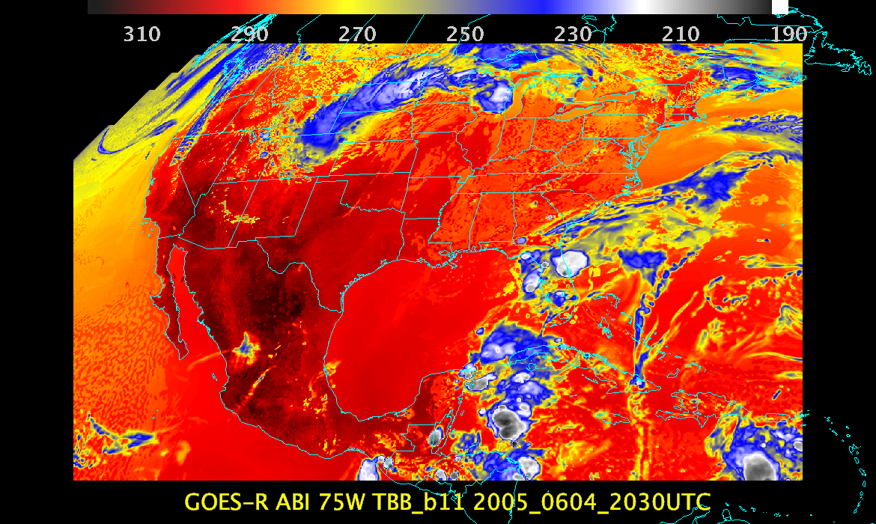

Slide 24
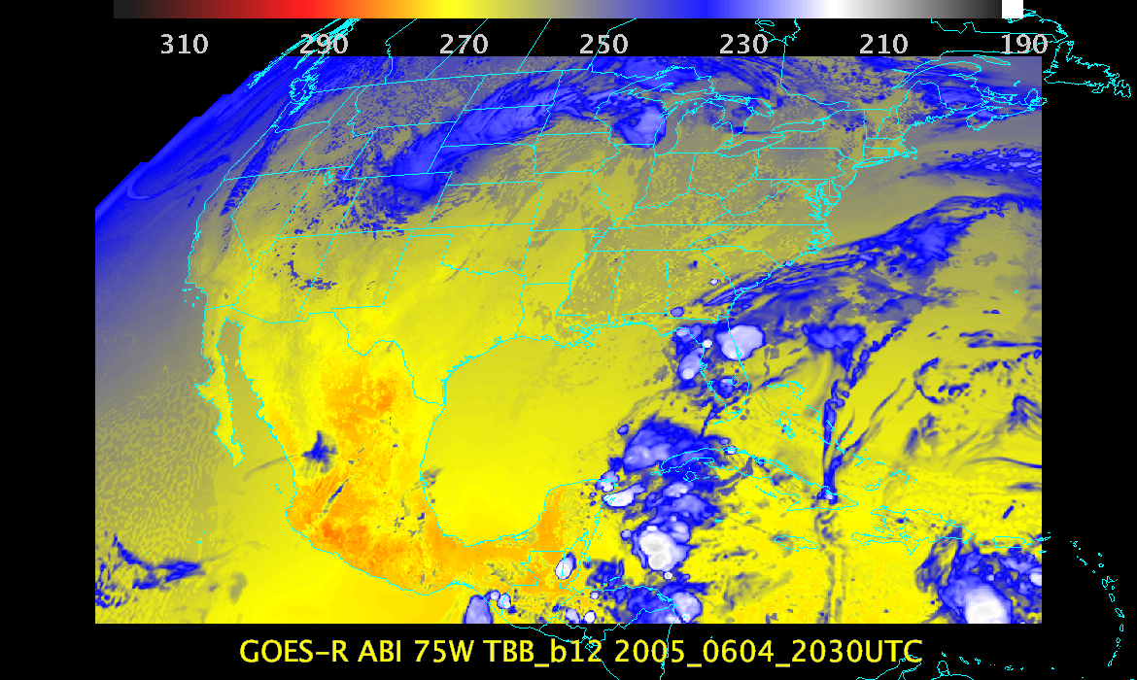

Slide 25
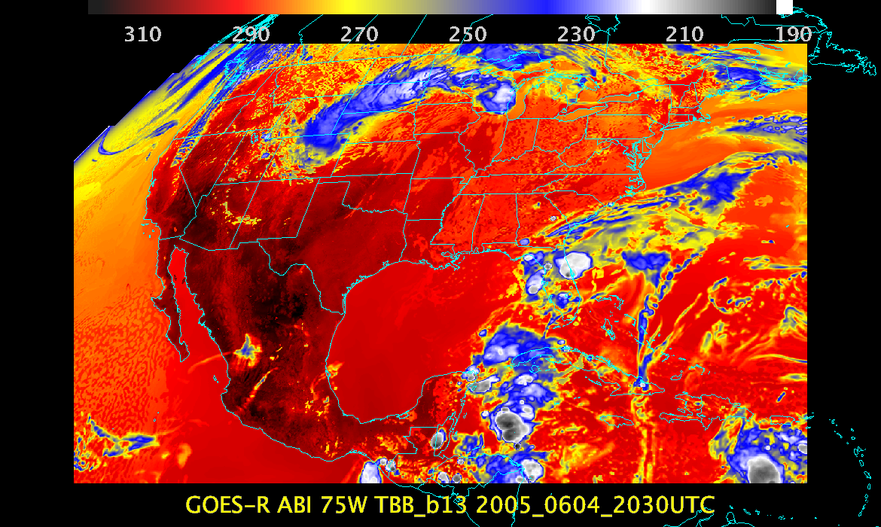

Slide 26
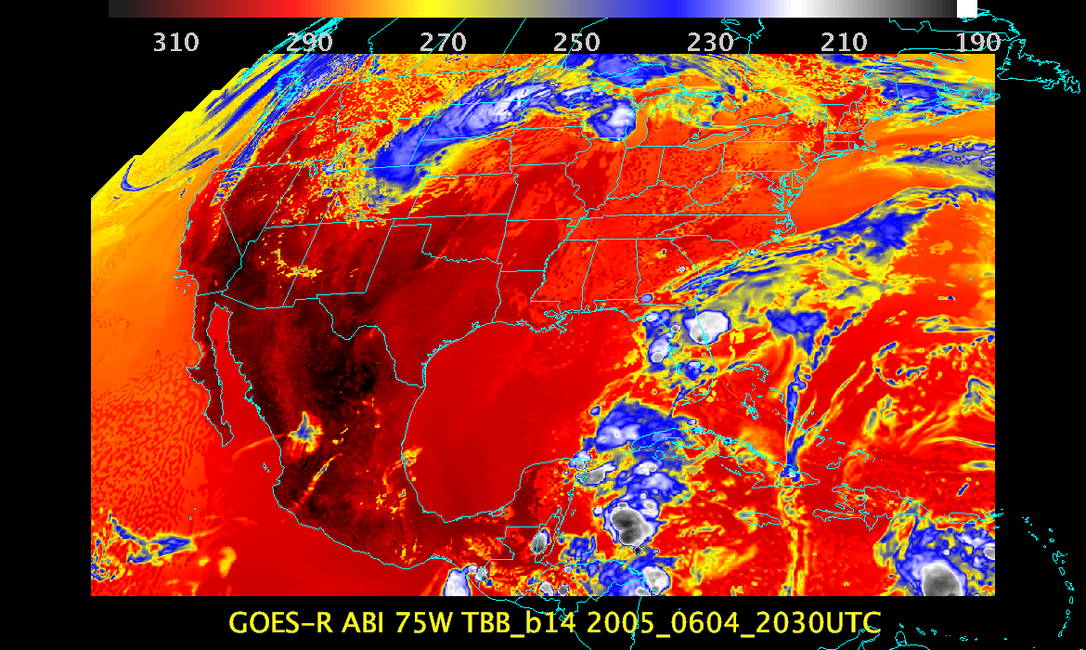

Slide 27
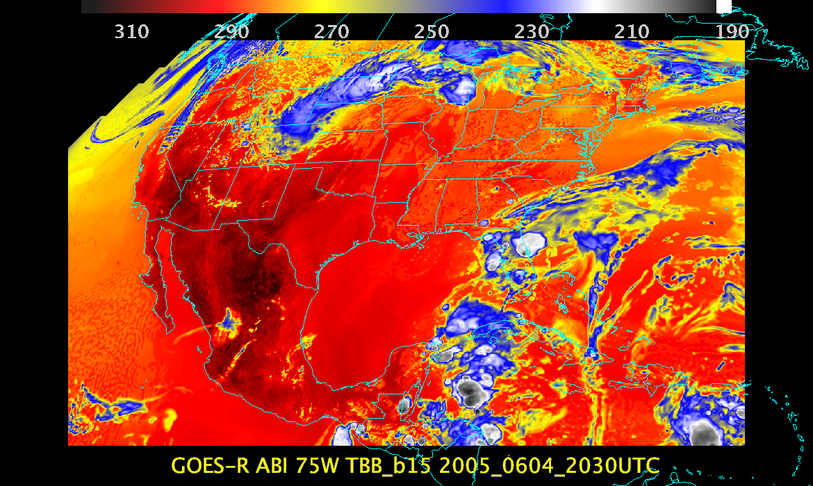

Slide 28
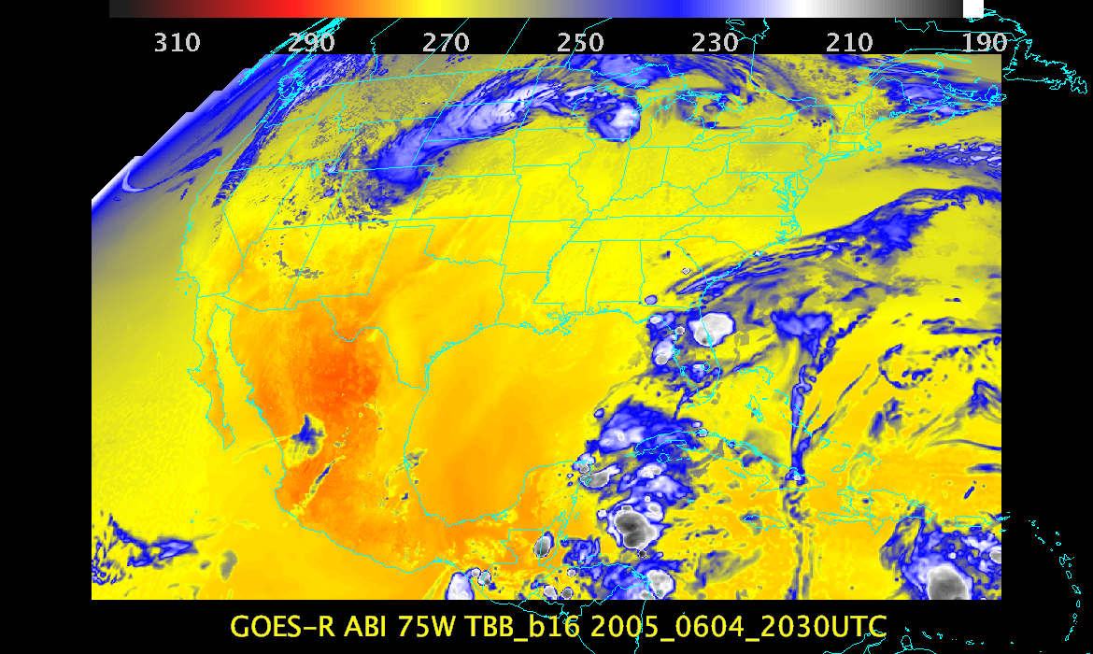

Slide 29
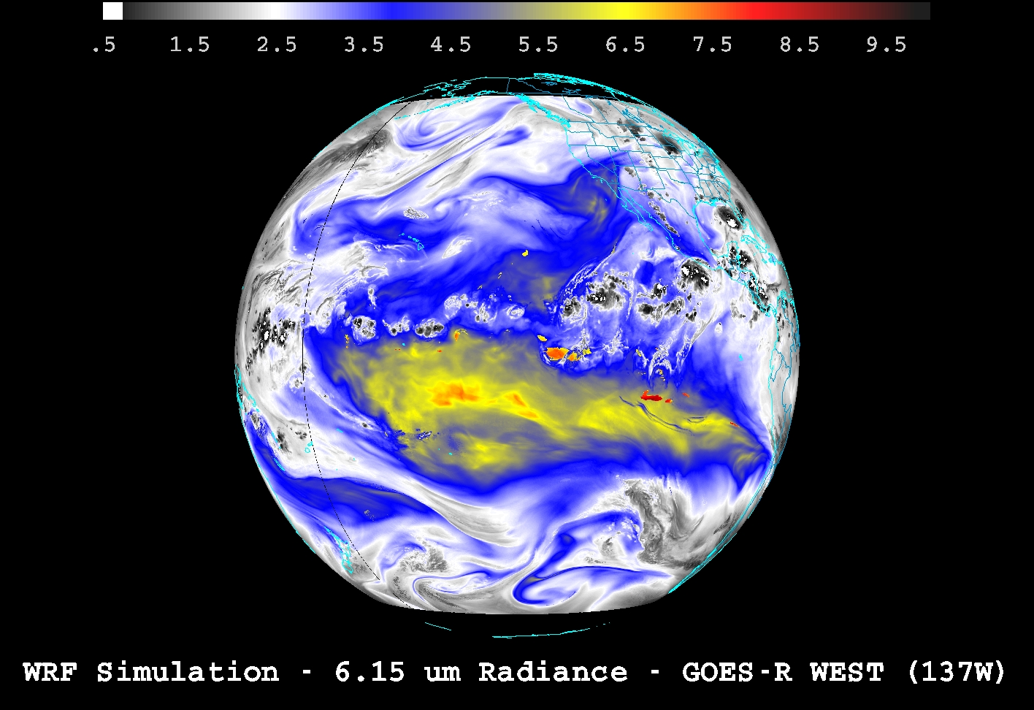
Demonstrating ABI “Fixed Grid Format” (FGF) from 137W
SSEC

Slide 30
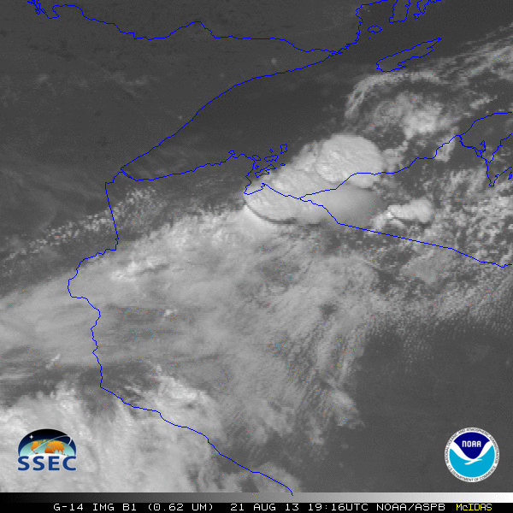
GOES-14: Special Rapid Scanning offers glimpse of the ABI
SRSOR (Super Rapid Scan Operations for GOES-R) from GOES-14 imager
Data between mid-August and September 24th and late October 2012; and two days in June and 12 days in mid-August, 2013.
http://cimss.ssec.wisc.edu/goes/srsor/GOES-14_SRSOR.html and http://cimss.ssec.wisc.edu/goes/srsor2013/GOES-14_SRSOR.html
Many phenomena were observed: convection, hurricanes, fires, smoke, ...
Data to many groups HPC, OPC, AWC, SPC, SAB, several regions, etc.
Animation from GOES-14 Imager visible image at 1-min time resolution.
GOES-14 provided very unique data and offered a glimpse into the possibilities that will be provided by the ABI on GOES-R in one minute mesoscale imagery.

Slide 31
OUTLINE
Products
Pre-Launch Validation Strategies
Routine Validation Tools
“Deep-Dive” Validation Tools
Post-Launch validation Plan
Further Enhancement and Utility of Validation Tools
Summary / Select References
Notes:
Plan on a 15-20 min presentation. Slide counts per topic area are provided as guidance. Slide counts will vary depending upon number of products and tools.

Slide 32
Validation Strategies
Compare GRB values to “CMIP” values to ‘close the loop’.
Generate a host of images
Animations
Generate zoomed images
Generate difference images
  Temporal
  Spectral
Monitor “forward model calc” vs “satellite obs”
Monitor image quality
Compare to other imagery (eg, VIIRS, etc.)
Inter-calibration (eg, GSICS)
Have a flexible, yet powerful, system to “query” the data
Combine images
Product generation!
Some of these fall under the calibration or system monitor groups!
Notes:
Highlight/summarize validation strategy for each product.
Identify reference/”ground truth” datasets that are needed and where/how these are obtained
Identify validation tools (routine & deep-dive) that are needed and being developed

Slide 33
Validation
Imagery does not have traditional ‘truth’ datasets for comparison, such as radiosondes or aircraft data. In light of this, we have defined our own ‘truth’ data via high resolution NWP runs, coupled with advanced forward modeling.
“digitize”
CMIP
“Output” netCDF
(w/ SI, un-scaling coefficients, Planck coeffs, E_sun, etc.)
“Input” netCDF
(w/ SI, etc.)
Original Proxy
“off-line”
“Validation” netCDF. Un-scale from SI, reflectance/radiance and Brightness Temperature (TBB) and Brightness Values (BV). Radiances.

Slide 34
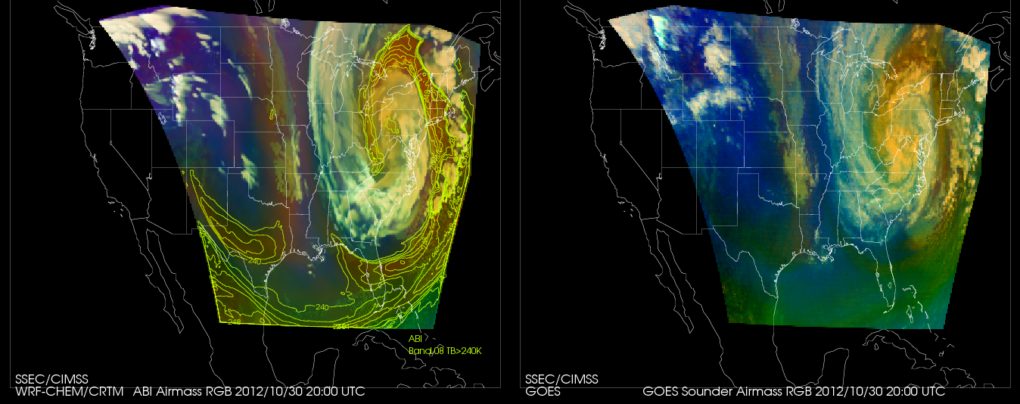
WRF-CHEM Proxy Hurricane Sandy simulation vs GOES Sounder Airmass RGB
October 26-31, 2012.
RGB Airmass shows entrainment of dry upper tropospheric air into Sandy during transition from tropical to extra-tropical storm
Calculation Observation
The Airmass RGB is designed for monitoring the evolution of cyclones, rapid cyclogenesis, jet streaks, and potential vorticity (PV) anomalies
Color scheme:
Ozone-poor tropical air masses are green, ozone-rich polar air masses are blue
Dry air masses in the upper troposphere are red to orange
High-level clouds are white, Mid-level clouds are brown
Magenta (limb viewing, disregard)
http://www.goes-r.gov/users/comet/npoess/multispectral_topics/rgb/navmenu.php_tab_1_page_6.7.0.htm

Slide 35
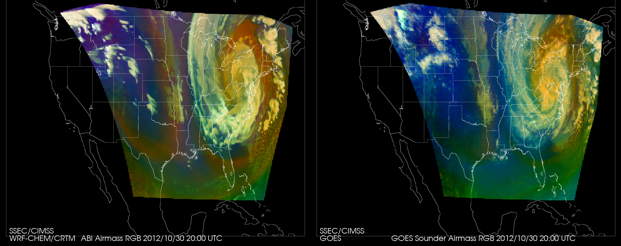
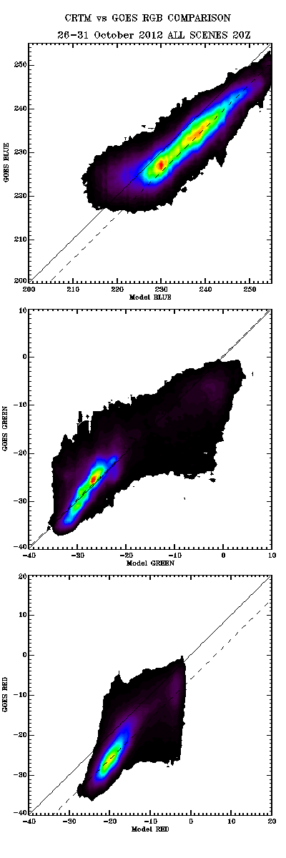
WRF-CHEM Proxy Hurricane Sandy simulation vs GOES Sounder Airmass RGB
October 26-31, 2012.
Validation with GOES Sounder RGB shows that biases are consistent with expected ABI and Sounder SRF differences (dashed)
Validation of proxy ABI RGB airmass vs GOES Sounder
Red
Green
Blue

Slide 36
OUTLINE
Products
Pre-Launch Validation Strategies
Routine Validation Tools
“Deep-Dive” Validation Tools
Post-Launch validation Plan
Further Enhancement and Utility of Validation Tools
Summary / Select References
Notes:
Plan on a 15-20 min presentation. Slide counts per topic area are provided as guidance. Slide counts will vary depending upon number of products and tools.

Slide 37
Routine Validation Tools
This tool set includes, but is not limited to:
Time series of radiances/brightness temperatures
Statistics of radiances/brightness temperatures
Generate a host of images, thumbnail images
Animations
Generate zoomed images
Monitor “forward model calc” vs “satellite obs”
Monitor image quality
Compare to other imagery (e.g., VIIRS, etc.)
More as we learn from current GOES & POES
Average of valid data samples
Number of valid data samples
Minimum value of valid data samples
Maximum value of valid data samples
Sum of valid data samples
Sum-of-squares of valid data samples
Total number of data samples within the sample set
Notes:
For each product, describe and illustrate the routine validation tools that you have or are developing. At a minimum address the following:
- Capabilities (in their final state)
- Datasets used
- Visualization software tools used (IDL, McIDAS, other…) to visualize the products, intermediate products, diagnostic data, product performance measures, reference/”ground-truth” data, etc…
-

Slide 38
”Deep-Dive”
Validation Tools
This tool set includes, but is not limited to:
  Additional Thumbnail images
  Full size and/or zoomed images
  Generate difference images
    Temporal
    Spectral
  Times series of radiances/brightness temperatures
    Longer time-series
  Statistics of radiances/brightness temperatures
    Longer times series
  “Forward Model Calc” vs “Satellite Obs” information
    From raobs, NWP, etc.
  Correlate image artifacts with calibration events
McIDAS + scripts
Notes:
For each product, describe and illustrate the “deep-dive” validation tools that you have or are developing. At a minimum address the following:
- Capabilities (in their final state)
- Intended use
- Datasets used
- Visualization software tools used (IDL, McIDAS, other…) to visualize the products, intermediate products, diagnostic data, product performance measures, reference/”ground-truth” data, etc…

Slide 39
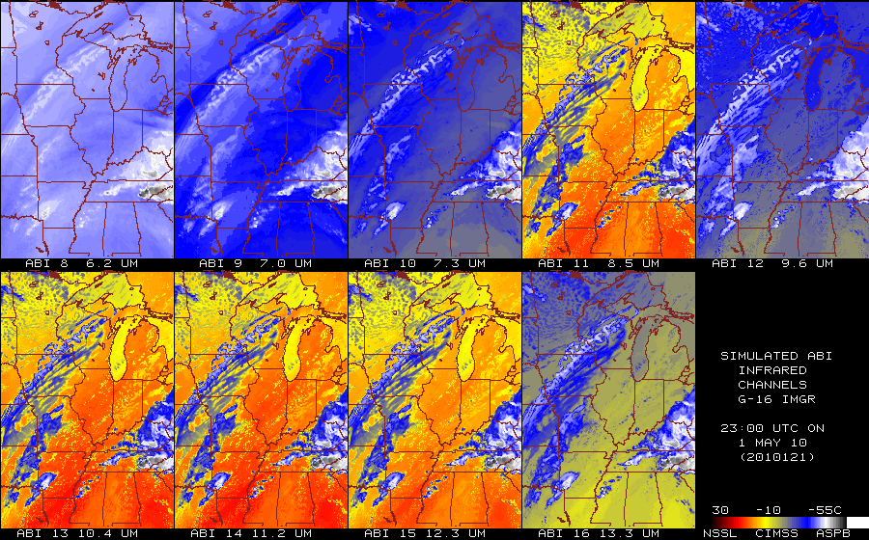
Calculated ABI bands
(subset)
From NSSL WRF
39

Slide 40
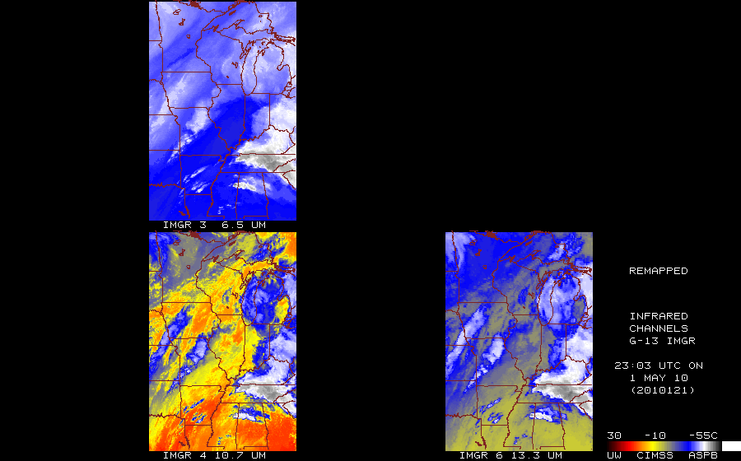
Observed GOES-13 Imager
http://cimss.ssec.wisc.edu/goes_r/proving-ground/nssl_abi/nssl_wrf_goes.html
40

Slide 41
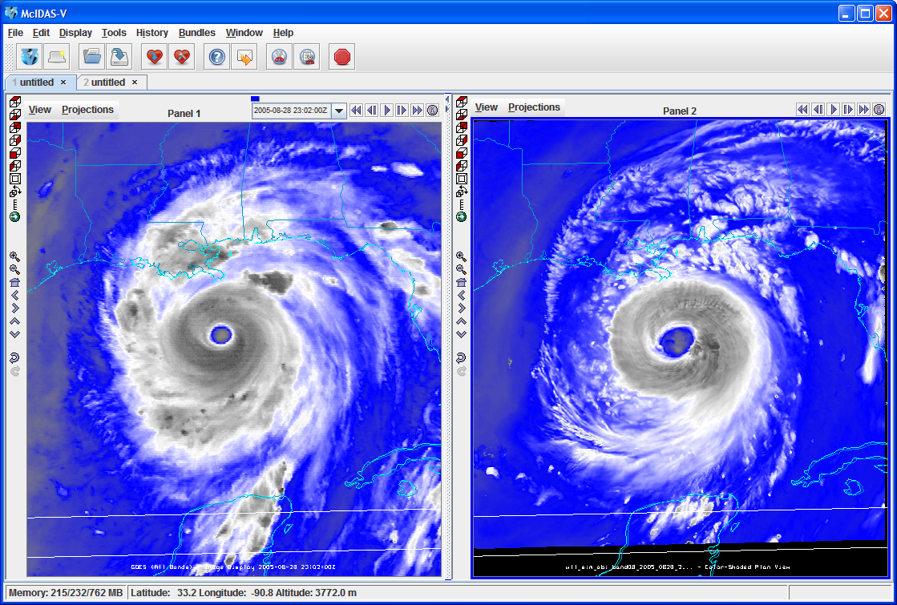
GOES Imager
GOES-R ABI
One is from a McIDAS AREA, while the other (simulated image) is from a netCDF.

Slide 42
Ideas for the Further Enhancement and Utility of Validation Tools
Comparison to other satellites
  Other images, Imagery correlations
  High-spectral resolution IR sounders
Radiance Quality Assessment
  Signal-to-noise ratio
  Striping
  INR
  Forward model “calc” vs “obs”
Product generation is a good check on the input values!
Hard to know the dividing line between imagery and calibration and/or system monitoring tools
Notes:
Please provide your thoughts and ideas for enhancing the capabilities and utililty of the validation tools beyond what you already planned to do. For example:
1) Could your matchup databases support product reprocessing?
2) What new visualization technologies could be used to further enhance the capability/utility of a routine or “deep-dive” validation tool?
3) What web interfaces to your validation tool outcomes could/should be developed (if not already developed)?
4) Other ideas?

Slide 43
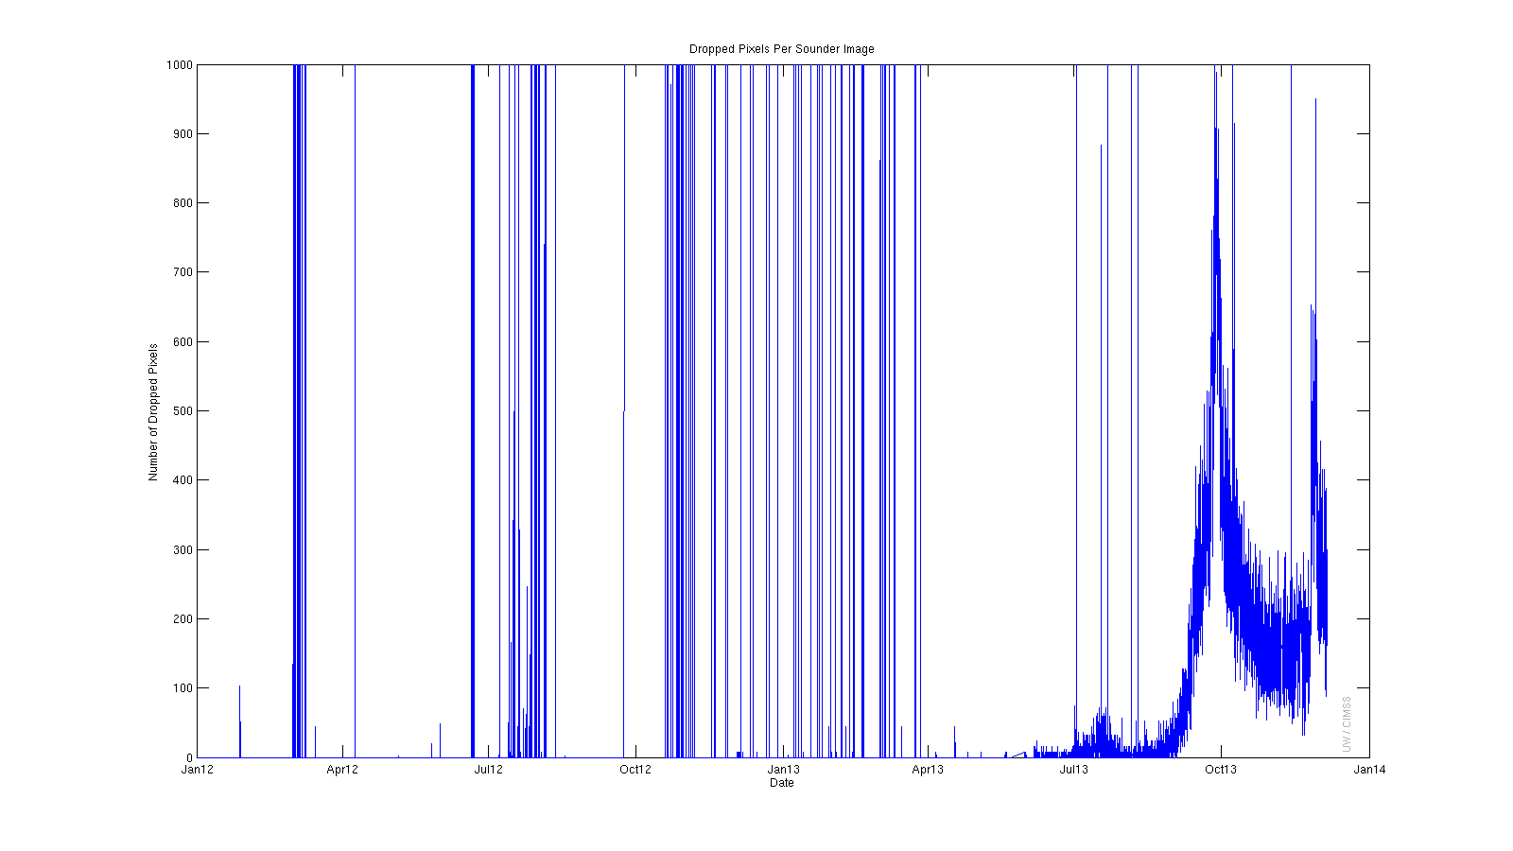
GOES-13 Sounder (ch8) “Dropped” Pixels Since 01Jan2012
Funding via GOES-R CWG
Dropped pixels have RAW, RAD, etc values of 0. RFI missing data also are 0, so it is difficult to distinguish the two phenomena. Most of these instances where the number of dropped pixels goes off the chart are RFI.

Slide 44
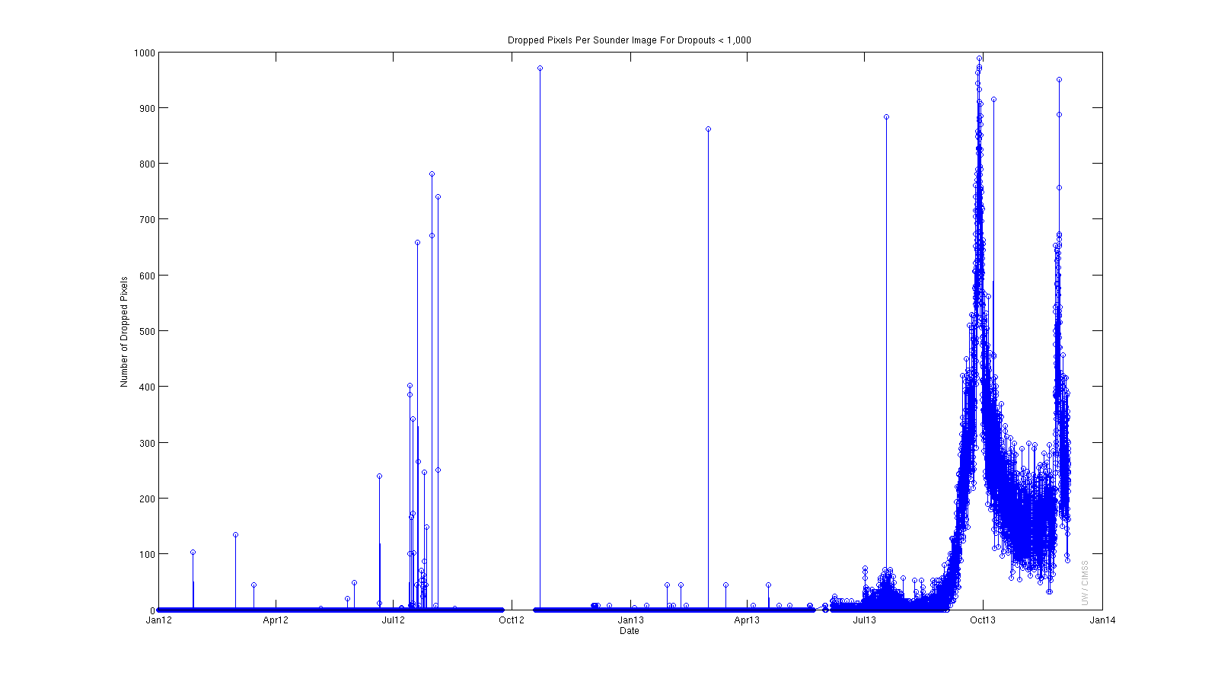
GOES-13 Sounder (ch8) “Dropped” Pixels Less Than 1,000
Funding via GOES-R CWG
This figure shows just the dropouts that are less than 1,000 per image. Many RFI cases are missing large chunks of the entire image. On June 20, 2012 there are consecutive images with dropouts and fewer than 1,000 per image.

Slide 45
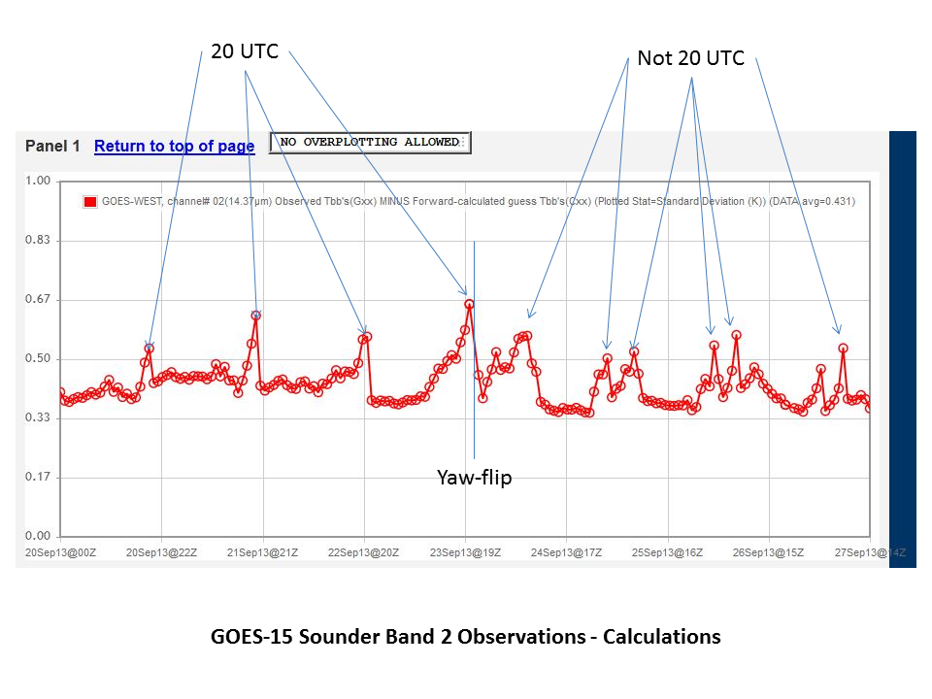
CIMSS/ASPB/SSEC Provided Important GOES Imager/Sounder Support During 2013
Funding via GIMPAP
GOES Sounder Tbb calculated versus observed values (e.g., above fig.)
Science support provided during GOES-13 outage (May 2013)
Stray light impingement during Imager space looks
Sounder striping
Imager co-registration
Sounder dropped pixels
GOES-15 Imager/Sounder nav. during semi-annual ‘yaw-flip' procedures
Notes:
GOES Diagnostic Team: Tim Schmit, Gary Wade, Tony Schreiner, Mat Gunshor, Jim Nelson

Slide 46
Topics
Product Generation and Assessment Using Available Proxy Data
  Highlight proxy products being generated
  Highlight validation tools/methods and recent validation results
  Highlight any user engagement activities
  Highlight interactions with or support provided to any GOES-R Proving Ground Demonstrations
Identifying and Planning for Algorithm Enhancements Beyond Baseline
  Description of algorithm enhancements that have been tested
  Highlight test results and benefits of enhancements
  List algorithm enhancements you envision needing to be transitioned to operations after launch
Road to GOES-R Post-Launch Test (PLT) and Post-Launch Product Validation
  AWG team plans and approach to validate your team’s product(s) post-launch
  User engagement plans
  Concerns/comments/questions related to the GOES-R PLT and/or post-launch validation
Notes:
Topic areas to cover. Plan on a 15-20 min presentation.

Slide 47
Enhancements
Complete web site, with both imagery and products, other sensors, etc…
Pseudo-natural color imagery, other combinations…
Consider an ‘emission-only’ product from 4 micrometer band
  Suggested by a review team

Slide 48
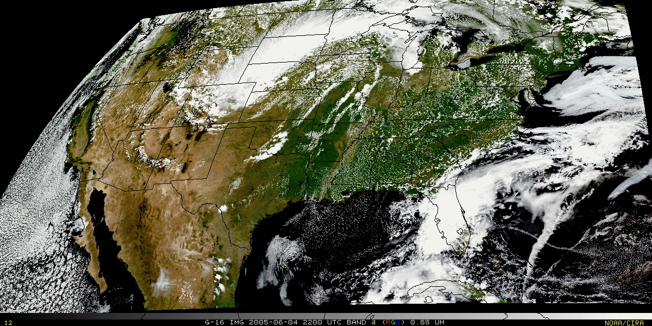
Validation – image combination
“True Color” with “synthetic” green band from ABI simulated data (from CIMSS); image from Don Hillger, RAMMB.

Slide 49

Validation – image combination movie
“True Color” with “synthetic” green band movie from ABI simulated data (from CIMSS); image from Don Hillger, RAMMB.

Slide 50
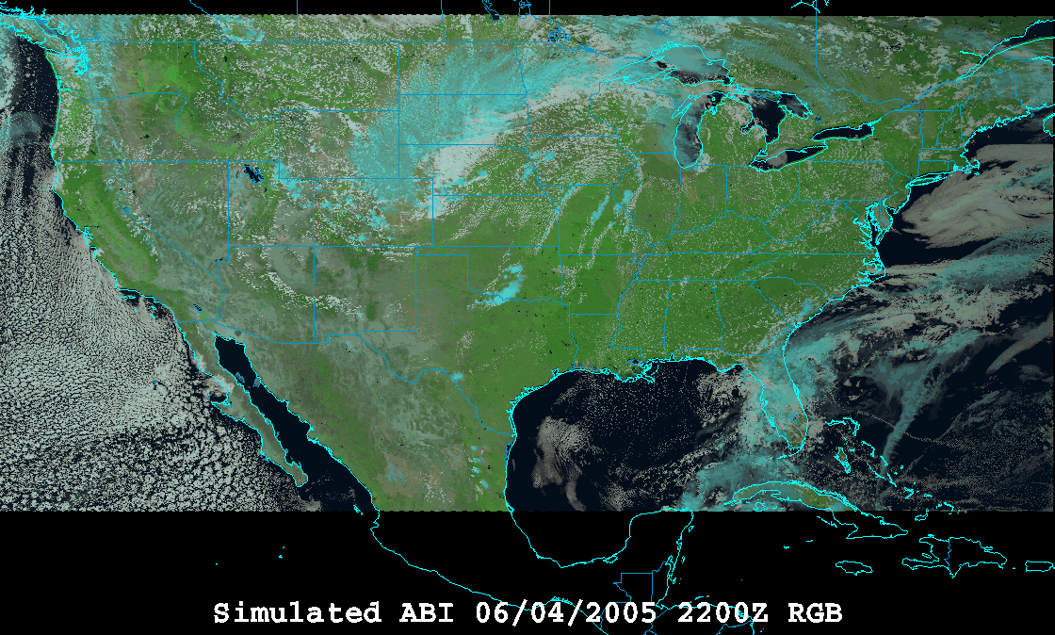
Validation – image combination
“RGB Color” (VIS 0.6, VIS 0.8, and NearIR 1.6 um) with ABI simulated data (from CIMSS); image from William Straka, CIMSS and using the EUMETSAT enhancement.

Slide 51
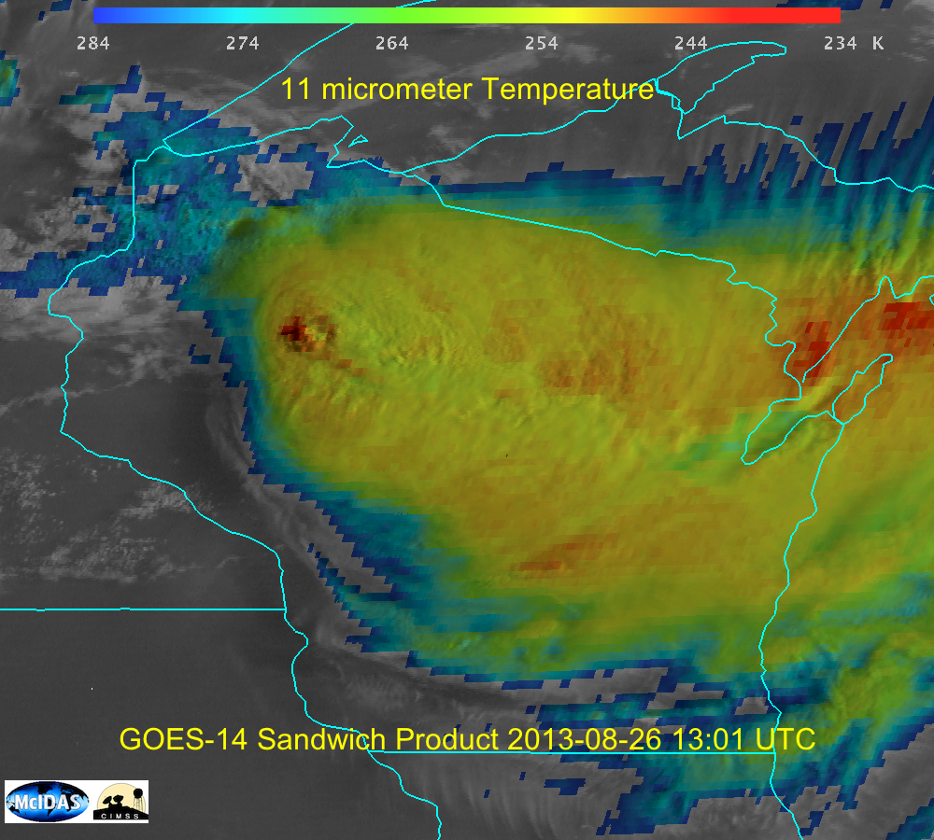
Validation – image combination
Vis and IR ‘sandwich’ product…
Created in McIDAS-V by Joleen Feltz; similar to the method of Martin Setvak

Slide 52
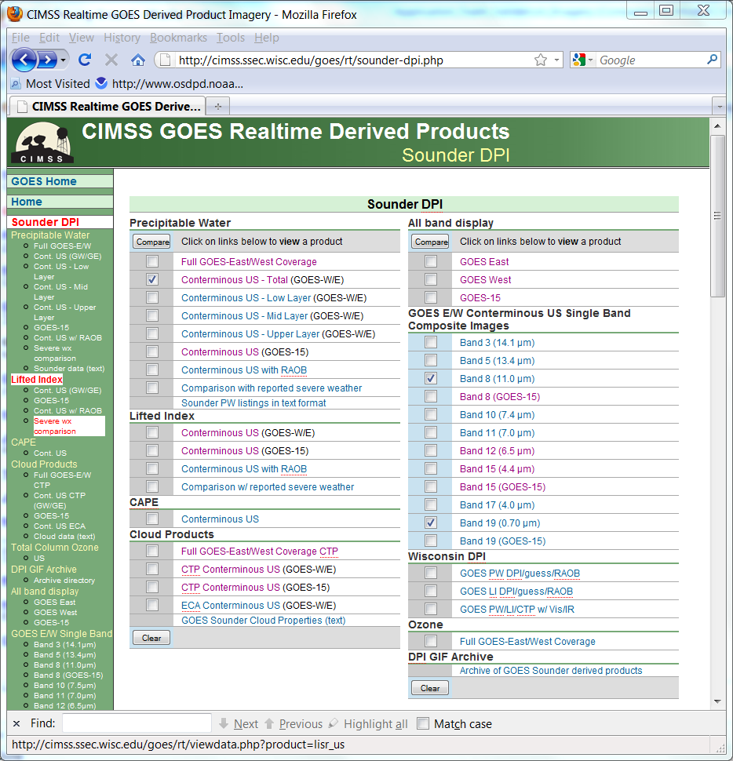

Slide 53
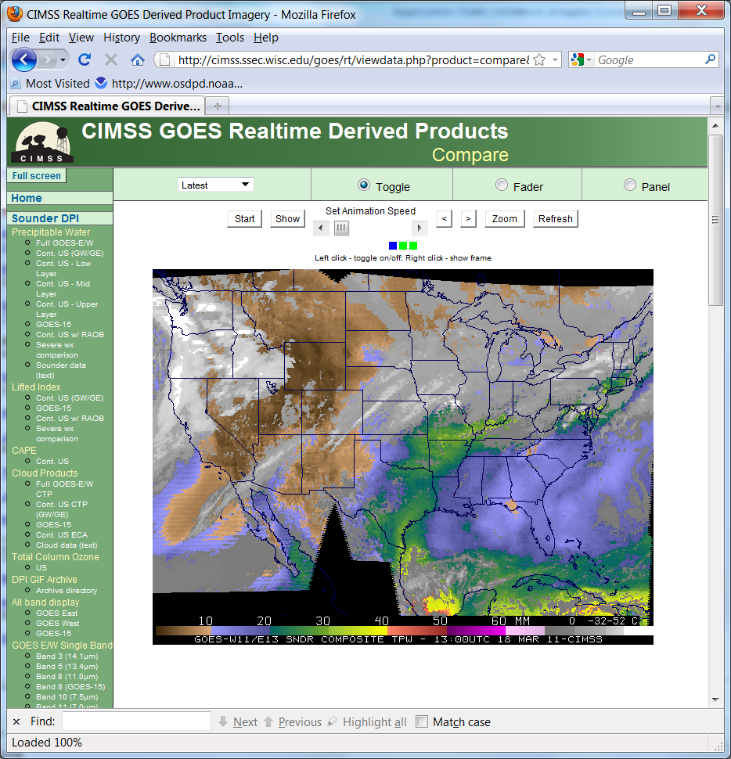

Slide 54
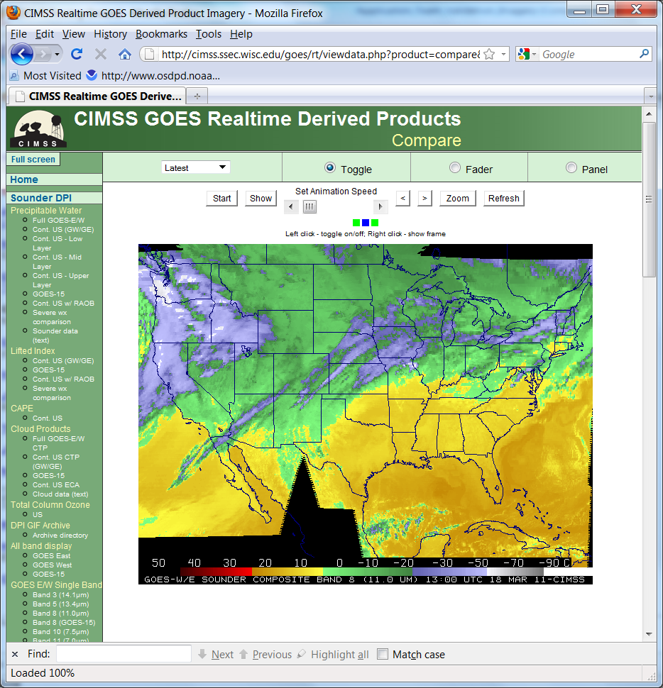

Slide 55
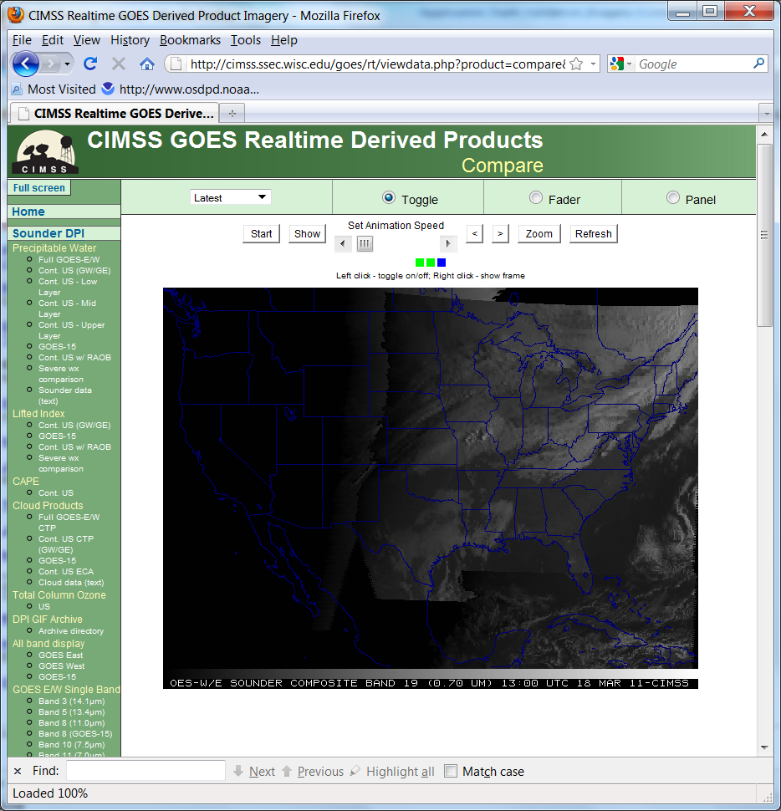

Slide 56
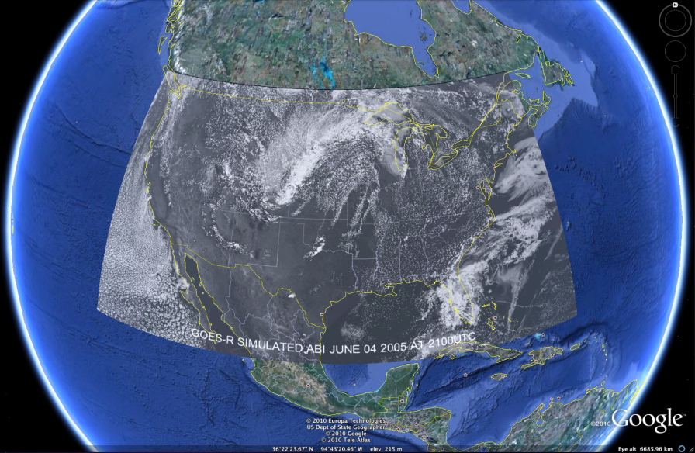
Google Earth
Consider other formats, such as google earth:
  http://cimss.ssec.wisc.edu/goes/abi/loops/links.html
  GOES-R Advanced Baseline Imager (ABI) Band 2 shown

Slide 57
Topics
Product Generation and Assessment Using Available Proxy Data
  Highlight proxy products being generated
  Highlight validation tools/methods and recent validation results
  Highlight any user engagement activities
  Highlight interactions with or support provided to any GOES-R Proving Ground Demonstrations
Identifying and Planning for Algorithm Enhancements Beyond Baseline
  Description of algorithm enhancements that have been tested
  Highlight test results and benefits of enhancements
  List algorithm enhancements you envision needing to be transitioned to operations after launch
Road to GOES-R Post-Launch Test (PLT) and Post-Launch Product Validation
  AWG team plans and approach to validate your team’s product(s) post-launch
  User engagement plans
  Concerns/comments/questions related to the GOES-R PLT and/or post-launch validation
Notes:
Topic areas to cover. Plan on a 15-20 min presentation.

Slide 58
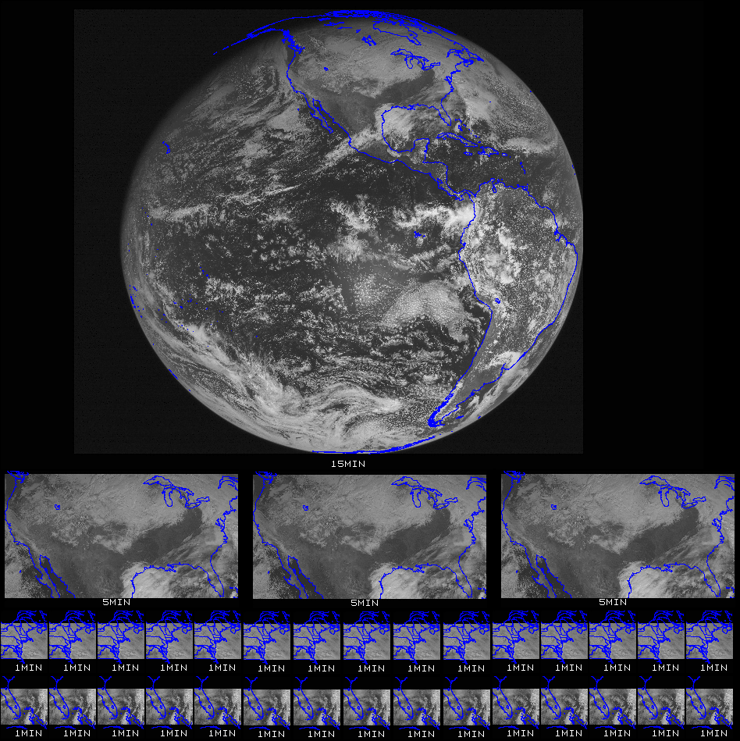
PLT
Ideally:
Fully funded teams! ☺
CMIP files will initially be validated against their raw counts. (Cross checking the conversion to radiance and reflectance factor/brightness temperature).
the GRB data will be fully accessible from the beginning of the PLT (Post Launch Test)
the PLT would be extended so that other scan modes (‘timelines’) could be tested
NWS and other users will be fully engaged
  Data flowing end-to-end

Slide 59
Summary
Imagery is the key product and hence needs a sufficient validation tool set.
This tool set should at least include:
  Thumbnail images
  Full size and/or zoomed images
  Animations
  Times series of radiances/brightness temperatures
  Statistics of radiances/brightness temperatures
  Temporal difference images
  Spectral band differences
  Combine images
  Product generation!
  Forward model “Calc” vs “Obs” information
Need a flexible system, which allows zooming, roaming, specialized enhancements, etc.
  Hope for the best, plan for the worst.
NOAA Science Tests Tech Reports for the GOES (lead by Hillger and Schmit)
  http://rammb.cira.colostate.edu/projects/goes-p/

Slide 60
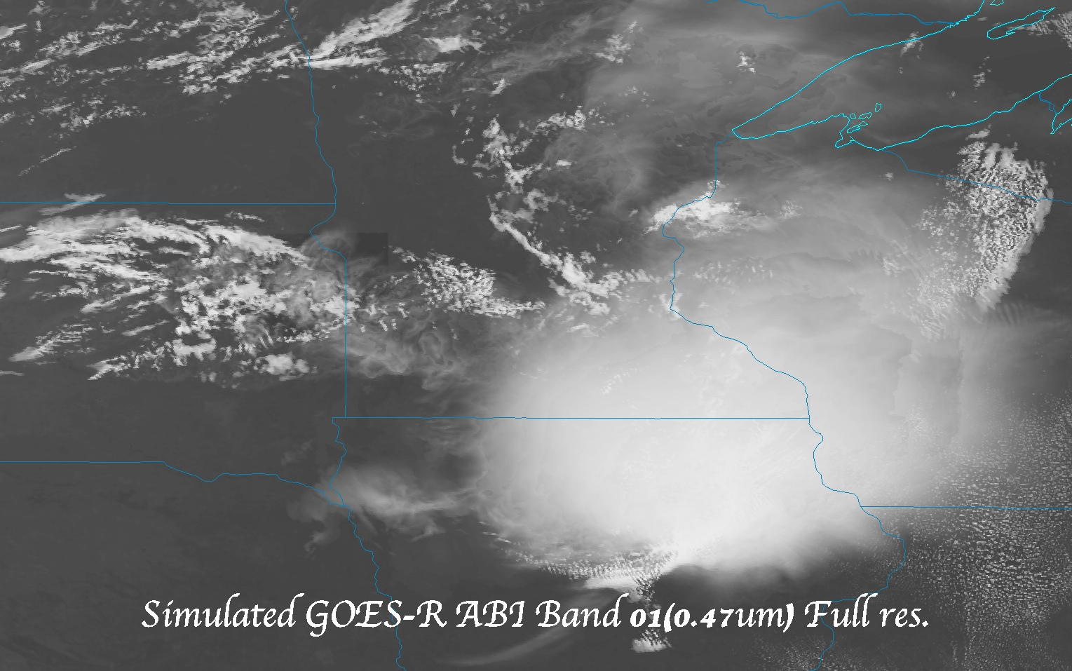
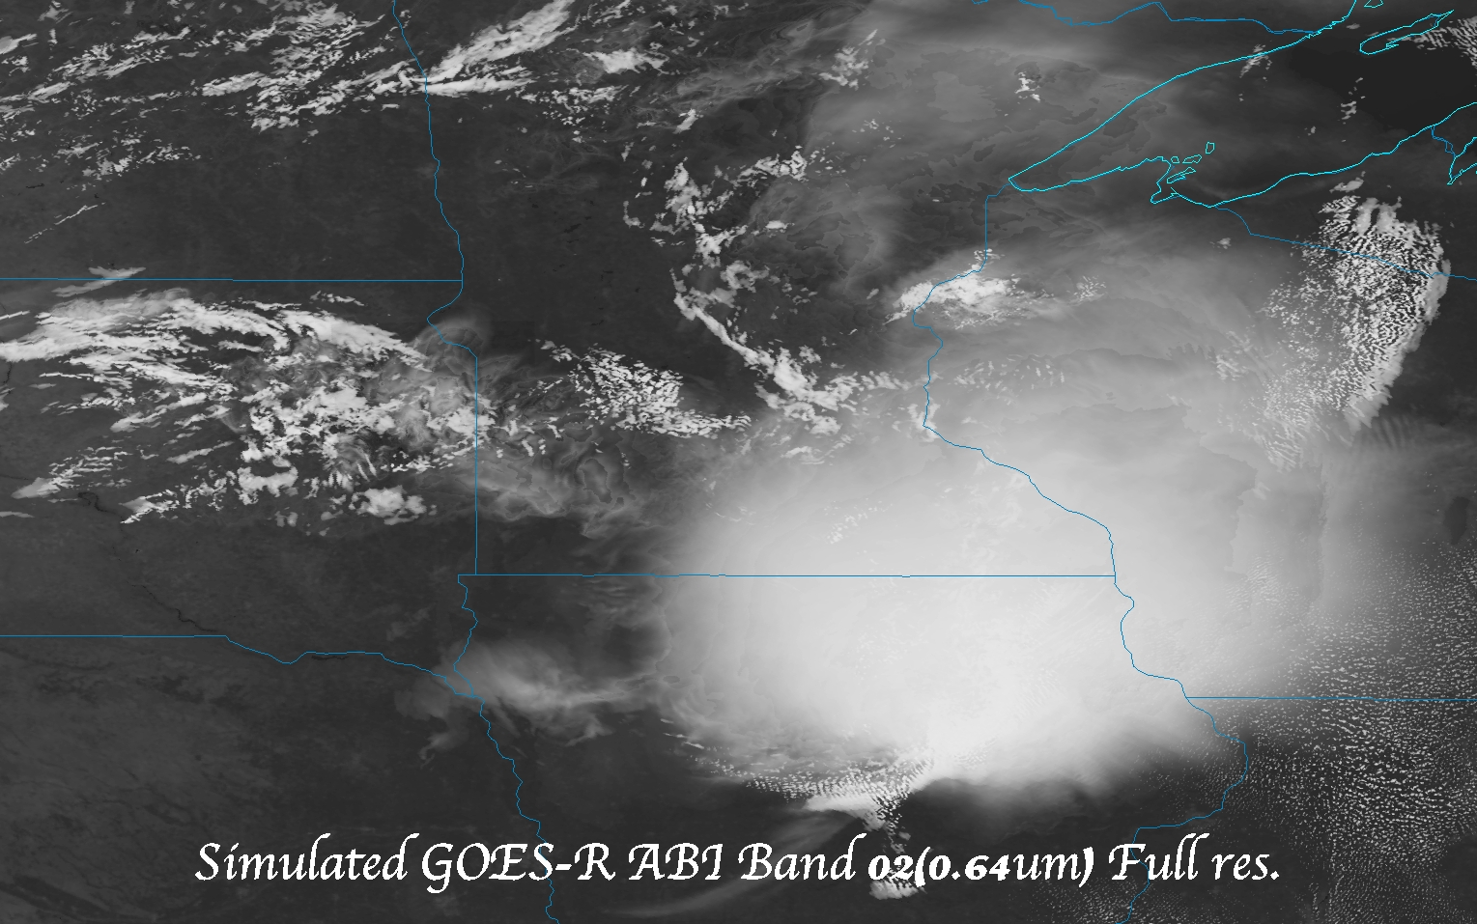
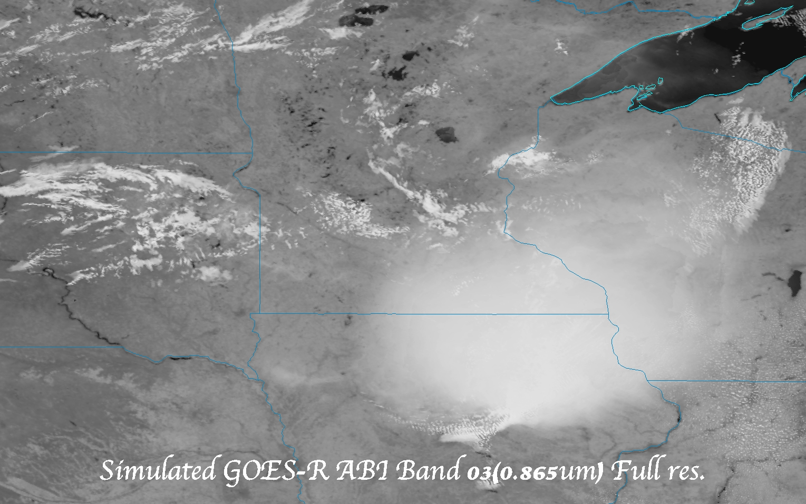
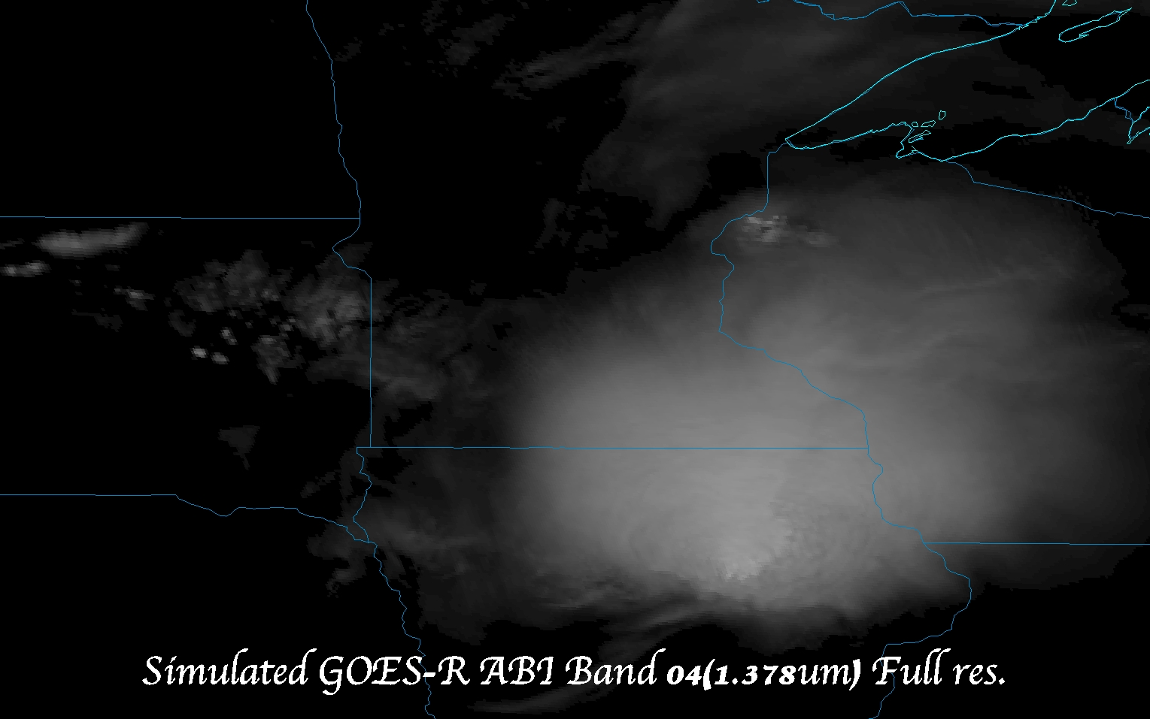
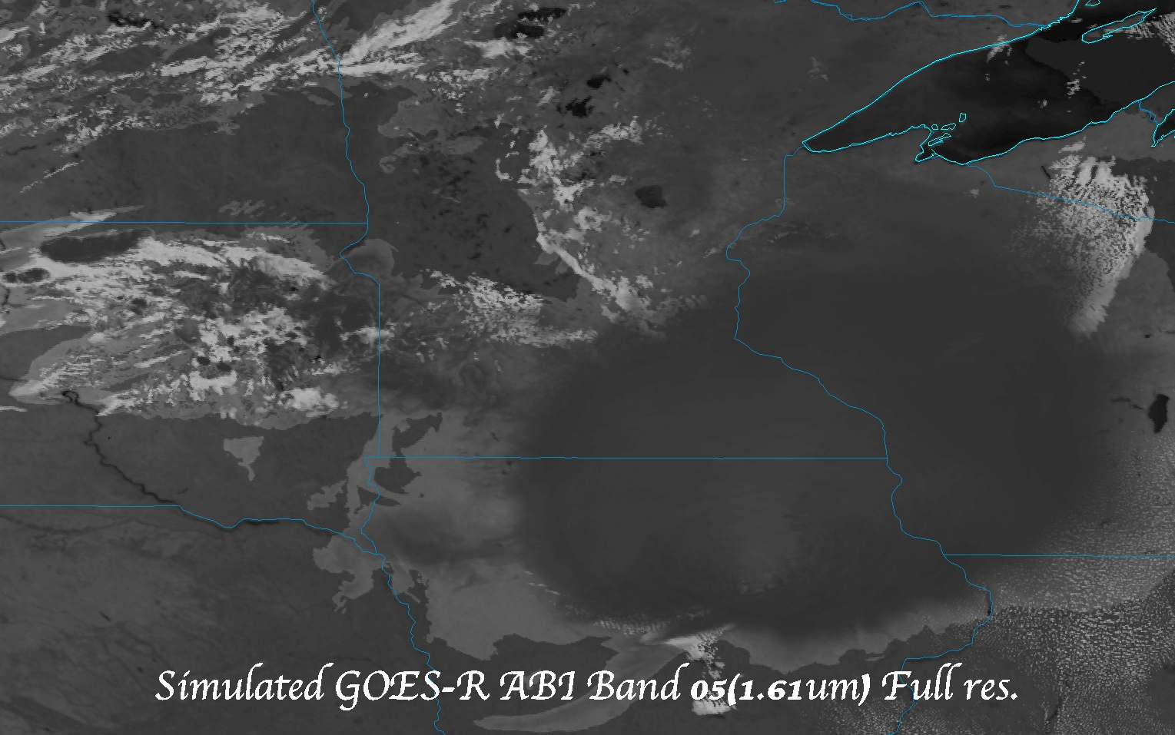
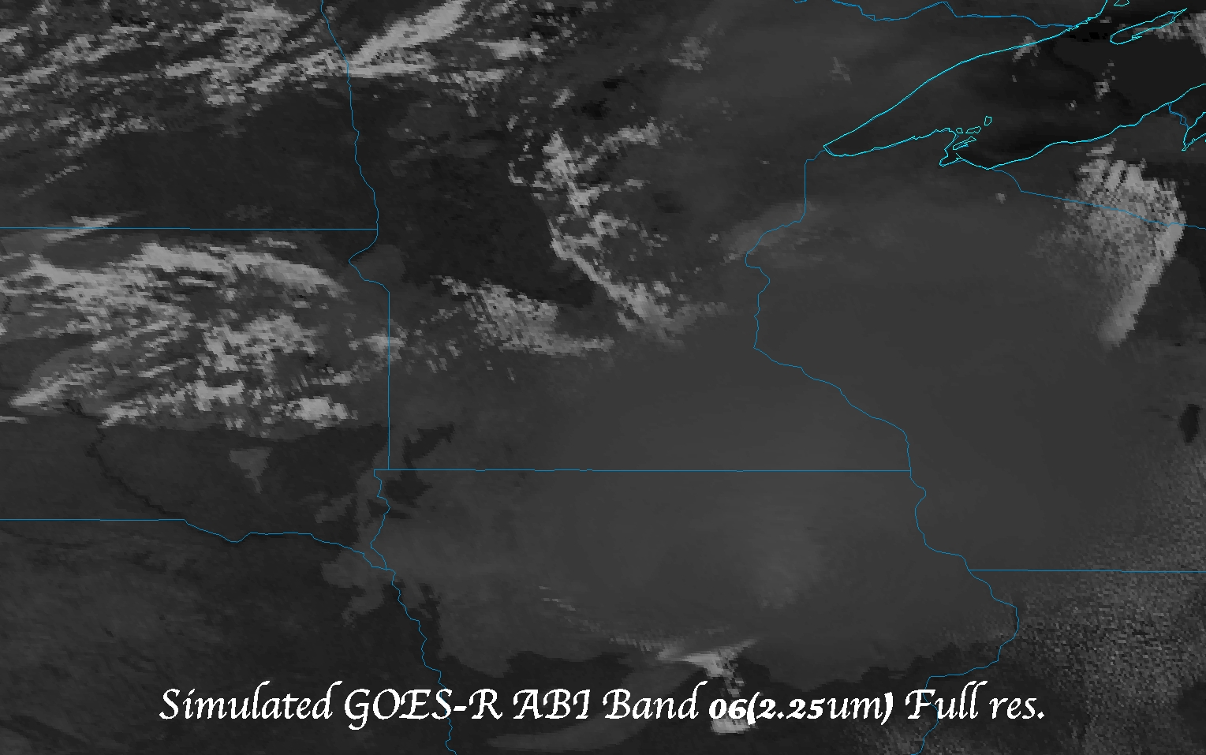
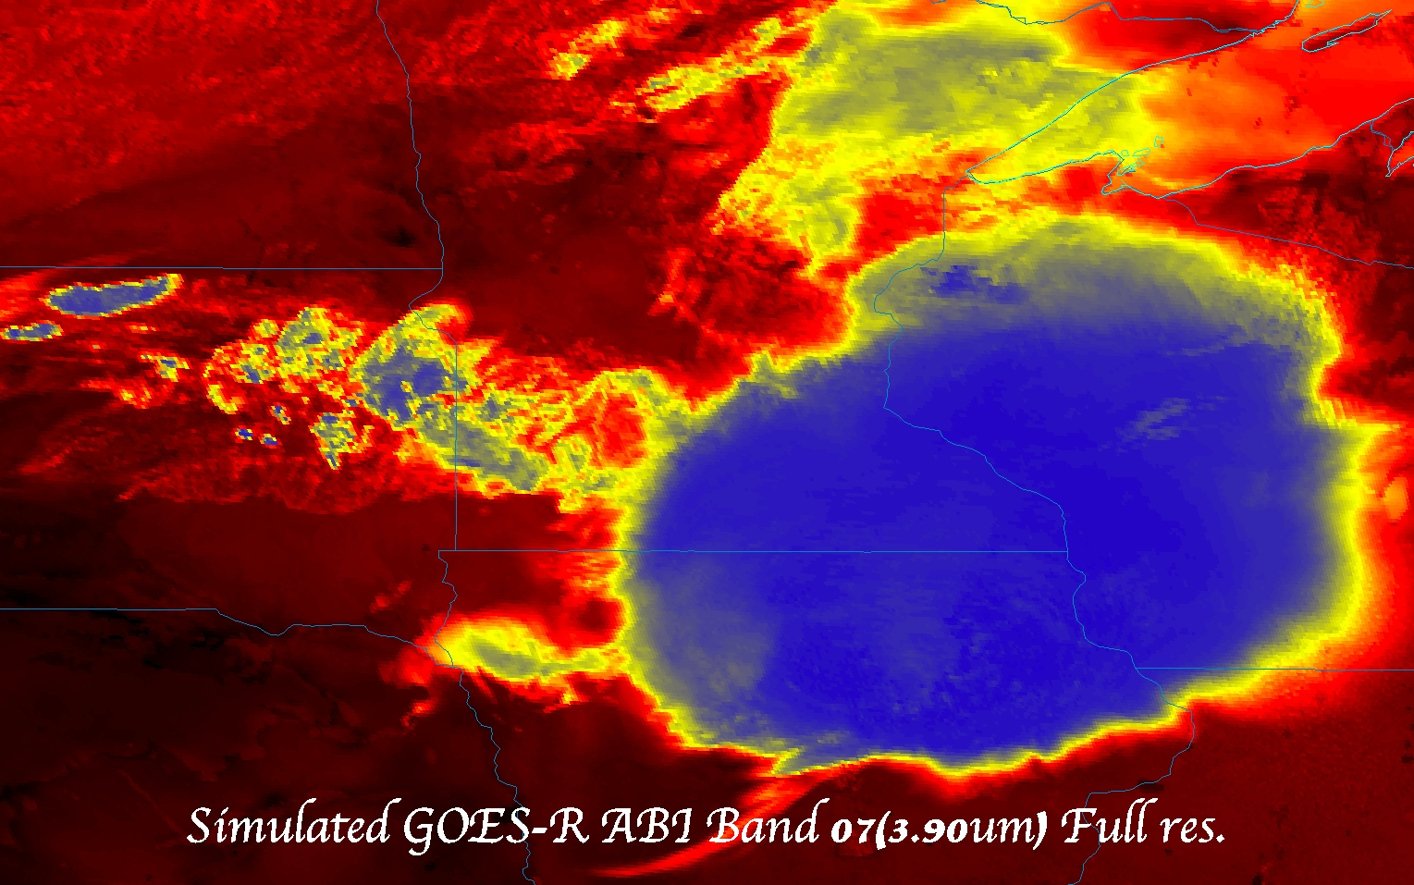










Slide 61

Reference
Schmit T.J., Goodman S.J., Lindsey D.T., R. M. Rabin, K. M. Bedka, M. M. Gunshor, J. L. Cintineo, C. S. Velden, A. S. Bachmeier, S. S. Lindstrom, and C. C. Schmidt, 2013: Geostationary operational environmental satellite (GOES)-14 super rapid scan operations to prepare for GOES-R. J. Appl. Remote Sens. 0001;7(1):073462. doi:10.1117/1.JRS.7.073462.
http://remotesensing.spiedigitallibrary.org/article.aspx?articleid=1790703

