Slide 1
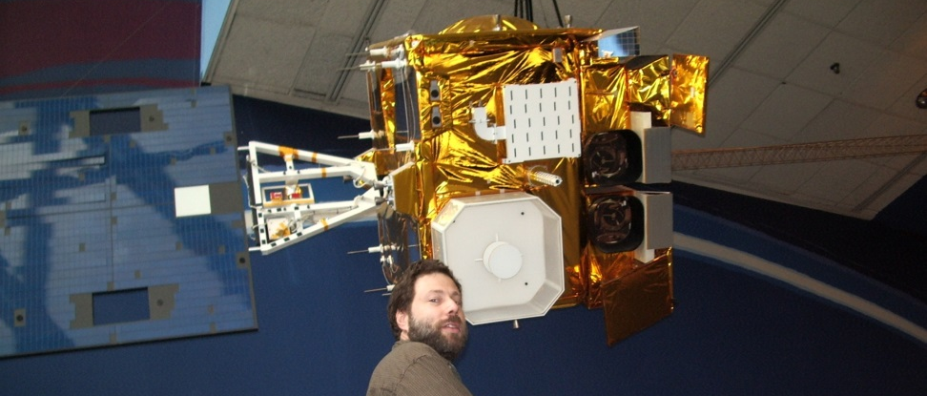
Current GOES (Imager and Sounder)
de facto NOAA GOES Instrument Scientist
Co-led NOAA Science Tests during checkouts
GOES-14 1min lead (idea, schedule, sector placement)
GOES-V/W Science Support (geo-OSSE, etc.)
GOES-R AWG Imagery Team Lead
Responsible for team with the Key Performance Parameter
GOES-R AWG Soundings Team Lead
Legacy (10km) DPI, etc.
GOES-R Product Working Group
Key member wrt ABI
Waivers, etc.
GOES-R (Misc)
DOE, CWG/CVCT, AHI, ABI scan modes, etc.
ABI band fact sheets
Education/Outreach/Service
Web Apps
Roof Top Cameras + GOES imagery
NOAA Satellite Conference poster co-chair
AMS co-chair for Next Satellite Symposium
Annual Meeting Oversight Committee (AMS)
BAMS co-editor (for satellites)
OSPO Support
Support when needed, imager and sounder (outages)
Calibration (dropped blocks, stray light)
Navigation and Schedules (Optimization, RSO)
Product impacts
Tim
Schmit

Slide 2
GOES-14 Super Rapid Scan Operations to Prepare for GOES-R (SRSOR)
SRSOR for 2015 include May 18-June 12, and August 10-22:
http://cimss.ssec.wisc.edu/goes/srsor2015/GOES-14_SRSOR.html
Data during parts of 2012 (Hurricane Sandy, convection), 2013 (CA Rim Fire, convection) and 2014 (Hurricane Marie, convection). 2016 data recently approved.
GOES-14 provided very unique data and offered a glimpse into the possibilities that will be provided by the ABI on GOES-R in one minute mesoscale imagery
Used by the NWS, including NOAA’s Storm Prediction Center (SPC), Weather Prediction Center (WPC) and others. These data helped showcase how rapid scan image can be used operationally.
GOES-14 visible image showing rapid convective (loops over just half an hour) during the flooding in Texas (May 25, 2015).
Notes:
http://cimss.ssec.wisc.edu/goes/srsor2015/GOES-14_SRSOR.html

Slide 3
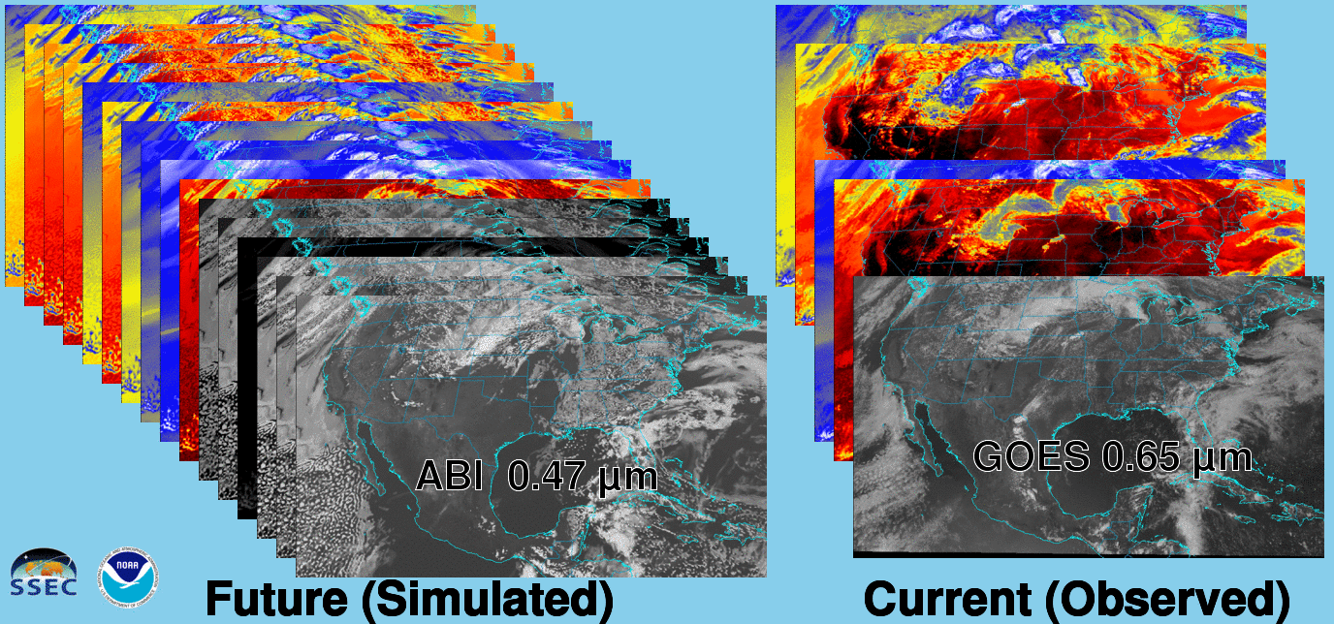
Future vs. Current Spectral Bands
The current GOES (right) has 5 spectral bands, while the GOES-R series ABI (left) will have 16 spectral bands.

Slide 4
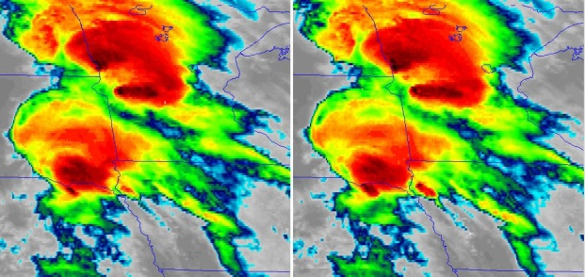
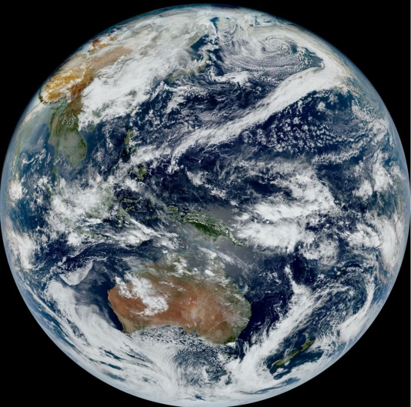
Educational Webapps
NOAA NESDIS ASPB teamed up with CIMSS researchers to develop four educational WebApps to explore space, time and spectral resolutions of satellite imagery.
Part of the GOES-R Educational Proving Ground at CIMSS:
http://cimss.ssec.wisc.edu/education/goesr
Teacher feedback: “…. Wow!! This is awesome!! This is impressive. Thank you for sharing. This is great. Thanks for all your hard work and help!!!! We are honored and will use it next week … Earth SySTEM Teacher Academy”
Spatial/Temporal
“What’s this?”
Spectral
Satellite RGB
Sample interactive educational webapps http://cimss.ssec.wisc.edu/goes/webapps/bandapp/
T. Schmit
Notes:
Tim Schmit, ASPB
https://ams.confex.com/ams/95Annual/webprogram/Paper265203.html ABI = Advanced Baseline Imager
Other new webapps: one to change both the spatial and temporal sampling and the other only the pixel sampling

