Slide 1
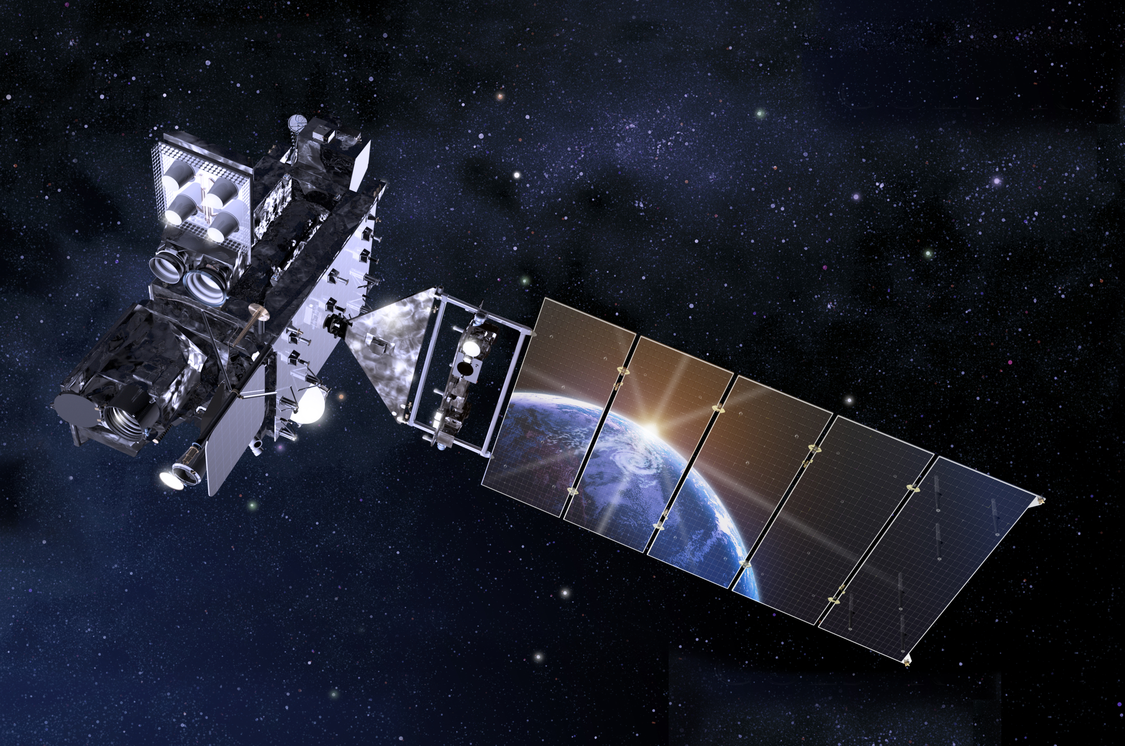
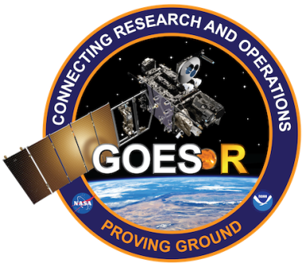
GOES-R Derived Products for
Operational Meteorology
Chris Schmidt
University of Wisconsin - CIMSS
Thanks to:
Chad M. Gravelle, PhD
GOES-R Satellite Liaison
NWS Operations Proving Ground
University of Wisconsin - CIMSS
Kansas City, MO
GOES-R Short Course
18 May 2016

Slide 2
Baseline and Future Capability Products
ABI Baseline Products
Aerosol Detection (Including Smoke and Dust) Aerosol Optical Depth (AOD) Clear Sky Masks Cloud and Moisture Imagery Cloud Optical Depth Cloud Particle Size Distribution Cloud Top Height Cloud Top Phase Cloud Top Pressure Cloud Top Temperature Derived Motion Winds Derived Stability Indices Downward Shortwave Radiation: Surface Fire/Hot Spot Characterization Hurricane Intensity Estimation Land Surface Temperature (Skin) Legacy Vertical Moisture Profile Legacy Vertical Temperature Profile Radiances Rainfall Rate/QPE Reflected Shortwave Radiation: TOA Sea Surface Temperature (Skin) Snow Cover Total Precipitable Water Volcanic Ash: Detection and Height
ABI Future Capability Products
Absorbed Shortwave Radiation: Surface Aerosol Particle Size Aircraft Icing Threat Cloud Ice Water Path Cloud Layers/Heights Cloud Liquid Water Cloud Type Convective Initiation Currents Currents: Offshore Downward Longwave Radiation: Surface Enhanced "V" / Overshooting Top Detection Flood/Standing Water Ice Cover Low Cloud and Fog Ozone Total Probability of Rainfall Rainfall Potential Sea and Lake Ice: Age, Concentration, and Motion Snow Depth (Over Plains) SO2 Detection Surface Albedo Surface Emissivity Tropopause Folding Turbulence Prediction Upward Longwave Radiation: Surface and TOA Vegetation Fraction: Green Vegetation Index Visibility

Slide 3
Baseline and Future Capability Products
ABI Baseline Products
Aerosol Detection (Including Smoke and Dust) Aerosol Optical Depth (AOD) Clear Sky Masks Cloud and Moisture Imagery Cloud Optical Depth Cloud Particle Size Distribution Cloud Top Height Cloud Top Phase Cloud Top Pressure Cloud Top Temperature Derived Motion Winds Derived Stability Indices Downward Shortwave Radiation: Surface Fire/Hot Spot Characterization Hurricane Intensity Estimation Land Surface Temperature (Skin) Legacy Vertical Moisture Profile Legacy Vertical Temperature Profile Radiances Rainfall Rate/QPE Reflected Shortwave Radiation: TOA Sea Surface Temperature (Skin) Snow Cover Total Precipitable Water Volcanic Ash: Detection and Height
ABI Future Capability Products
Absorbed Shortwave Radiation: Surface Aerosol Particle Size Aircraft Icing Threat Cloud Ice Water Path Cloud Layers/Heights Cloud Liquid Water Cloud Type Convective Initiation Currents Currents: Offshore Downward Longwave Radiation: Surface Enhanced "V" / Overshooting Top Detection Flood/Standing Water Ice Cover Low Cloud and Fog Ozone Total Probability of Rainfall Rainfall Potential Sea and Lake Ice: Age, Concentration, and Motion Snow Depth (Over Plains) SO2 Detection Surface Albedo Surface Emissivity Tropopause Folding Turbulence Prediction Upward Longwave Radiation: Surface and TOA Vegetation Fraction: Green Vegetation Index Visibility

Slide 4
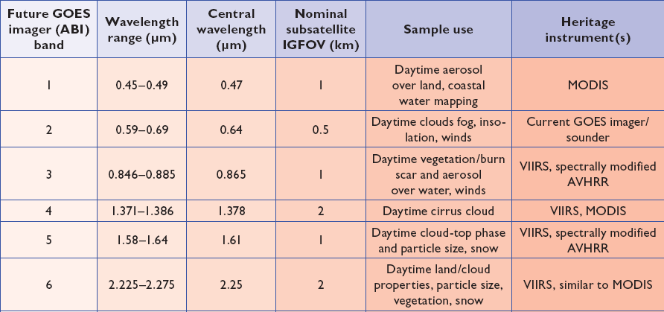
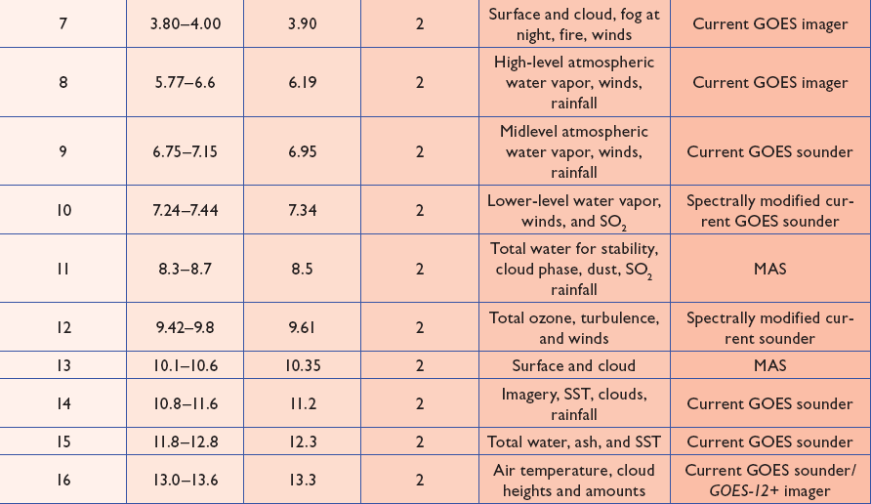
ABI Spectral Coverage:
From BTs to DPs
Our built in sensors work in the visible light regime (with varying degrees of success dependent upon genetics, history, and age). GOES and other satellites also look at the infrared to provide key information about the atmosphere and surface, as listed to the right and shown in the following slides using the Himawari-8 equivalents.
(Himawari-8 carries a modified copy of GOES-R’s ABI, and launched a year and a half before GOES-R will)

Slide 5
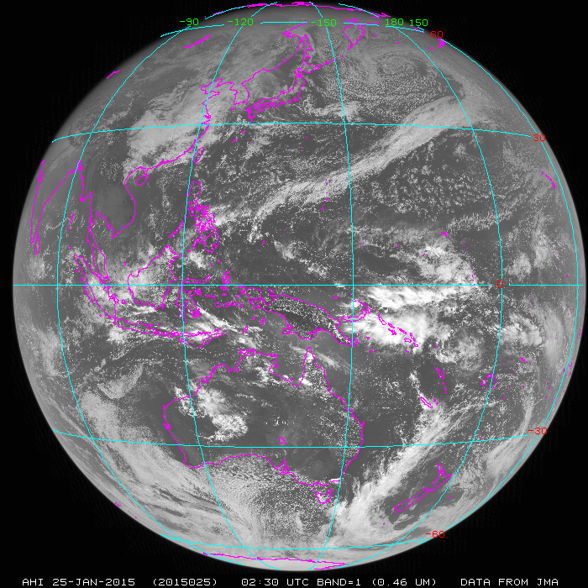
McIDAS-X

Slide 6
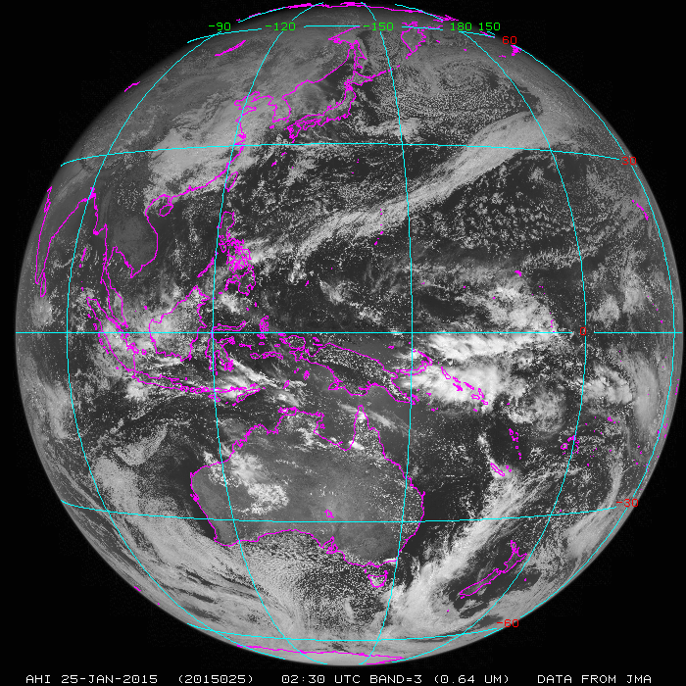

Slide 7
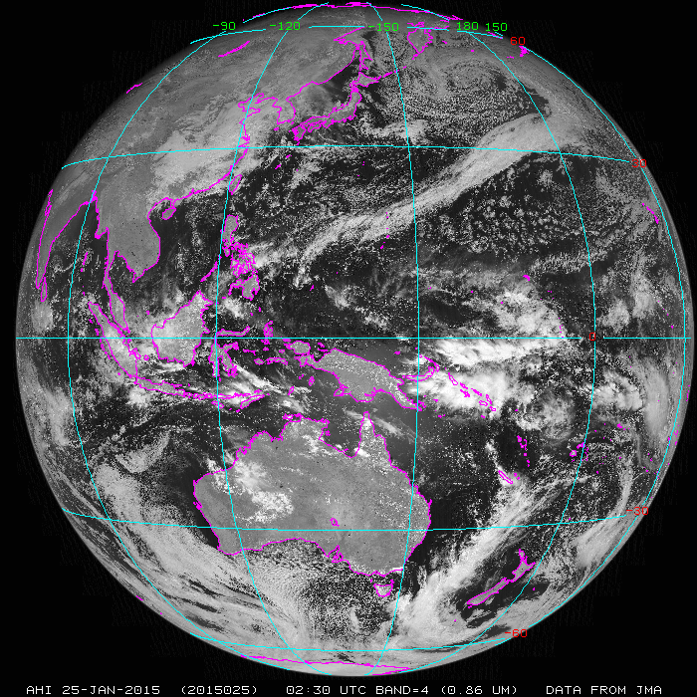

Slide 8
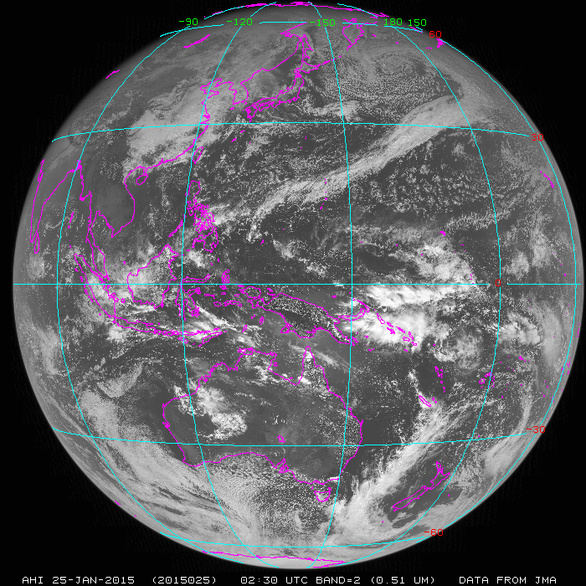
Placeholder for the 1.38 um band, which AHI does not have

Slide 9
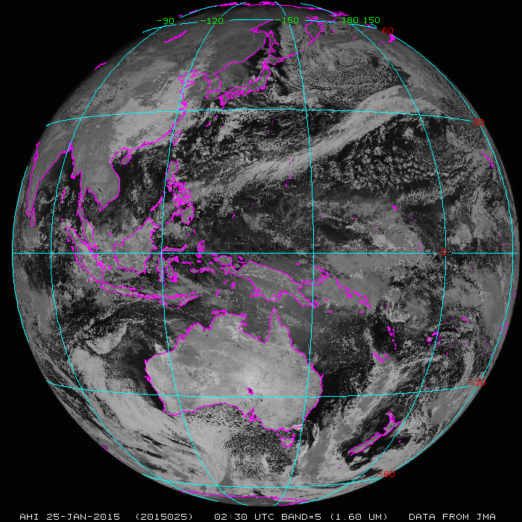

Slide 10
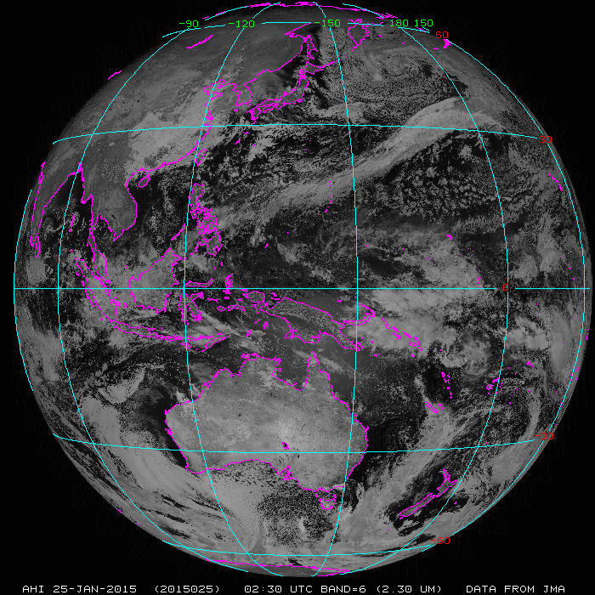

Slide 11
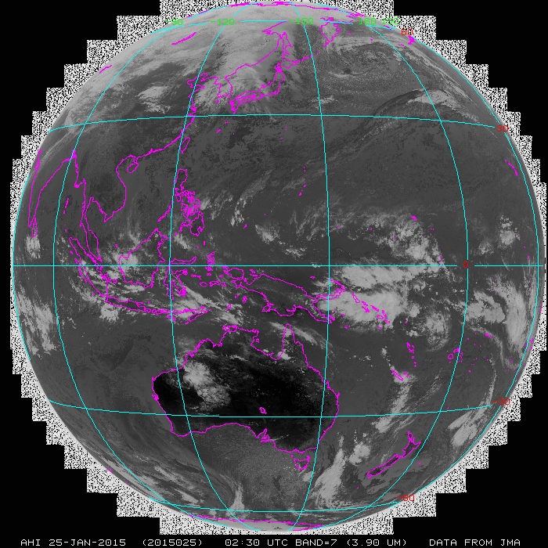

Slide 12
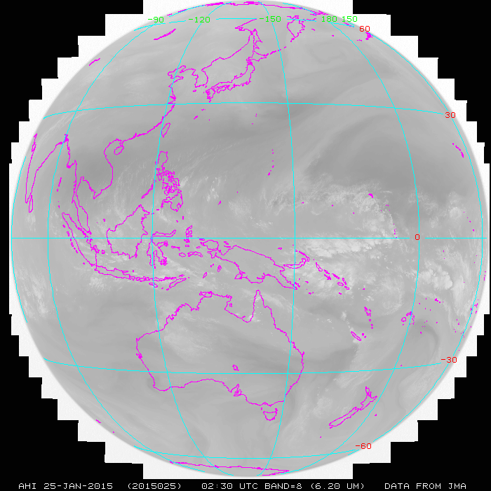

Slide 13
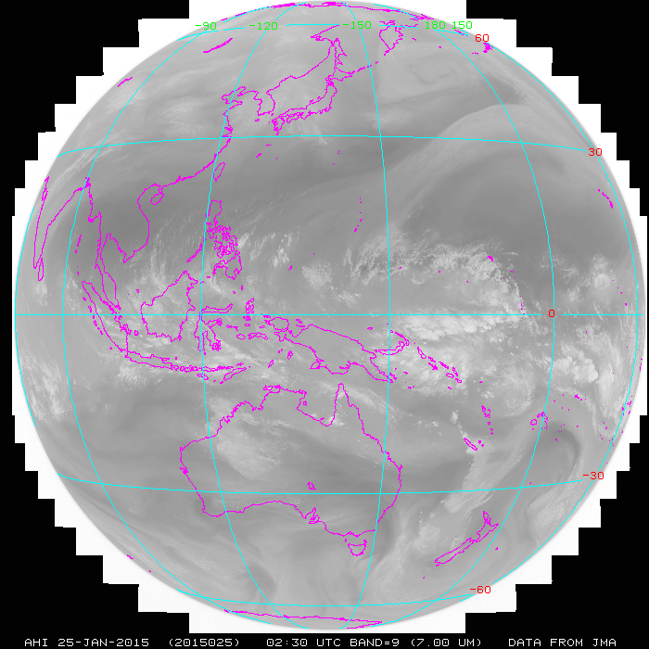

Slide 14
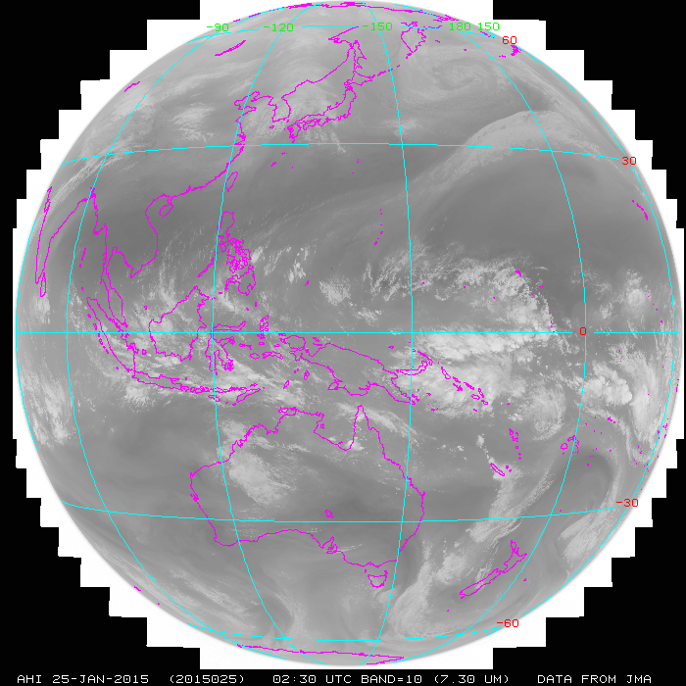

Slide 15
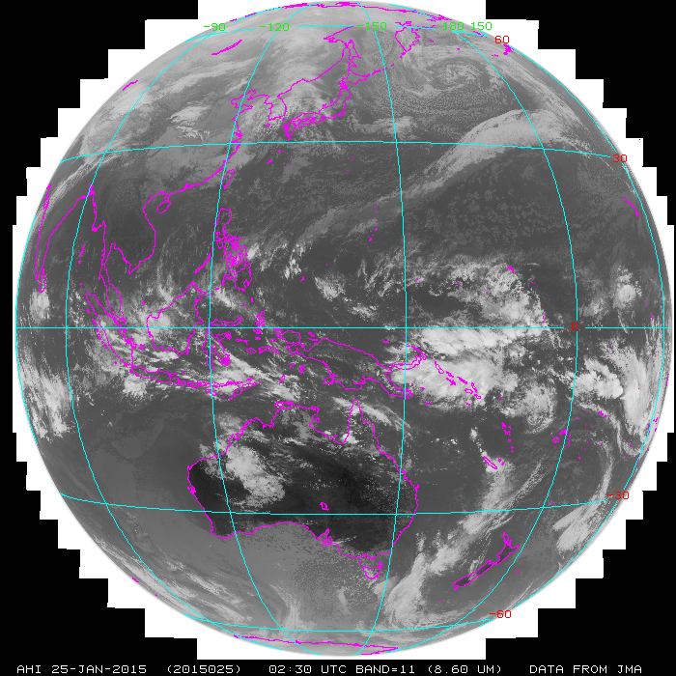

Slide 16
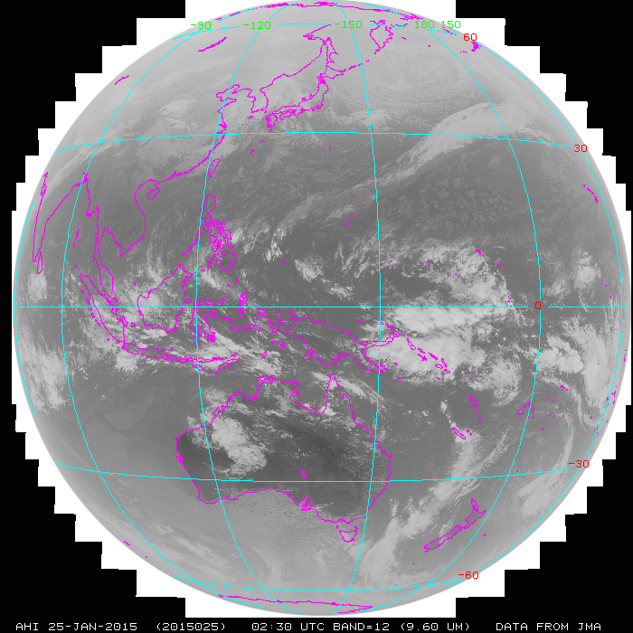
Why is this band “lighter” (ie seeing colder temperatures) than the ones before and after it?

Slide 17
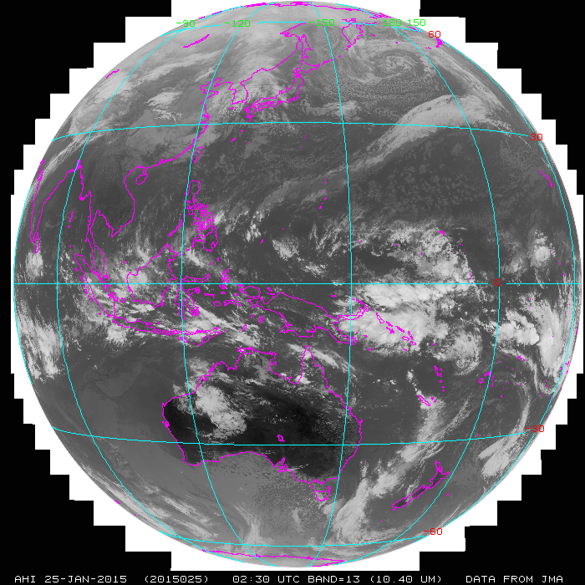

Slide 18


Slide 19


Slide 20
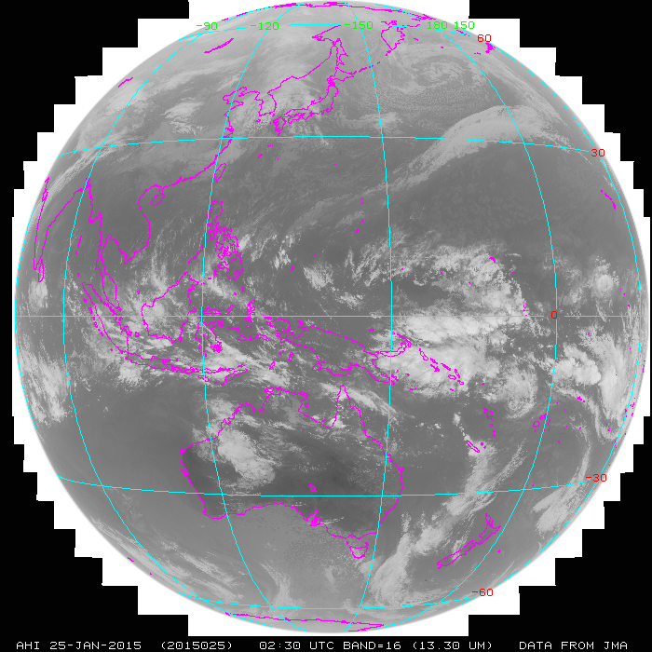
And why is this band “lighter” than the ones before it?

Slide 21
Derived Motion Winds…
Atmospheric Motion Vectors are derived from using a sequence of visible and/or IR spectral bands to track the motion of cloud features and water vapor gradients.
The resulting estimates of atmospheric motion are assigned heights by using the Cloud Height product.
Vital tropospheric wind information over expansive regions of the earth devoid of in-situ wind observations that include oceans and Southern Hemisphere land masses.
Key wind observations to operational NWP data assimilation systems where their use has been demonstrated to improved numerical weather prediction forecasts including tropical cyclones.
Provides improved guidance for NWS field forecasters.

Slide 22
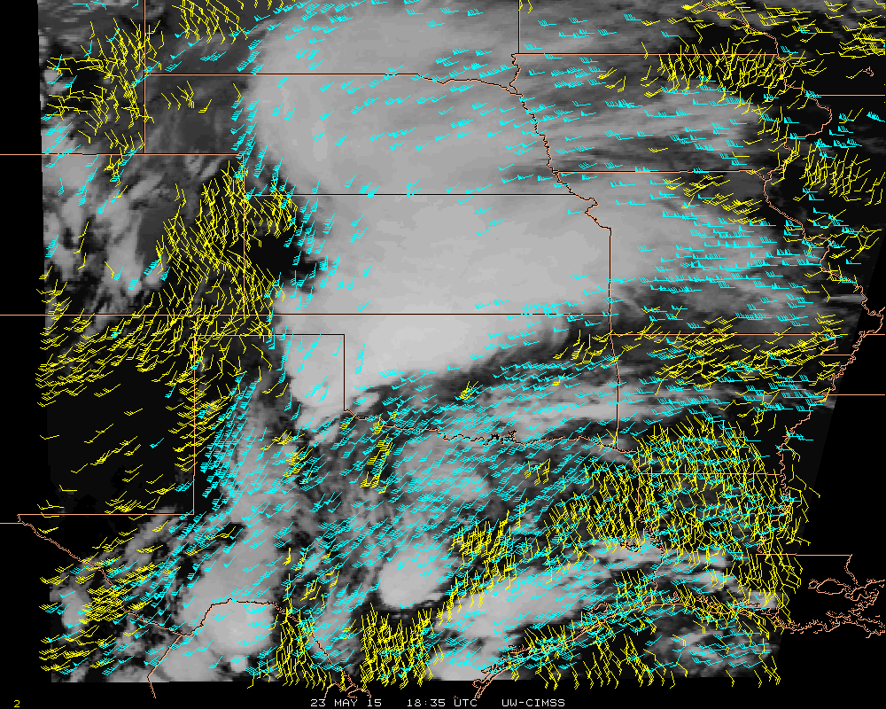
Derived Motion Winds…
upper-level winds
low-level winds
Notes:
Potentially every 10 minutes using 1-minute imagery.

Slide 23
Derived Stability Indices…
Derived Stability Indices such as…
Convective Available Potential Energy (CAPE)
Lifted Index (LI)
Totals Total (TT)
Showalter Index (SI)
K-Index (KI)
…will be computed from the retrieved atmospheric moisture and temperature profiles.
Aid forecasters in nowcasting convection by providing them with an observed plan view of these atmospheric stability parameters.
Forecasters will be able to monitor rapid changes in these indices over time, thus improving their situational awareness in pre-convective environments for potential watch/warning scenarios.

Slide 24
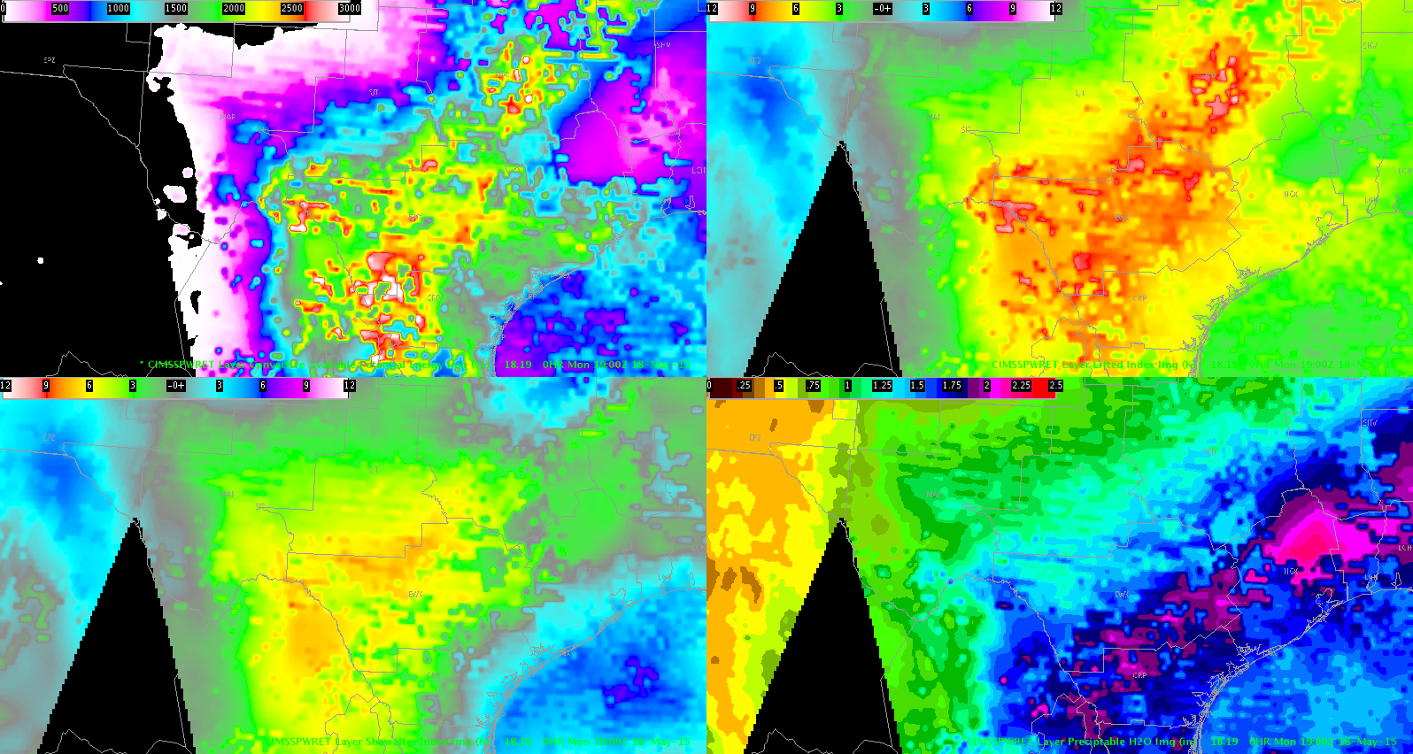
Derived Stability Indices…
CAPE
Lifted Index
Showalter Index
Precipitable Water

Slide 25
Hurricane Intensity Estimation…
The Hurricane Intensity algorithm will make use of the ABI longwave infrared window band to monitor changes in the cloud top temperature near the tropical cyclone center.
Analysis of the cloud top temperature field over the tropical cyclone, together with a cloud pattern recognition analysis, allows retrieval of an intensity estimate for the tropical cyclone valid at the time of the ABI image.
The improved spatial and temporal resolution provided by GOES-R will improve the HIE “scene type” selection process and provide more accurate automated storm center determinations, which are vital to accurate objective TC intensity analysis.
HIE Output:
- maximum sustained 1-minute surface winds (Kts)
- minimum sea level pressure (MSLP)
HIEs will provide critical guidance to forecasters at tropical cyclone forecast centers regarding tropical cyclone storm intensity from storm formation, through development and maturation, to dissipation.

Slide 26
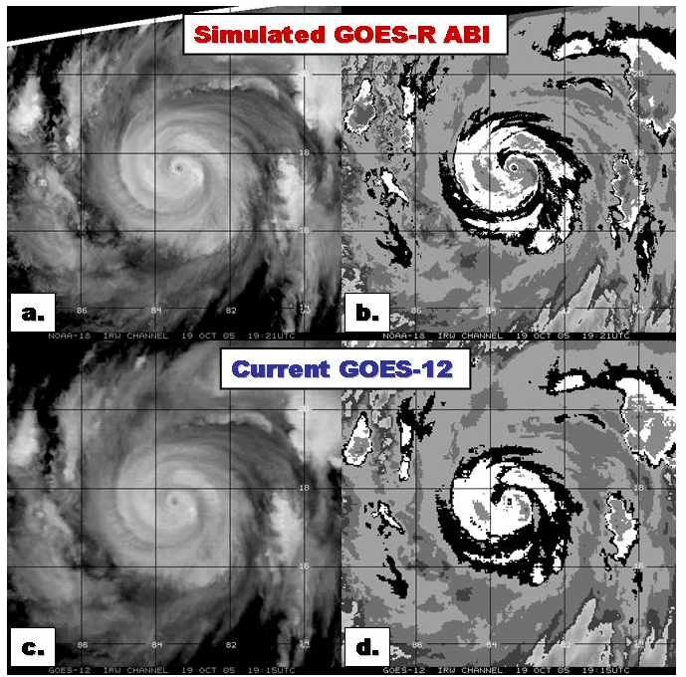
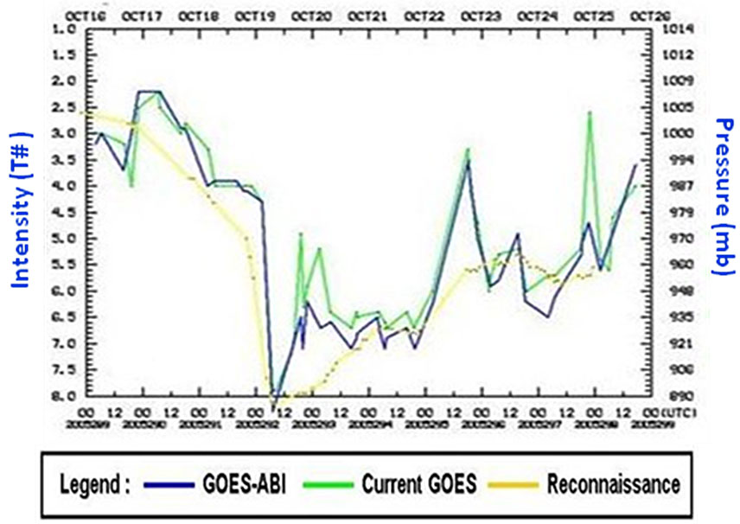
Hurricane Intensity Estimation…

Slide 27
Fire Detection and Characterization
The Fire Detection and Characterization Algorithm (FDCA) uses infrared data from the Advanced Baseline Imager to locate and determine the size, temperature, and radiative power output of fires within the satellite’s field of view.
Geostationary fire detection provides continuous monitoring of the fires, and allows tracking intensity on short time scales.
Fire detection today is used for aerosol and smoke modeling and for event monitoring.
Broadcasters, government agencies, and the public will have access to higher resolution and better data in the GOES-R era.
Large fires are of high local, regional, and sometimes national interest.

Slide 28
Why do we care about geostationary fire detection and characterization?
24/7 coverage allows for tracking trends and detecting fires earlier than allowed by polar platforms which will see a location once or twice a day. Geostationary satellites scan the Continental US almost 100 times a day, and some locations get even more coverage.
The fire’s radiative power (FRP), size, and temperature can be used to estimate intensity and emissions. FRP is related to the mass consumed by the fires.
Knowing what we cannot see is as important and knowing what we do see – with so many more “looks” we know more about the fires we can’t detect

Slide 29
How Does Fire Detection and Characterization Work?
Almost all algorithms use at least 2 IR bands: ~4 µm and ~11 µm.
Requires some additional information data (amount of water in the atmosphere, the surface composition).
Algorithm is contextual to best handle estimating what the surface looks like without a fire – we need to know that if we want to estimate the intensity of the fire.
Fires are always smaller than a GOES pixel, so there are limits to how well we can characterize them. Diffraction of the infrared light into the detector and uncertainty in the satellite navigation are the biggest factors.

Slide 30
How short and long-wave IR bands are used to detect & characterize fires
As the surface temperature increases, the peak of the Planck function shifts toward shorter wavelengths, so the radiance increases more rapidly at ~4 µm than ~11 µm. The different brightness temperature responses in these two infrared windows and background conditions can be used to detect fires and estimate sub-pixel fire size, temperature and fire radiative power (FRP).
The Planck function: Describes emitted energy at a given temperature and wavelength.
Radiance: A measure of the emitted energy.
Brightness Temperature: The temperature sensed by the detector, it is wavelength dependent and not the same as the bulk temperature of the surface or fire.

Slide 31
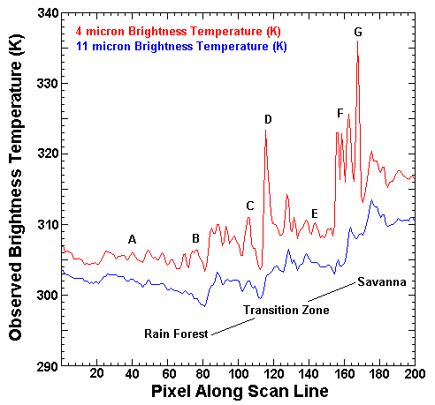
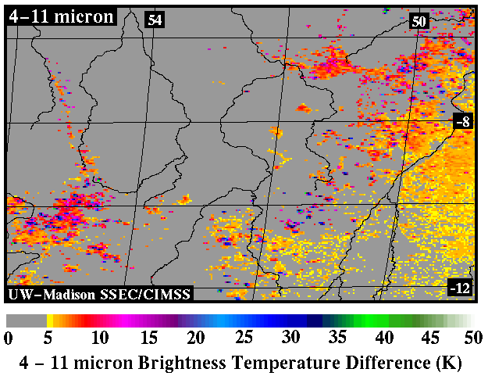
Fires are sub-pixel entities and IR responses to fires:
Typically, the difference in brightness temperatures between the two infrared windows is due to reflected solar radiation, surface emissivity differences, and water vapor attenuation. This normally results in brightness temperature differences of 2-4 K.
Larger differences occur when one part of a pixel (p) is substantially warmer than the rest of the pixel (1-p). The hotter portion will contribute more radiance (energy) in shorter wavelengths than in the longer wavelengths.
Pixel
p
1-p
Possible fires
Transition Zone
NE Brazil along the transition zone between forest and savanna
Brightness temperatures along a scan line in NE Brazil

Slide 32
What can we do today?
GOES-13 and GOES-15 cover the US, nominally every 15 minutes
Fires over about an acre in size can be detected but that is dependent upon conditions such as:
  Cloud cover
  Viewing angle
  Surface topography
Over the US GOES pixels cover ~20-30 km²
We can observe trends in intensity
Low false alarm rate, particularly for highest confidence fires (<5% in those categories)
Very high detection rate of larger fires (>95%)

Slide 33
GOES-14: Rim Fire
GOES-14 was in a special mode during the summer of 2013 as a testbed for GOES-R
Following example shows the nominal scan coverage (every 15 minutes)
The images were created using GOES visible and infrared (11 µm) clouds, WFABBA fires (yellow, red, magenta, blue), and the Blue Marble Second Generation from NASA
They are centered on the Rim Fire’s reported starting point and are in the GOES-14 native projection

Slide 34
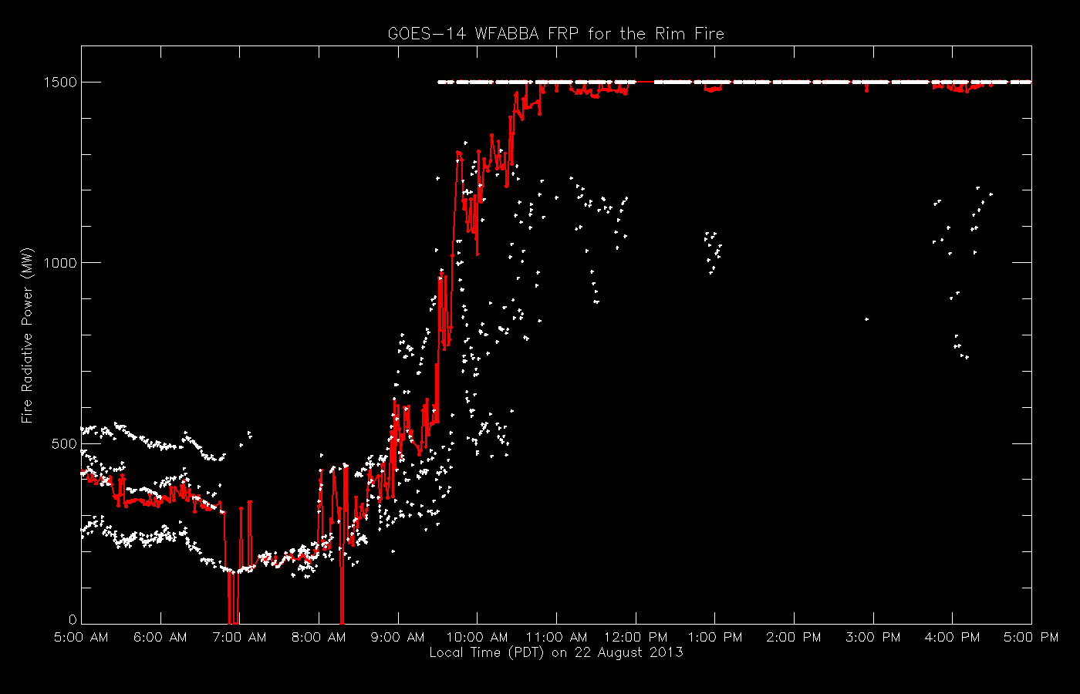
GOES-14: Rim Fire
Rim Fire FRP per GOES-14 pixel versus time for 1 minute GOES-14 WFABBA data. White points are individual pixels, red is the average.
Saturated pixels are capped at 1500 MW.
Explosive intensification between 9 am and 10 am PDT, per pixel 1 minute data shows this better than the previous examples.

Slide 35
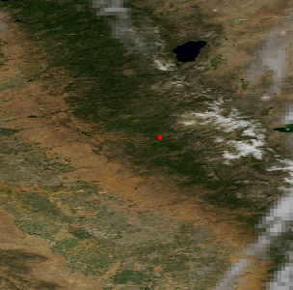
Fire Detection and Characterization
Imagery is typically available every 15 minutes today, but could be available every 30 seconds with GOES-R.
Rim Fire (2013)
Today (15 minute data)
GOES-R era (1 minute data)

Slide 36
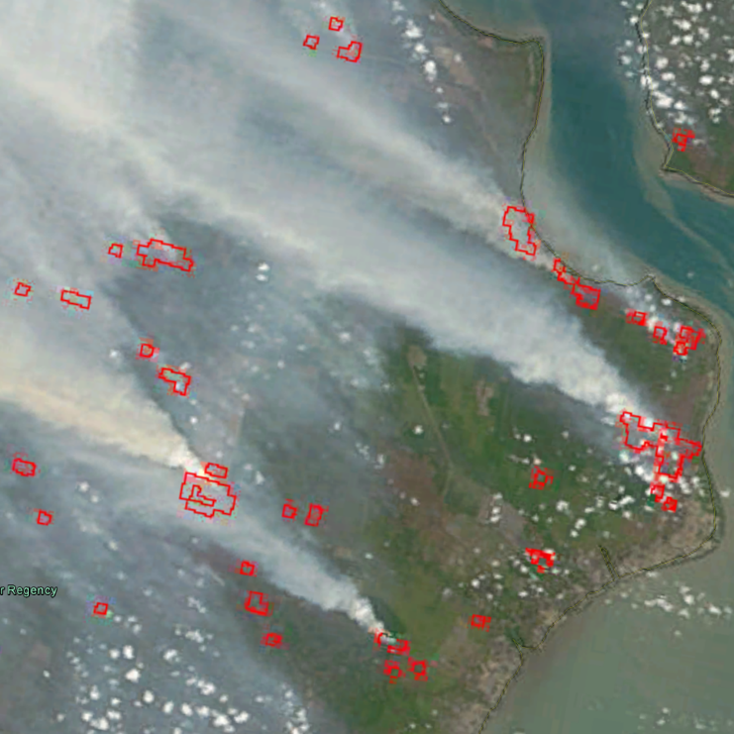
MODIS Detections over Sumatra
3:15 UTC on 24 September 2015

Slide 37
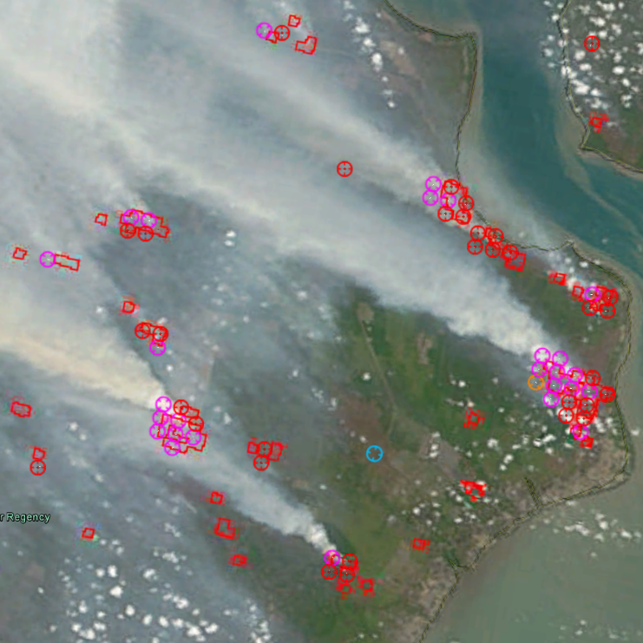
FDCA and MODIS detections over Sumatra
Himawari-8 AHI at 3:20 UTC on 24 September 2015
MODIS: Red polygons
FDCA:
Red – processed fire
Magenta – Cloud-covered fire
Cyan – Medium probability fire

Slide 38
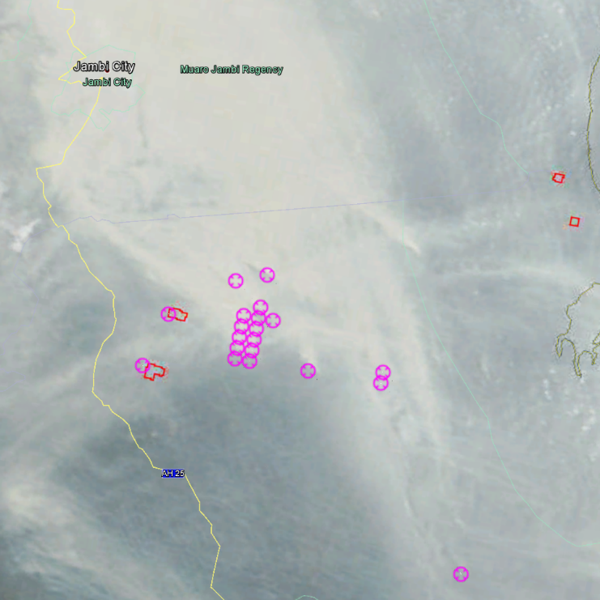
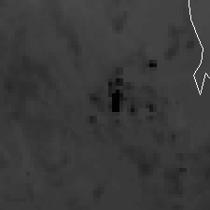
FDCA and MODIS detections over Sumatra
Himawari-8 AHI at 3:20 UTC on 24 September 2015
AHI band 7
MODIS algorithm did not detect fires under thick smoke, clearly visible in AHI band 7 (4 µm). FDCA labels the fires as cloud-covered due to high visible albedo.
One fire (yellow circle) was missed.

Slide 39
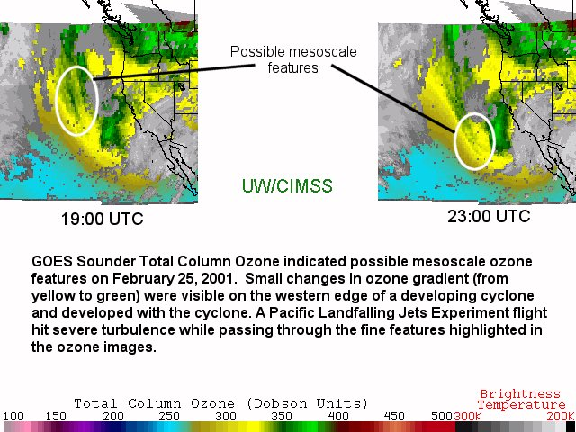
How We Got an Ozone Band on ABI
This won’t be available on day 1 (but should have been, it was a baseline GOES-R sounder product)

