Slide 1
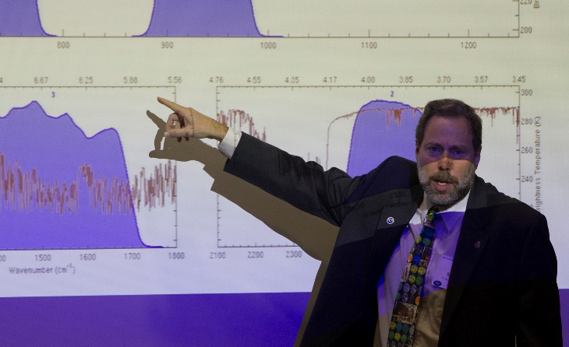
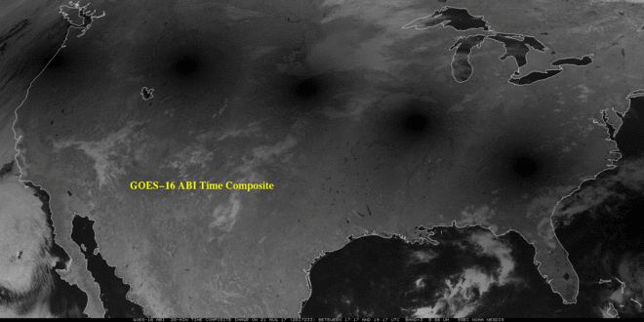
UW-Madison
The Advanced Baseline Imager
on the GOES-R Series
Timothy J. Schmit (tim.j.schmit@noaa.gov)
NOAA/NESDIS/Satellite Applications and Research
Advanced Satellite Products Branch (ASPB) Madison, WI
Plus many, many more…
Educator
Telecon
Jan 30, 2018

Slide 2
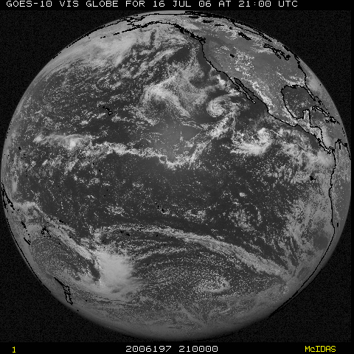
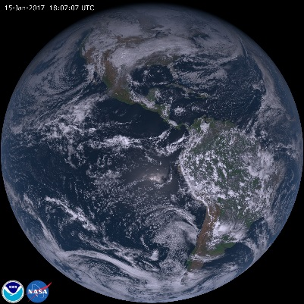
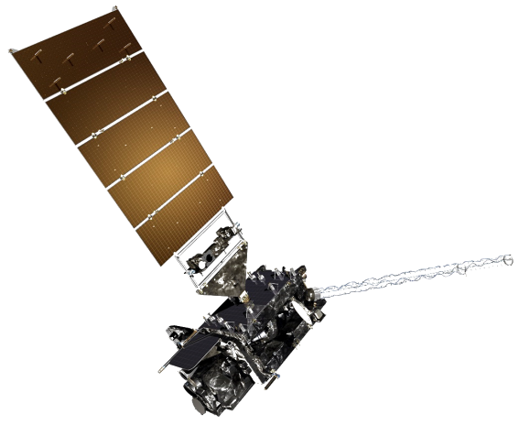
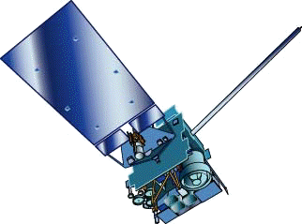
NOAA GOES Constellation (early 2018)
GOES-15
(135W)
GOES-16
(75W)
Operational
Operational
GOES-14
(105W)
Back-up
Notes:
Template footer obscured. Fixed.
Estimate during mid-2010.

Slide 3
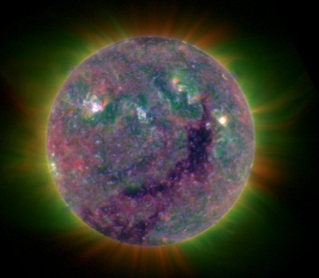
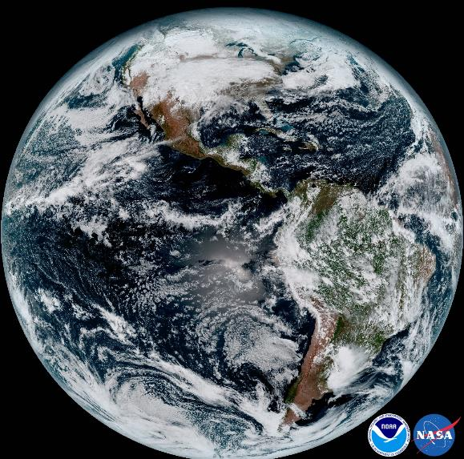
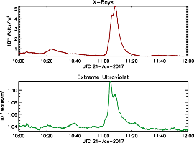
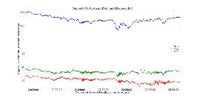
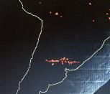
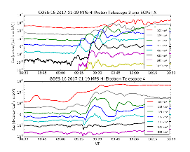
GOES-R Series Instruments
SUVI
XRS
EXIS
EUVS
MAG
SEISS
GLM
ABI
GOES-R Program Office
3-3
3-3

Slide 4
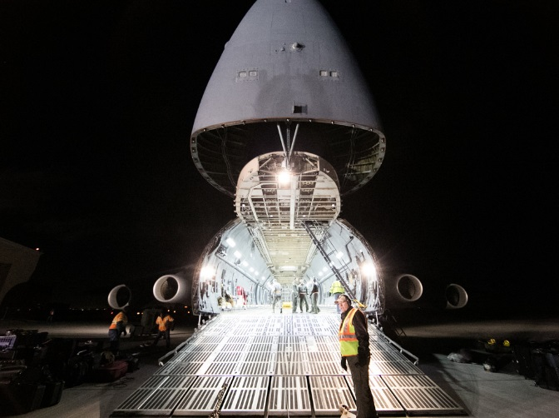
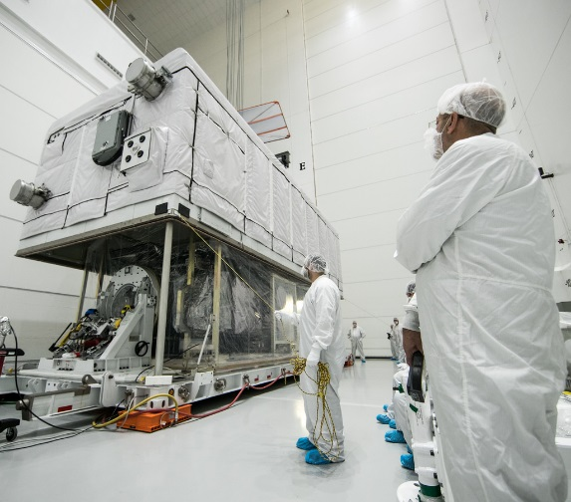
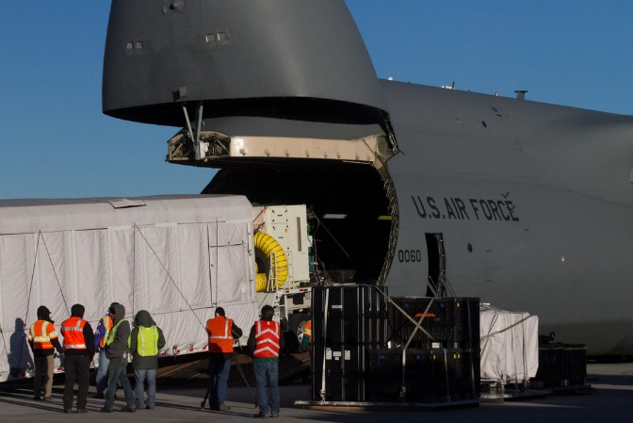
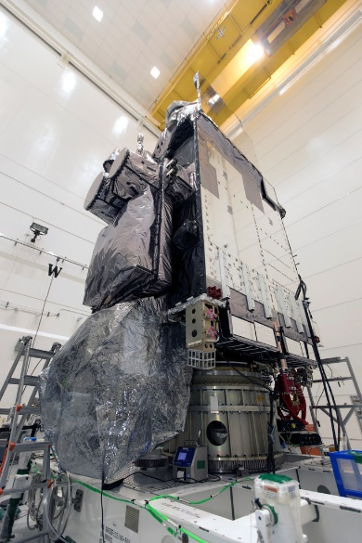
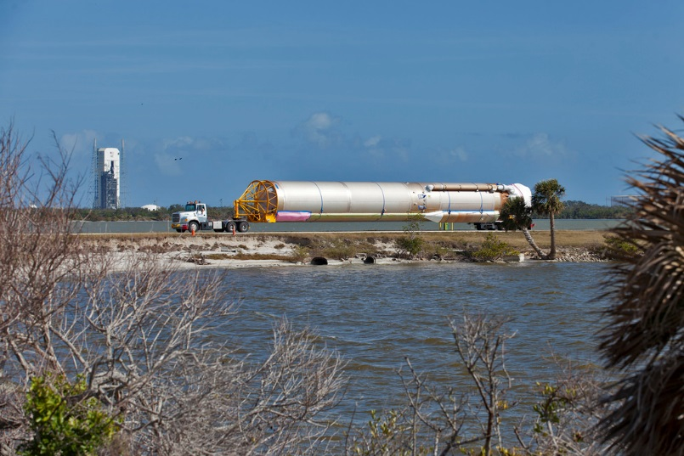
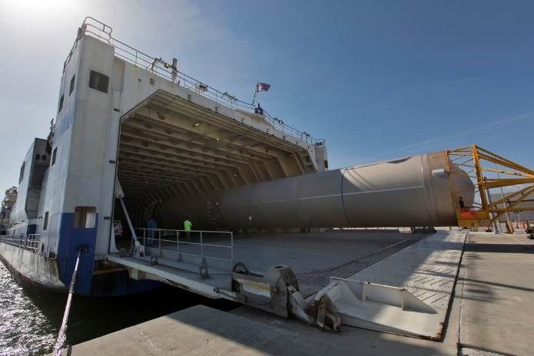
GOES-S to the Cape!
https://www.goes-r.gov/multimedia/goes-rLaunch.html#goes-r-launch

Slide 5
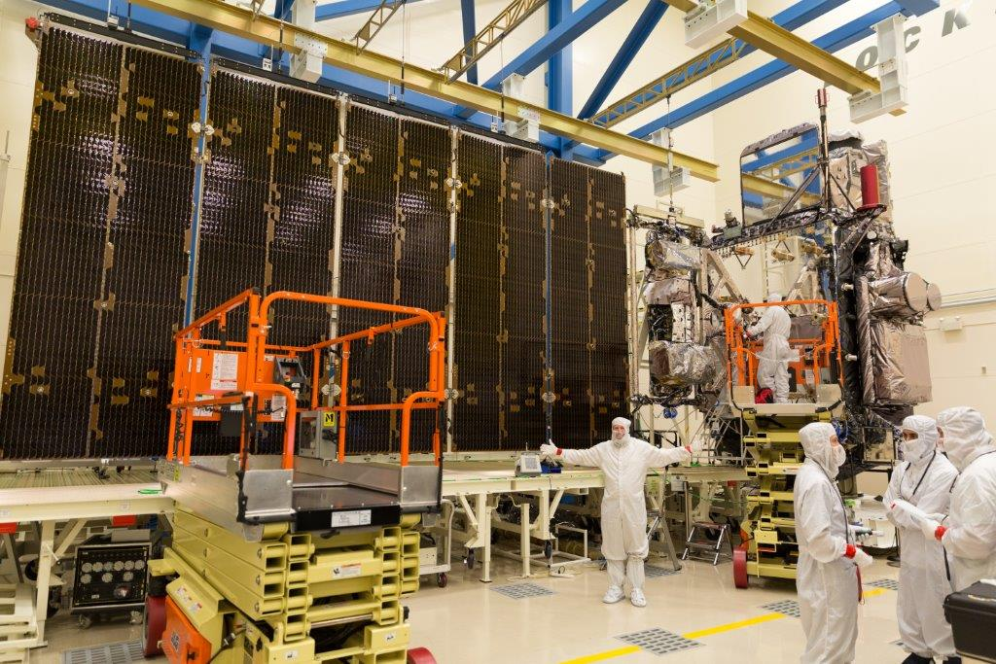
GOES-R Advanced Baseline Imager (ABI)
Spectral
Improved!
Spatial
Improved!
Temporal
Improved!
Calibration
Improved!
Lockheed Martin

Slide 6
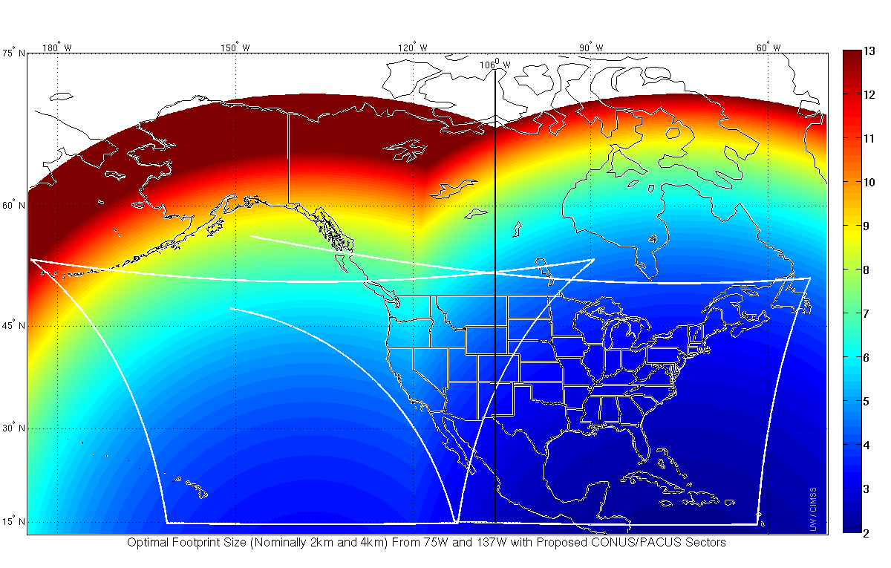
GOES-R (16) as GOES-East GOES-15 as GOES-West
106 W
The spatial resolution from the GOES-16 ABI is better than current GOES
for the eastern contiguous United States to 120 degrees West.
Even west of there, the ABI offers improved temporal resolution over western states.
Credit: Jun Li and Mat Gunshor
Notes:
So, If GOES-R is GOES-West at 137 W, and GOES-13 remains GOES-East at 75 W, the midpoint longitudinally is 106 W. But that's not where satellite resolution would be the same from each satellite; rather, GOES-R would have better spatial Resolution than GOES-13 all the way to 92 W, the approximate longitude of Duluth Minnesota at the western tip of Lake Superior. If GOES-R were GOES-East, superior spatial resolution from that GOES-East (relative to the resolution of GOES-14 or GOES-15 as GOES-West at 135W) would extend west all the way to 120 W, the longitude of Reno NV and Santa Barbara CA.
When GOES-R and GOES-S both are operational as GOES-East and GOES-West, the poorest spatial resolution will be along the 106W longitude line. Glasgow MT, and thereabouts, will have dubious distinction of the worst horizontal spatial resolution in CONUS – because it's halfway between the two satellites and farthest north.

Slide 7
California from GOES-East

Slide 8
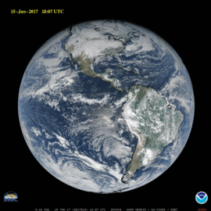
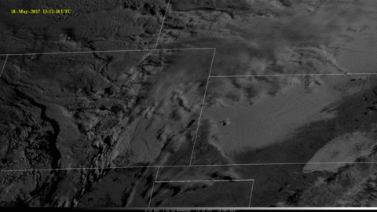
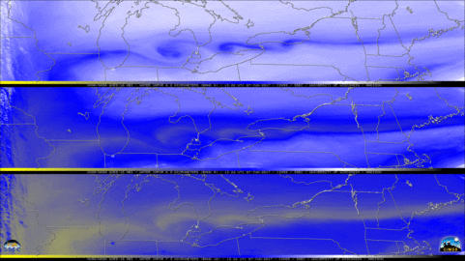
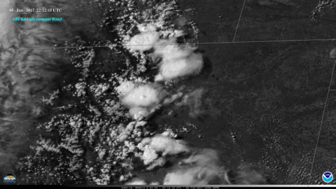
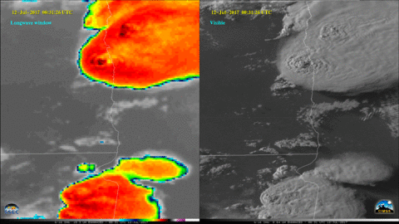
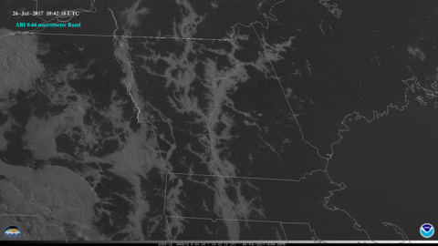
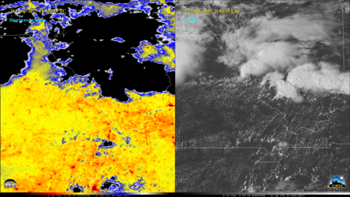
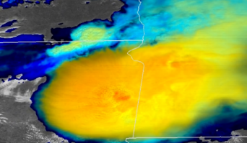
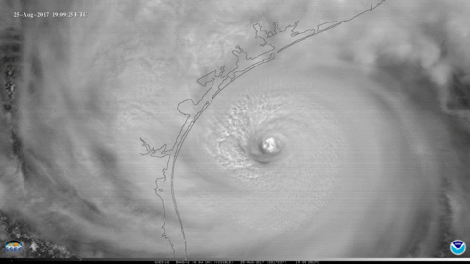
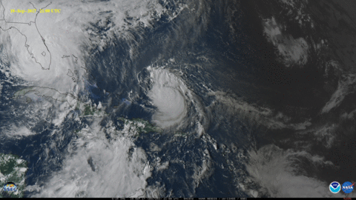
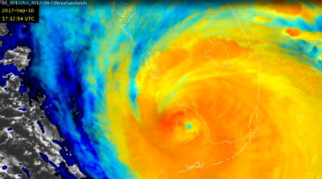
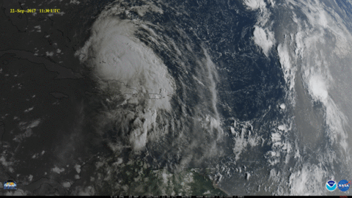
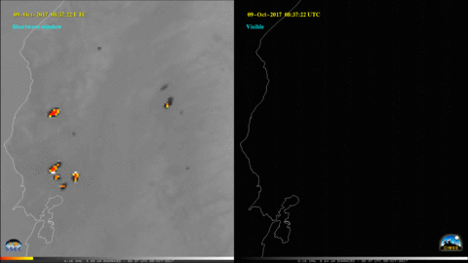
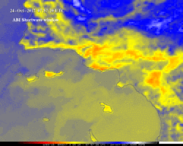
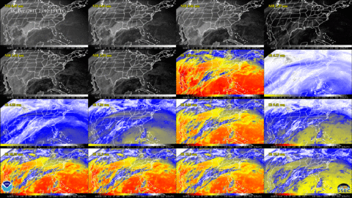
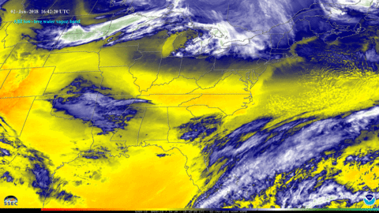
GOES-16 Advanced Baseline Imager (ABI)
Top “Ten” animations
January 15th
May 18th
June 7th
June 8th
July 11th
July 19th
July 26th
August 21st (two loops)
August 25th
October 24th
September 10th
September 15th
October 8th
September 2nd
December 18th
January 3, 2018
Click on the image for a You Tube animation
Most GOES-16 ABI data shown are preliminary, experimental, during on-orbit testing.

Slide 9
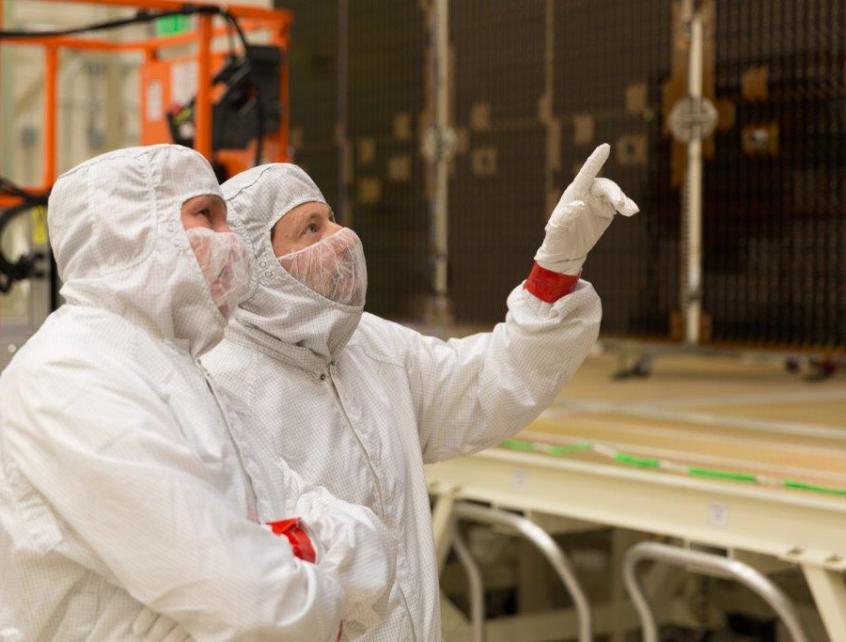
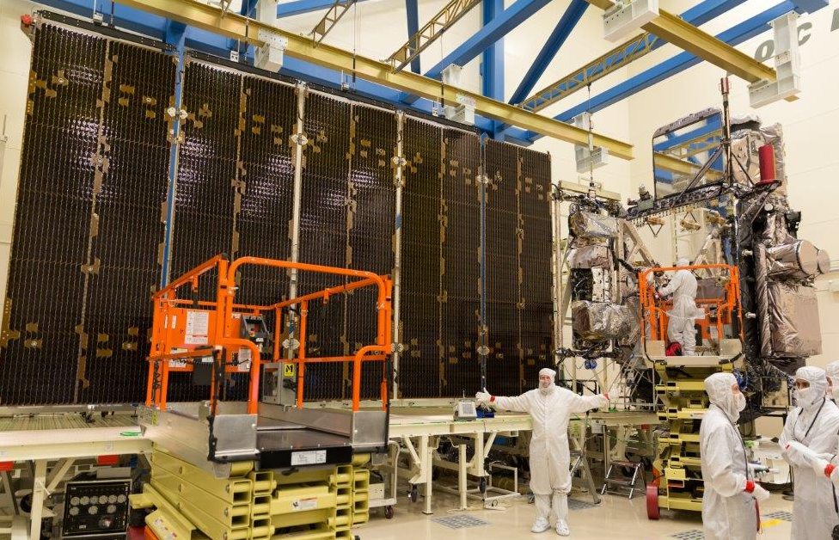
GOES-R Series web sites
http://www.goes-r.gov
http://cimss.ssec.wisc.edu/goes/goesdata.html
*Lockheed Martin
GOES-16 data shown are preliminary, experimental, during on-orbit testing.

Slide 10
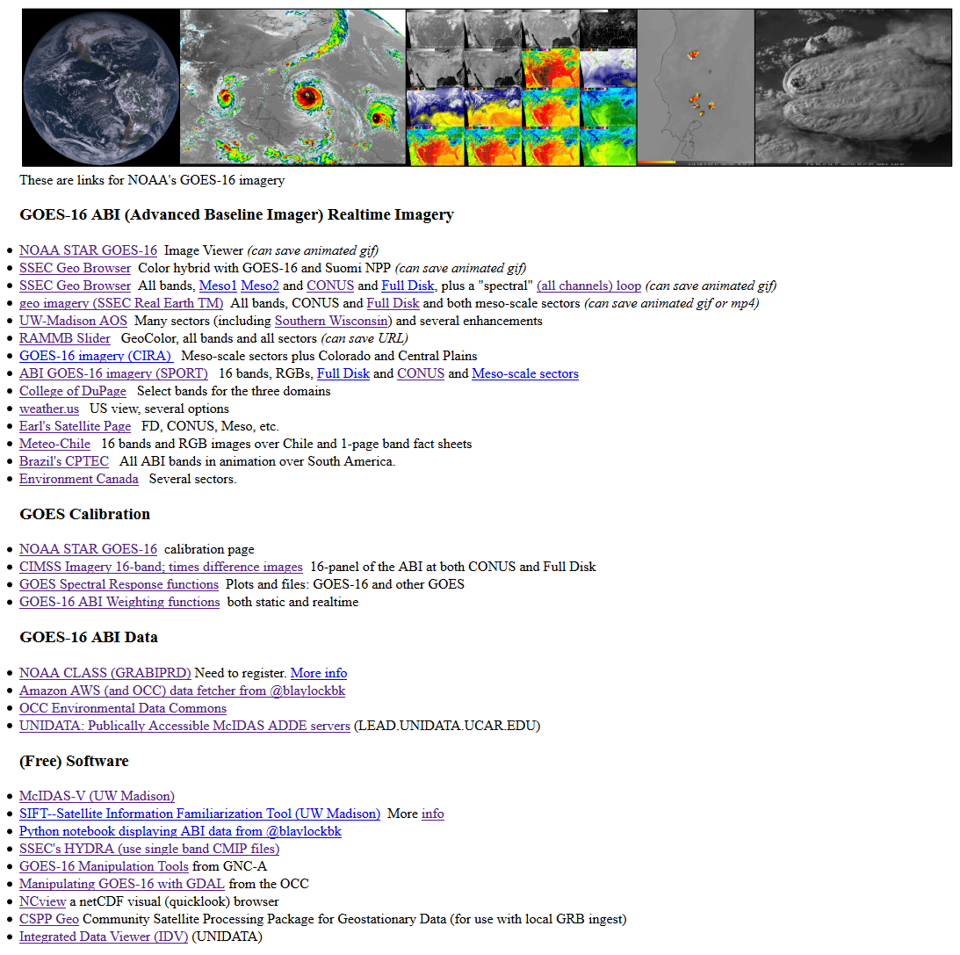
GOES-R Series web sites
http://cimss.ssec.wisc.edu/goes/goesdata.html
Notes:
animation

