Slide 1
GRB User Group
Over 80 members. The GRB User Group meets once every 3 months
GRB User Group includes NOAA Cooperative Institutes; NOAA Line Offices; and vendors, manufacturers, systems integrators, and users
Members provided feedback that resulted in fixes. Members continue to monitor GRB performance
Notes:
Members participated in the GRB to DB User tests during the GOES-16 post-launch test (PLT)
Members provided feedback that resulted in fixes. Members continue to monitor GRB performance
Example: Univ. of Wisconsin reported delays between metadata receipt and end of image that were greater than expected. The GOES-R program initiated an analysis
Members of the GRB User Group subscribe to the ESPC Notifications and can report any problems to both ESPC and to the Chairman of the GRB User Group)
For more information contact: james.mcnitt@noaa.gov

Slide 2
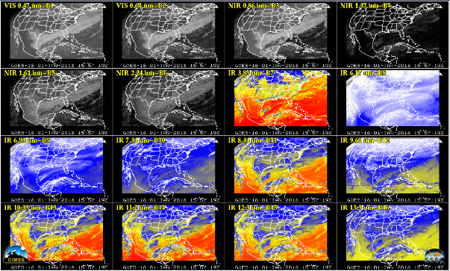
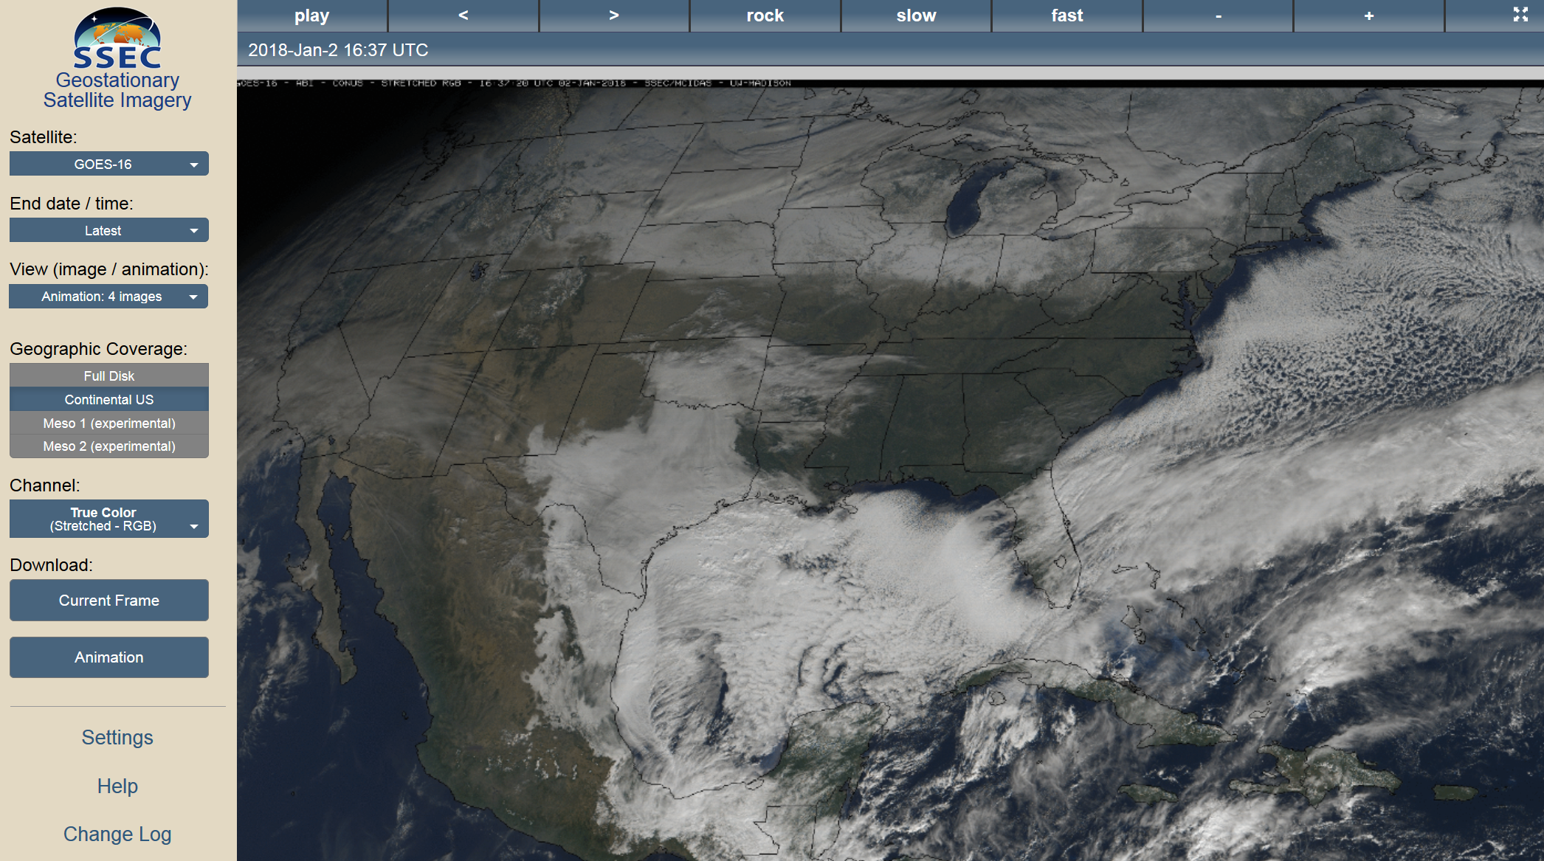
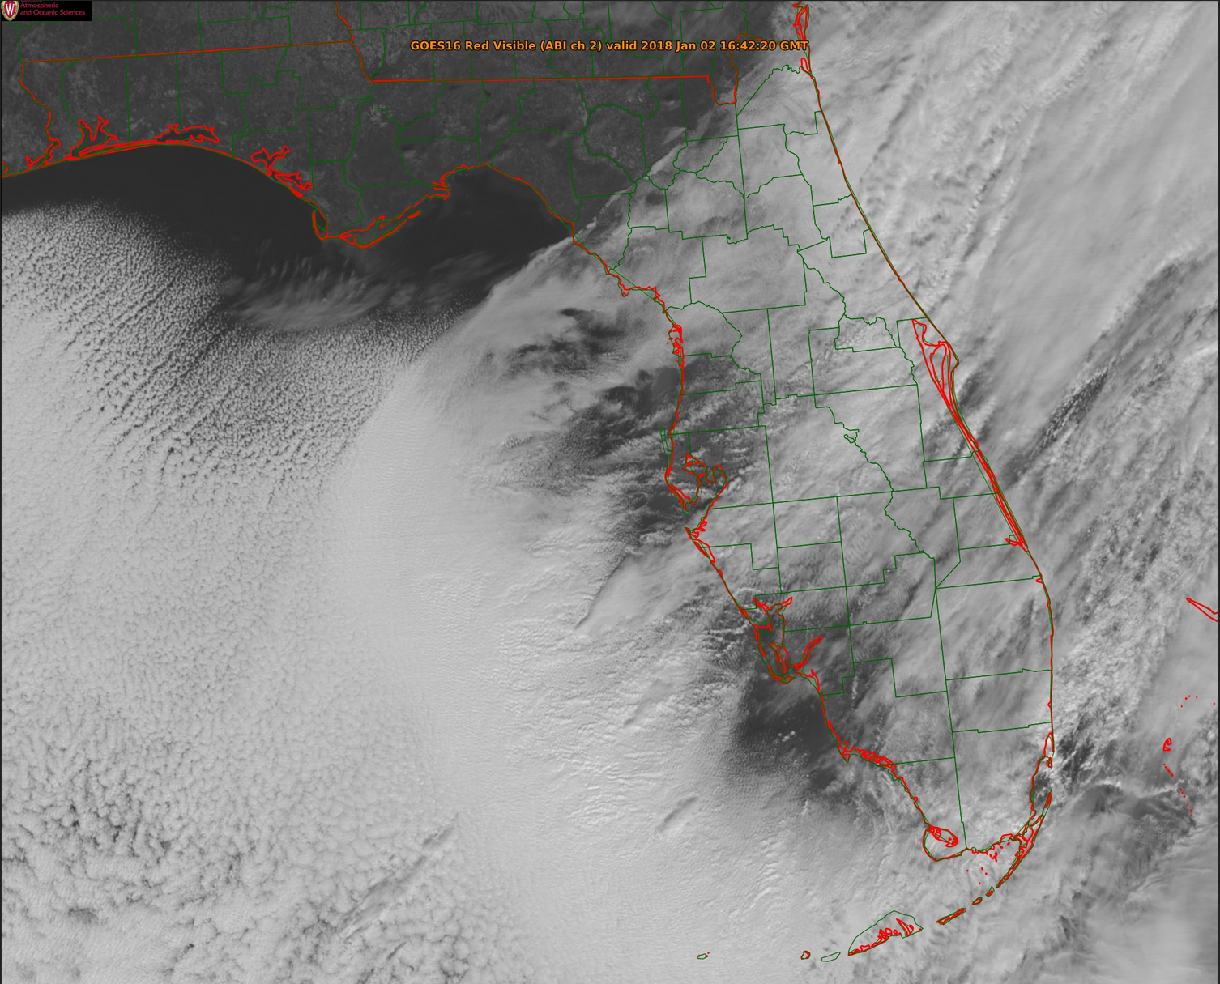
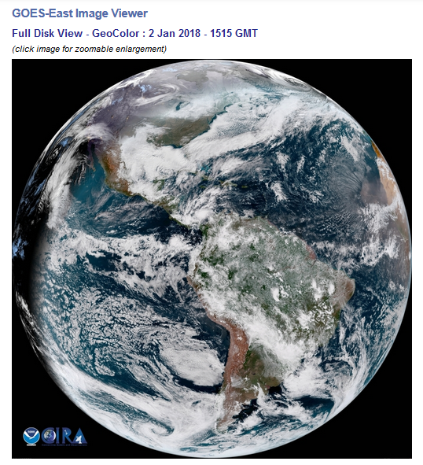
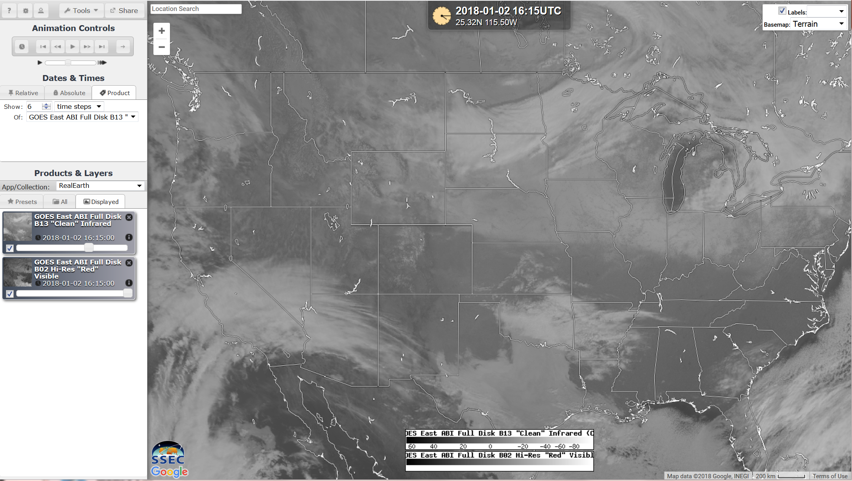
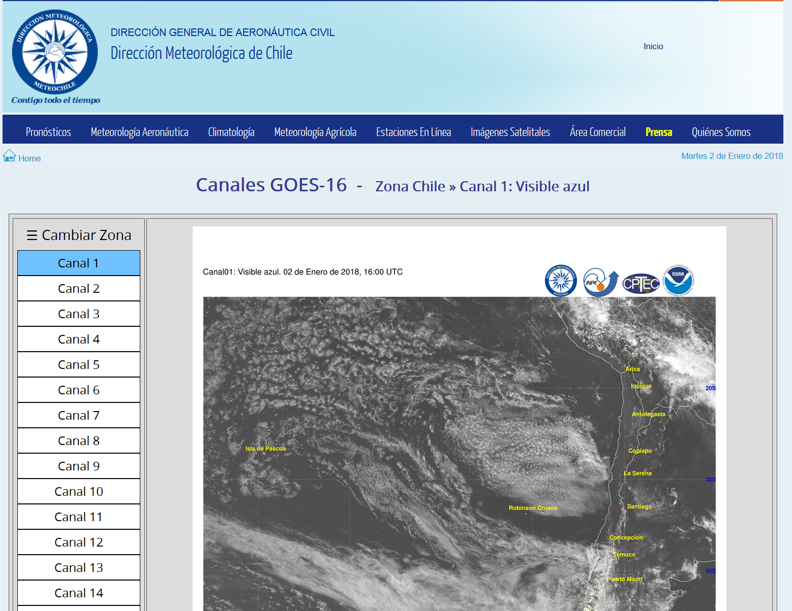
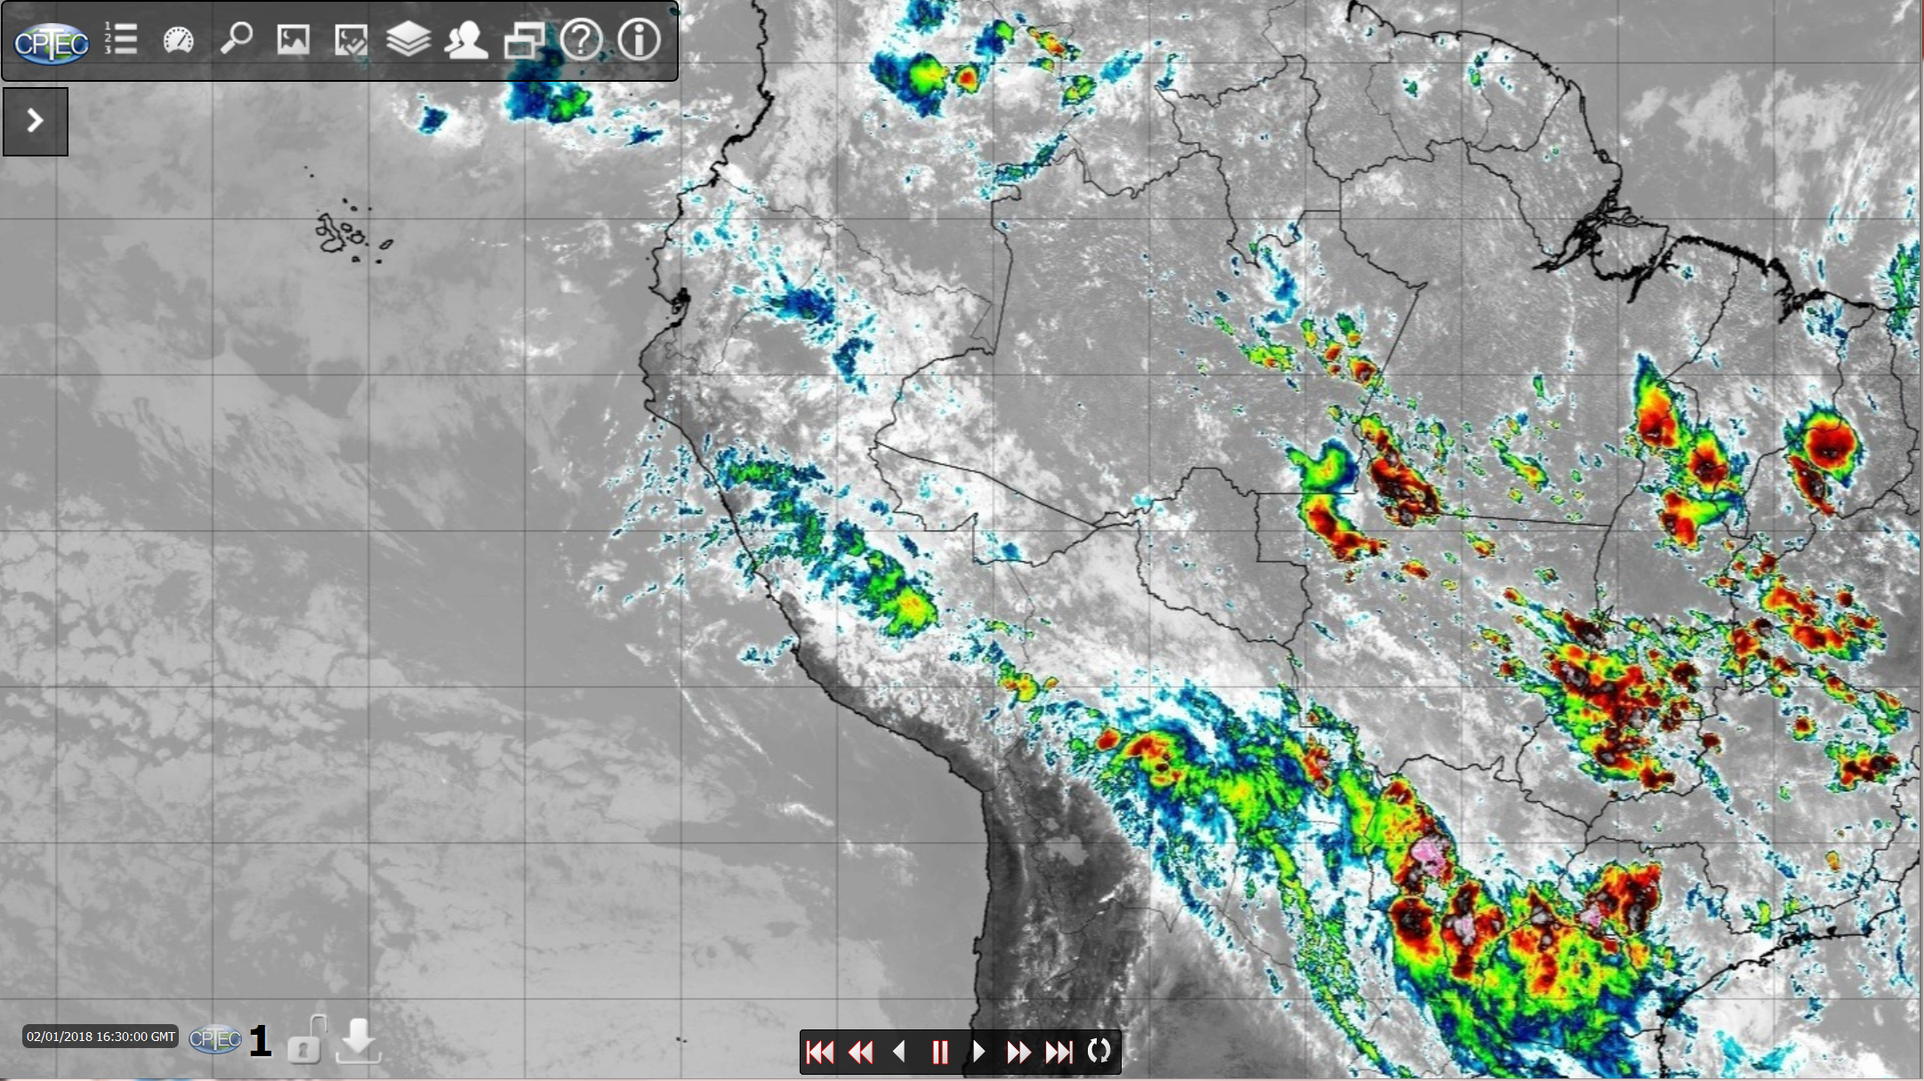
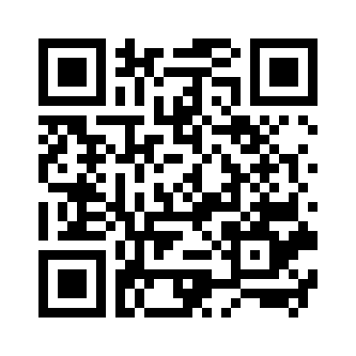
Examples of GRB Sites Posting Imagery
https://cimss.ssec.wisc.edu/goes/goesdata.html

