Slide 1
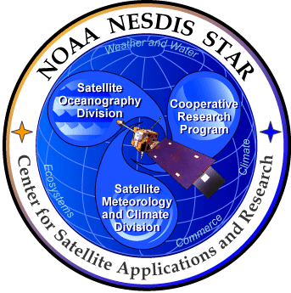

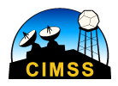
Satellite Measurements of Atmospheric Temperature and Moisture Profiles
(and derived quantities)
Timothy J. Schmit ¹, and Jun Li ²
¹ Center for Satellite Applications and Research (STAR),
NESDIS/NOAA Advanced Satellite Products Branch (ASPB)
² Cooperative Institute for Meteorological Satellite Studies,
University of Wisconsin-Madison
97th American Meteorological Society Annual Meeting
Observation Symposium: Problems, Progress, and Prospects
25 January 2017
Seattle, Washington

Slide 2
Thanks to
Steve Ackerman
Chris Barnet
Jordan Gerth
Mat Gunshor
Allen Huang
Yong-Keun Lee
Zhenglong Li
Paul Menzel
Justin Sieglaff
Bill Smith
Tony Wimmers
Fang Wang
Pei Wang
Etc.

Slide 3
Outline
History of soundings from space
Status of current sounding systems from space (IR, MW: Microwave, RO: Radio Occultation) and the uniqueness of high spectral resolution IR soundings
Applications of sounding from space
Gaps and unmet requirement (high temporal advanced sounding system from GEO)
Summary and future perspective

Slide 4

A (short) history of atmospheric sounding from space
Nimbus 3 carried IRIS and SIRS: first sounders in space
Kaplan, sounding retrieval method
King: concept
MTG-IRS
1956
GIIRS onboard FengYun-A: first hyperspectral IR sounding system from GEO orbit
1959
TIROS-N series with TOVS sounding system
1969
2021
1978
2016
1980
INSAT-3D
1994
2013
GOES-4 VAS: first (experimental) geostationary sounder
1998
2001
2002
2006
2011
CrIS
CHAMP (CHAllenging Minisatellite Payload): first radio occultation mission for soundings
Aqua AIRS: first hyperspectral IR sounder used by weather operations
GOES Sounder: first operational
Geo sounder
NOAA-K series with Advanced TOVS (ATOVS), first advanced microwave sounder
IASI: first operational hyperspectral IR sounder
4

Slide 5
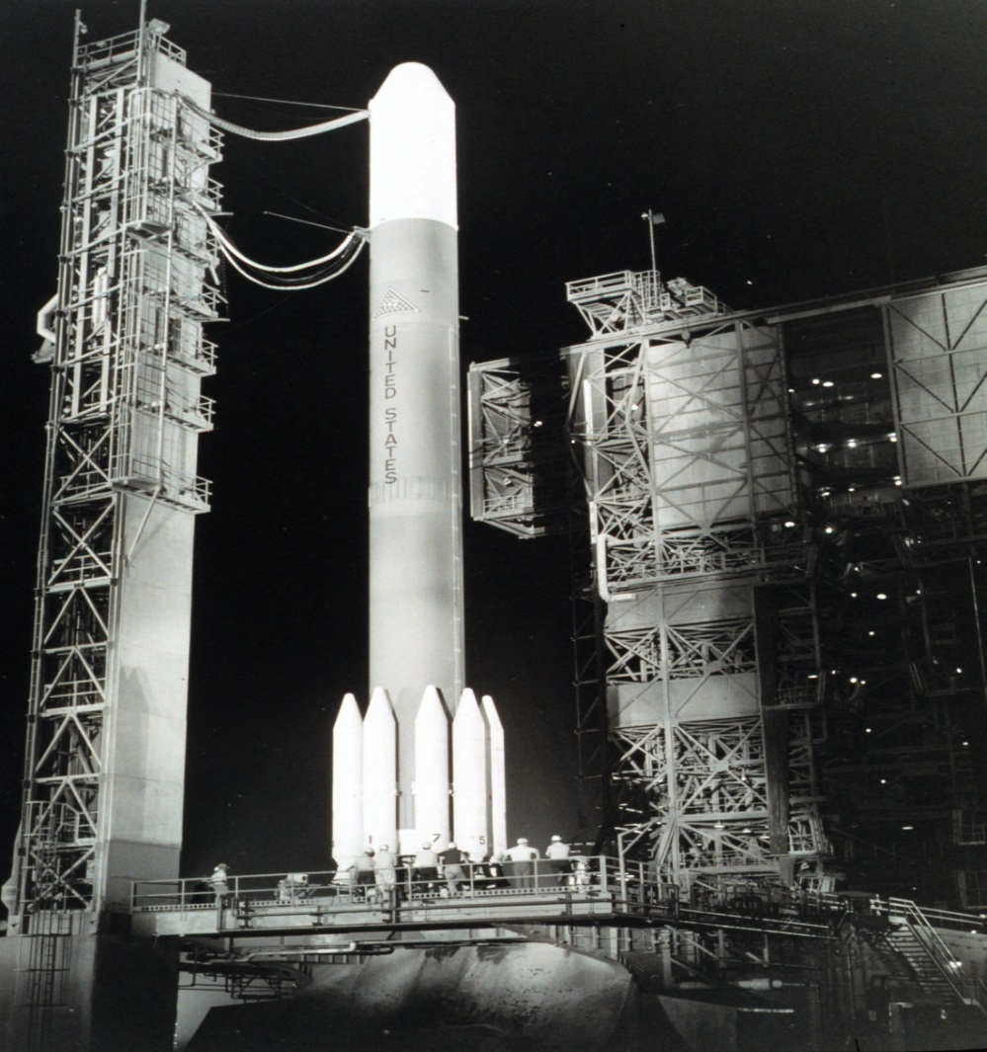
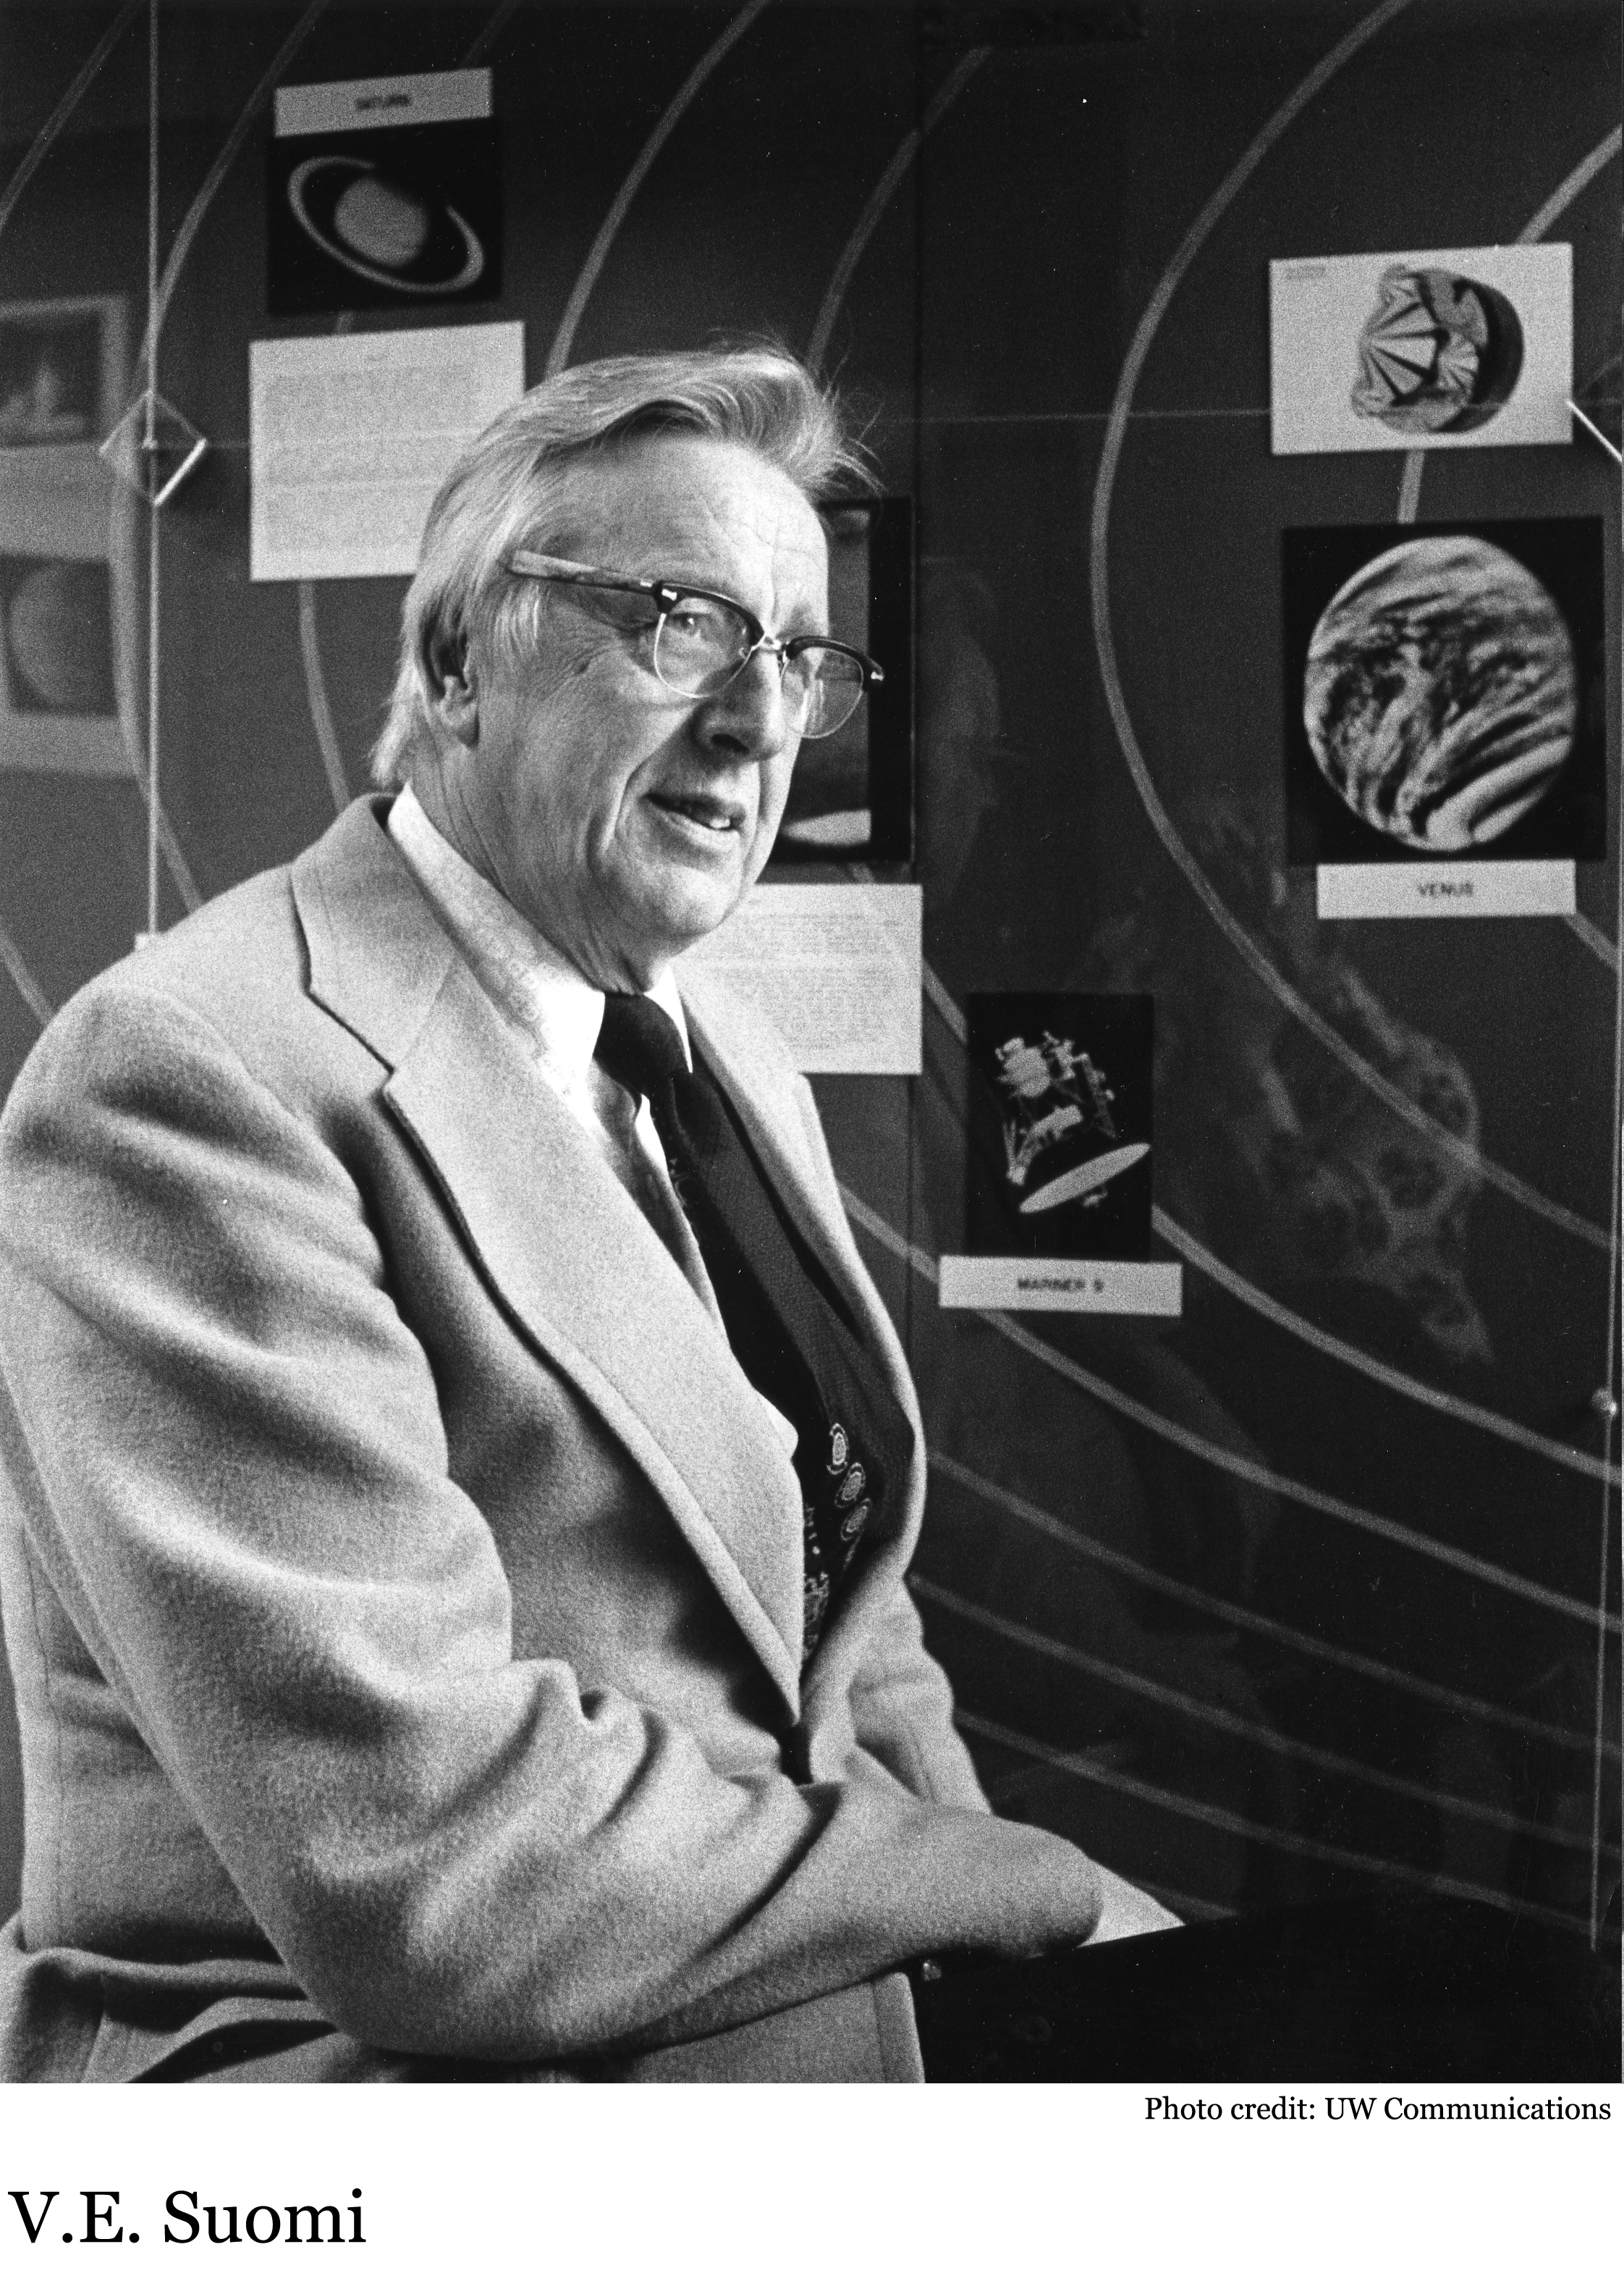
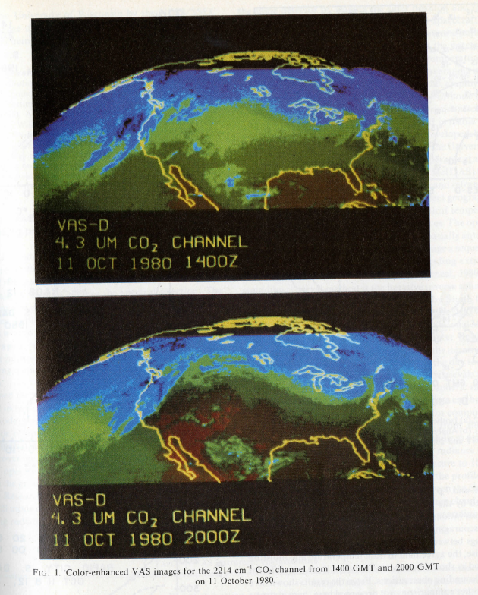
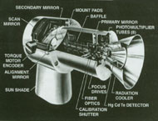
Professor Vern Suomi: father of satellite meteorology, founder of Space Science and Engineering Center of UW-Madison
1980: GOES-4 VAS: first geostationary sounder for more continuous atmospheric soundings from space
5

Slide 6
Outline
History of soundings from space
Status of current sounding systems from space (IR, MW, RO) and the uniqueness of high spectral resolution IR soundings
Applications of sounding from space
Gaps and unmet requirement (high temporal advanced sounding system from GEO)
Summary and future perspective

Slide 7
Current Major Sounding Systems from Space
Polar orbits:
  TOVS or ATOVS: NOAA series (U.S.), Metop series (Europe), NPP, FengYun-3 series (China);
  Hyperspectral IR sounders: Aqua-AIRS (U,S.), Metop-IASI (Europe), Suomi NPP-CrIS (U.S.), FY3D-HIRAS (China)
GEO orbits
  Classic (low spectral-resolution) infrared (IR) sounder: GOES Sounder (U.S.), Insat-3D sounder (India);
  Hyperspectral IR sounders: FY4A-GIIRS (China), MTG-IRS (EUMETSAT)
RO sounding system
  COSMIC (U.S.-Taiwan), Metop, FY3…
planned

Slide 8
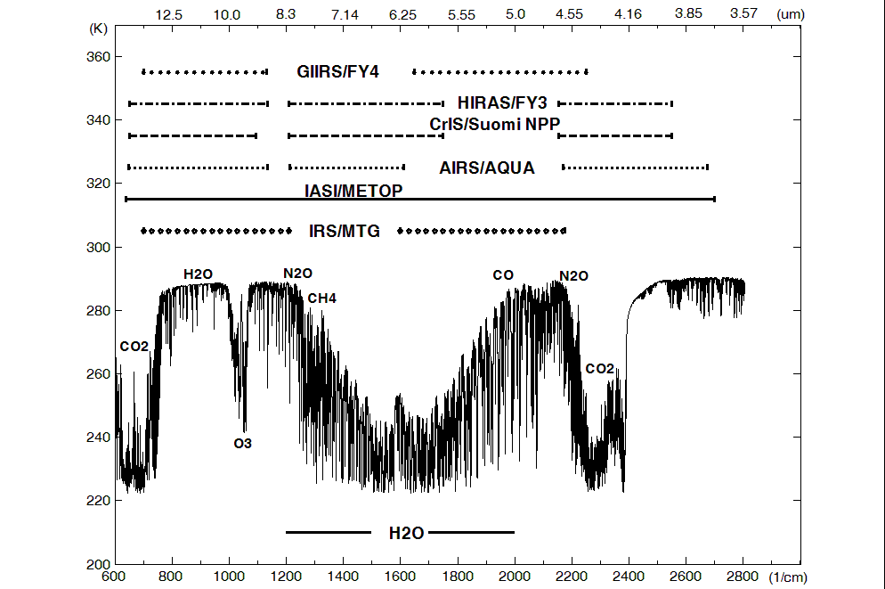
Hyperspectral IR sounder spectral coverage
8

Slide 9
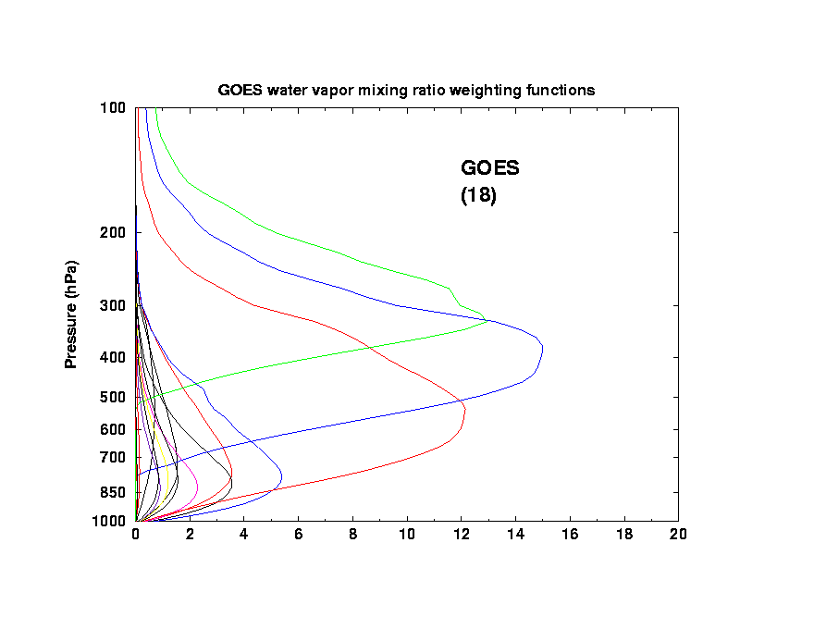
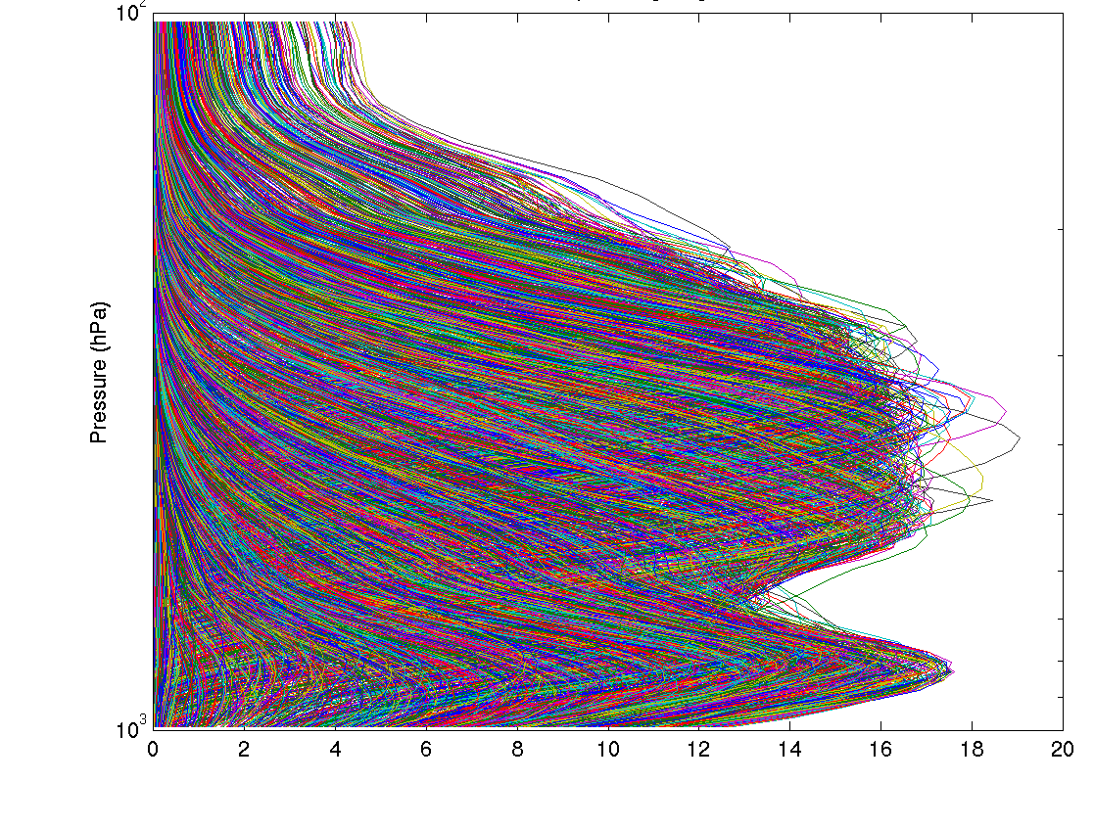
Hyperspectral/Ultraspectral Infrared Measurement Characteristics - continued
100
100
Advanced Sounder
(1000s)
GOES
(18)
Pressure (hPa)
Pressure (hPa)
1000
1000
Moisture Weighting Functions
High spectral resolution advanced sounder will have more and sharper weighting functions compared to current GOES low spectral resolution sounder.
Retrievals will have better vertical resolution.
9

Slide 10
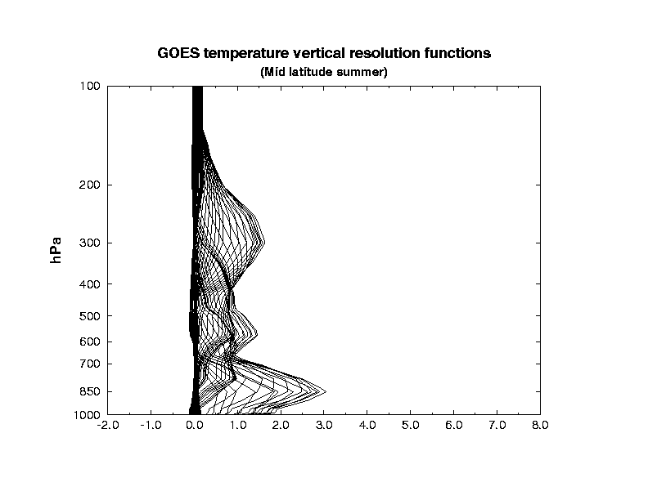
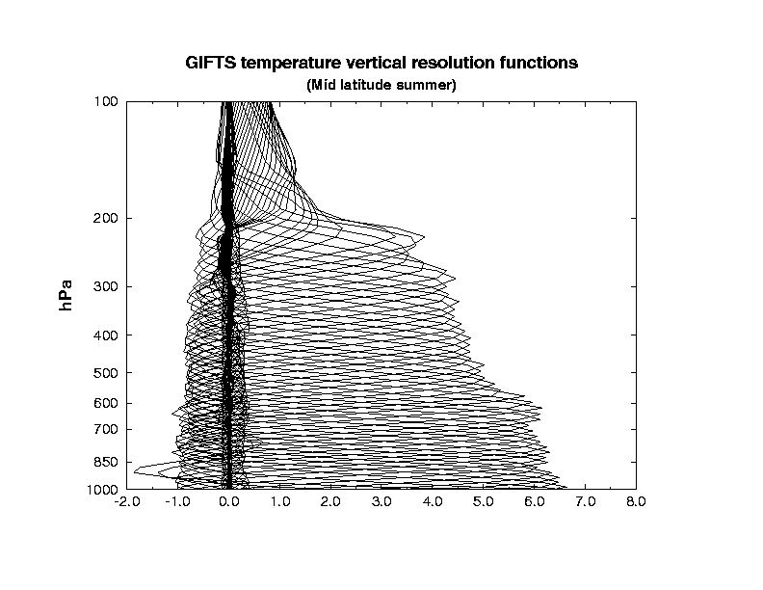
Hyperspectral/Ultraspectral Infrared Measurement Characteristics - continue
GOES Vert-Res.:
3-5 Km
HyperIR Vert-Res.:
1-2 Km
Temperature
Sounding
Current - GOES
HyperIR
~3 Pieces
10-12 Pieces
Much Enhanced Measurement Information Contents
10

Slide 11
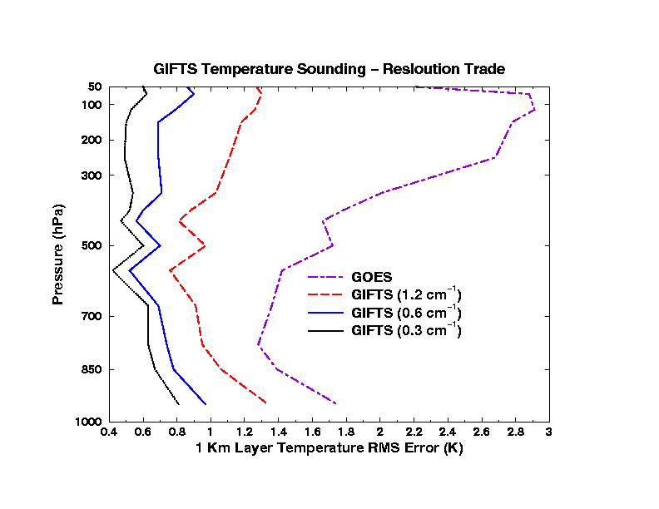
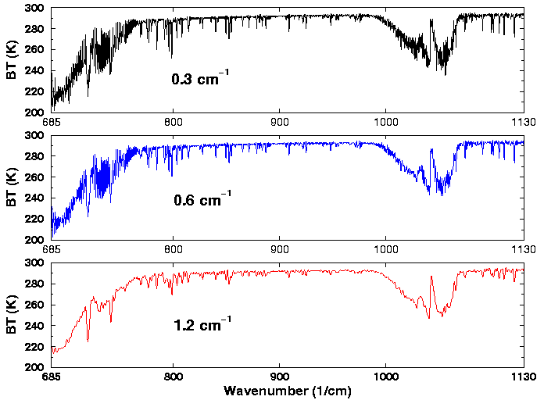
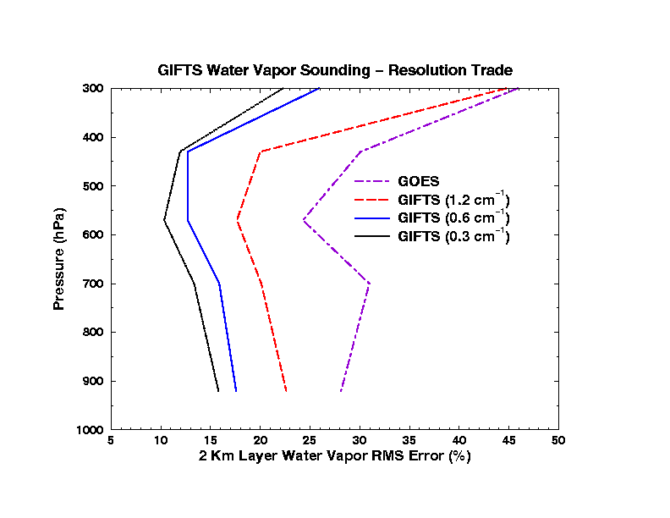
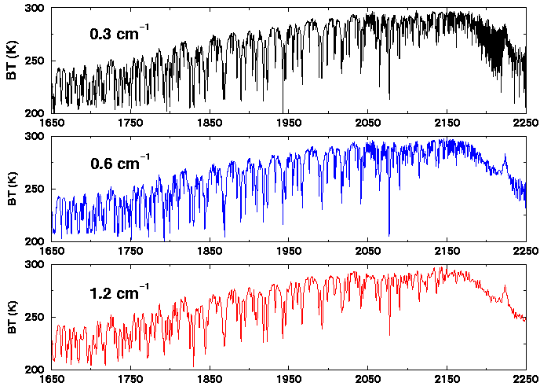
Spectral Resolution Impact on T/q Retrieval
LW
SMW
11
Notes:
Original Title: Spectral Resolution (0.3, 0.6, 1.2 cm**-1) impact on T/q retrieval

Slide 12
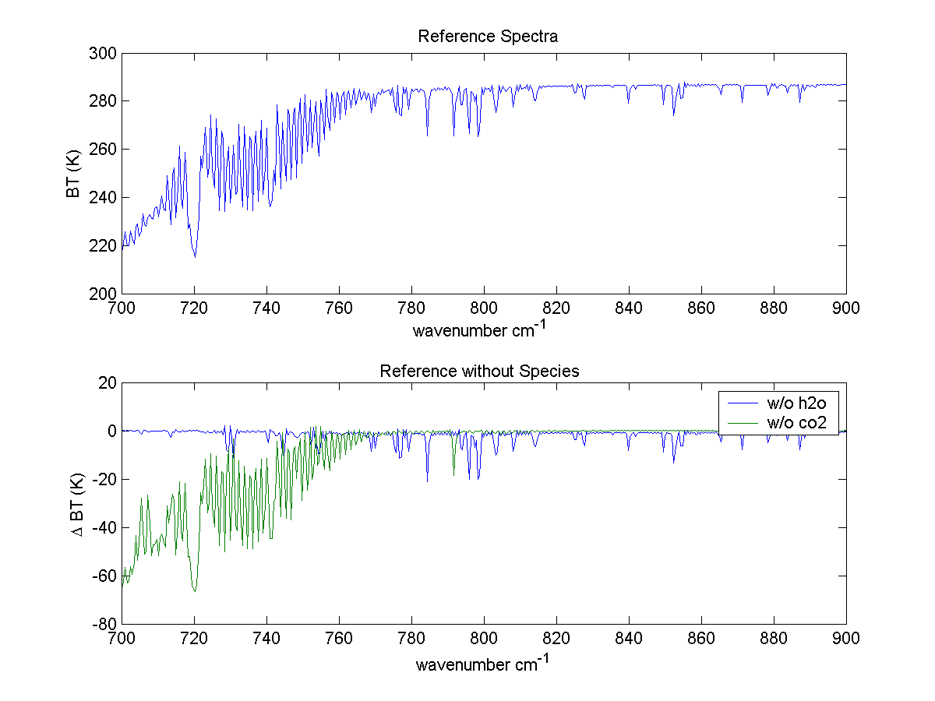
Why do we need a high spectral resolution sounder?
Analysis courtesy of Justin Sieglaff, CIMSS.
GOES-12 Sounder Bands
Smooth over required absorption lines
Compared to broadband sounders, observing absorption lines is mandatory to meeting requirements for temperature and moisture structure needed to improve weather forecasting
Many papers document science value of high spectral resolution sounder that support weather forecast needs.
12
Notes:
These are calculated spectra, showing important features dealing with temperature and moisture are in the high-spectral data, but are smoothed over in the broad-band data. Figure courtesy of J. Sieglaff, CIMSS.
I’m not sure it is useful to show an entire spectrum. Rather I prefer to show the above and indicate that it is these little wiggles that make the HES so valuable and that the current GOES smears out.

Slide 13
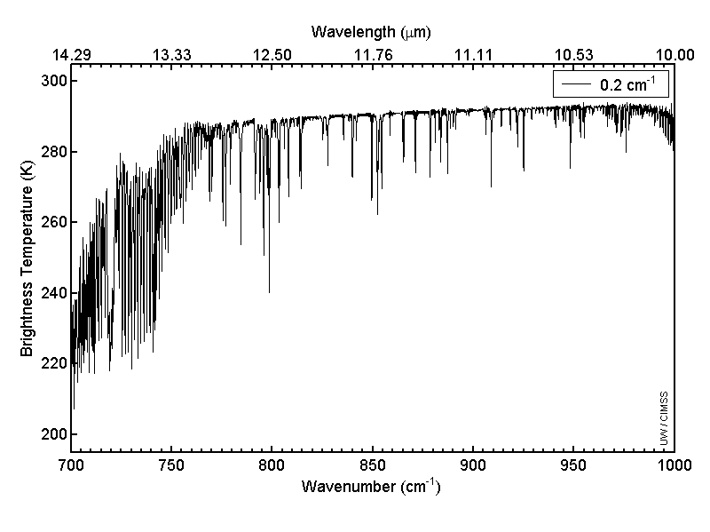
Off/On-line signal
Longwave window region
13

Slide 14
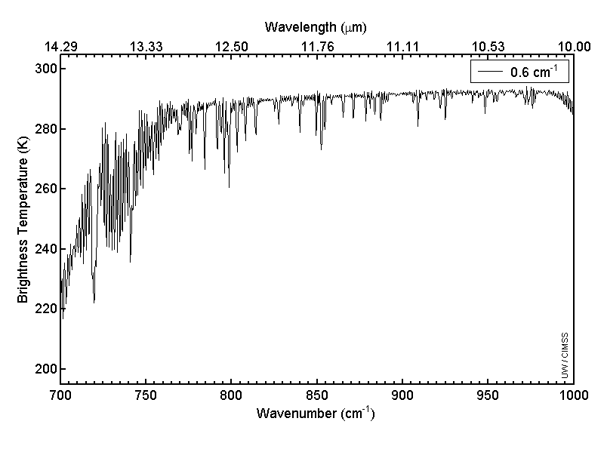
Longwave window region
14

Slide 15
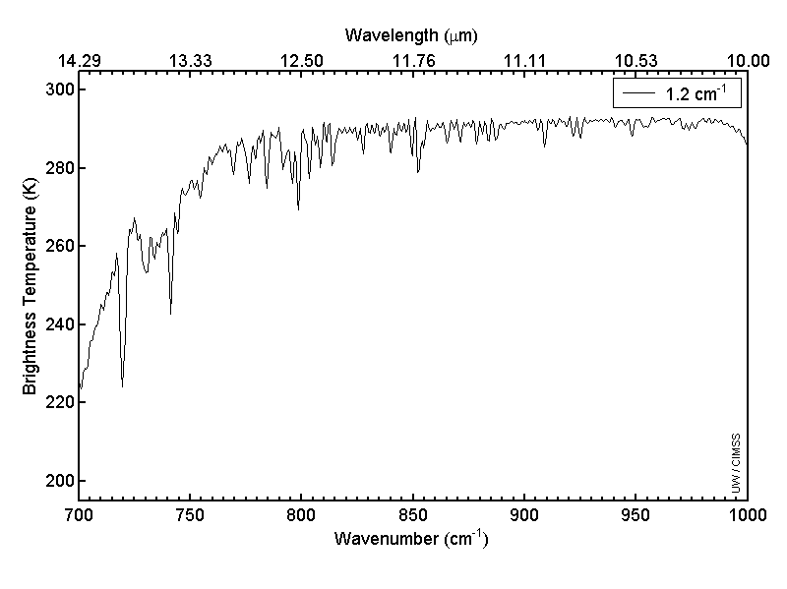
Longwave window region
15

Slide 16
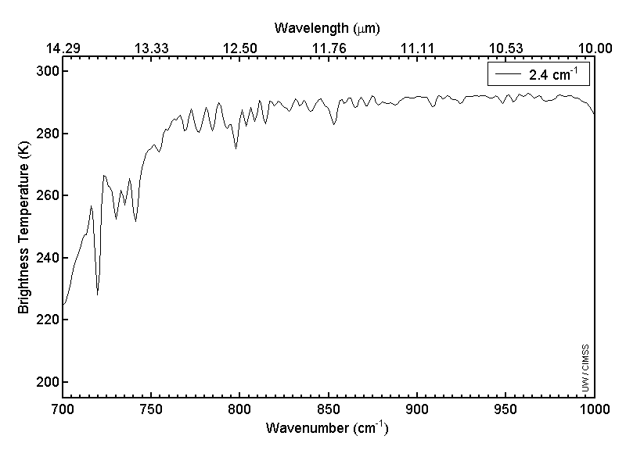
Longwave window region
16

Slide 17
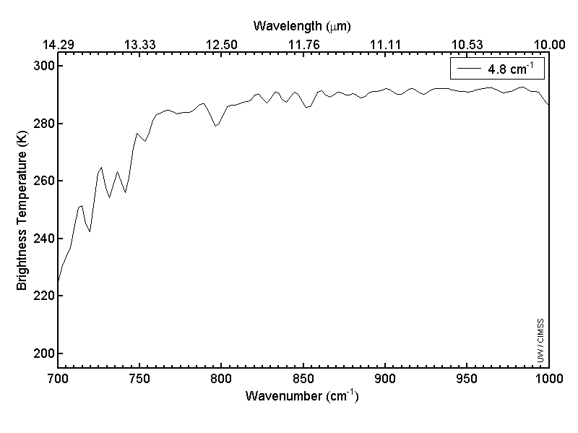
Longwave window region
17

Slide 18
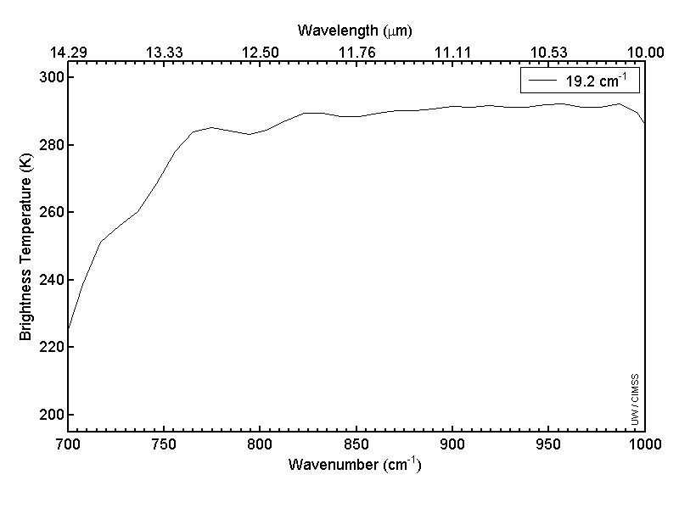
Longwave window region
18

Slide 19

Longwave window region
19

Slide 20
Capability: Vertical Information
Schmit et al. 2009
The relative vertical information is shown for radiosondes, a high-spectral infrared sounder, the current broad-band GOES Sounder and the ABI. The high-spectral sounder is much improved over the current sounder. This information content analysis does not account for any spatial or temporal differences.
Notes:
Plus, the ABI needs temperature information from NWP to compensate for only one co2 band.

Slide 21
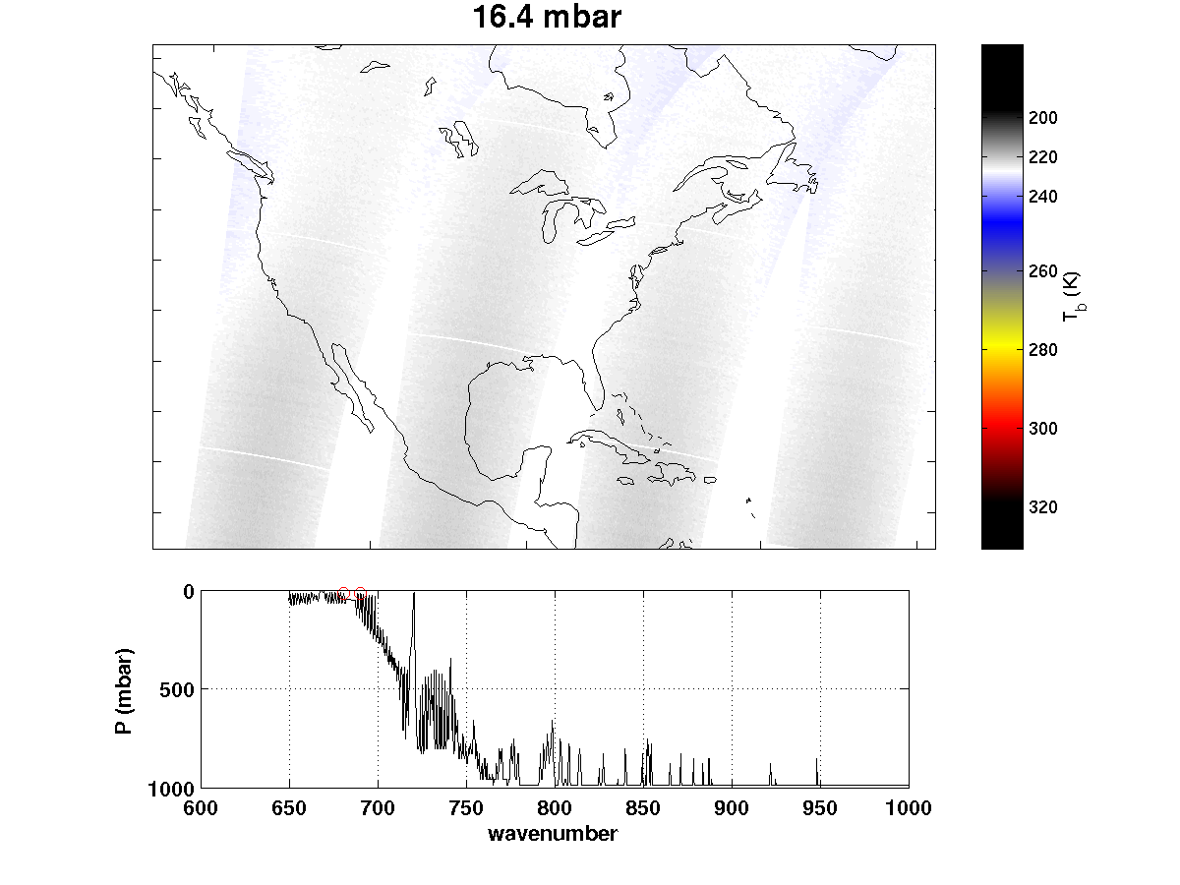
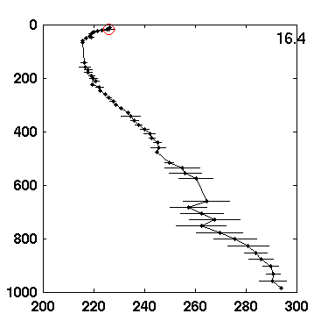
AIRS nighttime granules over CONUS, 6 Sept 2002
21

Slide 22
Outline
History of soundings from space
Status of current sounding systems from space (IR, MW, RO) and the uniqueness of high spectral resolution IR soundings
Applications of sounding from space
Gaps and unmet requirement (high temporal advanced sounding system from GEO)
Summary and future perspective

Slide 23
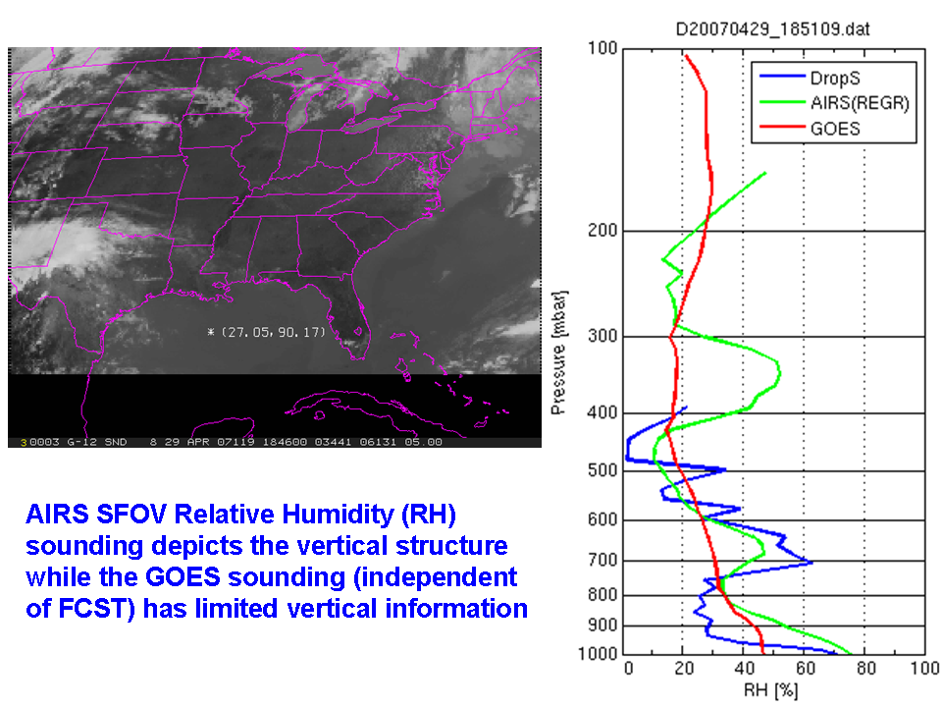
23

Slide 24
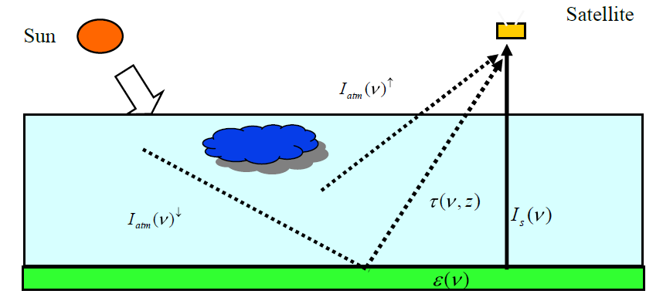
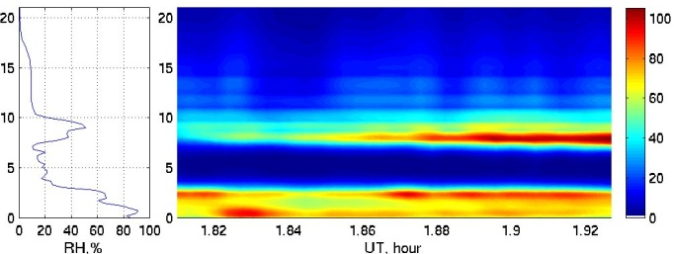
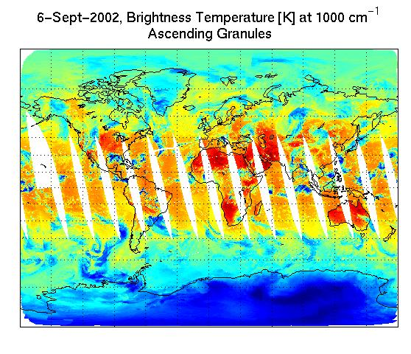
Radiative transfer model based on instrument specification and atmospheric radiation, absorption and scattering: R=H(X)
Atmospheric temperature and moisture sounding state
Satellite sounders do not measure soundings directly, a radiative transfer model is needed to link the satellite radiance measurements and atmospheric sounding state, and mathematical method is needed for extracting sounding information.
Inverse methodology：X=H⁻¹(R)
Satellite sounder radiance measurements: Rº
24

Slide 25
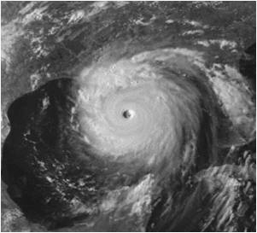
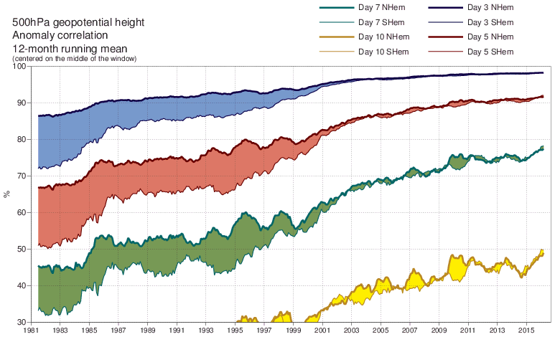






High resolution model and observations, advanced data assimilation for NWP: key to forecast improvement
2025: 5 km
~25km
~16km
~39km
~125km
~63km
~210km
AIRS (2002) data used
4D-Var with 12-hr Dec.2000
3DVAR
Jan. 1996
4D-Var with 6-hr window Nov.1997
25
Notes:
Horizontal mesh size has reduced exponentially over time with a halving roughly every 8 years.

Slide 26
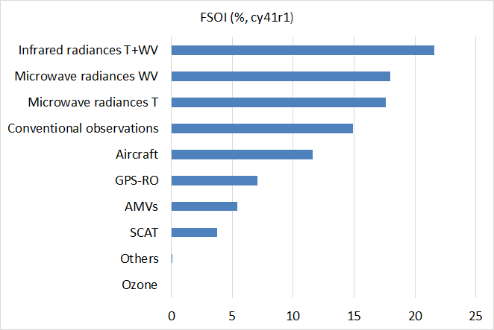
Impact evaluation of observing systems on ECMWF operational forecasts (20151101－20160307)
Temperature and/or moisture soundings from space
Total FSOI [%] by types of observations
 | November 2015 to March 2016 (cy41r1)
IR | 2 x IASI, AIRS, CrIS, 1 x HIRS, MTSAT-2/Himawari-8, GOES-13/15, MET-7/10
MW WV | All-sky: SSMIS, AMSR-2, GMI, 4 x MHS Clear-sky: ATMS, MWHS-FY3B
MW T | 6 x AMSU-A, ATMS
AMVs | 5 x Geos (MTSAT-2/Himawari-8, GOES-13/15, MET-7/10) MODIS, NOAA-AVHRR, MetOp-A/B, Dual MetOp
GPS-RO | MetOp-A/B, GRACE A, COSMIC-1/2/5, TerraSAR-X, TanDEM-X
SCAT | MetOp-A/B
Ozone | AURA OMI, NOAA-18 SBUV-2, MetOp-A/B GOME-2
Geer et al. 2016, WMO 6th Obs. Impact
Workshop,Shanghai
26

Slide 27
Other applications of hyperspectral IR measurements
Real-time weather monitoring (atmospheric motion, stability fields, clouds, winds, etc.);
Aviation safety (e.g., extreme cold temperatures, SO₂ associated with volcanic plumes);
Atmospheric composition (CO₂, CO, CH₄, SO₂, aerosols, dust, etc.);
Surface properties (emissivity);
Synergy with other measurements (handling clouds, inter-comparisons for calibration, etc.)
Climate data records (CDRs) (temperature, moisture, clouds);

Slide 28

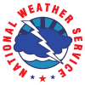
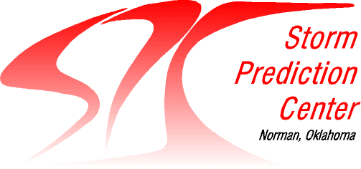
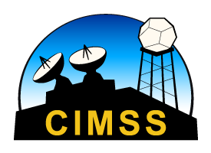


NUCAPS Soundings in AWIPS
Chris Barnet NOAA / STC Antonia Gambacorta NOAA / STC
Scott Lindstrom UW CIMSS Bill Line OU / CIMMS and NOAA / SPC
Tony Reale NOAA / SMCD Dan Nietfeld NOAA / NWS OAX
Revised: March 2016
28
Notes:
This is a training on NUCAPS Soundings that are available in AWIPS.
This training will explain how NUCAPS soundings are created, how to find them in AWIPS, how to use them and how to modify them.

Slide 29
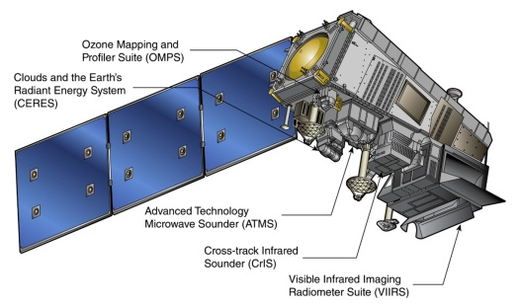
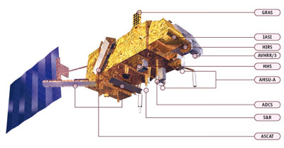
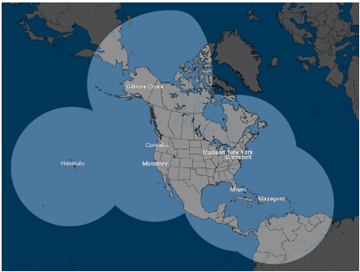
NUCAPS
NOAA-Unique Combined Atmospheric Processing System
  What is Combined?
    Suomi NPP/JPSS-1
      CrIS: Cross-track Infrared Sounder (1305 channels)
      ATMS: Advanced Technology Microwave Sounder (22 channels)
    Metop-A/Metop-B
      IASI: Infrared Atmospheric Sounding Interferometer (8461 channels)
      AMSU: Advanced Microwave Sounding Unit (12 channels)
      MHS: Microwave Humidity Sensor (4+1 Channels)
Overpass Times:
    Suomi NPP/JPSS
      East Coast: 05z/17z; Plains 06z/18z; West Coast 09z/21z
    Metop-A
      East Coast: 02z/14z; West Coast 05z/17z
    Metop-B
      East Coast: 03z/15z; West Coast 06z/18z
Svalbard
Downlink
NSOF
(NDE)
NWS
Gateway
Local Antenna Downlink
CONUS Data Flow
60-90 minutes
SBN
Antenna Data Flow
CSPP 30 minutes
WFO
WFO
29
Notes:
NUCAPS is the NOAA Unique CrIS ATMS Combined Atmospheric Processing System, combining information from CriS (an infrared sounder) and ATMS (a microwave sounder) on Suomi/NPP, or IASI and AMSU/MHS on MetopA and Metop/B. The Equatorial crossing times for the different polar orbiters are shown. Data appears in AWIPS after it is downlinked at Svalbard and then proceeds through computers that process it – and that process takes about 60 minutes. If you have access to a direct broadcast antenna, as shown in that small image, you can have NUCAPS soundings in AWIPS more quickly – about 30 minutes.

Slide 30
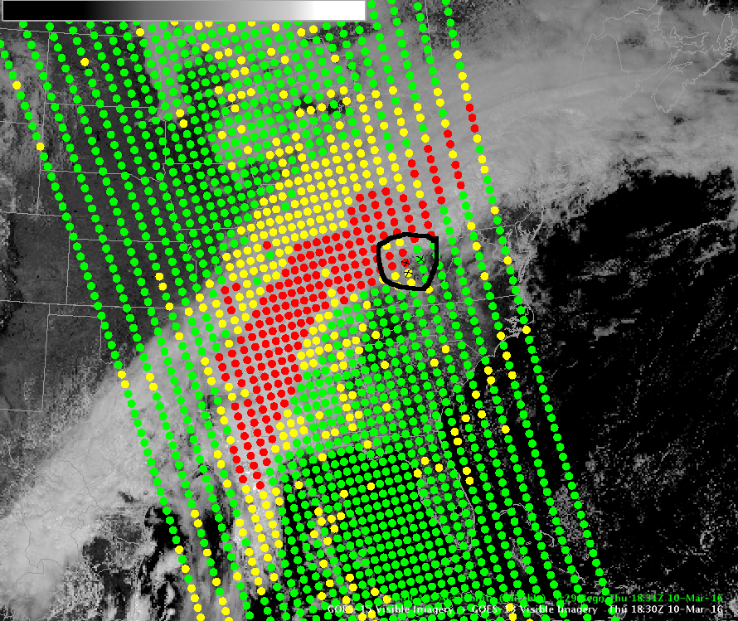
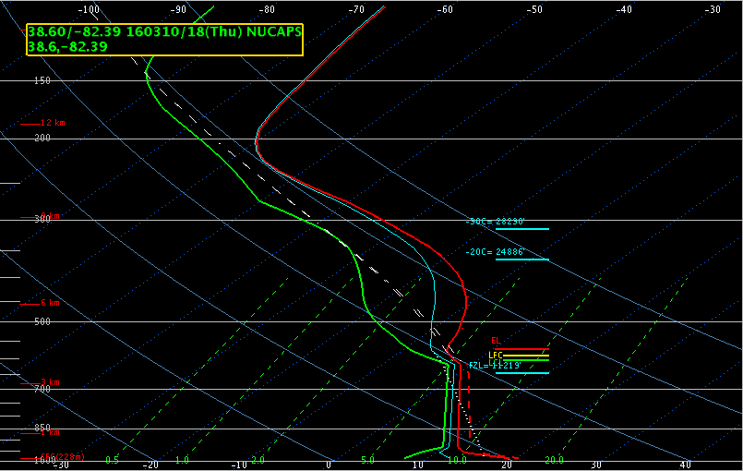
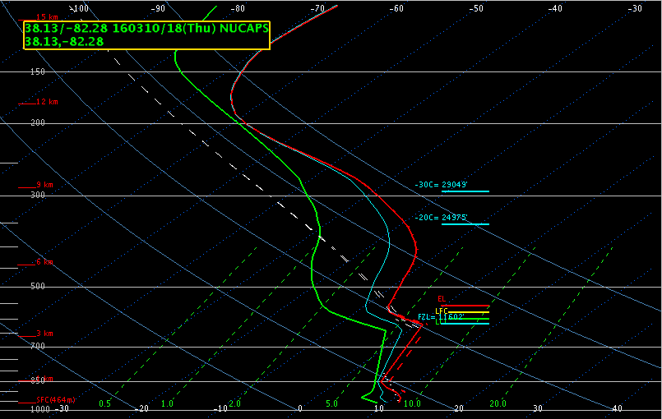
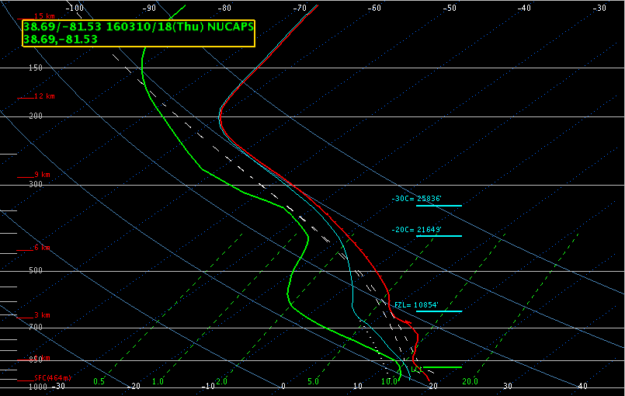
green = all good (microwave, regression, retrieval)
yellow = caution (microwave OK, IR regression or retrieval failed)
red = data likely unusable (microwave + others failed)(new in AWIPS 16-2.1-7)
30
Notes:
New to AWIPS 16.2.1-7: Color coded dots. Yellow and Red points have failed quality control, green points have passed QC. Red points denote soundings for which microwave and infrared retrievals have failed; yellow points denote soundings for which the microwave retrieval completed successfully but the infrared (sounder) regression or retrieval failed. Green points are good.

Slide 31
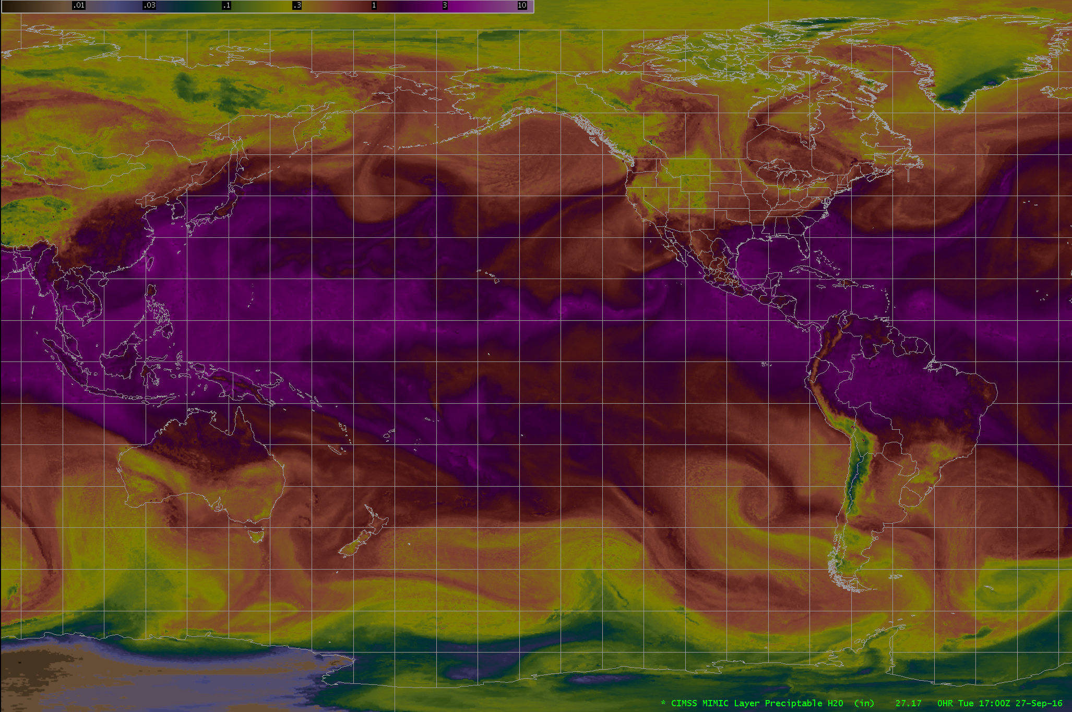
MIMIC (Morphed Integrated Microwave Imagery at CIMSS)
Displayed in AWIPS
31

Slide 32
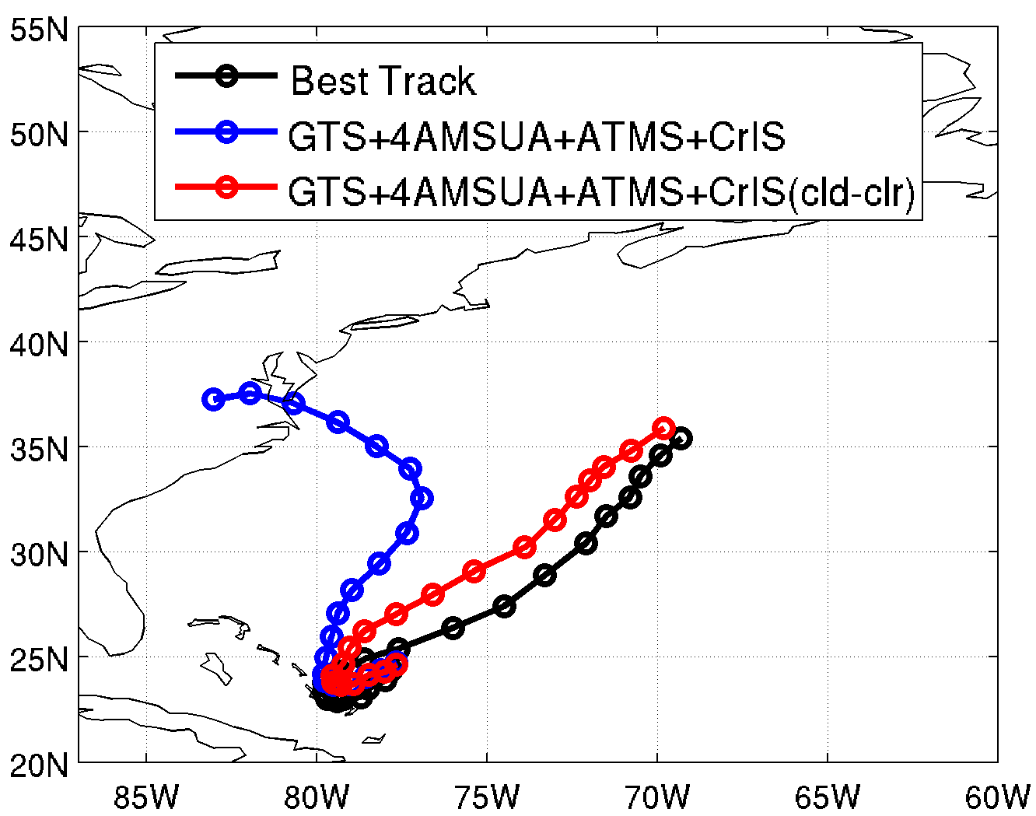
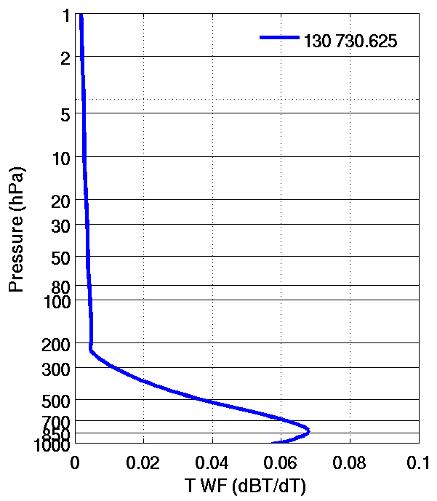
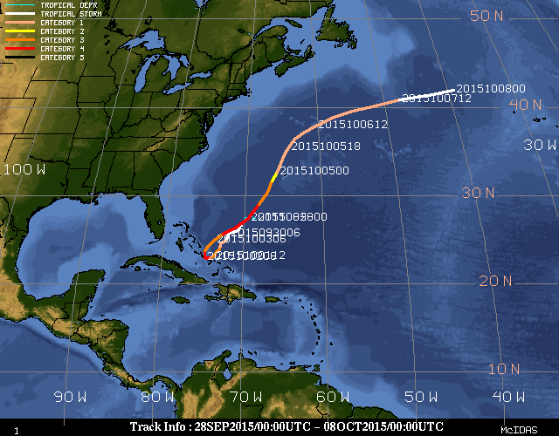
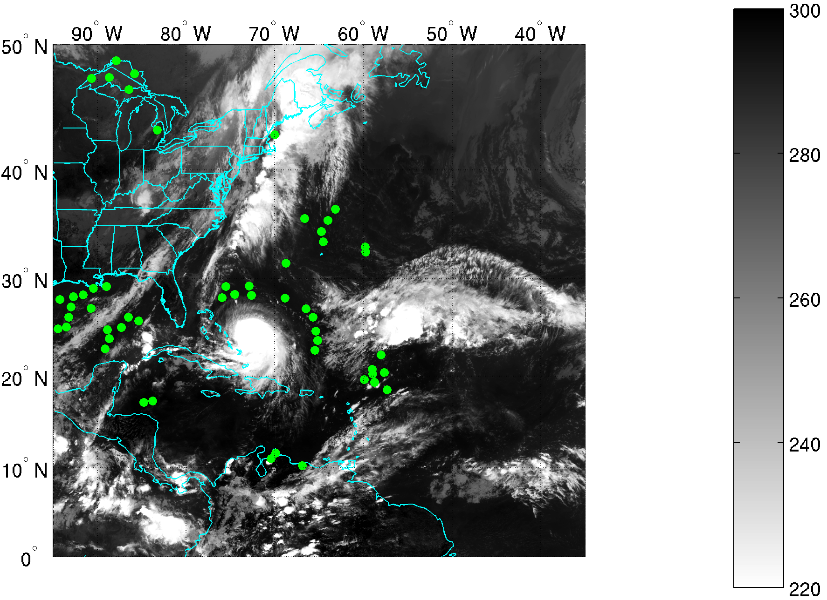
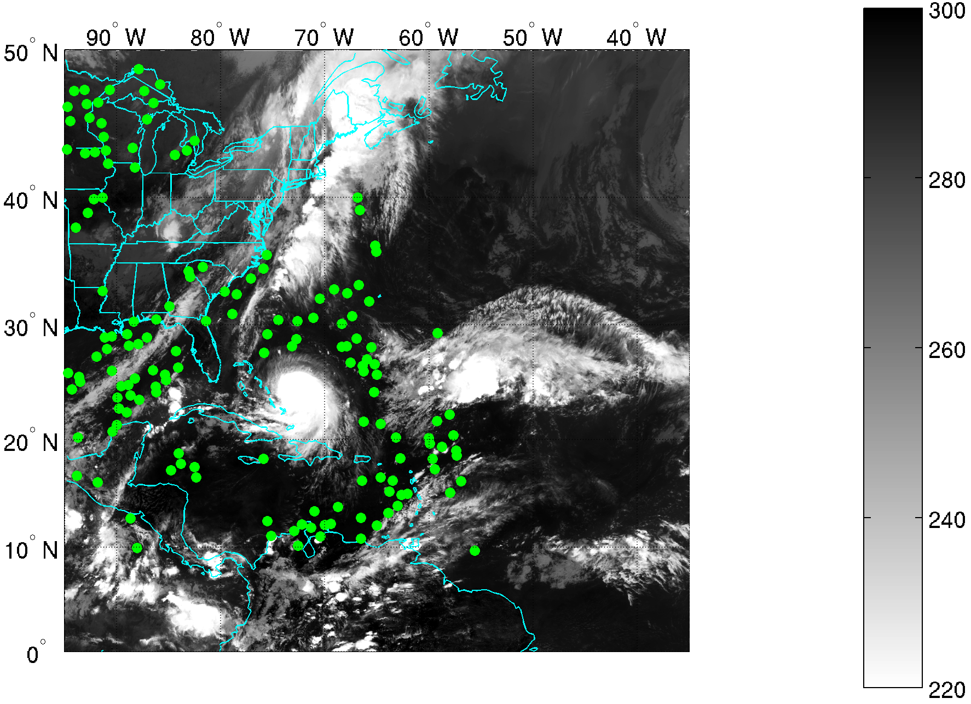
Hurricane Joaquin (2015) best track
Analyzing 120hr forecast from 09-30 18z
Weighting function of CrIS Channel 130
How do CrIS cloud-cleared radiances (CCRs) (Li et al. 2005) with help of VIIRS improve track forecast?
BT (K)
32
CrIS Original data assimilated at 09-30 18z of channel 130
CrIS CCR assimilated at 09-30 18z of channel 130
32
Notes:
A caption is added

Slide 33
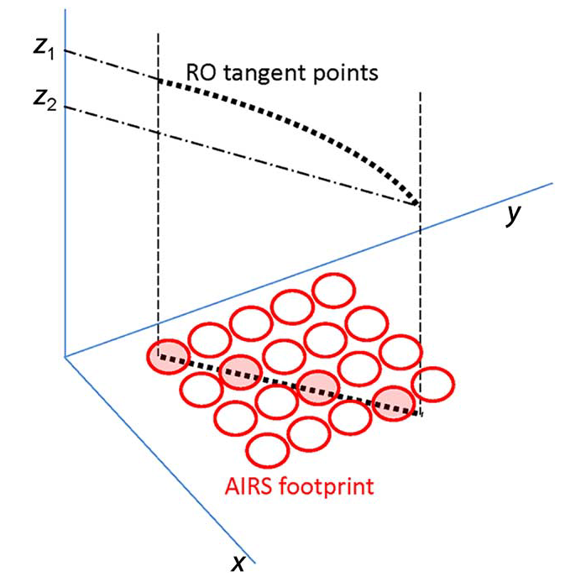
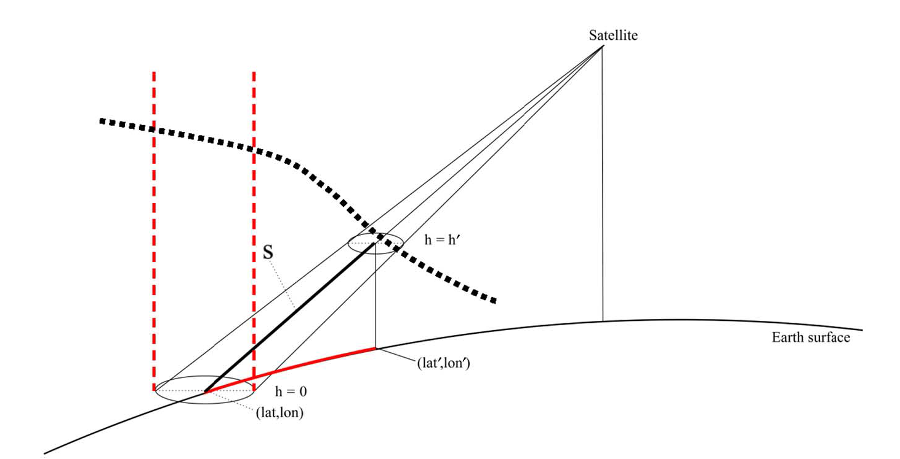
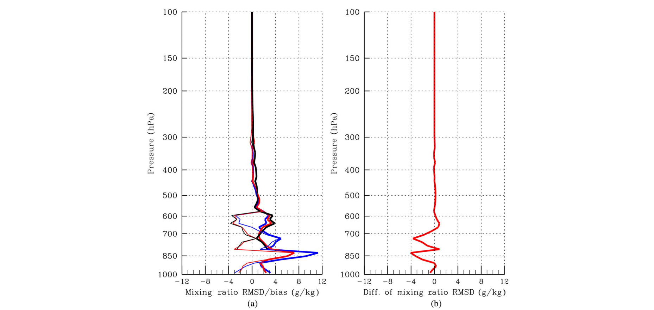
Improvements using RO with IR
Liu et al. 2016, IEEE-TGARS
Left panel (a) indicates the temperature RMSD (bold curves) and biases (thin curves) of AIRS-alone (EXP1; blue color) retrievals (blue), synergistic AIRS and F3/C RO retrievals (EXP2; red color), and F3/C level 2 product (EXP3; black color), using the ECMWF interim analysis as the reference. The right panel (b) shows the difference between the EXP2 and EXP1; negative values indicate reductions of RMSD.
33

Slide 34
Outline
History of soundings from space
Status of current sounding systems from space (IR, MW, RO) and the uniqueness of high spectral resolution IR soundings
Applications of sounding from space
Gaps and unmet requirement (high temporal advanced sounding system from GEO)
Summary and future perspective

Slide 35


Why do we need GEO hyperspectral IR sounders?
Q: GEO high temporal resolution observations GEO provide critical information for nowcasting, what is the impact in NWP models, for example, on storm forecasts?
Compared with LEO: Larger spatial coverage and higher temporal resolution for regional models
Compared with microwave sounders: finer vertical resolution
35

Slide 36
A. Value-added impact of GEO over LEO on TC track forecasts due to spatial coverage
Track RMSE (km)
Results are from 6-hour cycling
GEO +RAOB > LEO +RAOB
Larger spatial coverage from GEO provides value-added impact
None cycling and 3-hour cycling show similar results
Quick r-OSSE
36

Slide 37
The Need for Hyperspectral Sounders in Geostationary Orbit:
International Perspective
Presented by
Johannes Schmetz
EUMETSAT
37

Slide 38
CGMS and WMO have clearly recognised the need for hyperspectral sounding from geo-stationary orbit (1)
Action 31.36 from CGMS in 2003 reads:
  CGMS satellite operators to inform CGMS XXXII on plans to achieve the goal that all geostationary imagers should be upgraded to at least the level of SEVIRI by the 2015 timeframe; and frequent IR sounding should be made by high resolution spectrometers within the same timeframe.
38

Slide 39
WMO Commission for Basic Systems:
Expert Team on Evolution of the global observing system (1)
From Report of the 4th Session, Geneva, Switzerland, 7-11 July 2008, chaired by Dr. John Eyre
GEO Sounders:
– All meteorological geostationary satellites should be equipped with hyperspectral infrared sensors for frequent temperature/humidity sounding as well as tracer wind profiling with adequately high resolution (horizontal, vertical and time).
39

Slide 40
WMO Commission for Basic Systems:
Expert Team on Evolution of the global observing system (2)
Comment: Instruments of this type in geosynchronous orbit are high priority enhancements to the Global Observing System (GOS) for meeting existing user requirements in numerical weather prediction (NWP), nowcasting, hydrology and other applications areas. Based on the experience gained from classical IR sounding from GEO satellites and from hyperspectral Infrared sounding from LEO satellites, the impact of hyper-spectral sensors on GEO satellites is expected to be very positive. In addition, in order to optimize this impact, it would be useful to proceed with a direct demonstration mission based e.g. on the USA’s GIFTS development in advance of the planned operational series.
40

Slide 41
2007 NRC Decadal Survey Recommendation for Advanced Sounding is consistent with AoA
Page: ES-5
“The committee … recommends that NOAA develop a strategy to restore the previously planned capability to make high temporal- and vertical-resolution measurements of temperature and water vapor from geosynchronous orbit.”
“Recognizing the technological challenges and accompanying potential for growth in acquisition costs for HES, the committee recommends consideration of the following approaches:
  1. Complete the GIFTS instrument, deliver it to orbit via a cost-effective launch and spacecraft opportunity, and evaluate its potential to be a prototype for the HES instrument, and/or
  2. Extend the HES study contracts focusing on cost-effective approaches to achieving essential sounding capabilities to be flown in the GOES-R time frame.”
Notes:
The Weather Panel provides more specificity for the options stated above, the GIFTS option, and a follow-up that would lead to an operational sounder by 2018.
Earth Science and Applications from Space: National Imperatives for the Next Decade and Beyond

Slide 42
Summary and future perspective
Great progress, especially from polar-orbiters, has been made with respect to estimating atmospheric temperature and moisture vertical profiles from space. Estimate of temperature and moisture profiles, along with many derived parameters, as well as the direct use of radiances through assimilation into Numerical Weather Prediction (NWP) models.
Each instrument type, and orbit, brings unique information, with the most information being when all the data are combined.
  Radio occultation plus infrared are better than either alone.
  Microwave plus infrared are better than either alone.
The largest remaining observational gap is the high time resolution temperature and moisture profile measurements with high vertical resolution which need high spectral resolution instruments. While there are operational missions planned for over Europe and China, the U.S. has no defined current plans for similar sensors to monitor North America.
  While temperature and moisture profiles from polar-orbiting platforms are useful, there are many high impact weather situations where the structure of the atmosphere is changing more frequently.

Slide 43
Select Geo References
T. J. Schmit, W. F. Feltz, W. P. Menzel, J. Jung, A. P. Noel, J. N. Heil, J. P. Nelson III, and G. S. Wade, “Validation and use of GOES sounder moisture information,” Weather Forecast. 17, 139–154 (2002).
Schmit, Timothy J.; Feltz, Wayne F.; Menzel, W. Paul; Jung, James; Noel, Andrew P.; Heil, James N.; Nelson, James P. III and Wade, Gary S.. Validation and use of GOES sounder moisture information. Weather and Forecasting, Volume 17, Issue 1, 2002, pp.139-154.
Lee, Yong-Keun, Zhenglong Li, Jun Li, and, Timothy J. Schmit, 2014: Evaluation of the GOES-R ABI LAP retrieval algorithm using GOES-13 Sounder, Journal of Atmospheric and Oceanic Technology, 31, 3- 19.
Li, J., Jinlong. Li, J. Otkin, T. J. Schmit, and C. Liu, 2011: Warning information in a preconvection environment from the geostationary advanced infrared sounding system - A simulation study using IHOP case, Journal of Applied Meteorology and Climatology, 50, 776 - 783.
Wang, Fang; Li, Jun; Schmit, Timothy J. and Ackerman, Steven A.. Trade-off studies of a hyperspectral infrared sounder on a geostationary satellite. Applied Optics, Volume 46, Issue 2, 2007, pp.200-209
Li, Z., J. Li, W. P. Menzel, J. P. Nelson III, T. J. Schmit, Elisabeth Weisz, and S. A. Ackerman, 2009: Forecasting and nowcasting improvement in cloudy regions with high temporal GOES Sounder infrared radiance measurements, Journal of Geophysical Research. - Atmospheres, 114, D09216, doi:10.1029/2008JD010596.
Schmit, T. J., Li, J., S. A. Ackerman, J. J. Gurka, 2009: High spectral and high temporal resolution infrared measurements from geostationary orbit, J. Atmospheric and Oceanic Technology, 26, 2273 - 2292.
W. L. Smith Sr., H. Revercomb, G. Bingham, A. Larar, H. Huang, D. Zhou, J. Li, X. Liu, and S. Kireev, 2009: Evolution, current capabilities, and future advance in satellite ultra-spectral IR sounding, Atmos. Chem. Phys. Discuss., 9, 1–29.
Schmit, T. J., J. Li, J. J. Gurka, M. D. Goldberg, K. Schrab, Jinlong Li, and W. Feltz, 2008: The GOES-R Advanced Baseline Imager and the continuation of current GOES sounder products, J. of Appl. Meteorol. and Climatology, 47, 2696 – 2711.

Slide 44
Backup slides

Slide 45

Temperature resolution for 1 K accuracy
AMSU-A

Slide 46

Moisture (mixing ratio) vertical resolution for 25% accuracy
AMSU-B

Slide 47
The RMSE for GOES, AMSU-A and GOES/AMSU-A temperature retrieval from simulated radiances (834 independent comparisons)
(Li et al. 2000)

Slide 48
The coverage of polar-orbiting satellites and sensors used operationally at ECMWF in
October 2012.

Slide 49
The coverage and measurements/sensors on geostationary spacecraft plus polar AMVs.

Slide 50
Forecast tracks of Tropical Cyclone Sandy from (left) 0000 UTC 25 Oct 2012 analysis and (right) 0000 UTC 26 Oct 2012 analysis for NOPOLAR (red) using operational background errors and NOPOLAR using ensemble forecast-based background errors (EDA) (green) experiments. Black dots represent Sandy’s best track estimate. (McNally et al. 2014).

