Slide 1
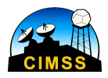
The Pre-launch History of the Advanced Baseline Imager (ABI) on GOES-R
Timothy J. Schmit (tim.j.schmit@noaa.gov)
NOAA/NESDIS/Satellite Applications and Research
Advanced Satellite Products Branch (ASPB)
Madison, WI
Mat Gunshor, Jim Gurka, Paul Menzel
12th Annual Symposium on New Generation Operational Environmental Satellite Systems
AMS Annual Meeting
New Orleans, LA
January 11, 2016
UW-Madison

Slide 2
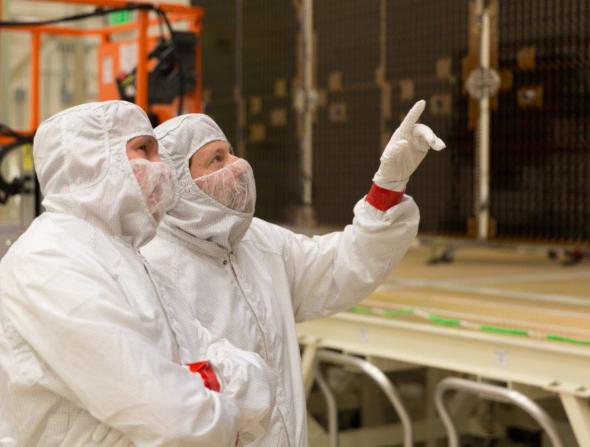
Outline
GOES-R series ABI
Overview
Spectral
Spatial
Temporal
ABS
Summary
Lockheed Martin

Slide 3
The Advanced Baseline Imager:
ABI Current
Spectral Coverage
16 bands 5 bands
Spatial resolution
0.64 μm Visible 0.5 km Approx. 1 km
Other Visible/near-IR 1.0 km n/a
Bands (>2 μm) 2 km Approx. 4 km
Spatial coverage
Full disk Every 15 min Scheduled (3 hrly)
CONUS Every 5 min ~4 per hour
Mesoscale Every 30 sec n/a
Visible (reflective bands)
On-orbit calibration Yes No
Notes:
The ABI allows more bands, finer spatial resolution, faster refresh rates and on-orbit calibration of all bands!

Slide 4
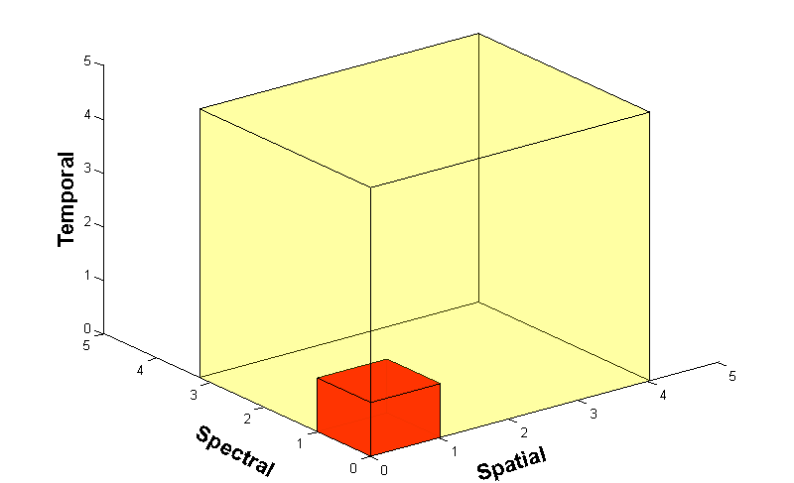
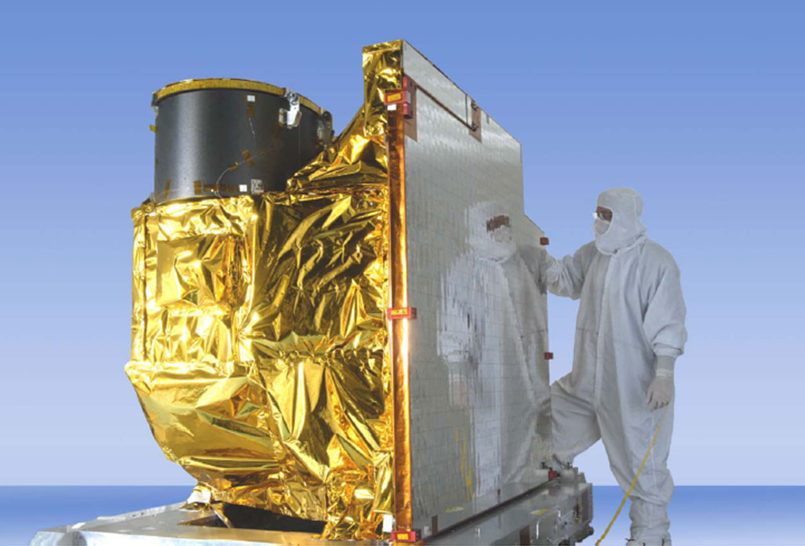
Advanced Baseline Imager
5
4
3
X
Faster coverage (5-minute full disk vs. 25-minute)
X
Improved spatial resolution
(2 km IR vs. 4 km)
X
More spectral bands (16 on ABI vs. 5 on the current imager)
Notes:
Slide from J. Gerth, CIMSS.

Slide 5
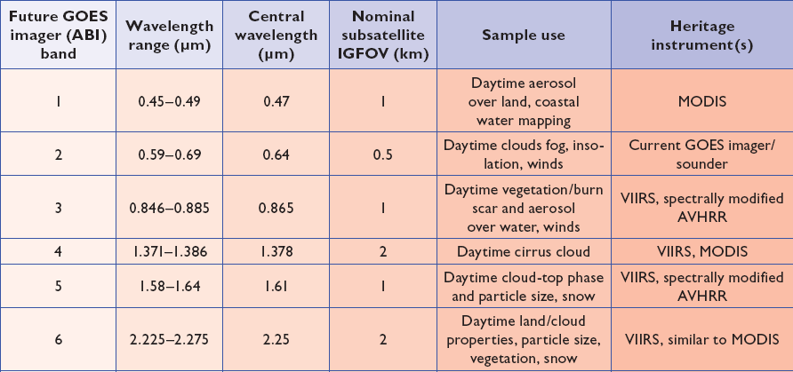
ABI spectral bands 1-6
Approximate:
2 visible bands and 4 near infrared bands on the ABI, compared to only one on today’s imager
Notes:
Final column added: heritage. The ABI band 1 was suggested by Dr. Fred Mosher at a GOES Users' Conference.
The ABI band 3 was suggested by the late Dr. C. Rao (of the then ORA).
Some of these bands have been shifted to more closely match those on the VIIRS.

Slide 6
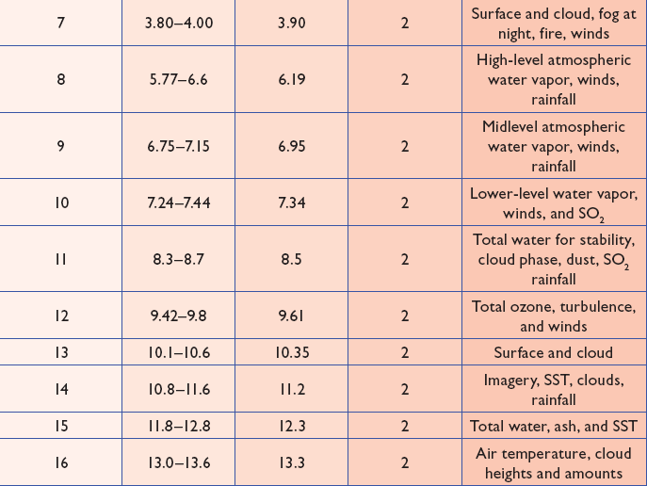
ABI spectral bands 7-16
Approximate:
10 infrared bands on the ABI, compared to four on today’s imager
Notes:
The ABI band 10 was modified to better depict upper-level SO2. (G. Ellrod and others)
The ABI band 11 was suggested by Steve Ackerman (CIMSS), based on HIRS experience.
The ABI band 13 was suggested by W. P. Menzel (then NOAA NESDIS).

Slide 7
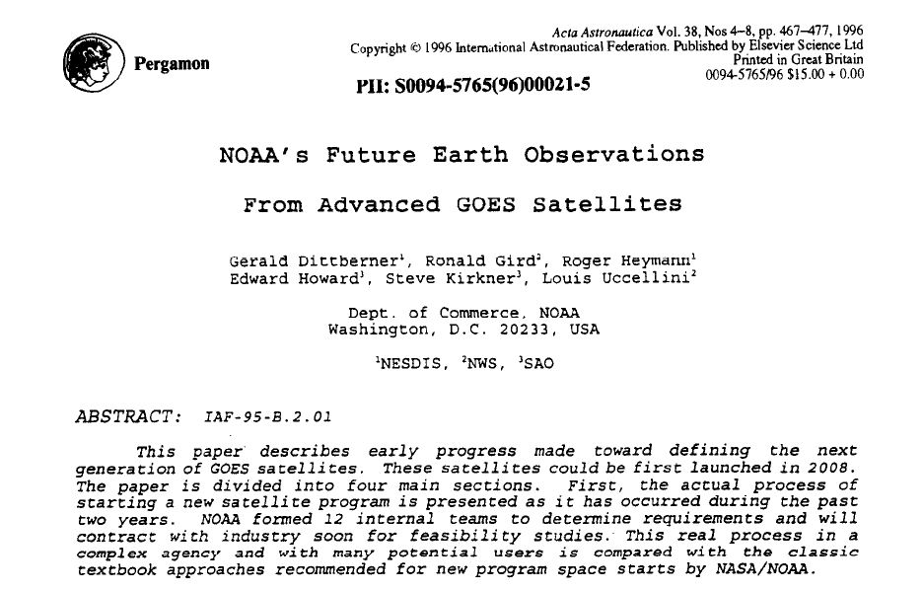
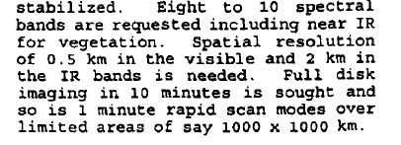
From 1996
"Full disk imaging in 10 minutes is sought and so is 1 minute rapid scan modes over limited areas of say 1000 x 1000 km."
“These satellites could be first launched in 2008”
Notes:
http://ac.els-cdn.com/0094576596000215/1-s2.0-0094576596000215-main.pdf?_tid=86f5529e-c98d-11e4-8a46-00000aacb35f&acdnat=1426257222_f09810532f99876bc6014fff4f4d65be
NOAA's future earth observations from advanced GOES satellites Dittberner G., Gird R., Heymann R., Howard E., Kirkner S., Uccellini L. (1996) Acta Astronautica, 38 (4-8) , pp. 467-477.

Slide 8
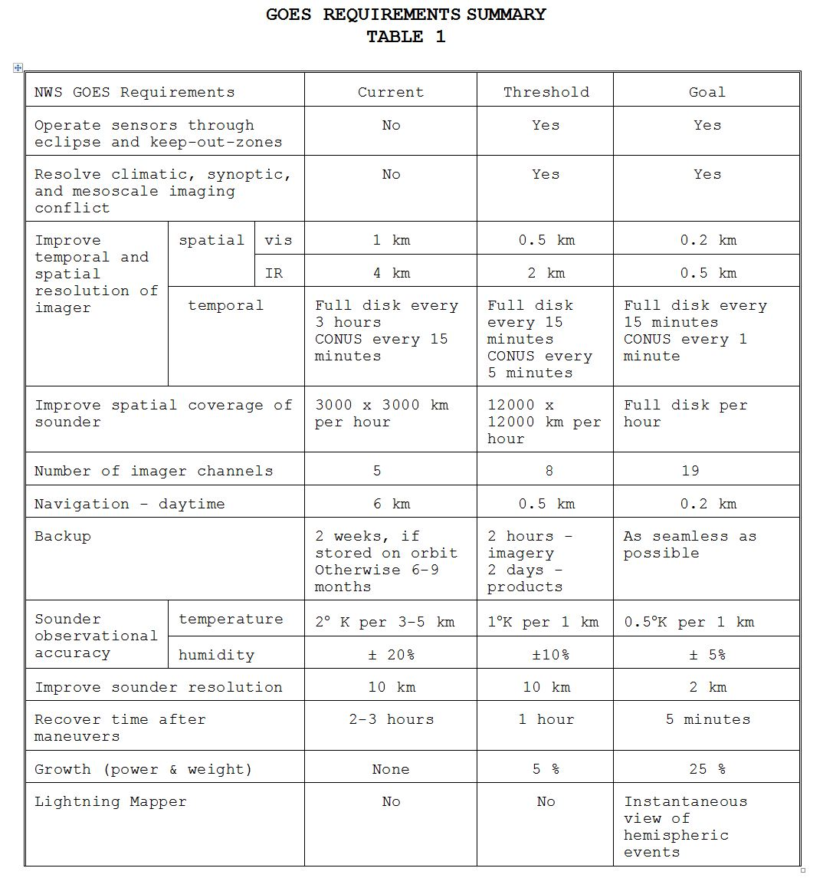
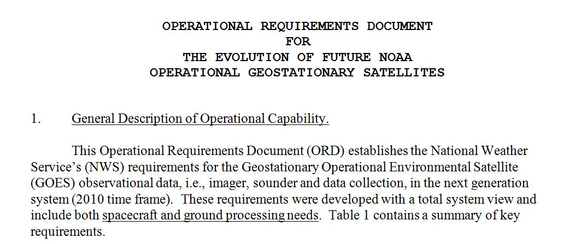
Late 1990s

Slide 9
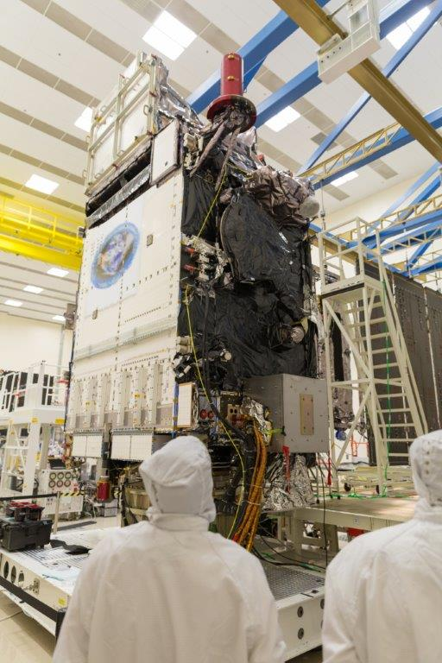
Outline
GOES-R series ABI
Overview
Spectral
Spatial
Temporal
ABS
Summary
Lockheed Martin

Slide 10
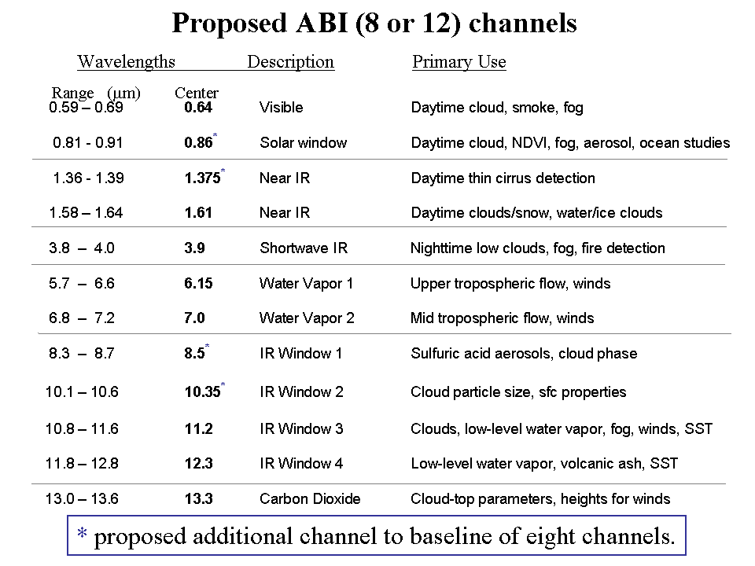
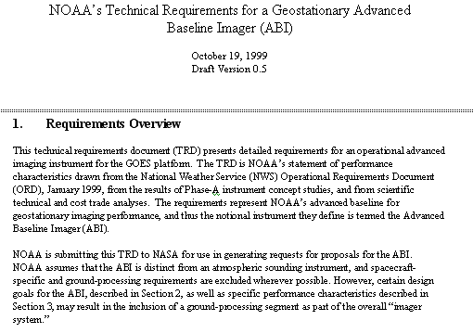
Mission Planning
STAR and CIMSS very involved during the early GOES-R series development. This includes: formulation studies for both ABI and Advanced Baseline Sounder (ABS), ABI band selection and modification, etc.
ABI/ABS Requirements.
circa 1999/2000
Originally ABI was only 8 spectral bands, now it is 16. All ABI bands were modified with input from STAR and its Cooperative Institutes.
Notes:
Significant remaining scientific challenges for the specific science topic
Next step(s)
Instruments (current/future), techniques, testbed, transition, …
Path into applications/operations
Who will use it and how
How will it get out to the real world

Slide 11
1 0.52 – 0.72 0.62 Visible Daytime clouds, fog 8 1.3 – 1.9 1.6 Near IR Daytime clouds/snow, water/ice clouds 2 3.8 – 4.0 3.9 Shortwave IR Nighttime low clouds, fog, fire detection 3 6.5 – 7.0 6.75 Water Vapor 1 Upper tropospheric flow, winds 6 7.0 – 7.5 7.25 Water Vapor 2 Mid tropospheric flow, winds 4 10.2 – 11.2 10.7 IR Window 3 Clouds, low-level water vapor, fog, winds 5 11.5 – 12.5 12.0 IR Window 4 Low-level water vapor, volcanic ash 7 13.2 – 13.8 13.5 Carbon Dioxide Cloud-top parameters, heights for winds
ABI - 8
# Wavelengths Description Primary Use
Range (μm) Center
Launch was planned for 2008!
ABI – circa 1999
(8 total bands, most spectrally wide)
Notes:
These 8 bands represent the current GOES imager “six” and 1.6 and 7.2 um bands.

Slide 12
0.59 – 0.69 0.64 Visible Daytime cloud, smoke, fog 0.81 ­ 0.91 0.86* Solar window Daytime cloud, NDVI, fog, aerosol, ocean studies 1.36 - 1.39 1.375* Near IR Daytime thin cirrus detection 1.58 – 1.64 1.61 Near IR Daytime clouds/snow, water/ice clouds 3.8 – 4.0 3.9 Shortwave IR Nighttime low clouds, fog, fire detection 5.7 – 6.6 6.15 Water Vapor 1 Upper tropospheric flow, winds 6.8 – 7.2 7.0 Water Vapor 2 Mid tropospheric flow, winds 8.3 – 8.7 8.5* IR Window 1 Sulfuric acid aerosols, cloud phase 10.1 – 10.6 10.35* IR Window 2 Cloud particle size, sfc properties 10.8 – 11.6 11.2 IR Window 3 Clouds, low-level water vapor, fog, winds, SST 11.8 – 12.8 12.3 IR Window 4 Low-level water vapor, volcanic ash, SST 13.0 – 13.6 13.3 Carbon Dioxide Cloud-top parameters, heights for winds
Proposed ABI (8 or 12) channels
Wavelengths Description Primary Use
Range (μm) Center
* proposed additional channel to baseline of eight channels.
Notes:
As originally proposed by the National Weather Service, the ABI was to have a minimum of 8 spectral channels. The selected channels were close to the five channels on the GOES-8 -10 imagers ( 0.64, 3.9, 6.15, 11.2, and 12.3 μm) supplemented with a snow/cloud discriminating 1.6 μm channel, a mid-tropospheric 7.0 um water vapor channel, and a cloud height determining 13.3 μm channel. Two additional channels were proposed to expand the capabilities closer to meeting NWS requirements and to enhance opportunities for weather and climate research and applications; the IR windows at 8.5 μm and 10.35 μm offer improved moisture, cloud, aerosol, and surface sensing capabilities. In addition some of the ABI-8 spectral widths were modified to complement other satellite spectral channels and to capitalize on experience gained with the MODIS Airborne Simulator (MAS). To round out an ABI-12, another visible channel at 0.86 μm was added to help with the detection of aerosols and vegetation and a near infrared channel at 1.38 μm to detect very thin cirrus in the upper troposphere.
The addition of the 8.5 μm enables detection of volcanic cloud with sulfuric acid aerosols and thin cirrus in conjunction with the 11.2 μm channel as well as determination of cloud micro-physical properties with the 11.2 and 12.3 μm channels. This includes a more accurate delineation of ice from water clouds during the day or night.
The addition of the 10.35 μm improves determination of micro-physical properties of clouds with the 11.2 and 12.3 μm channels; this includes a more accurate determination of cloud particle size during the day and night. Also, the observation of surface properties (such as SST) is improved using the 10.35μm along with the 8.6, 11.2, and 12.3 μm channels. Finally, there is more sensitivity to low level moisture with the additional split windows.
The 0.86 μm channel provides synergy with the AVHRR/3, as it is similar its channel 2. This channel is used for determining vegetation amount, aerosols and ocean/land studies. Characterizing aerosols and their optical properties is essential for improving a number of satellite products, for example SST, ocean color and surface temperatures. This channel also enables very localized vegetation stress monitoring, fire danger monitoring, and albedo retrieval.
The 1.38 μm channel is copied from one on MODIS. It does not see into the lower troposphere due to water vapor sensitivity and thus it provides excellent daytime sensitivity to very thin cirrus. This will aid several products relying on clear skies in the infrared windows, for example SST.

Slide 13
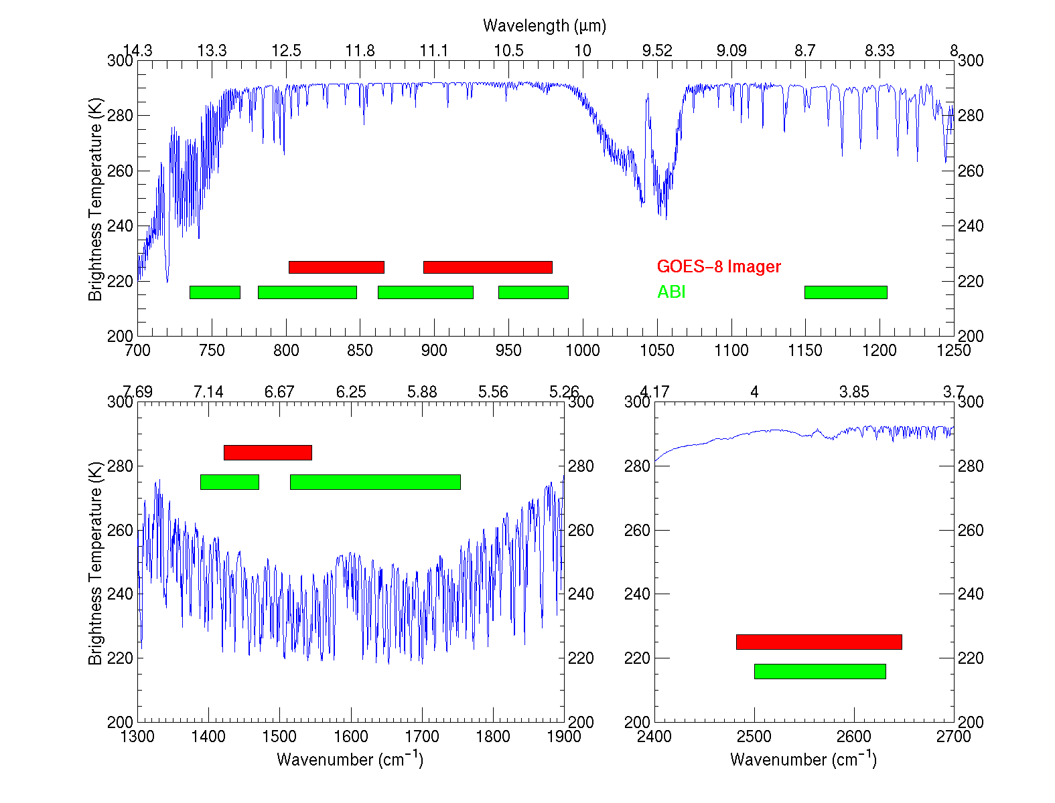
IR channels on the current GOES and the proposed ABI
The IR bands when ABI had 12 total bands
UW-Madison/CIMSS
Notes:
This figure, generated by Mat Gunshor, shows the spectral coverage of the current GOES Imager (in red) and that proposed in the IR region for the ABI (Advanced Baseline Imager) (in green). A sample high spectral resolution earth-emitted spectra is also plotted (in blue). It’s apparent that the ABI has advantages over the current GOES Imager. For example, a 13.3 um band for cloud heights, two water vapor bands instead of one, and a band covering at the 8.5 um region (for cloud phase).

Slide 14
ABI Bands (proposed 18)
Current GOES Imagers
MSG/Sounder
MODIS/MTG/etc
Notes:
Band pass are approximate

Slide 15
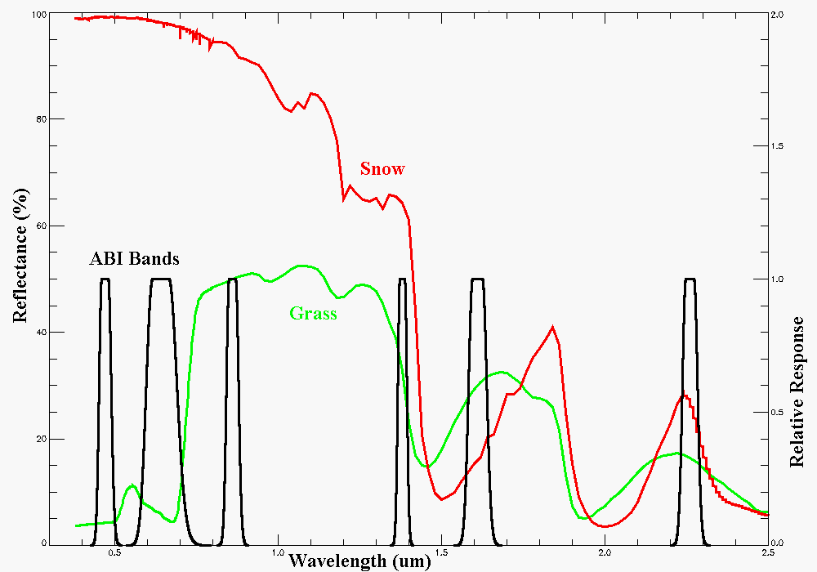
Visible and near-IR channels on the ABI
Snow, Phase
Part. size
Cirrus
Haze
Clouds
Veg.
The ABI visible and near-IR bands have many uses.
Notes:
Note how ABI bands 2 and 3 might indicate vegetation. ABI bands 2 and 5 (or 6) depict snow.
Schmit, T. J., M. M. Gunshor, W. P. Menzel, J. J. Gurka, J. Li, and A. S. Bachmeier, 2005: Introducing the next-generation Advanced Baseline Imager on GOES-R. Bull. Amer. Meteor. Soc., 86, 1079-1096.

Slide 16
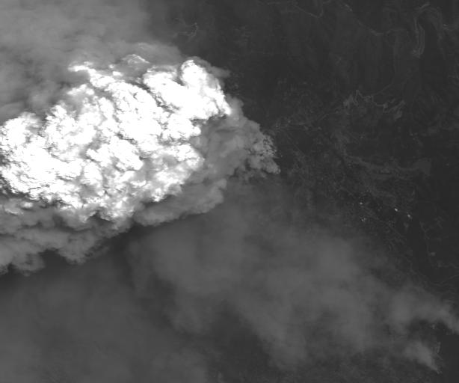
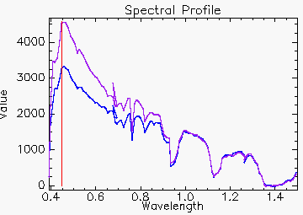
AVIRIS: Linden_haze_0.439_0.498um (simulated ABI band 1)
The 0.47 um band was added, in part, due to a request from Fred Mosher, then of the AWC
Smoke
Notes:
AVIRIS (Airborne Visible/Infrared Imaging Spectrometer)
Simulated by convolving mock ABI spectral response functions with either AVIRIS data.
This band was chosen to better monitor daytime smoke, etc.

Slide 17
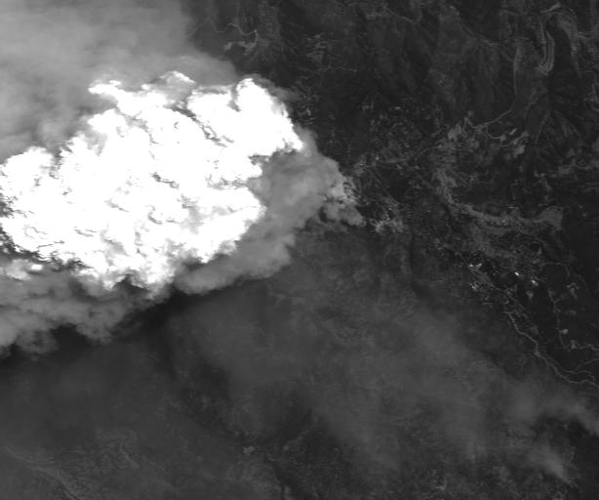
Linden_0.577_0.696_um (simulated ABI band 2)
Notes:
Simulated by convolving mock ABI spectral response functions with either AVIRIS data.

Slide 18
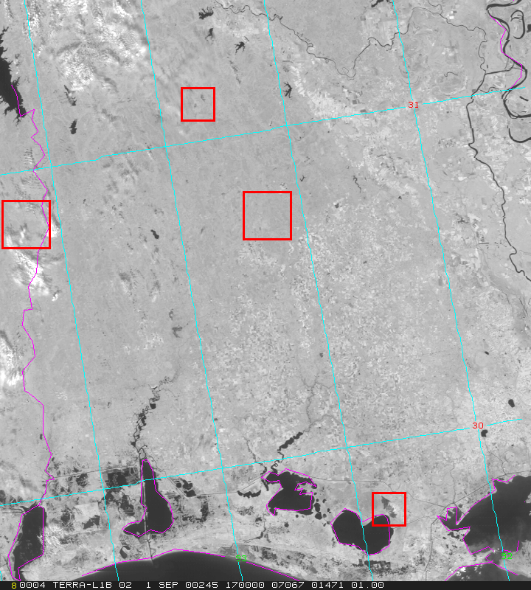
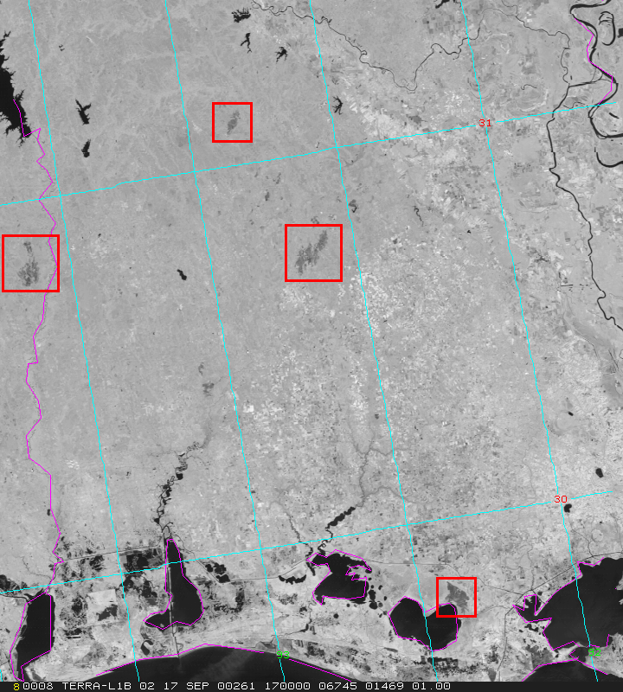
MODIS Detects Burn Scars in Louisiana
01 September 2000-- Pre-burning
17 September 2000-- Post-burning
Burn Scars
ABI will allow for diurnal characterizations of burn areas, this has implications for re-growth patterns.
Scars (dark regions) caused by biomass burning in early September are
evident in MODIS 250 m NIR channel 2 (0.85 μm) imagery on the 17th.
CIMSS, UW
MODIS Data from GSFC DAAC
Notes:
Figures from Chris Moeller, of CIMSS. The traditional visible 0.6um band does not show the burn scars (not shown).

Slide 19
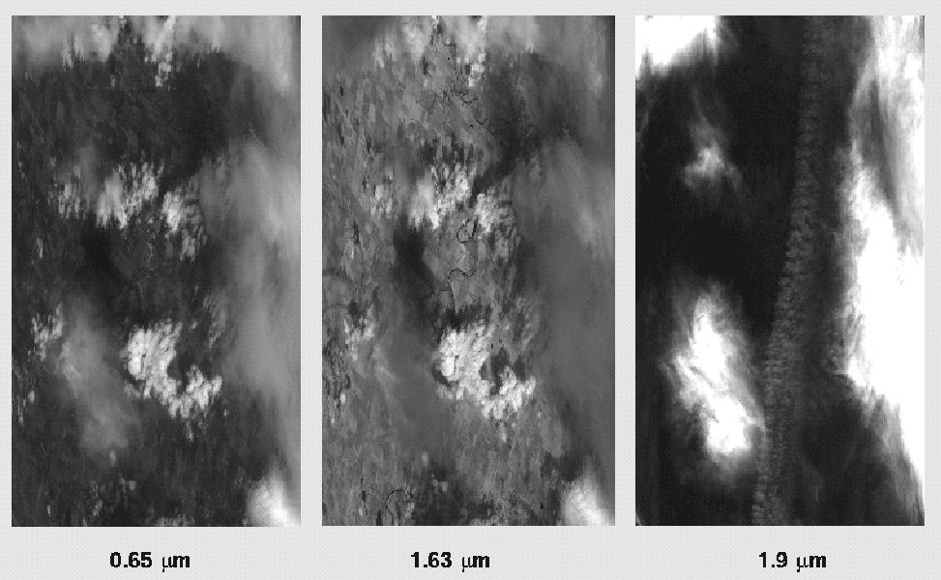
1.88 μm (or 1.38 μm) is helpful for contrail detection
Examples from MAS (Chs 2, 10, 16).
Contrail detection is important when estimating many surface parameters.
There is also interest in the climate change community.
Notes:
MODIS Airborne Simulator. The image is 1.88 um, but that’s similar to the physics as the band chosen for the ABI.

Slide 20
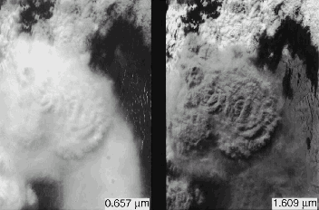
ABI (1.61 um) Example of MAS 0.66 and 1.61 um
convective cumulonimbus surrounded by lower-level water clouds
(King et al., JAOT, August 1996)

Slide 21
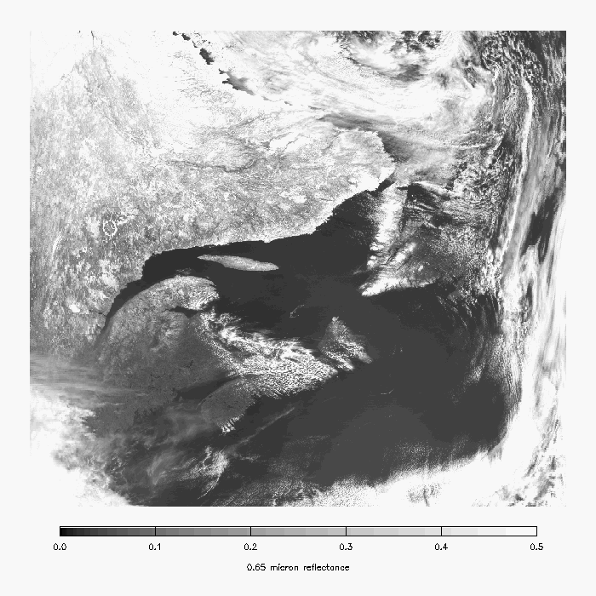
MODIS 0.65 µm -- Snow is bright (but so are clouds).
Snow
Notes:
Image from A. Heidnger of ASPB.

Slide 22
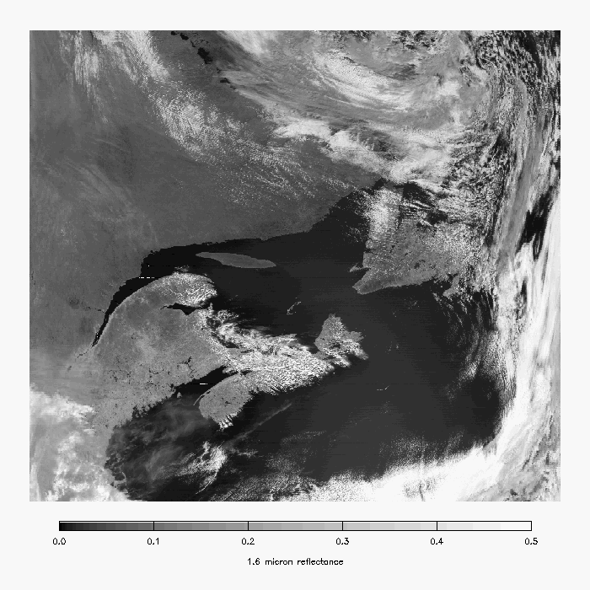
MODIS 1.6 µm -- Snow is darker.
Snow
Notes:
Image from A. Heidnger of ASPB.

Slide 23
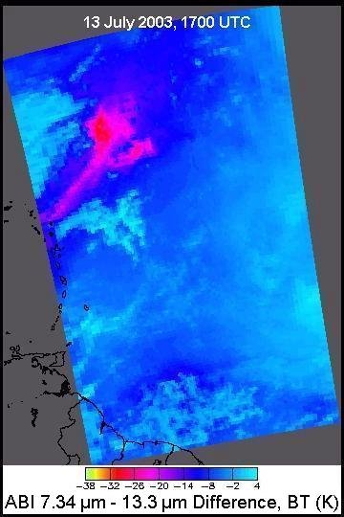
GOES-R ABI will detect SO2 plumes
Water Vapor Band Difference convolved from AIRS data
sees SO₂ plume from Montserrat Island, West Indies
SO₂ Plume
Current GOES Imager
No skill in monitoring
Figure courtesy of Kris Karnauskas
Current GOES Imager can not
detect SO₂
ABI 7.34 μm – 13.3 μm
Notes:
Current GOES can detect an ash cloud, but not the SO2 signature. The ABI can, if the plume is large and high enough.
Image on Right from:
Schmit, T. J., M. M. Gunshor, W. P. Menzel, J. J. Gurka, J. Li, and A. S. Bachmeier, 2005: Introducing the next-generation Advanced Baseline Imager on GOES-R. Bull. Amer. Meteor. Soc., 86, 1079-1096.

Slide 24
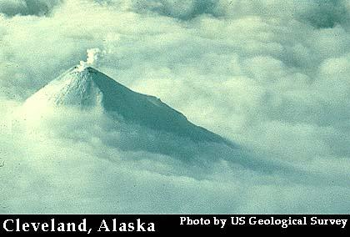
Volcanic Ash Plume: 11-12 and 8.5-11 μm images
One day after the Mt. Cleveland eruption
20 February 2001, 8:45 UTC
Simulated
ABI
(11-12 μm)
Simulated
ABI
(8.5-11 μm)
UW/CIMSS
Notes:
One of uses of the 8.5 um is better ash detection.

Slide 25
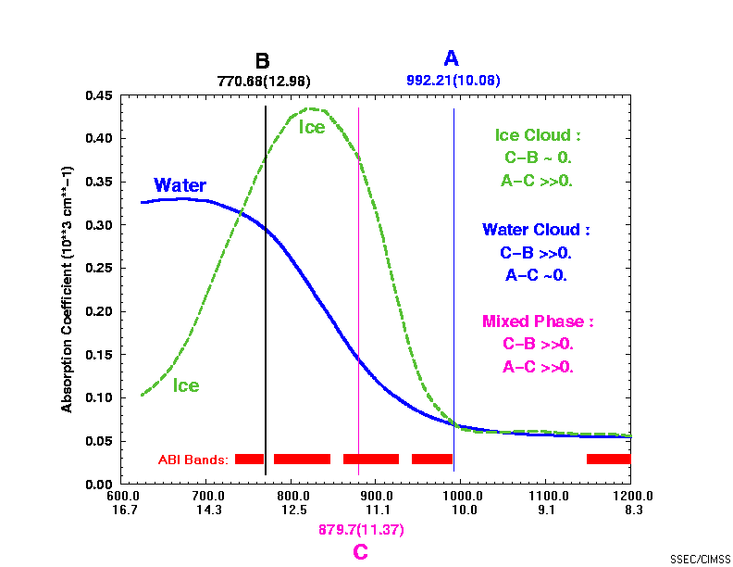
ABI -- 8.5 μm Based on MODIS used with ABI window channels to separate water from ice clouds
The 8.5 um band was added, in part, due to a request in the late 1980s from Steve Ackerman, CIMSS.
Notes:
Another use of the 8.5 um band is a day and night cloud-top phase product.

Slide 26
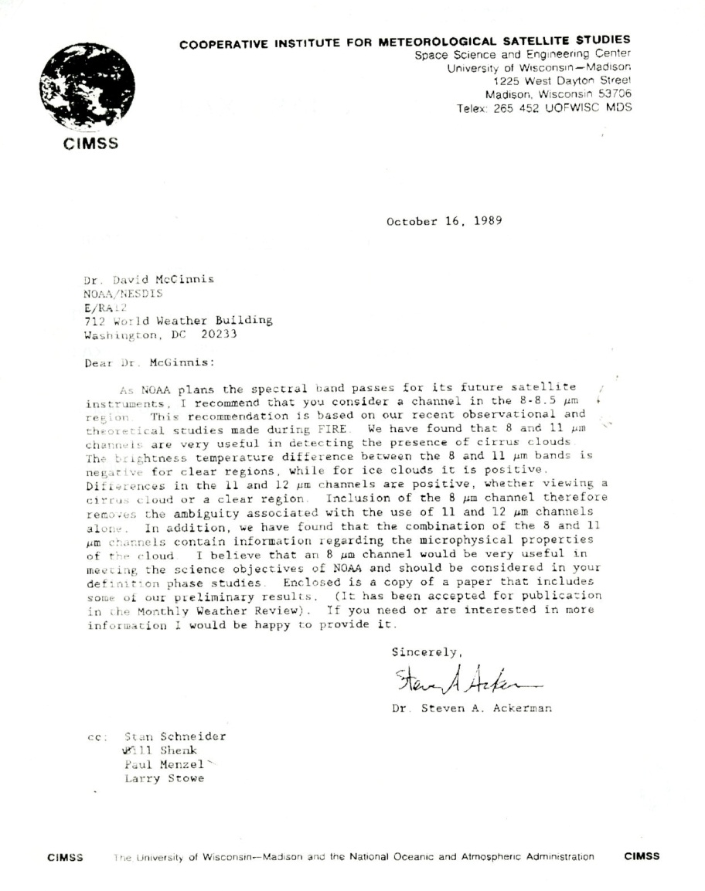
Ackerman memo (1989)
8 micrometer…very useful in detecting …cirrus information … microphysical properties

Slide 27
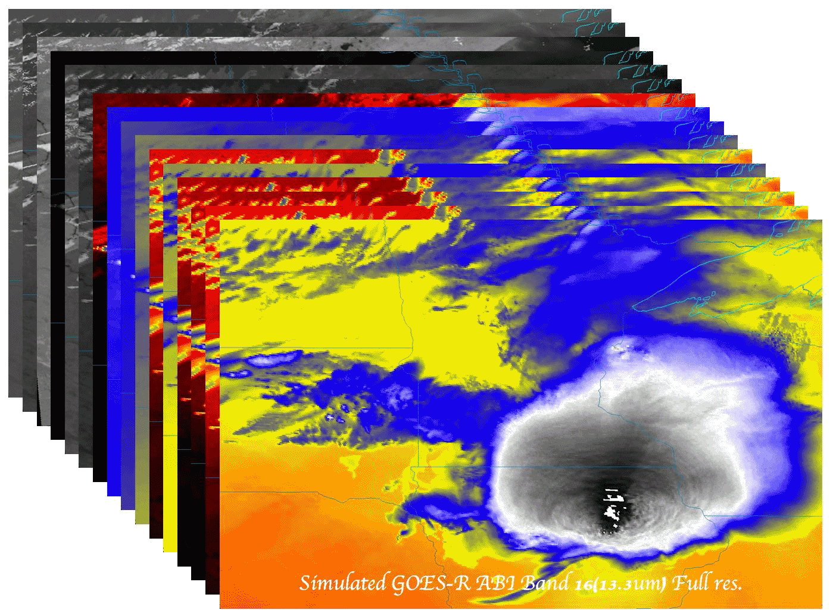
ABI Band “Champions”
CWL | Band # | Champion
0.47 | 1 | Fred Mosher
0.64 | 2 | Vern Suomi
0.86 | 3 | Nagaraja Rao
1.38 | 4 | Bo-Cai Gao
1.61 | 5 | L. Stowe
2.25 | 6 | M. King
3.9 | 7 | Vern Suomi
6.16 | 8 | Pierre Morel
6.93 | 9 | W. L. Smith
7.34 | 10 | Gary Ellrod
8.5 | 11 | S. Ackerman
9.61 | 12 | Art Neuendorffer
10.33 | 13 | W. P. Menzel
11.2 | 14 | Vern Suomi
12.3 | 15 | Vern Suomi
13.3 | 16 | W. L. Smith

Slide 28
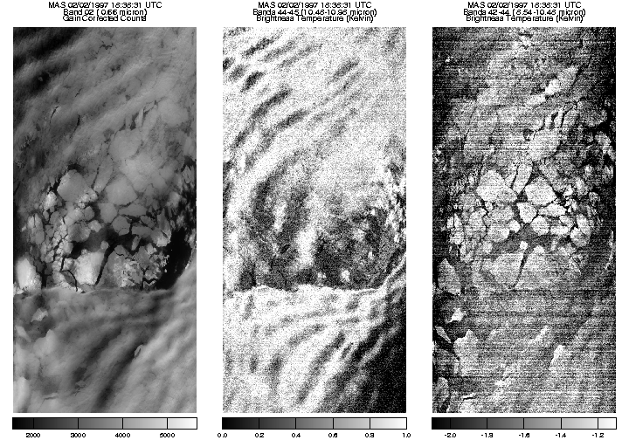
ABI (10.35 μm) Examples of MAS 0.66, 10.5-11.0, and 8.6-10.5 um reveal utility of new IR window for seeing through clouds to ice floes

Slide 29
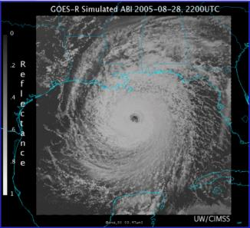
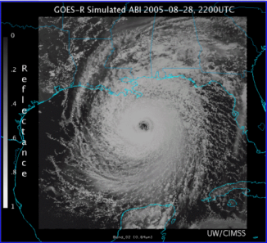
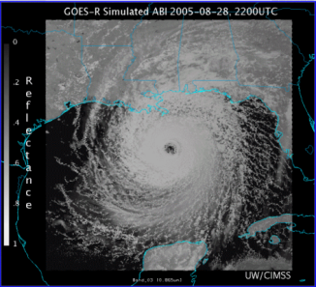
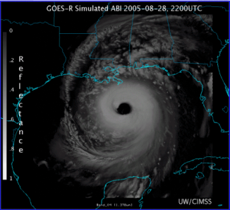
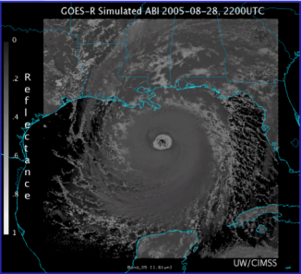
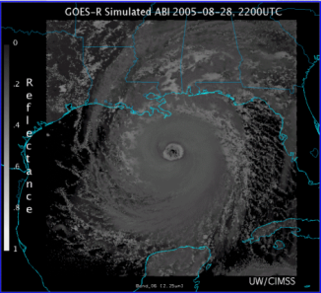
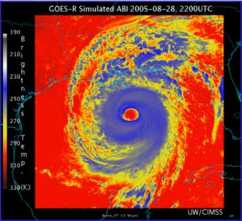
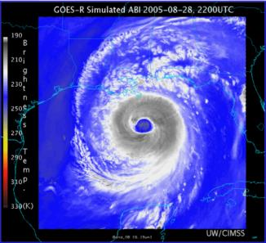
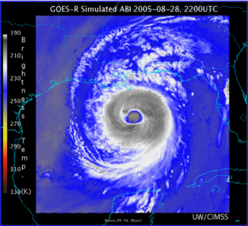
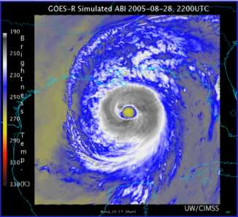
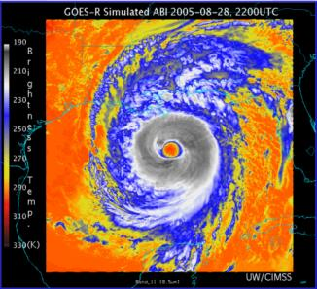
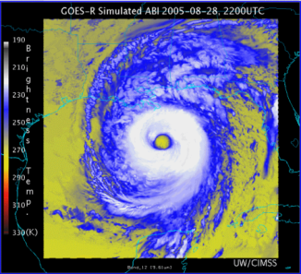
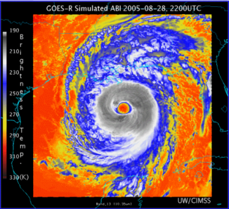
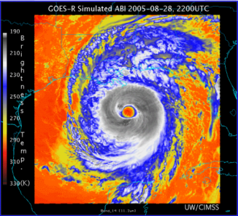
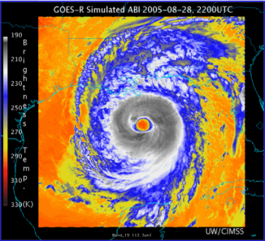
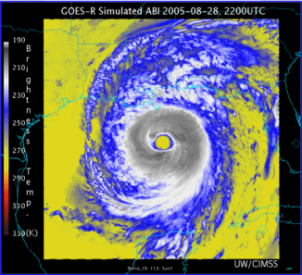
Visible
Visible
Near Infrared
Near Infrared
AWG Proxy ABI Simulations of Hurricane Katrina
Near Infrared
Near Infrared
Infrared
Infrared
NOAA/NESDIS STAR and GOES-R Imagery Team
Infrared
Infrared
Infrared
Infrared
Infrared
Infrared
Infrared
Infrared
Notes:
As shown in mcidas-v

Slide 30
0.47 μm
0.64 μm
0.86 μm
1.38 μm
AWG Proxy ABI Simulations of Hurricane Katrina
1.61 μm
2.26 μm
3.9 μm
6.19 μm
NOAA/NESDIS STAR and GOES-R Imagery Team
6.95 μm
7.34 μm
8.5 μm
9.61 μm
10.35 μm
11.2 μm
12.3 μm
13.3 μm
Notes:
As shown in mcidas-v

Slide 31
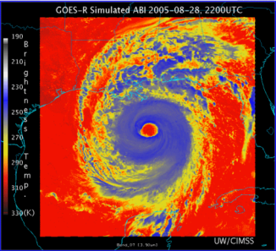
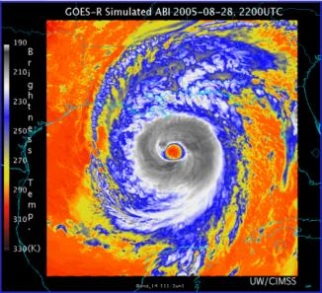
Corresponding current Imager bands of Hurricane Katrina
NOAA/NESDIS STAR

Slide 32
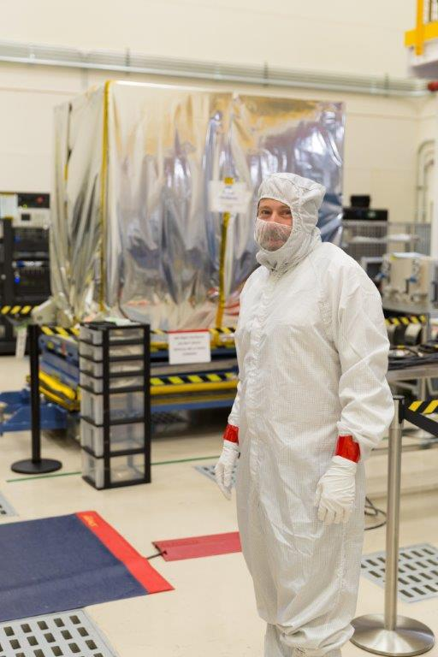
Outline
GOES-R series ABI
Overview
Spectral
Spatial
Temporal
ABS
Summary
Lockheed Martin

Slide 33
MTSAT vs AHI (Spatial)
Rinjani

Slide 34
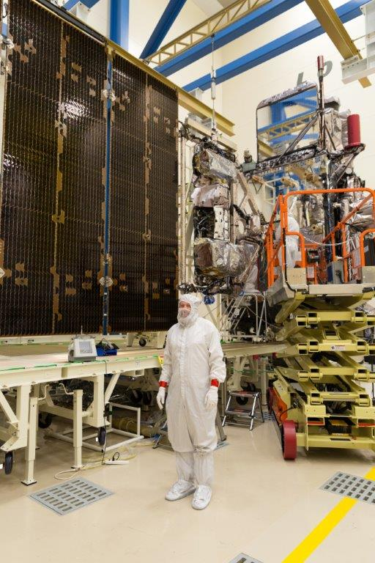
Outline
GOES-R series ABI
Overview
Spectral
Spatial
Temporal
ABS
Summary
Lockheed Martin

Slide 35
Meso-scale box locations are movable
1 min
1 min
5 min
15 min
Notes:
1-km² spatial resolution at satellite nadir. Pixel Areas are approximate. Each bin is rounded to the nearest 1km² until we get to 9.5km² and then all are binned into the red 10+ area. So the first, dark blue, ring covers pixel areas from 1 to 1.49km² and is labeled “1”, above 1.5 to below 2.5km² goes into the next ring and is called “2”, etc. GOES-West location. Proposed CONUS sector, approved by the NWS NOAT. Two meso-scale image sectors shown; these are selectable. The same central lat/lon used for these mesoscales produces a different sized and shaped area for different satellite locations.

Slide 36
Meso-scale box locations are movable
1 min
5 min
1 min
15 min
Notes:
1-km² spatial resolution at satellite nadir. Pixel Areas are approximate. Each bin is rounded to the nearest 1km² until we get to 9.5km² and then all are binned into the red 10+ area. So the first, dark blue, ring covers pixel areas from 1 to 1.49km² and is labeled “1”, above 1.5 to below 2.5km² goes into the next ring and is called “2”, etc. GOES-East location. Proposed CONUS sector, approved by the NWS NOAT. Two meso-scale image sectors shown; these are selectable. The same central lat/lon used for these mesoscales produces a different sized and shaped area for different satellite locations.

Slide 37
1-min imagery
1-min mode (SRSOR from GOES-14)
Operational (GOES-13)

Slide 38
A Glimpse into the Future
ABI-like
Hurricane Sandy from GOES-14 at two temporal resolutions

Slide 39
Outline
GOES-R series ABI
Overview
Spectral
Spatial
Temporal
ABS
Summary
Lockheed Martin

Slide 40
High Spectral Resolution IR
It also should be noted that the ABI was designed to have a companion high-spectral infrared sounder [Advanced Baseline Sounder]. This is why the ABI only has one CO₂ band.
On GOES-R originally called ABS, later HES (with a coastal waters imager).

Slide 41
Why do we need a high spectral resolution sounder?
Analysis courtesy of Justin Sieglaff, CIMSS.
GOES-12 Sounder Bands
Smooths over required absorption lines
Compared to broadband imagers and sounders, observing absorption lines is mandatory to meeting requirements for temperature and moisture structure needed to improve short-term weather forecasting
Many papers document science value of high spectral resolution sounder that support weather forecast needs. (Sieglaff et al., 2009)
Notes:
These are calculated spectra, showing important features dealing with temperature and moisture are in the high-spectral data, but are smoothed over in the broad-band data. Figure courtesy of J. Sieglaff, CIMSS.
I’m not sure it is useful to show an entire spectrum. Rather I prefer to show the above and indicate that it is these little wiggles that make the HES so valuable and that the current GOES smears out.

Slide 42
Improved products could be realized from combinations of ABI and HES (Hyperspectral Environmental Suite) data
Spatial
resolution
Temporal
resolution
Cloud
clearing
ABI
HES
Spectral
coverage
Surface
emissivity
Spectral resolution
circa 2004
HES cancelled in 2006

Slide 43
Outline
GOES-R series ABI
Overview
Spectral
Spatial
Temporal
ABS
Summary
Lockheed Martin

Slide 44
Huge, Great, Epic, Cosmic Progress!
Lockheed Martin

Slide 45
Advanced Baseline Imager Spectral Bands
AHI Band | AHI Approximate Central Wavelength (μm) | ABI Approximate Central Wavelength (μm) | ABI Band | Type | Nickname
1 | 0.47 | 0.47 | 1 | Visible | Blue
2 | 0.51 |  |  | Visible | Green
3 | 0.64 | 0.64 | 2 | Visible | Red
4 | 0.86 | 0.86 | 3 | Near-Infrared | Veggie
 |  | 1.4 | 4 | Near-Infrared | Cirrus
5 | 1.6 | 1.6 | 5 | Near-Infrared | Snow/Ice
6 | 2.3 | 2.2 | 6 | Near-Infrared | Cloud Particle Size
7 | 3.9 | 3.9 | 7 | Infrared | Shortwave Window
8 | 6.2 | 6.2 | 8 | Infrared | Upper-level Water Vapor
9 | 6.9 | 6.9 | 9 | Infrared | Mid-level Water Vapor
10 | 7.3 | 7.3 | 10 | Infrared | Lower-level Water Vapor
11 | 8.6 | 8.4 | 11 | Infrared | Cloud-Top Phase
12 | 9.6 | 9.6 | 12 | Infrared | Ozone
13 | 10.4 | 10.3 | 13 | Infrared | “Clean” Longwave Window
14 | 11.2 | 11.2 | 14 | Infrared | Longwave Window
15 | 12.4 | 12.3 | 15 | Infrared | “Dirty” Longwave Window
16 | 13.3 | 13.3 | 16 | Infrared | CO₂ Longwave
Notes:
Thanks to JMA and Bill Ward and Jordan Gerth.

Slide 46
Summary
The ABI on GOES-R will improve over the current instrument in many aspects:
Spatial, temporal, spectral, calibration, etc.
The great amount of information from the GOES-R will offer a continuation of current products and new products.
Thanks to JMA, Yasuhiko Sumida and SSEC
The ABI builds on previous experience/instruments:
The ABI has already had a long history, even before launch.
Similar imagers by Europe, Japan, Korea, etc.
ABI-like coverage of most of the globe!

Slide 47
Conclusions
The ABI on the GOES-R series continues the critical continuity of geostationary imagers and will have huge positive societal impacts, given its improved temporal, spatial, spectral and radiometric attributes.
Impact areas include, but are not limited to: weather, Numerical Weather Prediction, severe weather, hazards (volcanic ash plumes), aviation, environmental (fires), health (smoke), oceanographic, cryosphere, land, etc.
Part of a global constellation.

Slide 48
Geostationary Imagers: Number of Spectral bands (~ resolution)
Time | Instruments | Visible/NearIR | Infrared (IR)
Late 1950s | N/A | N/A | N/A
1966+ | ATS-1/3 (Spin-Scan Cloud Camera) | 1 (0.1 μm) | N/A
1967+ | ATS-3 (Multicolor Spin-Scan Cloud Camera) | 3 (0.1 μm) | N/A
1974 | ATS-6 (Geosynchronous Very High Resolution Radiometer) | 1 (0.2 μm) | 1 (2 μm)
1974/1975 | SMS-1/2 (Visible Infrared Spin-Scan Radiometer (VISSR)) | 1 (0.15 μm) | 1 (2 μm)
1975+ | GOES-1/3 (VISSR) | 1 (0.2 μm) | 1 (1 μm)
1980+ | GOES-4/7 (VISSR + VAS) | 1 (0.2 μm) | 3 (1 μm)
1994+ | Imager-8/12 + Sounder | 1 (0.2 μm) | 4 (1 μm)
2010+ | Imager-13/15 + Sounder | 1 (0.2 μm) | 4 (1 μm)
2017+ | ABI | 6 (0.1 μm) | 10 (1 μm)
2033?
Large improvements with the ABI!
U.S. Meteorological Imagers
Notes:
Value in parenthesis is approximate 50% width of the visible or IR window.
http://cimss.ssec.wisc.edu/goes/calibration/
Values are approximate.

Slide 49
Geostationary Imagers: Spatial Resolution (approximate)
Time | Instruments | Visible/NearIR | Infrared (IR)
Late 1950s | N/A | N/A | N/A
1966+ | ATS-1/3 (Spin-Scan Cloud Camera) | 4 km | N/A
1967+ | ATS-3 (Multicolor Spin-Scan Cloud Camera) | 4 km | N/A
1974 | ATS-6 (Geosynchronous Very High Resolution Radiometer) | 6 km | 11 km
1974/1975 | SMS-1/2 (Visible Infrared Spin-Scan Radiometer (VISSR)) | 1 km | 8 km
1975+ | GOES-1/3 (VISSR) | 1 km | 8 km
1980+ | GOES-4/7 (VISSR + VAS) | 1 km | 7-14 km
1994+ | Imager-8/12 + Sounder | 1 km | 4-8 km
2010+ | Imager-13/15 + Sounder | 1 km | 4 km
2017+ | ABI | 0.5 – 1 km | 2 km
2033?
Large improvements with the ABI!
U.S. Meteorological Imagers
Notes:
Values are approximate, at satellite sub-points. GOES Imager over-sampling not represented.

Slide 50
Geostationary Imagers: Temporal Resolution
Time | Instruments | Visible/NearIR | Infrared (IR)
Late 1950s | N/A | N/A | N/A
1966+ | ATS-1/3 (Spin-Scan Cloud Camera) | 20 min | N/A
1967+ | ATS-3 (Multicolor Spin-Scan Cloud Camera) | 24 min | N/A
1974 | ATS-6 (Geosynchronous Very High Resolution Radiometer) | 25 min | 25 min
1974/1975 | SMS-1/2 (Visible Infrared Spin-Scan Radiometer (VISSR)) | 20 min | 20 min
1975+ | GOES-1/3 (VISSR) | 30 min | 30 min
1980+ | GOES-4/7 (VISSR + VAS) | 30 min | 30 min
1994+ | Imager-8/12 + Sounder | 7 – 30 min | 7 – 30 min
2010+ | Imager-13/15 + Sounder | 7 – 30 min | 7 – 30 min
2017+ | ABI | 0.5 - 5 - 15 min | 0.5 - 5 - 15 min
2033?
Large improvements with the ABI!
U.S. Meteorological Imagers
Notes:
Values are approximate. Times are routine, not special modes.

Slide 51
Approximate spectral and spatial resolutions of US GOES Imagers
~ Band Center (um) | GOES-1/3 | GOES-4/7 | GOES-8/11 | GOES-12/13 | GOES-13/15 | GOES-R+
0.47
0.64
0.86
1.6
1.38
2.2
3.9
6.2
~6.7 |  | 14km
7.3
8.5
9.7
10.3
11.2
12.3
13.3
Visible
Near-IR
Box size represents pixel size
8
4
2
“MSI mode”
Infrared
Notes:
0.40 inches = 4km; 0.80 inches = 8km
MSI is Multi-Spectral Imaging Mode (dashed boxes)
This does not show other improvements: SNR, MTF, bit-depth, navigation, coverage rates, etc.
ATS and SMS not shown.

Slide 52
Thanks to…
Scott Lindstrom, Paul Menzel, Steven J. Goodman, Daniel T. Lindsey, Robert M. Rabin, Kristopher M. Bedka, John L. Cintineo, Christopher S. Velden, A. Scott Bachmeier, Mat Gunshor, Chris Schmidt, Yasuhiko Sumida
Roger Heymann, Kaba Bah, Joleen Feltz, Tom Whittaker, Jordan Gerth, Margaret Mooney, Andy Heidinger, William Straka, Jun Li, Steve Ackerman, Bob Aune, Don Hillger, Tony Schreiner, Justin Sieglaff, Jim Jung, Elaine Prins, Brad Pierce, Wayne Feltz, Jean Phillips, Linda Hedges, Jim Nelson, Gary Wade, Don Hillger, Jinlong Li, Jing Zheng, Allen Huang, Bob Rabin, the SSEC data center, Mike Pavolonis, Jaime Daniels, ASPB, STAR, NESDIS, NSSL, MUG, Kevin Ludlum, GOES operators, GOES shift supervisors, CWG, PRO, PWG, AWG, PSE, Mark DeMaria, Dave Martin, Bill Ward, SSD chiefs, Joe Schmit, etc!
GOES-R Program Office, Greg Mandt, NASA, Pam Sullivan, Tim Walsh, Exelis Industries, Harris, Lockheed Martin, and other industry partners, JMA, EUMETSAT, CGMS, etc.
You.

Slide 53
Acknowledgements
The authors would like to thank the entire GOES and GOES-R teams; both within the government, industry and academia.
The views, opinions, and findings contained in this presentation are those of the authors and should not be construed as an official National Oceanic and Atmospheric Administration or U.S. Government position, policy, or decision.

Slide 54
Back-up

Slide 55
Web page
www.goes-r.gov

Slide 56
GOES-R ABI Weighting Functions
ABI has 1 CO2 band, so upper-level temperature will be affected

Slide 57
GOES-13 Sounder WFs
The GOES-N sounder has 5 CO₂ bands, more SW bands

Slide 58
Example spectral coverage
Current GOES Sounder spectral coverage and that possible from an advanced high-spectral sounder. The broad-band nature of the current GOES limits the vertical resolution.

Slide 59
The relative vertical number of independent pieces of information is shown. Note that the moisture content is similar between the ABI and the current GOES Sounder. The Sounder does show more temperature information than the ABI. Caveat: Even if two systems have the same number of pieces of information, they may represent different vertical levels. This information content analysis does not account for any spatial or temporal differences.

Slide 60
Meso-scale box locations are movable
1 min
5 min
1 min
15 min
Notes:
1-km² spatial resolution at satellite nadir. Pixel Areas are approximate. Each bin is rounded to the nearest 1km² until we get to 9.5km² and then all are binned into the red 10+ area. So the first, dark blue, ring covers pixel areas from 1 to 1.49km² and is labeled “1”, above 1.5 to below 2.5km² goes into the next ring and is called “2”, etc. GOES-Test location. PUG CONUS sector. Two meso-scale image sectors shown; these are selectable. The same central lat/lon used for these mesoscales produces a different sized and shaped area for different satellite locations.

Slide 61
Next Generation Geo Imagers (multi-spectral (>11), on the order of 1km resolution, ~10 min FD)
2002 – SEVIRI (MSG) Europe
2014 – AHI (Himawari-8) Japan
2016 – ABI (GOES-R) USA
2016 – AGRI (FY4) China
2017 – MSU-GS (Electro-L) Russia
2017 – ABI (GOES-S) USA
2018 – AMI (KOMPSAT-2A) Korea
2019 – FCI (MTG) Europe
202? – anticipated ‘geo-like’ PCW. Canada

