Slide 1


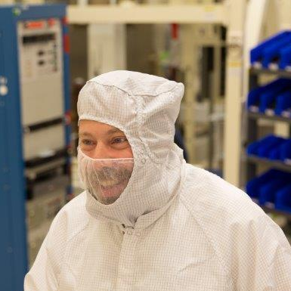


GOES-R ABI
  Timothy J. Schmit (tim.j.schmit@noaa.gov)
NOAA/NESDIS/Satellite Applications and Research
Advanced Satellite Products Branch (ASPB)
Madison, WI
GOES-R Short Course
AMS Annual Meeting
New Orleans, LA
January 10, 2016
UW-Madison

Slide 2

Thanks to…
Scott Lindstrom, Paul Menzel, Steven J. Goodman, Daniel T. Lindsey, Robert M. Rabin, Kristopher M. Bedka, John L. Cintineo, Christopher S. Velden, A. Scott Bachmeier, Mat Gunshor, Chris Schmidt, Yasuhiko Sumida
Kaba Bah, Joleen Feltz, Tom Whittaker, Jordan Gerth, Margaret Mooney, Andy Heidinger, William Straka, Jun Li, Steve Ackerman, Bob Aune, Don Hillger, Tony Schreiner, Justin Sieglaff, Jim Jung, Elaine Prins, Brad Pierce, Wayne Feltz, Jean Phillips, Linda Hedges, Jim Nelson, Gary Wade, Don Hillger, Jinlong Li, Jing Zheng, Allen Huang, Bob Rabin, the SSEC data center, Mike Pavolonis, Jaime Daniels, ASPB, STAR, NESDIS, NSSL, MUG, Kevin Ludlum, GOES operators, GOES shift supervisors, CWG, PRO, PWG, AWG, PSE, Mark DeMaria, Dave Martin, Bill Ward, SSD chiefs, Joe Schmit and many others!
GOES-R Program Office, Greg Mandt, NASA, Pam Sullivan, Tim Walsh, Exelis Industries, Harris, Lockheed Martin, and other industry partners, etc.
You.

Slide 3
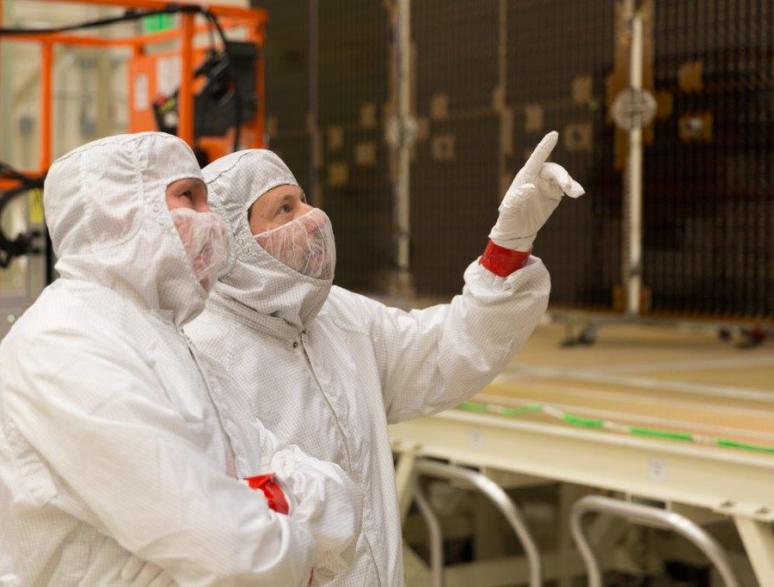
Outline
History
GOES-R ABI
  Spectral
  Spatial
  Temporal
JMA AHI
  Spectral
  Spatial
  Temporal
Summary
Lockheed Martin

Slide 4
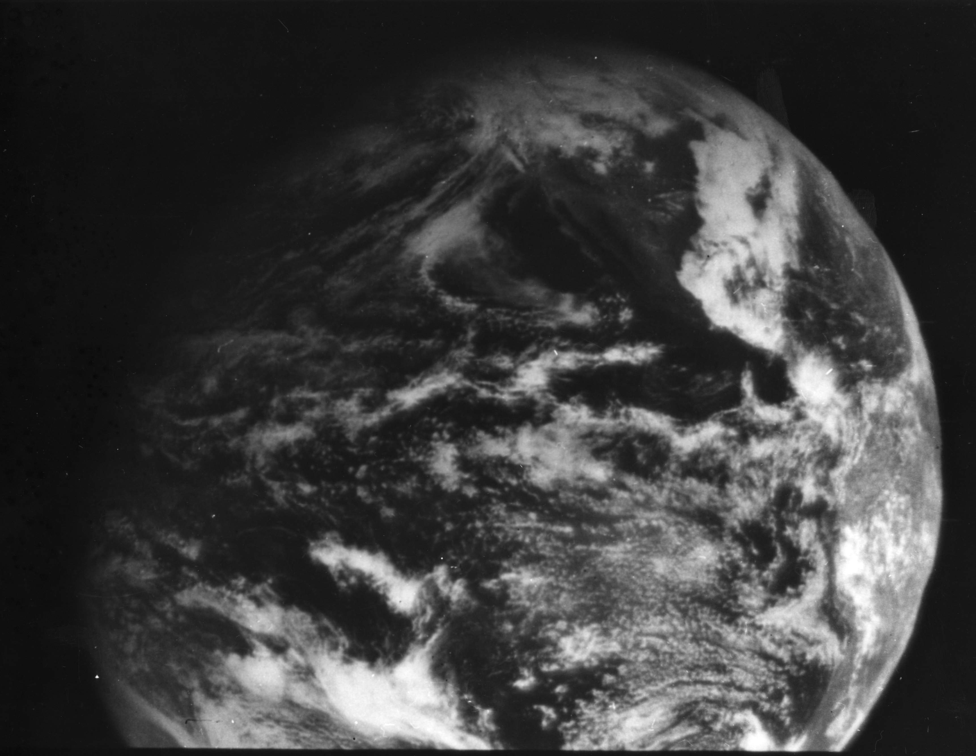
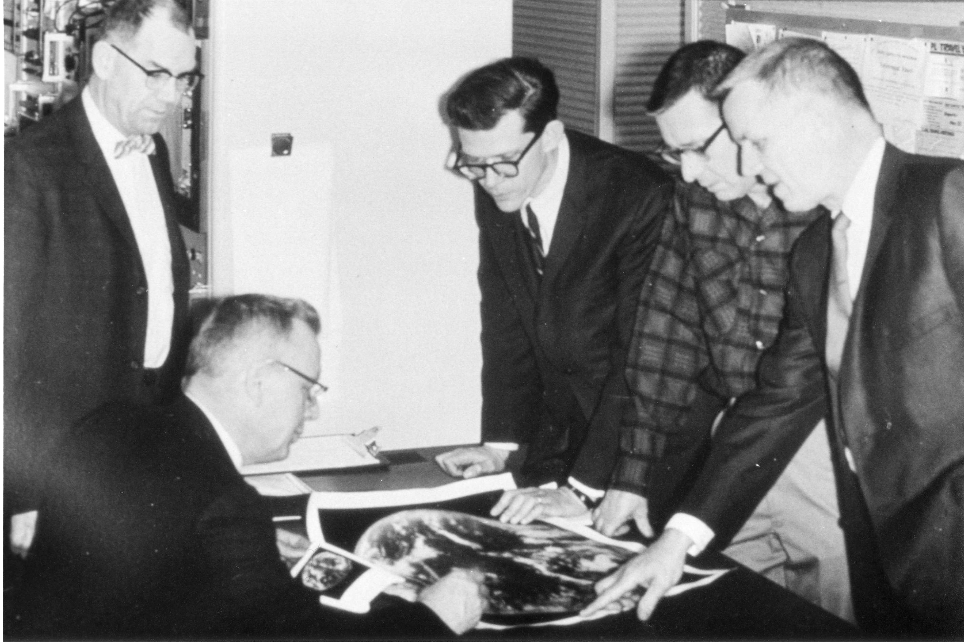
1966: ATS-1 launched
Applications Technology Satellite (ATS)-1 was the first geostationary imager, launched 6 December 1966. Imaging instrument designer and SSEC co-founder, Verner E. Suomi, proclaimed, “the clouds move, not the earth”.
11 December 1966
Notes:
http://cimss.ssec.wisc.edu/news/geo_image_anniversary.html

Slide 5
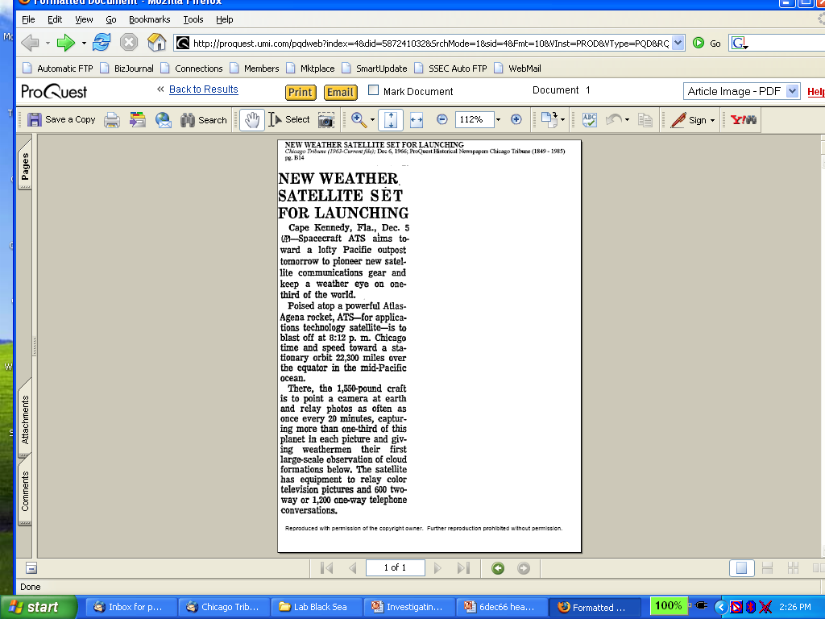
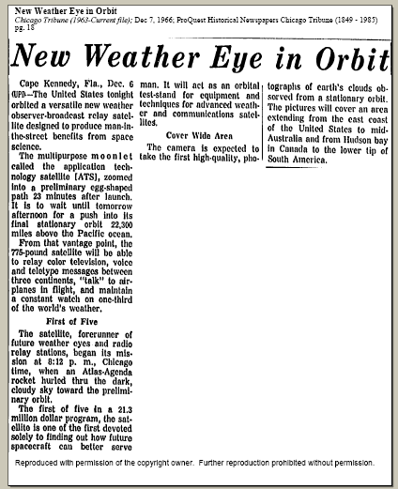
Suomi Introduced Time Continuous Imaging
Chicago Tribune
makes cautious
announcement
on 5 Dec 1966
of pending new
“weather eye”
On 7 Dec 1966 Tribune
declares
“multipurpose moonlet”
successfully launched
Notes:
Slide from Dr. Paul Menzel.

Slide 6
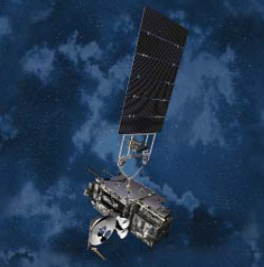
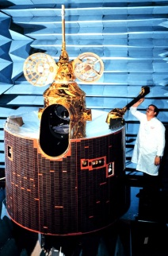
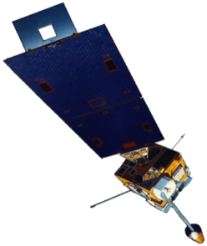
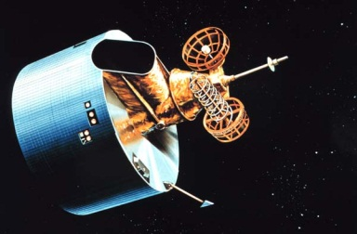
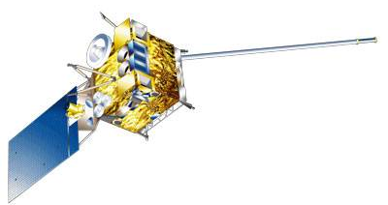
GOES History
GOES-1/3
Launched
1975
1977
1978
One visible and one infrared .
Operational.
GOES-4/7
Launched
1980
1981
1983
1987
VISSR–VAS visible, 12 IR. MSI (visible, IRW, and 2 additional IR channels)
GOES-8/12
Launched
1994
1995
1997
2000
2001
3-axis stabilized.
Imager Bands: 4 IR; 1 visible.
Operational Sounder
(18 IR bands)
GOES-13/14/15
Launched
2005
2009
2010
Better navigation and calibration.
No eclipse outages.
Better spatial resolutions for the 6.5 um on GOES-12+ and the 13.3 um band on GOES-14/15.
Operational Sounder
GOES-R/S/T/U
Planned Launch
2016
2017
2020
2025
Faster coverage.
16 Imager Bands.
Improved spatial.
No sounder.
GLM
Notes:
The circles represent an estimate of the impact of GOES on regional scale numerical models.

Slide 7
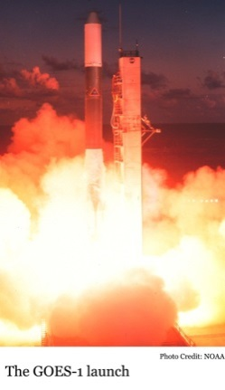
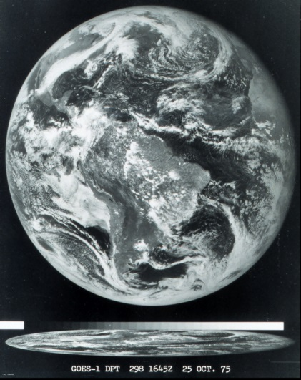
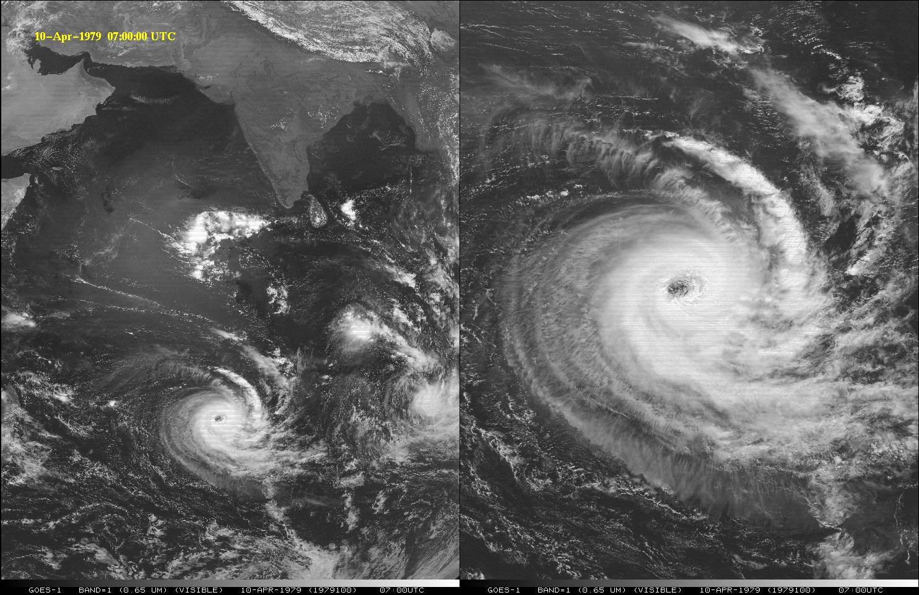
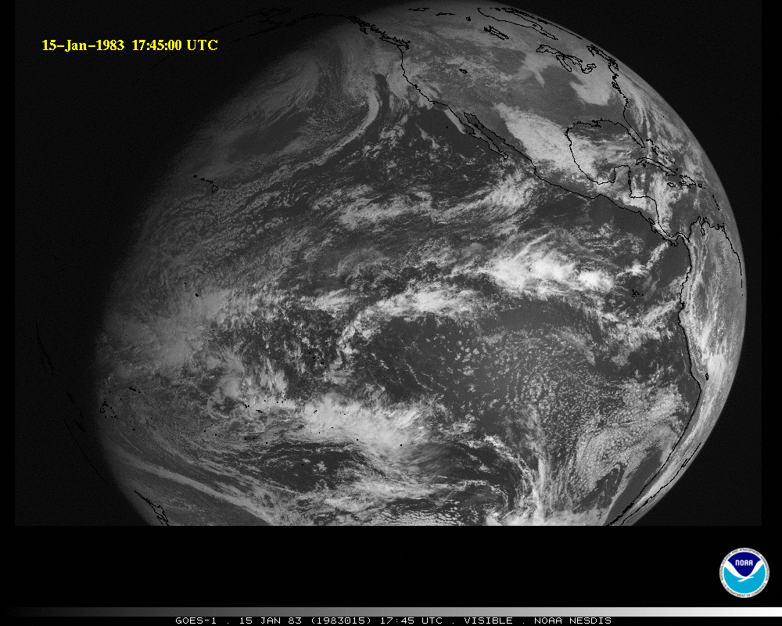
GOES-1 (1975)
GOES-1 launched on 16 October 1975
  One visible and One infrared (IR) band
GOES-1
Notes:
http://science.nasa.gov/missions/sms/

Slide 8
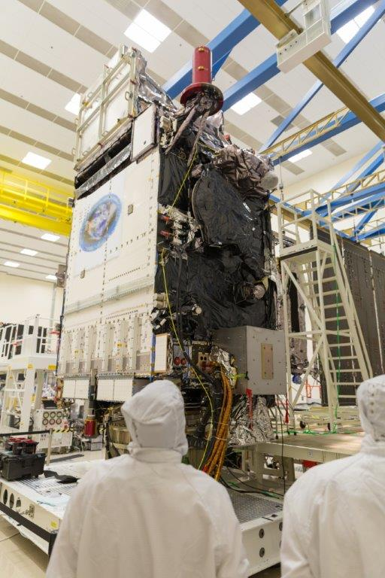
Outline
History
GOES-R ABI
  Spectral
  Spatial
  Temporal
JMA AHI
  Spectral
  Spatial
  Temporal
Summary
Lockheed Martin

Slide 9
The Advanced Baseline Imager:
ABI Current
Spectral Coverage
16 bands 5 bands
Spatial resolution
0.64 μm Visible 0.5 km Approx. 1 km
Other Visible/near-IR 1.0 km n/a
Bands (>2 μm) 2 km Approx. 4 km
Spatial coverage
Full disk 4 per hour Scheduled (3 hrly)
CONUS 12 per hour ~4 per hour
Mesoscale Every 30 sec n/a
Visible (reflective bands)
On-orbit calibration Yes No
Notes:
The ABI allows more bands, finer spatial resolution, faster refresh rates and on-orbit calibration of all bands!

Slide 10
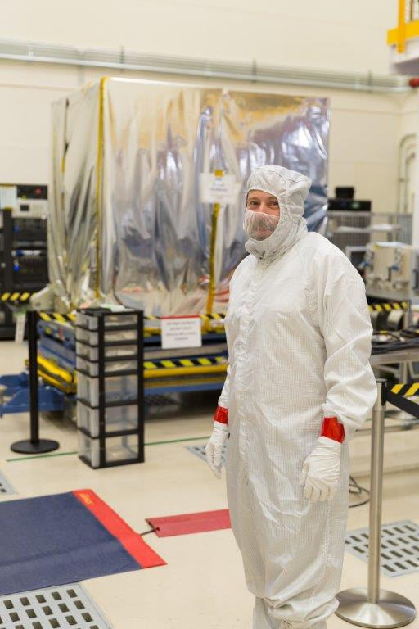

Advanced Baseline Imager
5
4
3
X
Faster coverage
(5-minute full disk vs. 25-minute)
X
Improved spatial
resolution
(2 km IR vs. 4 km)
X
More spectral bands (16 on ABI vs. 5 on the current imager)
Notes:
Slide from J. Gerth, CIMSS.

Slide 11
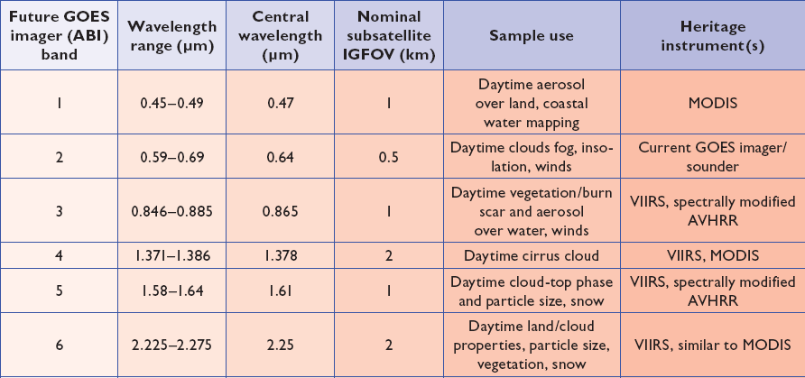
ABI bands 1-6
6 visible or near infrared bands on the ABI, compared to only one on today’s imager
Notes:
Final column added: heritage. The ABI band 1 was suggested by Dr. Fred Mosher at a GOES Users' Conference.
The ABI band 3 was suggested by the late Dr. C. Rao (of the then ORA).
Some of these bands have been shifted to more closely match those on the VIIRS.

Slide 12
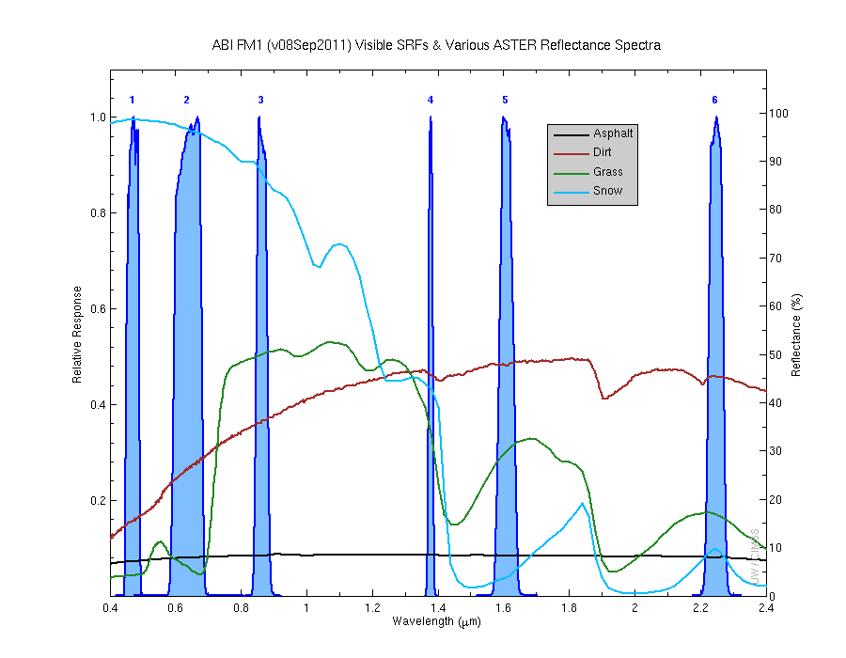
Visible and near-IR channels on the ABI
Aerosols, Insolation
Clouds, Snow
Vegetation, Imagery
Cloud mask, Suspended matter
Snow, Phase
Cloud Particle size
Sample use only, many other uses
The ABI visible and near-IR bands have many uses.
Notes:
Schmit, T. J., M. M. Gunshor, W. P. Menzel, J. J. Gurka, J. Li, and A. S. Bachmeier, 2005: Introducing the next-generation Advanced Baseline Imager on GOES-R. Bull. Amer. Meteor. Soc., 86, 1079-1096.

Slide 13
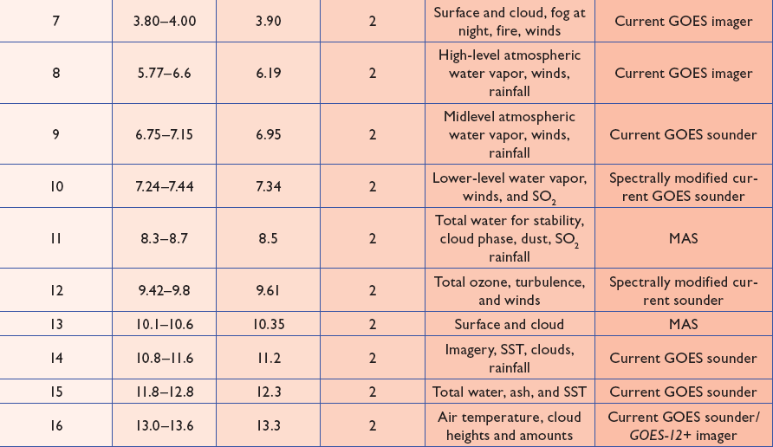
ABI bands 7-16
10 infrared bands on the ABI, compared to four on today’s imager
Notes:
The ABI band 10 was modified to better depict upper-level SO2. (G. Ellrod and others)
The ABI band 11 was suggested by Steve Ackerman (CIMSS), based on HIRS experience.
The ABI band 13 was suggested by W. P. Menzel (then NOAA NESDIS).

Slide 14
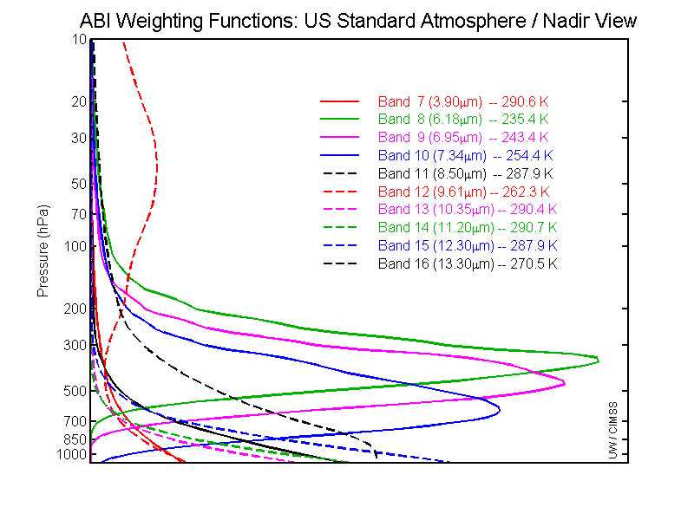
GOES-R ABI Weighting Functions
ABI has 1 CO₂ band, so upper-level temperature will be affected

Slide 15
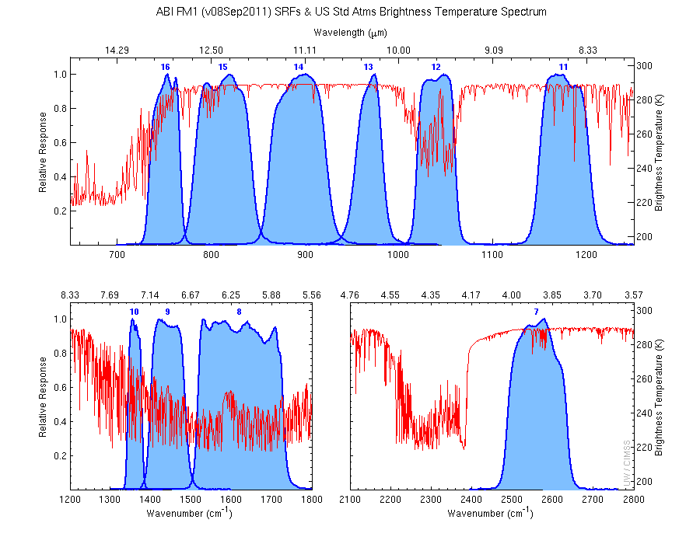
The IR channels on the ABI
Clouds, Stability Indices
SST, Fires, Radiances
Ozone, Downward Radiation
Rainfall, Aerosol
Hurricane, Imagery
Cloud Phase, SST
Sample use only, many other uses
SO2, Radiances
Winds, WV profiling
TPW, Rainfall rate
Fires, Fog
ABI has many more bands than the current operational GOES imagers.
Notes:
Schmit, T. J., M. M. Gunshor, W. P. Menzel, J. J. Gurka, J. Li, and A. S. Bachmeier, 2005: Introducing the next-generation Advanced Baseline Imager on GOES-R. Bull. Amer. Meteor. Soc., 86, 1079-1096.

Slide 16
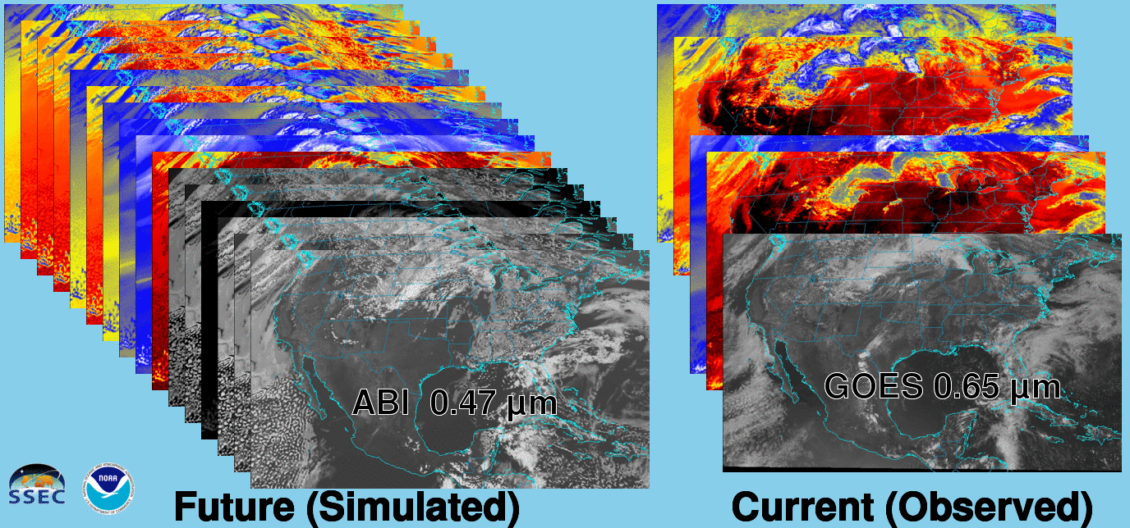
Future vs. Current Spectral Bands
The current GOES (right) has 5 spectral bands, while the GOES-R series ABI (left) will have 16 spectral bands.

Slide 17
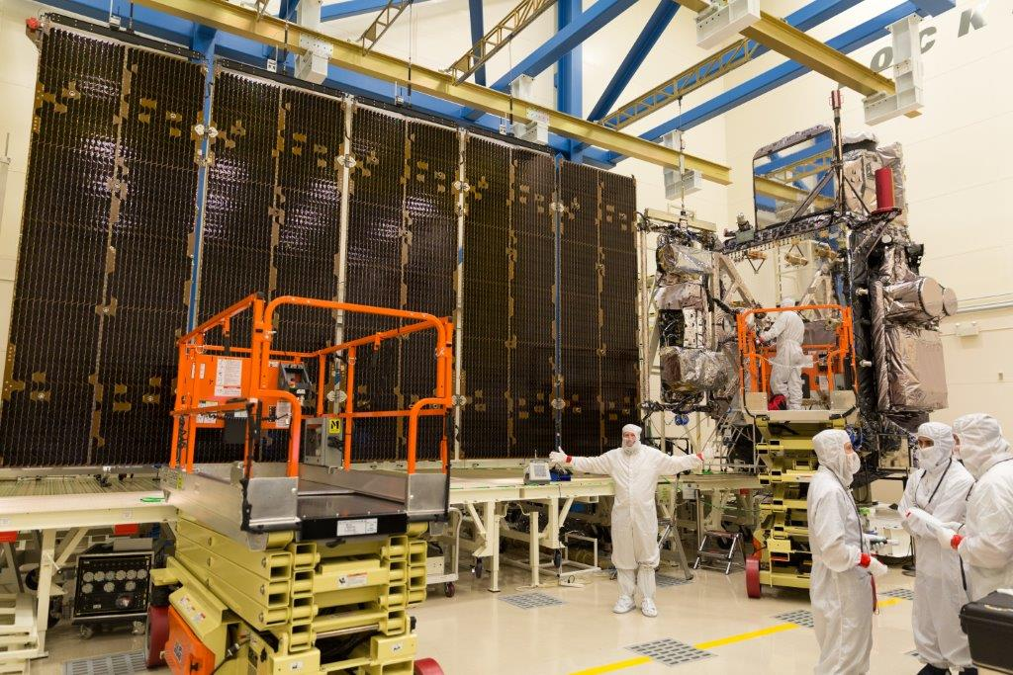
Outline
History
GOES-R ABI
  Spectral
  Spatial
  Temporal
JMA AHI
  Spectral
  Spatial
  Temporal
Summary
Lockheed Martin

Slide 18
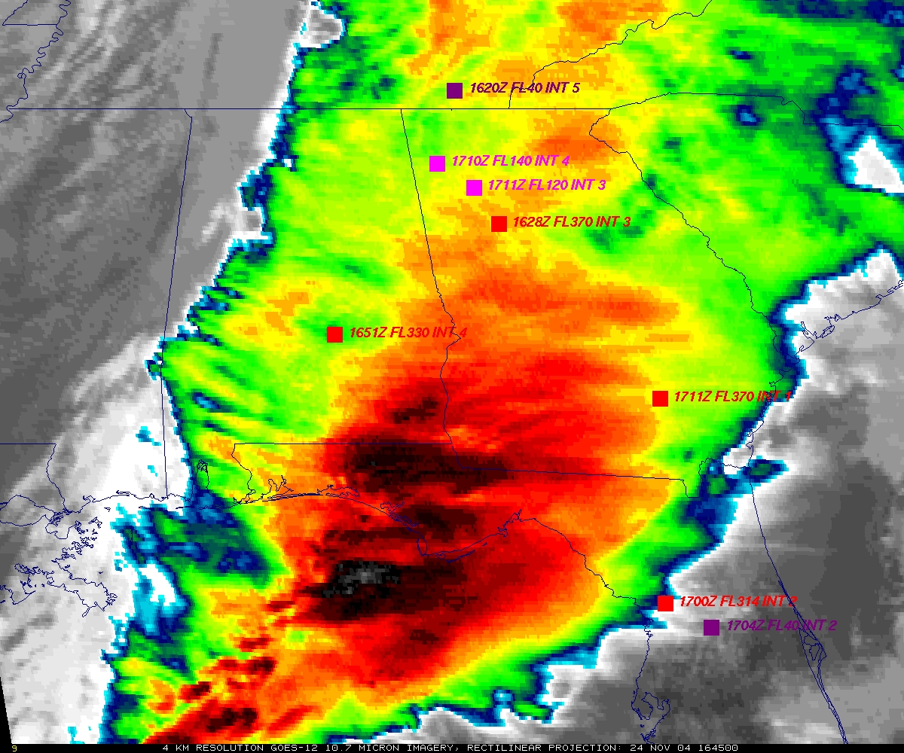
GOES
Figure courtesy of K. Bedka and W. Feltz

Slide 19
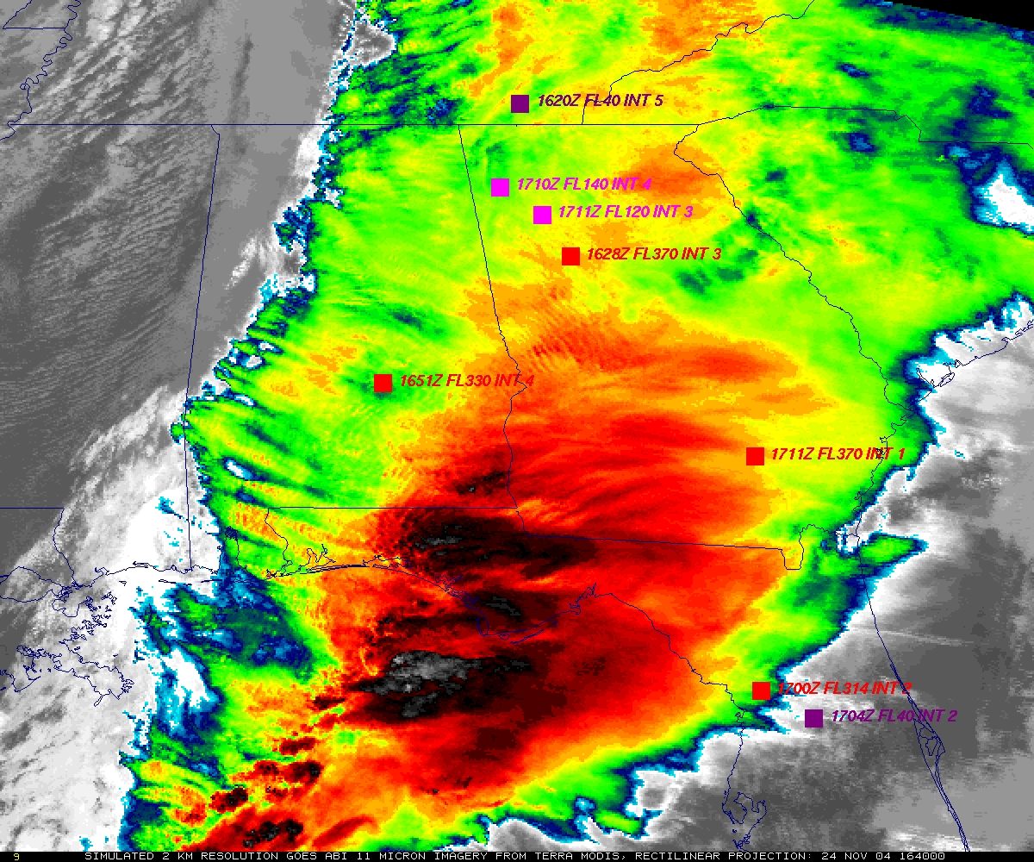
“ABI” from MODIS
Figure courtesy of K. Bedka and W. Feltz

Slide 20
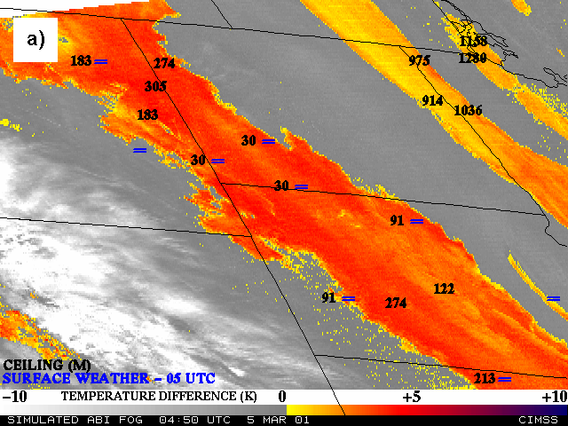
Nocturnal Fog/Stratus Over the Northern Plains
“ABI” 4 minus 11 μm Difference
ABI image (from MODIS) shows greater detail in structure of fog.
Notes:
Note the ABI (from MODIS) image is better spatial resolution and better signal-to-noise ratio then the GOES-10 imager.
Schmit, T. J., M. M. Gunshor, W. P. Menzel, J. J. Gurka, J. Li, and A. S. Bachmeier, 2005: Introducing the next-generation Advanced Baseline Imager on GOES-R. Bull. Amer. Meteor. Soc., 86, 1079-1096.

Slide 21
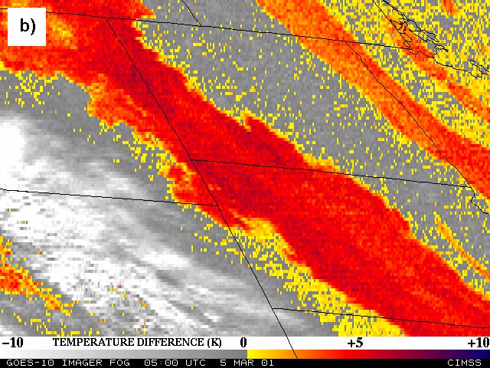
Nocturnal Fog/Stratus Over the Northern Plains
GOES-10 4 minus 11 μm Difference
ABI image (from MODIS) shows greater detail in structure of fog.
Notes:
Schmit, T. J., M. M. Gunshor, W. P. Menzel, J. J. Gurka, J. Li, and A. S. Bachmeier, 2005: Introducing the next-generation Advanced Baseline Imager on GOES-R. Bull. Amer. Meteor. Soc., 86, 1079-1096.

Slide 22
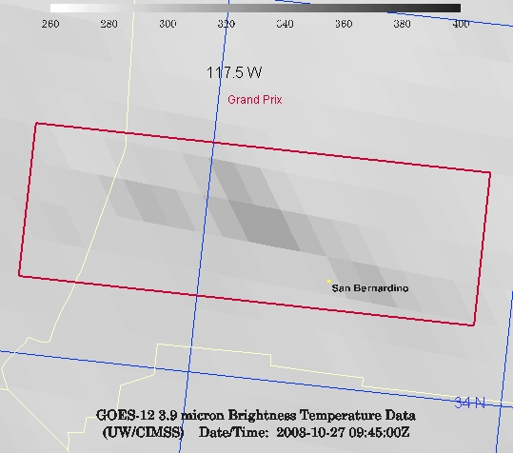
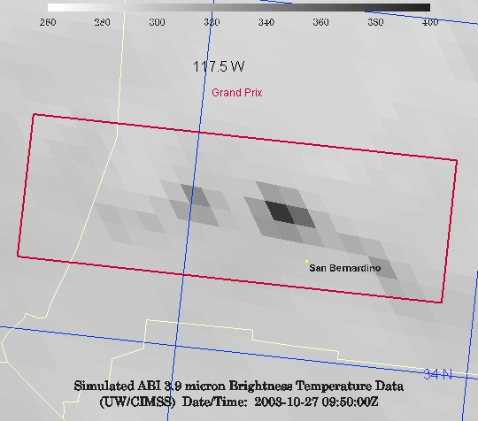
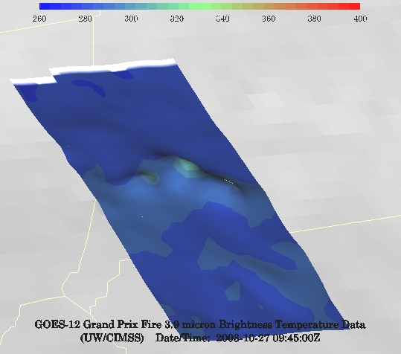
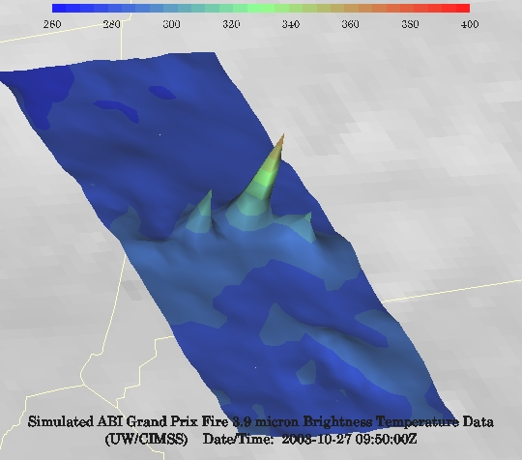
GOES-12 and GOES-R ABI
Simulation of Grand Prix Fire/Southern California
GOES-12
GOES-R ABI
GOES-12
GOES-R ABI
Notes:
Here are two different fires from J. Feltz of CIMSS (using mcidas-v). What we can see is a more defined peak in the higher resolution data and it is easier to pick out individual hotspots. In addition, the higher saturation temperature of the ABI allows us to see that the fire is around 370K. ABI is simulated from MODIS.

Slide 23
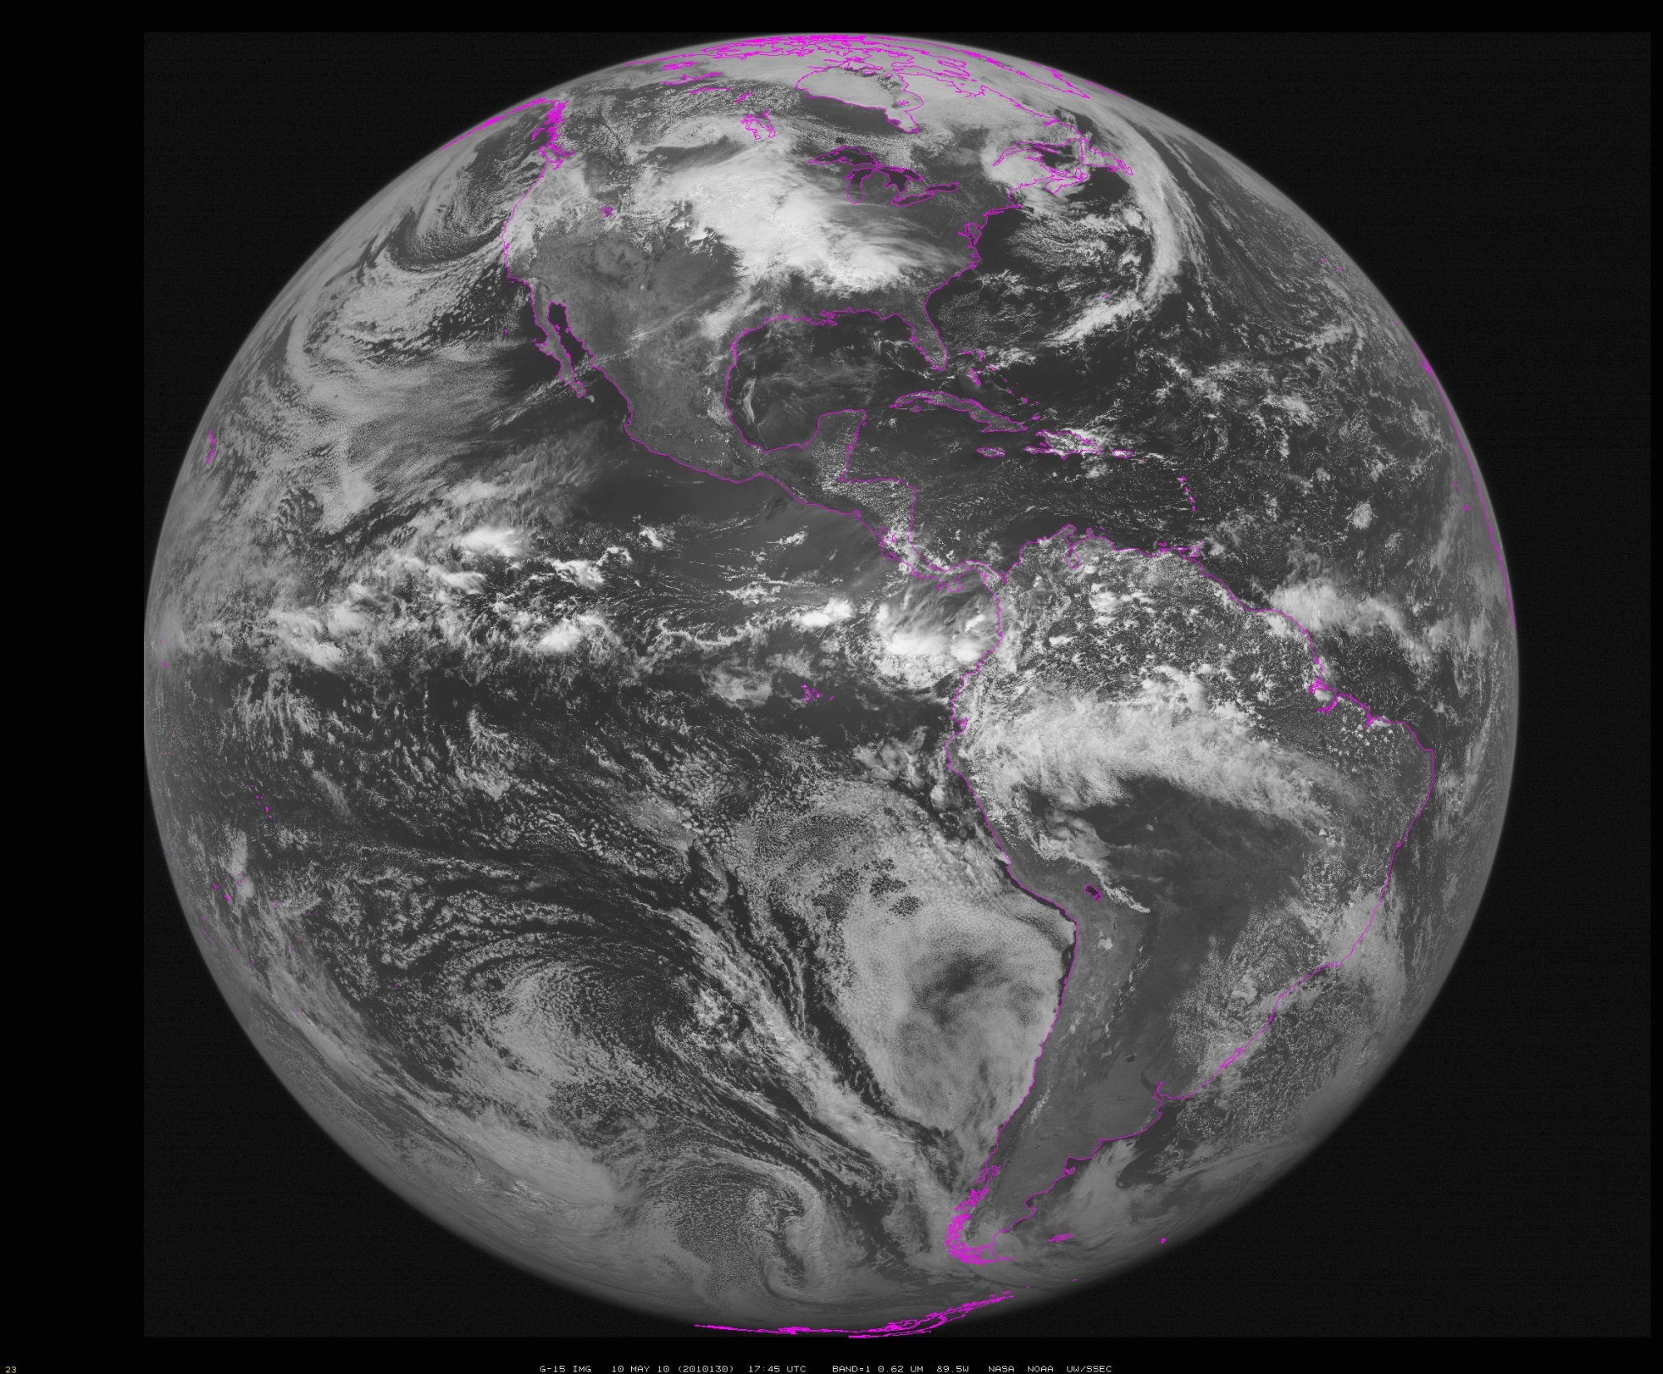
~90W
Notes:
Data from SSEC Data Center

Slide 24
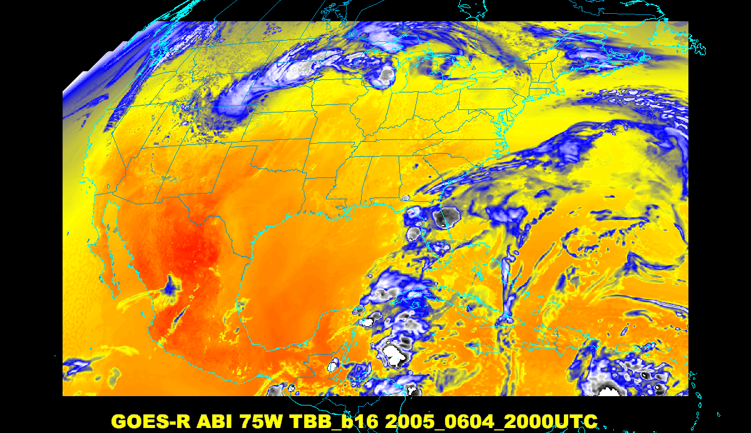
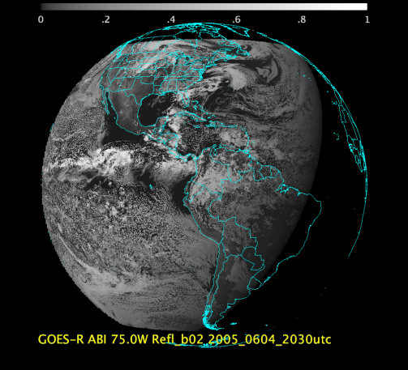
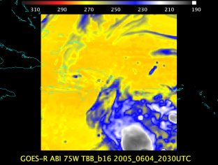
Baseline ABI Scan Modes
Scan mode (3) or ‘flex mode’ for the ABI:
- Full disk every 15 minutes + 5 min CONUS
+ 1-min mesoscales (2 locations).
[Scan mode (4) or ‘Continuous Full Disk’ (CFD) is a full disk every 5 min]
Notes:
CONUS image is the shifted center point.

Slide 25
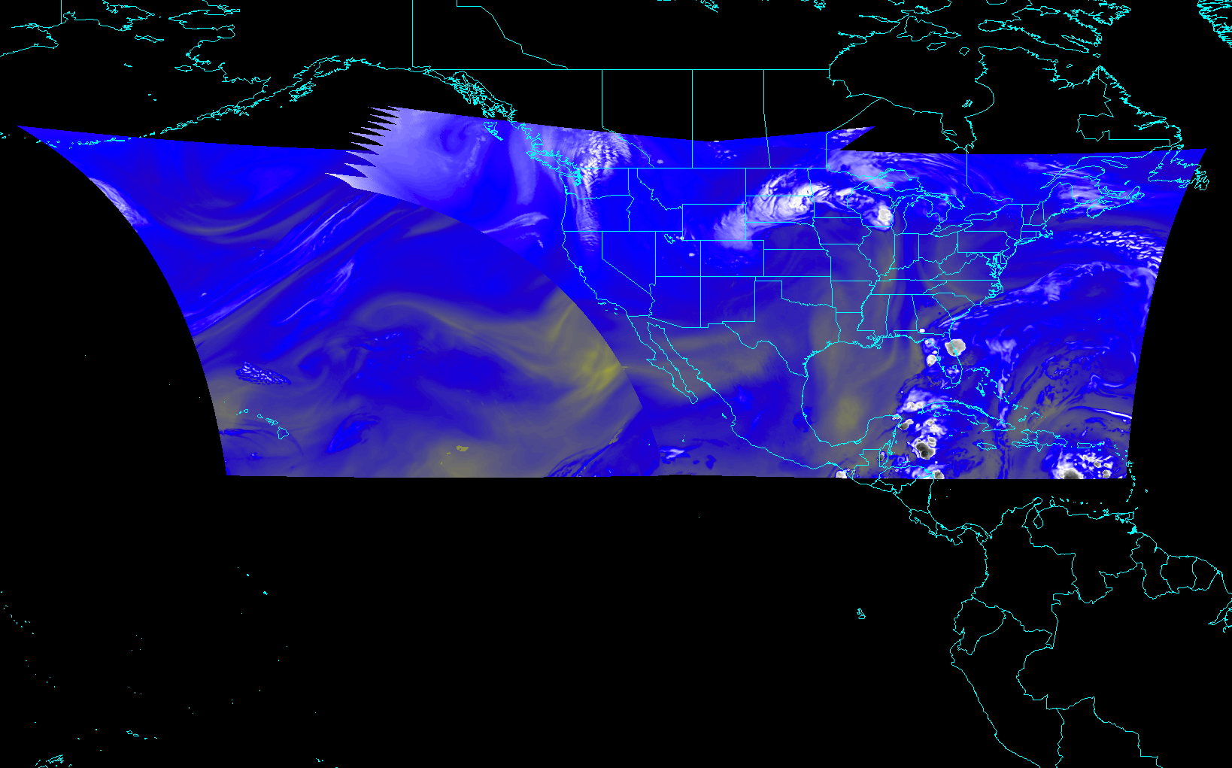
CONUS from East and West (NOAT/GORWG-approved)
Notes:
Different days simulated.

Slide 26
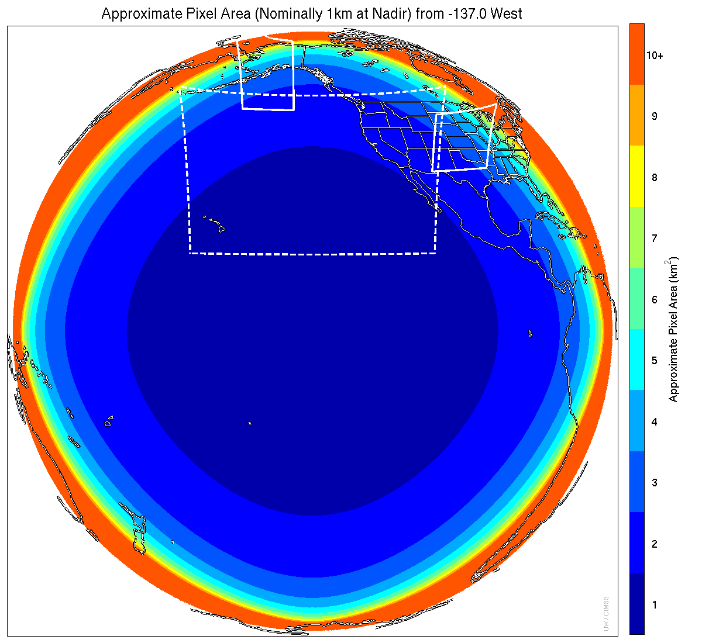
Meso-scale box locations are movable
1 min
1 min
5 min
15 min
Notes:
1-km² spatial resolution at satellite nadir. Pixel Areas are approximate. Each bin is rounded to the nearest 1km² until we get to 9.5km² and then all are binned into the red 10+ area. So the first, dark blue, ring covers pixel areas from 1 to 1.49km² and is labeled “1”, above 1.5 to below 2.5km² goes into the next ring and is called “2”, etc. GOES-West location. Proposed CONUS sector, approved by the NWS NOAT. Two meso-scale image sectors shown; these are selectable. The same central lat/lon used for these mesoscales produces a different sized and shaped area for different satellite locations.

Slide 27
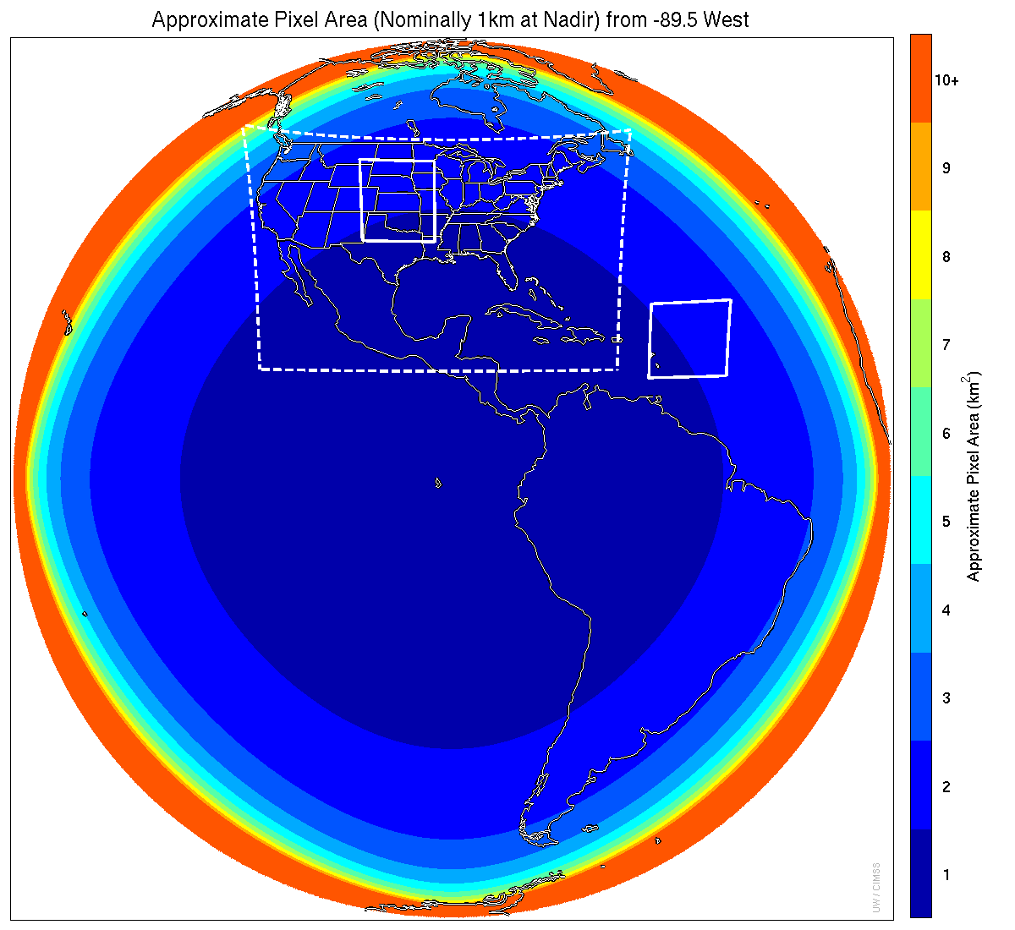
Meso-scale box locations are movable
1 min
5 min
1 min
15 min
Notes:
1-km² spatial resolution at satellite nadir. Pixel Areas are approximate. Each bin is rounded to the nearest 1km² until we get to 9.5km² and then all are binned into the red 10+ area. So the first, dark blue, ring covers pixel areas from 1 to 1.49km² and is labeled “1”, above 1.5 to below 2.5km² goes into the next ring and is called “2”, etc. GOES-Test location. PUG CONUS sector. Two meso-scale image sectors shown; these are selectable. The same central lat/lon used for these mesoscales produces a different sized and shaped area for different satellite locations.

Slide 28
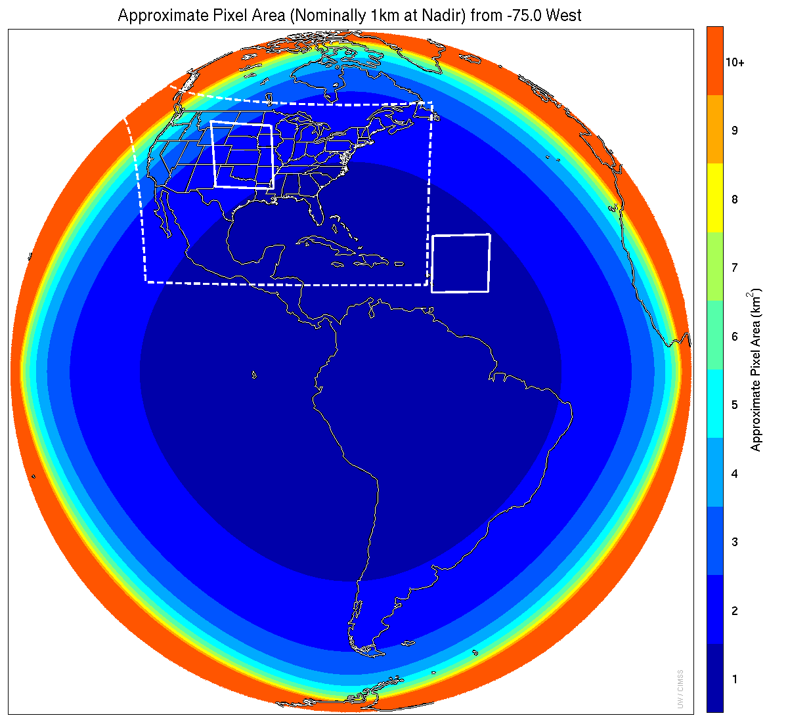
Meso-scale box locations are movable
1 min
5 min
1 min
15 min
Notes:
1-km² spatial resolution at satellite nadir. Pixel Areas are approximate. Each bin is rounded to the nearest 1km² until we get to 9.5km² and then all are binned into the red 10+ area. So the first, dark blue, ring covers pixel areas from 1 to 1.49km² and is labeled “1”, above 1.5 to below 2.5km² goes into the next ring and is called “2”, etc. GOES-East location. Proposed CONUS sector, approved by the NWS NOAT. Two meso-scale image sectors shown; these are selectable. The same central lat/lon used for these mesoscales produces a different sized and shaped area for different satellite locations.

Slide 29
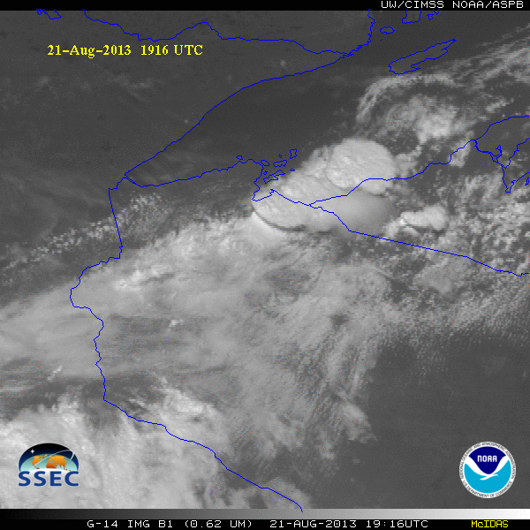
GOES-14 Super Rapid Scan Operations to Prepare for GOES-R (SRSOR)
SRSOR plans for 2015 include May 18-June 12, and August 10-22:
  http://cimss.ssec.wisc.edu/goes/srsor2015/GOES-14_SRSOR.html
  Data during parts of 2012 (Hurricane Sandy, convection), 2013 (CA Rim Fire, convection) and 2014 (Hurricane Marie, convection):
  http://cimss.ssec.wisc.edu/goes/srsor/GOES-14_SRSOR.html
  http://cimss.ssec.wisc.edu/goes/srsor2013/GOES-14_SRSOR.html
  http://cimss.ssec.wisc.edu/goes/srsor2014/GOES-14_SRSOR.html
GOES-14 provided very unique data and offered a glimpse into the possibilities that will be provided by the ABI on GOES-R in one minute mesoscale imagery
GOES-14 visible image showing rapid convective development
Notes:
http://cimss.ssec.wisc.edu/goes/srsor2015/GOES-14_SRSOR.html

Slide 30
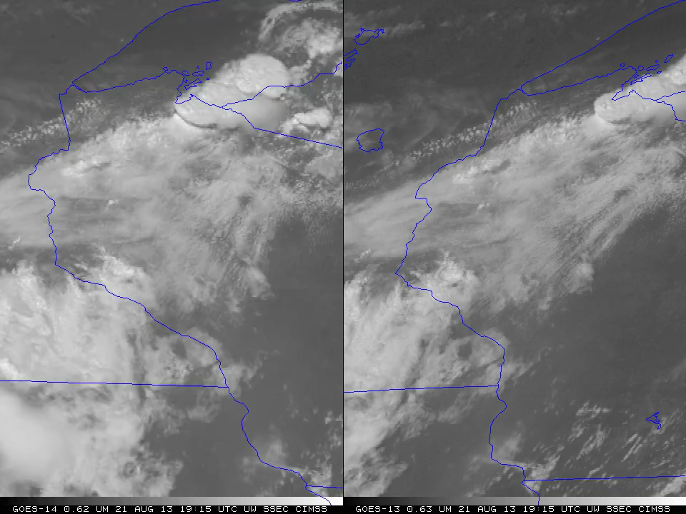
1-min imagery
1-min mode (SRSOR from GOES-14)
Operational (GOES-13)

Slide 31
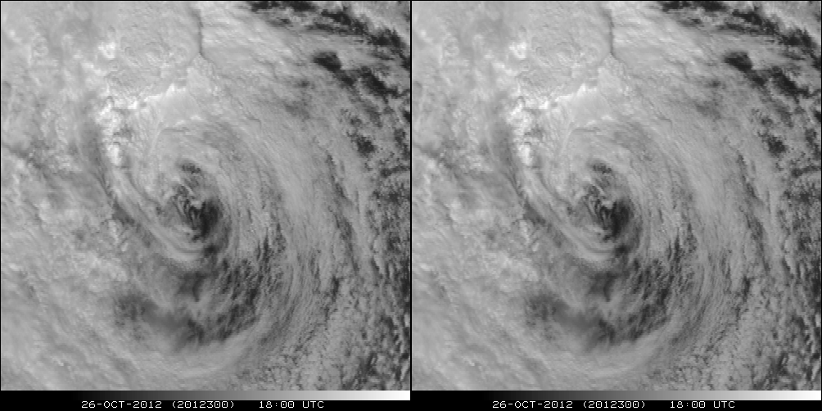
A Glimpse into the Future
ABI-like
Hurricane Sandy from GOES-14 at two temporal resolutions

Slide 32
Recent Mode 3 (Flex mode)
“Time-Time” chart
Note the ‘white’ space is instrument idle time.
DRAFT!!!!!
Notes:
Copy and pasted from excel. Pasted as a picture. Resized to 44% by 44% of original. Arrange -> Align -> Align Center & Align Middle

Slide 33
Baseline Time-Time Mode 4
(Continuous Full Disk)
This is the Continuous Full Disk (every 5 min) mode
This is the highest data rate.

Slide 34
Draft Scan Mode ”6” with 10-min FD
In 10-min:
  1 Full Disk +
  2 CONUS +
  20 Meso-scale
The 10-min Full Disk would offer synergy with other geos and improved AMVs outside of CONUS, plus still allow for meso-scale observations.
This draft mode 6 ideally could be tested during PLPT (Post Launch Products Test).
This mode should be easier to implement at the Ground System, because the scan sectors are the same size/locations as in mode 3.
DRAFT!
Notes:
Copy and pasted from excel. Pasted as a picture. Resized to 44% by 44% of original. Arrange -> Align -> Align Center & Align Middle

Slide 35
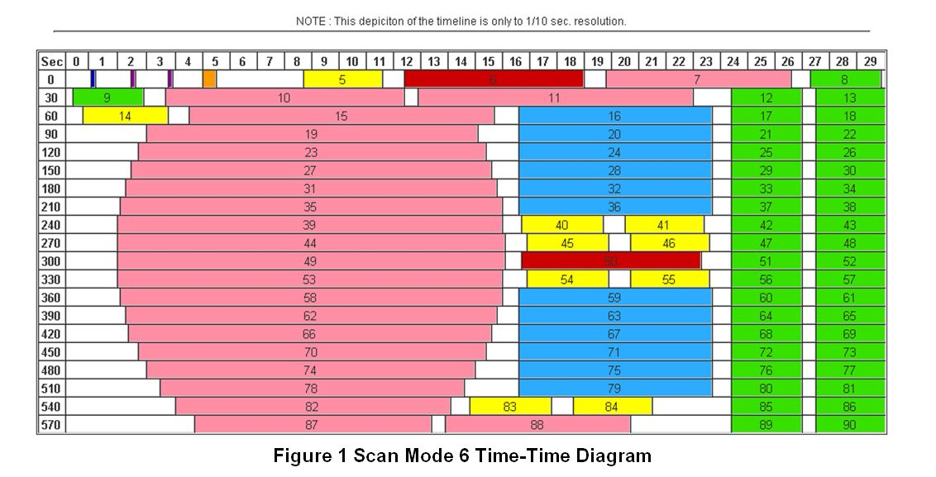
Draft Scan Mode ”6” with 10-min FD
Note less ‘white space’ than scan mode 3 (flex mode)
Time-time diagram from Exelis
Notes:
Copy and pasted from excel. Pasted as a picture. Resized to 44% by 44% of original. Arrange -> Align -> Align Center & Align Middle

Slide 36
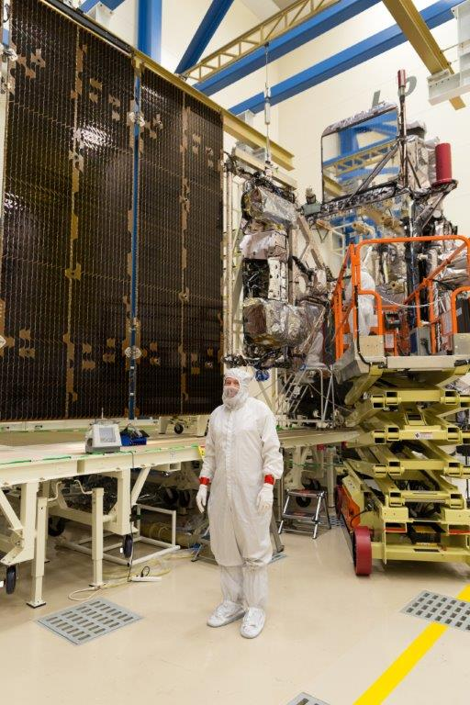
Outline
History
GOES-R ABI
  Spectral
  Spatial
  Temporal
JMA AHI
  Spectral
  Spatial
  Temporal
Summary
Lockheed Martin

Slide 37
Advanced Baseline Imager Spectral Bands
AHI Band | AHI Approximate Central Wavelength (μm) | ABI Approximate Central Wavelength (μm) | ABI Band | Type | Nickname
1 | 0.47 | 0.47 | 1 | Visible | Blue
2 | 0.51 |  |  | Visible | Green
3 | 0.64 | 0.64 | 2 | Visible | Red
4 | 0.86 | 0.86 | 3 | Near-Infrared | Veggie
 |  | 1.4 | 4 | Near-Infrared | Cirrus
5 | 1.6 | 1.6 | 5 | Near-Infrared | Snow/Ice
6 | 2.3 | 2.2 | 6 | Near-Infrared | Cloud Particle Size
7 | 3.9 | 3.9 | 7 | Infrared | Shortwave Window
8 | 6.2 | 6.2 | 8 | Infrared | Upper-level Water Vapor
9 | 6.9 | 6.9 | 9 | Infrared | Mid-level Water Vapor
10 | 7.3 | 7.3 | 10 | Infrared | Lower-level Water Vapor
11 | 8.6 | 8.4 | 11 | Infrared | Cloud-Top Phase
12 | 9.6 | 9.6 | 12 | Infrared | Ozone
13 | 10.4 | 10.3 | 13 | Infrared | “Clean” Longwave Window
14 | 11.2 | 11.2 | 14 | Infrared | Longwave Window
15 | 12.4 | 12.3 | 15 | Infrared | “Dirty” Longwave Window
16 | 13.3 | 13.3 | 16 | Infrared | CO₂ Longwave

Slide 38
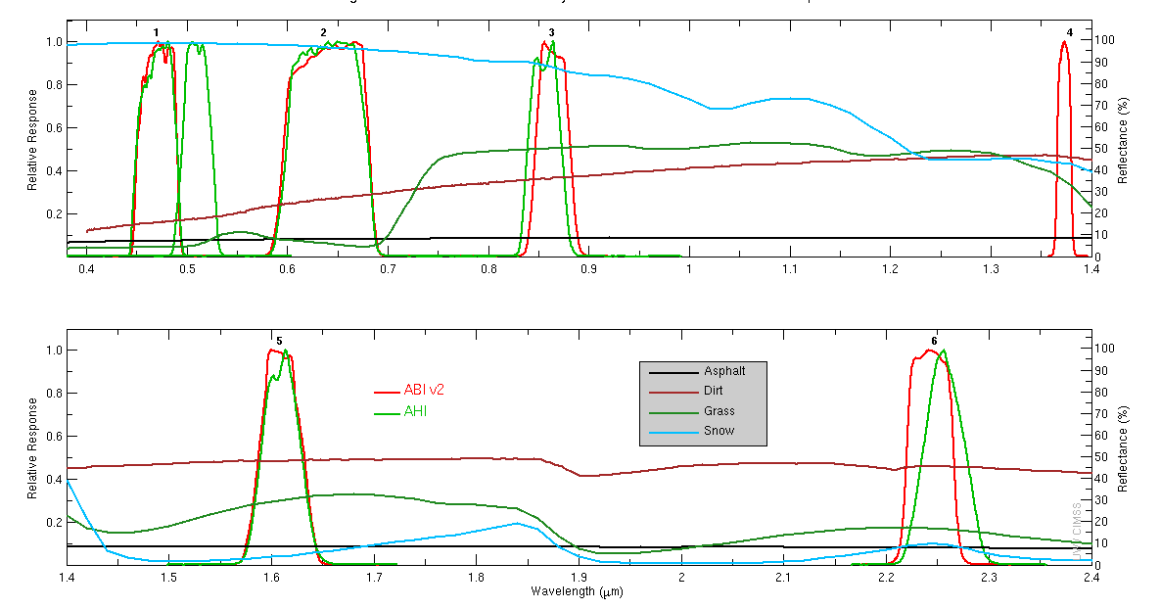
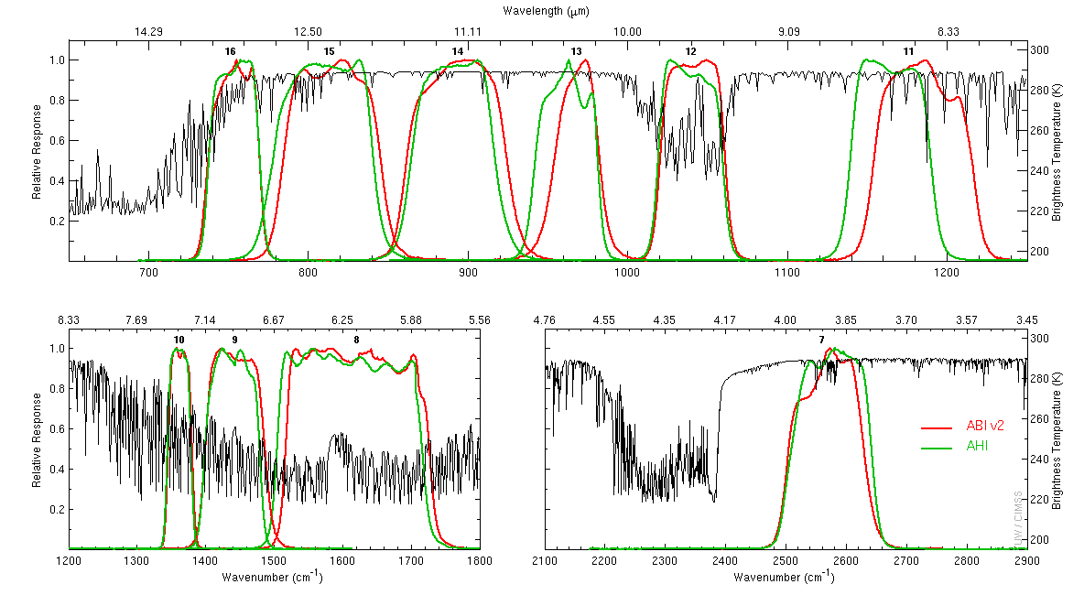
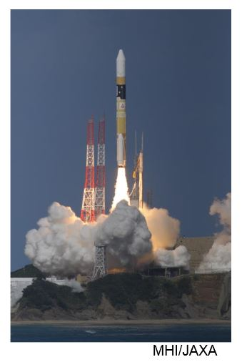
Japan’s Himawari launched and operational
Himawari-8 launched!
7 October 2014
16-band Advanced Himawari Imager (AHI)
10-min Full Disk
ABI-like
  15 of the 16 bands
AHI built by Exelis
Operational by JMA on July 7, 2015.
Visible/near Infrared
Infrared
Notes:
http://www.data.jma.go.jp/mscweb/en/himawari89/

Slide 39
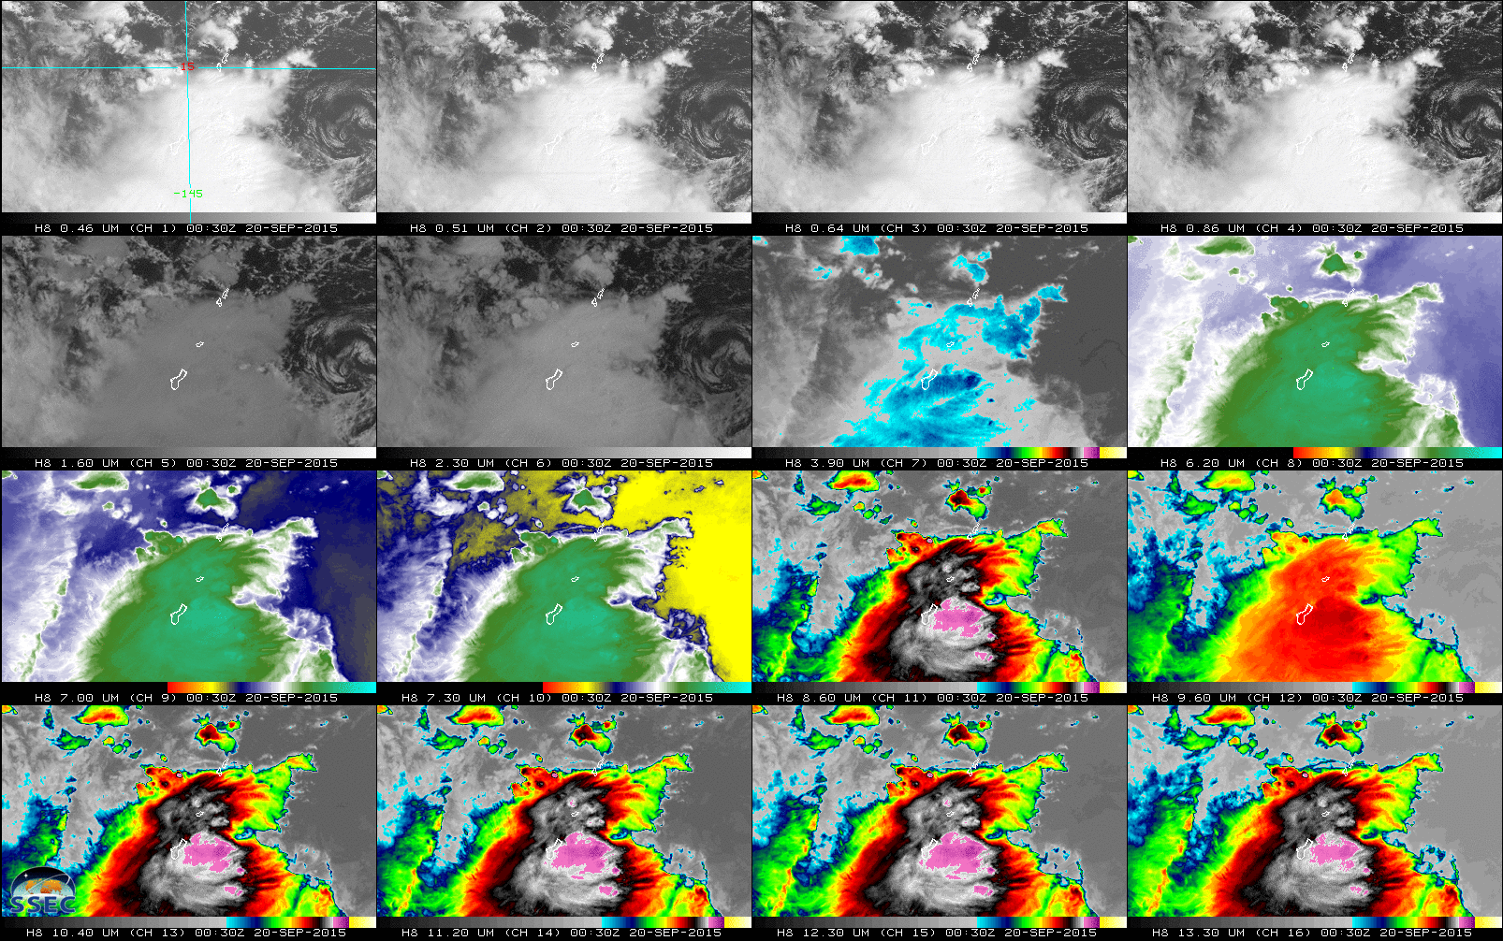
AHI: Spectral (20-September-2015)

Slide 40
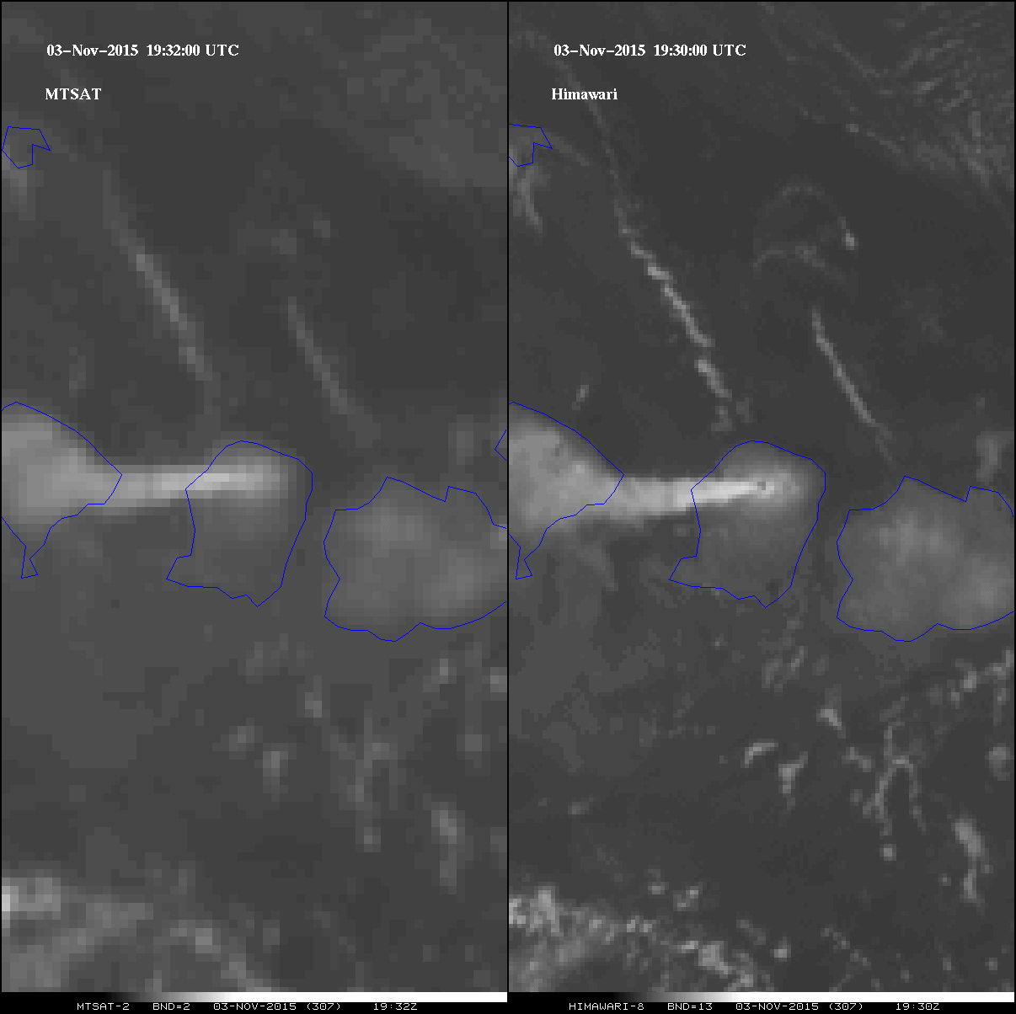
MTSAT vs AHI (Spatial)
Rinjani

Slide 41

MTSAT vs AHI (Temporal)
Manum

Slide 42

Japan’s Advanced Himawari Imager
25-January-2015
02:30 UTC
S. Miller (CIRA) on behalf of the GOES-R AWG Imagery Team

Slide 43

Outline
History
GOES-R ABI
  Spectral
  Spatial
  Temporal
JMA AHI
  Spectral
  Spatial
  Temporal
Summary
Lockheed Martin

Slide 44
Approximate spectral and spatial resolutions of US GOES Imagers
~ Band Center (um) | GOES-1/3 | GOES-4/7 | GOES-8/11 | GOES-12/13 | GOES-13/15 | GOES-R+
0.47
0.64
0.86
1.6
1.38
2.2
3.9
6.2
~6.7 |  | 14km
7.3
8.5
9.7
10.3
11.2
12.3
13.3
Visible
Near-IR
Box size represents pixel size
8
4
2
“MSI mode”
Infrared
Notes:
0.40 inches = 4km; 0.80 inches = 8km
MSI is Multi-Spectral Imaging Mode (dashed boxes)
This does not show other improvements: SNR, MTF, bit-depth, navigation, coverage rates, etc.
ATS and SMS not shown.

Slide 45

Summary
The ABI on GOES-R will improve over the current instrument in many aspects:
  Spatial, temporal, spectral, calibration, etc.
The great amount of information from the GOES-R will offer a continuation of current products and new products.
Thanks to JMA, Yasuhiko Sumida and SSEC
The ABI builds on previous experience/instruments:
  The ABI has already had a long history, even before launch.
Similar imagers by Europe, Japan, Korea, etc.
  ABI-like coverage of most of the globe!

Slide 46



Acknowledgements
The authors would like to thank the entire GOES and GOES-R teams; both within the government, industry and academia.
The views, opinions, and findings contained in this presentation are those of the authors and should not be construed as an official National Oceanic and Atmospheric Administration or U.S. Government position, policy, or decision.

