Slide 1
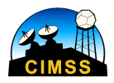
Hands-on exercise showcasing ABI’s 16 channels with improved spatial resolution and temporal refresh rate (plus Weighting Functions and RGB ABI examples) Tim Schmit, Scott Lindstrom, Mat Gunshor, Chris Schmidt, and Jordan Gerth (and others)
http://cimss.ssec.wisc.edu/goes/shortcourse/links.html
http://Tinyurl.com/shortcourse2016

Slide 2
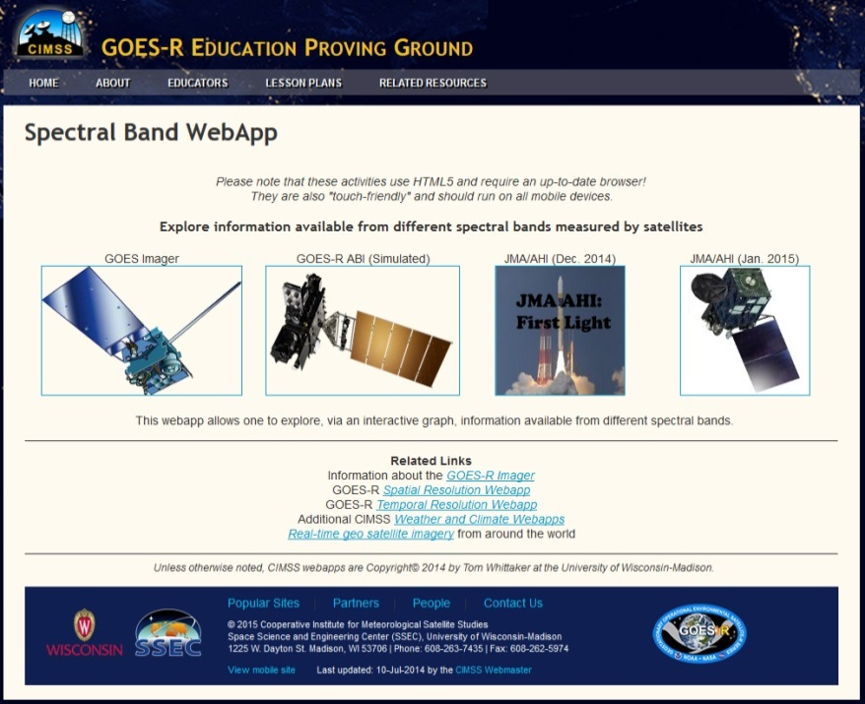
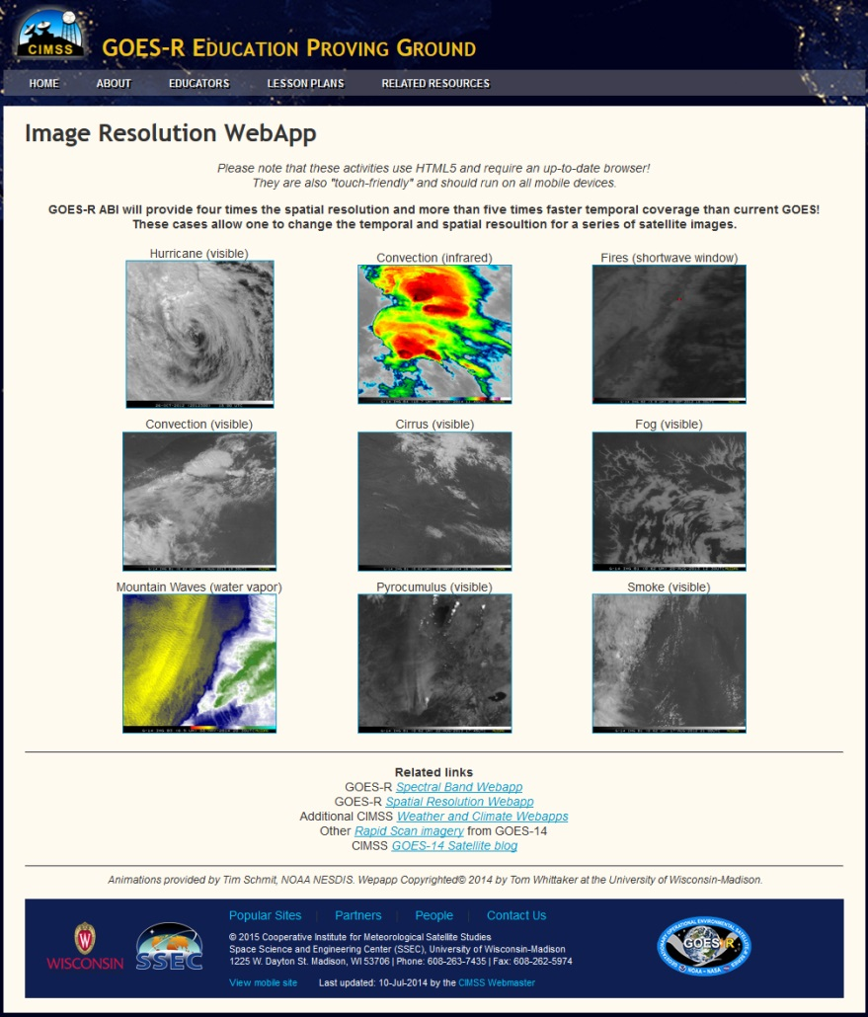
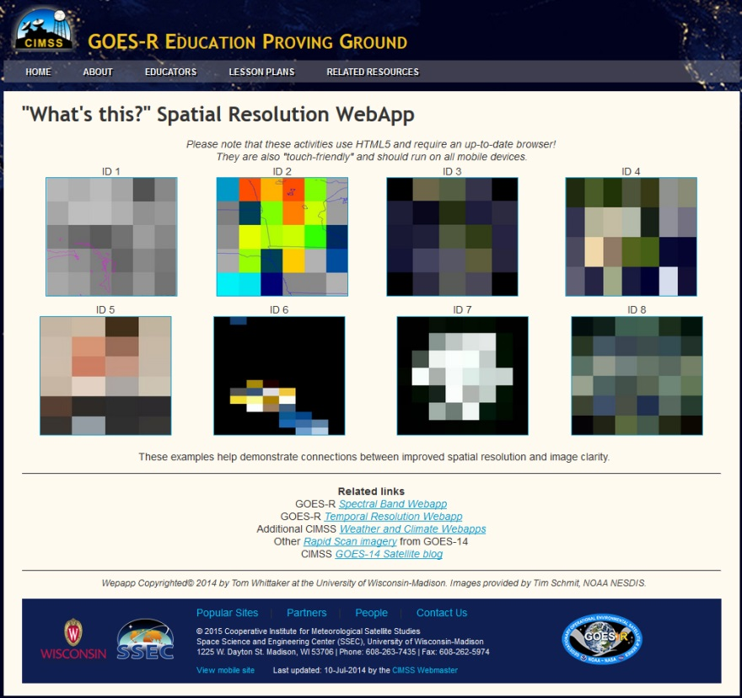
Educational WebApps
http://cimss.ssec.wisc.edu/education/goesr/

Slide 3
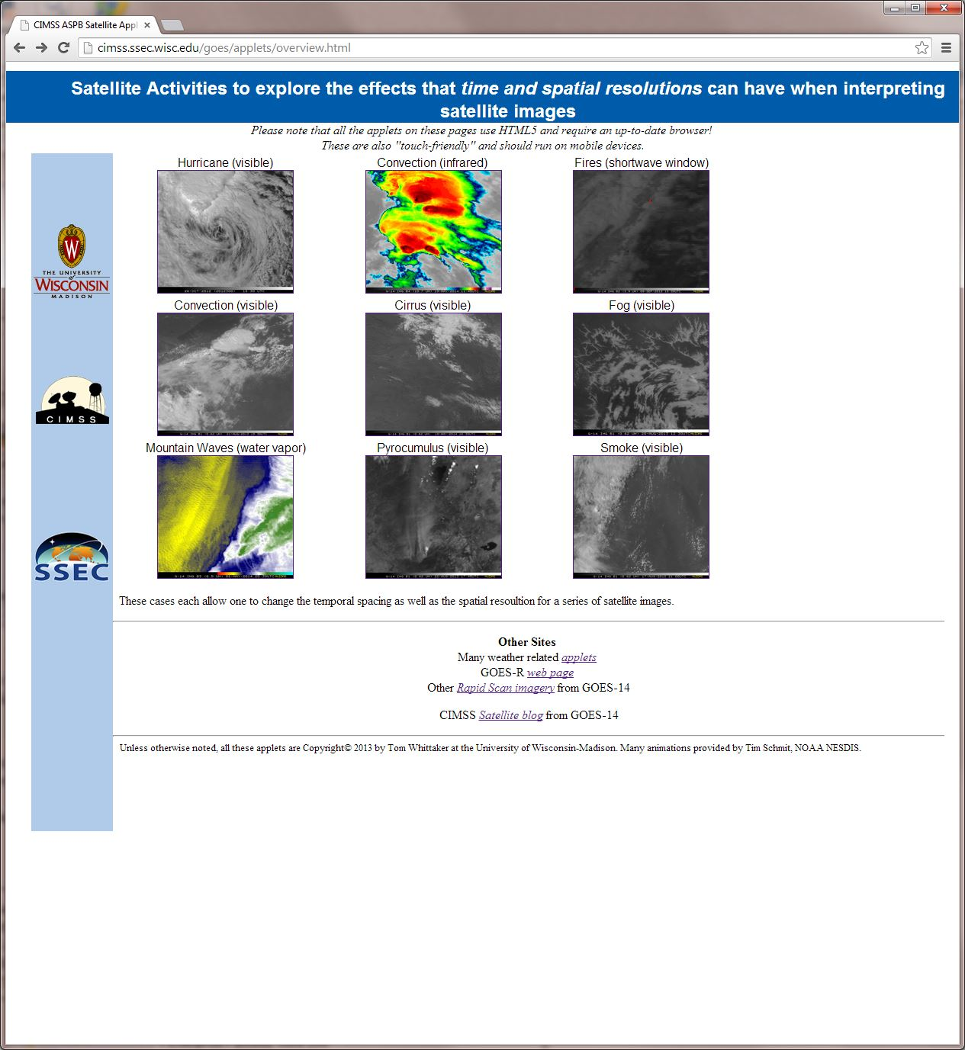
http://cimss.ssec.wisc.edu/goes/applets/overview.html

Slide 4
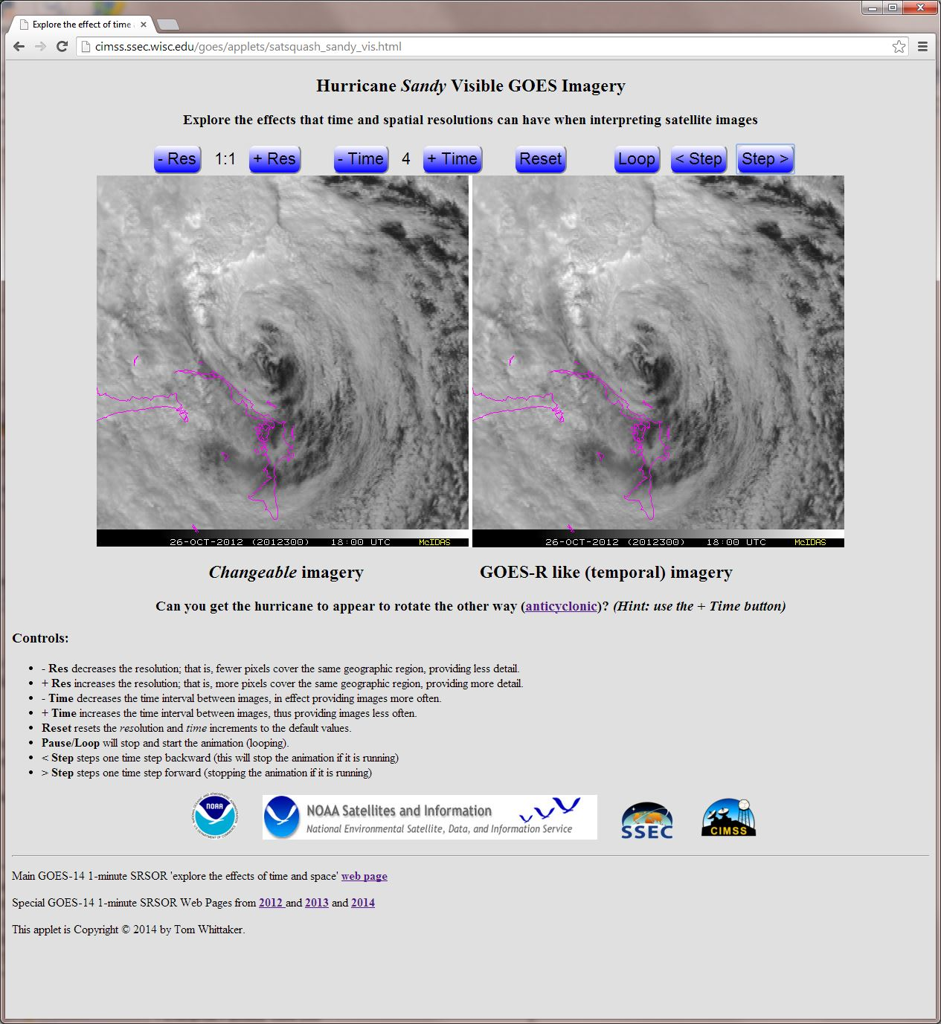

Slide 5
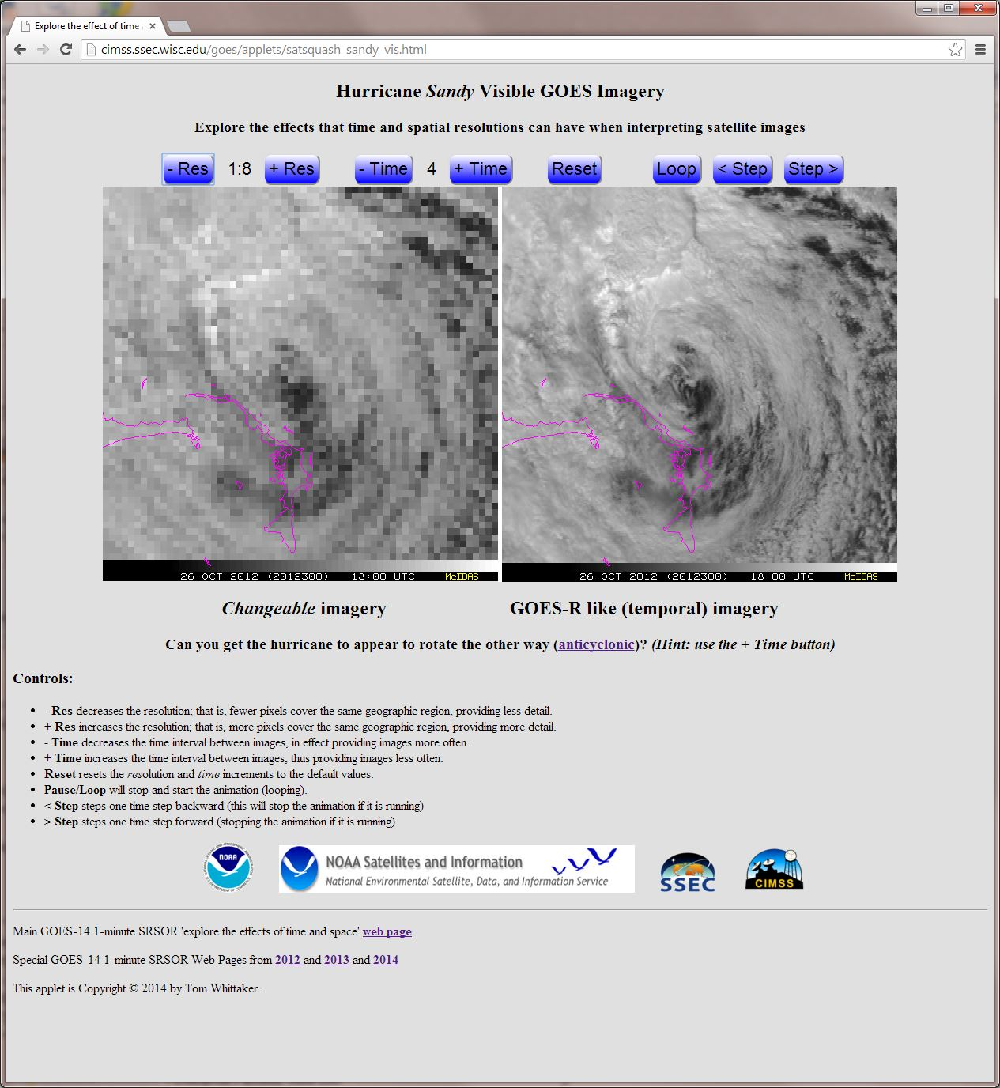

Slide 6
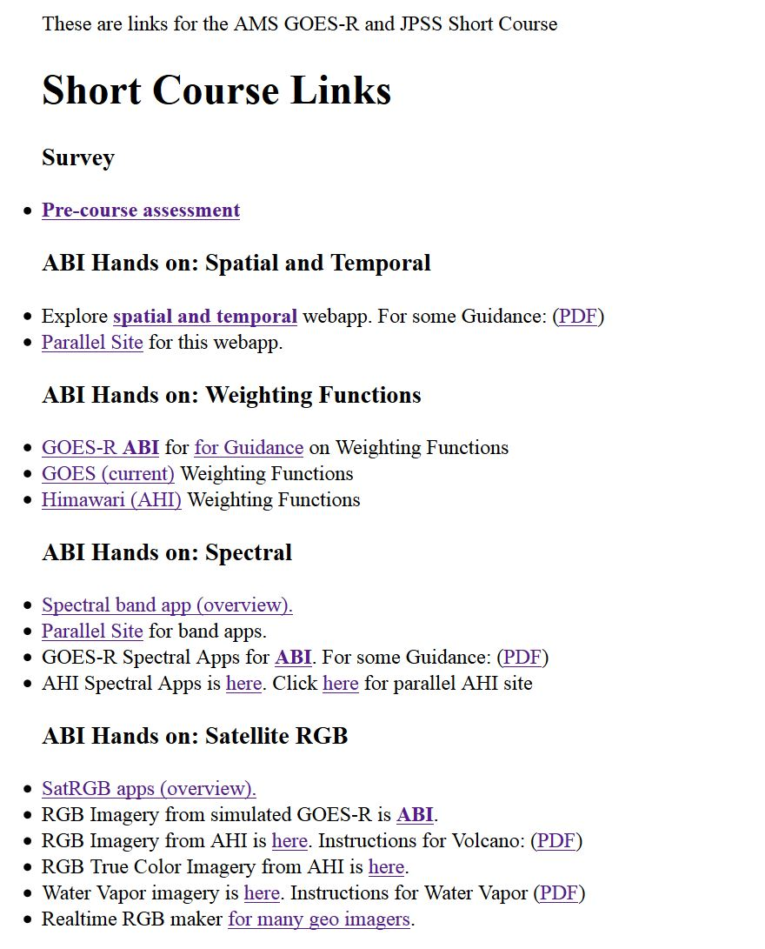
http://cimss.ssec.wisc.edu/goes/shortcourse/links.html
or
http://Tinyurl.com/shortcourse2016
Explore an example, what might advantages of high time observations be?
Note: The main purpose is to introduce the tools, they can be further explored later.

Slide 7
Weighting Functions
How the transmittance varies with height
The layer of the atmosphere observed by a given spectral band
Depends on the band, input temperature, moisture, ozone profiles, skin temperature, surface emissivity, plus the view (zenith) angle.
Clear-sky fast forward calculations
A surface emissivity value of 1 is used for each band.

Slide 8
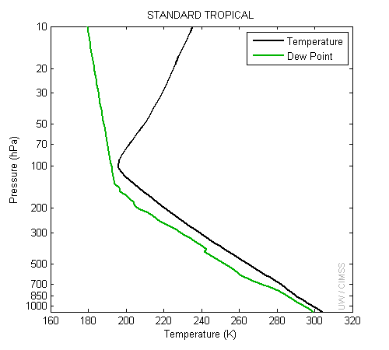
Temperature and moisture profiles

Slide 9
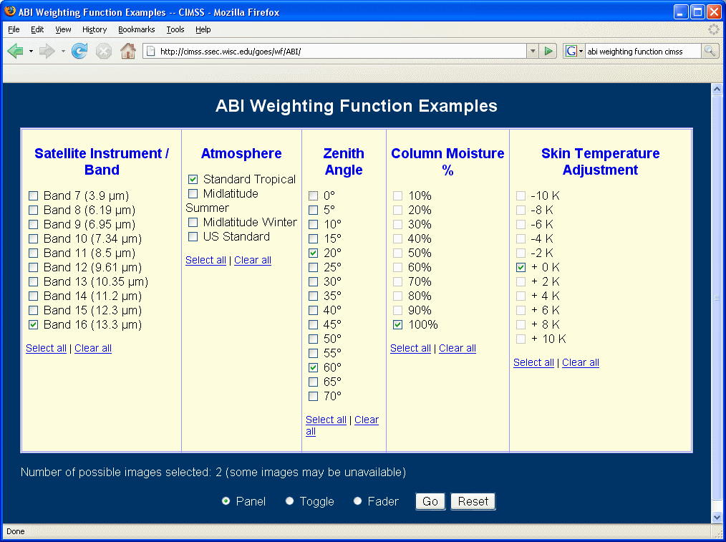
ABI Clear-sky Weighting Functions

Slide 10
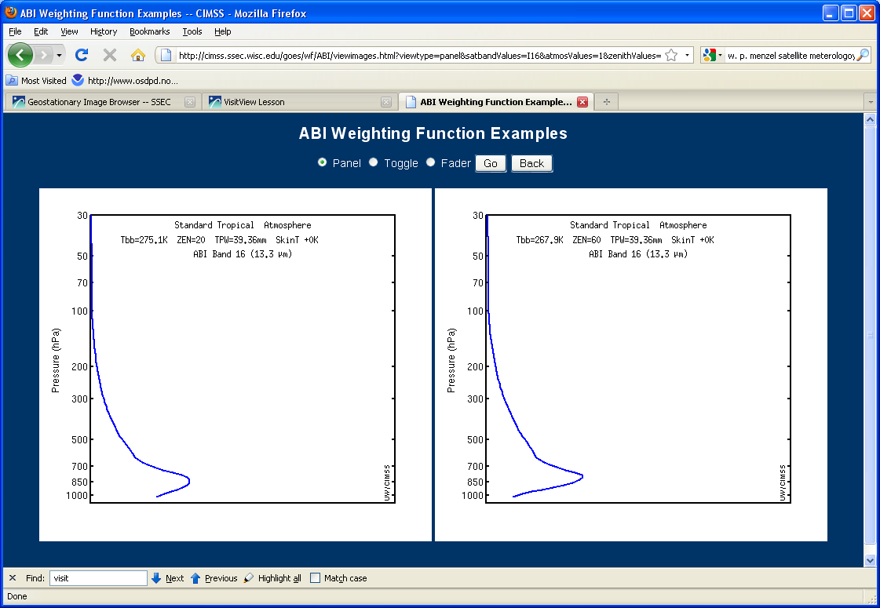
http://cimss.ssec.wisc.edu/goes/wf/ABI/

Slide 11
http://cimss.ssec.wisc.edu/goes/shortcourse/links.html
or
http://Tinyurl.com/shortcourse2016
How does view angle affect the brightness temperature?
Note: The main purpose is to introduce the tools, they can be further explored later.

Slide 12
Educational Spectral Webapp
NOAA NESDIS ASPB teamed up with CIMSS researchers to develop several educational WebApps to explore space, time and spectral resolutions of satellite imagery.
Part of the GOES-R Educational Proving Ground at CIMSS:
http://cimss.ssec.wisc.edu/education/goesr
Teacher feedback: “…. Wow!! This is awesome!! This is impressive. Thank you for sharing. This is great. Thanks for all your hard work and help!!!! We are honored and will use it next week … Earth SySTEM Teacher Academy”
Sample interactive “Bandapp” educational webapp using simulated ABI images:
http://cimss.ssec.wisc.edu/goes/webapps/bandapp/
Notes:
Tim Schmit, ASPB
https://ams.confex.com/ams/95Annual/webprogram/Paper265203.html ABI = Advanced Baseline Imager
Other new webapps: one to change both the spatial and temporal sampling and the other only the pixel sampling

Slide 13
http://cimss.ssec.wisc.edu/goes/shortcourse/links.html
or
http://Tinyurl.com/shortcourse2016
Explore an example, pick a case.
Turn on the “interactive chart”
What’s the general relationship between the visible and IR bands?
Note: The main purpose is to introduce the tools, they can be further explored later.

Slide 14
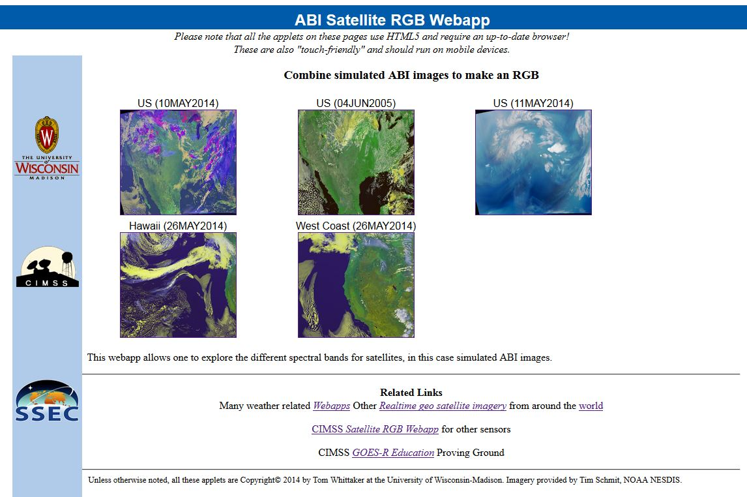
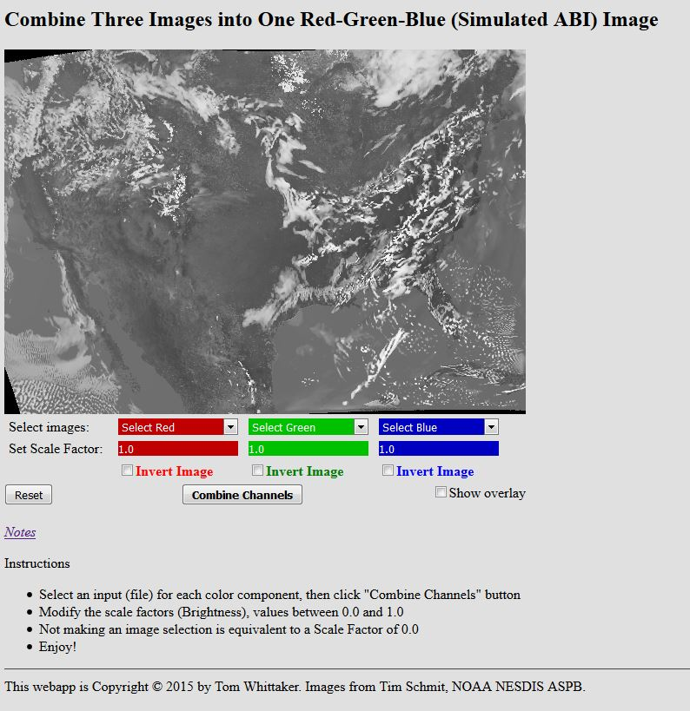
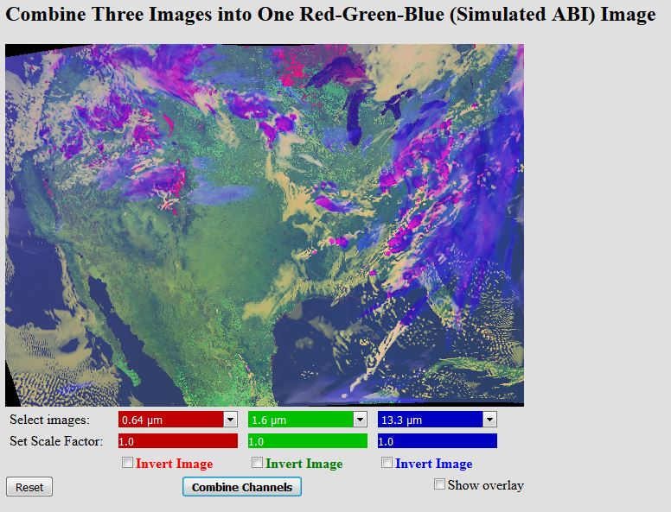
Educational RGB Webapp
Sample interactive “RGB” educational webapp using simulated ABI images:
http://cimss.ssec.wisc.edu/goes/webapps/satrgb/overview.html
Webapp to combine simulated ABI images into one image.
Notes:
Tim Schmit, ASPB
https://ams.confex.com/ams/95Annual/webprogram/Paper265203.html ABI = Advanced Baseline Imager
Other new webapps: one to change both the spatial and temporal sampling and the other only the pixel sampling

Slide 15
http://cimss.ssec.wisc.edu/goes/shortcourse/links.html
or
http://Tinyurl.com/shortcourse2016
Explore an example. Can you get the ice clouds to stand out?
Or the vegetation?
Note: The main purpose is to introduce the tools, they can be further explored later.

Slide 16
Background information

Slide 17
Himawari-8 imagery online
Japan Meteorological Agency
http://www.data.jma.go.jp/mscweb/data/himawari/
University of Wisconsin--Madison
http://www.ssec.wisc.edu/data/geo/
http://realearth.ssec.wisc.edu/
Colorado State University
http://rammb.cira.colostate.edu/ramsdis/online/himawari-8.asp
NICT
http://himawari8.nict.go.jp/
Australia (BoM)
http://satview.bom.gov.au/

Slide 18
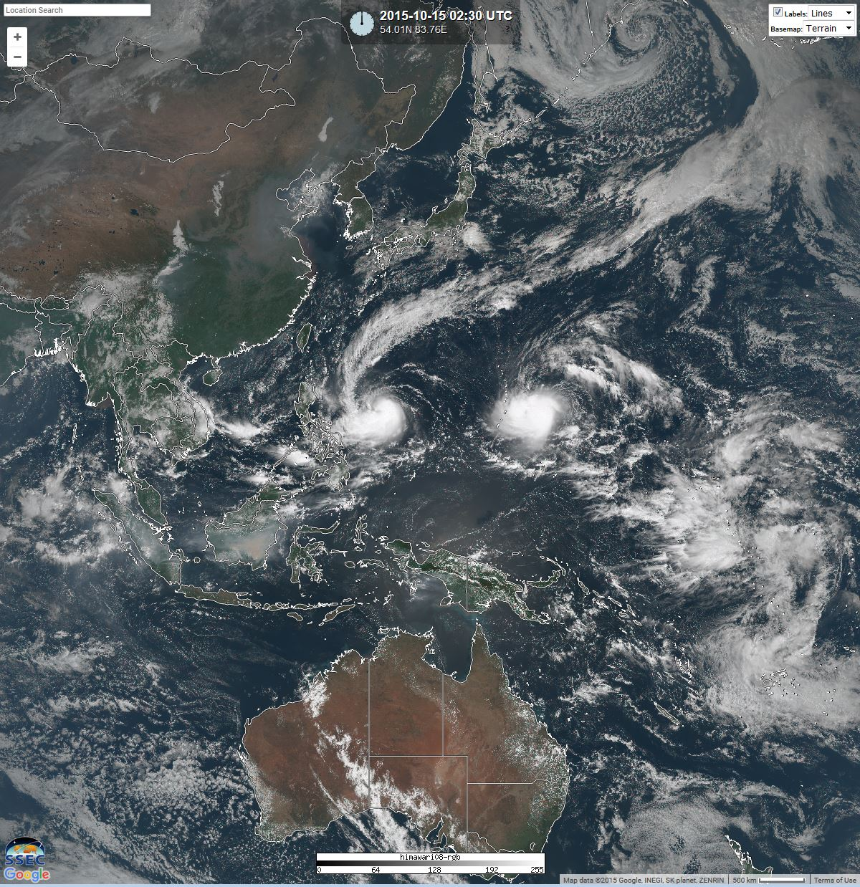
Recent AHI color image
in RealEarth

Slide 19
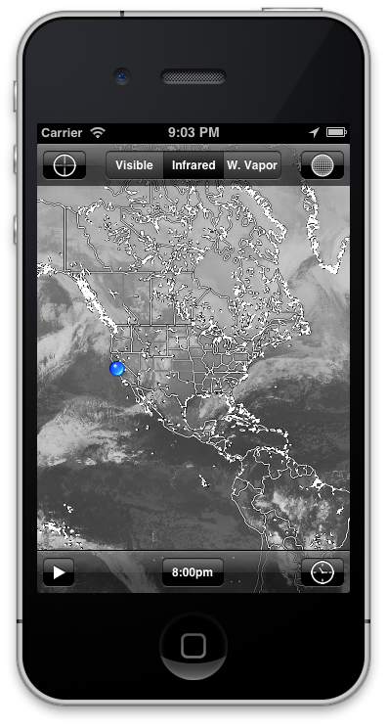
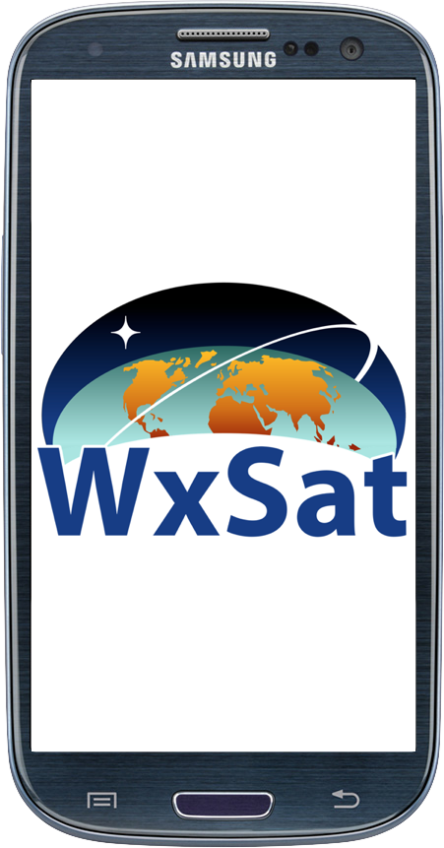
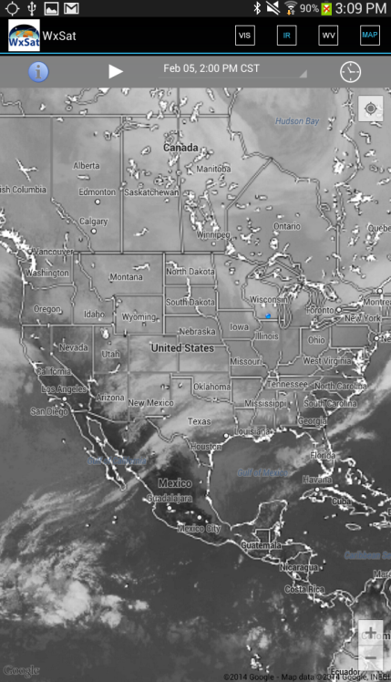
Mobile access to Satellite Imagery: Native app
http://realearth.ssec.wisc.edu/app
WxSat on iOS and Android
https://itunes.apple.com/us/app/wxsat/id627994249?mt=8
https://play.google.com/store/apps/details?id=edu.wisc.ssec.wxsat
Currently only global composites of visible, IR window, and water vapor channels

Slide 20
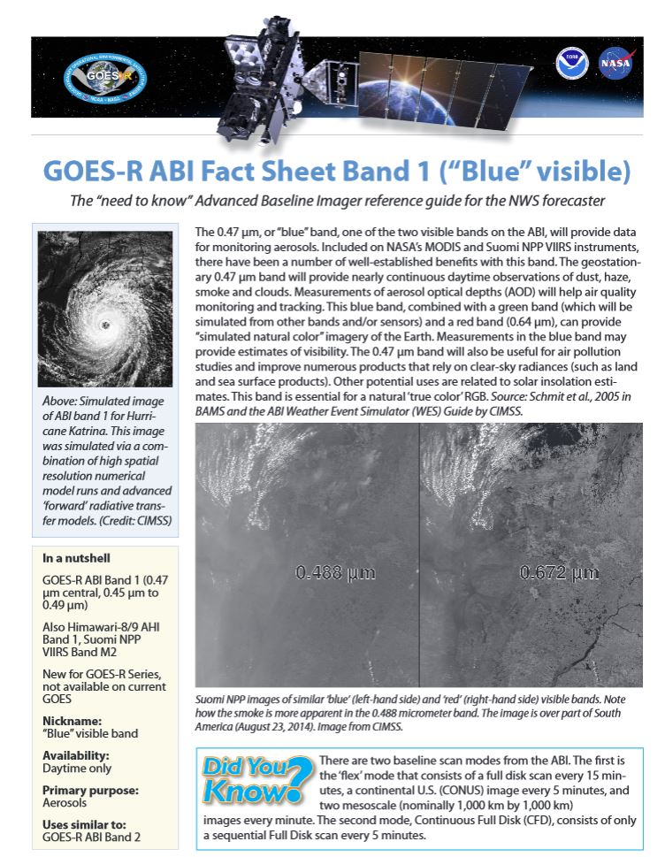
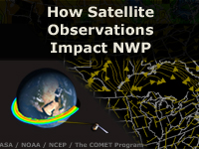
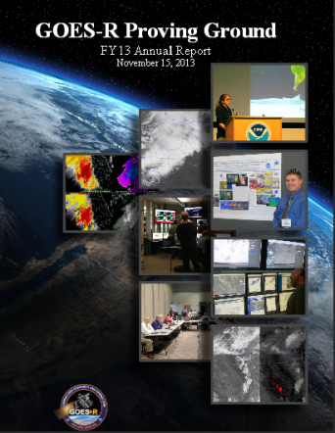
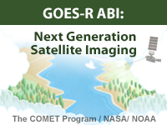
Training and User Education Materials
New!
Online Training Modules
How Satellite Observations Impact NWP
GOES-R ABI: Next Generation Satellite Imaging (COMET)
GOES-R: Benefits of Next-Generation Environmental Monitoring (COMET)
Satellite Hydrology and Meteorology for Forecasters (SHyMet)
SPoRT product training modules
VISIT Training Resources
Commerce Learning Center
ABI Band Fact Sheets
New!
Printed Materials
GOES-R Fact Sheets (18)
User Readiness Plan
GRB Downlink Specifications and Product Users Guide
Proving Ground Demonstration Final Reports and Annual Reports
20
Notes:
GOES-R: Benefits of Next Generation Environmental Monitoring - Includes an overview of the mission, instruments, system and services, satellite synergy, the role of GOES-R in the Global Observing System as well an environmental monitoring section that addresses the benefits of GOES-R and the ability to monitor 13 unique hazards and phenomena.
GOES-R 101 - Targeted for Forecasters and anyone else interested in basic aspects of GOES-R
Satellite Hydrology and Meteorology (SHyMeT) - Dedicated to operational satellite meteorology. The Forecaster track of the SHyMet course covers satellite imagery interpretation, including feature identification, water vapor channels, and what to expect on GOES-R. There is a session on remote sensing data for operational hydrology as well as one relating to aviation hazards. Other topics include an understanding of the Dvorak method in tropical cyclone analysis and the utility of cloud composites in forecasting
CIMSS Satellite Meteorology for Grades 7-12 -Meteorology is an excellent topic to introduce middle and high school students to geoscience, physics, chemistry, and applied mathematics. Satellite Meteorology provides scientists and educators with exciting tools for investigation, inquiry, analysis and stewardship.
Commerce Learning Center: Forecasters can take these training courses and get credit for taking them

Slide 21
ABI Bands Quick Information Guides
http://www.goes-r.gov/education/ABI-bands-quick-info.html

Slide 22
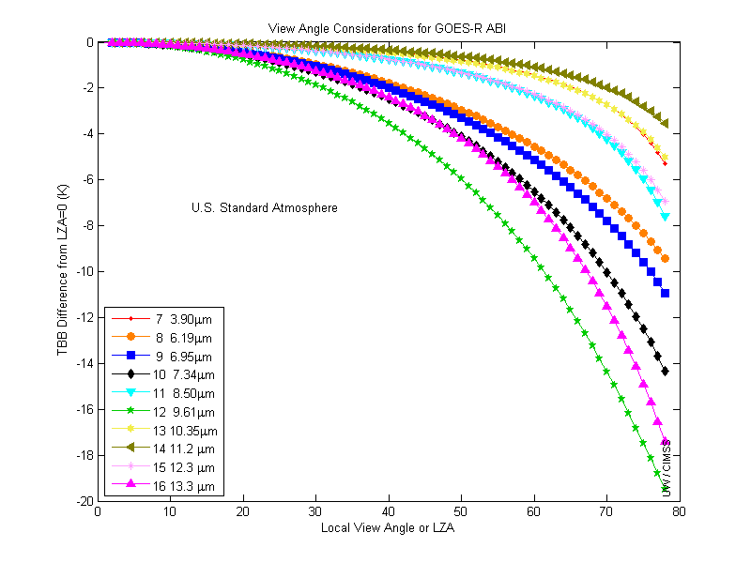
ABI Weighting Functions
As a function of….
View angle

Slide 23
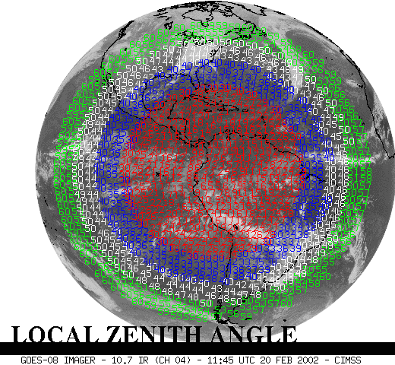
<30
<40
<50
<60
Current GOES-East Sample LZAs

Slide 24
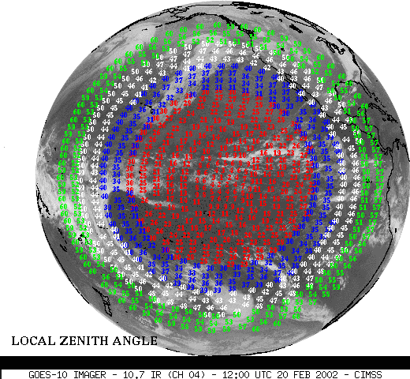
<30
<40
<50
<60
Current GOES-West Sample LZAs

