Slide 1
GOES-R ABI
(Advanced Baseline Imager)
Timothy J. Schmit (tim.j.schmit@noaa.gov)
NOAA/NESDIS/Satellite Applications and Research
Advanced Satellite Products Branch (ASPB)
Madison, WI
AMS Annual Meeting
New Orleans, LA
January 13, 2016
UW-Madison

Slide 2
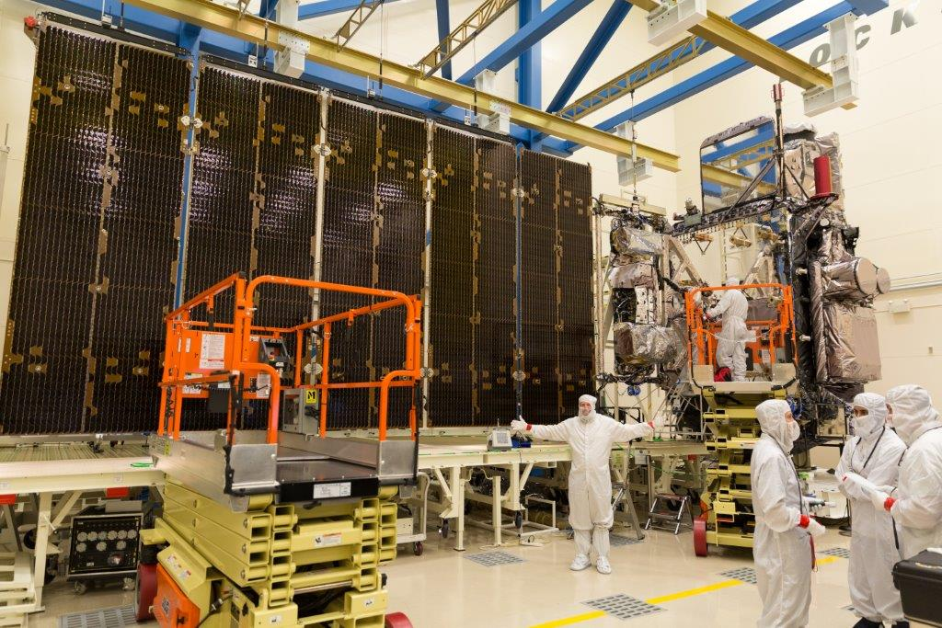
GOES-R ABI
Spectral, Spatial and Temporal
Improved, Improved and Improved
Lockheed Martin

Slide 3
The Advanced Baseline Imager:
ABI Current
Spectral Coverage
16 bands 5 bands
Spatial resolution
0.64 μm Visible 0.5 km Approx. 1 km
Other Visible/near-IR 1.0 km n/a
Bands (>2 μm) 2 km Approx. 4 km
Spatial coverage
Full disk 4 per hour Scheduled (3 hrly)
CONUS 12 per hour ~4 per hour
Mesoscale Every 30 sec n/a
Visible (reflective bands)
On-orbit calibration Yes No
Notes:
The ABI allows more bands, finer spatial resolution, faster refresh rates and on-orbit calibration of all bands!

Slide 4
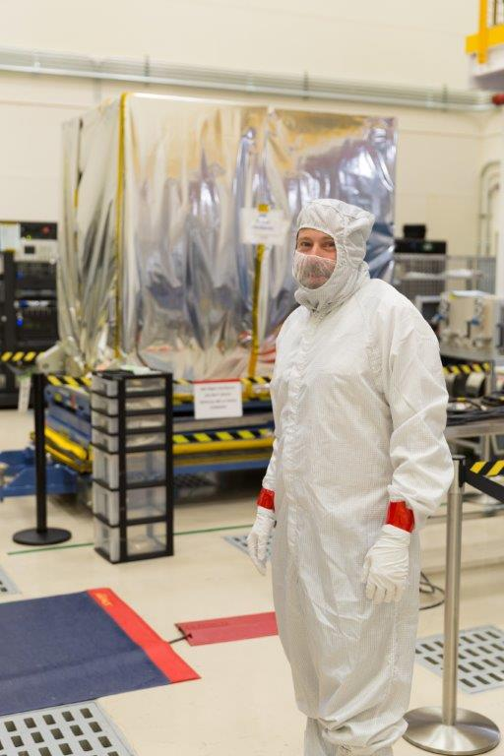
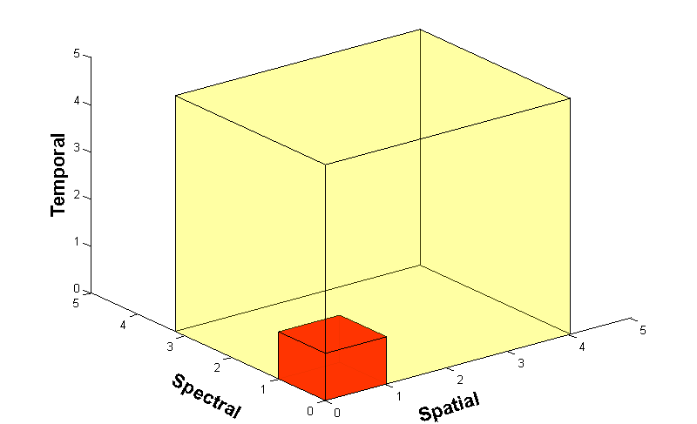
Advanced Baseline Imager
5
4
3
X
Faster coverage (5-minute full disk vs. 25-minute)
X
Improved spatial resolution
(2 km IR vs. 4 km)
X
More spectral bands (16 on ABI vs. 5 on the current imager)
Notes:
Slide from J. Gerth, CIMSS.

Slide 5
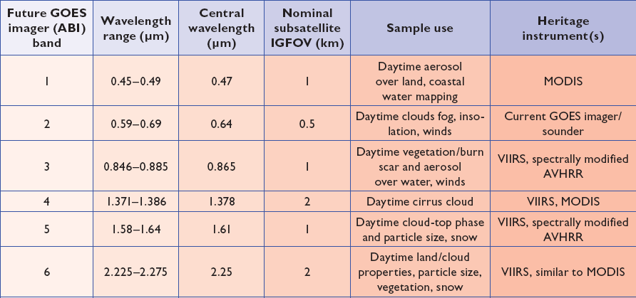
ABI bands 1-6
6 visible or near infrared bands on the ABI, compared to only one on today’s imager
Notes:
Final column added: heritage. The ABI band 1 was suggested by Dr. Fred Mosher at a GOES Users' Conference.
The ABI band 3 was suggested by the late Dr. C. Rao (of the then ORA).
Some of these bands have been shifted to more closely match those on the VIIRS.

Slide 6
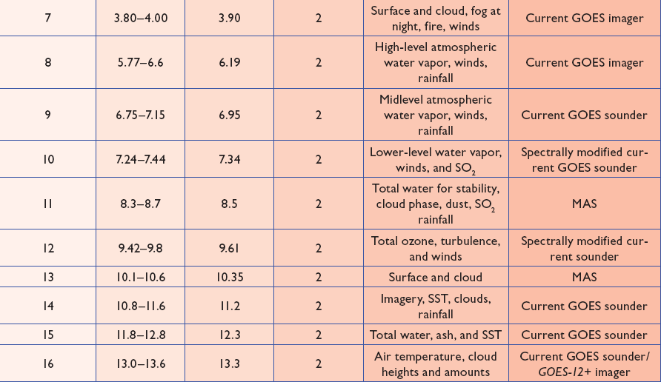
ABI bands 7-16
10 infrared bands on the ABI, compared to four on today’s imager
Notes:
The ABI band 10 was modified to better depict upper-level SO2. (G. Ellrod and others)
The ABI band 11 was suggested by Steve Ackerman (CIMSS), based on HIRS experience.
The ABI band 13 was suggested by W. P. Menzel (then NOAA NESDIS).

Slide 7
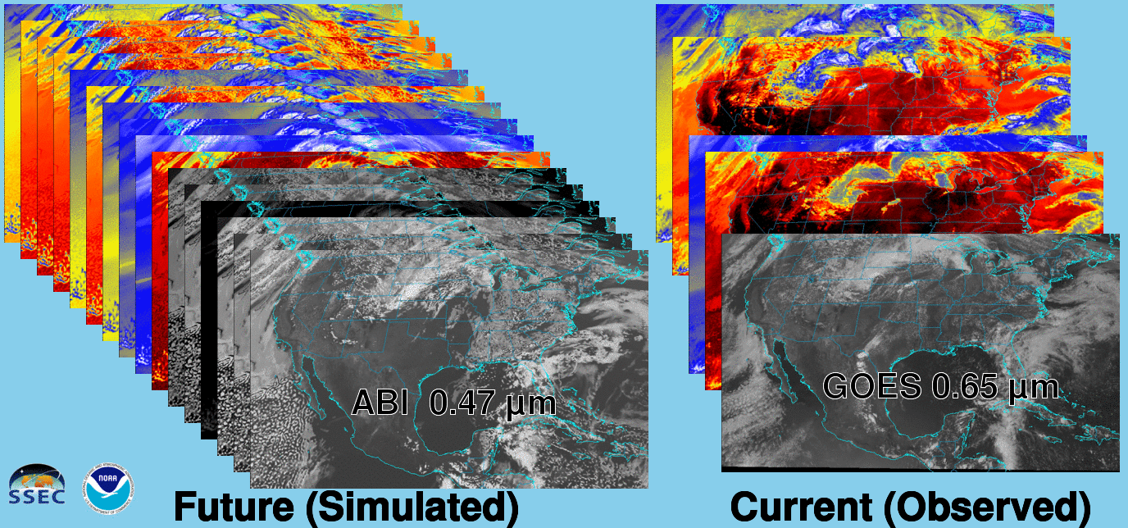
Future vs. Current Spectral Bands
The current GOES (right) has 5 spectral bands, while the GOES-R series ABI (left) will have 16 spectral bands.

Slide 8
AHI: Spectral (20-September-2015)

Slide 10
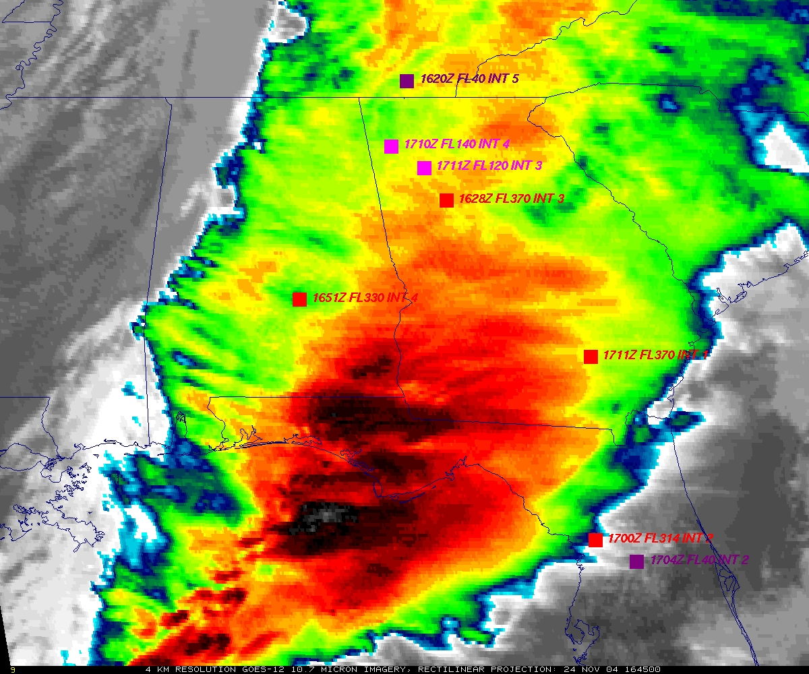
GOES
Figure courtesy of K. Bedka and W. Feltz

Slide 11
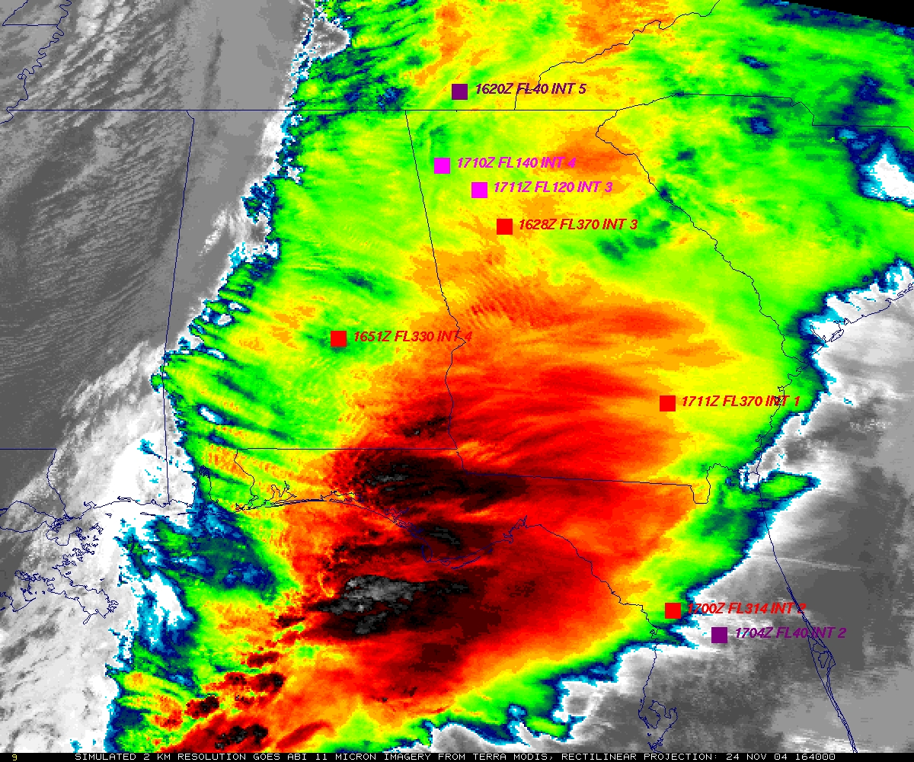
“ABI” from MODIS
Figure courtesy of K. Bedka and W. Feltz

Slide 12
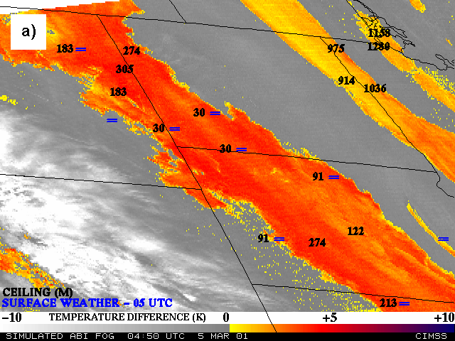
Nocturnal Fog/Stratus Over the Northern Plains
“ABI” 4 minus 11 μm Difference
ABI image (from MODIS) shows greater detail in structure of fog.
Notes:
Note the ABI (from MODIS) image is better spatial resolution and better signal-to-noise ratio then the GOES-10 imager.
Schmit, T. J., M. M. Gunshor, W. P. Menzel, J. J. Gurka, J. Li, and A. S. Bachmeier, 2005: Introducing the next-generation Advanced Baseline Imager on GOES-R. Bull. Amer. Meteor. Soc., 86, 1079-1096.

Slide 13
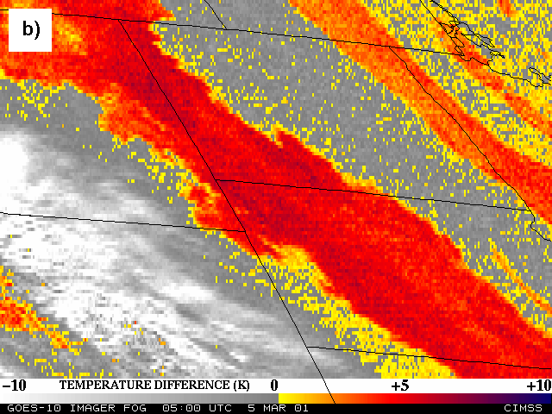
Nocturnal Fog/Stratus Over the Northern Plains
GOES-10 4 minus 11 μm Difference
ABI image (from MODIS) shows greater detail in structure of fog.
Notes:
Schmit, T. J., M. M. Gunshor, W. P. Menzel, J. J. Gurka, J. Li, and A. S. Bachmeier, 2005: Introducing the next-generation Advanced Baseline Imager on GOES-R. Bull. Amer. Meteor. Soc., 86, 1079-1096.

Slide 14
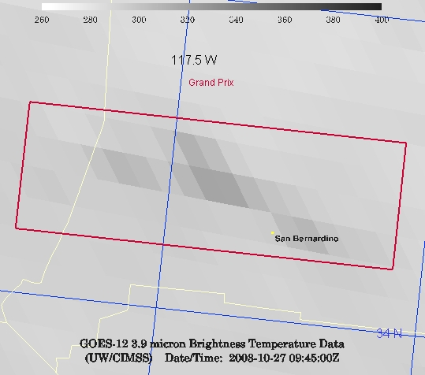
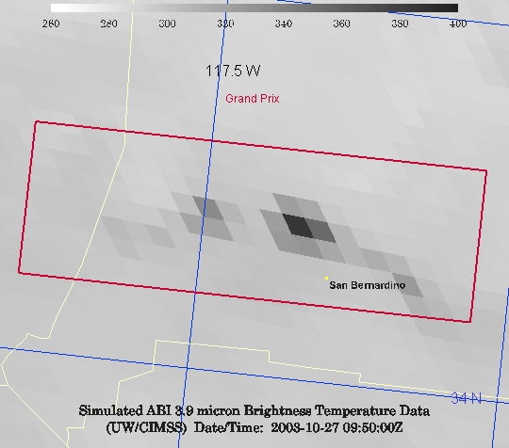
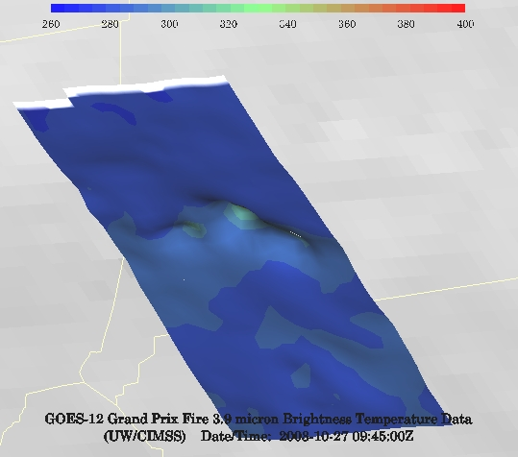
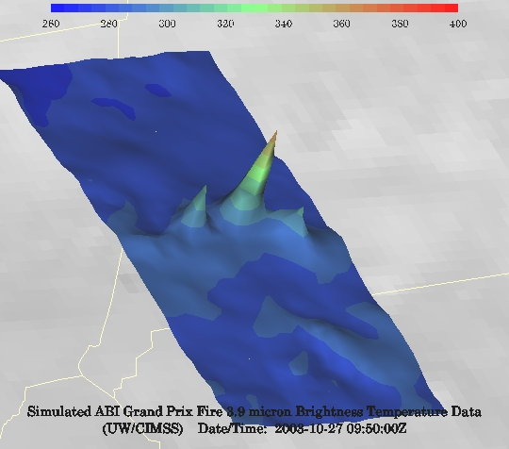
GOES-12 and GOES-R ABI
Simulation of Grand Prix Fire/Southern California
GOES-12
GOES-R ABI
GOES-12
GOES-R ABI
Notes:
Here are two different fires from J. Feltz of CIMSS (using mcidas-v). What we can see is a more defined peak in the higher resolution data and it is easier to pick out individual hotspots. In addition, the higher saturation temperature of the ABI allows us to see that the fire is around 370K. ABI is simulated from MODIS.

Slide 15
MTSAT vs AHI (Spatial)
Rinjani

Slide 16
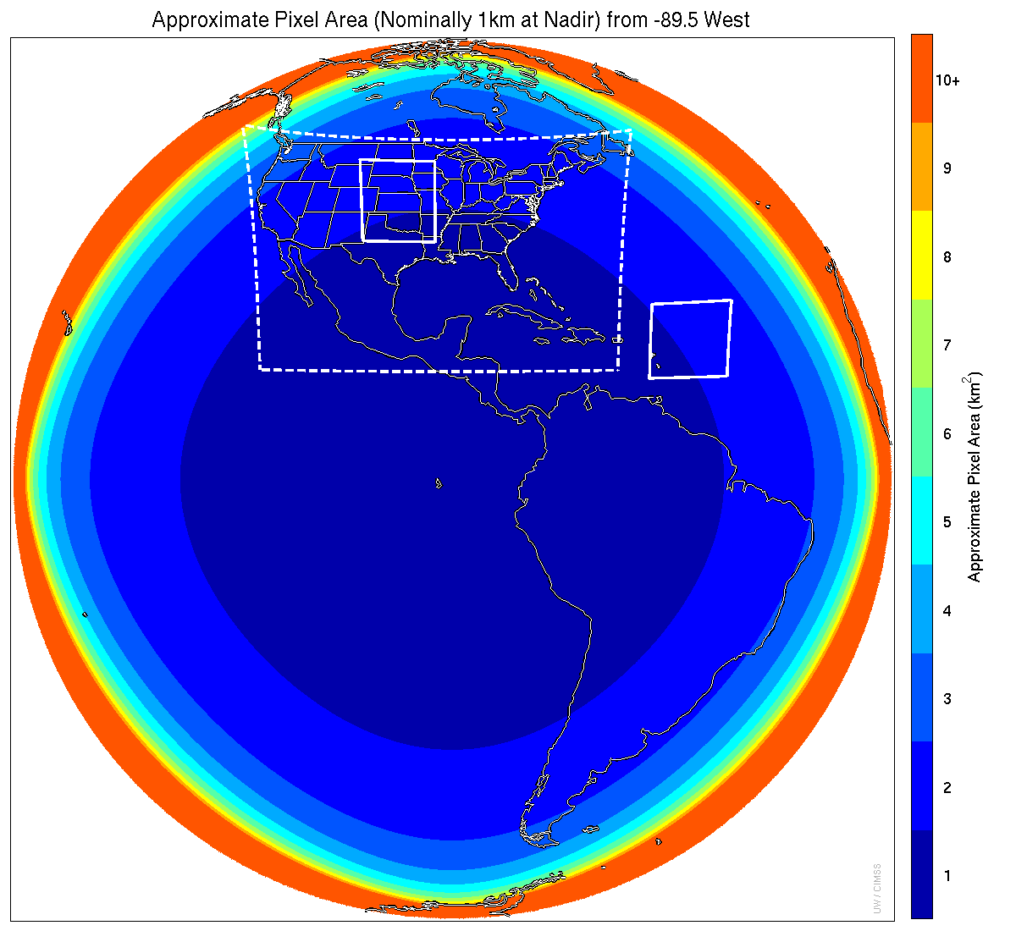
Meso-scale box locations are movable
1 min
5 min
1 min
15 min
Notes:
1-km² spatial resolution at satellite nadir. Pixel Areas are approximate. Each bin is rounded to the nearest 1km² until we get to 9.5km² and then all are binned into the red 10+ area. So the first, dark blue, ring covers pixel areas from 1 to 1.49km² and is labeled “1”, above 1.5 to below 2.5km² goes into the next ring and is called “2”, etc. GOES-Test location. PUG CONUS sector. Two meso-scale image sectors shown; these are selectable. The same central lat/lon used for these mesoscales produces a different sized and shaped area for different satellite locations.

Slide 17
GOES-14 Super Rapid Scan Operations to Prepare for GOES-R (SRSOR)
SRSOR plans for 2015 include May 18-June 12, and August 10-22:
http://cimss.ssec.wisc.edu/goes/srsor2015/GOES-14_SRSOR.html
Data during parts of 2012 (Hurricane Sandy, convection), 2013 (CA Rim Fire, convection) and 2014 (Hurricane Marie, convection):
http://cimss.ssec.wisc.edu/goes/srsor/GOES-14_SRSOR.html
http://cimss.ssec.wisc.edu/goes/srsor2013/GOES-14_SRSOR.html
http://cimss.ssec.wisc.edu/goes/srsor2014/GOES-14_SRSOR.html
GOES-14 provided very unique data and offered a glimpse into the possibilities that will be provided by the ABI on GOES-R in one minute mesoscale imagery
GOES-14 visible image showing rapid convective development
Notes:
http://cimss.ssec.wisc.edu/goes/srsor2015/GOES-14_SRSOR.html

Slide 18
1-min imagery
1-min mode (SRSOR from GOES-14)
Operational (GOES-13)

Slide 19
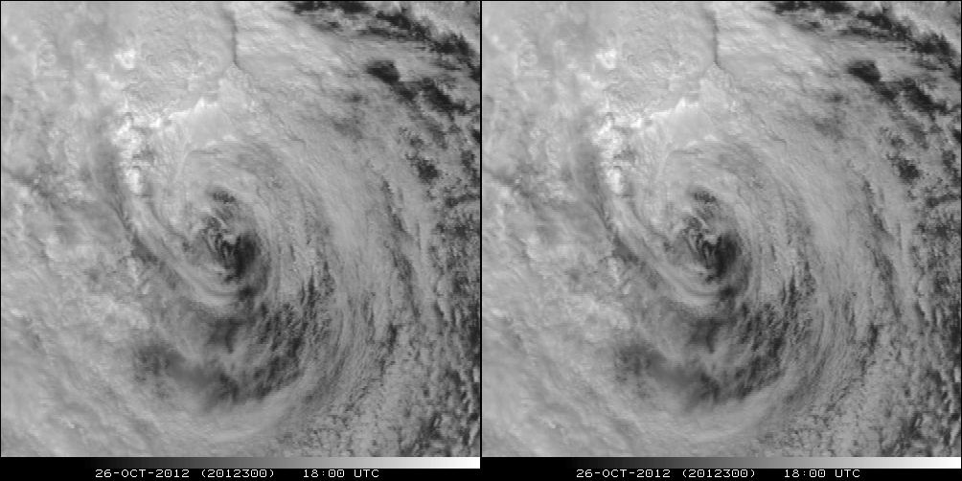
A Glimpse into the Future
ABI-like
Hurricane Sandy from GOES-14 at two temporal resolutions

Slide 20
MTSAT vs AHI (Temporal)
Manum

Slide 21
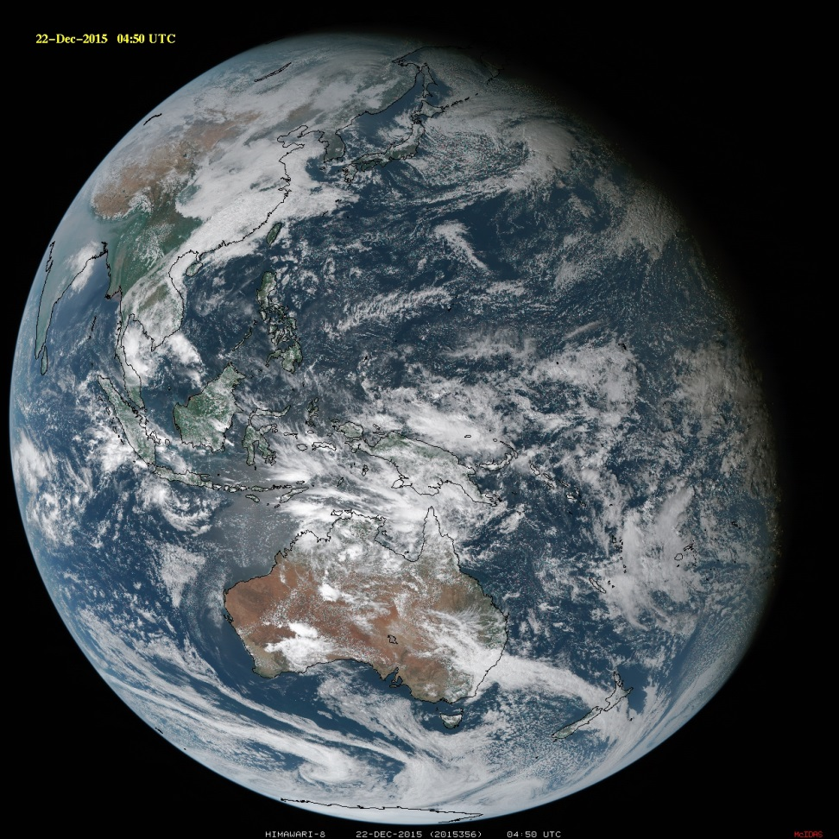
Summary
The ABI on GOES-R will improve over the current instrument in many aspects:
Spatial, temporal, spectral, calibration, etc.
The great amount of information from the GOES-R will offer a continuation of current products and new products.
Thanks to JMA, Yasuhiko Sumida and SSEC
The ABI builds on previous experience/instruments
Similar imagers by Europe, Japan, Korea, etc.
ABI-like coverage of most of the globe!

