Slide 1

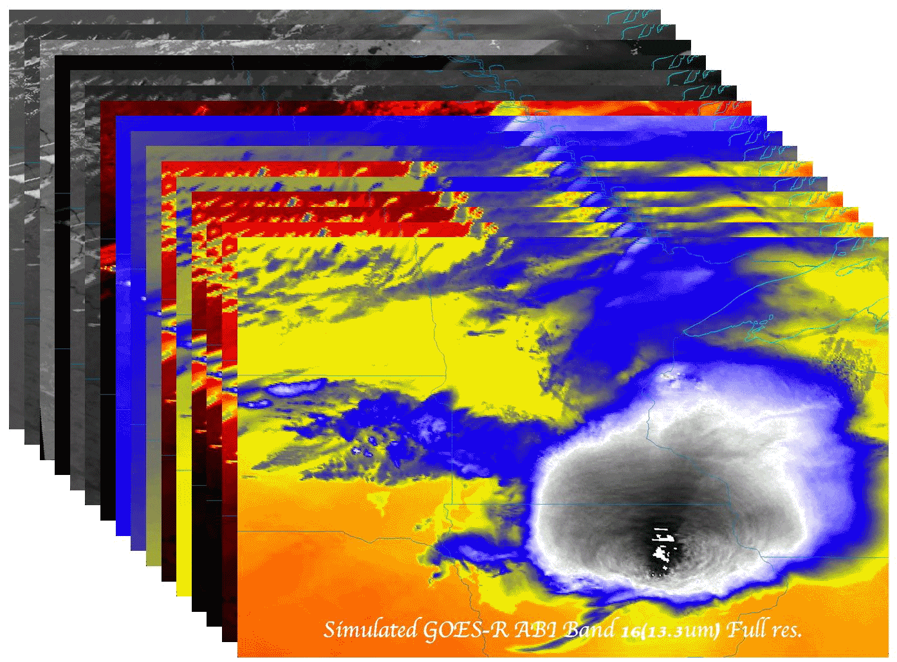

Preparing Users for the Advanced Baseline Imager (ABI) on GOES-R
  Timothy J. Schmit (tim.j.schmit@noaa.gov)
NOAA/NESDIS/StAR Advanced Satellite Products Branch (ASPB)
M. Gunshor, K. Bah, J. Gerth, B. Pierce,
Madison, WI
and S. J. Goodman
GOES-R Program Office (GPO)
11th Annual Symposium on New Generation Operational Environmental Satellite Systems
January 6, 2015
UW-Madison

Slide 2
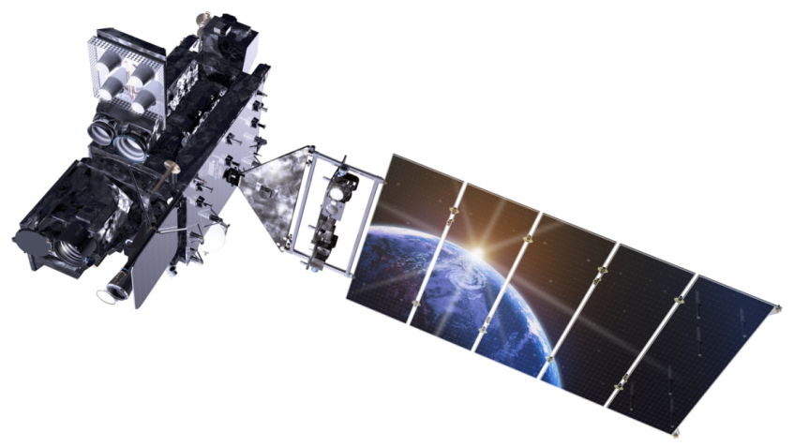
Outline
Background/Instrument
  8 to 16 spectral bands, scan options, etc.
Simulations
  triplets, WES, WRF Chem,
  NSSL-WRF
Education/Training
  COMET, VISIT, WF, webapps, papers, conferences, web pages, short courses
Other sensors
  AVIRIS, MAS, MODIS, SEVIRI, VIIRS, AHI, and SRSOR (GOES-14)
Lockheed Martin

Slide 3
1 0.52 – 0.72 0.62 Visible Daytime clouds, fog
8 1.3 – 1.9 1.6 Near IR Daytime clouds/snow, water/ice clouds
2 3.8 – 4.0 3.9 Shortwave IR Nighttime low clouds, fog, fire detection
3 6.5 – 7.0 6.75 Water Vapor 1 Upper tropospheric flow, winds
6 7.0 – 7.5 7.25 Water Vapor 2 Mid tropospheric flow, winds
4 10.2 – 11.2 10.7 IR Window 3 Clouds, low-level water vapor, fog, winds
5 11.5 – 12.5 12.0 IR Window 4 Low-level water vapor, volcanic ash
7 13.2 – 13.8 13.5 Carbon Dioxide Cloud-top parameters, heights for winds
ABI - 8
# Wavelengths Description Primary Use
Range (μm) Center
ABI – circa 1999
(8 total bands, most spectrally wide)
Notes:
These 8 bands represent the current GOES imager “six” and 1.6 and 7.2 um bands.

Slide 4
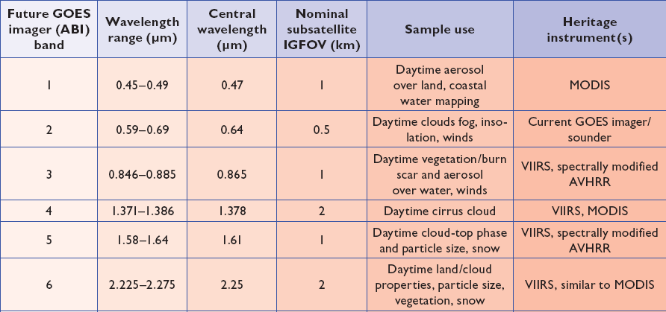
ABI bands 1-6
6 visible or near infrared bands on the ABI, compared to only one on today’s imager
Notes:
Final column added: heritage. The ABI band 1 was suggested by Dr. Fred Mosher at a GOES Users' Conference.
The ABI band 3 was suggested by the late Dr. C. Rao (of the then ORA).
Some of these bands have been shifted to more closely match those on the VIIRS.

Slide 5
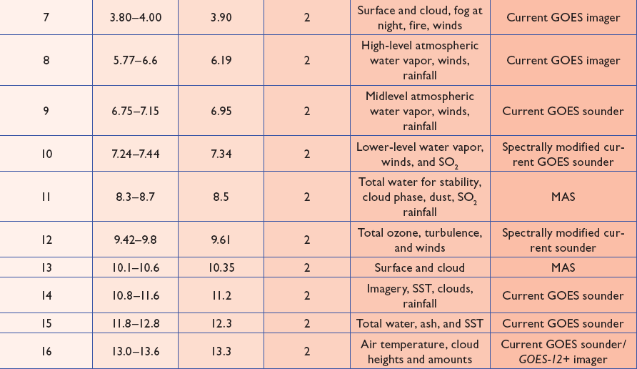
ABI bands 7-16
10 infrared bands on the ABI, compared to four on today’s imager
Notes:
The ABI band 10 was modified to better depict upper-level SO2. (G. Ellrod and others)
The ABI band 11 was suggested by Steve Ackerman (CIMSS), based on HIRS experience.
The ABI band 13 was suggested by W. P. Menzel (then NOAA NESDIS).

Slide 6
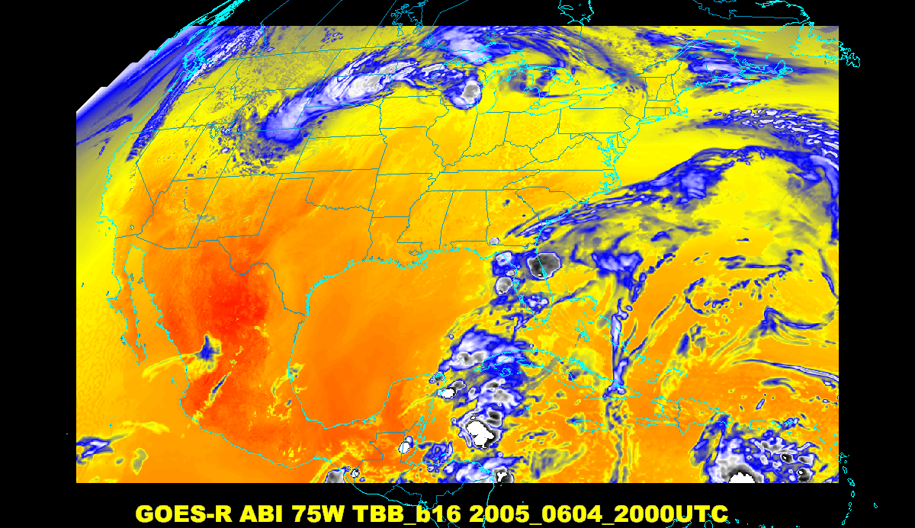
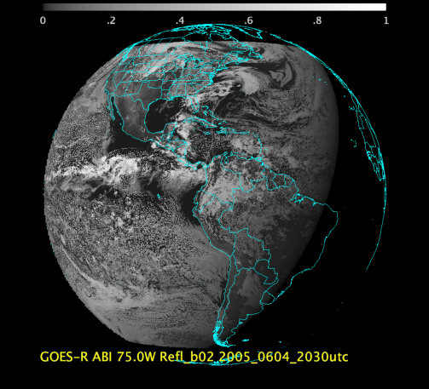
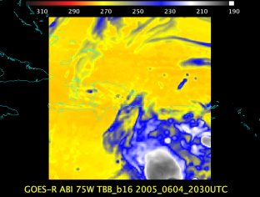
Baseline ABI Scan Modes
Scan mode (3) or ‘flex mode’ for the ABI:
- Full disk every 15 minutes + 5 min CONUS
+ 1-min mesoscales (2 locations).
[Scan mode (4) or ‘Continuous Full Disk’ (CFD) is a full disk every 5 min]
Notes:
CONUS image is the shifted center point.

Slide 7
Baseline Mode 3 “Time-Time” chart
Note many more star looks, especially IR stars.
Covers 15 minutes
Notes:
Copy and pasted from excel. Pasted as a picture. Resized to 44% by 44% of original. Arrange -> Align -> Align Center & Align Middle

Slide 8
Baseline Time-Time Mode 4
This is the Continuous Full Disk (every 5 min) mode
Covers 15 minutes

Slide 9
Exploratory ABI Scan Modes
At some point, other ABI scan mode could be possible. Although, this requires an upgrade to the ground system.
  The ABI instrument is capable of supporting other scan modes.
Use the ‘white space’ (or idle time) of when the ABI instrument is not scanning in mode 3 (‘flex’):
  increase to an ‘extended CONUS’ image.
  or
  Consider a full disk scan every 10 min (along with CONUS and meso-scale sectors). This would sync with the geo global constellation (EUMETSAT, AHI, AMI, AGRI, etc.).

Slide 10
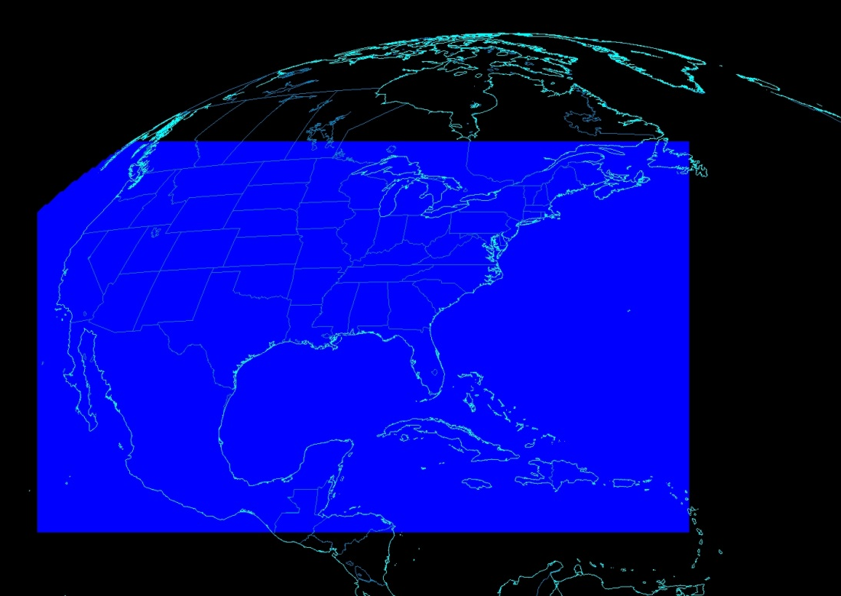
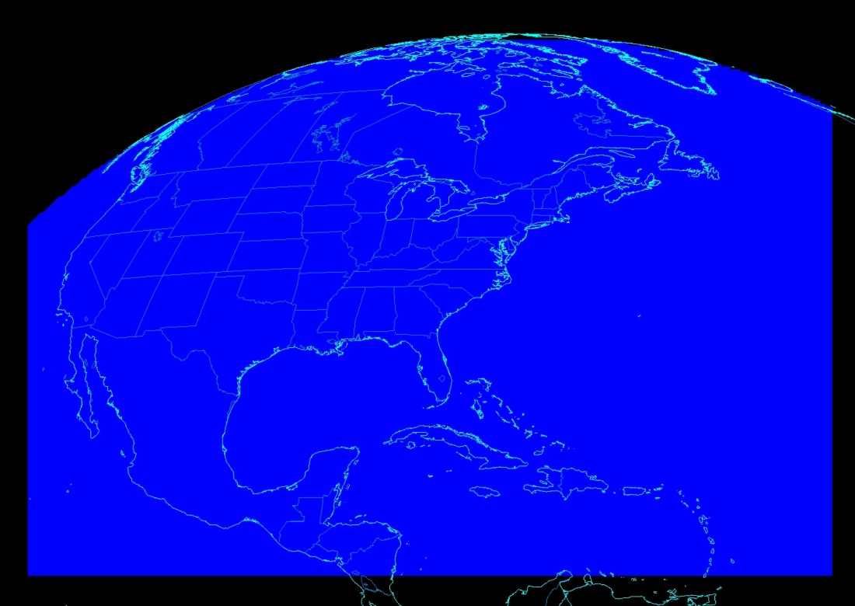
ABI CONUS Sector Size
Working on extending the ABI CONUS size to better address operational needs (and use time when the ABI instrument would be idle)
This would need a ground system upgrade
Other scan modes are being explored, e.g., full disk every 10 min + CONUS + mesoscales.
Mode 3
Current CONUS Sector for ABI
Mode “3a”
Proposed CONUS Sector for ABI

Slide 11
Draft “Mode 6” with 10-min FD
In 10-min:
  1 Full Disk
  2 CONUS
  20 Meso-scale
The 10-min Full Disk would offer synergy with other geos and improved AMVs outside of CONUS, plus still allow for meso-scale observations.
This draft mode 6 ideally could be tested during PLPT (Post Launch Products Test).
This mode should be easier to implement at the Ground System, since the scan sectors are the same size/locations as in mode 3.
Only proposed.
Notes:
Copy and pasted from excel. Pasted as a picture. Resized to 44% by 44% of original. Arrange -> Align -> Align Center & Align Middle

Slide 12
Outline
Background/Instrument
  8 to 16 spectral bands, scan options, etc.
Simulations
  triplets, WES, WRF Chem,
  NSSL-WRF
Education/Training
  COMET, VISIT, WF, webapps, papers, conferences, web pages, short courses
Other sensors
  AVIRIS, MAS, MODIS, SEVIRI, VIIRS, AHI, and SRSOR (GOES-14)
Lockheed Martin

Slide 13

In ABI FGF (75W)

Slide 14
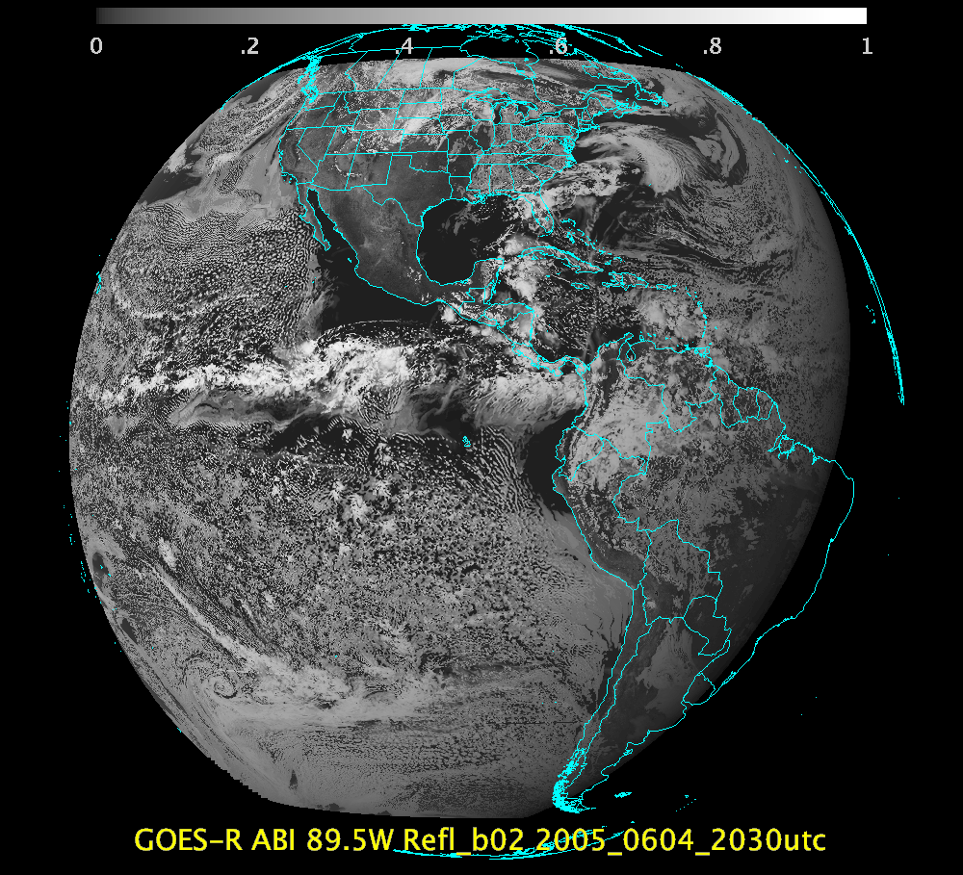
In ABI FGF (89.5W)
SSEC

Slide 15
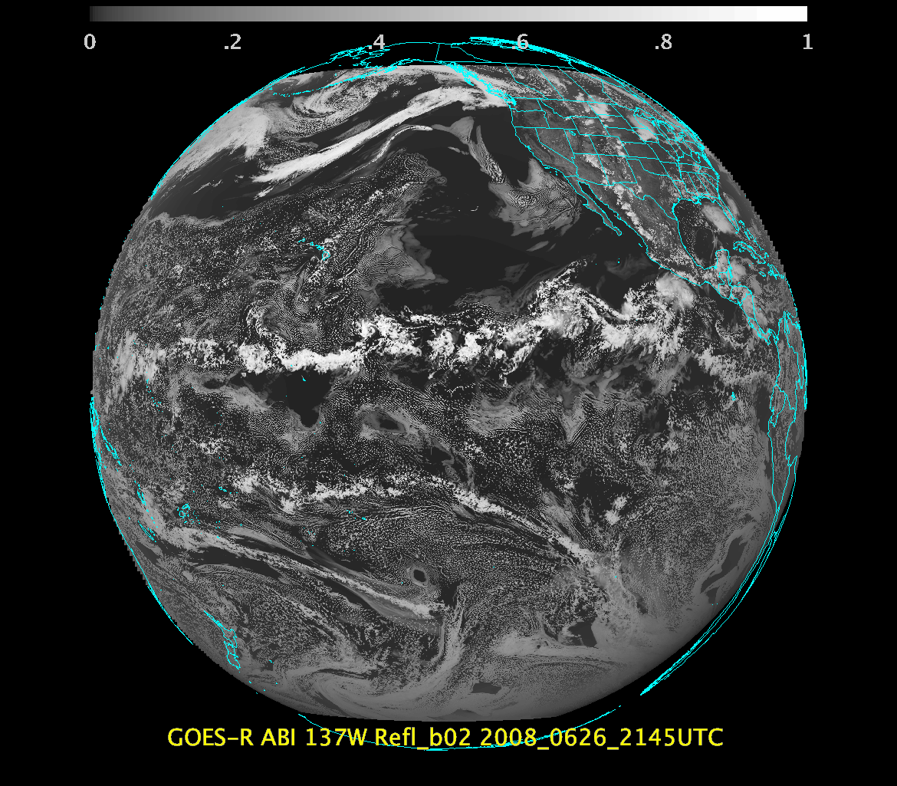
In ABI FGF (137W)
SSEC

Slide 16
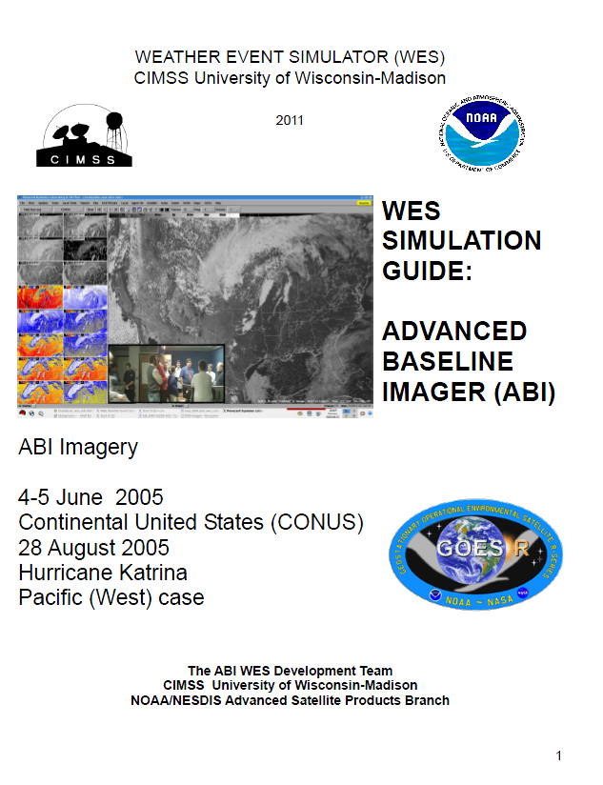
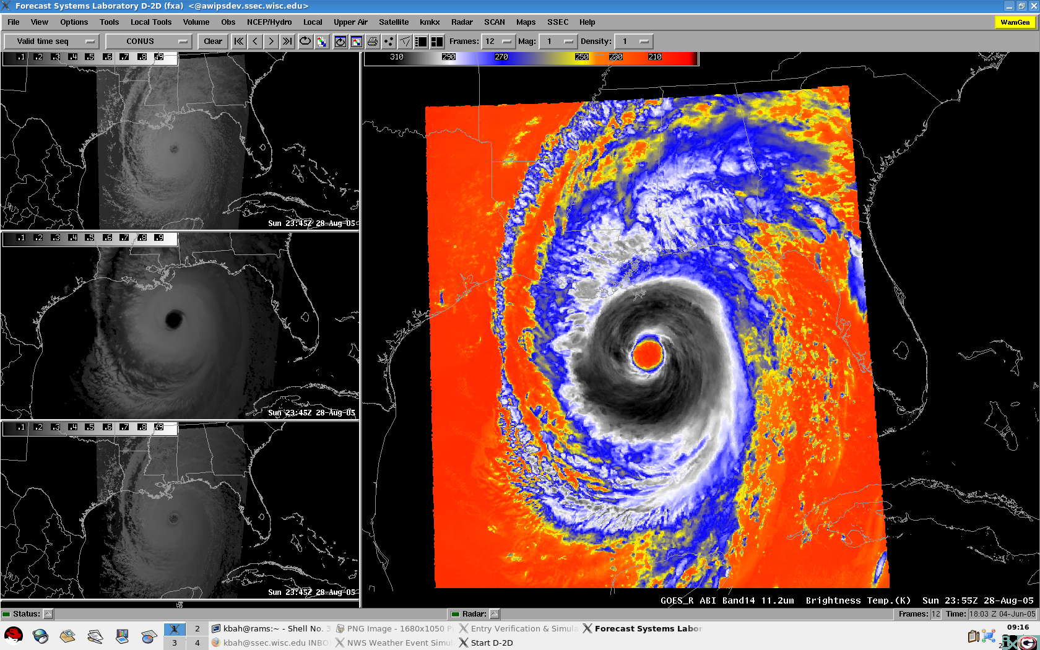
ABI WES
Contains simulated ABI for all bands for a June-2006 convective storm (CONUS and mesoscale), Hurricane Katrina, band differences, a WES (Weather Event Simulator) guide, etc.
http://cimss.ssec.wisc.edu/goes/abi/loops/WES_for_GOES-R_ABI_2011_Version.pdf

Slide 17
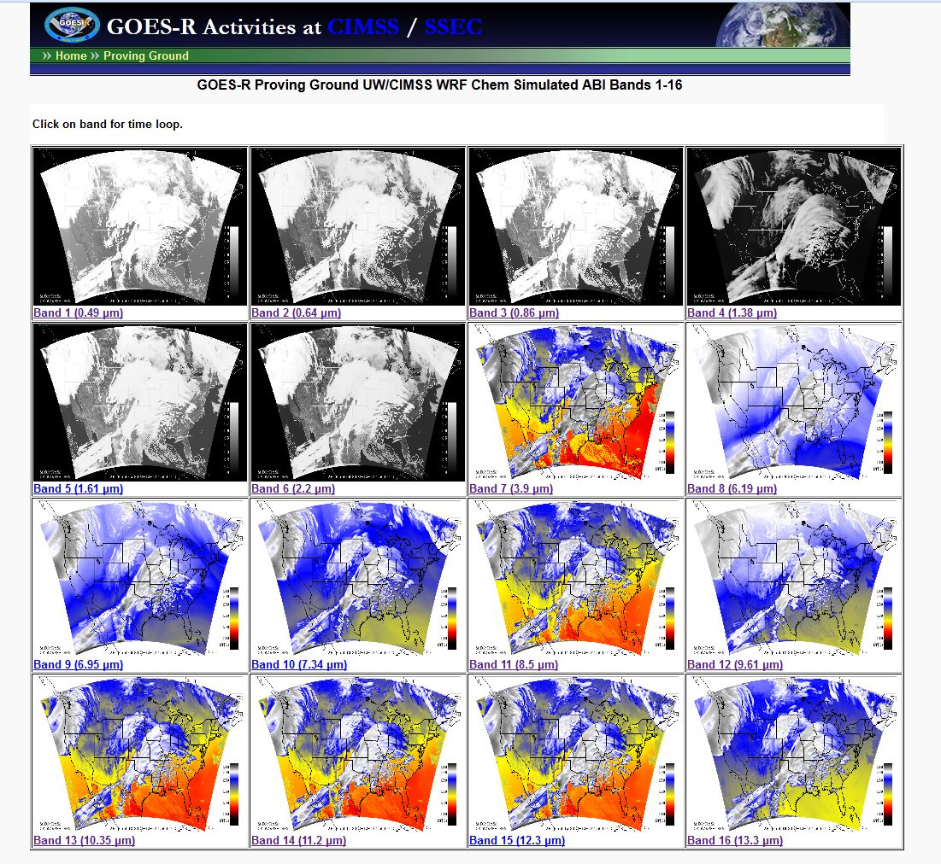
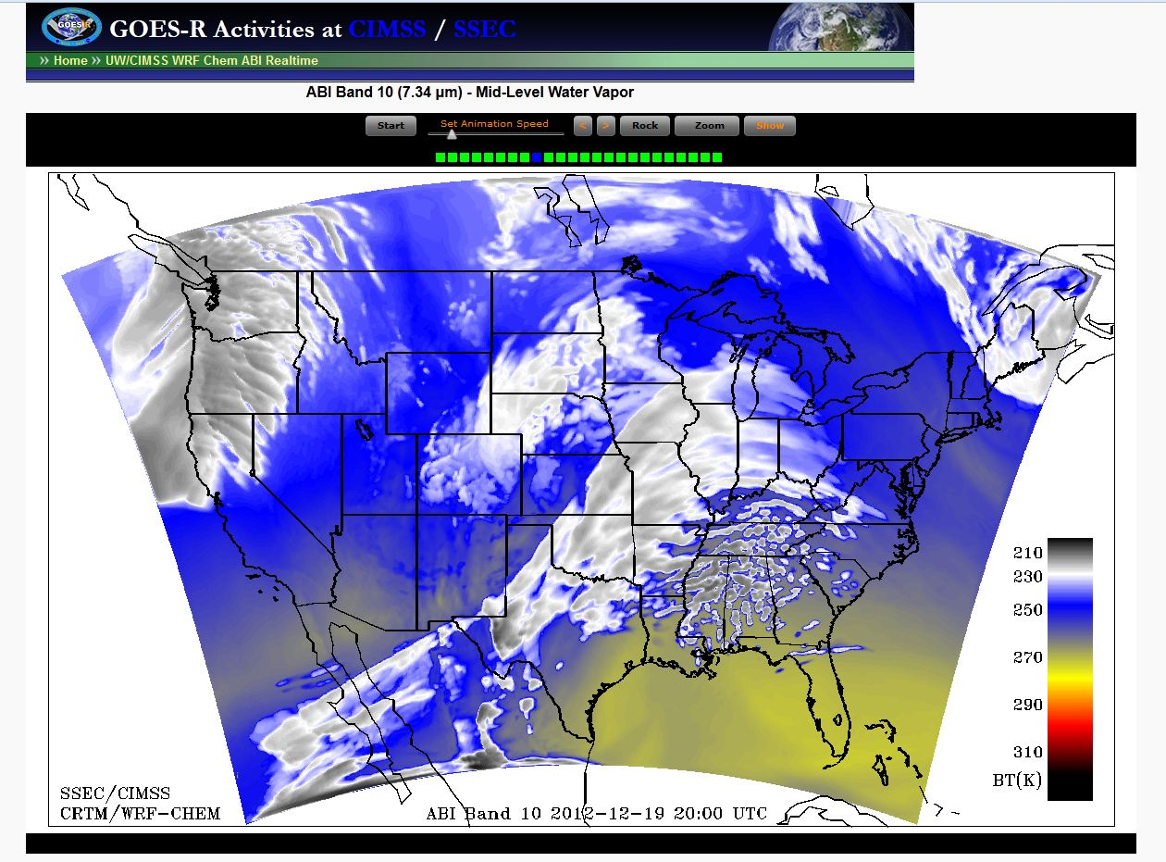
Near Realtime WRF Chem ABI runs
http://cimss.ssec.wisc.edu/goes_r/proving-ground/wrf_chem_abi/wrf_chem_abi.html

Slide 18
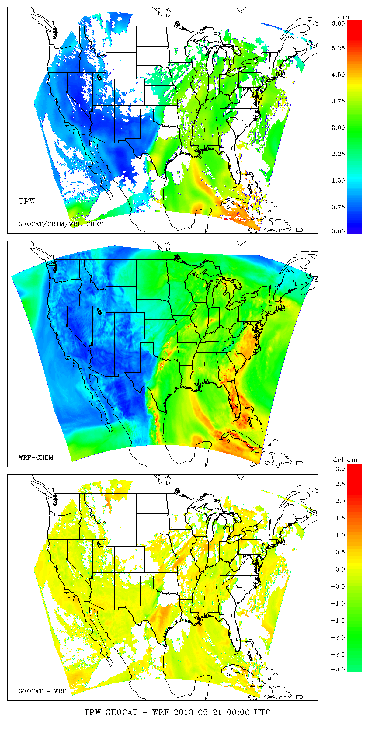
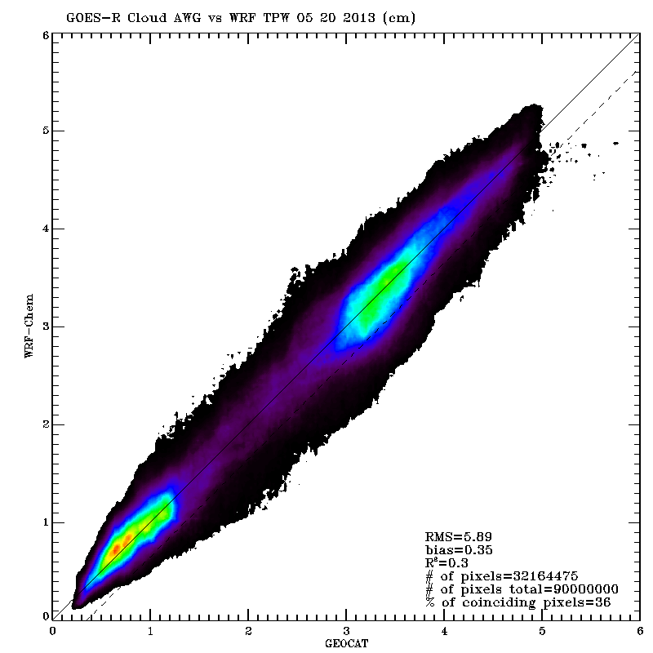
Synthetic Retrieval
Total Precip Water (TPW) Validation
Truth
Synthetic Retrieval - Truth

Slide 19
Outline
Background/Instrument
  8 to 16 spectral bands, scan options, etc.
Simulations
  triplets, WES, WRF Chem,
  NSSL-WRF
Education/Training
  COMET, VISIT, WF, webapps, papers, conferences, web pages, short courses
Other sensors
  AVIRIS, MAS, MODIS, SEVIRI, VIIRS, AHI, and SRSOR (GOES-14)
Lockheed Martin

Slide 20
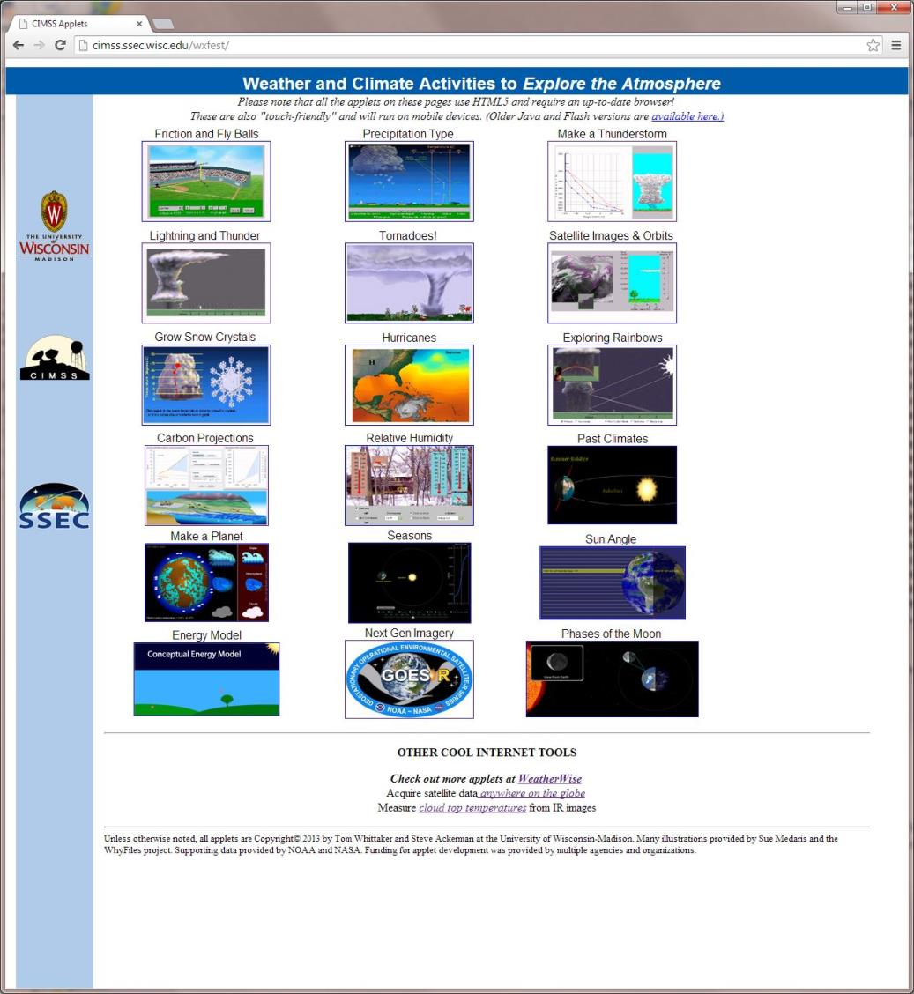
http://cimss.ssec.wisc.edu/wxfest/

Slide 21
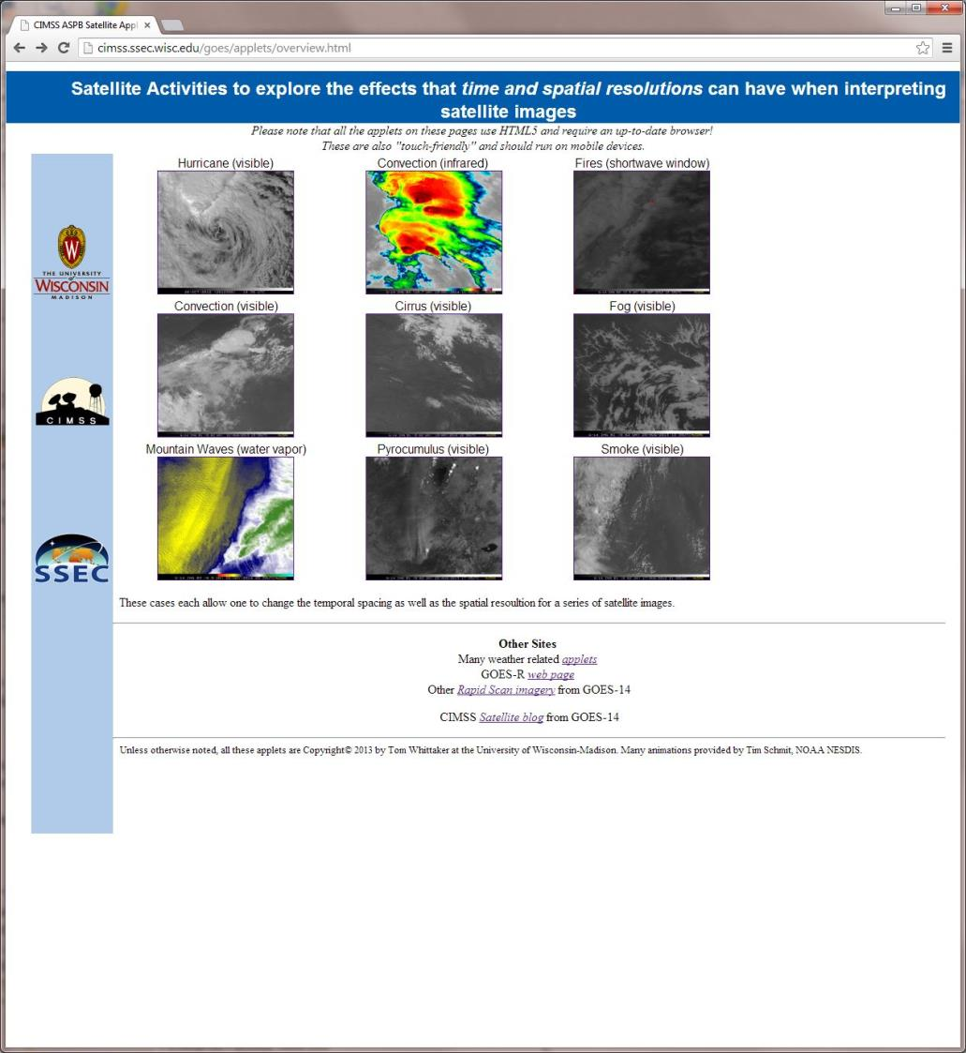
http://cimss.ssec.wisc.edu/goes/applets/overview.html

Slide 22
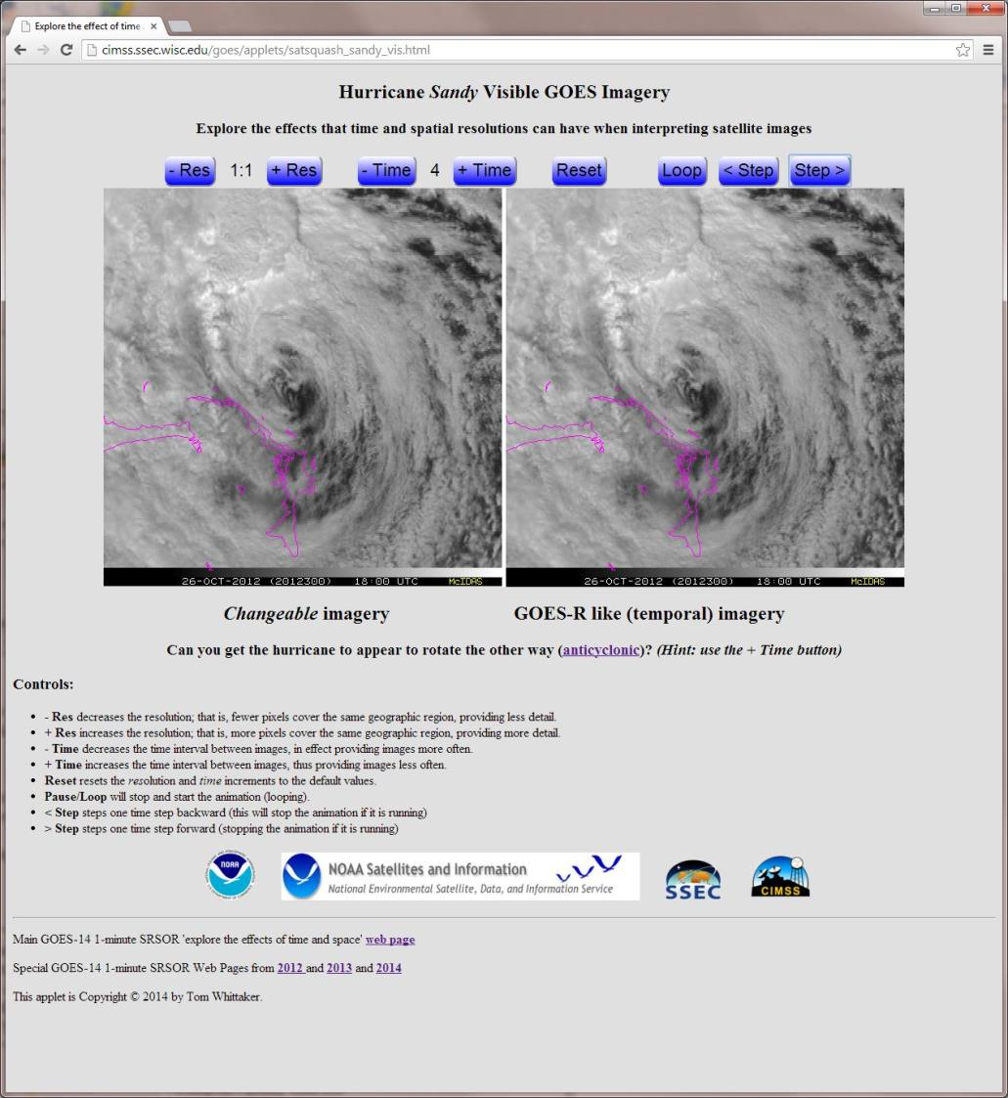

Slide 23
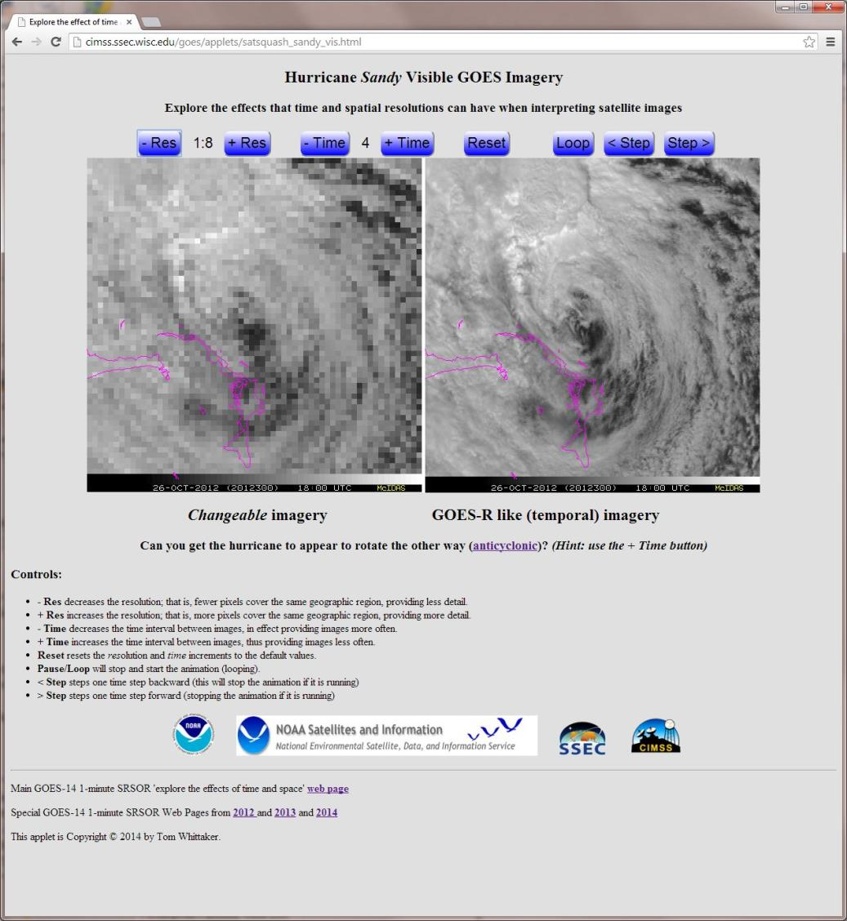

Slide 24
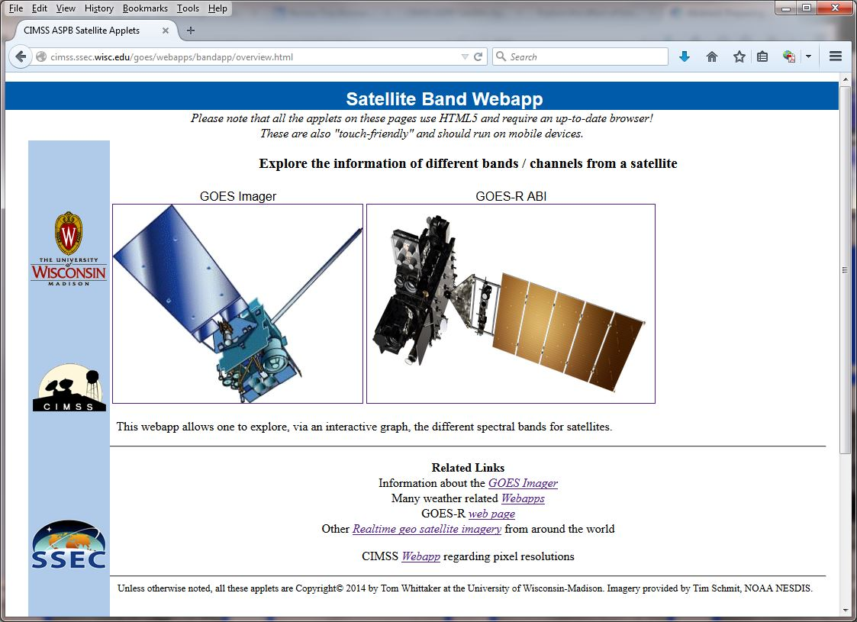
http://cimss.ssec.wisc.edu/goes/webapps/bandapp/overview.html

Slide 25
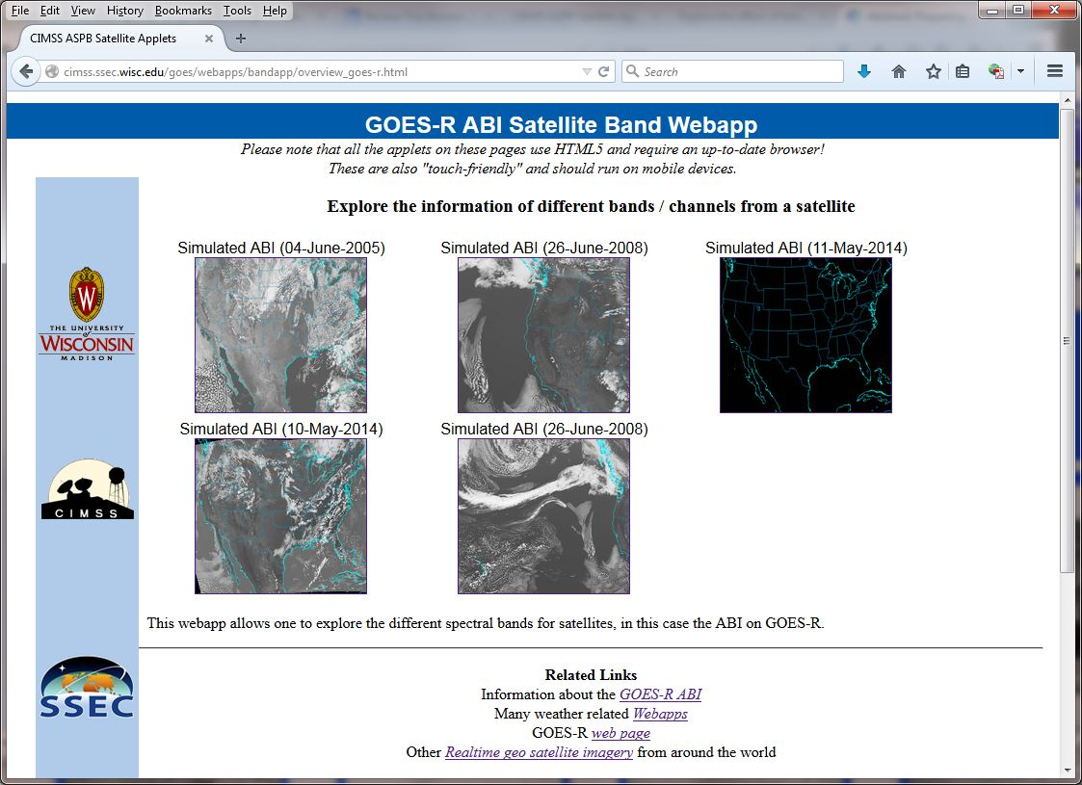
http://cimss.ssec.wisc.edu/goes/webapps/bandapp/overview.html

Slide 26
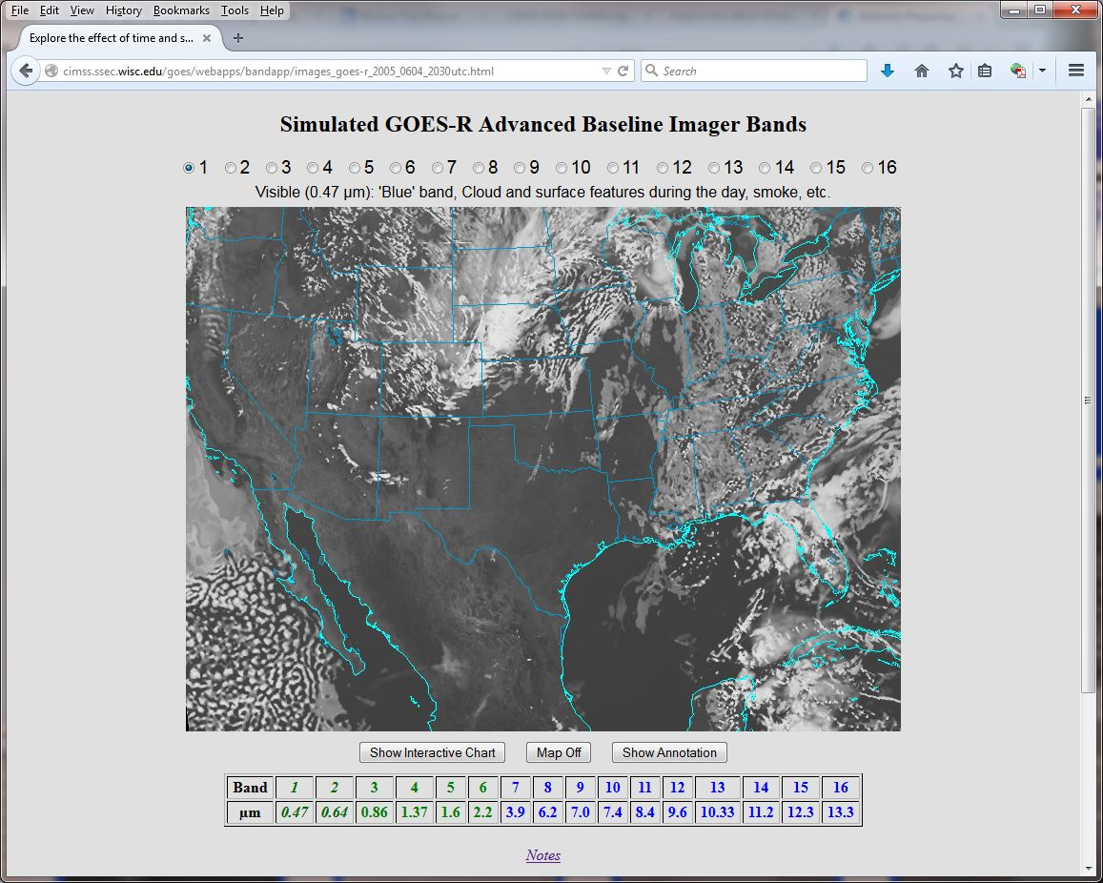
http://cimss.ssec.wisc.edu/goes/webapps/bandapp/overview.html

Slide 27
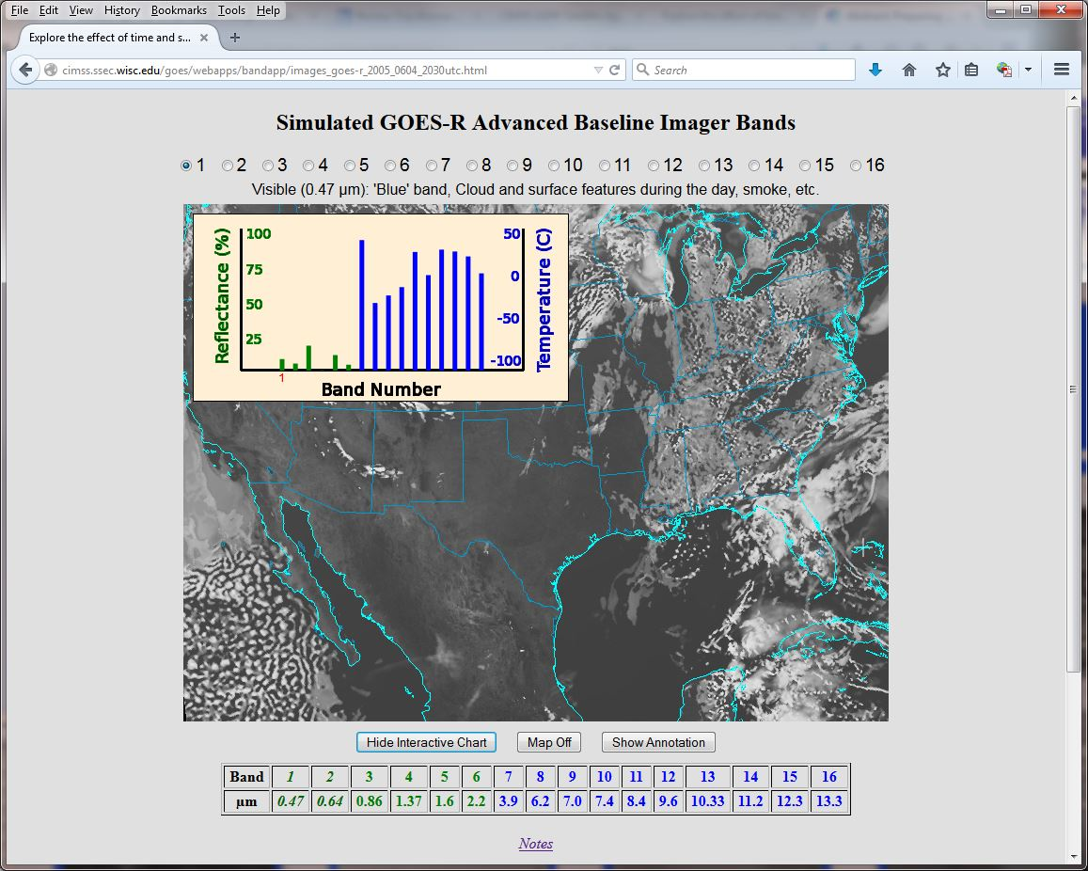
http://cimss.ssec.wisc.edu/goes/webapps/bandapp/overview.html
Land

Slide 28
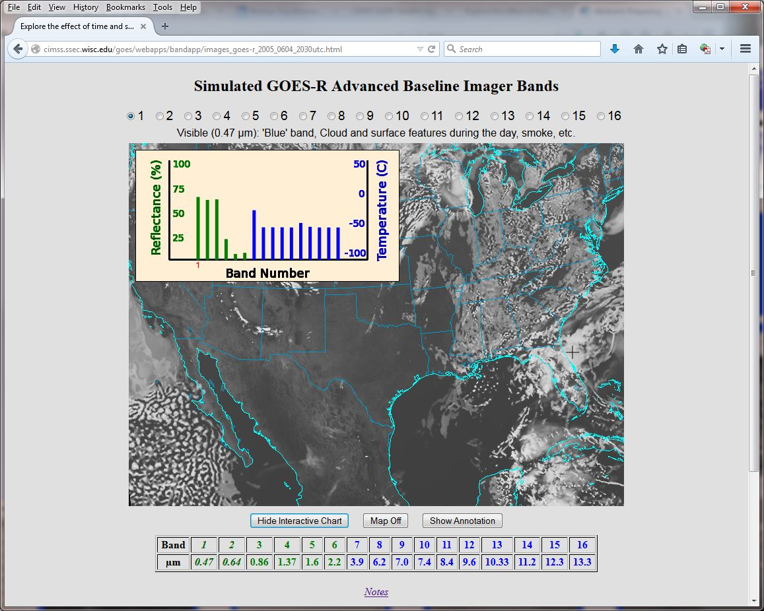
http://cimss.ssec.wisc.edu/goes/webapps/bandapp/overview.html
Cloud

Slide 29
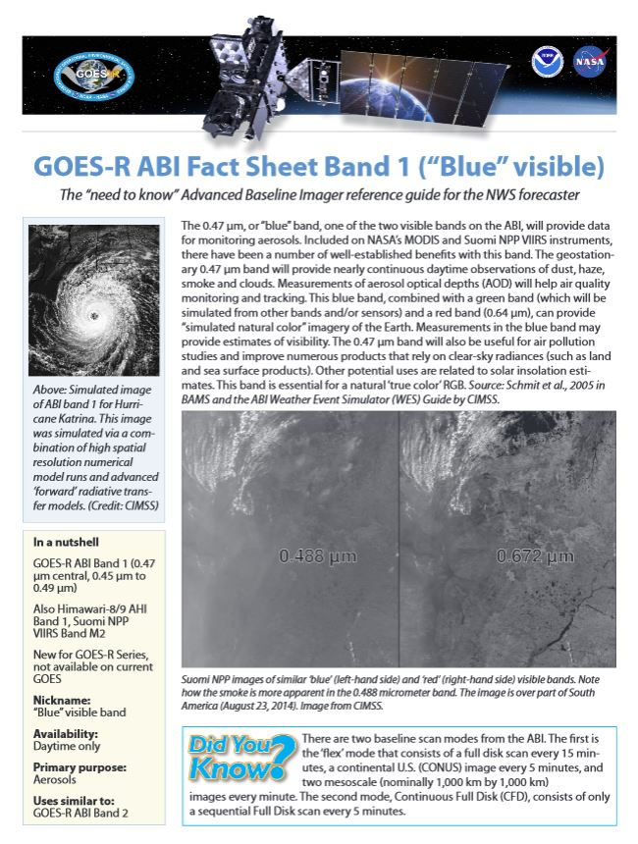
ABI Band Fact Sheets
http://www.goes-r.gov/education/ABI-bands-quick-info.html

Slide 30
Outline
Background/Instrument
  8 to 16 spectral bands, scan options, etc.
Simulations
  triplets, WES, WRF Chem,
  NSSL-WRF
Education/Training
  COMET, VISIT, WF, webapps, papers, conferences, web pages, short courses
Other sensors
  AVIRIS, MAS, MODIS, SEVIRI, VIIRS, AHI, and SRSOR (GOES-14)
Lockheed Martin

Slide 31
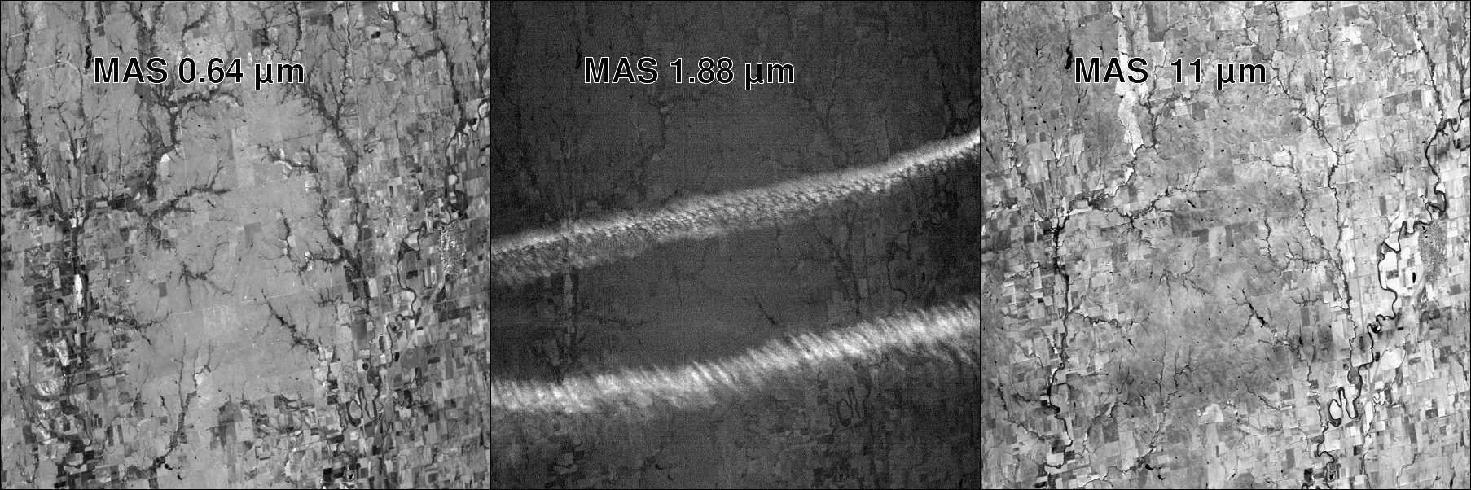
MODIS Airborne Simulator (MAS)
April 26, 1996
Note the cirrus clouds in the center image

Slide 32
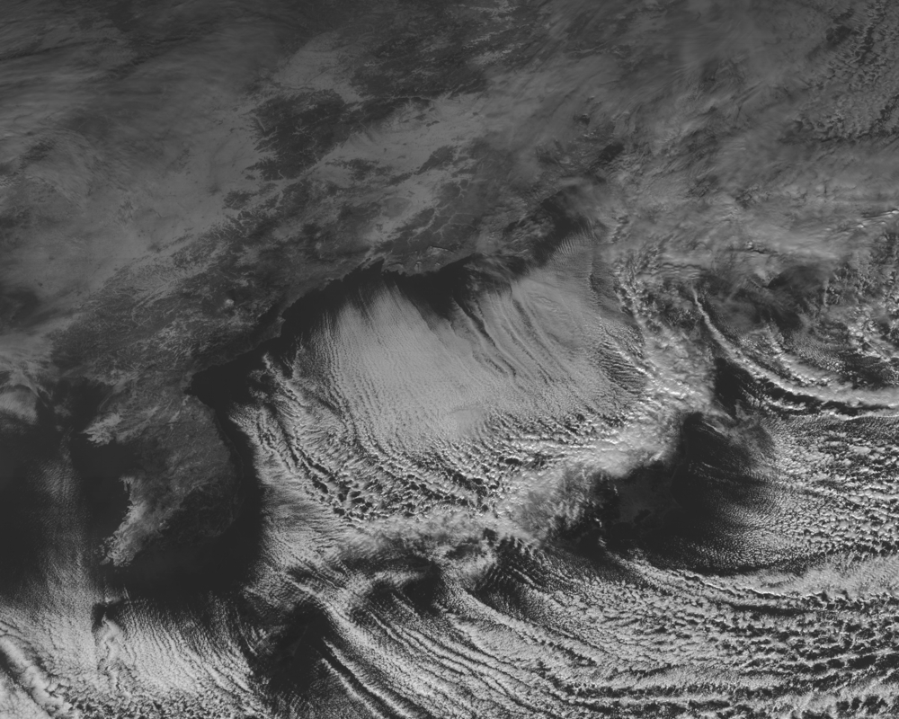
JMA’s AHI: 0.47 um
Notes:
December 18, 2014

Slide 33
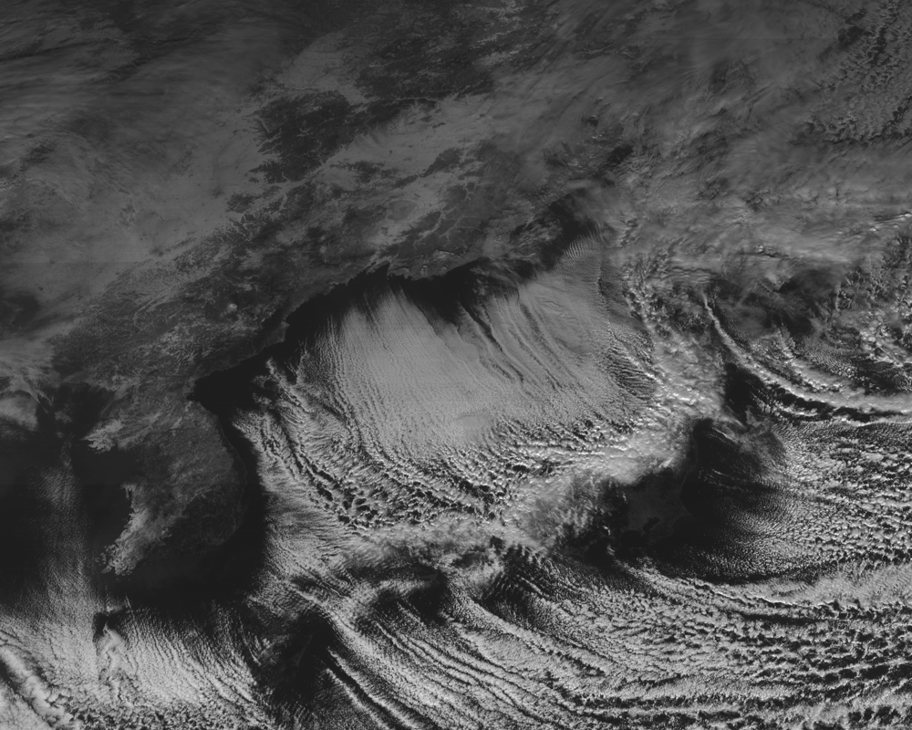
JMA’s AHI: 0.52 um

Slide 34
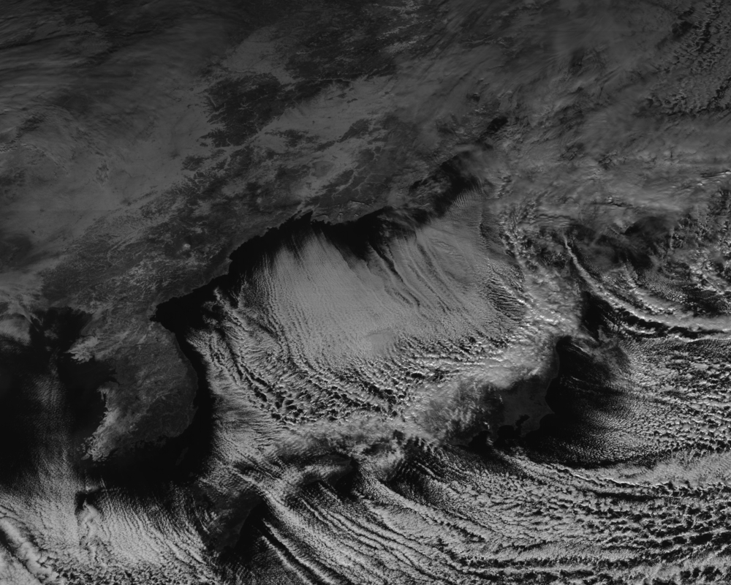
JMA’s AHI: 0.64 um

Slide 35
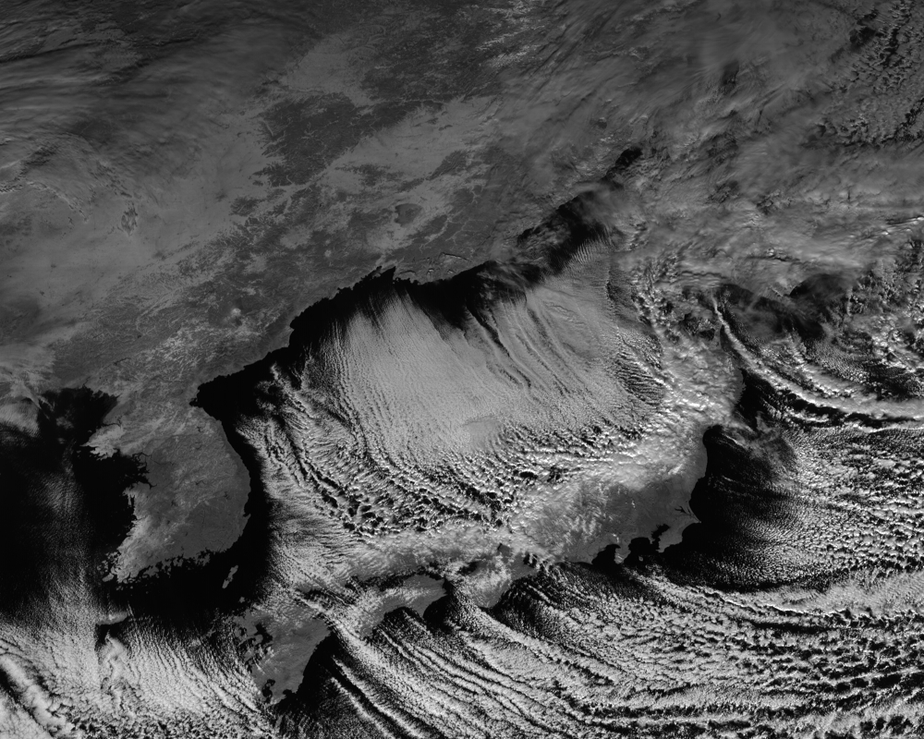
JMA’s AHI: 0.86 um

Slide 36
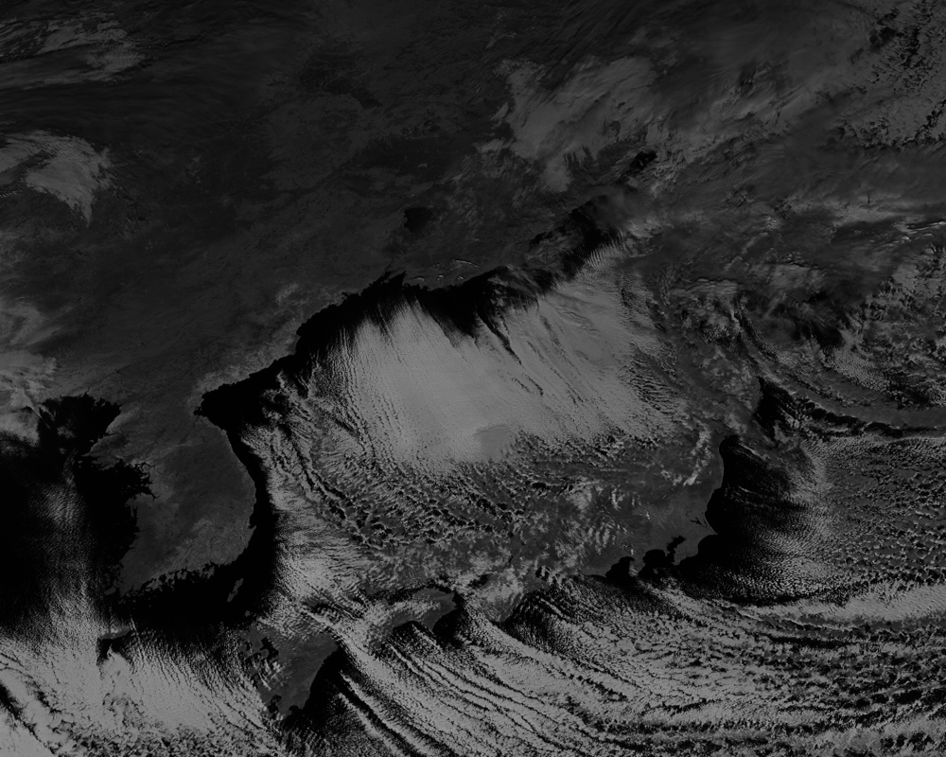
JMA’s AHI: 1.6 um

Slide 37
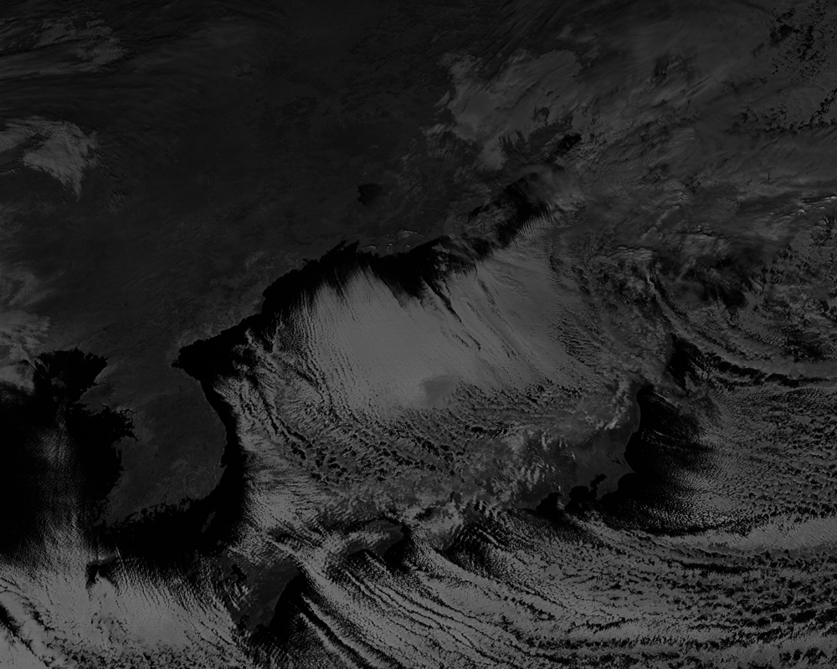
JMA’s AHI: 2.3 um

Slide 38
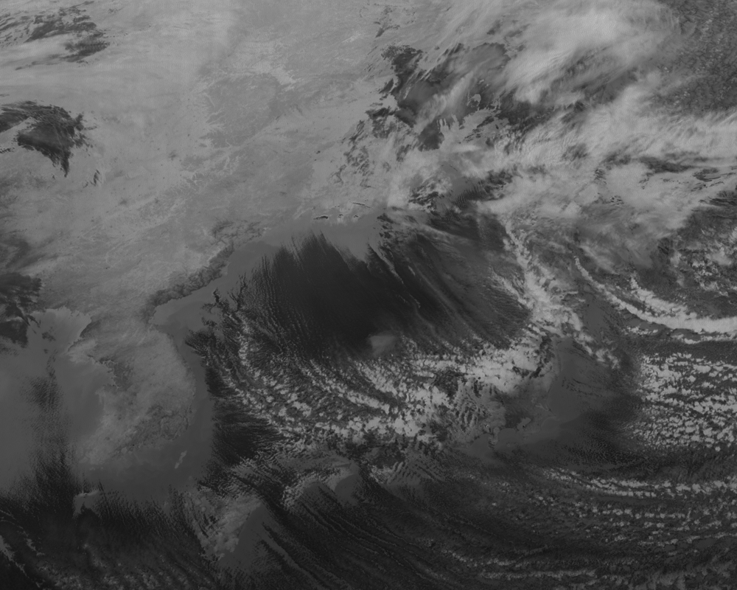
JMA’s AHI: 3.9 um

Slide 39
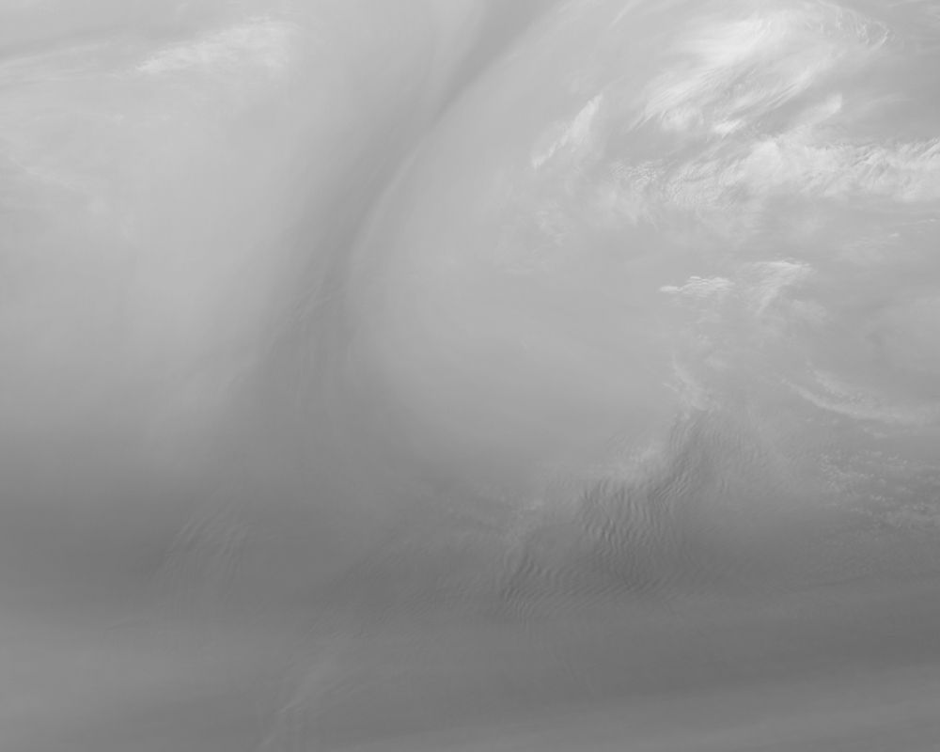
JMA’s AHI: 6.2 um

Slide 40
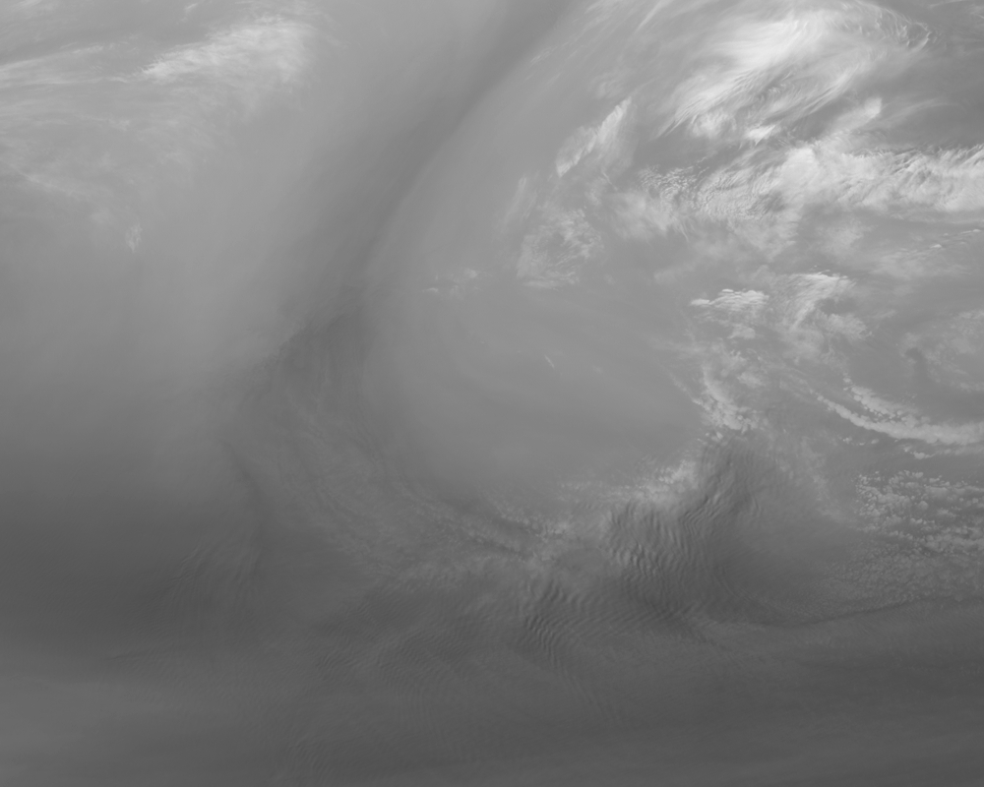
JMA’s AHI: 6.9 um

Slide 41
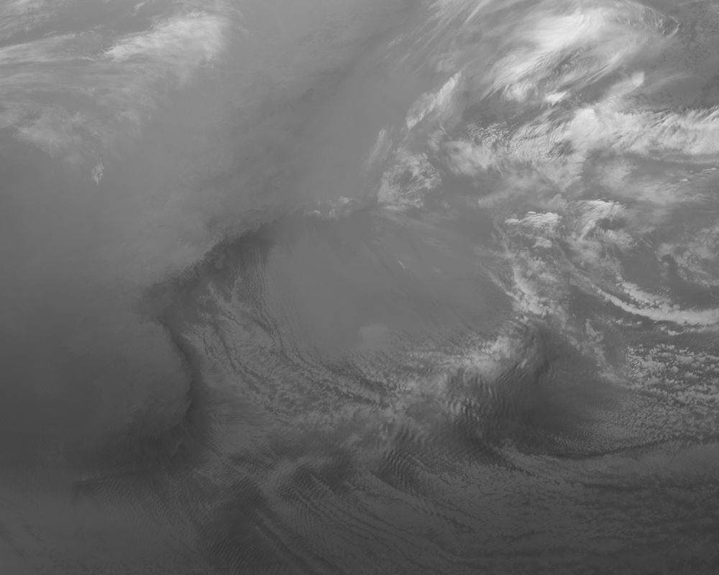
JMA’s AHI: 7.3 um

Slide 42
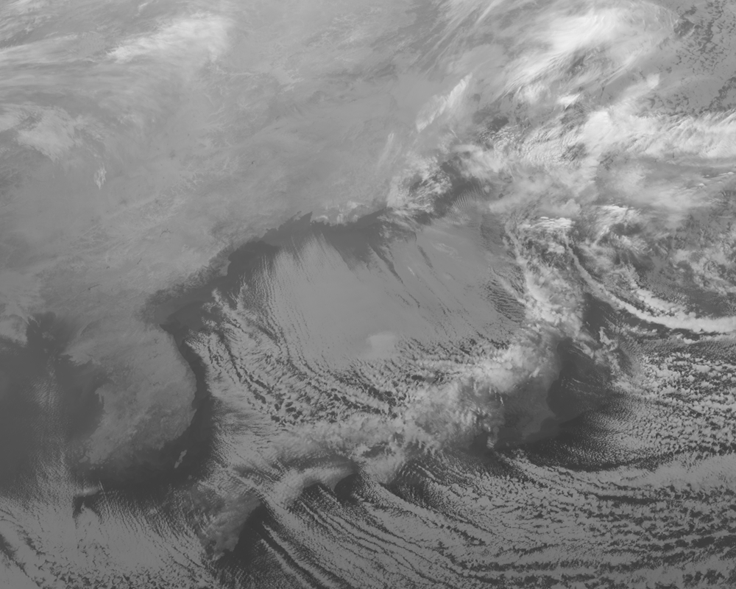
JMA’s AHI: 8.6 um

Slide 43
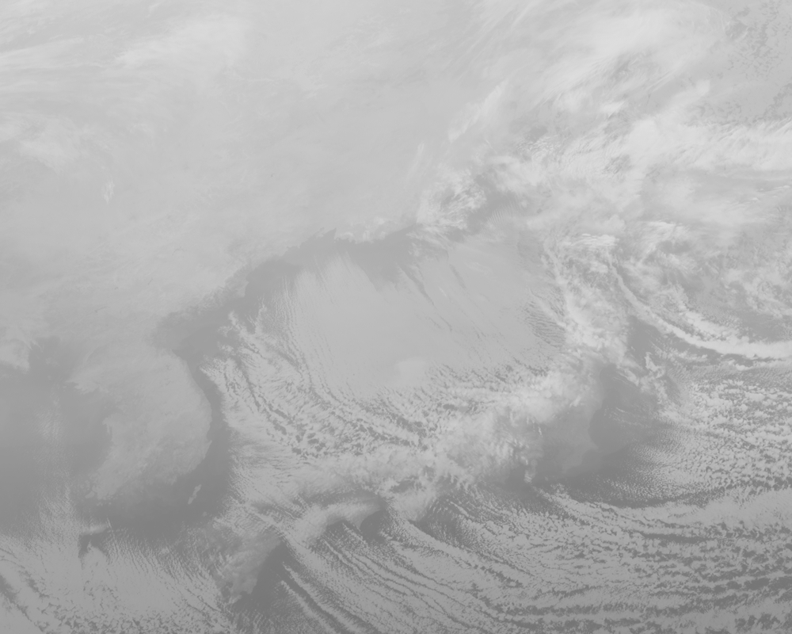
JMA’s AHI: 9.6 um

Slide 44
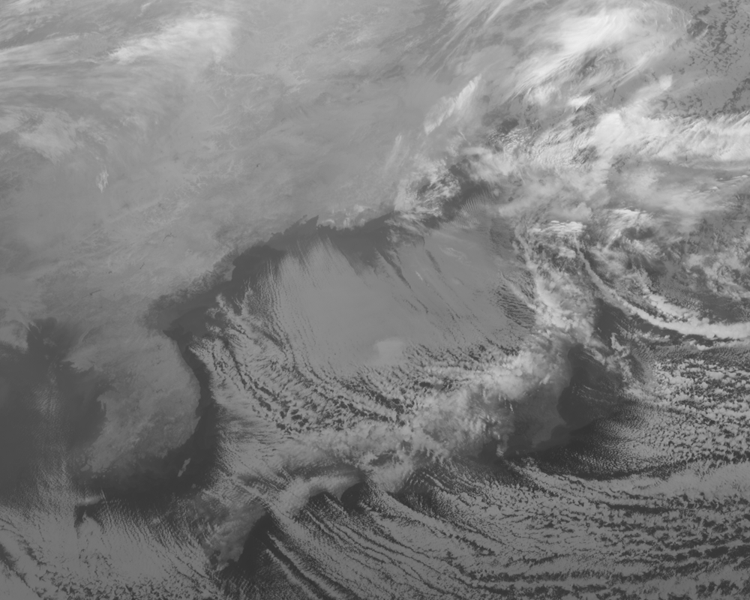
JMA’s AHI: 10.4 um

Slide 45

JMA’s AHI: 11.2 um

Slide 46

JMA’s AHI: 12.4 um

Slide 47
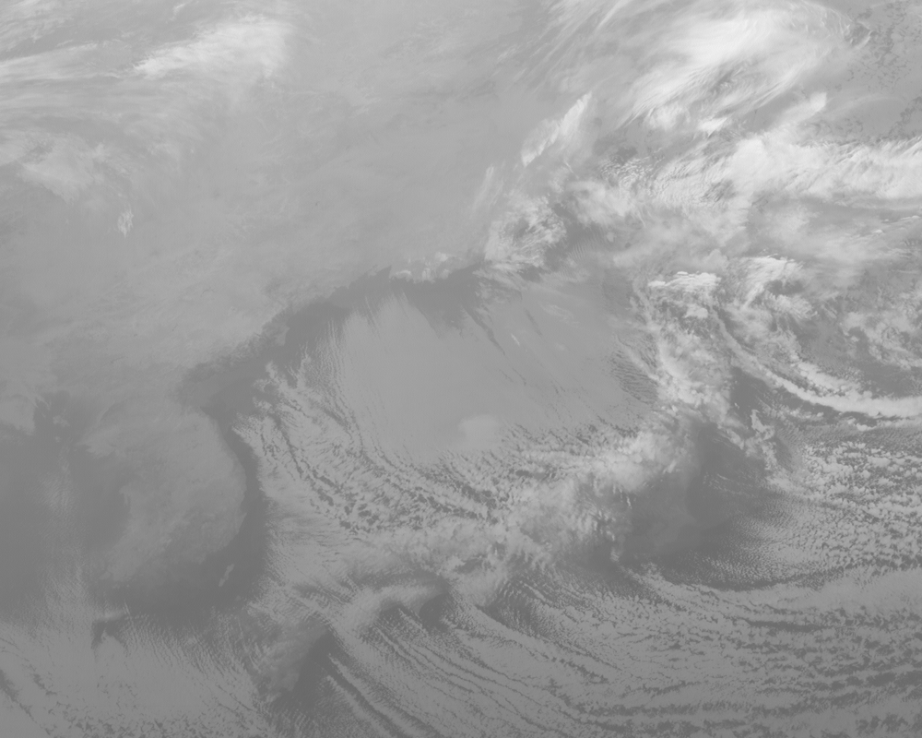
JMA’s AHI: 13.3 um
http://www.jma.go.jp/jma/jma-eng/satellite/news.html
http://cimss.ssec.wisc.edu/goes/blog/archives/category/himawari-8
http://cimss.ssec.wisc.edu/goes/webapps/bandapp/overview_ahi_first_light.html

Slide 48
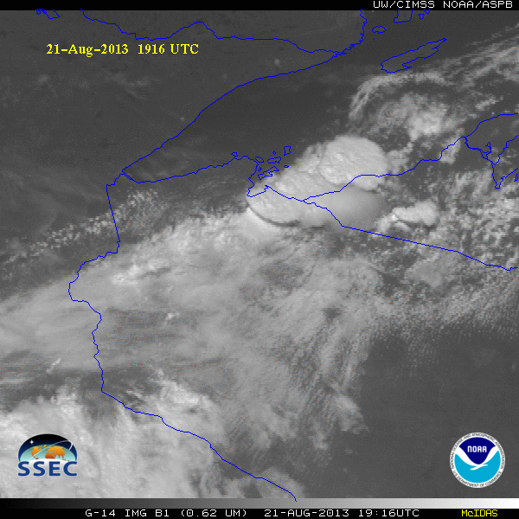
GOES-14 Super Rapid Scan Operations to Prepare for GOES-R (SRSOR)
SRSOR plans for 2015 include May 18-June 12, and August 10-22:
  http://cimss.ssec.wisc.edu/goes/srsor2015/GOES-14_SRSOR.html
  Data during parts of 2012 (Hurricane Sandy, convection), 2013 (CA Rim Fire, convection) and 2014 (Hurricane Marie, convection):
  http://cimss.ssec.wisc.edu/goes/srsor/GOES-14_SRSOR.html
  http://cimss.ssec.wisc.edu/goes/srsor2013/GOES-14_SRSOR.html
  http://cimss.ssec.wisc.edu/goes/srsor2014/GOES-14_SRSOR.html
GOES-14 provided very unique data and offered a glimpse into the possibilities that will be provided by the ABI on GOES-R in one minute mesoscale imagery
GOES-14 visible image showing rapid convective development

Slide 49
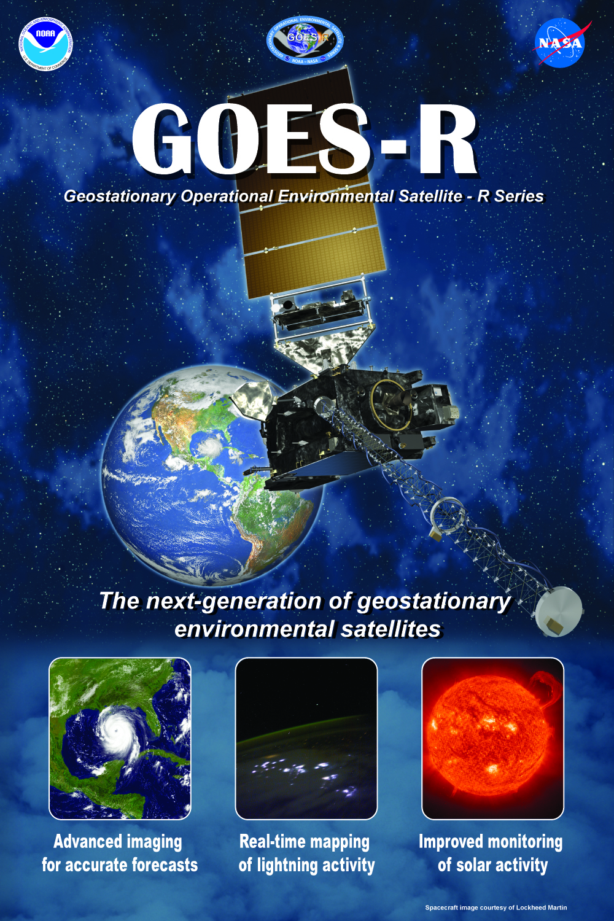


Thank you!
For more information visit www.goes-r.gov

