Slide 1
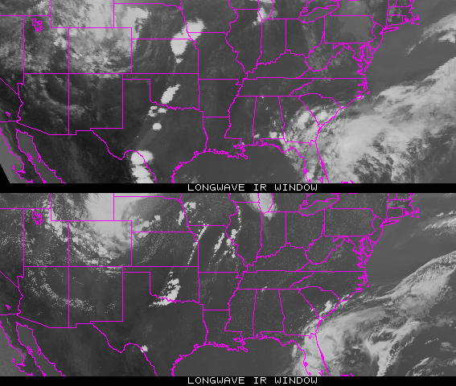
Real or Simulated?
Notes:
Both remapped to 10km. Top panel is the real.

Slide 2
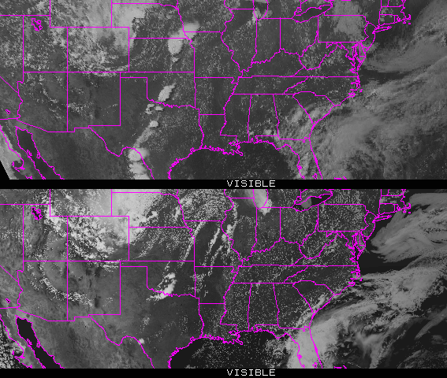
Real or Simulated?
Notes:
Both remapped to 10km. Top panel is the real.

Slide 3
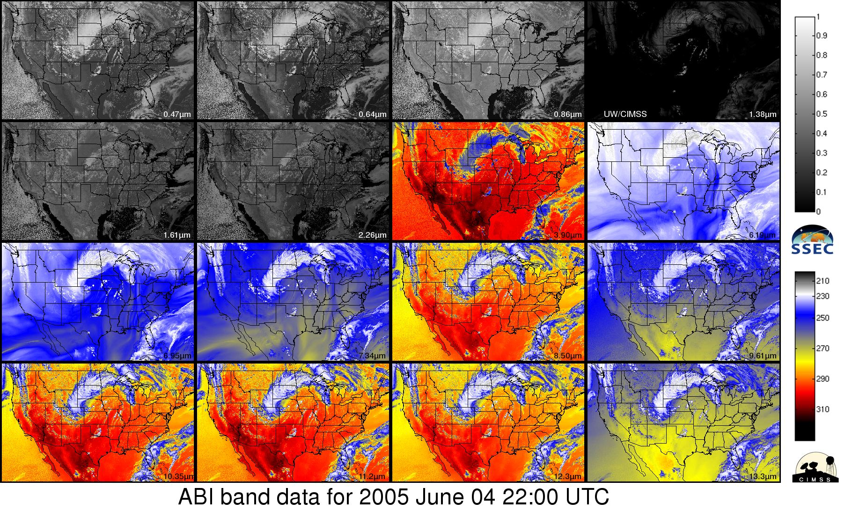
ABI bands via NWP simulation (CIMSS AWG Proxy Team)

Slide 4
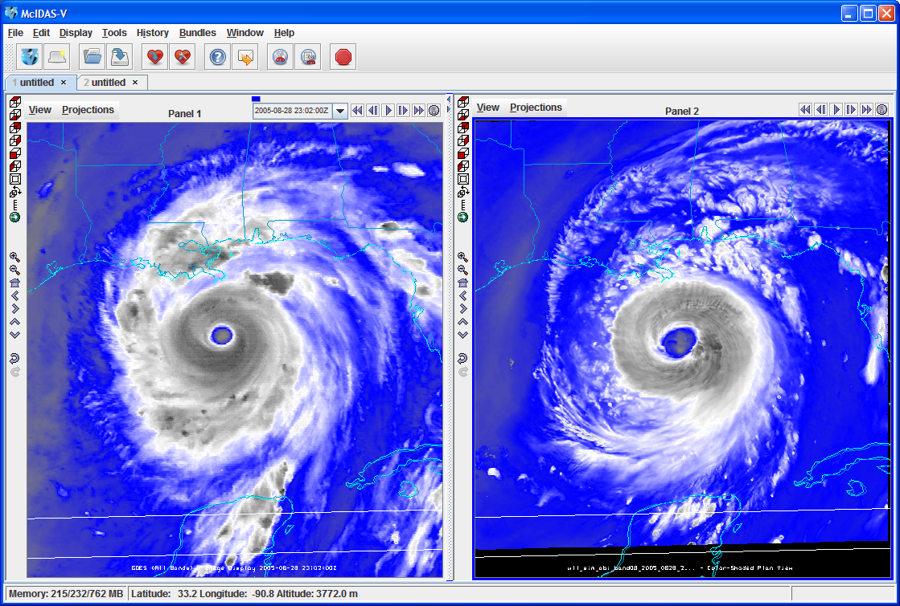
GOES Imager
GOES-R ABI
One is from a McIDAS AREA, while the other (simulated image) is from a netCDF.

Slide 5
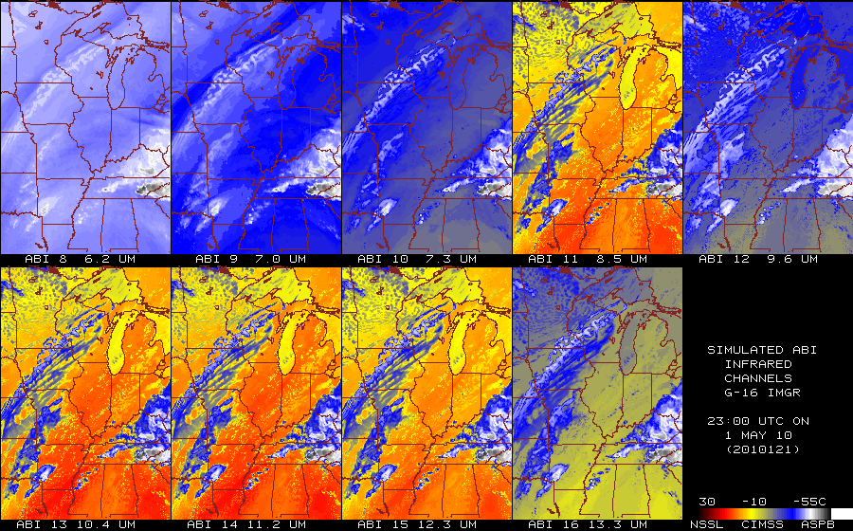
Calculated ABI bands
(subset)
From NSSL WRF
5

Slide 6
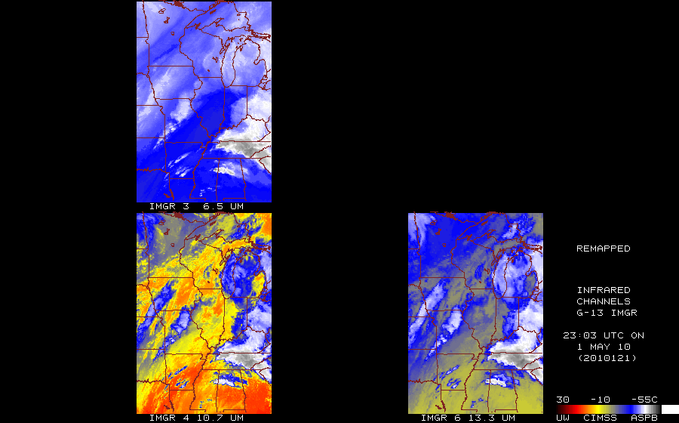
Observed GOES-13 Imager
http://cimss.ssec.wisc.edu/goes_r/proving-ground/nssl_abi/nssl_wrf_goes.html
6

Slide 7
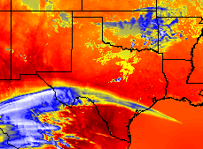
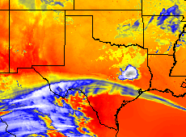
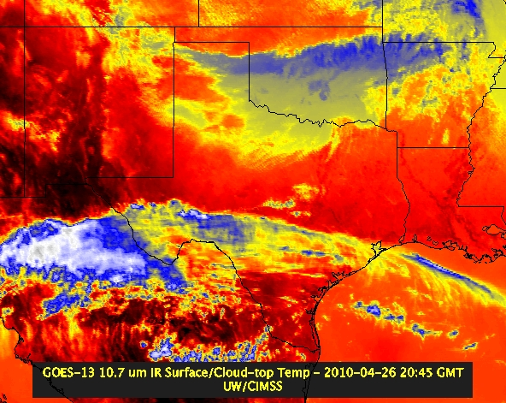
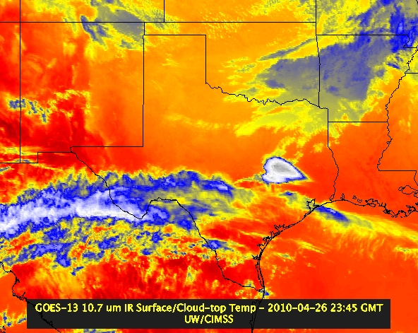
NSSL WRF and GOES Imager
“ABI” 21 UTC
“ABI” 00 UTC
GOES-13 21:15 UTC
GOES-13 23:45 UTC

Slide 8
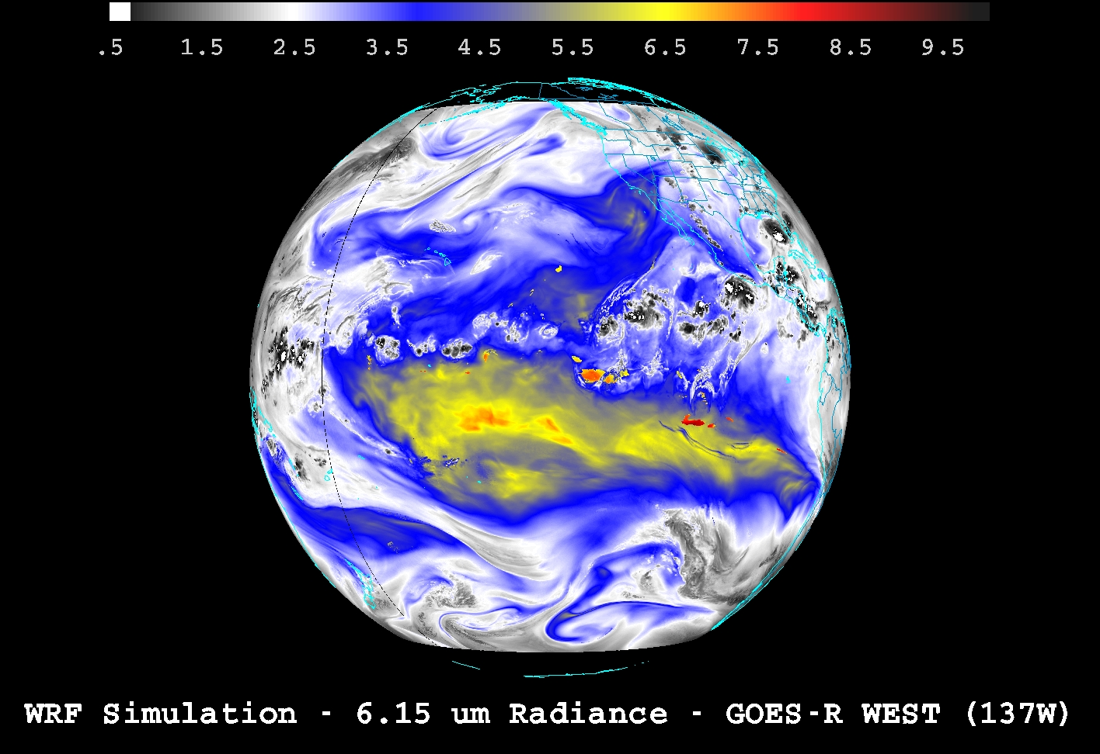
Demonstrating ABI “Fixed Grid Format” (FGF) from 137W
SSEC

Slide 9
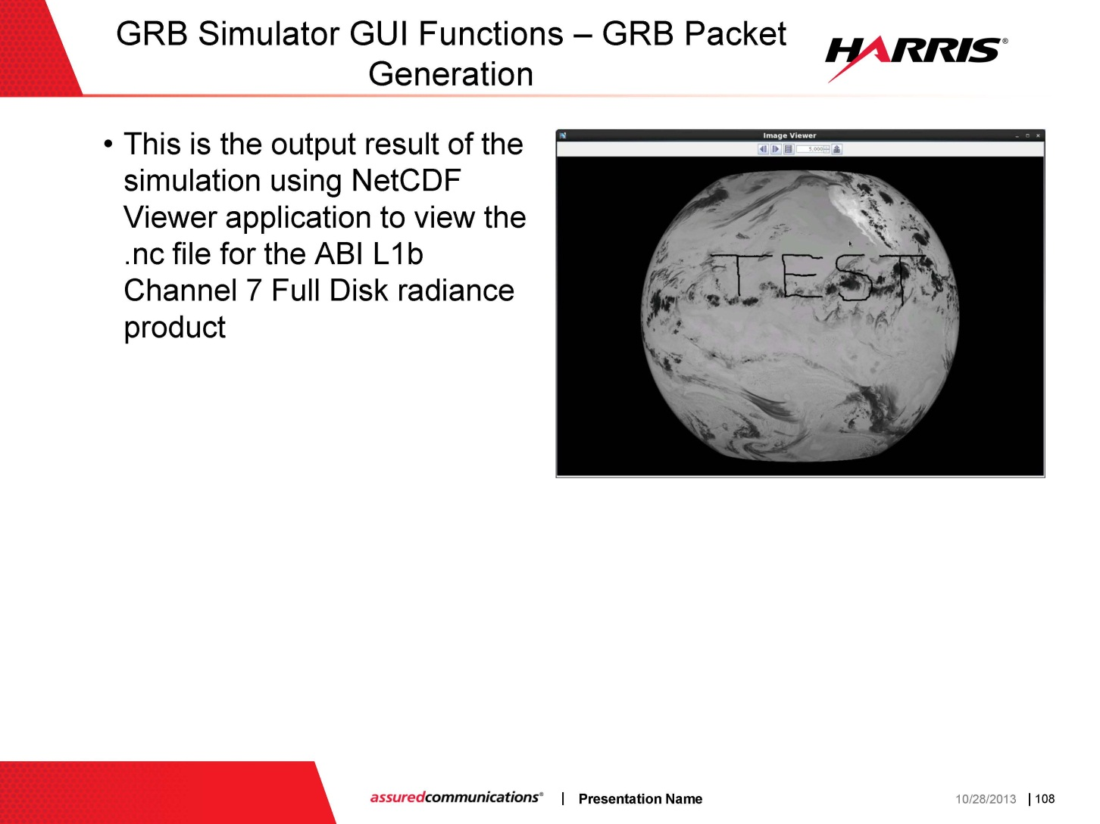
GRB Simulator (FD)
From GRB Simulator Industry Day

Slide 10
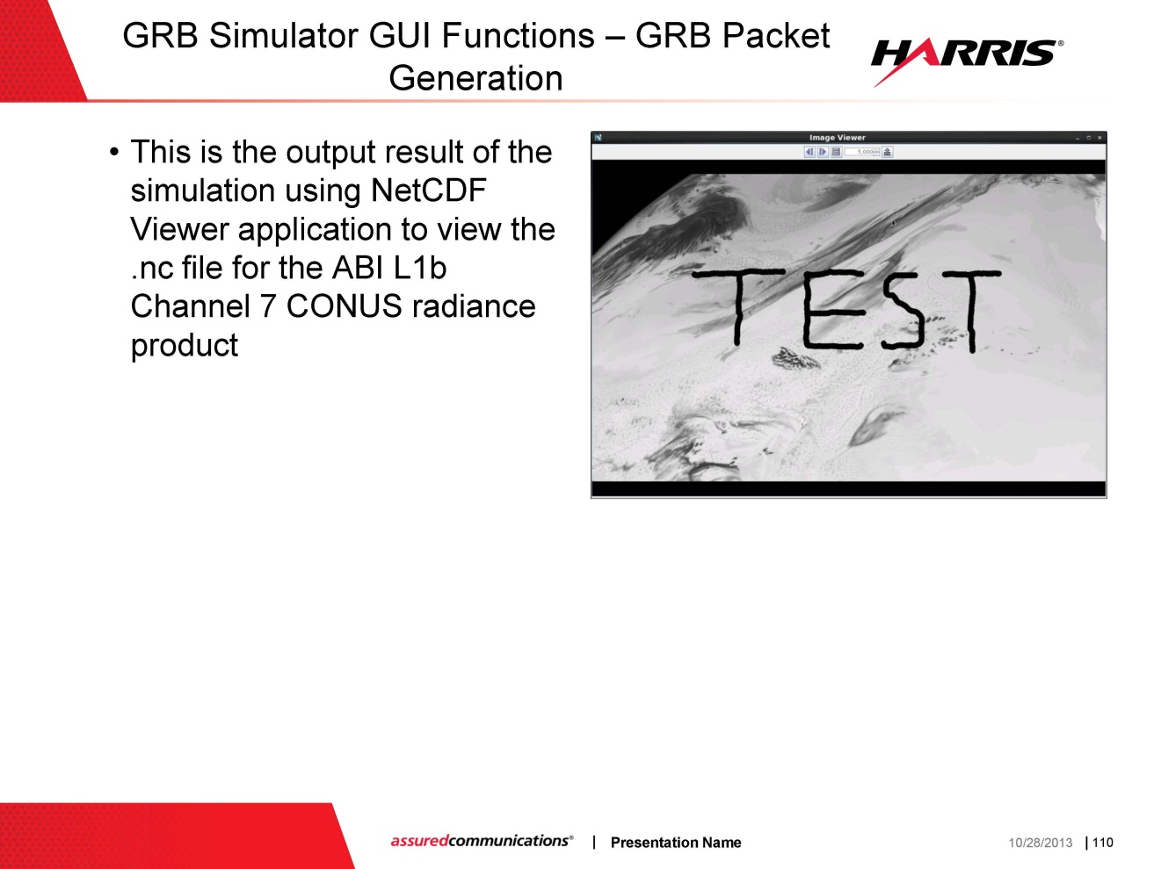
GRB Simulator (CONUS)
From GRB Simulator Industry Day

Slide 11
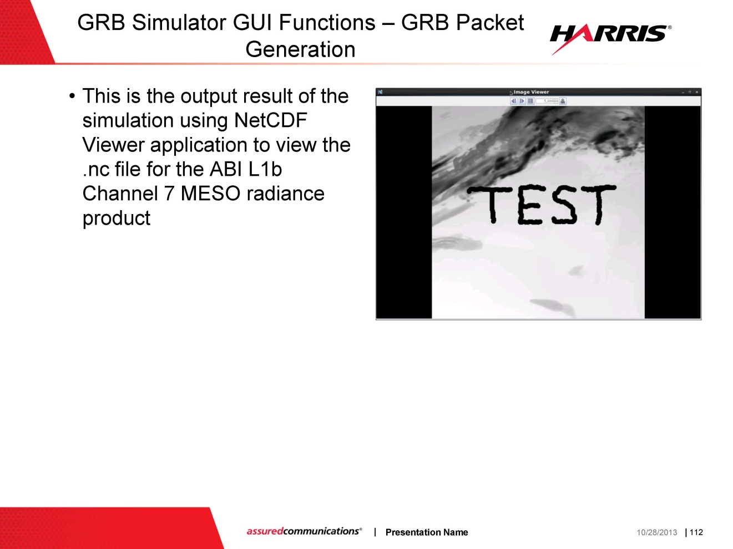
GRB Simulator (meso)
From GRB Simulator Industry Day

Slide 12
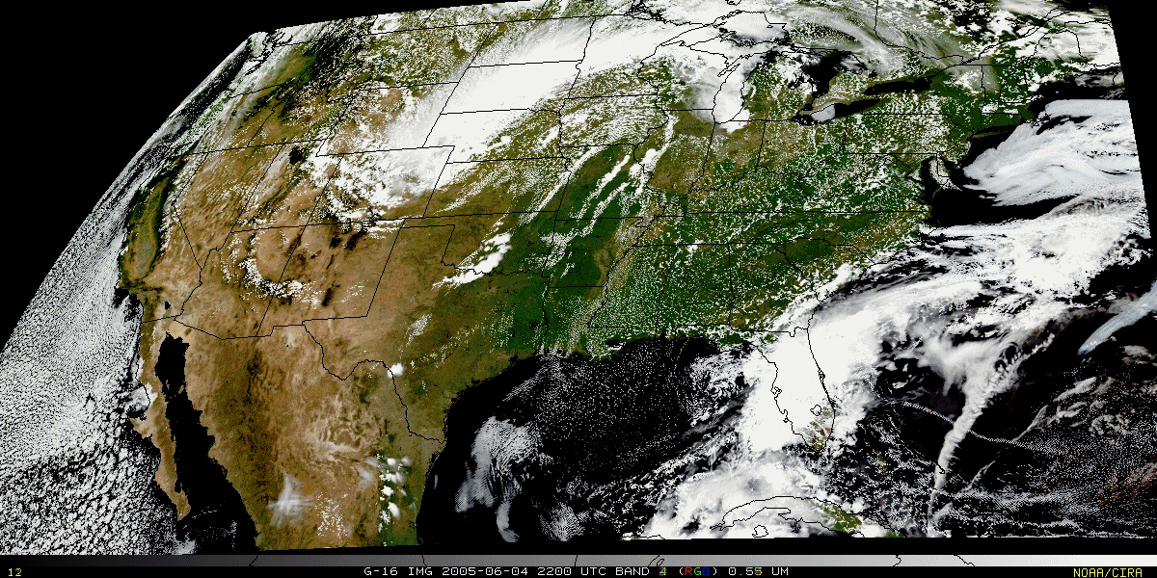
Validation – image combination
“True Color” with “synthetic” green band from ABI simulated data (from CIMSS); image from Don Hillger, RAMMB.

Slide 13

Validation – image combination movie
“True Color” with “synthetic” green band movie from ABI simulated data (from CIMSS); image from Don Hillger, RAMMB.

Slide 14
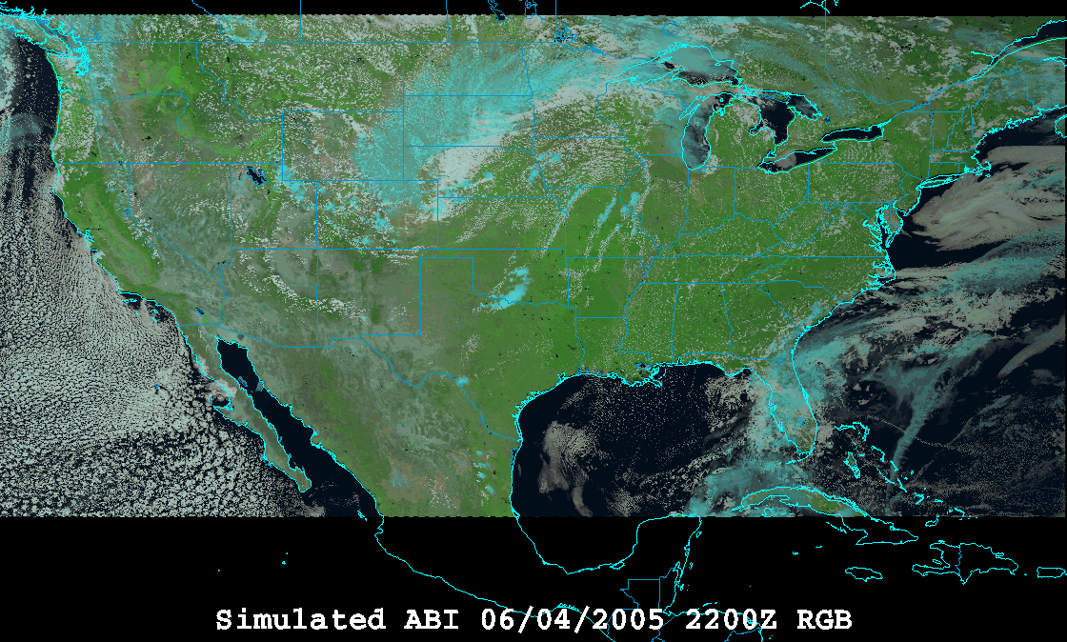
Validation – image combination
“RGB Color” (VIS 0.6, VIS 0.8, and NearIR 1.6 um) with ABI simulated data (from CIMSS); image from William Straka, CIMSS and using the EUMETSAT enhancement.

Slide 15
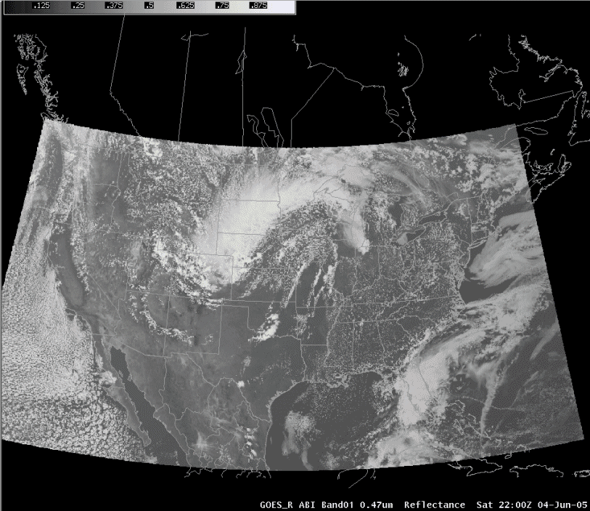
ABI in AWIPS (via netCDF)
Proxy Team; J. Oktin et al., CIMSS
Simulated Advanced Baseline Imager (ABI) bands shown; in the legacy AWIPS.
Notes:
http://cimss.ssec.wisc.edu/goes/abi/

Slide 16
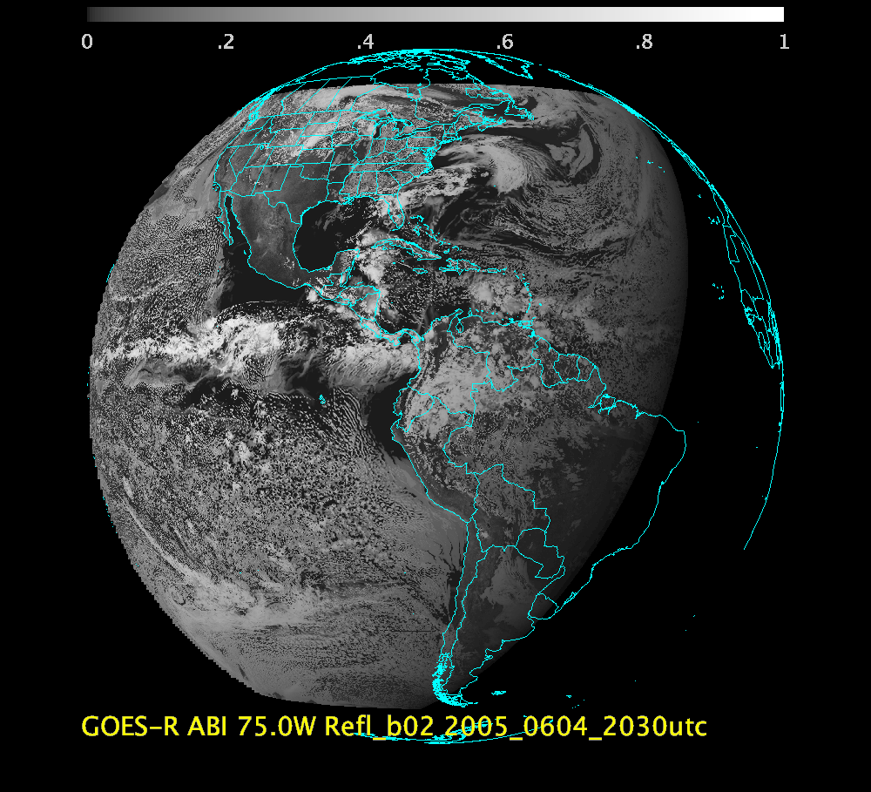
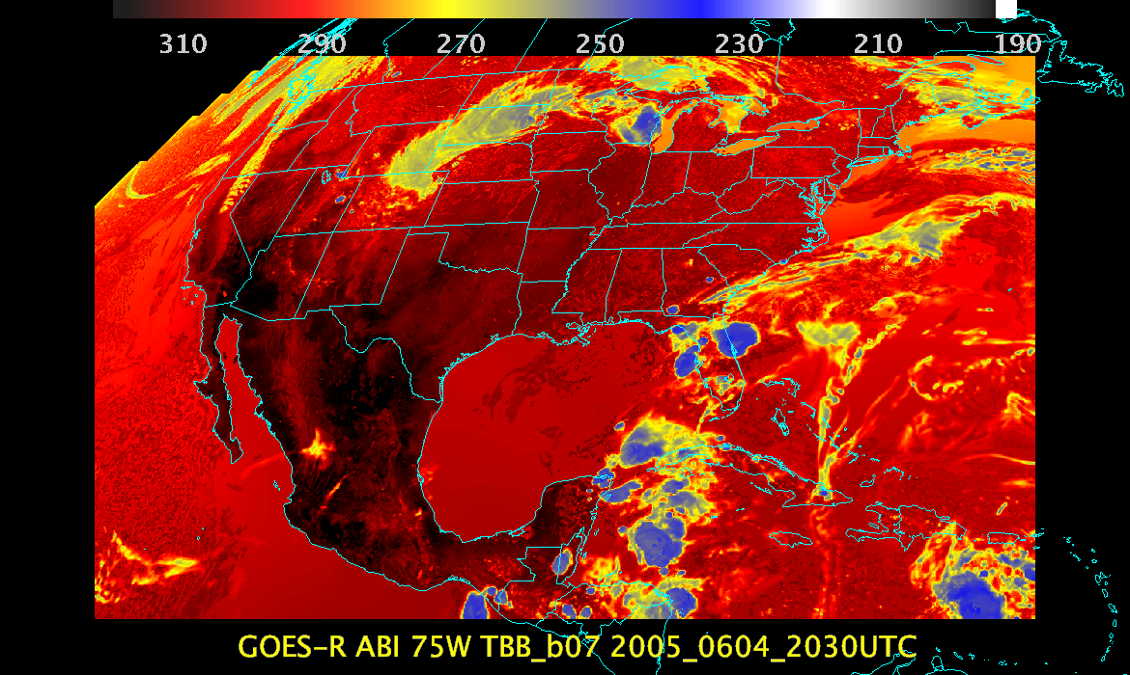
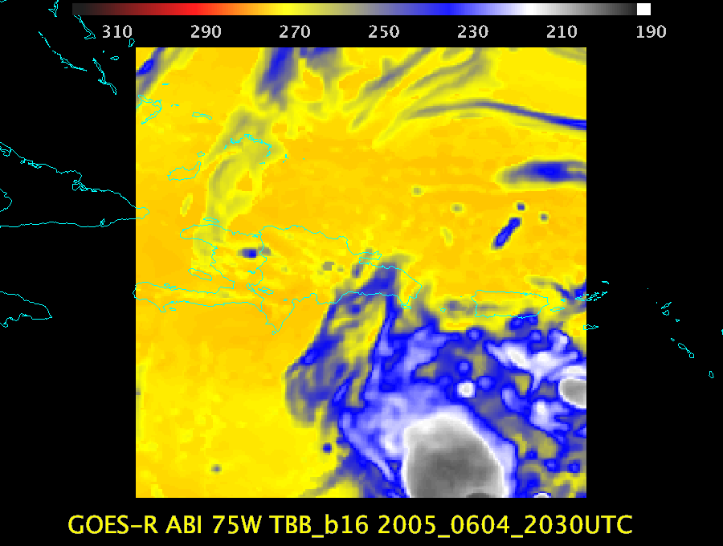
“Triplet” Examples
The “Triplet” refers to the needing at least three time periods for AMV processing.

Slide 17
“Triplet” Datasets
 | 75W | 89.5W | 137W
Model | WRF | WRF | WRF
Number of times | 7 | 7 | TBD
Time range | 20:00-20:30UTC | 20:00-20:30UTC | TBD
Day | 04-Jun-2005 | 04-Jun-2005 | TBD
Sectors | FD, CONUS, MESO | FD, CONUS, MESO | TBD
Types | GRB, VAL | GRB, VAL | TBD
Navigation | FGF | FGF | FGF

Slide 18
In ABI FGF (75W)

Slide 19
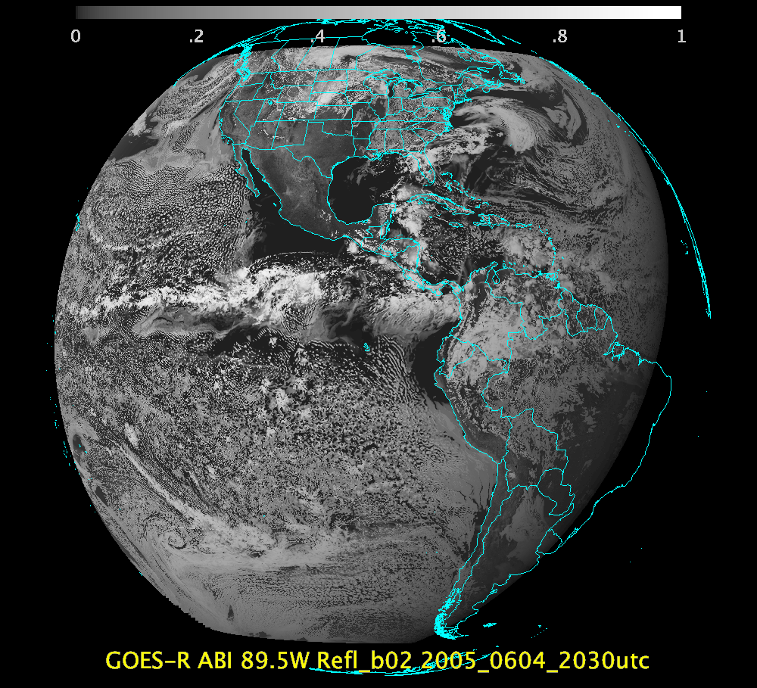
In ABI FGF (89.5W)
SSEC

Slide 20
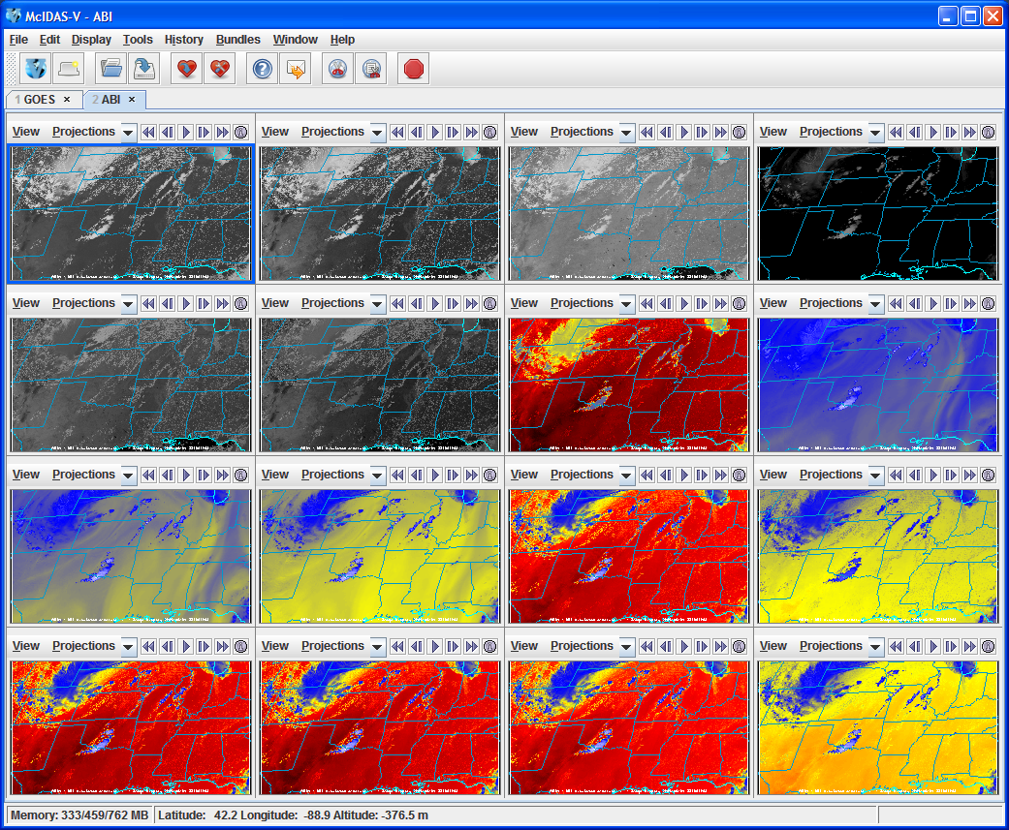
Example CMIP Output ABI bands in McIDAS-V

Slide 21
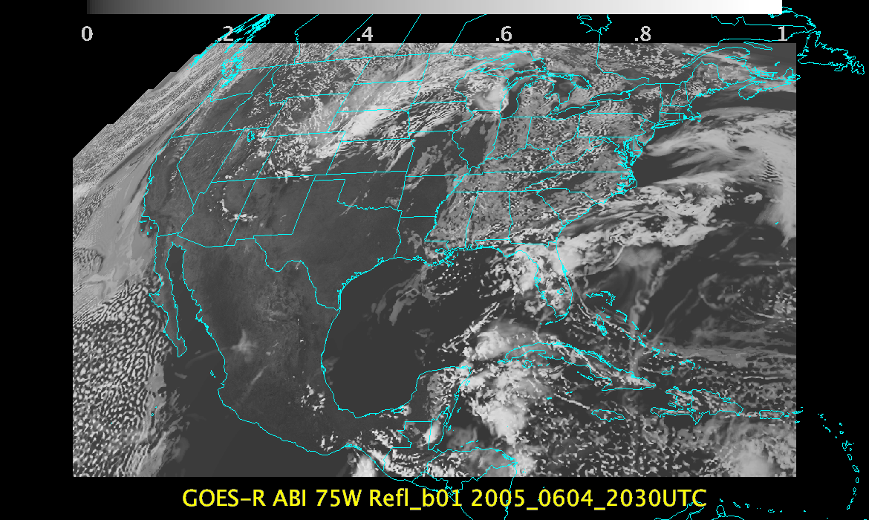

Slide 22
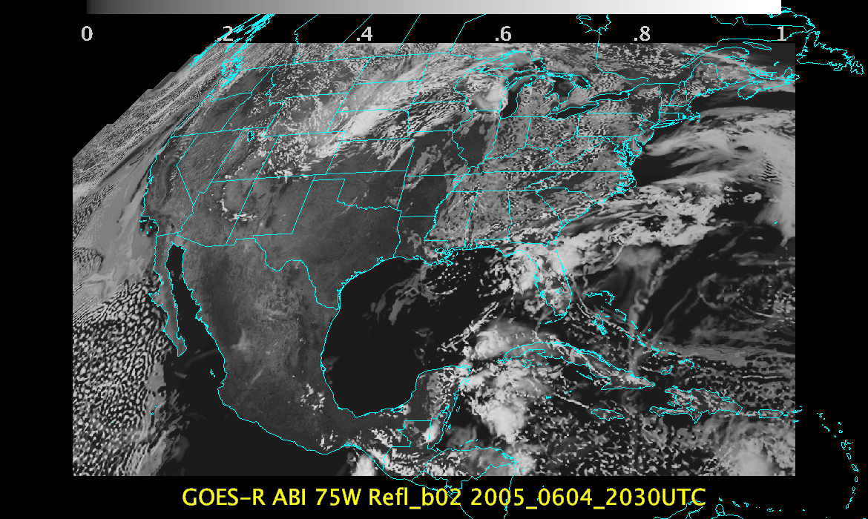

Slide 23
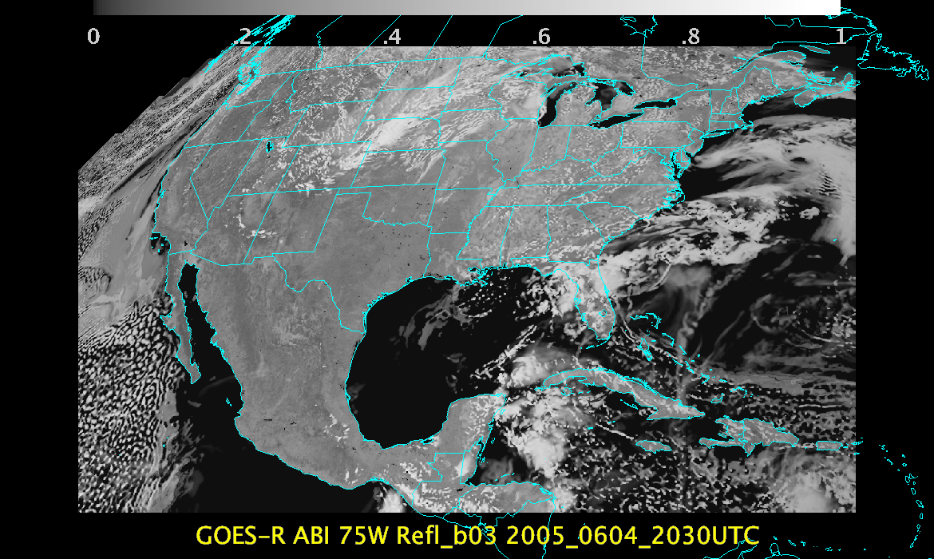

Slide 24
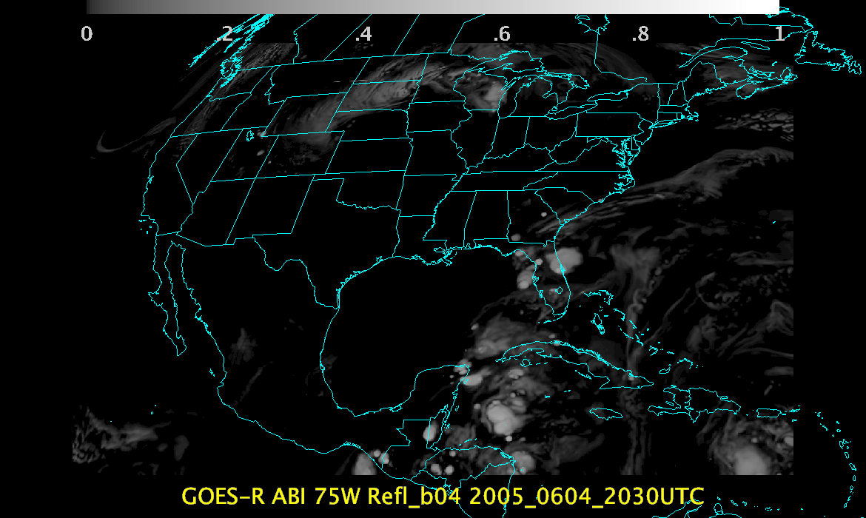

Slide 25
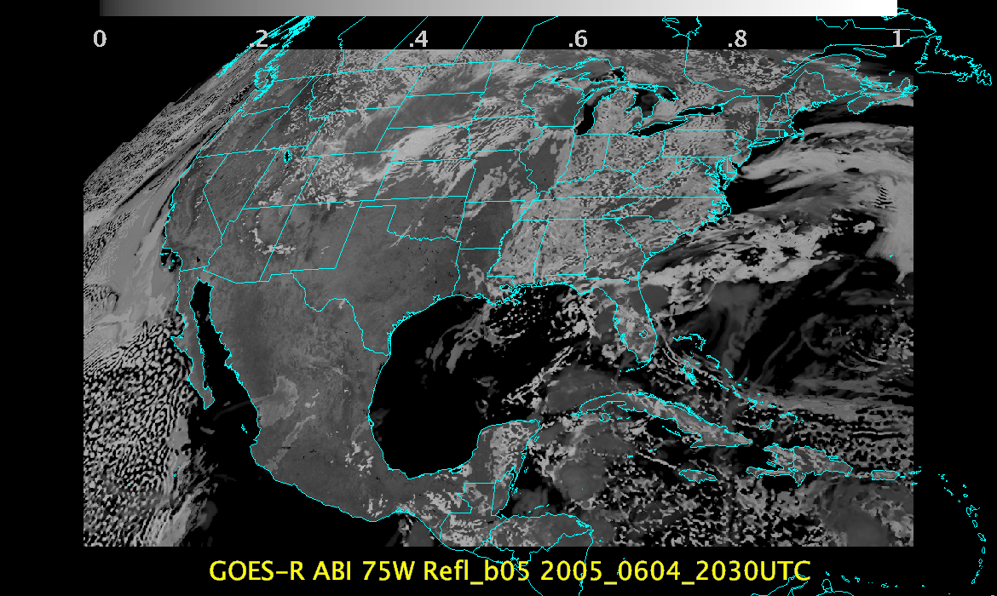

Slide 26
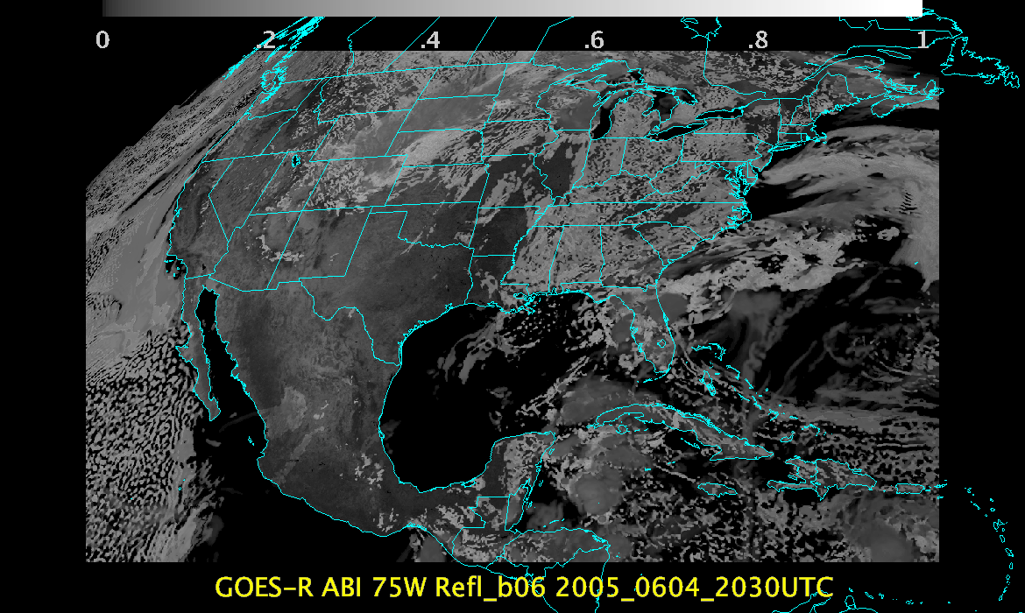

Slide 28
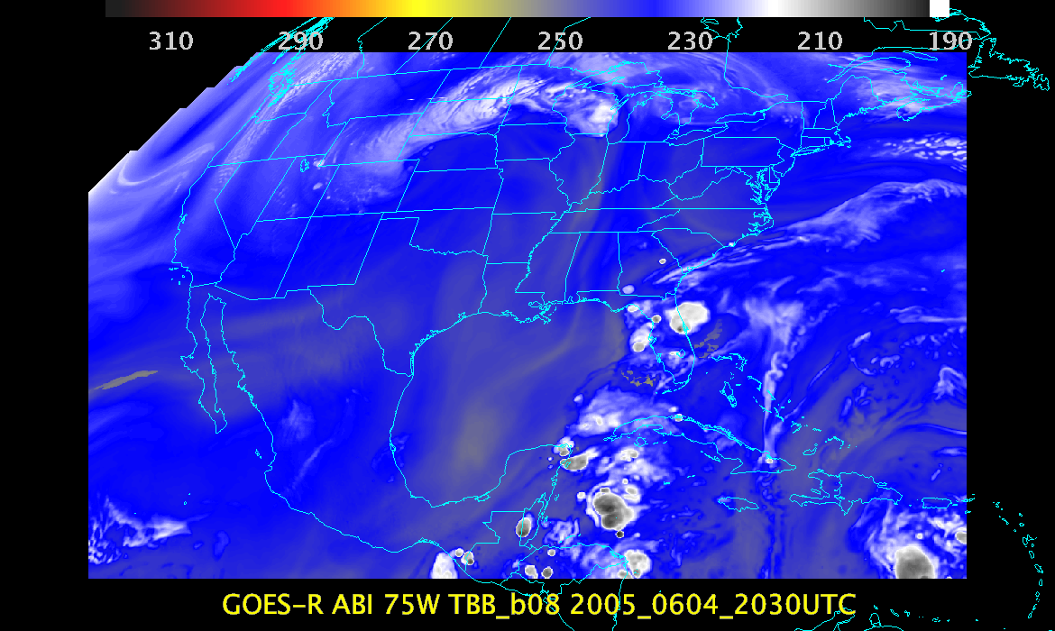

Slide 29
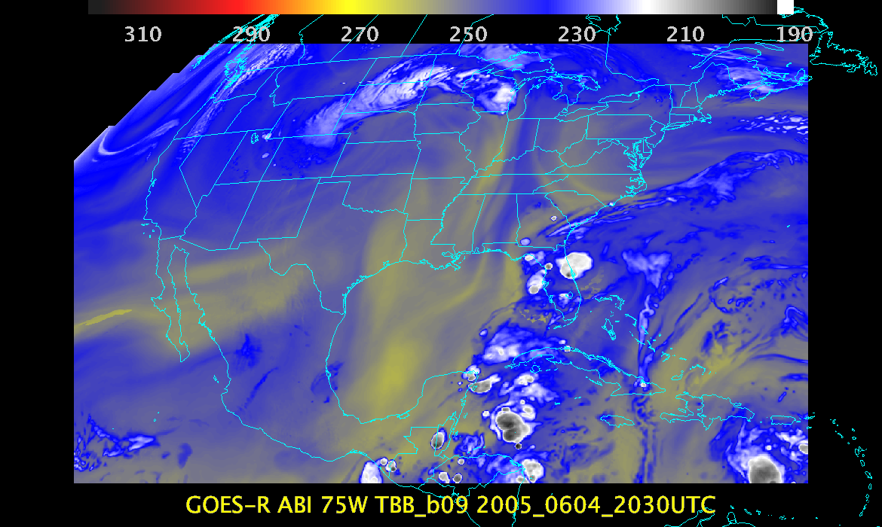

Slide 30
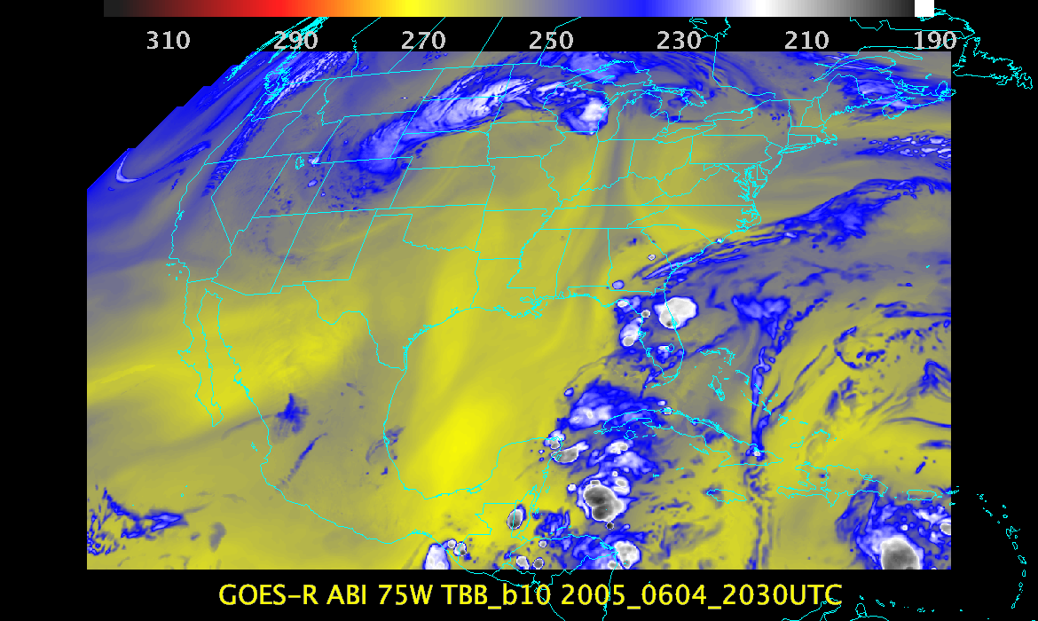

Slide 31
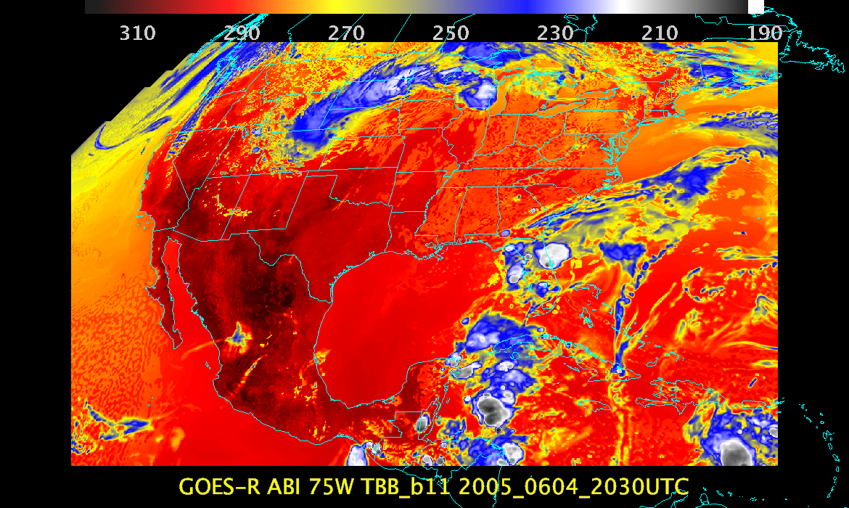

Slide 32
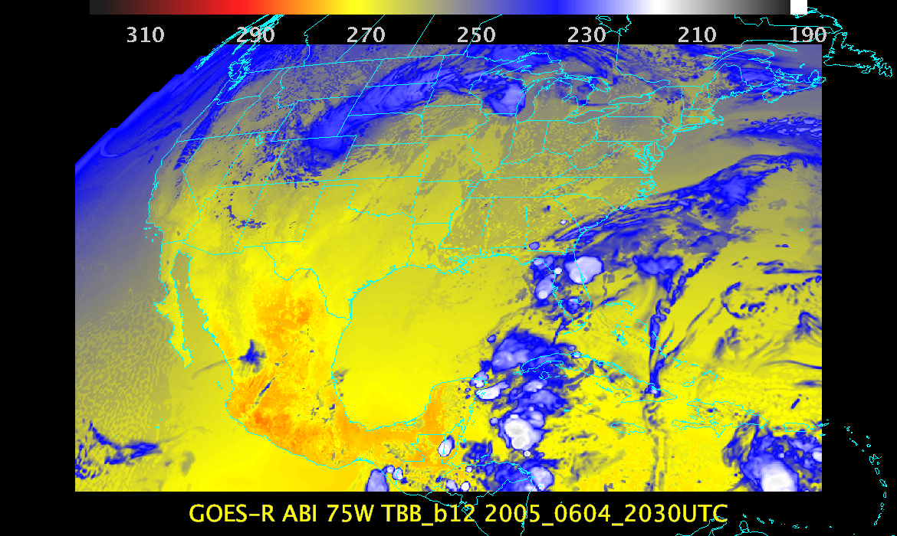

Slide 33
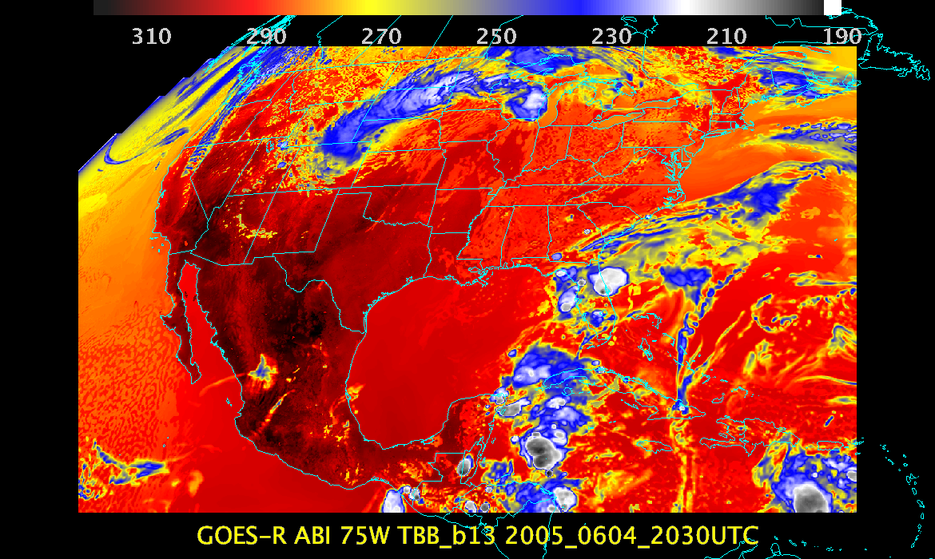

Slide 34
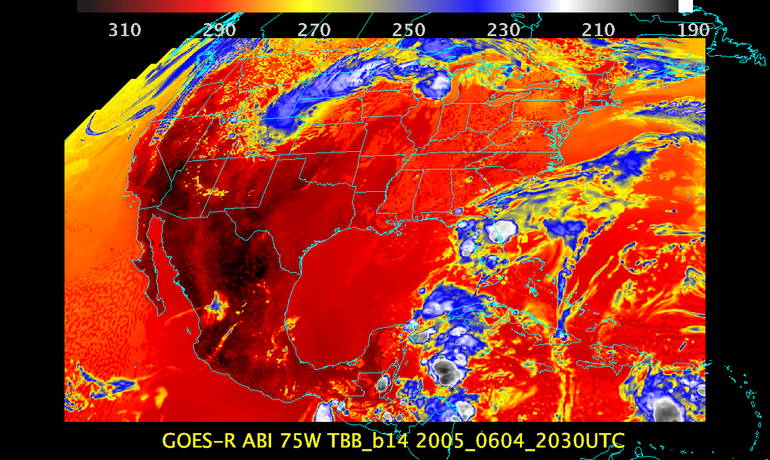

Slide 35
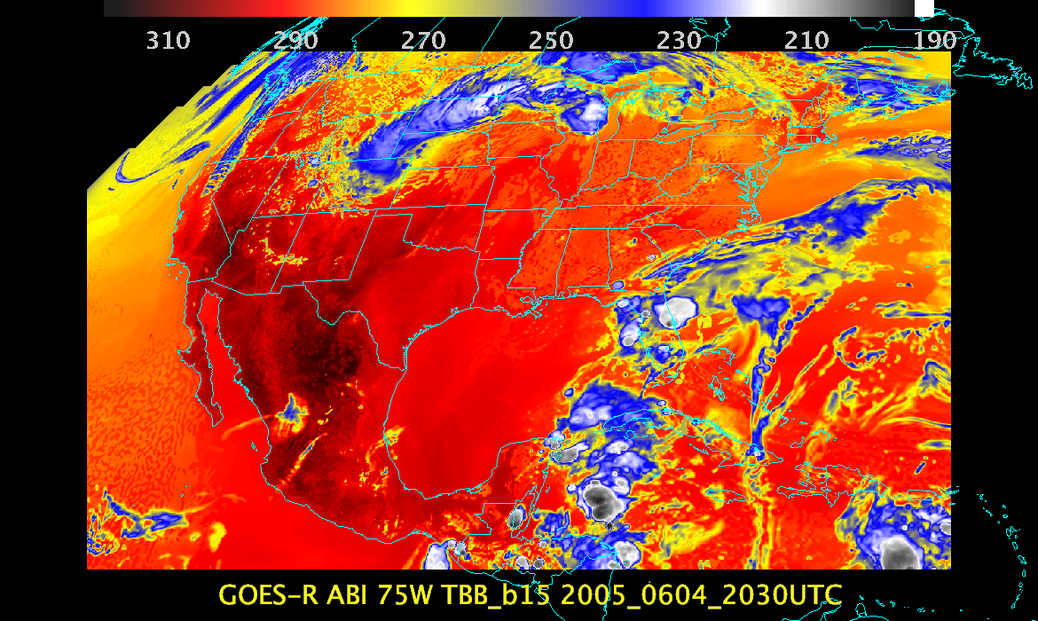

Slide 36
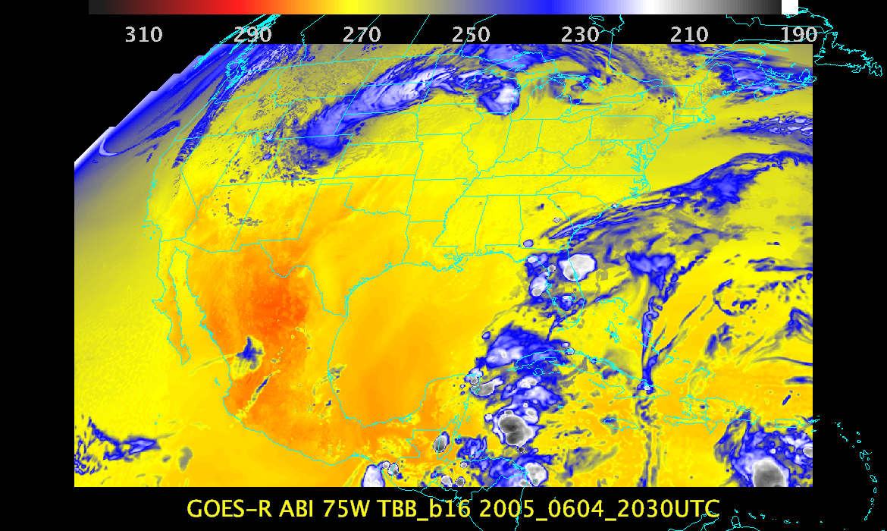

Slide 37
Background
GOES-R AWG realtime proxy system has been developed to:
Provide near-real-time proxy ABI data from WRF-Chem model forecasts over CONUS using the Community Radiative Transfer Model (CRTM) for all 16 ABI bands. (including products)
Remap it to the ABI Fixed Grid Format, compatible with GOES-R Re-Broadcast Level 1b data
Provide a validation system for verification of model simulated ABI radiances and derived products in near-real-time
Community Impact:
System will allow forecasters and other users to prepare for the new information that the ABI will provide on the atmosphere, clouds and the surface making use of the future GOES ReBroadcast (GRB) data and GOES-R ABI algorithms
These data can also be used for GOES-R pre-launch activities, such as testing GOES-R ground system throughput, and providing synthetic ABI imagery and products to AWIPS users
Realtime synthetic radiance imagery:
http://cimss.ssec.wisc.edu/goes_r/proving-ground/wrf_chem_abi/wrf_chem_abi.html
Realtime synthetic retrievals:
http://cimss.ssec.wisc.edu/goes_r/proving-ground/wrf_chem_abi/ABI-PRODUCTS/wrf_chem_abi_prod.html
Realtime synthetic GRB data:
ftp://ftp.ssec.wisc.edu/ABI/REALTIME_PROXY/

Slide 38
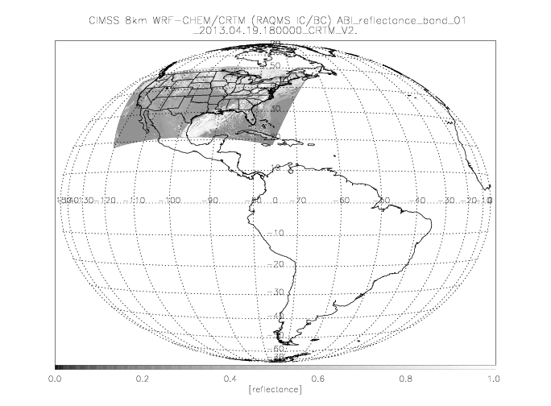

Slide 39
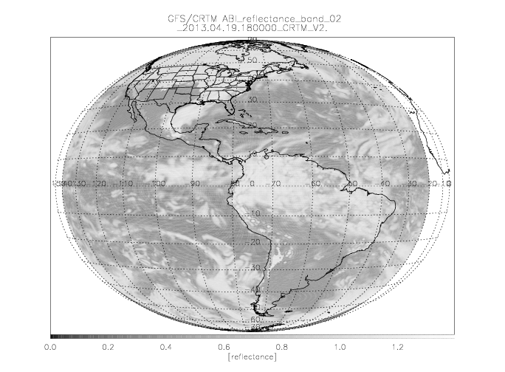

Slide 40
GOES-R ABI Profile Validation using Synthetic Retrievals
0.5ºx0.5º
GFS
Meteorological Forecast
1ºx1º
RAQMS Aerosol Forecast
1ºx1º
RAQMS Ozone Forecast
Truth
Total Column Ozone (TCO)
Truth
2x2km Fixed Grid
Remap (GOES-R GRB)
8x8km
WRF-Chem
Met/Aerosol Forecast (CONUS)
Total Precip Water (TPW)
Lifted Index (LI)
Validation:
WRF-Chem Truth
vs
ABI synthetic retrieval
CAPE
CRTM
Radiative Transfer
16 ABI bands
Total Column Ozone (TCO)
GEOCAT
GOES-R ABI
Legacy Profile Retrieval
using Synthetic Radiances
Total Precip Water (TPW)
2kmx2km Fixed Grid
Remap (GOES-R GRB)
Lifted Index (LI)
CAPE
Synthetic Retrieval

Slide 41
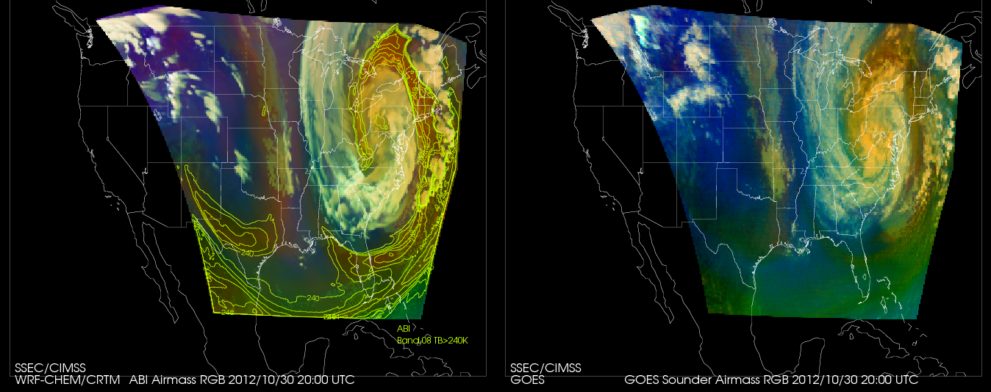
WRF-CHEM Proxy Hurricane Sandy simulation vs GOES Sounder Airmass RGB
October 26-31, 2012.
RGB Airmass shows entrainment of dry upper tropospheric air into Sandy during transition from tropical to extra-tropical storm
Calculation Observation
The Airmass RGB is designed for monitoring the evolution of cyclones, rapid cyclogenesis, jet streaks, and potential vorticity (PV) anomalies
Color scheme:
Ozone-poor tropical air masses are green, ozone-rich polar air masses are blue
Dry air masses in the upper troposphere are red to orange
High-level clouds are white, Mid-level clouds are brown
Magenta (limb viewing, disregard)
http://www.goes-r.gov/users/comet/npoess/multispectral_topics/rgb/navmenu.php_tab_1_page_6.7.0.htm

Slide 42
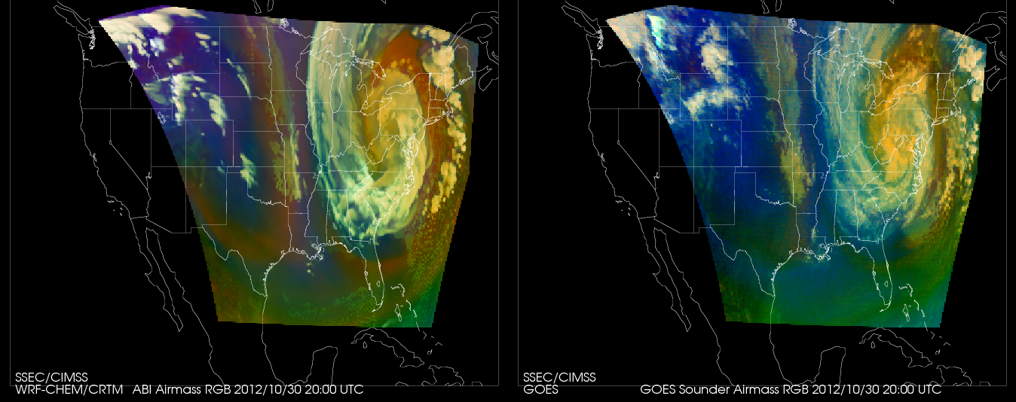
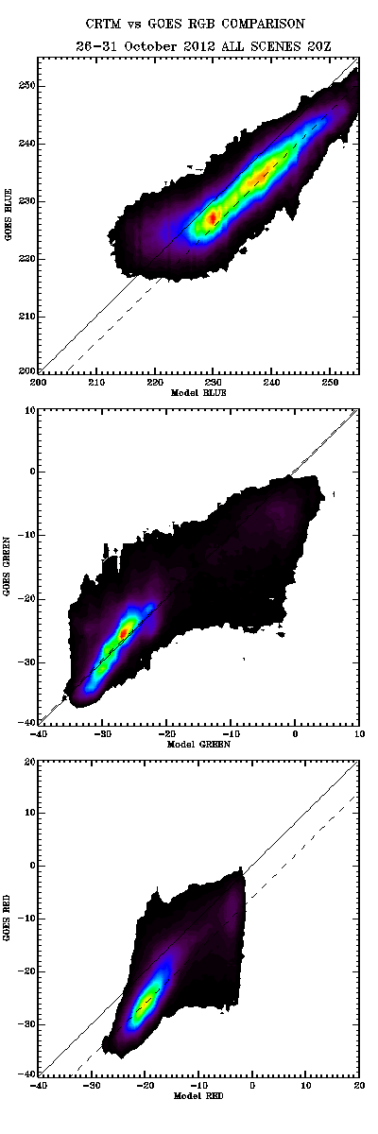
WRF-CHEM Proxy Hurricane Sandy simulation vs GOES Sounder Airmass RGB
October 26-31, 2012.
Validation with GOES Sounder RGB shows that biases are consistent with expected ABI and Sounder SRF differences (dashed)
Validation of proxy ABI RGB airmass vs GOES Sounder
Red
Green
Blue

Slide 43
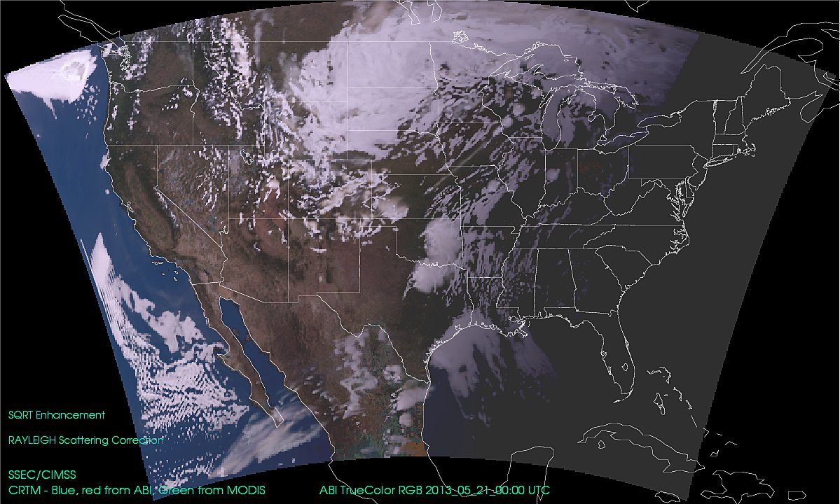
Moore OK Tornado Case Study
12Z May 20 to 12Z May 21, 2013

Slide 44
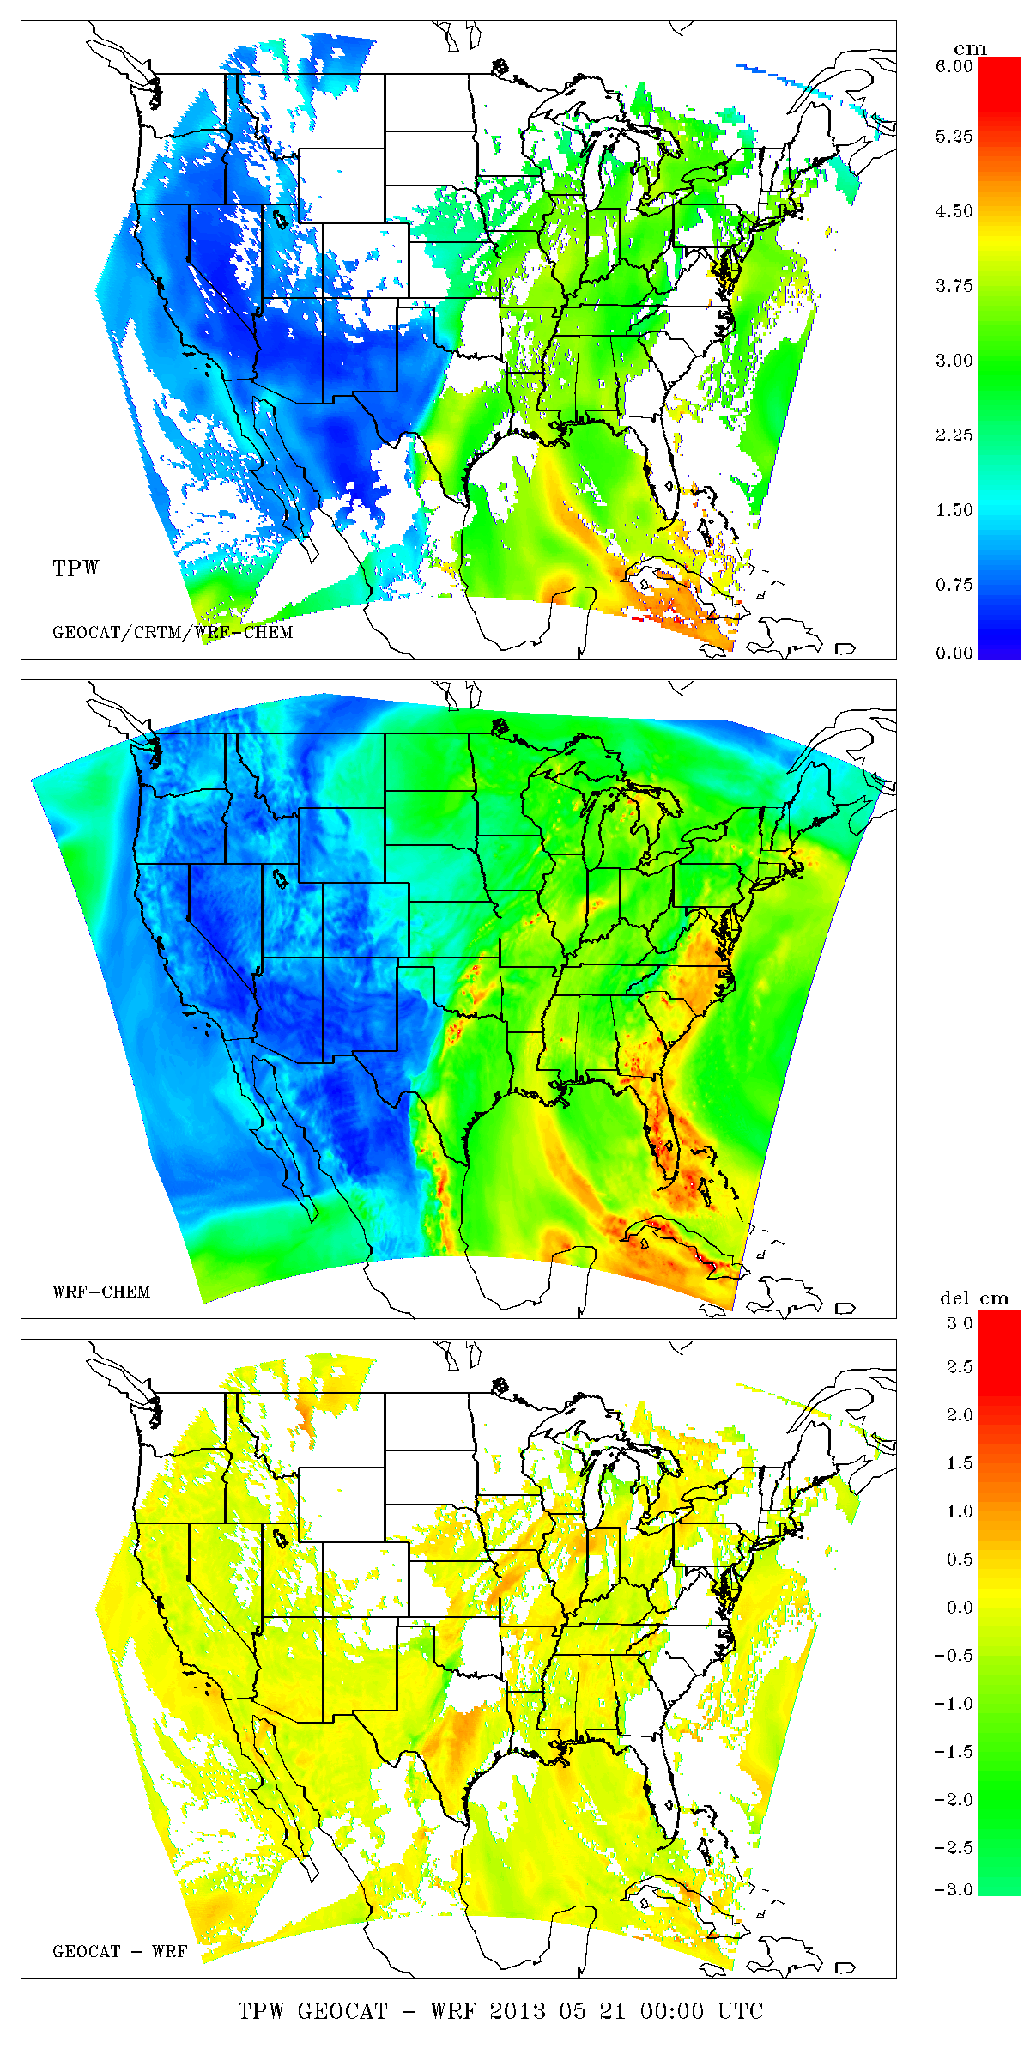
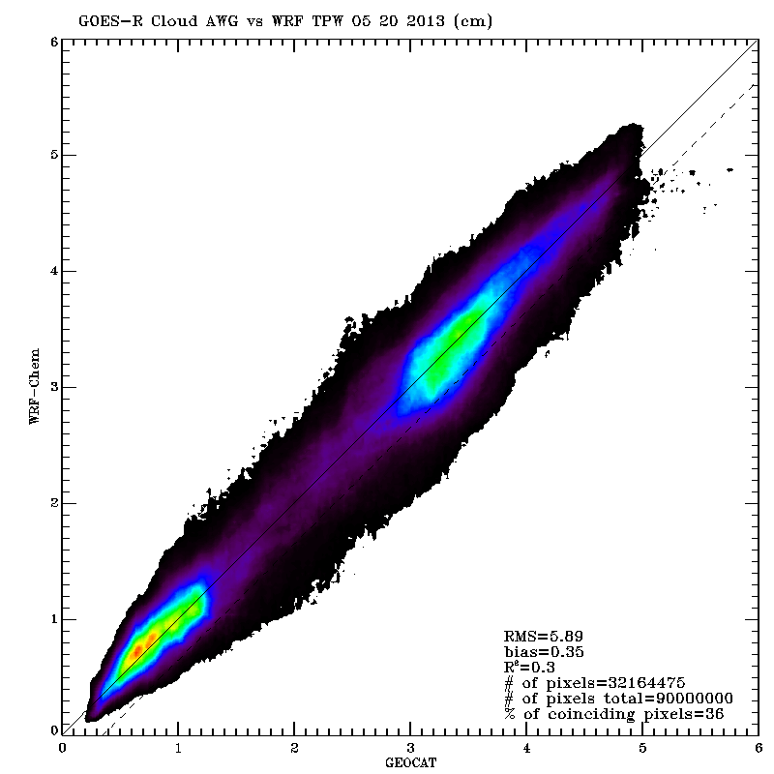
Synthetic Retrieval
Total Precip Water (TPW) Validation
Truth
Synthetic Retrieval - Truth

Slide 45
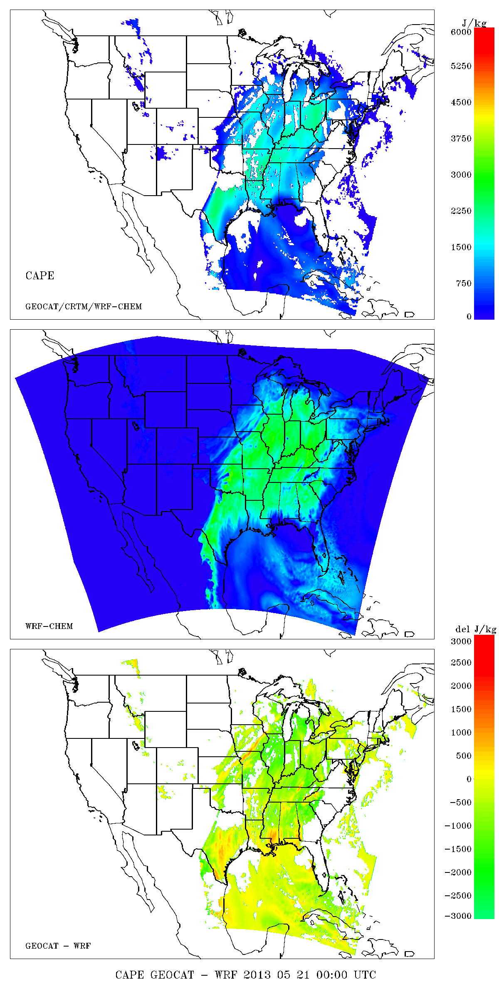
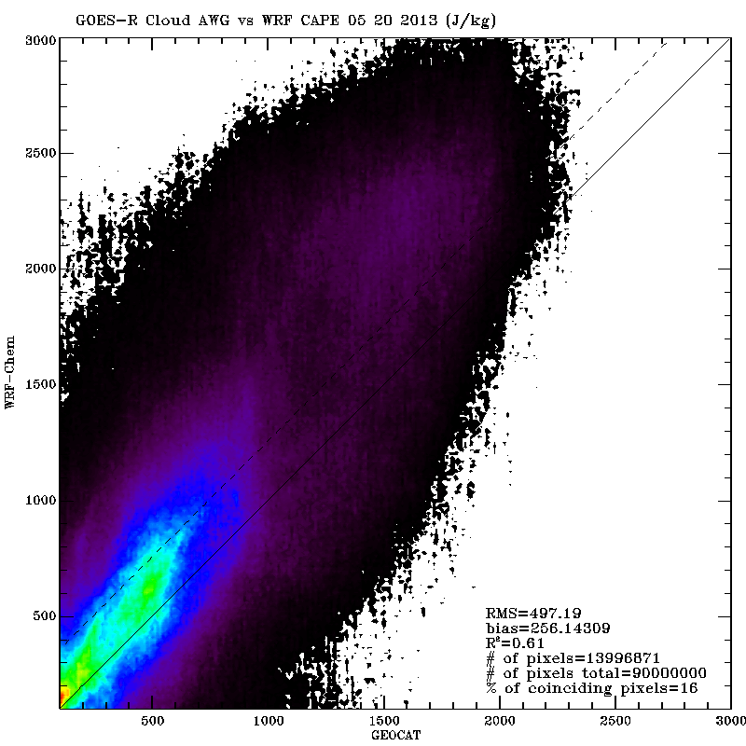
Synthetic Retrieval
CAPE Validation
Truth
Synthetic Retrieval - Truth

Slide 46
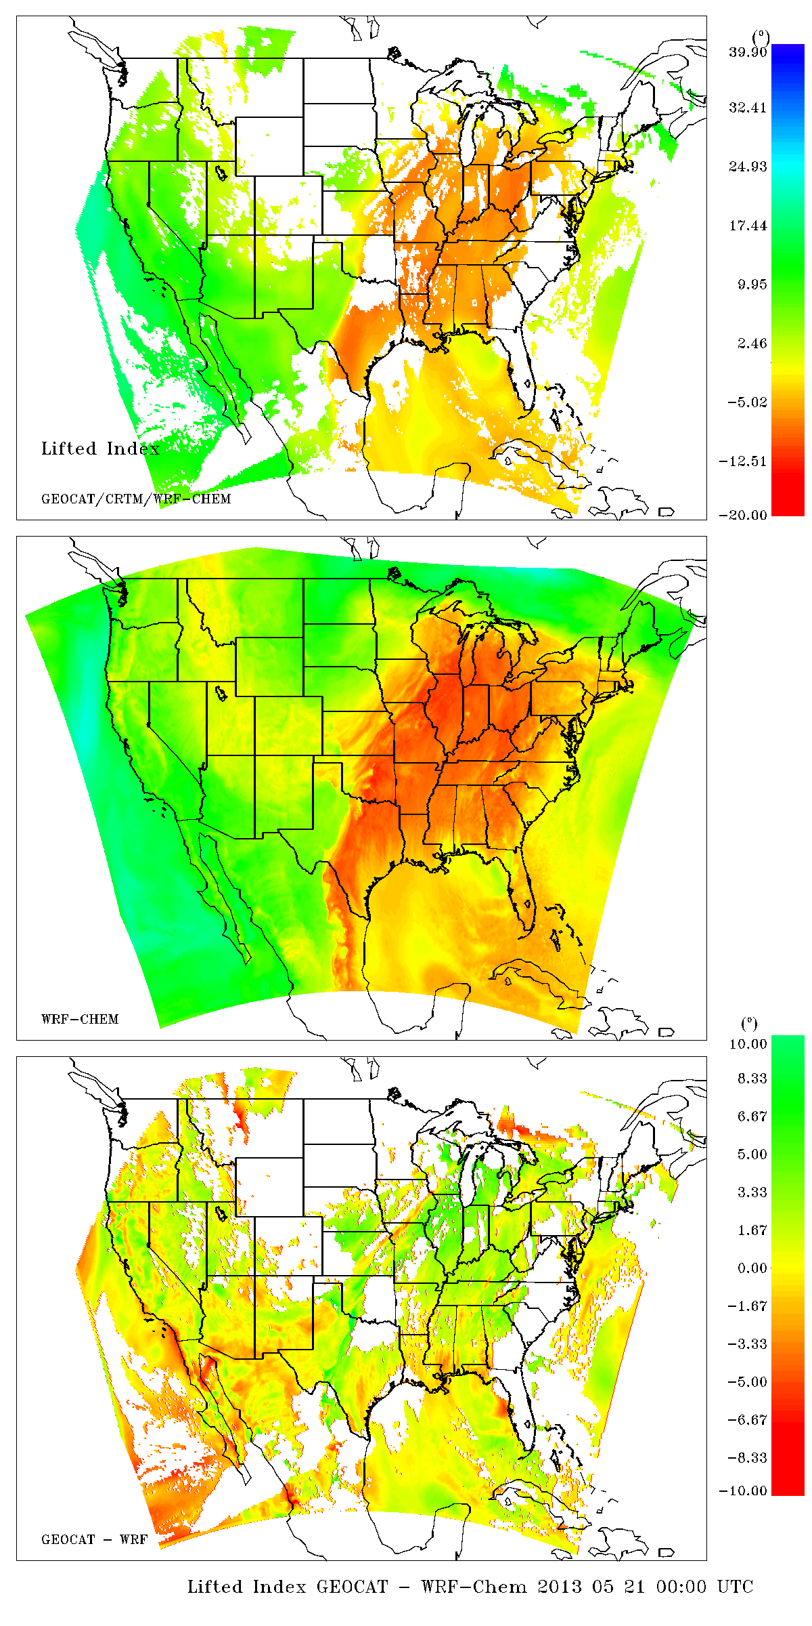
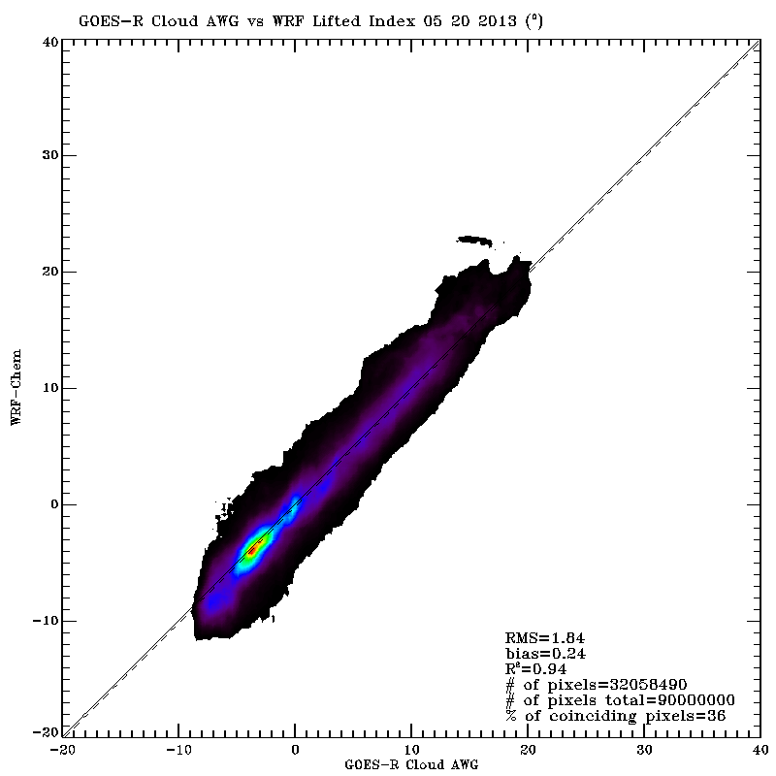
Synthetic Retrieval
Lifted Index (LI) Validation
Truth
Synthetic Retrieval - Truth

Slide 47
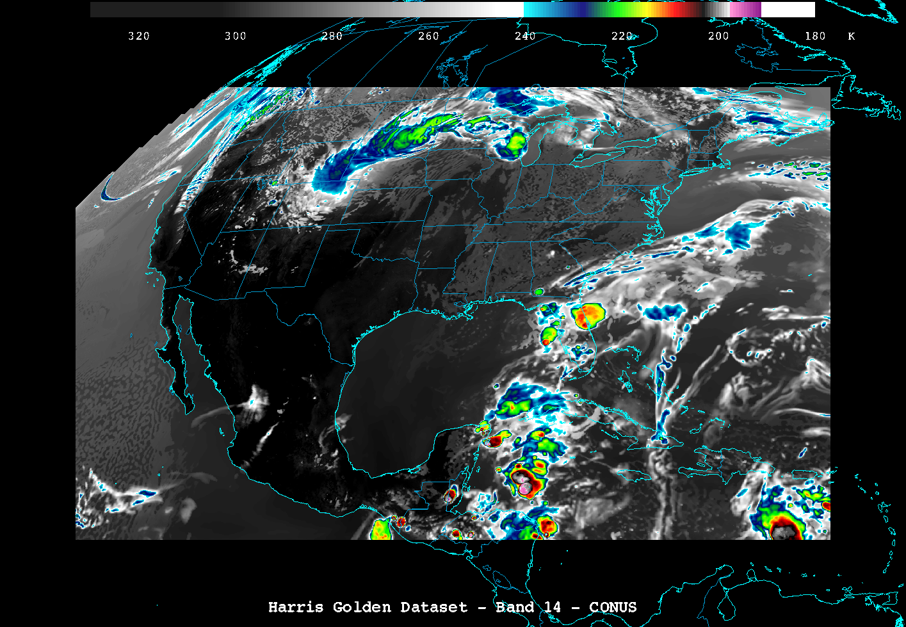
GOES-R GS Output
Image produced by W. Straka (CIMSS)

