Slide 1
SRSOR

Slide 2
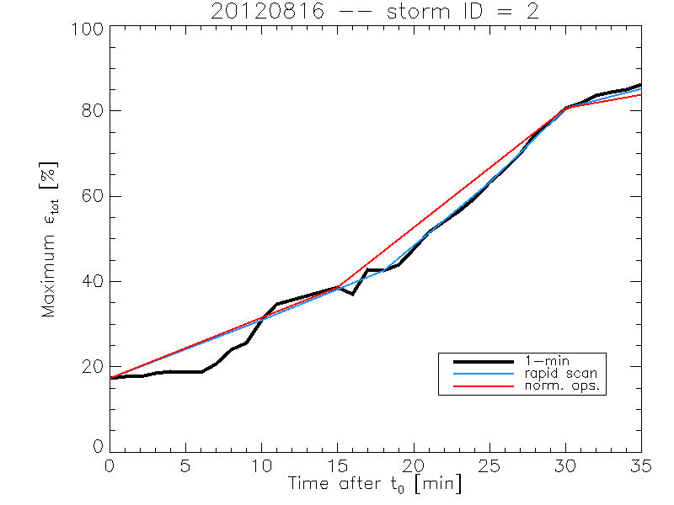
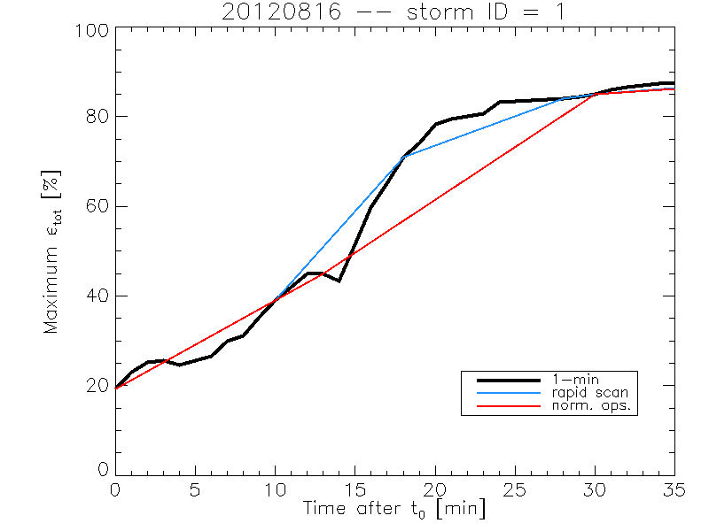
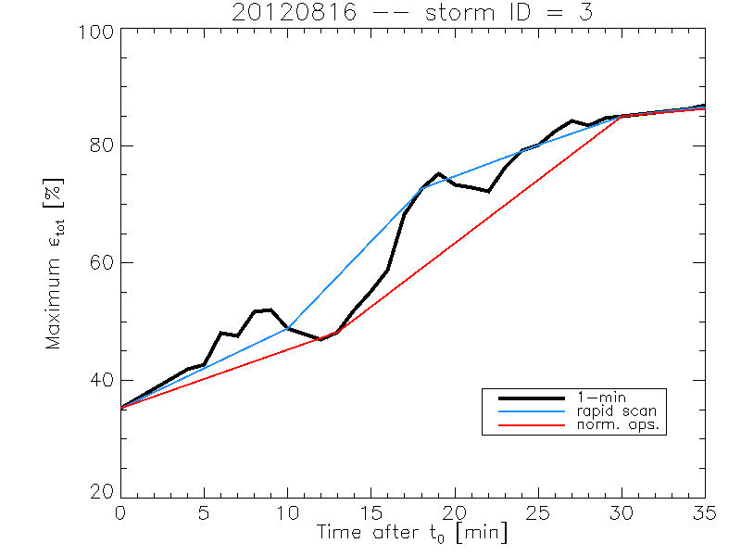
Rate of temporal cooling in the longwave infrared band
Rapid convection is often seen on geostationary data before significant radar echo's.
Cintineo et al., 2013 (CIMSS)

