Slide 1
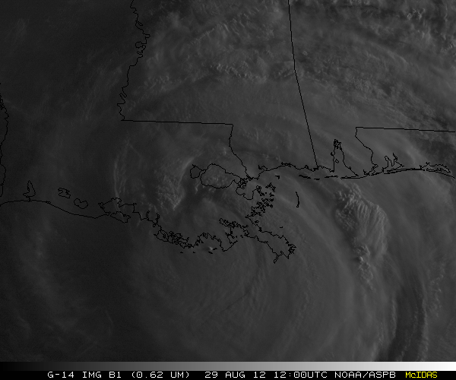
GOES-14: Special Rapid Scanning offers glimpse of the ABI
SRSOR (Super Rapid Scan Operations for GOES-R) from GOES-14 imager.
Decided on daily location for scanning between mid-August, mid-September, and late October, 2012
Posting many animations
http://cimss.ssec.wisc.edu/goes/srsor/GOES-14_SRSOR.html
Many phenomena: convection, hurricanes, fires, smoke, etc.,
Data to many groups HPC, OPC, AWC, SPC, web, YouTube, broadcasters, etc.
Animation from GOES-14 Imager visible image at 1-min time resolution.
SRSOR provided unique information and offers a glimpse into the possibilities that will be provided at even higher resolutions by the ABI on GOES-R.
Notes:
http://cimss.ssec.wisc.edu/goes/srsor/GOES-14_SRSOR.html Isaac.
Loops by T. Schmit, NOAA NESDIS.
Thanks to SSEC Data Center.

Slide 2
GOES-14 SRSOR
Visible
Infrared
Hurricane Sandy as seen with special 1-min interval imagery.
Notes:
Thanks to SSEC Data Center. Sandy. Loop by Scott Lindstrom, SSEC.

