Slide 1
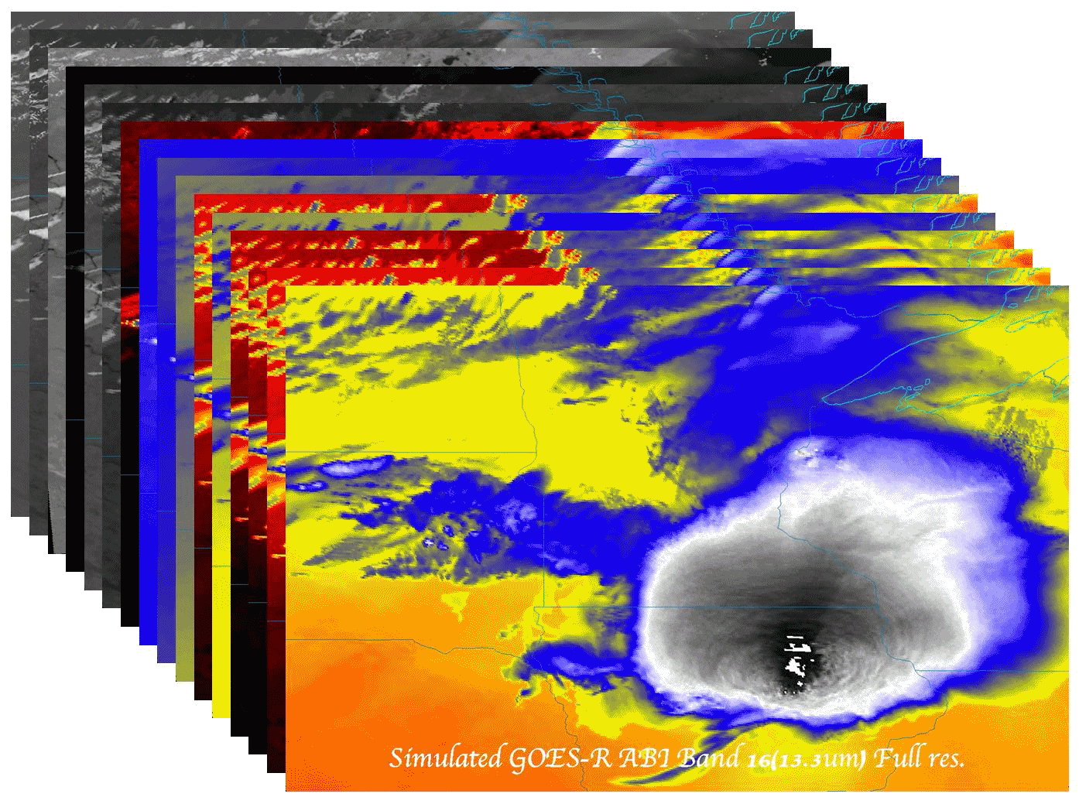
The History and Evolution of the GOES-R Advanced Baseline Imager
Timothy J. Schmit (tim.j.schmit@noaa.gov)
NOAA/NESDIS/Satellite Applications and Research
Advanced Satellite Products Branch (ASPB)
Madison, WI
AMS Annual Meeting
11th History Symposium
January 8, 2013
Austin, TX
UW-Madison

Slide 2
Co-authors: James J. Gurka, Mathew M. Gunshor, W. P. Menzel, J. Phillips
Special Thanks to:
S. Ackerman, W. L. Smith, Sr., R. Heymann, N. Rao, B. Baum, M. Griffin, A. Heidinger, J. Gurka, E. Prins, G. S. Wade, F. Mosher, G. Ellrod, J. Sieglaff, A. J. Schreiner, J. Li, M. Weinreb, S. Bachmeier, K. Strabala, J. Otkin, J. Feltz, J. Gerth, A. Huang, C. Velden, K. Bah, J. P. Nelson, C. Hayden, D. W. Martin, D. Hillger, D. Wade, D. Chesters, J. L. Schmit

Slide 3
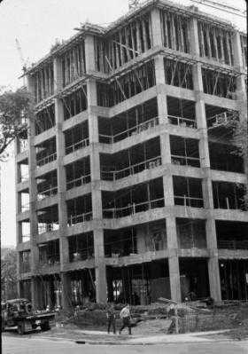
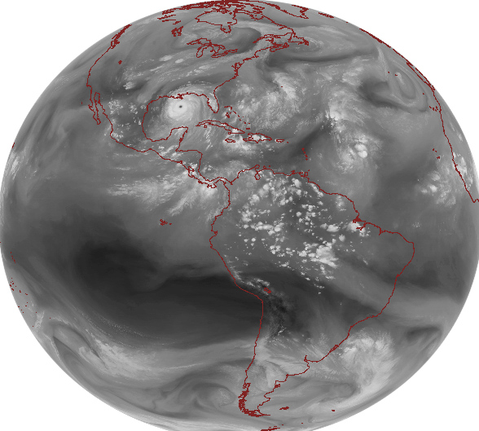
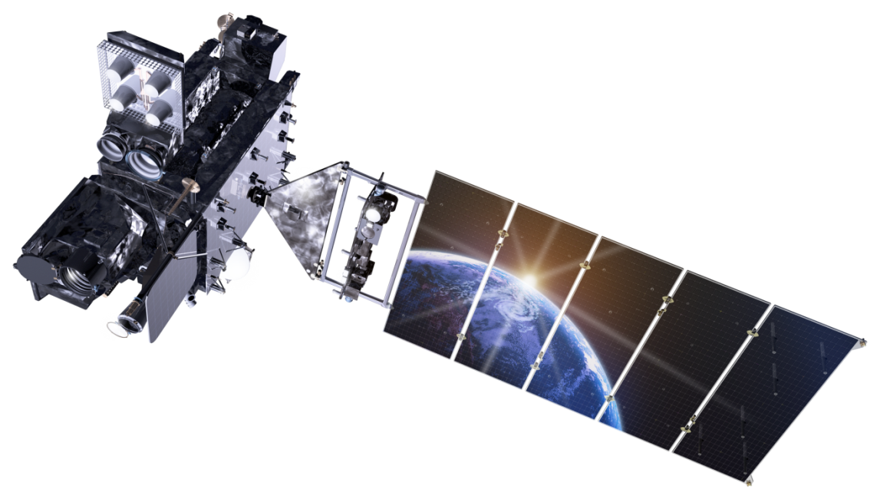
Outline
Early GOES
First 3 Generations
Current GOES
Fourth Generation
GOES-R ABI
Fifth Generation
Summary
Lockheed Martin

Slide 4
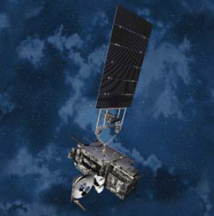
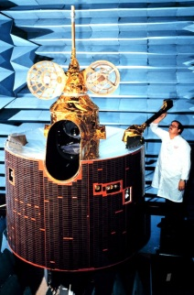
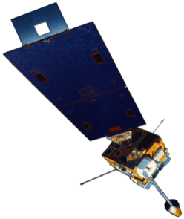
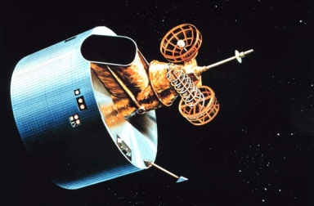
GOES History
GOES-1/3
Launched
1975
1977 1978
One visible and one infrared .
Operational.
GOES-4/7
Launched
1980
1981
1983
1987
VISSR–VAS visible, 12 IR. MSI (visible, IRW, and 2 additional IR channels)
GOES-8/12
Launched
1994
1995
1997
2000
2001
3-axis stabilized.
Imager Bands: 4 IR; 1 visible.
Operational Sounder
(18 IR bands)
GOES-13/14/15
Launched
2005
2009
2010
Better navigation and calibration.
No eclipse outages.
Better spatial resolutions for the 6.5 um on GOES-12+ and the 13.3 um band on GOES-14/15.
Operational Sounder
GOES-R/S+
Planned Launch
2015
2017
2020
2025
Faster coverage.
16 Imager Bands.
Improved spatial.
No sounder.
GLM
1G 2G 3G 4G 5G
Notes:
The circles represent an estimate of the impact of GOES on regional scale numerical models.

Slide 5
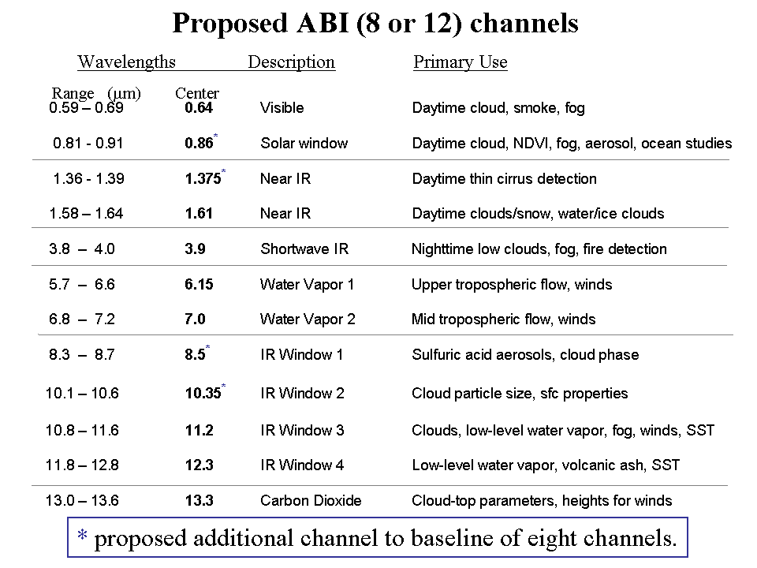
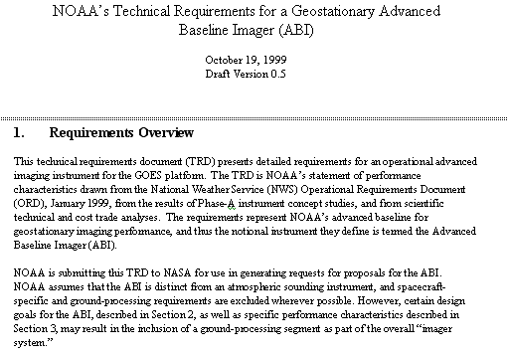
Mission Planning
STAR very involved during the early GOES-R series development. This includes: formulation studies for both ABI and Advanced Baseline Sounder (ABS), ABI band selection and modification, etc.
ABI/ABS Requirements.
circa 1999/2000
Originally ABI was only 8 spectral bands, now it is 16. All ABI bands were modified with input from STAR and it’s Cooperative Institutes.
Notes:
Significant remaining scientific challenges for the specific science topic
Next step(s)
Instruments (current/future), techniques, testbed, transition, …
Path into applications/operations
Who will use it and how
How will it get out to the real world

Slide 6
1 0.52 – 0.72 0.62 Visible Daytime clouds, fog 8 1.3 – 1.9 1.6 Near IR Daytime clouds/snow, water/ice clouds 2 3.8 – 4.0 3.9 Shortwave IR Nighttime low clouds, fog, fire detection 3 6.5 – 7.0 6.75 Water Vapor 1 Upper tropospheric flow, winds 6 7.0 – 7.5 7.25 Water Vapor 2 Mid tropospheric flow, winds 4 10.2 – 11.2 10.7 IR Window 3 Clouds, low-level water vapor, fog, winds 5 11.5 – 12.5 12.0 IR Window 4 Low-level water vapor, volcanic ash 7 13.2 – 13.8 13.5 Carbon Dioxide Cloud-top parameters, heights for winds
ABI - 8
Based on a NWS 1999 requirements document
# Wavelengths Description Primary Use
Range (μm) Center
ABI – circa 1999
(8 total bands, most spectrally wide)
Notes:
These 8 bands represent the current GOES imager “six” and 1.6 and 7.2 um bands.

Slide 7
0.59 – 0.69 0.64 Visible Daytime cloud, smoke, fog 0.81 ­ 0.91 0.86* Solar window Daytime cloud, NDVI, fog, aerosol, ocean studies 1.36 - 1.39 1.375* Near IR Daytime thin cirrus detection 1.58 – 1.64 1.61 Near IR Daytime clouds/snow, water/ice clouds 3.8 – 4.0 3.9 Shortwave IR Nighttime low clouds, fog, fire detection 5.7 – 6.6 6.15 Water Vapor 1 Upper tropospheric flow, winds 6.8 – 7.2 7.0 Water Vapor 2 Mid tropospheric flow, winds 8.3 – 8.7 8.5* IR Window 1 Sulfuric acid aerosols, cloud phase 10.1 – 10.6 10.35* IR Window 2 Cloud particle size, sfc properties 10.8 – 11.6 11.2 IR Window 3 Clouds, low-level water vapor, fog, winds, SST 11.8 – 12.8 12.3 IR Window 4 Low-level water vapor, volcanic ash, SST 13.0 – 13.6 13.3 Carbon Dioxide Cloud-top parameters, heights for winds
Proposed ABI (8 or 12) channels
Wavelengths Description Primary Use
Range (μm) Center
* proposed additional channel to baseline of eight channels.
Notes:
As originally proposed by the National Weather Service, the ABI was to have a minimum of 8 spectral channels. The selected channels were close to the five channels on the GOES-8 -10 imagers ( 0.64, 3.9, 6.15, 11.2, and 12.3 μm) supplemented with a snow/cloud discriminating 1.6 μm channel, a mid-tropospheric 7.0 um water vapor channel, and a cloud height determining 13.3 μm channel. Two additional channels were proposed to expand the capabilities closer to meeting NWS requirements and to enhance opportunities for weather and climate research and applications; the IR windows at 8.5 μm and 10.35 μm offer improved moisture, cloud, aerosol, and surface sensing capabilities. In addition some of the ABI-8 spectral widths were modified to complement other satellite spectral channels and to capitalize on experience gained with the MODIS Airborne Simulator (MAS). To round out an ABI-12, another visible channel at 0.86 μm was added to help with the detection of aerosols and vegetation and a near infrared channel at 1.38 μm to detect very thin cirrus in the upper troposphere.
The addition of the 8.5 μm enables detection of volcanic cloud with sulfuric acid aerosols and thin cirrus in conjunction with the 11.2 μm channel as well as determination of cloud micro-physical properties with the 11.2 and 12.3 μm channels. This includes a more accurate delineation of ice from water clouds during the day or night.
The addition of the 10.35 μm improves determination of micro-physical properties of clouds with the 11.2 and 12.3 μm channels; this includes a more accurate determination of cloud particle size during the day and night. Also, the observation of surface properties (such as SST) is improved using the 10.35μm along with the 8.6, 11.2, and 12.3 μm channels. Finally, there is more sensitivity to low level moisture with the additional split windows.
The 0.86 μm channel provides synergy with the AVHRR/3, as it is similar its channel 2. This channel is used for determining vegetation amount, aerosols and ocean/land studies. Characterizing aerosols and their optical properties is essential for improving a number of satellite products, for example SST, ocean color and surface temperatures. This channel also enables very localized vegetation stress monitoring, fire danger monitoring, and albedo retrieval.
The 1.38 μm channel is copied from one on MODIS. It does not see into the lower troposphere due to water vapor sensitivity and thus it provides excellent daytime sensitivity to very thin cirrus. This will aid several products relying on clear skies in the infrared windows, for example SST.

Slide 8
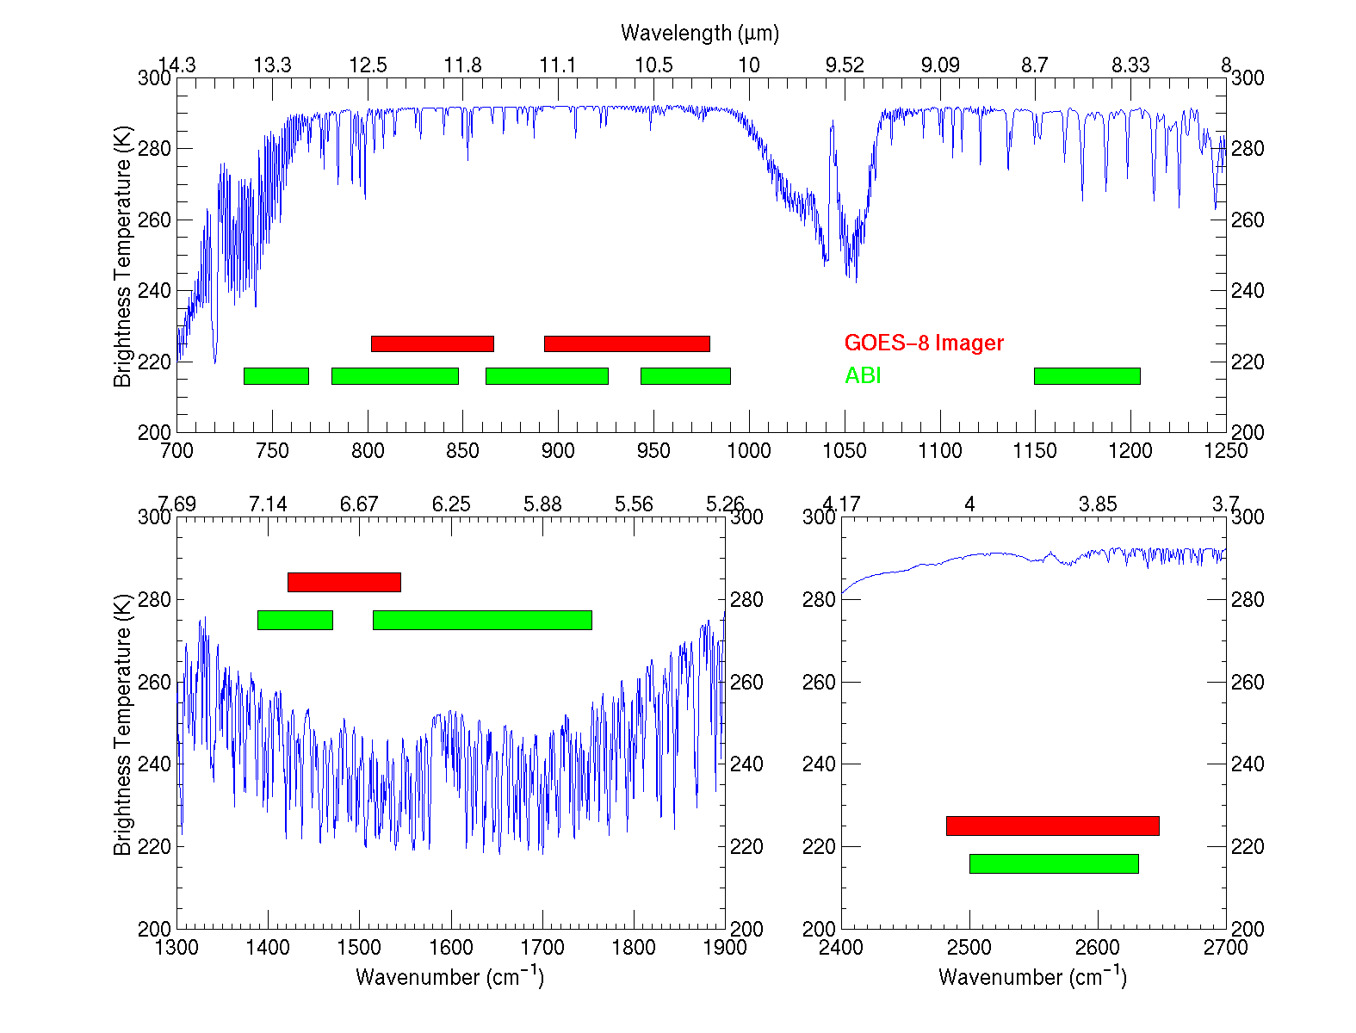
IR channels on the current GOES and the proposed ABI
Based on a NWS 1999 requirements document
UW-Madison/CIMSS
Notes:
This figure, generated by Mat Gunshor, shows the spectral coverage of the current GOES Imager (in red) and that proposed in the IR region for the ABI (Advanced Baseline Imager) (in green). A sample high spectral resolution earth-emitted spectra is also plotted (in blue). It’s apparent that the ABI has advantages over the current GOES Imager. For example, a 13.3 um band for cloud heights, two water vapor bands instead of one, and a band covering at the 8.5 um region (for cloud phase).

Slide 9
ABI Bands (proposed 18)
Current GOES Imagers
MSG/Sounder
MODIS/MTG/etc
Notes:
Band pass are approximate

Slide 10
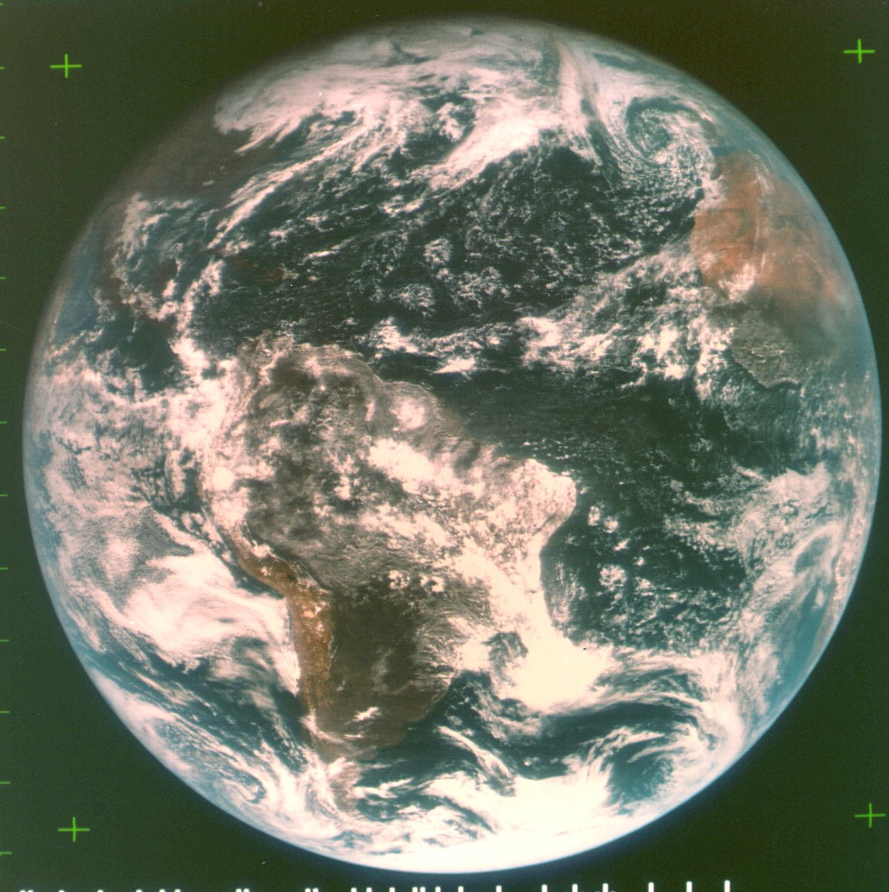
ATS-III November 18, 1967
The spin scan cloud camera provided full disk visible images of the earth and its cloud cover every 20 minutes.
Note the ‘natural color’ image from the 3 visible spectral bands.
Notes:
Natural color images from the geo perspective are possible, as demonstrated in 1967.

Slide 11
Options 3b. 2.6.6 VIIRS Compatibility Study
The Contractor shall assess the impact of modifying the Spectral Response Envelope of the reflective channels to be consistent with the current VIIRS design. The required changes are:
a) Move the 0.47 um channel to 0.488 um with a nominal bandwidth of 0.02 um,
b) Change the 0.64 um channel nominal bandwidth to 0.08 um,
c) Move the 0.86 um channel to 0.865 um with a nominal bandwidth of 0.039 um,
d) Move the 1.38 um channel to 1.378 um with a nominal bandwidth of 0.015 um,
e) Move the 2.26 um channel to 2.25 um with a nominal bandwidth of 0.050 um.

Slide 12
a) Move the 0.47 um channel to 0.488 um with a nominal bandwidth of 0.02 um, [No, need shorter wavelength for better scattering. VIIRS has 2 bands in this region!]
b) Change the 0.64 um channel nominal bandwidth to 0.08 um, [OK, but also shift center to 0.645 um to match HES-CW.]
c) Move the 0.86 um channel to 0.859 um with a nominal bandwidth of 0.039 um, [OK, but width of 0.039 and 0.04 um so similar the same performance may be the same!]
d) Move the 1.38 um channel to 1.378 um with a nominal bandwidth of 0.015 um, [OK, if noise is still OK!]
e) Move the 2.26 um channel to 2.25 um with a nominal bandwidth of 0.050 um. [Actually change to 2.13 um to match MODIS, VIIRS and MTG!]

Slide 13
ABI 6.2 um, 7.0 um, and 7.4 um bands
Effects of changing central wavenumber
Current ABI Bandwidth
Possible ABI shifted Bandwidth
6.2 um band
5.7 um - 6.6 um
6.2 um band adjusted
5.77 um - 6.6 um
7.0 um band
6.8 um - 7.2 um
6.95 um band
6.75 um - 7.15 um
7.4 um band
7.3 um - 7.5 um
7.34 um band
7.24 um - 7.44 um

Slide 14
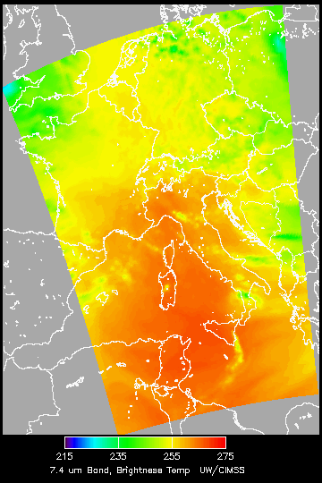
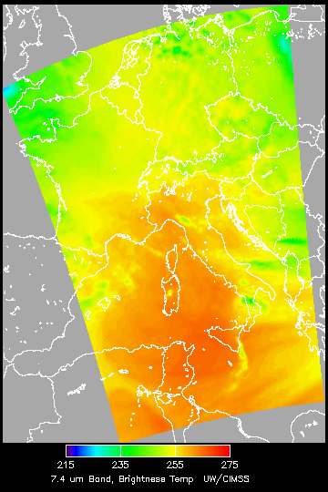
ABI 7.4 um Band
ABI 7.4 um
“ABI 7.34 um”

Slide 15
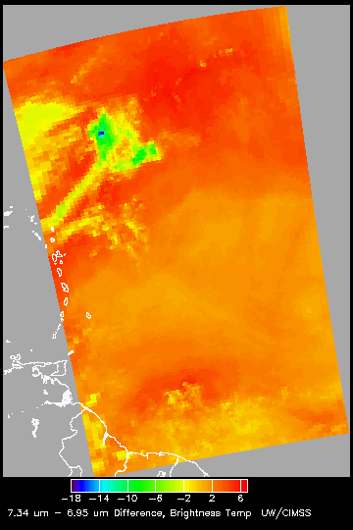
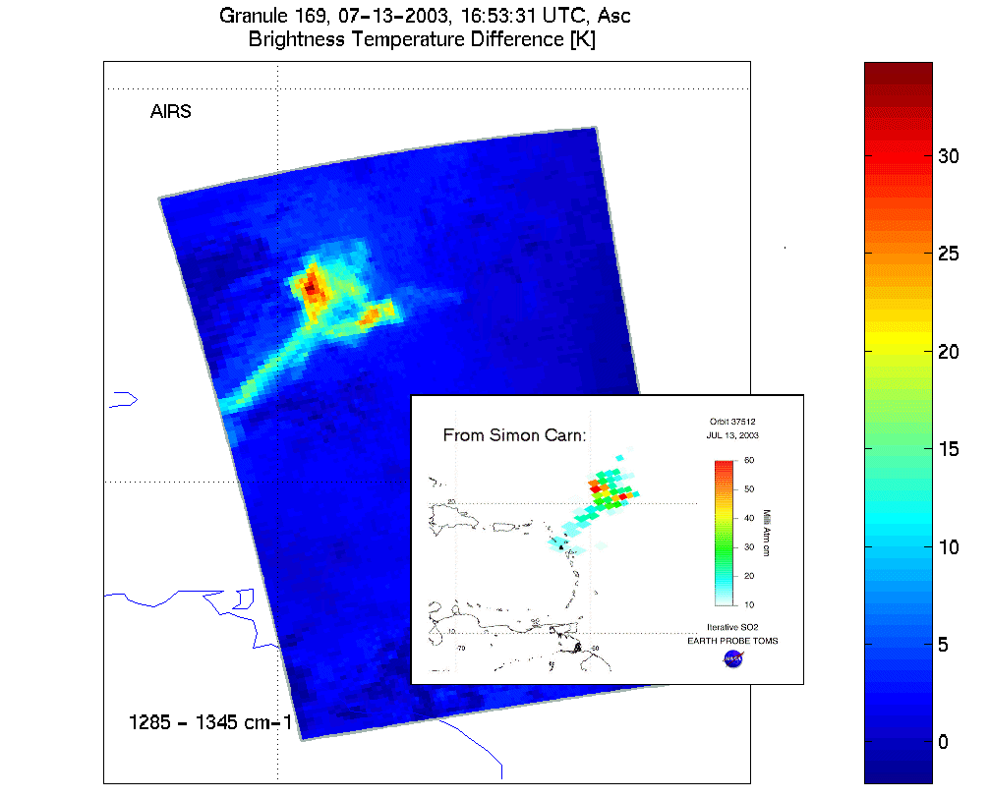
GOES-R ABI detects some SO2 plumes
Water Vapor Band Difference convolved from AIRS data
sees SO₂ plume from Montserrat Island, West Indies. High-spectral AIRS sees a larger brightness temperature difference.
SO₂ Plume
High-spectral sounder data gives a much greater brightness temperature difference (by almost a factor of 2) than broad-band instruments.
ABI 7.34 μm - 6.95 μm
AIRS 7.8 μm – 7.43 μm
Notes:
Current GOES can detect an ash cloud, but not the SO2. Note different color scales!

Slide 16
Other considerations
Other bands considered on the ABI:
a 0.55 um band, similar to MODIS for the generation of ‘natural color’ images.
a 3.7 um band for better night-time cloud detection
It also should be noted that the ABI was designed to have a companion high-spectral infrared sounder. This is why the ABI only has one CO₂ band.

Slide 17
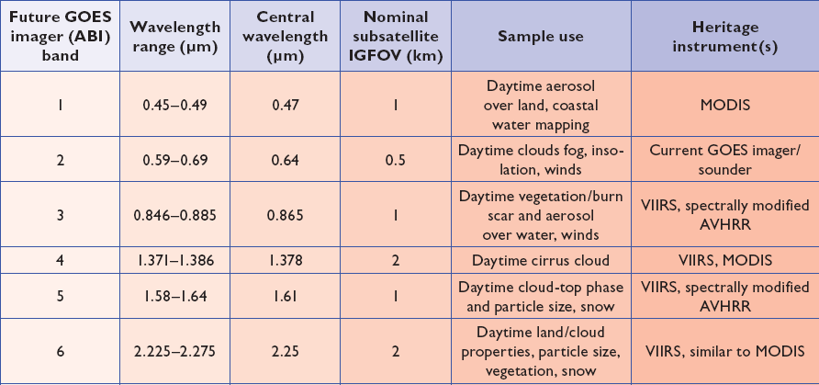
ABI bands 1-6
Notes:
Final column added: heritage. The ABI band 1 was suggested by Dr. Fred Mosher at a GOES Users' Conference.
The ABI band 3 was suggested by the late Dr. C. Rao (of the then ORA).
Some of these bands have been shifted to more closely match those on the VIIRS.

Slide 18
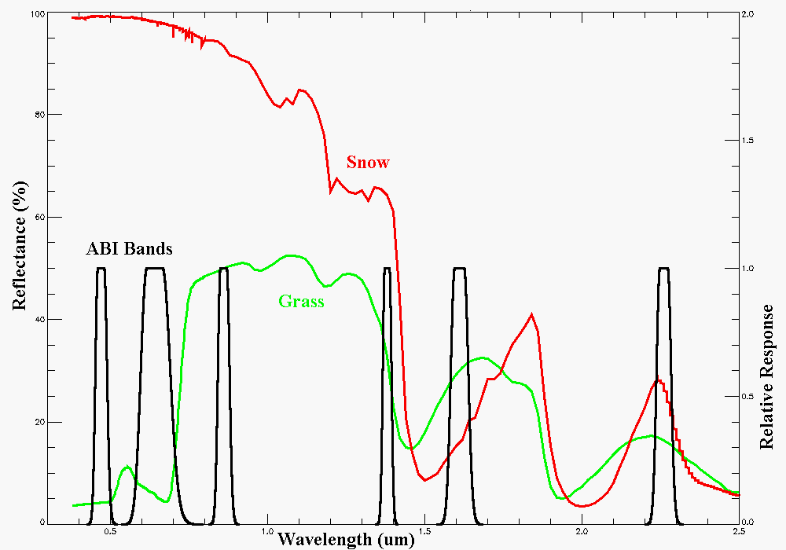
Visible and near-IR channels on the ABI
Snow, Phase
Part. size
Cirrus
Haze
Clouds
Veg.
The ABI visible and near-IR bands have many uses.
Notes:
Note how ABI bands 2 and 3 might indicate vegetation. ABI bands 2 and 5 (or 6) depict snow.
Schmit, T. J., M. M. Gunshor, W. P. Menzel, J. J. Gurka, J. Li, and A. S. Bachmeier, 2005: Introducing the next-generation Advanced Baseline Imager on GOES-R. Bull. Amer. Meteor. Soc., 86, 1079-1096.

Slide 19
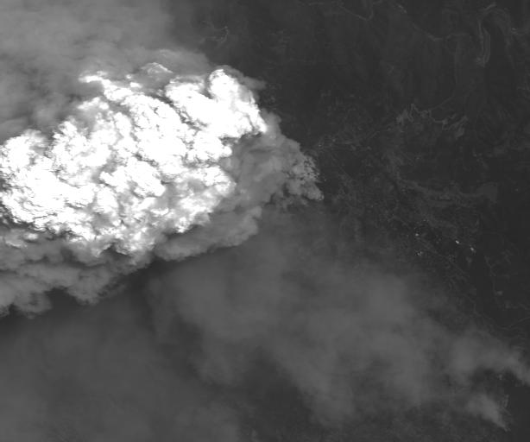
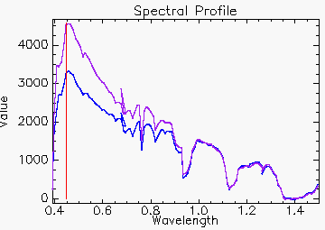
AVIRIS: Linden_haze_0.439_0.498um (simulated ABI band 1)
The 0.47 um band was added, in part, due to a request from Fred Mosher, then of the AWC
Smoke
Notes:
AVIRIS (Airborne Visible/Infrared Imaging Spectrometer)
Simulated by convolving mock ABI spectral response functions with either AVIRIS data.
This band was chosen to better monitor daytime smoke, etc.

Slide 20
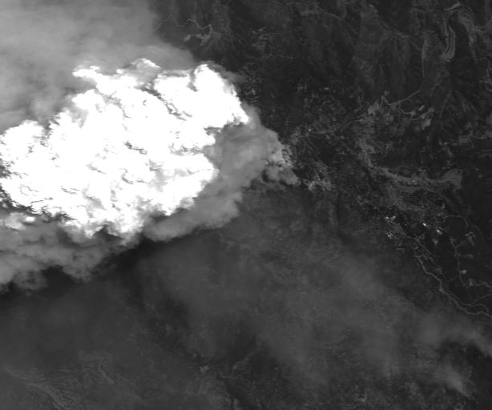
Linden_0.577_0.696_um (simulated ABI band 2)
Notes:
Simulated by convolving mock ABI spectral response functions with either AVIRIS data.

Slide 21
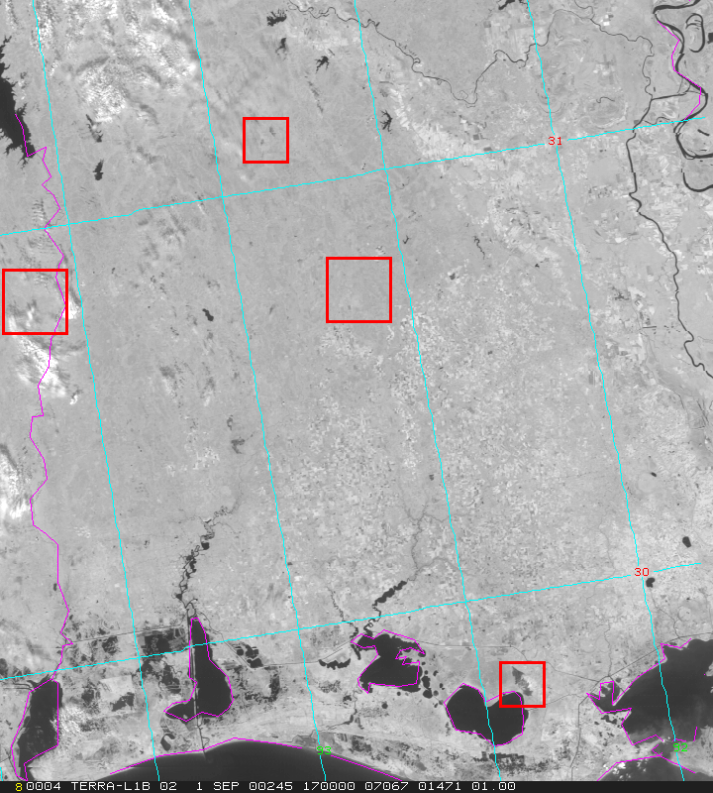
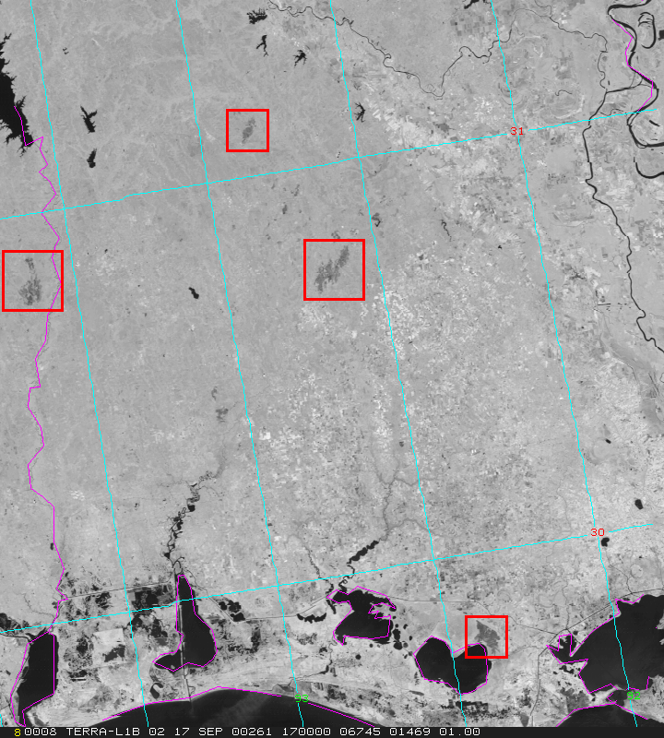
MODIS Detects Burn Scars in Louisiana
01 September 2000-- Pre-burning
17 September 2000-- Post-burning
Burn Scars
ABI will allow for diurnal characterizations of burn areas, this has implications for re-growth patterns.
Scars (dark regions) caused by biomass burning in early September are
evident in MODIS 250 m NIR channel 2 (0.85 μm) imagery on the 17th.
CIMSS, UW
MODIS Data from GSFC DAAC
Notes:
Figures from Chris Moeller, of CIMSS. The traditional visible 0.6um band does not show the burn scars (not shown).

Slide 22
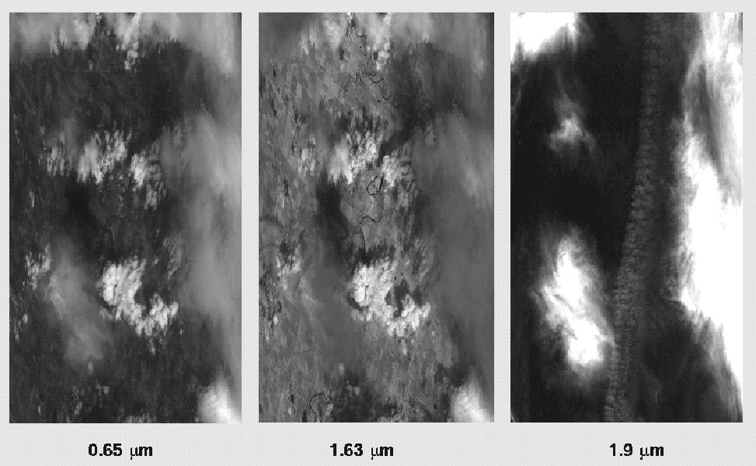
1.88 μm (or 1.38 μm) is helpful for contrail detection
Examples from MAS (Chs 2, 10, 16).
Contrail detection is important when estimating many surface parameters.
There is also interest in the climate change community.
Notes:
MODIS Airborne Simulator. The image is 1.88 um, but that’s similar to the physics as the band chosen for the ABI.

Slide 23
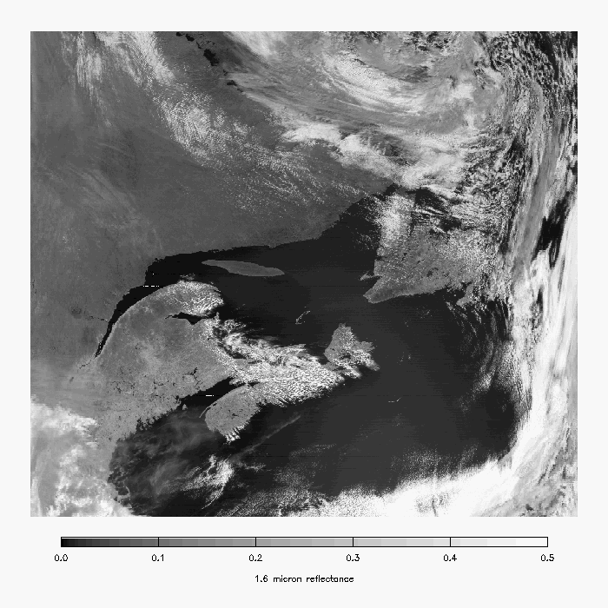
MODIS 1.6 µm -- Snow is darker.
Snow
Notes:
Image from A. Heidnger of ASPB.

Slide 24
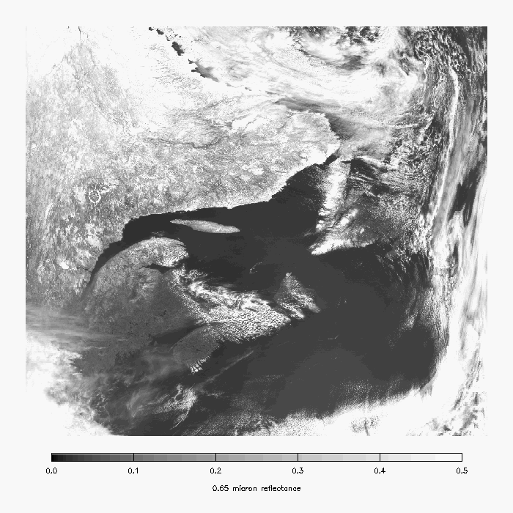
MODIS 0.65 µm -- Snow is bright (but so are clouds).
Snow
Notes:
Image from A. Heidnger of ASPB.

Slide 25
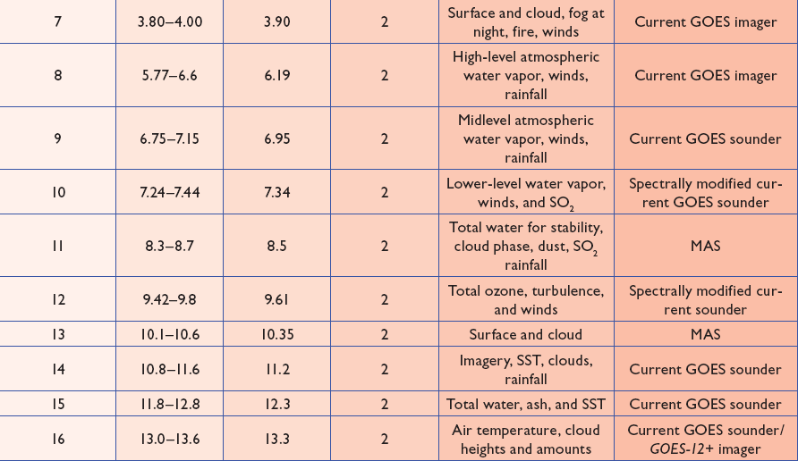
ABI bands 7-16
Notes:
The ABI band 10 was modified to better depict upper-level SO2. (G. Ellrod and others)
The ABI band 11 was suggested by Steve Ackerman (CIMSS), based on HIRS experience.
The ABI band 13 was suggested by W. P. Menzel (then NOAA NESDIS).

Slide 26
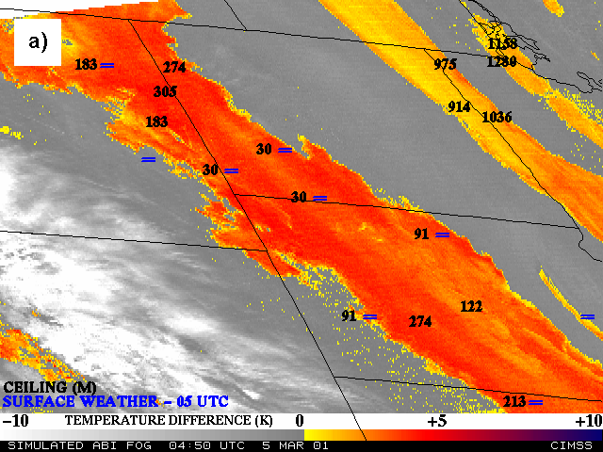
Nocturnal Fog/Stratus Over the Northern Plains
“ABI” 4 minus 11 μm Difference
ABI image (from MODIS) shows greater detail in structure of fog.
Notes:
Note the ABI (from MODIS) image is better spatial resolution and better signal-to-noise ratio then the GOES-10 imager.
Schmit, T. J., M. M. Gunshor, W. P. Menzel, J. J. Gurka, J. Li, and A. S. Bachmeier, 2005: Introducing the next-generation Advanced Baseline Imager on GOES-R. Bull. Amer. Meteor. Soc., 86, 1079-1096.

Slide 27
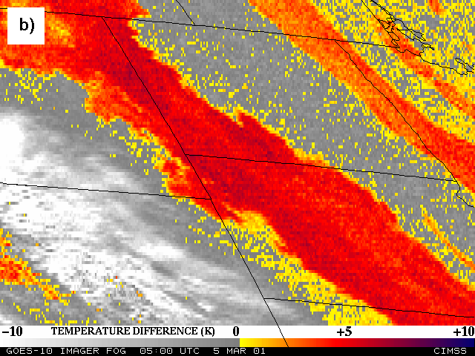
Nocturnal Fog/Stratus Over the Northern Plains
GOES-10 4 minus 11 μm Difference
ABI image (from MODIS) shows greater detail in structure of fog.
Notes:
Schmit, T. J., M. M. Gunshor, W. P. Menzel, J. J. Gurka, J. Li, and A. S. Bachmeier, 2005: Introducing the next-generation Advanced Baseline Imager on GOES-R. Bull. Amer. Meteor. Soc., 86, 1079-1096.

Slide 28
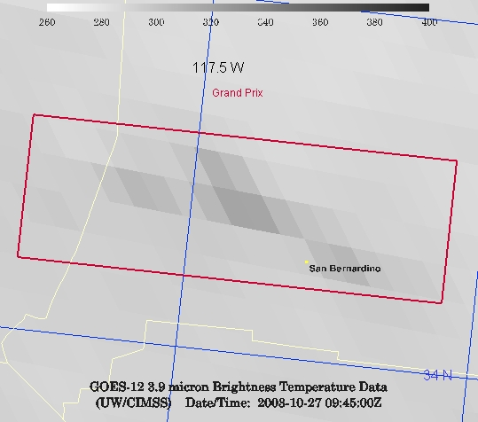
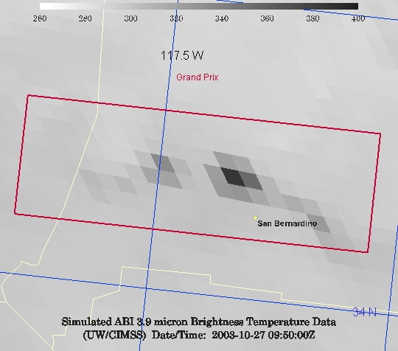
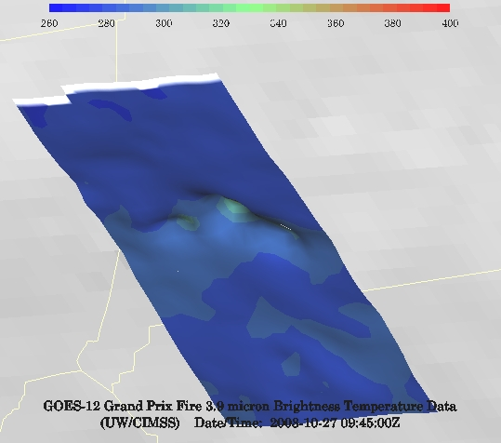
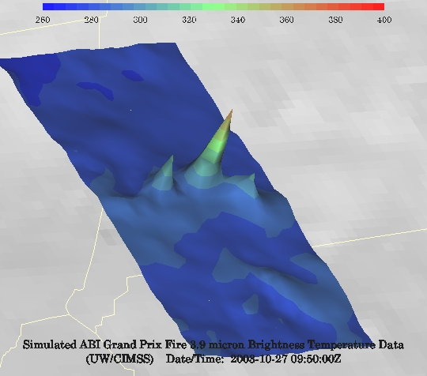
GOES-12 and GOES-R ABI
Simulation of Grand Prix Fire/Southern California
GOES-12
GOES-R ABI
GOES-12
GOES-R ABI
Notes:
Here are two different fires from J. Feltz of CIMSS (using mcidas-v). What we can see is a more defined peak in the higher resolution data and it is easier to pick out individual hotspots. In addition, the higher saturation temperature of the ABI allows us to see that the fire is around 370K. ABI is simulated from MODIS.

Slide 29
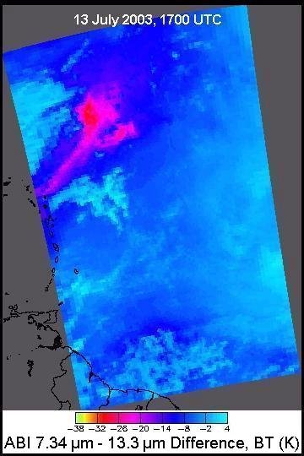
GOES-R ABI will detect SO2 plumes
Water Vapor Band Difference convolved from AIRS data
sees SO₂ plume from Montserrat Island, West Indies
SO₂ Plume
Current GOES Imager
No skill in monitoring
Figure courtesy of Kris Karnauskas
Current GOES Imager can not
detect SO₂
ABI 7.34 μm – 13.3 μm
Notes:
Current GOES can detect an ash cloud, but not the SO2 signature. The ABI can, if the plume is large and high enough.
Image on Right from:
Schmit, T. J., M. M. Gunshor, W. P. Menzel, J. J. Gurka, J. Li, and A. S. Bachmeier, 2005: Introducing the next-generation Advanced Baseline Imager on GOES-R. Bull. Amer. Meteor. Soc., 86, 1079-1096.

Slide 30
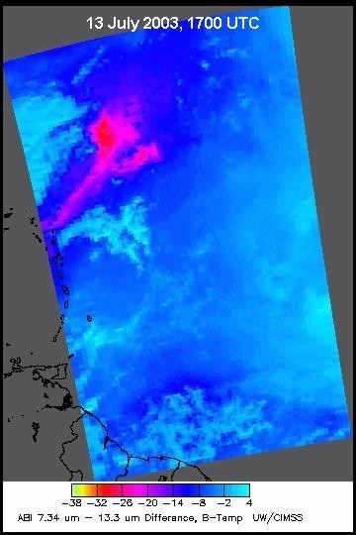
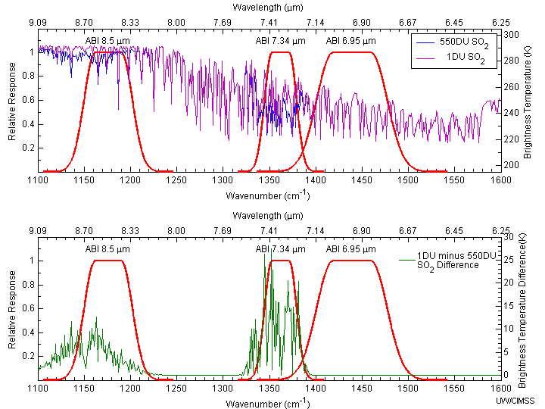
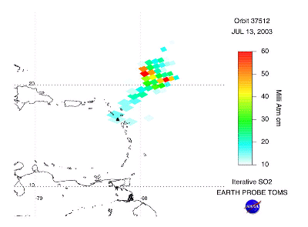
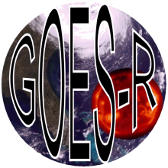
USING GOES-R TO HELP MONITOR UPPER LEVEL SO₂
Anthony J. Schreiner*, Timothy J. Schmit#, Jun Li*, Gary P. Ellrod#, Mat Gunshor*
*CIMSS #NOAA/NESDIS
Simulated IR spectrums for “normal” and “SO₂ enriched” atmosphere and spectral response functions
Plume
Simulated GOES-R ABI
Image Difference
TOMS
Difference and GOES-R ABI SRF
The 7.3 um band was spectrally modified to better detect upper-level SO2. This was, in part, due to a suggestion of G. Ellrod.
Carn

Slide 31
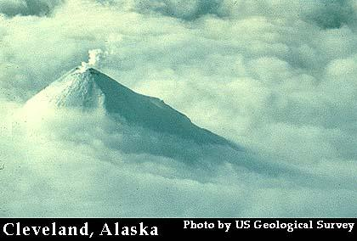
Volcanic Ash Plume: 11-12 and 8.5-11 μm images
One day after the Mt. Cleveland eruption
20 February 2001, 8:45 UTC
Simulated
ABI
(11-12 μm)
Simulated
ABI
(8.5-11 μm)
UW/CIMSS
Notes:
One of uses of the 8.5 um is better ash detection.

Slide 32
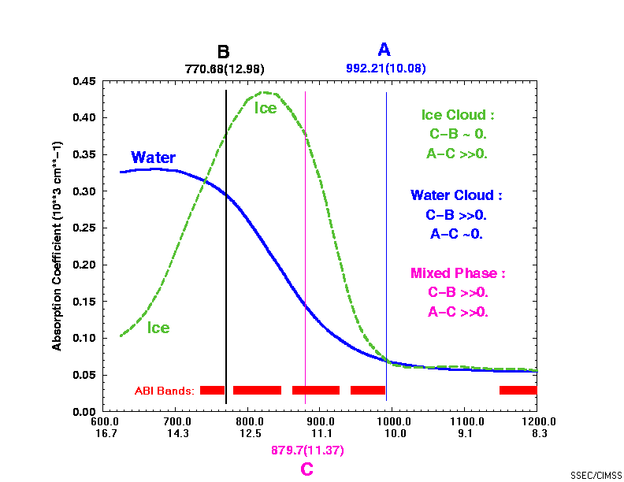
ABI -- 8.5 μm Based on MODIS used with ABI window channels to separate water from ice clouds
The 8.5 um band was added, in part, due to a request in the late 1980s from Steve Ackerman, CIMSS.
Notes:
Another use of the 8.5 um band is a day and night cloud-top phase product.

Slide 33
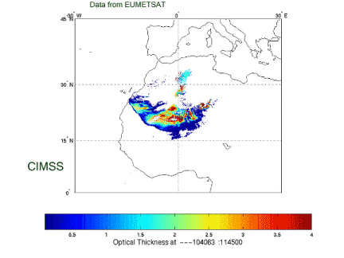
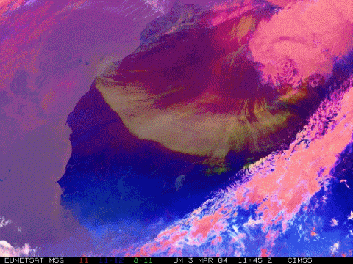
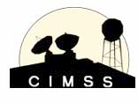
Aerosol/Dust Optical Thickness Retrieval
Results from SEVIRI@EUMETSAT
In general, GOES-R products will be more quantitative that current GOES.
Figure courtesy of J. Li and P. Zhang
Notes:
The 8.5 um is also very helpful for dust detection.

Slide 34
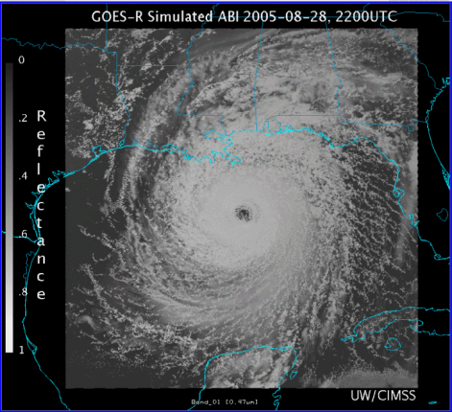
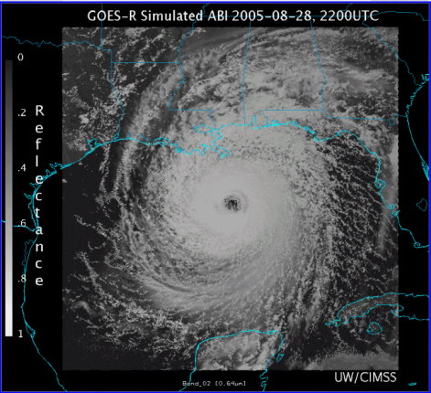
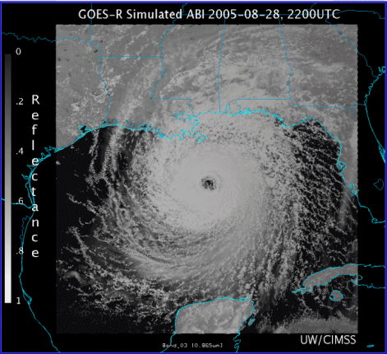
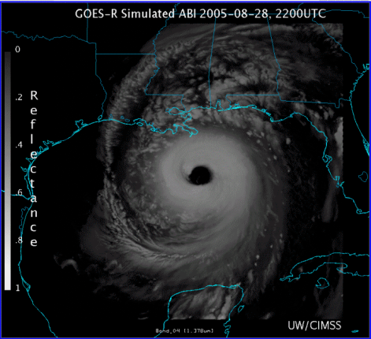
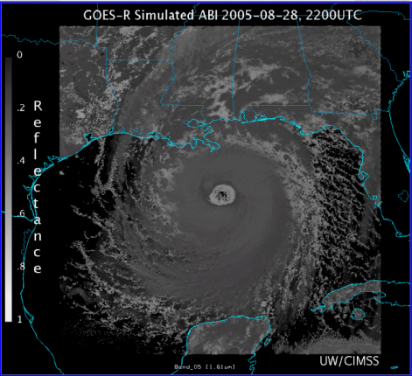
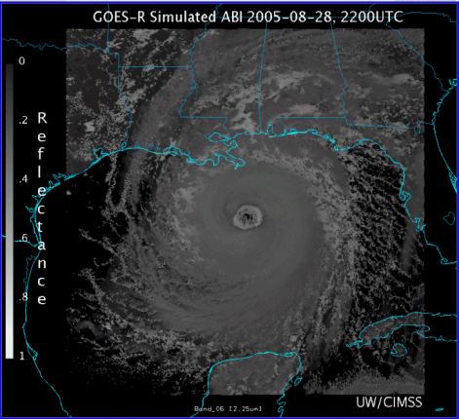
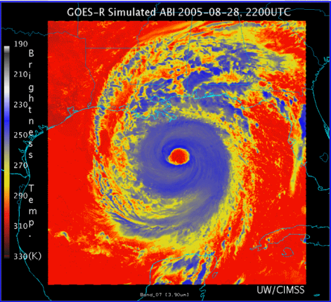
0.47 μm
0.64 μm
0.86 μm
1.38 μm
AWG Proxy ABI Simulations of Hurricane Katrina
1.61 μm
2.26 μm
3.9 μm
6.19 μm
NOAA/NESDIS STAR and GOES-R Imagery Team
6.95 μm
7.34 μm
8.5 μm
9.61 μm
10.35 μm
11.2 μm
12.3 μm
13.3 μm
Notes:
As shown in mcidas-v

Slide 35
Visible and near-IR channels on the ABI
Aerosols, Insolation
Clouds, Snow
Vegetation, Imagery
Cloud mask, Suspended matter
Snow, Phase
Cloud Particle size
Sample use only, many other uses
The ABI visible and near-IR bands have many uses.
Notes:
Schmit, T. J., M. M. Gunshor, W. P. Menzel, J. J. Gurka, J. Li, and A. S. Bachmeier, 2005: Introducing the next-generation Advanced Baseline Imager on GOES-R. Bull. Amer. Meteor. Soc., 86, 1079-1096.

Slide 36
The IR channels on the ABI
Clouds, Stability Indices
SST, Fires, Radiances
Ozone, Downward Radiation
Rainfall, Aerosol
Hurricane, Imagery
Cloud Phase, SST
Sample use only, many other uses
SO2, Radiances
Winds, WV profiling
TPW, Rainfall rate
Fires, Fog
ABI has many more bands than the current operational GOES imagers.
Notes:
Schmit, T. J., M. M. Gunshor, W. P. Menzel, J. J. Gurka, J. Li, and A. S. Bachmeier, 2005: Introducing the next-generation Advanced Baseline Imager on GOES-R. Bull. Amer. Meteor. Soc., 86, 1079-1096.

Slide 37
GOES-R ABI Weighting Functions
ABI has only 1 CO₂ band.
Notes:
This figure was generated by M. Gunshor, of CIMSS.

Slide 38
ABI Band “Champions”
CWL | Band # | Champion
0.47 | 1 | Fred Mosher
0.64 | 2 | Vern Suomi
0.86 | 3 | Nagaraja Rao
1.38 | 4 | Bo-Cai Gao
1.61 | 5 | L. Stowe
2.25 | 6 | M. King
3.9 | 7 | Vern Suomi
6.16 | 8 | Pierre Morel
6.93 | 9 | W. L. Smith
7.34 | 10 | Gary Ellrod
8.5 | 11 | S. Ackerman
9.61 | 12 | Art Neuendorffer
10.33 | 13 | W. P. Menzel
11.2 | 14 | Vern Suomi
12.3 | 15 | Vern Suomi
13.3 | 16 | W. L. Smith

Slide 39
Ackerman memo (1989)
8 micrometer…very useful in detecting …cirrus information … microphysical properties

Slide 40
GOES Fly-out Schedule
http://www.goes-r.gov/

Slide 41
The Advanced Baseline Imager:
ABI Current
Spectral Coverage
16 bands 5 bands
Spatial resolution
0.64 μm Visible 0.5 km Approx. 1 km
Other Visible/near-IR 1.0 km n/a
Bands (>2 μm) 2 km Approx. 4 km
Spatial coverage
Full disk 4 per hour Scheduled (3 hrly)
CONUS 12 per hour ~4 per hour
Mesoscale Every 30 sec n/a
Visible (reflective bands)
On-orbit calibration Yes No
Notes:
The ABI allows more bands, finer spatial resolution, faster refresh rates and on-orbit calibration of all bands!

Slide 42
Approximate spectral and spatial resolutions of US GOES Imagers
~ Band Center (um) | GOES-6/7 | GOES-8/11 | GOES-12/N | GOES-O/P | GOES-R+
0.47
0.64
0.86
1.6
1.38
2.2
3.9
6.2
6.5/6.7/7 | 14km
7.3
8.5
9.7
10.35
11.2
12.3
13.3
Visible
Near-IR
Box size represents detector size
8
4
2
“MSI mode”
Infrared
Notes:
0.40 inches = 4km; 0.80 inches = 8km
MSI is Multi-Spectral Imaging Mode (dashed boxes)
This does not show other improvements: SNR, MTF, bit-depth, navigation, coverage rates, etc.

Slide 43
Imager Coverage in ~30 minutes
 | Current Imager (Rapid Scan mode) | Future Imager (“Flex” mode)
Full Disk | 0 | 2
Northern Hemi | 1 | -
CONUS | 3 | 6
Mesoscale | 0 | 60
Full Disk
N. Hemisphere
CONUS
Mesoscale

Slide 44
GOES-R like intervals
Notes:
.mov version

Slide 45
GOES Outages -- approximate hours/year
Satellite Series | KOZ, Eclipse and Stray Light (spring and fall) | Housekeeping, SEM calibration, Maneuvers and Yaw-flip
GOES-8 thru -12 | 420 | 211
GOES-13/14/15 (may be reduced) | 220 | 107
GOES-R ABI | ~6 - 40 | ~2 - 6
Improved stray light performance with the ABI.
0400 UTC
0500 UTC
0600 UTC
Outage
during
landfall
Hurricane
Ivan
Notes:
2004, Hurricane Ivan.

Slide 46
Improved products could be realized from combinations of ABI and HES (Hyperspectral Environmental Suite) data
Spatial
resolution
Temporal
resolution
Cloud
clearing
ABI
HES
Spectral
coverage
Surface
emissivity
Spectral resolution
cira 2004
HES cancelled in 2006

Slide 47
GOES-R main instruments
ABI – Advanced Baseline Imager
Space Weather/Solar
SEISS
SUVI
EXIS
Magnetometer
ABI covers the earth 5X faster than current Imager
Geostationary Lightning Mapper
Images courtesy of SOHO EIT, a joint NASA/ESA program
Unique Payload Services
No Sounder

Slide 48
GOES-R Series Overview
No dedicated Sounder
Advanced Baseline Imager (ABI)
Geostationary Lightning Mapper (GLM)
Space Weather
Space Environmental In-Situ Suite (SEISS)
Solar Ultra Violet Imager (SUVI)
Extreme Ultra Violet/X-Ray Irradiance Sensor (EXIS)
Magnetometer
Communications
GOES Rebroadcast (GRB)
Low Rate Information Transmissions (LRIT)
Emergency Managers Weather Information Network (EMWIN)
Search and Rescue (SAR)
Data Collection System (DCS)
Notes:
Advanced Baseline Imager (ABI) Earth-viewing
Geostationary Lightning Mapper (GLM) Earth-viewing
Solar Ultra-Violet Imager (SUVI) Sun-viewing
EUVS and XRS Irradiance Sensors (EXIS) Sun-viewing
Space Environment In-Situ Suite (SEISS) Space-viewing
Magnetometer (MAG) Space-viewing

Slide 49
GOES-R
Folks who named the instruments
Schmit
Coakley
?
Hawkins
Goodman
Notes:
Graphic from LM

Slide 50
Summary
The ABI on GOES-R will improve over the current instrument in many aspects (spatial, temporal, spectral, etc.).
The great amount of information from the GOES-R will offer a continuation of current products and new products.
The ABI builds on previous experience and instruments.
The ABI has already had a long history, even before launch.
Contact information: tim.j.schmit@noaa.gov

Slide 51
Acknowledgements
The authors would like to thank the entire GOES and GOES-R teams; both within the government, industry and academia.
The views, opinions, and findings contained in this presentation are those of the authors and should not be construed as an official National Oceanic and Atmospheric Administration or U.S. Government position, policy, or decision.

Slide 52
Web page
www.goes-r.gov

Slide 53
Links
http://www.goes-r.gov
http://www.meted.ucar.edu/index.htm
http://cimss.ssec.wisc.edu/goes_r/proving-ground.html
http://cimss.ssec.wisc.edu/goes_r/proving-ground/nssl_abi/nssl_abi_rt.html
http://cimss.ssec.wisc.edu/goes/abi/
http://cimss.ssec.wisc.edu/goes/blog/
http://www.ssec.wisc.edu/data/geo/
http://cimss.ssec.wisc.edu/goes/srsor/GOES-14_SRSOR.html

Slide 54
GOES-R ABI Products
Baseline Products
Future Capabilities
Advanced Baseline Imager (ABI)
Aerosol Detection (Including Smoke and Dust) Aerosol Optical Depth (AOD) Clear Sky Masks Cloud and Moisture Imagery Cloud Optical Depth Cloud Particle Size Distribution Cloud Top Height Cloud Top Phase Cloud Top Pressure Cloud Top Temperature Derived Motion Winds Derived Stability Indices Downward Shortwave Radiation: Surface Fire/Hot Spot Characterization Hurricane Intensity Estimation Land Surface Temperature (Skin) Legacy Vertical Moisture Profile Legacy Vertical Temperature Profile Radiances Rainfall Rate/QPE Reflected Shortwave Radiation: TOA Sea Surface Temperature (Skin) Snow Cover Total Precipitable Water Volcanic Ash: Detection and Height
Advanced Baseline Imager (ABI)
Absorbed Shortwave Radiation: Surface Aerosol Particle Size Aircraft Icing Threat Cloud Ice Water Path Cloud Layers/Heights Cloud Liquid Water Cloud Type Convective Initiation Currents Currents: Offshore Downward Longwave Radiation: Surface Enhanced “V”/Overshooting Top Detection Flood/Standing Water Ice Cover Low Cloud and Fog Ozone Total Probability of Rainfall Rainfall Potential Sea and Lake Ice: Age Sea and Lake Ice: Concentration Sea and Lake Ice: Motion Snow Depth (Over Plains) SO₂ Detection Surface Albedo Surface Emissivity Tropopause Folding Turbulence Prediction Upward Longwave Radiation: Surface Upward Longwave Radiation: TOA Vegetation Fraction: Green Vegetation Index Visibility

Slide 55
Pseudo-Natural Color

