Slide 1
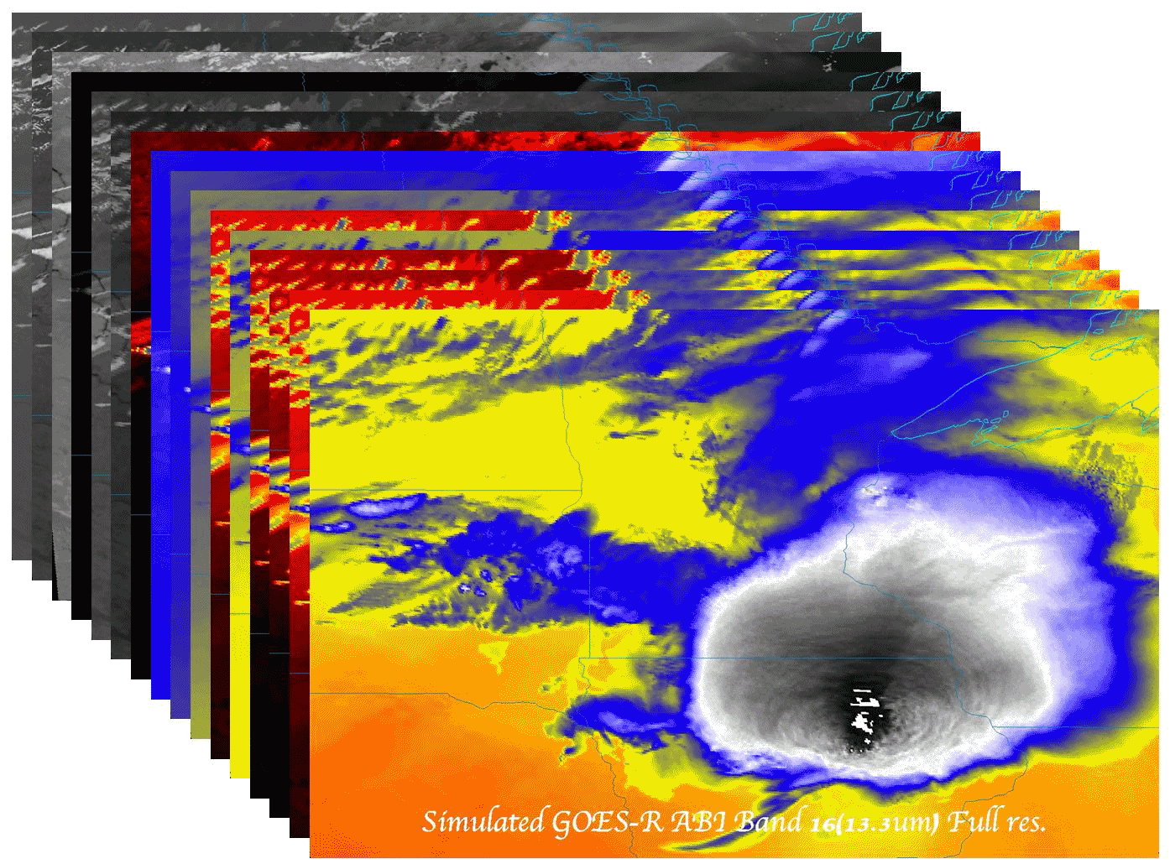
Operational uses of the ABI (Advanced Baseline Imager) on the GOES-R series
Timothy J. Schmit (tim.j.schmit@noaa.gov)
NOAA/NESDIS/Satellite Applications and Research
Advanced Satellite Products Branch (ASPB)
Madison, WI
Mathew M. Gunshor, Kaba Bah, James J. Gurka, Jason Otkin
Future Satellite Symposium
Austin, TX
6-10 January 2013
UW-Madison

Slide 2
Thanks to…
Scott Lindstrom, Scott Bachmeier, Joleen Feltz, William Straka, Jun Li, Scott Bachmeier, Steve Ackerman, Bob Aune, Don Hillger, Paul Menzel, Steve Ackerman, Tony Schreiner, Justin Sieglaff, Jim Jung, Elaine Prins, Brad Pierce, Wayne Feltz, Jean Phillips, Gary Wade, Don Hillger, Jinlong Li, Jing Zheng, Allen Huang, Bob Rabin, the SSEC data center, Mike Pavolonis, Jaime Daniels, ASPB, STAR, NESDIS, NSSL, MUG, Kevin Ludlum, GOES operators, GOES shift supervisors, Mark DeMaria, and many others!
GOES-R Program Office (Steve Goodman, etc.), NASA, ITT Industries, other industry partners, etc.
You.

Slide 3
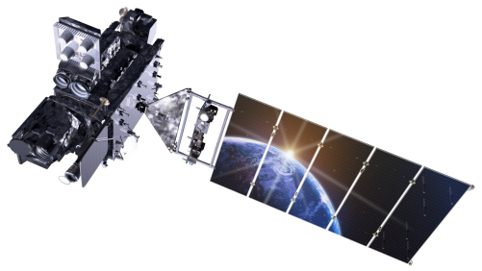
Outline
ABI (Advanced Baseline Imager)
Temporal
Spatial
Spectral
Products
Summary
More information
Questions
Lockheed Martin

Slide 4
The Advanced Baseline Imager:
ABI Current
Spectral Coverage
16 bands 5 bands
Spatial resolution
0.64 μm Visible 0.5 km Approx. 1 km
Other Visible/near-IR 1.0 km n/a
Bands (>2 μm) 2 km Approx. 4 km
Spatial coverage
Full disk 4 per hour Scheduled (3 hrly)
CONUS 12 per hour ~4 per hour
Mesoscale Every 30 sec n/a
Visible (reflective bands)
On-orbit calibration Yes No

Slide 5
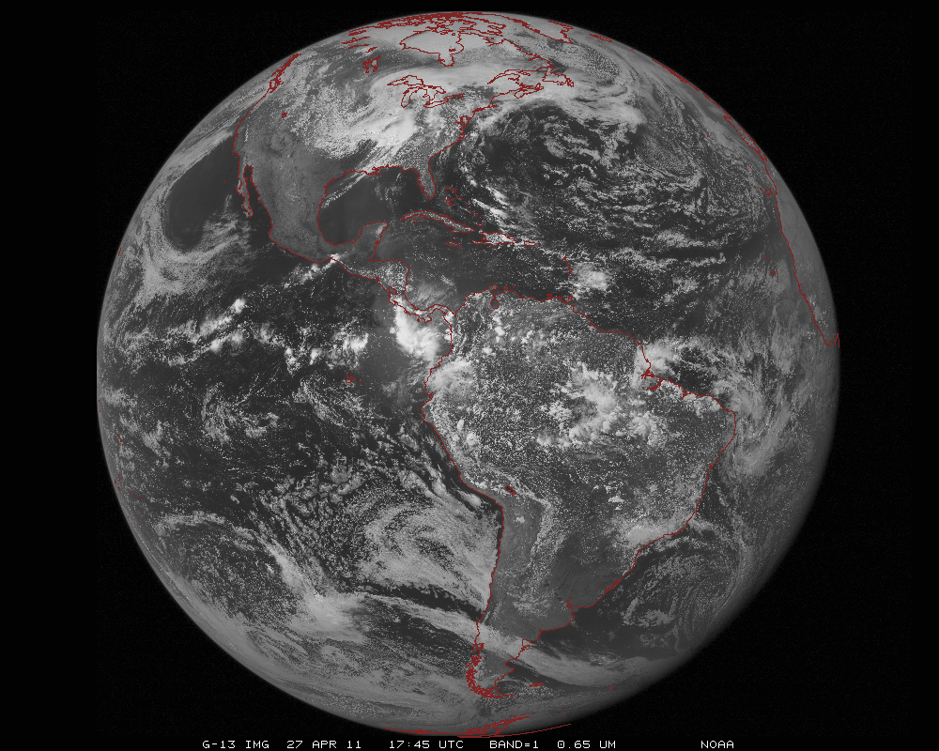
ABI scans about 5 times faster
than the current GOES imager
Anticipated scan mode for the ABI:
- Full disk images every 15 minutes + 5 min CONUS images + mesoscale.

Slide 6
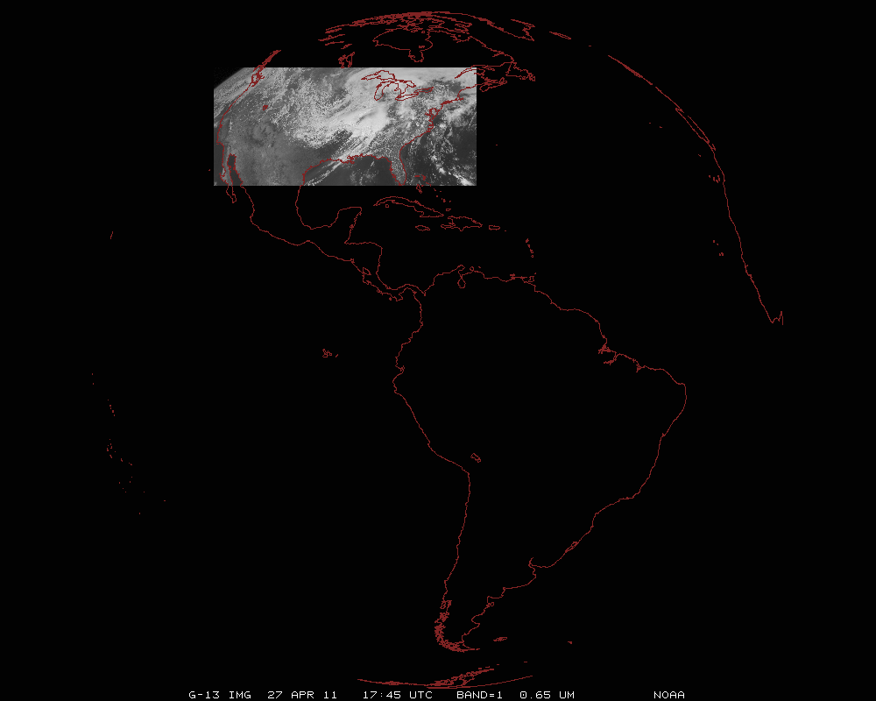
ABI can offer Continental US images every 5 minutes for routine monitoring of a wide range of events (storms, dust, clouds, fires, winds, etc).
This is every 15 or 30 minutes with the current GOES in routine mode.
Notes:
Approx. size of CONUS

Slide 7
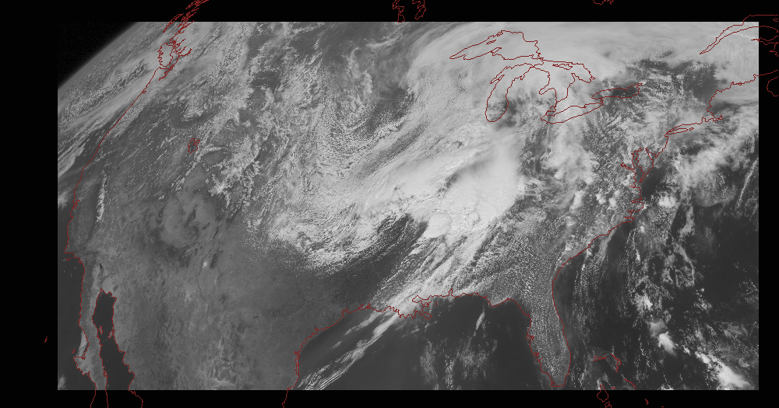
Notes:
Approx. size of CONUS

Slide 8
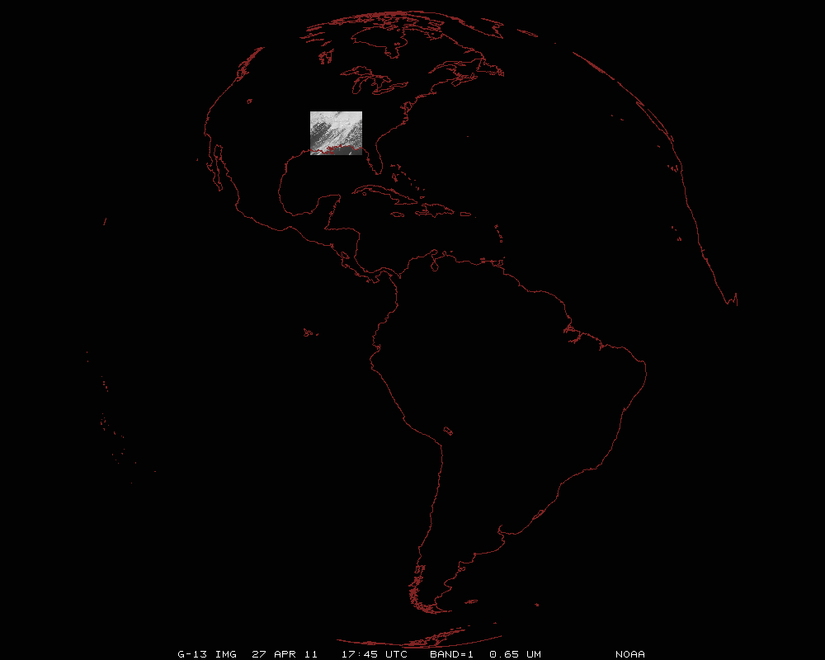
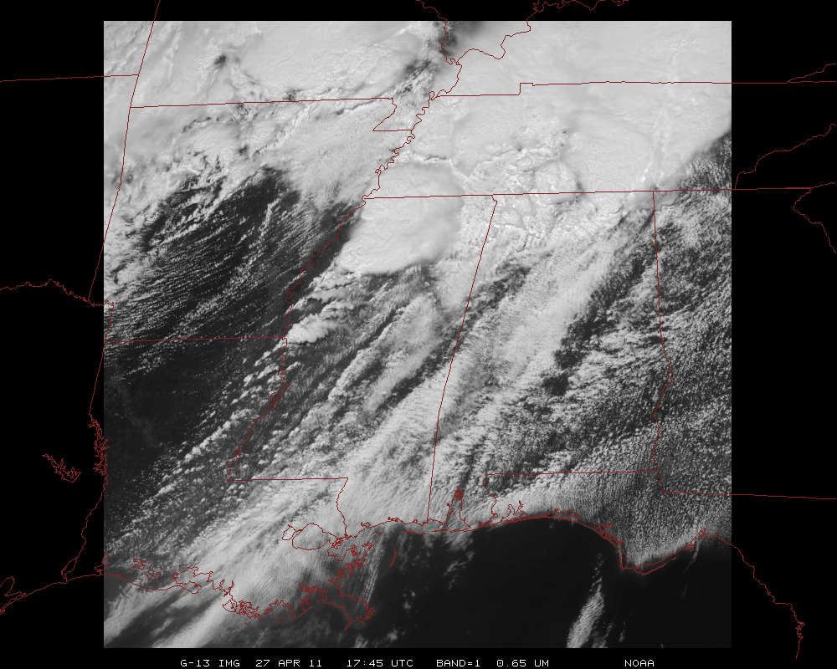
Mesoscale images every 30 seconds for rapidly changing phenomena
(thunderstorms, hurricanes, fires, etc). Or two regions every 60 seconds.
Notes:
Approx. size of meso-scale showing “Franklin”.

Slide 9
1-min imagery
Operational (GOES-13)
1-min mode (SRSOR from GOES-14)

Slide 10
SRSOR

Slide 11
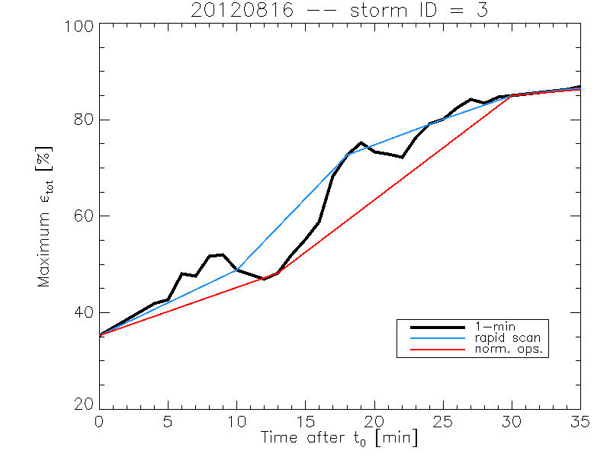
Rate of temporal cooling in the longwave infrared band
Cintineo et al., 2013 (CIMSS)

Slide 12
GOES-14 SRSOR of Sandy (Visible)
The 1-min interval imagery shows ‘what is happening’, not ‘what has happened’.
Notes:
Thanks to SSEC. More info: http://cimss.ssec.wisc.edu/goes/srsor/GOES-14_SRSOR.html
Loops by T. Schmit, NOAA NESDIS.

Slide 13
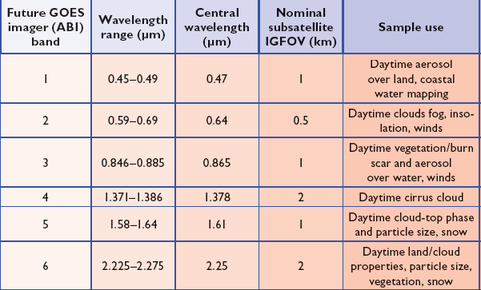
ABI Visible/Near-IR Bands
Schmit et al, 2005
Notes:
Schmit, T. J., M. M. Gunshor, W. P. Menzel, J. J. Gurka, J. Li, and A. S. Bachmeier, 2005: Introducing the next-generation Advanced Baseline Imager on GOES-R. Bull. Amer. Meteor. Soc., 86, 1079-1096.

Slide 14
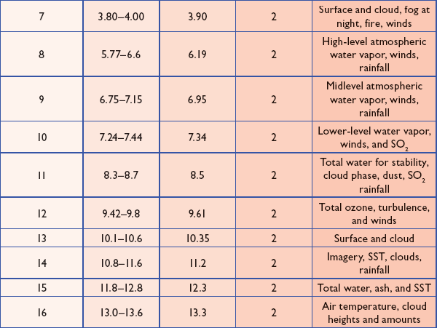
ABI IR Bands
Schmit et al, 2005
Notes:
Schmit, T. J., M. M. Gunshor, W. P. Menzel, J. J. Gurka, J. Li, and A. S. Bachmeier, 2005: Introducing the next-generation Advanced Baseline Imager on GOES-R. Bull. Amer. Meteor. Soc., 86, 1079-1096.

Slide 15
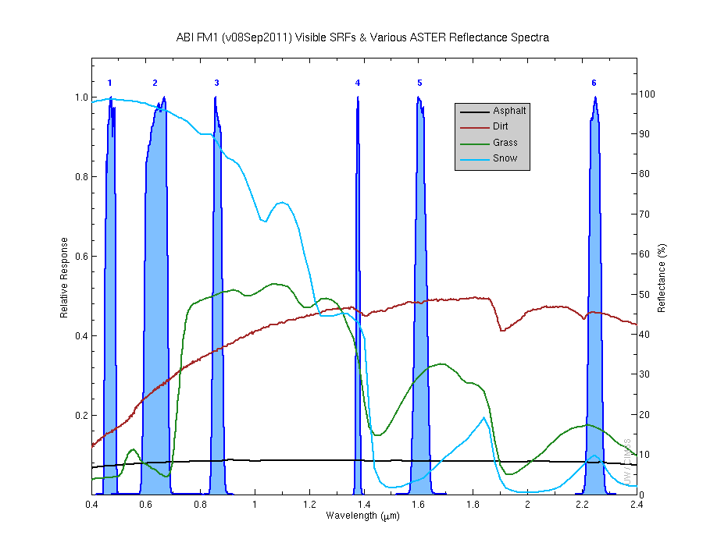
Visible and near-IR channels on the ABI
Aerosols, Insolation
Clouds, Snow
Vegetation, Imagery
Cloud mask, Suspended matter
Snow, Phase
Cloud Particle size
Sample use only, many other uses
The ABI visible and near-IR bands have many uses.
Notes:
Schmit, T. J., M. M. Gunshor, W. P. Menzel, J. J. Gurka, J. Li, and A. S. Bachmeier, 2005: Introducing the next-generation Advanced Baseline Imager on GOES-R. Bull. Amer. Meteor. Soc., 86, 1079-1096.

Slide 16
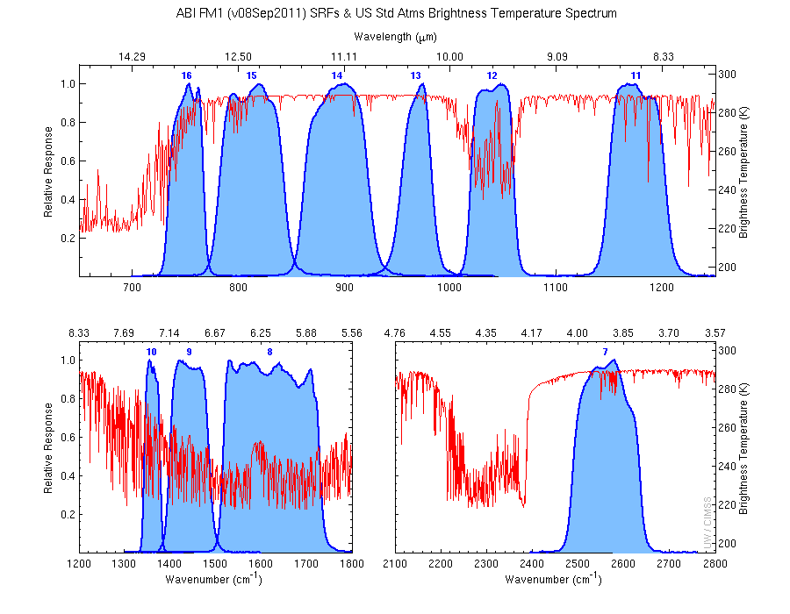
The IR channels on the ABI
Clouds, Stability Indices
SST, Fires, Radiances
Ozone, Downward Radiation
Rainfall, Aerosol
Hurricane, Imagery
Cloud Phase, SST
Sample use only, many other uses
SO2, Radiances
Winds, WV profiling
TPW, Rainfall rate
Fires, Fog
ABI has many more bands than the current operational GOES imagers.
Notes:
Schmit, T. J., M. M. Gunshor, W. P. Menzel, J. J. Gurka, J. Li, and A. S. Bachmeier, 2005: Introducing the next-generation Advanced Baseline Imager on GOES-R. Bull. Amer. Meteor. Soc., 86, 1079-1096.

Slide 17
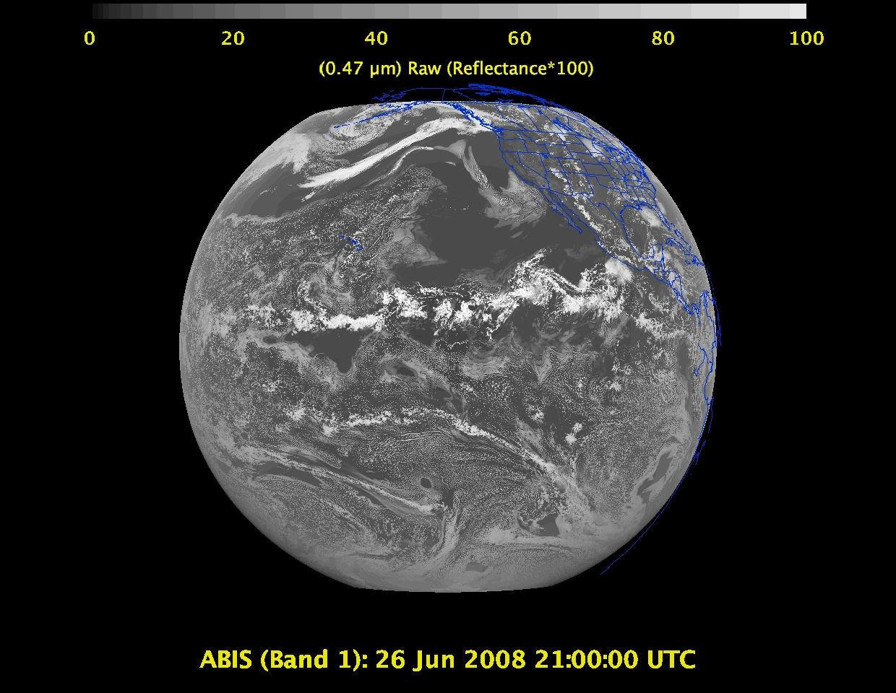
Daytime “Blue” band – aerosols, solar insolation, snow cover

Slide 18
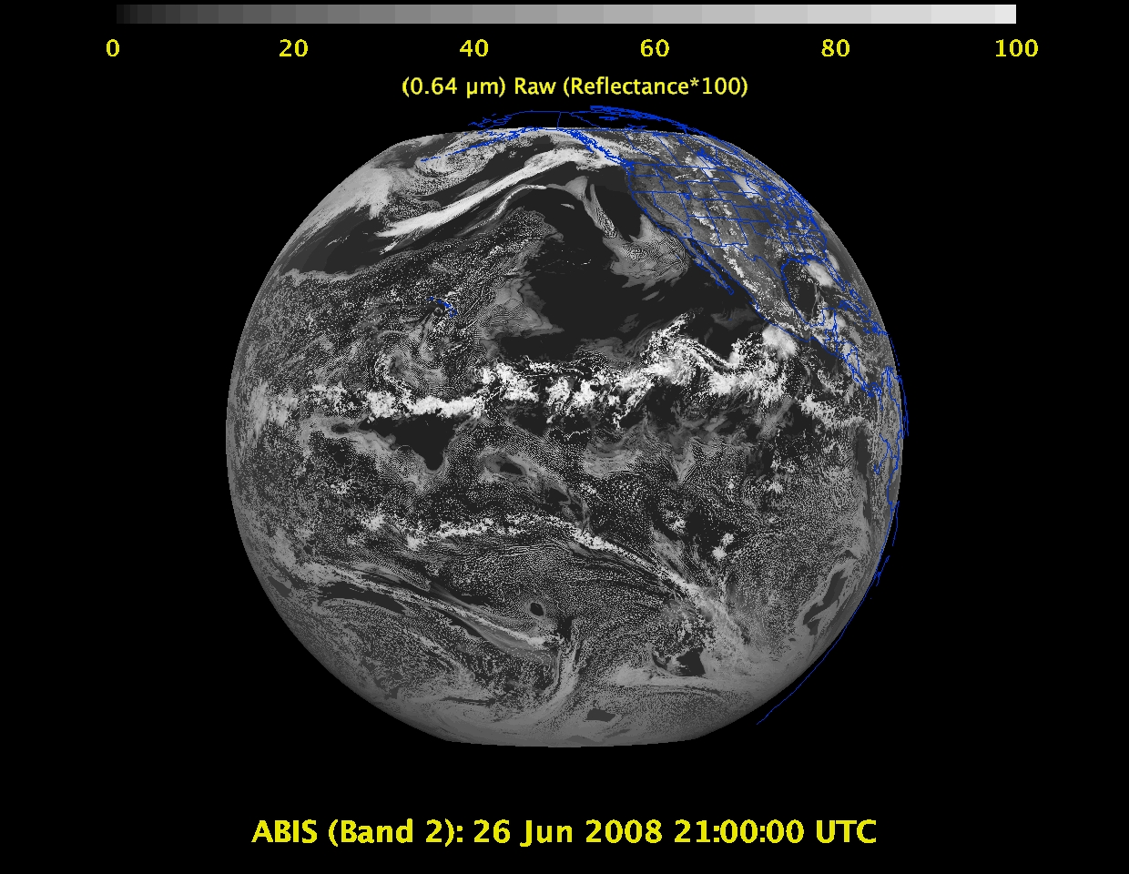
Daytime “Red” band – clouds, cloud-mask, optical depth, winds, etc.

Slide 19
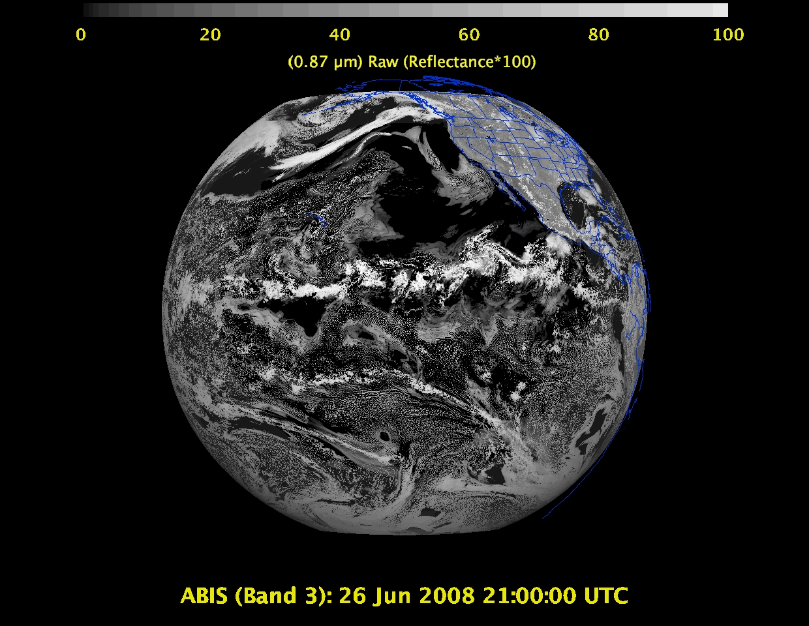
Daytime “Veggie” band – NDVI, solar insolation, snow cover

Slide 20
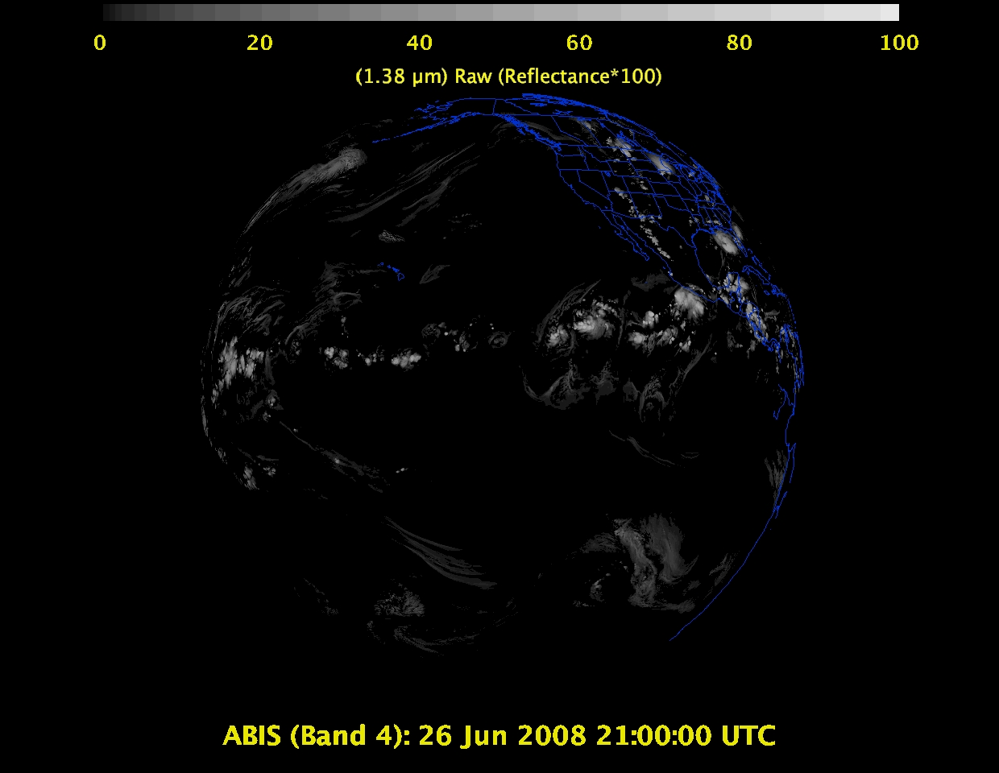
1 Daytime “Cirrus” band – cloud mask, aerosol detection

Slide 21
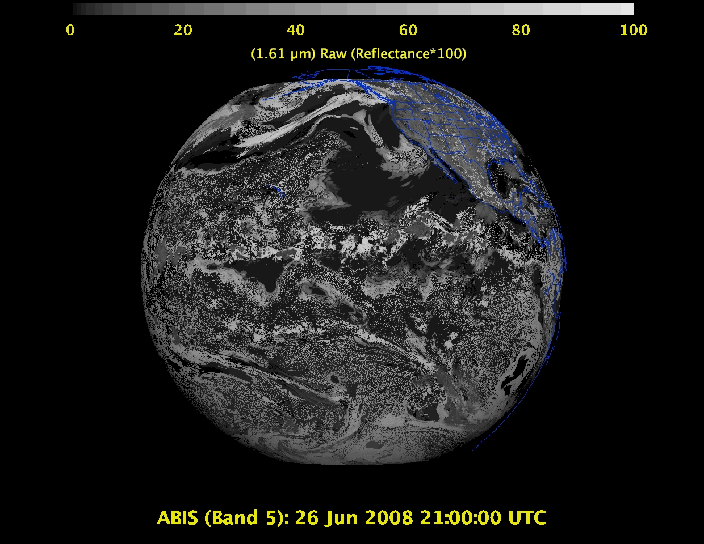
Daytime “Snow” band – snow cover, cloud mask, etc.

Slide 22
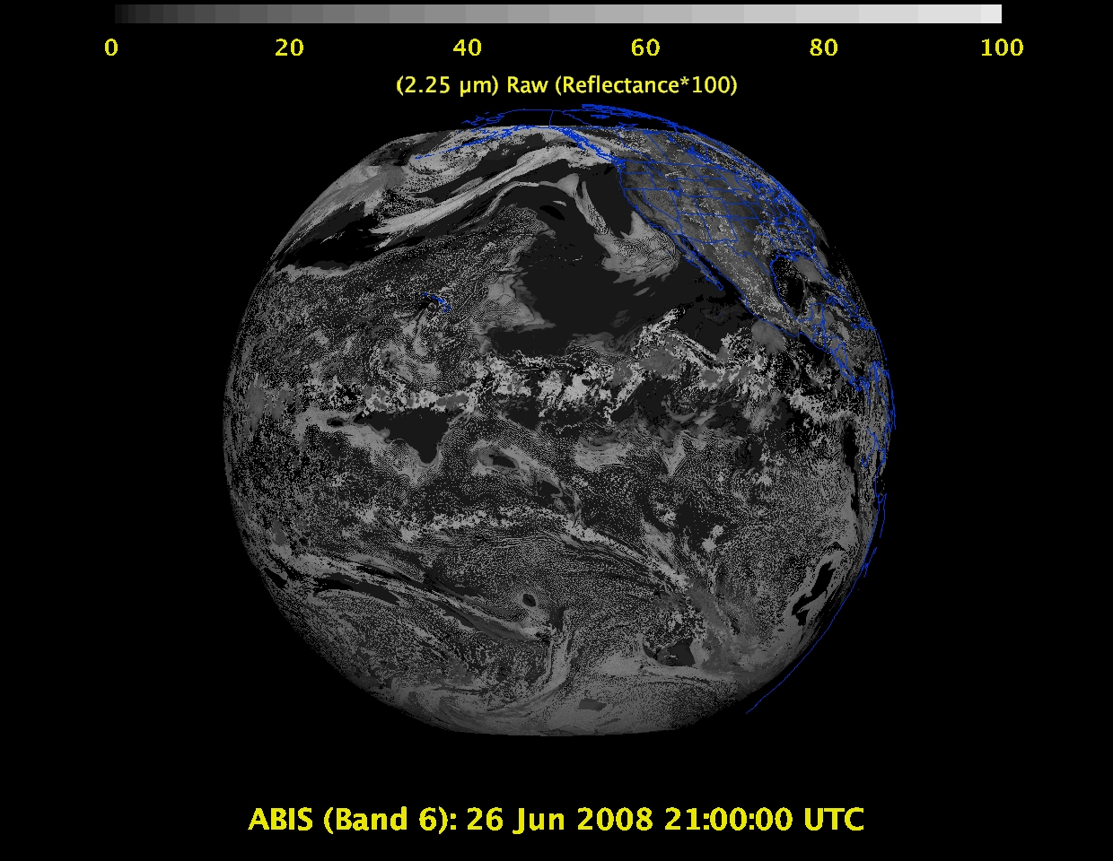
Daytime “Cloud-top phase” band – cloud particle size, snow cover

Slide 23
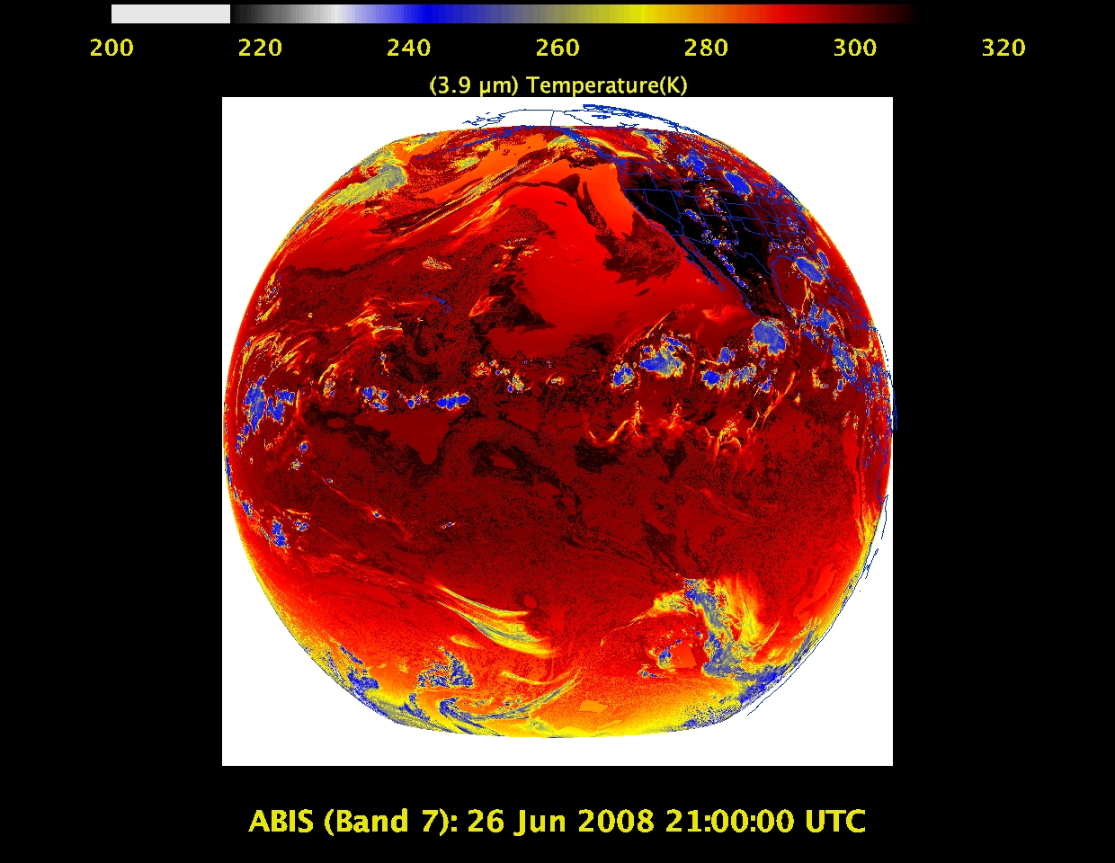
Shortwave IR window band - fog, fires, winds, SST, etc.

Slide 24
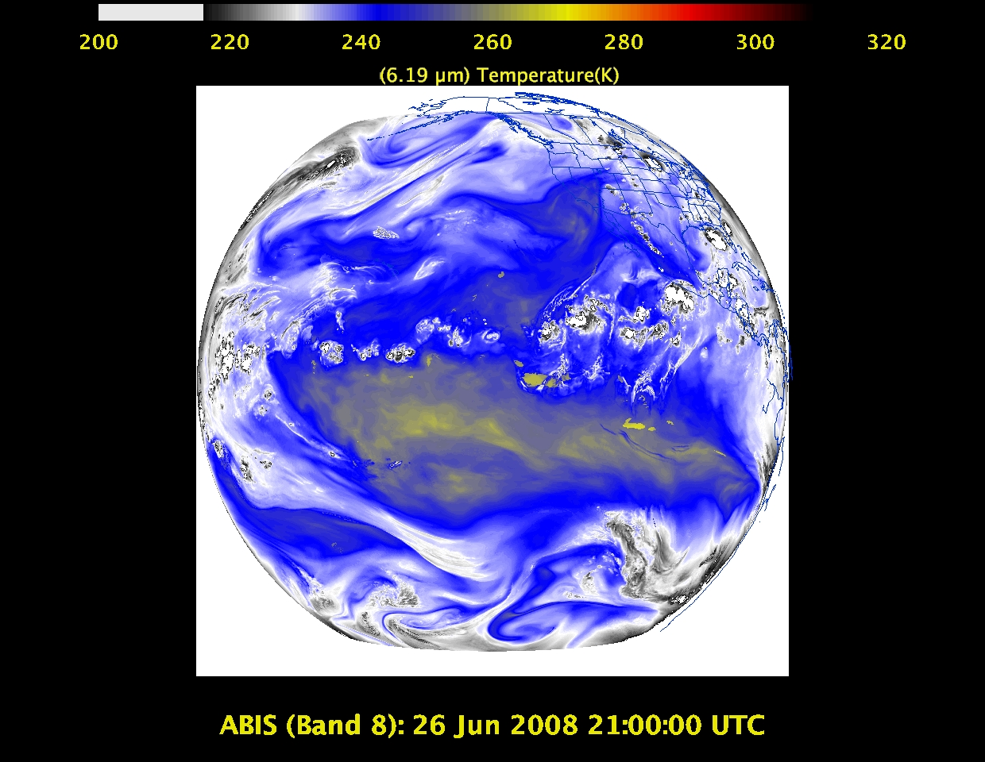
Upper-level tropospheric water vapor band – moisture, flow, winds

Slide 25
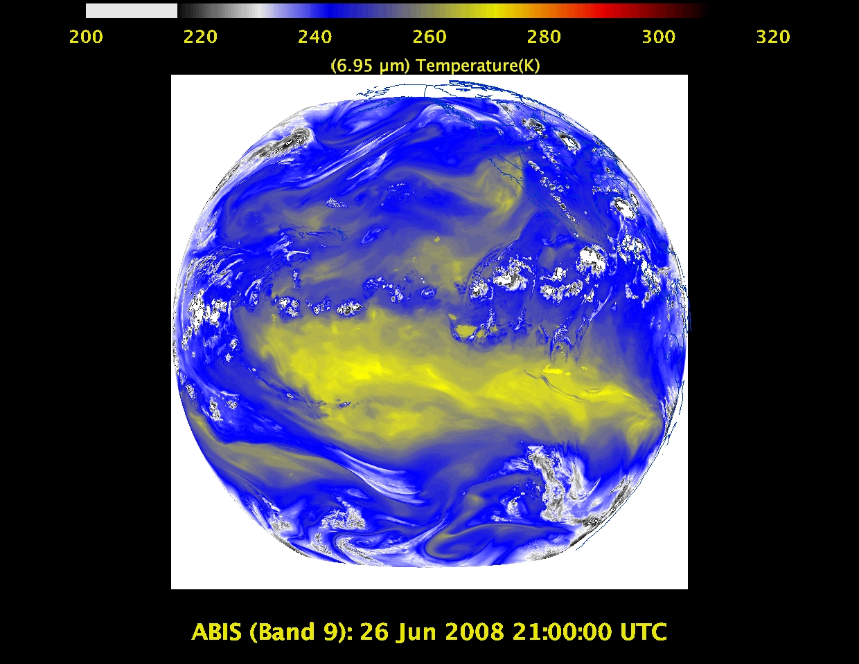
Upper/mid-level tropospheric water vapor band – moisture, flow, winds

Slide 26
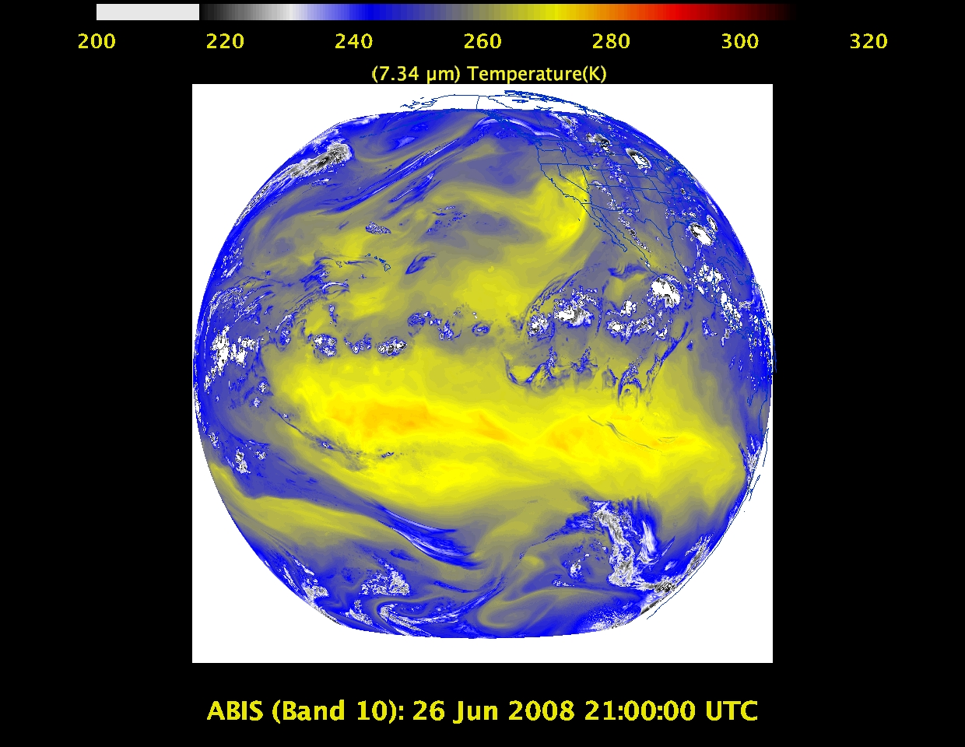
Lower mid-level tropospheric water vapor band– moisture, flow, winds

Slide 27
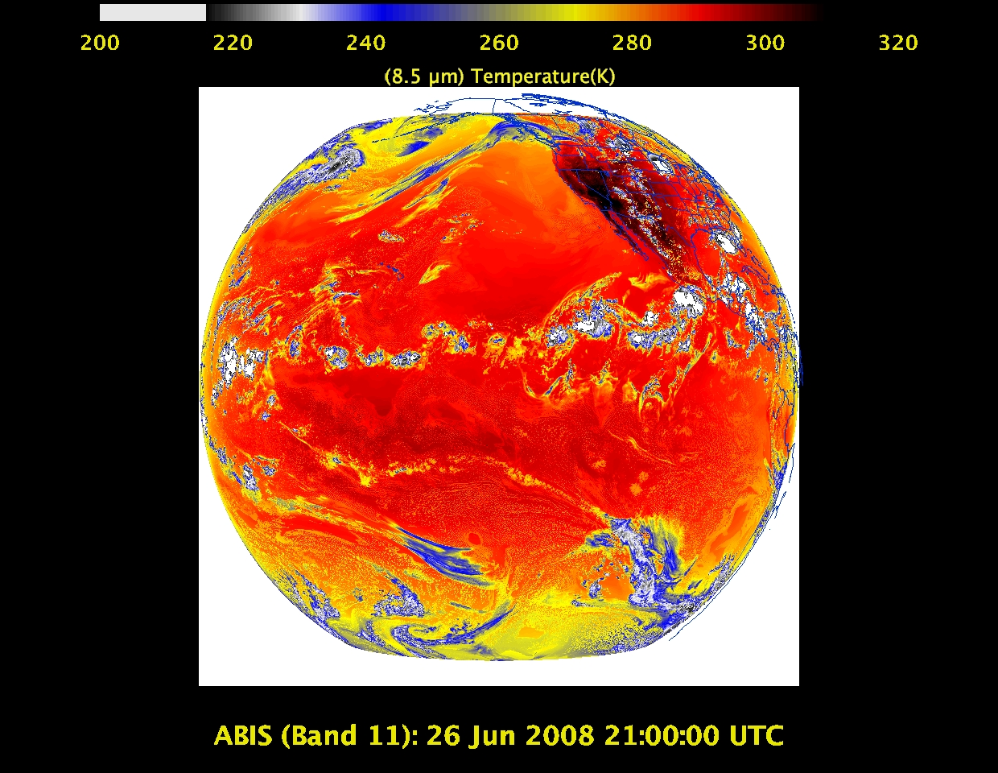
“Cloud-top phase” band – SO₂, dust, SST, stability indices, etc.

Slide 28
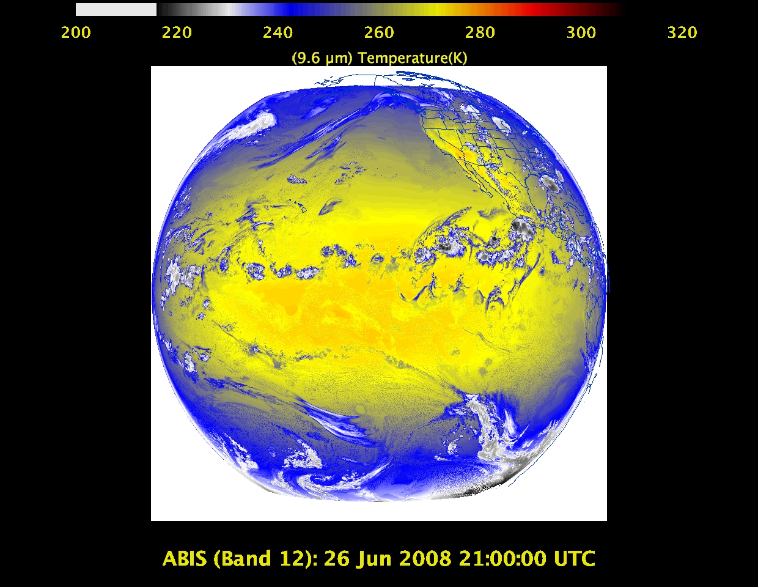
“Ozone” band

Slide 29
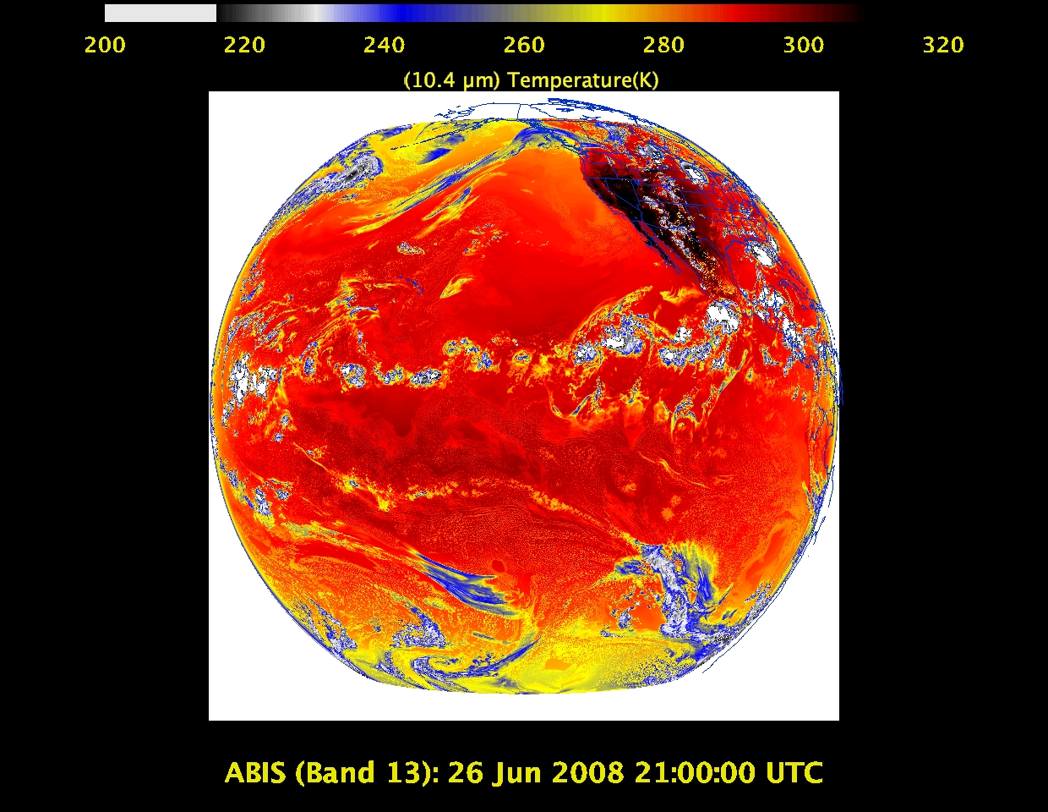
“Clean” IR longwave window band – imagery, TPW, etc.

Slide 30
IR longwave window band – many cloud parameters, SST, snow cover

Slide 31
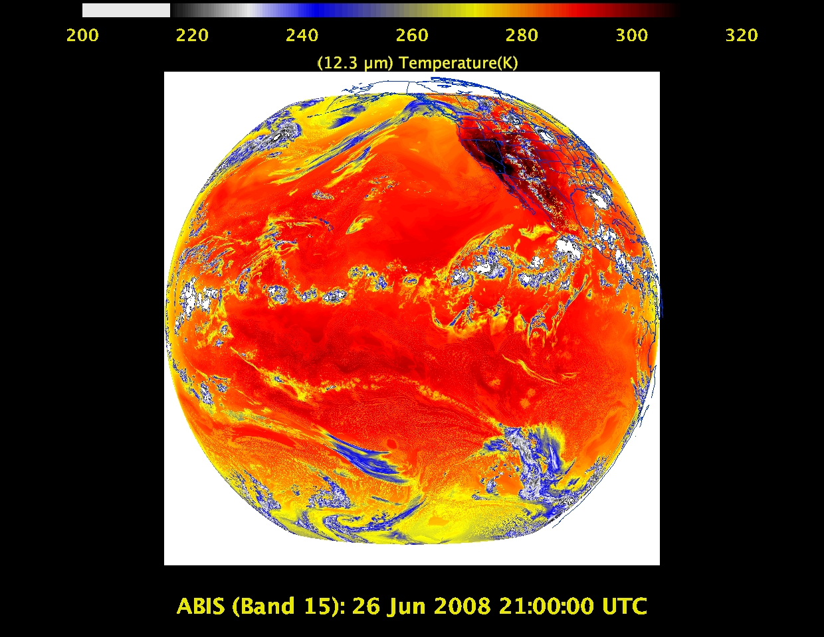
“Dirty” IR longwave window band – many cloud parameters, TPW

Slide 32
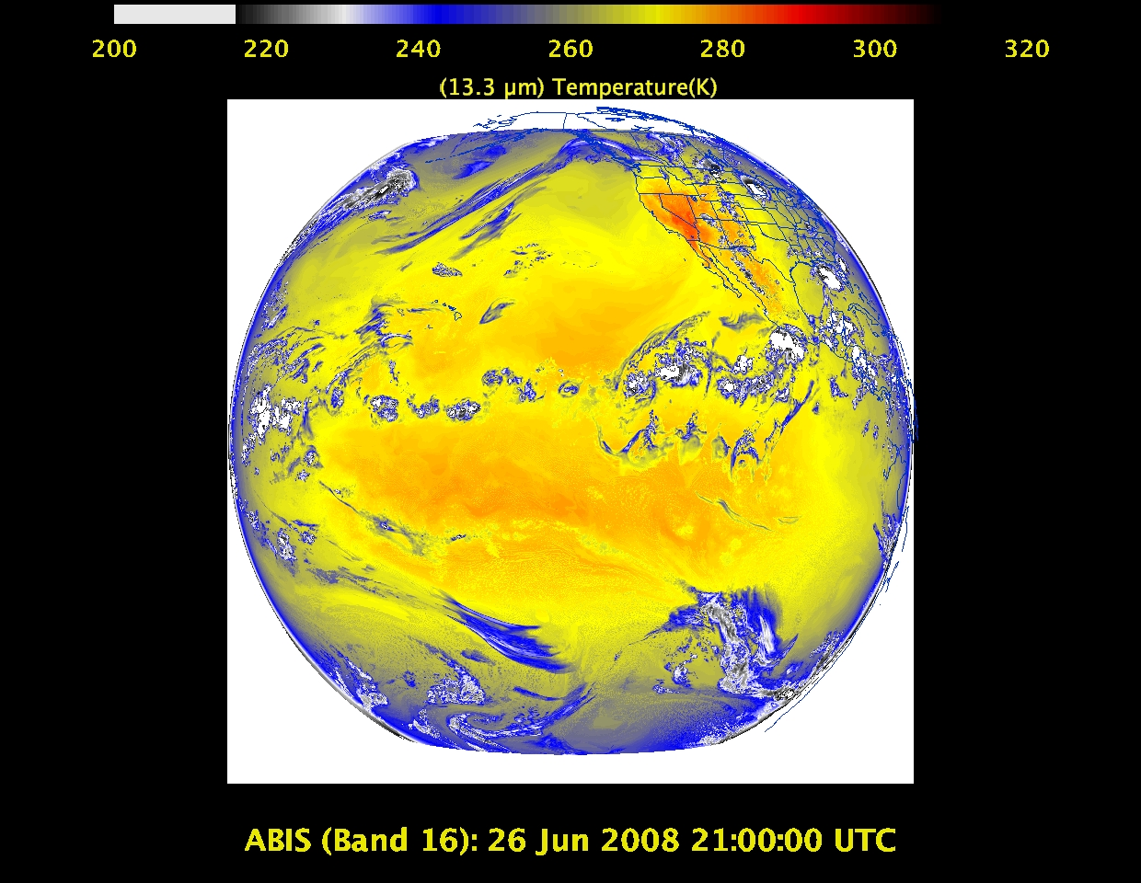
“CO2” longwave IR band – cloud height/pressure, stability indices

Slide 33
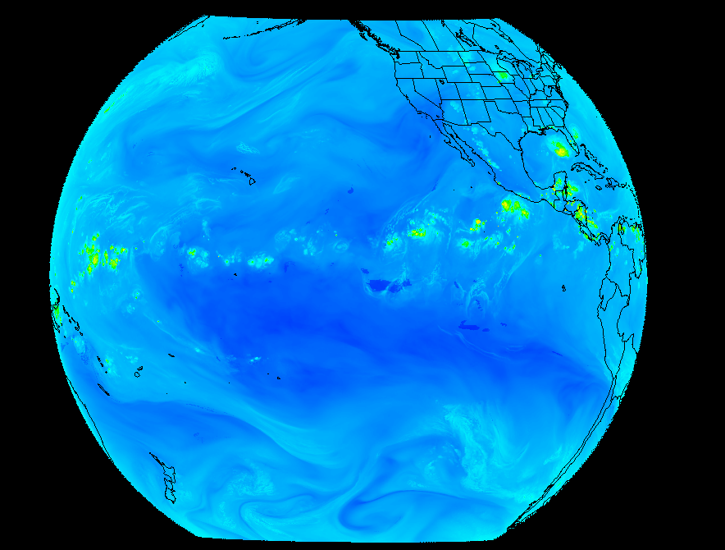
Outline
ABI (Advanced Baseline Imager)
Temporal
Spatial
Spectral
Products
Summary
More information
Questions

Slide 34
GOES-R ABI Products
Baseline Products
Future Capabilities
Advanced Baseline Imager (ABI)
Aerosol Detection (Including Smoke and Dust) Aerosol Optical Depth (AOD) Clear Sky Masks Cloud and Moisture Imagery Cloud Optical Depth Cloud Particle Size Distribution Cloud Top Height Cloud Top Phase Cloud Top Pressure Cloud Top Temperature Derived Motion Winds Derived Stability Indices Downward Shortwave Radiation: Surface Fire/Hot Spot Characterization Hurricane Intensity Estimation Land Surface Temperature (Skin) Legacy Vertical Moisture Profile Legacy Vertical Temperature Profile Radiances Rainfall Rate/QPE Reflected Shortwave Radiation: TOA Sea Surface Temperature (Skin) Snow Cover Total Precipitable Water Volcanic Ash: Detection and Height
Advanced Baseline Imager (ABI)
Absorbed Shortwave Radiation: Surface Aerosol Particle Size Aircraft Icing Threat Cloud Ice Water Path Cloud Layers/Heights Cloud Liquid Water Cloud Type Convective Initiation Currents Currents: Offshore Downward Longwave Radiation: Surface Enhanced “V”/Overshooting Top Detection Flood/Standing Water Ice Cover Low Cloud and Fog Ozone Total Probability of Rainfall Rainfall Potential Sea and Lake Ice: Age Sea and Lake Ice: Concentration Sea and Lake Ice: Motion Snow Depth (Over Plains) SO₂ Detection Surface Albedo Surface Emissivity Tropopause Folding Turbulence Prediction Upward Longwave Radiation: Surface Upward Longwave Radiation: TOA Vegetation Fraction: Green Vegetation Index Visibility

Slide 35
Three Groups of Users
Direct use of radiances/imagery
Numerical models
Forecasters
Broadcasters
General public/private sector/Internet
Direct use of satellite products
Numerical models
Forecasters
Blended products, etc.
General public/private sector/Internet
Use of services which use data/products
Basically everyone!

Slide 36
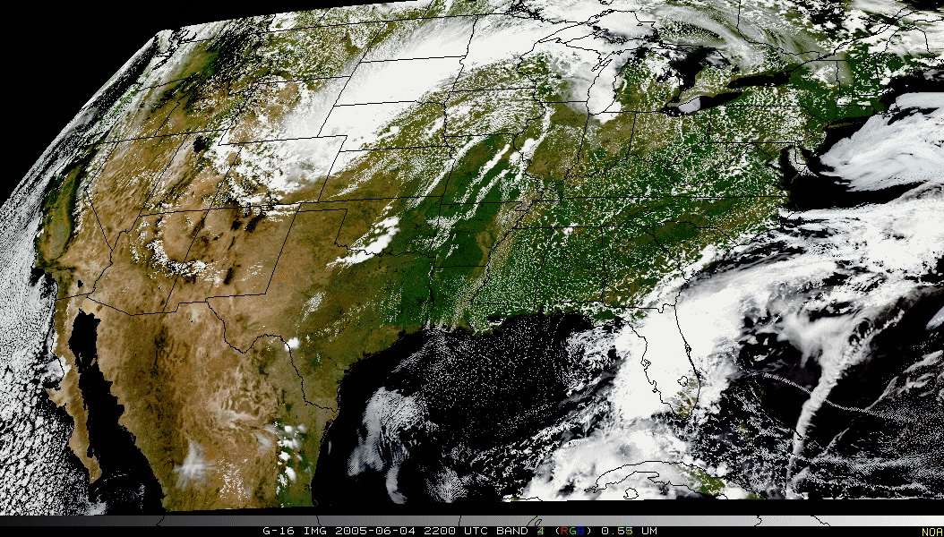
Pseudo-Natural Color

Slide 37
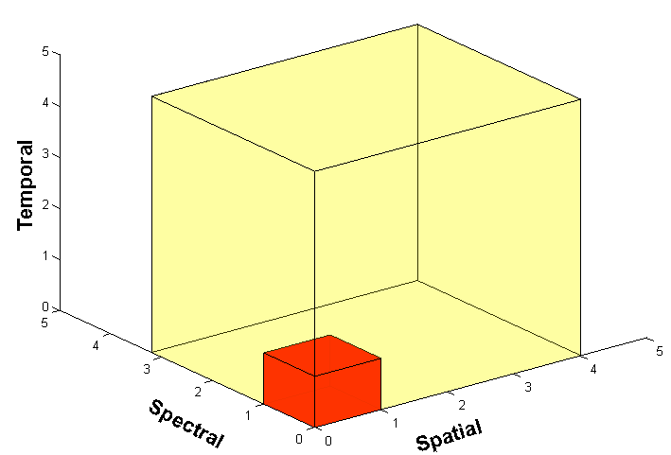
Outline
ABI (Advanced Baseline Imager)
Temporal
Spatial
Spectral
Products
Summary
More information
Questions

Slide 38
Approximate spectral and spatial resolutions of US GOES Imagers
~ Band Center (um) | GOES-6/7 | GOES-8/11 | GOES-12/N | GOES-O/P | GOES-R+
0.47
0.64
0.86
1.6
1.38
2.2
3.9
6.2
6.5/6.7/7 | 14km
7.3
8.5
9.7
10.35
11.2
12.3
13.3
Visible
Near-IR
Box size represents pixel size
8
4
2
“MSI mode”
Infrared
Notes:
0.40 inches = 4km; 0.80 inches = 8km
MSI is Multi-Spectral Imaging Mode (dashed boxes)
This does not show other improvements: SNR, MTF, bit-depth, navigation, coverage rates, etc.

Slide 39
Summary
1. The GOES-R ABI provides mission continuity
2. Two times the image navigation quality
3. Three times the number of imaging bands
4. Four times the spatial resolutions
5. Five times the coverage rate

Slide 40
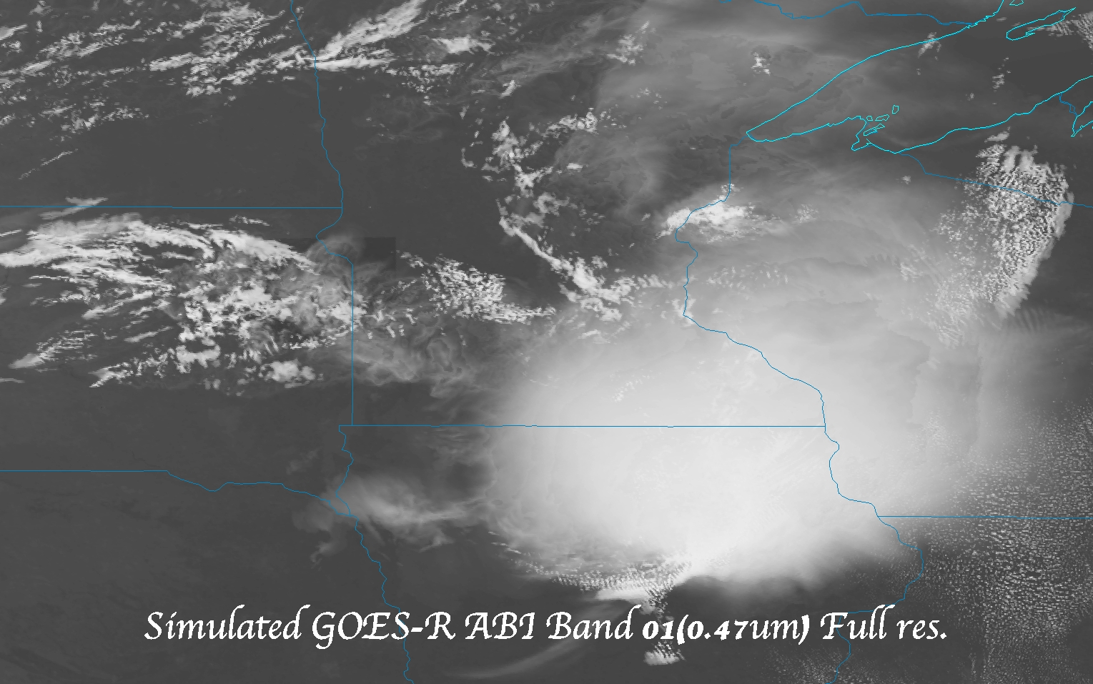
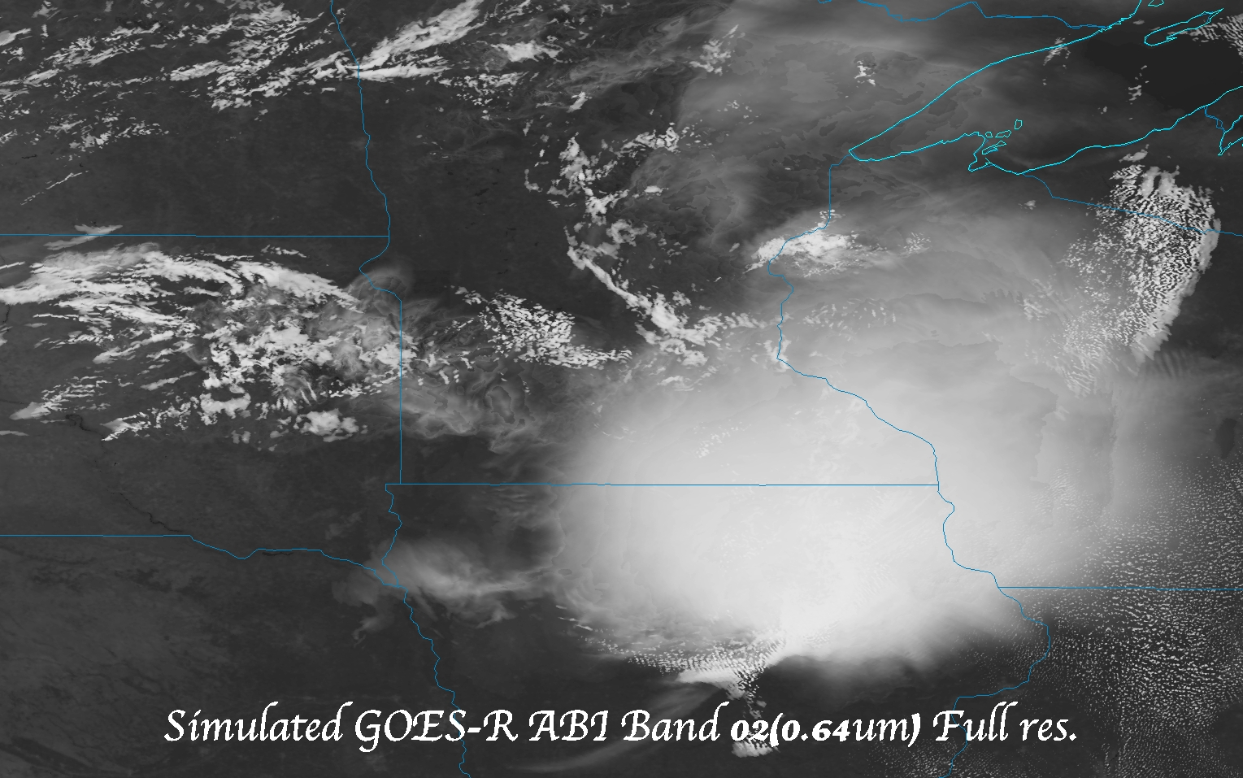
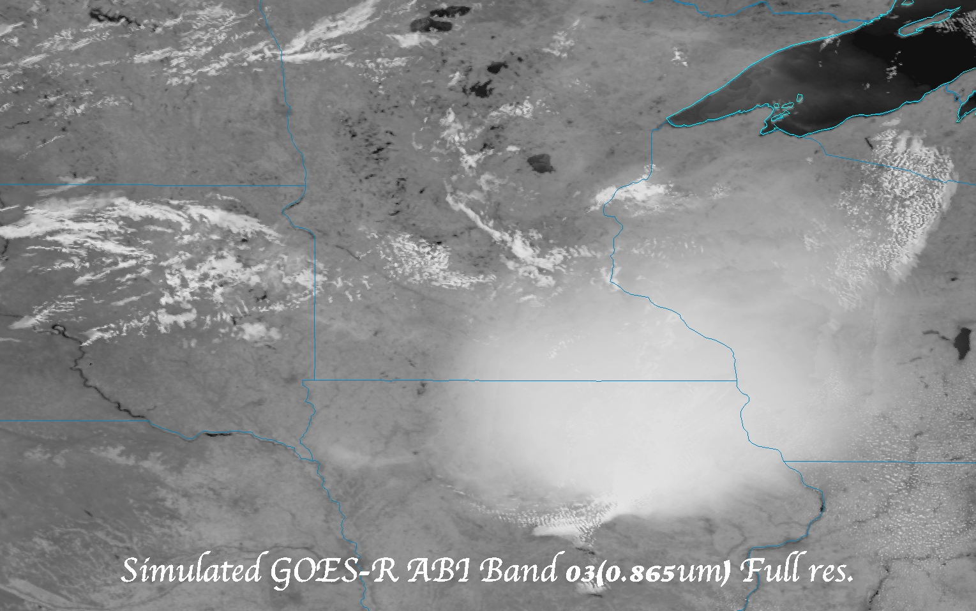
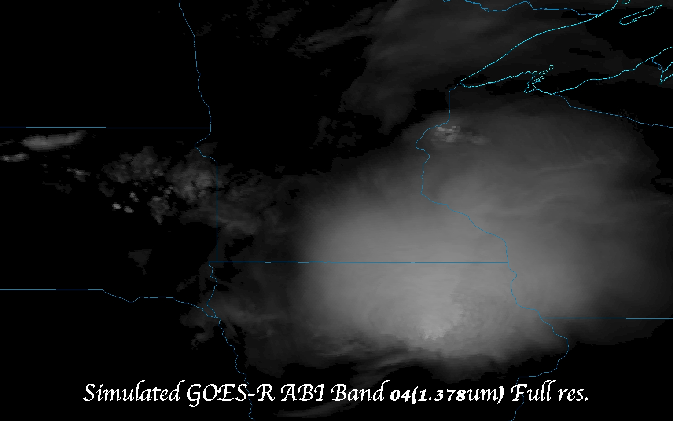
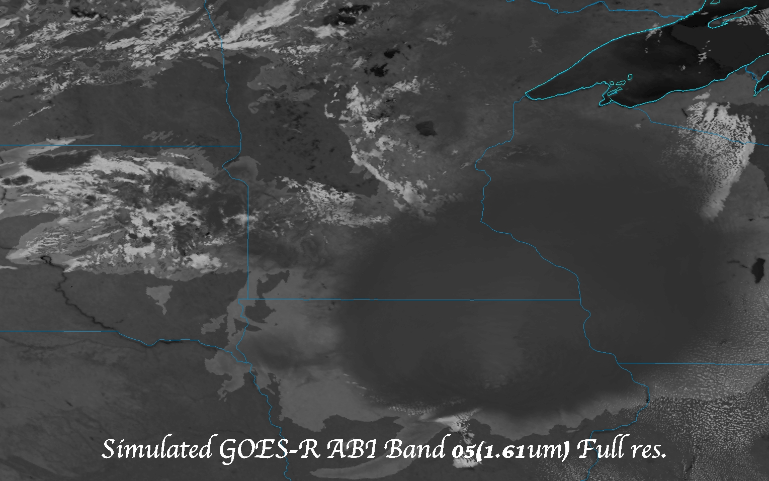
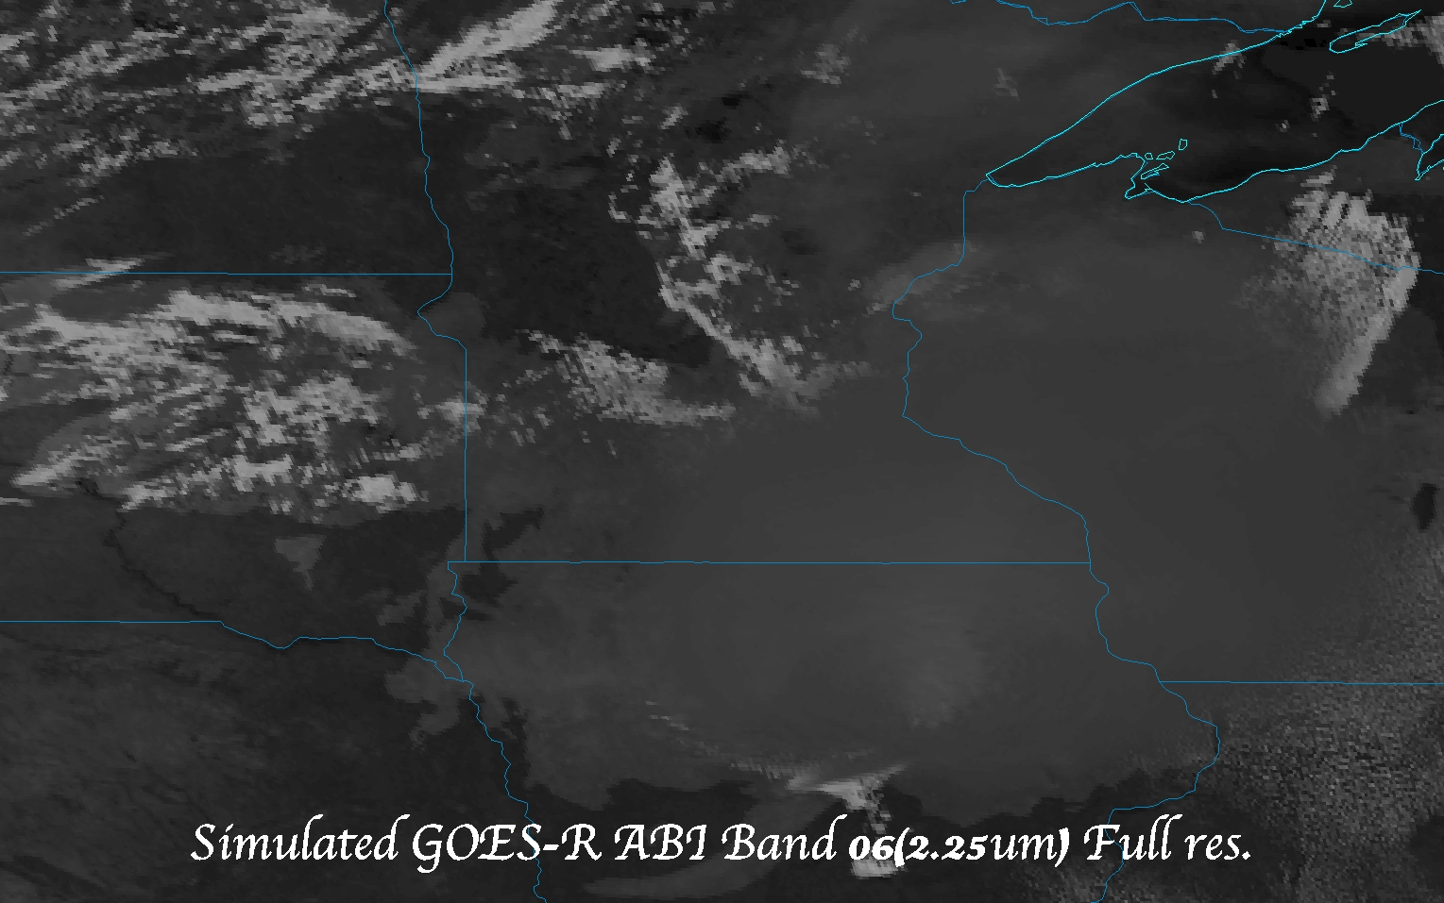
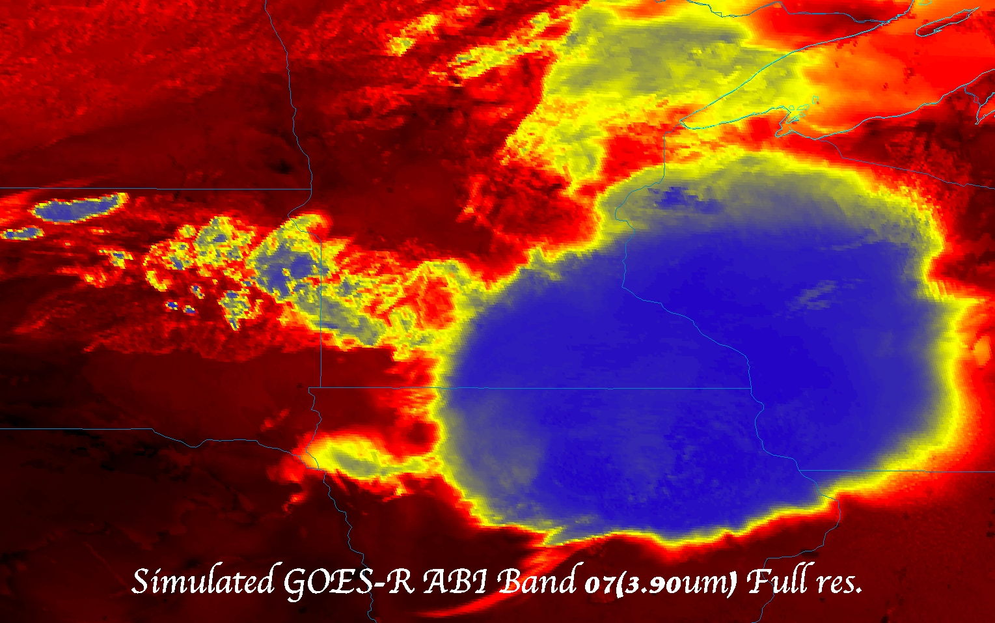
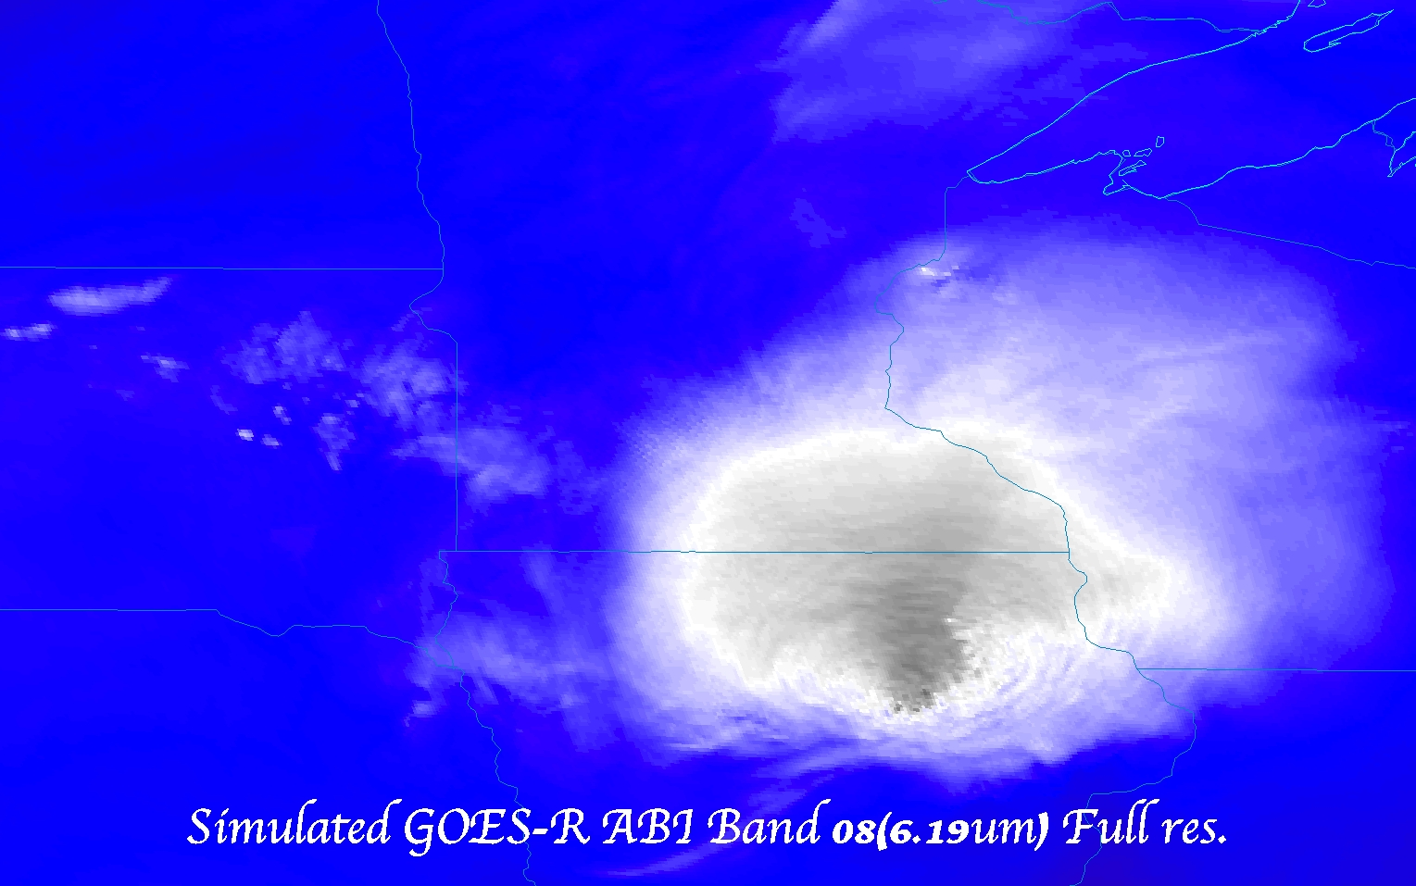
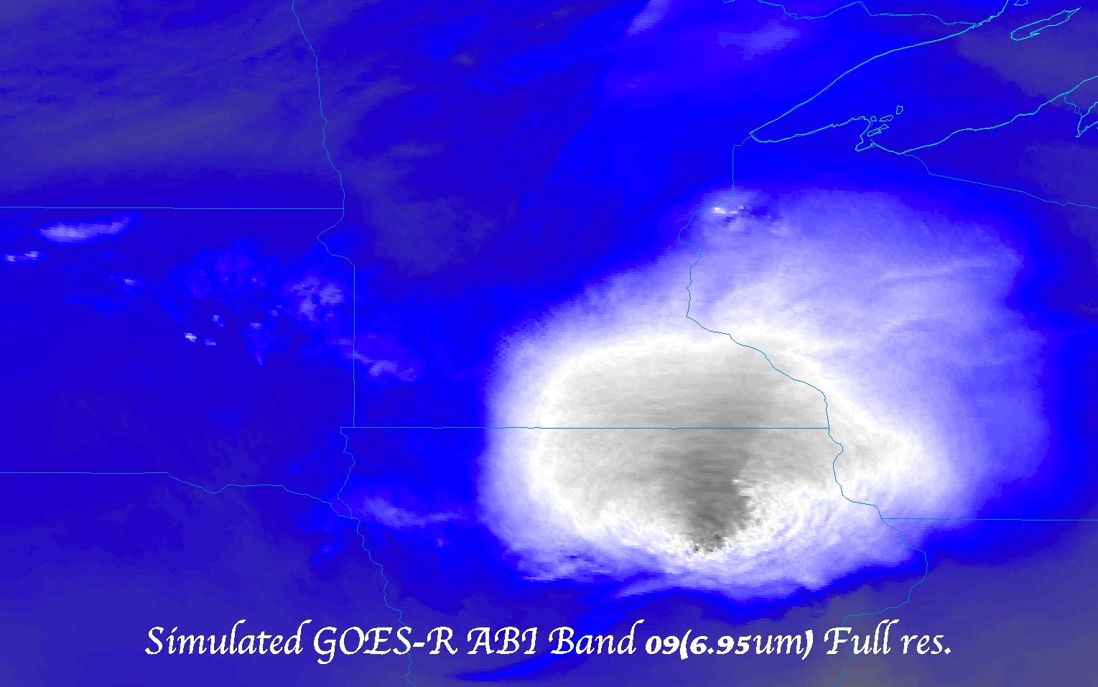
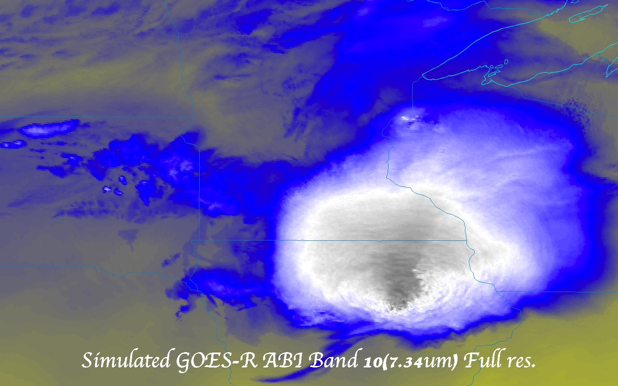
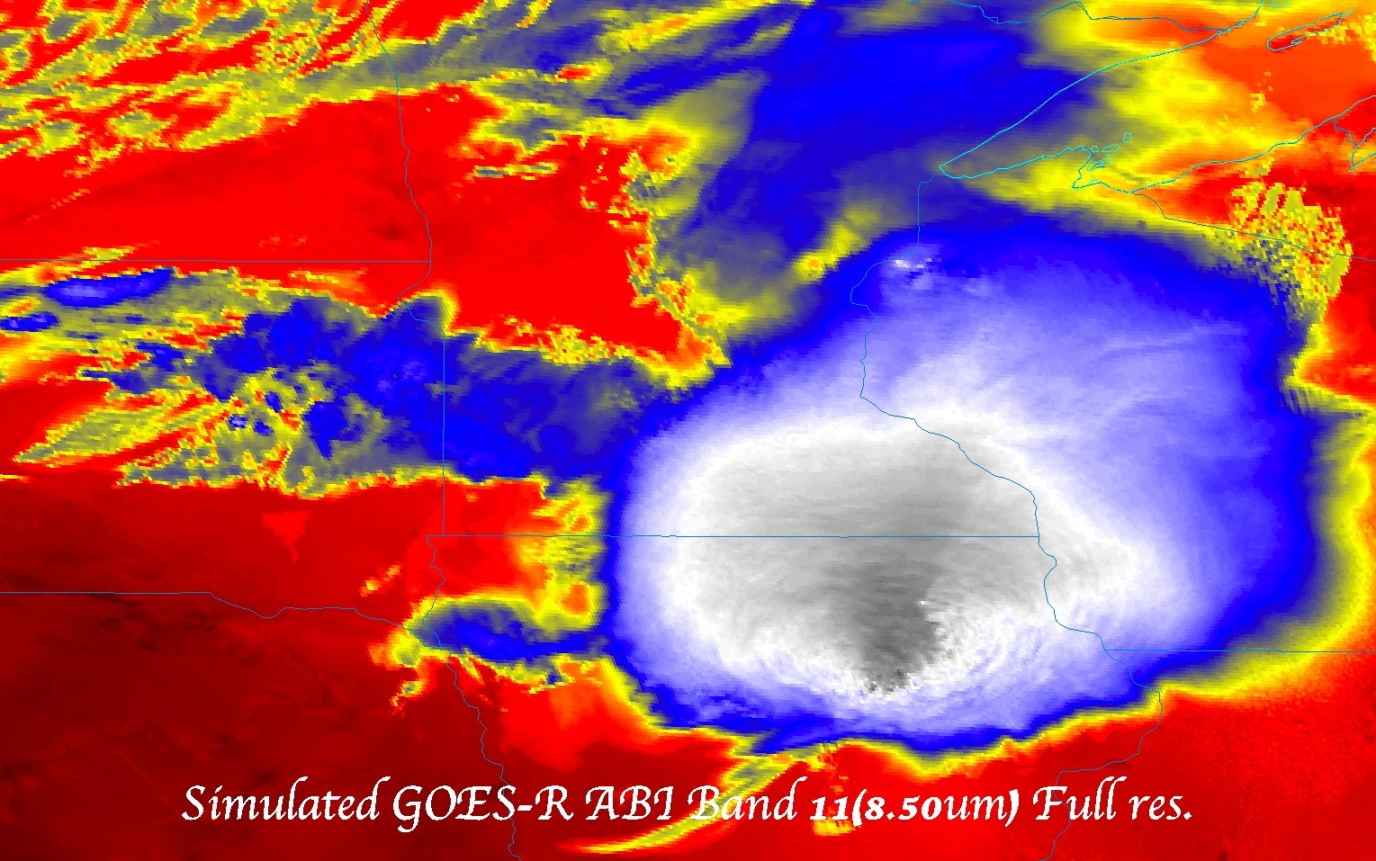
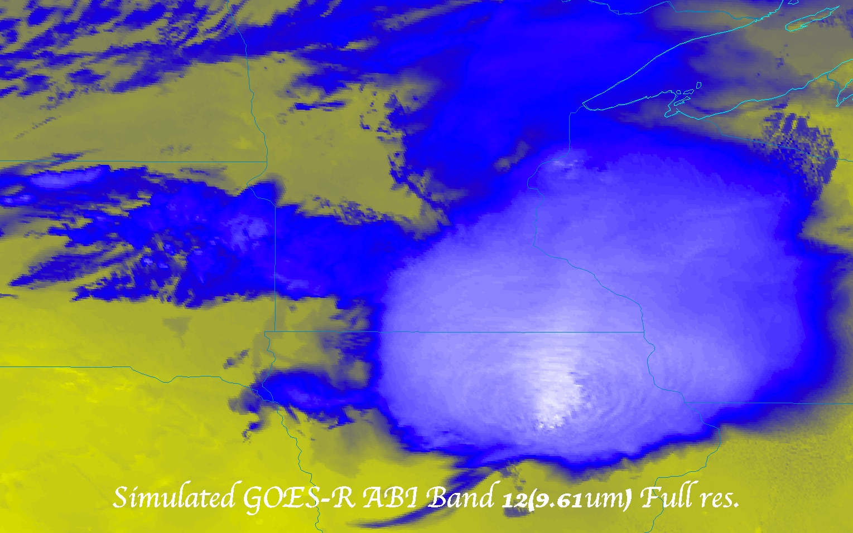
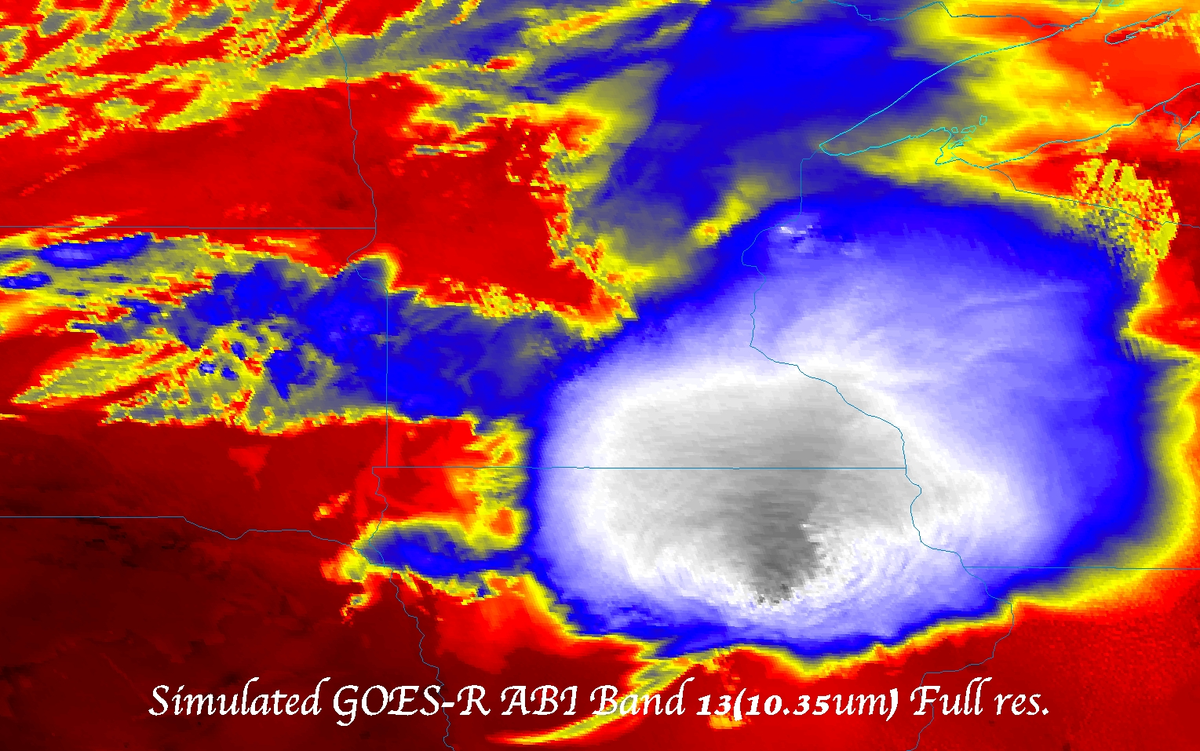
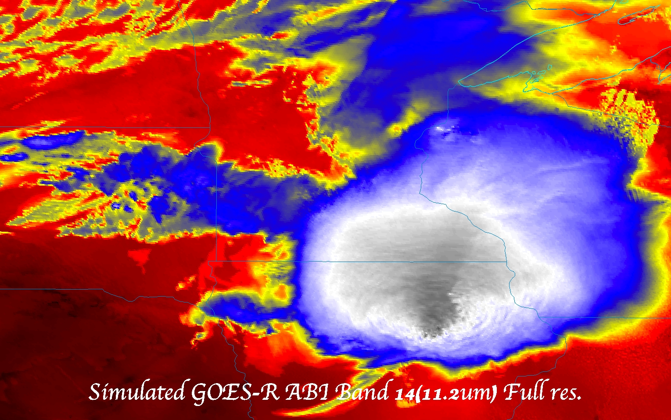
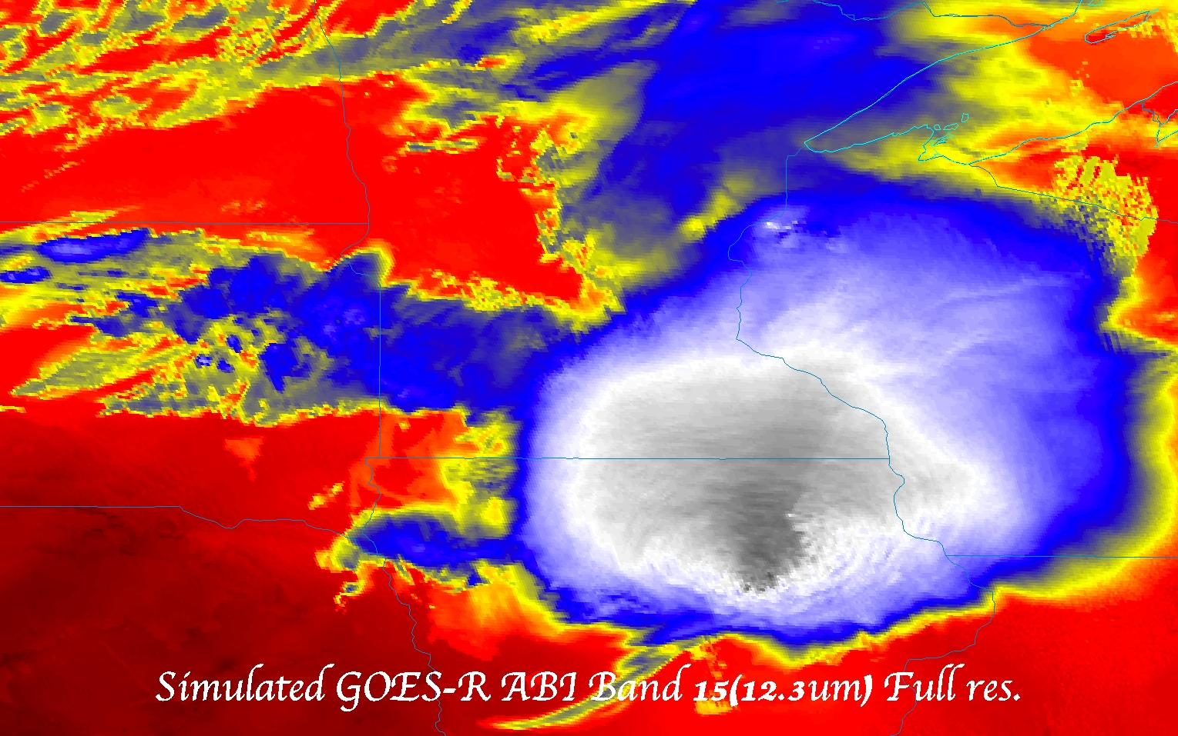
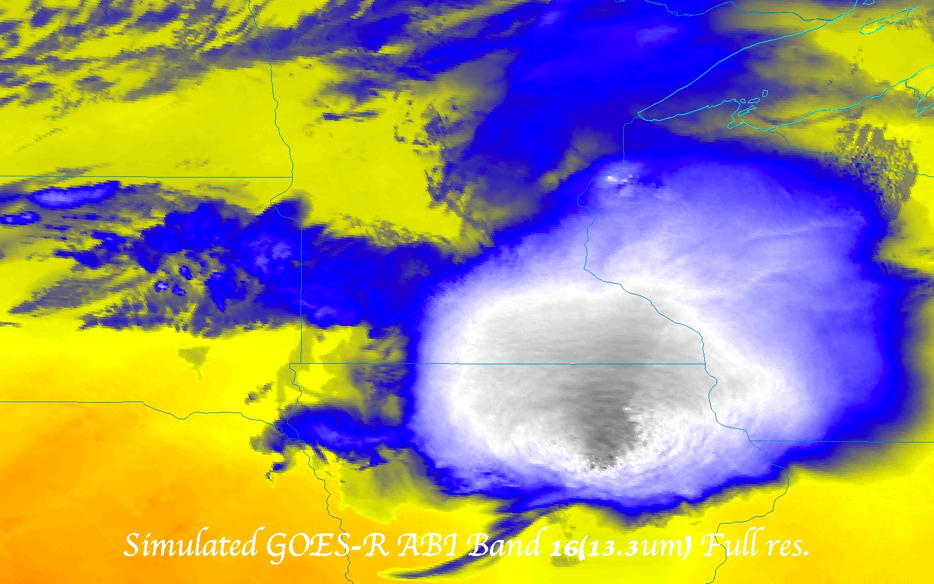

Slide 41
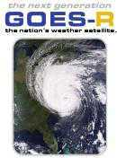
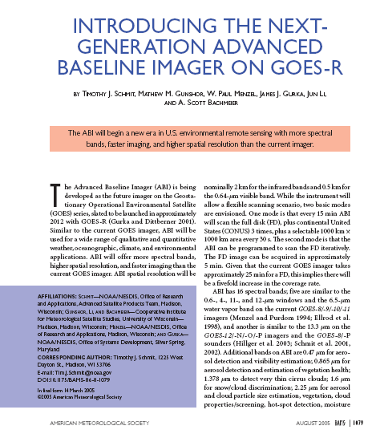
More information
GOES-R:
http://www.goes-r.gov
http://www.meted.ucar.edu/index.htm
http://cimss.ssec.wisc.edu/goes_r/proving-ground.html
GOES and NASA:
http://goespoes.gsfc.nasa.gov/goes/index.html
http://goes.gsfc.nasa.gov/text/goes.databookn.html
UW/SSEC/CIMSS/ASPB:
http://cimss.ssec.wisc.edu/goes_r/proving-ground/nssl_abi/nssl_abi_rt.html
http://cimss.ssec.wisc.edu/goes/abi/
http://cimss.ssec.wisc.edu/goes/blog/
http://www.ssec.wisc.edu/data/geo/
http://cimss.ssec.wisc.edu/goes/srsor/GOES-14_SRSOR.html
AMS BAMS Article on the ABI (Aug. 2005)

Slide 42
GOES-14 in Special Rapid Scan mode
SRSOR (Super Rapid Scan Operations for GOES-R) from GOES-14 imager while it was out of storage.
Worked with OSPO to define schedules
Deciding on daily location for scanning between mid-August and end of October
Posting many animations
http://cimss.ssec.wisc.edu/goes/srsor/GOES-14_SRSOR.html
Many phenomena were observed: convection, hurricanes, fires, smoke, etc.,
Data to many groups HPC, OPC, AWC, SPC, etc.
Animation from GOES-14 Imager visible at 1-min time resolution.
SRSOR provided unique information and offers a glimpse into the possibilities that will be provided at even higher resolutions by the ABI on GOES-R.

