Slide 1
Imagery
- Remapped imagery; on a CIMSS Satellite blog
http://cimss.ssec.wisc.edu/goes/blog/archives/7527
- GOES-R ABI WES
- GOES-14 transition
- GOES-R Scan strategy?

Slide 2
Imagery
- Remapped imagery; on a CIMSS Satellite blog
http://cimss.ssec.wisc.edu/goes/blog/archives/7527
- GOES-R ABI WES
- GOES-14 transition
- GOES-R Scan strategy?

Slide 3
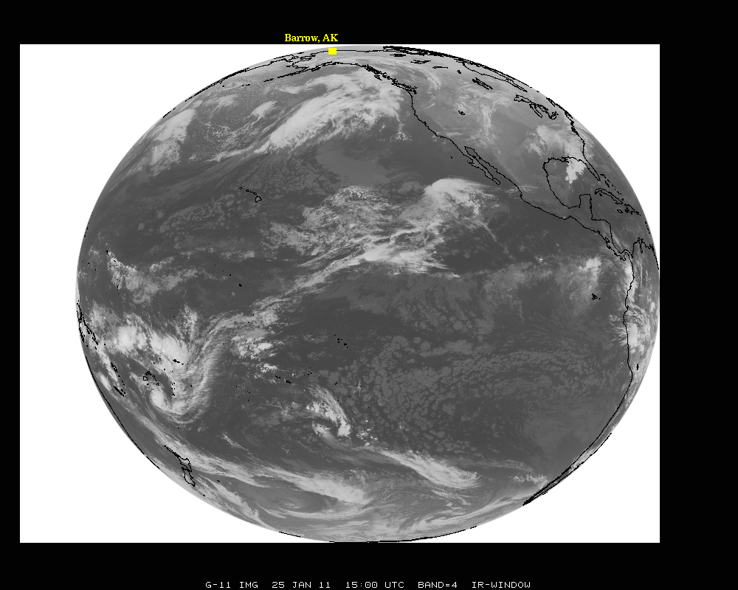

Slide 4
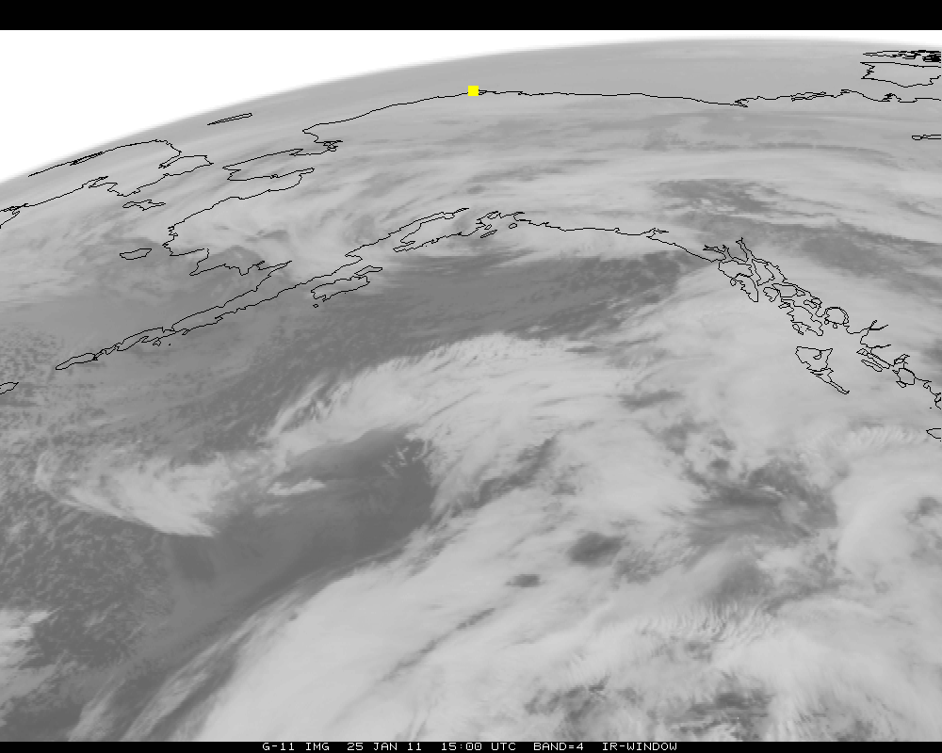

Slide 5
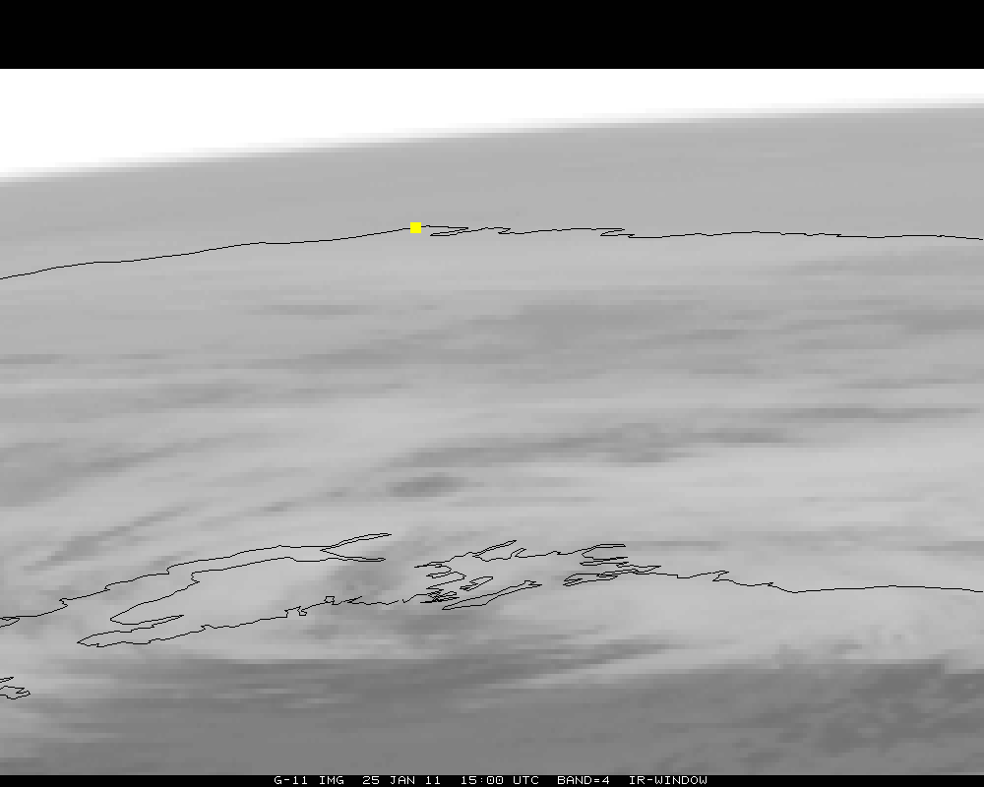
Notes:
LZA of Barrow is approximately 81 degrees.

Slide 6
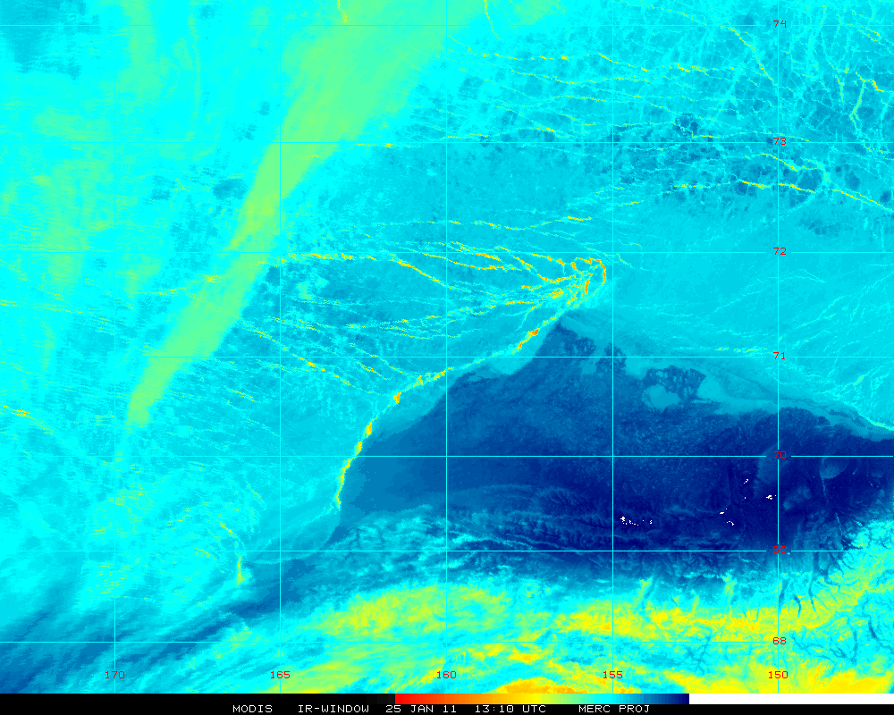
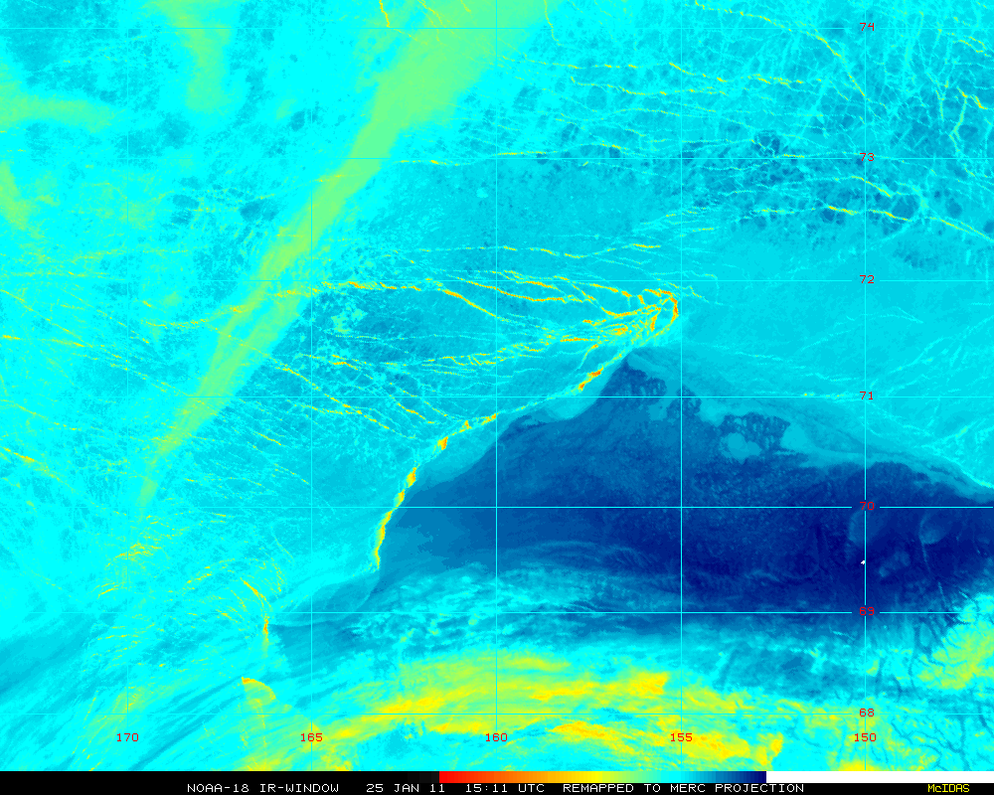
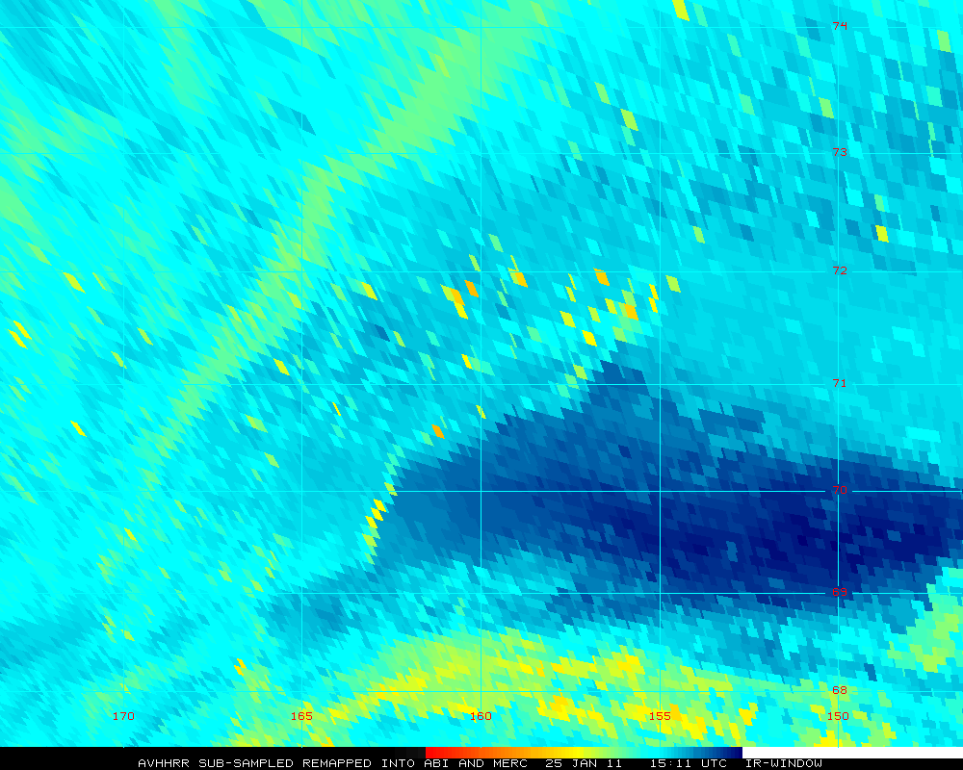
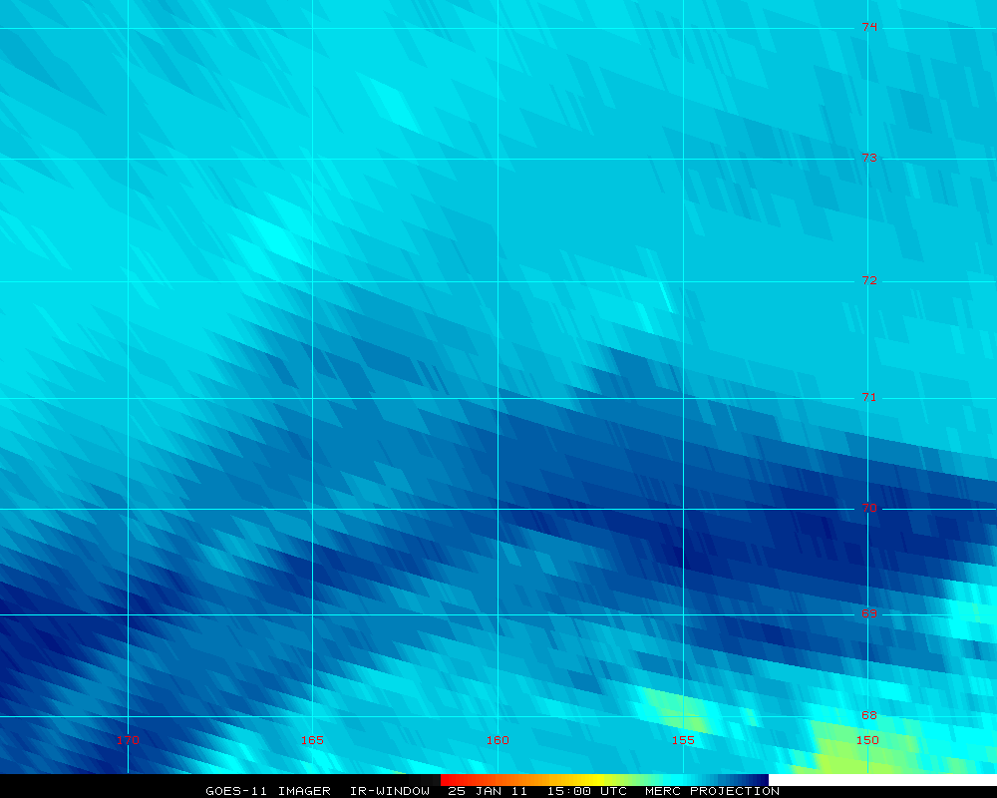
Imagery near Barrow, AK
Remapped MODIS
Remapped AVHRR
AVHRR remapped to ABI
GOES remapped
http://cimss.ssec.wisc.edu/goes/blog/archives/7527
Notes:
Note that the GOES is an actual image, while the others are from MODIS (one image) and AVHRR (two images). No ‘point spread function’ blurring has been applied, hence an actual ABI image might be a bit less sharp.
The point isn’t that only GOES-R should be used for Barrow, but that the ABI will improve over the current GOES imager.
Note that all images have been remapped to a mercator projection.

Slide 7
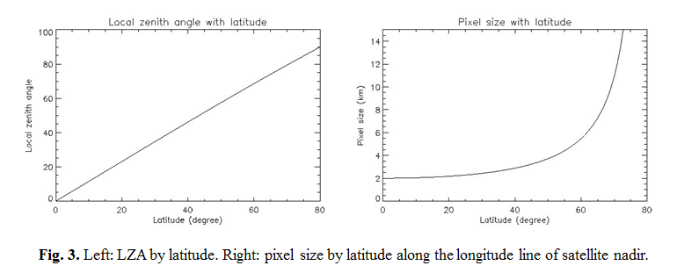
ABI
Figure from J. Key
LZA of Barrow, AK is approximately 81 degrees.

Slide 8
Imagery
- Remapped imagery; on a CIMSS Satellite blog
http://cimss.ssec.wisc.edu/goes/blog/archives/7527
- GOES-R ABI WES
- GOES-14 transition
- GOES-R Scan strategy?

Slide 9
GOES-R ABI WES Case
A version is available with simulated ABI data
Added simulated data over the Pacific Ocean.
Updated WES guide
Have inquired about eventual steps for converting case into AWIPS II compliant format.

Slide 10
ABI Band 1 (0.47 um)

Slide 11
ABI Band 2 (0.64 um)

Slide 12
ABI Band 3 (0.86 um)

Slide 13
ABI Band 4 (1.38 um)

Slide 14
ABI Band 5 (1.6 um)

Slide 15
ABI Band 6 (2.25 um)

Slide 16
ABI Band 7 (3.9 um)

Slide 17
ABI Band 8 (6.2 um)

Slide 18
ABI Band 9 (7.0 um)

Slide 19
ABI Band 10 (7.34 um)

Slide 20
ABI Band 11 (8.5 um)

Slide 21
ABI Band 12 (9.6 um)

Slide 22
ABI Band 13 (10.35 um)

Slide 23
ABI Band 14 (11.2 um)

Slide 24
ABI Band 15 (12.3 um)

Slide 25
ABI Band 16 (13.3 um)

Slide 26
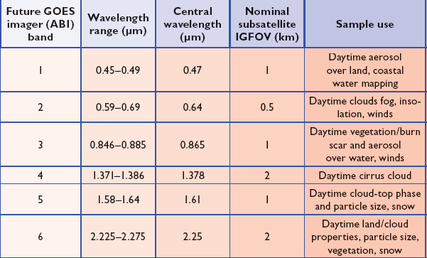
ABI Visible/Near-IR Bands
Schmit et al, 2005
Notes:
Schmit, T. J., M. M. Gunshor, W. P. Menzel, J. J. Gurka, J. Li, and A. S. Bachmeier, 2005: Introducing the next-generation Advanced Baseline Imager on GOES-R. Bull. Amer. Meteor. Soc., 86, 1079-1096.

Slide 27
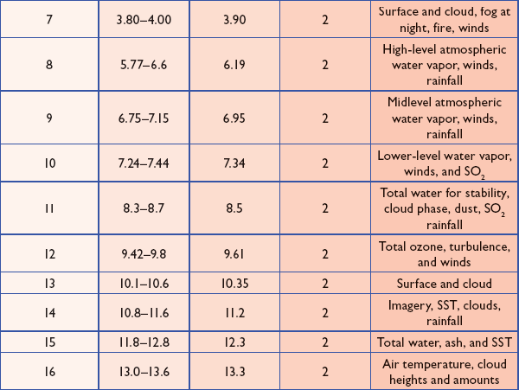
ABI IR Bands
Schmit et al, 2005
Notes:
Schmit, T. J., M. M. Gunshor, W. P. Menzel, J. J. Gurka, J. Li, and A. S. Bachmeier, 2005: Introducing the next-generation Advanced Baseline Imager on GOES-R. Bull. Amer. Meteor. Soc., 86, 1079-1096.

Slide 28
Imagery
- Remapped imagery; on a CIMSS Satellite blog
http://cimss.ssec.wisc.edu/goes/blog/archives/7527
- GOES-R ABI WES
- GOES-14 transition
- GOES-R Scan strategy?

Slide 29
Operational GOES Updates
As of May 10, 2010
http://www.nesdis.noaa.gov/FlyoutSchedules.html

Slide 30
GOES-11 to GOES-14
Newer spacecraft design
Less noisy data
Spectrally modified imager band 3
‘water vapor’
Improved imager band 6 (13.3 um) spatial resolution
Modified GVAR format
No 12 um band on Imager
Improved INR and Operation thru eclipse
Tentatively scheduled for December 2011

Slide 33
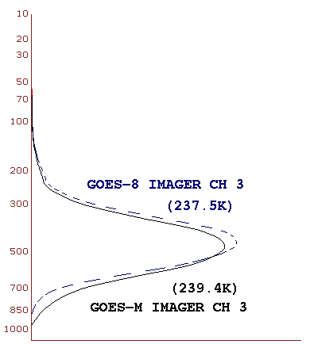
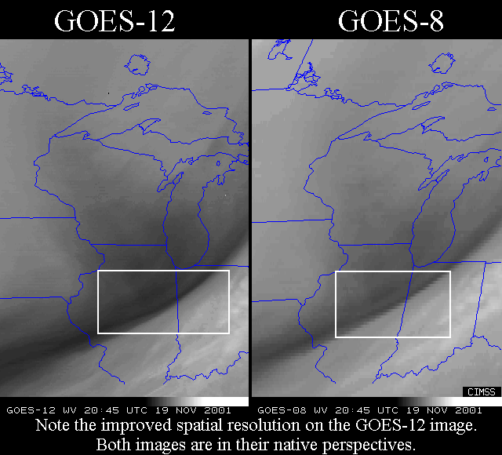
Water vapor band

Slide 34
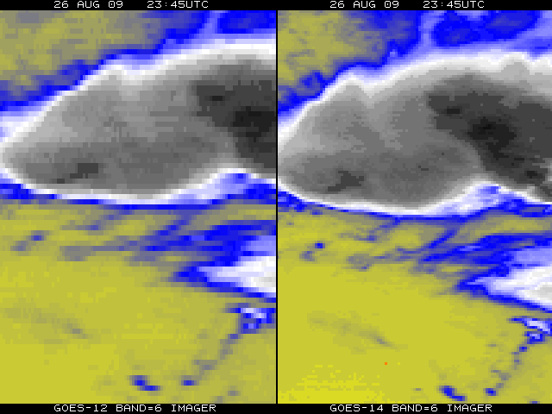
Improved spatial resolution of GOES-14 Imager band 6
GOES-12
GOES-14
The improved spatial resolution of the Geostationary Operational Environmental Satellites (GOES)-14 imager band 6 has been verified. This band, centered at 13.3 um, has a number of uses, the main being cloud height determination.
Important diagnostic work was under-taken. After an issue was raised dealing with the data stream of imager band 6, the suggested fix was implemented at the ground station. Many groups, both within NOAA/NESDIS, the Cooperative Institutes, NASA and others, quickly worked together to fix this issue.
The 13.3 um band 6 of the GOES-12 (left panel) has an 8 km IGFOV (Instantaneous Geometric Field of View); while the same band on the GOES-14 (right panel) has a 4 km IGFOV. Note the finer resolution of the cloud edges and the ‘cleaner’ image.
The improved spatial resolution of the GOES-14 imager band 6 (over GOES-12/13 imagers) has been verified with initial on-orbit data.
Sponsor: OSD G-PSDI Program
Notes:
GOES-14 (previously GOES-0) was launched on June 27, 2009.
The issue with the band 6 of the imager, was the detector order was initially flipped in the data stream. This was fixed on August 24, 2009 (not shown).
More information can be found at:
http://rammb.cira.colostate.edu/projects/goes-o/
http://cimss.ssec.wisc.edu/goes/blog/archives/3054
Don Hillger and Tim Schmit are co-leading the GOES-14 NOAA science test.
The above images were ingested by the SSEC data center in Madison, WI. Image generated by T. Schmit of NOAA NESDIS STAR ASPB.
###

Slide 35
GOES-14 NOAA/Science Test Website
GOES-14 Tech memo avaliable
http://rammb.cira.colostate.edu/projects/goes-o/
35

Slide 36
GOES-14 Imager and Sounder
http://rammb.cira.colostate.edu/projects/goes-o/
http://www.star.nesdis.noaa.gov/star/GOES-14FirstImage.php
http://www.ssec.wisc.edu/media/spotlight/goes14/ir.html
http://cimss.ssec.wisc.edu/goes/blog/archives/3054
http://www.ssec.wisc.edu/data/geo/index.php?satellite=goes14&file=jpg
http://cimss.ssec.wisc.edu/goes/rt/sounder-dpi.php
Notes:
T. Schmit

Slide 37
Imagery
- Remapped imagery; on a CIMSS Satellite blog
http://cimss.ssec.wisc.edu/goes/blog/archives/7527
- GOES-R ABI WES
- GOES-14 transition
- GOES-R Scan strategy?

Slide 38
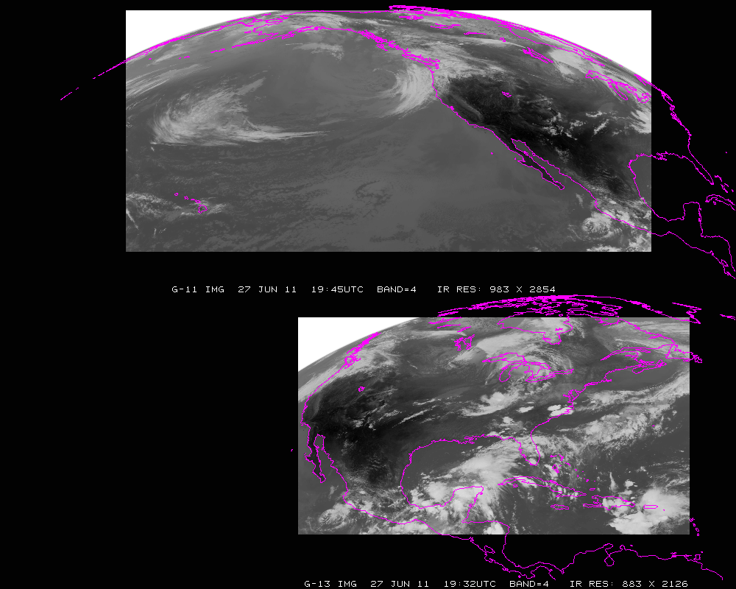
Current GOES Imager scans: PACUS and CONUS (note that PACUS is one-third larger). These regions are sub-selected for AWIPS.

Slide 39
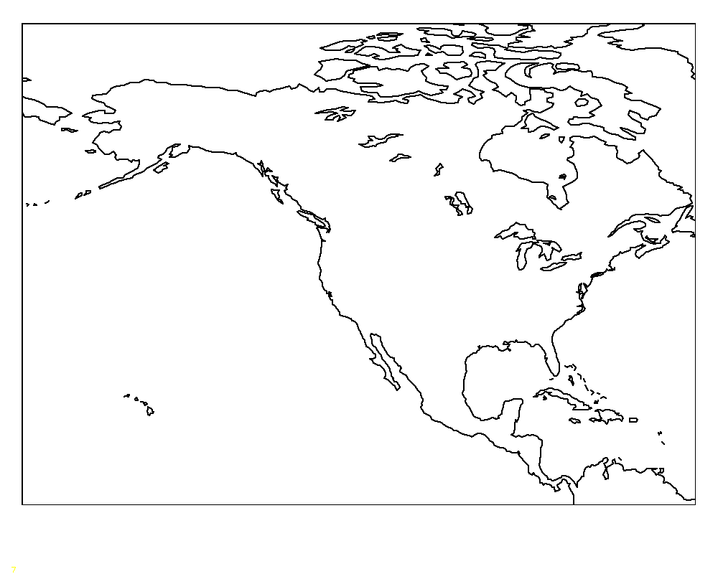
Proposed –Shifted “5 min PACUS”
“5 min PACUS”
Proposed “shifted” “PACUS” would give a 5 min scan of AK and western CONUS. This would mean that HI would need to be covered with one of the meso-scales (and 15 min FD); if in ‘flex mode (3)’. Note that the positions are approximate.

Slide 40
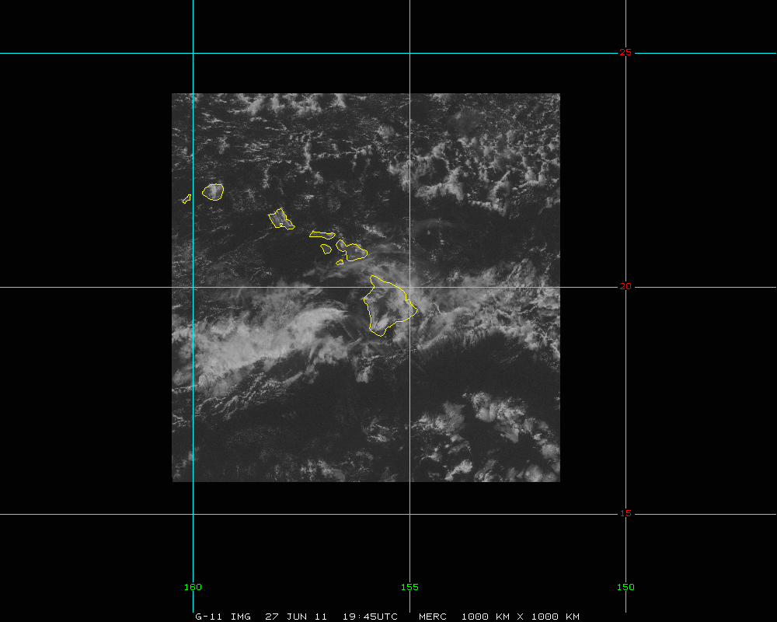
HI -- mesoscale
Approximately 1000 km x 1000 km.

