Slide 1
Quick Look: AHI and MTSAT
(visible and longwave window IR)
Data from:
http://www.data.jma.go.jp/mscweb/en/himawari89/space_segment/spsg_sample.html
Displayed in McIDAS-V and -X
M. Gunshor, K. Bah
CIMSS
Timothy J. Schmit (tim.j.schmit@noaa.gov)
NOAA/NESDIS/StAR Advanced Satellite Products Branch (ASPB)
Madison, WI
CIMSS Satellite blog:
http://cimss.ssec.wisc.edu/goes/blog/archives/17658
January/February, 2015
UW-Madison

Slide 2
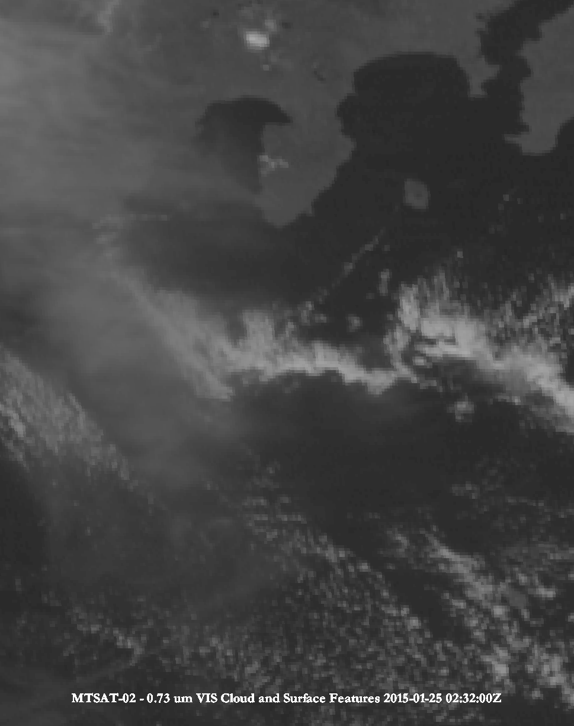
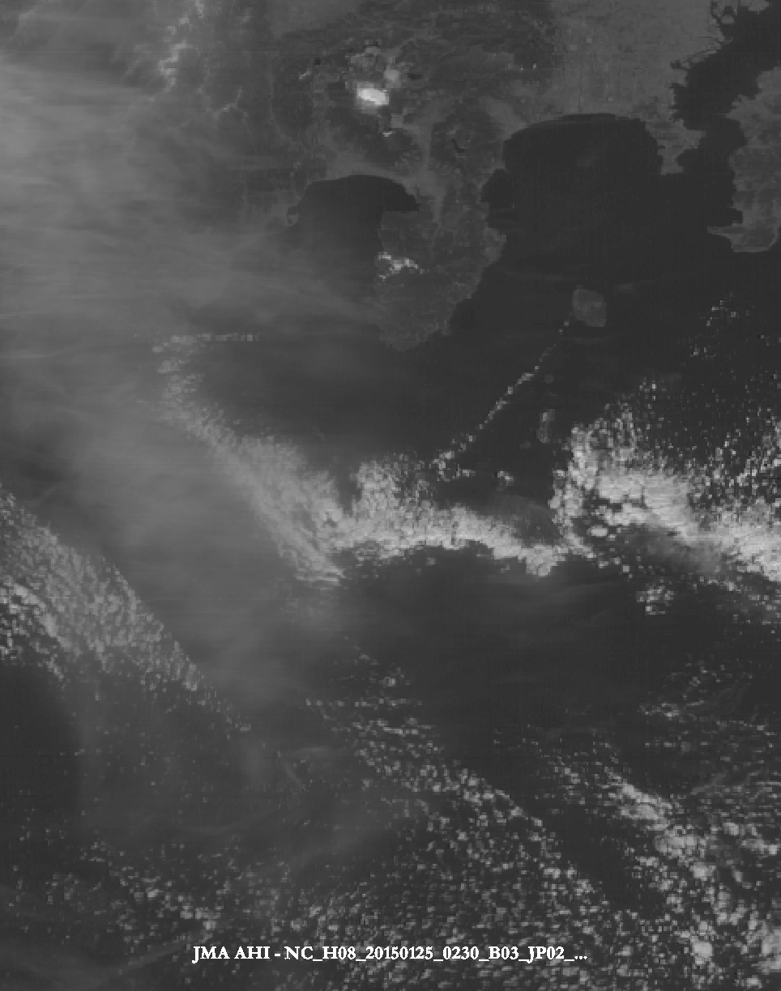
MTSAT and AHI (visible)
McIDAS-V
Approximate spatial resolution: 1 km
Approximate spatial resolution: 0.5 km
Notes:
Images made with McIDAS-V by M. Gunshor, using a ‘square root’ enhancement.

Slide 3
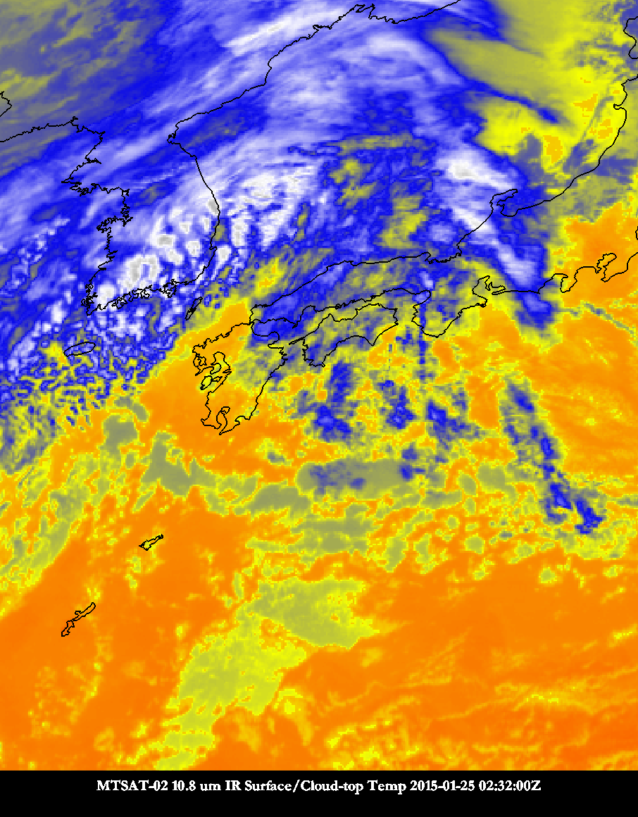
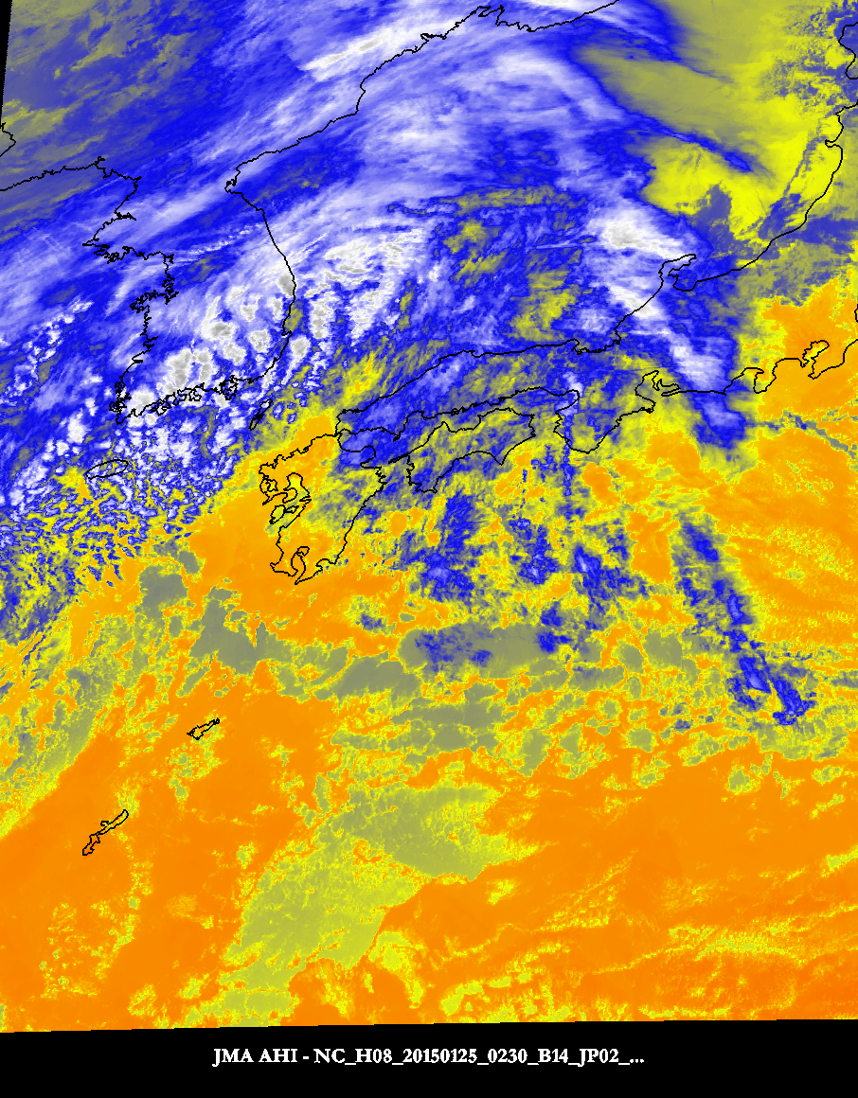
MTSAT and AHI (longwave infrared)
McIDAS-V
Approximate spatial resolution: 4 km
Approximate spatial resolution: 2 km
Notes:
Images made with McIDAS-V by M. Gunshor. Cool colors are colder brightness temperatures.
Data from:
http://www.data.jma.go.jp/mscweb/en/himawari89/space_segment/spsg_sample.html
Displayed in McIDAS-V

Slide 4
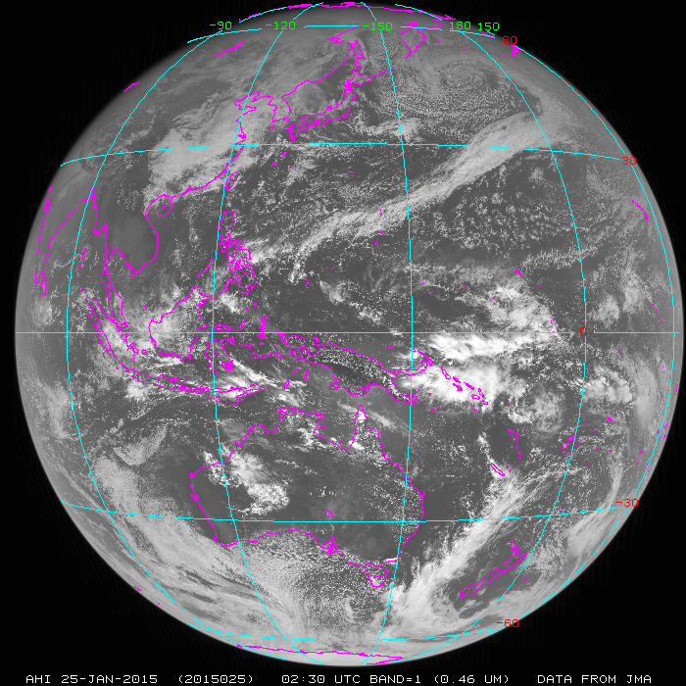
McIDAS-X

Slide 5
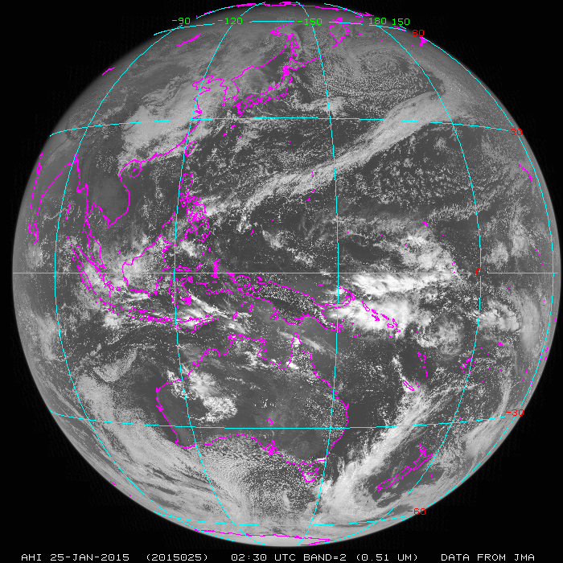

Slide 6
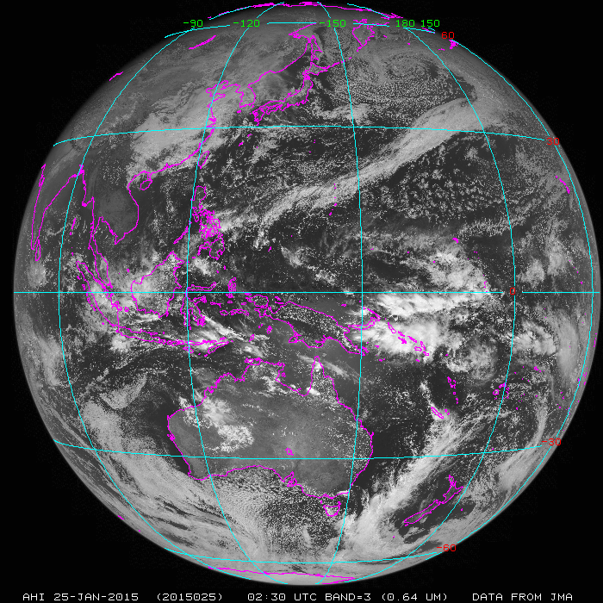

Slide 7
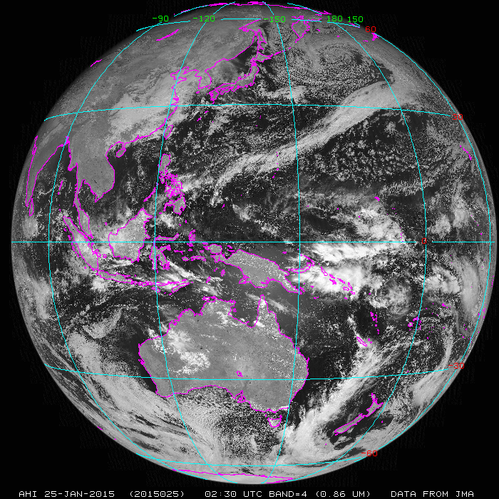

Slide 8
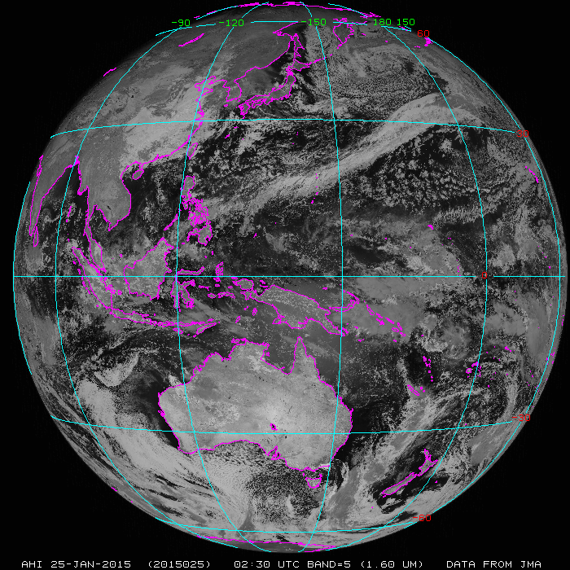

Slide 9
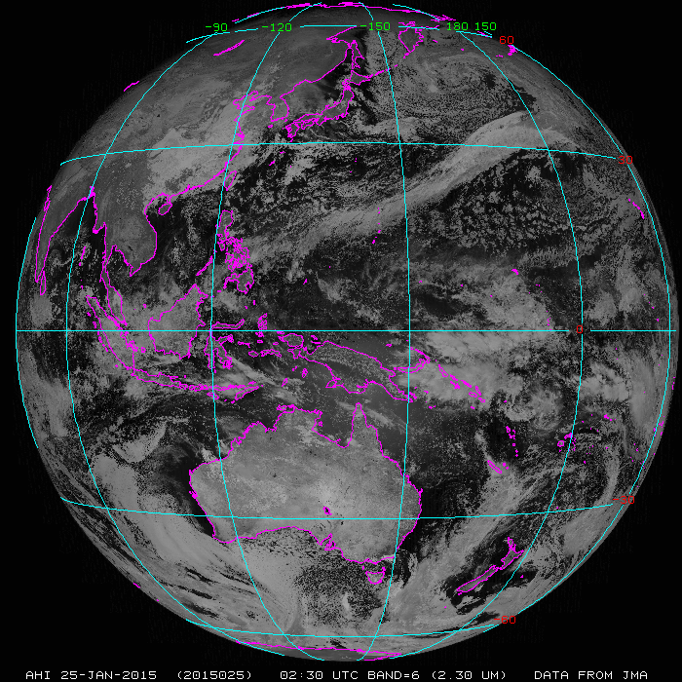

Slide 10
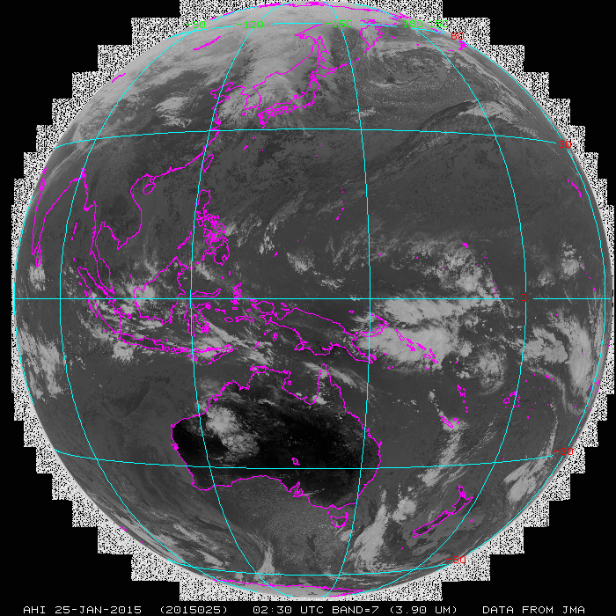

Slide 11
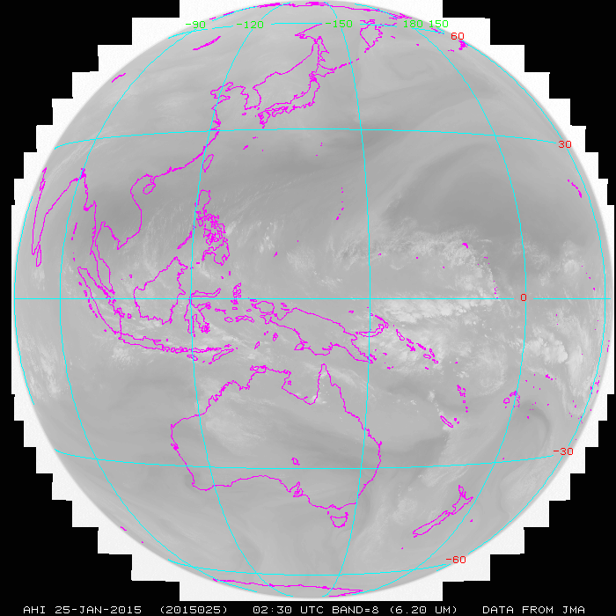

Slide 12
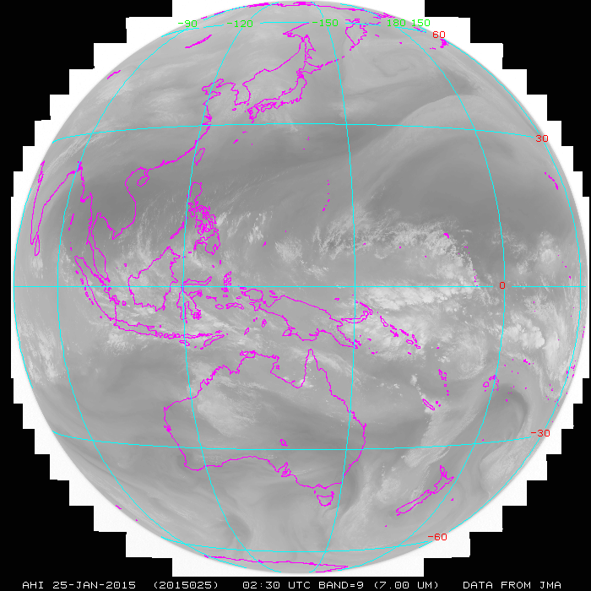

Slide 13
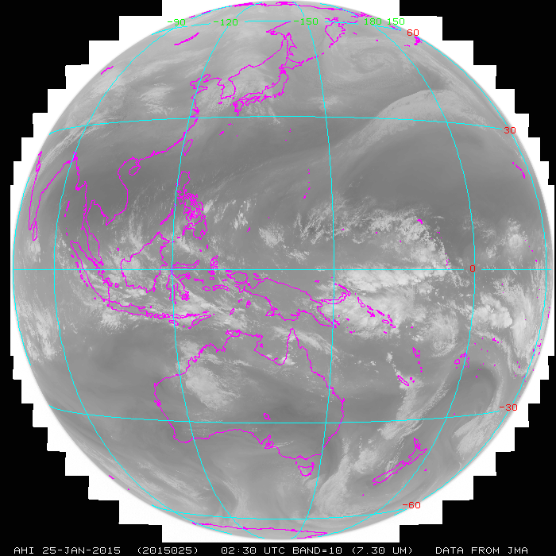

Slide 14
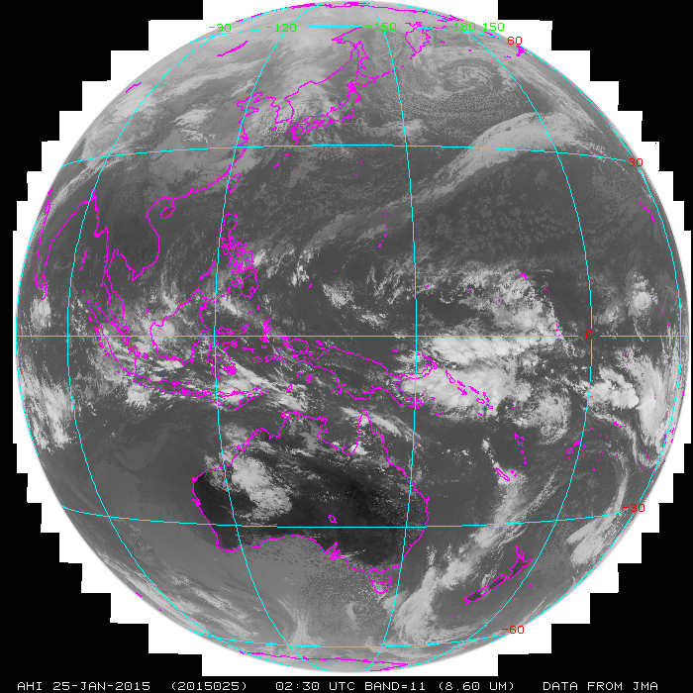

Slide 15
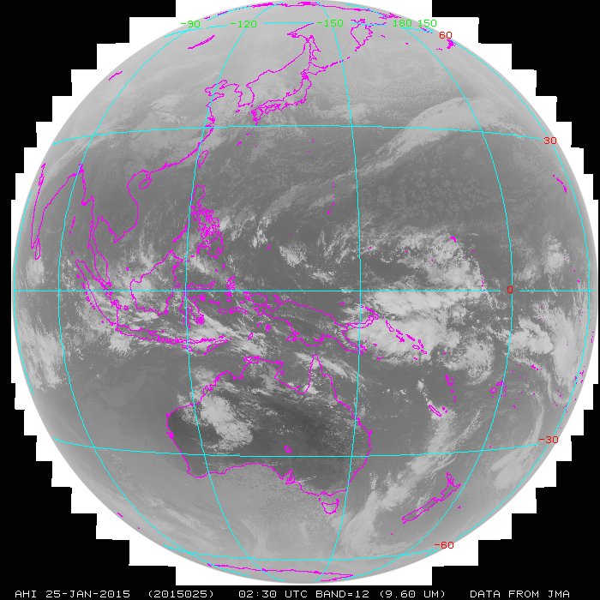

Slide 16
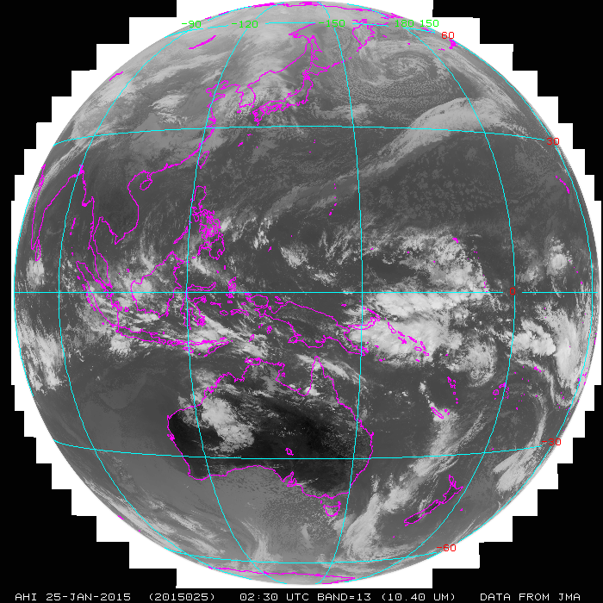

Slide 19
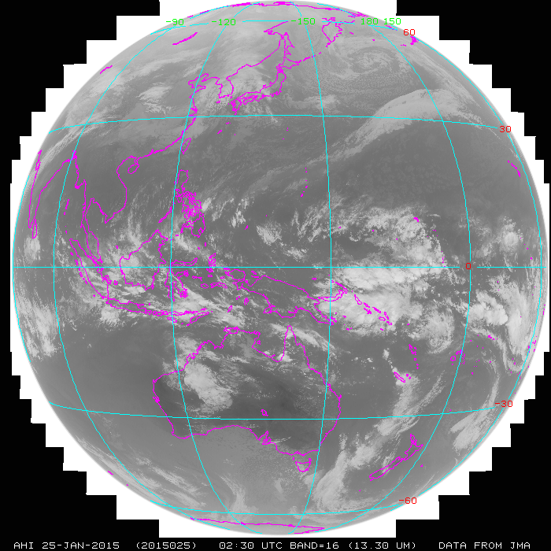

Slide 20
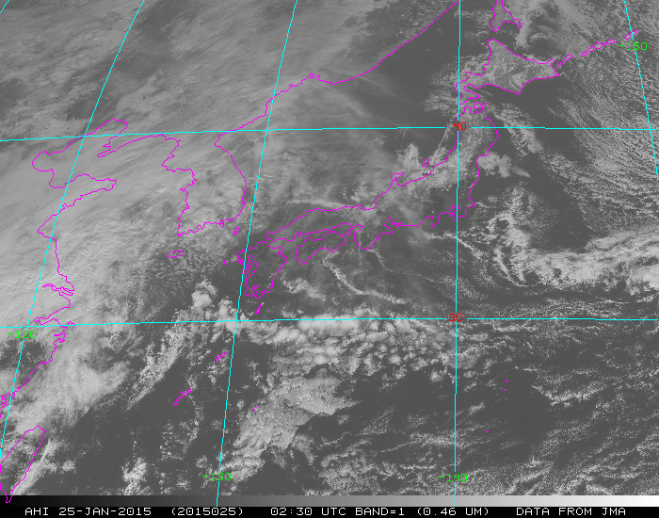

Slide 21
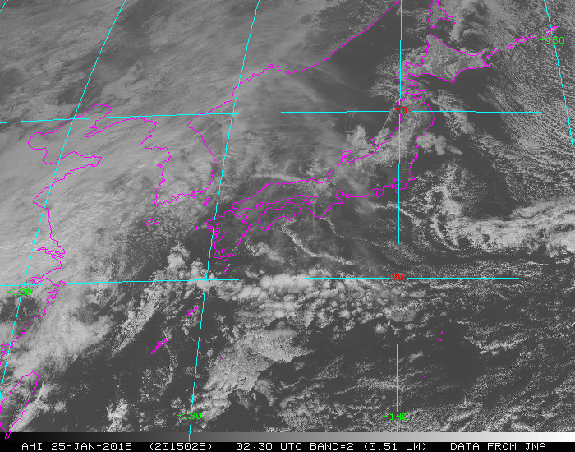

Slide 22
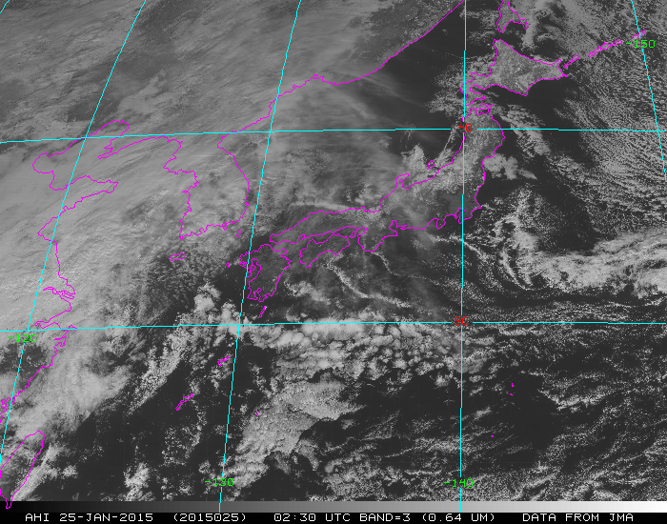

Slide 23
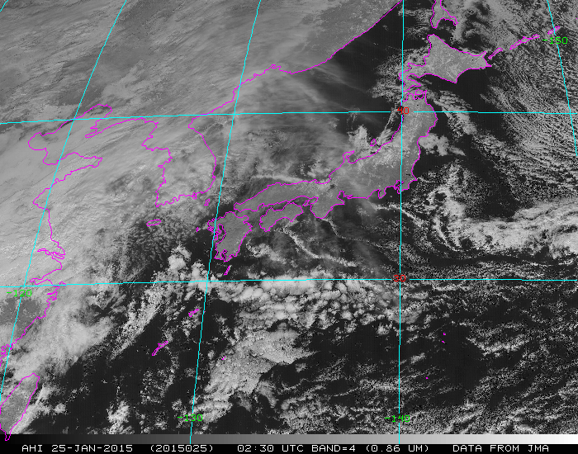

Slide 24
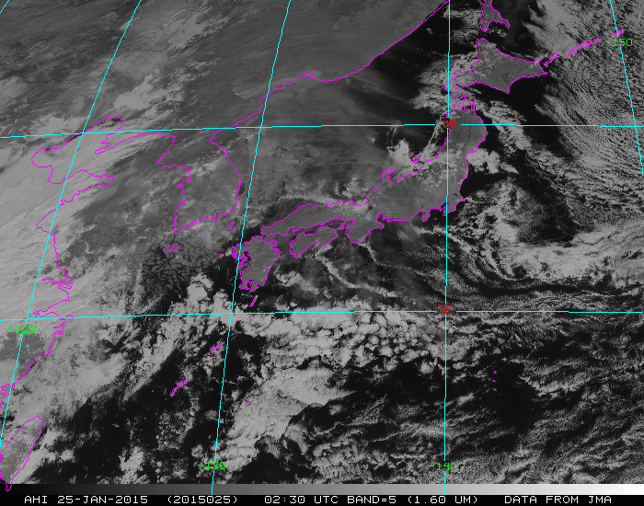

Slide 25
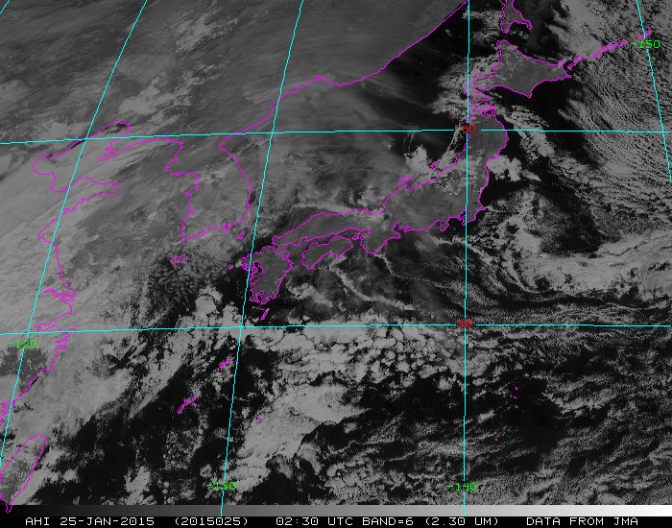

Slide 26
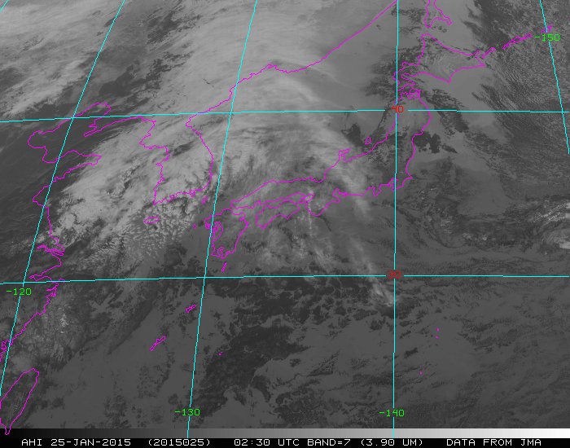

Slide 27
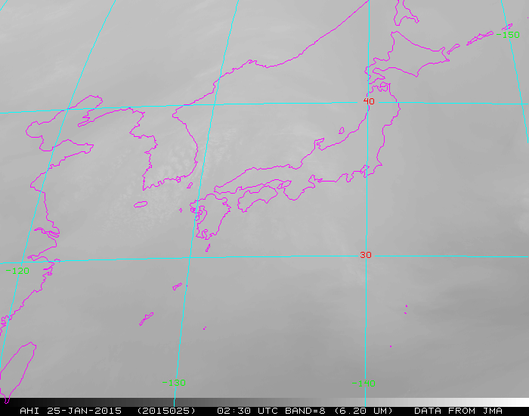

Slide 28
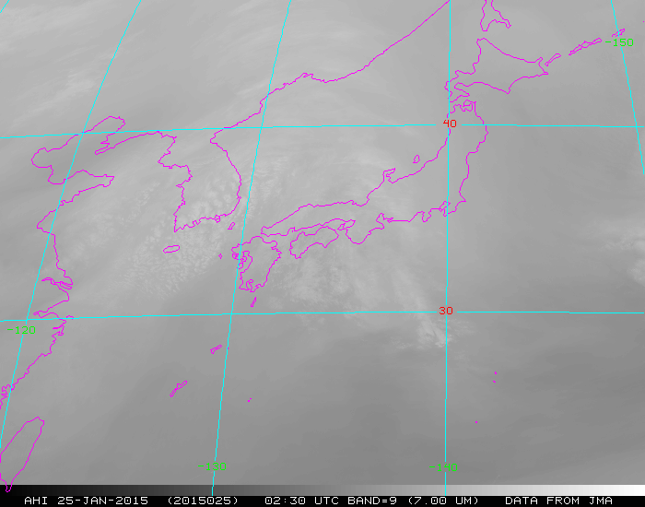

Slide 29
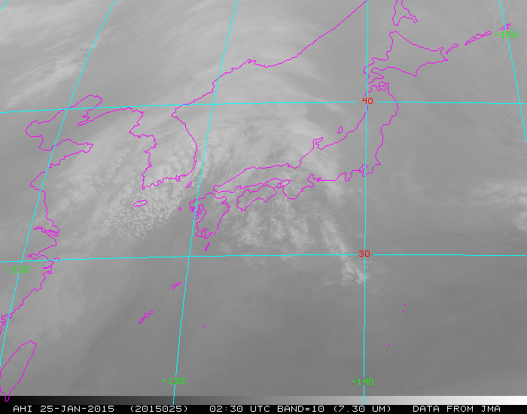

Slide 30
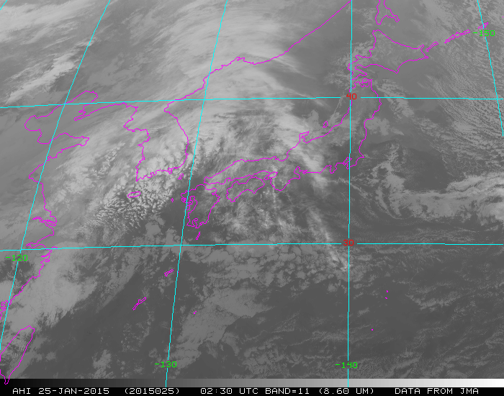

Slide 31
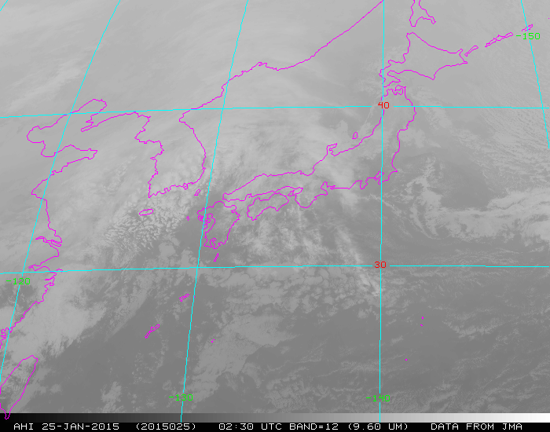

Slide 33
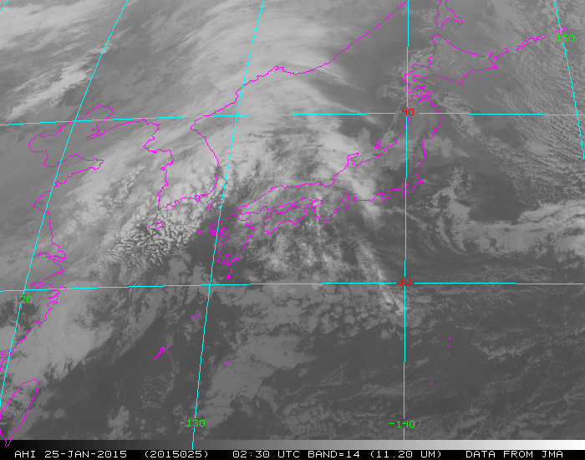

Slide 34
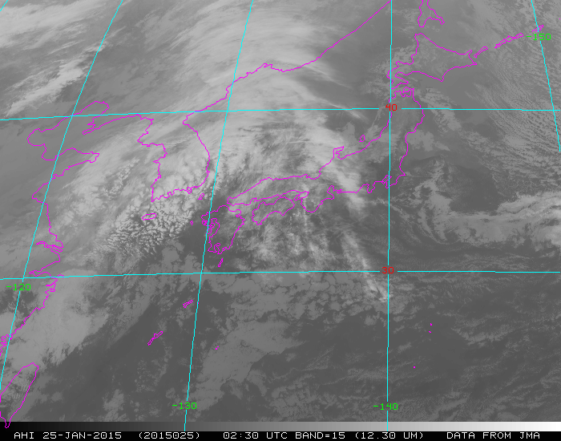

Slide 35
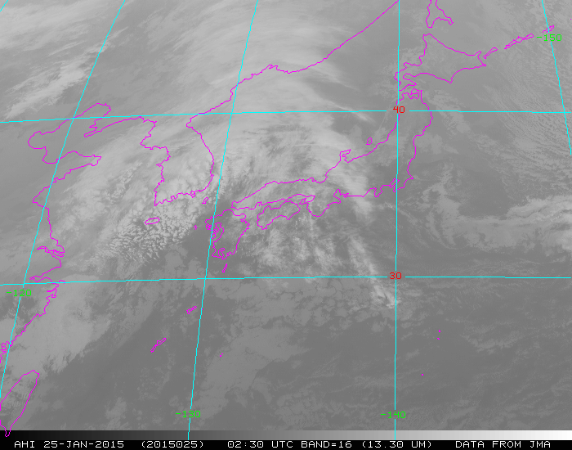

Slide 36
66 South -- Icebergs
Dark at 1.6 um

Slide 37
Educational Webapps with AHI
NOAA NESDIS ASPB teamed up with CIMSS researchers to develop three educational WebApps to explore space, time and spectral resolutions of satellite imagery.
Part of the GOES-R Educational Proving Ground at CIMSS:
http://cimss.ssec.wisc.edu/education/goesr
Added several AHI cases from both the first light and January 25th cases.
http://cimss.ssec.wisc.edu/goes/webapps/bandapp/overview_ahi_first_images.html
Sample interactive “Bandapp” educational webapp using simulated ABI images:
http://cimss.ssec.wisc.edu/goes/webapps/bandapp/
T. Schmit
Notes:
Tim Schmit, ASPB
https://ams.confex.com/ams/95Annual/webprogram/Paper265203.html ABI = Advanced Baseline Imager
Other new webapps: one to change both the spatial and temporal sampling and the other only the pixel sampling

Slide 38
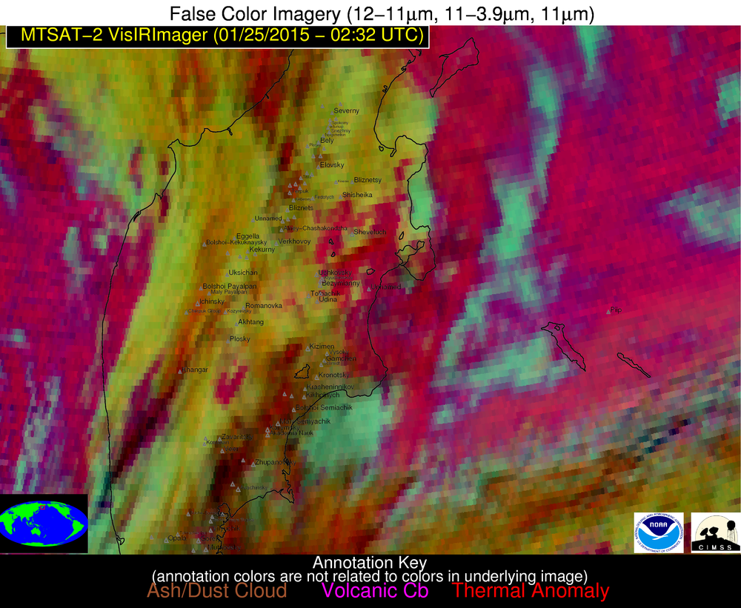

Slide 39
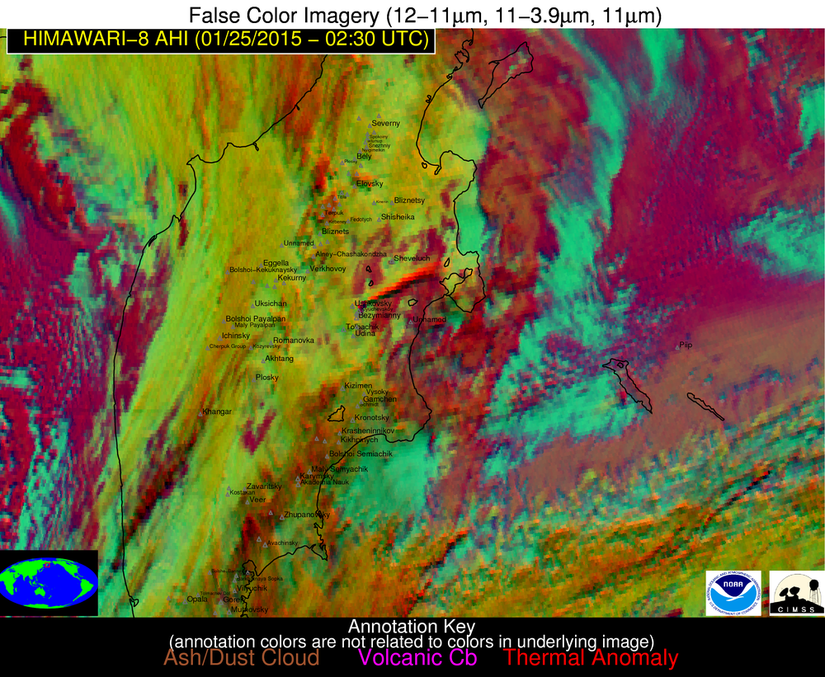
The ash plume is clearly discernable in the Himawari-8 AHI imagery constructed using similar spectral channels
Klyuchevskoy ash plume
Notes:
The AHI resolution at a viewing angle of 65+ degrees is actually better than MTSAT or GOES at nadir.

Slide 40
The ash plume is not discernable in MTSAT false color imagery
Klyuchevskoy ash plume

