Slide 1

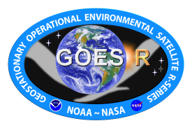


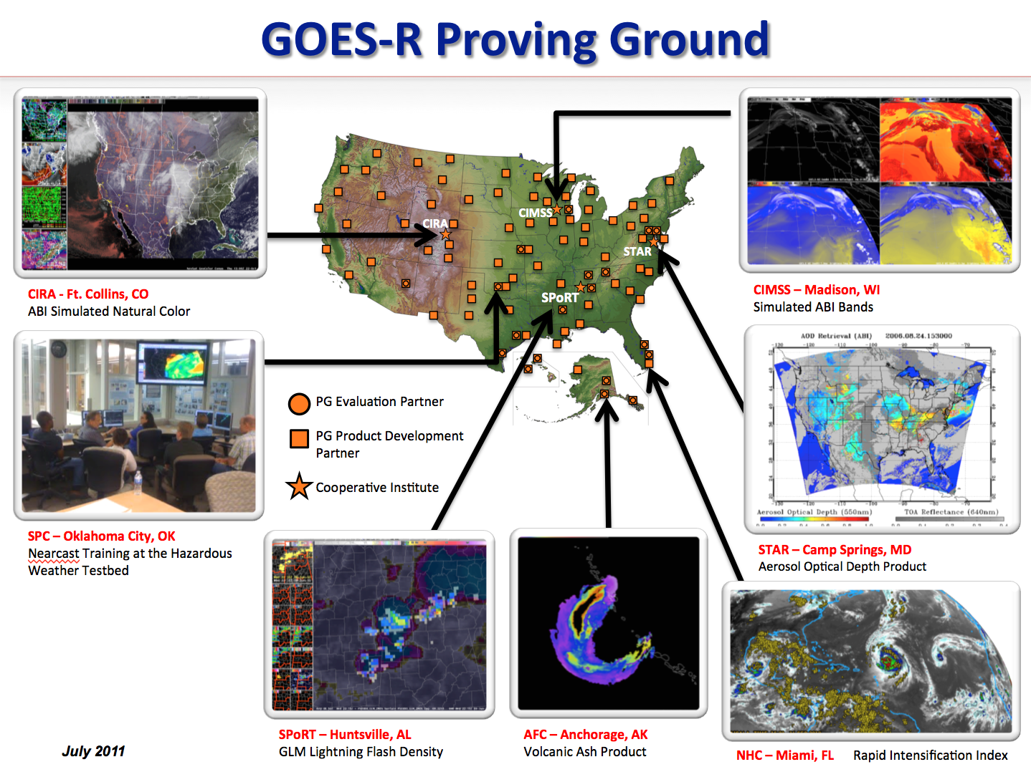
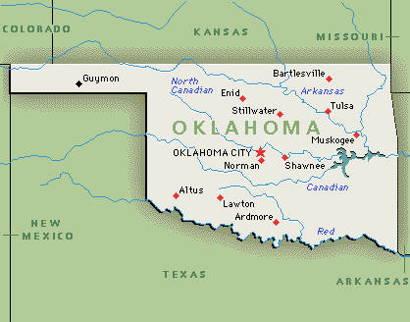
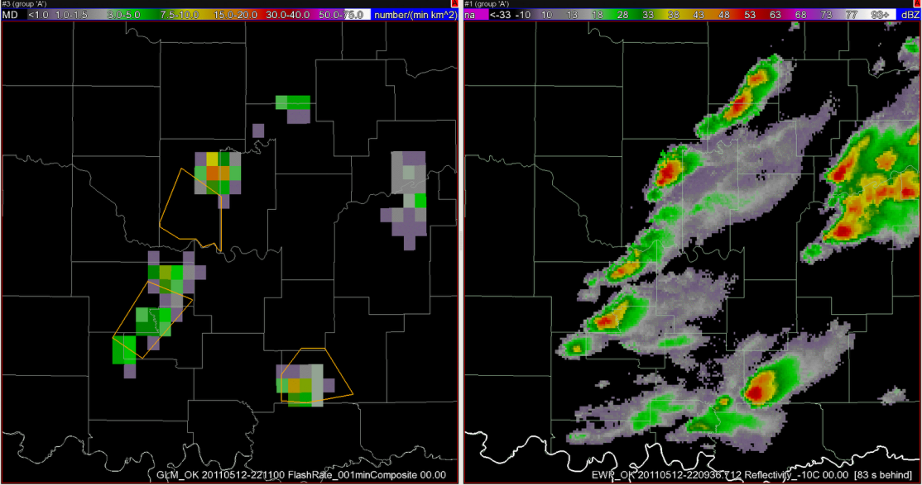
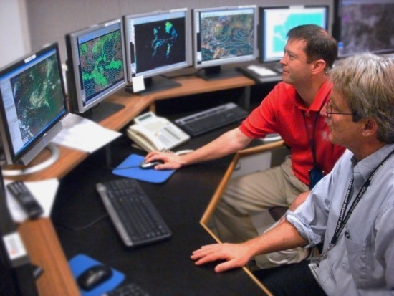
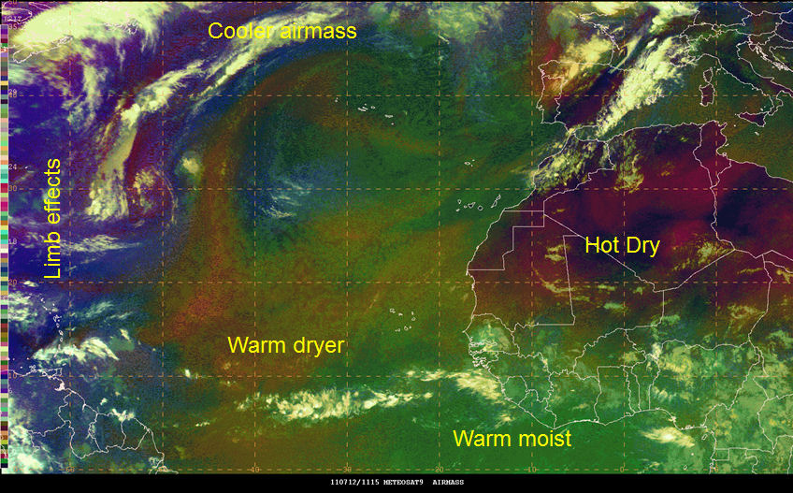
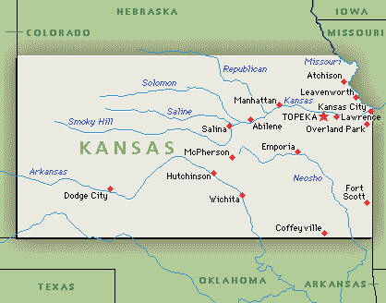
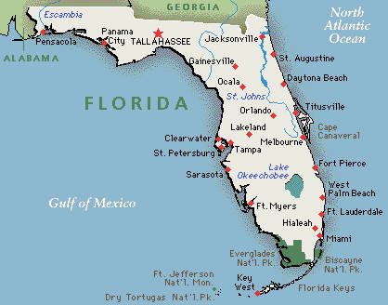
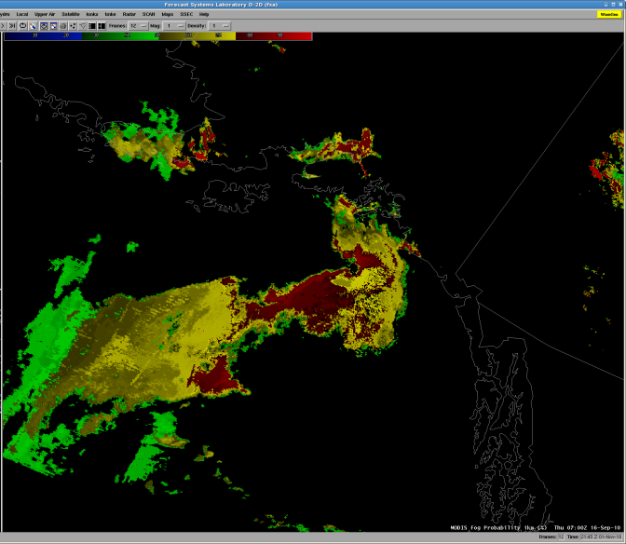
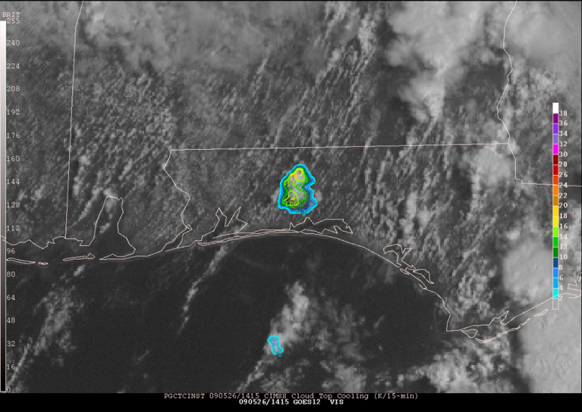
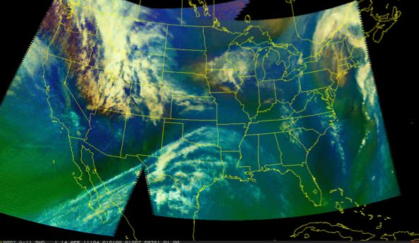
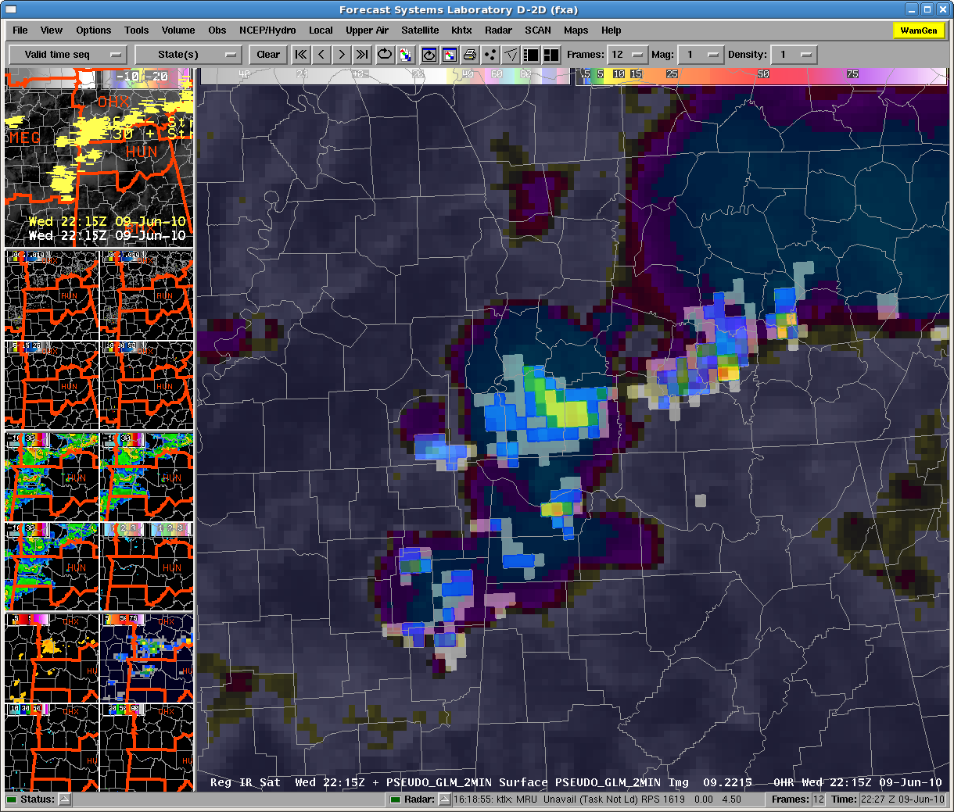
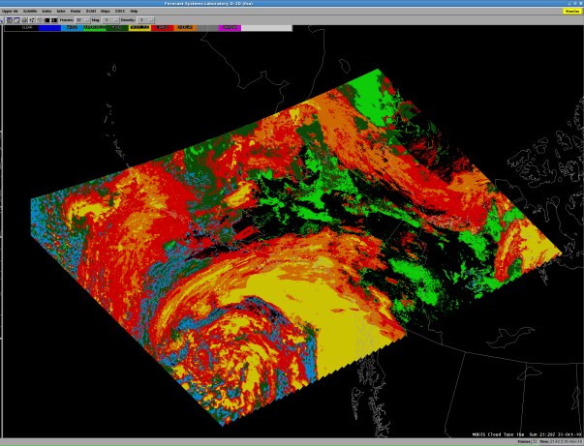
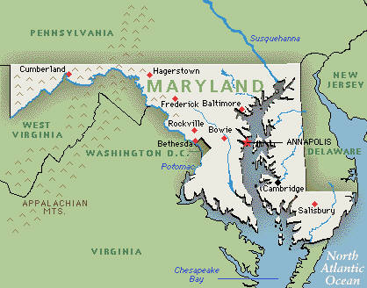
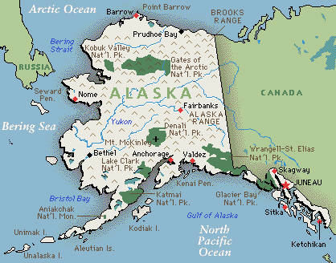
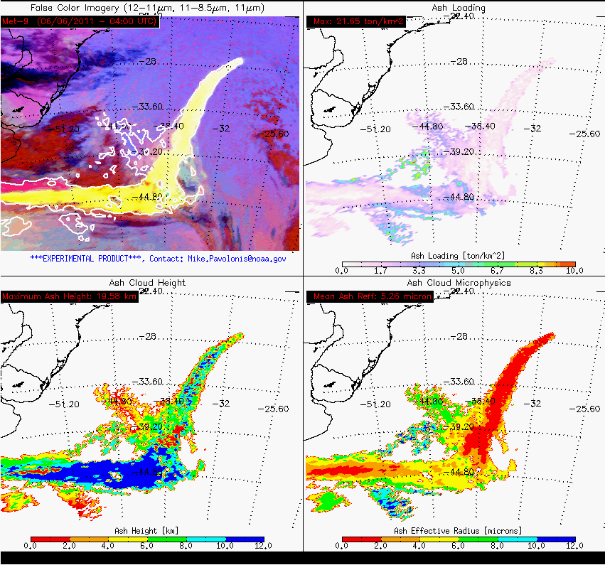
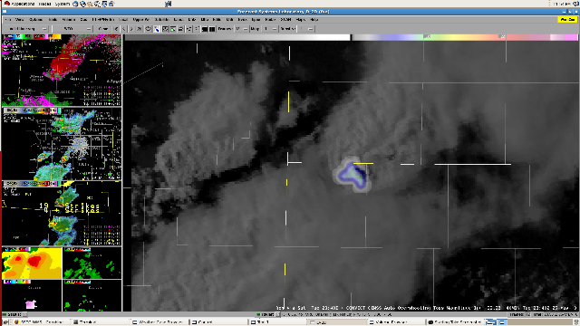
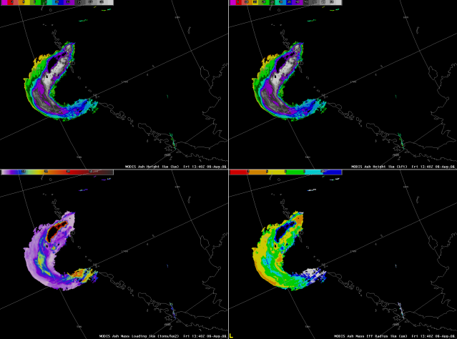
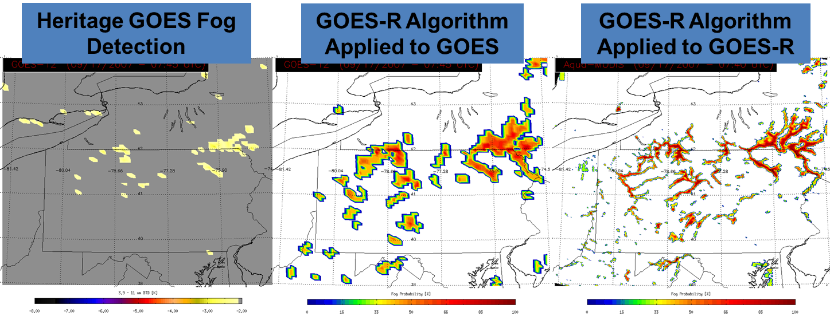
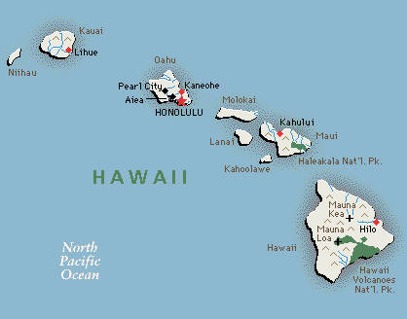
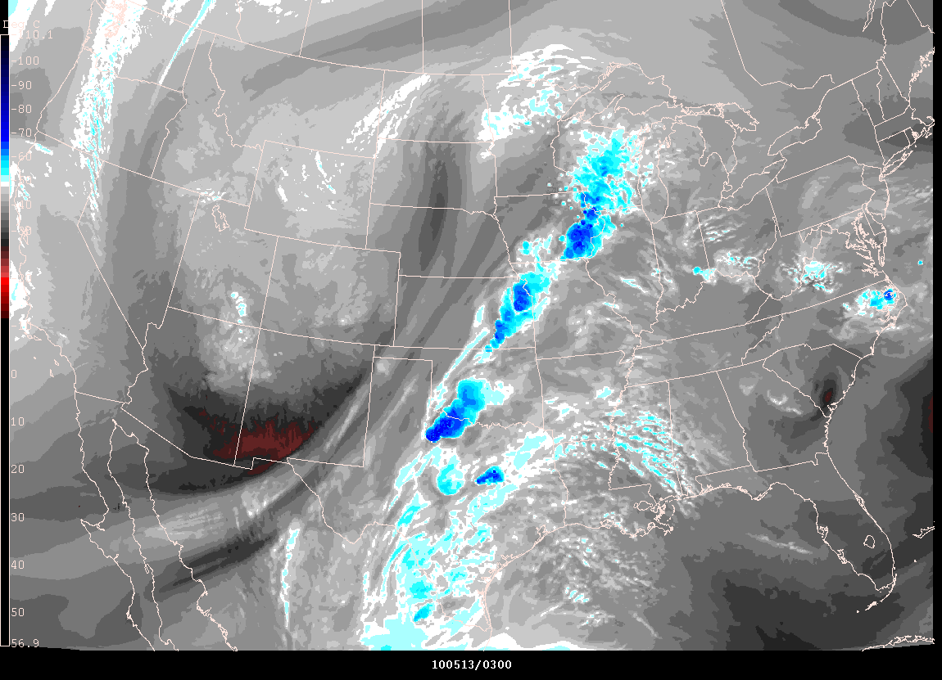
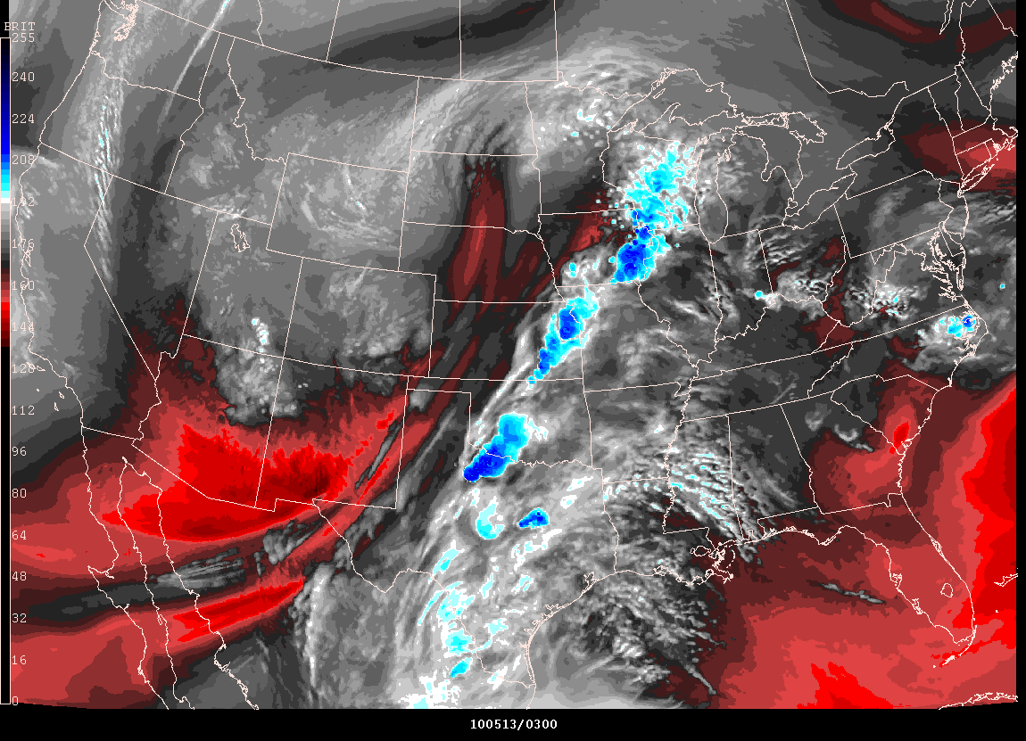
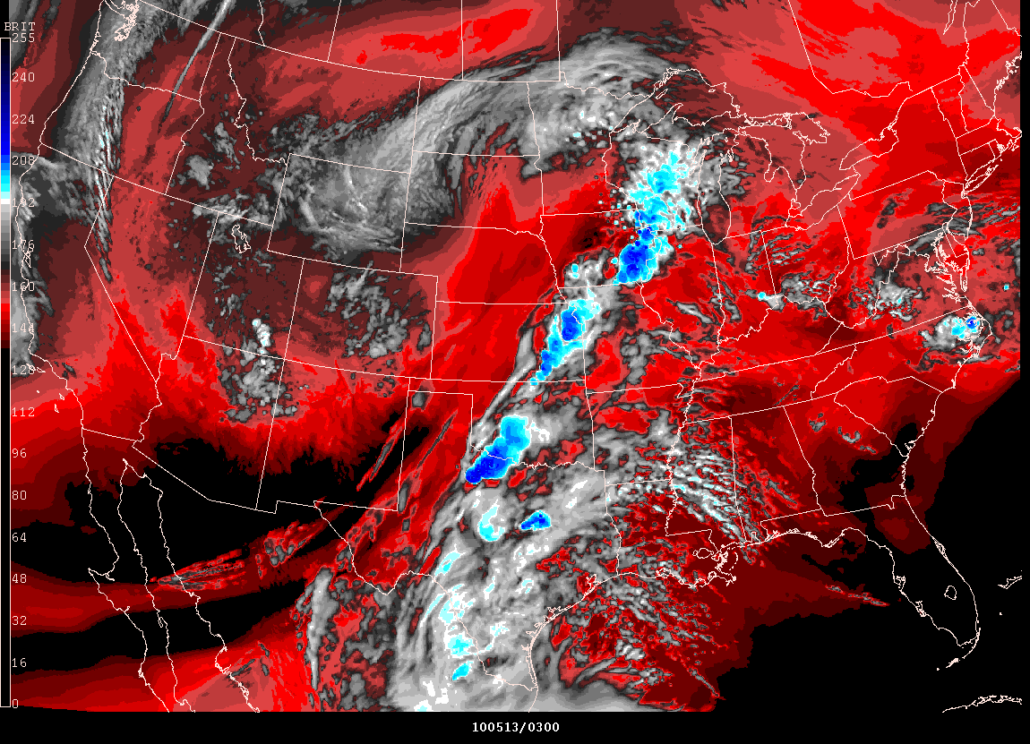
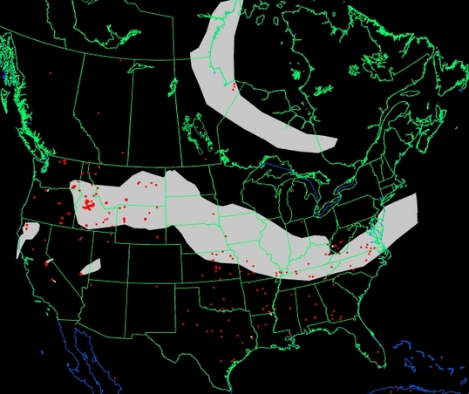
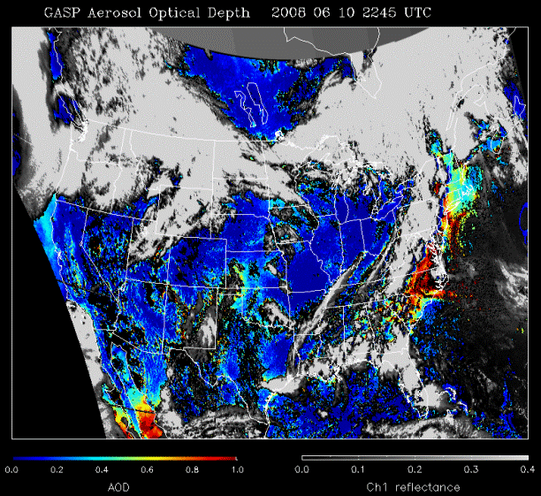
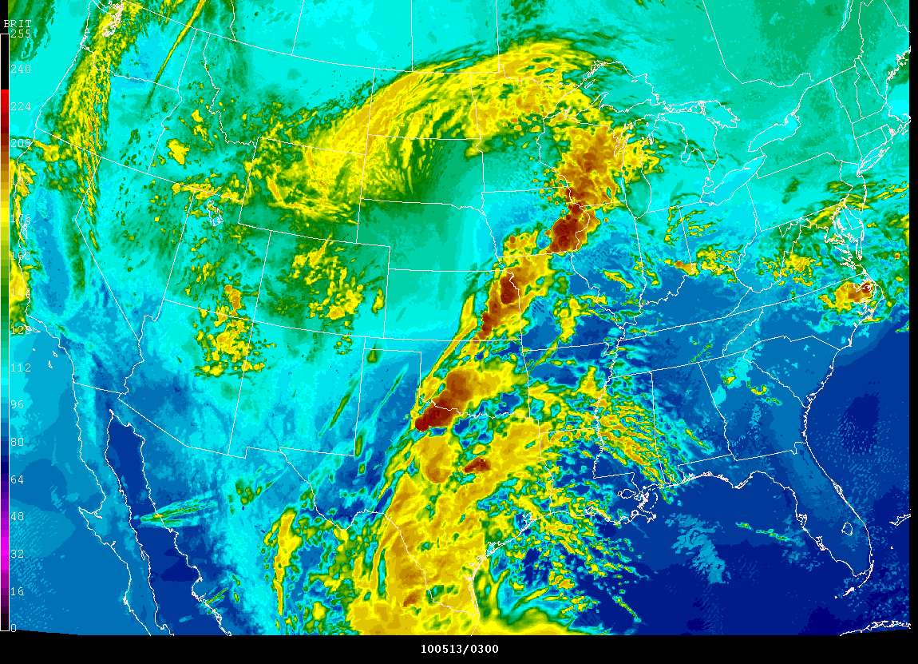
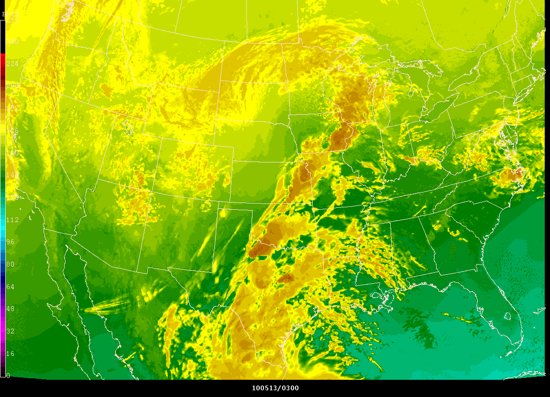
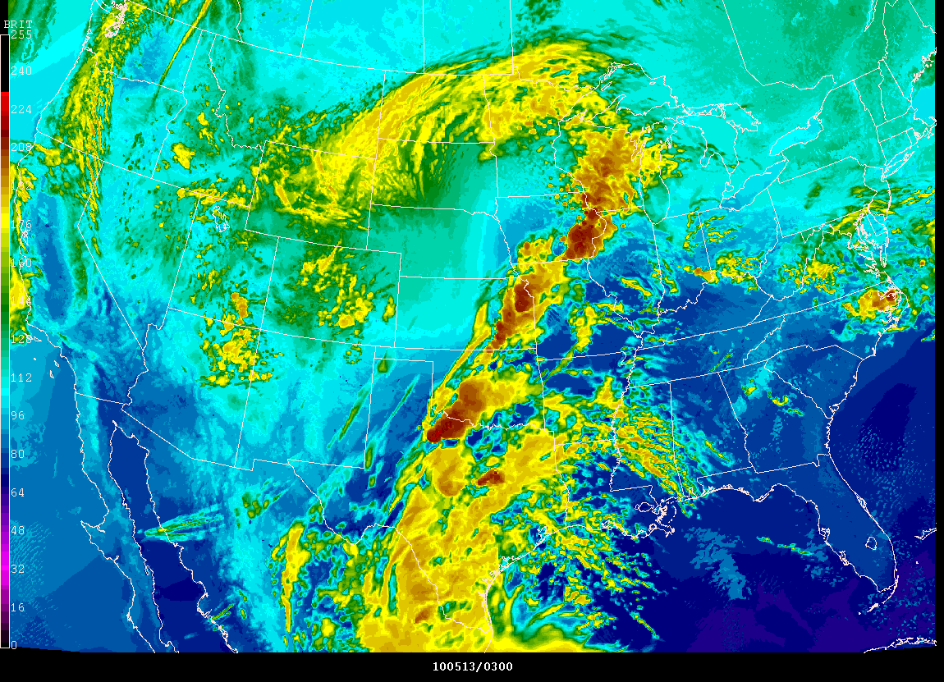
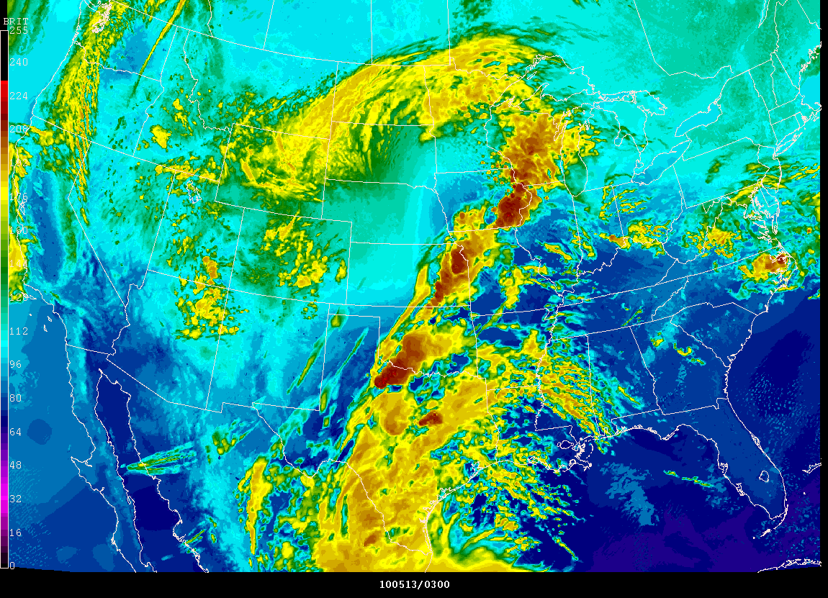
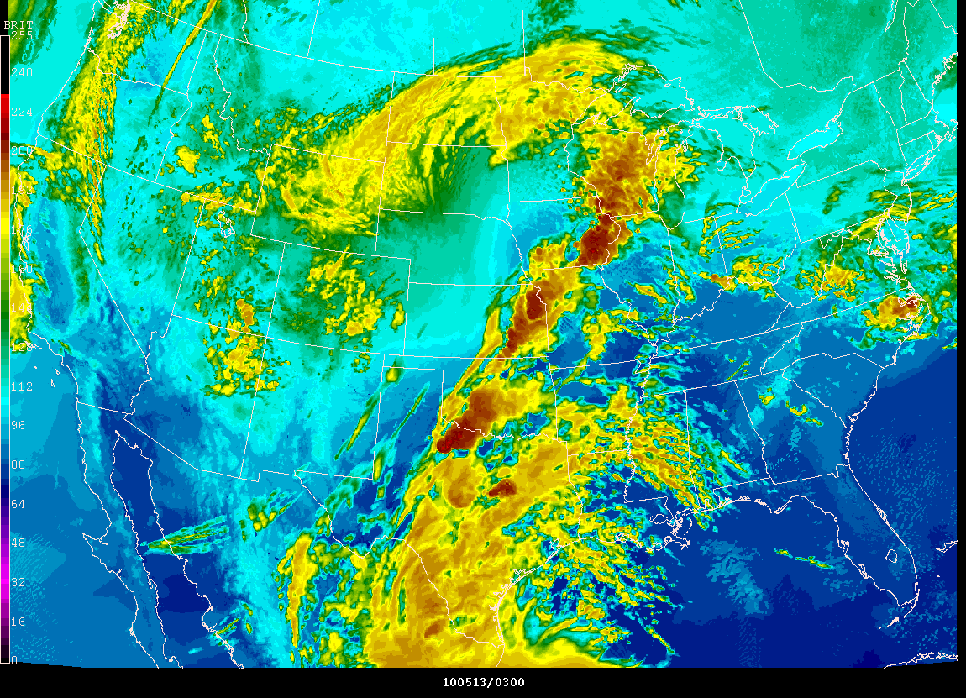
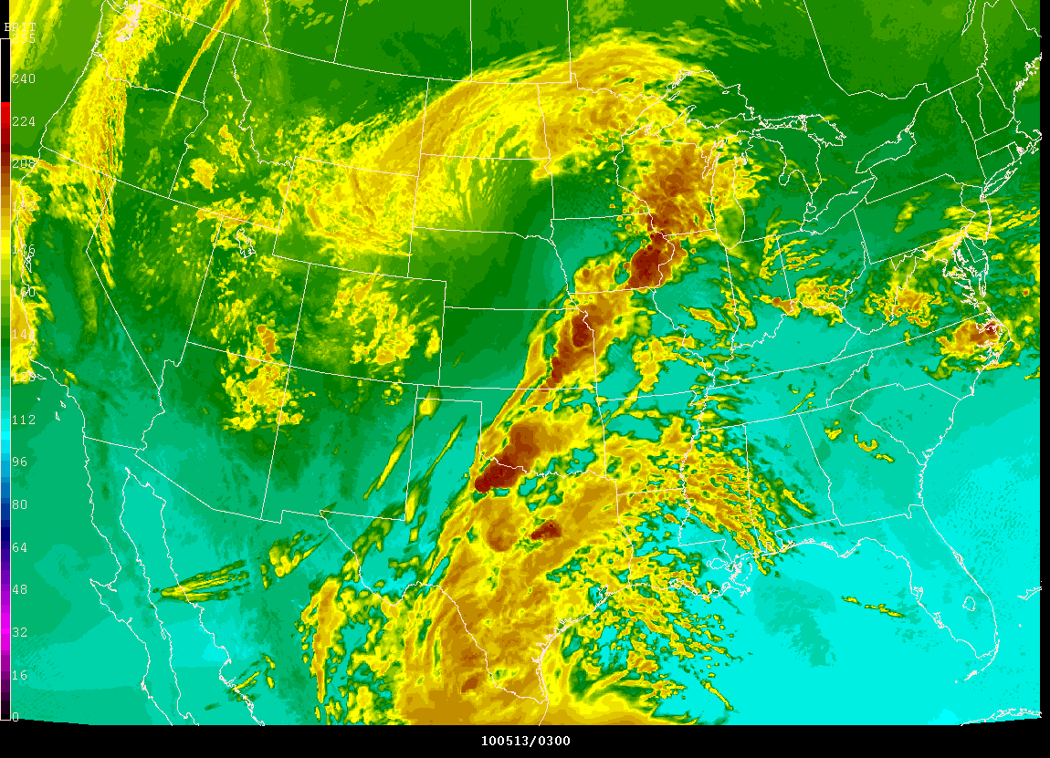
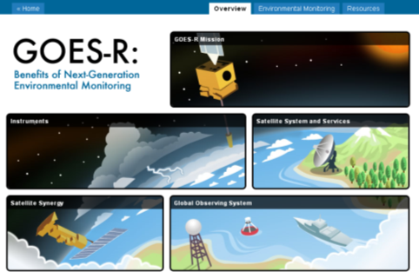
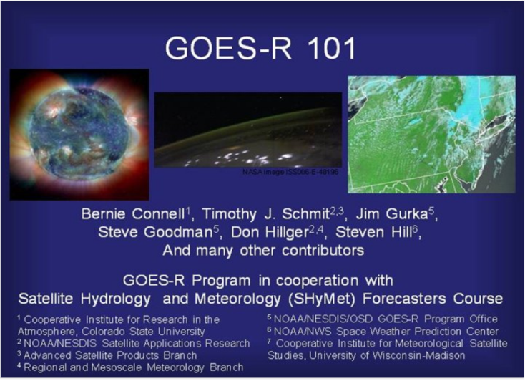
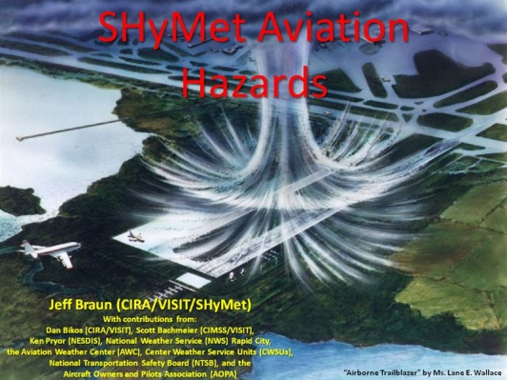
The GOES-R Proving Ground: 2012 Update
(IN53C-1639 AGU 2011)
Timothy Schmit, Mark DeMaria and Daniel Lindsey
NOAA/NESDIS/Center for Satellite Applications and Research (STAR)
Anthony Mostek and Brian Motta
NWS Training Division, Boulder, CO
Bonnie Reed
General Dynamics Information Technology
Geoffrey Stano and Richard Blakeslee
NASA/MSFC Short-term Prediction Research and Transition (SPoRT) Center, Huntsville, AL
Russell Schneider
Director, NOAA/NWS/Storm Prediction Center, Norman, OK
Chris Siewert
Cooperative Institute for Mesoscale Meteorological Studies, NOAA/NWS/Storm Prediction Center, Norman, OK
Donald Macgorman and Kristin Kuhlman
NOAA/ Office of Atmospheric Research/ NSSL, Norman, OK
Wayne Feltz
Cooperative Institute for Meteorological Satellite Studies (CIMSS), Madison, WI
Gary Hufford
NWS Alaska Region Scientific Services Division, Anchorage, AK
  What is the GOES-R Proving Ground?
  Collaborative effort between the GOES-R Program Office, selected NOAA/ NASA Cooperative Institutes, NWS forecast offices, NCEP National Centers, JCSDA, and NOAA Testbeds
  Where proxy and simulated GOES-R products are tested, evaluated and integrated into operations before the GOES-R launch
  A key element of GOES-R User Readiness (Risk Mitigation)
The GOES-R Proving Ground engages NWS in pre-operational demonstrations of selected capabilities of next generation GOES
Objective is to bridge the gap between research and operations by:
  Utilizing current systems (satellite, terrestrial, or model/synthetic) to emulate future GOES-R capabilities
  Infusing GOES-R products and techniques into NWS operations with emphasis on AWIPS and transitioning to AWIPS-II.
  Engaging in a dialogue to provide feedback to developers from users
The Proving Ground accomplishes its mission through:
  Sustained interaction between developers and end users for training, product evaluation, and solicitation of user feedback.
  Close coordination with GOES-R Algorithm Working Group (AWG) and Risk Reduction programs as sources of demonstration products, promoting a smooth transition to operations
Intended outcomes are Day-1 readiness and maximum utilization for both the developers and users of GOES-R products, and an effective transition to operations
Jim Gurka
Steve Goodman
GOES-R Program Office
2011: HWT/SPC Spring Exp.
Lightning Detection with the GLM
HWT 2011 Spring Exp.
GOES-R Proving Ground Partners
A Pseudo GLM (PGLM) total lightning product assisted in a severe thunderstorm warning at NOAA’s Hazardous Weather Testbed on May 12, 2011 in Norman, Oklahoma. A rapid increase of the total lightning rate, along with the forecaster’s interrogation of radar data, led to a severe thunderstorm warning, later verified with several severe hail reports.
Research using total lightning trends to diagnose severe storm intensification indicates the potential to increase warning lead-time to 20 minutes or more
The PGLM flash extent density was a useful precursor in identifying when the first cloud-to-ground strikes would occur. The PGLM preceded the first cloud-to-ground strike by approximately 30 minutes.
GLM’s ability to detect in-cloud lightning before the first ground strike provides a valuable early warning indicator to enhance lightning safety
Evaluating Products with greatest operational value
Nearcasting products
- Routinely used at all the desks in both the EFP and EWP
- Did a good job showing where convection is likely and just as important… where it can be ruled out in the next 1-6 hours
LMA: pseudo GLM products
- Routinely used in the EWP
- Numerous examples operational value in generating forecasts and warnings and in identifying when 1st cloud to ground flash will occur
Simulated CMI from NSSL WRF
- Part of daily routine at the CI desk for model performance evaluation
UPDATE
UWCI & OT
GOES-13
The PGLM flash extent density is on the left with the corresponding radar reflectivity on the right.
Location
Hazardous Weather Testbed/Storm Prediction Center, Norman, OK
Focus
Convection
Duration
-17 May – 18 June 2011
Products
Cloud and moisture imagery
Convective initiation
  3 products
Overshooting-top / Enhanced-V detection
Total lightning detection
  2 products
Severe hail probability
Nearcasting product
2011: Hurricane Season
2010 NHC
2011: Aviation Weather
RGB Air Mass Product (SEVIRI)
  Products evaluated and user feedback:
Hurricane Intensity Estimate (HIE)
    - Generally comparable to ADT, but min SLP can be unrealistically low at times
    - Adjusted applied to HIE pressure estimate
RGB Air Mass Product
    - Useful complement to the dust product
    - In some ways better separates the dry from moist air masses
    - At times product indicates polar air at very low latitudes
    - There are limb effects that could be corrected as a f(zenith angle)
S SAL Product
    - Animated version: improvement over static images
    - May be contamination near stratocumulus fields
SRSO data
    - Large number of excellent cases obtained due to GOES-15 science test coinciding with the peak of the hurricane season
Lightning based RII
    - Post season preliminary results show lightning reduces false alarms of rapid intensity forecasts
    - Additional testing needed to increase sample size
Location
Aviation Weather Center, Kansas City, KS
Focus
Aviation
Products
Low Cloud and Fog
SO2 Detection
Volcanic Ash Detection and Height
Aircraft Icing Threat
UW Convective Initiation
Nearcasting Model
Duration
-1 Jun – 31 Oct (TBD) 2011
Location
National Hurricane Center, Miami, FL
Focus
Tropical Weather
Products
Hurricane Intensity Estimate
Enhanced “V”/Overshooting Tops
Super Rapid Scan Imagery
False color imagery product
GOES-R natural color imagery product
Rapid Intensity Index
RGB Aerosol/Dust Product
RGB Airmass Product
Saharan Air Layer Product
Duration
-1 Aug – 30 Nov 2011
NHC 2010
RGB Airmass
RGB Airmass
2011: OPC and SAB
Low Cloud and Fog
UWCI
Future Capability:
Fog Detection
2011:High Latitude and Arctic
Baseline Product:
Volcanic Ash Product Suite
Chile's Puyehue-Cordón Caulle Volcano erupted on June 4, 2011, forming a tall ash plume above the Andes Mountains
The GOES-R Proving Ground provides near real-time volcanic ash retrieval products (using Meteosat SEVIRI data as a proxy for the GOES-R Advanced Baseline Imager) to identify a significant volcanic ash plume emerging over the Atlantic Ocean impacting aviation operations with many cancelled flights.
Similar data was provided by STAR to the London Volcanic Ash Advisory Center (VAAC) during the eruption of Eyjafjallajökull in Iceland in May 2010.
The GOES-R fog detection product will significantly improve geostationary satellite fog monitoring capabilities because:
Improved algorithm technology - the GOES-R algorithm provides quantitative information on fog probability, while heritage GOES fog detection products are more qualitative in nature
Improved sensor technology - the ABI has greatly improved spectral information, spatial resolution, and temporal resolution
Pseudo GLM
Cloud Phase
Enhanced V/OT
Volcanic Ash
Products
Cloud Mask
Cloud Phase
Low Cloud and Fog
SO2 Detection
Volcanic Ash Detection and Height
Duration
- 6 Dec 2010 – 31 Aug 2011
Location
Alaska Region
  GINA
  WFO Fairbanks
  WFO Anchorage
  WFO Juneau
  AAWU
Focus
Snow/Cloud/Ash/Aviation
Location Products
Ocean Prediction Center, Camp Springs, MD - Cloud/Moisture Imagery
NESDIS Satellite Analysis Branch, Camp Springs, MD - Convective Initiation
Focus - Cloud Top Phase/Height/Temperature
Offshore T-Storms - Enhanced “V”/Overshooting Top Detection
Duration - Lightning Detection
-Approx. June – Sept 2011
Demonstrations 2011
HPC and SAB
Demonstrations 2011 Air Quality Experiment
Future Demonstrations Pacific Region
Product Demonstrations
Location
Hydrometeorological Prediction Center, Camp Springs, MD
NESDIS Satellite Analysis Branch, Camp Springs, MD
Focus
Precipitation/QPF
Products
Cloud/Moisture Imagery
Derived Motion Winds
RGB Airmass
Rainfall Rate/QPE
Duration
-Approx. July – Oct 2011
Location
UMBC
EPA Region III
Focus
Air Quality
Products
Aerosol Optical Depth
Aerosol Detection (Smoke/Dust)
Fire/Emissions
RGB Imagery
Duration
Approx. 11 July – 24 2011
Notes
Coincides with the DISCOVER-AQ experiment
Location
Pacific Region
Focus
Tropical Cyclone
Heavy Rainfall
Aviation
Products (List is under Review)
Tropical Cyclone Intensity
Lightning Detection
Volcanic Ash Detection and Height
SO2 Detection
Aerosol Detection
Rainfall Rate/QPE
Oragraphic Rain Index
Total Precipitable Water
Atmospheric Rivers
UW Convective Initiation
Start Date
-TBD
  Space Weather: NWS SWPC
  and NESDIS NGDC
    Planning phase-implementation plan in development
    Solar thematic maps (SUVI)
    Products from NASA SDO to approximate GOES-R SUVI
    Create means to ingest and display GOES-R like Level 2+ products
Simulated Satellite Imagery
HMS Fire and Smoke Product
AOD
Training and Education
What is available now?
Future Plans:
2012 And Beyond
Summary
Listed/linked on GOES-R Home page
Proving Ground Overview
GOES-R 101 (SHyMet)
Satellite Meteorology for Grades 7 – 12
GOES-R: Benefits of Next-Generation Environmental Monitoring (COMET)
GOES-R Trifold flyer
http://www.goes-r.gov/users/training.html
  - Demonstrate products and decision aids in NOAA Testbeds, NCEP Centers, WFOs, and the NWS Proving Ground at Training Center
  - Transition from Warning Related Products to remaining Baseline Products, Day 2 Future Capability, Decision Aids, Decision Support Services
  - Continue to develop, demonstrate, and test as part of decision support services
  - Enhanced JPSS collaboration (fused products, VIIRS and SEVIRI as a proxy for ABI)
- GOES-R Proving Ground provides mechanism to:
  Involve CIs, AWG, National Centers, NOAA Testbeds and WFOs in user readiness
  Get prototype GOES-R products in hands of forecasters
  Keep lines of communication open between developers and forecasters
  Allow end user to have say in final product, how it is displayed and integrated into operations
- Proving Ground continues to grow and plans are in place for 2012 and beyond.
- For GOES-R to be a success, forecasters must be able to use GOES-R products on Day 1!
Online training modules
http://meted.ucar.edu/goes_r/envmon/
http://cimss.ssec.wisc.edu/satmet/
http://rammb.cira.colostate.edu/visit/video/goesr101/player.html
http://rammb.cira.colostate.edu/training/shymet/forecaster_intro.asp
Proving Ground is both a source and a recipient of Training
COMET Summer Faculty Course: “Integrating Satellite Data and Products into Geoscience Courses with Emphasis on Advances in Geostationary Satellite System,” Aug. 8-12, 2011.
Outreach Projects (with NWSFOs): reach out to GOES-R Proving Ground Partners and connect with faculty and students to prepare for GOES-R

