Slide 1
AWIPS CONUS Scene Issue
Taft Irons
SEIT
6/23/2011

Slide 2
ABI CONUS Swath Issue
GS FPS version 2.5 Appendix E specifies that CONUS East and West corner points are in the ABI PORD
ABI PORD does not specify coordinates or a bounding box for CONUS East and West products (only a reference area for CONUS as a whole)
CONUS definition per ABI PORD017 states: Defined as a nadir-viewed rectangle 8.0215 x 4.8129 degrees, 5000 East/West x 3000 North/South kilometers, approximately in the geographic area of 10N-60N latitude and 60W-125W longitude (shown on next slide).
IIT ABI swath timeline shows CONUS collection in 6 swaths (mode 3)
If the AWIPS 2005 ICD areas were used, ABI cannot scan the areas in 6 swaths

Slide 3
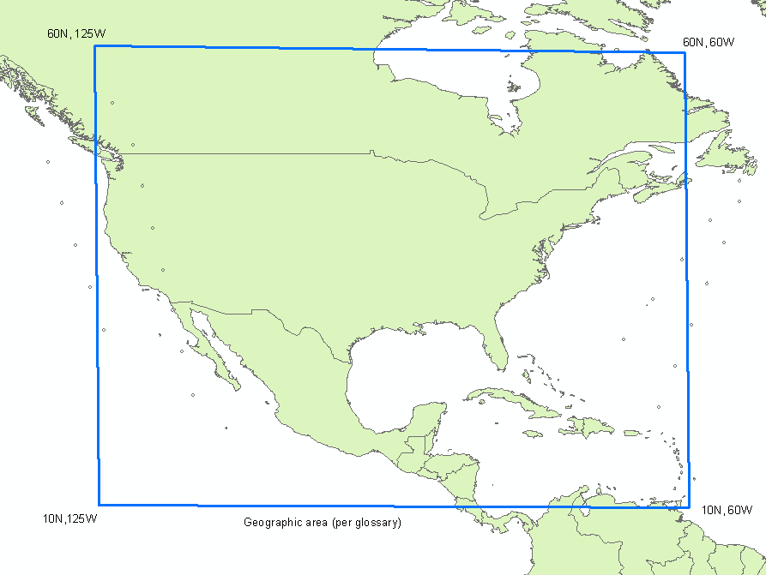
ABI PORD Definition of CONUS (Fixed Grid GRS80)

Slide 4
AWIPS 2005 ICD
AWIPS 2005 ICD defines CONUS products as (shown on next diagram as CONUS East and West):
East CONUS West CONUS
Lower Left: Lower Left:
16.369N 113.133W 12.190N 133.459W
Lower Right: Lower Right:
14.335N 65.091W 17.514N 92.720W
Upper Right: Upper Right:
57.289N 49.385W 61.257N 91.444W
Upper Left: Upper Left:
59.844N 123.044W 54.536N 152.855W
For sizing reference only, using the AWIPS 2005 ICD coordinates*:
CONUS East 1km resolution Lambert Conformal grid size of 21.74 Mega Pixels
.5 km resolution (1 channel): 187 MB
1km resolution (3 channels): 140 MB
2 km resolution (12 channels): 140 MB
CONUS West 1km resolution Lambert Conformal grid size of 19.23 Mega Pixels
.5 km resolution (1 channel): 165 MB
1km resolution (3 channels): 124 MB
2 km resolution (12 channels): 124 MB
Note: * reflects 5% SEIT margin (CDR), 2.5% netCDF overhead, 16 bit depth

Slide 5
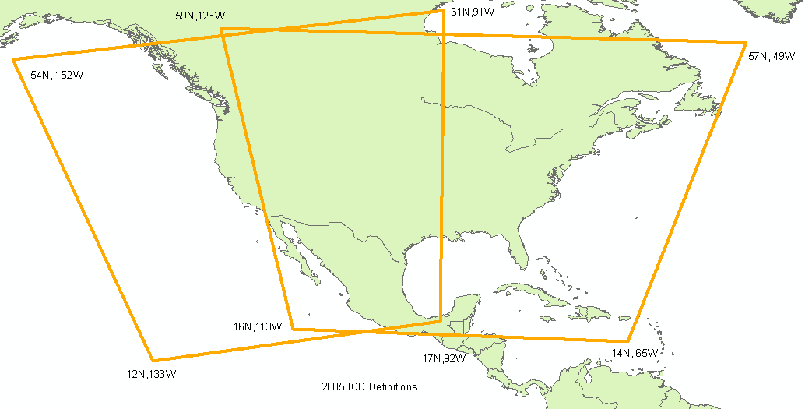
AWIPS 2005 ICD CONUS (Fixed Grid GRS80)
CONUS West
CONUS East

Slide 6
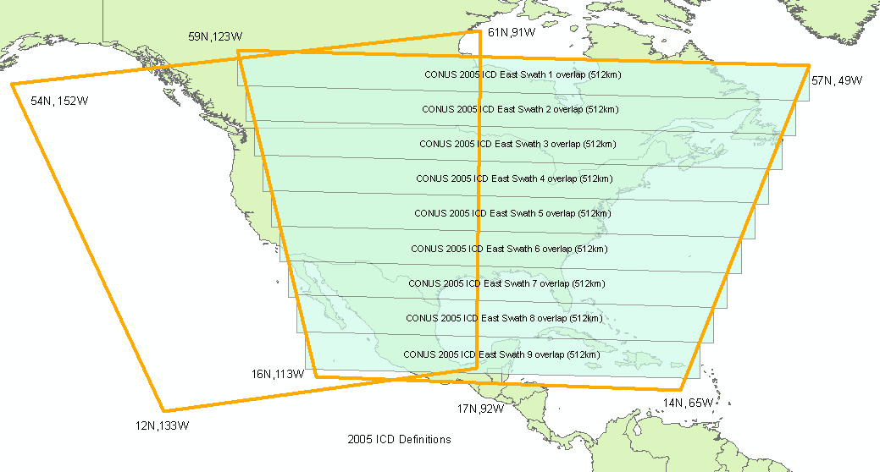
Graphical Depictions Fixed Grid (GRS80) to cover 2005 ICD area
Would take approx. 9 ABI swaths to cover the 2005 ICD area

Slide 7
ABI Swath Information
Using Carr Assumptions:
1.024 (2.4%) swath overlap which accounts for 12.29 km
512 km swath size with 500 km of usable data
To cover the AWIPS 2005 ICD bounding box, would require a total of 9 swaths of ABI data to collect
2.4% swath overlap was taken into account in previous graphics

Slide 8
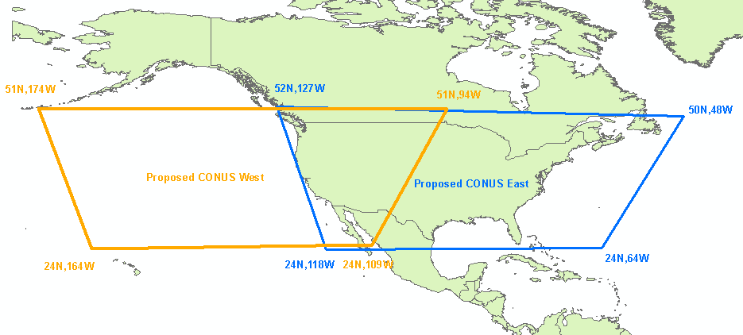
Proposed CONUS (Fixed Grid GRS80)
Cuts down the amount of data (less than the 2005 ICD) to the 3k by 5k definition to keep ABI at 6 swaths

Slide 9
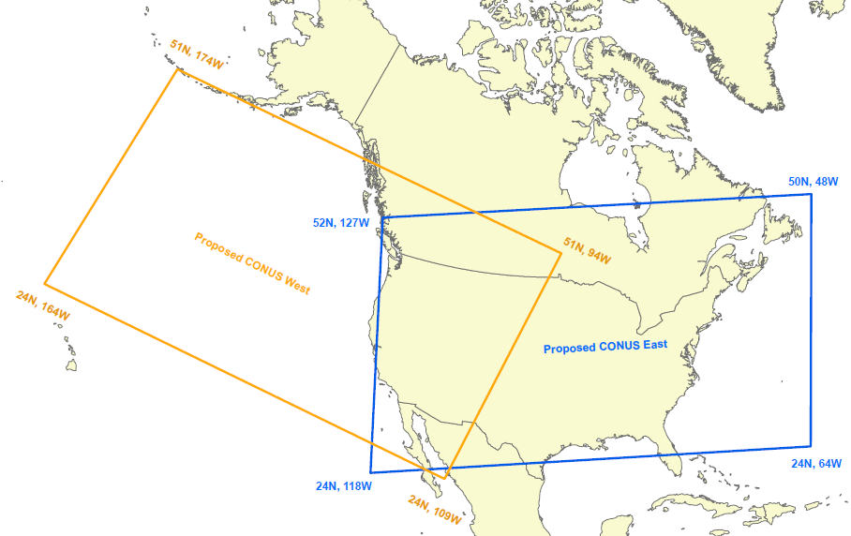
Proposed CONUS (Lambert Conformal Projection)

Slide 10
Proposed CONUS (Lambert Conformal) Sizing
For sizing and testing purposes, the proposed CONUS sizing using the bounding boxes*:
CONUS East 1km resolution grid size of 15.88 Mega Pixels
.5 km resolution (1 channel): 137 MB
1km resolution (3 channels): 103 MB
2 km resolution (12 channels): 103 MB
CONUS West 1km resolution grid size of 15.89 Mega Pixels
.5 km resolution (1 channel): 137 MB
1km resolution (3 channels): 103 MB
2 km resolution (12 channels): 103 MB
Note: * reflects 5% SEIT margin (CDR), 2.5% netCDF overhead, 16 bit depth

Slide 11
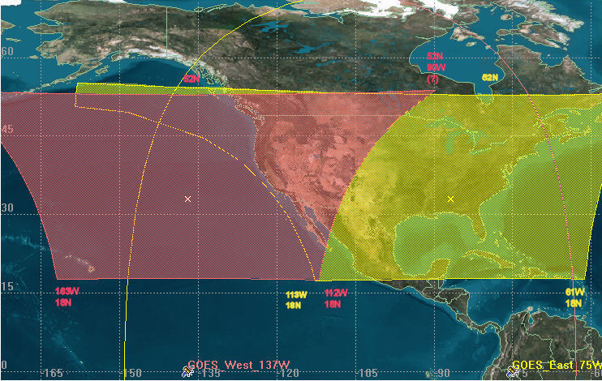
Notional GOES-R GSP CONUS Sectors
Would take more than 6 ABI swaths to cover each of the GSP sectors shown

Slide 12
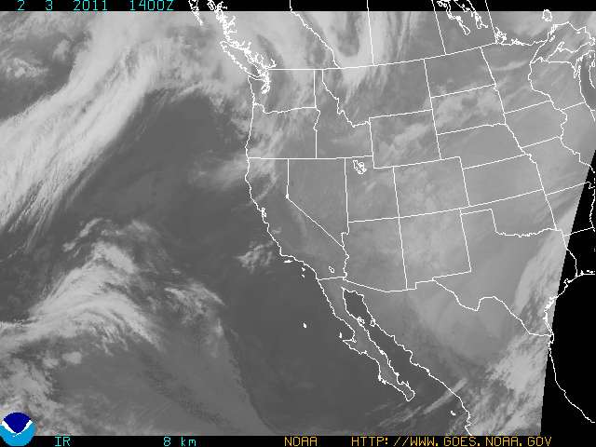
Current CONUS GOES West

Slide 13
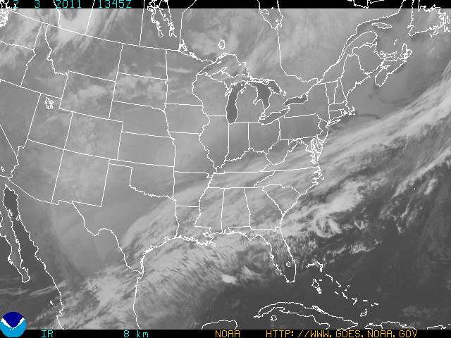
Current CONUS GOES East

Slide 14
Conclusion
Since the corner points for CONUS will be modified up to and after launch, a notional bounding box will be sufficient for sizing and testing purposes
The 2005 ICD bounding boxes should not be used for sizing and processing purposes (larger bounding box than the requirement)
The proposed notional bounding box that meets the ABI PORD (3k by 5k) requirement is sufficient for testing and sizing purposes
East CONUS West CONUS
Lower Left: Lower Left:
24N 118W 24N 164W
Lower Right: Lower Right:
24N 64W 24N 109W
Upper Right: Upper Right:
50N 48W 51N 94W
Upper Left: Upper Left:
52N 127W 51N 174W

