Slide 1
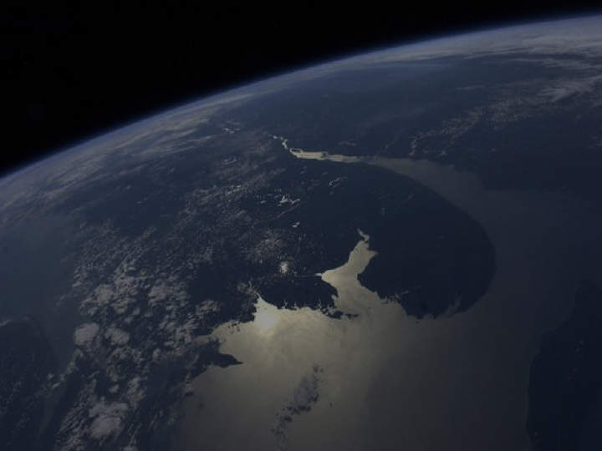
Measuring Fire Scars with JPSS Satellites to Provide Preliminary Burn Intensity Estimates to NWS for Debris Flow Hazard Assessment
Sam Batzli, Dave Parker, Russ Dengel, Nick Bearson Space Science & Engineering Center, University of Wisconsin-Madison
Katherine Rowden
NOAA/NWS – Spokane WFO
Ivan Csiszar
NOAA/NESDIS – STAR
Mary Ellen Miller
Michigan Tech
AGU2020 Session: IN034. NOAA Satellite Proving Grounds to Enhance User Applications I

Slide 2
Providing Faster Satellite-derived Input Maps for Mudslide Forecasters
Sam Batzli, Dave Parker, Russ Dengel, Nick Bearson Space Science & Engineering Center, University of Wisconsin-Madison
Mary Ellen Miller
Michigan Tech
Ivan Csiszar
NOAA/NESDIS – STAR
Katherine Rowden
NOAA/NWS – Spokane WFO

Slide 3
The Situation – Debris Flows after Fires
Source of graphic: “How the harrowing Thomas Fire planted the seed for California's deadly mudslides” Washington Post, By Angela Fritz January 10, 2018
Healthy soil and vegetation absorbs rain and stabilizes slopes.
Fire destroys this stability.
Risk of mudslides increases after fires.

Slide 4
The Situation – Debris Flows After Fires
Montecito, CA, January 7, 2018. Source: “Your Questions About The California Mudslides, Answered.” Huffingtonpost.com, By Lydia O’Connor January 11, 2018 08:37 pm ET Updated Nov 26, 2018.

Slide 5
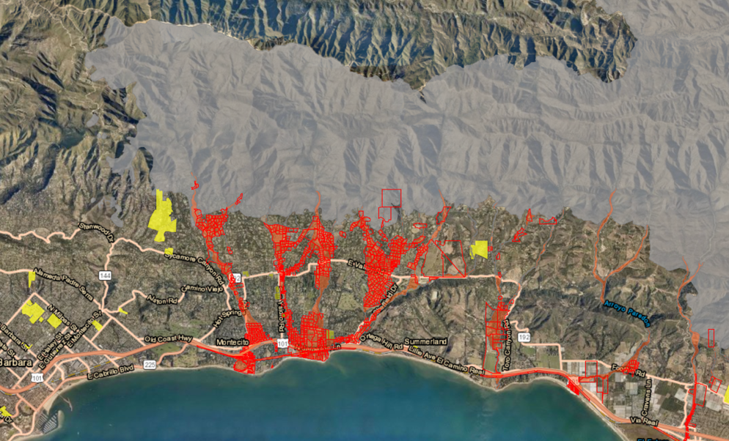
The Concern – Hazard Warnings
Burn Scar
Evacuation Orders
Example evacuation order map from 5 March 2019. Source: County of Santa Barbara, Emergency Operation Center and Santa Barbara County Sheriff

Slide 6
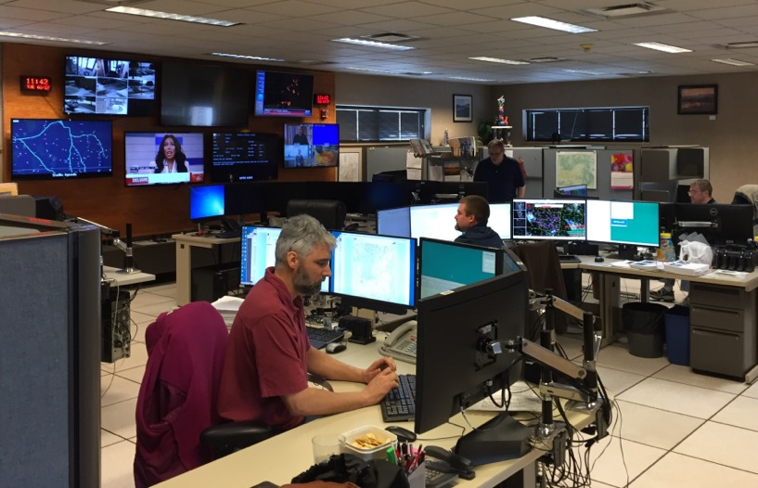
The Concern – Hazard Warnings
Evacuation Orders
National Weather Service – Weather Forecast Office. 24/7 Forecast and Warning Operations. Source: Katherine Rowden

Slide 7
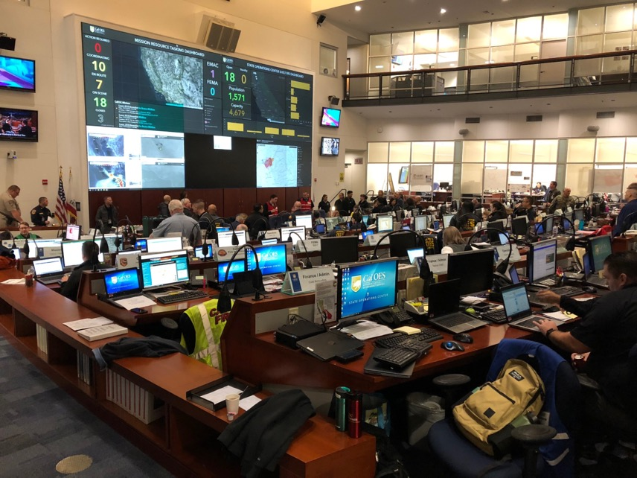
The Concern – Hazard Warnings
Evacuation Orders
Cal EOC (California Emergency Operations Center). Source: Katherine Rowden

Slide 8
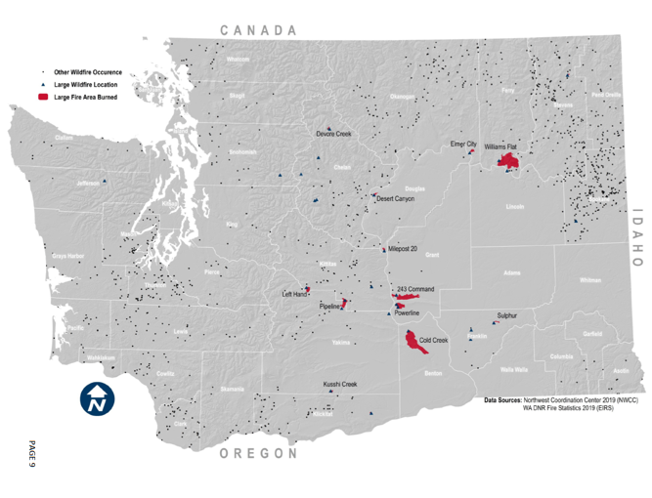
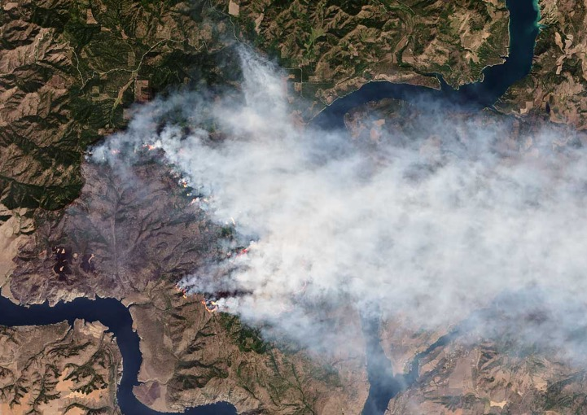
Williams Flats Fire Example
44,446 Acres :: 8/2/2019- 8/25/2019 :: Lightning
Location of fire from “Fire Season Summary – 2019”, Washington DNR
Landsat 8 True Color RGB image Aug. 7, 2019, (WRS-2: Path 44, Row 27) https://earthobservatory.nasa.gov/images/145446/flying-through-a-fire-cloud

Slide 9
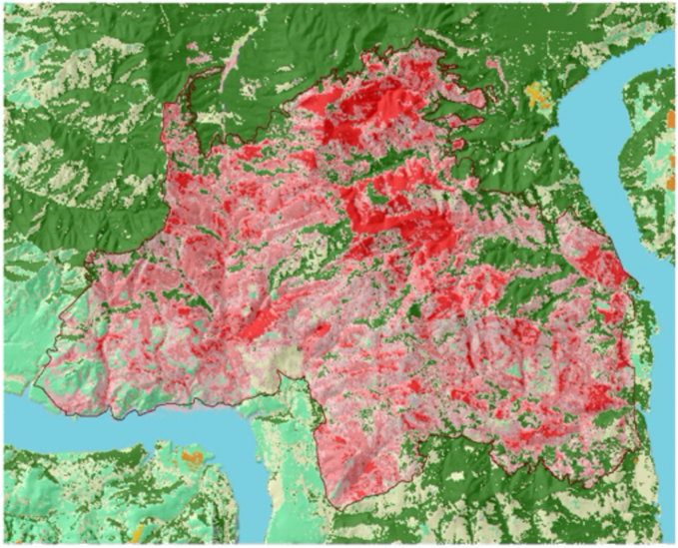
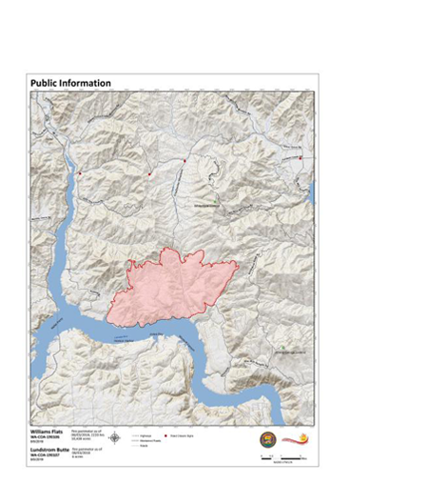
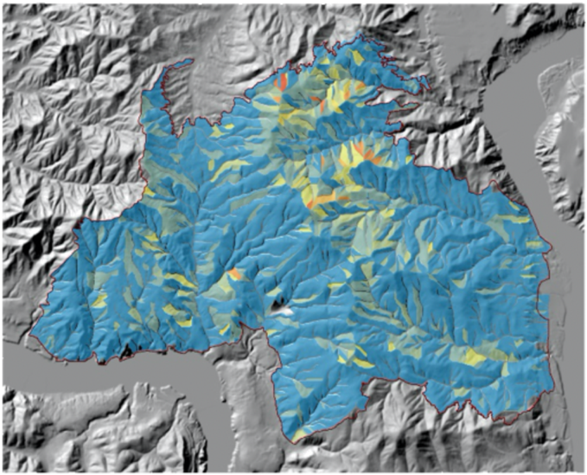
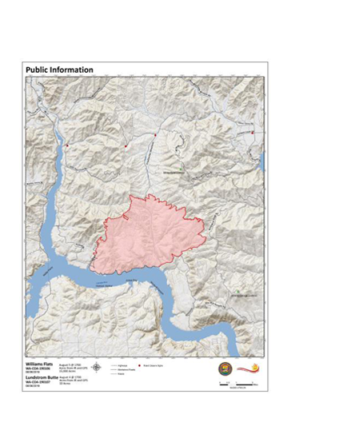
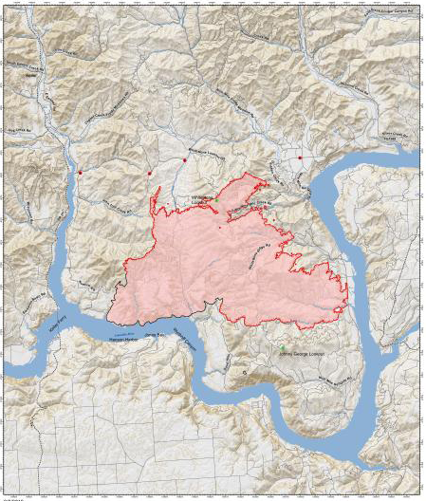
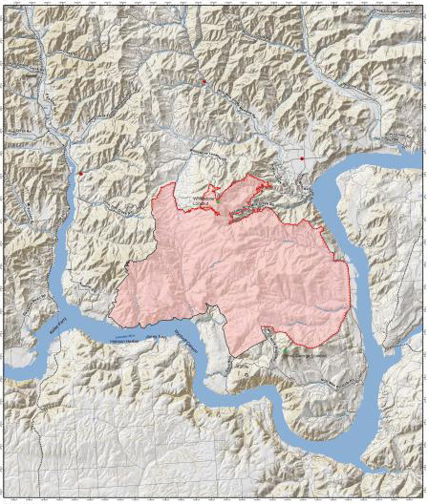
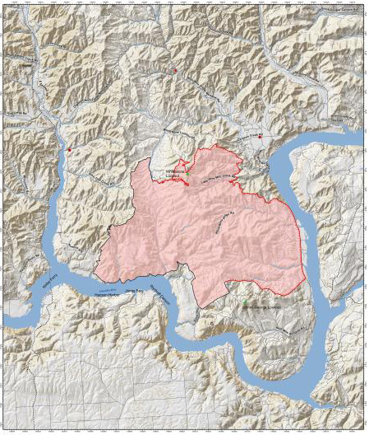
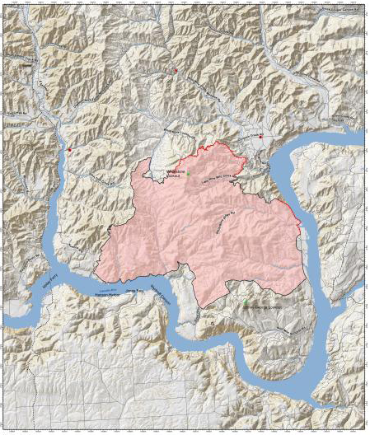
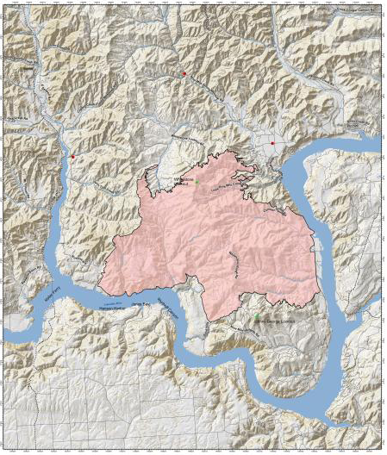
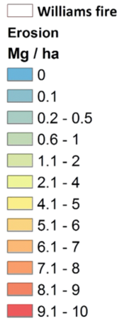
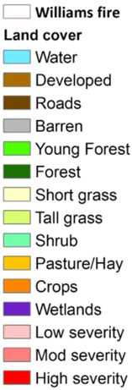
Williams Flats Fire Example
05 August 2019
06 August 2019
08 August 2019
10 August 2019
11 August 2019
14 August 2019
25 August 2019
Burn severity map derived by US Forest Service from Landsat 8, added to erosion model. Courtesy of Mary Ellen Miller, Michigan Tech.
https://inciweb.nwcg.gov/incident/maps/6493/

Slide 10
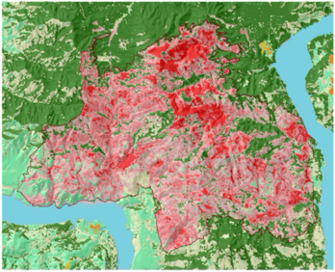
BARC: A Burned Area Reflectance Classification is a satellite-derived map of postfire vegetation condition. It is used as an input to the burn severity map produced by the Burned Area Emergency Response (BAER) teams.
Landsat 8
16-day Repeat Cycle
185km Swath Width
Fire → Burn Scar → Observation → Processing → BARC Map/BAER Team → GIS Model → Weather Forecast → Warning!
Landsat-Based 30m
Aug 23
Sept 8
Oct 10
1
2
3
4
5
6
7
8
9
10
11
12
13
14
15
1
2
3
4
5
6

Slide 11
BARC vs BRIDGE
Current Method: Normalized Burn Ratio (NBR) is an index designed to highlight burnt areas in large fire zones.
Alternative Method: Normalized Difference Vegetation Index (NDVI) is a quantitative index of greenness that relates to vegetation health.
NBR =
(NIR - SWIR)
(NIR + SWIR)
NDVI =
(NIR - Red)
(NIR + Red)
Used with Landsat imagery as input for Burned Area Reflectance Classification “BARC” maps at 30m resolution
Good accuracy, but 16-day repeat cycle
Latency issue for NWS - sometimes late or never
MODIS 500m product (MCD64A1) only monthly
No VIIRS version of this product (yet?)
Shows promise for rapid production of preliminary Burn Intensity Delta Greenness Estimation “BRIDGE” maps at 375m
Medium Accuracy, but nearly daily
Rapidly Available
Fire damages vegetation
NDVI is an operational JPSS product

Slide 12
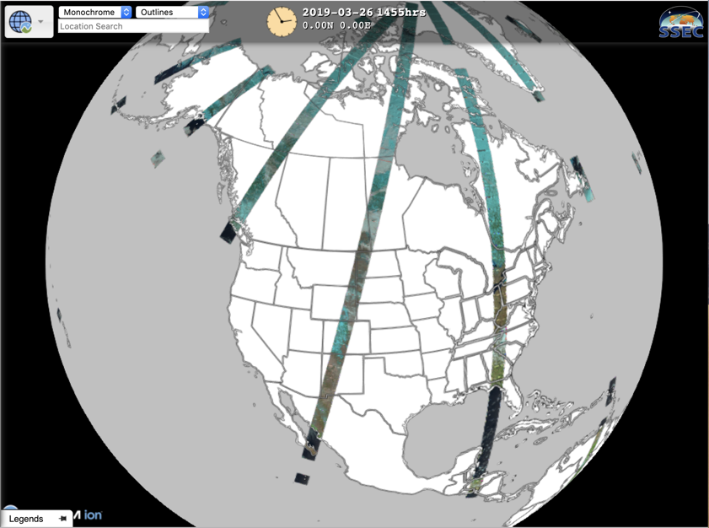
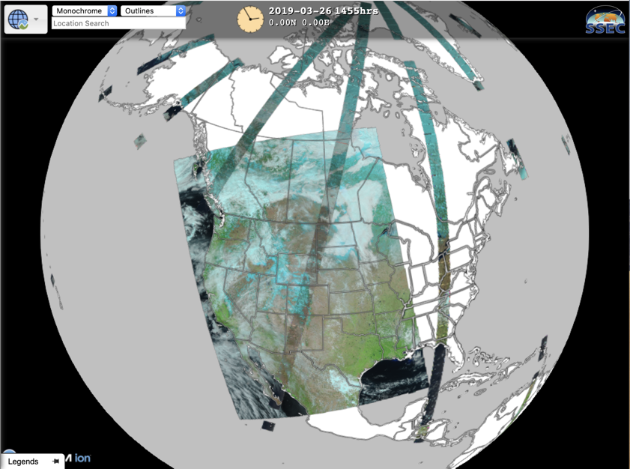
Observation: OLI and VIIRS
S-NPP and NOAA-20
VIIRS:
3000km
Landsat OLI:
185km
https://realearth.ssec.wisc.edu

Slide 13
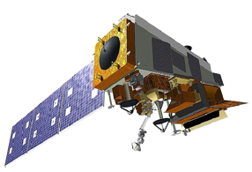
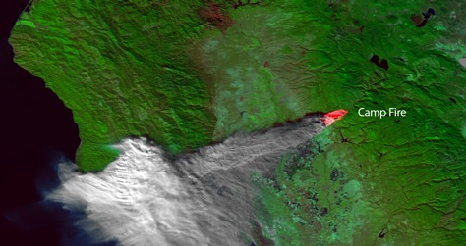
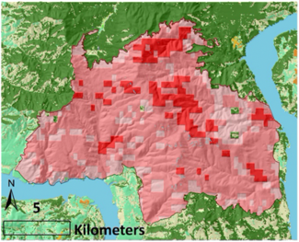
BRIDGE Map
S-NPP and
NOAA-20
1-day Repeat Cycle
3000km Swath Width
Fire → Burn Scar → Observation → Processing → BRIDGE → GIS Model → Weather Forecast → Warning!
Aug 07
VIIRS - Based 500m
Aug 23
Aug 27
S-NPP
NOAA20
16
1
2
3
4
5
6
7
8
9
10
11
12
13
14
15
16
1
2
3
4
5
6
1
2
3
4
5
6
7
8
9
10
11
12
13
14
15
1
2
3
4
5
6

Slide 14
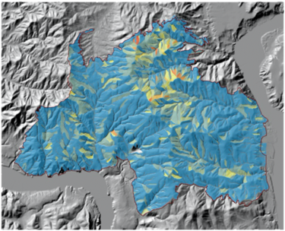
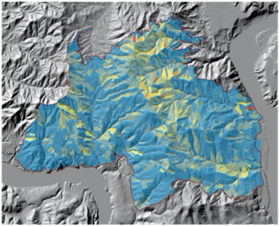
Comparing Results
Landsat - BARC
30m
Oct 10
VIIRS - BRIDGE
500m
Aug 27
44-Days Earlier

Slide 15
Comparing Results
Landsat - BARC

Slide 16
Comparing Results
VIIRS - BRIDGE

Slide 17
Conclusion
BARC maps are more accurate
BRIDGE maps are more timely
BRIDGE maps appear to be accurate “enough”

Slide 18
Considerations and Next Steps
More case studies will be processed
Continue efforts to automate with web- based dashboard
Utilize Direct broadcast for ”after” imagery to cut latency

