Slide 1











Earth, Air, Fire, and Water
Integrating Visualization of Weather and Land Processes With Map Services
Sam Batzli, Dave Parker,
Nick Bearson, Russ Dengel
Space Science & Engineering Center

Slide 2





Why do this? What’s our motivation?
We can learn a lot about our data by simply looking at it and making comparisons with other data. (quality control, validation)
We can learn a lot about our planet and its processes by comparing datasets across disciplines. (Fire ← → Wind, Smoke ← → Air, Land ← → Floods)
We can bring information together and visualize it for
decision support. But only if we can make the complex
simple, without losing its value
If we do it well, we can actually help save lives

Slide 3
One Tool (our tool) is “RealEarth” (Real-time data of the Earth)
RealEarth is a server-based data visualization platform developed at SSEC/CIMSS, University of Wisconsin-Madison that provides satellite imagery and related data products to desktop and mobile devices.
It is built on open source software including, MapServer, GDAL, Proj4, PHP, JavaScript, and Python.
The purpose of RealEarth is to provide a simple interface for data visualization and comparison across the atmospheric, oceanic, and Earth science domains.
But anyone who has wanted to compare various data sets of Earth observations with visualization immediately encounters basic challenges… that we have mostly addressed.

Slide 4
Challenges as we visualize data across disciplines…
Resolution
  Spatial …what is large? What is small? It depends… (5cm aerial imagery 4km model data)
  Spectral …what can we see? What can we not see? (support different “views” of the same data)
  Temporal …what is old? What is often? Animation?… (support for seconds to multiple years)
Reach
  Audience …who cares? (customizable interface and API)
  Complexity …how can we make the complex less confusing? (collections, categories, search, metadata)
  Scale …can we grow? (data volume and popularity: VMs, containers, load balancing, caching)

Slide 7
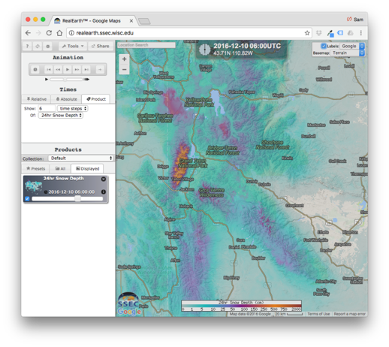
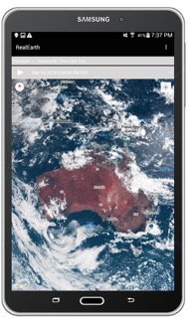
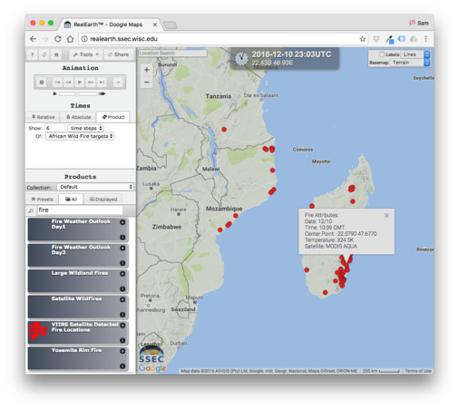
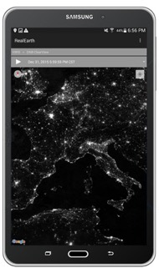
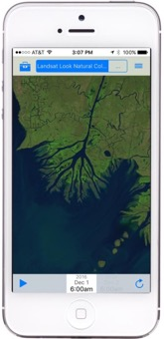
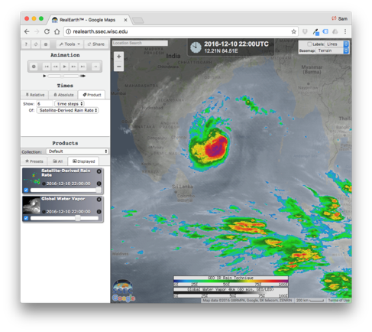
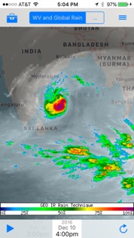
Basic RealEarth Features
Typical web mapping functions (pan, zoom, layer order and transparency)
Choose background map, turn labels on/off
Full-featured API, over 450 “products”
Animate and share movies through social media
Embed map in your website
Add your own data: Upload GeoTIFF, GeoJSON easily
Interoperable with GIS (WMS/WMTS, QGIS, ArcGIS Pro)
Synchronize favorites with our mobile apps
“Probe” (right-click) imagery for pixel-level data values

Slide 8
Advanced RealEarth Features
Automate product generation (command-line uploads – Unix/Linux)
Include “link-back” URL to original source data
Globe view (dynamic) and polar views
Set notifications to mobile devices for raster value thresholds
Develop custom interface
Develop custom enhancements/views of same data
Collaboration screen-share mode
Full system available as a VM, spin up your own and join
the federation, if you choose.

Slide 9
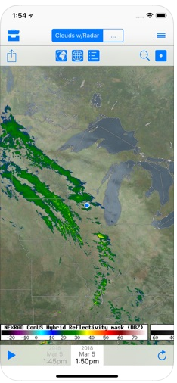
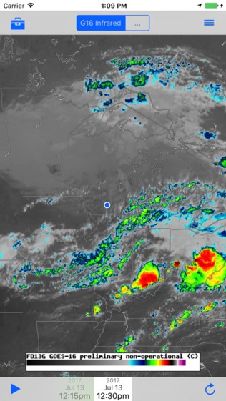
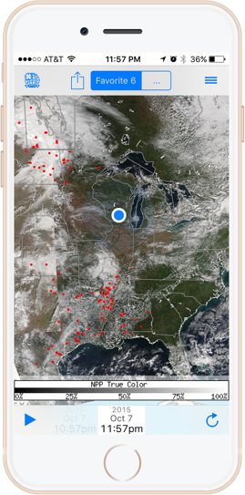
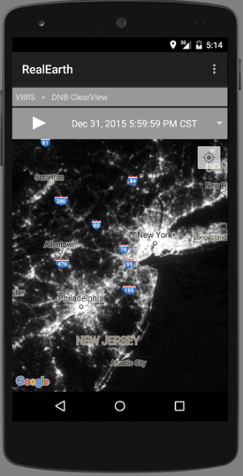
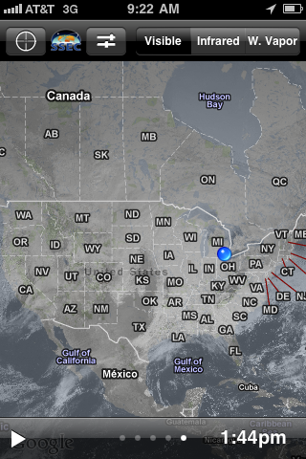


RealEarth and Related Apps
JPSS-ISEE
RealEarth
GOES
WxSat
Search Google Play and the AppStore for “SSEC RealEarth”

Slide 10
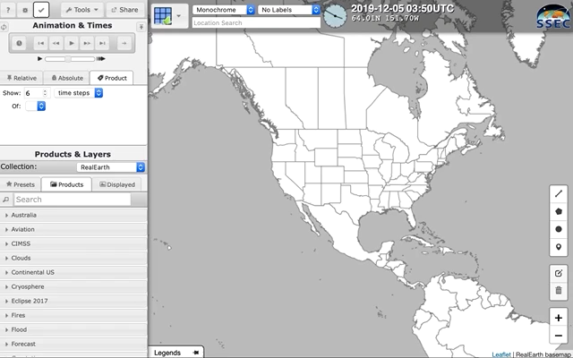
Jumping in… zooming to area of interest

Slide 11
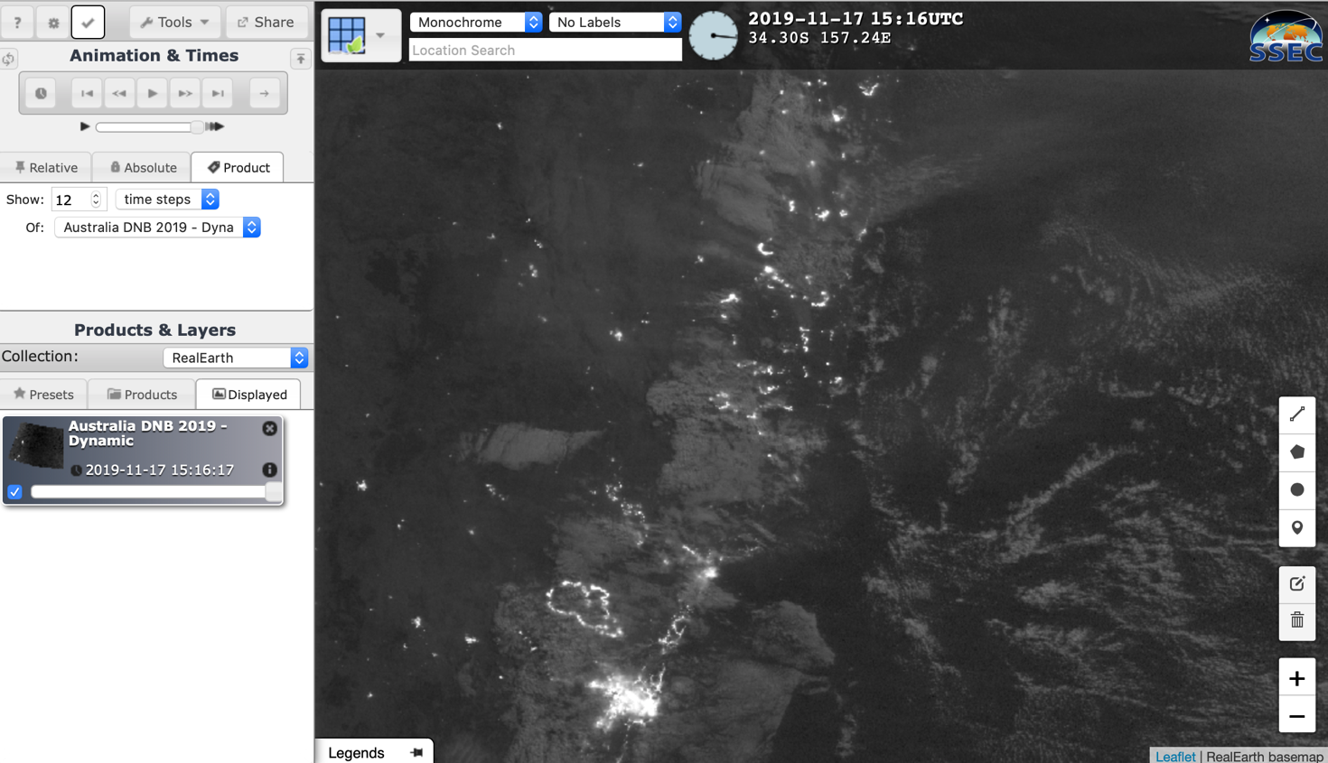
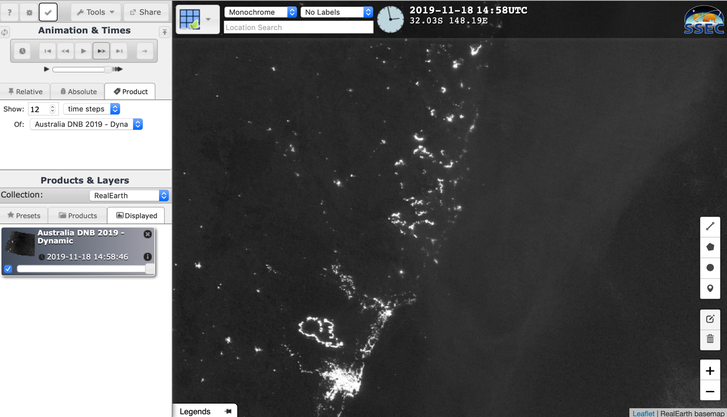
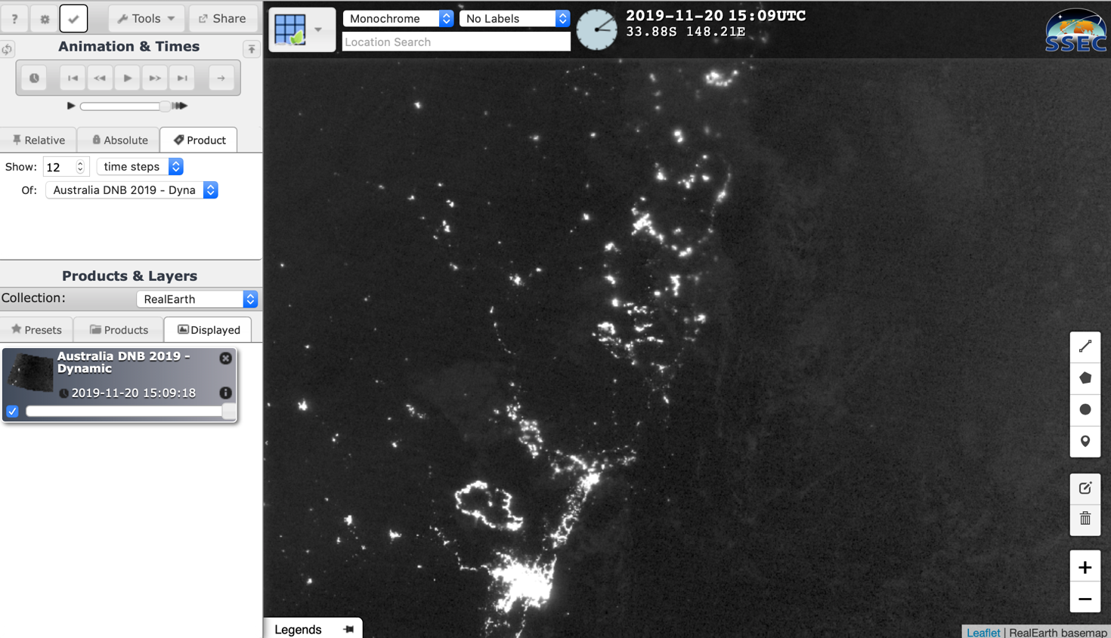
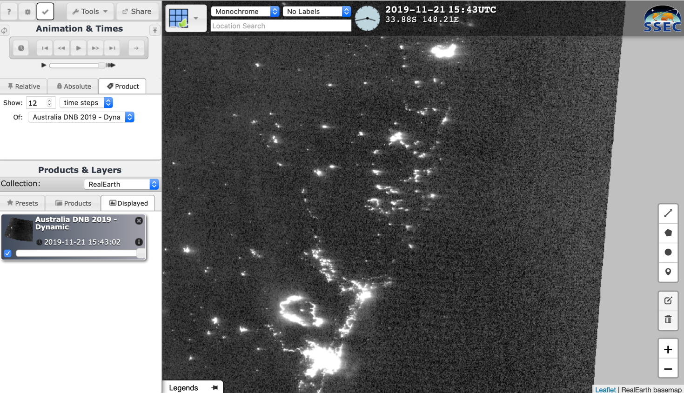
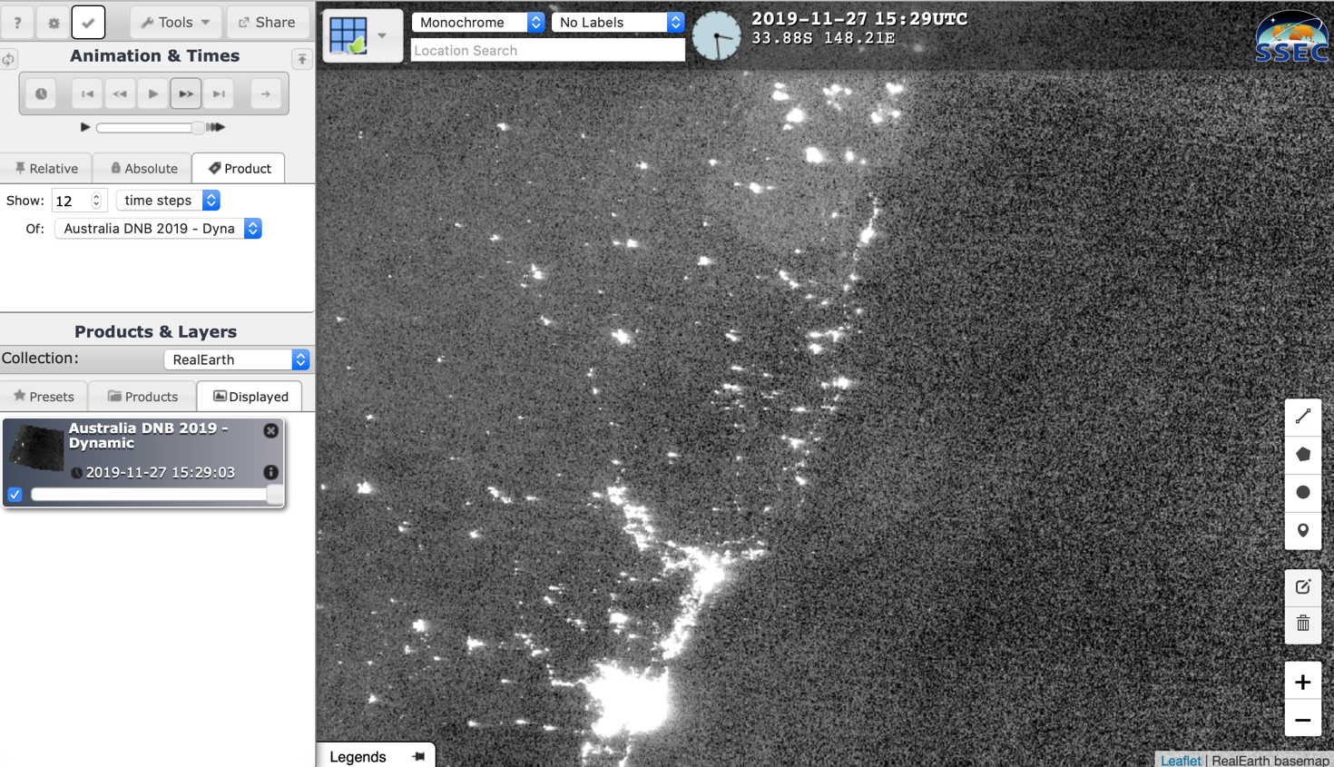
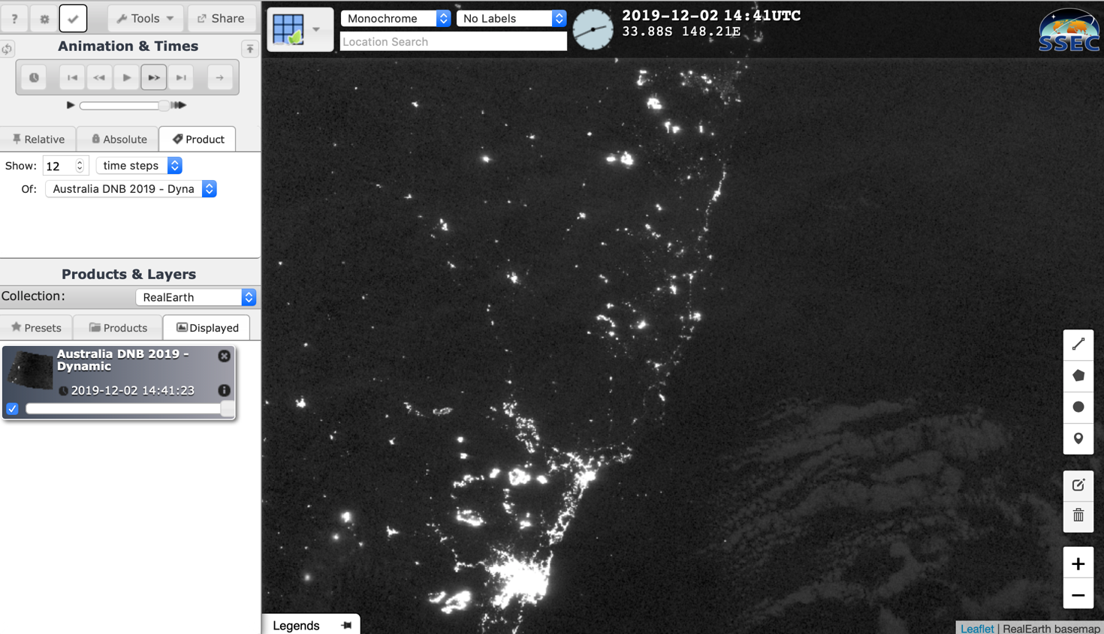
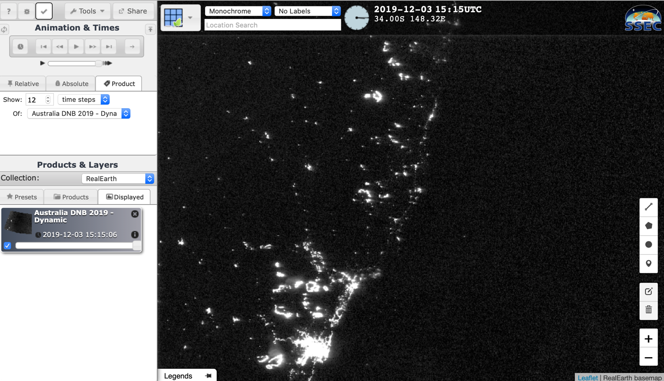

Animate and Share

Slide 12
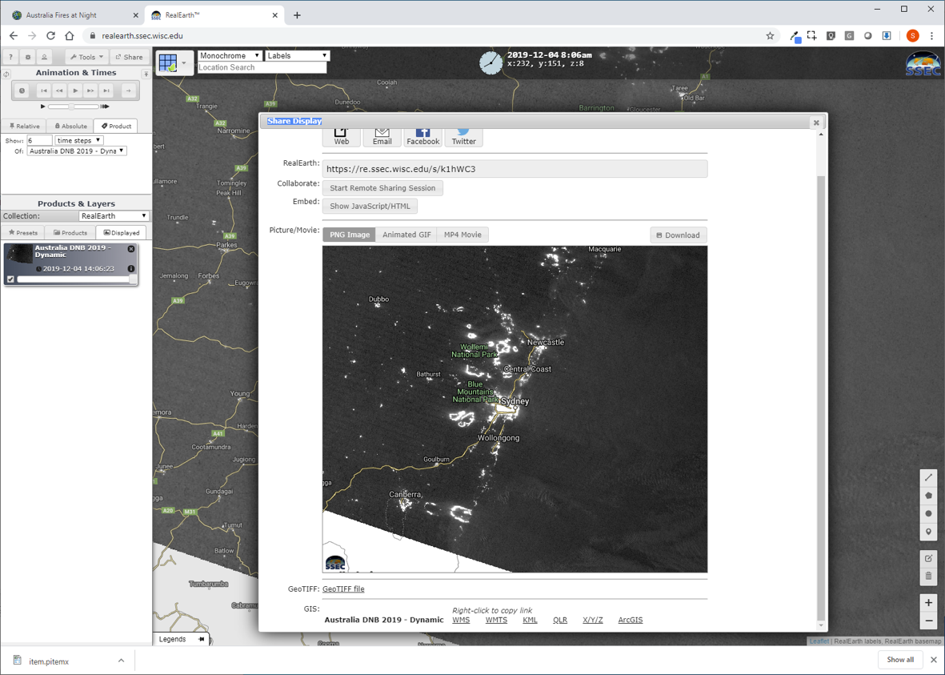

Slide 13
But what if we want to do more…
RealEarth is for discovery and visualization
It supports only simple analysis
It re-publishes data and imagery in GIS-friendly formats
It has useful API
You can add your own data
But what about more analysis?

Slide 14
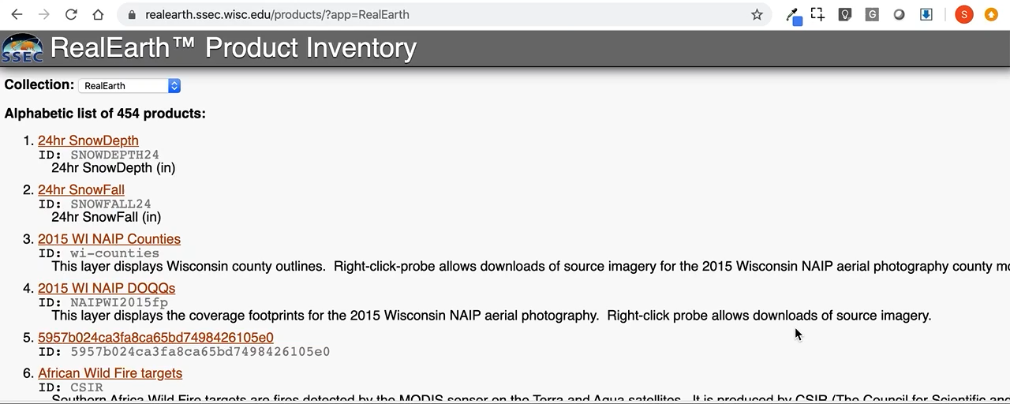
So many data layers, so little time…
“In an information-rich world, the wealth of information …creates a poverty of attention and a need to allocate that attention efficiently…”
-- Herbert Simon, 1971
https://realearth.ssec.wisc.edu/products/

Slide 15
So many data layers, so little time…
Let’s Supplement Existing Workflows – make it easy to integrate…
Rather than trying to re-train the workforce
Examples from the NOAA’s JPSS Thematic Initiatives. These initiatives seek to reduce the risk of hazards through collaboration among scientists, agency officials, and on-the-ground professionals.
  JPSS Thematic Initiative: Fire and Smoke
  JPSS Thematic Initiative: River Ice and Flooding
  Some of these agencies and on-the-ground professionals use GIS
Let’s use WMTS (OGC) -- Both ArcGIS and QGIS can Read WMTS

Slide 16
Fire

Slide 17
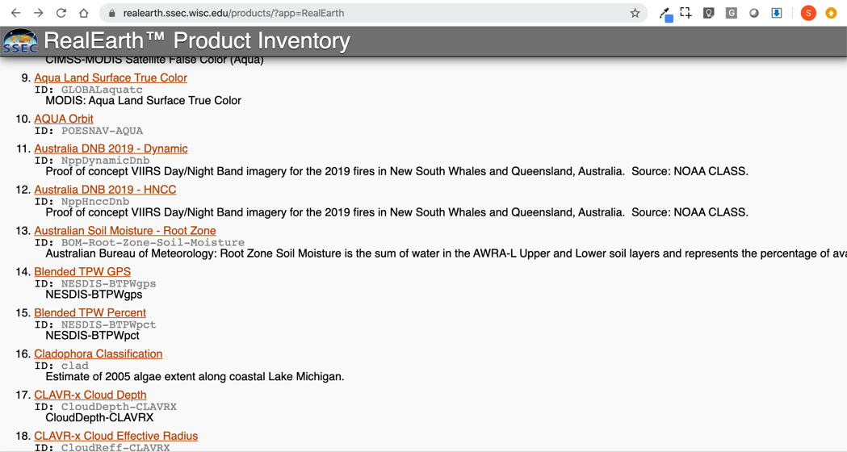
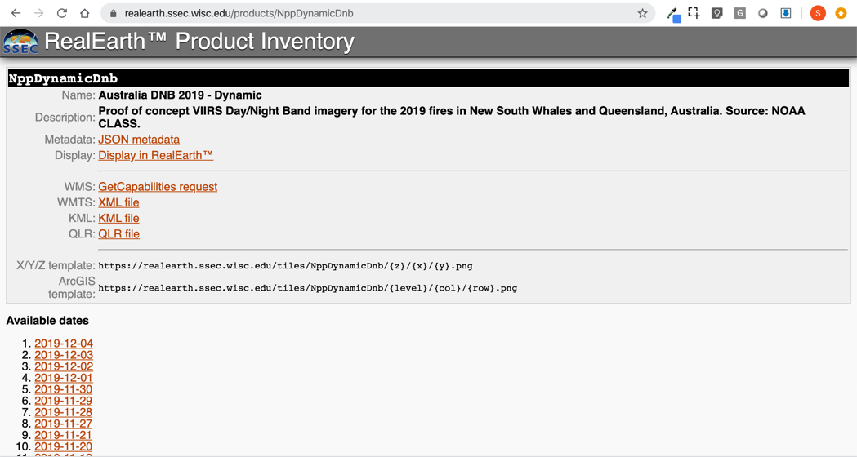
RealEarth WMTS
https://realearth.ssec.wisc.edu/products/

Slide 18
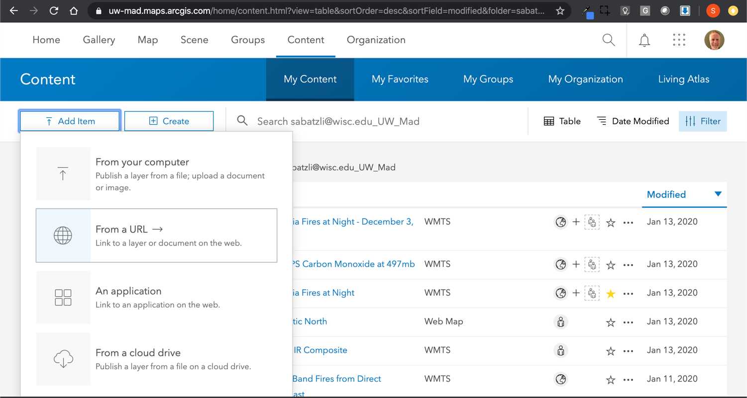

Slide 19
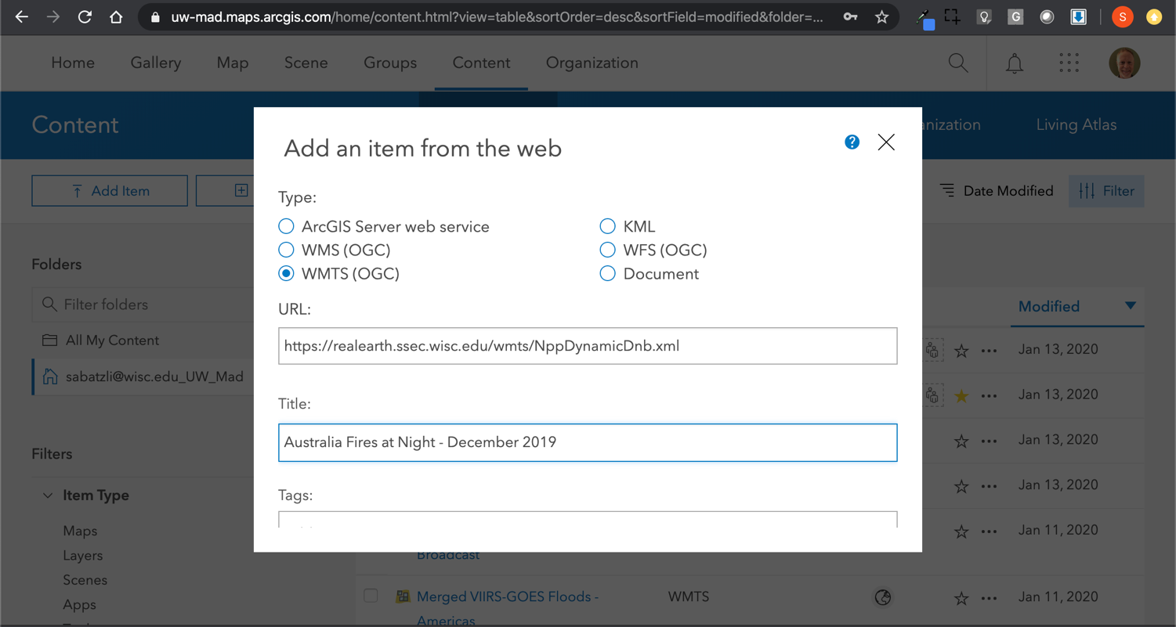

Slide 20
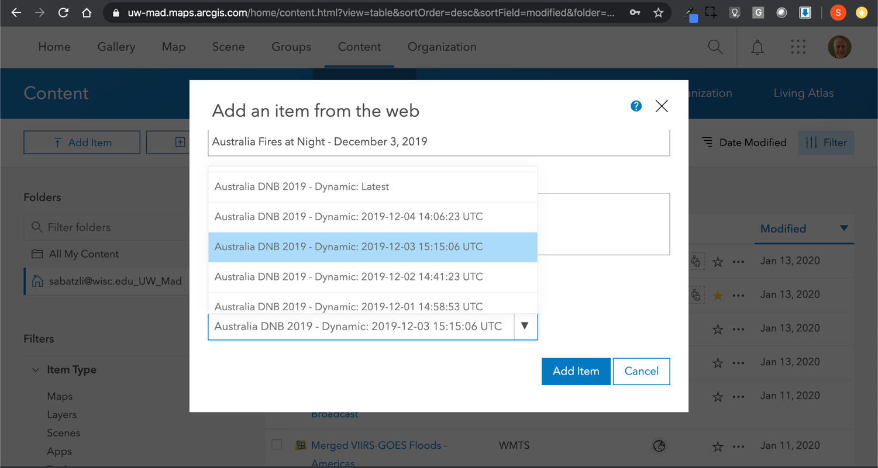

Slide 21
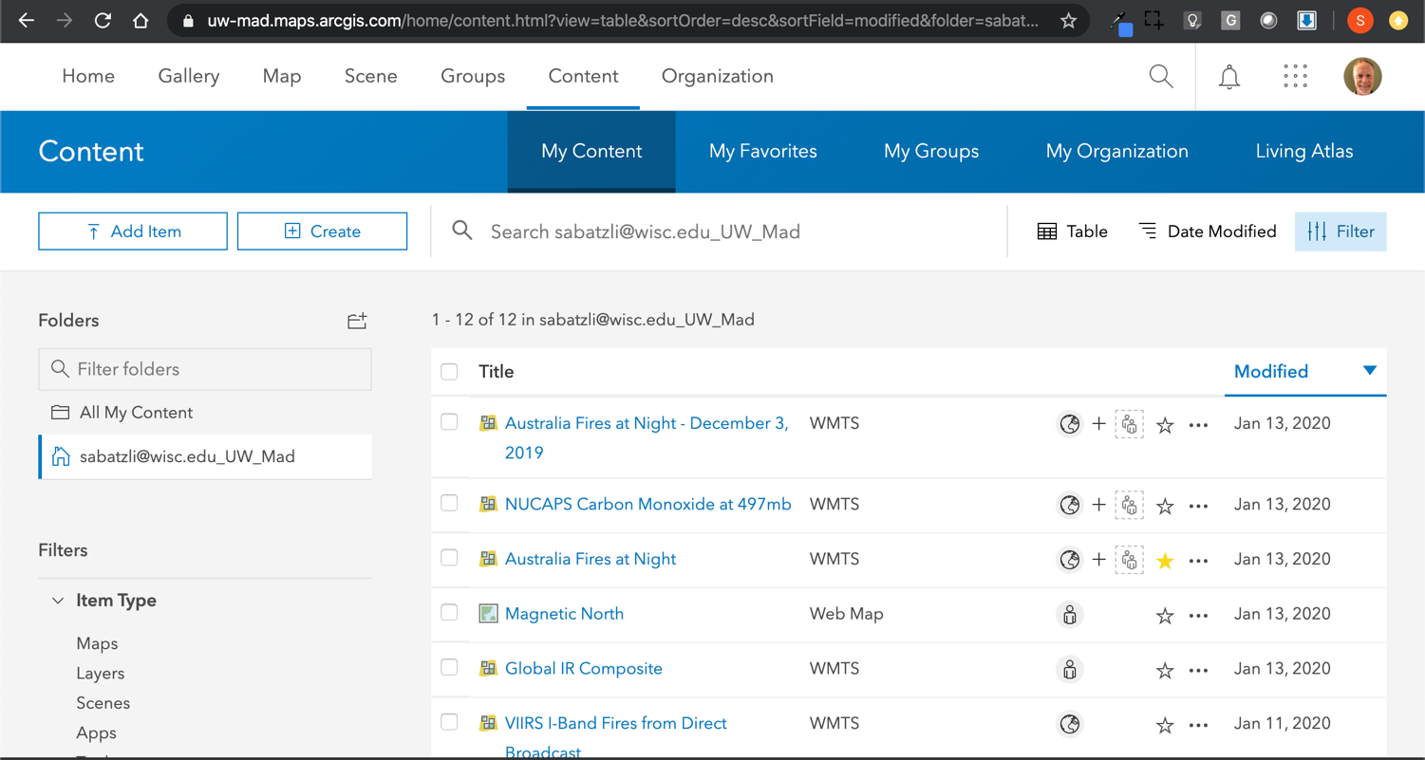

Slide 22
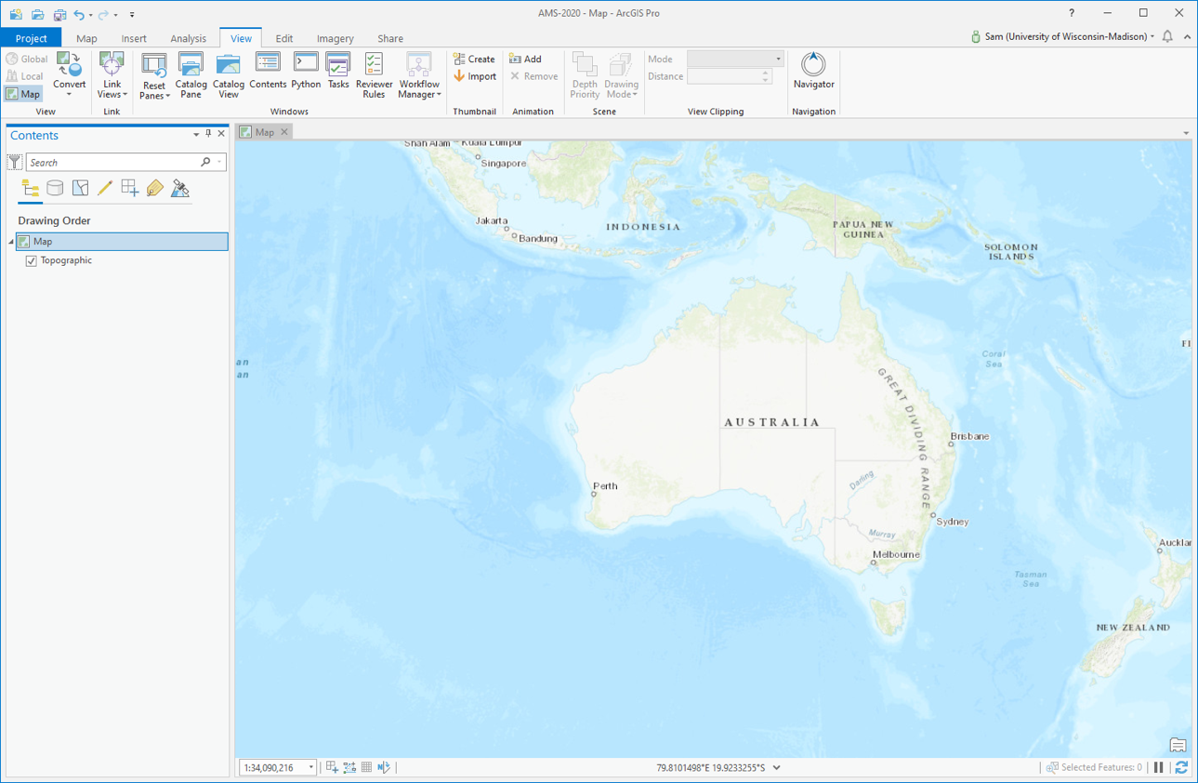

Slide 23
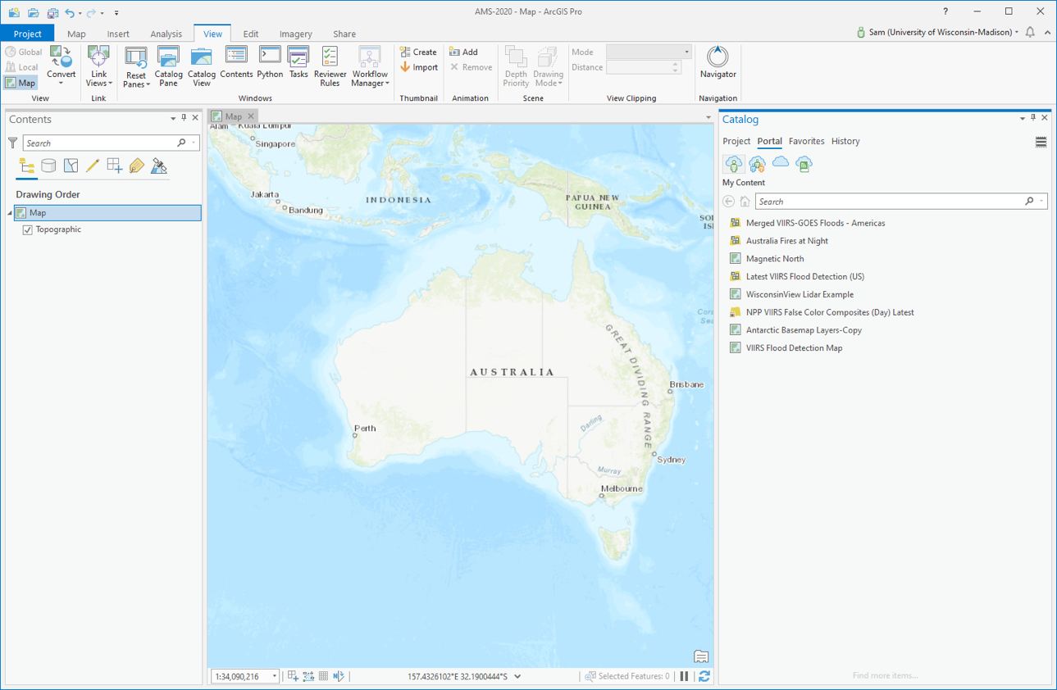

Slide 24
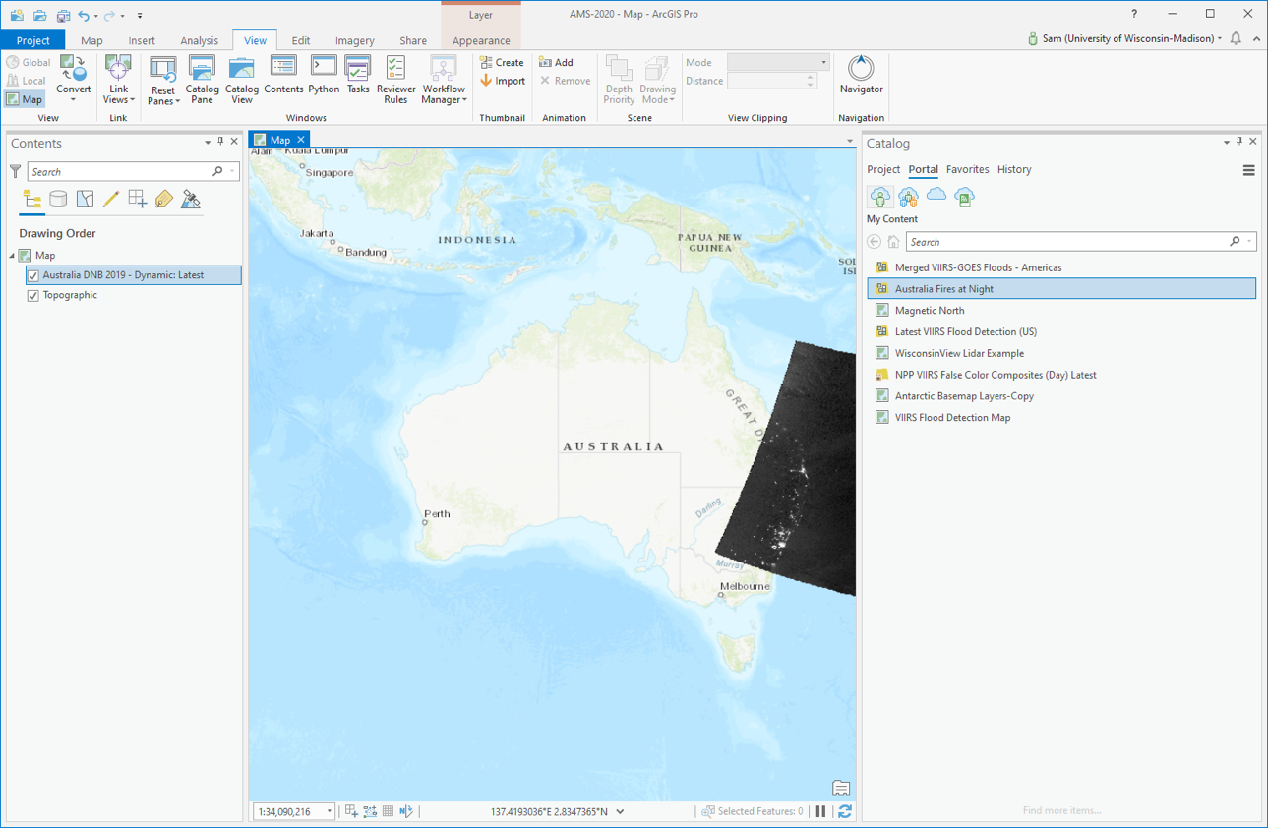

Slide 25
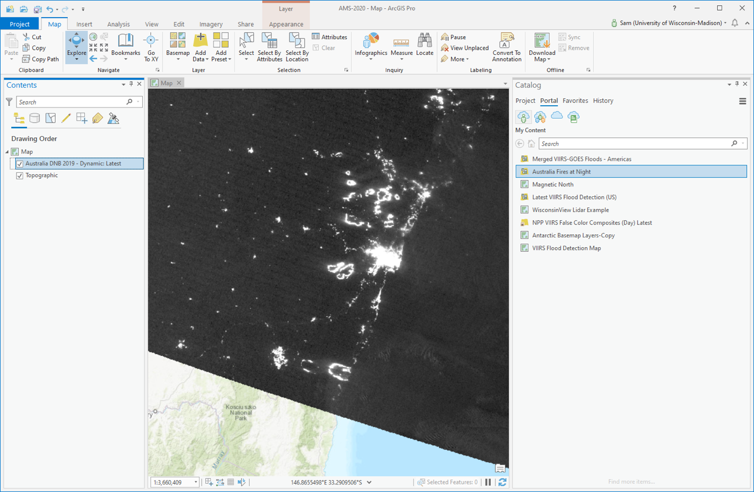

Slide 26
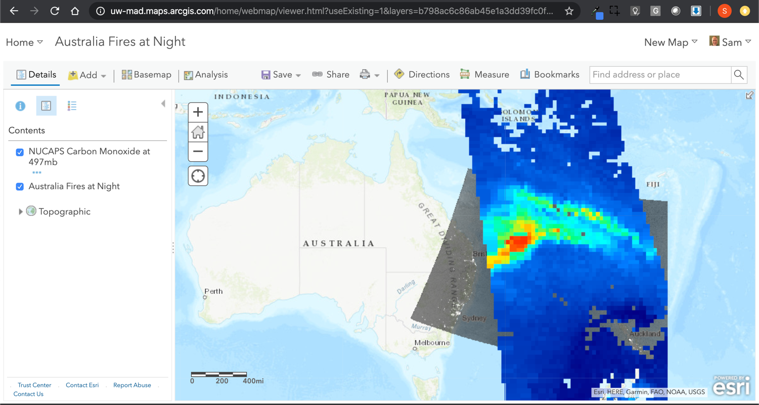

Slide 27
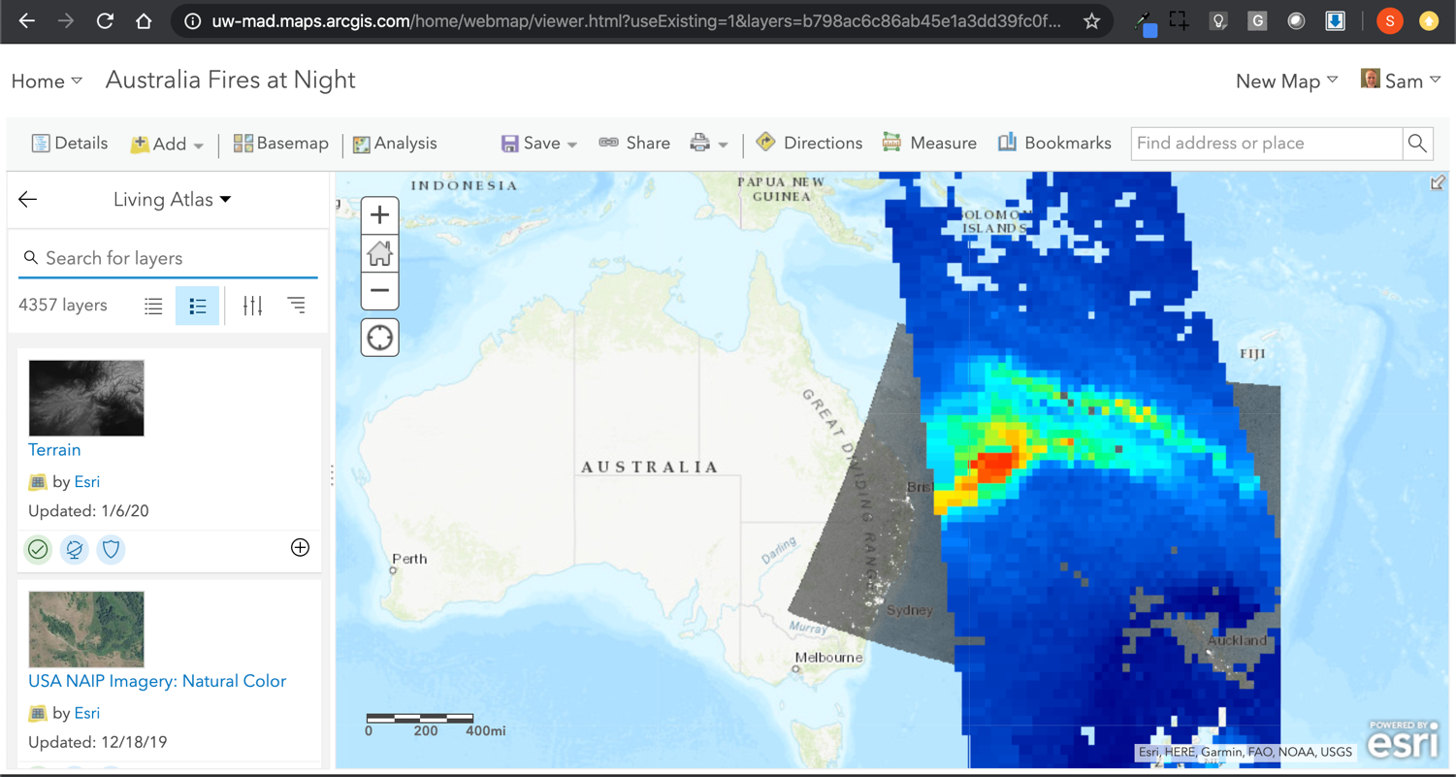
RealEarth and Related Apps

Slide 28
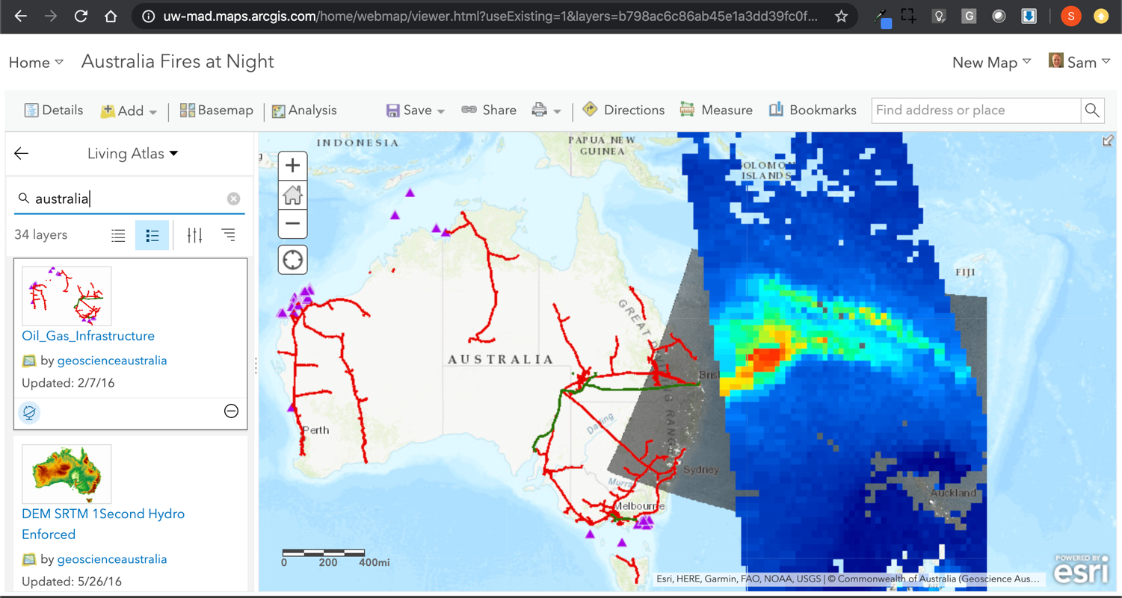

Slide 29
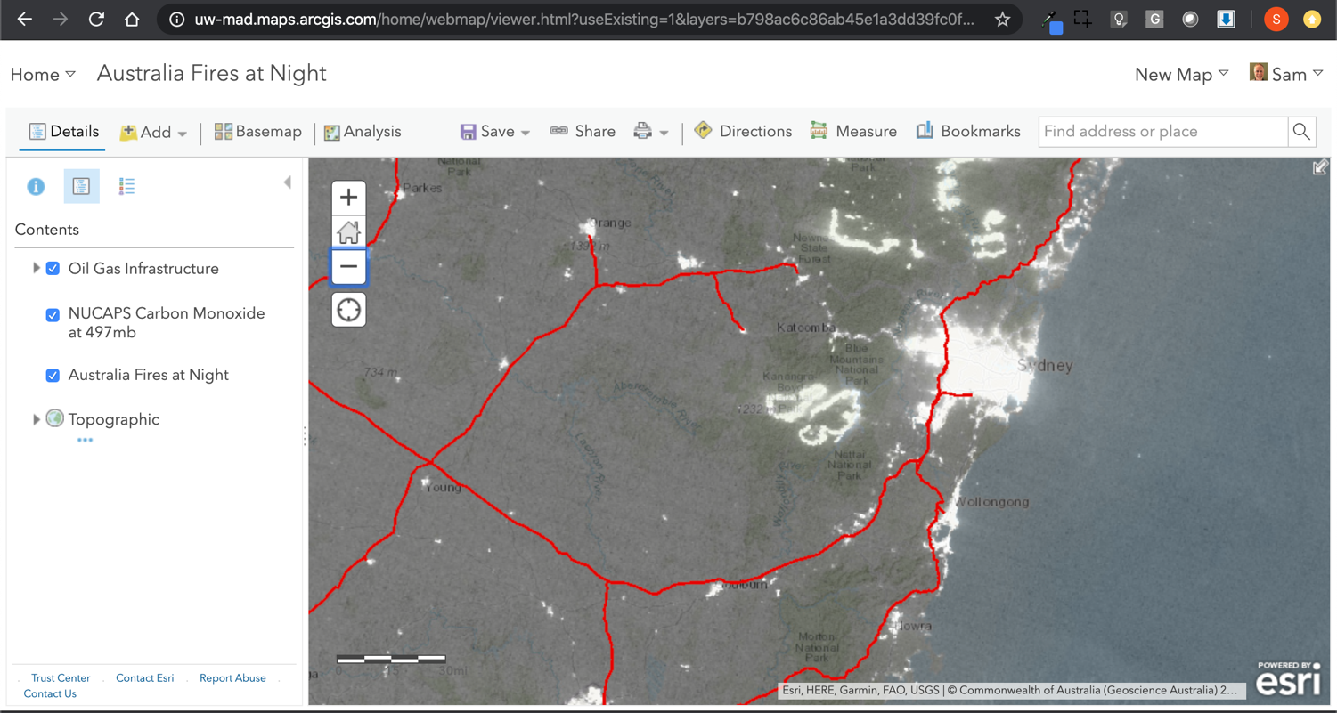

Slide 30
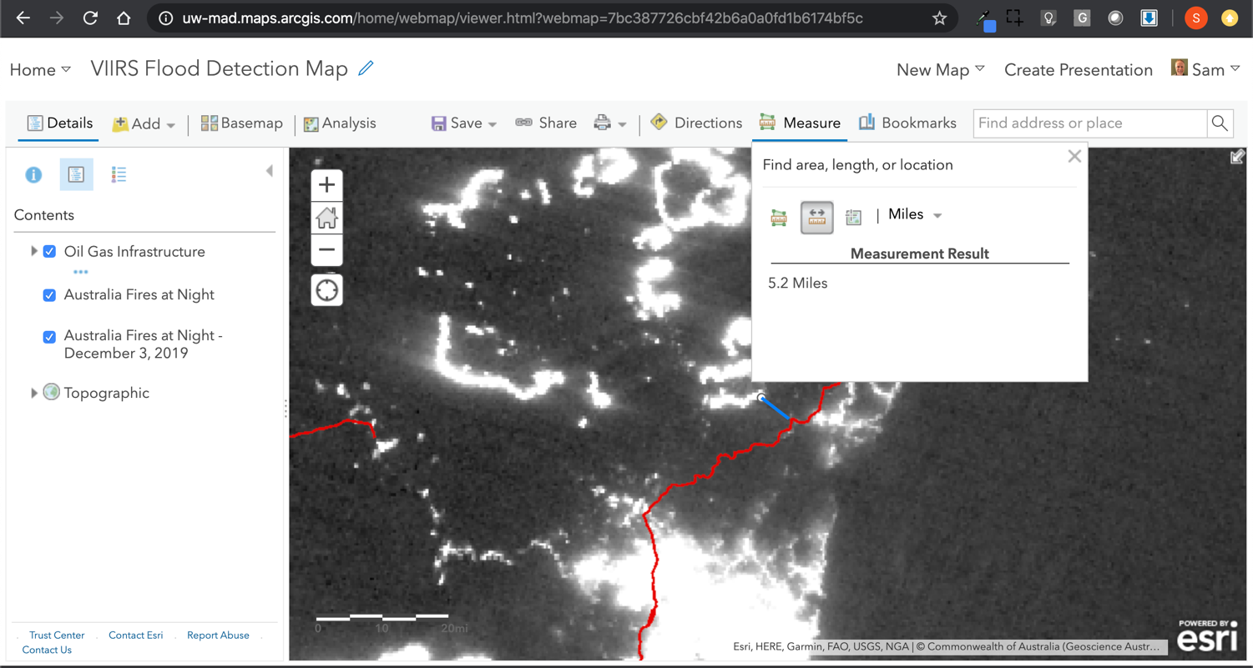

Slide 31
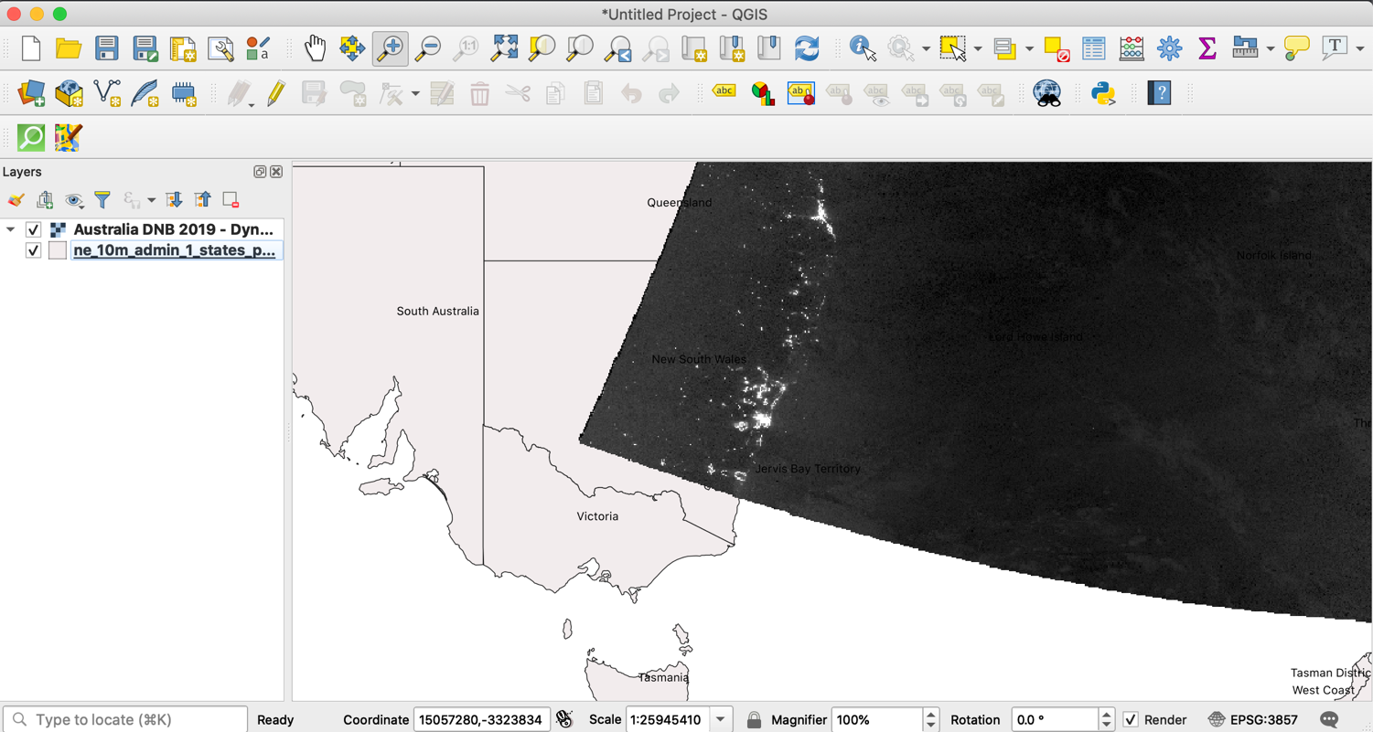

Slide 32
Floods

Slide 33
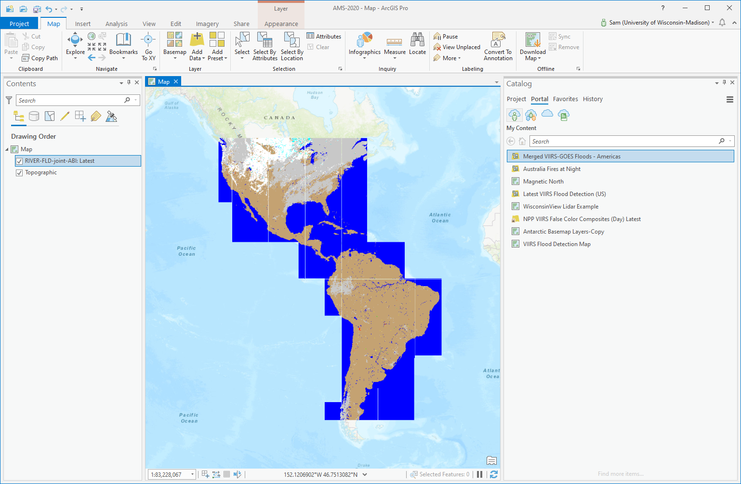

Slide 34
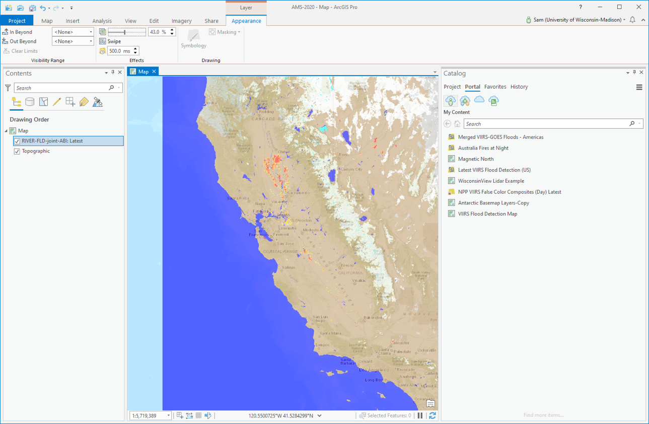

Slide 35
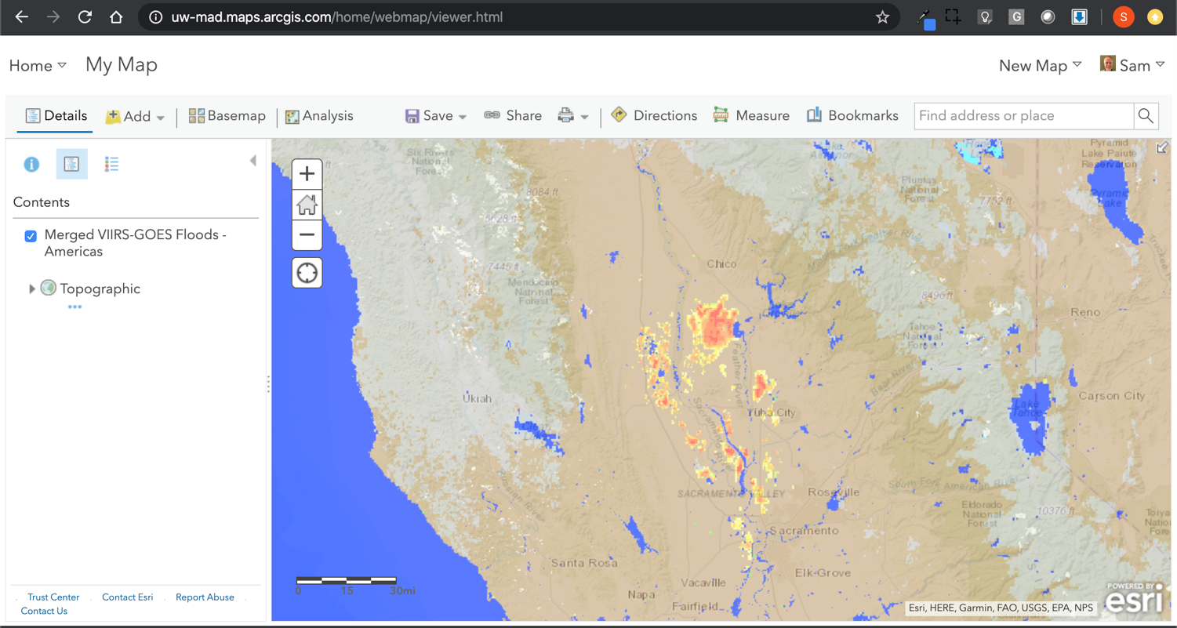

Slide 36
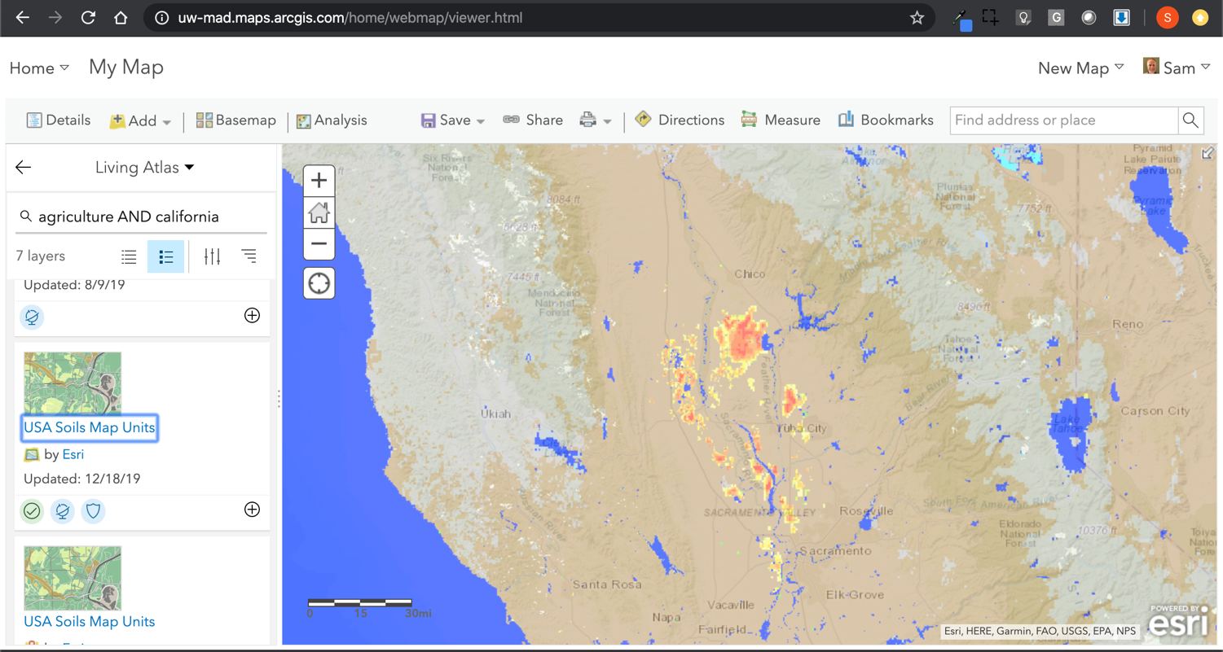

Slide 37
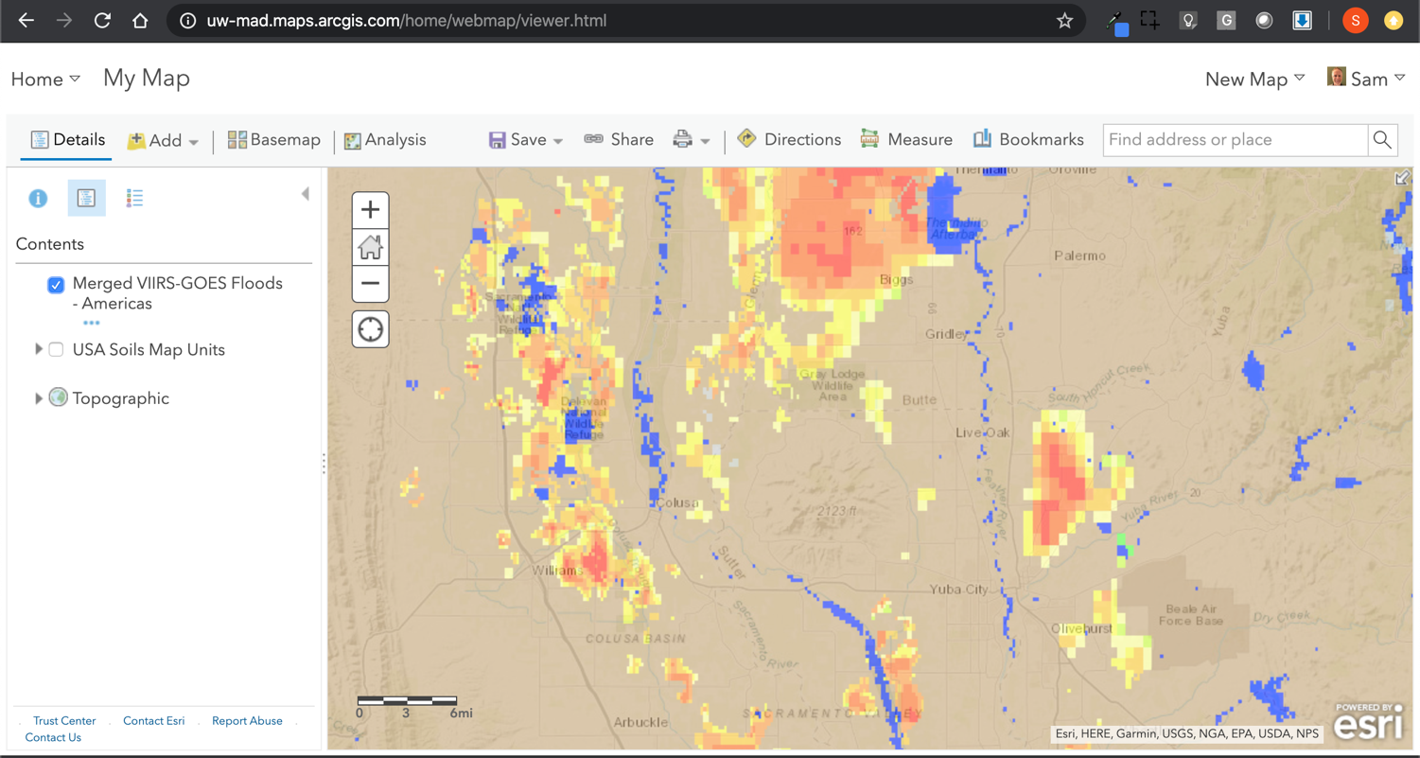

Slide 38
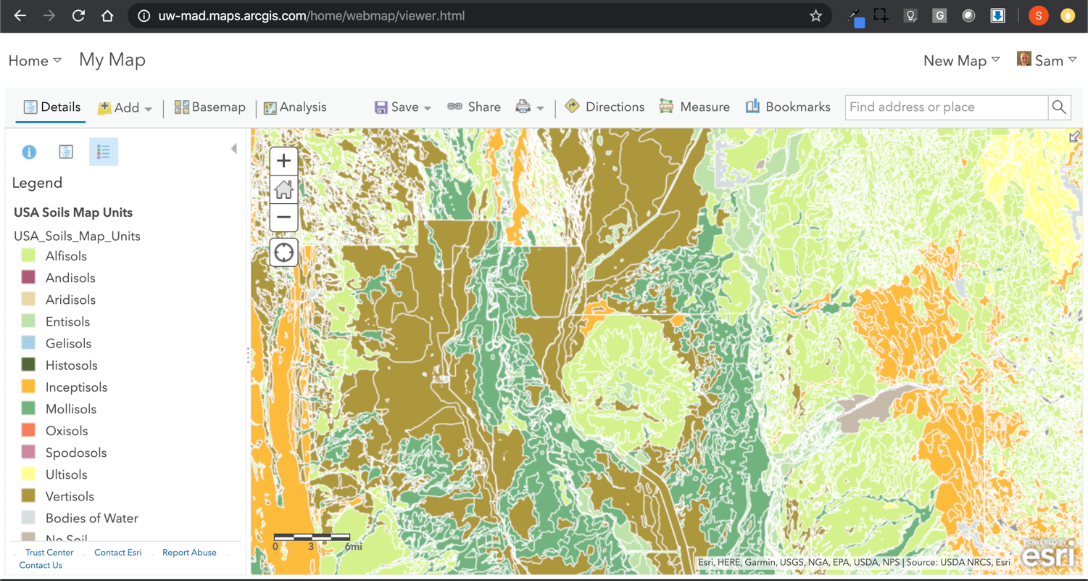

Slide 39
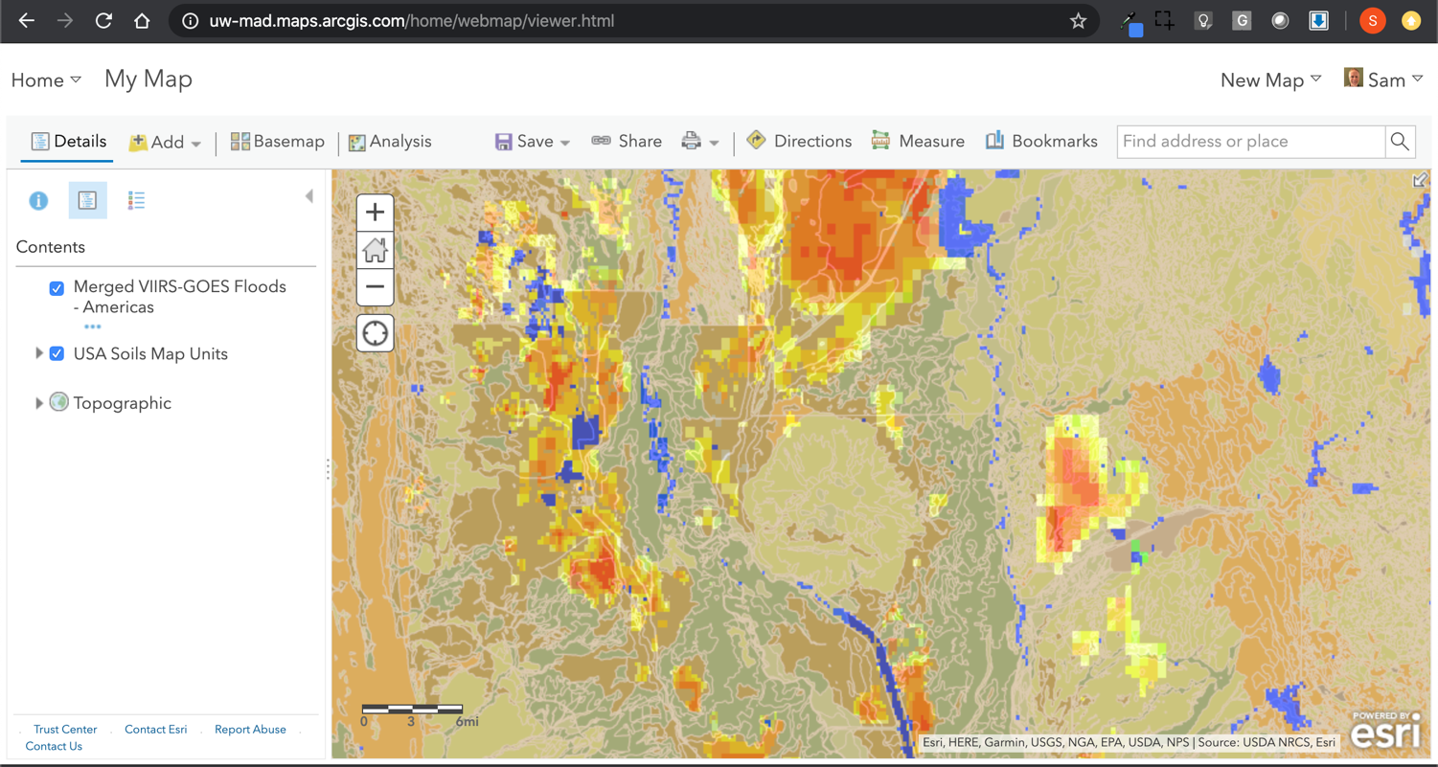

Slide 40
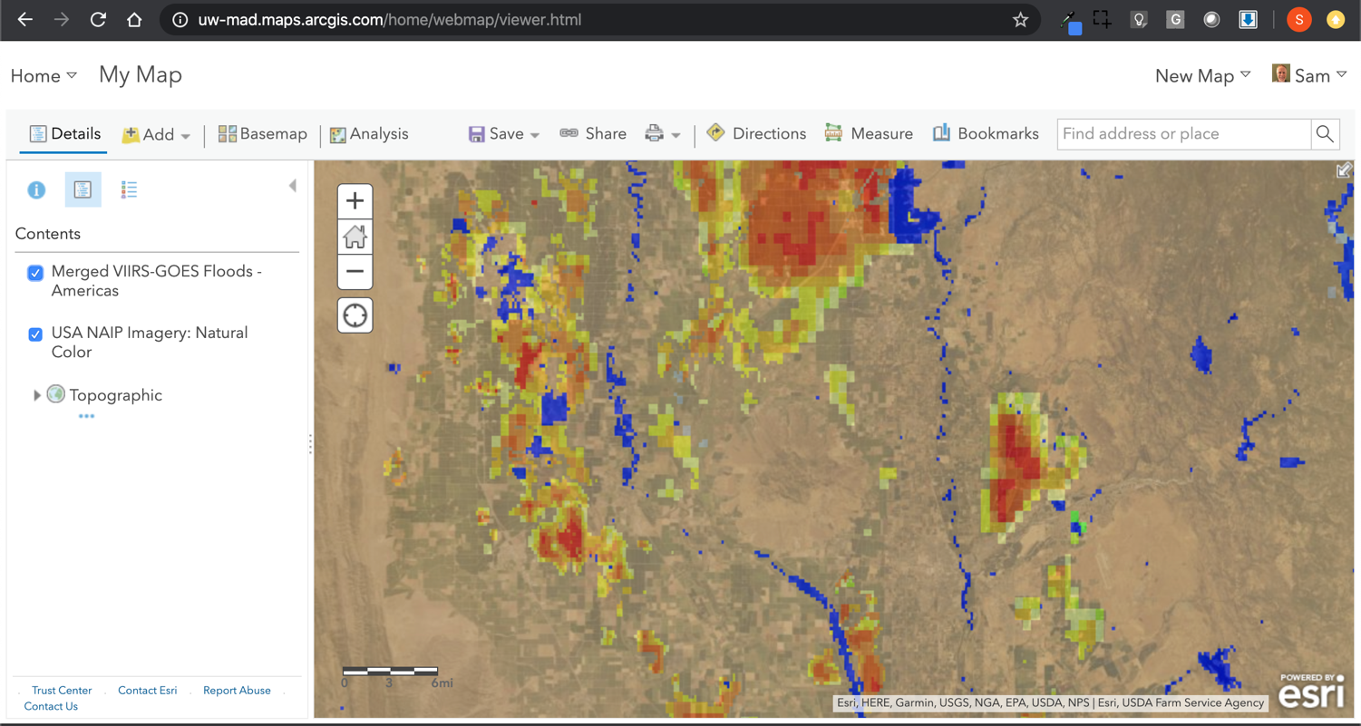

Slide 41
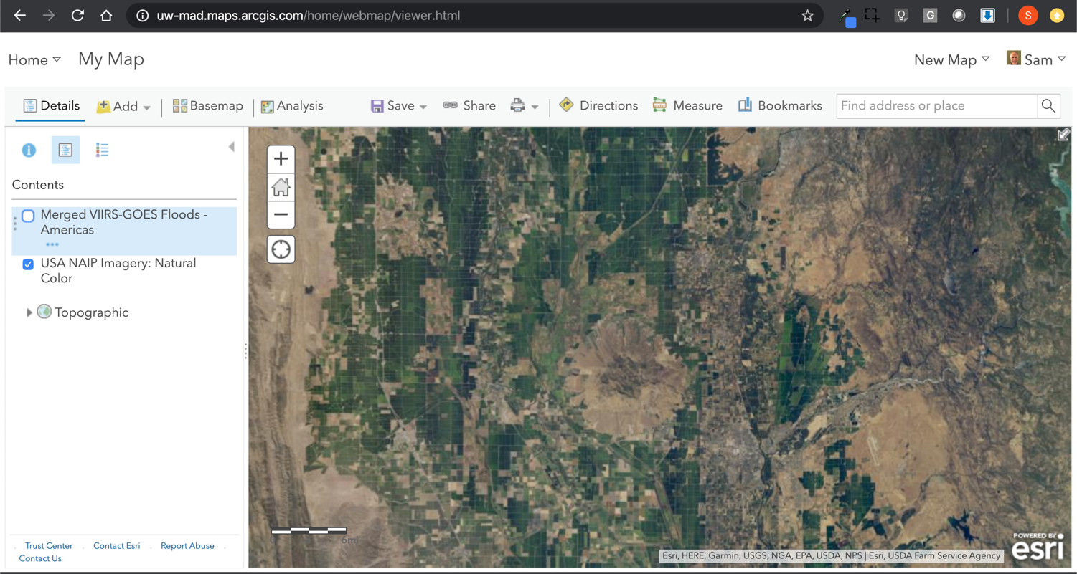

Slide 42
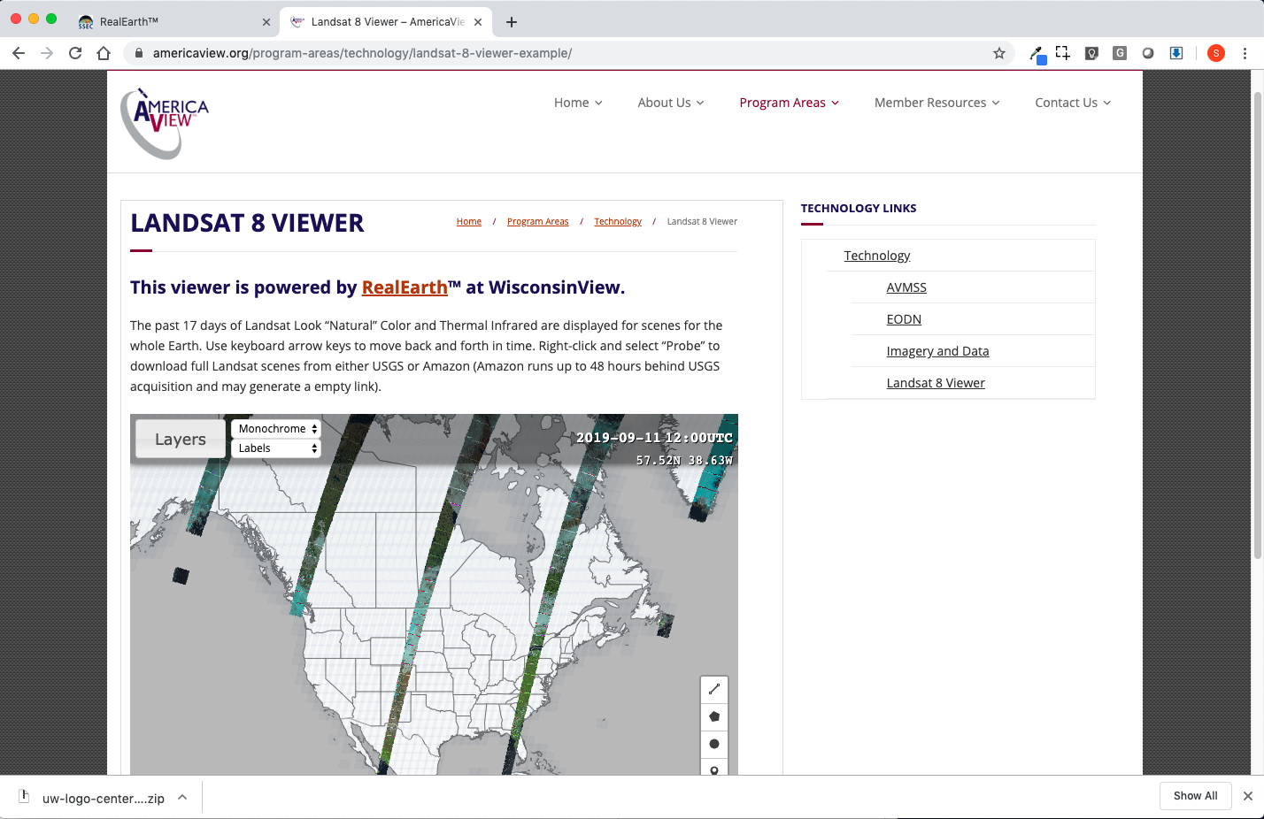
RealEarth website – Embedding with API

Slide 43
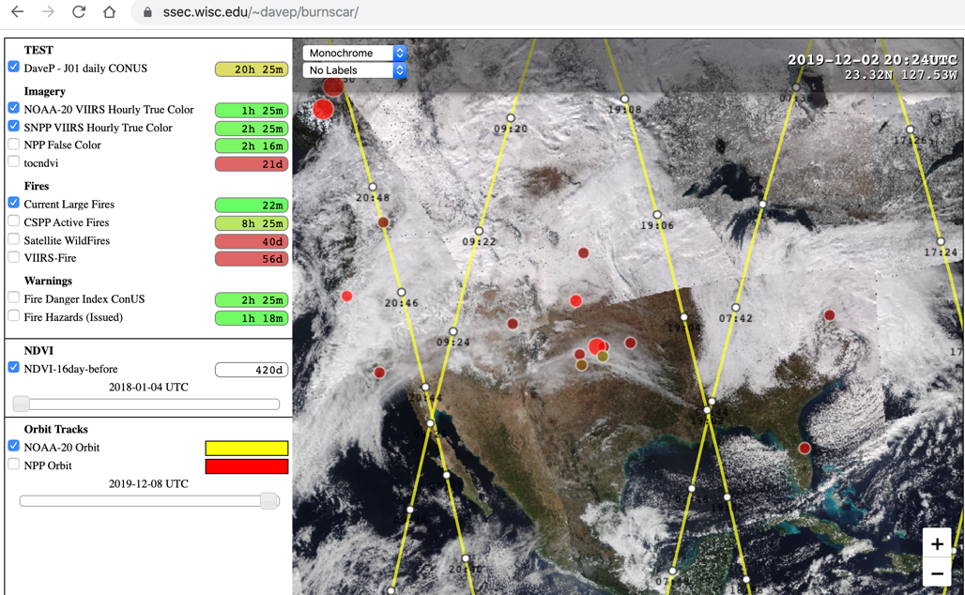
Burn Scar Mapping Tool:

Slide 44
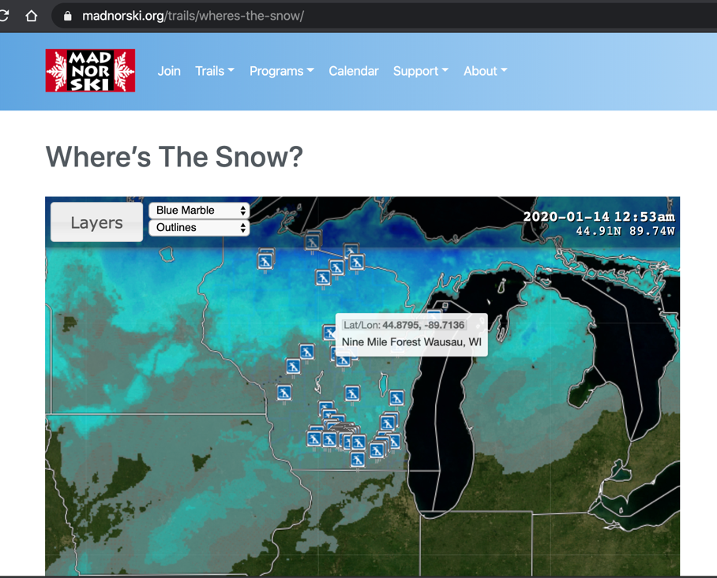
Public Usage

Slide 45

Uploading your own data to RealEarth:
re_upload sm_pct_actual_month_rootzoon_soil_moisture_lzw.tif Australian Soil Moisture - Root Zone 20191204 120000

Slide 46

Uploading your own data to RealEarth:

Slide 47

RealEarth Supported input files
RealEarth can ingest imagery and vector data.
  Image formats
    GeoTIFF
    McIDAS-X AREA
  Shape (point/line/polygon) formats:
    GeoJSON
    ESRI Shapefile
  Others requiring custom pre-processing to convert to the above
    GRIB/GRIB2
    Gridded NetCDF/HDF
    csv, text, ascii
Files for registered products can be uploaded via users through scripts or via a browser form
Color enhancements and custom legends can be created for any product.

Slide 48
Takeaways
It is useful to bring land and weather info together…
If it is the Right Information at the Right Time in the Right Context
Such integration prompts multiple technical concerns at both ends (format, time, styling…)
There is room for improvement in both directions:
Weather Data / Interfaces ← → GIS / Land/Human Data (better data preparation, managing near real-time and caching, animation)
Opportunities Abound! Let’s Collaborate!

Slide 49
Many people to thank…
Allen Huang
Mitch Goldberg
Steve Goodman
Liam Gumley
Jerry Robaidek
Kathy Strabala
Developers: Dave Parker, Nick Bearson, Russ Dengel, Tommy Jasmin
Researchers: who furnish data (Ivan Csiszar, Bob Carp, Jay Hoffman, Andy Heidinger, Jeff Key, William Straka, Tony Wimmers, and dozens more…
https://re.ssec.wisc.edu (interface)
realearth@ssec.wisc.edu (support)
https://ssec.wisc.edu/realearth (project website)

