Slide 1
NOAA/CIMSS ProbSevere Model
– National Weather Center –
Norman, OK
February 2018
John Cintineo (UW-CIMSS)
Michael Pavolonis (NOAA/NESDIS)
Justin Sieglaff (UW-CIMSS)
Dan Lindsey (NOAA/NESDIS)
Jason Brunner (UW-CIMSS)
Notes:
This training module describes the NOAA/CIMSS Prob Severe statistical model, provides examples of the model output in AWIPS-II, and briefly discusses model validation and model limitations. Why do we need a statistical model to nowcast severe weather?
The uses of statistical models are becoming more and more important and common place as data volumes explode in all aspects of our lives. Statistical models are used with great success to predict things like presidential elections and outcomes of the NCAA basketball tournament. Meteorology is no different; as bigger and more frequent data becomes available to forecasters it becomes more important to distill gigabytes of data into kilobytes of useful information. And that is what the NOAA/CIMSS Prob Severe model does.

Slide 2
Outline
What is ProbSevere?
What data does ProbSevere use?
Automated integration of information
Examples
ProbSevere – “all hazards”
Bulk verification
ProbSevere in HWT; media
Caveats
Next steps
Summary
Notes:
This training module describes the NOAA/CIMSS Prob Severe statistical model, provides examples of the model output in AWIPS-II, and briefly discusses model validation and model limitations. Why do we need a statistical model to nowcast severe weather?
The uses of statistical models are becoming more and more important and common place as data volumes explode in all aspects of our lives. Statistical models are used with great success to predict things like presidential elections and outcomes of the NCAA basketball tournament. Meteorology is no different; as bigger and more frequent data becomes available to forecasters it becomes more important to distill gigabytes of data into kilobytes of useful information. And that is what the NOAA/CIMSS Prob Severe model does.

Slide 3
Outline
What is ProbSevere?
What data does ProbSevere use?
Automated integration of information
Examples
ProbSevere – “all hazards”
Bulk verification
ProbSevere in HWT; media
Caveats
Next steps
Summary
Notes:
This training module describes the NOAA/CIMSS Prob Severe statistical model, provides examples of the model output in AWIPS-II, and briefly discusses model validation and model limitations. Why do we need a statistical model to nowcast severe weather?
The uses of statistical models are becoming more and more important and common place as data volumes explode in all aspects of our lives. Statistical models are used with great success to predict things like presidential elections and outcomes of the NCAA basketball tournament. Meteorology is no different; as bigger and more frequent data becomes available to forecasters it becomes more important to distill gigabytes of data into kilobytes of useful information. And that is what the NOAA/CIMSS Prob Severe model does.

Slide 4
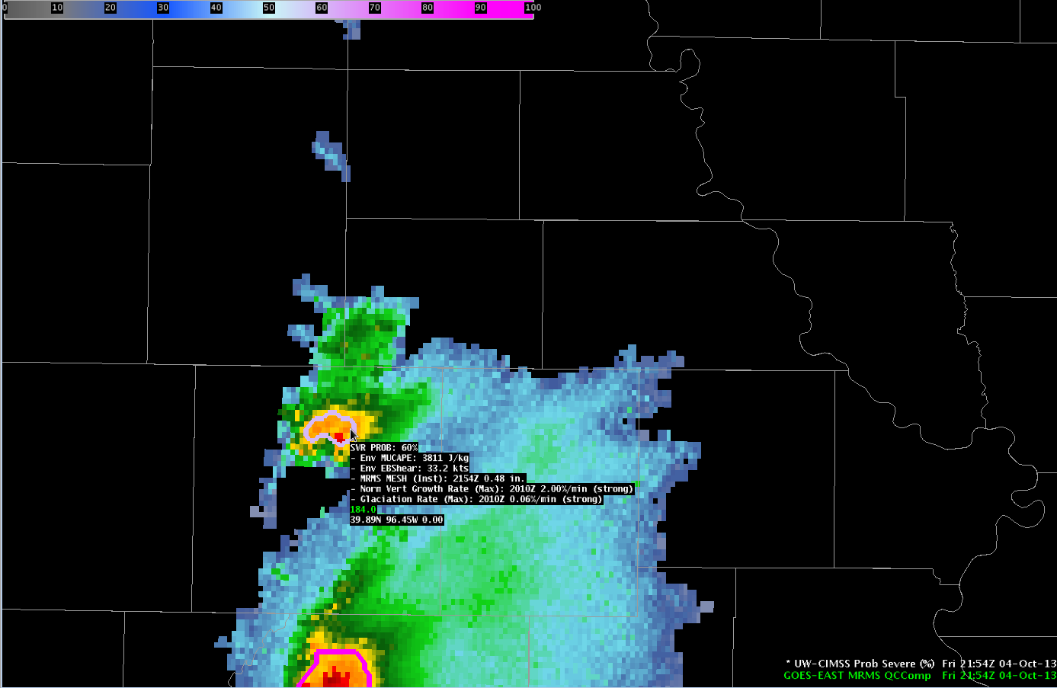
NOAA/CIMSS ProbSevere Model Goals
Notes:
The Prob Severe model is a statistical model that employs NWP environmental information, satellite observations, radar, and total lightning observations. Before a brief discussion of the statistical model and data used, it is critical to define the objectives of the model.
In this image you can see a developing strong thunderstorm. The statistical model is designed to predict (in a probabilistic manner) that a given developing storm will produce severe weather in the next 60 minutes.
In the example shown, the developing storm has a 60% probability of producing severe weather in the next 60 minutes.
It is important to use the model output in two manners. One, as a “pre-polygon” product, helping a forecaster make the decision to first warn or not warn a storm. Two, using the model probabilities past issuance of the first severe warning—for example if warning re-issuance is needed or not. In all cases, ProbSevere should be used as an additional guidance, combined with forecaster experience and traditional analysis techniques when determining if one should issue a warning or not.

Slide 5
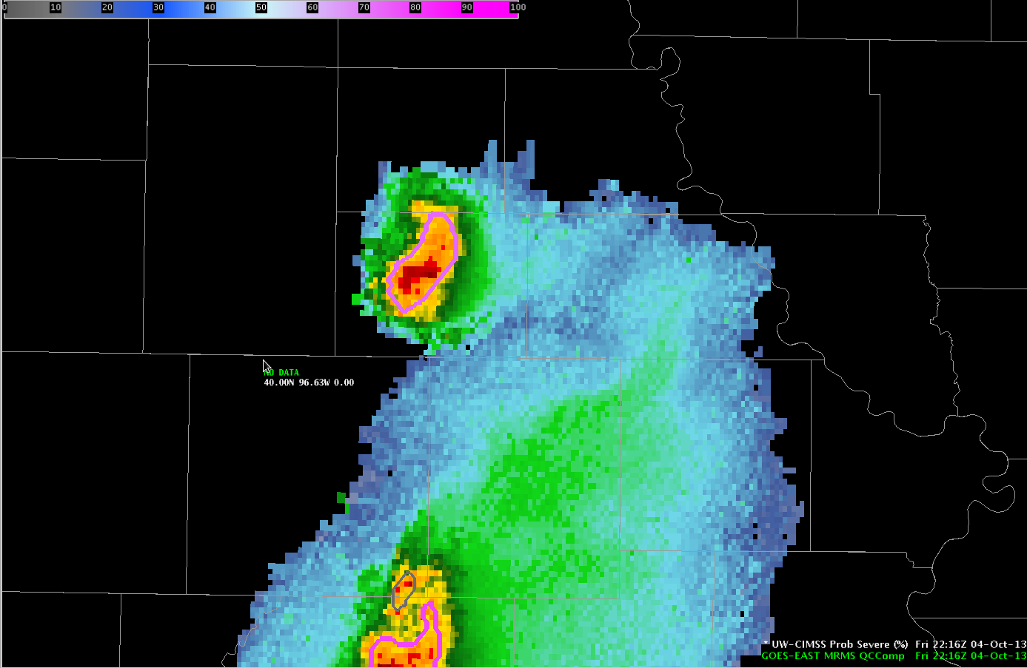
NOAA/CIMSS ProbSevere Model Goals
This statistical model predicts the probability that a storm will produce severe weather in the near-term (in the next 60 min).
Notes:
The Prob Severe model is a statistical model that employs NWP environmental information, satellite observations, radar, and total lightning observations. Before a brief discussion of the statistical model and data used, it is critical to define the objectives of the model.
In this image you can see a developing strong thunderstorm. The statistical model is designed to predict (in a probabilistic manner) that a given developing storm will produce severe weather in the next 60 minutes.
In the example shown, the developing storm has a 60% probability of producing severe weather in the next 60 minutes.
It is important to use the model output in two manners. One, as a “pre-polygon” product, helping a forecaster make the decision to first warn or not warn a storm. Two, using the model probabilities past issuance of the first severe warning—for example if warning re-issuance is needed or not. In all cases, ProbSevere should be used as an additional guidance, combined with forecaster experience and traditional analysis techniques when determining if one should issue a warning or not.

Slide 6
NOAA/CIMSS ProbSevere Model Goals
This statistical model predicts the probability that a storm will produce severe weather in the near-term (in the next 60 min).
ProbSevere can be used as a ‘pre-polygon’ product as well as an aid for warning reissuance.
Notes:
The Prob Severe model is a statistical model that employs NWP environmental information, satellite observations, radar, and total lightning observations. Before a brief discussion of the statistical model and data used, it is critical to define the objectives of the model.
In this image you can see a developing strong thunderstorm. The statistical model is designed to predict (in a probabilistic manner) that a given developing storm will produce severe weather in the next 60 minutes.
In the example shown, the developing storm has a 60% probability of producing severe weather in the next 60 minutes.
It is important to use the model output in two manners. One, as a “pre-polygon” product, helping a forecaster make the decision to first warn or not warn a storm. Two, using the model probabilities past issuance of the first severe warning—for example if warning re-issuance is needed or not. In all cases, ProbSevere should be used as an additional guidance, combined with forecaster experience and traditional analysis techniques when determining if one should issue a warning or not.

Slide 7
NOAA/CIMSS ProbSevere Model
Probability derived from: environment observations
Notes:
Every detail of the statistical model is not important for understanding the model on a high-level. The following equation describes the model on a high level. Simply, the model probability for a given storm is a function of storm environment, specifically instability and shear, and four observational predictors.
In the model, the storm environment is characterized, to a first order, as a combination of instability and shear computed from the Rapid Refresh model.
The observational predictors are comprised of two satellite growth rates, one instantaneous radar field, and one instantaneous total lightning field.
Because observational predictors drive the model—model output does not exist until clouds begin to develop. The model does not predict cloud growth nor predict where a storm will move—but gives a probability a given storm will first produce severe weather in the next 60 minutes, wherever it may move.
On the bottom right corner of certain slides you will see a “Supplemental Training Link”. This link opens a web page with a bit more detail about the slide topic.

Slide 8
NOAA/CIMSS ProbSevere Model
Probability derived from: environment observations
RAP NWP: MUCAPE and Effective Bulk Shear
Notes:
Every detail of the statistical model is not important for understanding the model on a high-level. The following equation describes the model on a high level. Simply, the model probability for a given storm is a function of storm environment, specifically instability and shear, and four observational predictors.
In the model, the storm environment is characterized, to a first order, as a combination of instability and shear computed from the Rapid Refresh model.
The observational predictors are comprised of two satellite growth rates, one instantaneous radar field, and one instantaneous total lightning field.
Because observational predictors drive the model—model output does not exist until clouds begin to develop. The model does not predict cloud growth nor predict where a storm will move—but gives a probability a given storm will first produce severe weather in the next 60 minutes, wherever it may move.
On the bottom right corner of certain slides you will see a “Supplemental Training Link”. This link opens a web page with a bit more detail about the slide topic.

Slide 9
NOAA/CIMSS ProbSevere Model
Probability derived from: environment observations
RAP NWP: MUCAPE and Effective Bulk Shear
OBSERVATIONAL PREDICTORS:
2 satellite growth rates
1 instantaneous radar field
1 instantaneous total lightning/effective bulk shear field
Notes:
Every detail of the statistical model is not important for understanding the model on a high-level. The following equation describes the model on a high level. Simply, the model probability for a given storm is a function of storm environment, specifically instability and shear, and four observational predictors.
In the model, the storm environment is characterized, to a first order, as a combination of instability and shear computed from the Rapid Refresh model.
The observational predictors are comprised of two satellite growth rates, one instantaneous radar field, and one instantaneous total lightning field.
Because observational predictors drive the model—model output does not exist until clouds begin to develop. The model does not predict cloud growth nor predict where a storm will move—but gives a probability a given storm will first produce severe weather in the next 60 minutes, wherever it may move.
On the bottom right corner of certain slides you will see a “Supplemental Training Link”. This link opens a web page with a bit more detail about the slide topic.

Slide 10
Naïve Bayesian classifier
Naïve assumption
C_{severe}: Belonging to the “severe class”
F: set of predictor values
i: index for an individual predictor
N: number of total predictors
Notes:
Naïve Bayes is simple to understand (i.e., not “block box”), easy to train with a small amount of training data, surprisingly effective.

Slide 11
Outline
What is ProbSevere?
What data does ProbSevere use?
Automated integration of information
Examples
ProbSevere – “all hazards”
Bulk verification
ProbSevere in HWT; media
Caveats
Next steps
Summary
Notes:
This training module describes the NOAA/CIMSS Prob Severe statistical model, provides examples of the model output in AWIPS-II, and briefly discusses model validation and model limitations. Why do we need a statistical model to nowcast severe weather?
The uses of statistical models are becoming more and more important and common place as data volumes explode in all aspects of our lives. Statistical models are used with great success to predict things like presidential elections and outcomes of the NCAA basketball tournament. Meteorology is no different; as bigger and more frequent data becomes available to forecasters it becomes more important to distill gigabytes of data into kilobytes of useful information. And that is what the NOAA/CIMSS Prob Severe model does.

Slide 12
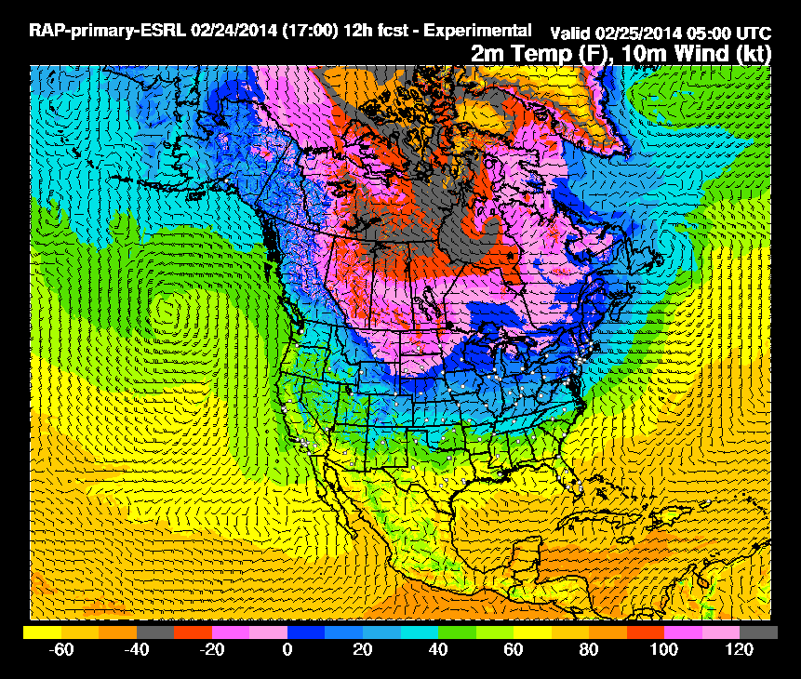
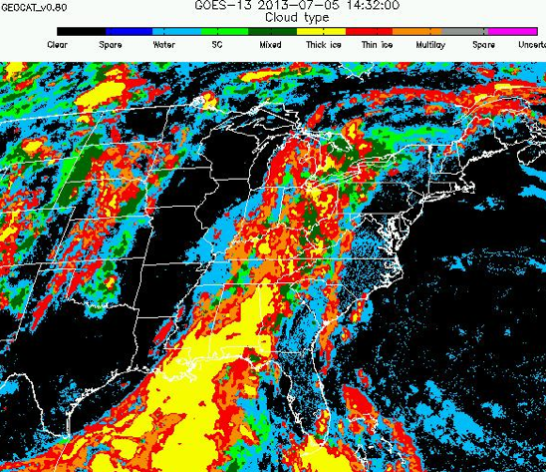
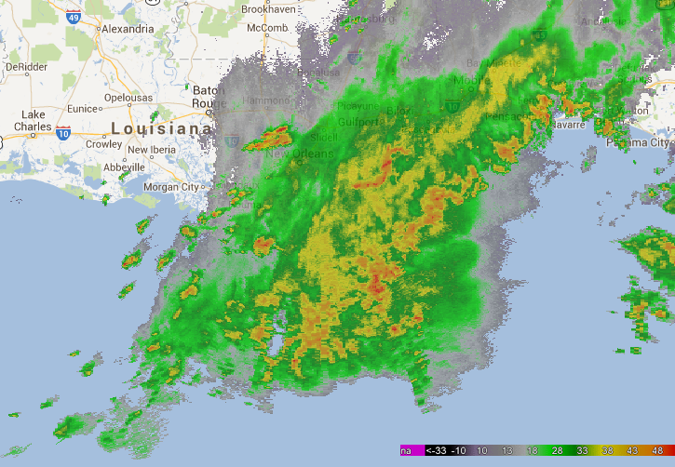
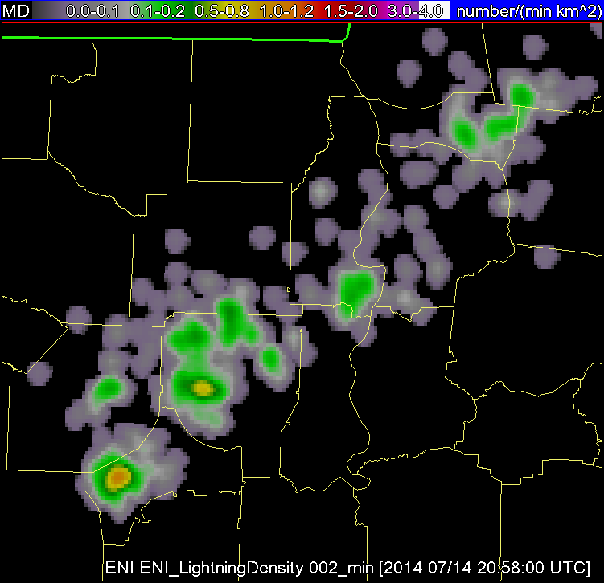
What data does the model use?
High-resolution NWP data
Satellite Imagery and Derived Products
Radar Imagery and Derived Products
Total Lightning
Storm Environment
Cloud Tracking and Cloud Growth Rates
Radar Tracking and Storm Intensity
Storm flash rate
Rapid Refresh
(RAP)
Earth Networks
Total Lightning Network
(ENTLN)
GOES-16
MRMS
Notes:
A few more details about the input data into the statistical model are beneficial. The high-resolution NWP data are used to characterize the instability and shear of the environment a storm develops.
The satellite imagery is used in two ways; to track clouds across space and time—in the same way a human views satellite imagery loops and to quantify the cloud growth rates, which are used as predictors in the model.
The radar data are used in a similar manner as the satellite data. The radar data are used to track storm cells in reflectivity imagery—again like how a meteorologist looks at a loop of radar imagery. And to quantify the intensity of the precipitation core of a developing thunderstorm, which is used as a predictor in the model.
The total lightning data are used to quantify the number of lightning flashes per minute within a radar tracked storm cell.
Before discussing a few more details about the input datasets, a schematic of how the statistical model works is presented in the following slide.
.

Slide 13
NOAA/CIMSS ProbSevere Timeline
2015:
ProbSevere Improved
Derived from:
NWP
GOES-13/15
NEXRAD (MRMS)
2017:
“All Hazards” ProbSevere
Including:
ProbHail, ProbWind, ProbTor
More physically relevant NWP and observational predictors for each hazard
2014:
ProbSevere Introduced
Derived from:
NWP
GOES-13
NEXRAD (MRMS)
2016:
Earth Networks Total
Lightning incorporated into ProbSevere
2018:
ABI incorporated.
Refinements to ProbHail, ProbWind, and ProbTor
Notes:
The timeline above shows the development history of ProbSevere and its evaluation within the Hazardous Weather Testbed, including the transition from “legacy” ProbSevere to “All Hazards” ProbSevere in 2017.

Slide 14
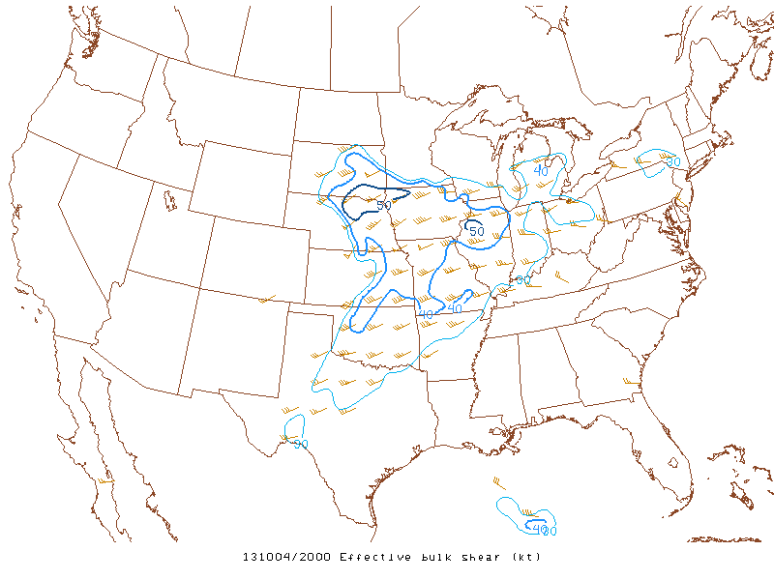
Data sources – Rapid Refresh (RAP)
Effective bulk shear (EBS):
  Discriminates well between supercell and non-supercell convection
  Normalizes shear between storms with deep and shallow inflow layers
Supplemental Training Link
Notes:
The storm environment information currently comes from the Rapid Refresh model. Recall we use model information to make a first order approximation of the storm environment—namely instability and shear.
The environmental shear parameter used is the effective bulk shear. The EBS normalizes shear between storms with deep and shallow inflow layers and is more accurate when considering elevated convection.
The environmental instability parameter used is the most unstable CAPE. The MUCAPE provides a generous estimate of instability. MUCAPE is useful for both surface based convection as well as elevated convection.
The RAP data are temporally composited and spatially smoothed, which acts to mitigate NWP phase and placement errors in convective development. The last outcome we want is a poor NWP solution to squash model probabilities incorrectly—surely if strong convection is developing there must be sufficient CAPE.

Slide 15
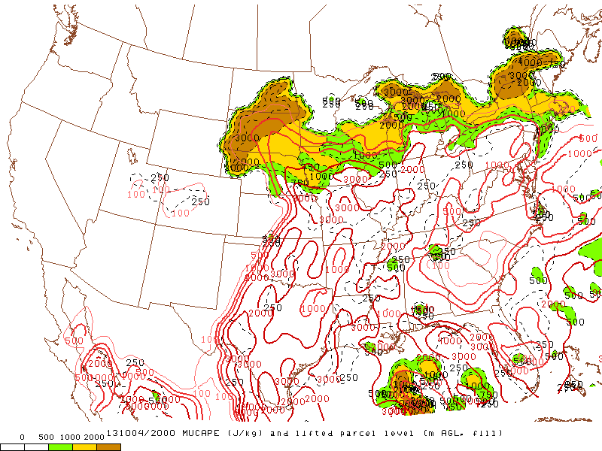
Data sources – Rapid Refresh (RAP)
Effective bulk shear (EBS):
  Discriminates well between supercell and non-supercell convection
  Normalizes shear between storms with deep and shallow inflow layers
Most-unstable CAPE (MUCAPE):
  Rough estimate of maximum updraft potential, even for elevated convection.
Supplemental Training Link
Notes:
The storm environment information currently comes from the Rapid Refresh model. Recall we use model information to make a first order approximation of the storm environment—namely instability and shear.
The environmental shear parameter used is the effective bulk shear. The EBS normalizes shear between storms with deep and shallow inflow layers and is more accurate when considering elevated convection.
The environmental instability parameter used is the most unstable CAPE. The MUCAPE provides a generous estimate of instability. MUCAPE is useful for both surface based convection as well as elevated convection.
The RAP data are temporally composited and spatially smoothed, which acts to mitigate NWP phase and placement errors in convective development. The last outcome we want is a poor NWP solution to squash model probabilities incorrectly—surely if strong convection is developing there must be sufficient CAPE.

Slide 16
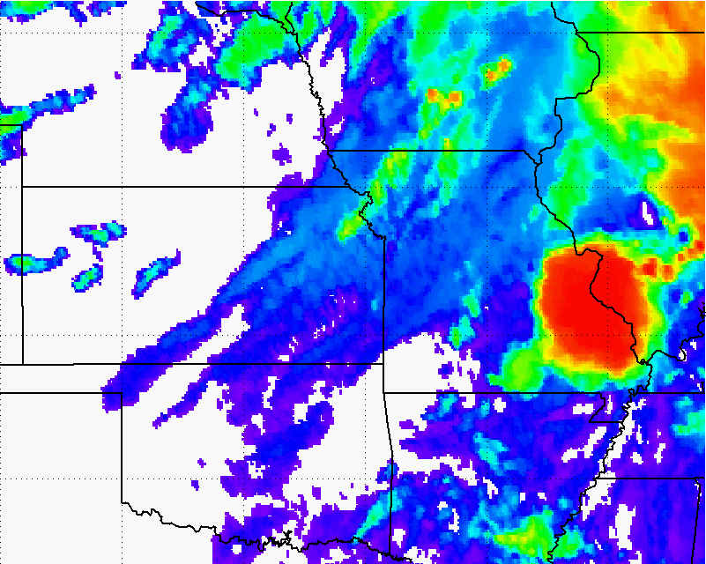
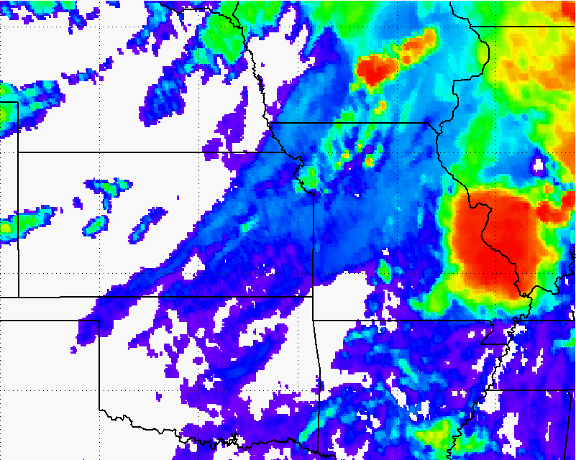
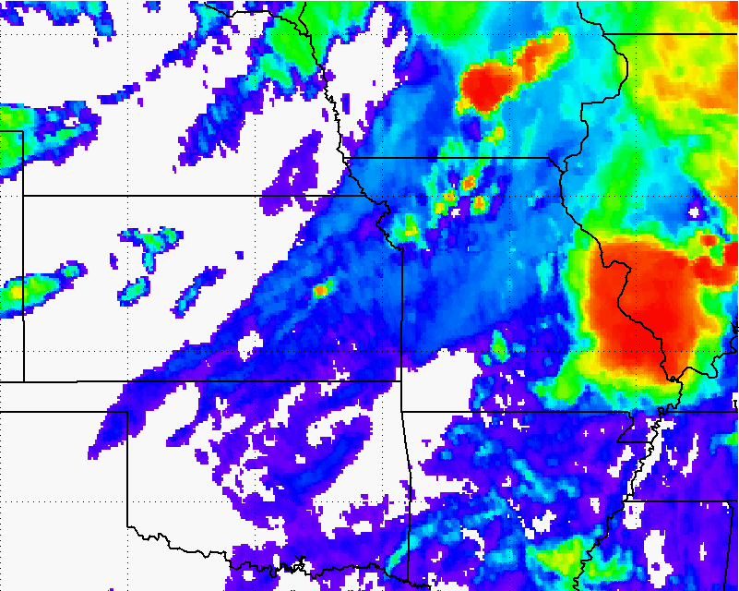
Data sources – GOES-derived Cloud Properties
How much does a developing storm-top cool over a period of time?
  Infers vertical growth of convective clouds (and updraft strength)
Supplemental Training Link
Notes:
The two satellite cloud growth predictors used in the statistical model are a normalized vertical cloud growth rate and a glaciation rate.
How quickly a developing storm cools in infrared brightness temperatures is an indicator of severe potential. In the example over eastern Kansas, we can see rapid cooling in the imagery and the computer quantifies this cooling rate, which is used as input into the statistical model. The cooling rate we use is normalized—such that seasonal and latitudinal differences in the cooling rates are automatically accounted for.
The other satellite predictor used is the glaciation rate or how quickly the cloud-top is transitioning from liquid water cloud droplets (blue in the imagery) to ice crystals (orange, red, and gray in the imagery). Like the normalized vertical growth rates, the computer quantifies this information and how quickly a developing storm-top transitions from water tops to ice tops is an indicator of severe potential.

Slide 17
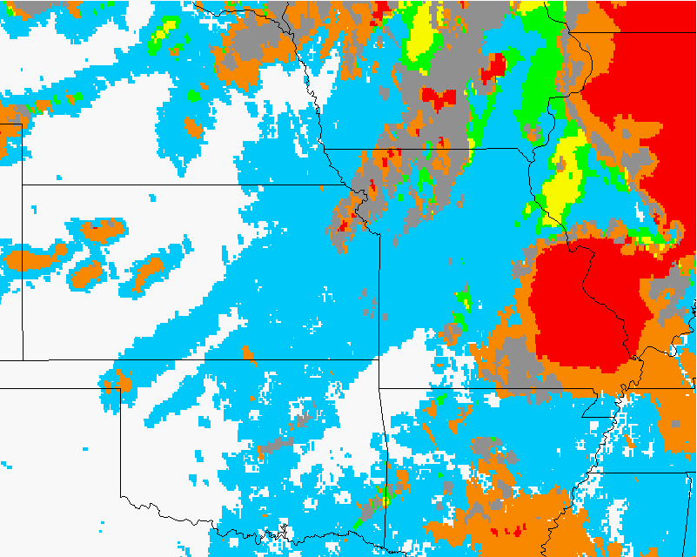
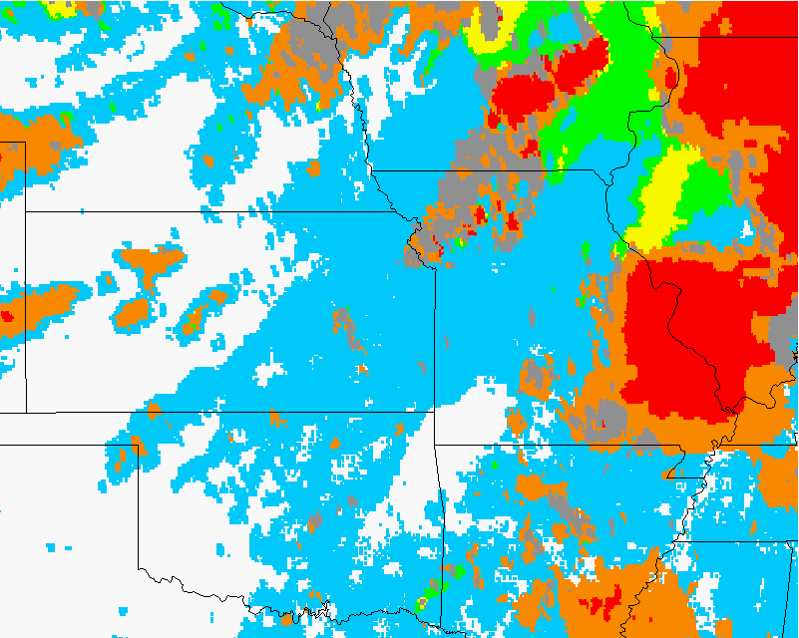
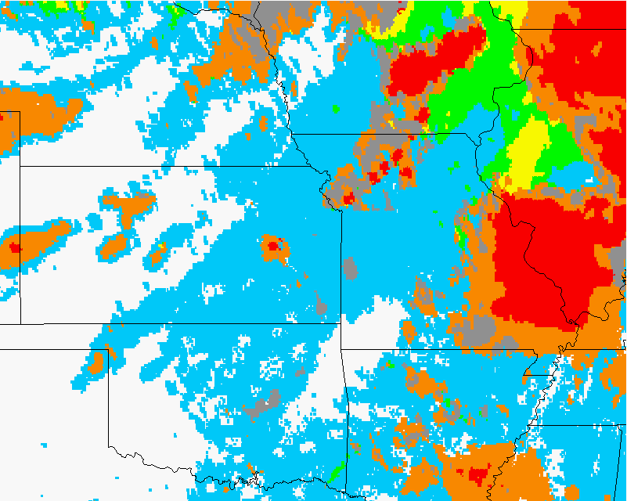
Data sources – GOES-derived Cloud Properties
How much does a developing storm-top cool over a period of time?
  Infers vertical growth of convective clouds (and updraft strength)
Rate-of-change in ice-cloud fraction:
  At cloud-top
  Infers vertical growth and glaciation rate (i.e., how fast is the cloud-top changing from mostly liquid water to ice).
Supplemental Training Link
Notes:
The two satellite cloud growth predictors used in the statistical model are a normalized vertical cloud growth rate and a glaciation rate.
How quickly a developing storm cools in infrared brightness temperatures is an indicator of severe potential. In the example over eastern Kansas, we can see rapid cooling in the imagery and the computer quantifies this cooling rate, which is used as input into the statistical model. The cooling rate we use is normalized—such that seasonal and latitudinal differences in the cooling rates are automatically accounted for.
The other satellite predictor used is the glaciation rate or how quickly the cloud-top is transitioning from liquid water cloud droplets (blue in the imagery) to ice crystals (orange, red, and gray in the imagery). Like the normalized vertical growth rates, the computer quantifies this information and how quickly a developing storm-top transitions from water tops to ice tops is an indicator of severe potential.

Slide 18
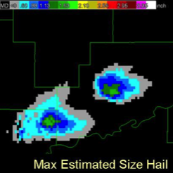
Data sources – MRMS products
Maximum Expected Size of Hail (MESH):
  Empirically derived from the Severe Hail Index (SHI)
  SHI is a thermally-weighted vertical integration of reflectivity above the melting level
(Figure from OU-CIMMS)
Supplemental Training Link
Notes:
The radar storm cell tracking utilizes the MRMS reflectivity at the -10 Celsius isotherm. The radar field used as a predictor in the statistical model is the MRMS maximum expected size of hail or MESH. The MESH is derived from the Severe Hail Index algorithm, which is essentially a vertical integration of reflectivity above the melting level.

Slide 19
Data sources – ENI Total Lightning
Earth Networks Total Lightning:
  Total flashes contained within radar objects are summed.
Notes:
The total lightning data used as a predictor in the statistical model are the Earth Networks total lightning flashes. For those unfamiliar with total lightning data, total lightning refers to cloud-to-ground strikes PLUS cloud-to-cloud flashes. The ENI total lightning data serves as a proxy for the GOES-R Geostationary Lightning Mapper instrument. The individual lightning flashes are summed within each radar object and have units of flashes per minute. Unlike the satellite and radar based observational predictors, total lightning is not a 1-D predictor, rather it is combined with effective bulk shear and used as a 2-D predictor. This accounts for storms that can have high electrical activity but low effective bulk shear—which will only seldom produce severe weather.

Slide 20
Outline
What is ProbSevere?
What data does ProbSevere use?
Automated integration of information
Examples
ProbSevere – “all hazards”
Bulk verification
ProbSevere in HWT; media
Caveats
Next steps
Summary
Notes:
This training module describes the NOAA/CIMSS Prob Severe statistical model, provides examples of the model output in AWIPS-II, and briefly discusses model validation and model limitations. Why do we need a statistical model to nowcast severe weather?
The uses of statistical models are becoming more and more important and common place as data volumes explode in all aspects of our lives. Statistical models are used with great success to predict things like presidential elections and outcomes of the NCAA basketball tournament. Meteorology is no different; as bigger and more frequent data becomes available to forecasters it becomes more important to distill gigabytes of data into kilobytes of useful information. And that is what the NOAA/CIMSS Prob Severe model does.

Slide 21
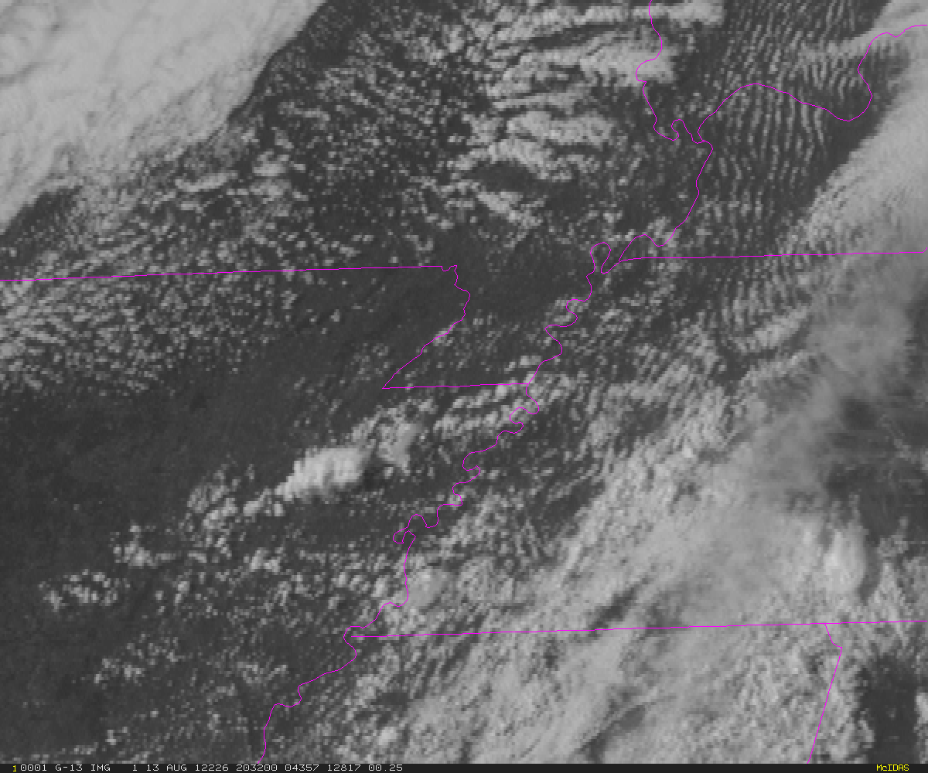
Automated integration of information
Notes:
The following schematic illustrates how satellite and radar data are tracked by the computer and how this all feeds data into the statistical model—without dwelling on the complicated details of satellite and radar tracking. First we have a visible satellite image. A meteorologist doesn’t look at this image and see pixels—
A meteorologist sees cloud clusters, developing thunderstorms, etc.
So it is necessary to train the computer to think like a meteorologist. The computer needs to identify cloud boundaries and track those cloud clusters and their evolution over time.
The same concepts apply to radar data. Again the computer needs to “think” like a human and identify storms or cells.
And like with satellite data, the computer needs to track these storm cells and their evolution over time.
So how does this all come together?
Once a developing storm exhibits moderate reflectivity, the computer identifies and tracks cells in radar imagery. Once storms are tracked on radar, they inherit the parent cloud’s satellite growth information, which generally occurred earlier in the storm life cycle. Additionally, total lightning information is obtained for each radar-tracked storm. The satellite growth rates, radar storm intensity, and total lightning information are input into the statistical model to derive the probability of severe weather.
The computer continues to track storms in both satellite and radar imagery and continually updates probabilities, as new observations are available.

Slide 22
Automated integration of information
Notes:
The following schematic illustrates how satellite and radar data are tracked by the computer and how this all feeds data into the statistical model—without dwelling on the complicated details of satellite and radar tracking. First we have a visible satellite image. A meteorologist doesn’t look at this image and see pixels—
A meteorologist sees cloud clusters, developing thunderstorms, etc.
So it is necessary to train the computer to think like a meteorologist. The computer needs to identify cloud boundaries and track those cloud clusters and their evolution over time.
The same concepts apply to radar data. Again the computer needs to “think” like a human and identify storms or cells.
And like with satellite data, the computer needs to track these storm cells and their evolution over time.
So how does this all come together?
Once a developing storm exhibits moderate reflectivity, the computer identifies and tracks cells in radar imagery. Once storms are tracked on radar, they inherit the parent cloud’s satellite growth information, which generally occurred earlier in the storm life cycle. Additionally, total lightning information is obtained for each radar-tracked storm. The satellite growth rates, radar storm intensity, and total lightning information are input into the statistical model to derive the probability of severe weather.
The computer continues to track storms in both satellite and radar imagery and continually updates probabilities, as new observations are available.

Slide 23
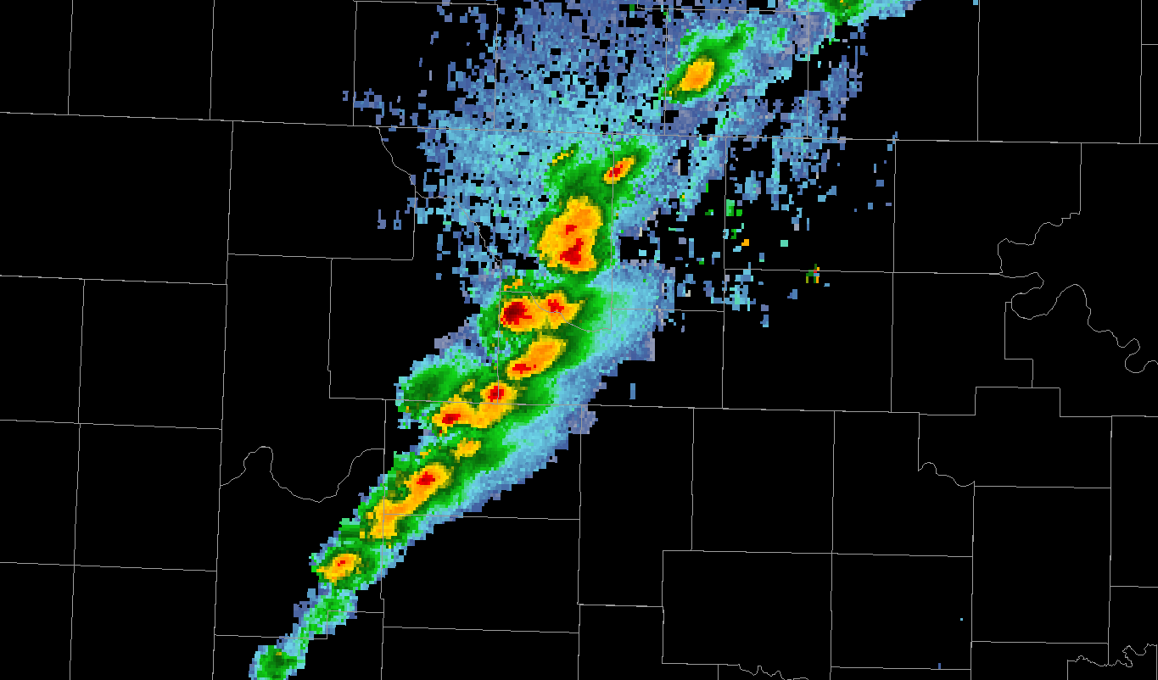
Automated integration of information
Notes:
The following schematic illustrates how satellite and radar data are tracked by the computer and how this all feeds data into the statistical model—without dwelling on the complicated details of satellite and radar tracking. First we have a visible satellite image. A meteorologist doesn’t look at this image and see pixels—
A meteorologist sees cloud clusters, developing thunderstorms, etc.
So it is necessary to train the computer to think like a meteorologist. The computer needs to identify cloud boundaries and track those cloud clusters and their evolution over time.
The same concepts apply to radar data. Again the computer needs to “think” like a human and identify storms or cells.
And like with satellite data, the computer needs to track these storm cells and their evolution over time.
So how does this all come together?
Once a developing storm exhibits moderate reflectivity, the computer identifies and tracks cells in radar imagery. Once storms are tracked on radar, they inherit the parent cloud’s satellite growth information, which generally occurred earlier in the storm life cycle. Additionally, total lightning information is obtained for each radar-tracked storm. The satellite growth rates, radar storm intensity, and total lightning information are input into the statistical model to derive the probability of severe weather.
The computer continues to track storms in both satellite and radar imagery and continually updates probabilities, as new observations are available.

Slide 24
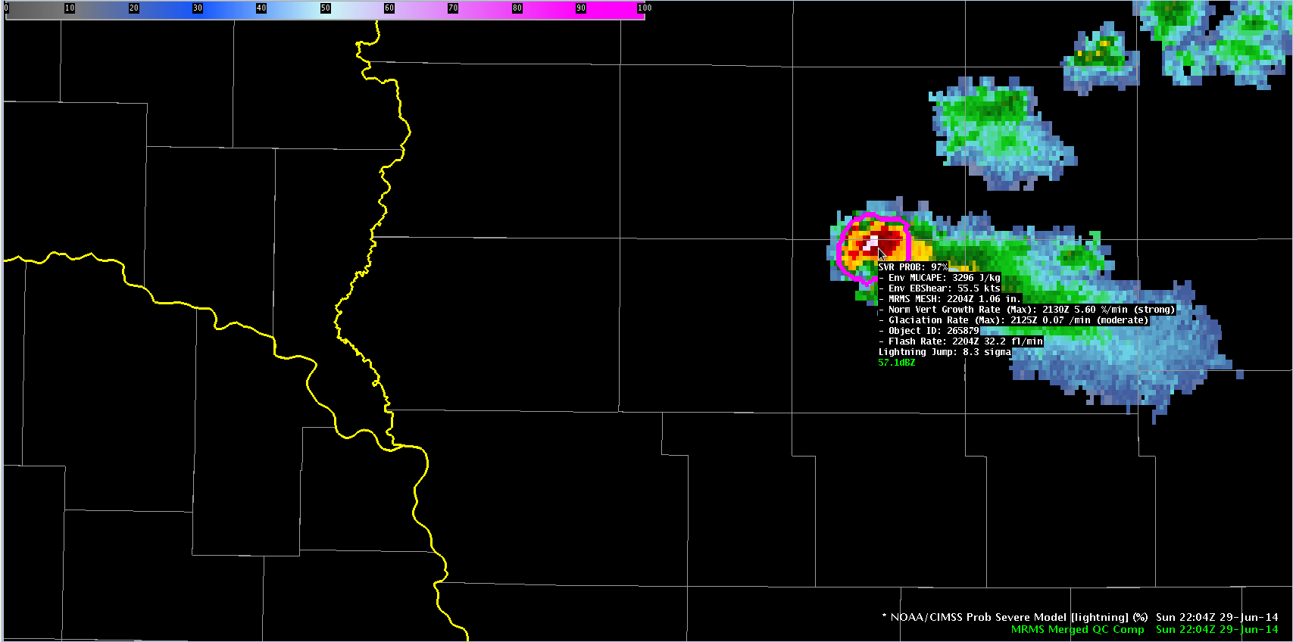
ProbSevere Model AWIPS-II Display
Model output are shapefiles contoured around radar storm cells.
Enhancement designed for overlay atop radar reflectivity—but can be overlaid on any field (satellite, radar velocity, etc.).
Sampling offers readout of model probability as well as each model predictor.
Notes:
We will now transition from discussing how the statistical model works and learning about the input datasets to showing examples of how the model performed in some severe weather events.
The model output is displayed in two ways. One is a probability contour with a color enhancement designed for overlay on top of typical radar reflectivity color tables (e.g. greens, yellows, and reds are avoided in the ProbSevere colortable). The shapefile nature of the output makes the display very flexible—the contours can be overlaid on any field within AWIPS-II (e.g., radar velocity). Additionally, the model probability and each model predictor is displayed as text when sampling is turned on. The following bullets briefly describe the text read-out.
This field is the ProbSevere probability and ranges between 0 and 100% for a given storm cell.
This field is the most unstable CAPE from our RAP composite for the storm cell.
This field is the effective bulk shear from our RAP composite for the storm cell.
This field is the MRMS MESH value—the time and value are provided. Note the MRMS may not match a single radar site MESH algorithm—both time and value.
This field is the normalized vertical growth rate of the storm. It is the maximum value attained during the growth stage of the storm and the time that maximum value occurred. The units are percentage of the troposphere depth the cloud grew per minute. The exact values are not terribly important—we append a statistical measure of intensity with the terms “weak”, “moderate”, or “strong”.
This field is the glaciation rate or the rate at which the storm-top transitioned from liquid water droplets to ice crystals. It is the maximum value attained during the growth stage of the storm and the time that maximum value occurred. The units are a percentage of water to ice conversion per minute. Again we append a statistical measure of intensity with the terms “weak”, “moderate”, or “strong”.
This field is the flash rate--the time and value are provided. Recall the total lightning is part of a 2-D predictor in the ProbSevere model—combining effective bulk shear and total lightning flash rate.
While each model predictor is provided in the text read-out, it is important to emphasize—the sum of the information--the probability--is more valuable than any individual piece of information.

Slide 25
ProbSevere Model AWIPS-II Display
SVR Prob: Probability of Severe 0-100%.
Notes:
We will now transition from discussing how the statistical model works and learning about the input datasets to showing examples of how the model performed in some severe weather events.
The model output is displayed in two ways. One is a probability contour with a color enhancement designed for overlay on top of typical radar reflectivity color tables (e.g. greens, yellows, and reds are avoided in the ProbSevere colortable). The shapefile nature of the output makes the display very flexible—the contours can be overlaid on any field within AWIPS-II (e.g., radar velocity). Additionally, the model probability and each model predictor is displayed as text when sampling is turned on. The following bullets briefly describe the text read-out.
This field is the ProbSevere probability and ranges between 0 and 100% for a given storm cell.
This field is the most unstable CAPE from our RAP composite for the storm cell.
This field is the effective bulk shear from our RAP composite for the storm cell.
This field is the MRMS MESH value—the time and value are provided. Note the MRMS may not match a single radar site MESH algorithm—both time and value.
This field is the normalized vertical growth rate of the storm. It is the maximum value attained during the growth stage of the storm and the time that maximum value occurred. The units are percentage of the troposphere depth the cloud grew per minute. The exact values are not terribly important—we append a statistical measure of intensity with the terms “weak”, “moderate”, or “strong”.
This field is the glaciation rate or the rate at which the storm-top transitioned from liquid water droplets to ice crystals. It is the maximum value attained during the growth stage of the storm and the time that maximum value occurred. The units are a percentage of water to ice conversion per minute. Again we append a statistical measure of intensity with the terms “weak”, “moderate”, or “strong”.
This field is the flash rate--the time and value are provided. Recall the total lightning is part of a 2-D predictor in the ProbSevere model—combining effective bulk shear and total lightning flash rate.
While each model predictor is provided in the text read-out, it is important to emphasize—the sum of the information--the probability--is more valuable than any individual piece of information.

Slide 26
ProbSevere Model AWIPS-II Display
Env MUCAPE: RAP composite MUCAPE for storm environment.
Notes:
We will now transition from discussing how the statistical model works and learning about the input datasets to showing examples of how the model performed in some severe weather events.
The model output is displayed in two ways. One is a probability contour with a color enhancement designed for overlay on top of typical radar reflectivity color tables (e.g. greens, yellows, and reds are avoided in the ProbSevere colortable). The shapefile nature of the output makes the display very flexible—the contours can be overlaid on any field within AWIPS-II (e.g., radar velocity). Additionally, the model probability and each model predictor is displayed as text when sampling is turned on. The following bullets briefly describe the text read-out.
This field is the ProbSevere probability and ranges between 0 and 100% for a given storm cell.
This field is the most unstable CAPE from our RAP composite for the storm cell.
This field is the effective bulk shear from our RAP composite for the storm cell.
This field is the MRMS MESH value—the time and value are provided. Note the MRMS may not match a single radar site MESH algorithm—both time and value.
This field is the normalized vertical growth rate of the storm. It is the maximum value attained during the growth stage of the storm and the time that maximum value occurred. The units are percentage of the troposphere depth the cloud grew per minute. The exact values are not terribly important—we append a statistical measure of intensity with the terms “weak”, “moderate”, or “strong”.
This field is the glaciation rate or the rate at which the storm-top transitioned from liquid water droplets to ice crystals. It is the maximum value attained during the growth stage of the storm and the time that maximum value occurred. The units are a percentage of water to ice conversion per minute. Again we append a statistical measure of intensity with the terms “weak”, “moderate”, or “strong”.
This field is the flash rate--the time and value are provided. Recall the total lightning is part of a 2-D predictor in the ProbSevere model—combining effective bulk shear and total lightning flash rate.
While each model predictor is provided in the text read-out, it is important to emphasize—the sum of the information--the probability--is more valuable than any individual piece of information.

Slide 27
ProbSevere Model AWIPS-II Display
Env EBShear: RAP composite effective bulk shear for storm environment.
Notes:
We will now transition from discussing how the statistical model works and learning about the input datasets to showing examples of how the model performed in some severe weather events.
The model output is displayed in two ways. One is a probability contour with a color enhancement designed for overlay on top of typical radar reflectivity color tables (e.g. greens, yellows, and reds are avoided in the ProbSevere colortable). The shapefile nature of the output makes the display very flexible—the contours can be overlaid on any field within AWIPS-II (e.g., radar velocity). Additionally, the model probability and each model predictor is displayed as text when sampling is turned on. The following bullets briefly describe the text read-out.
This field is the ProbSevere probability and ranges between 0 and 100% for a given storm cell.
This field is the most unstable CAPE from our RAP composite for the storm cell.
This field is the effective bulk shear from our RAP composite for the storm cell.
This field is the MRMS MESH value—the time and value are provided. Note the MRMS may not match a single radar site MESH algorithm—both time and value.
This field is the normalized vertical growth rate of the storm. It is the maximum value attained during the growth stage of the storm and the time that maximum value occurred. The units are percentage of the troposphere depth the cloud grew per minute. The exact values are not terribly important—we append a statistical measure of intensity with the terms “weak”, “moderate”, or “strong”.
This field is the glaciation rate or the rate at which the storm-top transitioned from liquid water droplets to ice crystals. It is the maximum value attained during the growth stage of the storm and the time that maximum value occurred. The units are a percentage of water to ice conversion per minute. Again we append a statistical measure of intensity with the terms “weak”, “moderate”, or “strong”.
This field is the flash rate--the time and value are provided. Recall the total lightning is part of a 2-D predictor in the ProbSevere model—combining effective bulk shear and total lightning flash rate.
While each model predictor is provided in the text read-out, it is important to emphasize—the sum of the information--the probability--is more valuable than any individual piece of information.

Slide 28
ProbSevere Model AWIPS-II Display
MRMS MESH: Storm maximum MESH. Time and size (inches).
Notes:
We will now transition from discussing how the statistical model works and learning about the input datasets to showing examples of how the model performed in some severe weather events.
The model output is displayed in two ways. One is a probability contour with a color enhancement designed for overlay on top of typical radar reflectivity color tables (e.g. greens, yellows, and reds are avoided in the ProbSevere colortable). The shapefile nature of the output makes the display very flexible—the contours can be overlaid on any field within AWIPS-II (e.g., radar velocity). Additionally, the model probability and each model predictor is displayed as text when sampling is turned on. The following bullets briefly describe the text read-out.
This field is the ProbSevere probability and ranges between 0 and 100% for a given storm cell.
This field is the most unstable CAPE from our RAP composite for the storm cell.
This field is the effective bulk shear from our RAP composite for the storm cell.
This field is the MRMS MESH value—the time and value are provided. Note the MRMS may not match a single radar site MESH algorithm—both time and value.
This field is the normalized vertical growth rate of the storm. It is the maximum value attained during the growth stage of the storm and the time that maximum value occurred. The units are percentage of the troposphere depth the cloud grew per minute. The exact values are not terribly important—we append a statistical measure of intensity with the terms “weak”, “moderate”, or “strong”.
This field is the glaciation rate or the rate at which the storm-top transitioned from liquid water droplets to ice crystals. It is the maximum value attained during the growth stage of the storm and the time that maximum value occurred. The units are a percentage of water to ice conversion per minute. Again we append a statistical measure of intensity with the terms “weak”, “moderate”, or “strong”.
This field is the flash rate--the time and value are provided. Recall the total lightning is part of a 2-D predictor in the ProbSevere model—combining effective bulk shear and total lightning flash rate.
While each model predictor is provided in the text read-out, it is important to emphasize—the sum of the information--the probability--is more valuable than any individual piece of information.

Slide 29
ProbSevere Model AWIPS-II Display
Norm Vert Growth Rate (Max): Maximum storm cell satellite vertical growth rate.
Time occurred, normalized vertical cloud growth rate per minute.
Classified as weak, moderate, or strong.
Notes:
We will now transition from discussing how the statistical model works and learning about the input datasets to showing examples of how the model performed in some severe weather events.
The model output is displayed in two ways. One is a probability contour with a color enhancement designed for overlay on top of typical radar reflectivity color tables (e.g. greens, yellows, and reds are avoided in the ProbSevere colortable). The shapefile nature of the output makes the display very flexible—the contours can be overlaid on any field within AWIPS-II (e.g., radar velocity). Additionally, the model probability and each model predictor is displayed as text when sampling is turned on. The following bullets briefly describe the text read-out.
This field is the ProbSevere probability and ranges between 0 and 100% for a given storm cell.
This field is the most unstable CAPE from our RAP composite for the storm cell.
This field is the effective bulk shear from our RAP composite for the storm cell.
This field is the MRMS MESH value—the time and value are provided. Note the MRMS may not match a single radar site MESH algorithm—both time and value.
This field is the normalized vertical growth rate of the storm. It is the maximum value attained during the growth stage of the storm and the time that maximum value occurred. The units are percentage of the troposphere depth the cloud grew per minute. The exact values are not terribly important—we append a statistical measure of intensity with the terms “weak”, “moderate”, or “strong”.
This field is the glaciation rate or the rate at which the storm-top transitioned from liquid water droplets to ice crystals. It is the maximum value attained during the growth stage of the storm and the time that maximum value occurred. The units are a percentage of water to ice conversion per minute. Again we append a statistical measure of intensity with the terms “weak”, “moderate”, or “strong”.
This field is the flash rate--the time and value are provided. Recall the total lightning is part of a 2-D predictor in the ProbSevere model—combining effective bulk shear and total lightning flash rate.
While each model predictor is provided in the text read-out, it is important to emphasize—the sum of the information--the probability--is more valuable than any individual piece of information.

Slide 30
ProbSevere Model AWIPS-II Display
Glaciation rate (Max): Maximum storm cell satellite glaciation rate.
Time occurred, percentage of conversion from water to ice cloud-tops per minute. Classified as weak, moderate, or strong.
Notes:
We will now transition from discussing how the statistical model works and learning about the input datasets to showing examples of how the model performed in some severe weather events.
The model output is displayed in two ways. One is a probability contour with a color enhancement designed for overlay on top of typical radar reflectivity color tables (e.g. greens, yellows, and reds are avoided in the ProbSevere colortable). The shapefile nature of the output makes the display very flexible—the contours can be overlaid on any field within AWIPS-II (e.g., radar velocity). Additionally, the model probability and each model predictor is displayed as text when sampling is turned on. The following bullets briefly describe the text read-out.
This field is the ProbSevere probability and ranges between 0 and 100% for a given storm cell.
This field is the most unstable CAPE from our RAP composite for the storm cell.
This field is the effective bulk shear from our RAP composite for the storm cell.
This field is the MRMS MESH value—the time and value are provided. Note the MRMS may not match a single radar site MESH algorithm—both time and value.
This field is the normalized vertical growth rate of the storm. It is the maximum value attained during the growth stage of the storm and the time that maximum value occurred. The units are percentage of the troposphere depth the cloud grew per minute. The exact values are not terribly important—we append a statistical measure of intensity with the terms “weak”, “moderate”, or “strong”.
This field is the glaciation rate or the rate at which the storm-top transitioned from liquid water droplets to ice crystals. It is the maximum value attained during the growth stage of the storm and the time that maximum value occurred. The units are a percentage of water to ice conversion per minute. Again we append a statistical measure of intensity with the terms “weak”, “moderate”, or “strong”.
This field is the flash rate--the time and value are provided. Recall the total lightning is part of a 2-D predictor in the ProbSevere model—combining effective bulk shear and total lightning flash rate.
While each model predictor is provided in the text read-out, it is important to emphasize—the sum of the information--the probability--is more valuable than any individual piece of information.

Slide 31
ProbSevere Model AWIPS-II Display
Flash Rate: Total lightning flash rate within radar object. Time and flash rate (flashes / min).
The lightning jump anomaly, while not explicitly used in the ProbSevere model, is also provided.
Notes:
We will now transition from discussing how the statistical model works and learning about the input datasets to showing examples of how the model performed in some severe weather events.
The model output is displayed in two ways. One is a probability contour with a color enhancement designed for overlay on top of typical radar reflectivity color tables (e.g. greens, yellows, and reds are avoided in the ProbSevere colortable). The shapefile nature of the output makes the display very flexible—the contours can be overlaid on any field within AWIPS-II (e.g., radar velocity). Additionally, the model probability and each model predictor is displayed as text when sampling is turned on. The following bullets briefly describe the text read-out.
This field is the ProbSevere probability and ranges between 0 and 100% for a given storm cell.
This field is the most unstable CAPE from our RAP composite for the storm cell.
This field is the effective bulk shear from our RAP composite for the storm cell.
This field is the MRMS MESH value—the time and value are provided. Note the MRMS may not match a single radar site MESH algorithm—both time and value.
This field is the normalized vertical growth rate of the storm. It is the maximum value attained during the growth stage of the storm and the time that maximum value occurred. The units are percentage of the troposphere depth the cloud grew per minute. The exact values are not terribly important—we append a statistical measure of intensity with the terms “weak”, “moderate”, or “strong”.
This field is the glaciation rate or the rate at which the storm-top transitioned from liquid water droplets to ice crystals. It is the maximum value attained during the growth stage of the storm and the time that maximum value occurred. The units are a percentage of water to ice conversion per minute. Again we append a statistical measure of intensity with the terms “weak”, “moderate”, or “strong”.
This field is the flash rate--the time and value are provided. Recall the total lightning is part of a 2-D predictor in the ProbSevere model—combining effective bulk shear and total lightning flash rate.
While each model predictor is provided in the text read-out, it is important to emphasize—the sum of the information--the probability--is more valuable than any individual piece of information.

Slide 32
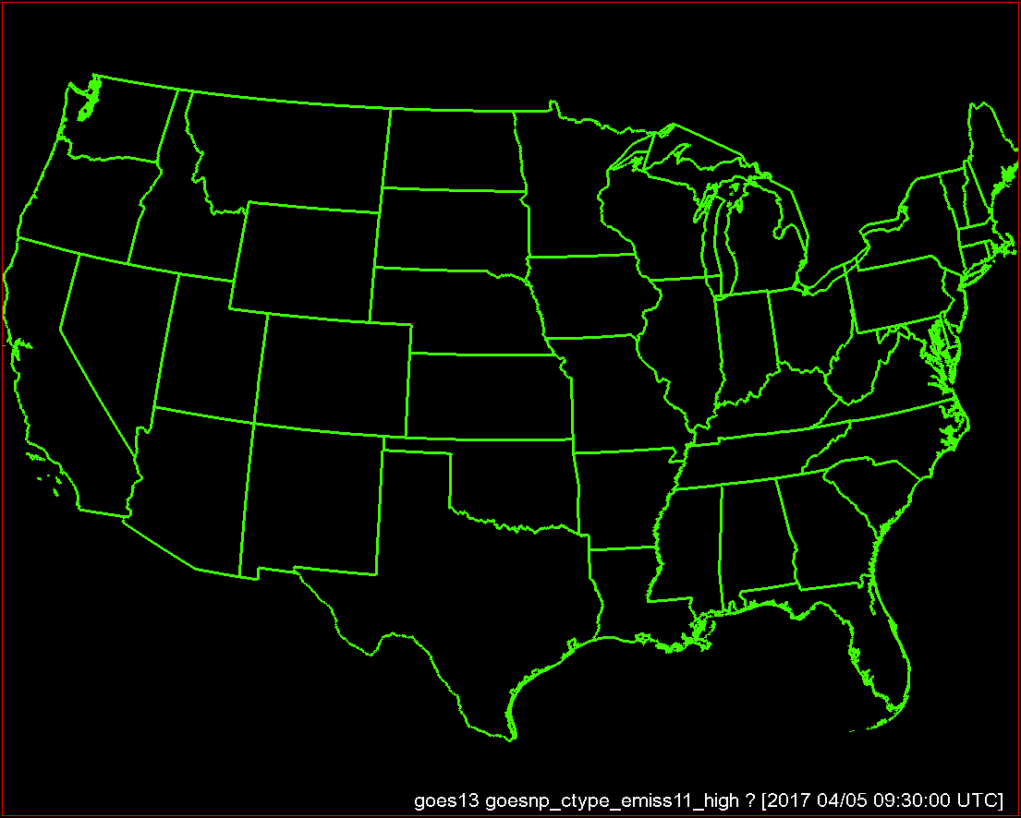
Focus on developing storms along
Mississippi / Alabama border

Slide 33
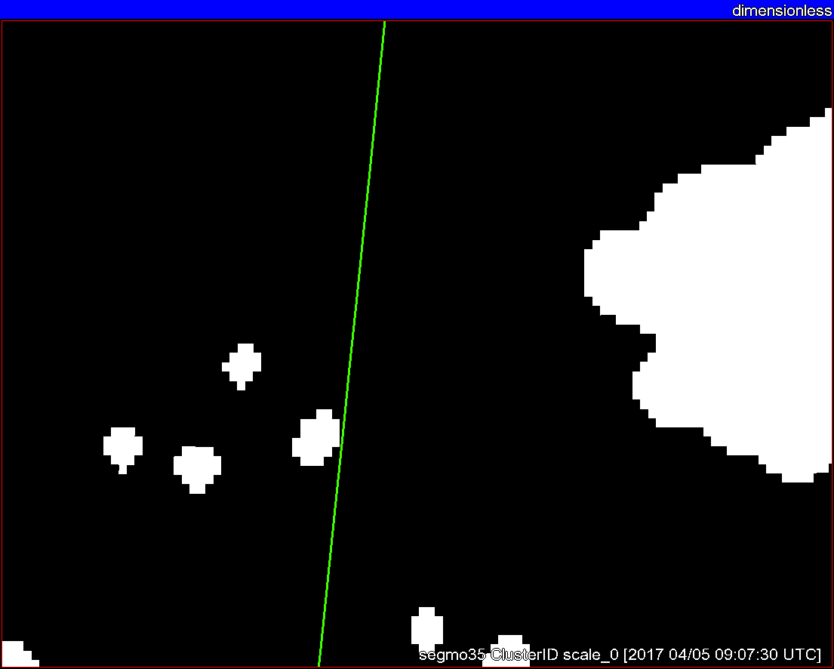
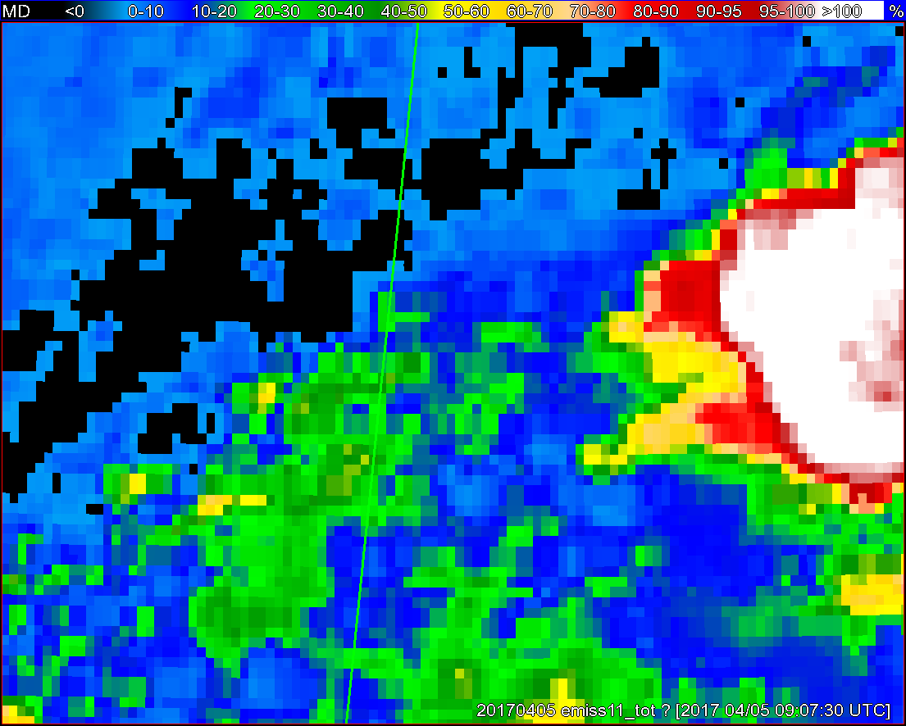
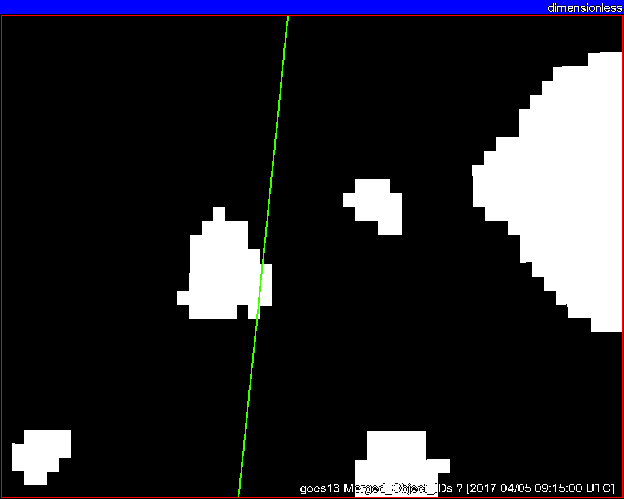
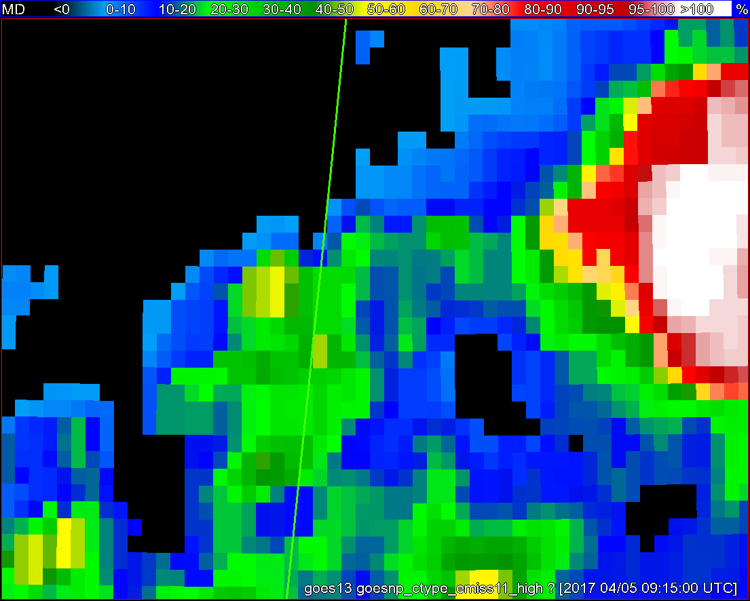
Objects
11-µm top-of-troposphere emissivity
GOES - 16
GOES - 13
Notes:
I put this example in just to illustrate satellite object tracking. I think this does a better job than past examples. Also shows the differences between G16 and NOP. Should go pretty quick.

Slide 34
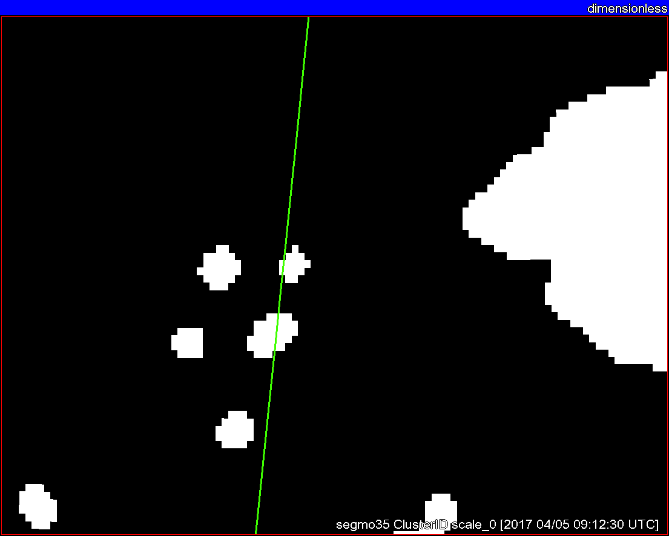
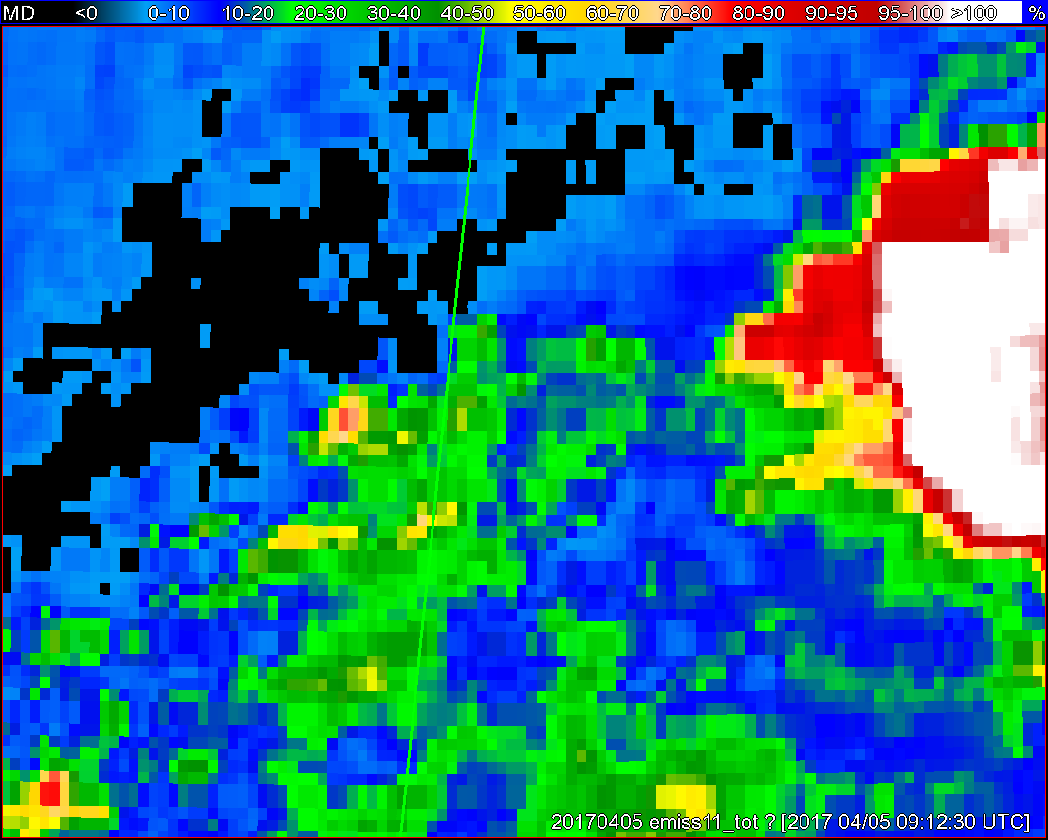
Objects
11-µm top-of-troposphere emissivity
GOES - 16
GOES - 13

Slide 35
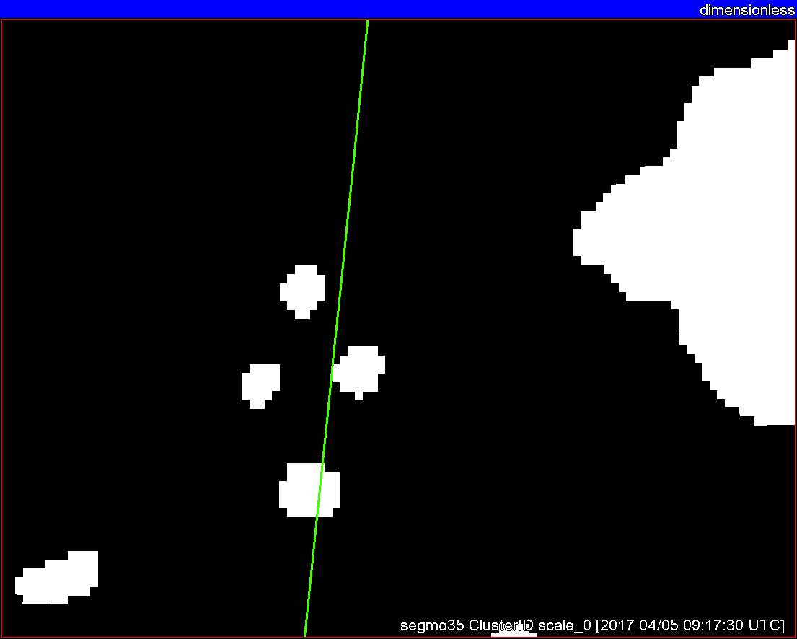
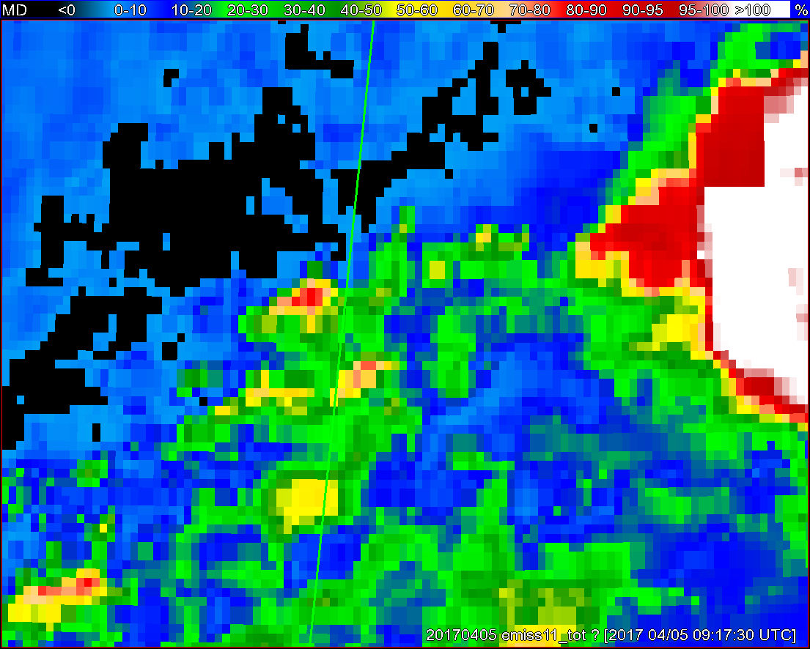
Objects
11-µm top-of-troposphere emissivity
GOES - 16
GOES - 13

Slide 36
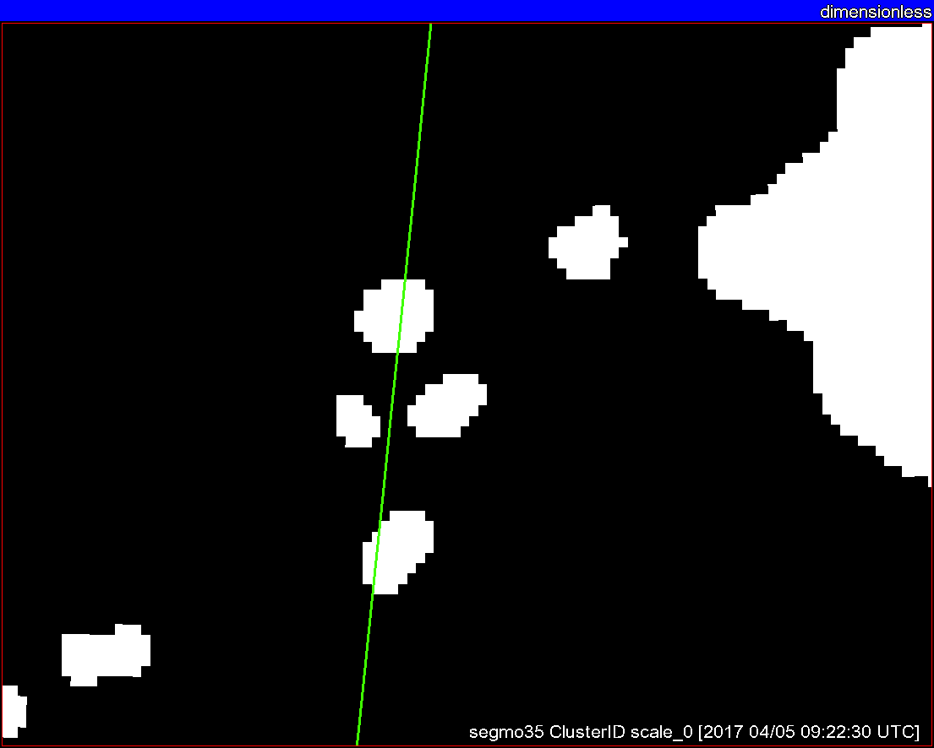
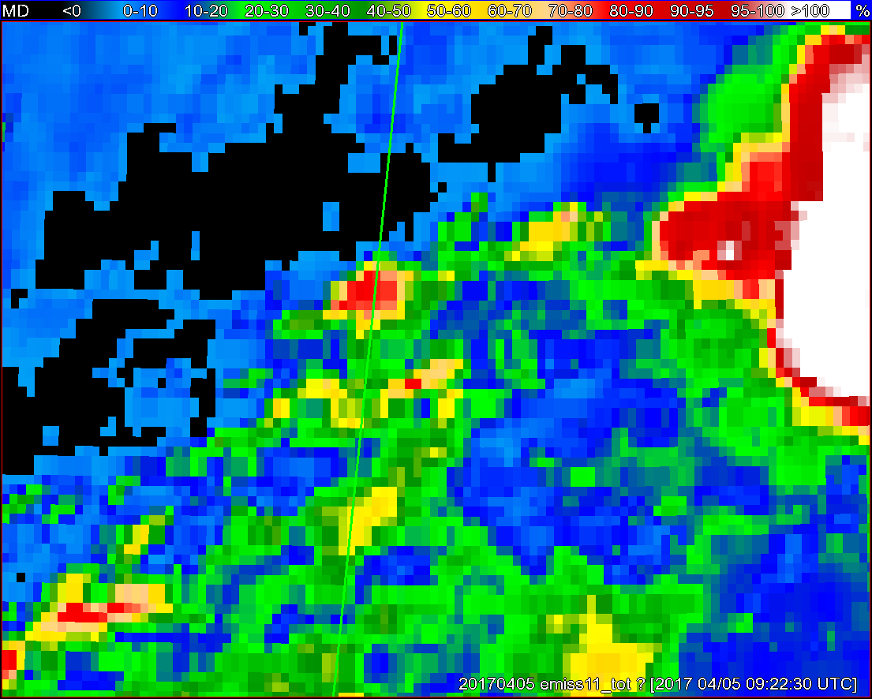
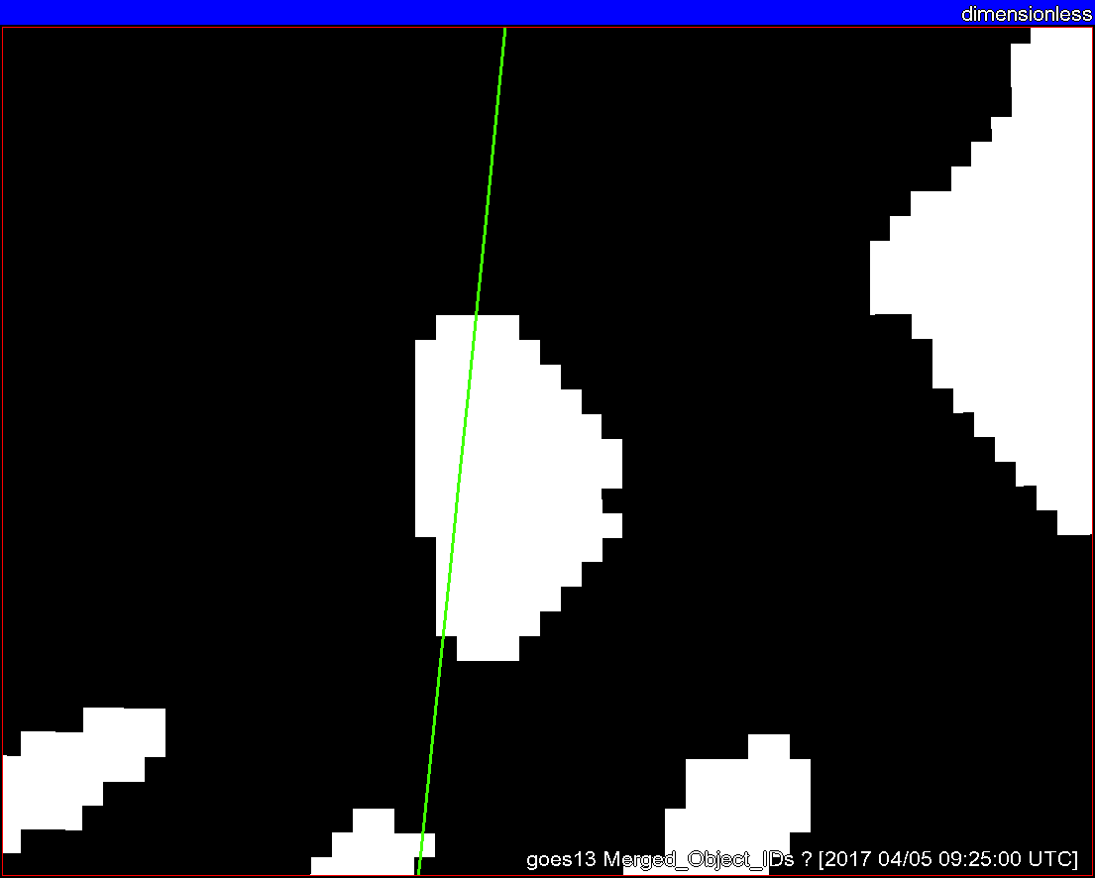
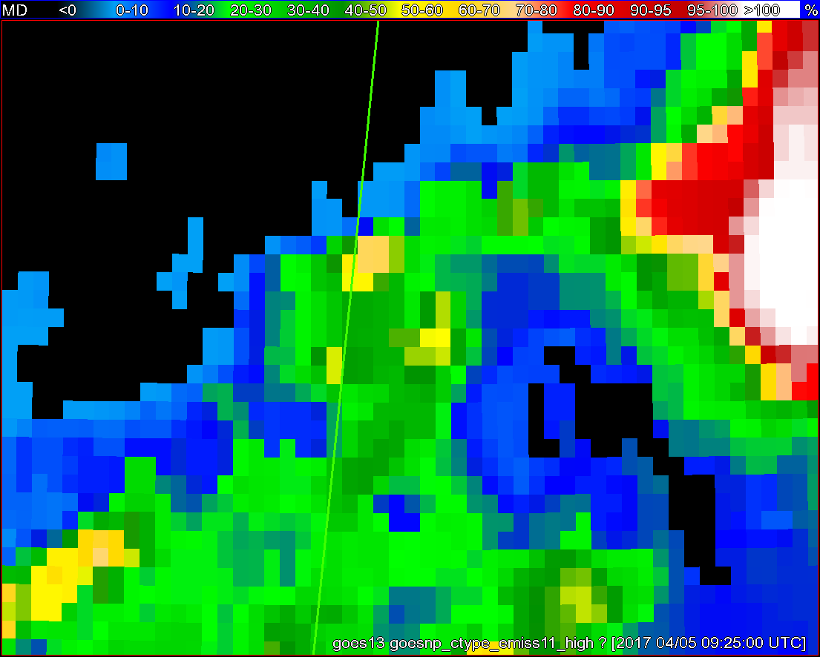
Objects
11-µm top-of-troposphere emissivity
GOES - 16
GOES - 13

Slide 37
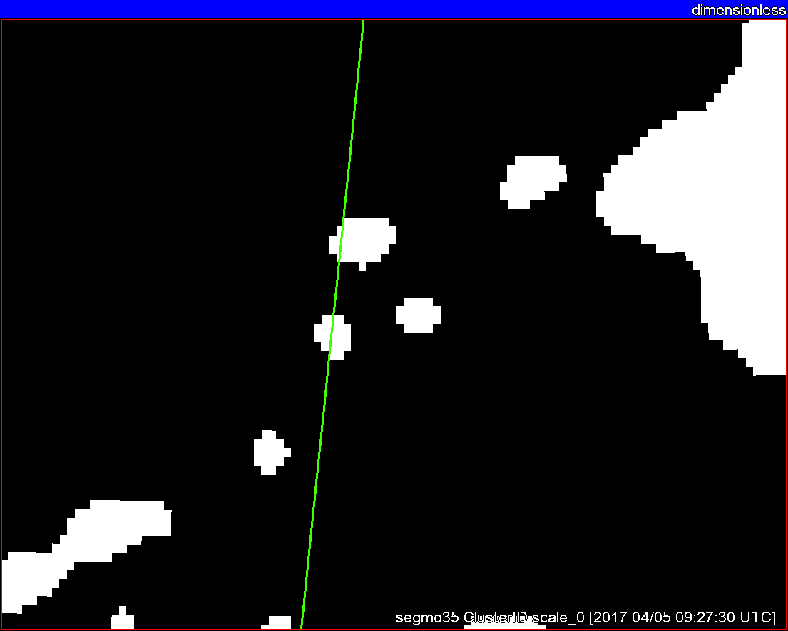
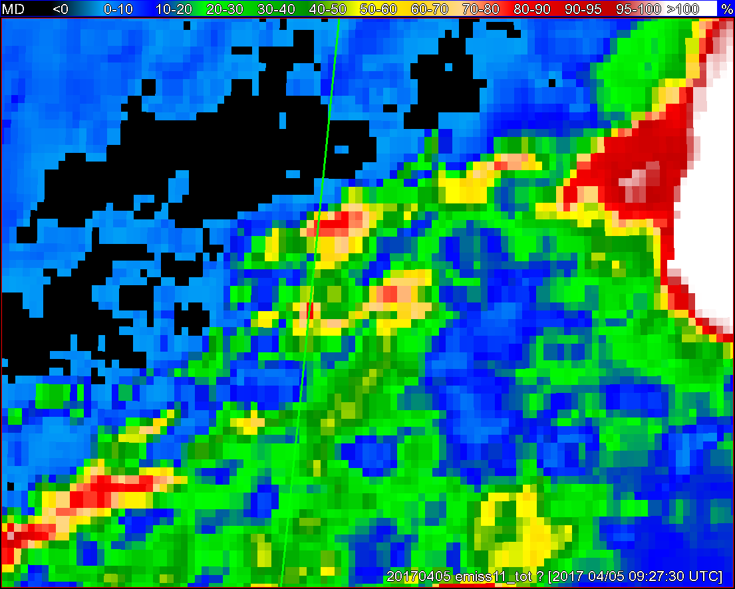
Objects
11-µm top-of-troposphere emissivity
GOES - 16
GOES - 13

Slide 38
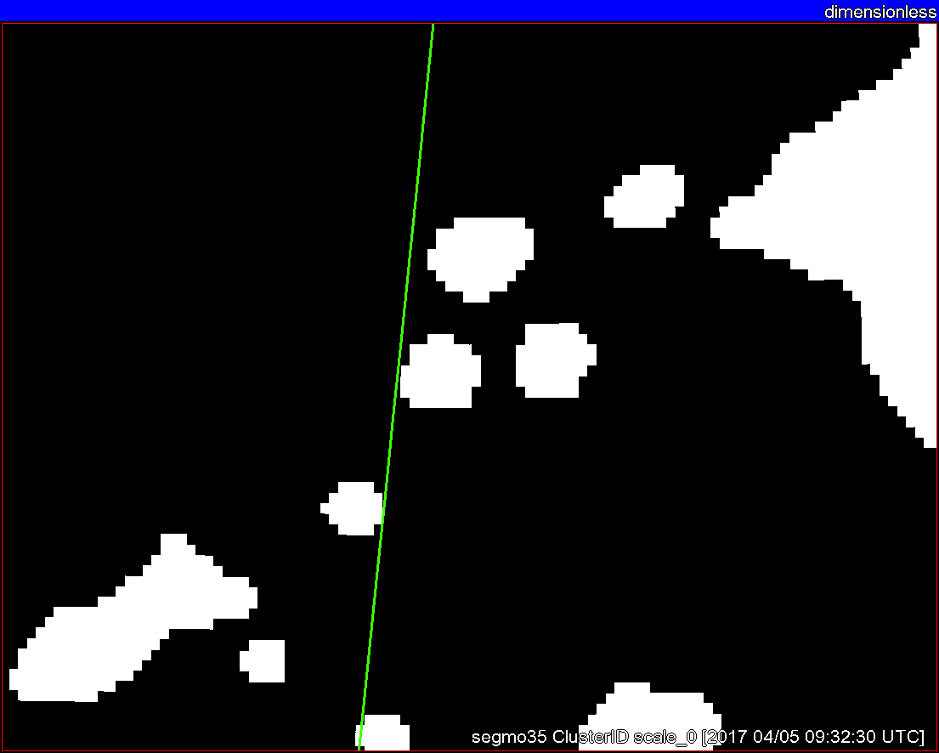
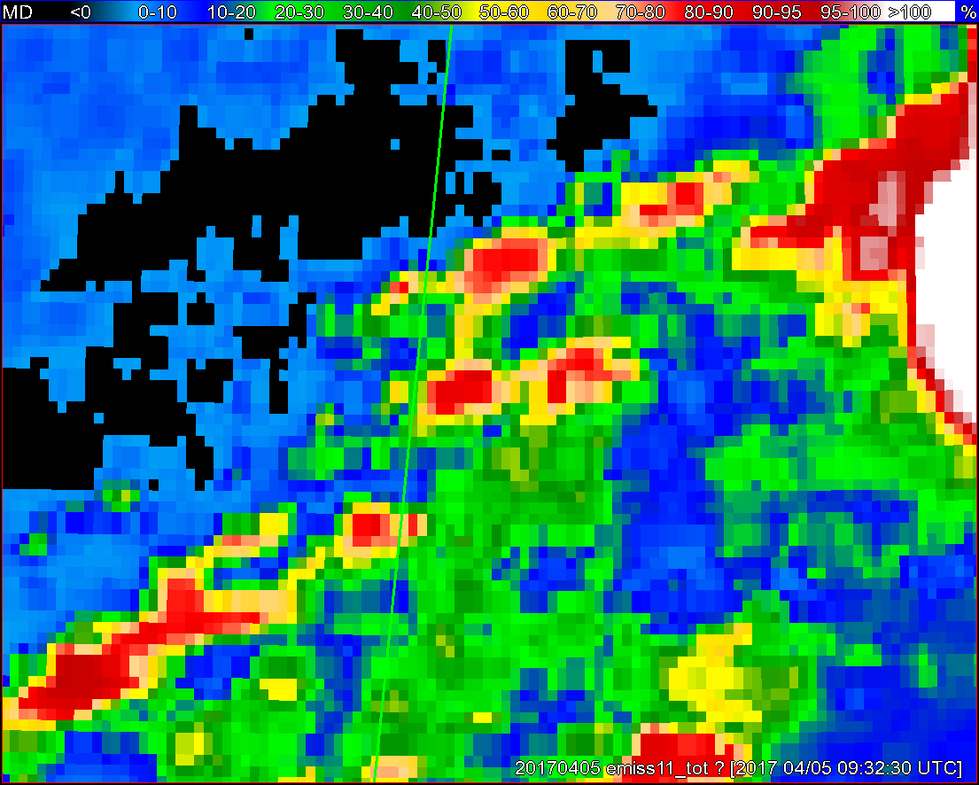
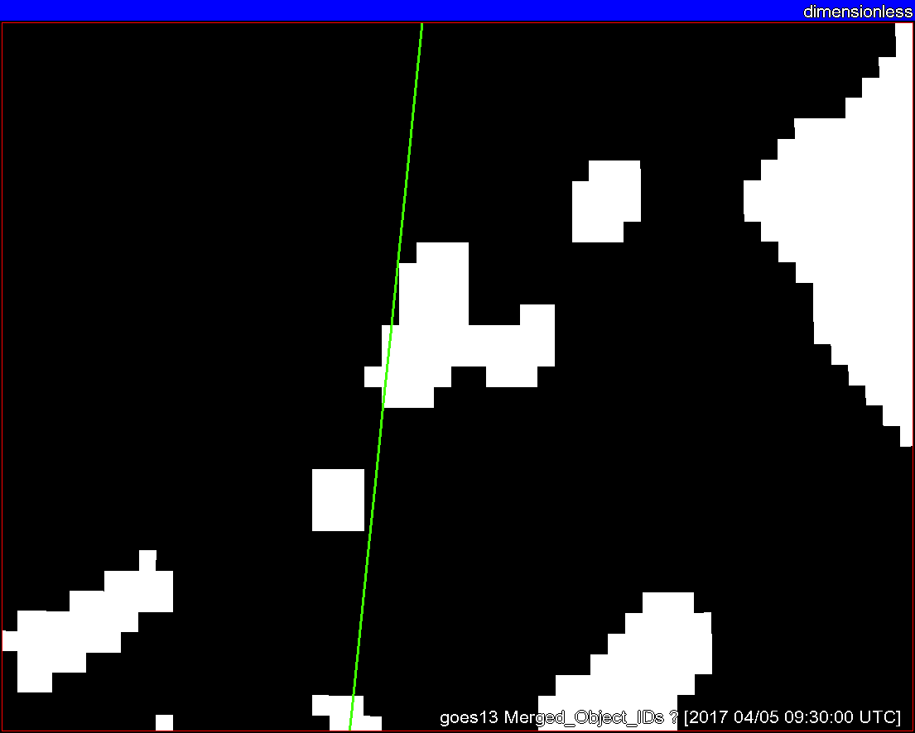
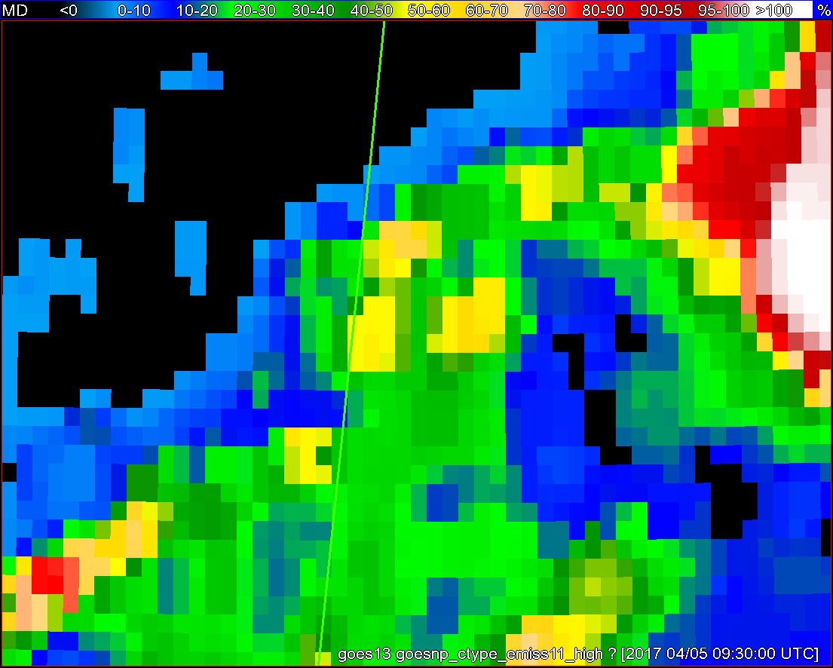
Objects
11-µm top-of-troposphere emissivity
GOES - 16
GOES - 13

Slide 39
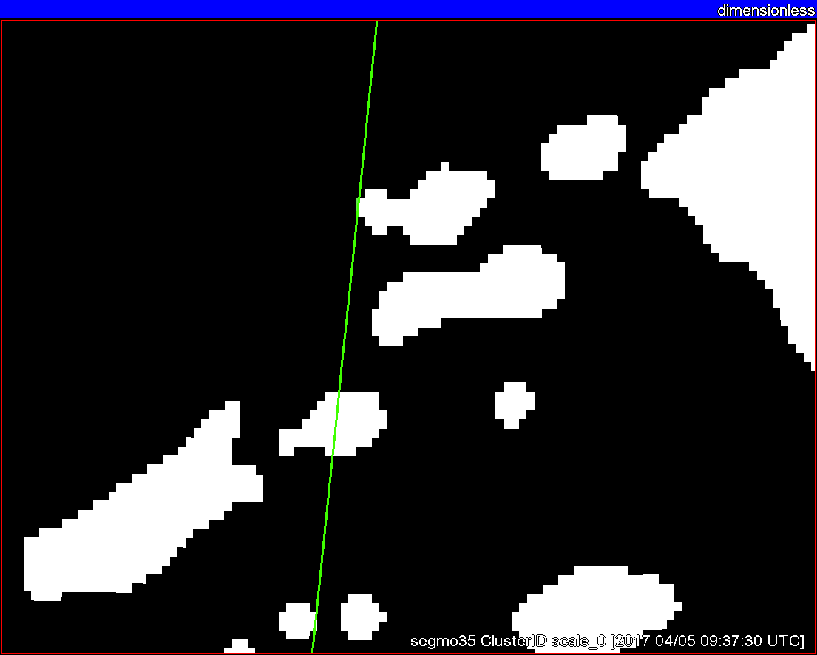
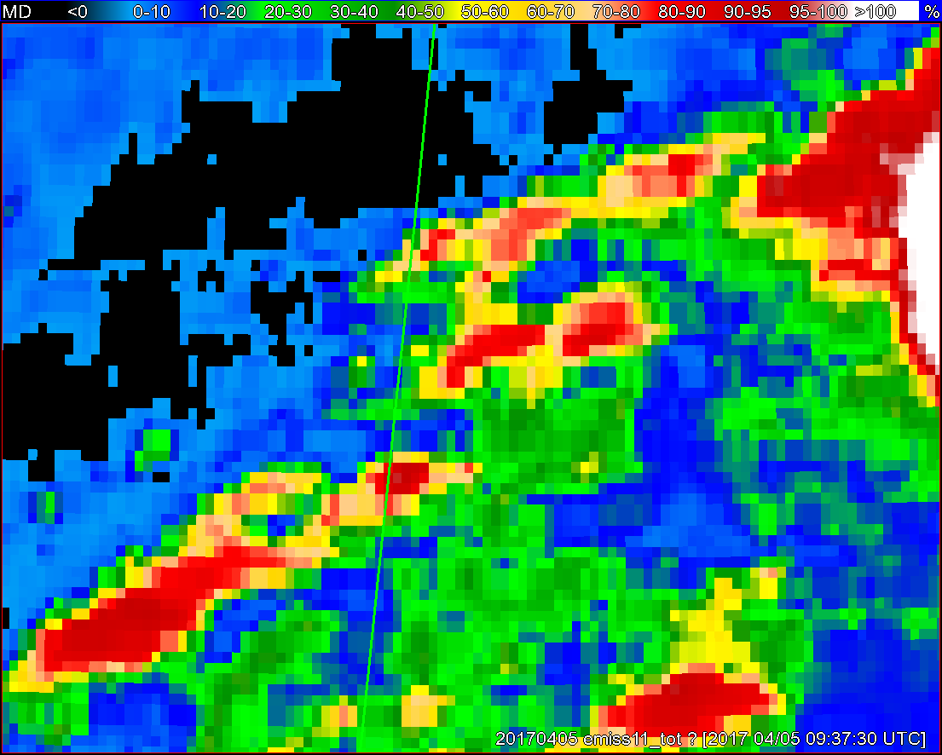
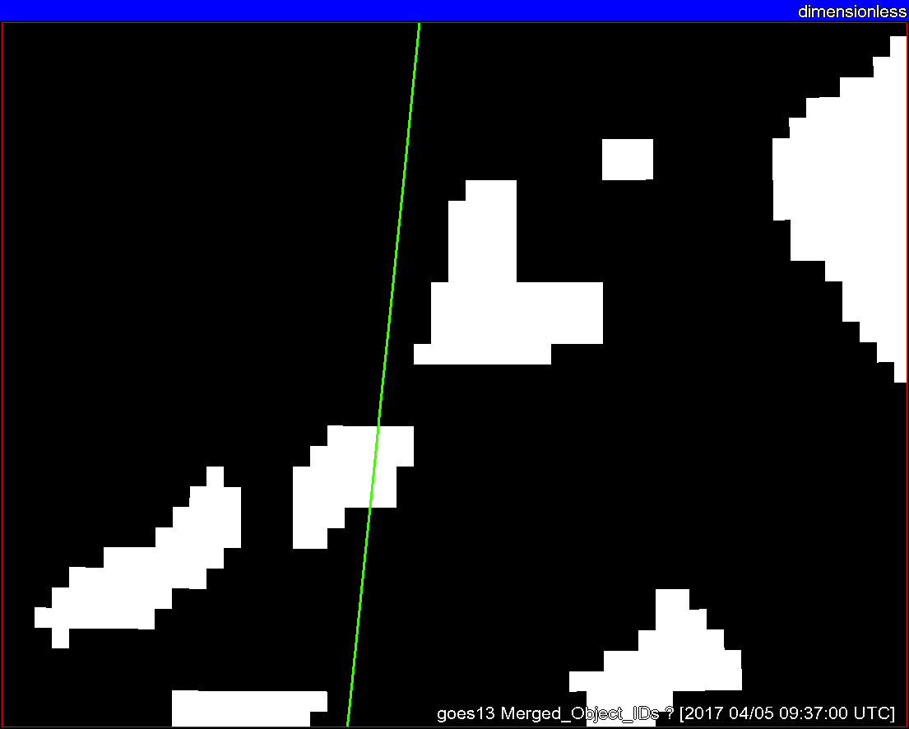
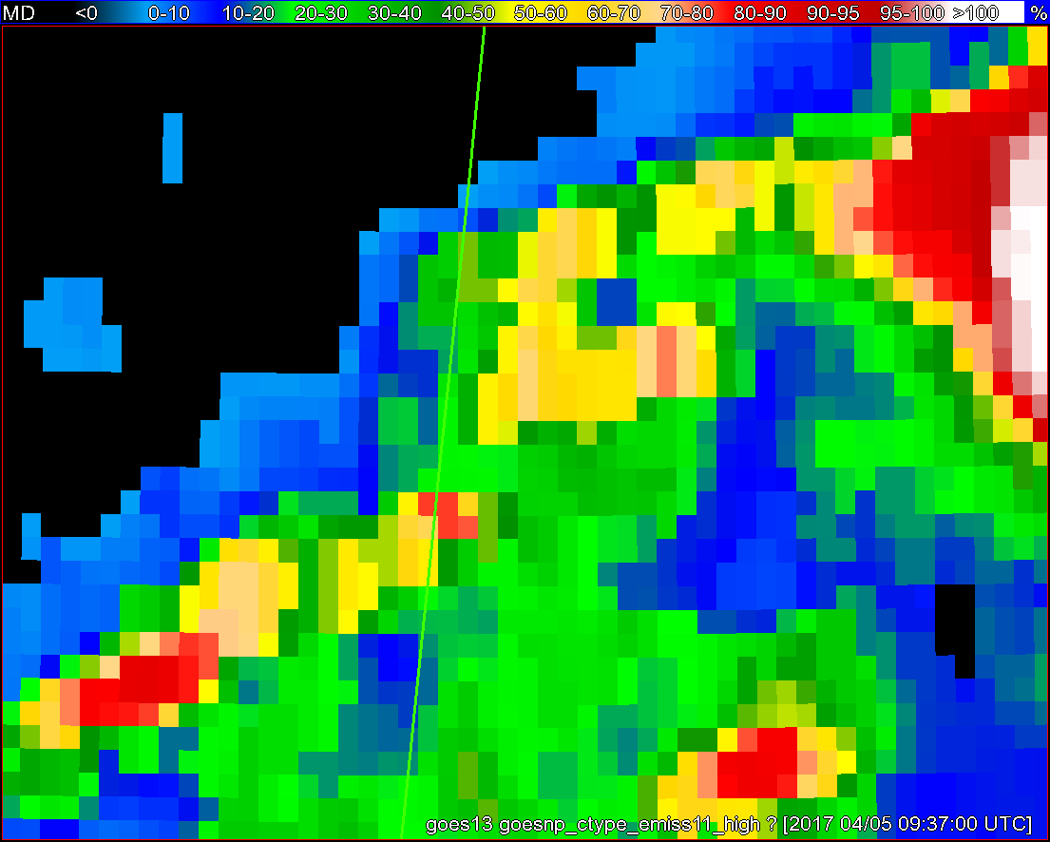
Objects
11-µm top-of-troposphere emissivity
GOES - 16
GOES - 13

Slide 40
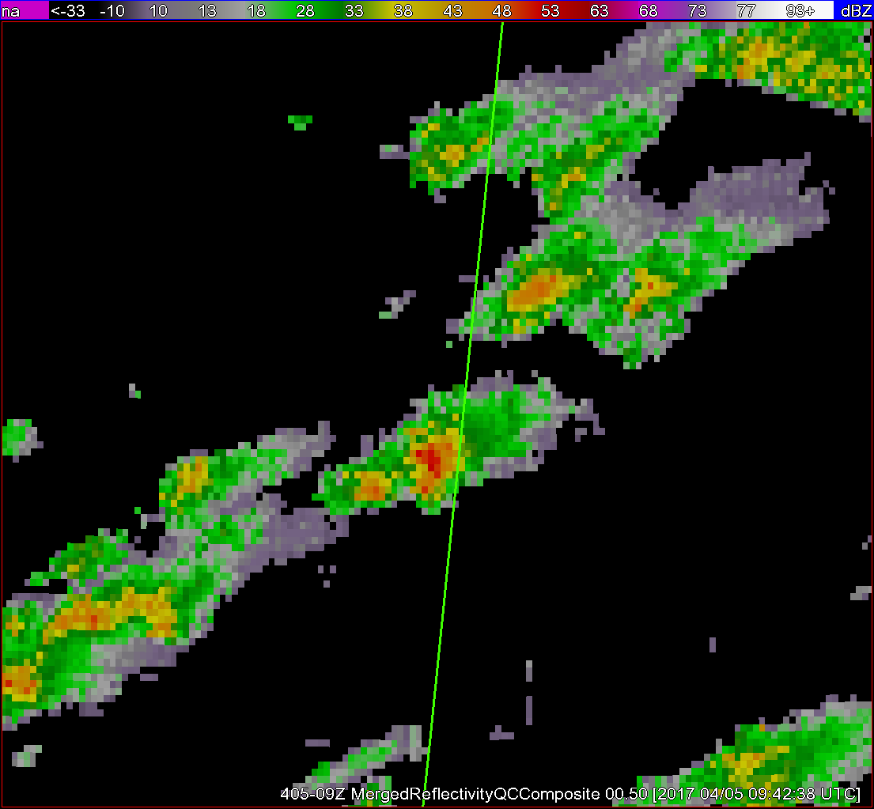
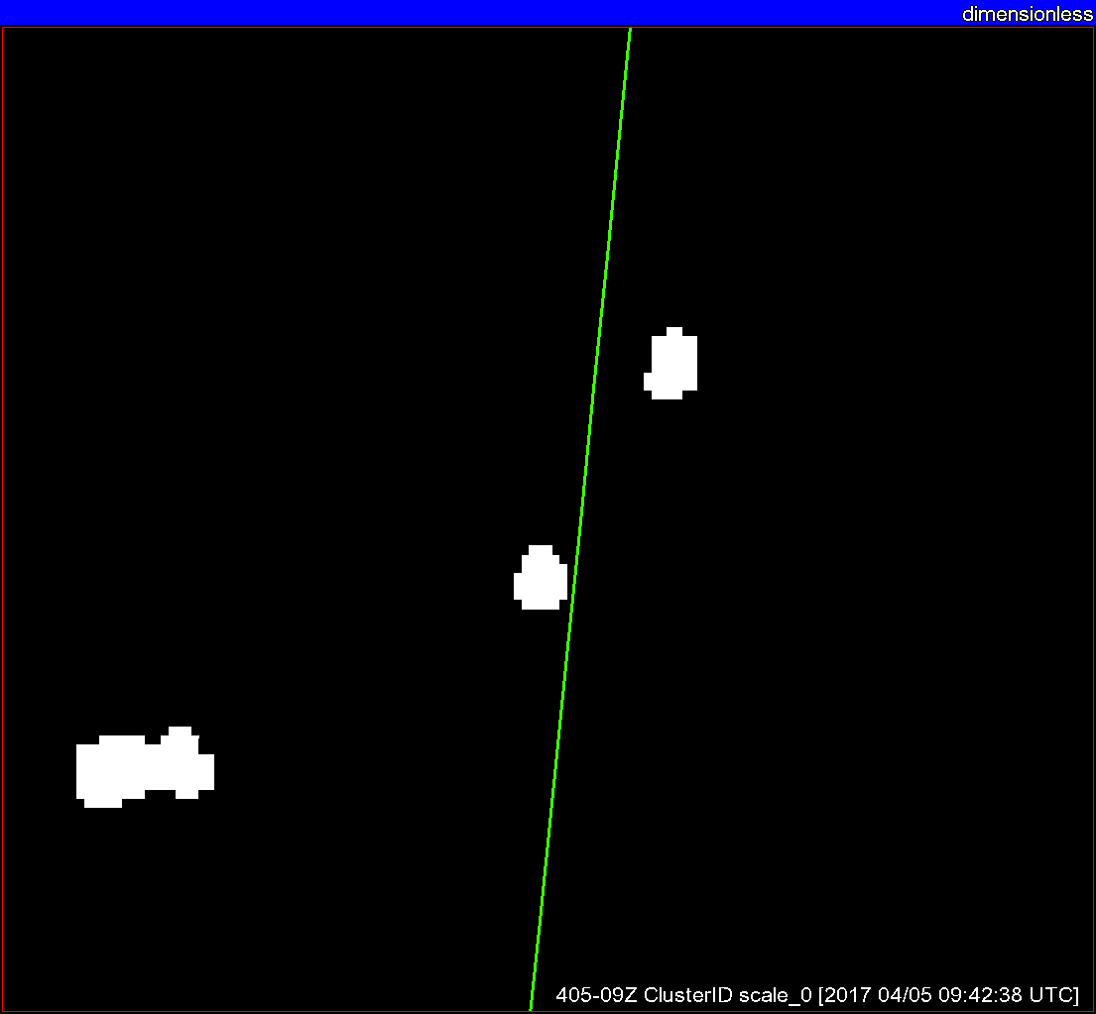
Radar reflectivity
Radar objects
+ G16 satellite objects
Satellite objects
ε_{tot}

Slide 41
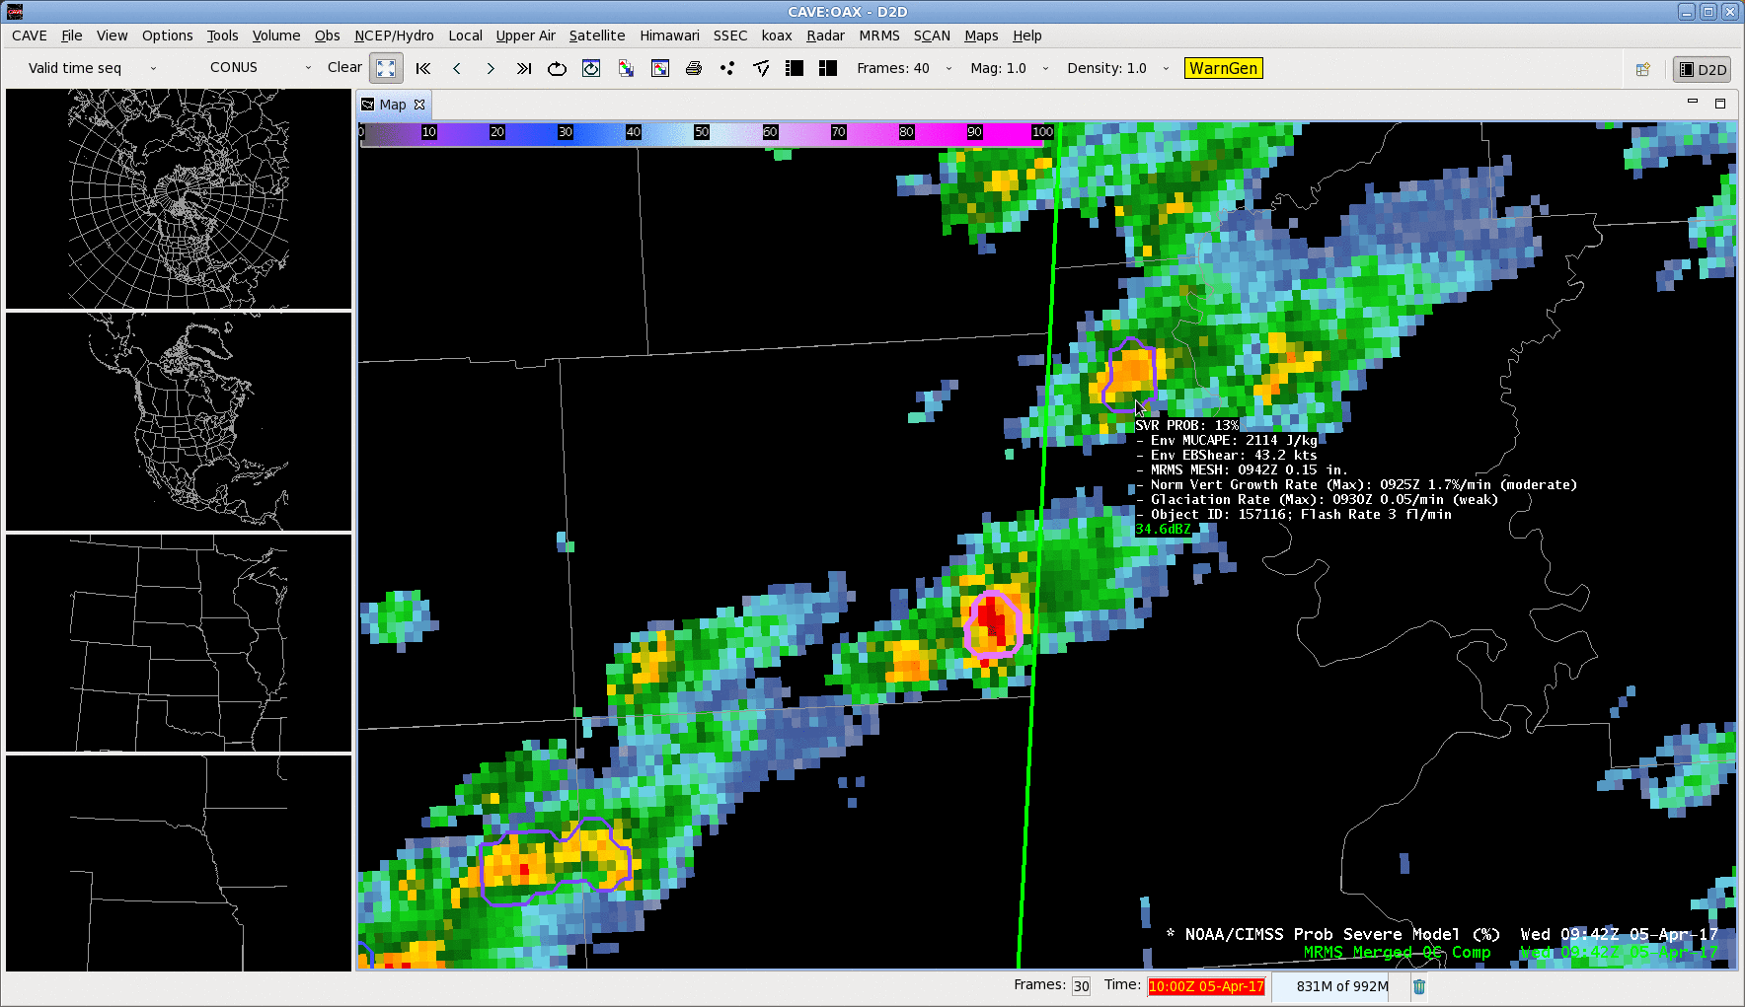

Slide 42

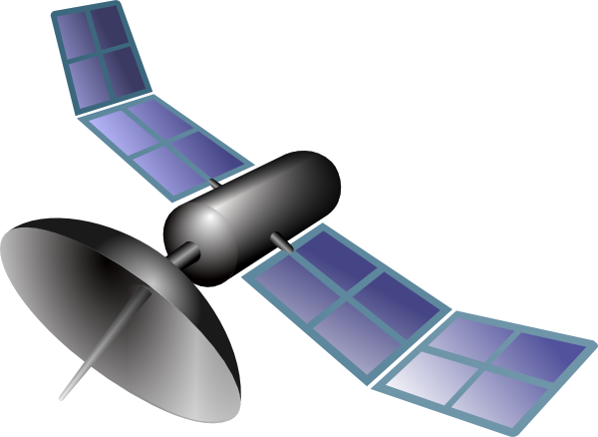
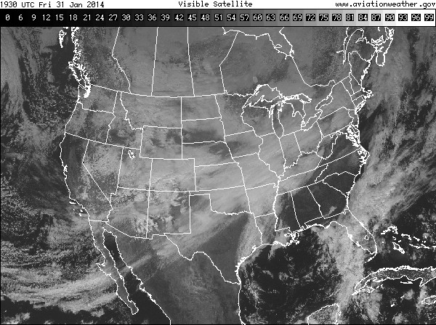
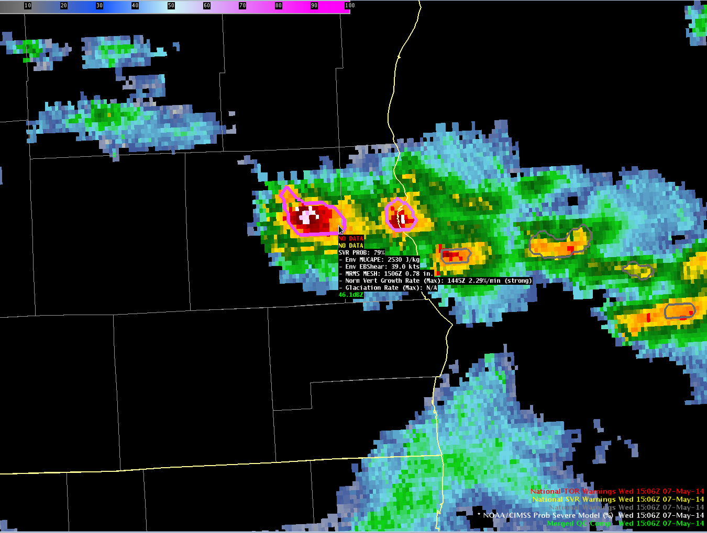
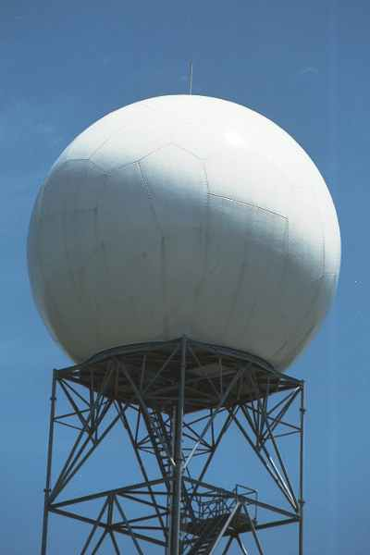
ProbSevere Model Real-Time Operations
Satellite, radar, lightning, and model data have different timescales
ProbSevere probabilities can change each time new data are available
EMC
In one hour…
1 set of RAP grids
8 CONUS satellite scans (in rapid scan)
ProbSevere
30 lightning files
OUTPUT
Input: 1300 MB
30 CONUS radar scans
Output: 6 MB
30 output files (~0.2 MB/file)
Notes:
So how is all this information combined in real-time processing? Unlike most GOES-R related projects that update with each satellite scan—ProbSevere is different. The model updates at the frequency of the MRMS radar data—about every 2 minutes.
When a storm develops and is tracked within satellite imagery, it has information about the storm environment from the RAP composite—which updates every hour. The probabilities are computed for every set of MRMS radar data—about every 2 minutes. The ENI total lightning data is also updated every 2 minutes. The update frequency of the current GOES satellite in routine scan mode is every 15 minutes, or roughly every 7.5 minutes in rapid-scan mode.
The critical point is:
The model does not wait on a satellite scan—it uses the most recent information available from satellite—whether the satellite is in routine scan mode or rapid scan mode. So users should expect updates in AWIPS-II about every 2 minutes.

Slide 43
ProbSevere Model Real-Time Operations
Satellite, radar, lightning, and model data have different timescales
ProbSevere probabilities can change each time new data are available
EMC
In one hour…
With 1 GOES-16 ABI
1 set of RAP grids
8 CONUS satellite scans (in rapid scan)
ProbSevere
30 lightning files
OUTPUT
Input: 9000 MB
30 CONUS radar scans
File size: 0.2 MB
30 output files
Notes:
So how is all this information combined in real-time processing? Unlike most GOES-R related projects that update with each satellite scan—ProbSevere is different. The model updates at the frequency of the MRMS radar data—about every 2 minutes.
When a storm develops and is tracked within satellite imagery, it has information about the storm environment from the RAP composite—which updates every hour. The probabilities are computed for every set of MRMS radar data—about every 2 minutes. The ENI total lightning data is also updated every 2 minutes. The update frequency of the current GOES satellite in routine scan mode is every 15 minutes, or roughly every 7.5 minutes in rapid-scan mode.
The critical point is:
The model does not wait on a satellite scan—it uses the most recent information available from satellite—whether the satellite is in routine scan mode or rapid scan mode. So users should expect updates in AWIPS-II about every 2 minutes.

Slide 44
ProbSevere Model Real-Time Operations
Satellite, radar, lightning, and model data have different timescales
ProbSevere probabilities can change each time new data are available
EMC
In one hour…
With 1 GOES-R ABI +
HRRR
1 set of RAP grids
8 CONUS satellite scans (in rapid scan)
ProbSevere
30 lightning files
OUTPUT
Input: 12,500 MB
30 CONUS radar scans
File size: 0.2 MB
30 output files
Notes:
So how is all this information combined in real-time processing? Unlike most GOES-R related projects that update with each satellite scan—ProbSevere is different. The model updates at the frequency of the MRMS radar data—about every 2 minutes.
When a storm develops and is tracked within satellite imagery, it has information about the storm environment from the RAP composite—which updates every hour. The probabilities are computed for every set of MRMS radar data—about every 2 minutes. The ENI total lightning data is also updated every 2 minutes. The update frequency of the current GOES satellite in routine scan mode is every 15 minutes, or roughly every 7.5 minutes in rapid-scan mode.
The critical point is:
The model does not wait on a satellite scan—it uses the most recent information available from satellite—whether the satellite is in routine scan mode or rapid scan mode. So users should expect updates in AWIPS-II about every 2 minutes.

Slide 45
Outline
What is ProbSevere?
What data does ProbSevere use?
Automated integration of information
Examples
ProbSevere – “all hazards”
Bulk verification
ProbSevere in HWT; media
Caveats
Next steps
Summary
Notes:
This training module describes the NOAA/CIMSS Prob Severe statistical model, provides examples of the model output in AWIPS-II, and briefly discusses model validation and model limitations. Why do we need a statistical model to nowcast severe weather?
The uses of statistical models are becoming more and more important and common place as data volumes explode in all aspects of our lives. Statistical models are used with great success to predict things like presidential elections and outcomes of the NCAA basketball tournament. Meteorology is no different; as bigger and more frequent data becomes available to forecasters it becomes more important to distill gigabytes of data into kilobytes of useful information. And that is what the NOAA/CIMSS Prob Severe model does.

Slide 46
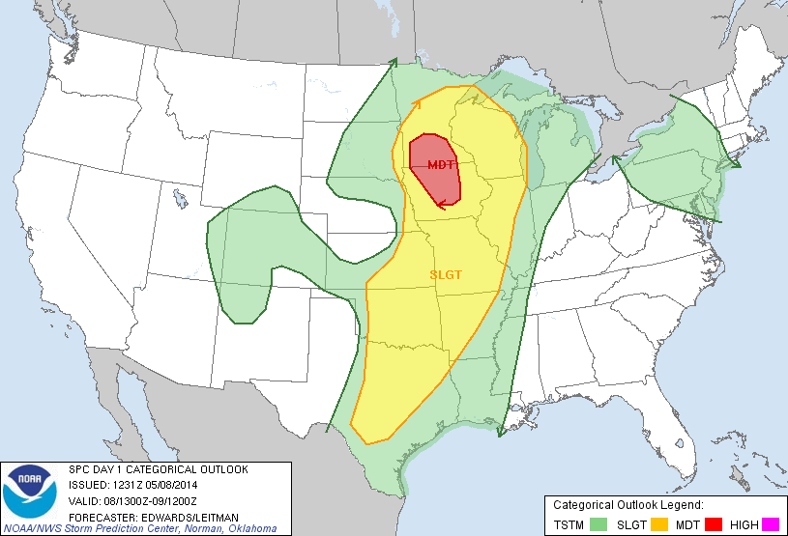
08 May 2014
Notes:
Now getting to examples, the first example is over southeastern South Dakota on the western edge of a slight risk region as depicted by the Storm Prediction Center outlook.

Slide 47
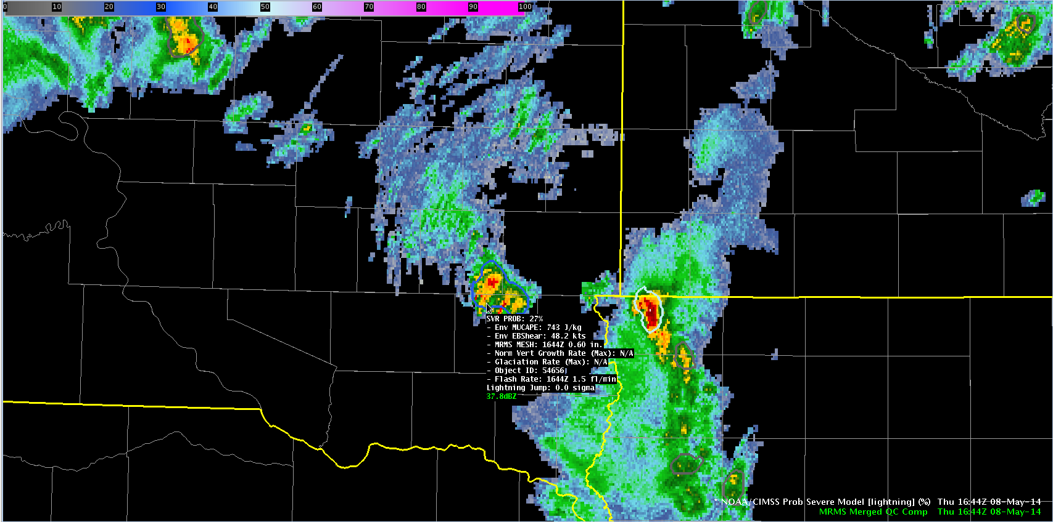
1644 UTC May-08-2014
MUCAPE ~ 750 J kg⁻¹
Eff. shear ~ 48 kts
Prob = 27%
Highly sheared environment
Low MESH
Low lightning
SD
IA
Notes:
In these examples, MRMS composite reflectivity is shaded and the ProbSevere contours are overlaid on the reflectivity data with the text read-out provided for the storm of interest. At 1644UTC a developing storm had marginal instability but significant shear. The probability at this time was low—only 27% as the MRMS MESH and total lightning were fairly low.

Slide 48

1646 UTC May-08-2014
MUCAPE ~ 750 J kg⁻¹
Eff. shear ~ 48 kts
Prob = 54%
Strong satellite growth and glaciation rates.
Small increase in lightning.
SD
IA
Notes:
At 1646 UTC, satellite growth rates were diagnosed and included into the ProbSevere calculation. Both the vertical growth rate and glaciation rate were in the ‘strong’ category, which drove the probability up to 54%.

Slide 49

1648 UTC May-08-2014
MUCAPE ~ 750 J kg⁻¹
Eff. shear ~ 48 kts
Prob = 78%
Strong satellite growth and glaciation rates.
MESH increases to 0.89”.
Lightning continues to increase.
SD
IA
Notes:
Two minutes later, the storm continued to intensify as indicated by the MESH and total lightning read-outs. The probably again jumped, now to 78%.

Slide 50

1726 UTC May-08-2014
MUCAPE ~ 750 J kg⁻¹
Eff. shear ~ 48 kts
Prob = 85%
KFSD issues SVR warning @ 1726 UTC.
Golf ball sized hail report @ 1732 UTC.
SD
IA
Notes:
The storm continued to exhibit high probabilities and at 1726 UTC a severe thunderstorm warning was issued by the Sioux Falls WFO. 6 minutes later the first severe report of golf ball sized hail was received. This example demonstrates how ProbSevere can be used to identify a storm that is likely to produce severe weather and potentially be used to increase lead-time. [For those interested, the storms over extreme northwestern Iowa/southwestern MN had lower probabilities and did not produce severe reports.]

Slide 51

What information does the satellite provide?
1646 UTC May-08-2014
Prob = 54%
Prob = 27%
NWP + Satellite + Radar + Lightning
NWP + Satellite + Radar + Lightning
Time (UTC) | With Satellite | Without Satellite
1644 | 27% (no sat. growth yet) | 27%
1646 | 54% | 27%
1648 | 78% | 54%
1728 | 85% | 65%
Notes:
We are often asked, what value do the satellite growth rates provide? Using this example, you can see at 1646 UTC, by removing the satellite observations, the ProbSevere probability is reduced by HALF! Additionally, removing the satellite growth rates reduces the amount of lead-time gained.

Slide 52

05-06 May 2014
Notes:
The next example is within a general thunderstorm risk region over southeastern Virginia on the evening of May 6, 2014.

Slide 53

0210 UTC May-06-2014
MUCAPE ~ 650 J kg⁻¹
Eff. shear ~ 35 kts
Prob = 9%
Low elevated CAPE
High shear
Strong 850 mb forcing
VA
NC
Notes:
Staring at 0210 UTC a developing thunderstorm is highlighted northwest of Wakefield, VA. This area was in a region of strong low-level warm air advection, characterized by marginal instability and moderate/high effective bulk shear. At this time, the probability is quite low—9%.

Slide 54

0212 UTC May-06-2014
MUCAPE ~ 650 J kg⁻¹
Eff. shear ~ 35 kts
Prob = 23%
MESH increases to ~0.60”
VA
NC
Notes:
At 0212 UTC, the probability increased from 9 to 23% as the MRMS MESH increased to near 0.60”.

Slide 55

0214 UTC May-06-2014
MUCAPE ~ 650 J kg⁻¹
Eff. shear ~ 35 kts
Prob = 46%
MESH increased to ¾”
Flash rate increasing
VA
NC
Notes:
Two minutes later, the probability again increased, now to 46% as MESH again increased to near ¾” and the flash rate also increased.

Slide 56

0216 UTC May-06-2014
MUCAPE ~ 650 J kg⁻¹
Eff. shear ~ 35 kts
Prob = 81%
Strong satellite growth rates
Strong sat. glaciation rates
VA
NC
Notes:
By 0216 UTC, strong satellite growth rate and glaciation rate drove the probability up to 81%.

Slide 57

0222 UTC May-06-2014
MUCAPE ~ 650 J kg⁻¹
Eff. shear ~ 35 kts
Prob = 94%
MESH is now over 1.1”
Lightning continues to increase.
VA
NC
Notes:
6 minutes later, the ProbSevere values were up to 94% with MESH over 1.1” and continued increase in total lightning.

Slide 58

0238 UTC May-06-2014
MUCAPE ~ 650 J kg⁻¹
Eff. shear ~ 35 kts
Prob = 97%
Report of 1.25” hail.
SVR issued @ 0241 UTC.
VA
NC
Notes:
At 0238 UTC, 16 minutes after ProbSevere surpassed the 90% threshold and 22 minutes after passing the 50% threshold, a report of 1.25” hail was received and a severe thunderstorm warning was issued at 0241 UTC. In marginal cases—like this case, where a severe thunderstorm watch was not justified, ProbSevere can still provide beneficial lead-time on severe weather.

Slide 59

15 Feb 2016
Notes:
This example focuses on Gulf Coast region on February 15, 2016.

Slide 60

1838 UTC Feb-15-2016
MUCAPE ~ 2000 J kg⁻¹
Eff. shear ~ 35 kts
Prob = 31%
Moderate CAPE
High Shear
Strong satellite growth rate
TX
LA
Notes:
At 1838 UTC over southwestern Louisiana, the environment was characterized by moderate-high instability and moderate-high shear. The highlighted storm had 31% probability with strong satellite normalized growth rate.

Slide 61

1840 UTC Feb-15-2016
MUCAPE ~ 2000 J kg⁻¹
Eff. shear ~ 35 kts
Prob = 52%
Increasing MESH and lightning
TX
LA
Notes:
At 1840 UTC, the probability increased to 52% as MESH and total lightning increased.

Slide 62

1842 UTC Feb-15-2016
MUCAPE ~ 2000 J kg⁻¹
Eff. shear ~ 35 kts
Prob = 69%
Increasing MESH ~0.75”
TX
LA
Notes:
Another probability jump occurred two minutes later as the MESH increased to ¾”.

Slide 63

1848 UTC Feb-15-2016
MUCAPE ~ 2000 J kg⁻¹
Eff. shear ~ 35 kts
Prob = 85%
Lightning continues to increase.
MESH approaching 1.00”
TX
LA
Notes:
By 1848 UTC the probability was now exceeding 80%, with MESH near 1.0” and a continued increase in total lightning.

Slide 64

1854 UTC Feb-15-2016
MUCAPE ~ 2000 J kg⁻¹
Eff. shear ~ 35 kts
Prob = 93%
TX
LA
Notes:
6 minutes later at 1854 UTC, the probability was now 93%.

Slide 65

1912 UTC Feb-15-2016
MUCAPE ~ 2000 J kg⁻¹
Eff. shear ~ 35 kts
Prob = 86%
TX
LA
Notes:
Small fluctuations of ProbSevere probabilities occurred between 1854 and 1912 UTC, but maintained values in excess of 80%. [While not the focus of this example, the line to the north and cell to the southeast also produced severe reports.]

Slide 66

1924 UTC Feb-15-2016
MUCAPE ~ 2000 J kg⁻¹
Eff. shear ~ 35 kts
Prob = 91%
1.0” hail report @ 1925 UTC
TX
LA
Notes:
At 1924 UTC the probability of this storm was 91% and the first severe report (1.0” hail) was received 1 minute later @ 1925 UTC.

Slide 67

1928 UTC Feb-15-2016
MUCAPE ~ 2000 J kg⁻¹
Eff. shear ~ 35 kts
Prob = 91%
SVR Warning @ 1928 UTC
TX
LA
Notes:
At 1928 UTC the first severe thunderstorm warning was issued. Again ProbSevere can be used to identify storms that are likely to produce severe weather and in conjunction with a forecaster’s experience and examination of all radar tilts can be used to increase lead-time.

Slide 68

1708 UTC Feb-15-2016
MUCAPE ~ 1650 J kg⁻¹
Eff. shear ~ 23 kts
Prob = 5%
SVR Warning @ 1656 UTC
SVR Wind @ 1705 UTC
LA
MS
Notes:
Shifting further northeast during this event over southwestern Mississippi, at 1708 UTC, the ProbSevere values were drastic underestimates. In this example a severe warned storm has ProbSevere value of 5% and produced 3 wind damage reports between 1705 and 1737 UTC. This example highlights the most significant shortcoming in the current configuration of the ProbSevere model. In this case, while the environment was supportive of severe weather, the observational predictors did not appropriately reflect the situation—the MESH values are low, little lightning exists, and the satellite was not able to determine growth rates (indicated by N/A). The next phase of ProbSevere research will look to provide hazard specific probabilities (e.g., hail, wind, and tornado), which will allow for the most physically relevant NWP and observational predictors to be used for each hazard type.

Slide 69
Outline
What is ProbSevere?
What data does ProbSevere use?
Automated integration of information
Examples
ProbSevere – “all hazards”
Bulk verification
ProbSevere in HWT; media
Caveats
Next steps
Summary
Notes:
This training module describes the NOAA/CIMSS Prob Severe statistical model, provides examples of the model output in AWIPS-II, and briefly discusses model validation and model limitations. Why do we need a statistical model to nowcast severe weather?
The uses of statistical models are becoming more and more important and common place as data volumes explode in all aspects of our lives. Statistical models are used with great success to predict things like presidential elections and outcomes of the NCAA basketball tournament. Meteorology is no different; as bigger and more frequent data becomes available to forecasters it becomes more important to distill gigabytes of data into kilobytes of useful information. And that is what the NOAA/CIMSS Prob Severe model does.

Slide 70
NOAA/CIMSS ProbSevere Model (All Hazards)
– Training Module –
Spring 2017
Notes:
This is a short training module for users of the NOAA/CIMSS ProbSevere ‘All Hazards’ Model.
ProbSevere All Hazards is an improvement to the NOAA/CIMSS ProbSevere model. ProbSevere All Hazards generates probabilities for the 3 severe storm hazards--severe hail, severe straight-line winds, and tornadoes. This training module is designed for users that are already familiar with the legacy NOAA/CIMSS ProbSevere model and provides only information very specific to the ProbSevere All Hazards model—including data used, examples, validation statistics, and best practices for ProbSevere All Hazards usage by operational forecasters.
If you are not familiar with ProbSevere it is recommended you first complete the 2016 ProbSevere training module available at: http://cimss.ssec.wisc.edu/severe_conv/training/training.html Additionally this training will not focus on the tornado aspect of ProbSevere All Hazards since a specific ProbTor training module has been created. This training module will focus on the hail and wind hazards and how ProbSevere All Hazards improves upon the previous version of ProbSevere, especially for wind hazards.
For simplicity, we will refer to ProbSevere All Hazards as ProbSevere. If we are making a comparison to the previous version/legacy ProbSevere, we will explicitly state that as such.

Slide 71

NOAA/CIMSS ProbSevere Model Goals
ProbSevere is a statistical model designed to increase forecaster confidence and/or increase lead-time in severe thunderstorm/tornado warning issuance.
The “all hazards” version of ProbSevere provides the probability of severe wind (ProbWind), the probability of severe hail (ProbHail), and the probability of tornado (ProbTor). The overall probability of severe is given by the maximum of ProbWind, ProbHail, and ProbTor.
ProbSevere can be used as a ‘pre-polygon’ product as well as an aid for warning reissuance.
Notes:
ProbSevere follows the same radar object-based naïve Bayesian statistical framework as the legacy NOAA/CIMSS ProbSevere model and also follows the same display concepts (both in AWIPS-II and PHI visualization). ProbSevere is the probability a storm will produce severe weather in the next 60 minutes. The displayed probability is the maximum of the three hazard predictions—severe hail, severe wind, and tornado.
ProbSevere is a statistical model designed to increase forecaster confidence and/or increase lead-time in severe thunderstorm/tornado warning issuance.

Slide 72
NOAA/CIMSS ProbSevere Model
Storm objects are identified and tracked from radar reflectivity—identically to the legacy version of ProbSevere
Each storm object has a probability for:
  Severe Hail (ProbHail)
  Severe Straight-line Winds (ProbWind)
  Tornado (ProbTor)
The most significant improvements between legacy ProbSevere and “all hazards” ProbSevere is for storms that produce severe straight-line winds and/or tornado.
Notes:
ProbSevere employs the same object tracking and statistical model as the previous version/legacy ProbSevere, except more physically relevant NWP and radar observations are used to predict each specific hazard.
ProbSevere most significantly improved for wind and tornado hazards, with more modest improvement for hail hazards (the previous version of ProbSevere already demonstrated excellent skill with respect to the hail hazard).

Slide 73
NOAA/CIMSS ProbSevere Model
Probabilities are a function of the dynamic and thermodynamic environment and observations
ProbWind:
a priori: f(MeanWind 900-700 mb / MLCAPE)
VIL Density
Flash Rate vs 3-6 km AzShear
MeanWind 900-700 mb vs. 0-2 km AzShear
Satellite Growth Rate
Satellite Glaciation Rate
ProbHail:
a priori: f(MUCAPE/EBS)
MESH vs. Wet Bulb 0°C Height
Flash Rate vs. EBS
Lapse Rate (700-500 mb ) vs. min average RH (700-450 mb)
Satellite Growth Rate
Satellite Glaciation Rate
ProbTor:
a priori: 0.01
Max 0-2km AzShear
98th %ile 0-2km AzShear vs. 0-1km SRH
98th %ile 3-6km AzShear vs. max flash density
EBS vs. MeanWind 900-700mb
MLCAPE; MLCIN
Notes:
For ProbSevere the most pertinent environmental and observational datasets are utilized for the targeted hazard.
For ProbHail:
a priori: MUCAPE/EBS—measure of potential updraft intensity for most unstable parcel and potential storm organization
Maximum Expected Size of Hail (MESH) vs the height of the wet bulb 0C--inclusion of the wet bulb 0C paired with MESH better accounts for lack of melting in low-topped hail storms and increased melting in many southeastern US summertime storms.
Flash Rate (Earth Networks Total Lightning) vs Effective Bulk Shear—measure of updraft strength and potential storm organization
Lapse rate (700-500 mb) vs minimum average RH in 700-450 mb layer—Combination of steeper mid-level lapse rates and drier mid-level air are more favorable for severe hail
Satellite growth and glaciation rates—Measures of initial updraft intensity
For ProbWind:
a priori: Mean wind (900-700 mb)/MLCAPE—measure of environmental momentum to potentially transfer to the surface and potential updraft intensity for mixed-layer parcels (mixed-layer parcels are better for wind, while most unstable parcels are better for hail).
VIL Density—Measure of precipitation core intensity
Flash Rate vs 3-6 km AzShear—measure of updraft intensity and proxy for strength of mid-level storm winds
Mean wind (900-700 mb) vs 0-2 km AzShear—measure of environmental momentum to potentially transfer to the surface and proxy for strength of low-level storm winds
Satellite growth and glaciation rates—Measures of initial updraft intensity

Slide 74


ProbSevere Model AWIPS-II Display
Model output are shapefiles contoured around radar storm cells.
Enhancement designed for overlay atop radar reflectivity—but can be overlaid on any field (satellite, radar velocity, etc.).
Sampling offers readout of model probability as well as each model predictor.
Notes:
The ProbSevere visualization in AWIPS-2 is shown. The ProbSevere visualization utilizes the same concept as legacy ProbSevere, a contour around an identified radar object is color-coded based on the ProbSevere value. Since some predictors are used by more than 1 individual hazard prediction, the predictors listed in the read-out are not grouped by individual hazard prediction, but all the predictors used to compute ProbHail, ProbWind, and ProbTor are listed.
It should be noted for 2017 HWT we are providing 2 versions of ProbSevere in the AWIPS-2 menu—ProbSevere Full and ProbSevere Light. The “Full” version is what is shown here. The “Light” version offers the forecaster the same probabilities, but with fewer predictors shown for a smaller read-out footprint.

Slide 75
ProbSevere Model AWIPS-II Display
ProbSevere = Maximum of:
ProbHail: Probability of Hail; 0-100%
ProbWind: Probability of Wind; 0-100%
ProbTor: Probability of Tornado; 0-100%
Notes:
The contours shaded on the AWIPS-2 terminal is the ProbSevere probability—which is the maximum of the 3 component probabilities (ProbHail, ProbWind, ProbTor).

Slide 76
ProbSevere Model AWIPS-II Display
MUCAPE: Most Unstable parcel CAPE (J/kg)
MLCAPE: Mixed-layer parcel CAPE (J/kg)
MLCIN: Mixed-layer parcel CIN (J/kg)
Notes:
These NWP-based (RAP model) predictors are used to measure the potential atmospheric instability and inhibition.

Slide 77
ProbSevere Model AWIPS-II Display
EBS: Effective Bulk Shear (kts)
SRH 0-1km AGL: Storm relative helicity in 0-1 km layer above ground level (m²/s²)
MeanWind 700-900 mb: Mean wind in the 700-900 mb layer (kts)
Notes:
These are the NWP-based kinematic fields used within ProbSevere.

Slide 78
ProbSevere Model AWIPS-II Display
MESH: Storm maximum MRMS MESH (inches)
VIL Density: Storm maximum MRMS VIL Density (g/m³)
Notes:
The storm cell’s maximum MRMS MESH and MRMS VIL Density are radar measurements of the storm’s precipitation core.

Slide 79
ProbSevere Model AWIPS-II Display
Flash Rate: Total lightning flash rate within radar object (flashes / min)
Flash Density (max in last 30 min): Maximum flash density within object in past 30 minutes
Notes:
The storm cell’s maximum total lightning flash rate and flash density are used by ProbSevere and offer an additional measure of the storm’s updraft intensity.

Slide 80
ProbSevere Model AWIPS-II Display
Max LLAzShear: Maximum MRMS 0-2 km AzShear within radar object
98% LLAzShear: 98th percentile MRMS 0-2 km AzShear within radar object
98% MLAzShear: 98th percentile MRMS 3-6 km AzShear within radar object
Notes:
These predictors are MRMS observations of the storm wind field intensity/rotation.

Slide 81
ProbSevere Model AWIPS-II Display
Norm Vert Growth Rate: Maximum storm cell satellite vertical growth rate (%)
Glaciation rate: Maximum storm cell satellite glaciation rate (%)
Time occurred; classified as weak, moderate, or strong.
Notes:
These predictors are derived from the GOES-EAST and GOES-WEST satellites and measure the storm’s initial updraft intensity. It should be noted that during 2017, we will continue to use GOES-13 and GOES-15—GOES-16(R) measurements are not yet employed during 2017. We cannot yet use GOES-16 measurements because the statistical model needs a sufficient period of training data—2017 will serve as the GOES-16 training dataset—we anticipate using GOES-16 measurements in 2018.

Slide 82
ProbSevere Model AWIPS-II Display
Wetbulb 0°C hgt: Height of wetbulb 0°C (m, above ground level)
Lapse Rate 700-500 mb: Lapse rate in the 700-500 mb layer (C/km)
minAvgRH 700-450 mb: Minimum mean RH in 700-450 mb layer (%)
Notes:
These are additional NWP-based predictors used by the ProbSevere model—specifically in the ProbHail computation.

Slide 83
ProbSevere Model AWIPS-II Display
Avg. beam height (ARL): Average beam height above radar level (kft and km). (Assuming a standard atmosphere.)
Notes:
The average center beam height above radar level is provided within the ProbSevere read-out. Since ProbSevere relies on radar observations, the forecaster is encouraged to use the same beam height/blockage considerations as when using single site radar observations.

Slide 84

05April 2017
Notes:
We will show an example of ProbSevere before moving to validation and best practices.
This example focuses on northeastern Alabama during the early morning hours of April 5, 2017.

Slide 85


05 April 2017 – 1000 UTC
ProbSevere = 25%
Sufficient instability and moderate effective bulk shear
Notes:
A storm near Talladega, Alabama was developing at 1000 UTC on 05 April 2017.
The environment was favorable for severe weather and at 1000 UTC ProbSevere was 25% (ProbHail: 19%, ProbWind: 25%).

Slide 86


05 April 2017 – 1010 UTC
ProbSevere = 76%
Significant ProbSevere increase over past 10 minutes due to increasing radar and lightning intensity
Notes:
Ten minutes later, ProbSevere jumped to 76% (ProbHail: 76%; Probwind: 68%)
The ProbSevere values jumped due to increases in MRMS MESH/VIL Density as well as storm flash rate.

Slide 87


05 April 2017 – 1014 UTC
ProbSevere = 90%
Only 4 minutes later, ProbSevere value is now very high due further storm strengthening
Notes:
Only 4 minutes later, at 1014 UTC, ProbSevere jumped to 90% (ProbHail: 90%; ProbWind: 88%)

Slide 88


05 April 2017 – 1022 UTC
ProbSevere = 94%
At 1022 UTC NWS issues severe thunderstorm warning
1027 UTC: First wind report
1030 UTC: First hail report
Notes:
At 1022 UTC the NWS in Birmingham issued a severe thunderstorm warning.
The first wind report was at 1027 UTC and first hail report was at 1030 UTC (1.00”), with subsequent golf ball sized hail reports.
This example illustrates the potential utility of ProbSevere to the warning forecaster:
As a potential to increase lead-time—the ProbSevere values jumped above 70% 12 minutes prior to the warning and 17 minutes prior to the first wind report.
As a potential to increase confidence–the warning forecaster may not need to “wait for 1 or 2 more volume scan(s)” when adding ProbSevere to their toolkit.

Slide 89

05 April 2017 – Time Series
Notes:
This slide shows a time series of many fields for the severe thunderstorm we’ve just covered.
There are many curves, but focus on the solid red line (ProbSevere) with the axis label on the left.
At the bottom of the plot you will see time as well as NWS warnings and severe weather reports.
To PHI users, real-time time-series capabilities will be available within the PHI tool.
To HWT users, we do not yet have a time-series capability in AWIPS-2, but recognize the value and are working toward this capability.
The highlights of this time-series include:
Rapidly increasing ProbSevere values prior to the first severe thunderstorm warning and well in advance of the first wind report, which can increase confidence in issuing a severe thunderstorm warning and as well as increase lead-time.

Slide 90
ProbTor
Notes:
This training module describes the NOAA/CIMSS Prob Severe statistical model, provides examples of the model output in AWIPS-II, and briefly discusses model validation and model limitations. Why do we need a statistical model to nowcast severe weather?
The uses of statistical models are becoming more and more important and common place as data volumes explode in all aspects of our lives. Statistical models are used with great success to predict things like presidential elections and outcomes of the NCAA basketball tournament. Meteorology is no different; as bigger and more frequent data becomes available to forecasters it becomes more important to distill gigabytes of data into kilobytes of useful information. And that is what the NOAA/CIMSS Prob Severe model does.

Slide 91

02 April 2017
Notes:
We will show an example of ProbTor before moving to validation and best practices for using ProbTor.
This example focuses on Louisiana on April 2, 2017 in a very favorable kinematic environment for tornadoes as evidenced by the SPC outlook.

Slide 92


02 April 2017 – 1818 UTC
ProbTor = 53%
Very favorable kinematics
Low-level rotation increased in past 8 minutes
Notes:
At 1818 UTC the ProbTor value increased to 53%, coincident with the Lake Charles office issuing a tornado warning. In this example ProbTor can assist the warning forecaster by 1) demonstrating an increased tornado threat with this storm as evidenced by increasing ProbTor values from 16% at 1806 UTC to 53% at 1818 UTC and 2) highlighting this storm as the storm with the largest threat relative to the remaining storms (ProbTor values < 10%).

Slide 93

02 April 2017 – Time Series
Notes:
This slide shows a time series of many fields for the tornadic storm we’ve just covered.
There are many curves, but focus on the solid red line (ProbTor) with the axis label on the left.
At the bottom of the plot you will see time as well as NWS warnings and severe weather reports.
To PHI users, real-time time-series capabilities will be available within the PHI tool.
To HWT users, we do not yet have a time-series capability in AWIPS-2, but recognize the value and are working toward this capability.
The highlights of this time-series include:
Rapidly increasing ProbTor values prior to the first tornado warning and well in advance of the first tornado report, which can increase confidence in issuing a tornado warning and potentially increase lead-time.
ProbTor values can fluctuate considerably in response to changing observations of low and mid level storm rotation and total lightning density. A drop in ProbTor values should NOT necessarily be interpreted as an end to the tornadic threat, but may simply be storm cycling. Continued monitoring of the storm remains essential.

Slide 94

06 April 2017

Slide 95

EF-2 Okeechobee Co.
Notes:
This training module describes the NOAA/CIMSS Prob Severe statistical model, provides examples of the model output in AWIPS-II, and briefly discusses model validation and model limitations. Why do we need a statistical model to nowcast severe weather?
The uses of statistical models are becoming more and more important and common place as data volumes explode in all aspects of our lives. Statistical models are used with great success to predict things like presidential elections and outcomes of the NCAA basketball tournament. Meteorology is no different; as bigger and more frequent data becomes available to forecasters it becomes more important to distill gigabytes of data into kilobytes of useful information. And that is what the NOAA/CIMSS Prob Severe model does.

Slide 96
EF-2 Okeechobee Co.
Notes:
This training module describes the NOAA/CIMSS Prob Severe statistical model, provides examples of the model output in AWIPS-II, and briefly discusses model validation and model limitations. Why do we need a statistical model to nowcast severe weather?
The uses of statistical models are becoming more and more important and common place as data volumes explode in all aspects of our lives. Statistical models are used with great success to predict things like presidential elections and outcomes of the NCAA basketball tournament. Meteorology is no different; as bigger and more frequent data becomes available to forecasters it becomes more important to distill gigabytes of data into kilobytes of useful information. And that is what the NOAA/CIMSS Prob Severe model does.

Slide 97

EF-2 Okeechobee Co.
Notes:
This training module describes the NOAA/CIMSS Prob Severe statistical model, provides examples of the model output in AWIPS-II, and briefly discusses model validation and model limitations. Why do we need a statistical model to nowcast severe weather?
The uses of statistical models are becoming more and more important and common place as data volumes explode in all aspects of our lives. Statistical models are used with great success to predict things like presidential elections and outcomes of the NCAA basketball tournament. Meteorology is no different; as bigger and more frequent data becomes available to forecasters it becomes more important to distill gigabytes of data into kilobytes of useful information. And that is what the NOAA/CIMSS Prob Severe model does.

Slide 98

October 23, 2017
Notes:
This training module describes the NOAA/CIMSS Prob Severe statistical model, provides examples of the model output in AWIPS-II, and briefly discusses model validation and model limitations. Why do we need a statistical model to nowcast severe weather?
The uses of statistical models are becoming more and more important and common place as data volumes explode in all aspects of our lives. Statistical models are used with great success to predict things like presidential elections and outcomes of the NCAA basketball tournament. Meteorology is no different; as bigger and more frequent data becomes available to forecasters it becomes more important to distill gigabytes of data into kilobytes of useful information. And that is what the NOAA/CIMSS Prob Severe model does.

Slide 99

October 23, 2017
Notes:
This training module describes the NOAA/CIMSS Prob Severe statistical model, provides examples of the model output in AWIPS-II, and briefly discusses model validation and model limitations. Why do we need a statistical model to nowcast severe weather?
The uses of statistical models are becoming more and more important and common place as data volumes explode in all aspects of our lives. Statistical models are used with great success to predict things like presidential elections and outcomes of the NCAA basketball tournament. Meteorology is no different; as bigger and more frequent data becomes available to forecasters it becomes more important to distill gigabytes of data into kilobytes of useful information. And that is what the NOAA/CIMSS Prob Severe model does.

Slide 100

October 23, 2017
Notes:
This training module describes the NOAA/CIMSS Prob Severe statistical model, provides examples of the model output in AWIPS-II, and briefly discusses model validation and model limitations. Why do we need a statistical model to nowcast severe weather?
The uses of statistical models are becoming more and more important and common place as data volumes explode in all aspects of our lives. Statistical models are used with great success to predict things like presidential elections and outcomes of the NCAA basketball tournament. Meteorology is no different; as bigger and more frequent data becomes available to forecasters it becomes more important to distill gigabytes of data into kilobytes of useful information. And that is what the NOAA/CIMSS Prob Severe model does.

Slide 101

July 20, 2017
Notes:
This training module describes the NOAA/CIMSS Prob Severe statistical model, provides examples of the model output in AWIPS-II, and briefly discusses model validation and model limitations. Why do we need a statistical model to nowcast severe weather?
The uses of statistical models are becoming more and more important and common place as data volumes explode in all aspects of our lives. Statistical models are used with great success to predict things like presidential elections and outcomes of the NCAA basketball tournament. Meteorology is no different; as bigger and more frequent data becomes available to forecasters it becomes more important to distill gigabytes of data into kilobytes of useful information. And that is what the NOAA/CIMSS Prob Severe model does.

Slide 102

July 20, 2017
Notes:
This training module describes the NOAA/CIMSS Prob Severe statistical model, provides examples of the model output in AWIPS-II, and briefly discusses model validation and model limitations. Why do we need a statistical model to nowcast severe weather?
The uses of statistical models are becoming more and more important and common place as data volumes explode in all aspects of our lives. Statistical models are used with great success to predict things like presidential elections and outcomes of the NCAA basketball tournament. Meteorology is no different; as bigger and more frequent data becomes available to forecasters it becomes more important to distill gigabytes of data into kilobytes of useful information. And that is what the NOAA/CIMSS Prob Severe model does.

Slide 103

July 20, 2017
Notes:
This training module describes the NOAA/CIMSS Prob Severe statistical model, provides examples of the model output in AWIPS-II, and briefly discusses model validation and model limitations. Why do we need a statistical model to nowcast severe weather?
The uses of statistical models are becoming more and more important and common place as data volumes explode in all aspects of our lives. Statistical models are used with great success to predict things like presidential elections and outcomes of the NCAA basketball tournament. Meteorology is no different; as bigger and more frequent data becomes available to forecasters it becomes more important to distill gigabytes of data into kilobytes of useful information. And that is what the NOAA/CIMSS Prob Severe model does.

Slide 104
Outline
What is ProbSevere?
What data does ProbSevere use?
Automated integration of information
Examples
ProbSevere – “all hazards”
Bulk verification
ProbSevere in HWT; media
Caveats
Next steps
Summary
Notes:
This training module describes the NOAA/CIMSS Prob Severe statistical model, provides examples of the model output in AWIPS-II, and briefly discusses model validation and model limitations. Why do we need a statistical model to nowcast severe weather?
The uses of statistical models are becoming more and more important and common place as data volumes explode in all aspects of our lives. Statistical models are used with great success to predict things like presidential elections and outcomes of the NCAA basketball tournament. Meteorology is no different; as bigger and more frequent data becomes available to forecasters it becomes more important to distill gigabytes of data into kilobytes of useful information. And that is what the NOAA/CIMSS Prob Severe model does.

Slide 105
ProbSevere Model Performance
POD/FAR/CSI
Reliability
Skill plots show ProbSevere is less skillful than experienced forecasters (as expected) , but is comparable and offers increased lead-time
Reliability diagram shows slight over forecast bias for most probability thresholds, but “all hazards” ProbSevere is well calibrated overall
Notes:
The ProbSevere preliminary verification shown on this slide includes 2,250 severe storms and 42,000 non-severe storms during 2016.
ProbSevere is fairly well calibrated and users should expect verification at the approximate rate as the probability (e.g., a storm achieving a 40% probability will produce severe weather 4 in 10 times, a storm achieving a 80% probability will produce severe weather about 8 in 10 times, and so on).
The skill and lead-time analysis demonstrates that ProbSevere is not as skilled experienced NWS forecasters, yet is comparable. The increased lead-time and well-calibrated probabilities can offer the forecaster 1) increased confidence in their decision making and 2) increased lead-time in making warning decisions.

Slide 106
ProbSevere – Wind Improvement
Wind LSR’s Only Legacy ProbSevere
Wind LSR’s Only ProbWind from “all hazards” ProbSevere
Skill plots show that the ProbWind component of “all hazards” ProbSevere significantly improves upon the severe probability from the legacy version of ProbSevere.
Notes:
The ProbWind preliminary verification for wind events shown on this slide includes 1,650 severe storms and 42,000 non-severe storms during 2016.
ProbSevere—ProbWind incorporates more physically relevant NWP predictors and more direct measurements of thunderstorm wind velocity than the original version of ProbSevere. As such this figure shows the ProbSevere--ProbWind (right) has significantly higher POD, lower FAR and higher CSI for most probability thresholds when scoring for wind events (and is also better calibrated (more reliable), not shown).

Slide 107


ProbSevere – Wind Improvement
06 April 2017 – 1748 UTC near Washington DC
Legacy ProbSevere: 12%
ProbHail: 13%, ProbWind: 80%, ProbTor: 14%
Notes:
This is a specific example of of the improvement of ProbSevere for a wind event near Washington DC at 1748 UTC on 06 April 2017.
ProbSevere is 80% (from ProbWind prediction) compared to legacy ProbSevere being only 12%.
This storm had a history of producing wind damage and continued to produce wind damage reports for the following ~2 hours through the Baltimore area.

Slide 108
ProbTor Model Performance
POD/FAR/CSI
Reliability
Verification against LSR’s shows that ProbTor is less skillful than experienced forecasters (as expected), but offers increased lead-time
Reliability analysis shows ProbTor tends to slightly under forecast when probability is ≤ 60% and slightly over forecast when the probability is ≥ 70%
Overall, ProbTor is well-calibrated
Notes:
POD/FAR/CSI/reliability statistics are for ALL tornadoes in validation database. (60 days in 2016; 325 tornadic storms; 45,586 non-tornadic storms)
The lead-time statistics are measured to the FIRST tornado report associated with tornadic storms.
ProbTor skill (as expected) is poorer than experienced NWS forecasters, yet still comparable (CSI: ProbTor: 0.18 vs NWS: 0.23). However, ProbTor, in the median, provides 10-minutes greater lead-time than traditional techniques (ProbTor: 35 min vs NWS: 25 min)**.
ProbTor users should utilize the good reliability of the probabilities, for example a storm with 33% ProbTor will produce a tornado a bit more than 1 in 3 times; a storm with 50% ProbTor will produce a tornado a bit more than 1 in 2 times.
**Note the NWS lead-time values are larger than published statistics. This is due to the validation methodology, since ProbTor can count as a hit up to 90 minutes in the future, we do not penalize the NWS for the first TOR report occurring AFTER (spatially ‘down wind’ of) the initial warning, which acts to inflate total lead-time. The difference between the two lead-times is what is significant.

Slide 109
http://cimss.ssec.wisc.edu/severe_conv/training/validation.html
ProbSevere validation by WFO
Notes:
This is a specific example of of the improvement of ProbSevere for a wind event near Washington DC at 1748 UTC on 06 April 2017.
ProbSevere is 80% (from ProbWind prediction) compared to legacy ProbSevere being only 12%.
This storm had a history of producing wind damage and continued to produce wind damage reports for the following ~2 hours through the Baltimore area.

Slide 110
Outline
What is ProbSevere?
What data does ProbSevere use?
Automated integration of information
Examples
ProbSevere – “all hazards”
Bulk verification
ProbSevere in HWT; media
Caveats
Next steps
Summary
Notes:
This training module describes the NOAA/CIMSS Prob Severe statistical model, provides examples of the model output in AWIPS-II, and briefly discusses model validation and model limitations. Why do we need a statistical model to nowcast severe weather?
The uses of statistical models are becoming more and more important and common place as data volumes explode in all aspects of our lives. Statistical models are used with great success to predict things like presidential elections and outcomes of the NCAA basketball tournament. Meteorology is no different; as bigger and more frequent data becomes available to forecasters it becomes more important to distill gigabytes of data into kilobytes of useful information. And that is what the NOAA/CIMSS Prob Severe model does.

Slide 111
2016 HWT

Slide 112
2016 HWT

Slide 113

ProbSevere at the HWT-EWP
Q1: “In general, did model output help you increase your confidence in issuing warnings?”
Q2: “In general, did model output help increase the lead time in which you were able to issue warnings?”
Q3: “Would you use ProbSevere hazard prediction output during warning operations at your WFO if available?”
Notes:
This is a specific example of of the improvement of ProbSevere for a wind event near Washington DC at 1748 UTC on 06 April 2017.
ProbSevere is 80% (from ProbWind prediction) compared to legacy ProbSevere being only 12%.
This storm had a history of producing wind damage and continued to produce wind damage reports for the following ~2 hours through the Baltimore area.

Slide 114

The Weather Channel feature

Slide 115
Local Media Coverage: Peoria, IL
https://www.youtube.com/watch?v=493mk5K1pO8

Slide 116
Outline
What is ProbSevere?
What data does ProbSevere use?
Automated integration of information
Examples
ProbSevere – “all hazards”
Bulk verification
ProbSevere in HWT; media
Caveats
Next steps
Summary
Notes:
This training module describes the NOAA/CIMSS Prob Severe statistical model, provides examples of the model output in AWIPS-II, and briefly discusses model validation and model limitations. Why do we need a statistical model to nowcast severe weather?
The uses of statistical models are becoming more and more important and common place as data volumes explode in all aspects of our lives. Statistical models are used with great success to predict things like presidential elections and outcomes of the NCAA basketball tournament. Meteorology is no different; as bigger and more frequent data becomes available to forecasters it becomes more important to distill gigabytes of data into kilobytes of useful information. And that is what the NOAA/CIMSS Prob Severe model does.

Slide 117
ProbSevere: Known Caveats
ProbSevere requires an identifiable object in radar reflectivity
  Most often in linear modes, object identification can become more difficult—the absence of an object (and hence ProbSevere value) does not mean there is no severe weather threat
ProbSevere is impacted by radar beam blockage and increasing beam height away from radar just as base NEXRAD data are
Linear convective modes → underforecast (esp. with low lightning/MESH)
Use ProbSevere with caution within 10 mi of the radar for wind/tornado prediction, as AzShear values may be artificially high due t0 non-meteorological targets.
Lead-time will be greatest when the satellite can observe the development of the storm from immature cumulus to cumulonimbus

Slide 118
Outline
What is ProbSevere?
What data does ProbSevere use?
Automated integration of information
Examples
ProbSevere – “all hazards”
Bulk verification
ProbSevere in HWT; media
Caveats
Next steps
Summary
Notes:
This training module describes the NOAA/CIMSS Prob Severe statistical model, provides examples of the model output in AWIPS-II, and briefly discusses model validation and model limitations. Why do we need a statistical model to nowcast severe weather?
The uses of statistical models are becoming more and more important and common place as data volumes explode in all aspects of our lives. Statistical models are used with great success to predict things like presidential elections and outcomes of the NCAA basketball tournament. Meteorology is no different; as bigger and more frequent data becomes available to forecasters it becomes more important to distill gigabytes of data into kilobytes of useful information. And that is what the NOAA/CIMSS Prob Severe model does.

Slide 119



Probabilistic Hazards Information (PHI)
Images from OU/NSSL

Slide 120


ProbSevere in PHI
2016 (ProbSevere)
2017 (ProbHail, ProbWind, ProbTor)
Forecasters used some level of automation (ProbSevere value and/or object) on ~90% of forecasts in 2016-17
ProbSevere value overridden by forecasters ~75% of time in 2017
  Override median: +8% (2017)
2016
2017
Karstens and Coauthors, 2018: Development of Human-Machine Mix for Severe Convective Warnings.
Wea. Forecasting, in review
Notes:
2016 (left) and 2017 (right)

Slide 121

Next Steps
Improve ProbSevere prediction/calibration in certain modes
  e.g., low-lightning storms, dry microbursts
Investigate more ABI and GLM predictors
  meso sectors
Create trends display in AWIPS2
R2O transition underway!
  NWS OSTI project
  NCO responsibility, under MRMS system
  Working with MDL and NSSL
Notes:
This training module describes the NOAA/CIMSS Prob Severe statistical model, provides examples of the model output in AWIPS-II, and briefly discusses model validation and model limitations. Why do we need a statistical model to nowcast severe weather?
The uses of statistical models are becoming more and more important and common place as data volumes explode in all aspects of our lives. Statistical models are used with great success to predict things like presidential elections and outcomes of the NCAA basketball tournament. Meteorology is no different; as bigger and more frequent data becomes available to forecasters it becomes more important to distill gigabytes of data into kilobytes of useful information. And that is what the NOAA/CIMSS Prob Severe model does.

Slide 122






Future Research
Quantitatively assess G16 growth rates (relative to GOES-1[3-5])
ABI adds +4 min of leadtime! (median)
Super-rapid scan growth rates (∆t ≤ 1 min)
Cb storm-top properties
Total lightning + satellite imager + NWP only product
Images are from NOAA, NASA, and UW-CIMSS

Slide 123
Outline
What is ProbSevere?
What data does ProbSevere use?
Automated integration of information
Examples
ProbSevere – “all hazards”
Bulk verification
ProbSevere in HWT; media
Caveats
Next steps
Summary
Notes:
This training module describes the NOAA/CIMSS Prob Severe statistical model, provides examples of the model output in AWIPS-II, and briefly discusses model validation and model limitations. Why do we need a statistical model to nowcast severe weather?
The uses of statistical models are becoming more and more important and common place as data volumes explode in all aspects of our lives. Statistical models are used with great success to predict things like presidential elections and outcomes of the NCAA basketball tournament. Meteorology is no different; as bigger and more frequent data becomes available to forecasters it becomes more important to distill gigabytes of data into kilobytes of useful information. And that is what the NOAA/CIMSS Prob Severe model does.

Slide 124
ProbSevere: Summary
ProbSevere is a statistical model that incorporates NWP fields, radar observations, and total lightning observations to predict the probability a storm will produce severe weather in the next 0-60 minutes. Additionally, ProbSevere now provides probabilistic guidance to each hazard—severe hail, severe straight-line winds, and tornado.
ProbSevere should be used in combination with existing radar interrogation techniques and is designed to increase forecaster confidence and increase lead-time

Slide 125
References
Cintineo, J. L., M. J. Pavolonis, J. M. Sieglaff, D. T. Lindsey, L. Cronce, J. Gerth, B. Rodenkirch, J. Brunner, and C. Gravelle, 2018: The NOAA/CIMSS ProbSevere Model - incorporation of total lightning and validation. Wea. Forecasting, accepted
Cintineo, J. L., M. J. Pavolonis, J. M. Sieglaff, and D.T. Lindsey, 2014: An empirical model for assessing the severe weather potential of developing convection. Weather and Forecasting., 29, 639-653.
Cintineo, J. L., M. J. Pavolonis, J. M. Sieglaff, and A. K. Heidinger, 2013: Evolution of severe and non-severe convection inferred from GOES-derived cloud properies. J. Appl. Meteorol. Climatol., 52, 2009-2023.
Lakshmanan, V., T. Smith, G. Stumpf, and K. Hondl, 2007: The Warning Decision Support System-Integrated Information. Weather and Forecasting, 22, doi:10.1175/WAF1009.1
Pavolonis, M. J., 2010: Advances in Extracting Cloud Composition Information from Spaceborne Infrared Radiances-A Robust Alternative to Brightness Temperatures. Part I: Theory. Journal of Applied Meteorology and Climatology, 49, doi:10.1175/2010JAMC2433.1.
Pavolonis, M.J., 2010: ABI Cloud Type/Phase Algorithm Theoretical Basis Document. NOAA NESDIS Center for Satellite Applications and Research (STAR), 60 pp.
Sieglaff, Justin M., D. C. Hartung, W. F. Feltz, L. M. Cronce, V. Lakshmanan, 2013: A satellite-based convective cloud object tracking and multipurpose data fusion tool with application to developing convection. J. Atmos. Oceanic Technol., 30, 510–525.
Witt, A., M. D. Eilts, G. J. Stumpf, J. T. Johnson, E. D. W. Mitchell, K. W. Thomas, 1998: An Enhanced Hail Detection Algorithm for the WSR-88D. Wea. Forecasting, 13, 286–303.

Slide 126
Contact
Mike Pavolonis (michael.pavolonis@noaa.gov)
John Cintineo (john.cintineo@ssec.wisc.edu)
Justin Sieglaff (justin.sieglaff@ssec.wisc.edu)
Dan Lindsey (dan.lindsey@noaa.gov)
To access this training online and access supplement training material links from this presentation please see:
http://cimss.ssec.wisc.edu/severe_conv/training/training.html
See ProbSevere blog posts from previous HWTs:
http://goesrhwt.blogspot.com/search/label/ProbSevere
See ProbSevere/ProbTor blog posts on CIMSS Satellite Blog:
http://cimss.ssec.wisc.edu/goes/blog/?s=probsevere
Notes:
Please contact the statistical model researchers with questions, suggestions, etc. at the email addresses provided. To access this training online and access supplemental training material links from this presentation please follow the URL provided. This concludes the ProbSevere training module.

