Slide 1
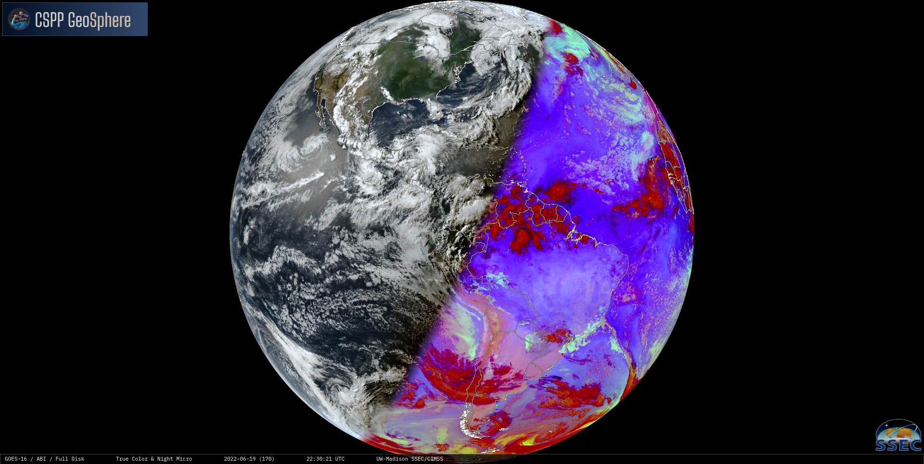
From Packets to Interactive Imagery
GeoSphere
David Hoese
Clayton Suplinksi
Graeme Martin
Ray Garcia
Will Roberts

Slide 2
David Hoese
Software developer - SSEC/UW-Madison
Lead developer on
GeoSphere
Geo2Grid/Polar2Grid
SIFT
Open source developer and contributor
Satpy
Pyresample
VisPy
…others

Slide 3
The rest of the team
Clayton Suplinski
Frontend developer
Ray Garcia
Backend developer
Will Roberts
Backend developer
Graeme Martin
Principal Investigator, tester, proposal writer, report writer
Scott Nolin and Jesse Stroik
Technical computing and cluster fixers

Slide 4
Project Goals
Convert GOES-ReBroadcast (GRB) to image tiles quickly (low latency)
Use high-quality imagery created with CSPP Geo Geo2Grid software
Cloud-friendly development with multiple environments (commercial cloud, self-hosted) in mind
Make a good-looking website with a simple UI
Do it on a budget
2 developers
1 self-hosted server
Learn “Stuff” (Kubernetes)
Phase 2: Make it better (GOES-17, video sharing, optimizations, etc)

Slide 5
DEMO!!!
😨

Slide 6
Evolution of GeoSphere

Slide 7
Evolution of GeoSphere - Phase 1

Slide 8
Evolution of GeoSphere - Phase 1
Website

Slide 9
Evolution of GeoSphere - Phase 1
GRB
Geo2Grid
Website

Slide 10
Evolution of GeoSphere - Phase 1
GRB
Geo2Grid
MapCache
Website

Slide 11
Evolution of GeoSphere - Phase 1
GRB
Geo2Grid
MapServer
MapCache
Website

Slide 12
Evolution of GeoSphere - Phase 1
GRB
Geo2Grid
Tile Indexer
MapServer
MapCache
Website

Slide 13
Evolution of GeoSphere - Phase 1
GRB
Geo2Grid
Tile Indexer
API
MapServer
MapCache
Website

Slide 14
Evolution of GeoSphere - Phase 1
GRB
Geo2Grid
Tile Indexer
RabbitMQ
API
MapServer
MapCache
Website

Slide 15
Evolution of GeoSphere - Phase 1
NetCDF
GRB
Geo2Grid
Tile Indexer
RabbitMQ
GeoTIFFs
API
MapServer
MapCache
Website

Slide 16
Evolution of GeoSphere - Phase 1
NetCDF
GRB
Geo2Grid
Tile Indexer
RabbitMQ
GeoTIFFs
API
Shapefiles
MapServer
MapCache
Website

Slide 17
Evolution of GeoSphere - Phase 1
NetCDF
GRB
Geo2Grid
Tile Indexer
RabbitMQ
GeoTIFFs
API
Shapefiles
PostGIS
MapServer
MapCache
Website

Slide 18
Evolution of GeoSphere - Phase 2
NetCDF
GRB
Geo2Grid
Tile Indexer
RabbitMQ
GeoTIFFs
API
PostGIS
MapServer
MapCache
Website

Slide 19
Evolution of GeoSphere - Infrastructure
“Cluster”
Cluster
1 Node
1 Node
1 Node
1 Node
1 Node
1 Node
1 Node

Slide 20
Future - Finishing up Phase 2
Upgrade Geo2Grid to 1.1 beta ✓
Add MP4 video generation ✓
Switch from CGI scripts to FastAPI ✓
GOES-17 | GOES-18 → GOES-West
Optimizations
Larger tiles
JPEG compression
Background processing on the client
More products (ABI L2, other RGBs, etc)
S3 storage backend

Slide 21
Multi-node processing - I lied
Cluster
GeoTIFFs
1 Node
1 Node
1 Node
1 Node
1 Node
1 Node

Slide 22
Multi-node processing - I lied
Geo2Grid
MapServer
GeoTIFFs
1 Node
Tile Indexer

Slide 23
Multi-node processing - I lied
Geo2Grid
MapServer
GeoTIFFs
1 Node
Tile Indexer
NetCDF
GRB

Slide 24
Multi-node processing - CephFS S3
1 Node
1 Node
1 Node
1 Node
1 Node
1 Node

Slide 25
Multi-node processing - CephFS S3
Geo2Grid
1 Node
1 Node
GRB
MapServer
1 Node
1 Node
Tile Indexer
1 Node
1 Node

Slide 26
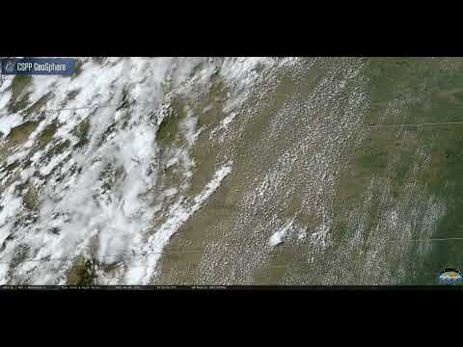
Thanks
Beta testers
Tim Schmit, Jim Nelson, Mat Gunshor, Scott Lindstrom, Liam Gumley, Kathy Strabala, Sam Batzli, Jerry Robaidek
GeoSphere: https://geosphere.ssec.wisc.edu/
CSPP Geo: https://cimss.ssec.wisc.edu/csppgeo/
Video on Youtube

